Slide 1
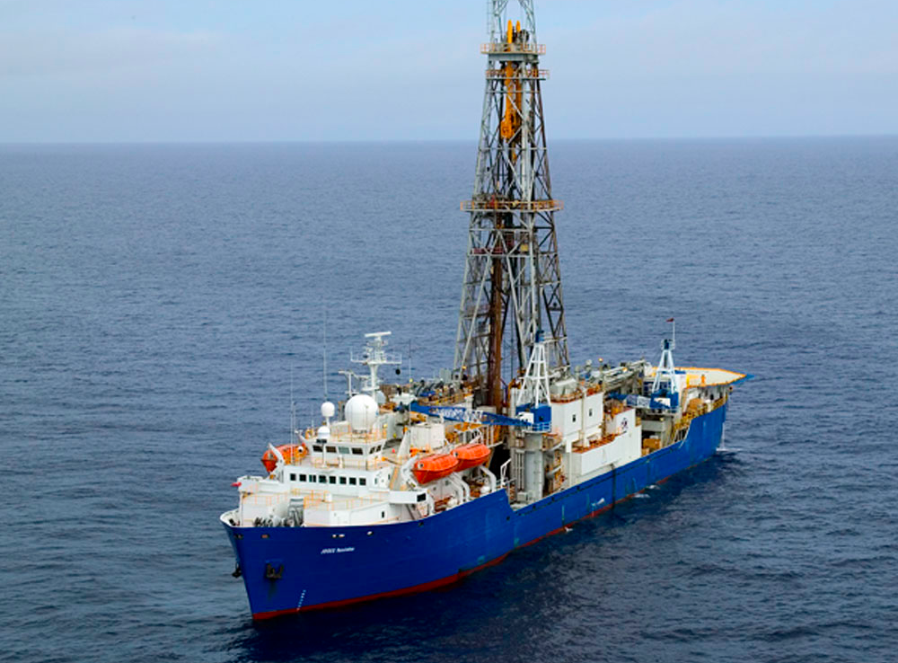
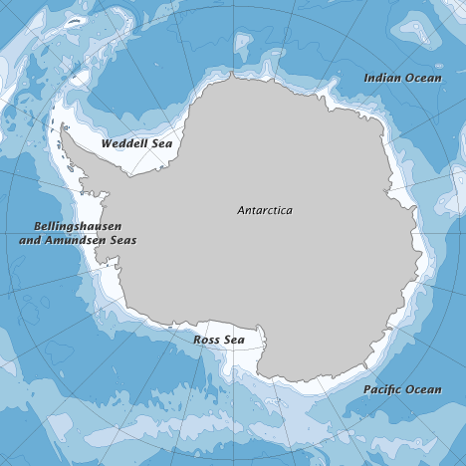
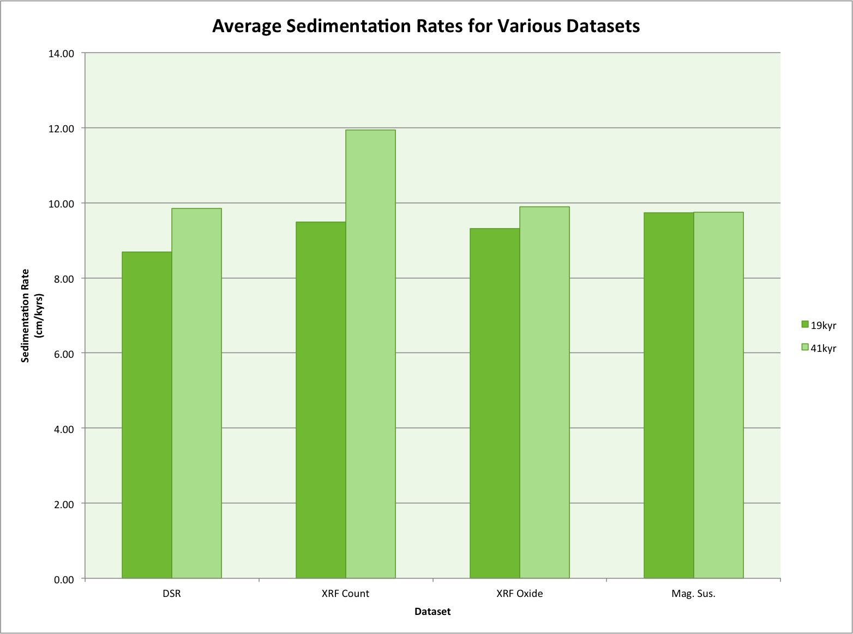
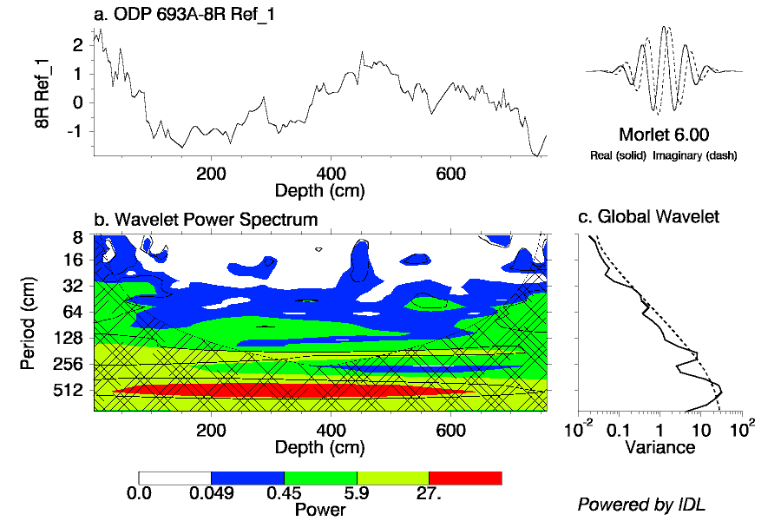
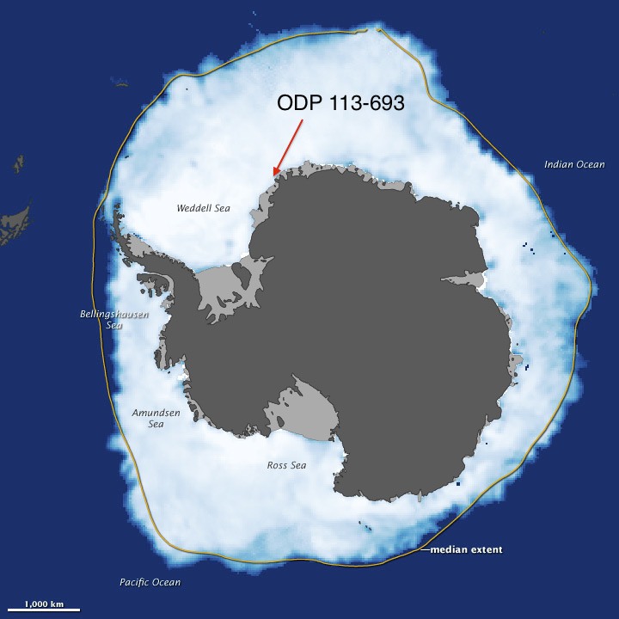
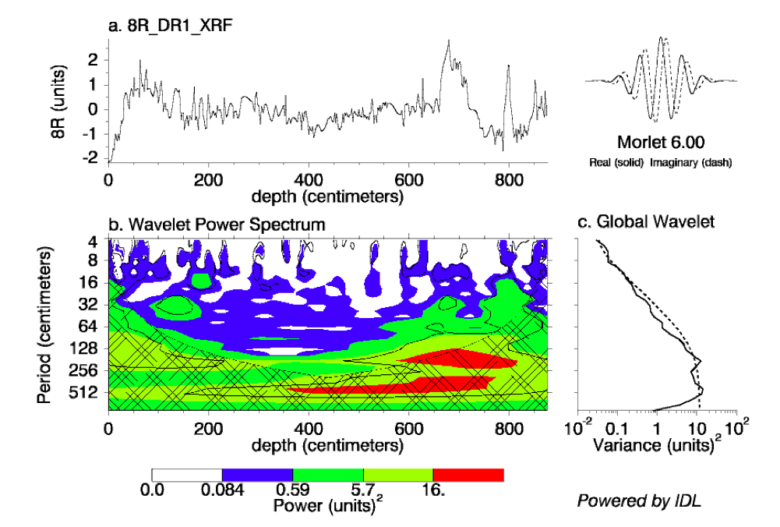
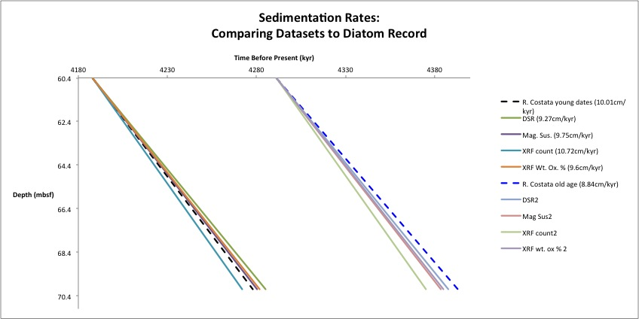
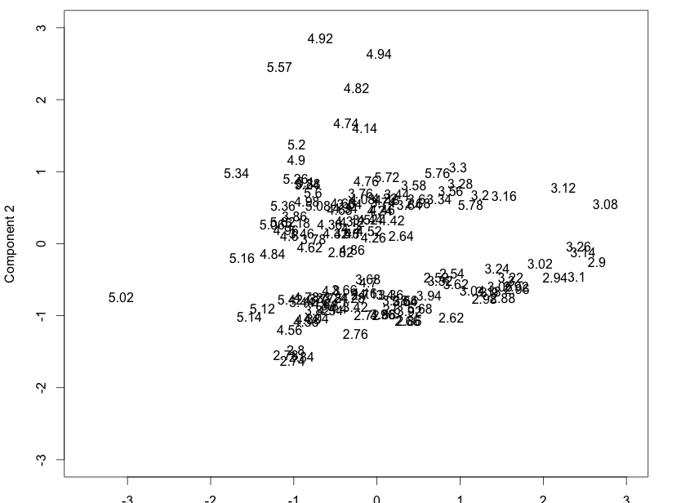
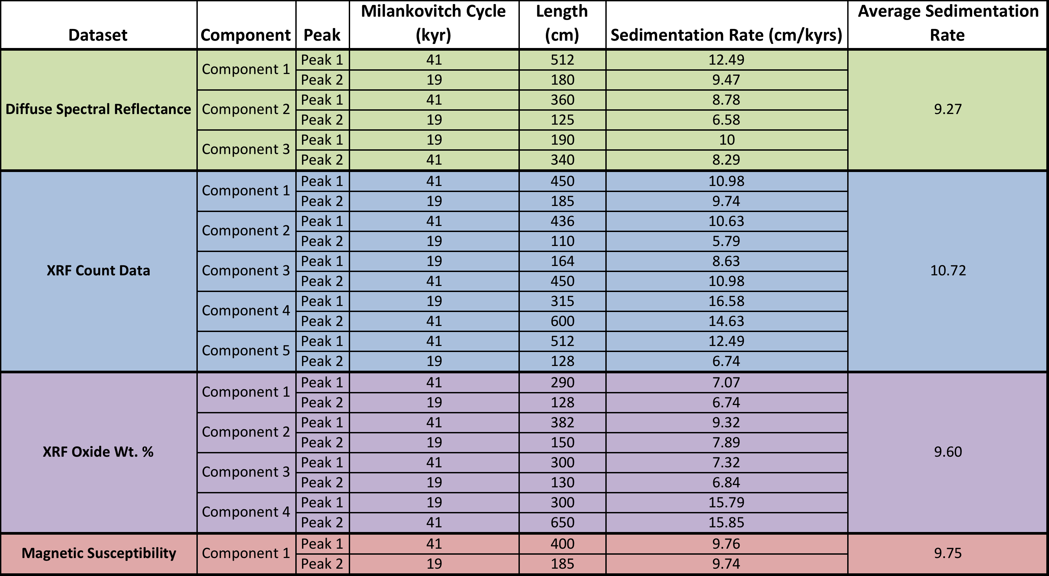

Comparison of XRF and Spectral Reflectance Derived Cyclicity in
Pliocene Sediments from ODP Site 693, Dronning Maud Land Antarctica
James Hall¹, Tavo True-Alcala¹, Jason Gross¹, Vanessa Castello¹, Cassandra Stirpe², Joseph Ortiz³, and Suzanne OConnell¹
¹Wesleyan University, Middletown, CT 06459, ²Vassar College, Poughkeepsie, NY 12604, ³Kent State University, Kent, OH 44240
INTRODUCTION
RESULTS
RESULTS (cont’d)
The International Ocean Discovery Program is a deep-sea drilling collaboration that aims to “recover geological data and samples from beneath the ocean floor to study the history and dynamics of Planet Earth” (IODP website). The samples used in this research were taken from cores recovered during the 113th expedition of ODP.
This project focuses on Core 693A-8R from in the Weddell Sea adjacent to Dronning Maud Land, Antarctica that was deposited during the Pliocene epoch. The Pliocene epoch is of particular interest as atmospheric CO₂ levels were around 400ppm, about the same as current levels. The sea level during this time was significantly higher than today.
Our research focuses on tying sedimentation patterns throughout the core to Milankovitch cycles.
We identified a total of 12 significant components from VPCA across the three different datasets. The majority of wavelet plots generated from the components showed two strong peaks of periodicity: one with a length around 440cm and the other with a length around 180cm.
Wavelet output for the first DSR and XRF count components. Peaks for both are around 500cm and 180cm and are significant beyond our chosen red noise level.
Comparison across the results from all four datasets show similar sedimentation rates after peaks have been assigned to 41,000 year obliquity and 19,000 year precession cycles. Results are summarized in the table below.
Rates were generally similar but did vary between the 19 and 41kyr cycles, as shown below.
Preliminary diatom data can give us a sense of absolute dating as well as estimated sedimentation rates. Using the earliest dates for first and last appearances of R. Costata, we calculated a starting age of 4.183Ma and a sedimentation rate of 10.01cm/kyr which falls within the range calculated from our wavelets. Using the later dates for R. Costata, we calculated a starting age of 4.291Ma and a sedimentation rate of 8.36cm/kyr.
Location of ODP 113-693A shown by red arrow (image from nasa.gov).
METHODS
Our research uses four datasets: diffuse spectral reflectance (DSR), XRF element counts, oxide weight percent, and magnetic susceptibility.
The XRF scanner collected a continuous downcore dataset whereas reflectance data was collected using a photospectrometer on discrete fine-grain (<63 um) samples throughout the core. The magnetic susceptibility dataset is also continuous downcore data.
Varimax-rotated Principal Component Analysis (VPCA), a data reduction technique that separates large datasets into condensed components, was used to highlight the underlying relationships within the XRF and DSR data.
Wavelet Analysis was used to identify the amplitude and lengths of the periodicities of the rotated components as well as the magnetic susceptibility data.
Milankovitch Cycles were assigned to the periodicities extracted from the wavelet analyses and were used to determine sedimentation rates throughout the core.
Comparison of sedimentation rates derived from earliest and latest diatom records and VPCA component data.
CONCLUSIONS
The sedimentation rate during the Pliocene at our core site was high (on the order of 10cm/kyr) as supported by all four datasets as well as the diatom record. Our results suggest that obliquity was the dominant forcing during this period as evidenced by the prominent peaks displayed by the wavelets at that periodicity. 19,000-year precession was the secondary Milankovitch cycle in terms of dominance.
Table comparing sedimentation rates based on components from all four datasets.

