Slide 1
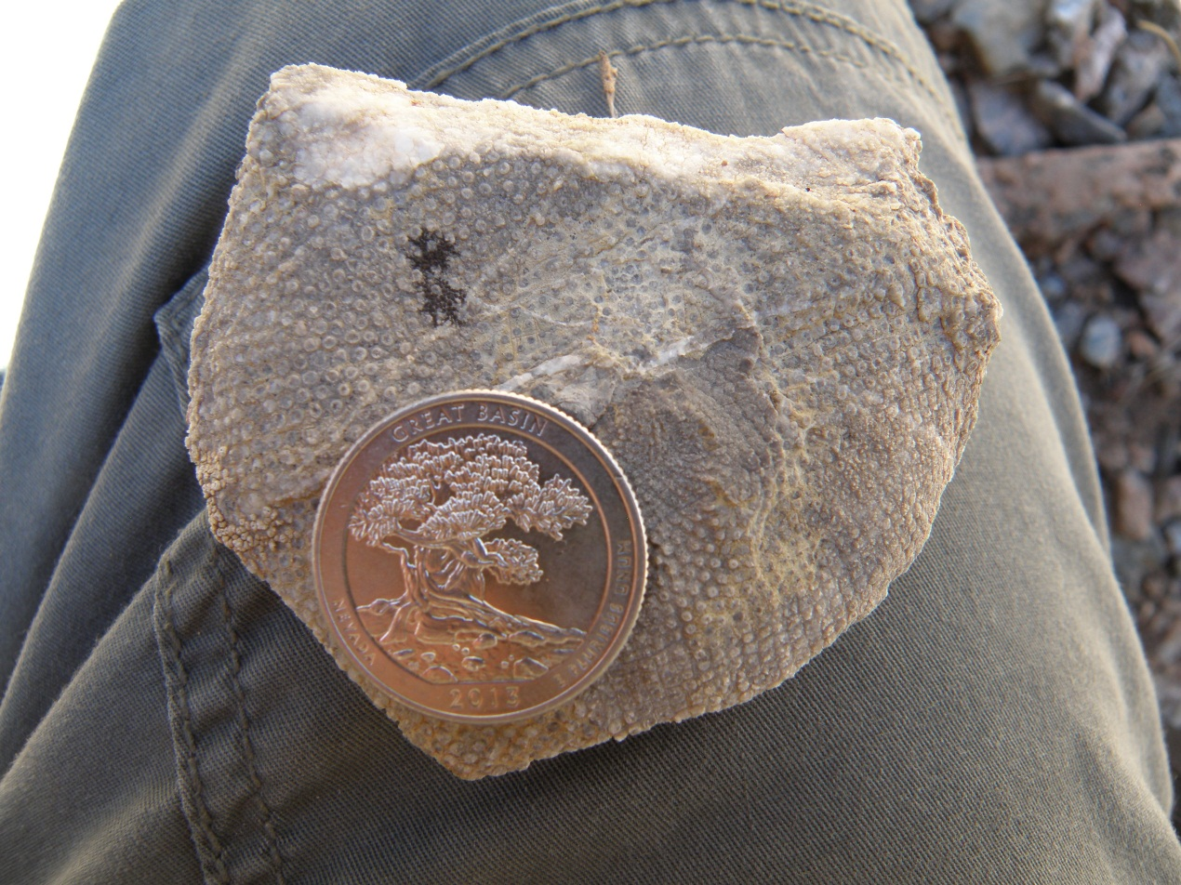


The Marine Paleozoic Fossil Record of Great Basin National Park, Nevada
Kaytan Kelkar and AnnMarie Jones
Mosaics in Science and GeoCorps America 2014

Slide 2
Project Goals
To conduct an inventory of the paleontological resources.
To prospect known fossil localities for new specimens.
Documentation of new fossiliferous sites.
Collection of rare well preserved specimens for future scientific study.
Completion of condition assessments for new fossil localities.

Slide 3
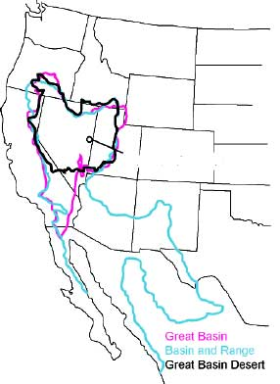
Great Basin National Park
The park is situated in the Basin and Range Province.
The Great Basin is a unique hydrological system.
Great Basin National Park
Large elevation change has lead to varied ecosystems.
Park attractions include Wheeler Peak, Lehman Caves and the Bristlecone Pines.
(nps.gov)

Slide 4
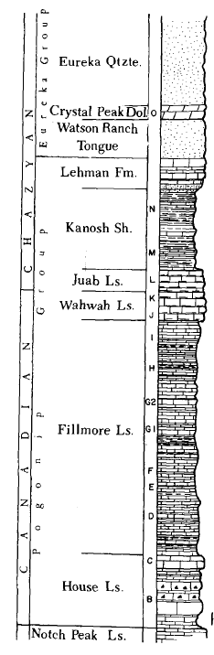
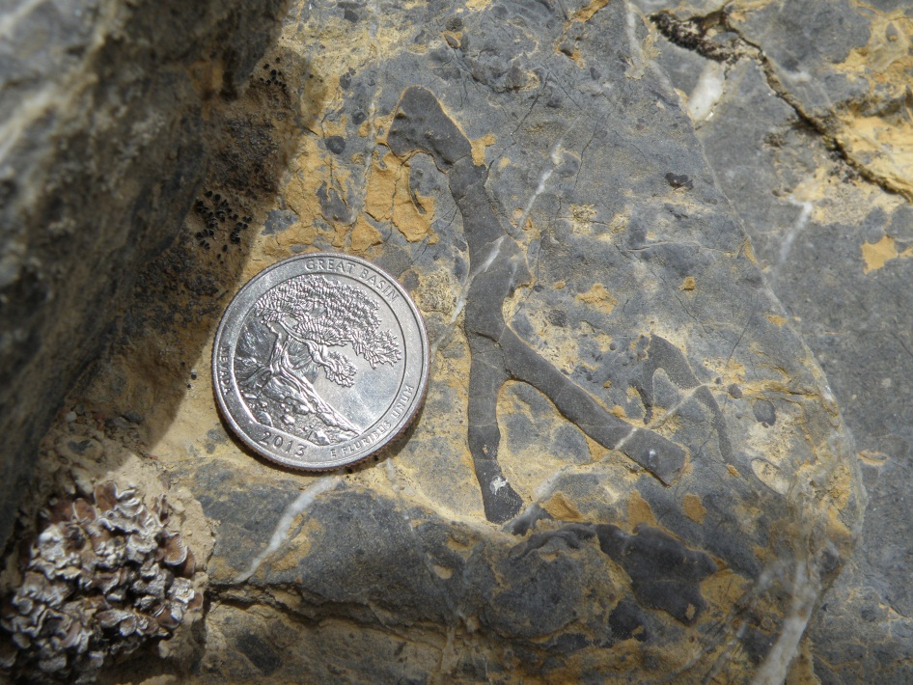
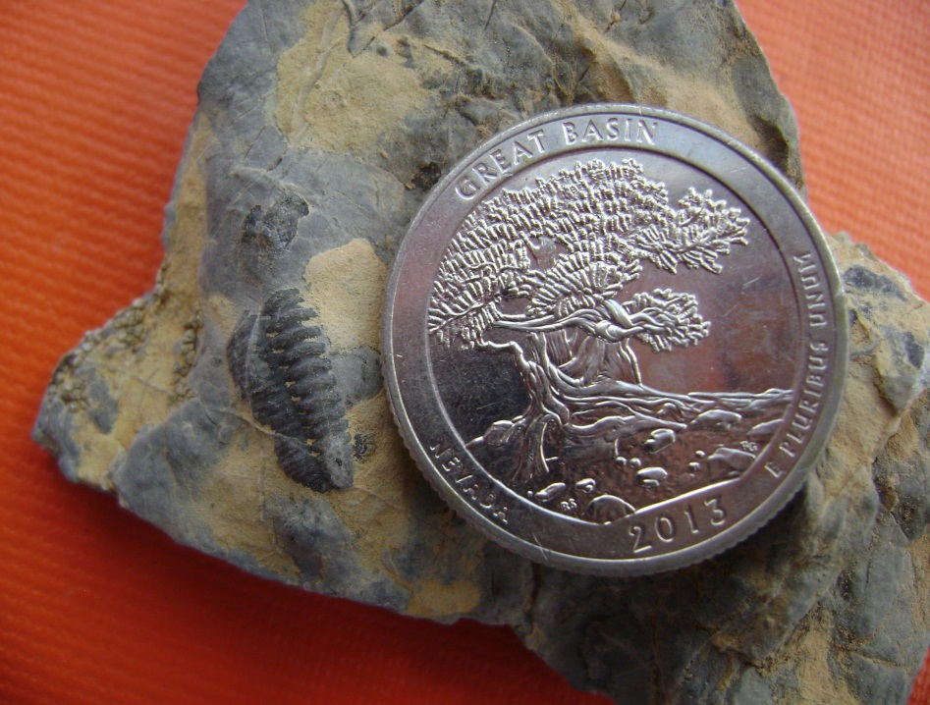
Developing a Search Image
Branching
Bryozoan
Trilobite
(Jensen, 1968)

Slide 5
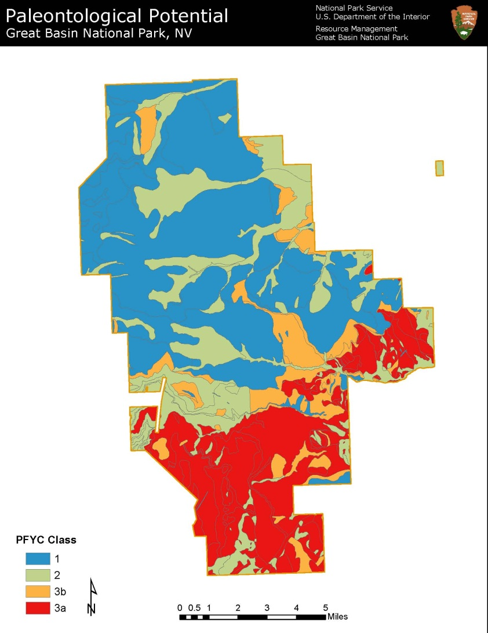
Prospecting Probability
Primary lithology found in park is Sedimentary and Metamorphic.
BLM Potential Fossil Yield Classification developed before inventory.
Map of paleontological potential based on park geology.
(Resource Management, GRBA)

Slide 6
Study Area

Slide 7
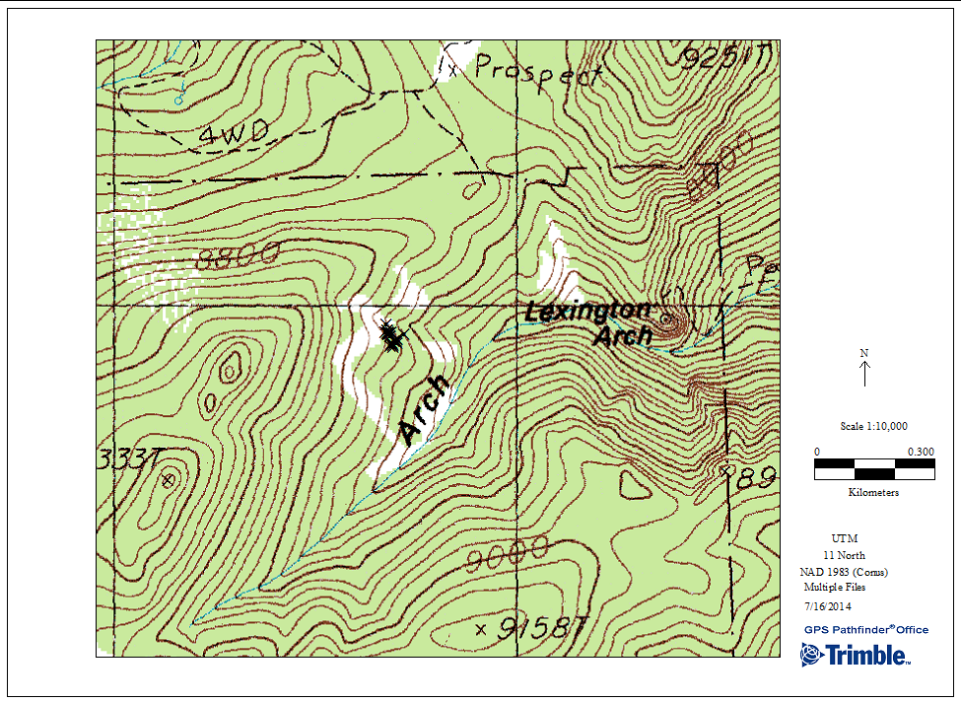
Data Collection
GRBA PAL Locality 00077 GPS points
GPS points plotted in Trimble Pathfinder to identify fossiliferous areas.

Slide 8
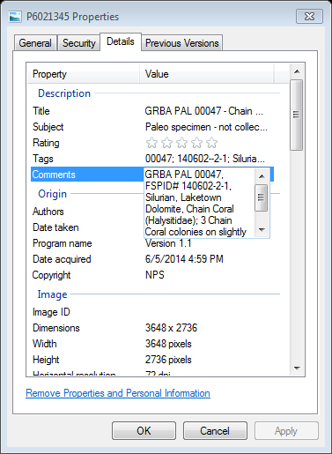
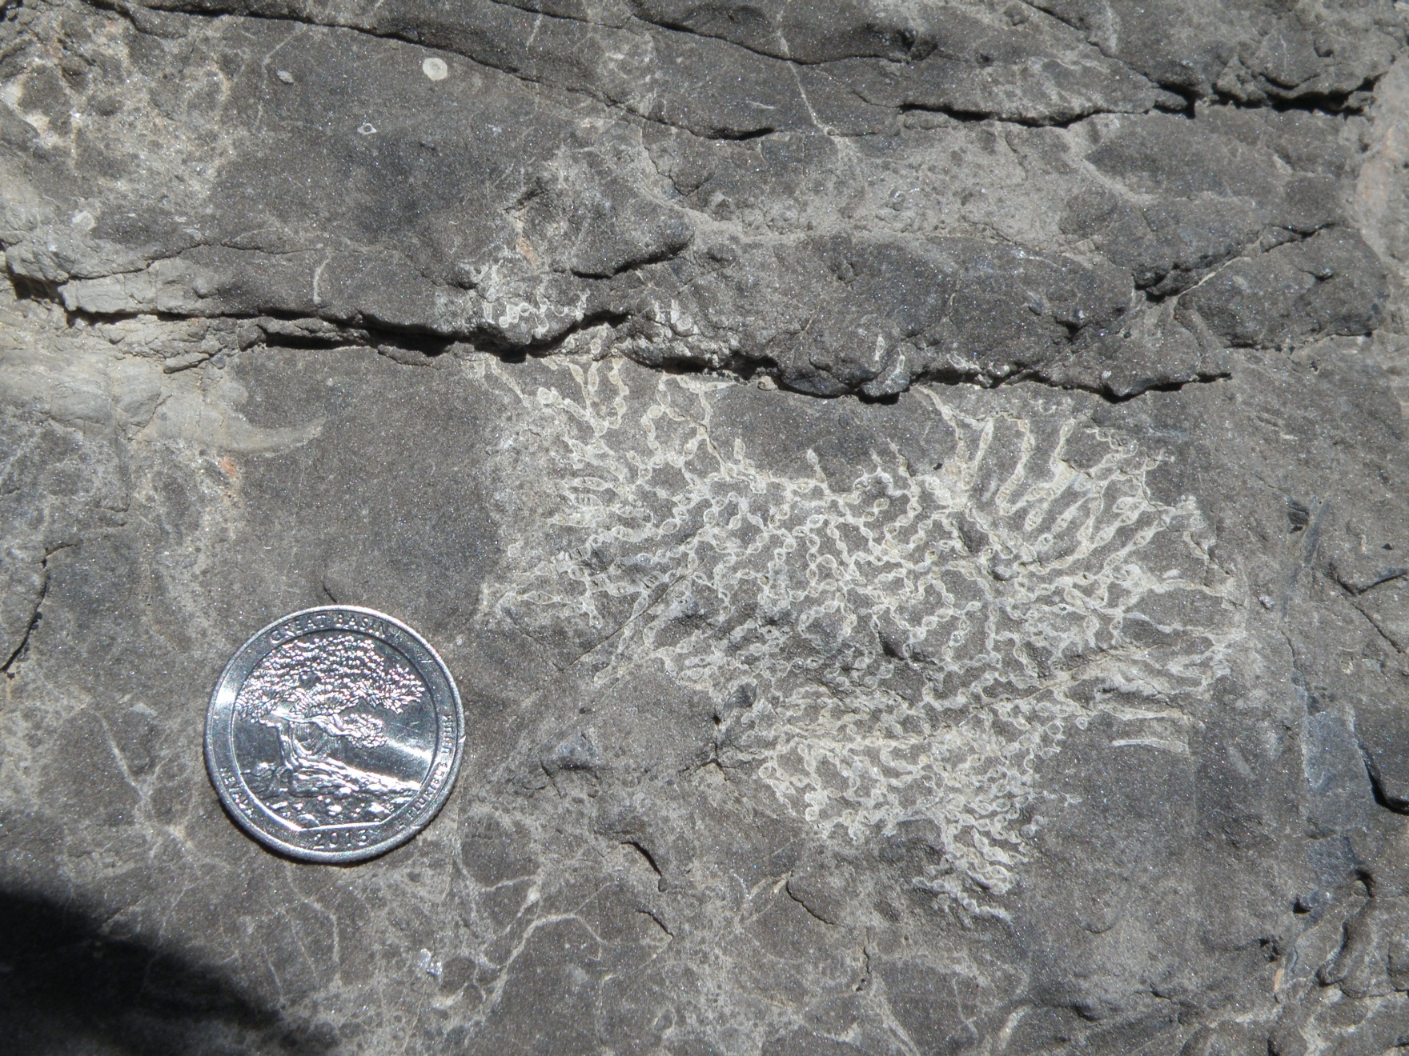
Macrophotography Metadata

Slide 9
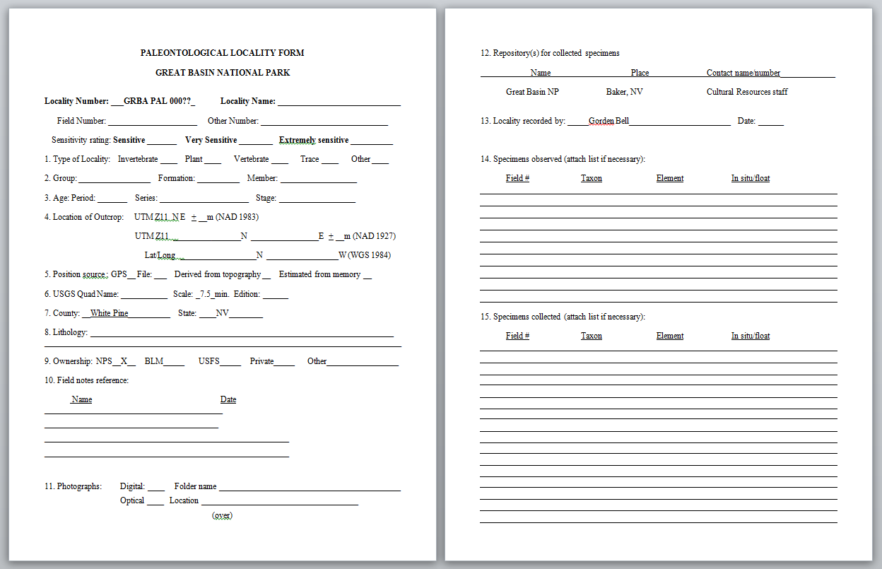
Locality Registration
PLF forms recorded for specimen sensitivity and fossil taxonomy.

Slide 10
Challenges
Initially training the eye to develop a search image.
Distinguishing stratigraphic units.
Locating specimens in previously documented sites through photo interpretation.
Overcast conditions not ideal for fossil prospecting.
Assigning localities for small specimen yield areas.

Slide 11
Data Analysis
GPS Data Collection per Geologic Period
42
213

Slide 12
Field Observations
Specimen GPS Points for Pogonip Group per Unit

Slide 13
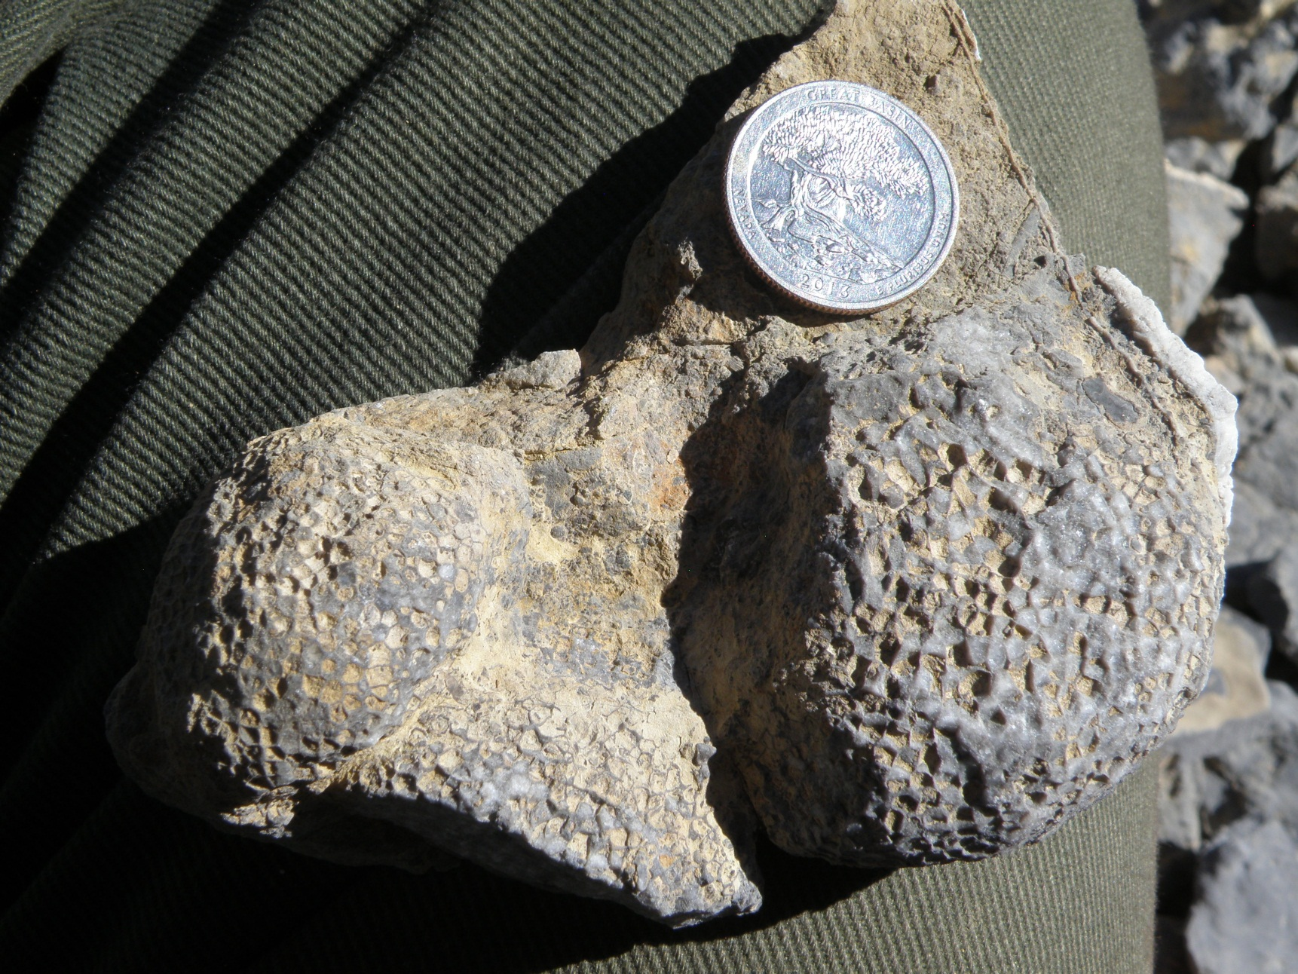
Future Research Subjects
Early coral evolution not very well understood.

Slide 14
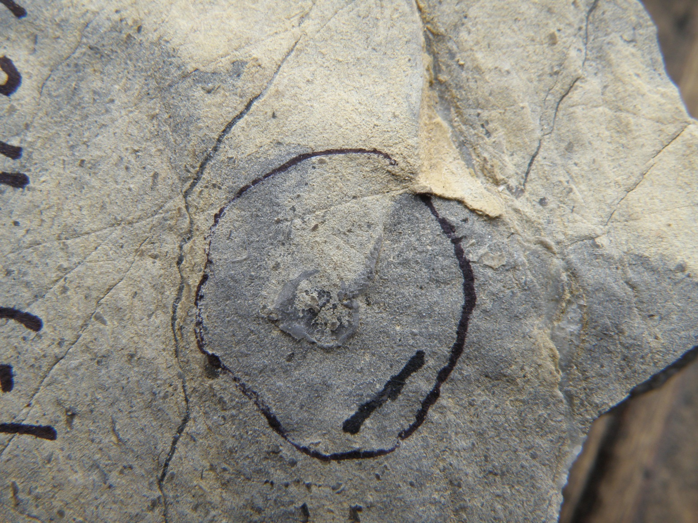
Stylophoran (Echinoderm)
A new species of Stylophoran could offer valuable morphological information.

Slide 15
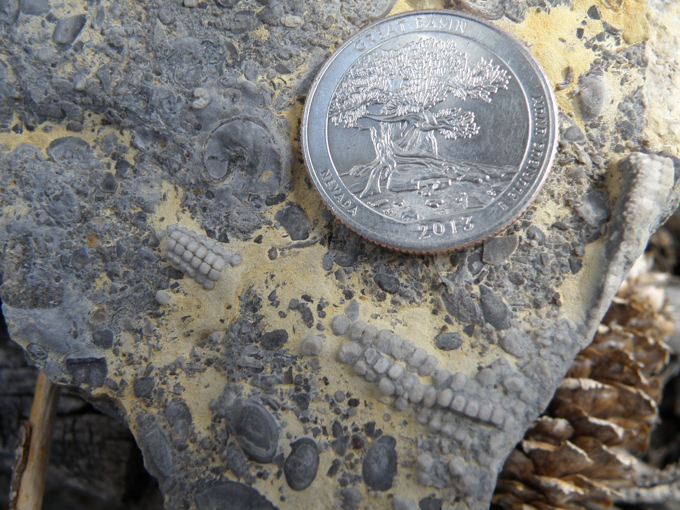
Starfish (Stelleroid)
The Stelleroid is being closely studied by Echinoderm specialists.

Slide 16
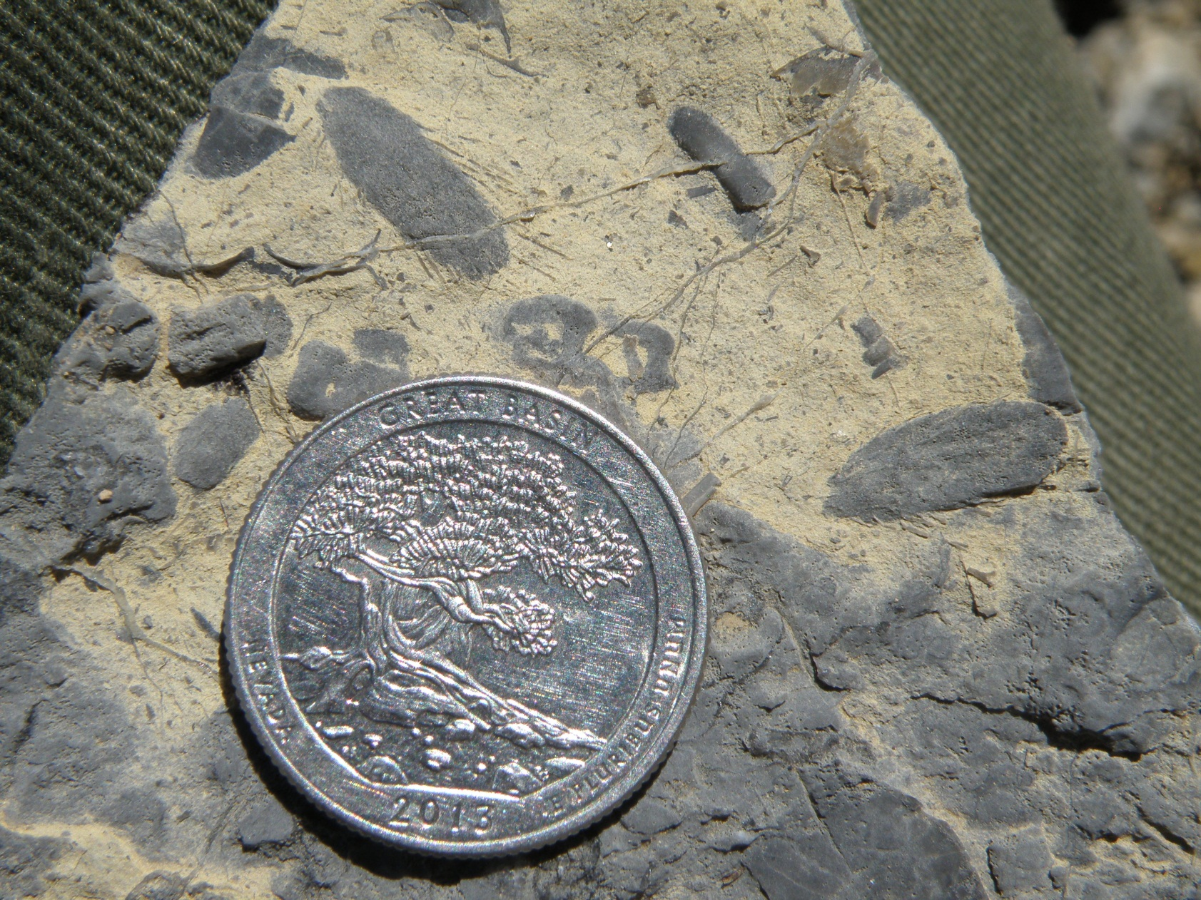
Early Sponges
This specimen requires further biostratigraphic analysis.

Slide 17
Conclusions
15 new localities documented in 2014.
A total of 255 GPS points recorded.
The Lehman Formation was identified as the most fossiliferous stratigraphic unit.
Further scientific research required for rare specimens including Corals, Stylophoran (Echinoderm) and Stelleroid (Starfish) .
A paleontological inventory is a continuous process.
Further cataloging of collected samples to be completed.

Slide 18
Acknowledgements
I am grateful to the Geological Society of America and the National Park Service for giving me this excellent opportunity.
I would like to thank Gorden Bell for his support and guidance towards this project.
I would like to thank AnnMarie Jones for her helpful inputs.

Slide 19
Works Cited
Jensen, R.G., March 15, 1968. Ordovician Brachiopods from the Pogonip Group of Millard County, Western Utah, Geology Studies Brigham Young University, Vol. 14; 67- 100.
Bell, G. L., Jr., and Lohman, N. E. 2012. Map of Paleontological Potential in Great Basin National Park, Nevada, Resources Management Internal Report, Great Basin National Park.

