Slide 1



Hyperspectral imaging of marble-hosted sapphire from the Beluga Occurrence, Baffin Island, Nunavut, Canada
David Turner, M.Sc., P.Geo., PhD Candidate
Prof. Benoit Rivard, University of Alberta
Prof. Lee Groat, University of British Columbia
Dr. Jilu Feng, Dr. Tashia Dzikowski, and Mr. Philippe Belley

Slide 2
Outline
Objectives and Background
Hyperspectral Imaging / Reflectance Spectroscopy
Geology of marble hosted sapphire at Beluga Showing
Results
Conclusions

Slide 3
1. Objectives and Background
Investigate the potential of hyperspectral imaging as applied to gem deposits
Extend information from the lab to the field
  Ground based imaging
  Aerial imaging
Experience with geology of gemstones
Current PhD work on hyperspectral imaging of rare earth element minerals / rocks

Slide 4
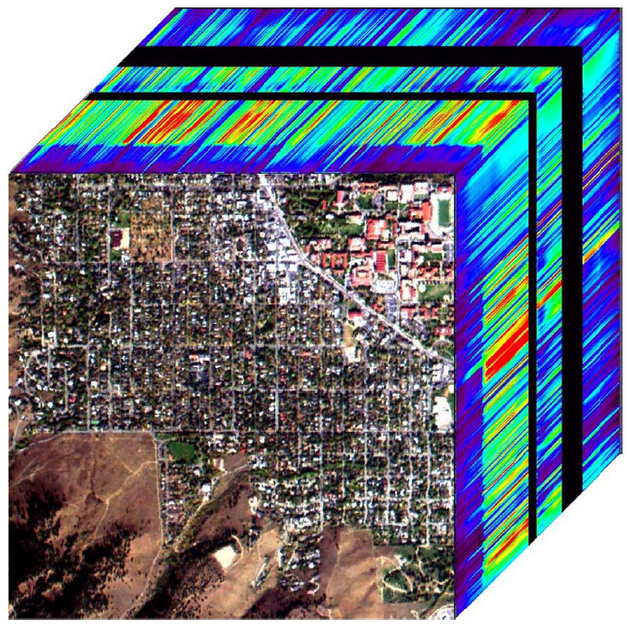
2. Hyperspectral Imaging (HSI)
Primarily a reflected light-based technique
Rapid, non-destructive and requires little to no sample prep
Well-established satellite and
airborne technique
Output is a ‘data cube’ with x-y
coordinates and spectral response
along the z-axis
Importance of spectral resolution
(mineral spectrum recognition)
Importance of spatial resolution
(pixel sizes and target implications)

Slide 5

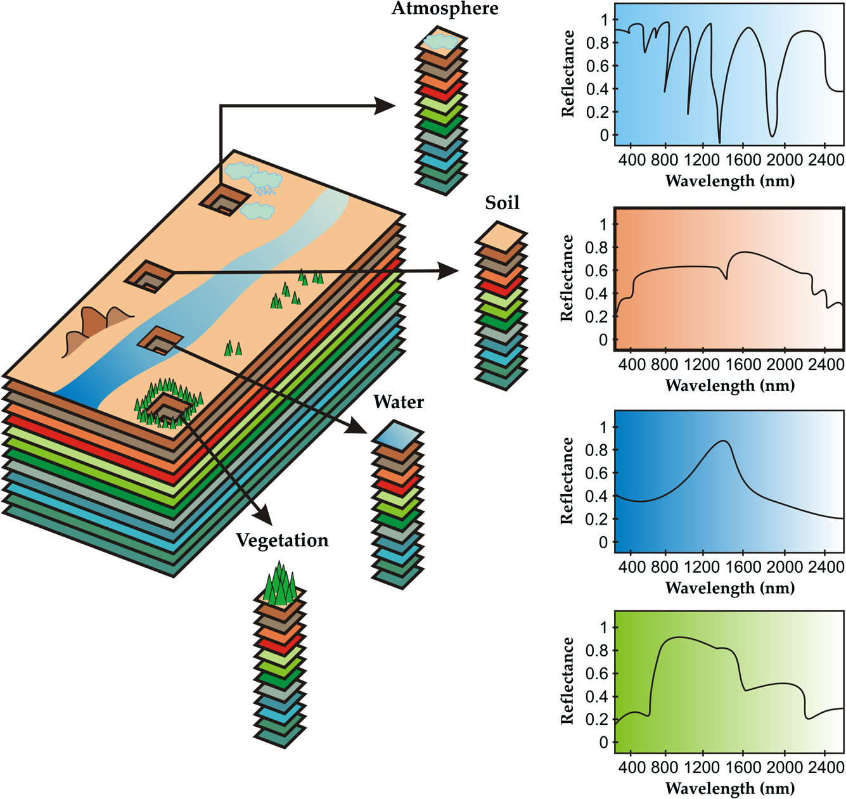
Molero et al. 2012

Slide 6
Absorptions in Minerals
Electronic processes
  Crystal field effects (Cr³⁺, Fe^{2+,3+}, Nd³⁺…)
  Charge transfers (Fe³⁺ – Ti⁴⁺)
  Conduction bands (diamond, sulphide minerals)
  Colour centres (fluorite)
Vibrational processes
  OH, H2O (water, micas, framework silicates)
  CO3 (carbonate minerals, framework silicates)
  HSO4 (gypsum, framework silicates)

Slide 7
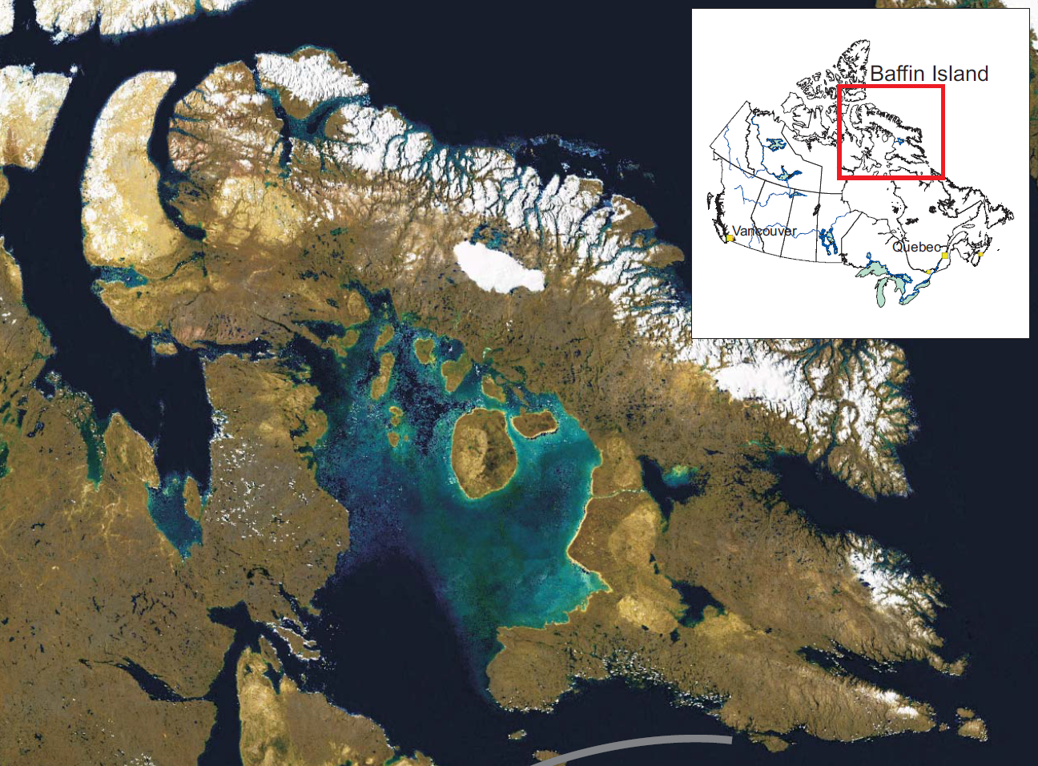
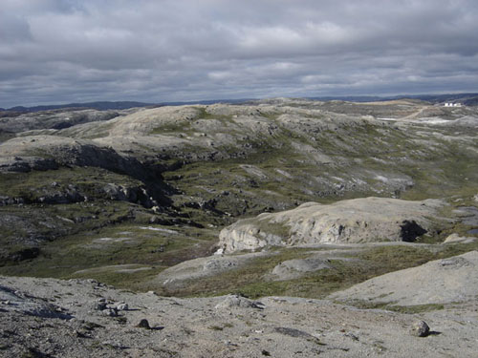
3. Geology at Beluga Showing

Slide 8
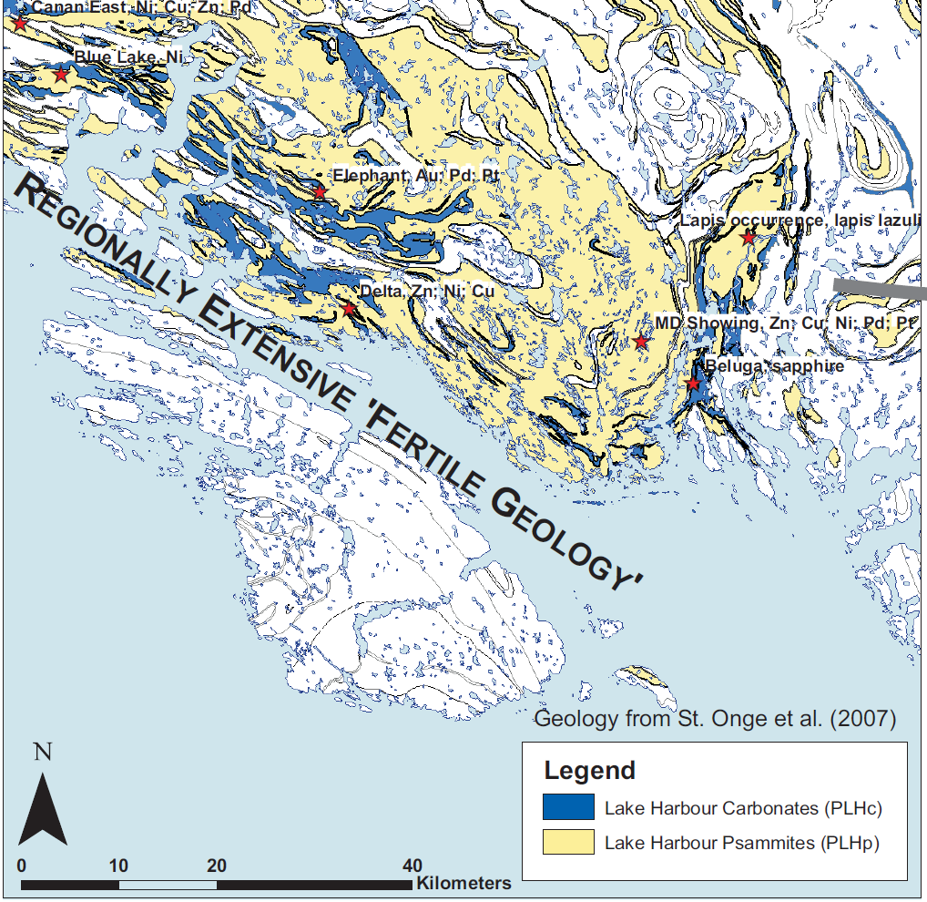

Slide 9
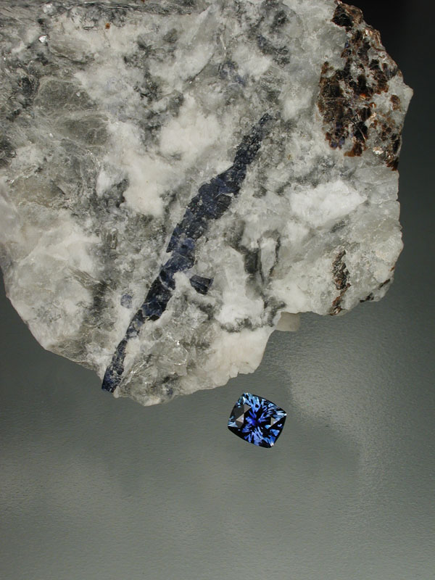
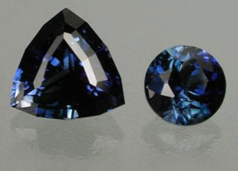
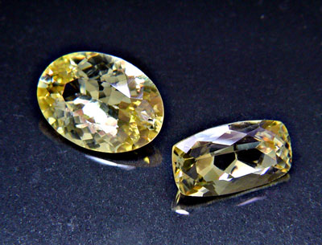
0.66 & 0.30 cts
1.47 & 1.09 cts
1.17 carats

Slide 10
MARBLE
CALCSILICATE
“PODS” OF
DIOPSIDE AND
NEPHELINE
PHLOGOPITE-ALBITE SYMPLECTITE WITH LATER SCAPOLITE
ZEOLITIZATION
FLUID INDUCED RETROGRADE MUSCOVITE, ALBITE, CALCITE AND CORUNDUM
P-T < 710°C and 6 kbar
Notes:
Corundum bearing “pods” occur within marbles of the extensive Lake Harbour Group assemblage
“Ground prep” is indicated by phlogopite-albite symplectite with later scapolite after diopside and nepheline
Retrograde reactions breakdown nepheline and scapolite to produce muscovite, albite, calcite and corundum
A very late and poorly documented zeolitization stage overprints corundum

Slide 11
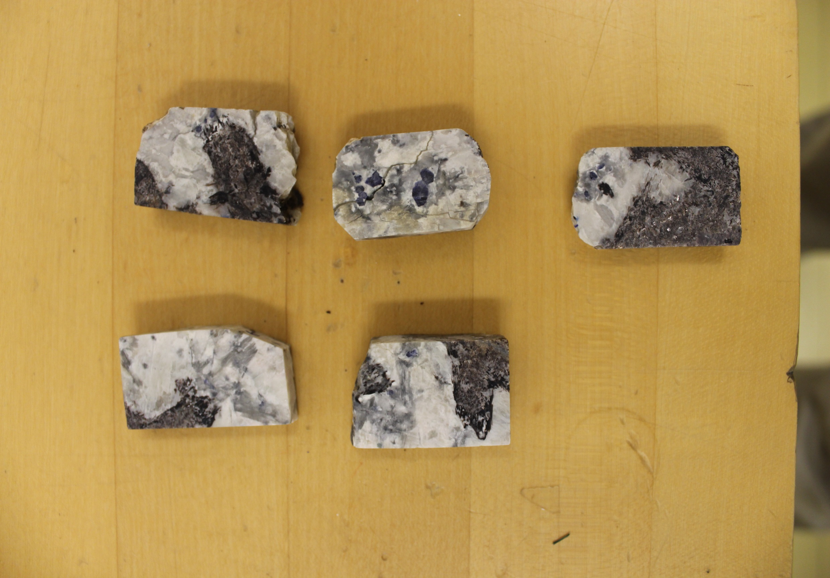
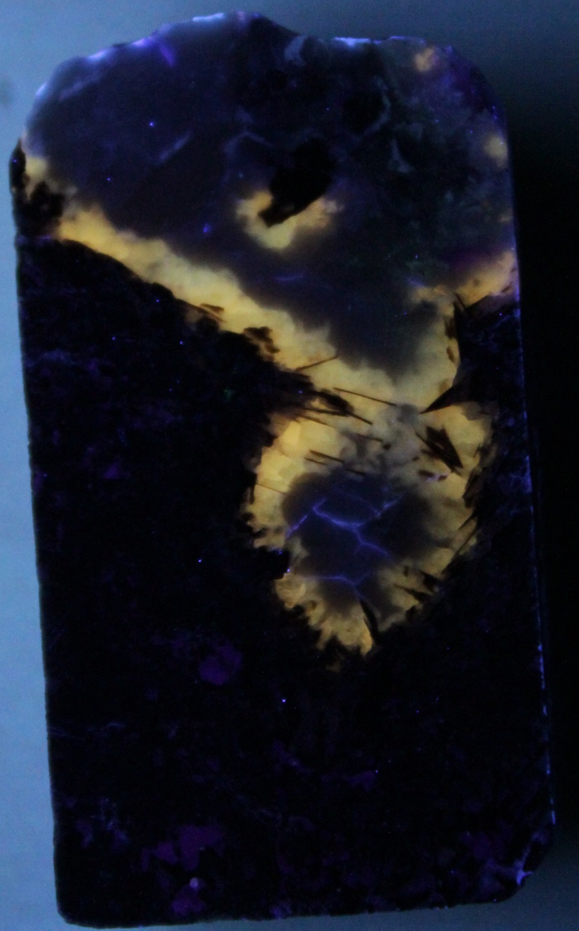
RETROGRADE MUSC-COR-ALB-CAL
Fine grained “mess”
SCAPOLITE!
SYMPLECTITE

Slide 12
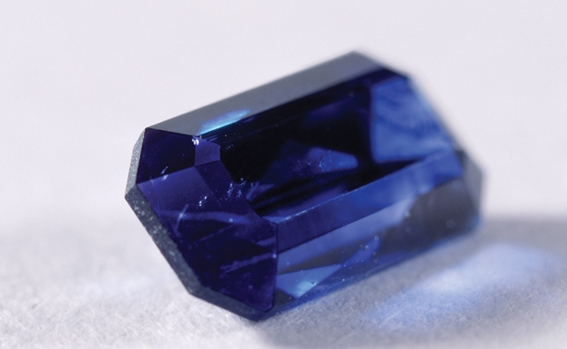
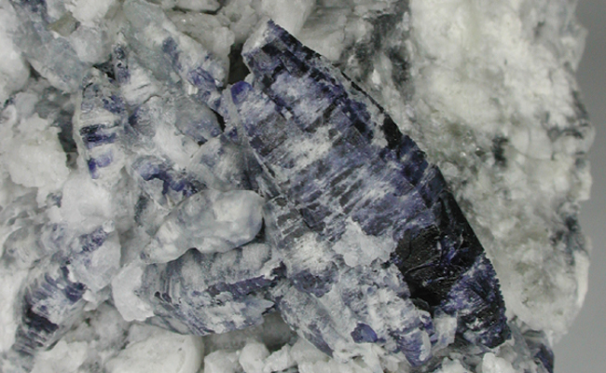
Thankfully zeolite minerals are not always present!

Slide 13
4. Results: Key Spectral Groups (SWIR)
Phlogopite symplectite
Scapolite
Muscovitic retrograde alteration
Zeolitization (thomsonite?)
Unknown mineral with prominent absorption located at 1477 nm (Sulfur related?)

Slide 14
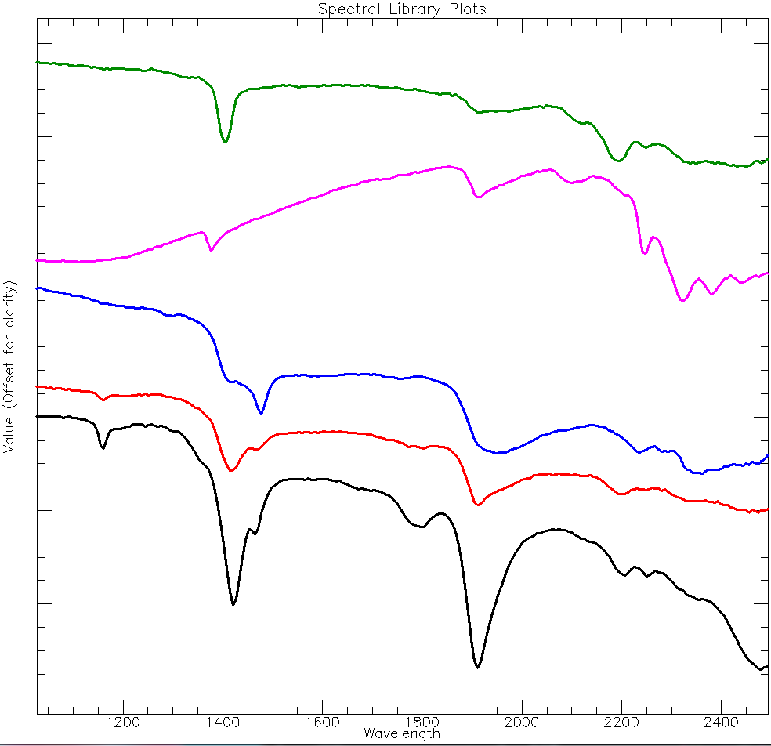
Muscovitic alteration
Phlogopite symplectite
1477 nm phase
scapolite
zeolite

Slide 15
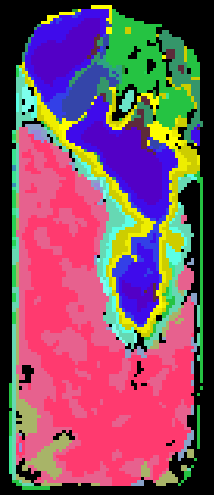

“Lithology” Mapping using SAM

Slide 16
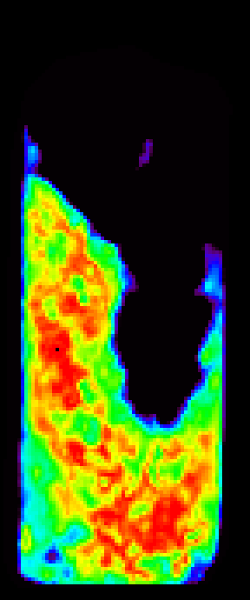
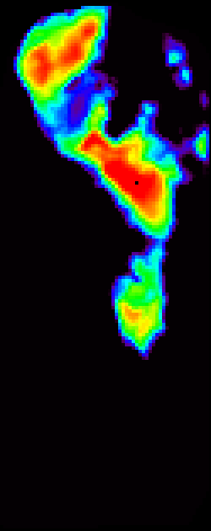
Mapping Phlogopite Symplectite + Muscovitic Alteration (SAM)

Slide 17
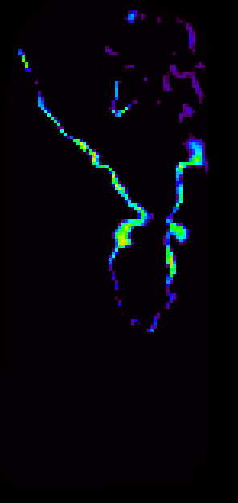
Mapping Scapolite using SAM

Slide 18

Mapping Zeolite (thomsonite) using SAM

Slide 19
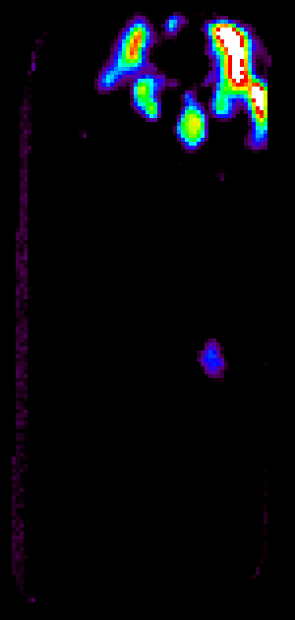
Mapping the Absorption at 1477 nm

Slide 20
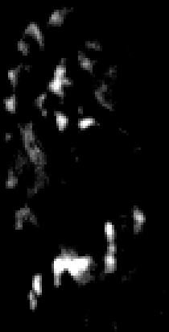
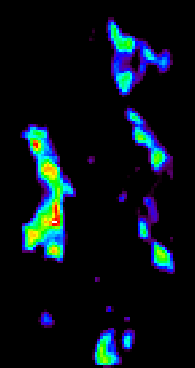
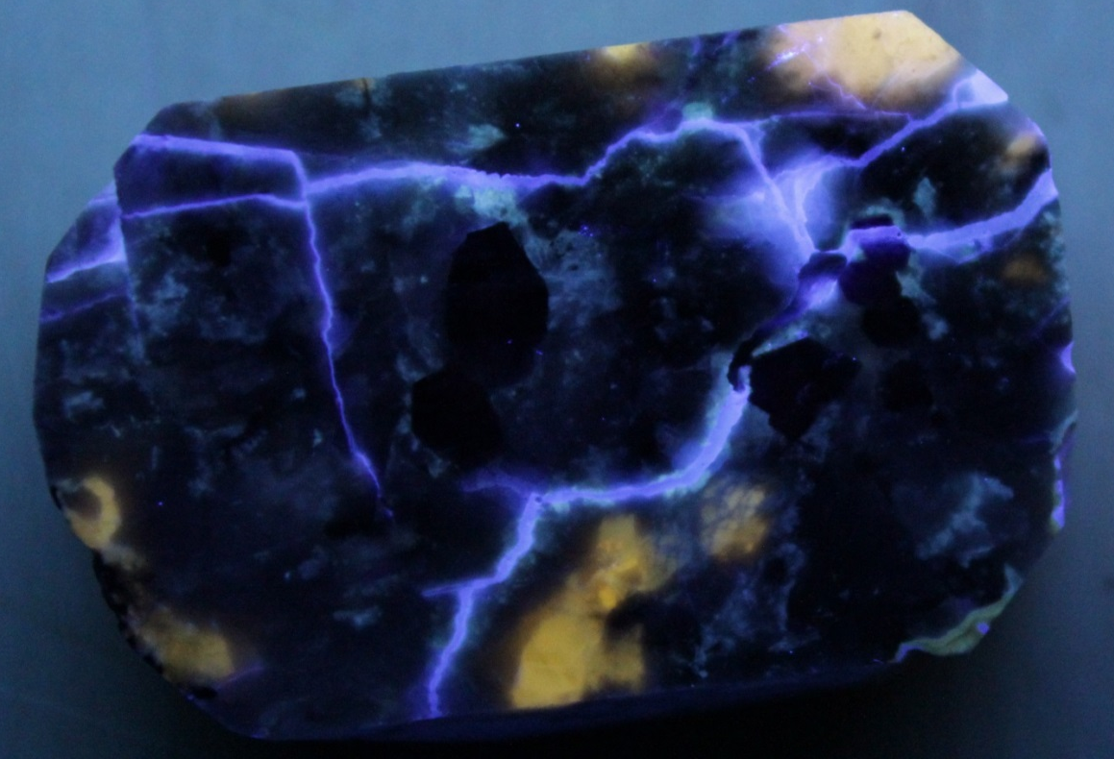
Zeolite and 1477 in other samples
Thomsonite map
Strength of 1477 nm absorption
corundum

Slide 21
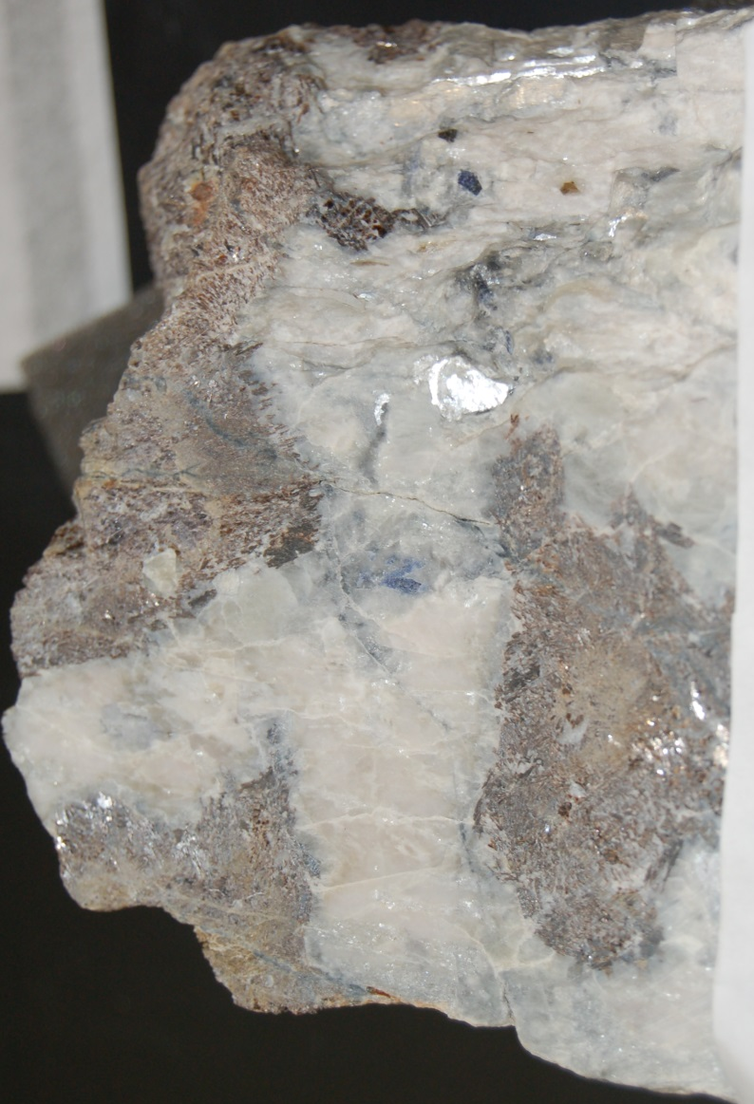
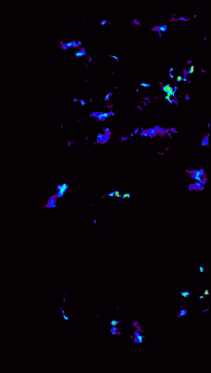
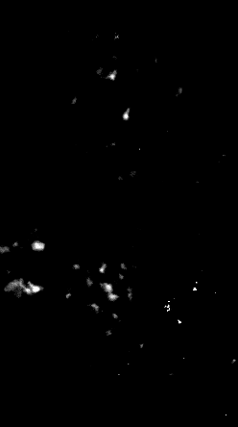
Thomsonite (SAM)
1477 nm abs depth

Slide 22
5. Conclusions and Future Work
Successfully map key mineralogical components related to marble-hosted sapphire mineralization at Beluga Showing in a laboratory setting
  Phlogopite symplectite, scapolite, retrograde muscovitic alteration, zeolitization, 1477 nm phase
Some Remaining Scientific Questions:
  How exactly does zeolitization fit into paragenesis?
  What is the origin of the 1477 nm absorption feature?
  How variable is the scapolite chemistry?
How well will this translate to field based studies?

Slide 23


Thank you!

