Slide 1
Evaluating the emplacement of CO₂ reservoirs: A case study from the Virunga Volcanic Province
Erica Maletic, Thomas Darrah, Robert Poreda, Dario Tedesco
The Ohio State University
School of Earth Sciences
Notes:
-Hi I’m Erica and I will do great on this presentation!
-I will talk about the geochemistry of modern volcanic analogs for CO2 reservoirs
-Before starting I’d like to acknowledge my co-authors: My advisor at OSU Tom Darrah, Bob Poreda, and Dario Tedesco

Slide 2
Motivation
Enhanced oil recovery (EOR)
Inject miscible fluids
- Typically CO₂
Notes:
Enhanced oil recovery (EOR) involves the injection of miscible fluids such as carbon dioxide (CO2) in the subsurface.

Slide 3
Motivation
Enhanced oil recovery (EOR)
Inject miscible fluids
- Typically CO₂
Recover hydrocarbon fluids
- Typically done for the secondary or tertiary recovery of hydrocarbon fluids
Notes:
-The goal of EOR is to increase and create hydrocarbon recovery from conventional hydrocarbon reservoirs.
Most hydrocarbon fields have undergone primary hydrocarbon recovery (relying on overpressure of the formation and/or pumping) and secondary hydrocarbon recovery (e.g., water flooding).

Slide 4
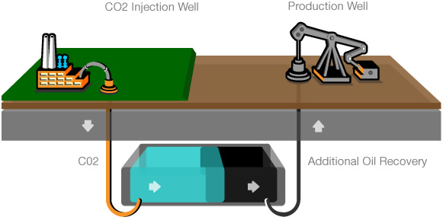
Economically Viable Volcanic Gases?
2b1st Consulting
Notes:
-Here is an overly-simplified diagram of how this all works…
-CO2 injected (on left) and oil recovered (on right).

Slide 5
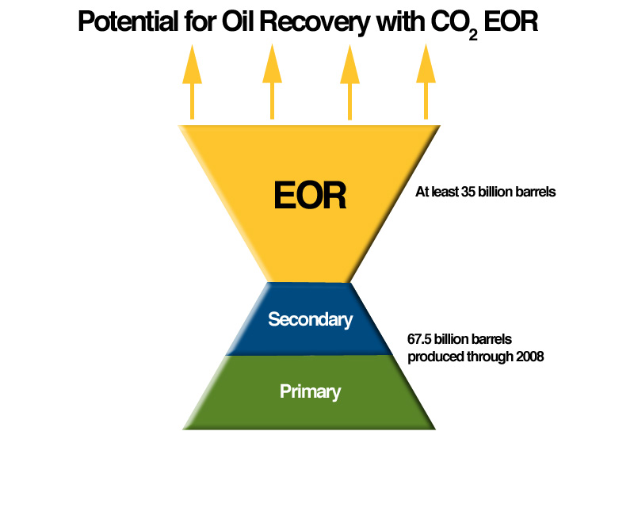
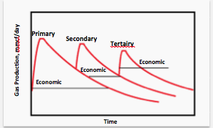
Economic Potential of EOR
Tertiary
Notes:
EOR is typically done as a tertiary (third) method.
But this is of great importance as many fields produce nearly equivalent amount of hydrocarbons from each of the primary, secondary, and tertiary activities. (You may not need to say all of this, but its good information and you can work in as much as you feel comfortable with).

Slide 6
Motivation
Enhanced oil recovery (EOR)
Inject miscible fluids
- Typically CO₂
Recover hydrocarbon fluids
- Typically done for the secondary or tertiary recovery of hydrocarbon fluids
EOR has extended or revitalized the life of oil reservoirs globally
Notes:
Enhanced oil recovery (EOR) has extended and improved the life of oil reservoirs globally.

Slide 7
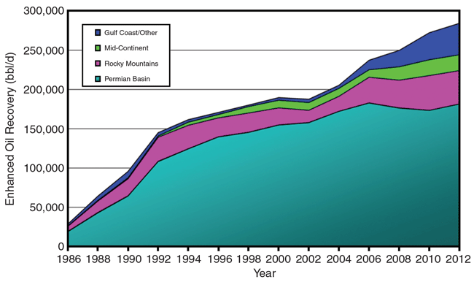
Notes:
-The increase in oil recovery using EOR has improved oil production dramatically and in a variety of fields.

Slide 8
Motivation
Enhanced oil recovery (EOR)
Inject miscible fluids
- Typically CO₂
Recover hydrocarbon fluids
- Typically done for the secondary or tertiary recovery of hydrocarbon fluids
EOR has extended or revitalized the life of oil reservoirs globally
Limited number of CO₂ fields globally
Notes:
Despite the economic successes and potential, there are a limited number of viable CO2 fields in the world.

Slide 9
Motivation
Enhanced oil recovery (EOR)
Inject miscible fluids
- Typically CO₂
Recover hydrocarbon fluids
- Typically done for the secondary or tertiary recovery of hydrocarbon fluids
EOR has extended or revitalized the life of oil reservoirs globally
Limited number of CO₂ fields
Must better understand the volcanic setting of existing CO₂ reserves in order to meet growing demand for CO₂

Slide 10
Motivation
Develop a suite of geochemical techniques to characterize volcanic systems
Study modern volcanic analogs to better understand the emplacement of existing CO₂ fields
Our approach:
-Gas chemistry
-Stable isotope geochemistry
-Noble gas
-Igneous mineralogy and composition
Notes:
In order to continue meeting industrial demands, new CO2 reserves must be identified, adeptly managed, and exploited. We are working on developing a suite of geochemical tracers that can determine the source and migrational history of CO2 in potential CO2 reservoirs.
We are studying modern volcanic analogs so that we might better understand where exploitable CO2 reserves will be located.
Our approach is analyze both the gas and rock chemistry of modern analogs.
We focus on the major, noble gas and stable isotopic composition of natural gases and fluid inclusions in volcanic rocks.
And the mineralogy and trace element chemistry of igneous products.

Slide 11
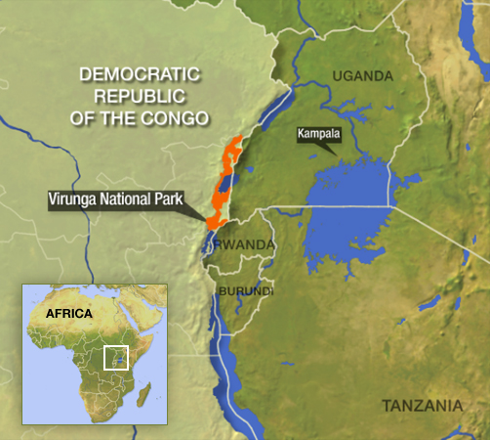
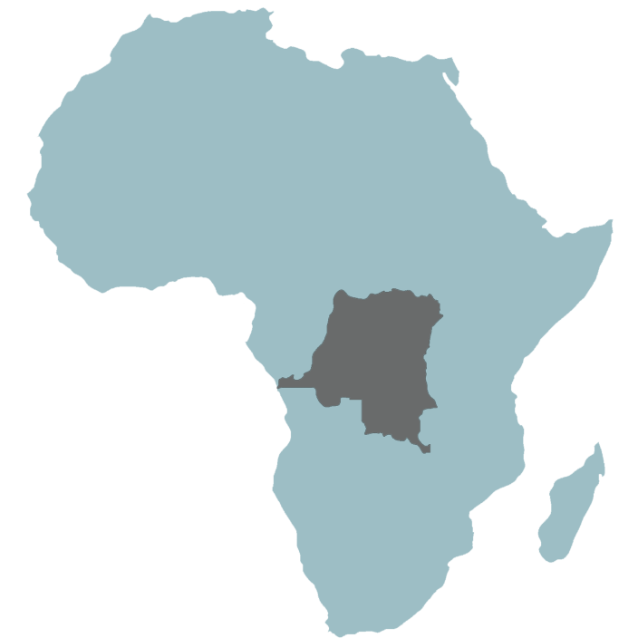
Modern Volcanic Analog: Virunga VP
Eastern border of DRC
DRC
Resolution Possible, UK
NPR
Notes:
Today, I will discuss an appropriate modern analog in the volcanically active Virunga Volcanic Province located in the Democratic Republic of Congo.

Slide 12
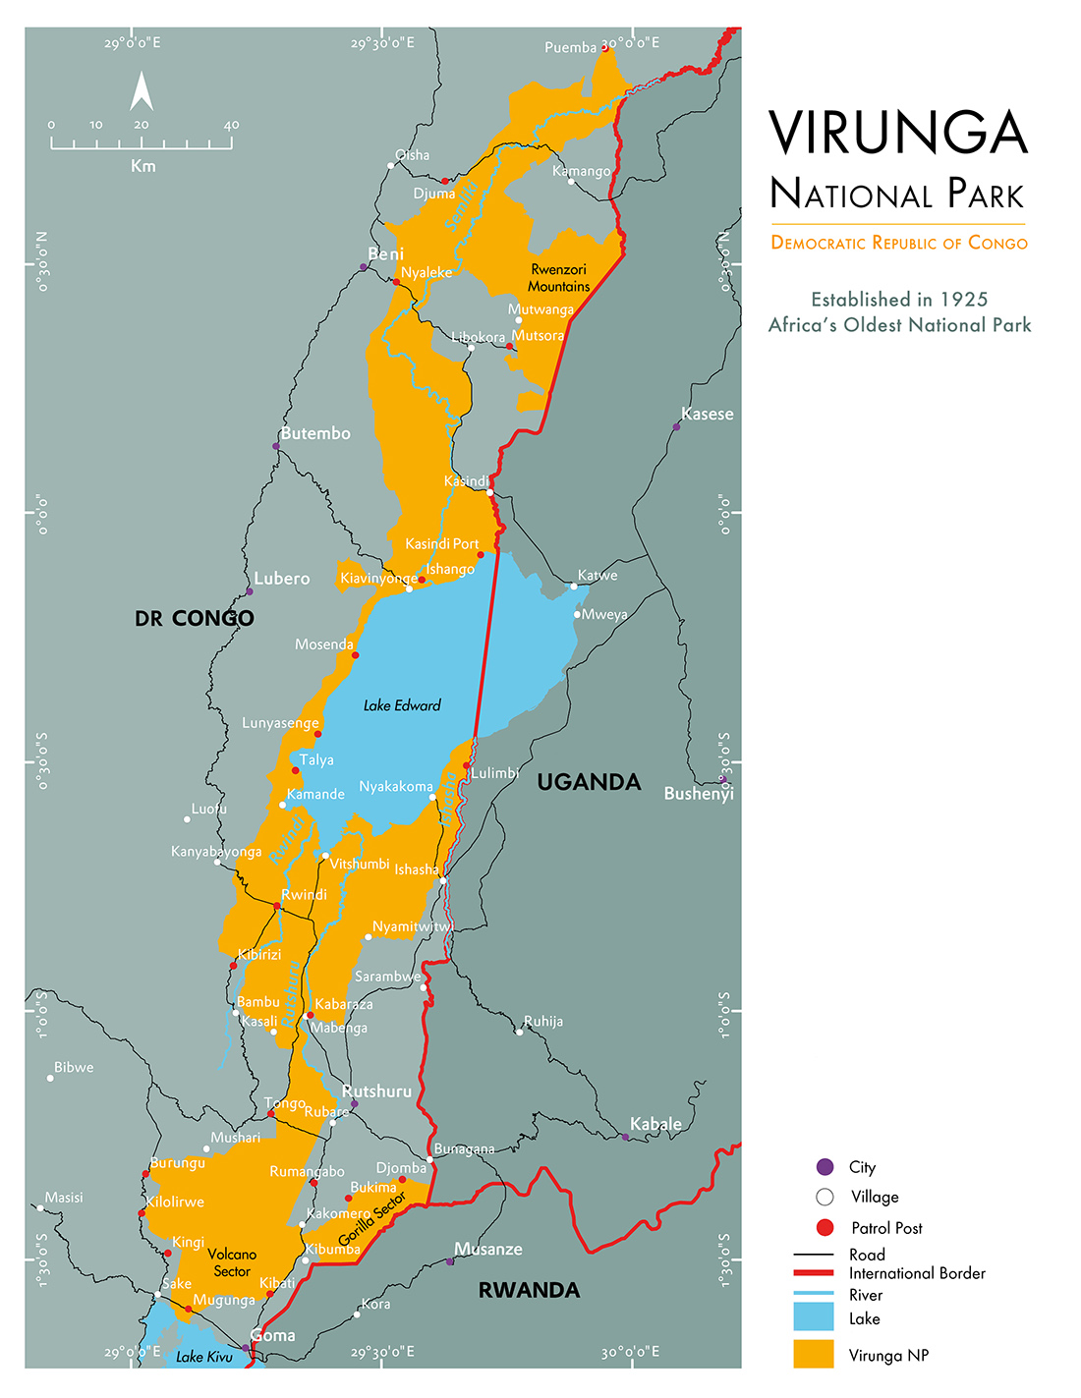

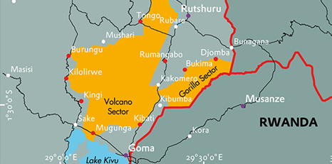
Geographical Setting: East African Rift
Virunga National Park website
Notes:
The VVP is located in the western branch of the East African Rift north of Lake Kivu and the city of Goma, DRC.

Slide 13
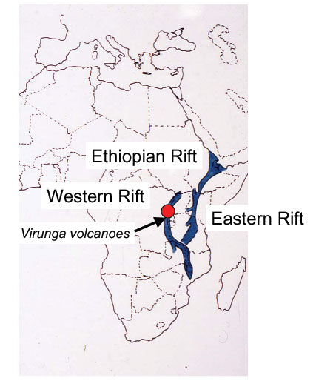
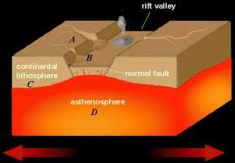
Geological Setting
Penn State, Earth 105
Notes:
The area is an active rift zone located near the ancient suture zone between the Nubian plate and the Tanzanian Craton.

Slide 14
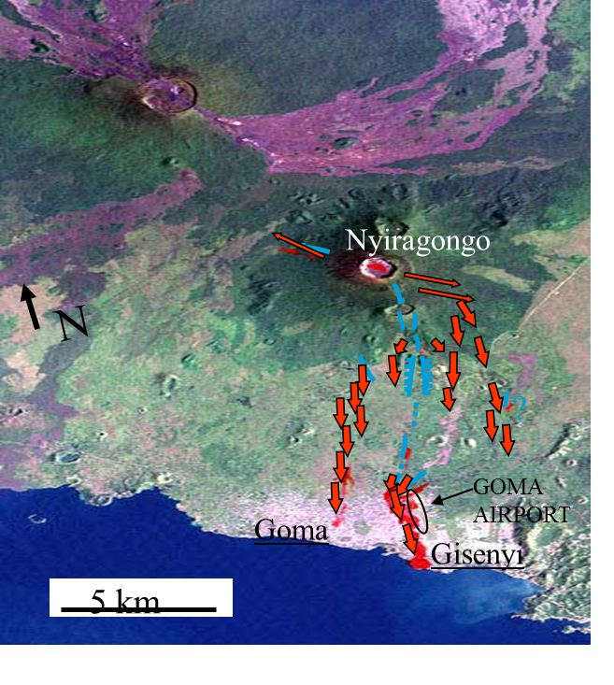
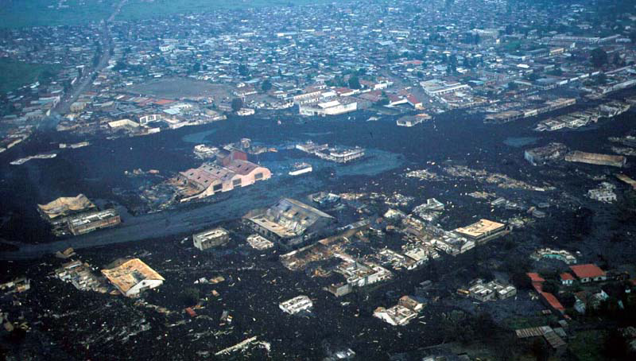
Virunga Up Close
Two most prevalent volcanoes
Nyiragongo
Nyamulagira
History of erupting highly alkali-rich ultra-basic lava
National Geographic, 2014
Notes:
-Most of the volcanism from the area is from the Nyiragongo and Nyamuragira volcanoes. Today I’ll focus on the area near Nyiragongo.
-These volcanoes are extremely active on the human timescale, the last big eruption being in 2002.
-Known to produce peculiar volcanic products that are silica-undersaturated (low SiO2) and have a very high alkali (K and Na) content.
-In addition to the volcanic systems we have collected fluids from a variety of fumarolic gas discharges across the rift.

Slide 15
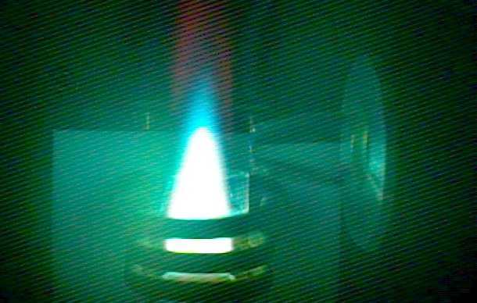
Rock Composition Methods
Measure:
Major elements (e.g., Mg, Ca, Na, K, and Si)
By ICP-OES
Trace elements such and Ba, Sr, U, Th, and REEs
By ICP-MS
Worley and Kvech, Virginia Tech

Slide 16
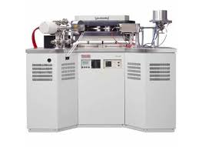
Gas Composition Methods
Measure:
Gas chemistry (CO₂, CH₄, N₂, H₂)
By GC-TCD/FID
Stable isotopes (δ¹³C-CO₂)
By Isotope Ratio MS
Noble Gas MS (He, Ne, Ar, Kr, Xe and their isotopes)
Thermo Fisher Helix NG-MS

Slide 17
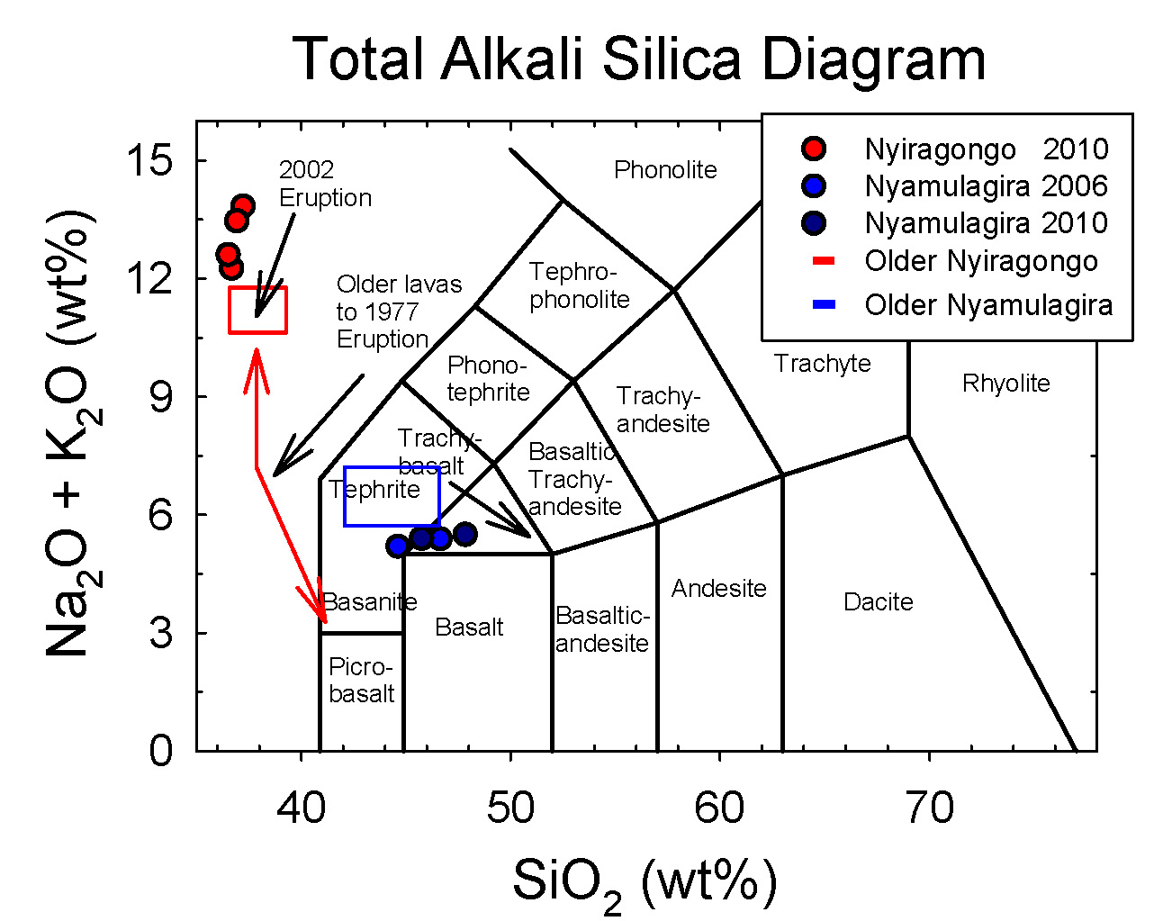
Source Rock Composition
Silica-undersaturated
Ultra-alkaline
Carbonatite lavas
Located proximal to re-activated failed rifts along previous suture zones
Following: Chakrabarti et al, 2009
Notes:
-Mineralogy of Nyiragongo and Nyamagura are distinct
-Nyiragongo is unique in that it is highly silica undersaturated and has extremely high alkali earth enrichments (Na + K).
-Consistent with carbonatite composition reported in Chakrabarti et al, 2009

Slide 18
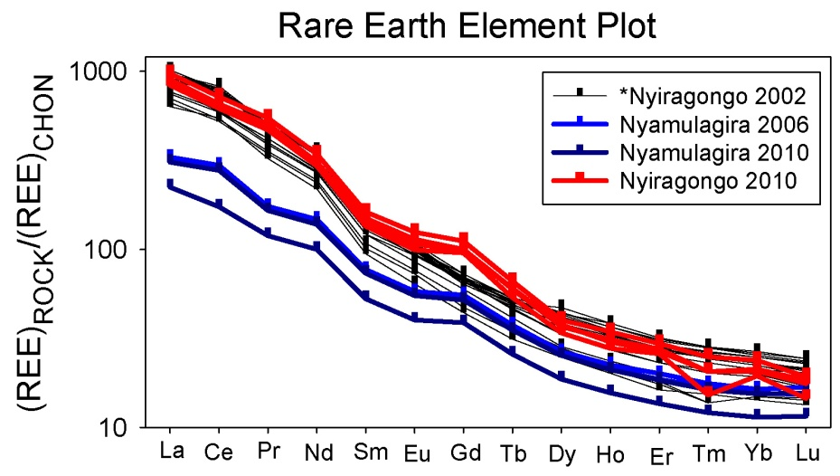
Trace Element Composition
Enriched patterns of light REEs compared to many other magmatic sources
Consistent with carbonatite lavas reported in Chakrabarti et al, 2009
Notes:
A plot of chondrite (CHON) normalized rare earth element (REE) patterns of Nyiragongo and Nyamulagira.
-Show extreme light REE enrichment.

Slide 19
Trace Element Composition
Enriched patterns of light REEs compared to many other magmatic sources
Consistent with carbonatite lavas reported in Chakrabarti et al, 2009
Gd enrichment is consistent with a high degree of metasomatism
Notes:
A plot of chondrite (CHON) normalized rare earth element (REE) patterns of Jackson Dome, Nyiragongo, and Nyamulagira.
Gd enrichment is consistent with a high degree of metasomatism

Slide 20
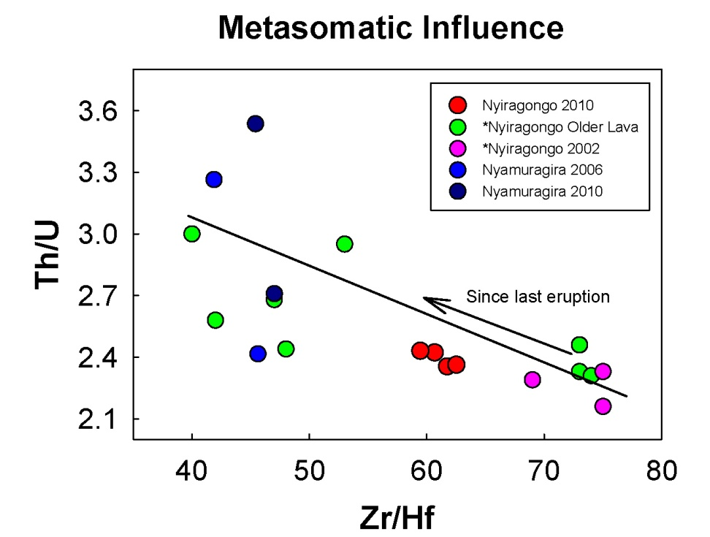
Nascent Plume or Metasomatism?
Gd anomaly, Th/U and Zr/Hf are sensitive and diagnostic tracers of metasomatism
Notes:
-Low Th/U and high Zr/Hf are consistent with metasomatism.
-The amount of metasomatic influence is variable over time.
-Since 2002 eruption the amount of metasomatic influence is decreasing.

Slide 21
Nascent Plume or Metasomatism?
Metasomatism: chemical alteration by hydrothermal processes
Carbonate metasomatism in subduction zones
Carbonatite lavas
Common evidence of extreme carbonate metasomatism
Gd anomaly
Th/U
Zr/Hf
Gas geochemistry data are consistent with other areas located proximal to failed rifts along previous suture zones
Notes:
-For those who might be unfamiliar, metasomatism is the chemical alteration of rocks by hydrothermal processes
-carbonate metasomatism is common in subduction zones, which can result in these carbonatite lavas
-The Gd anomaly previously shown, as well as low Th/U and high Zr/Hf ratios are common tracers of this process.
-These same tracers seen at Nyiragongo are consistent with other CO2 reservoirs that are close to failed rifts along previous suture zones

Slide 22
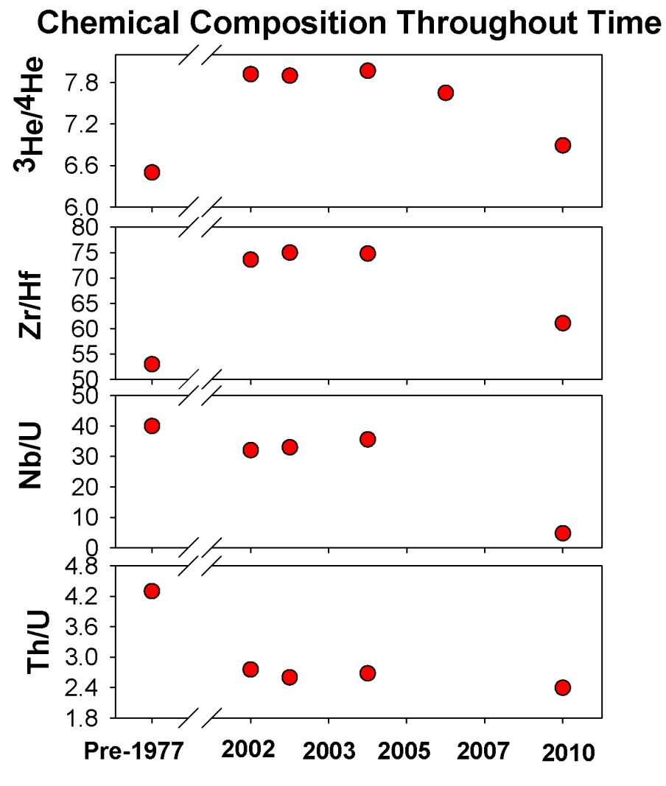
How do gases compare?
Helium isotopic composition typical of MORB
Diagnostic trace element patterns mimic temporal trends in helium isotopic composition
Both helium isotopes and trace elements suggest a variable metasomatic influence
Notes:
-Again, Helium isotopic composition of the gas discharged at Nyiragongo changes through time.
-Varies from MORB-like composition (8Ra) down to 6.5Ra, which is more consistent with sub-continental lithospheric mantle
-Interestingly the helium isotope values change in a coherent pattern with the trace elements that are diagnostic of variable metasomatism
-Since the 2002 eruption, the pattern seems to have returned to a more “sub-continental lithospheric” pattern.

Slide 23
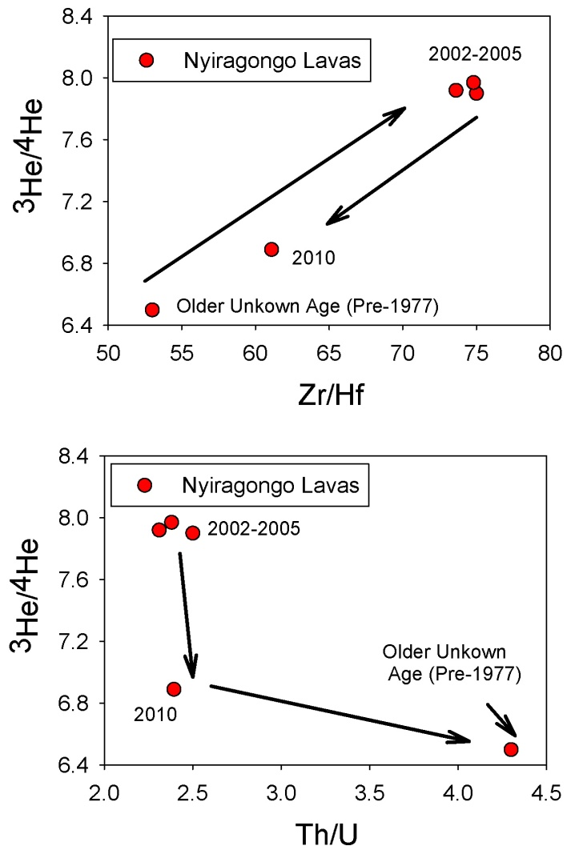
How do gases compare to trace elements?
Helium isotopic ratio is decreasing since the 2002 eruption
Lava volume increases → decreasing evidence for metasomatic inputs
Extrapolating to periods of lower metasomatic influence helium isotope ratio is likely ~6Ra and consistent with SCL
Notes:
-Here is are some clearer graphs of how the ¾ ratios vary relative to the Zr/Hf and Th/U ratios over time.
Interestingly the helium isotope values change in a coherent pattern with the trace elements that are diagnostic of variable metasomatism
-As the helium isotopic composition decreases, the influence from metasomatism decreases.

Slide 24
Gas Chemistry
Noble gas and stable isotopes are consistent with “water-washing”
Caused by water-gas interactions in the crust (e.g., Gilfillan et al, 2009; Darrah et al, 2013)
Biogenic
“Water-washing”
Darrah et al, 2012b
Notes:
Like other CO2 reservoirs: the Nyiragongo gases appear to be consistent with MORB and sub-continental lithospheric values.
The stable isotopes of Nyiragongo plot along a pattern of water-gas interactions (water-washing). These patterns are consistent with observations by Ballentine’s group at Jackson Dome (Zhou et al, 2012) and the Four Corners (Gilfillan et al, 2008; 2009).

Slide 25
Summary
Plume hypothesis is still possible, but the data seems to cycle between MORB and SCLM
Helium isotopes appear to vary with trace elements in a manner consistent with the “metasomatic” influence
Gas composition is similar to Jackson Dome and some aspects of the Four Corners CO₂ fields
Future work: other CO₂ reservoirs
Notes:
SCLM is sub-continental lithospheric mantle.

Slide 26
Acknowledgements
Questions?

