Slide 1
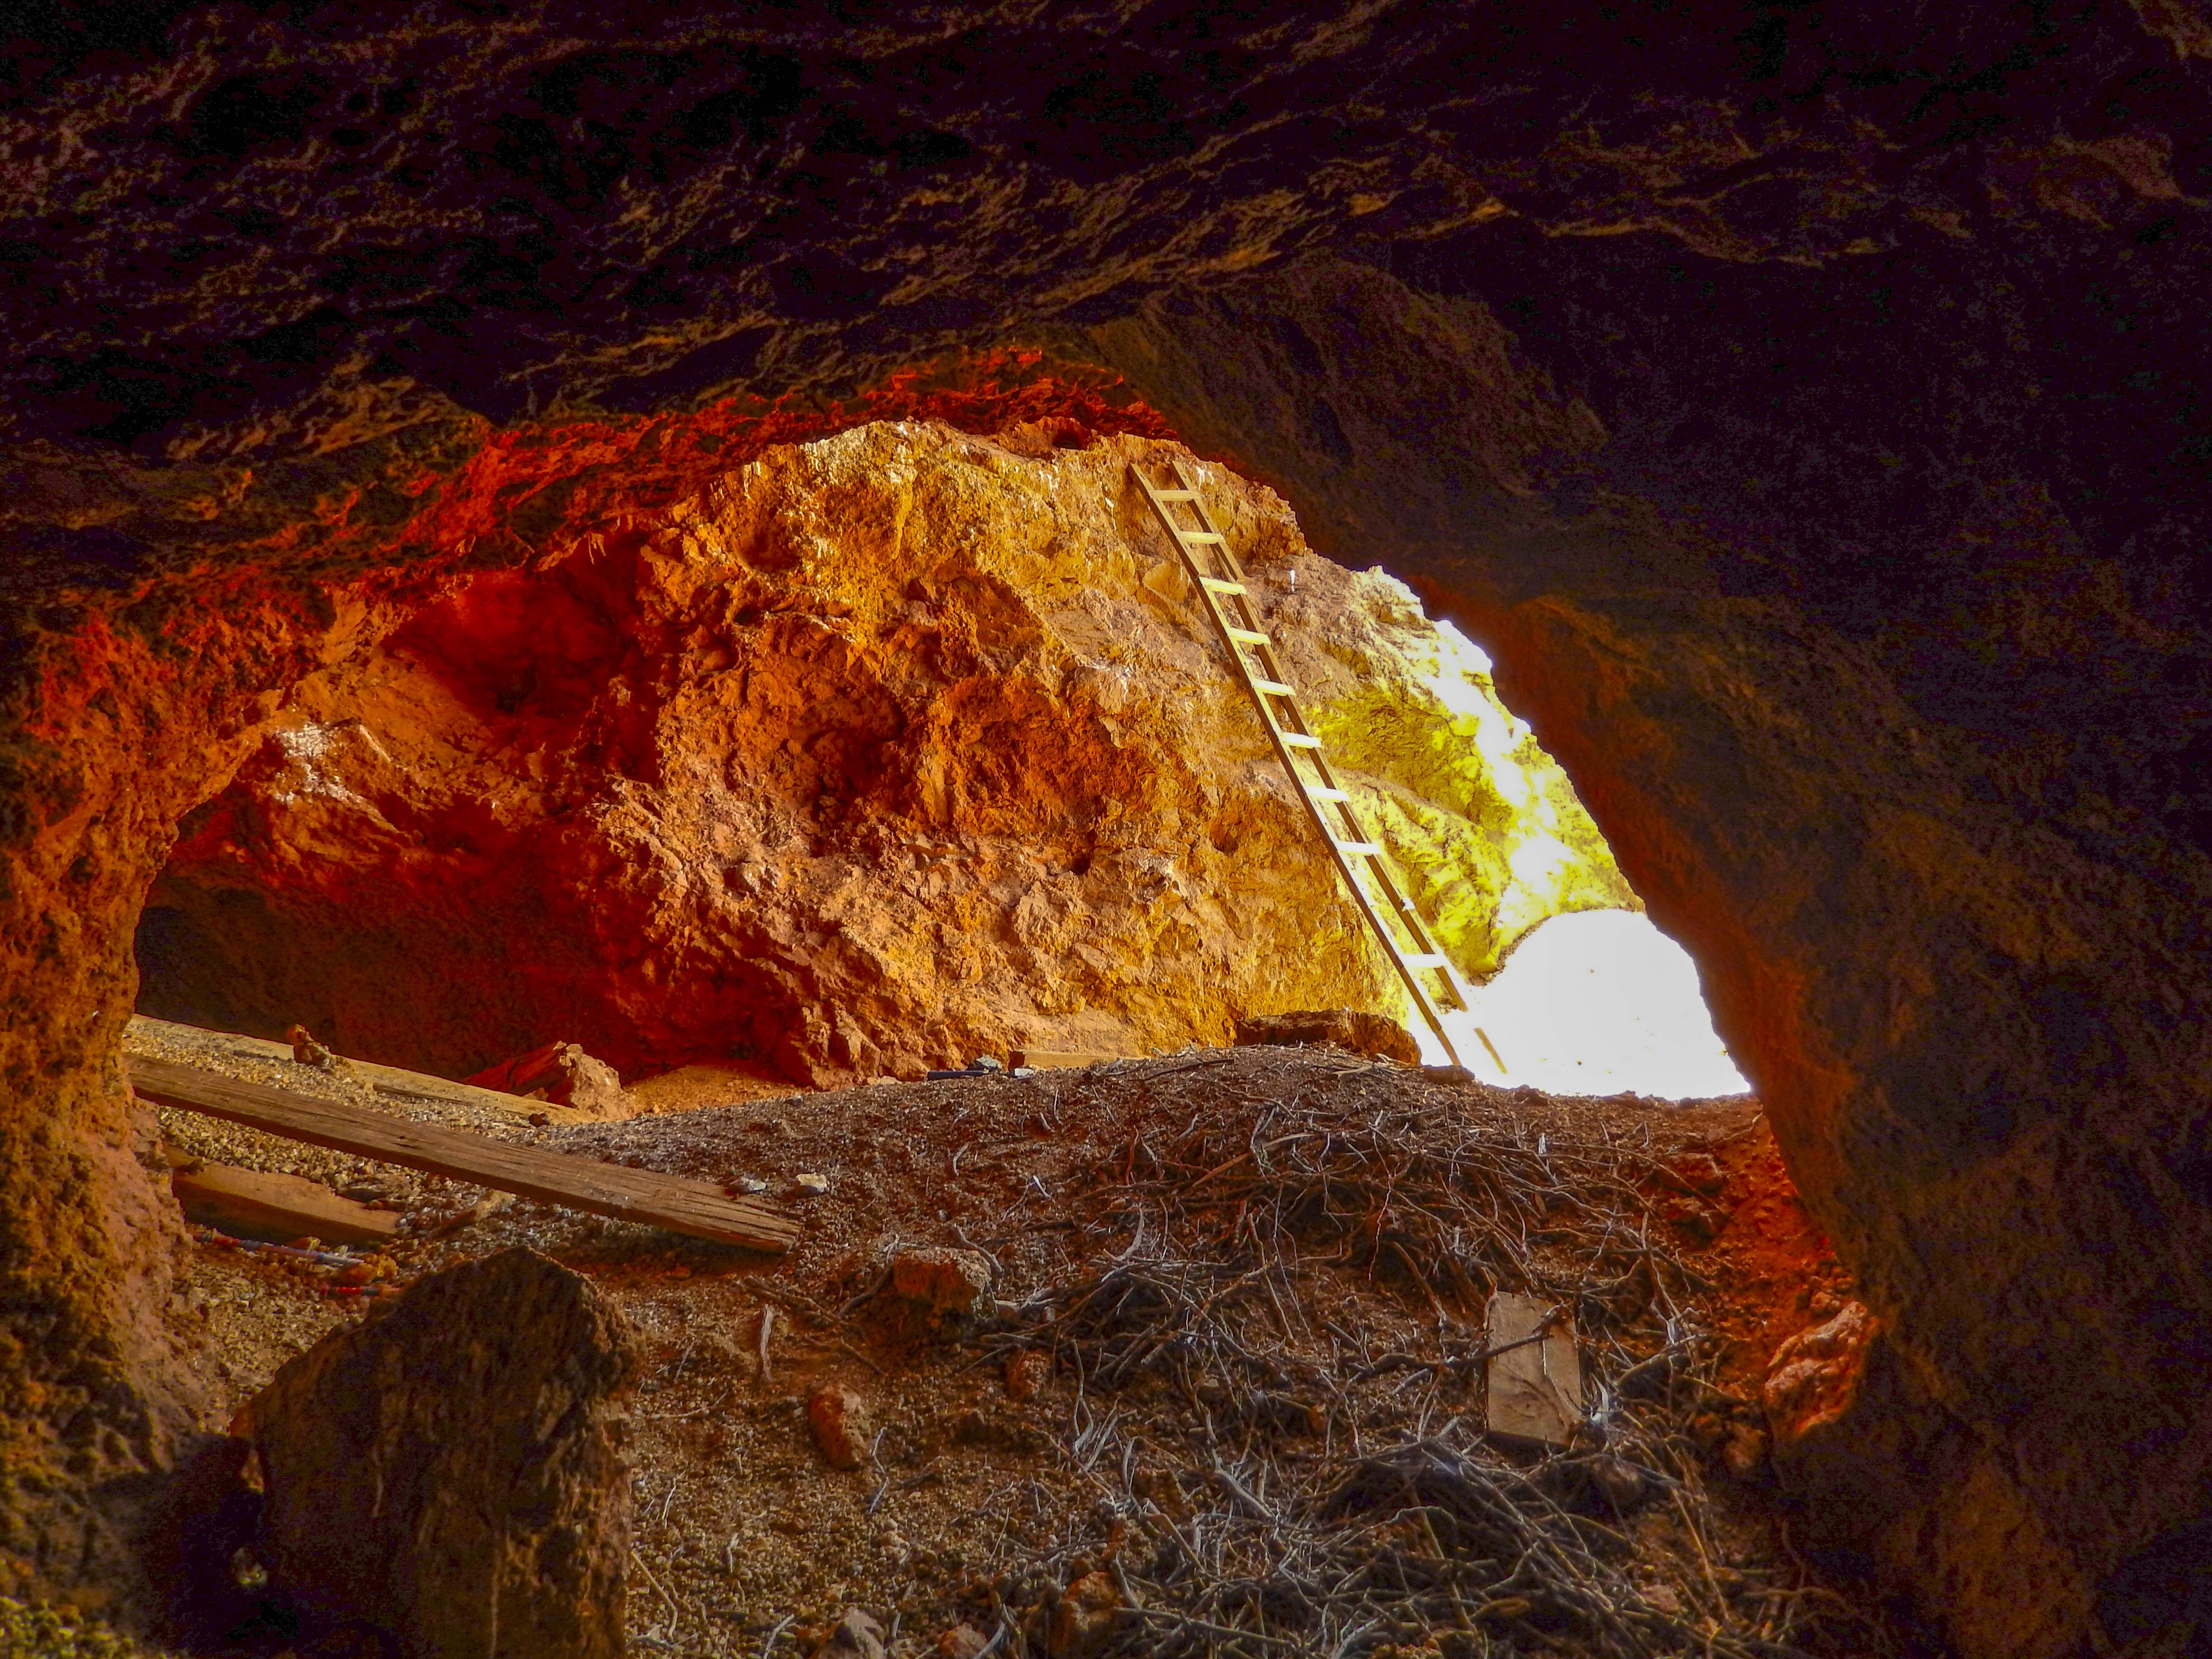


using surficial geochemistry and boxwork structures of gossans as a tool for mineral exploration: A PILOT STUDY IN UTAH
ANDREW LAWRENCE
Sutterfield, David R.; Arnoff, Michael J.; Fletcher, Andrew W.;Matheson, Ephram C.; Kerswell, Buchanan; Natter, Daniel H.; Fellows, Steven A,; Emerman, Steven A.

Slide 2
Overview
Introduction to Gossan Formation
Present Research Question
Methods
Preliminary Results (proof of concept)
Future Work and Applications
Conclusions

Slide 3
General Ore Deposit Characteristics
Ore deposits are variable but can be grouped based on common formation models and elemental suites
Common deposit types include:
Porphyry (Cu, Mo, Sn etc.)
Seven unique subtypes
Skarn (Cu, W, Zn, Pb, Fe, Au, Ag etc.)
Seven unique subtypes
VMS (Base metals ± Au & Ag)
Three unique subtypes

Slide 4
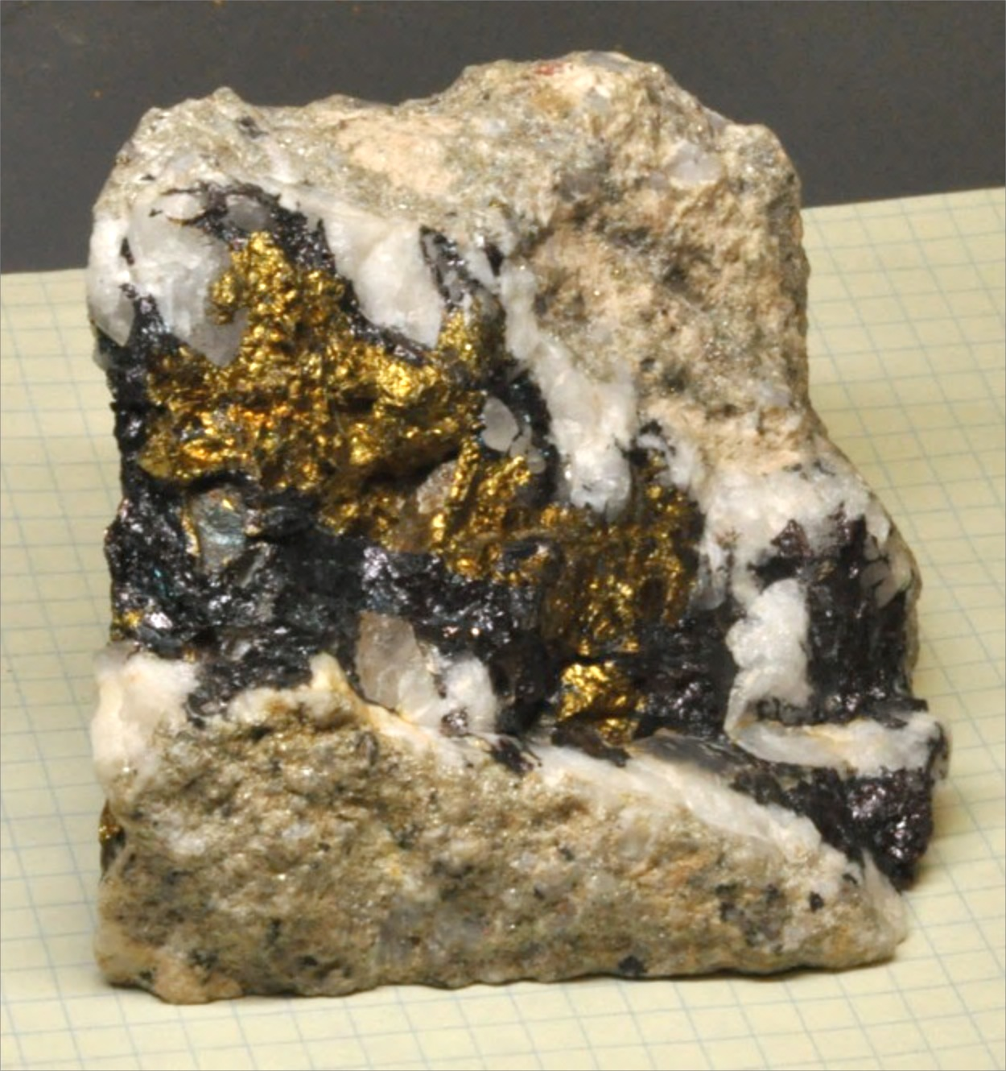
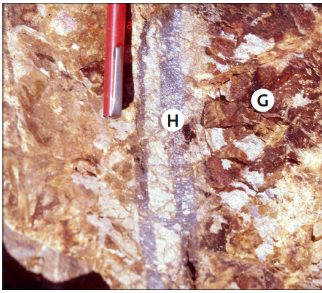
Oxidizing of Ore Deposits
Sulfides
Gossan
From Gossans and Leached Cappings Taylor, 2011

Slide 5
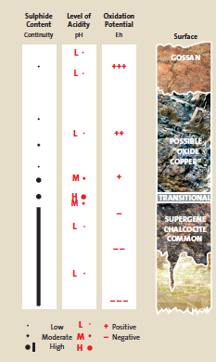
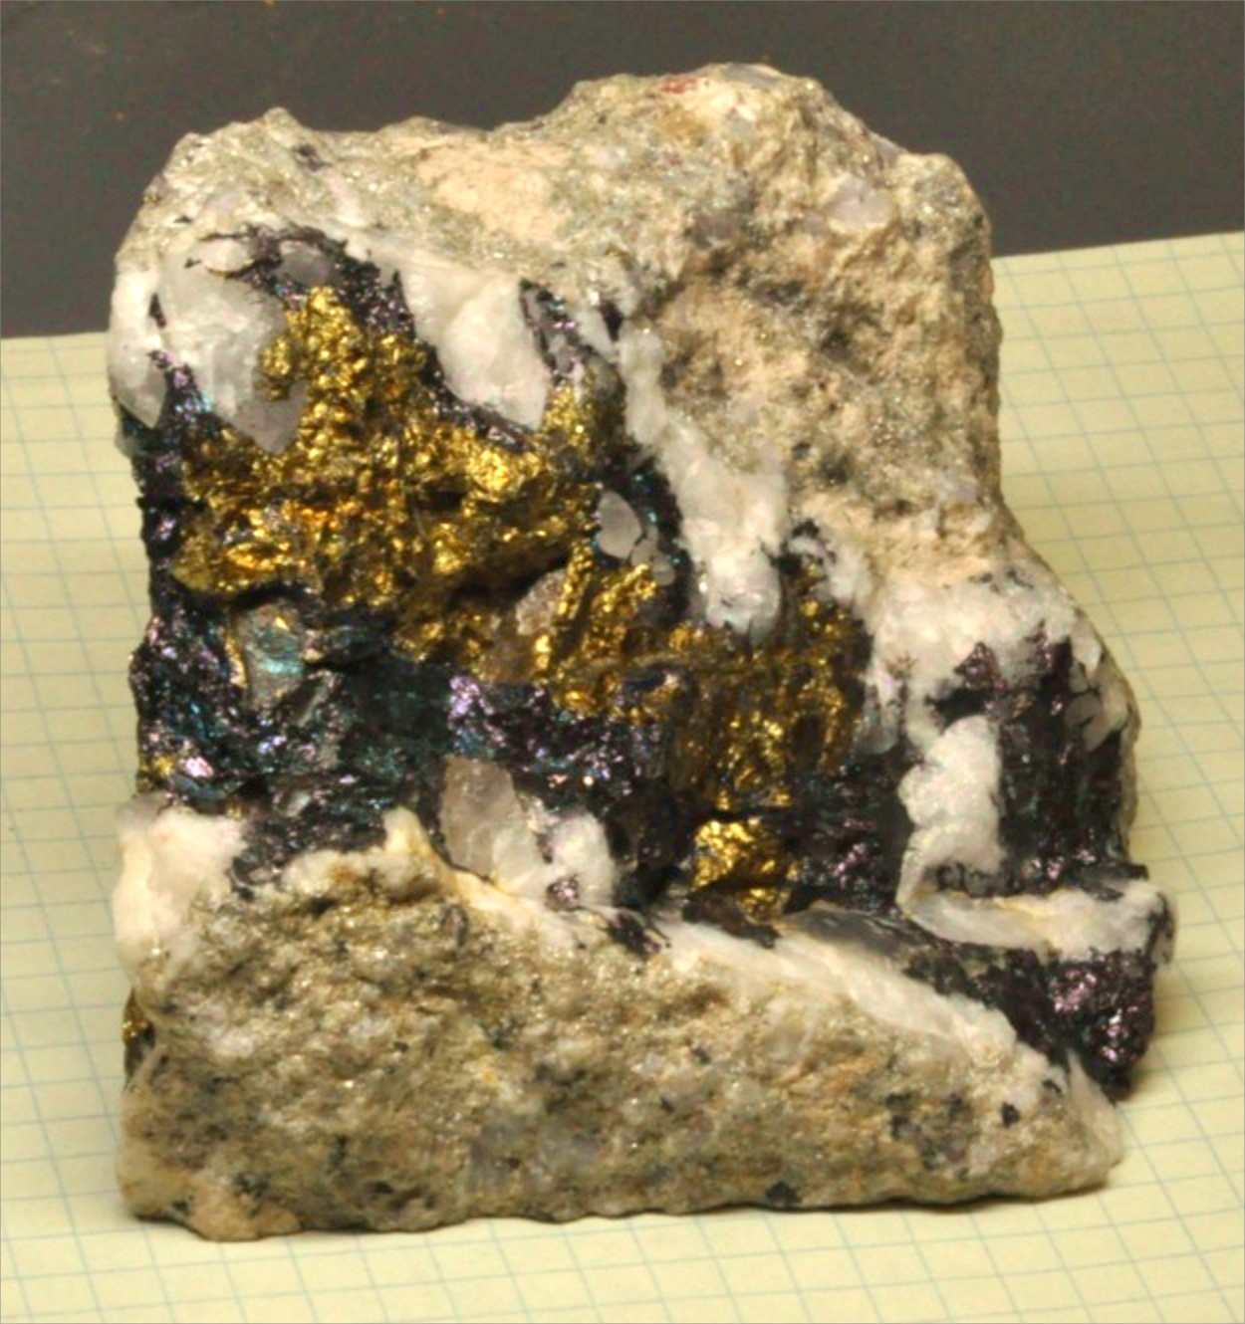
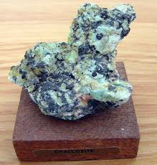
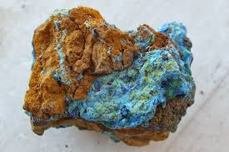
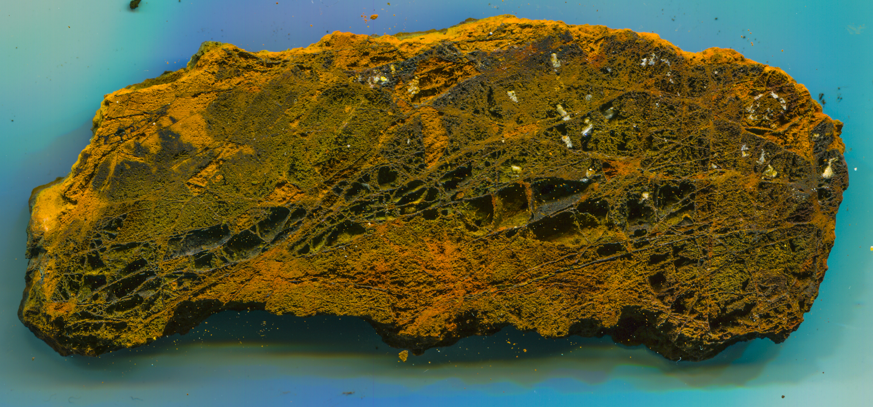
Cross-Section Through an Oxidized Sulfide-Bearing Outcrop
Oxide Zone:
Low to Moderate pH
Possible Oxide Ore
Possible Sulfides
Gossan:
Low pH
Oxidized
Leached
Low Sulfides
Supergene Zone:
Low to Moderate pH
Chalcocite likely
Reducing
Primary Sulfide Zone:
Low pH
Chalcopyrite Bornite
Reducing
From Gossans and Leached Cappings Taylor, 2011

Slide 6
Does gossan retain a unique chemical and/or physical fingerprint that can make predictions about hidden sulphide bodies at depth prior to expensive drilling or geophysical surveys?

Slide 7
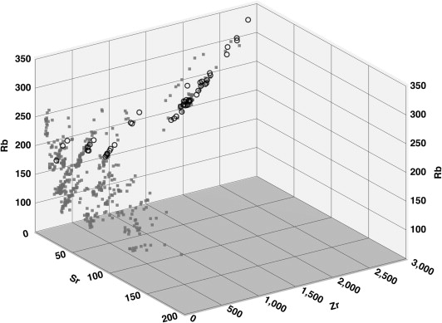
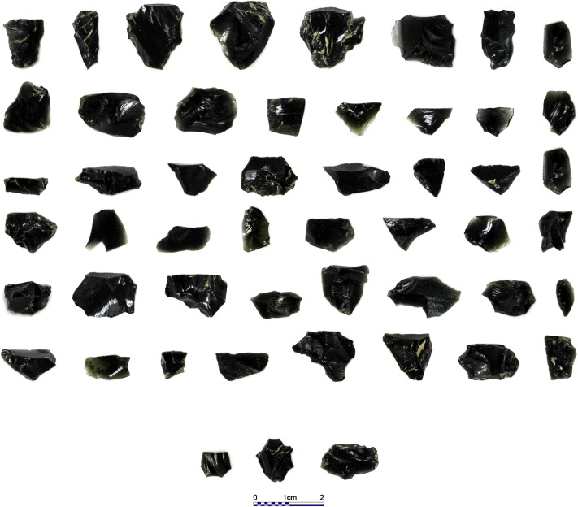
An archeological example
Validity of “off-the-shelf” handheld portable xrf for sourcing near eastern obsidian chip debris
Artifacts plot within the same chemical field as the source region
Open Circles are XRF analyses of various artifacts
Small Gray Squares are XRF analyses from various obsidian source regions
Frahm 2013, Journal of Archeological Science

Slide 8
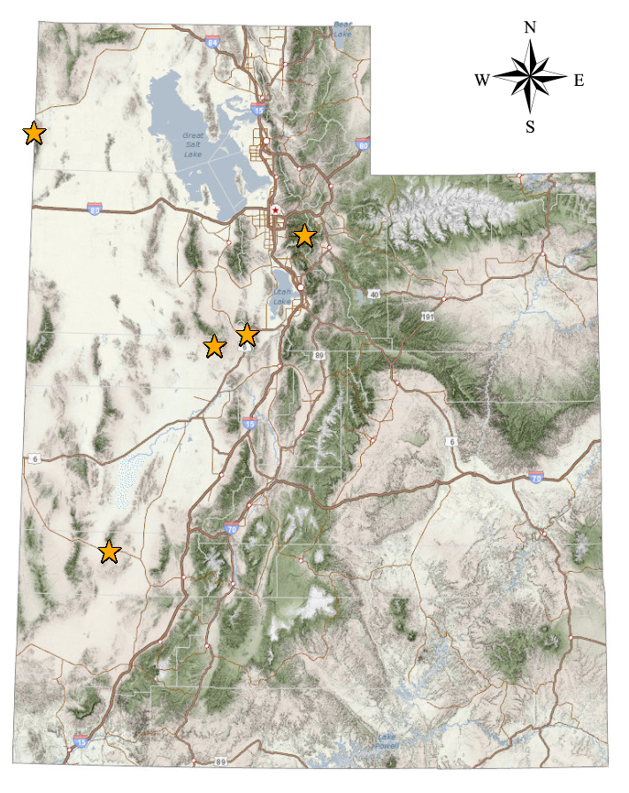
Sample Locations
Notes:
GG is LC

Slide 9
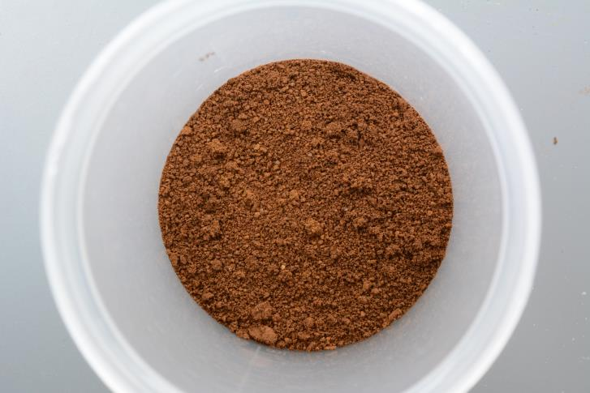
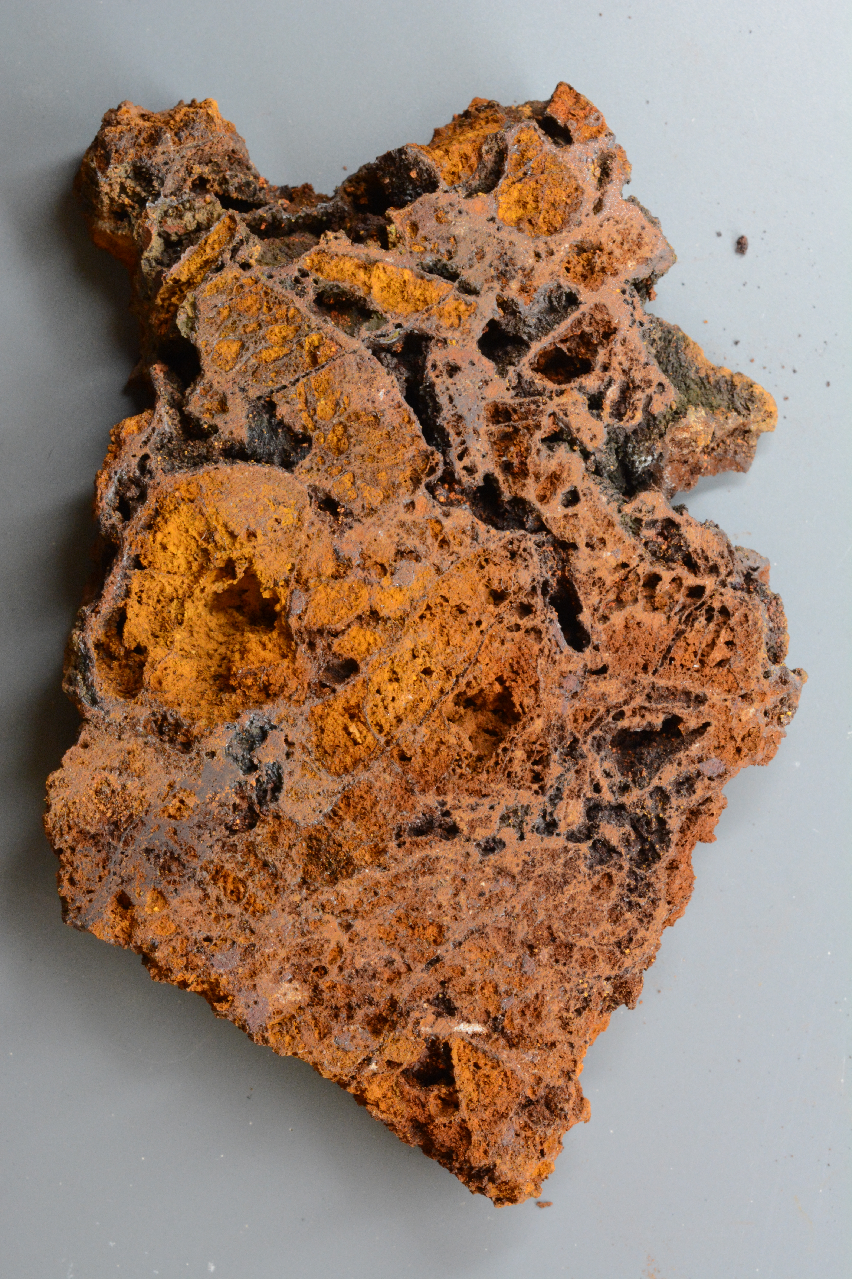
1. Characterize physical attributes of hand samples from known deposits.
Methods:
Cellular structure
Cell shape and size
Cell wall thickness
Angular intersections between walls
Color (RGB or CMYK) of hand sample

Slide 10
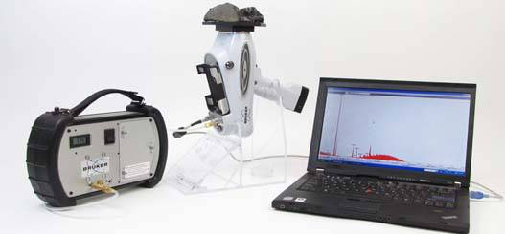
Methods:
2. Analyze homogenized hand samples with Bruker portable XRF.
Use normalized raw counts to build a spectra for each sample
Collect and average a large number of spectra for each location to address heterogeneity of the deposit
Build a database to match unknown spectra to known
spectra
Bruker pXRF

Slide 11
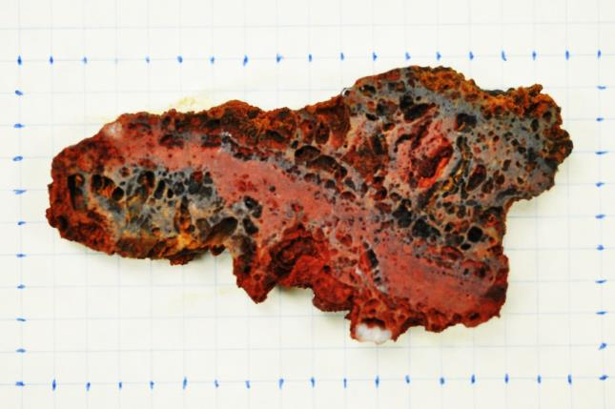
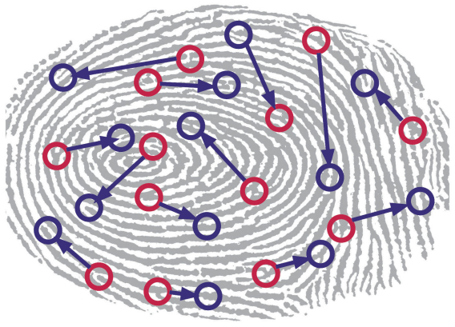
Methods:
3. Use results to build a physio-chemical fingerprint representative of that deposit to use for future comparison of unknown samples
Physical
Chemical
+
+

Slide 12
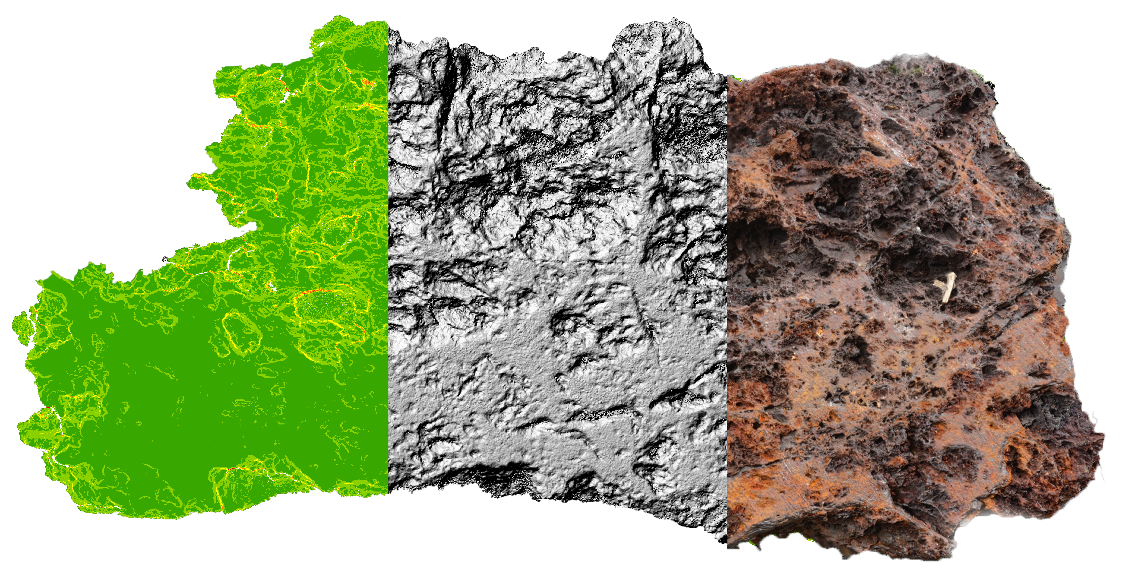
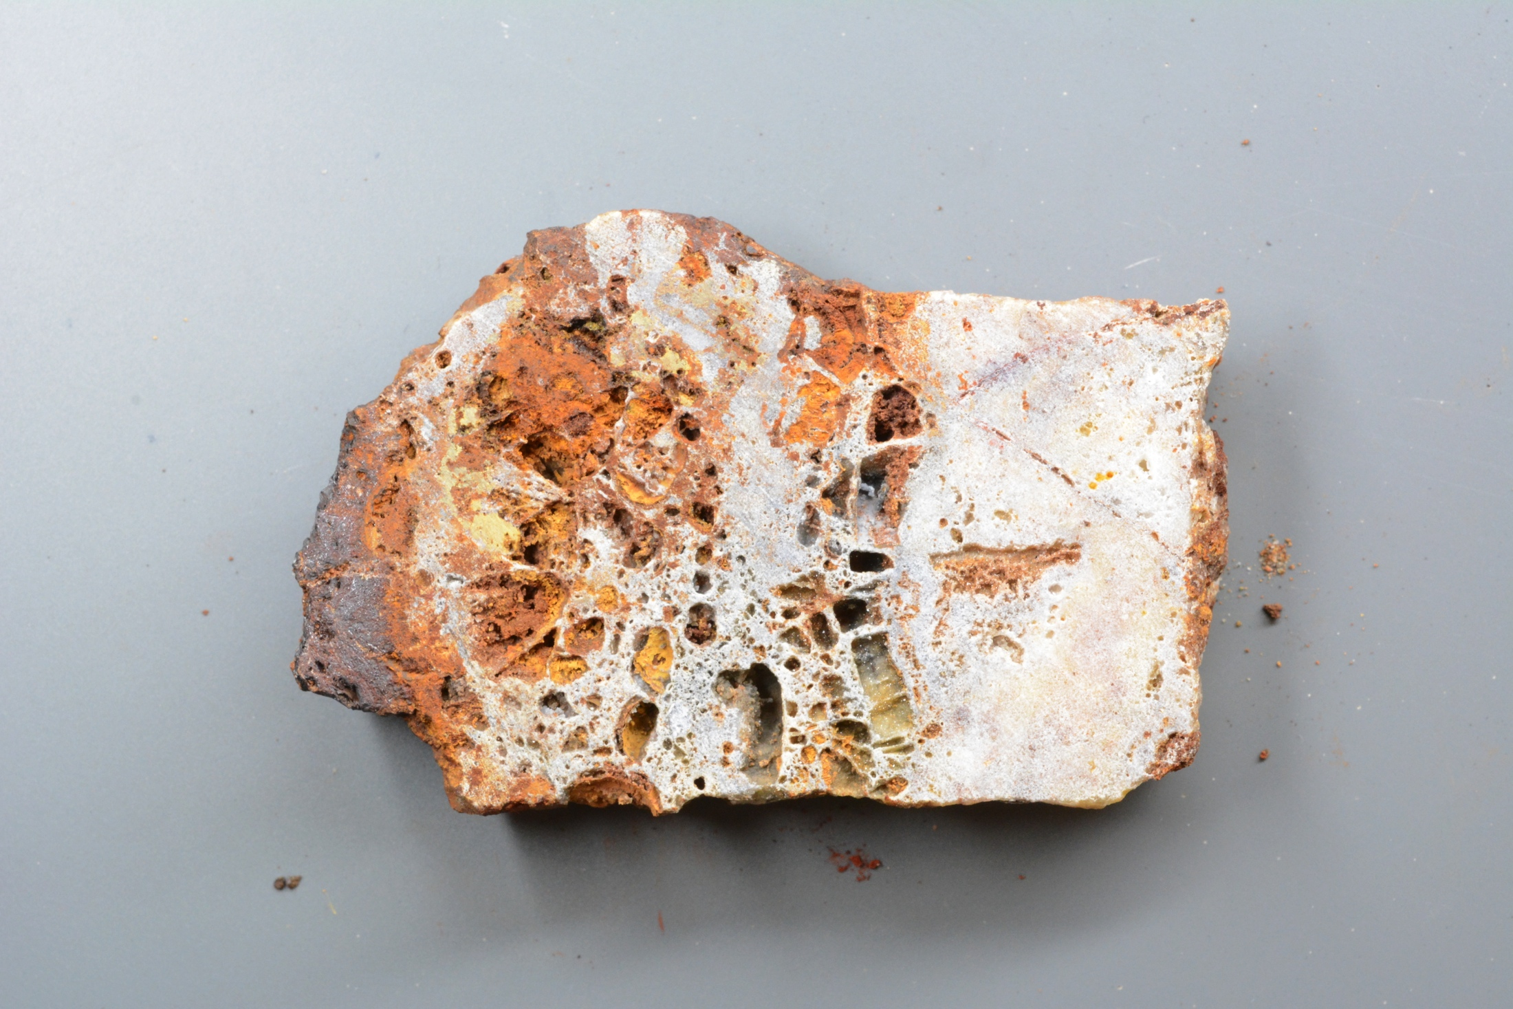
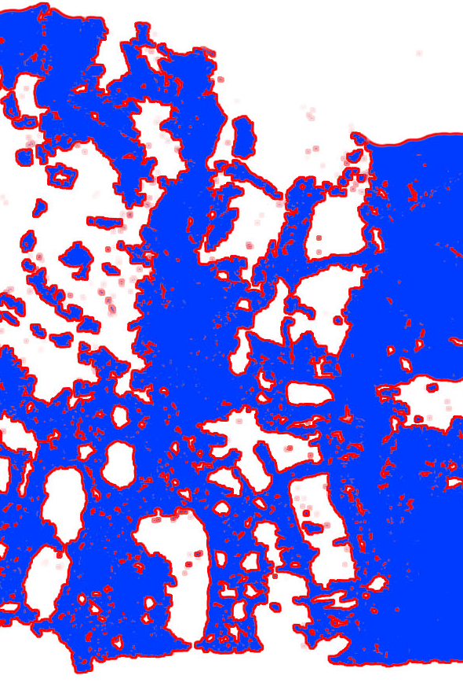
Preliminary Results: Boxwork micro-geospatial analysis
AGISoft and DEM and GIS software Micro geospatial analysis.

Slide 13
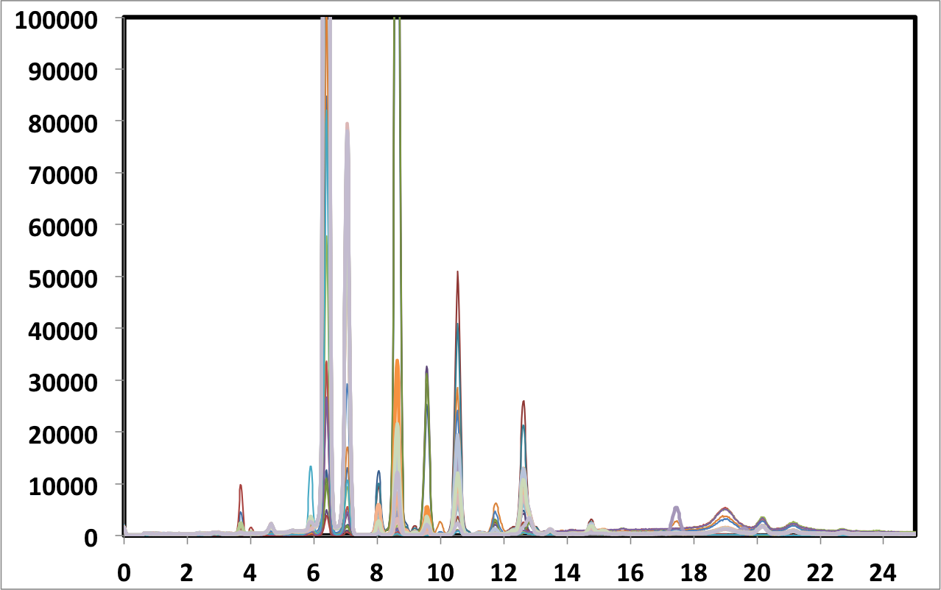
Preliminary Results: Raw XRF Spectra from various skarn deposits
Fe
Cu
Zn
Logged counts norm. to total counts
Pb
Many More
KeV

Slide 14
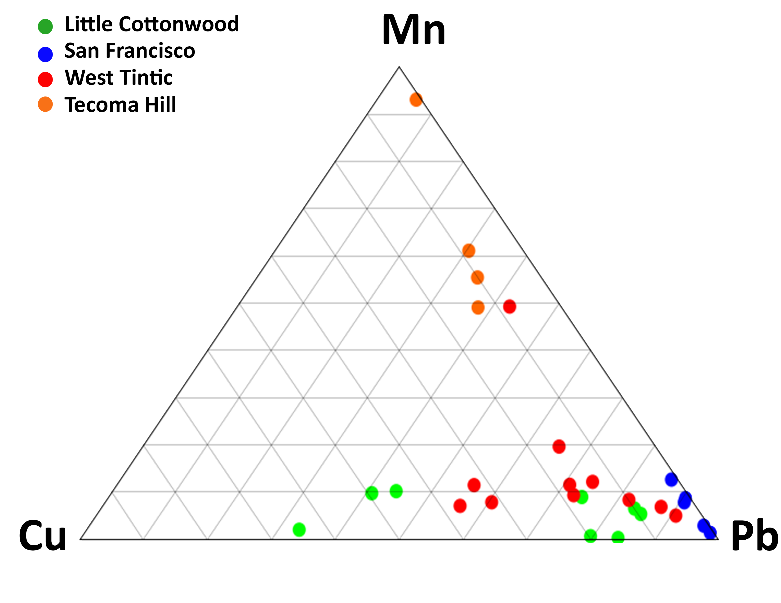
Preliminary Results: Ternary plot of Mn-Cu-Pb showing the unique chemical fingerprint of each gossan
Tecoma Hill
Mn-rich
West Tintic
Intermediate
San Francisco
Pb-rich
Little Cottonwood
Mn-poor

Slide 15
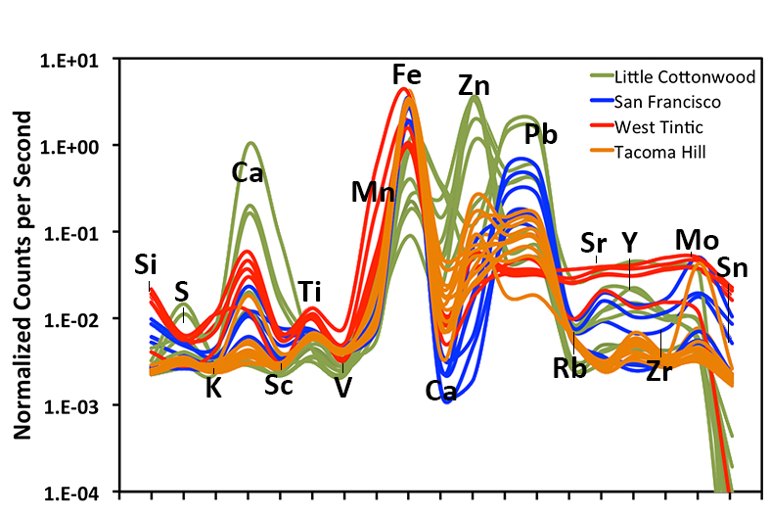
Preliminary Results: Example of chemical fingerprints of four unique skarn deposits
Simplified spectra of normalized and logged counts per second for various skarn deposits

Slide 16
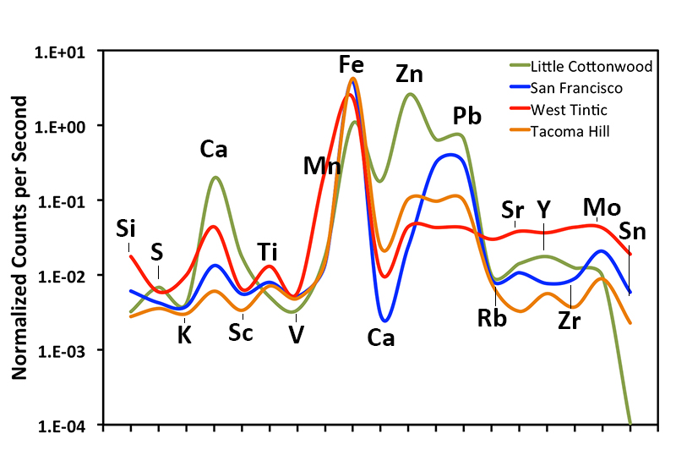
Preliminary Results: Average chemical fingerprints of four unique skarn deposits
Simplified spectra of normalized and logged counts per second for various skarn deposits

Slide 17
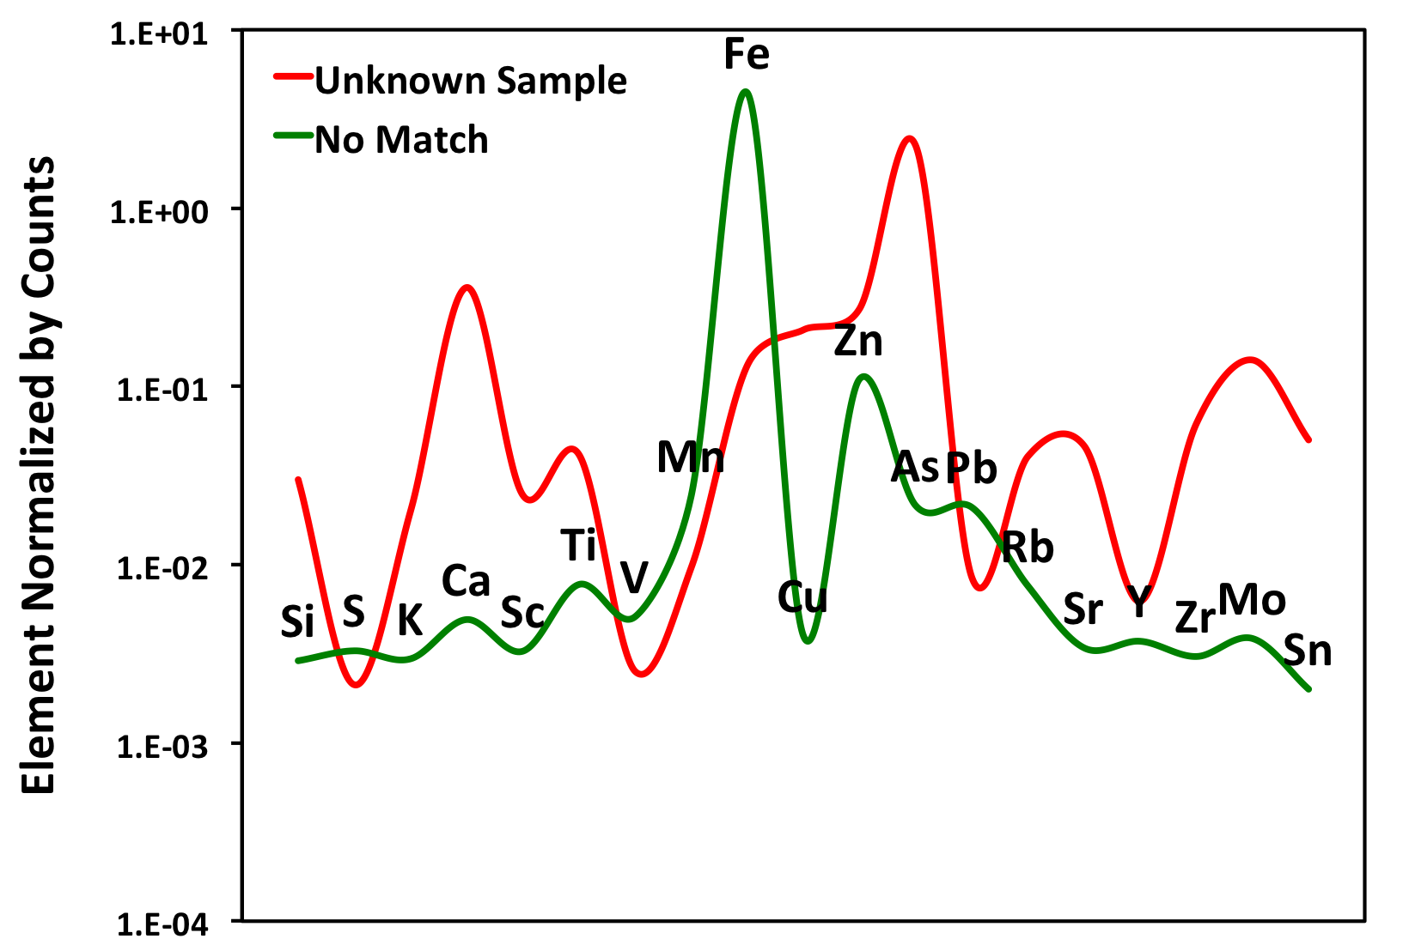
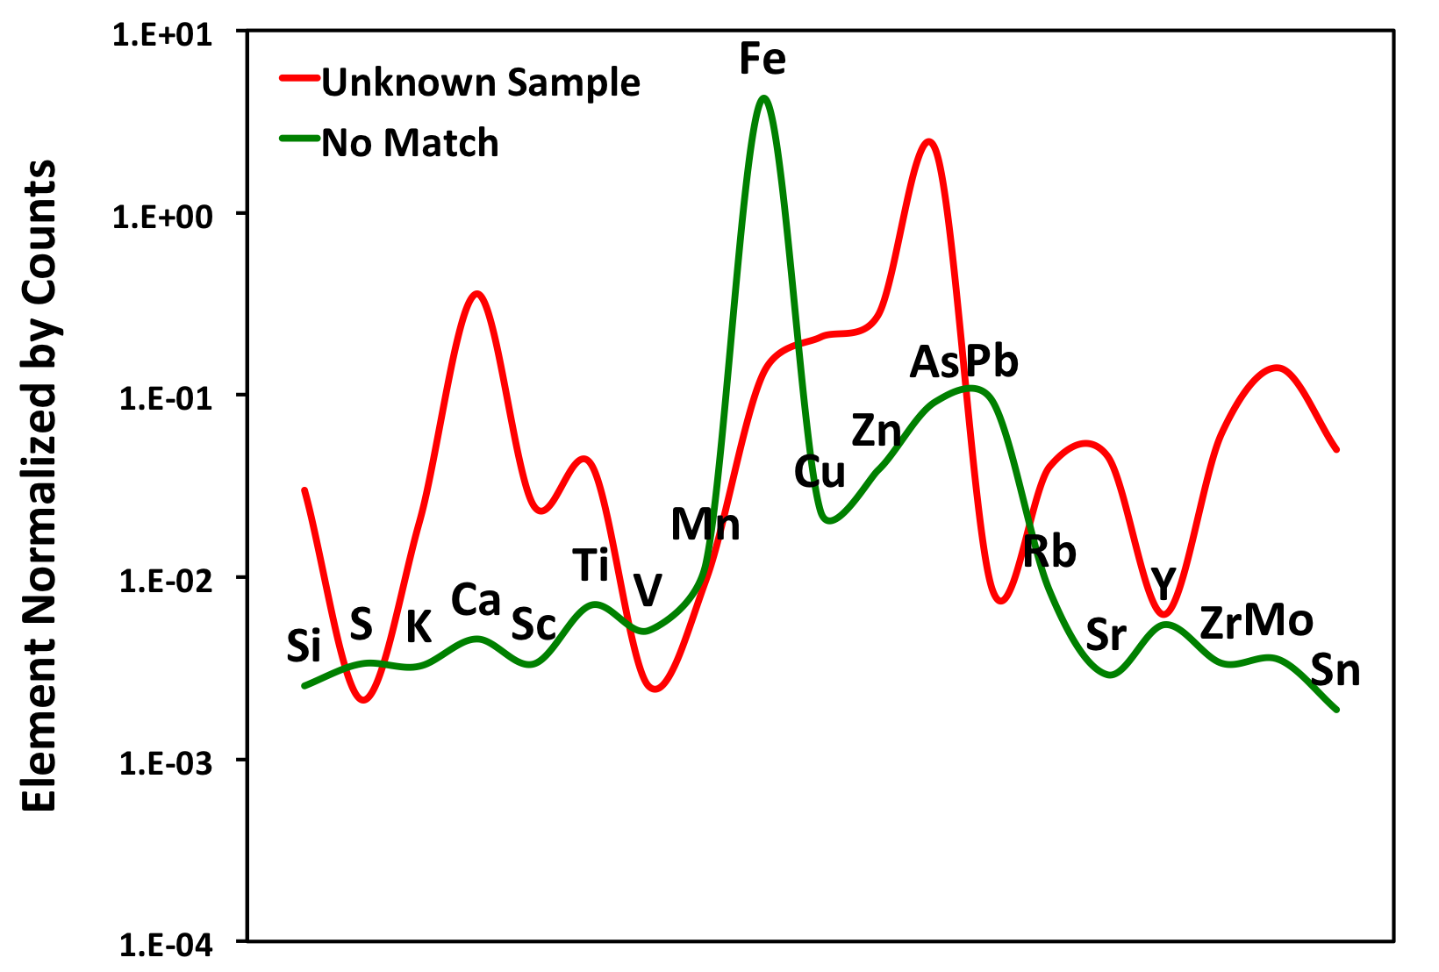
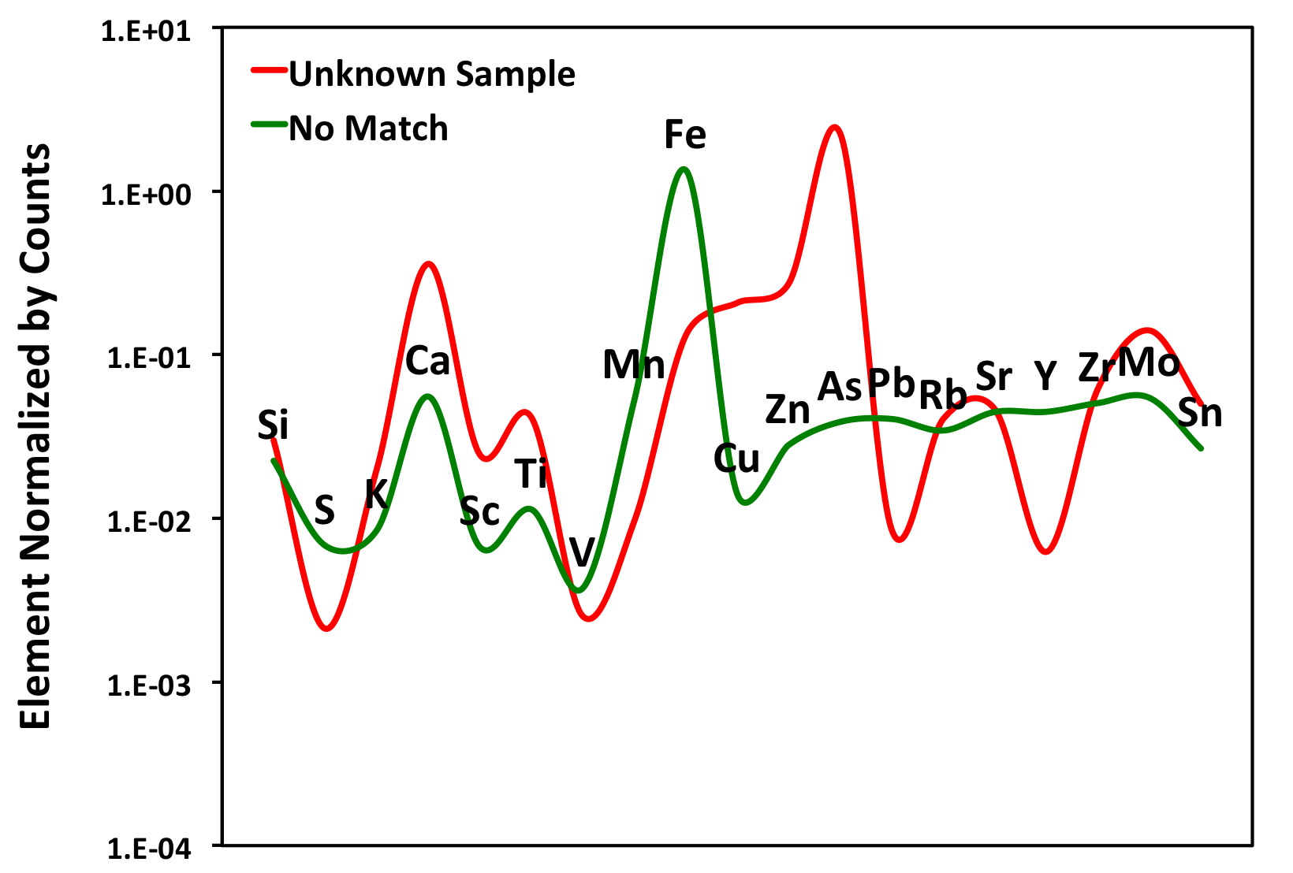
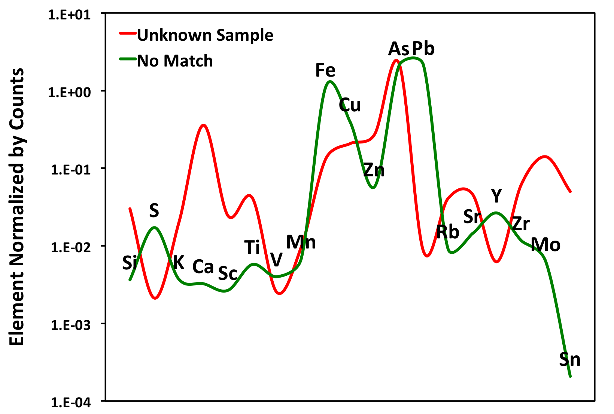
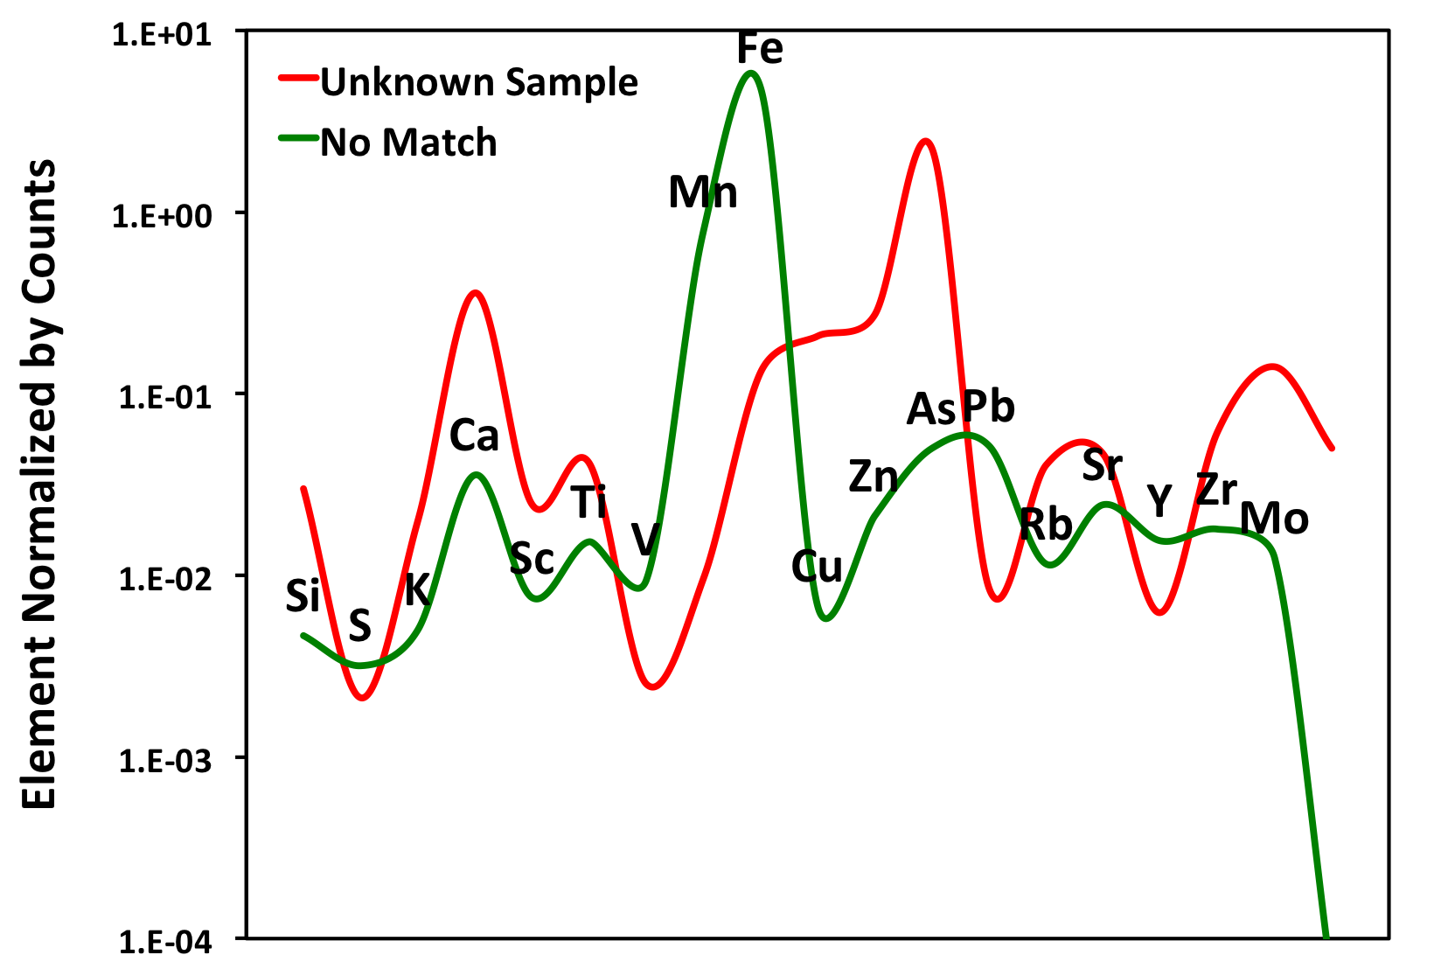
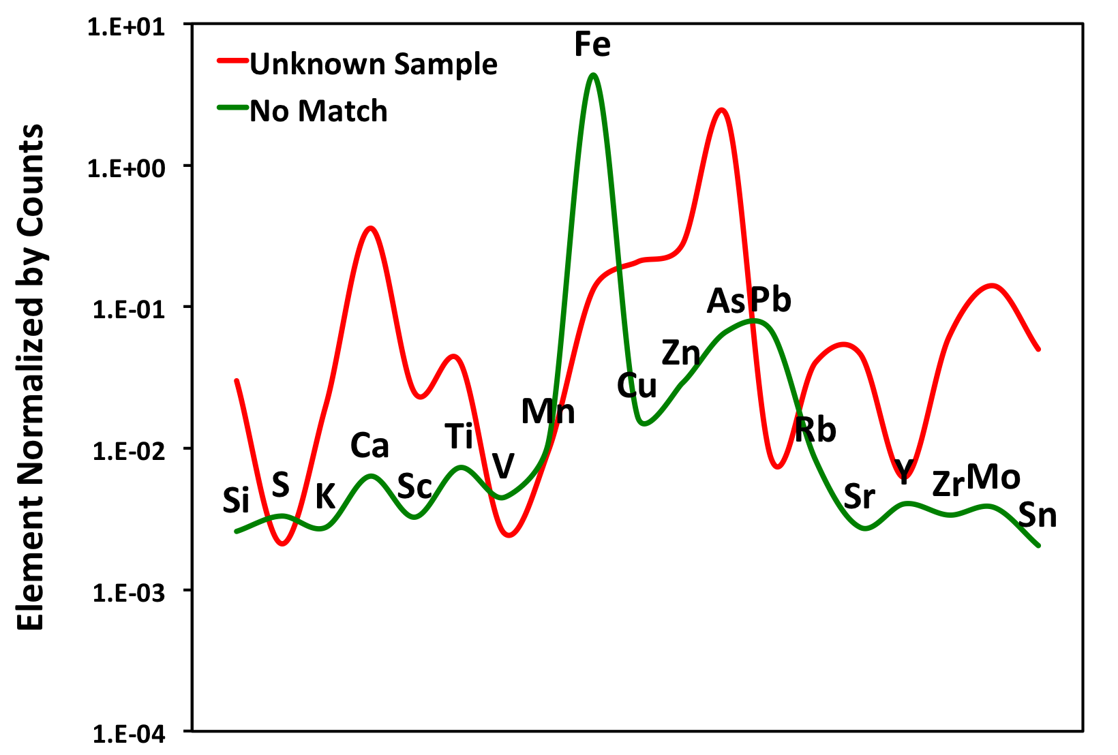
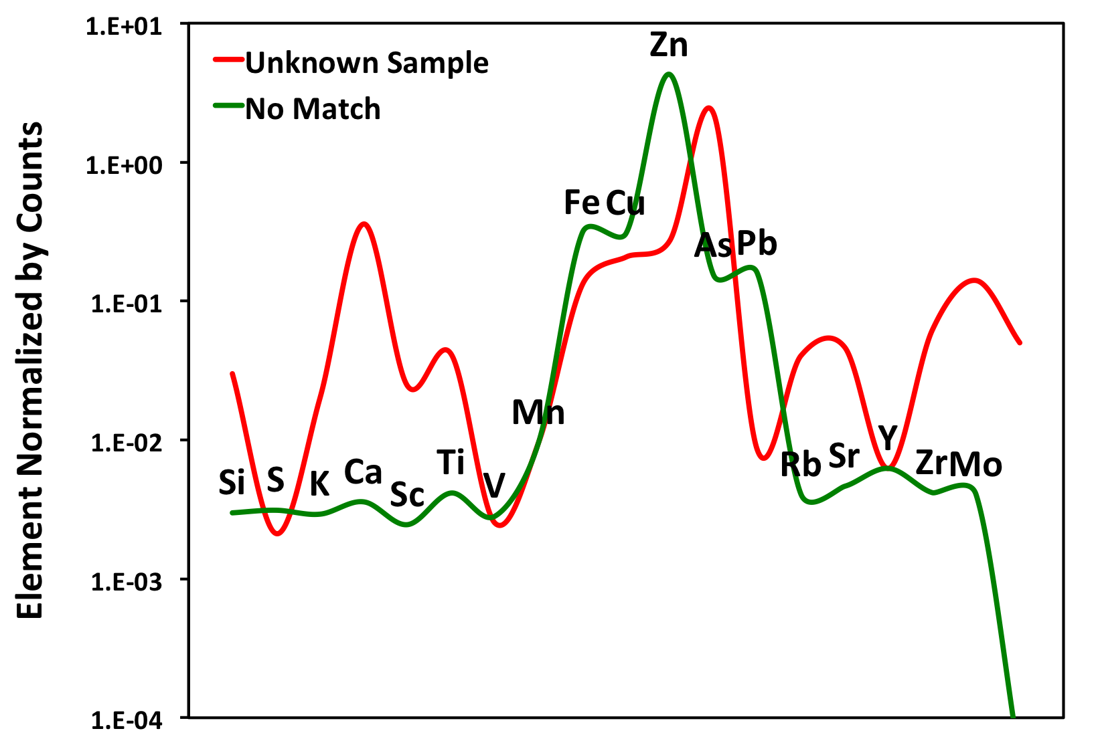
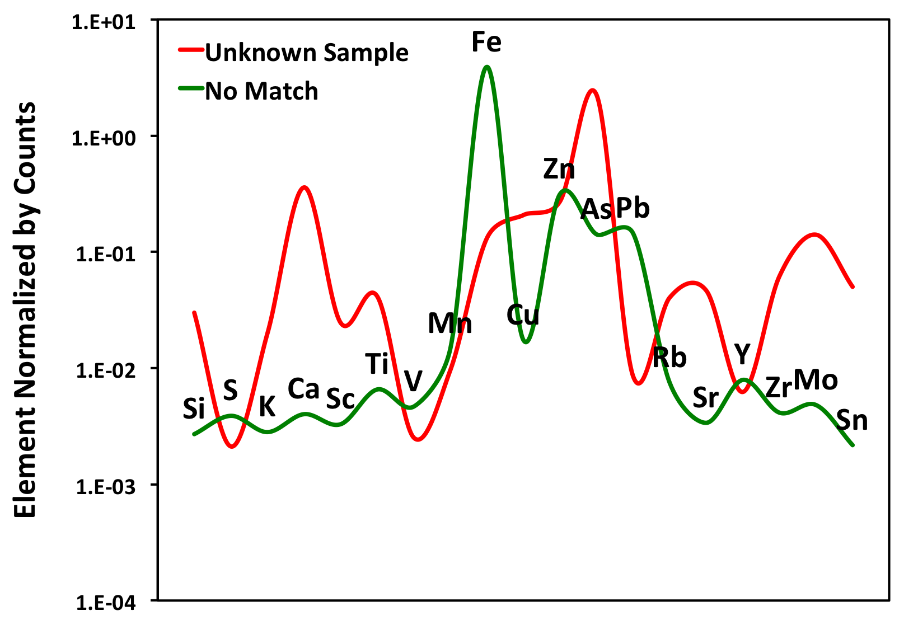
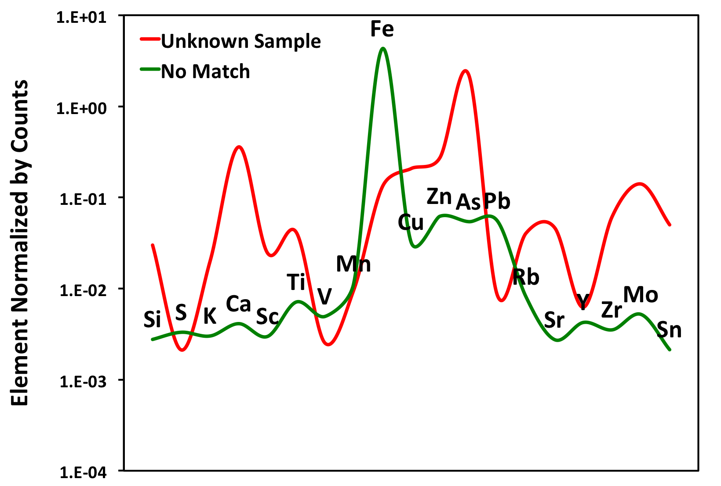
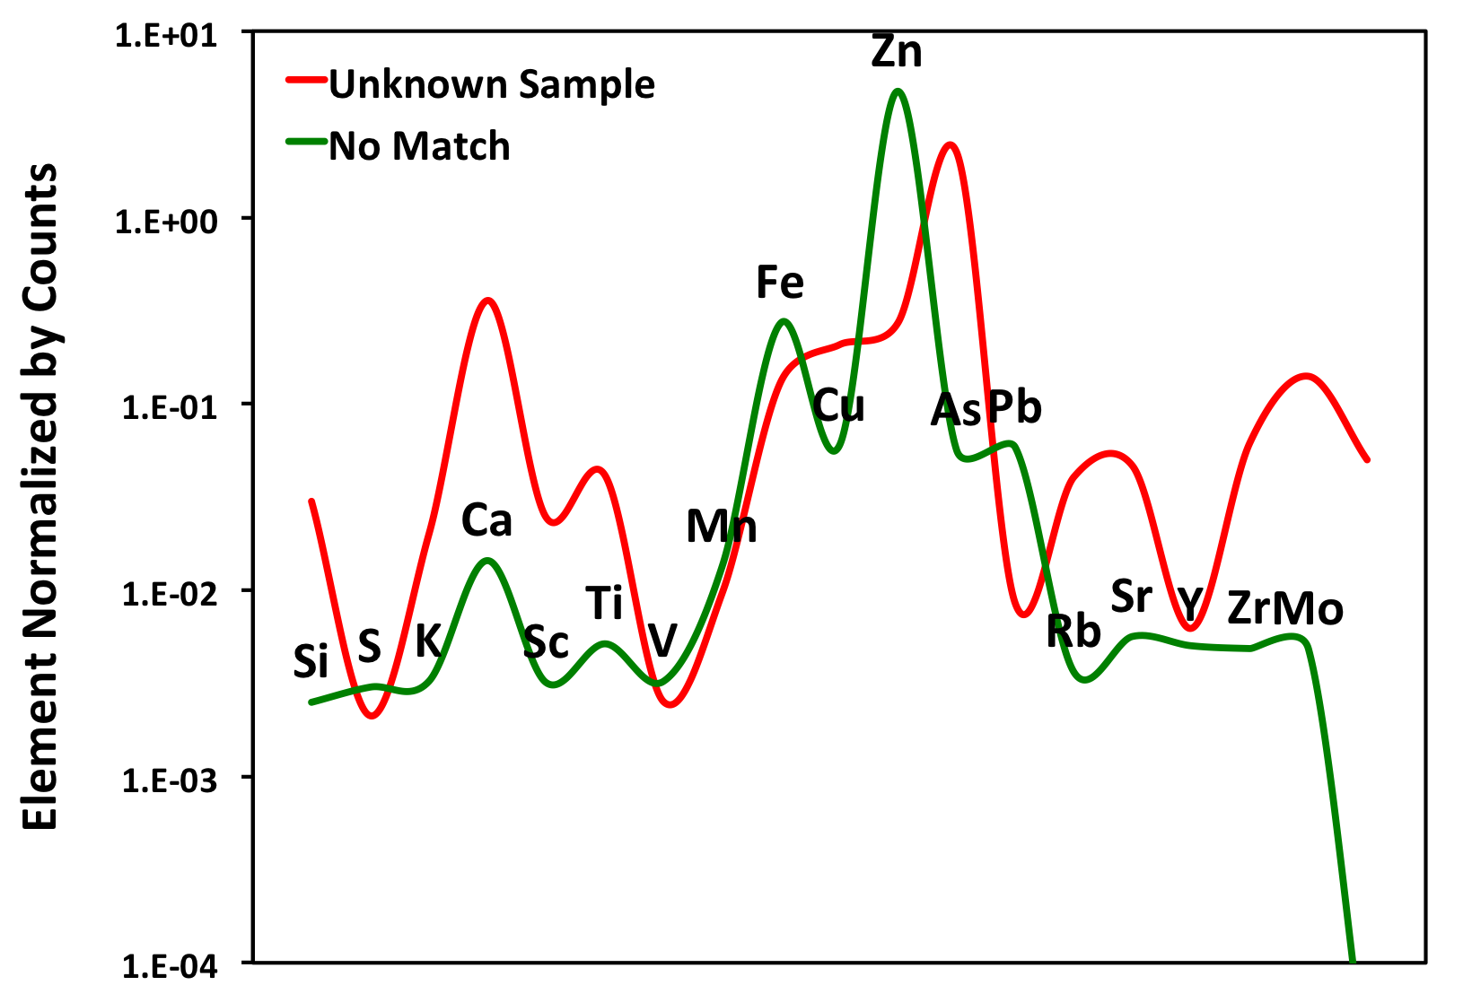
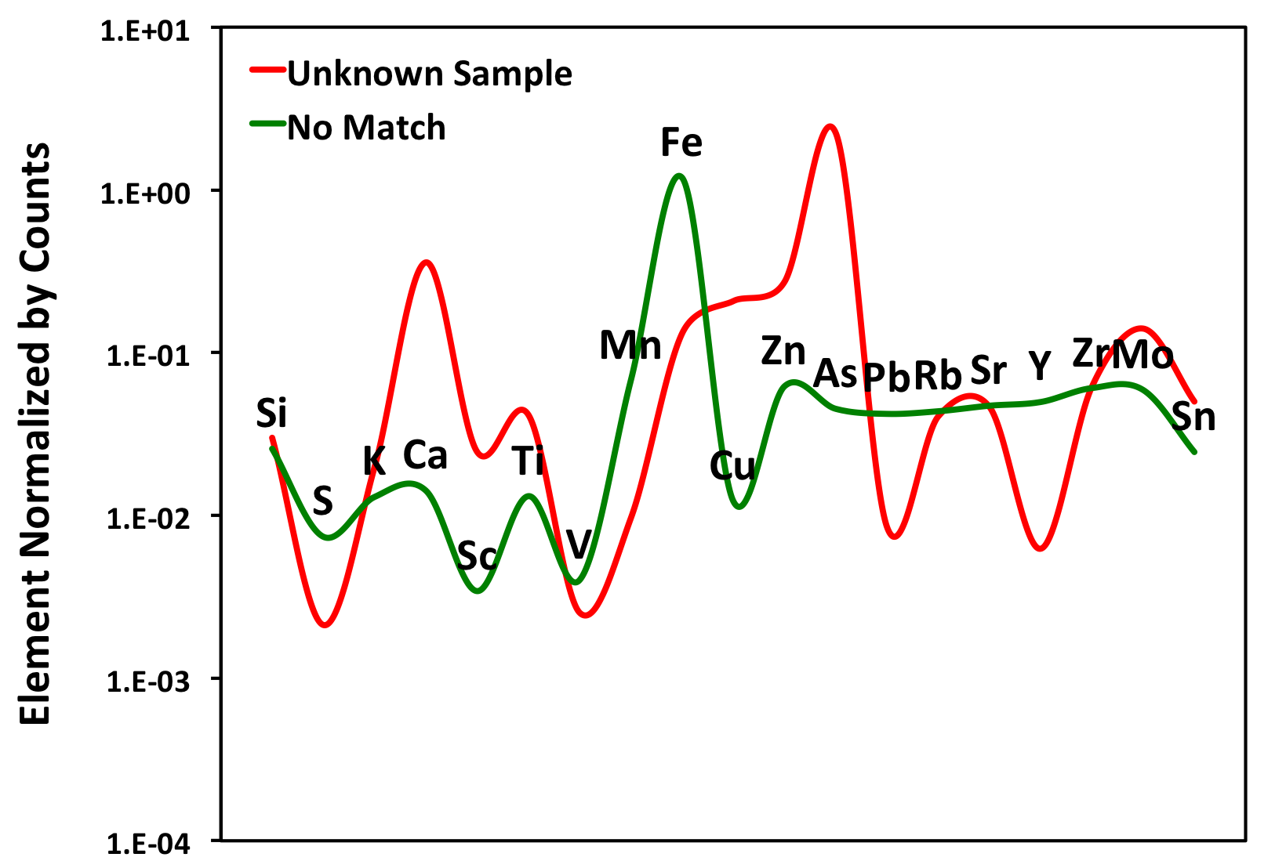
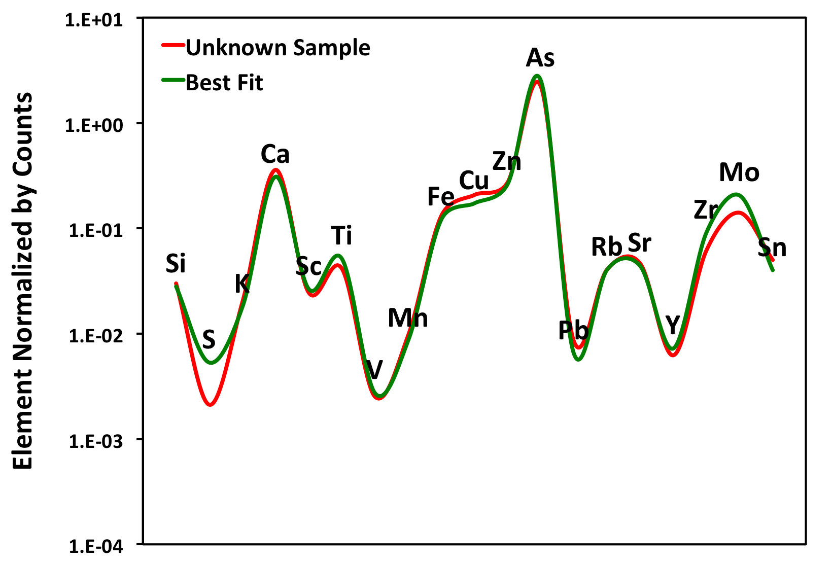
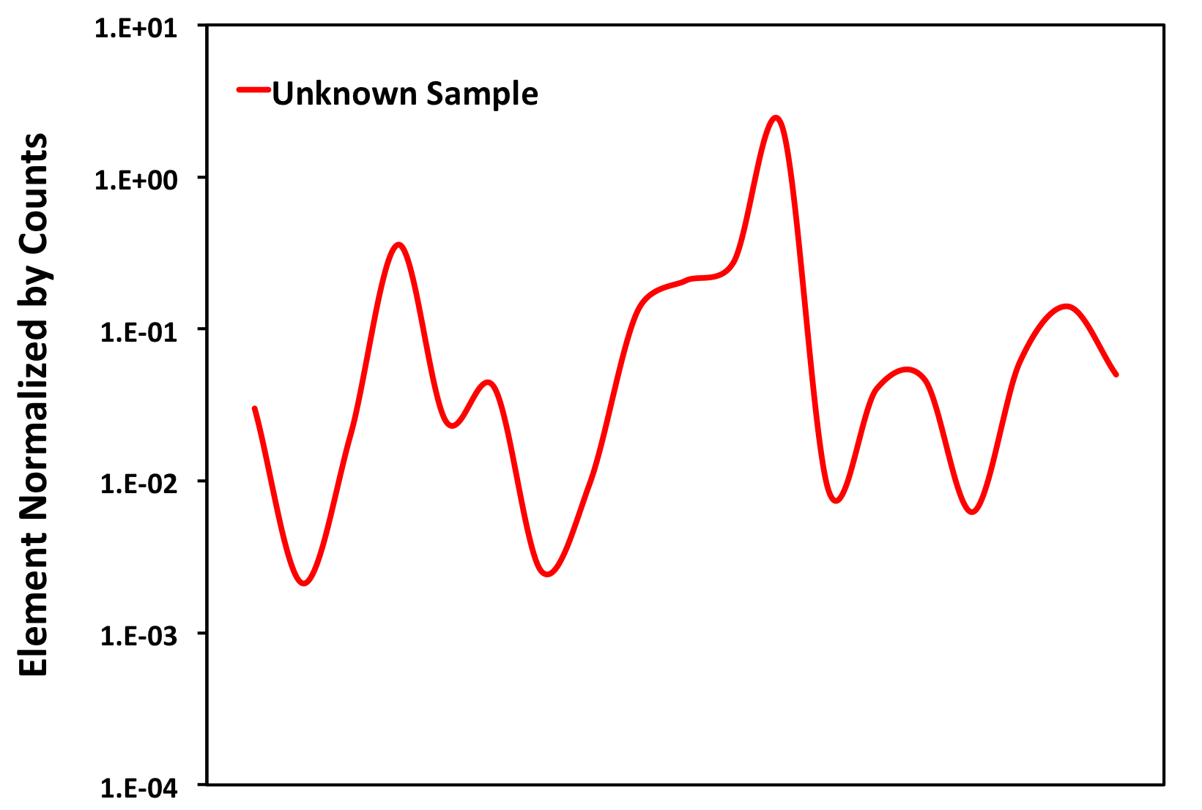
Future Applications: Chemical spectra curve fitting (least squares)
Positive Match: Climax-Style Porphyry

Slide 18
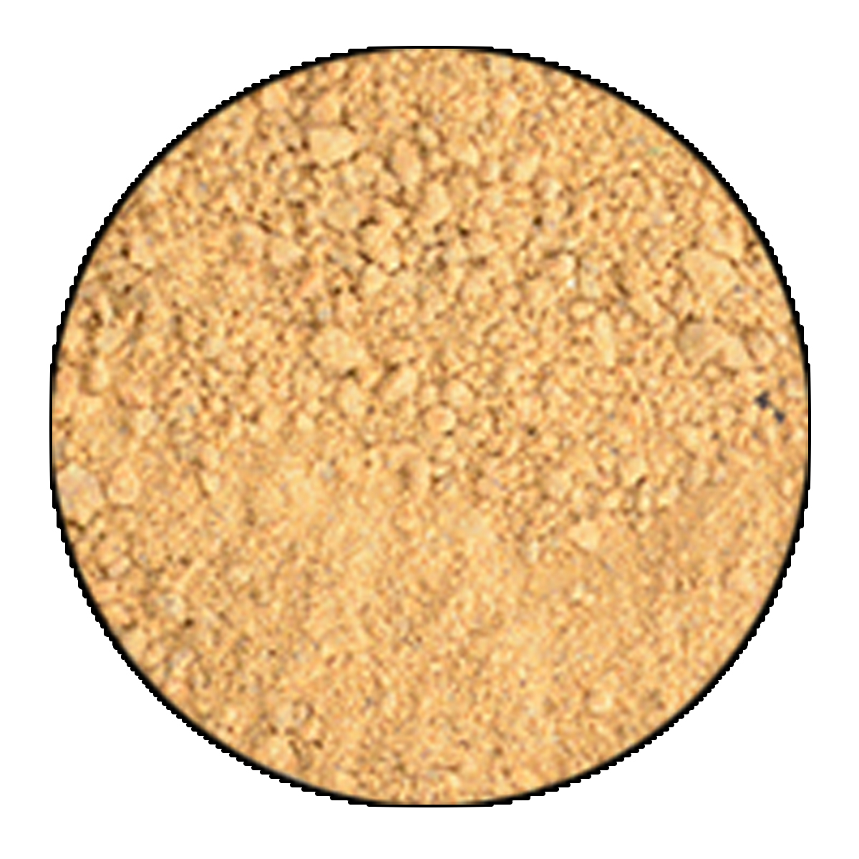
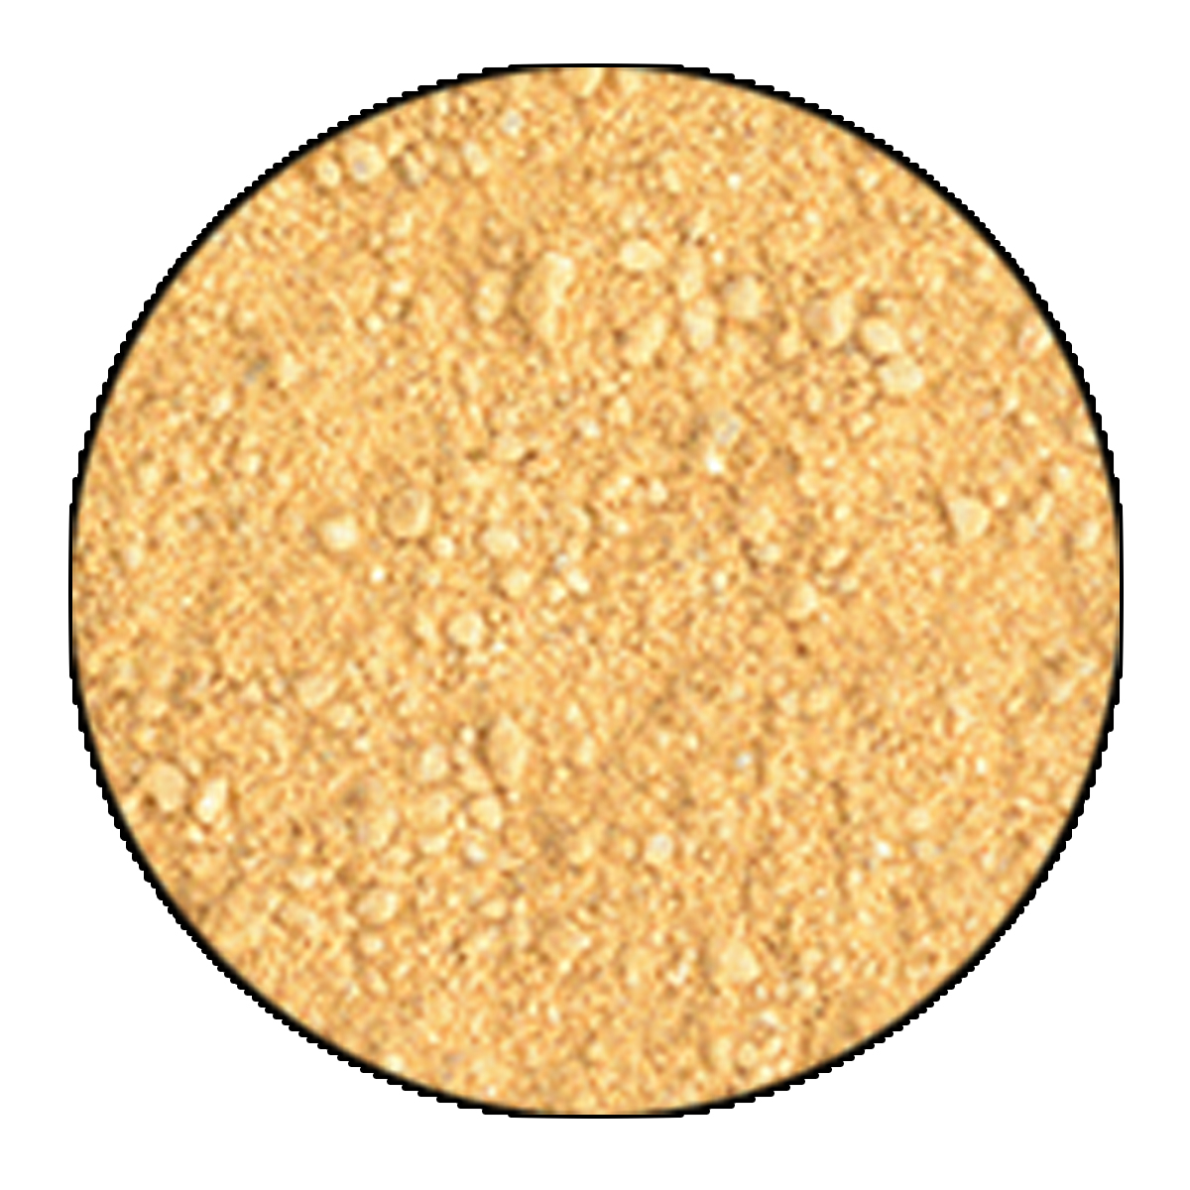
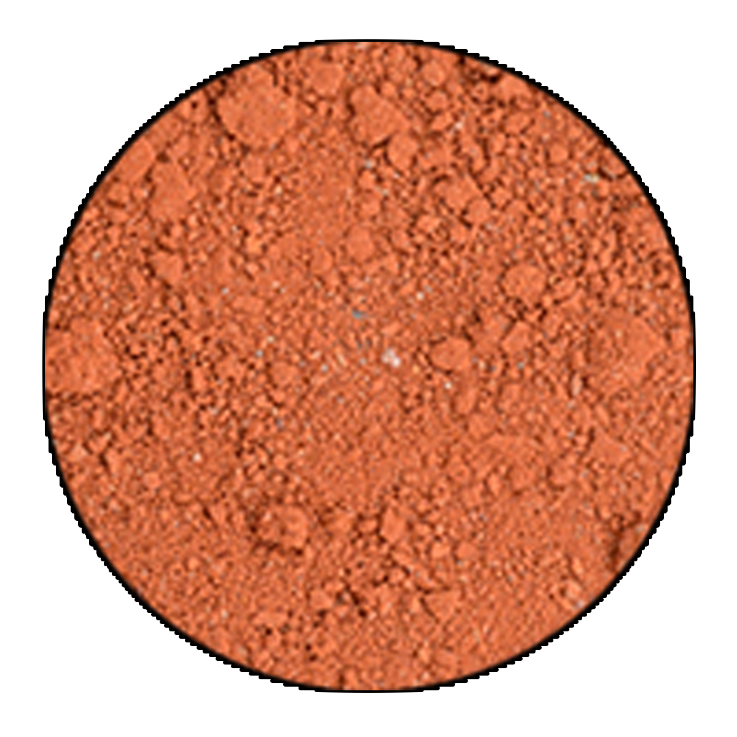
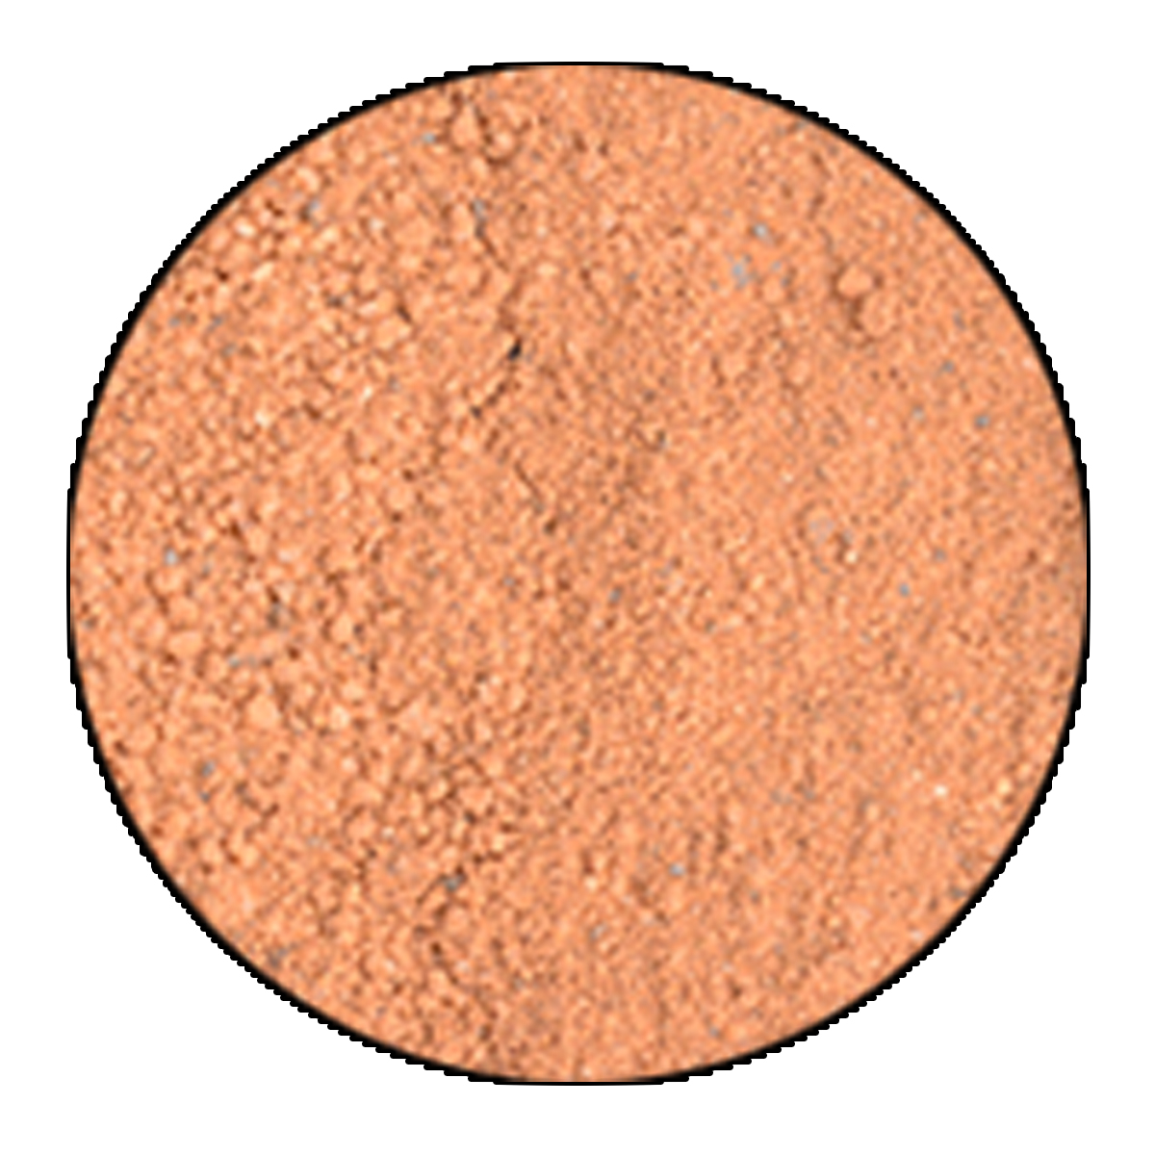
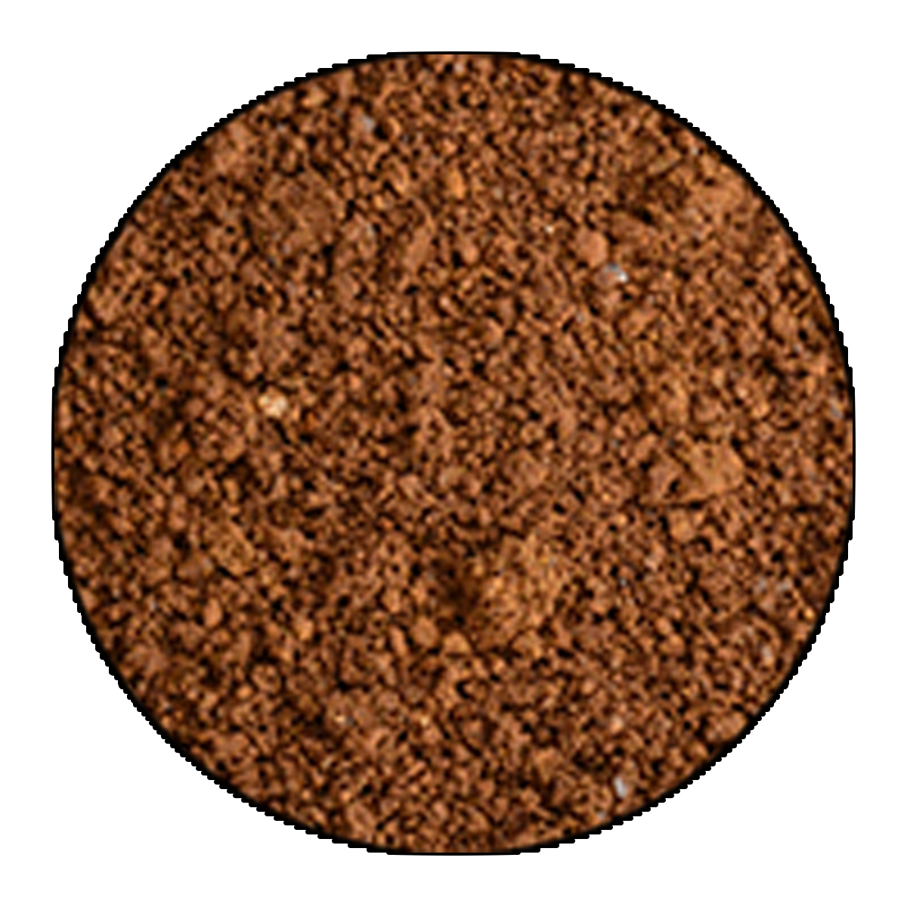
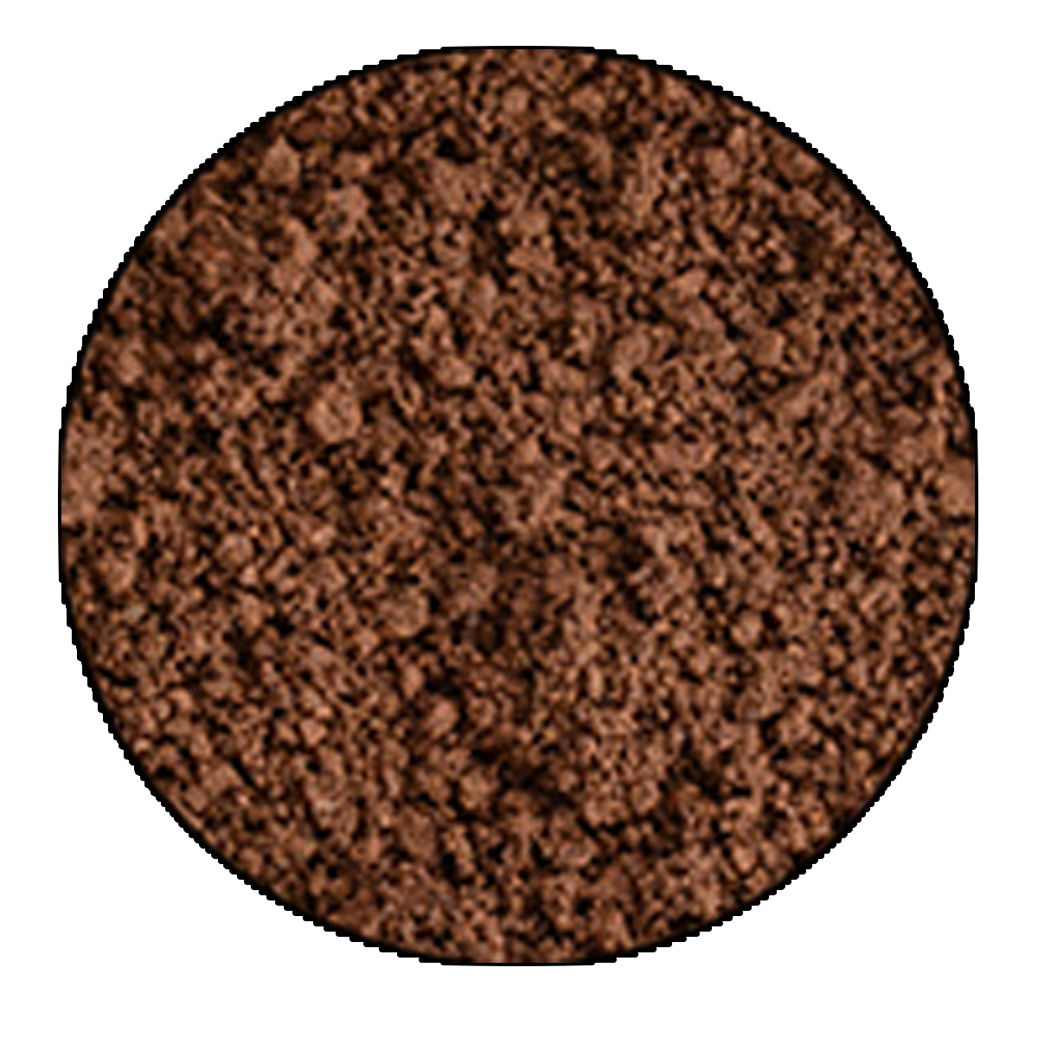
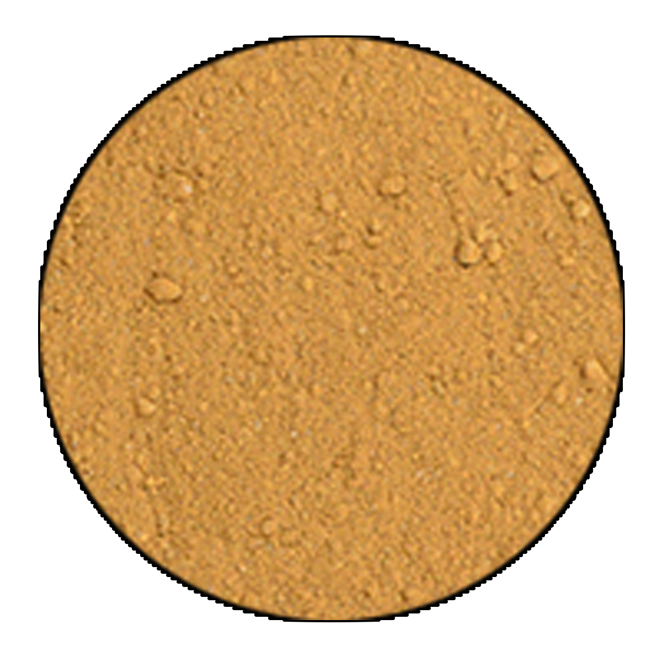
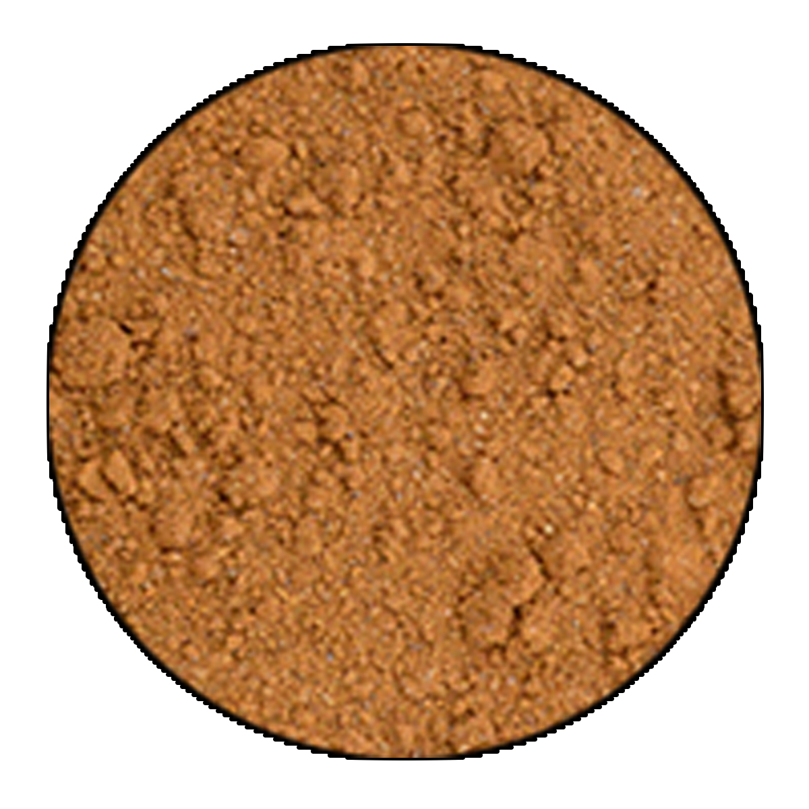
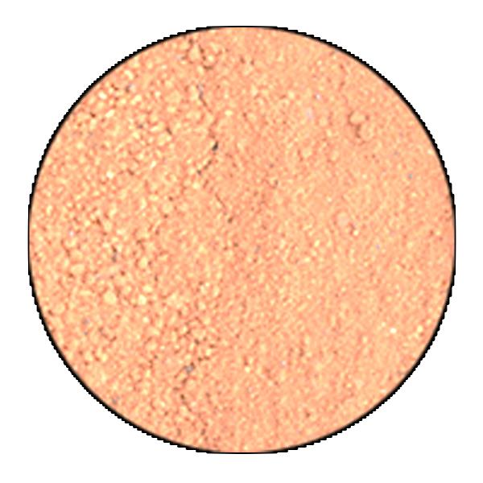
Future Applications : Color matching (possible use of remote sensing)
Possible Match
No Match

Slide 19
Conclusions
Each ore deposit shows a distinct chemical spectra with unique boxwork structures.
Heterogeneity of chemical spectra and boxwork structures within and between deposits can be addressed with a very large number of samples.
3-D microgeospatial techniques offer an exciting new way to correlate the physical features of gossan with chemical data.
Developing a large database of known chemical spectra and physical gossan characteristics will allow us to quickly make predictions about the hidden sulfide body saving time, money, and improving discovery potential.

Slide 20
Acknowledgments
Advisor: Steve Fellows
UVU Colleagues: David Sutterfield, Michael Arnoff, Andrew Fletcher, Ephram Matheson, Buchanan Kerswell, Daniel Natter, Steven Emerman
Bruce Kaiser at Bruker

