Slide 1
Martian aeolian systems
Lori K Fenton, SETI Institute
© ESA/DLR/FU Berlin
Notes:
Much of Mars is covered in aeolian systems. Their study is similar to that of terrestrial aeolian systems.

Slide 2
Major avenues of research
Sources: provenance, composition, transport distance
Wind regime: weather patterns, wind directions, relative strengths over time
Age: formation time, current and past activity
Sediment state: (Kocurek and Lancaster, 1999)
➔ transport capacity, sediment supply, sediment availability
Erosion/deposition rates (a.k.a. “why nonaeolian scientists might care”):
➔ Preservation potential of biosignatures, exhumation of landforms, sources of atmospheric dust, climate change
➔ Aeolian processes generally dominate landscape evolution over last ~3 Ga
Notes:
All of this adds up to the sediment state, which consist of curves of … vs. time.

Slide 3
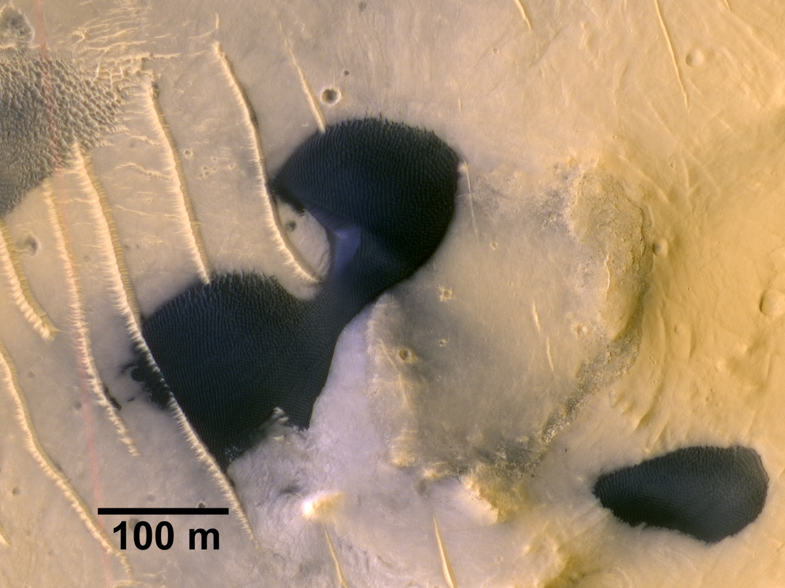
Transverse Aeolian
Ridges (TARs)
Large Dark Dunes (LDDs)
Notes:
Often found together. History likely related, not yet known how.

Slide 4
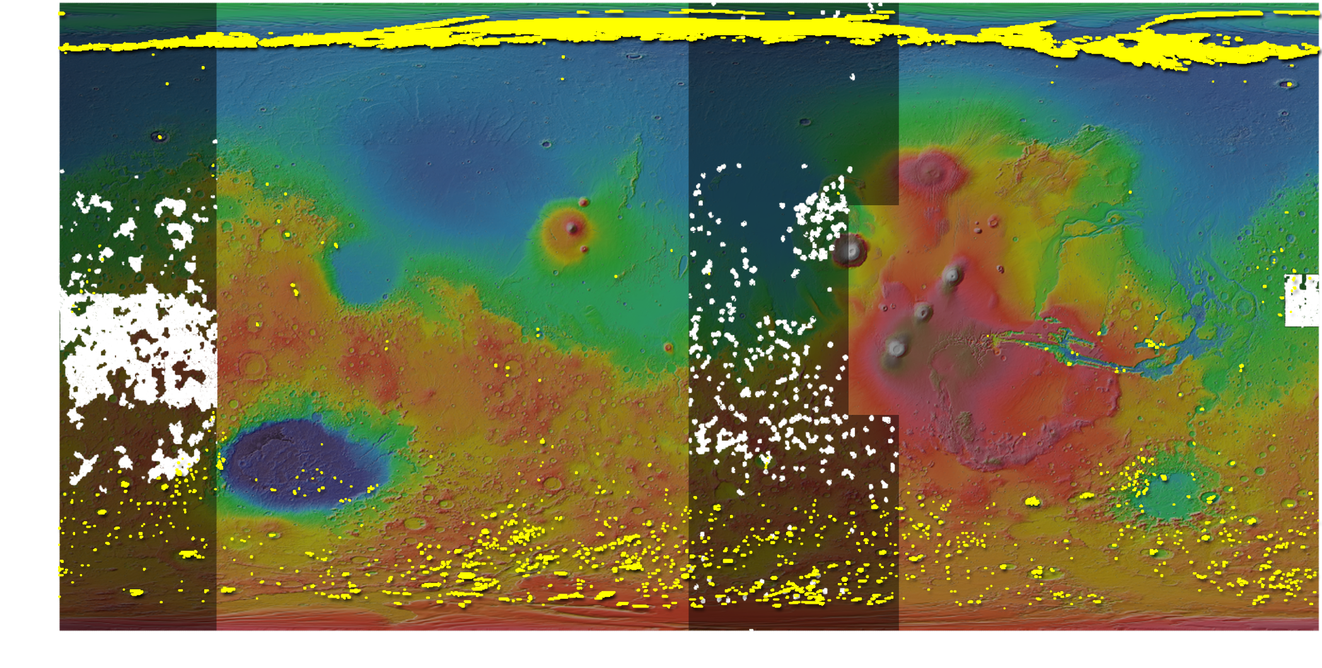
1
LDDs
TARs
2
2
1. Olympia Undae, Ewing et al. (2010)
2. Ganges Chasma, Fenton et al. (2014)
2. Meridiani Planum, Fenton et al. (submitted)

Slide 5
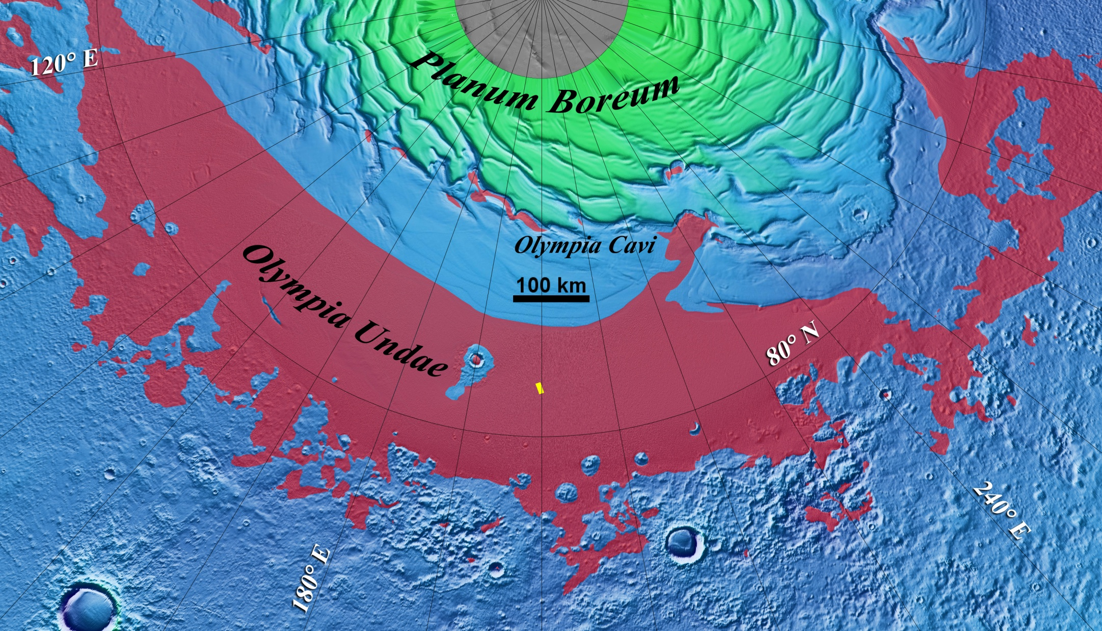
1. Olympia Undae, Ewing et al. (2010)
Sand source: “Planum Boreum cavi unit”, ~1 Ga, extensive,
few 100 m thick, visible foresets (Tanaka et al., 2008)
Notes:
1300 km wide, area 360x103km2 about size of Taklamakan , scarps 0.5-1.5 km

Slide 6
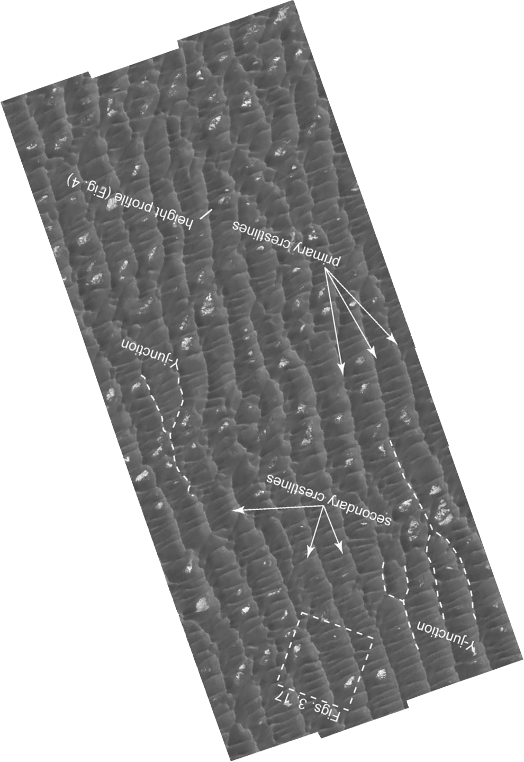
1. Olympia Undae, Ewing et al. (2010)
Crestlines:
Primary: NNW/SSE
ENE wind
Secondary: NE/SW
formative wind?
star dunes or complex pattern?
N
Notes:
West slopes steeper, so consider primary dunes transverse to ENE wind.

Slide 7
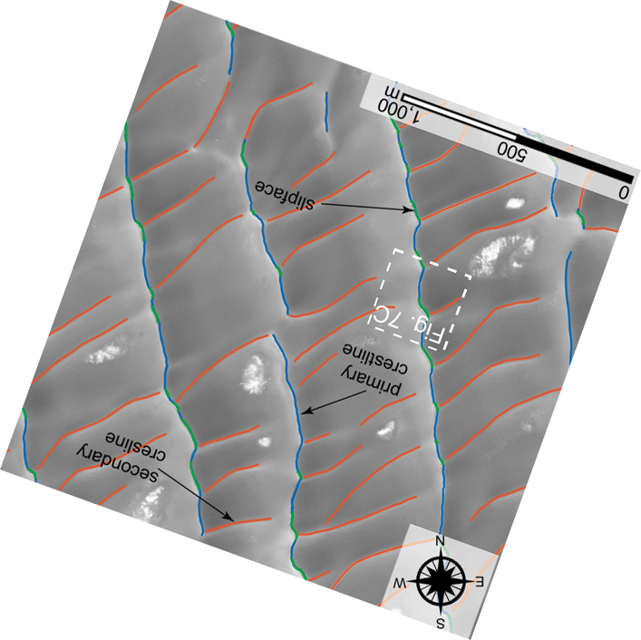
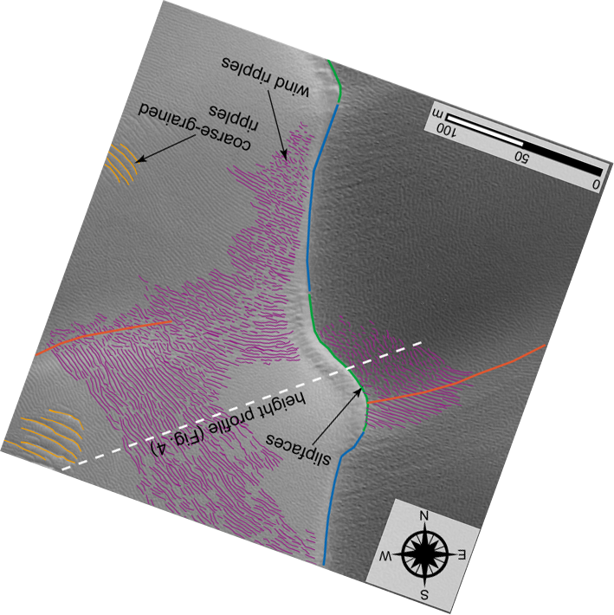
1. Olympia Undae, Ewing et al. (2010)
Primaries: broken, kinked
Secondaries: connect with primaries at kinks
Notes:
Primaries: unbroken crestlines in blue, and “kinks” in green Secondaries: connect with kinks and broken parts ➔ kinks are incipient defects

Slide 8
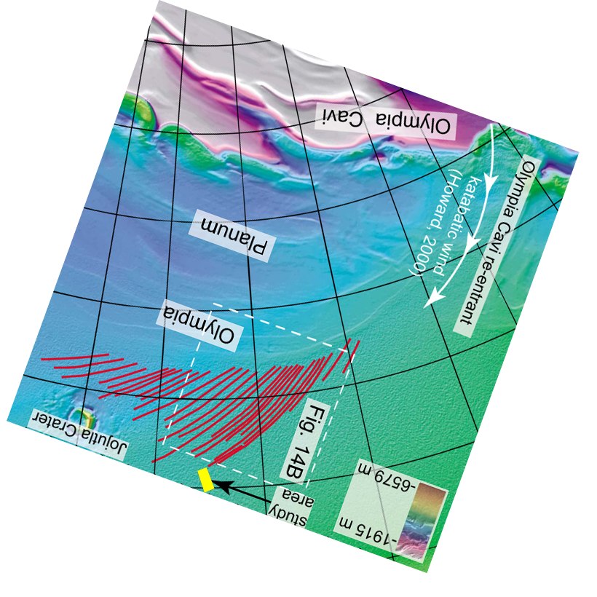
1. Olympia Undae, Ewing et al. (2010)
Complex pattern:
ENE wind: primary
Erosion of scarps,
➔ NE wind: secondary
- Secondary dunes longitudinal to NE katabatic flow
- Primary dunes forms areal limit boundary for secondaries
Notes:
Earlier time when ENE wind formed mature primaries,
Then erosion of scarps and influx of sand, enhanced katabatic winds from NE that disrupts pattern of primaries, tries to reorient them.

Slide 9
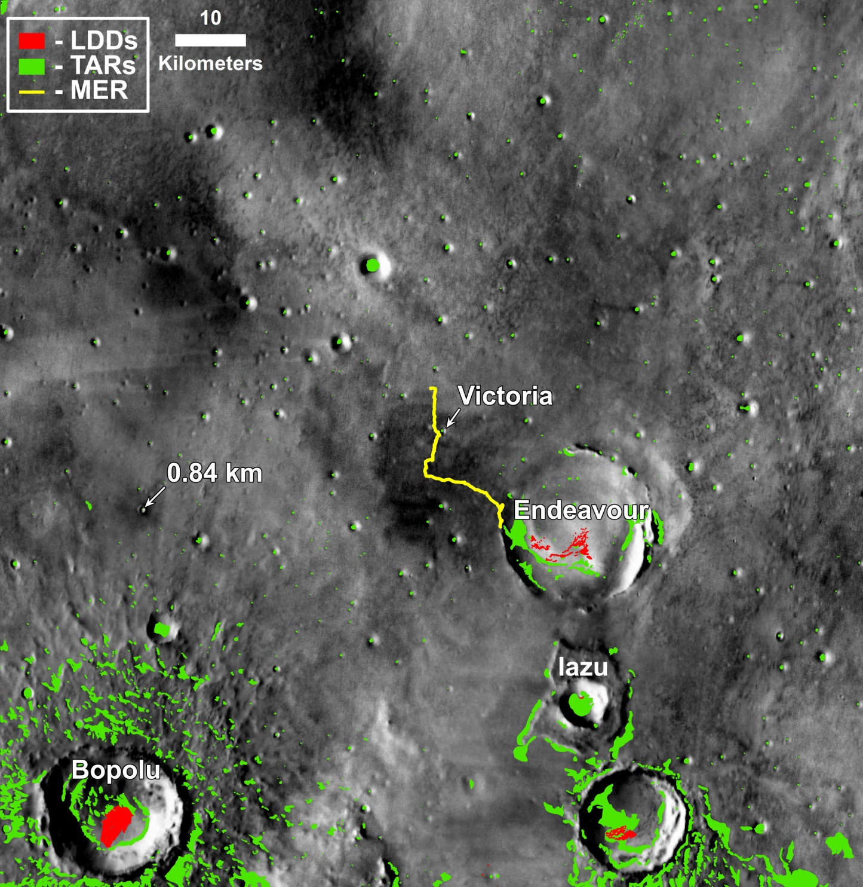
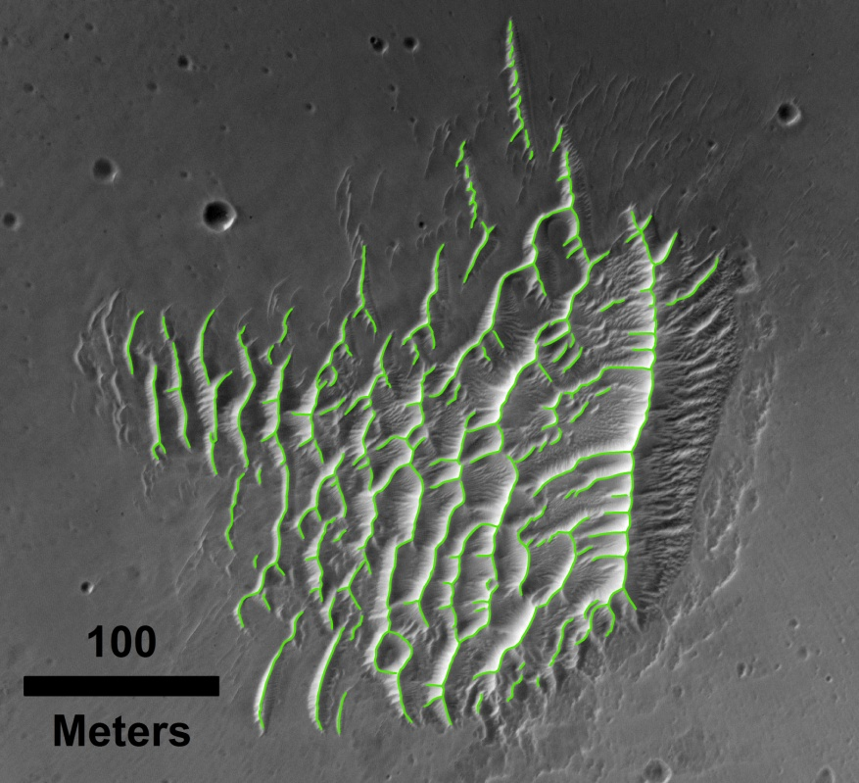
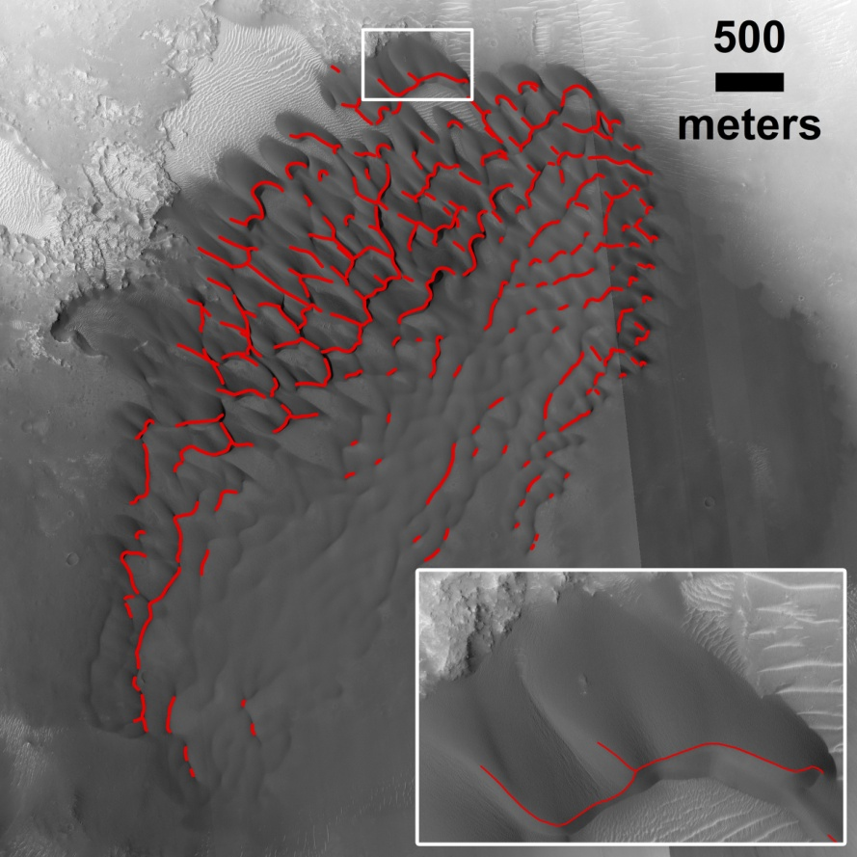
2. Meridiani Planum, Fenton et al., submitted
MER Opportunity landing site
Notes:
Landing date: Jan 25, 2004.
Driven as of Oct. 2014: >40 km

Slide 10
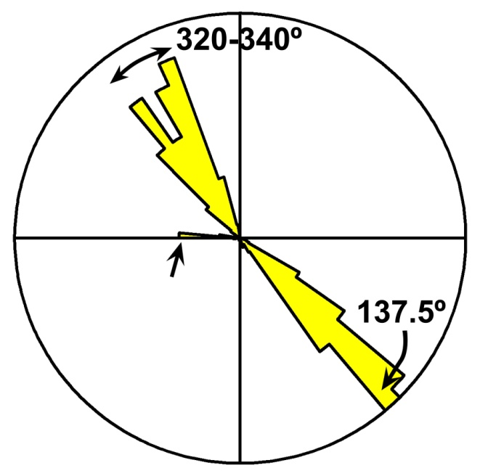
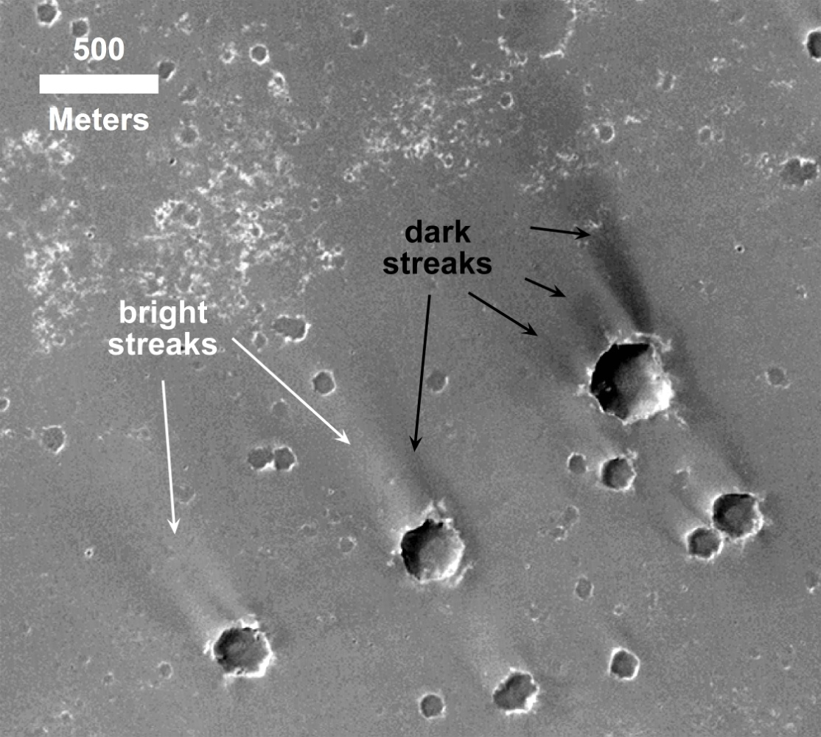
2. Meridiani Planum, Fenton et al., submitted
Generation 4: Active today
NW + SE winds ➔
Chojnacki et al. (2011; 2014); Edgett (2002); Geissler et al. (2008); Jerolmack et al. (2006)
Notes:
Active today: NW, SE winds move dark sand.

Slide 11
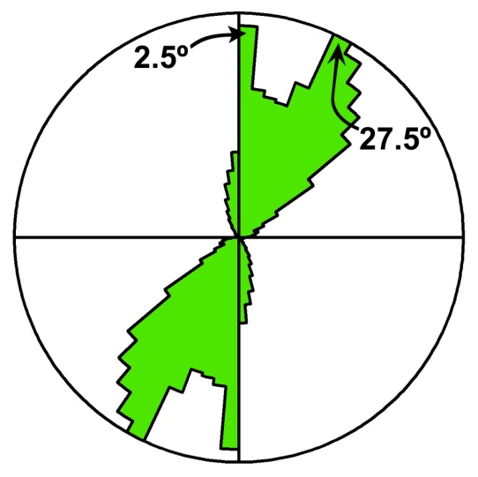
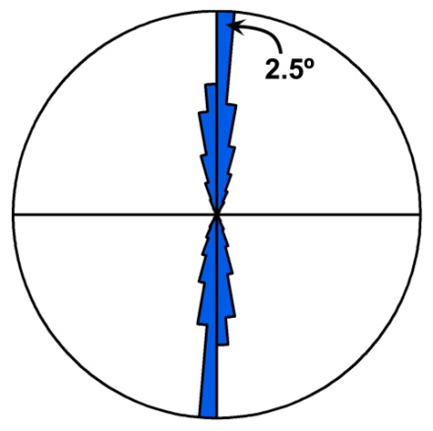
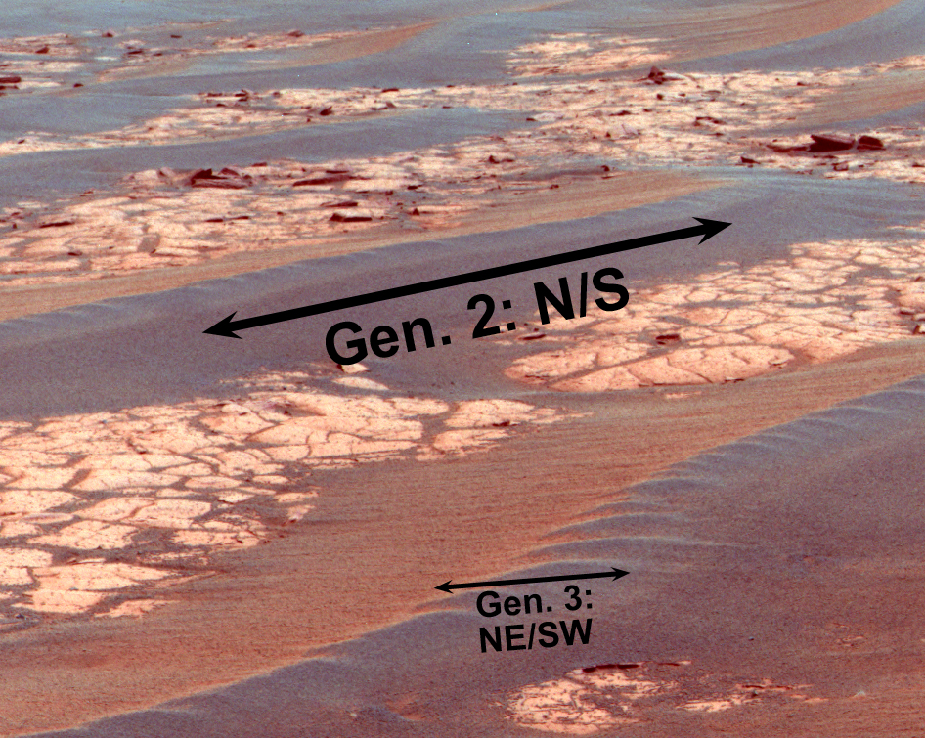
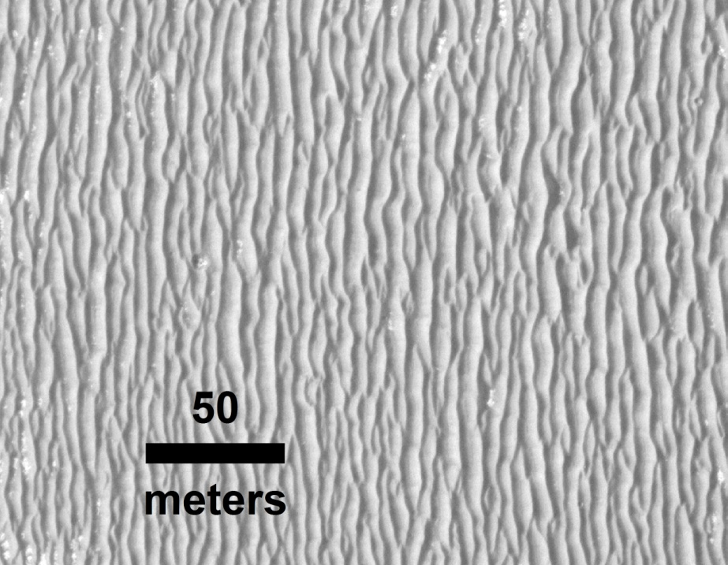
2. Meridiani Planum, Fenton et al., submitted
Generations 2 and 3:
- plains ripples, “purgatoids”, formed by E wind
Last active ~50-200 ka (Golombek et al., 2010)
Stabilized by cohesion (Sullivan et al., 2005)
Looking ~NW
Notes:
Can be dated. Two sets of orientations: older and younger (N/S, NE/SE). Last activity 50-200 ka.

Slide 12
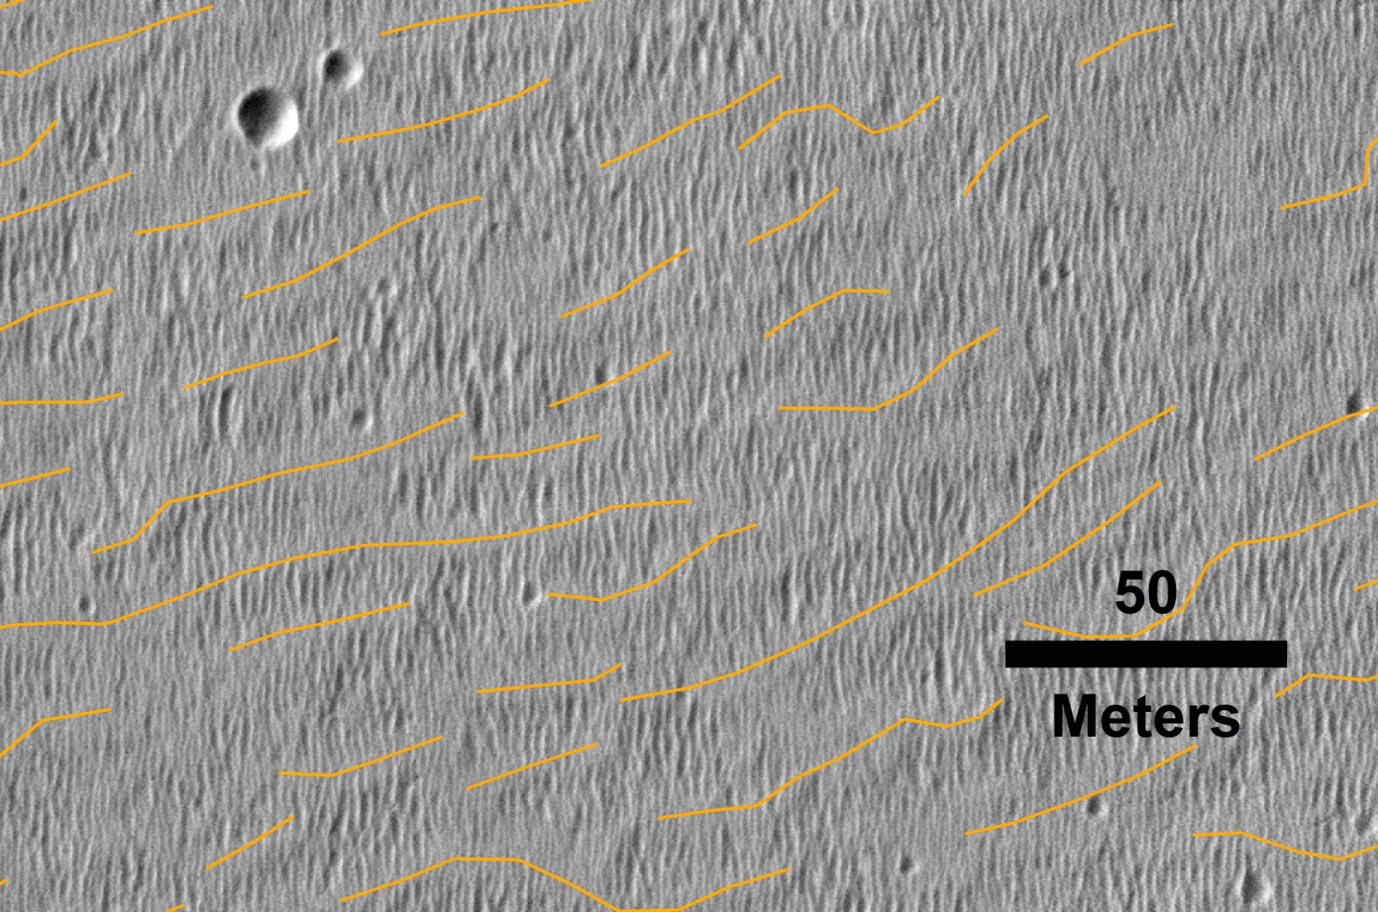
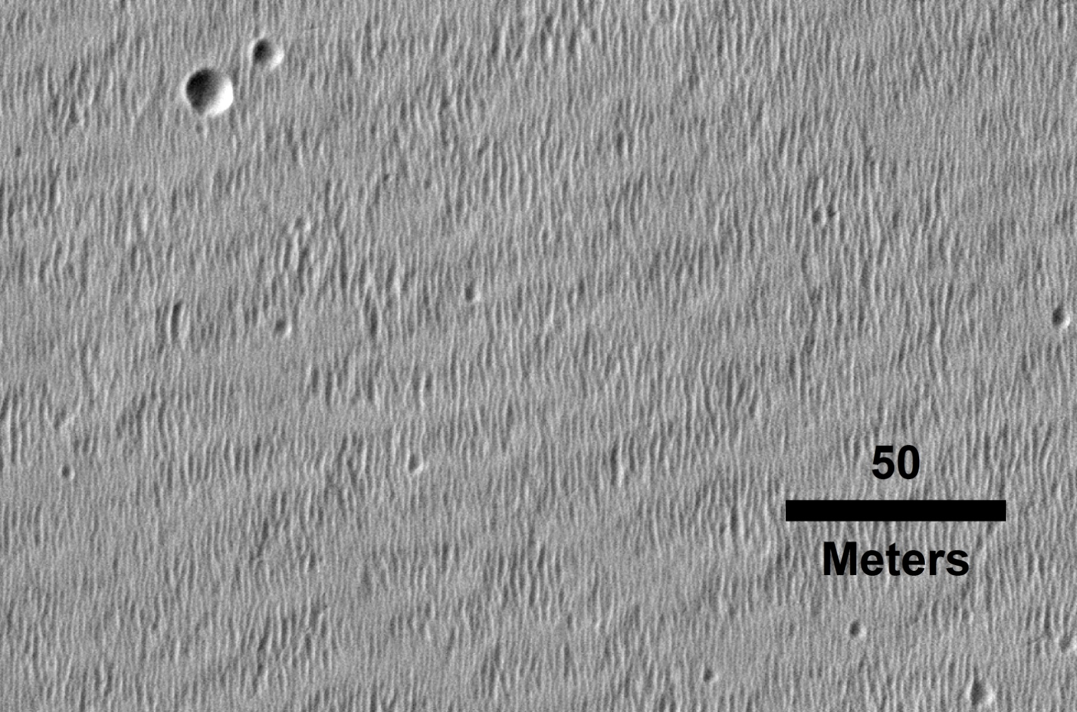
2. Meridiani Planum, Fenton et al., submitted
Generation 1: Older bedforms (TARs?)
Silvestro et al., submitted
Notes:
15-20 m wl

Slide 13
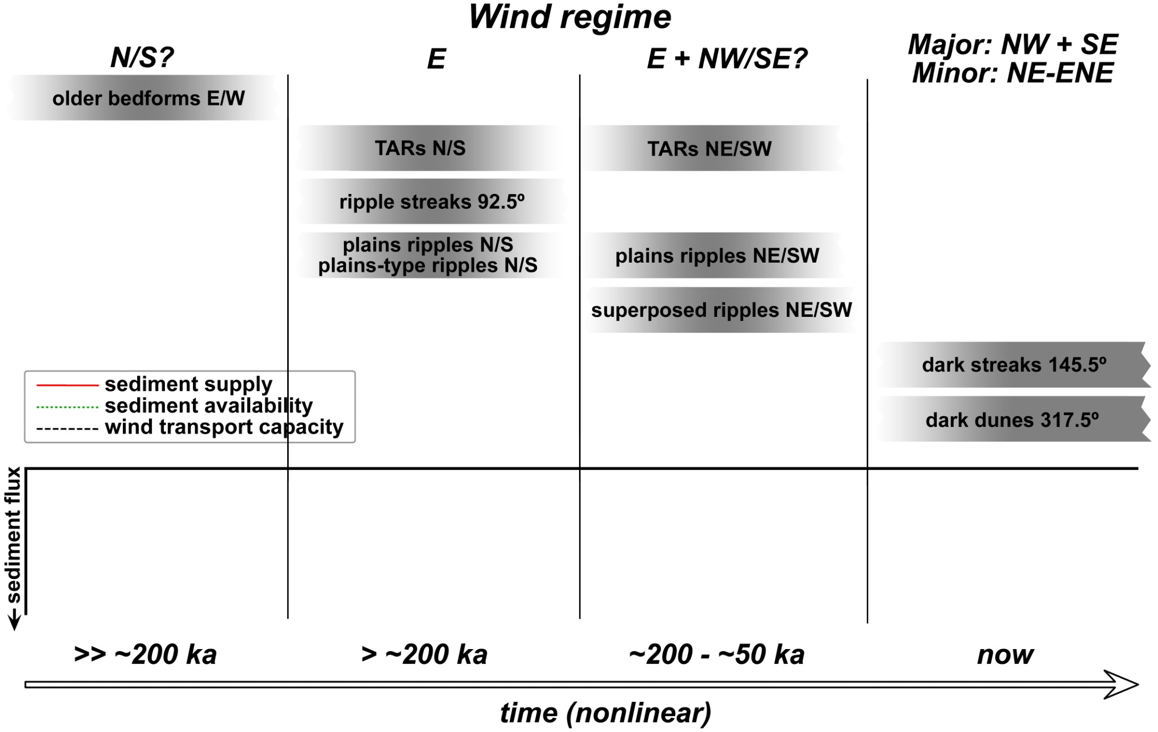
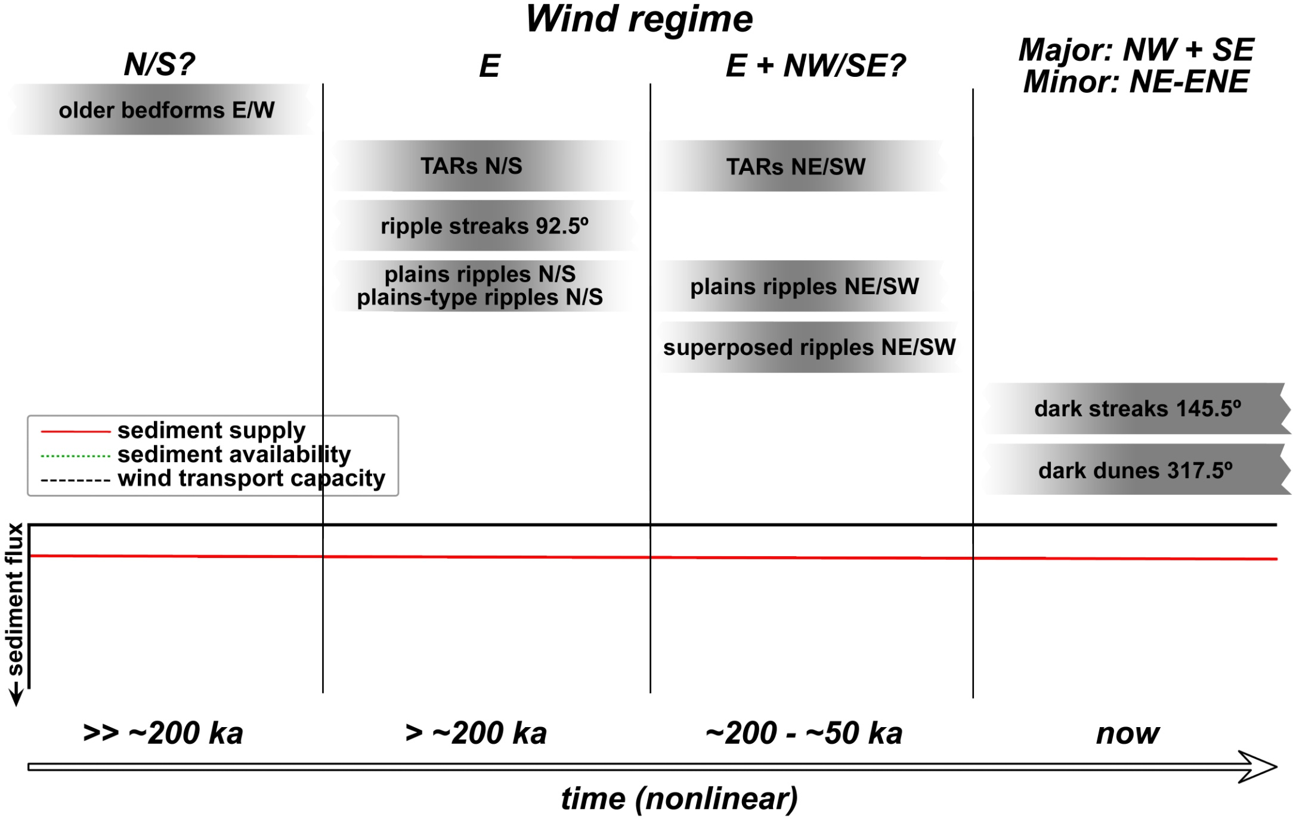

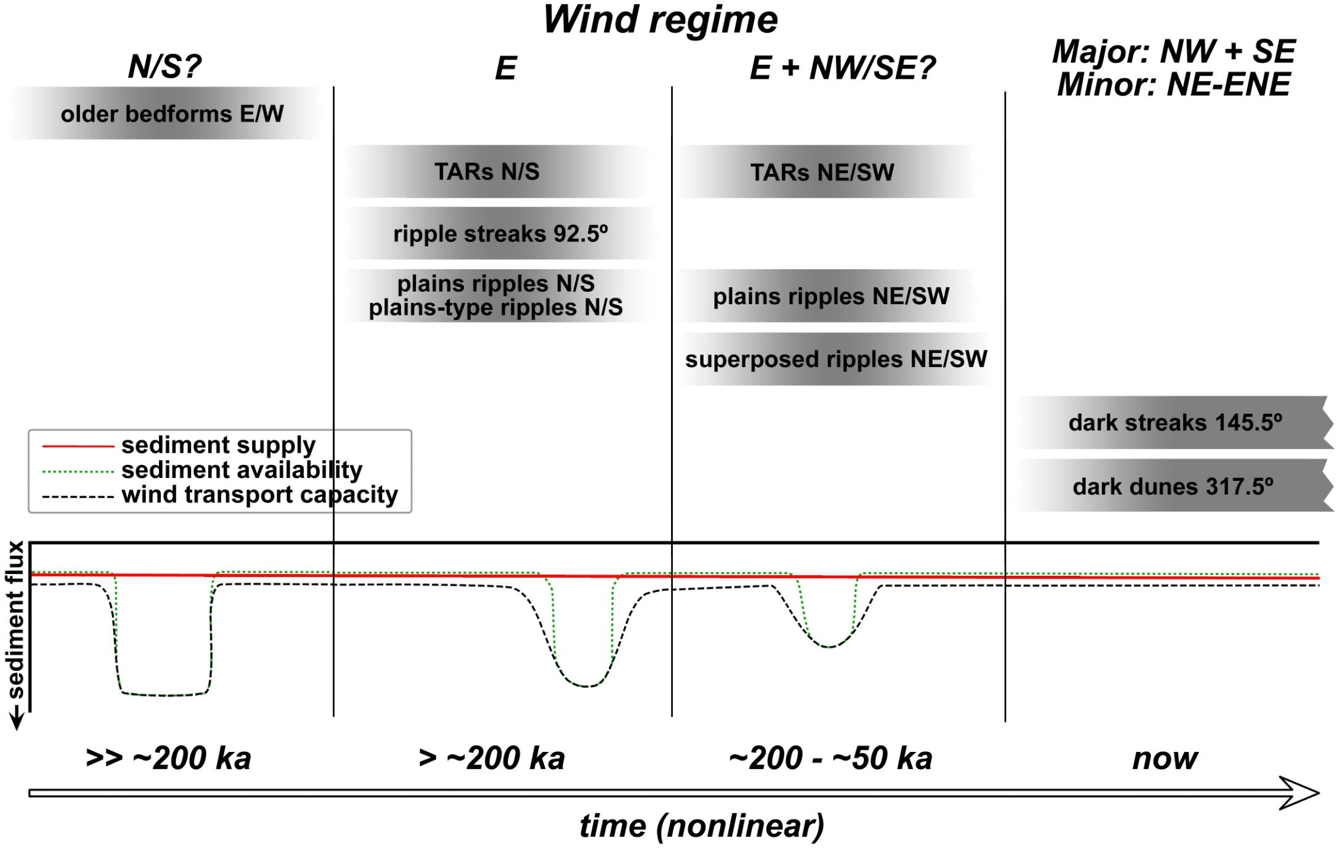
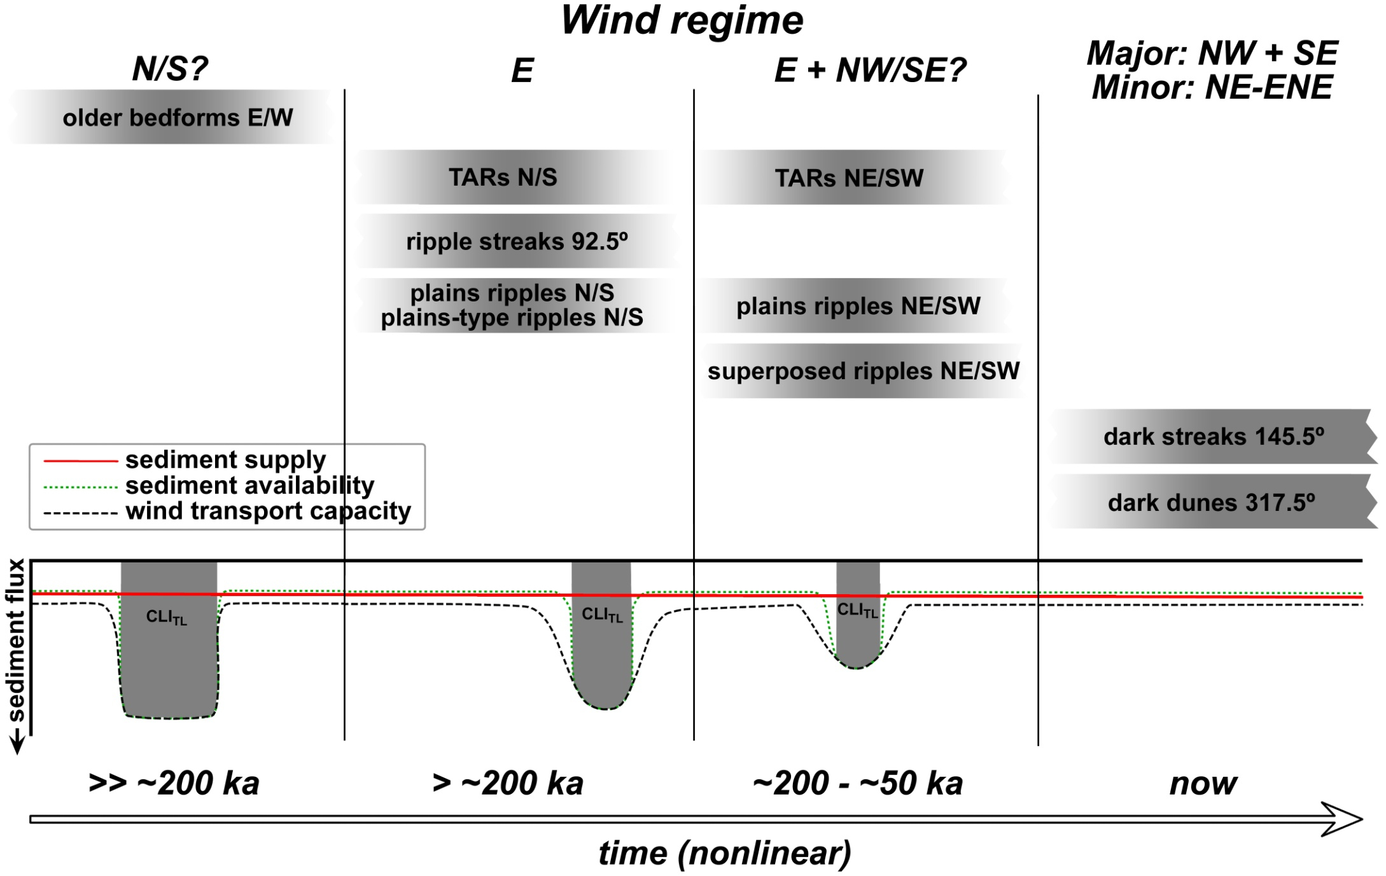
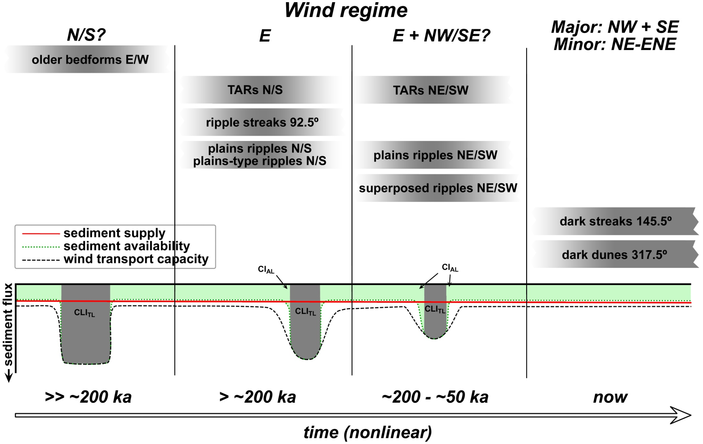
2. Meridiani Planum, Fenton et al., submitted
Notes:
Sediment state: induration, wind needed to blow strong enough to mobilize grains

Slide 14
More Mars aeolian presentations at GSA:
Fourth Planetary Dunes Workshop
May 19-22, 2015
Boise State University, Boise, ID, USA
Field Trip: Bruneau Dunes State Park
http://www.hou.usra.edu/meetings/dunes2015/
Rubin et al., 202-3, Rm. 301, Tues., 8:40 am
Bridges et al., 202-12, R. 301, Tues., 11:00 am
Day et al., 202-13, Rm. 301, Tues., 11:15 am
Runyon, Bridges, & Pelletier, 329-10, Rm. 301, Wed., 3:30 pm
Johnson & Zimbelman, 329-11, Rm. 301, Wed., 3:45 pm

