Slide 1
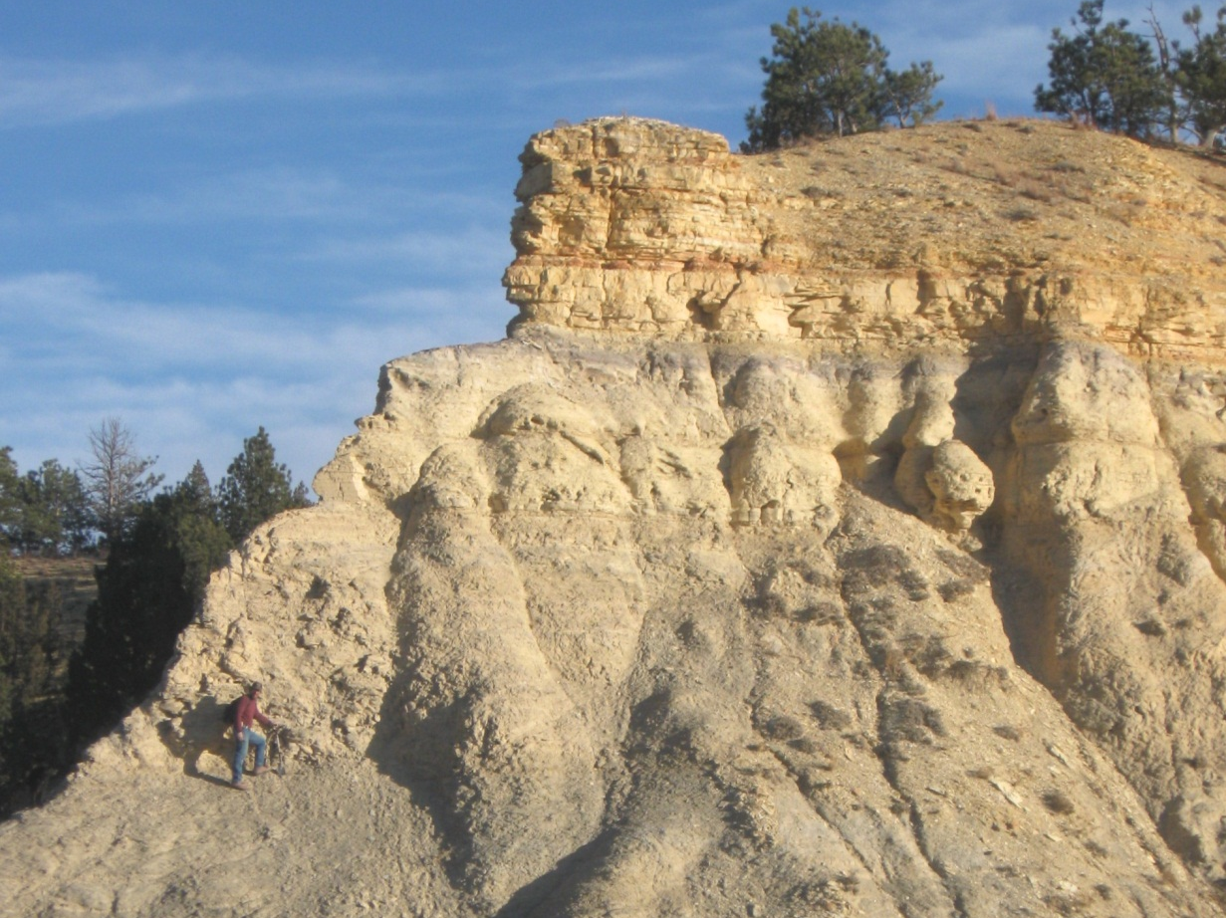


Northwest Nebraska’s Chadron Dome is not a Dome
Steven A. Welch Michael B. Leite
Chadron State College

Slide 2
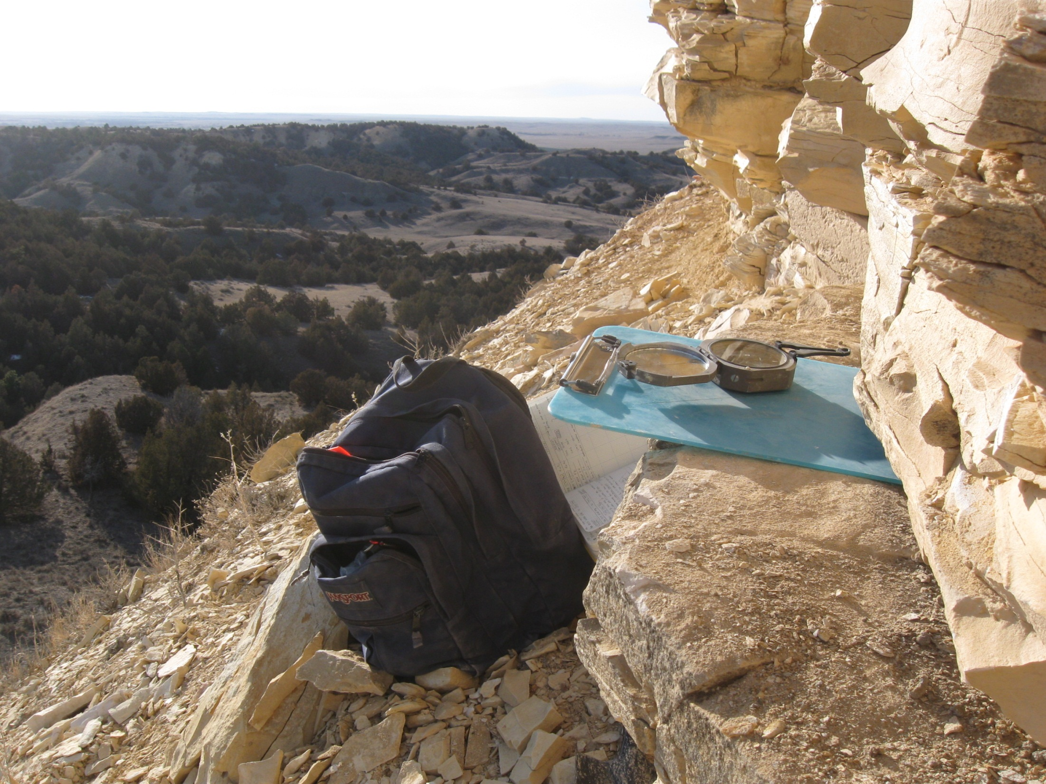
17 Minute “To do” List
Define Terms: What is was are were the Chadron Dome(s)?
Methodology for constructing Structural Contours
If it’s not a dome, then what is it?
Who cares?

Slide 3
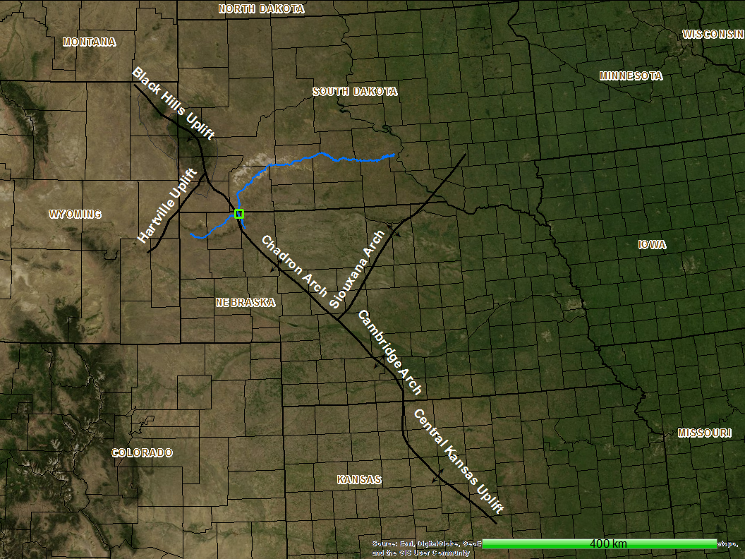
Adapted from Stix (1982)

Slide 4
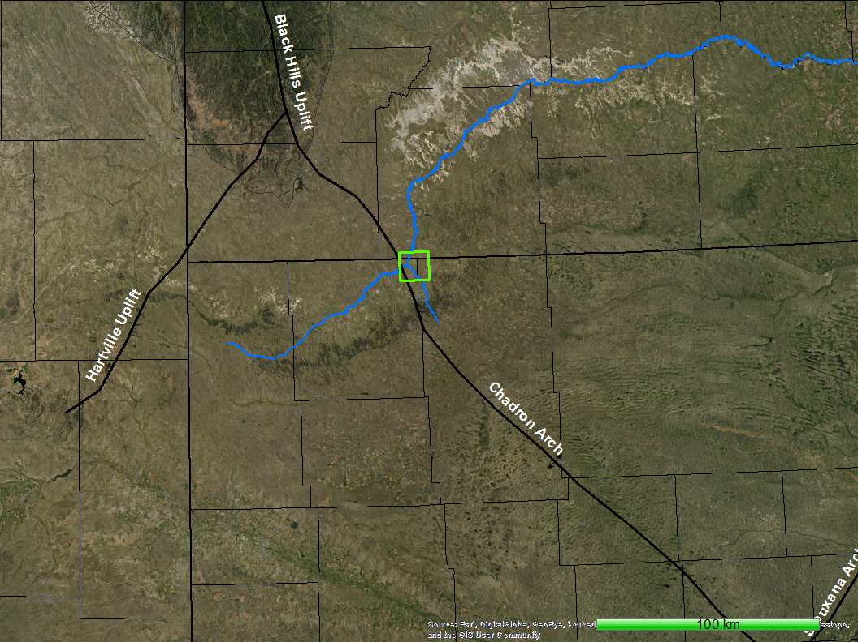
White River
Beaver Creek
Notes:
White River/Beaver Creek

Slide 5
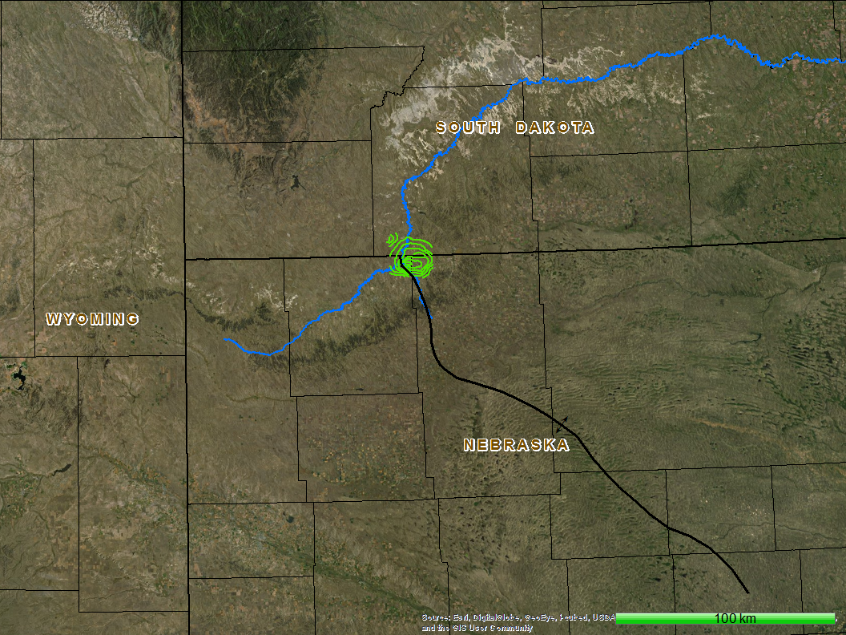
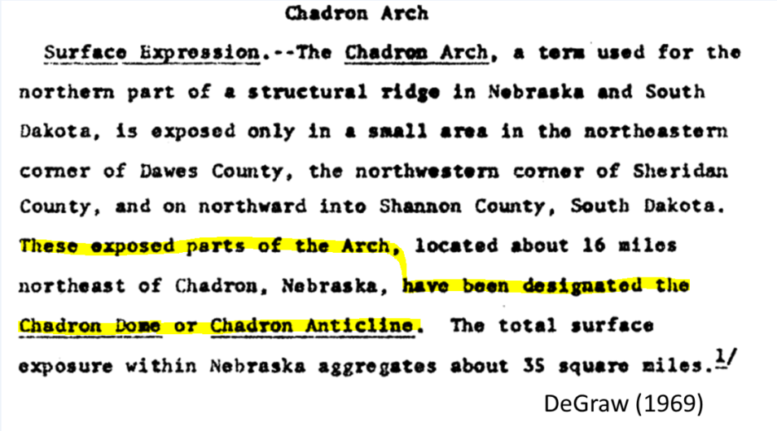
Chadron Dome
Structural Contours
Moore 1954
Chadron Arch
DeGraw (1969)

Slide 6
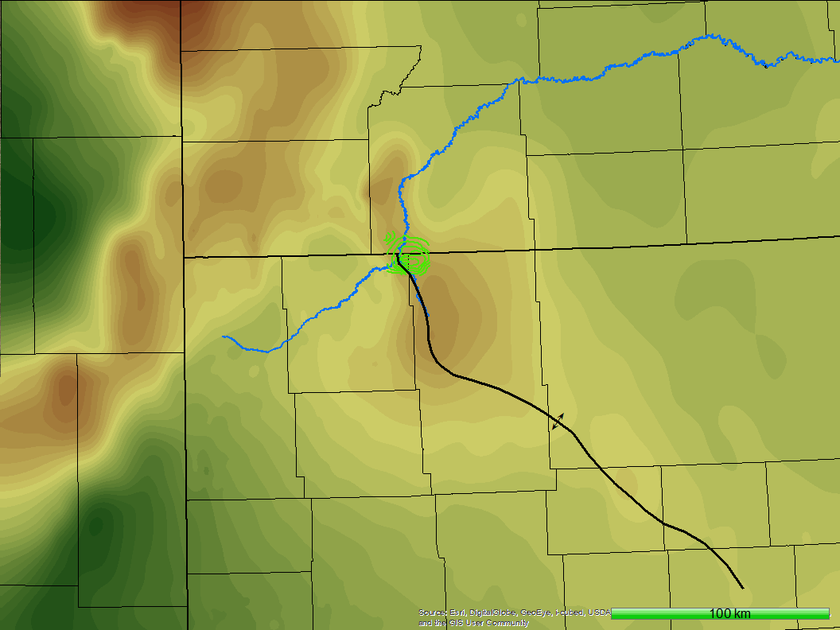

Slide 7


Slide 8
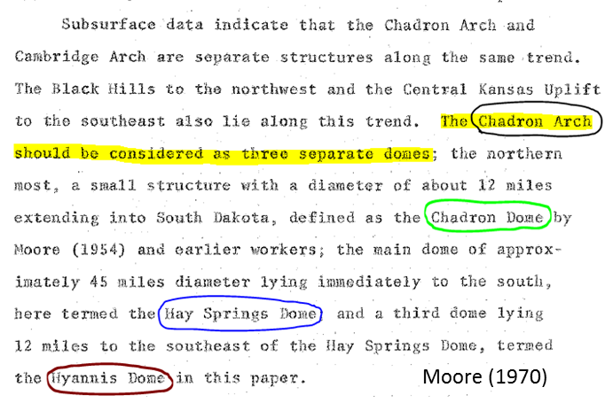
X
Chadron Arch

Slide 9
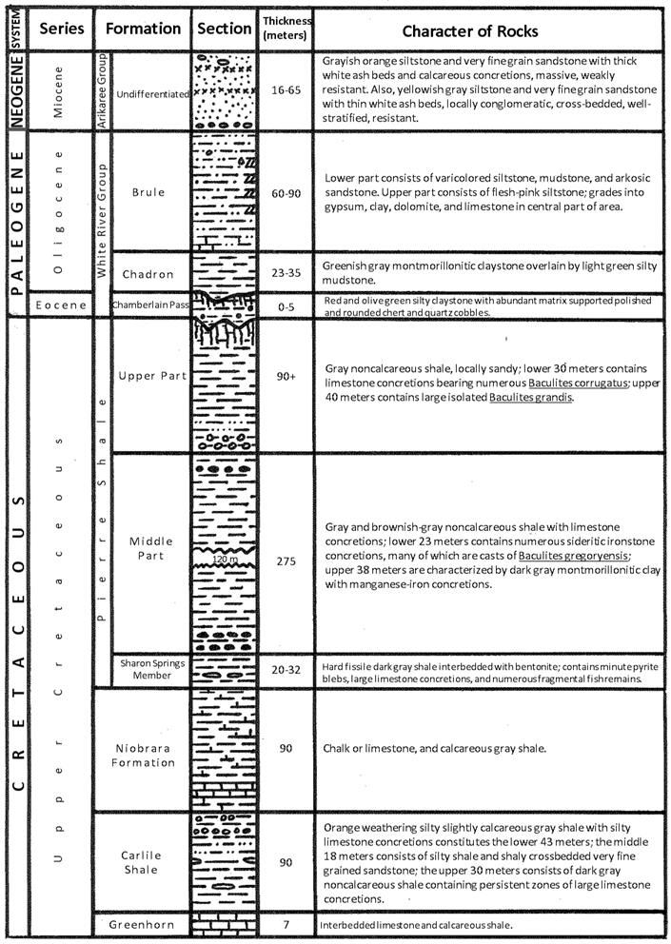
Regional
Stratigraphy
Adapted from
Dunham (1961)

Slide 10
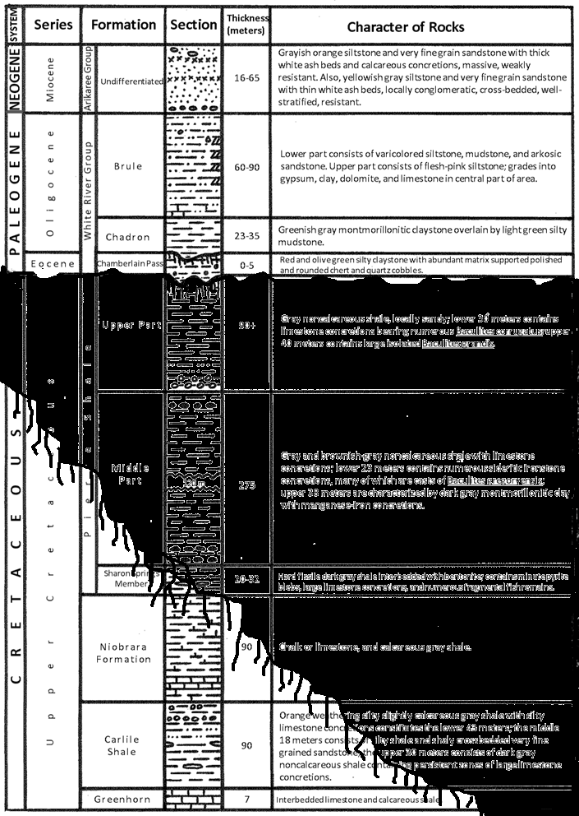
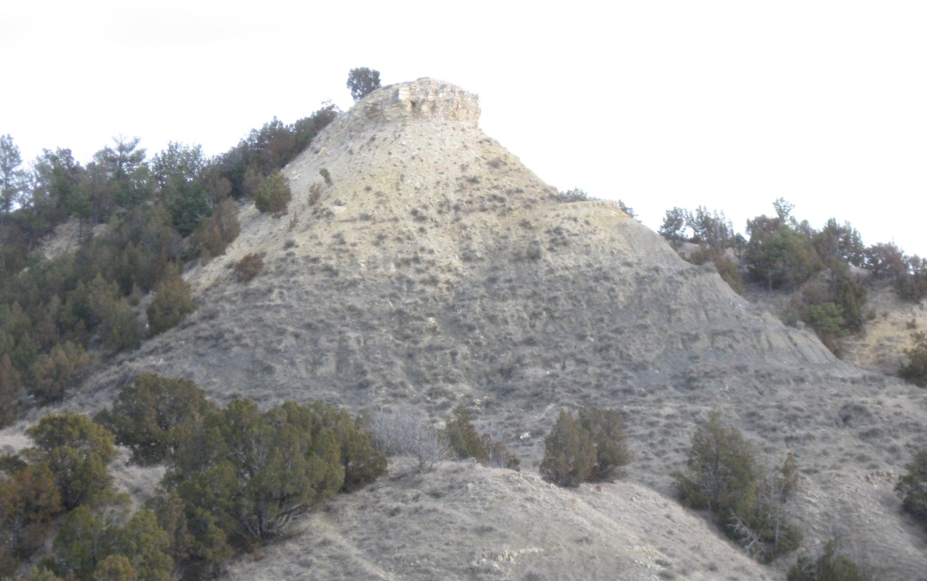
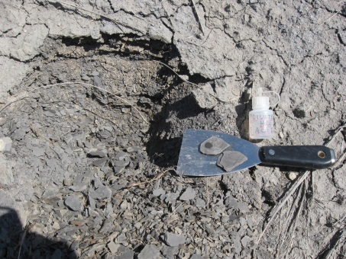
Chadron
“Dome”
Stratigraphy
Adapted from
Dunham (1961)

Slide 11
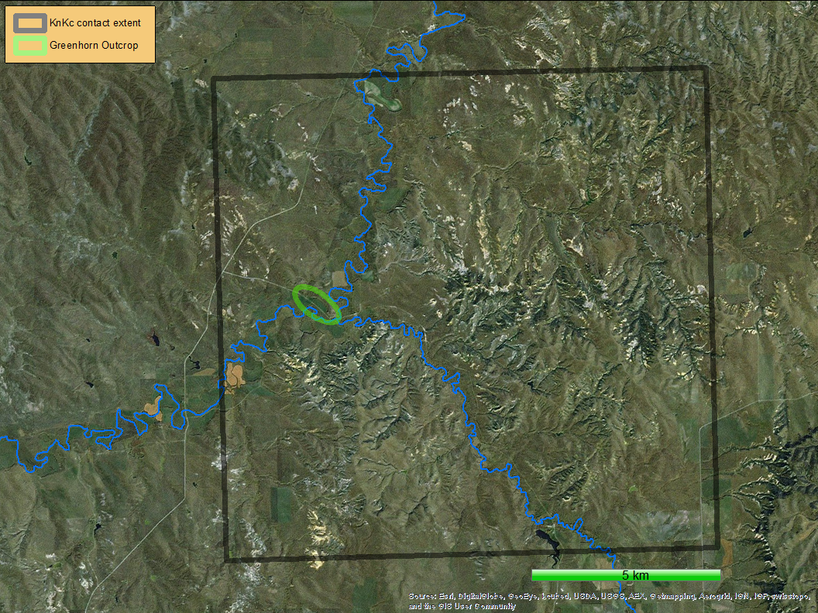
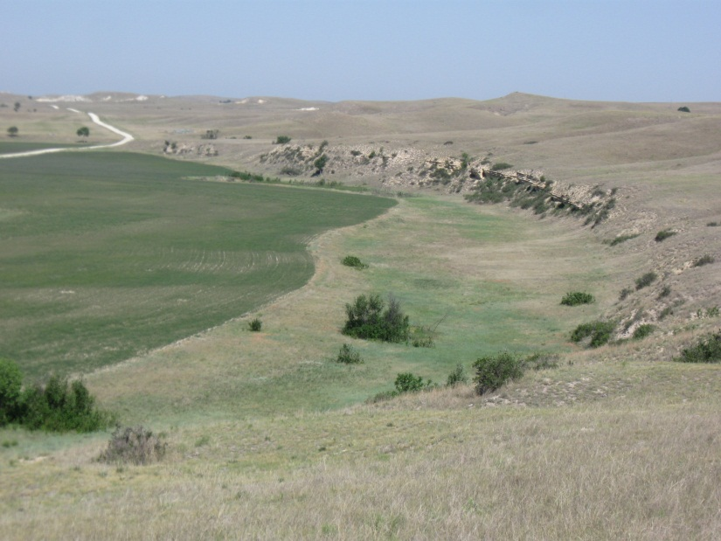

Slide 12
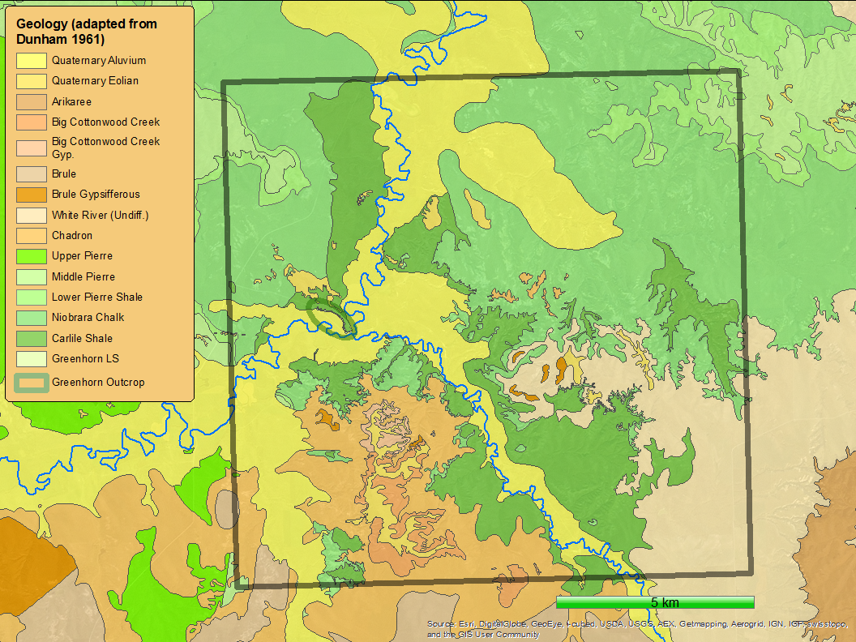

Slide 13
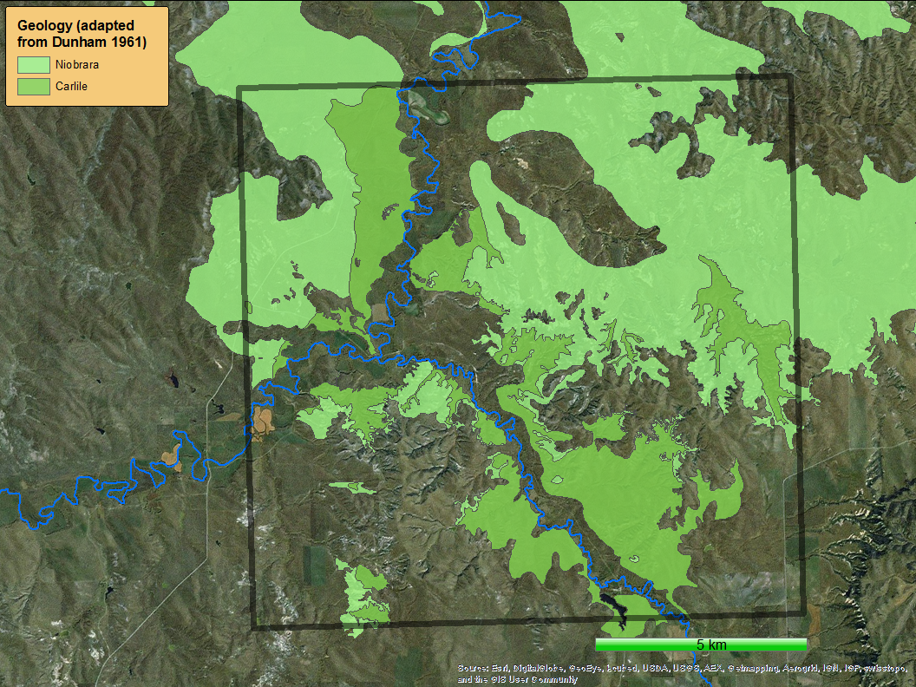

Slide 14
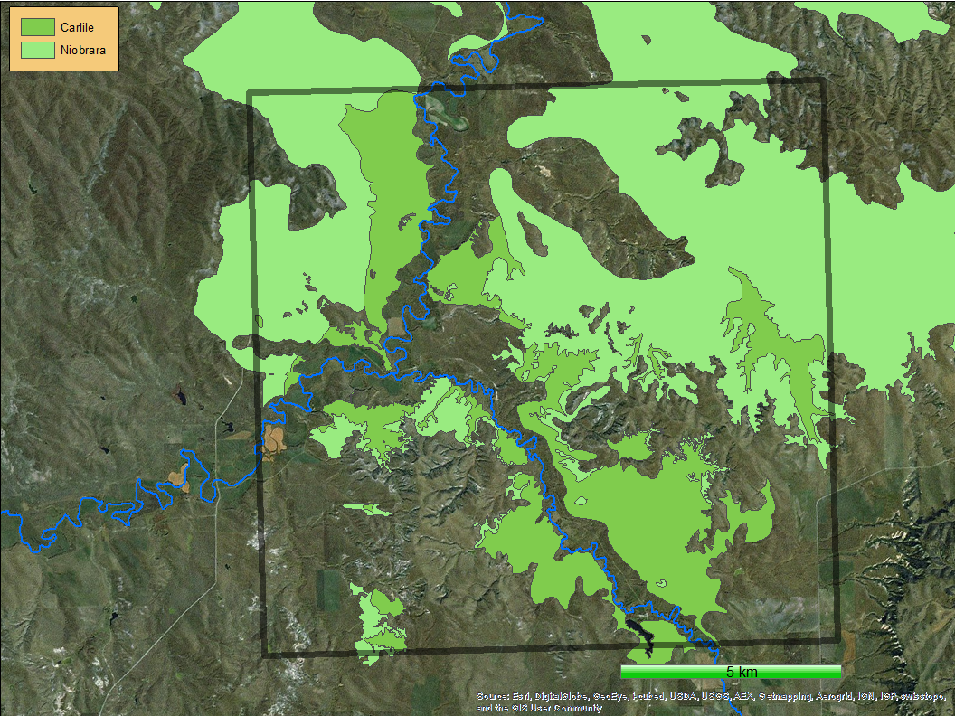
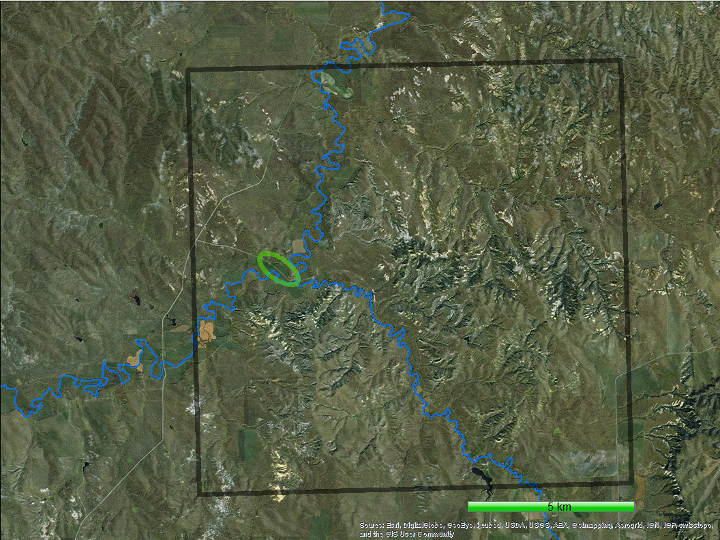
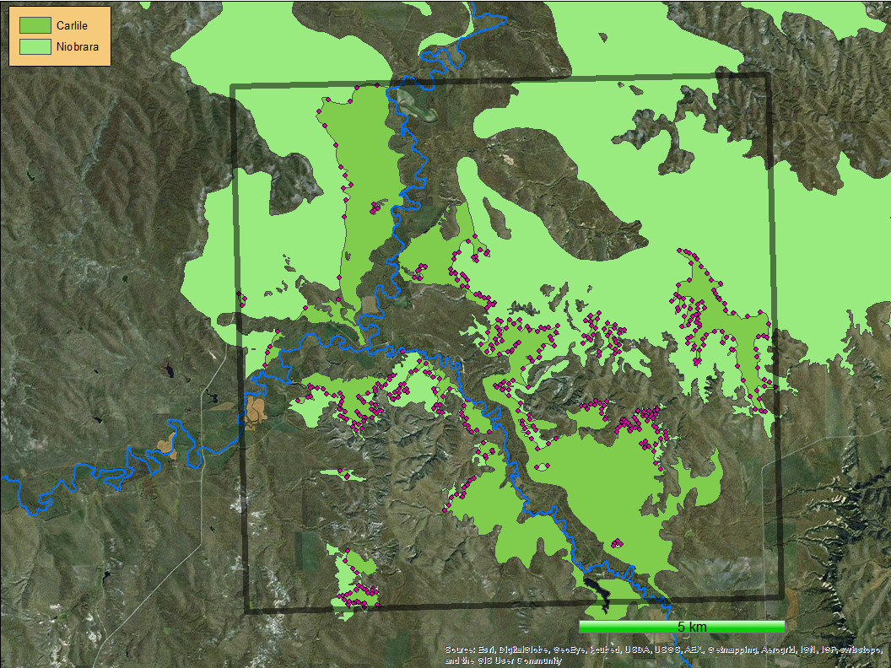
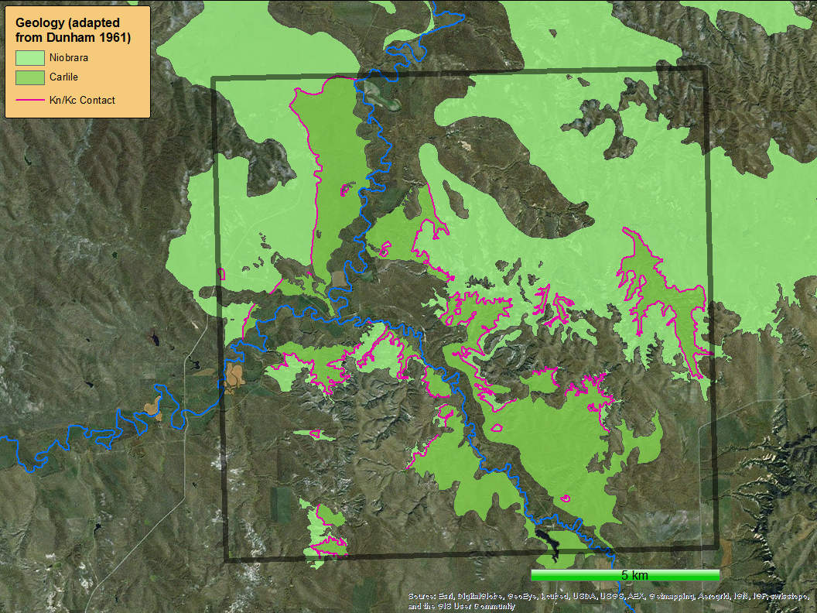

Slide 15


Slide 16
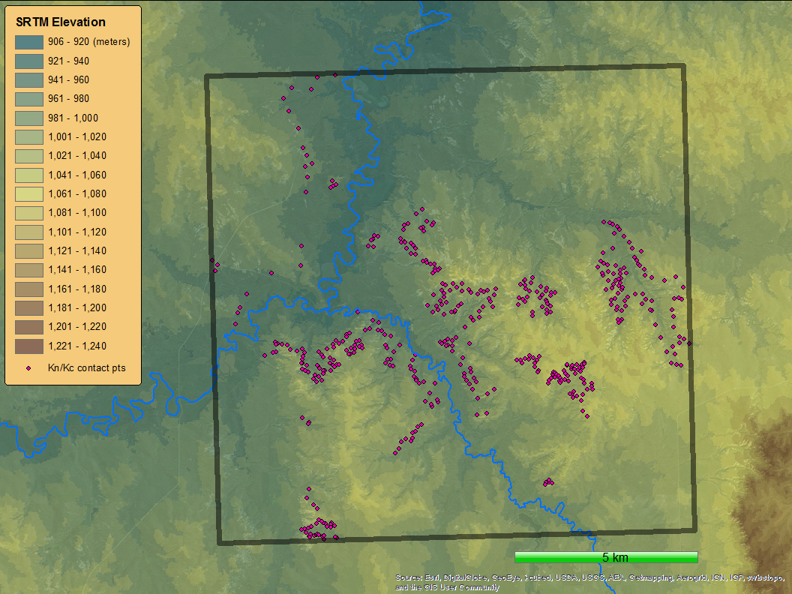

Slide 17
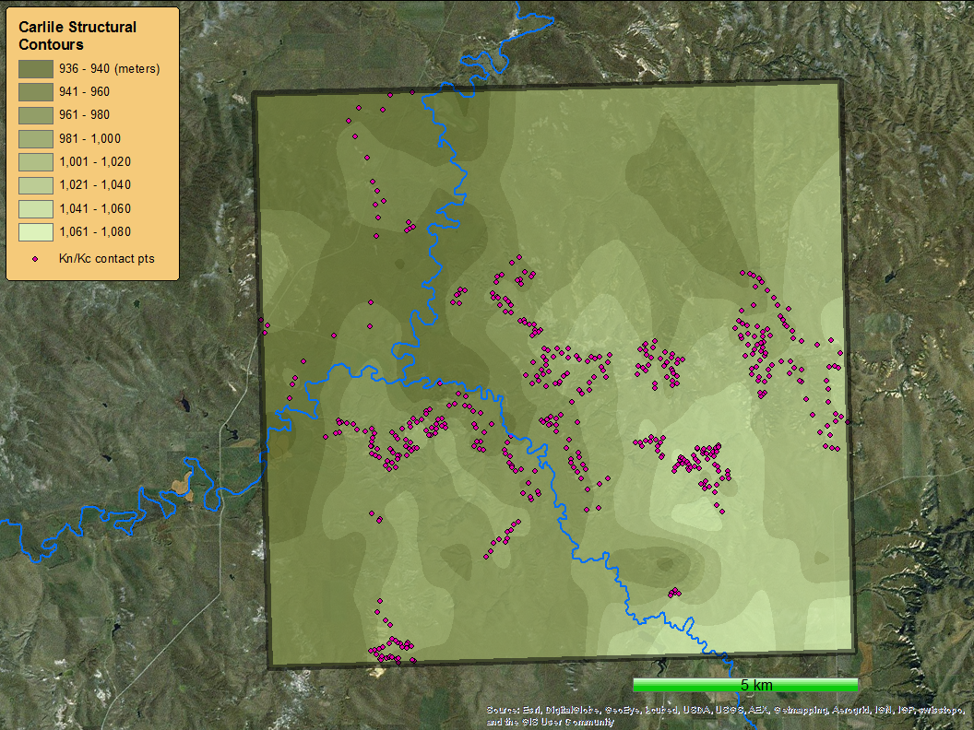
?
?

Slide 18
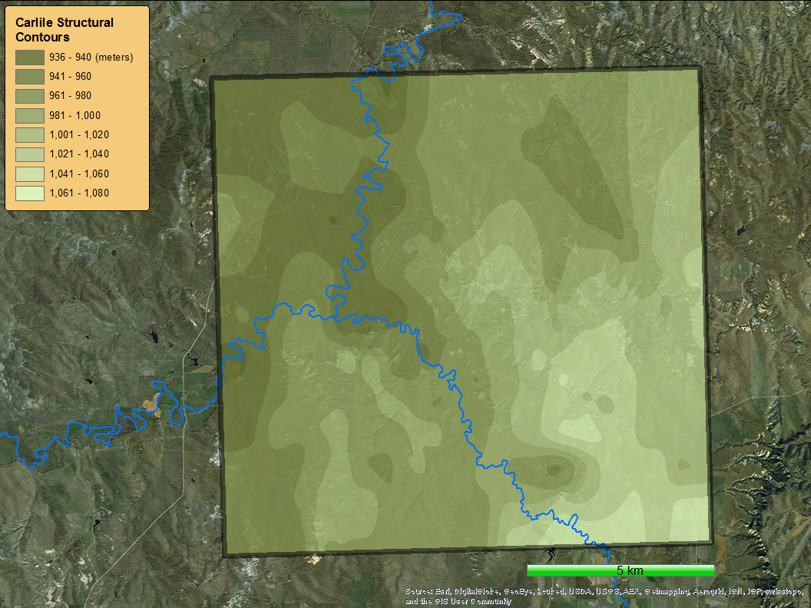

Slide 19
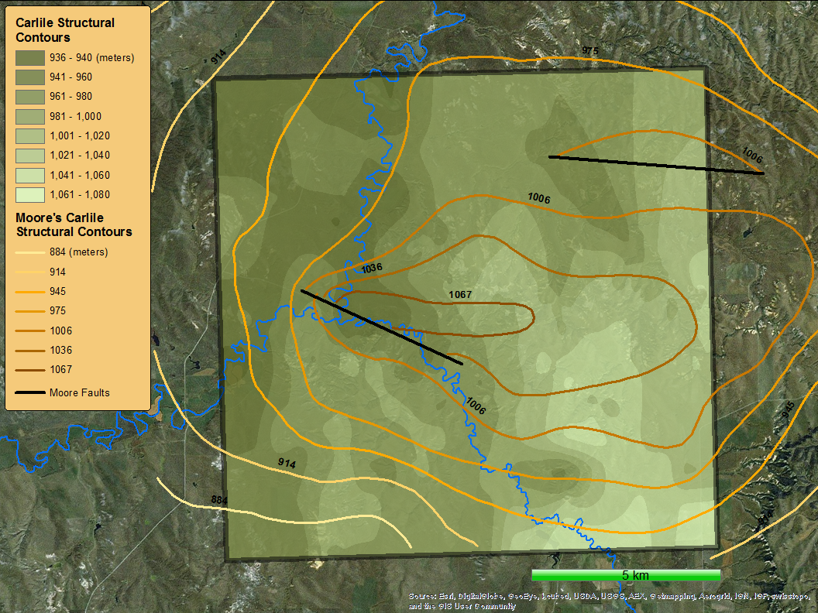

Slide 20
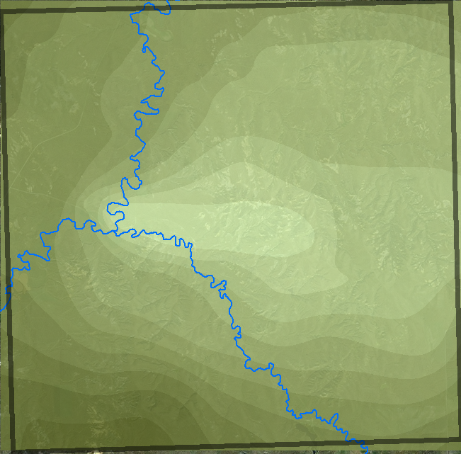
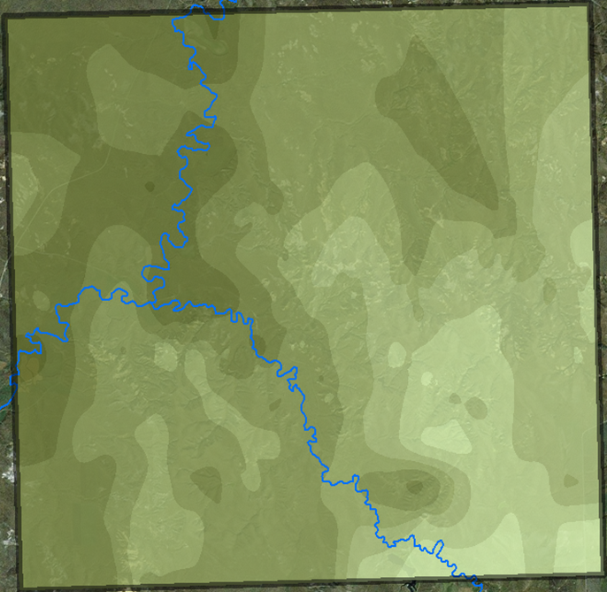
Top of Carlile Shale Structural Contours
Moore (1954)
This Study

Slide 21
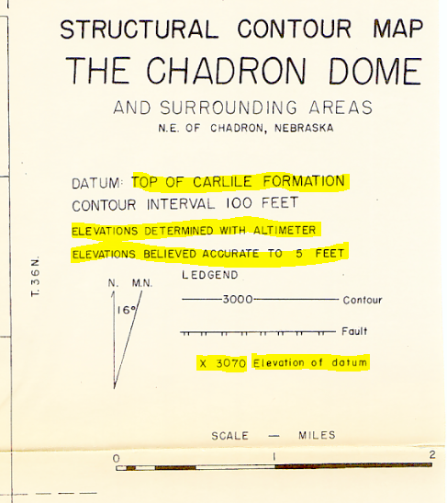

Slide 22
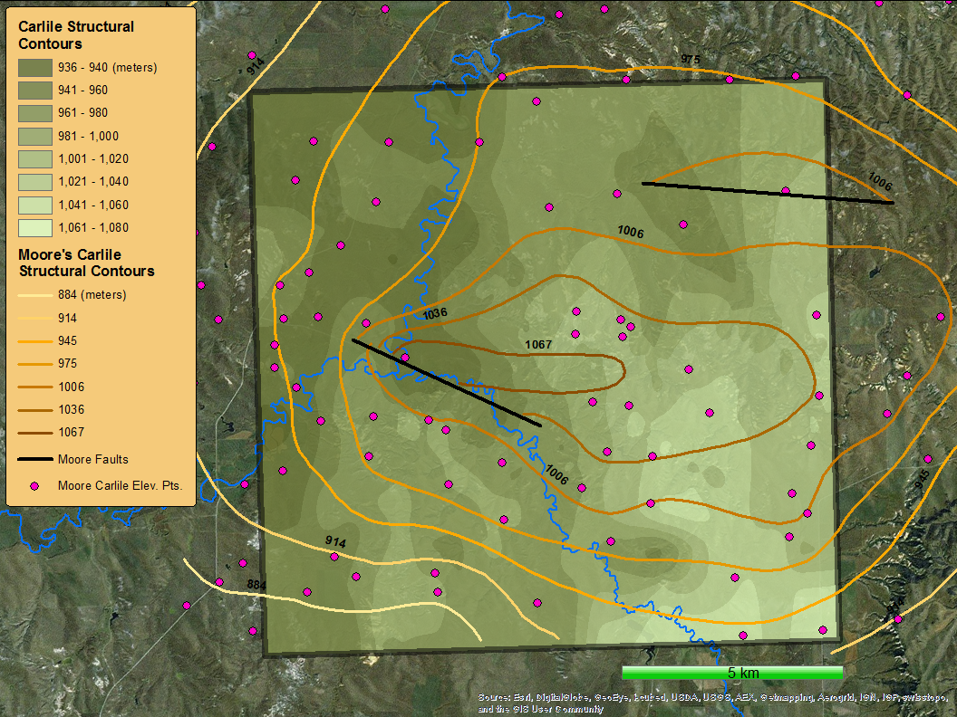

Slide 23
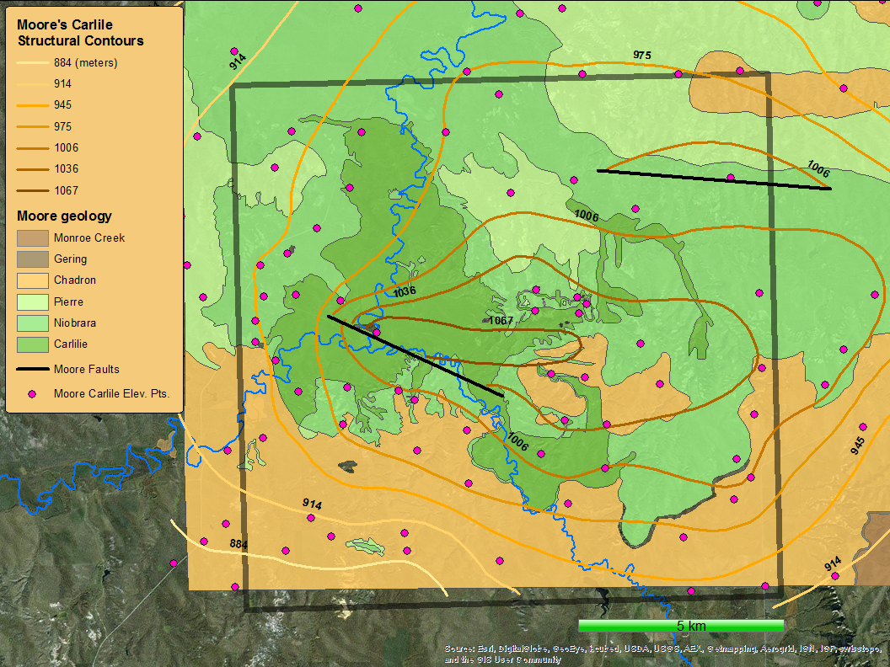

Slide 24
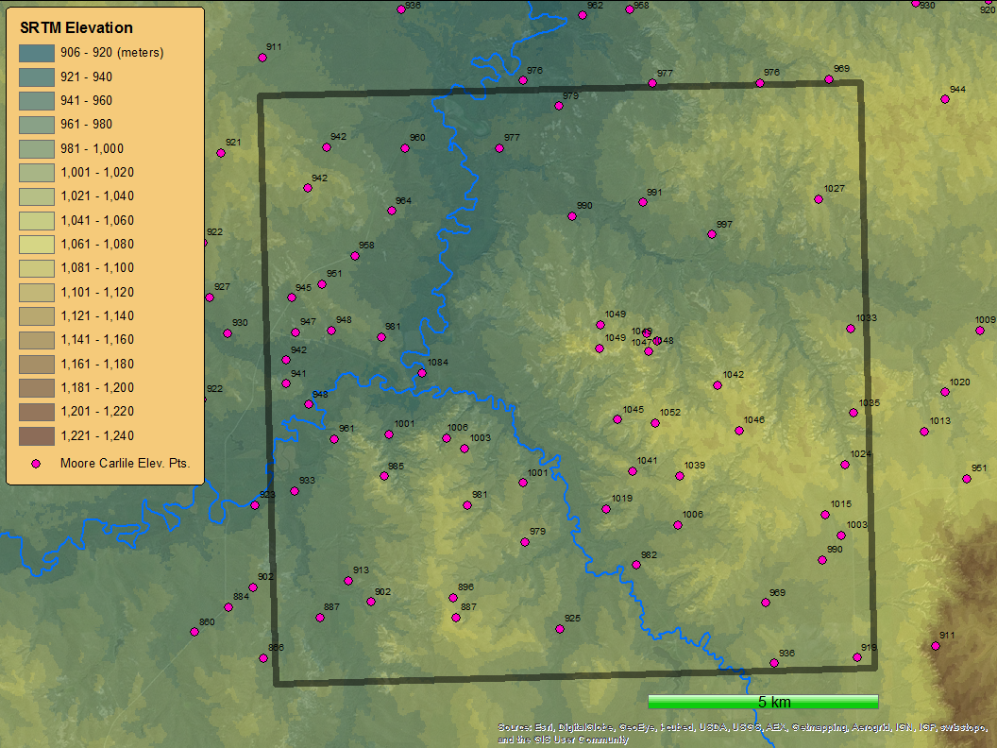

Slide 25
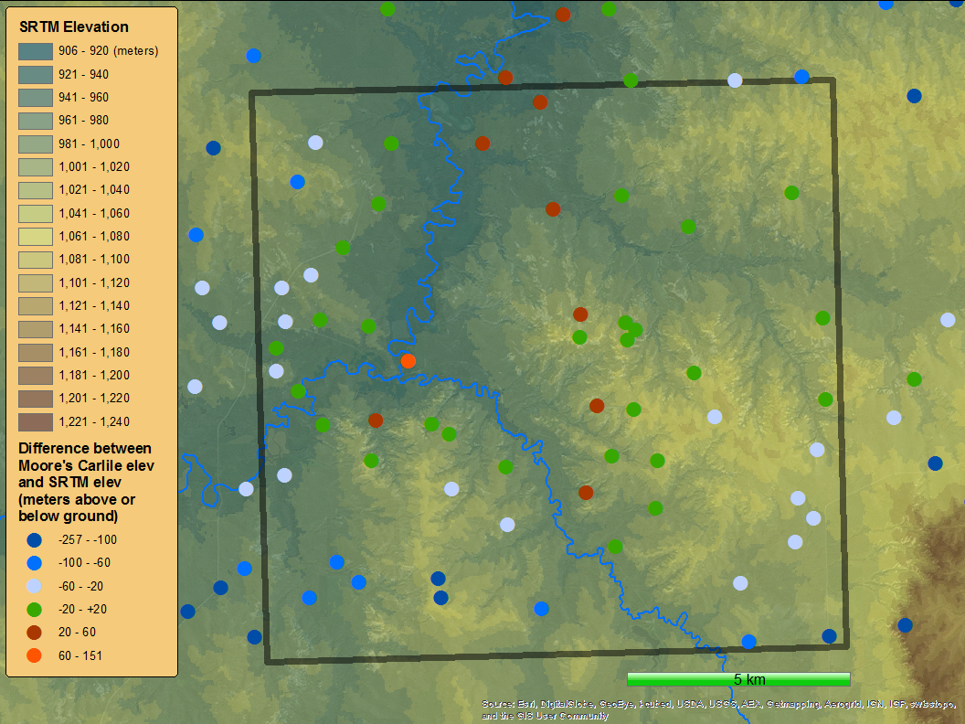

Slide 26
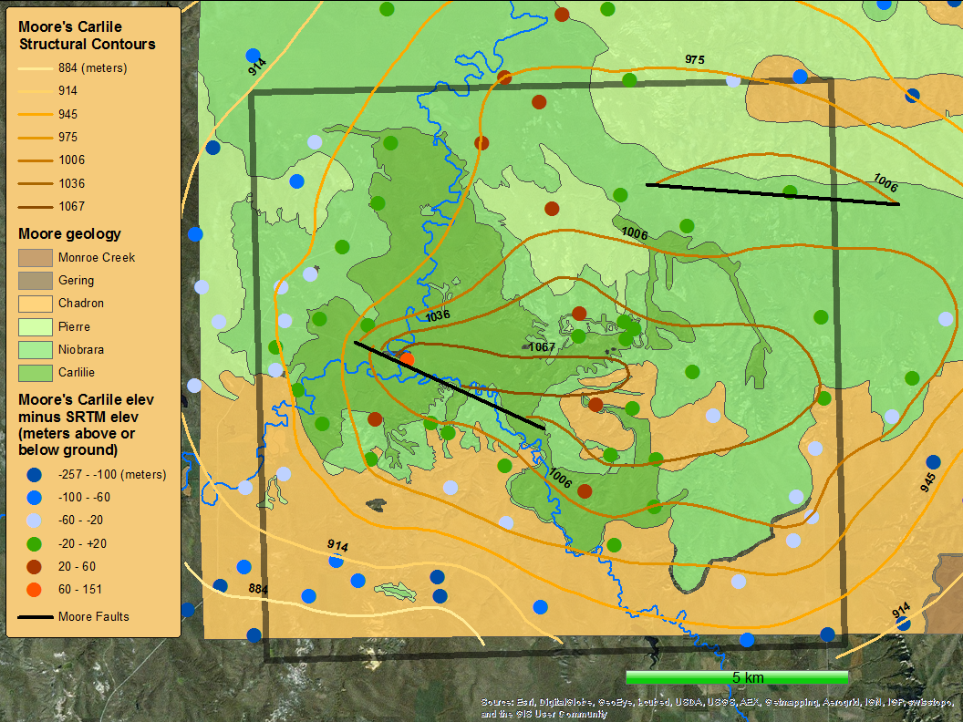

Slide 27
Top of Carlile Shale Structural Contours
X
Moore (1954)
This Study

Slide 28
If it’s not a dome, what is it?

Slide 29
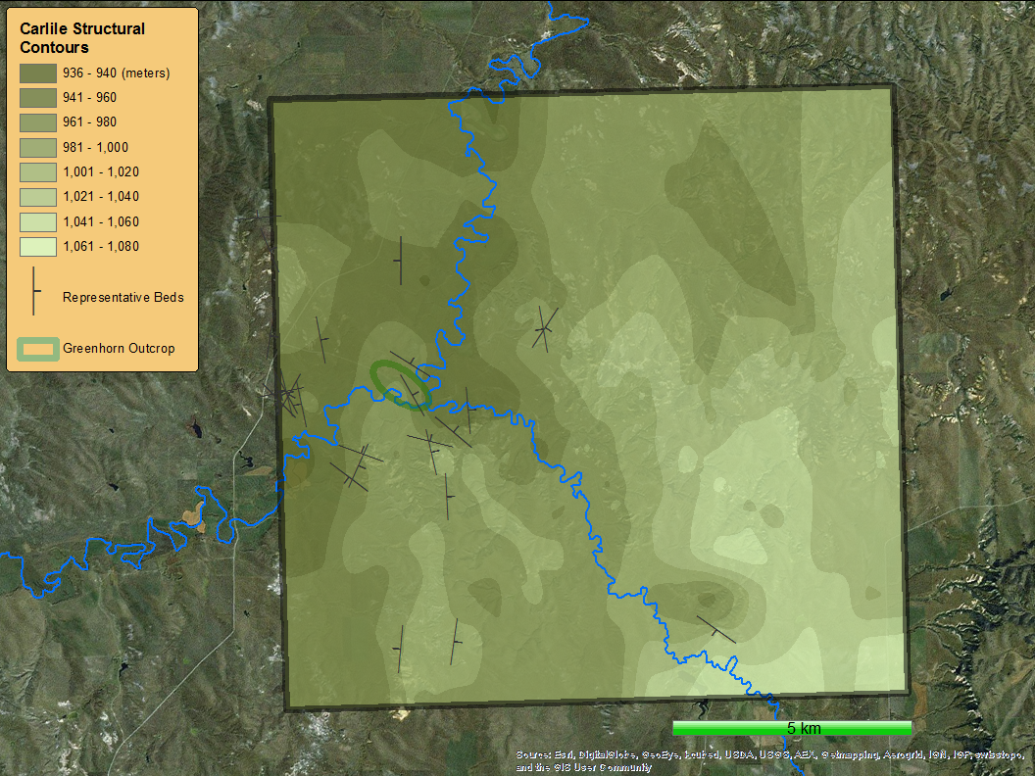

Slide 30
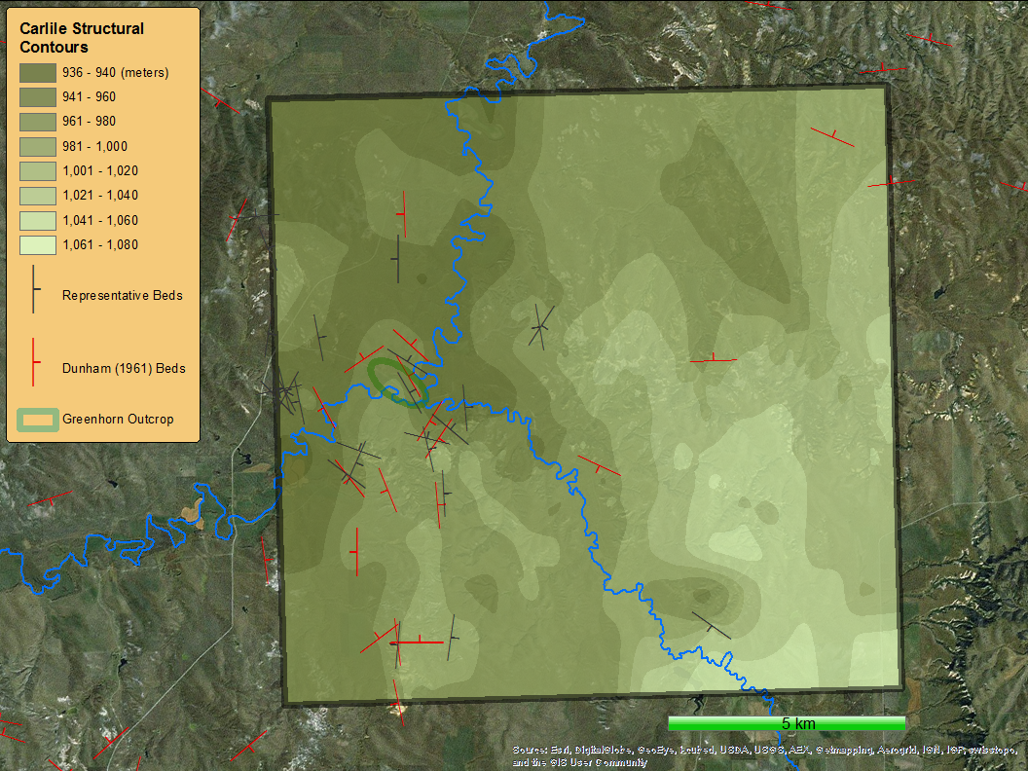

Slide 31
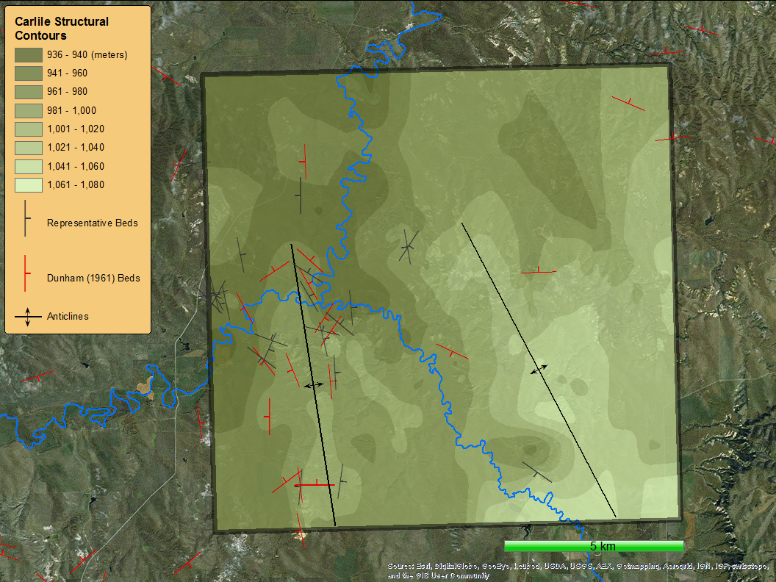

Slide 32
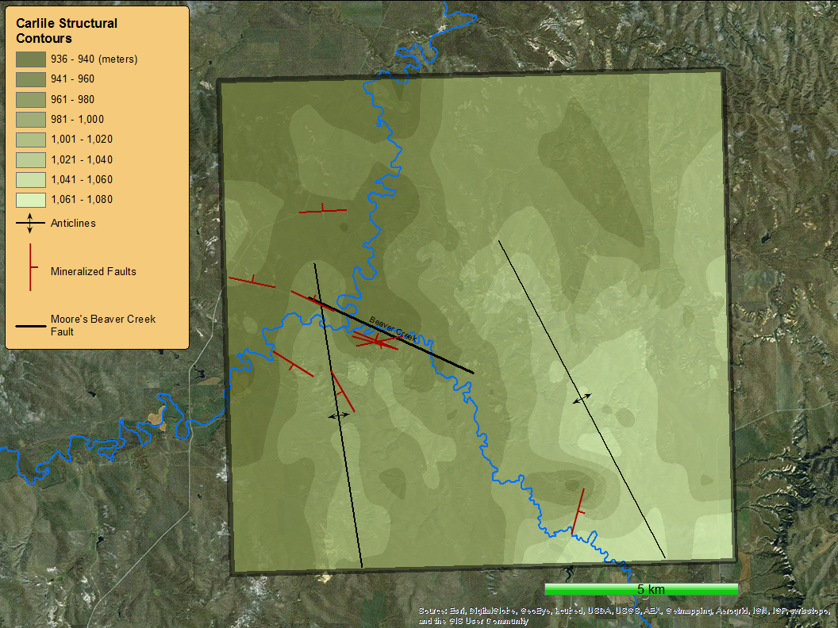
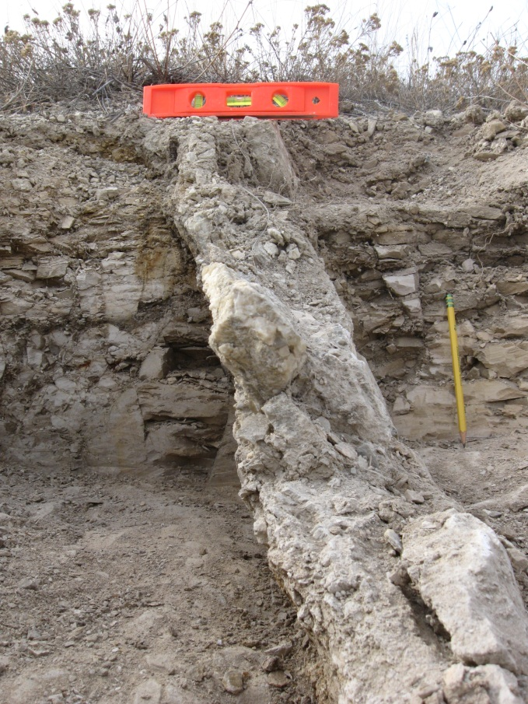
Down
Up
Up
Down

Slide 33
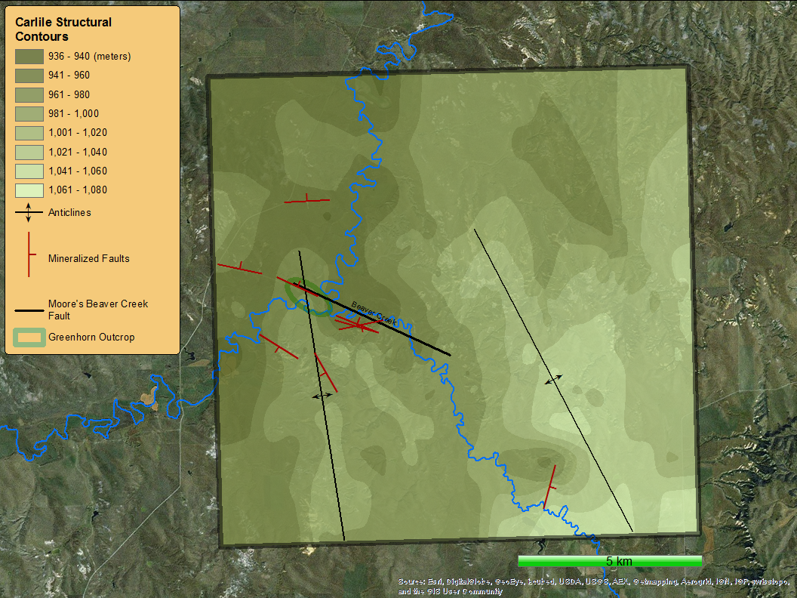
If it’s not a dome, what is it?
A fractured and eroded anticline
Down
Up

Slide 34
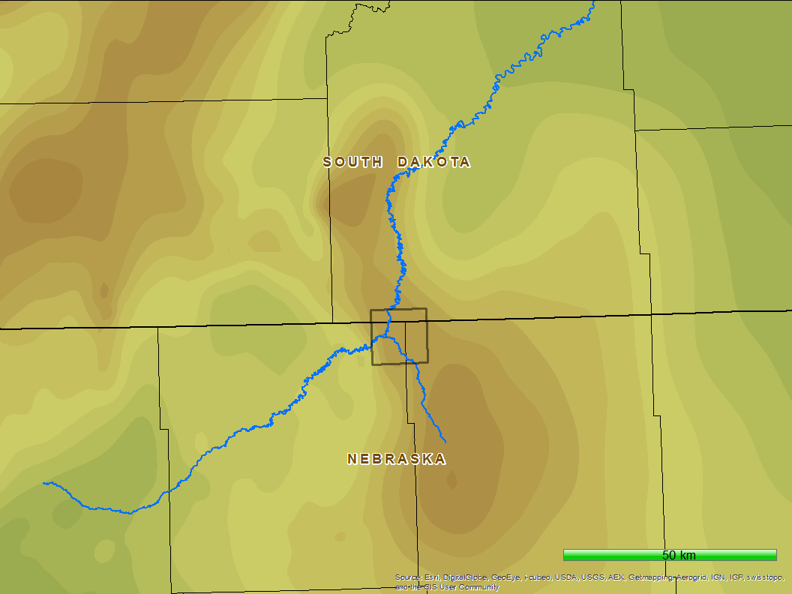

Slide 35
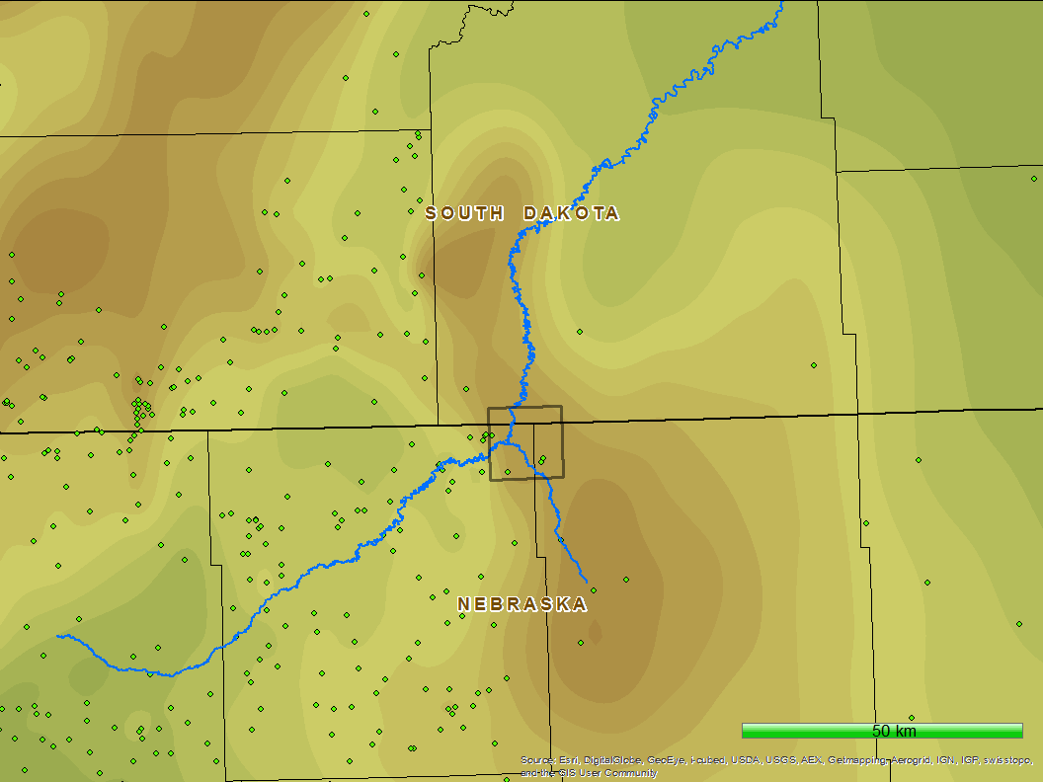

Slide 36
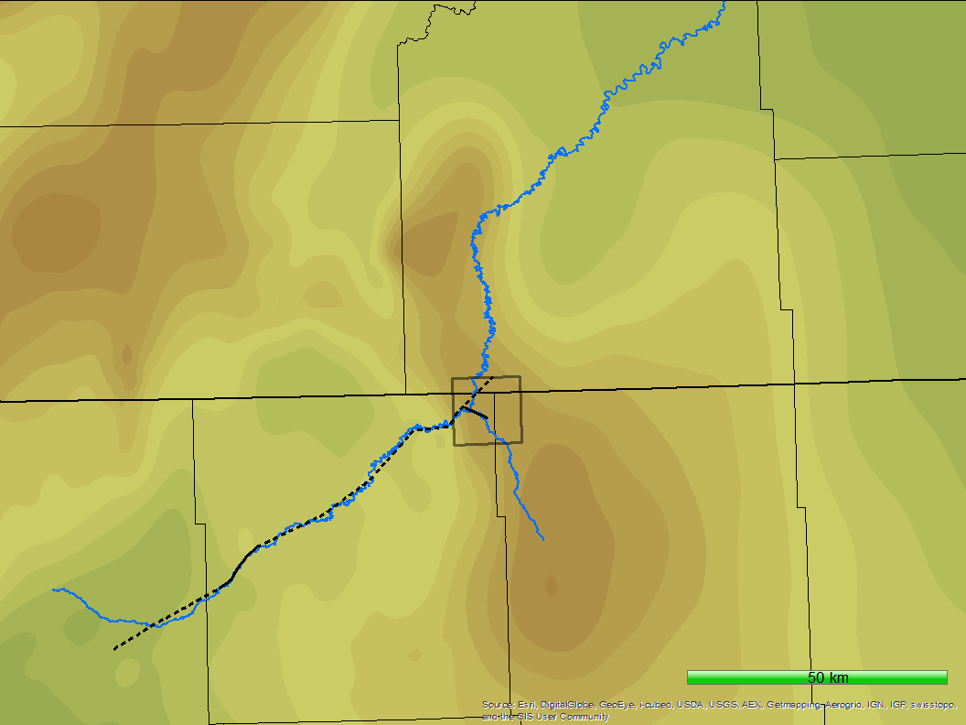
Why is this important?

Slide 37
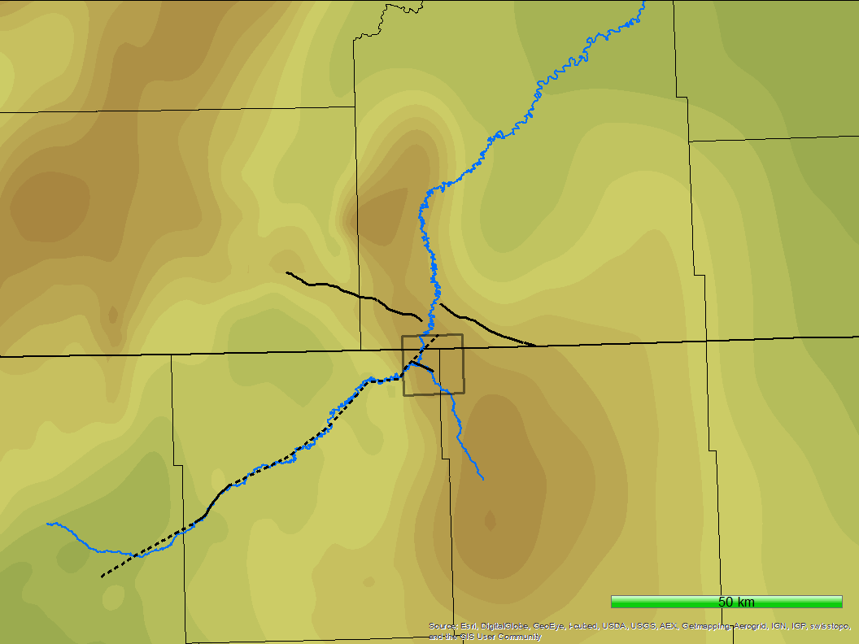
Why is this important?

Slide 38

Why is this important?

Slide 39
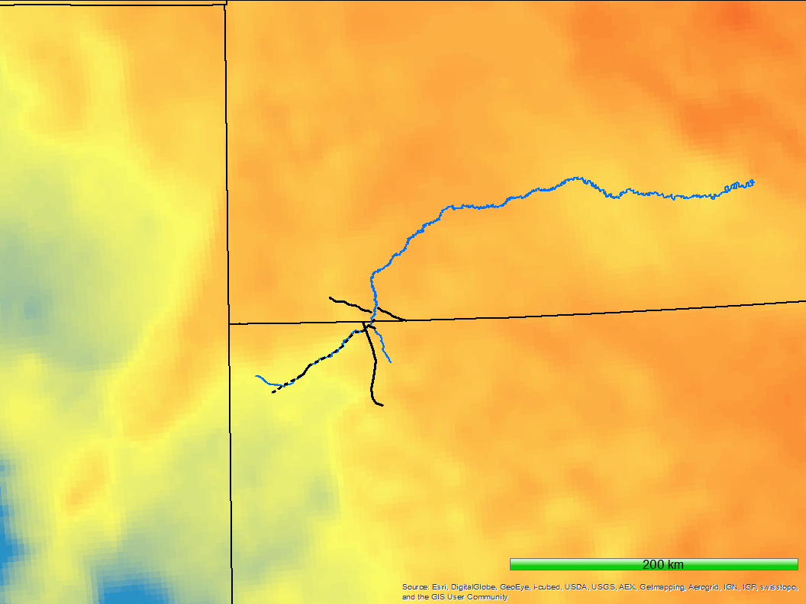
Why is this important?

Slide 40
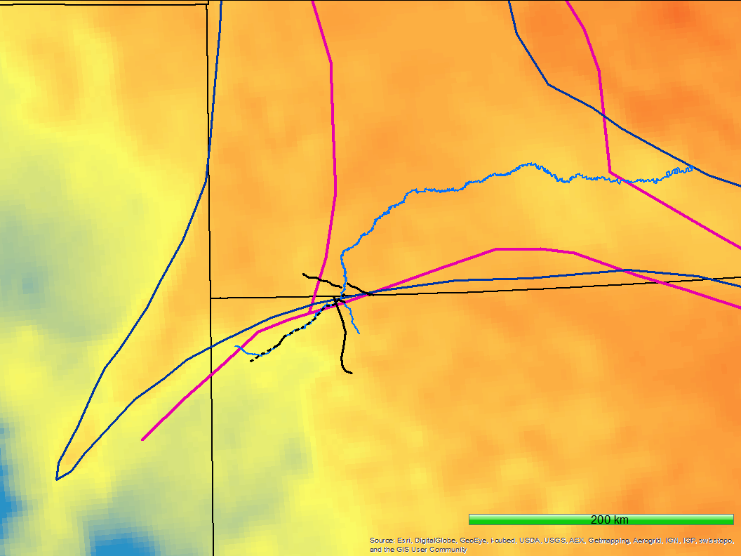
Why is this important?
Superior Craton
Trans-Hudson Orogen
Wyoming Craton
After Sims (1993)
Yavapai Orogeny
After Whitmeyer (2007)
Cheyenne Belt

Slide 41
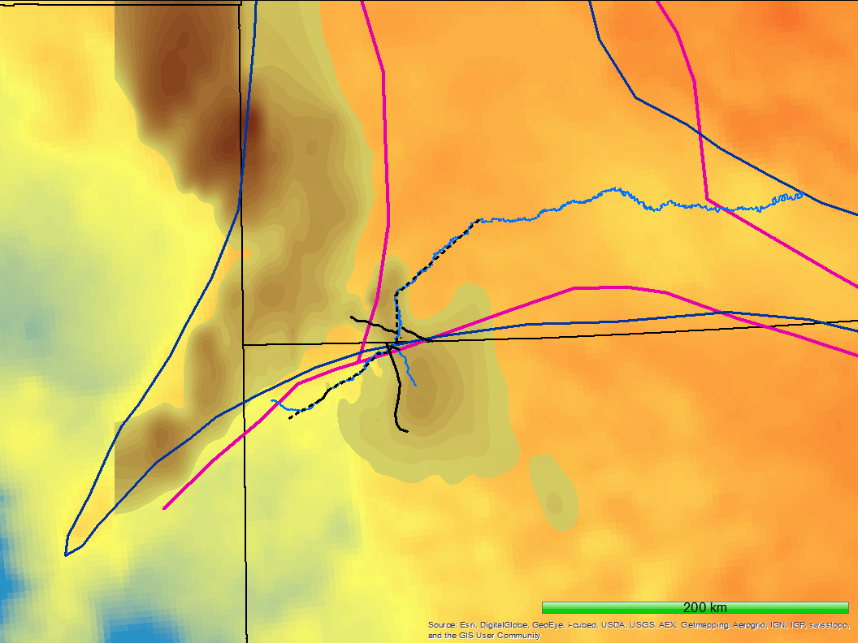
Why is this important?
Superior Craton
The idea of a dome placidly poking through the tertiary cover should be dispelled…
….and be replaced with the notion of a structural arch interacting with multiple fractures, structural weaknesses and a continental boundary.
Trans-Hudson Orogen
Wyoming Craton
Yavapai Orogeny
Cheyenne Belt

Slide 42
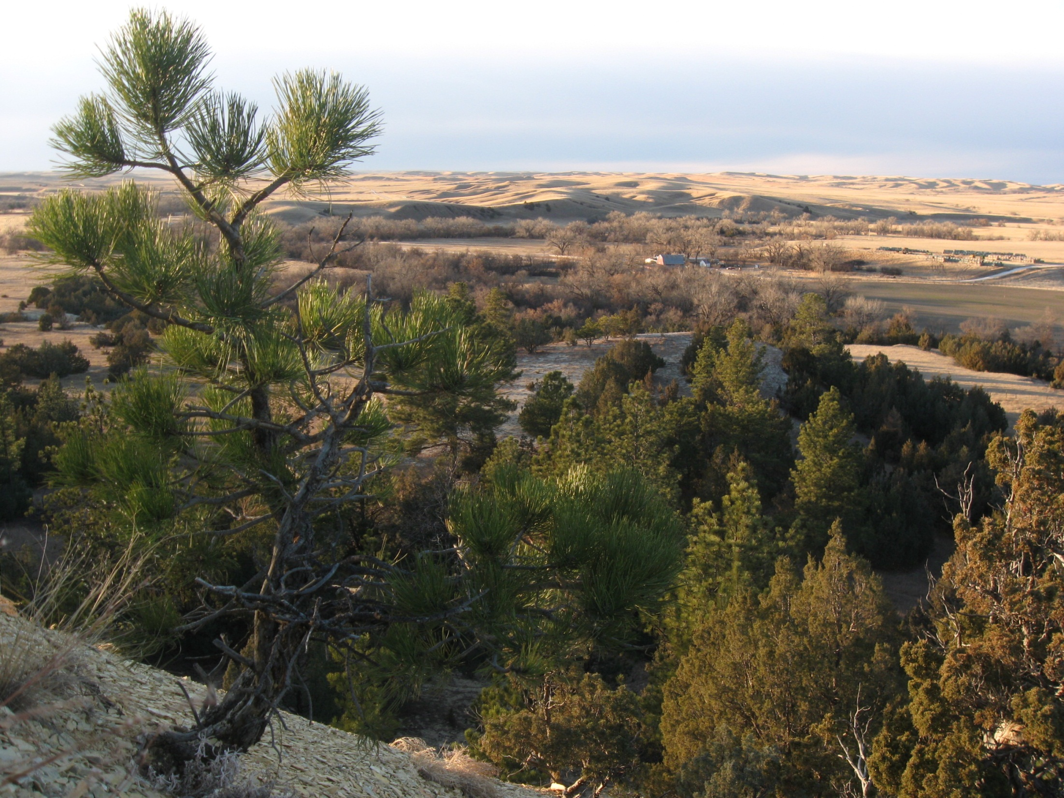
Kind Thanks!
Andrea and Galen Voss
Nebraska NASA Space Grant
Hannan LaGarry

