Slide 1



New Correlations in Raccoon Creek Group (Atokan and Lower Desmoinesian) of Indiana and Southern Illinois
W. John Nelson¹, Philip R. Ames²,
Scott D. Elrick¹, Philip H. Heckel³
1 - Illinois State Geological Survey - UIUC
2 – Peabody Energy
3 – University of Iowa

Slide 2
Abstract
New understandings of Middle Pennsylvanian stratigraphy in Indiana and adjacent Illinois have arisen from three decades of collective investigations of active coal mines, cores and other borehole records, literature review, and conodont study. Among our findings (in descending stratigraphic order), the black, phosphatic Carrier Mills Shale occurs the length of the outcrop belt in Indiana, where it had been termed Logan Quarry Shale at the north end. The Stonefort Limestone and underlying black shale and coal also are regionally continuous, at least toward the south. The Holland Limestone appears to be lenticular, either deposited in flooded estuaries, or incised by later valley formation. The name Silverwood Limestone is discarded because of inadequate stratigraphic context in its type area.
The Minshall, Buffaloville and Lewisport coals are closely if not exactly correlative and underlie the Perth/Curlew Limestone, close to the Atokan-Desmoinesian boundary. The Upper and Lower Block Coals are highly lenticular in their type area northeast of Terre Haute, and their southward correlation remains in question. The Lead Creek Limestone is regionally widespread, but comprises perhaps as many as three cycles of marine incursion. The underlying Mariah Hill (IN) and Dunbar (KY) coals are approximate equivalents. All of these units are lenticular.
The ultimate goal of this research is to unify bed, member, and formation terminology throughout the Illinois basin.

Slide 3
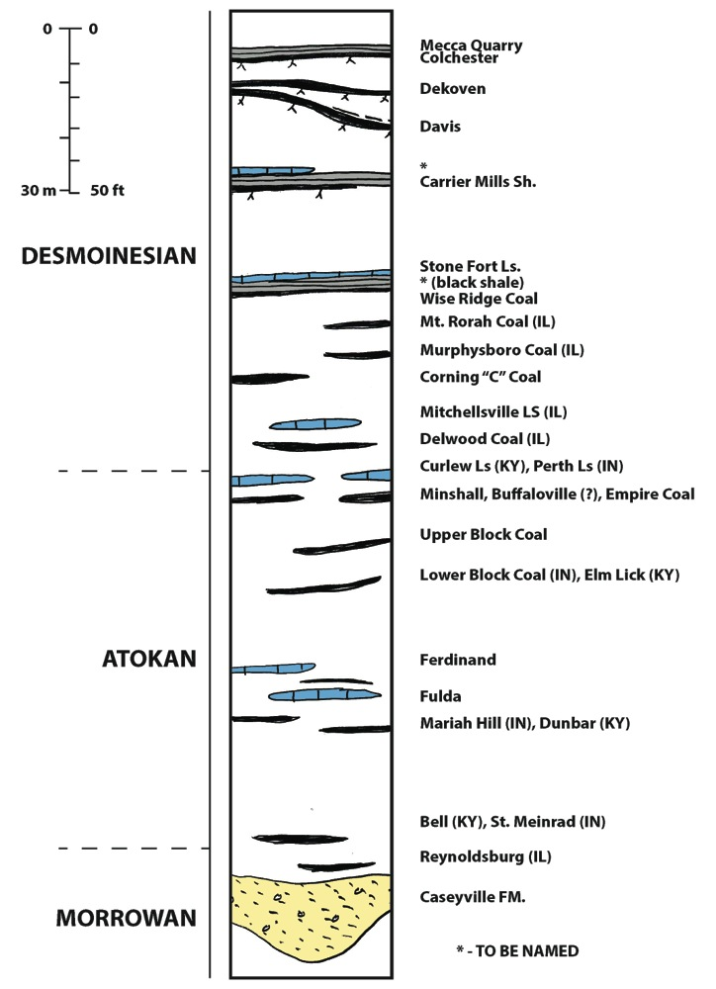
Stratigraphic Column

Slide 4
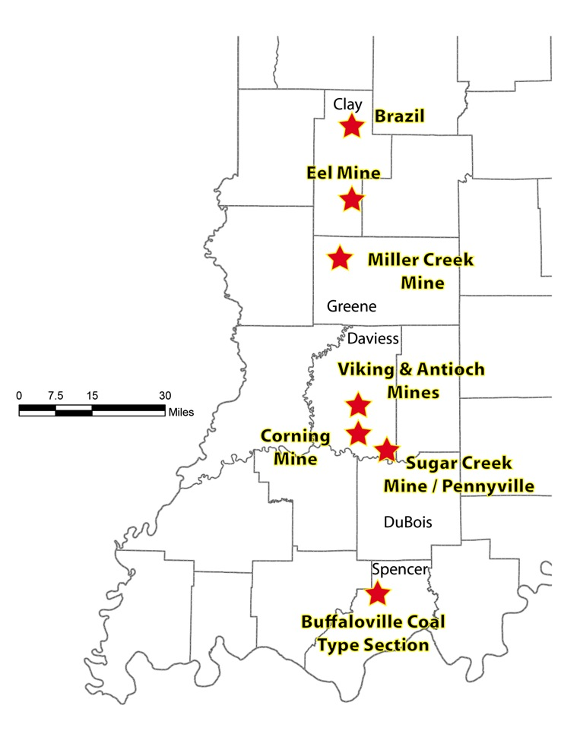
Location map

Slide 5
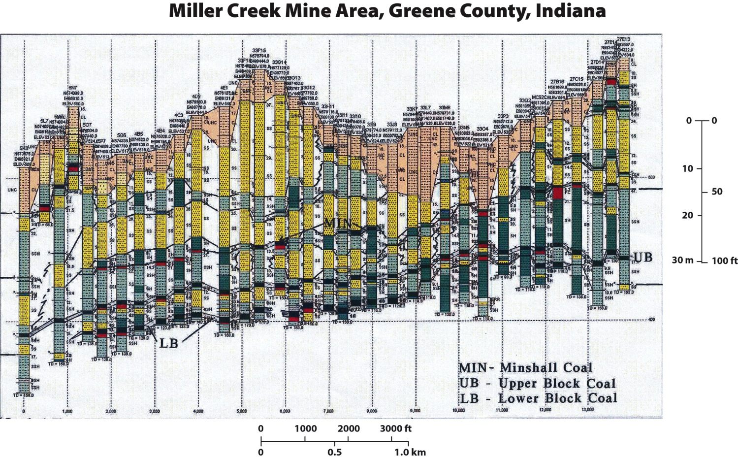
Example of extreme drill hole density in cross sections

Slide 6
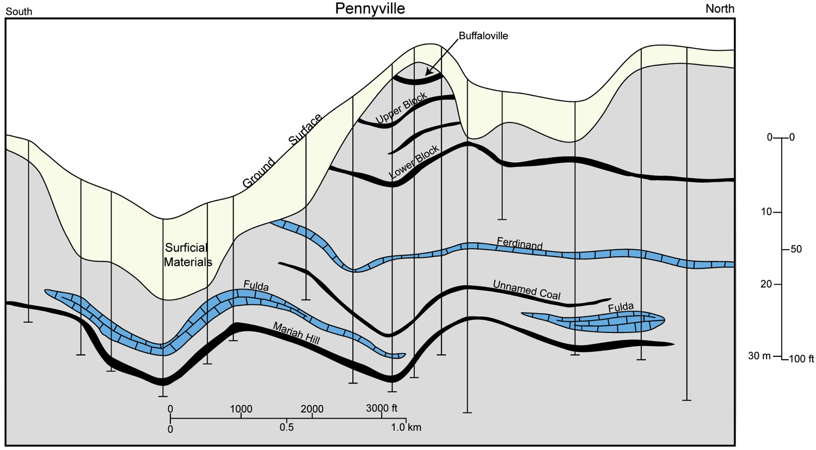
Pennyville cross section, Daviess Co.
Ferdinand and Fulda Limestone Beds occur intermittently the length of the outcrop belt in Indiana. These beds are middle Atokan based on fusulinid content and are the oldest marine units having any lateral continuity.

Slide 7
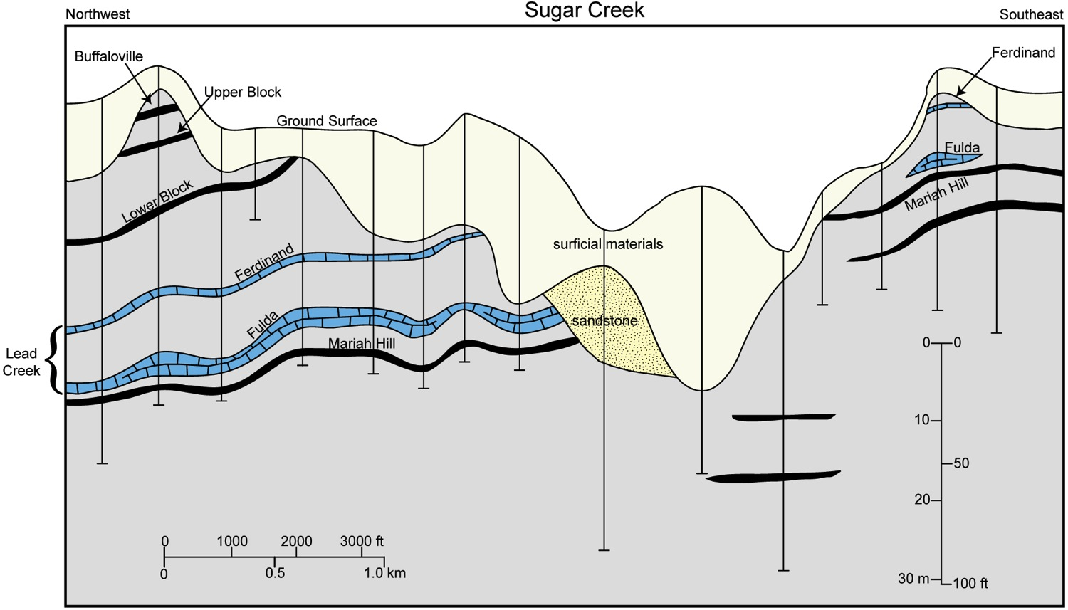
Sugar Creek cross section, Daviess Co.
Ferdinand and Fulda Limestone Beds are well developed in this area.

Slide 8
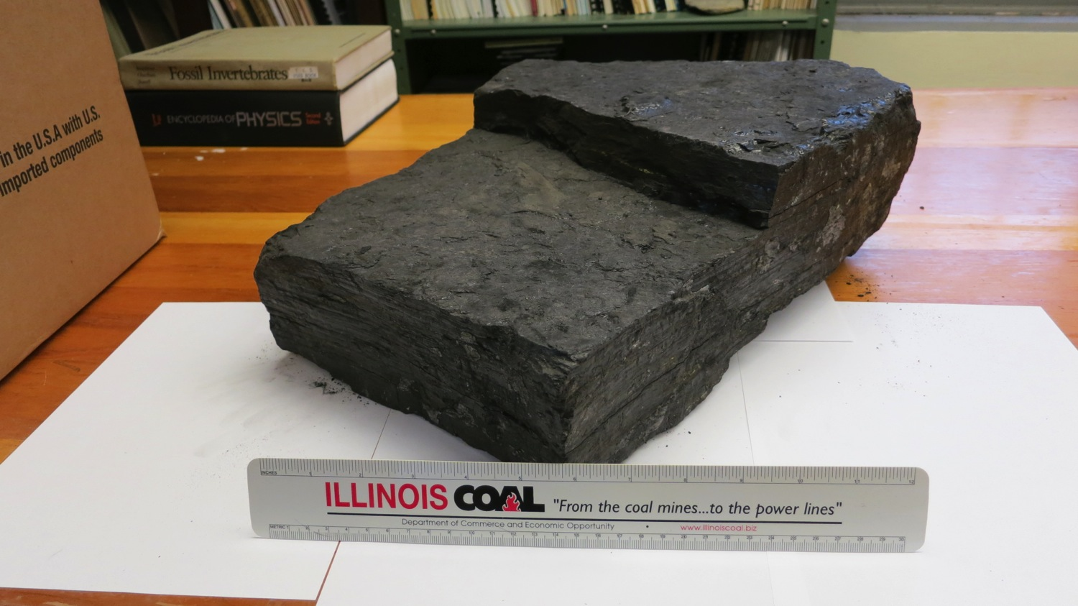
Example - Block Coal
In type area near Brazil, IN, the Lower and Upper Block coals are dull banded or splint coals that exhibit very widely spaced, cubic fracture. Hence the name ‘Block’.

Slide 9
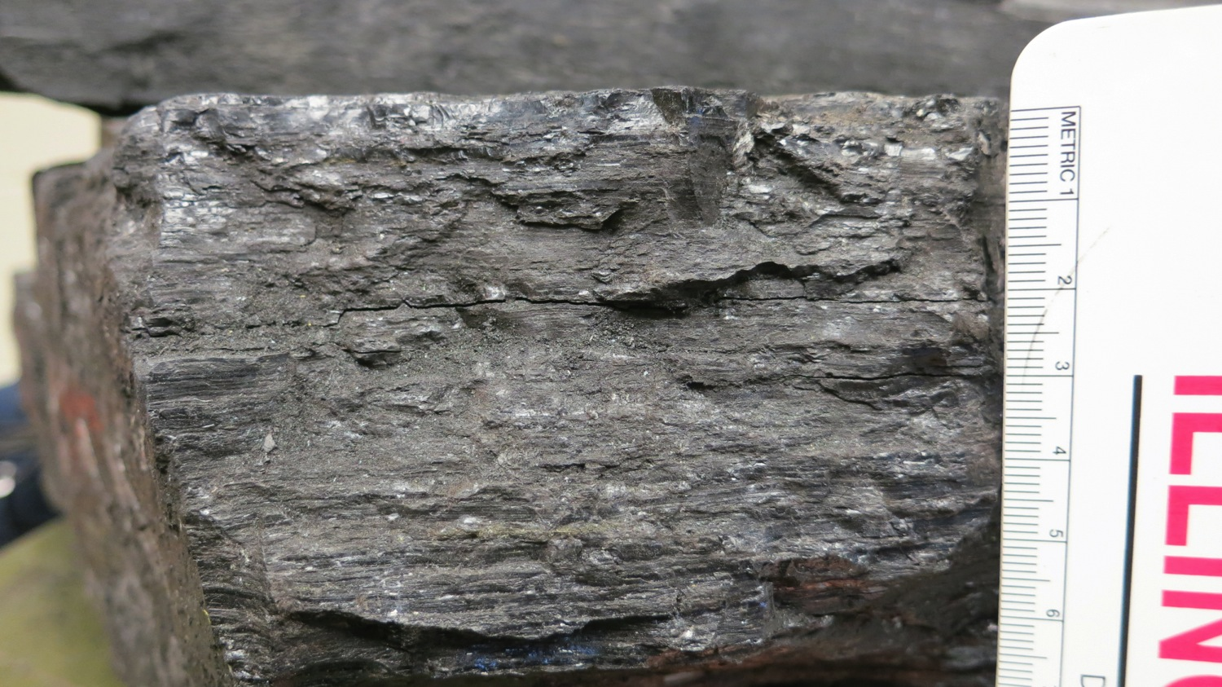
Dull banded nature of Block coal

Slide 10
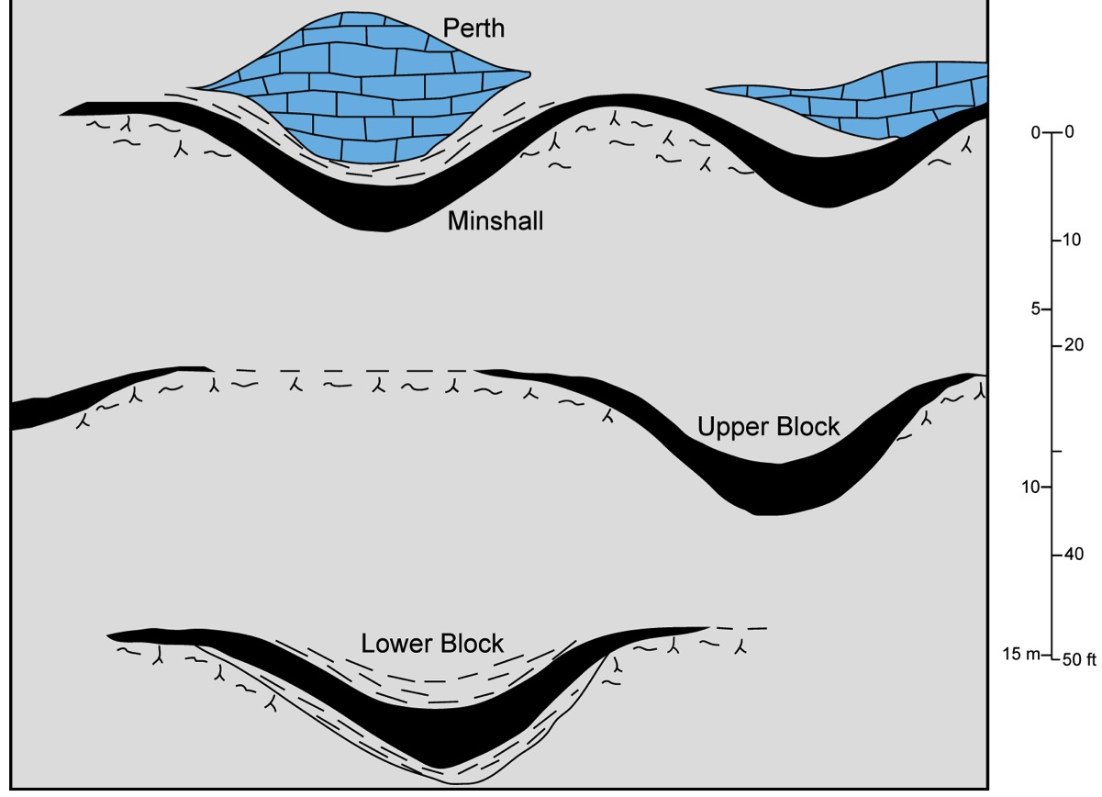
Block coal relationships
In northern area, the Block and Minshall coals as well as the Perth Limestone are highly lenticular. The coal seams thicken markedly into topographic depressions, indicating peat accumulation on an irregular landscape.

Slide 11
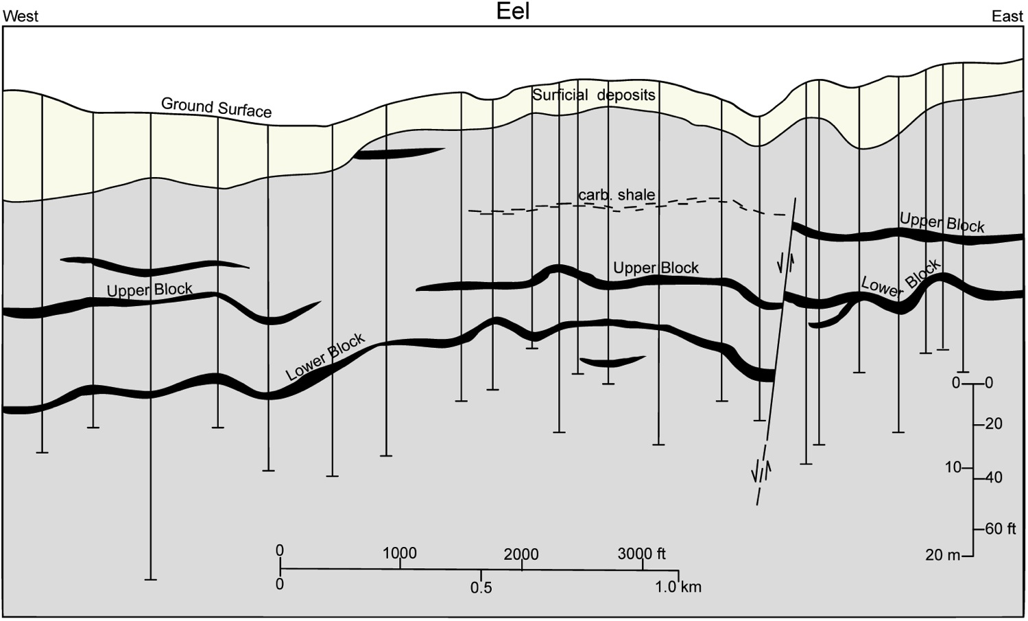
Eel cross section, southern Clay Co.
Coal seams show significant irregularity over relatively short lateral distances in the northern area.

Slide 12
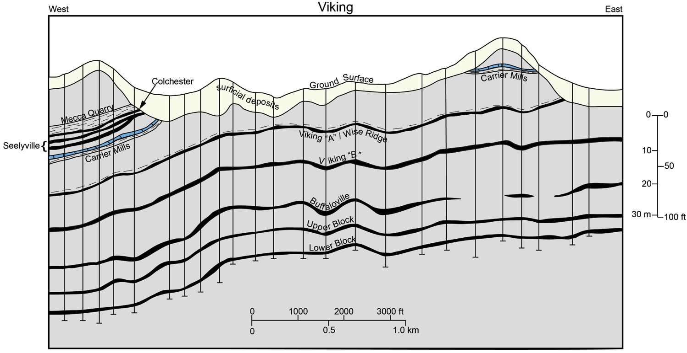
Viking cross section, Daviess Co.
Further south in Daviess, Co., IN, the coal beds exhibit less variation in thickness and greater lateral continuity.

Slide 13
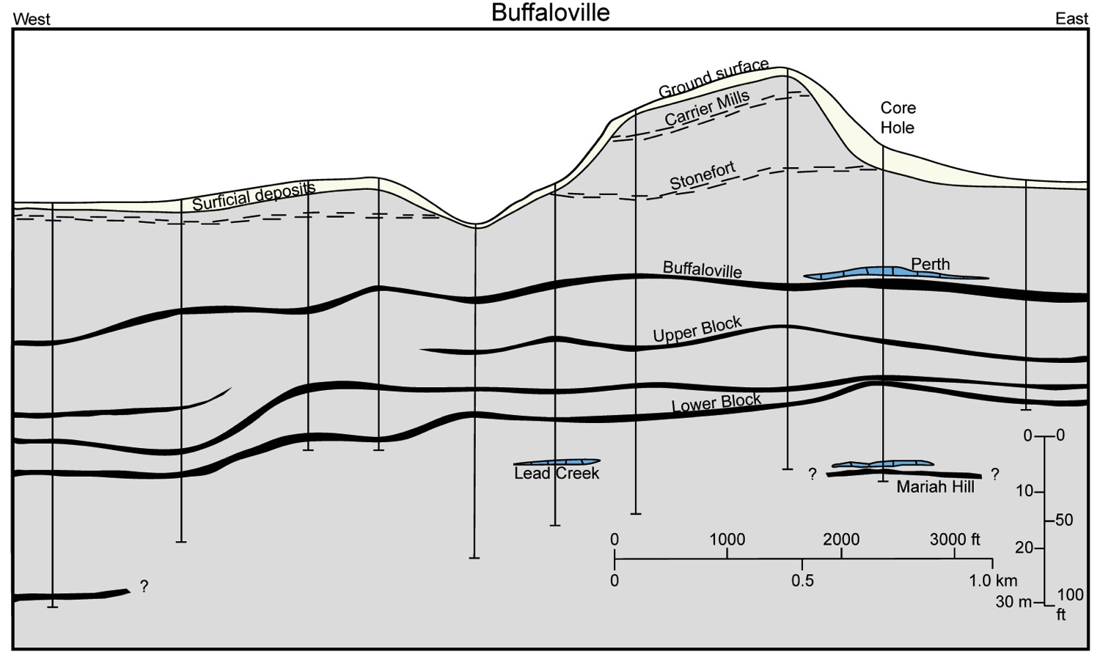
Buffaloville coal cross section – type area, Spencer Co. IN
Other marker beds including Lead Creek Limestone, Block coals, Stonefort and Carrier Mills can be identified in the area.

Slide 14
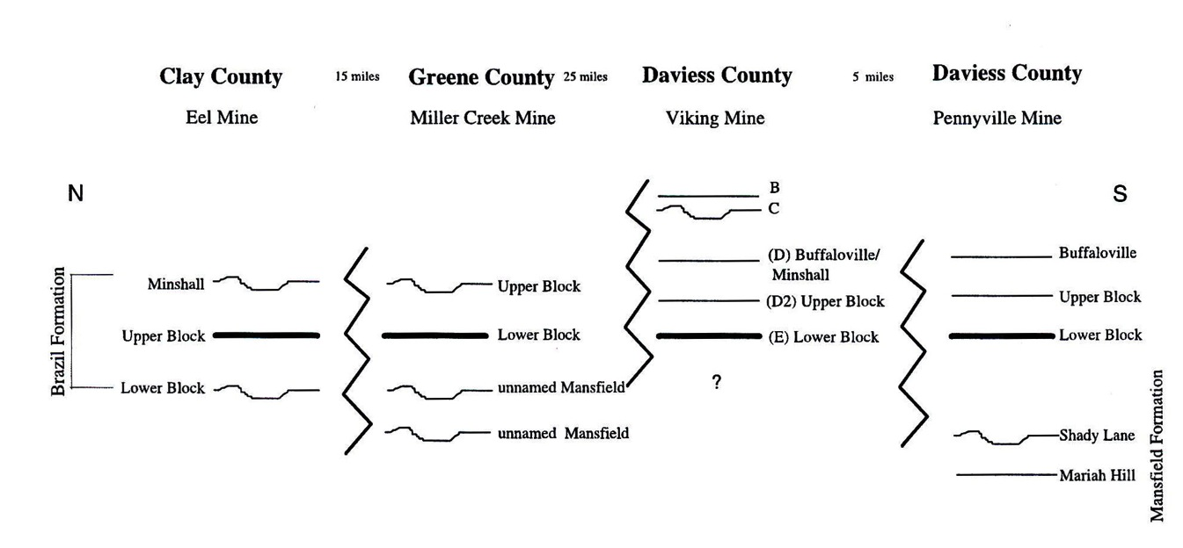
Possible correlations of Block coals from Mastarlerz, Ames and Padgett, IJCG, 2003
The Upper Block of type area in Clay Co. may be the Lower Block, as mapped further south. The type Minshall may correspond to the Upper Block of southern Indiana.

Slide 15
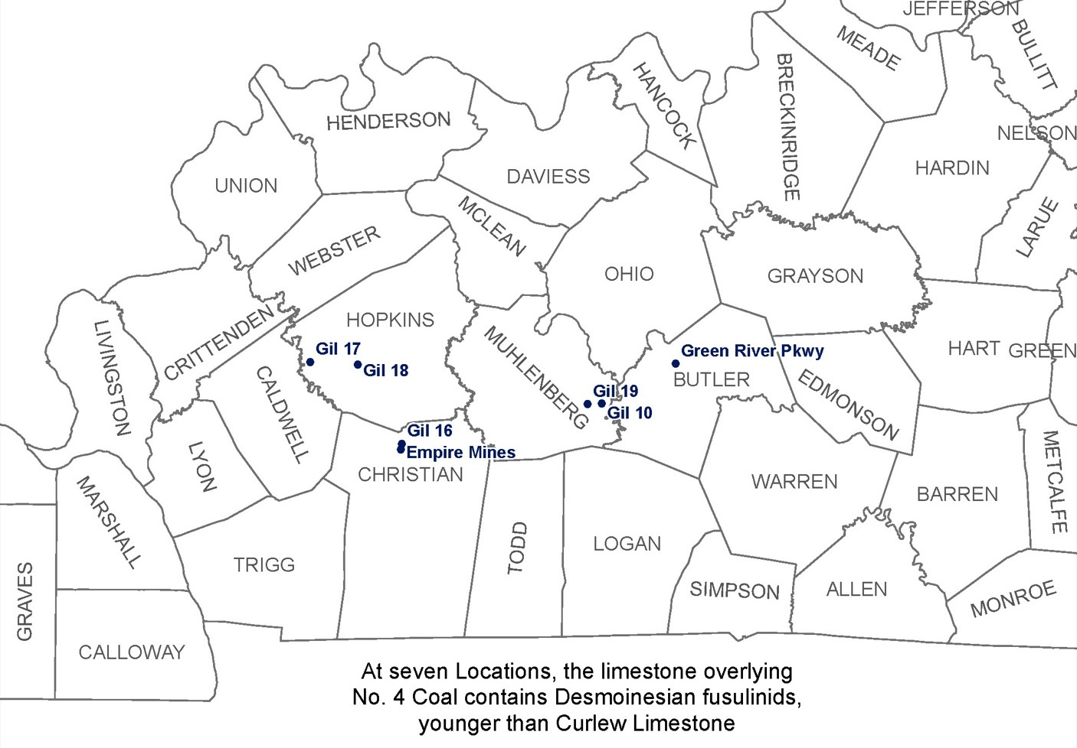
Western Ky. No. 4 coal has been widely mapped underlying the Curlew Limestone which is latest Atokan or earliest Desmoinesian. However, fusulinid studies by Douglass (1987) indicate the limestone overlying No. 4 coal is actually younger than the Curlew.

Slide 16
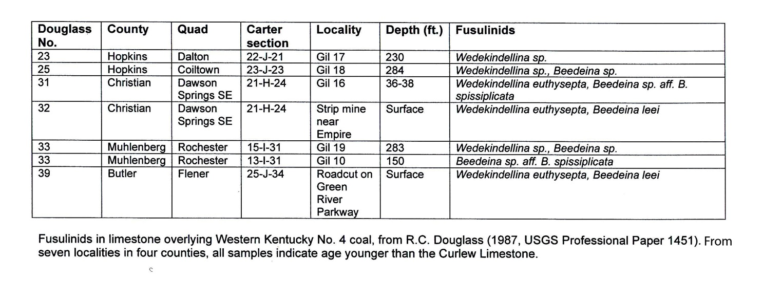
Fusulinids in limestone over W.K. No. 4 coal
Specifically all of the above are early Desmoinesian fusulinids.

Slide 17
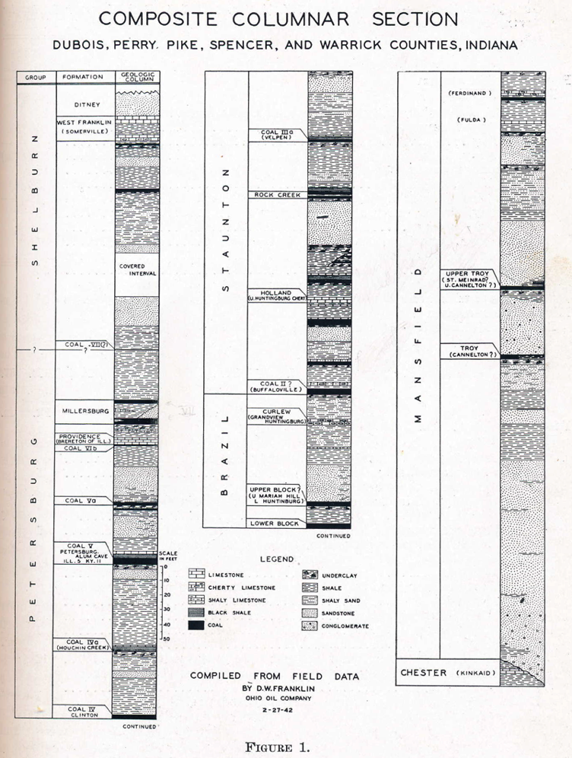
Composite section (Holland limestone)
Section from Franklin and Wanless (1944).
Holland

Slide 18
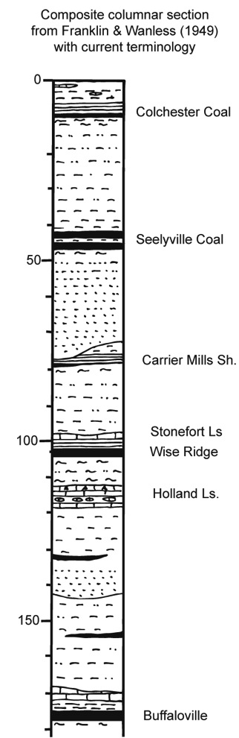
Stratigraphic column – type Holland
Also from Franklin and Wanless (1944), but with modern unit names. The Holland is a locally occurring marine limestone that appears to be restricted to estuaries beneath the Wise Ridge coal.

Slide 19
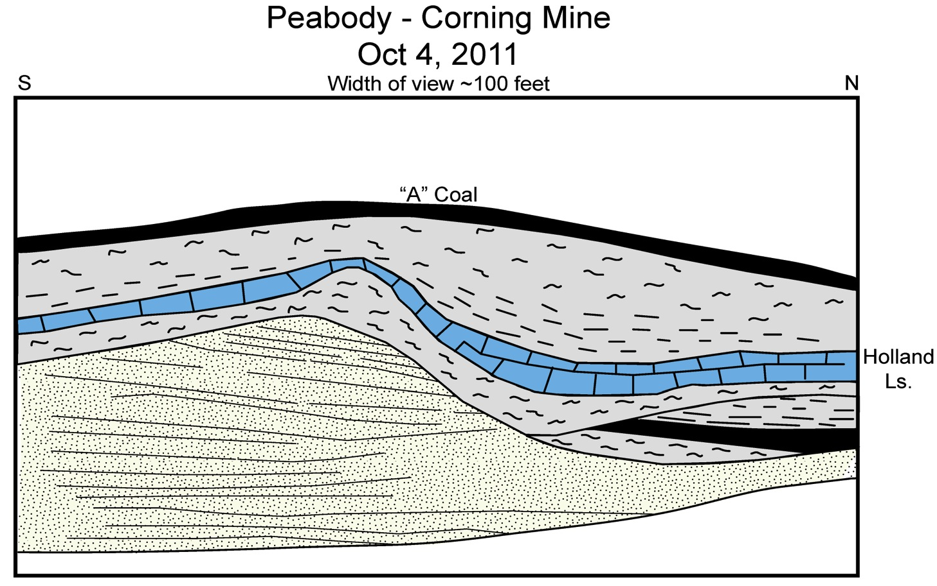
Holland limestone at Corning mine, Daviess Co.
From, Daviess CO. about 30 miles to the north of the type area. The limestone is highly localized within the mine.

Slide 20
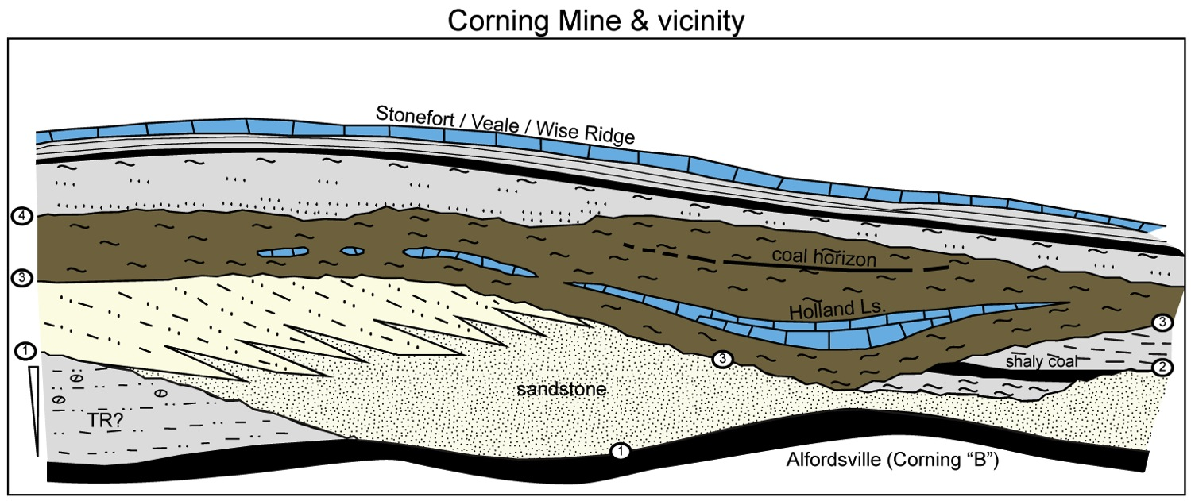
Holland limestone at Corning mine
From, Daviess CO. about 30 miles to the north of the type area. The limestone is highly localized within the mine.

Slide 21
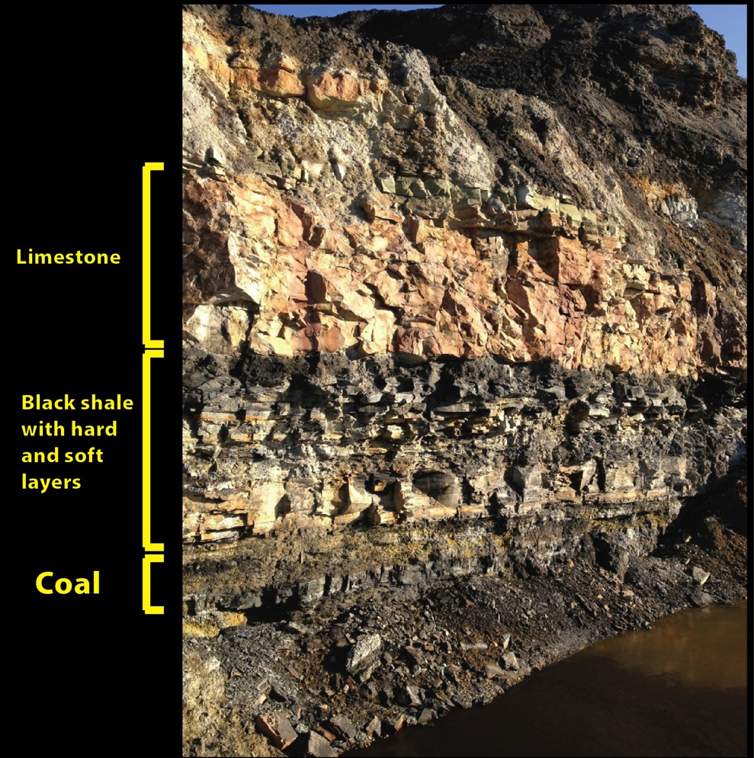
Carrier Mills shale and overlying limestone – Antioch Mine, Daviess Co.
Core through the type area of the Carrier Mills Shale, many miles to the south west, contains Gondolella pulchra acme zone in its middle beds

Slide 22
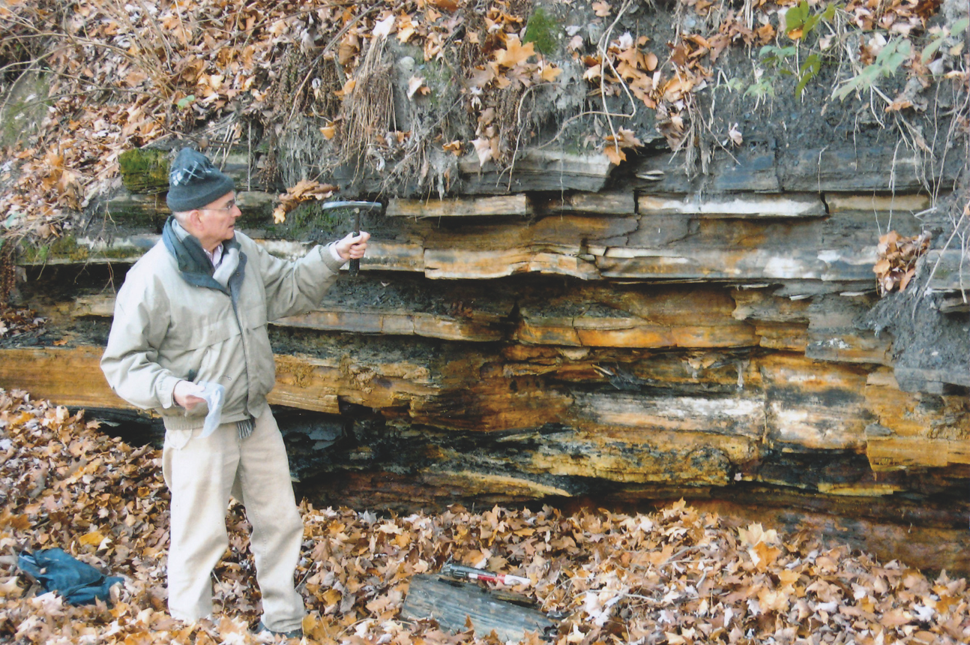
Carrier Mills shale
West of Rockville in Parke Co., IN. Zangerl and Richardson called this the Logan Quarry Shale. The alternating hard and soft layers are diagnostic of this unit. Gondolella pulchra acme zone occurs in the middle beds at the the level of the hammer handle. Phil Heckel for scale.

Slide 23
Conodont localities across the Illinois Basin and Midcontinent at the level of the Carrier Mills shale.

Slide 25
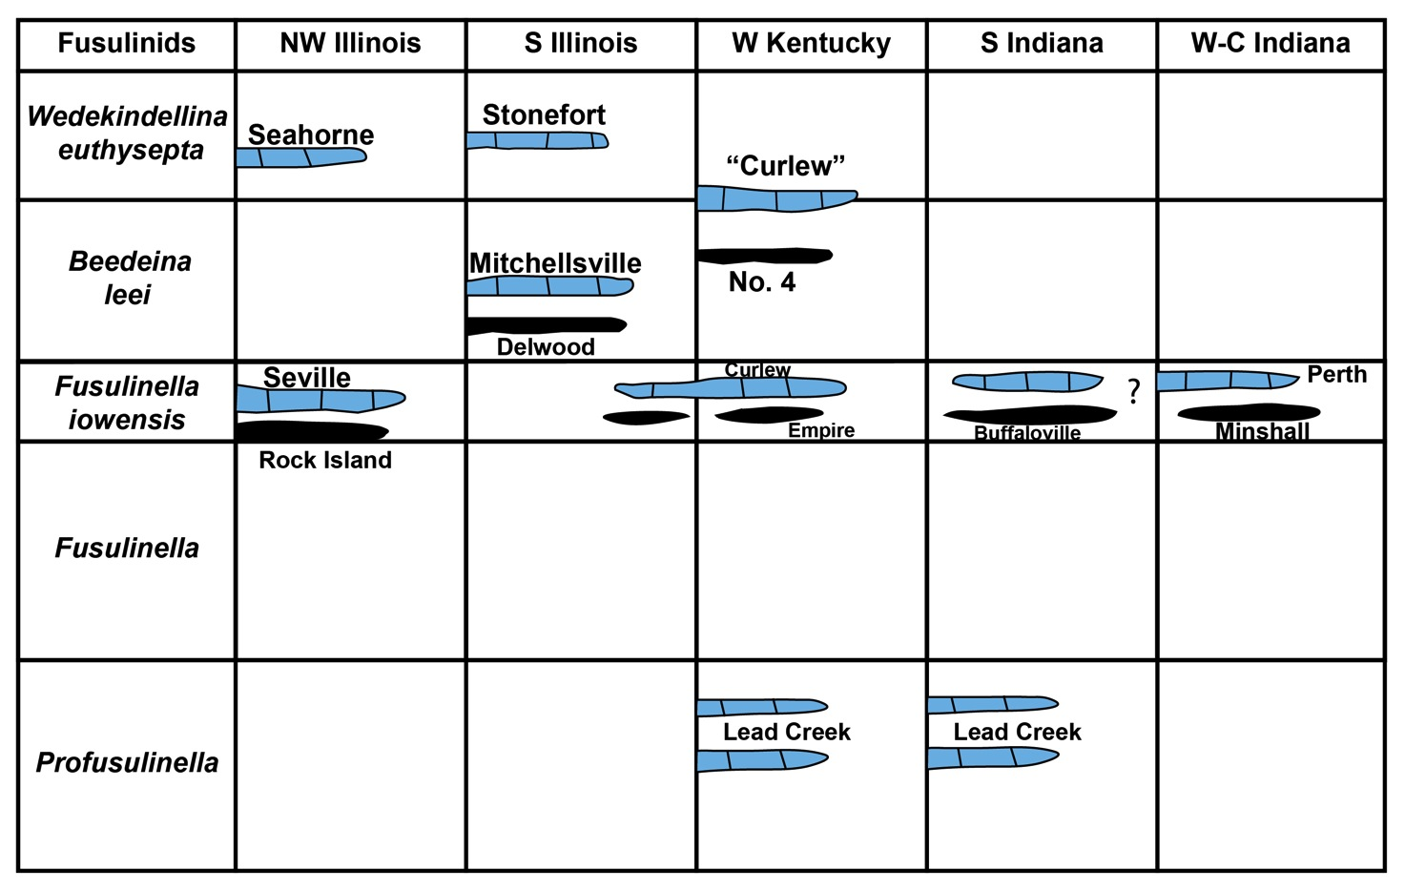
Regional correlations - Fusulinids

