Slide 1
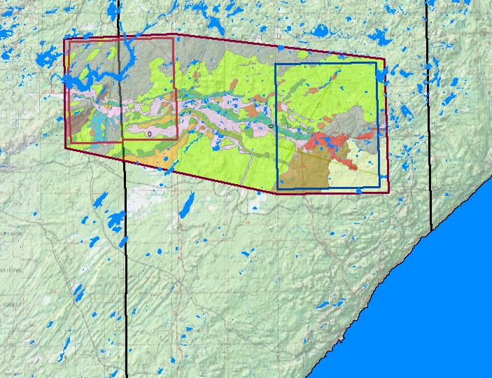
OVERVIEW OF MAPPING AREA
Notes:
2 pilot areas were selected as a test for mapping in a new area. In the end, an envelope around and between the pilot areas was mapped too.

Slide 2
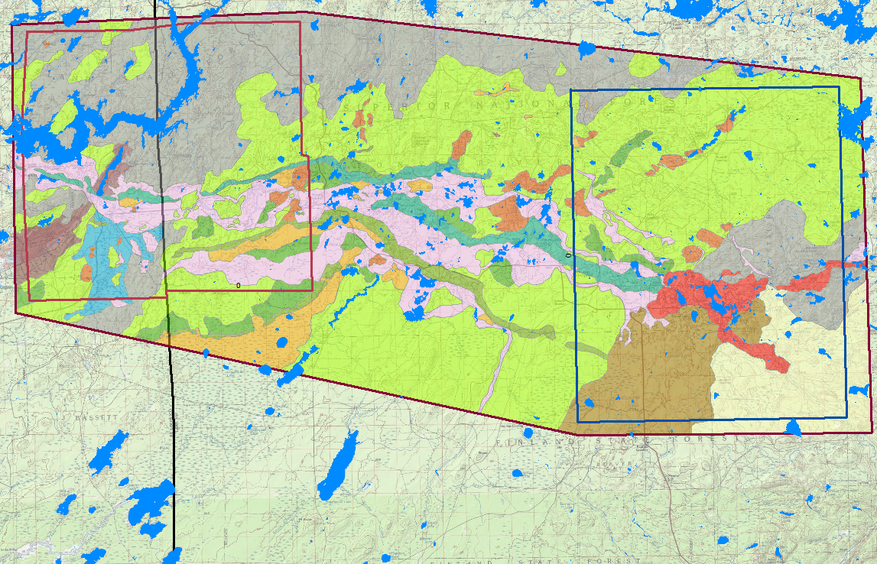
Pilot areas and surroundings
Notes:
This map shows the intersection between the Highland moraine of the Superior lobe and a set of Rainy lobe moraines, including the Vermilion moraine, the last recessional moraine south of the Canadian border. Most of the area is north of the continental divide, so meltwater can no longer flow south. It is diverted west along the retreating margin of the Rainy lobe, and eventually flows into Lake Agassiz.

Slide 3
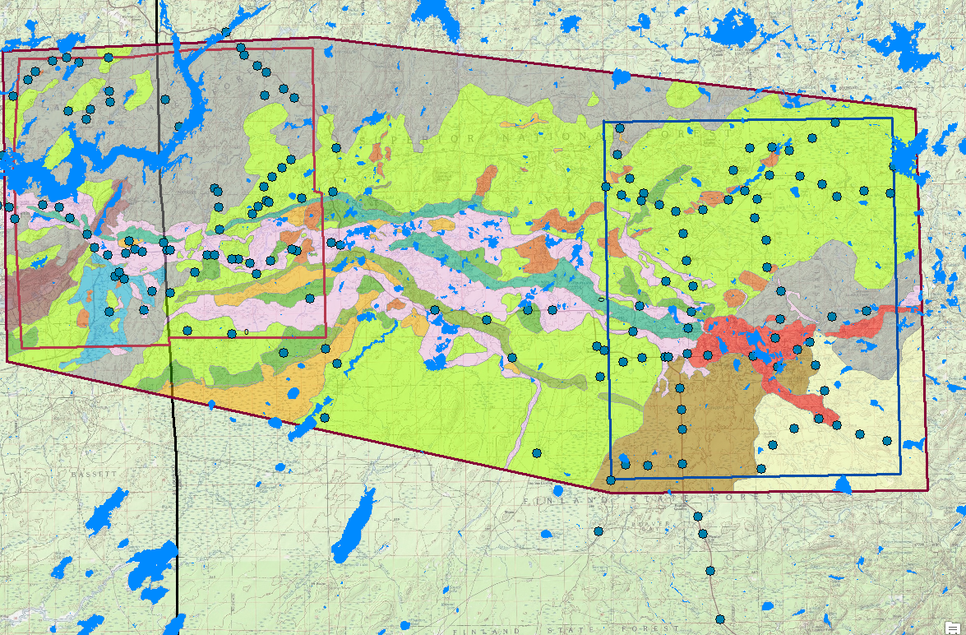
PASSIVE SEISMIC POINTS
Notes:
Passive seismic relies on natural vibrations within the earth from various sources. Here, it is mainly used to estimate depth to bedrock. It generally agrees with other data sources, but has given some anomalously deep estimates in places.

Slide 4
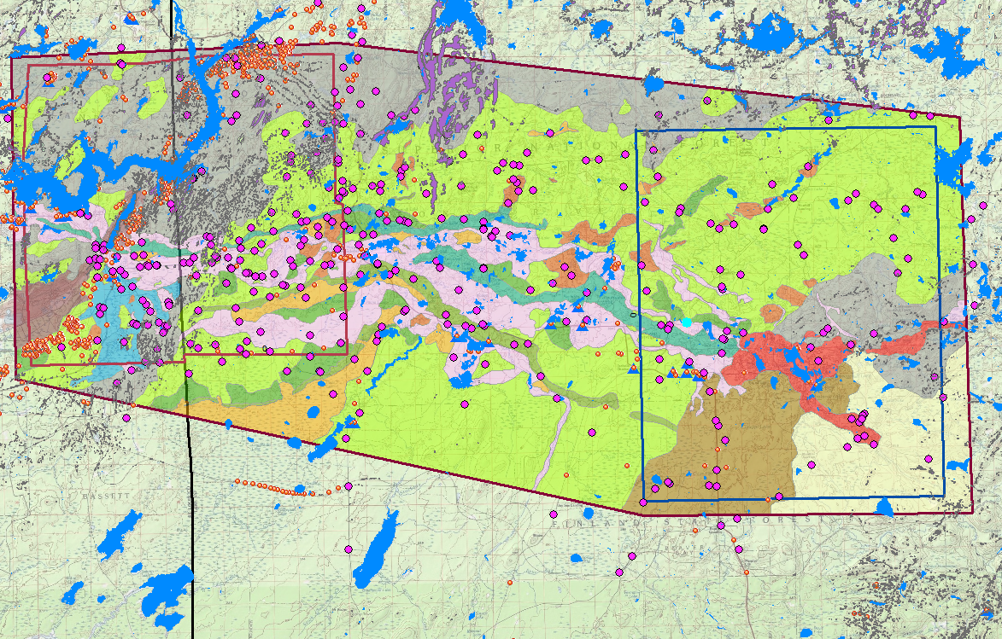
OUTCROPS AND DATA POINTS
Notes:
Outcrops are outlined in black. Well logs are red-orange circles; most of these are mineral exploration borings. Magenta circles are surface exposures and shallow soil borings.

Slide 5
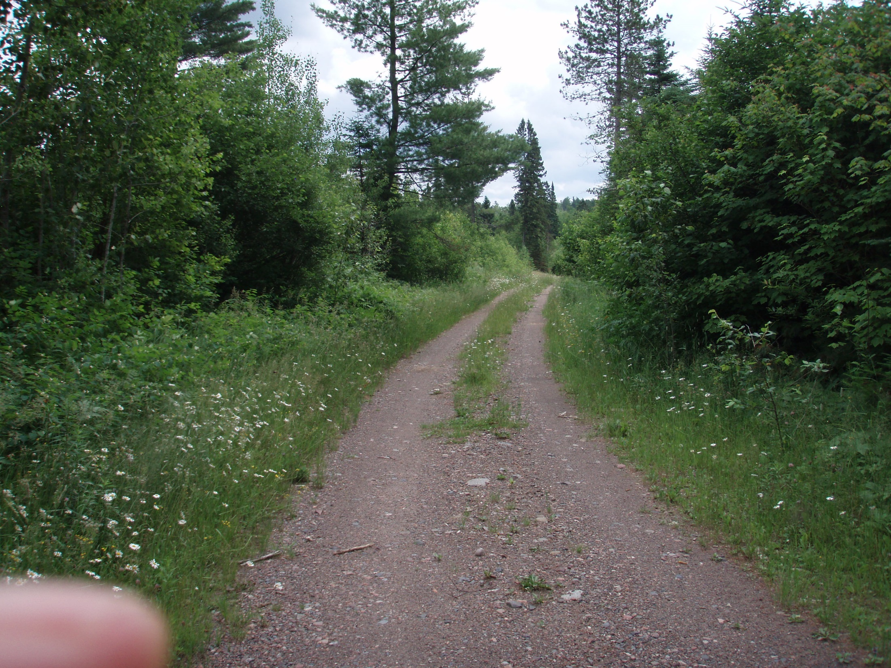
GOOD NATIONAL FOREST ROAD
Notes:
The road network is a major limitation to field mapping in this area. Here is a relatively smooth, “high-speed” road.

Slide 6
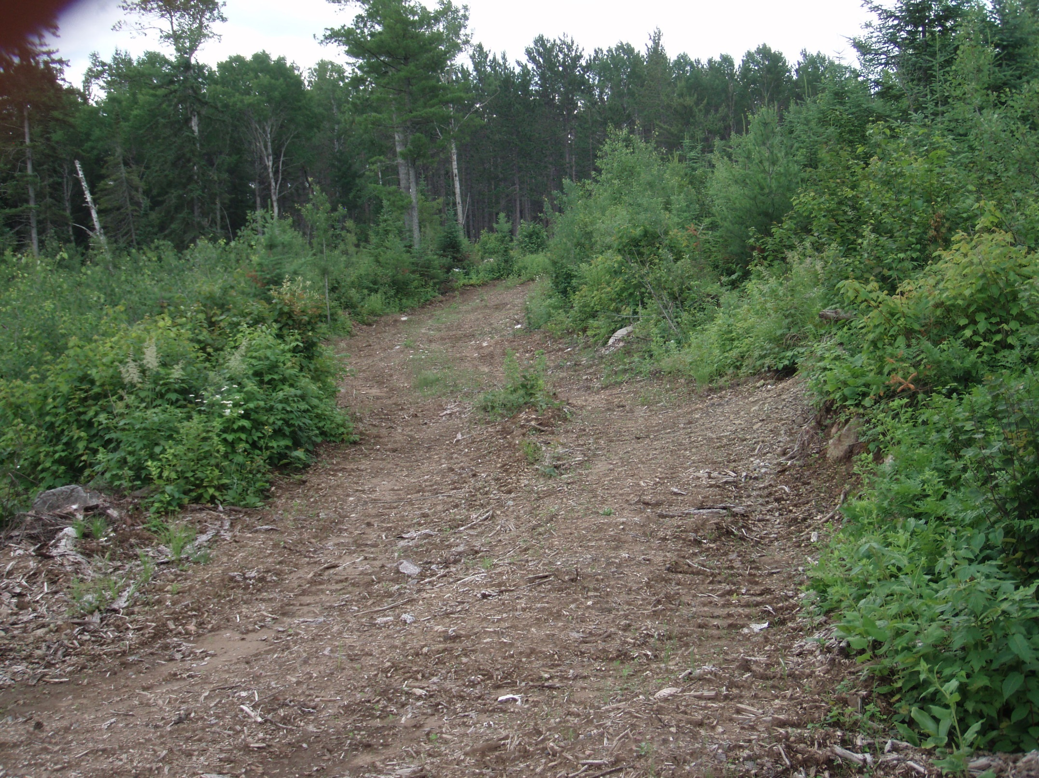
BAD ROAD
Notes:
A recent logging road. Drive slowly and with care. Most of these are blocked off again as soon as the timber is taken out.

Slide 7
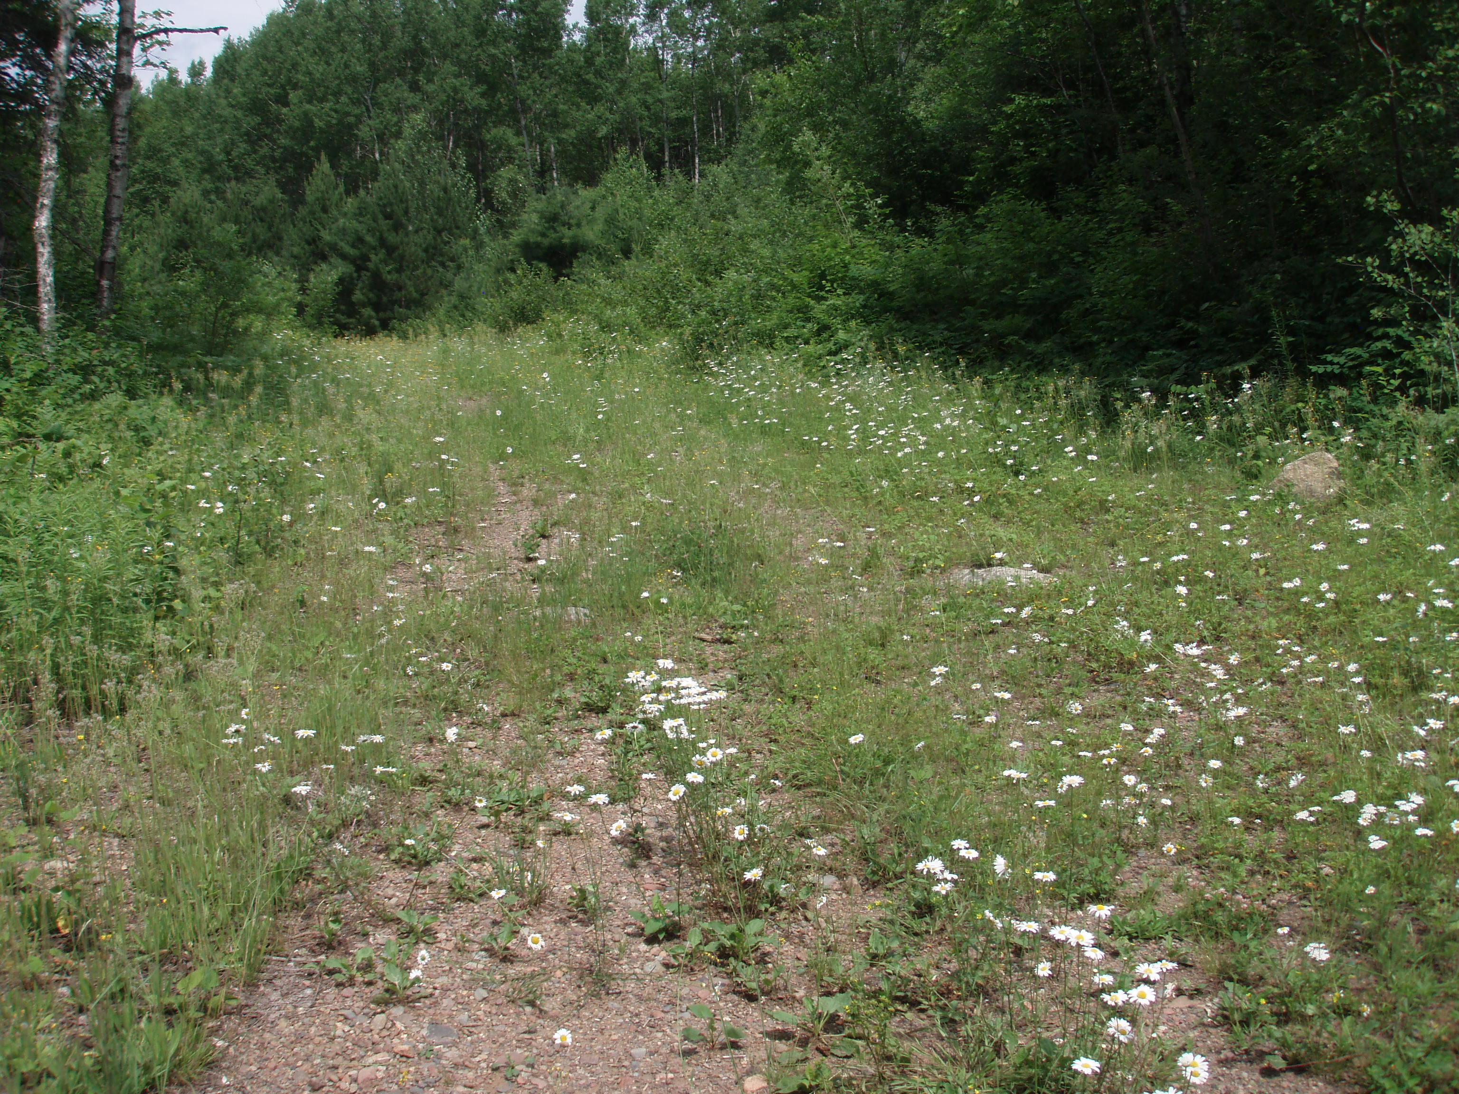
THE ROAD LESS TRAVELED BY
Notes:
This one looks pretty good from the main road, but hardly traveled. Roads like this never get better, but only worse the farther you drive.

Slide 8
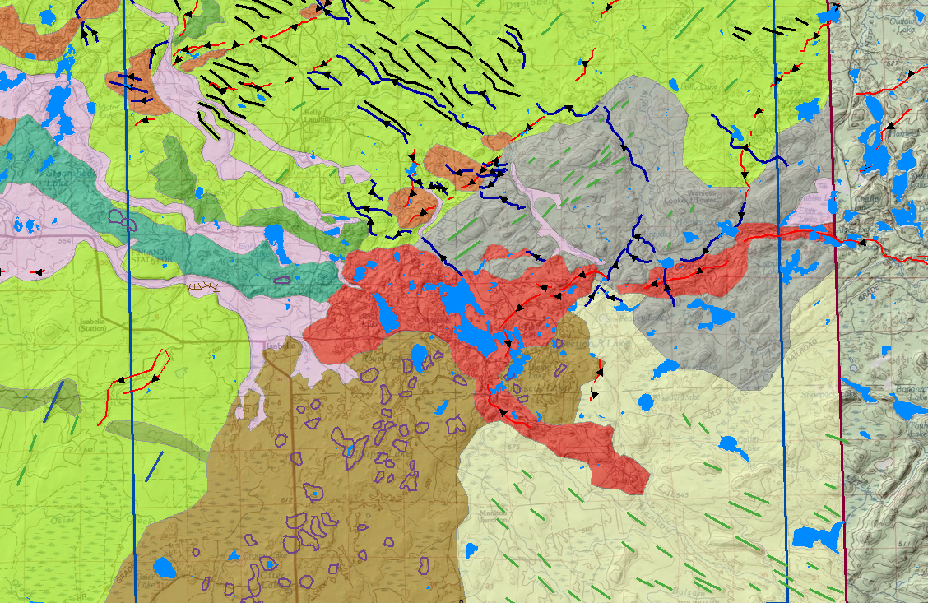
ISABELLA AREA
Notes:
Straight line segments (flutes and drumlins) show flow directions, almost at right angles. Many ice-walled lake plains in the Highland moraine, and a few in the Vermilion moraine. Red in the center is a huge area of collapsed ice-contact sand and gravel from the Superior lobe, fed by two main esker systems. This in turn feeds several outwash flow paths (pink) going west.

Slide 9
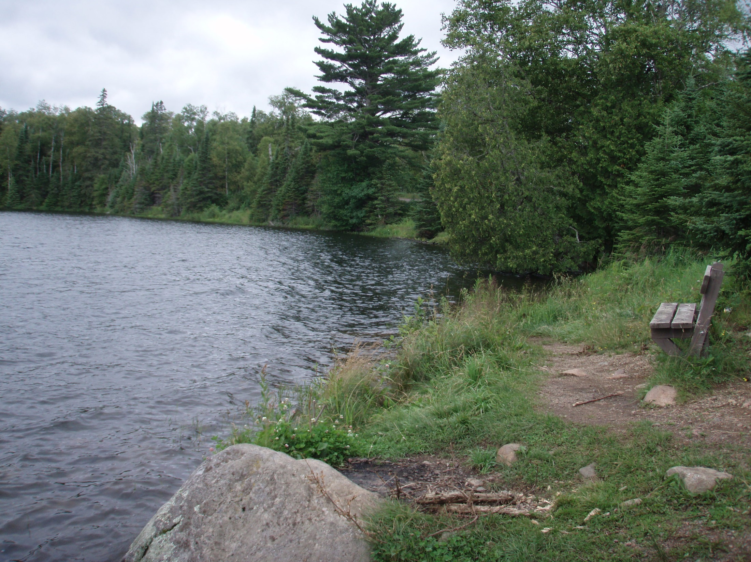
DIVIDE LAKE
Notes:
Divide Lake is in the center of the big area of collapsed ice-contact sand and gravel. Some of the clasts are huge, indicating a high-energy system.

Slide 10
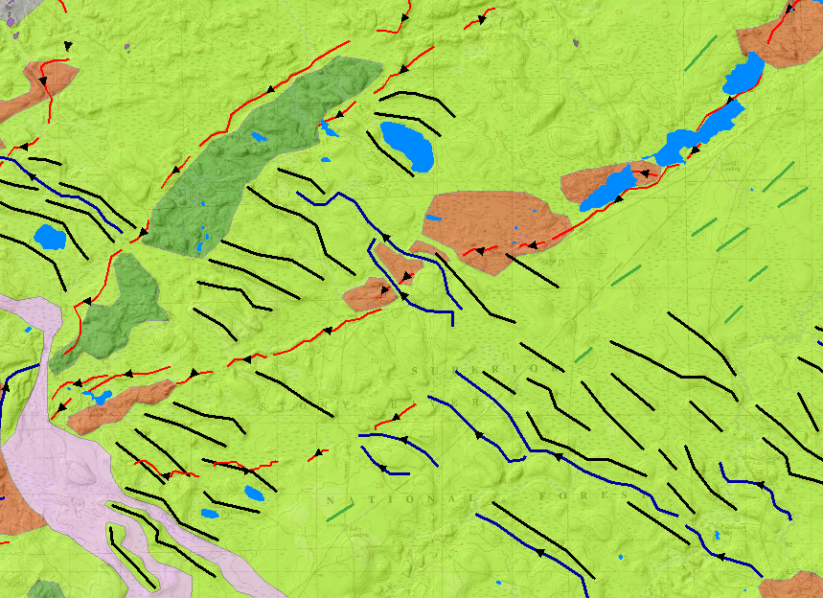
ESKERS, FLUTES AND ROGEN MORAINE
Notes:
Rogen moraine forms at right angles to ice flow. Drumlins (or in this case flutes) and eskers form parallel to ice flow. Rogen moraine is rare in Minnesota. The ridges formed all at once under the glacier and do not reflect individual ice margins. Minor flowpaths from the Superior lobe follow the swales between the ridges.

Slide 11
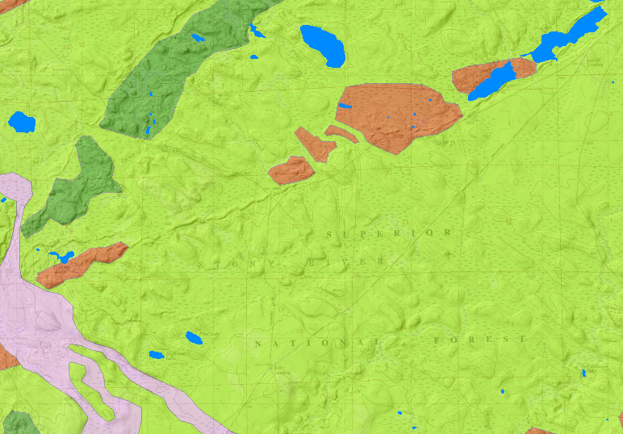
LIDAR, NO SYMBOLS
Notes:
Don’t take my word for it…see the landforms for yourself. The topography on topo maps is not resolved well enough to make this kind of map. LiDAR shows the detail that you need.

Slide 12
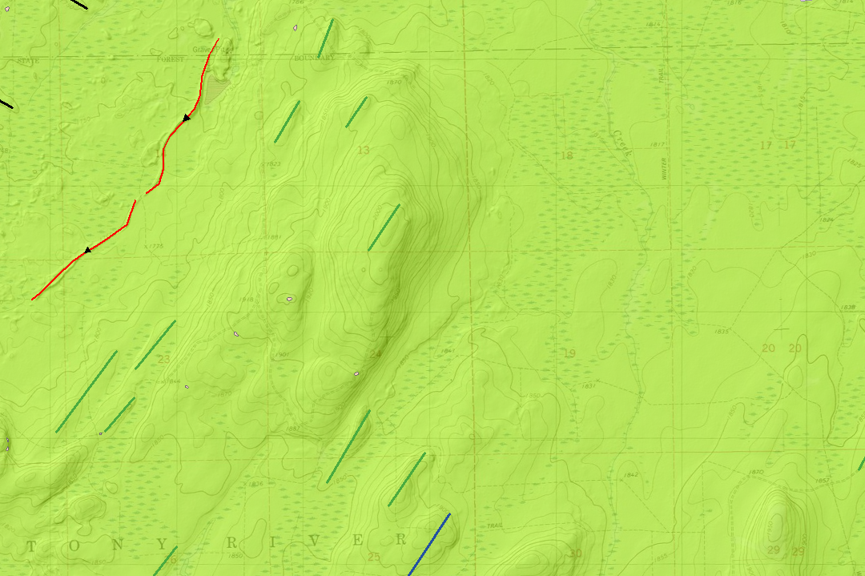
DRUMLINS…OR FLUTES?
Notes:
On a topo map, this looks like a drumlin—the northernmost of the Toimi drumlins. When you look at it up close, it looks like a cluster of flutes rather than a big drumlin. I placed the flute symbols on the more obvious streamlines, but the whole landform is more or less streamlined

Slide 13
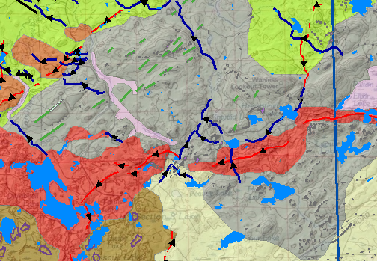
NEAR-SURFACE BEDROCK
Notes:
Area in gray is mapped as near-surface bedrock. Distinguished geomorphically by bedrock structural elements, esp. long straight joints. Surface has been reshaped by glacier sliding.

Slide 14
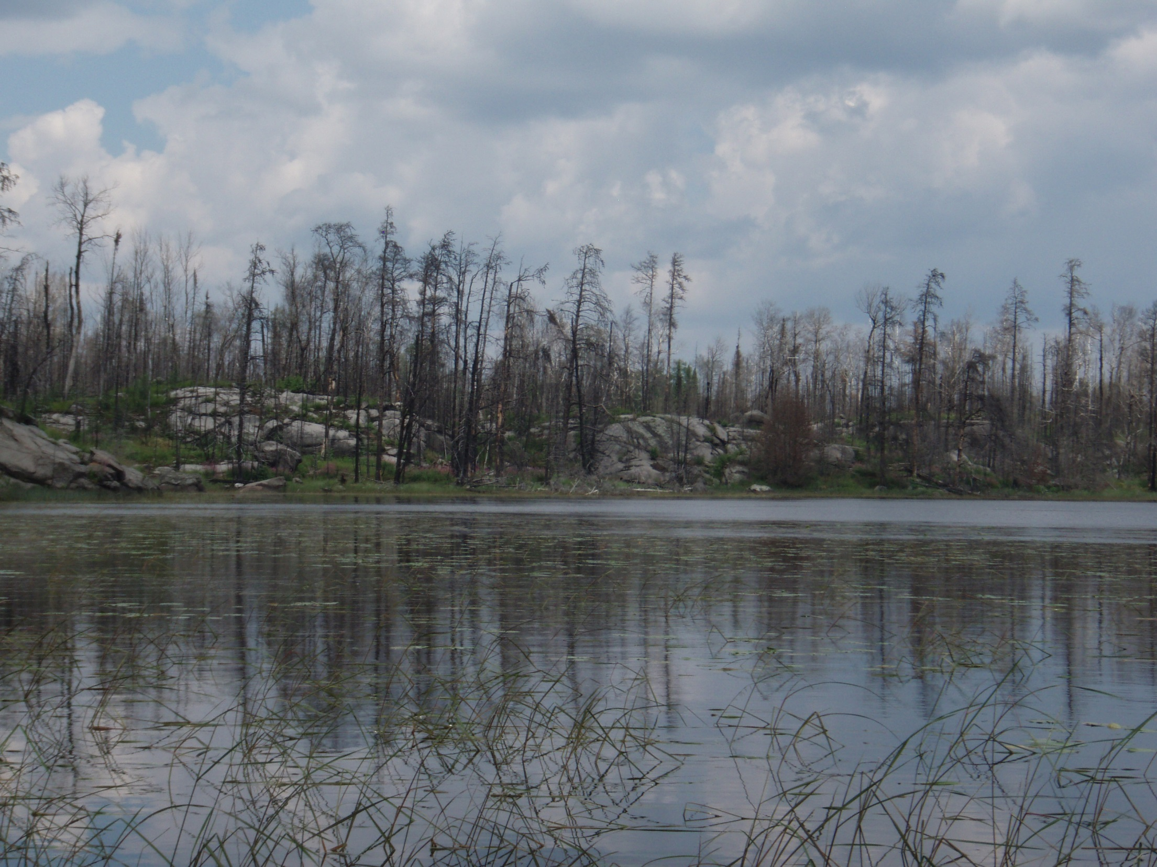
BEDROCK KNOBS IN BURNED AREA
Notes:
The burned area is north of my mapping area, but it’s a good example of what you can see when the trees, moss and brush are burned off. The knobs are bare, but the low places in between have some drift or weathered rock. Big bedrock joints have very thick fills in places.

Slide 15
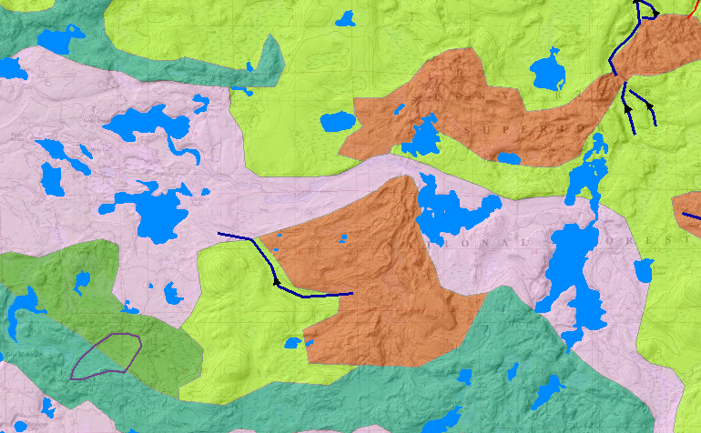
SUPERIOR OUTWASH
Notes:
In some places the outwash is fairly flat with visible channel scars. Other places are highly collapsed; here, the outwash must have been deposited over stagnant ice left behind by the retreating Rainy lobe. In places the outwash is a cobble gravel, indicating very high flow velocity.

Slide 16
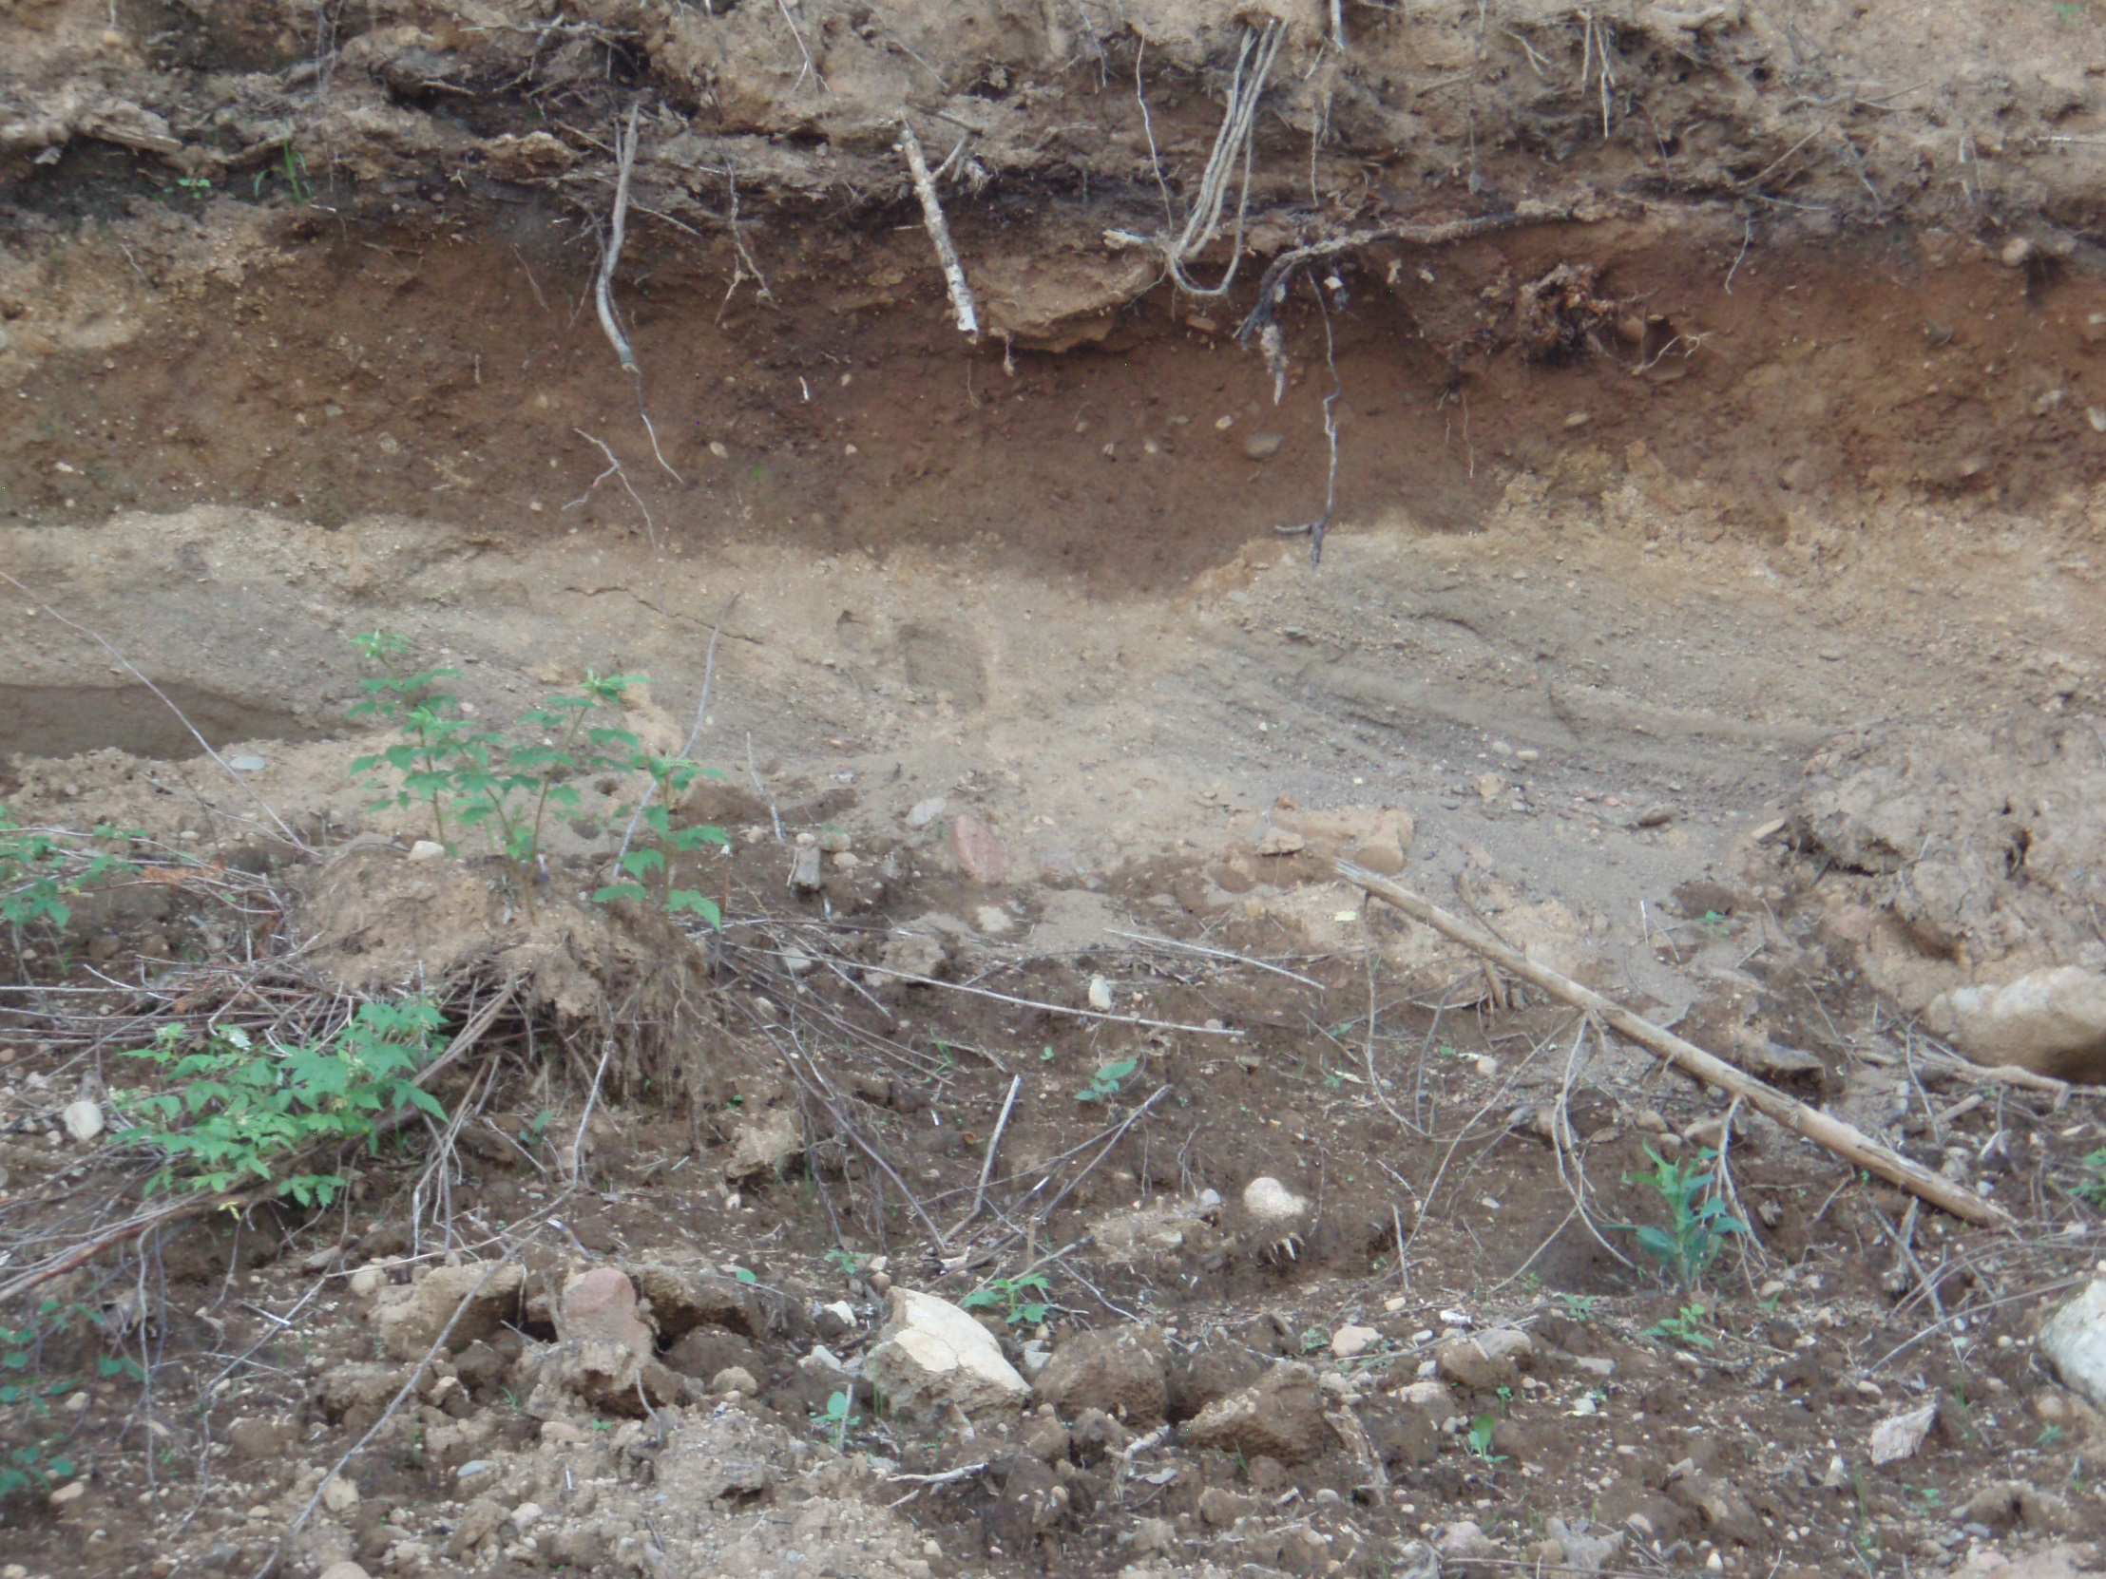
LOESS-COVERED SUPERIOR OUTWASH
Notes:
This is a minor outwash draining the Highland moraine; not as coarse as the outburst-type flows. Covered by a loess of silt and fine sand.

Slide 17
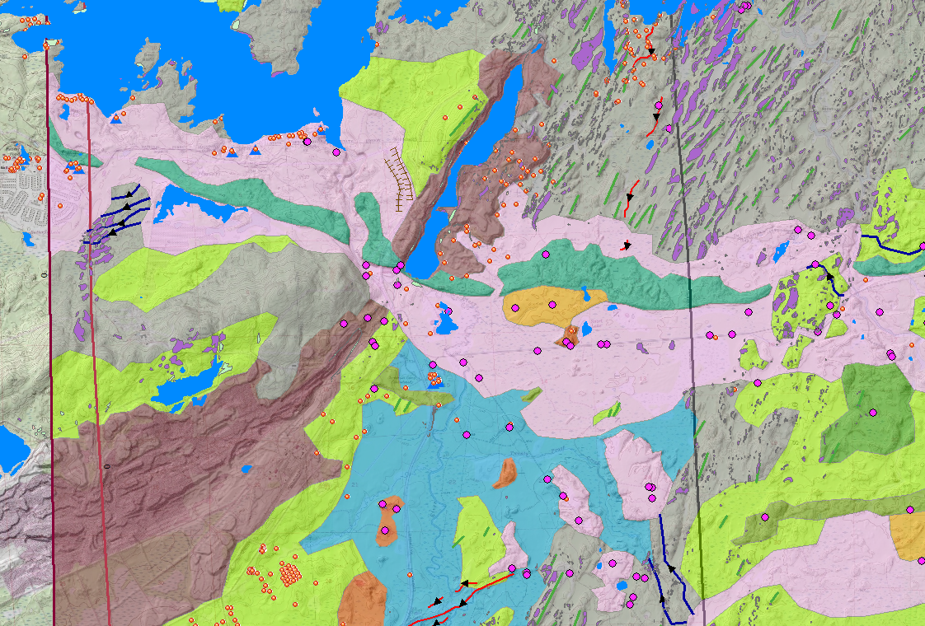
GLACIAL LAKE DUNKA
Notes:
Lake bottom sediments are in dusty blue. Typically fine red sand and silt; red color indicates Superior provenance. Contemporary deltas (pink) are red sand and fine gravel. As the lake drained, Superior outwash covered part of the lake bottom on its way through a gap in the Giant’s Range. Brown is pits and dumps from iron mining.

Slide 18
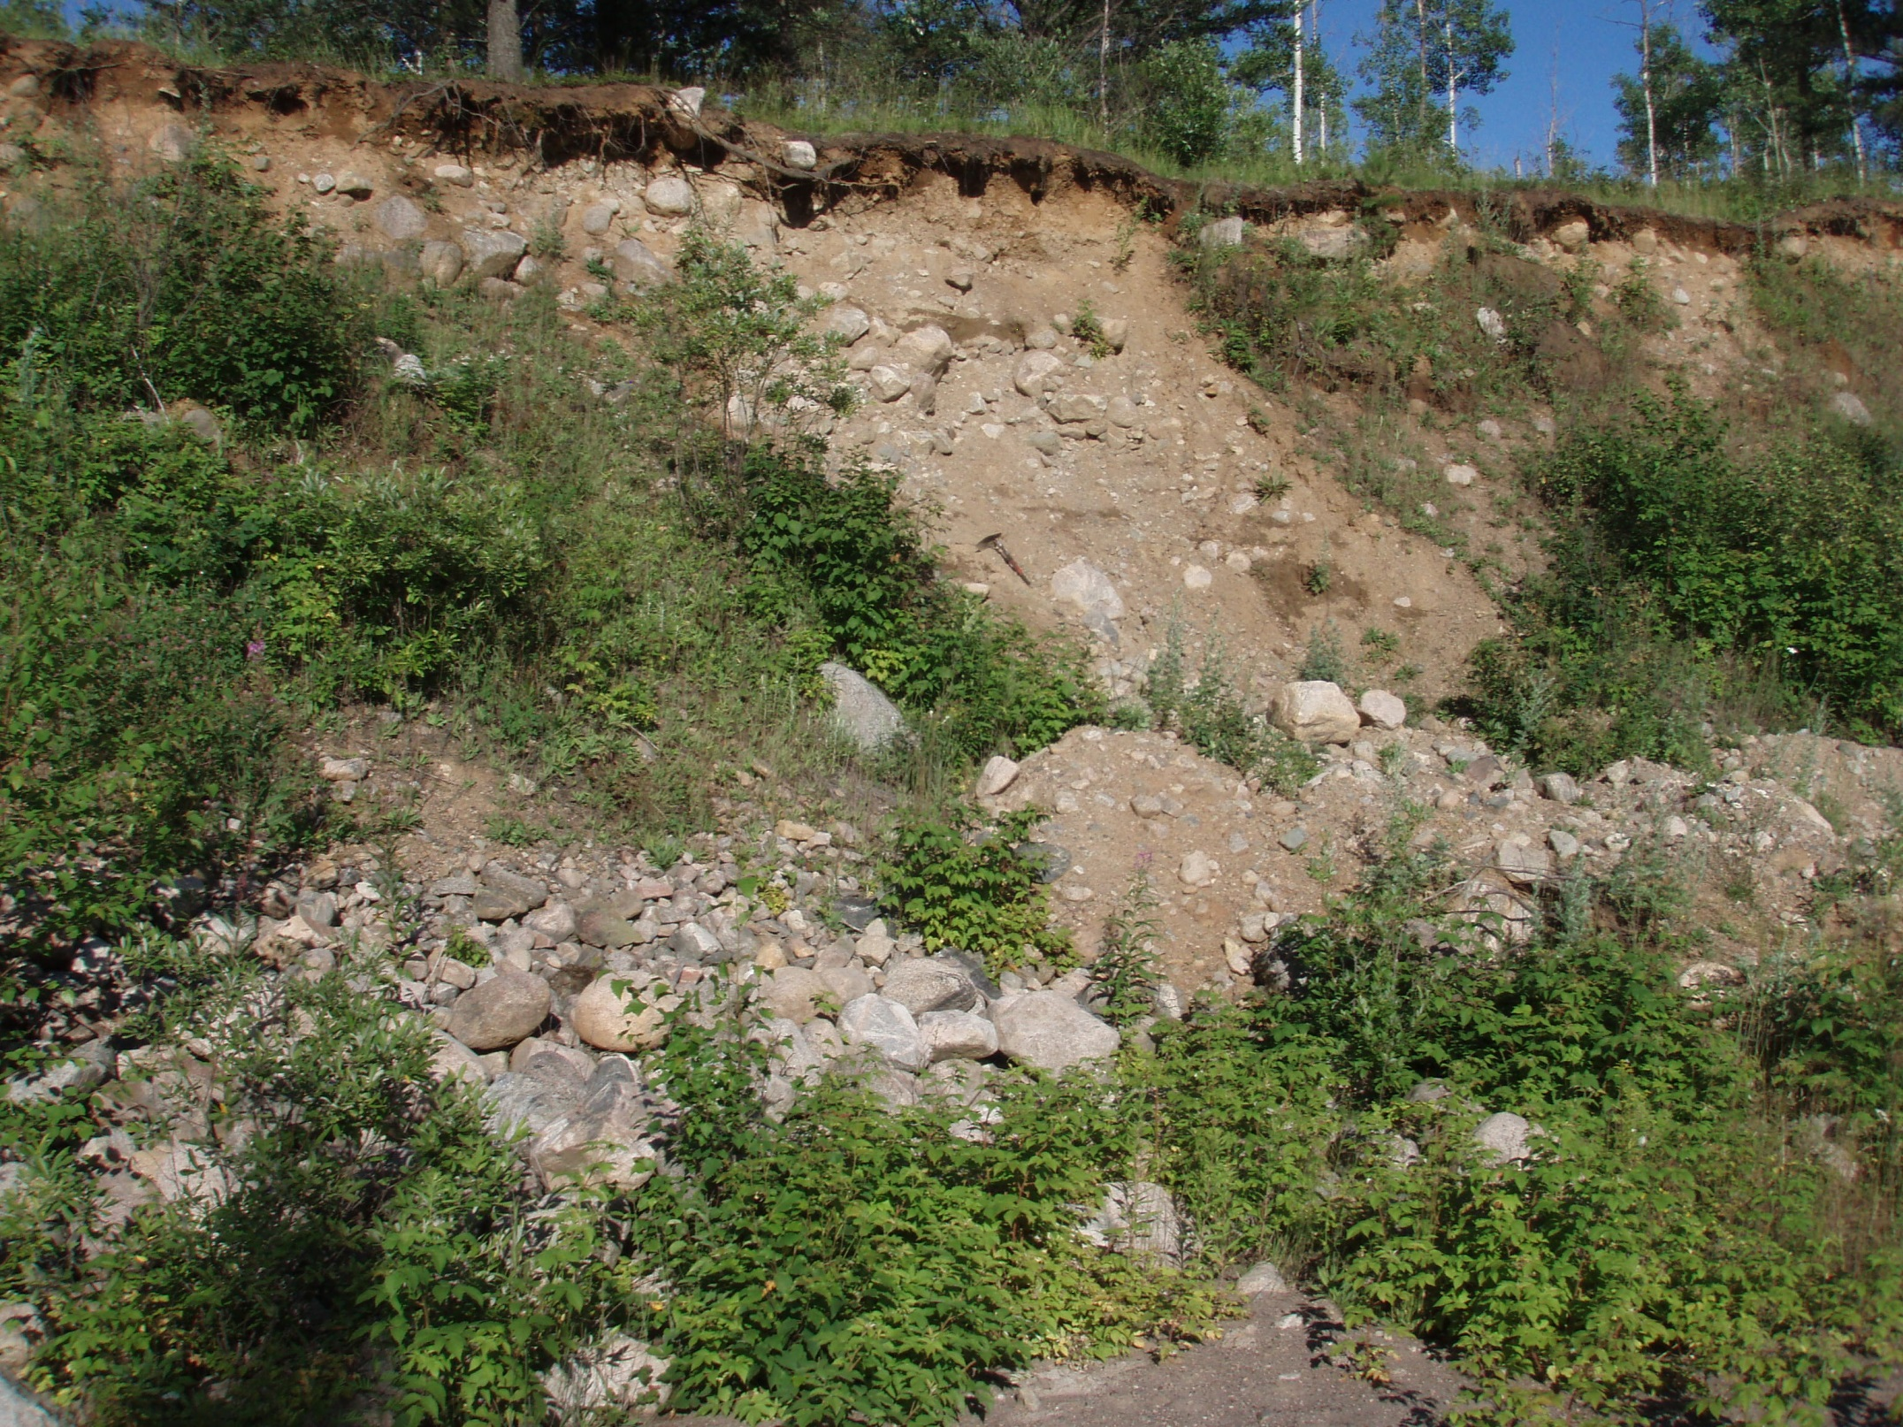
VERMILION MORAINE NORTH OF BABBITT
Notes:
Moraine sediment here is extremely coarse, with lots of boulders and mega-boulders; almost all derived from Canadian Shield. Very crudely sorted in places.

Slide 19
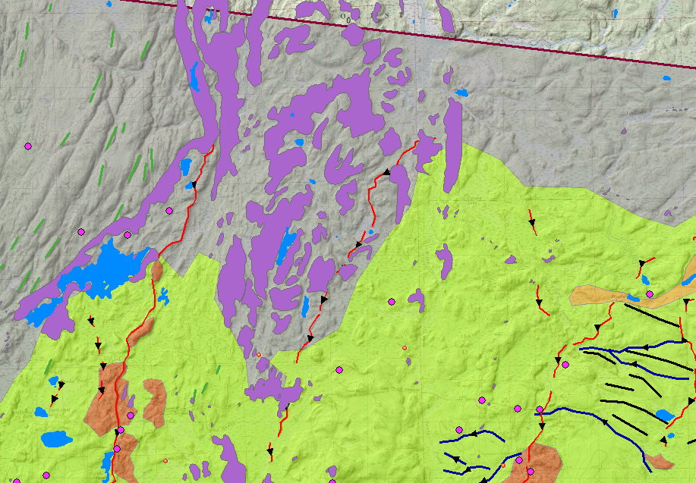
BALD EAGLE INTRUSION
Notes:
The Bald Eagle Intrusion is well-exposed in outcrop, and has been well-studied by geologists. The outcrop pattern provides sort of a test to my line between Rainy subglacial till and near-surface bedrock.

Slide 20
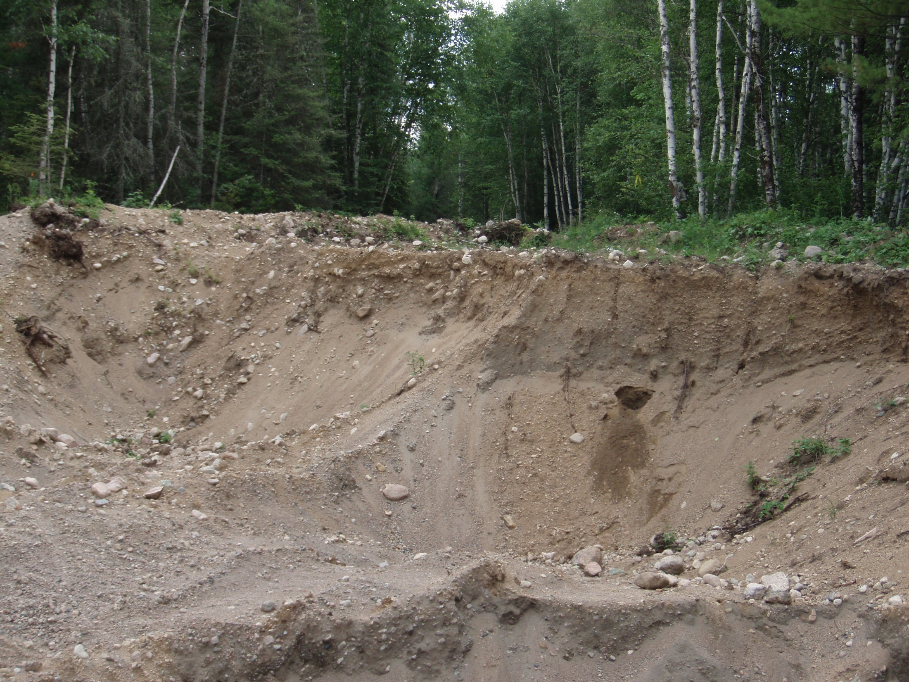
RAINY LOBE OUTWASH
Notes:
This outwash is rocky, but mega-boulders are missing. Weathered surface has been scraped off.

Slide 21
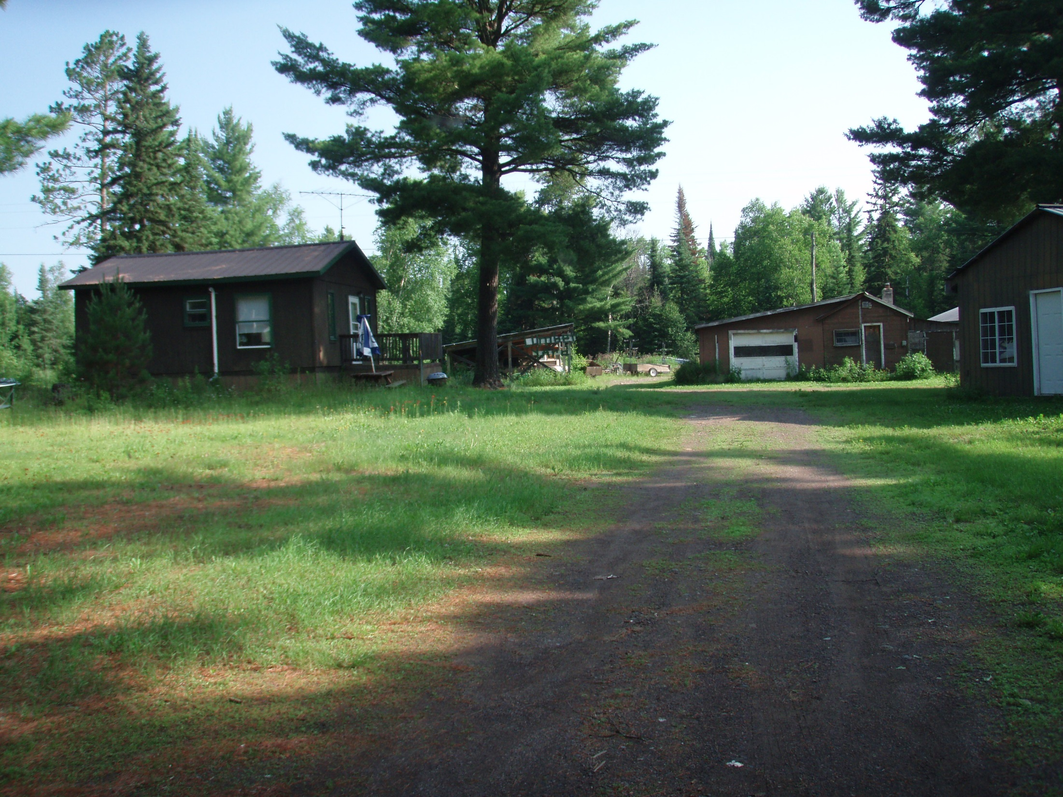
KNOTTED PINE CABINS
Notes:
Could also be called “Mosquito Haven” (despite being on an outwash plain)

Slide 22
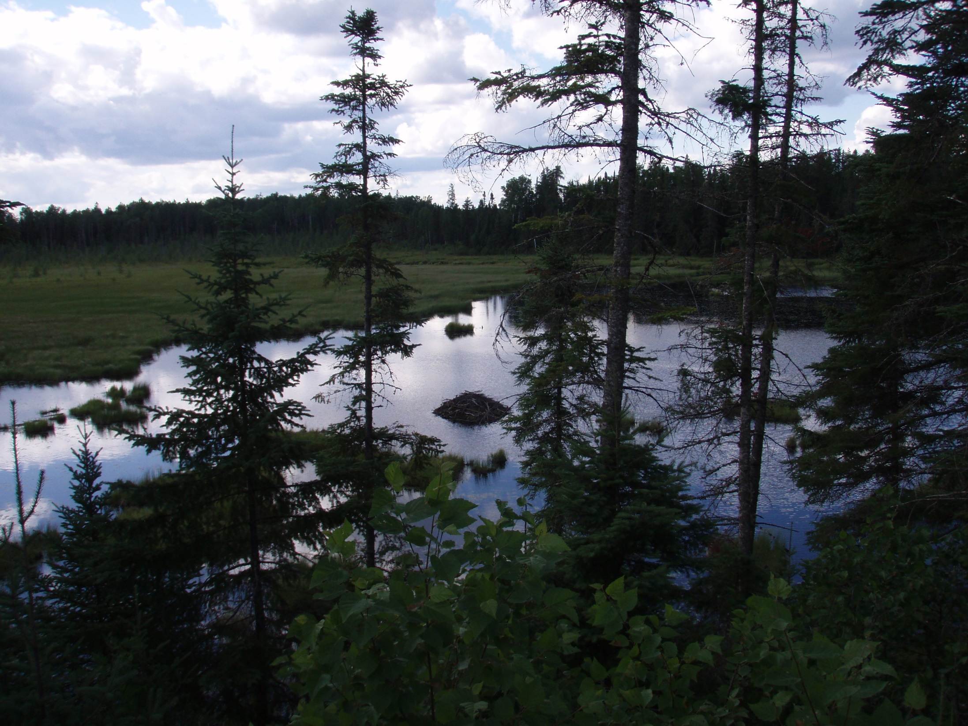
BEAVER POND IN TWILIGHT
Notes:
No sunset shot from the Arrowhead, but this will have to do.

