Slide 1
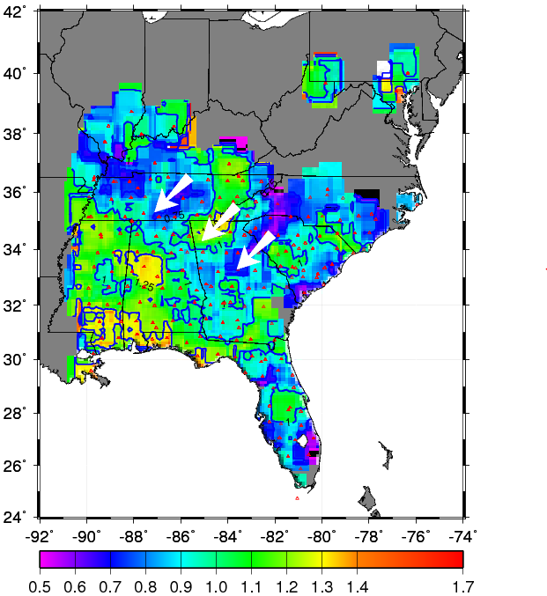
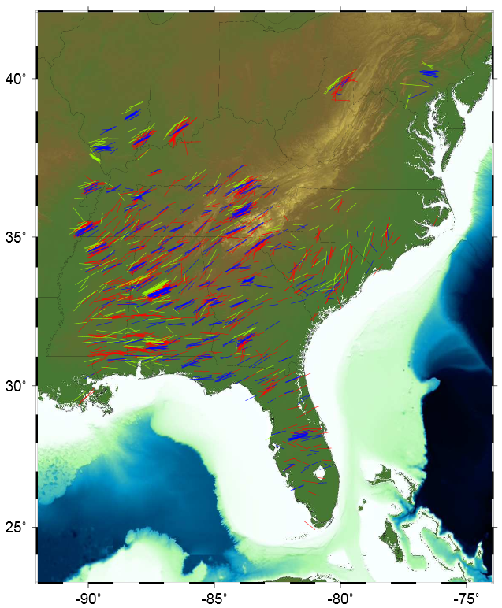
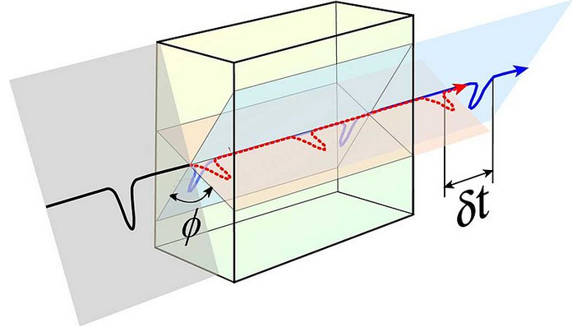
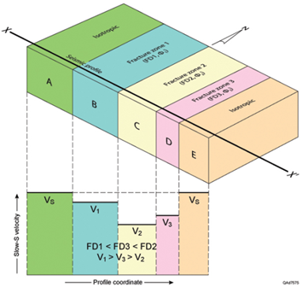
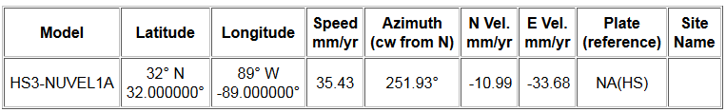
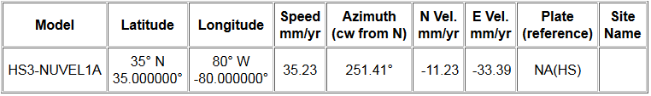
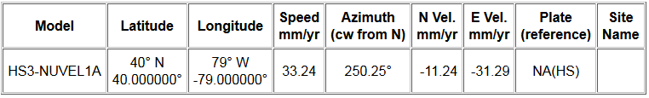
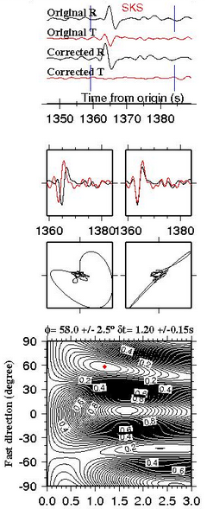
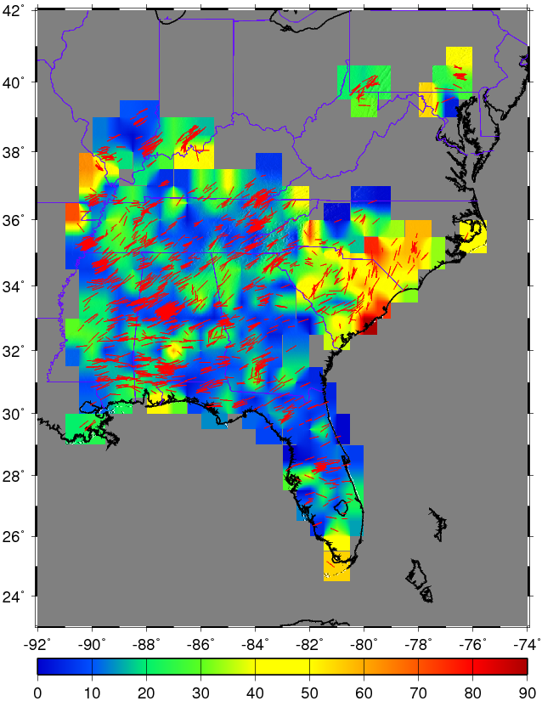
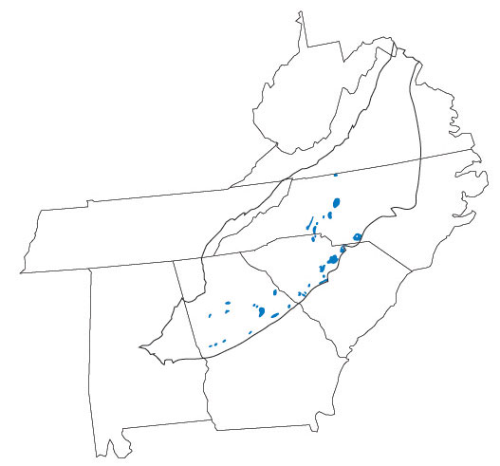
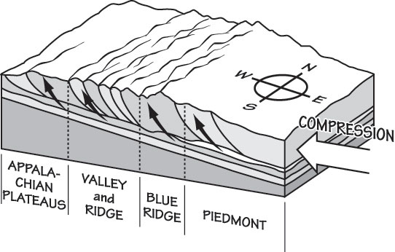
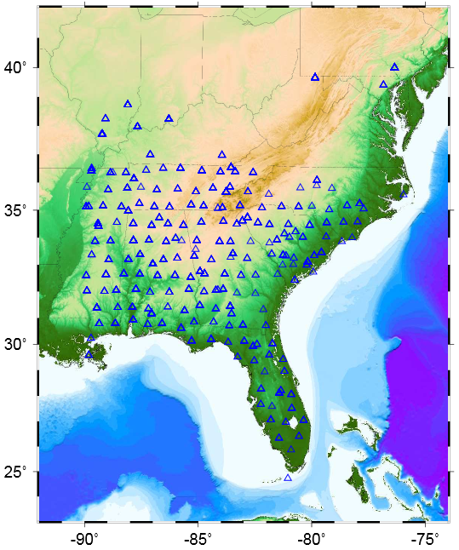
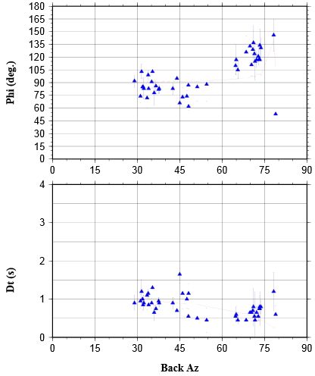
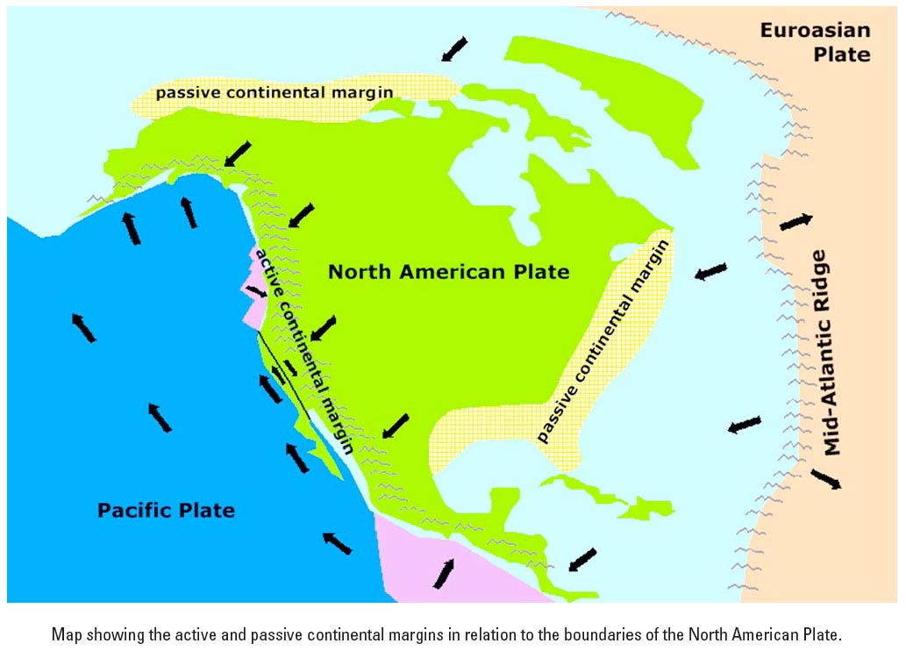
Seismic Anisotropy Beneath the Southeastern United States:
Influences of Mantle Flow and Tectonic Events
Wanying Wang* (Advisor: Dr. Stephen Gao)
Department of Geological Sciences and Engineering, Missouri University of Science and Technology *ww53f@mst.edu
Summary
The main purpose of the research is to investigate the interior structure beneath the southeastern United States (90°W~75°W, 42°N~24°N) by using the shear-wave-splitting technique, which provides constraints to characterize the mantle flow direction and strength of anisotropy. At most stations, the detected polarization directions of the fast wave are approximately parallel to the absolute plate motion (APM) direction of the North American plate, suggesting a coupling between the asthenosphere and the lithosphere. The similarity between the Appalachian Mountain’s strike and the fast directions, and the significant differences between APM direction and the fast directions at the eastern margin indicate a contribution of anisotropy from lithospheric deformational processes. The splitting time between the fast and slow shear waves, which can be utilized to characterize the strength of anisotropy, shows systematical distribution through the study area. The study confirms the contribution of both fossil fabrics in the lithosphere and present mantle flow in the asthenosphere to the observed seismic anisotropy.
Data and Method
Results
Fig. 10. The distribution of splitting times. Green to red indicates values larger than 1.0s. Blue to purple indicates values smaller than 0.8s. The larger values and smaller values shows alternately linear distribution. Arrows highlight the pattern.
Fig. 2. Shear-wave splitting phenomenon . There are two resulting splitting parameters that can indicate the orientation and strength of seismic anisotropy accumulated along the ray path, the polarization direction of the fast wave (fast direction) and the arrival time difference between the fast and slow waves (splitting time). The direction of fast wave is parallel to the A-axis of the anisotropy that causes the splitting.
Fig. 6. All measurements. The color red, green, and blue stand for phases of SKS, SKKS, and PKS, respectively. The length and direction of a segment indicate the splitting time and fast direction, respectively.
Fast orientation at the vicinity of the mountain range is parallel to the strike. According to Refayee, H.A., et al., (2013), the mantle flow direction is approximately the same as the fast orientation.
Fig. 2. http://garnero.asu.edu/
Fig. 3. The relationship between velocity of slow wave and the fracture density (Hardage, 2011). As fracture density increases, the velocity of slow wave decreases, while the velocity of fast wave doesn’t change much.
Conclusions
The resulting fast orientations show the influence of mantle flow. The orientations at the vicinity of the mountain range change as the strike changes, which indicates the influence of mountain building events.
Small differences between APM and fast directions dominate in this area. This shows that the coupling between lithosphere and asthenosphere is the main cause of the observed anisotropy.
The linear distribution of larger and smaller splitting time values indicates the influence of collisional events.
The area that has the largest values of splitting time is located approximately at the mountain range and might be the result of igneous intrusion.
Acknowledgements
IRIS DMC provides the data set used in this study. I appreciate Dr. S. Gao for enlightening me of the study of seismology. F. Kong provided me great help during the processing of this project. B. Yang helped me when digitizing Figure 8. The Missouri S&T OURE program funded this research.
References
Refayee, H. A., Yang, B. B., Liu, K. H., & Gao, S. S. (2013). Mantle flow and lithosphere–asthenosphere coupling beneath the southwestern edge of the North American craton: Constraints from shear-wave splitting measurements. Earth and Planetary Science Letters.
Hardage, B., (2011). Fracture Identification and Evaluation Using S Waves. Search and Discovery Article.
Fig. 7. Plate motion at three points. Calculated at http://www.unavco.org using HS3-NUVEL-1A model.
Fig. 4. Example of A-ranked measurement. This event was recorded by the station USINxx_NM. The upper three windows show the seismographs, the middle windows show the particle motions and the lower three show the possible range of parameters. The seismograph of this event shows obviously signals on original radial and original transverse components, and at on the corrected components, the energy transported from the transverse component to the radial.
Fig. 8. Differences between the fast orientations and the absolute plate motion of the North America plate (APM). The NE part of the study area is characterized by mostly NS fast directions and small splitting times, probably suggesting non-horizontal flow.
Background
The Southeastern United States suffered complex geological movements including compressional events, slab subduction and igneous intrusion. The compressional events happened since 480 million years ago rose the mountain chain. The igneous intrusion events also contributed to the mountain building. While these events could cause anisotropy, the exact anisotropy-forming mechanisms are still debated.
Fig. 1.1
http://geology.teacherfriendlyguide.org
Fig. 1.2. http://geology.teacherfriendlyguide.org
Fig. 9. Azimuthal variations of splitting parameters at the vicinity of SIUCxx_NM, locates at 37.7N, 89.22W. The optimal splitting parameters are (0.0, 1.10) for the lower layer and (87.0, 2.00) for the upper layer.
Fig. 1.1 Paleozoic mafic intrusion.
Fig. 1.2. The collisional event.
Fig. 1.3. The current plate motion.
Fig. 5. Distribution of 248 stations. 1,762 good measurements were chosen from a total of 18,686 events.
Fig. 1.3
http://www.geologycafe.com/class

