Slide 1
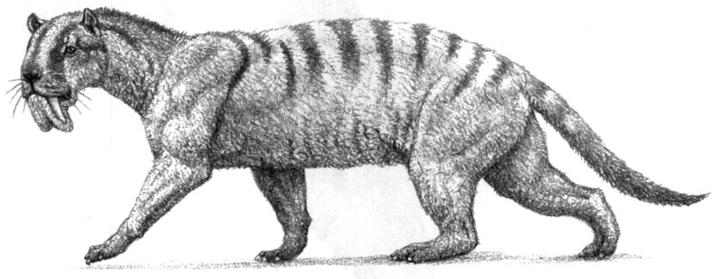
Using the Force: Forelimb robustness of Thylacosmilus atrox and other saber-toothed carnivores
Laurel Perper and John Orcutt
Cornell College
laurelsperper@gmail.com

Slide 2
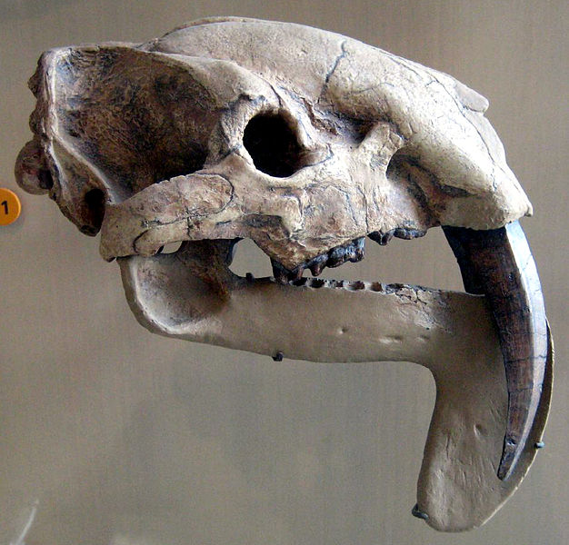
What is Thylacosmilus?
Extinct saber-toothed marsupial from South America
“Pouch saber”
Late Miocene to Late Pliocene
“Cat-like,” but not a felid
Peculiar morphology
Cast of Thylacosmilus skull at the American Museum of Natural History (type specimen at the Field Museum of Natural History)
Notes:
Importance: post-cranial skeleton peculiar in that limb bones are particularly strong
Thylacosmilus, a South American sparassodont marsupial, possesses a number of strange qualities, such as it’s flexible neck, rigid back, (Argot, 229). It also happens to be the ONLY known saber-tooth form among marsupials. What is most important to this study, however, is the unusually robust forearms
Many paleontologists are drawn to the teeth of saber-toothed felids, and the postcrania is primarily neglected. Examining the post cranial features gives us insight into the prey-killing strategies and other morphological aspects of such strange creatures.
The teeth however, are still quite important. Scimitar toothed cats possess shorter, more serrated canines. Dirk- toothed cats possess longer, flatter canines. Conical toothed cats are what we see in modern analogues.
“This study focuses on the forelimbs of Thylacosmilus and how such abnormally reinforced bones, particularly the humerus, allowed for this animal to take down large prey. We hypothesize that Thylacosmilus would most likely have wrapped one forelimb around the neck of its prey and used the other to push back the head of the unfortunate animal, exposing critical veins and allowing for a swift kill via a bite to the neck.” – from abstract

Slide 3
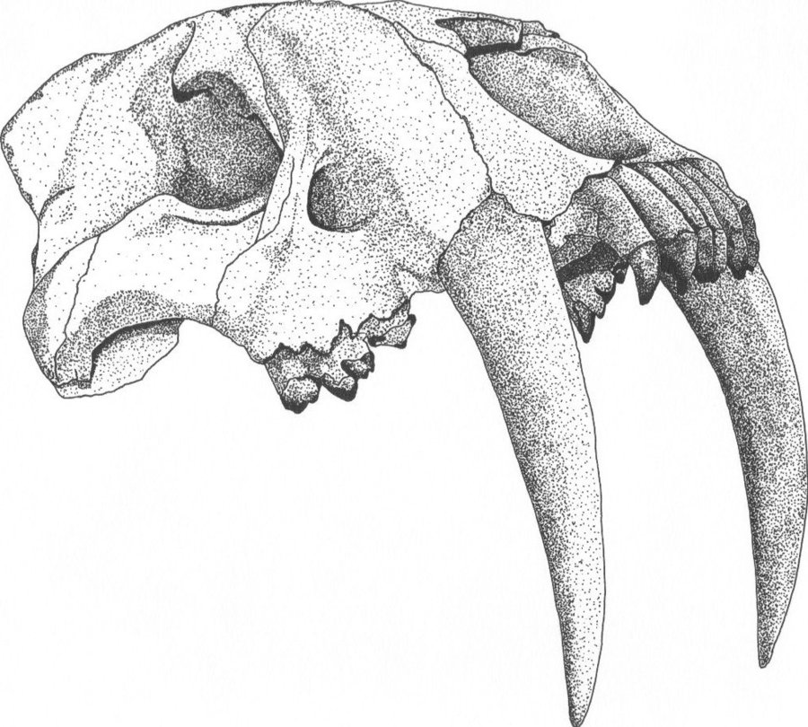
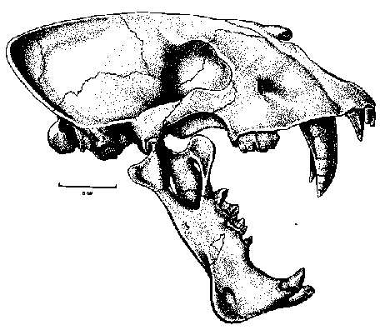
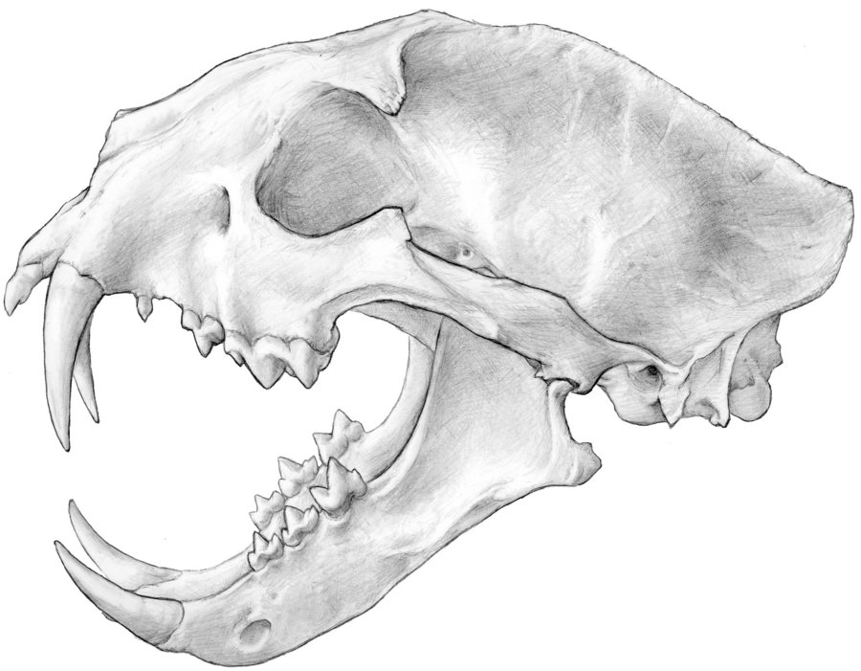
Types of Sabers
Dirk
Scimitar
Conical
Smilodon skull
Homotherium skull
Clouded leopard skull

Slide 4
Prey-Killing Strategies of Feliforms
Meachen-Samuels and Van Valkenburgh (2009)
Extant feliforms
Ambush vs. pursuit predators
Prey size
Meachen-Samuels (2012)
“Functional link between canine shape and forelimb morphology”
Modern and extinct feliforms
Bivariate analysis of canine indices vs. forelimb measurements
Notes:
Large-prey specialists are more likely to have more robust forelimbs, wider paws, and longer teeth. Smaller prey specialists tend to be faster with shorter, more serrated teeth.
Meachen-Samuels hypothesizes that there is a “functional link between canine shape and forelimb morphology,” and the two variables are what gives insight to the killing strategies of various saber-toothed and conical-toothed feliforms.
Thylacosmilus was not initially included in Julie’s data, so I was given the opportunity to take measurements myself from the FMNH. Plotting Thylacosmilus against the other data revealed some surprising results.

Slide 5
Questions
Since it is a marsupial, why is Thylacosmilus so cat-like?
What could have caused such peculiar morphology?
Why is it the only known saber-tooth member of the marsupials?
How did it hunt and kill its prey?
Hypothesis: Thylacosmilus was an ambush predator
How does it compare with other saber-toothed predators?

Slide 6
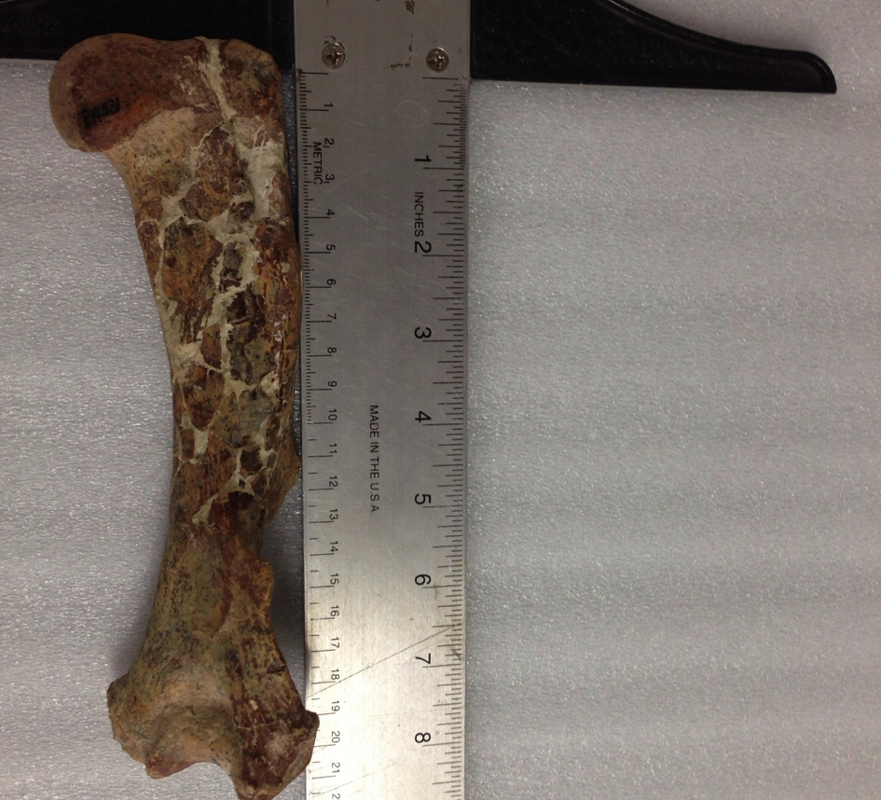
Methods
Forelimb measurements define whether animal is ambush predator or pursuit predator
Measurements of paratype/holotype at FMNH
Bivariate analysis of canine index vs forelimb measurements of cats (Meachen-Samuels, et al)
Humerus of Thylacosmilus atrox
Notes:
FMNH – Field Museum of Natural History
Data is of both extinct and extant cats
Forelimb fossils courtesy of the Field Museum of Natural History, measurements done by myself and my co-author John, data analyses courtesy of Mrs. Julie Meachen-Samuels
In the words of Julie, “Thylacosmilus is a beef cake!”

Slide 7
PAW
Smilodon fatalis
Canine Index
Notes:
PAW – Proximal paw width
Calculation – (M2PML + M3PML + M4PML + M5PML)/M3L
Thylacosmilus atrox plotted closely with Barbourofelis loveorum, Smilodon gracilis, and Hoplophoneus primaevus

Slide 8
HEI
Barbourofelis loveorum
Thylacosmilus atrox
Smilodon fatalis
Canine Index
Smilodon gracilis
Notes:
HEI – Humeral epicondylar index
Calculation – HEB/HL
Thylacosmilus plots closely with Barbourofelis loveorum, Smilodon gracilis, and Smilodon fatalis

Slide 9
HRI
Barbourofelis loveorum
Thylacosmilus atrox
Smilodon fatalis
Canine Index
Smilodon gracilis
Notes:
***HRI – Humeral Robustness index
Calculation – HD/HL
This is where the robustness of Thylacosmilus’ humeri is so pronounced! We had to adjust our dimensions because it was initially off the charts.
Plots atypically to the right; unusually robust humerus
Future research:
Further inference of morphology and behaviors of thylacosmilids and other saber-toothed feliforms

Slide 10
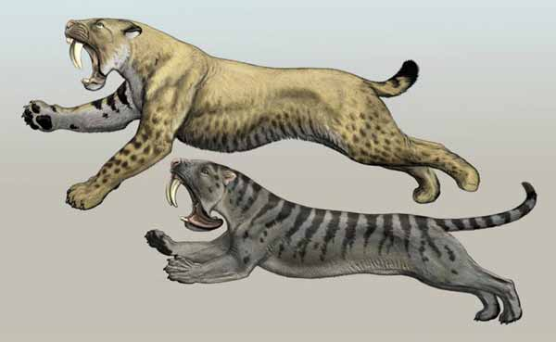
Artist Carl Buell’s interpretation of side-by-side comparison of Smilodon and Thylacosmilus
Notes:
Thylacosmilus was a bit smaller than depicted here, but I wanted to include this picture to give the audience a general idea of
How incredibly cat-like this marsupial is
Similarities and differences between one of the data points near which Thylacosmilus closely plots

Slide 11
Results
Plots closely with Smilodon and Barbourofelis
Likely an ambush predator
Robust arms for anchoring prey, preventing struggle
Long, flattened dirk teeth to deliver swift blow to critical veins
Larger prey
Illustration of Thylacosmilus by Mauricio Antón
Notes:
Thylacosmilus plotted near larger saber-toothed carnivores such as Smilodon and Barbourofelis.
Thylacosmilus is most likely an ambush predator due to its reinforced forearms and its longer dirk teeth
It uses its robust forearms to anchor itself to the animal. It does so by wrapping one arm around the neck and using the other to push back the head of the unfortunate animal. Doing so exposes critical veins so that Thylacosmilus can put it’s large canines to work, severing the veins and ultimately killing the animal. The anchoring movement doesn’t allow for much of a struggle from the prey, which in turn reduces the risk of canine injury to the predator. In short, this animal was not very fast, but it sure was quite powerful. It had the strength to take down larger prey without risking too much injury to its canines.
Pursuit predators, such as the modern cheetah, have more slender forearms and shorter teeth. Because these faster, more slender cats do not have the weight or the strength to prevent a struggle from their prey, their teeth are shorter to reduce the risk of injury to the predator. Pursuit predators generally go after smaller prey, another insurance to prevent injury.
You probably don’t want to be stalked by a Thylacosmilus.

Slide 12
Further Research
Why is Thylacosmilus so cat-like?
What could have driven the evolution of such a peculiar morphology?
Environment
Open woodlands/grasslands
Prey selection
Larger prey such as toxodonts, rodents, other ungulates
Phylogenetic constraints
Evolution from earlier form
Competition with other predators

Slide 13
Acknowledgments
Julie Meachen with Des Moines University
and
Susumu Tomiya and Bill Simpson with the Field Museum of Natural History

Slide 14
Bibliography
Argot, Christine. Functional-adaptive features and palaeobiologic implications of the postcranial skeleton of the late Miocene sabretooth borhyaenoid Thylacosmilus atrox (Metatheria). Alcheringa: An Australian Journal of Palaeontology. 29, 2 (2009): 229-266.
Meachen-Samuels, Julie, et al. Forelimb indicators of prey-size preference in the Felidae. Journal of Morphology. 270 (2009): 729-274.
Meachen-Samuels, Julie. Morphological convergence of the prey-killing arsenal of saber-tooth predators. Paleobiology. 38, 1 (2012): 1-14.

