Slide 1
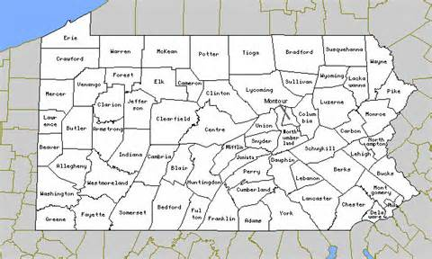
REPTILE TRACKWAYS PROVIDE A TRIASSIC DATE FOR ENIGMATIC ROCKS AT VALLEY QUARRIES FAIRFIELD OPERATION, PA.
Robert E. Weems, Randy Van Scyoc (presenting),
G. Robert Ganis, and Brad Bender
ADAMS

Slide 2
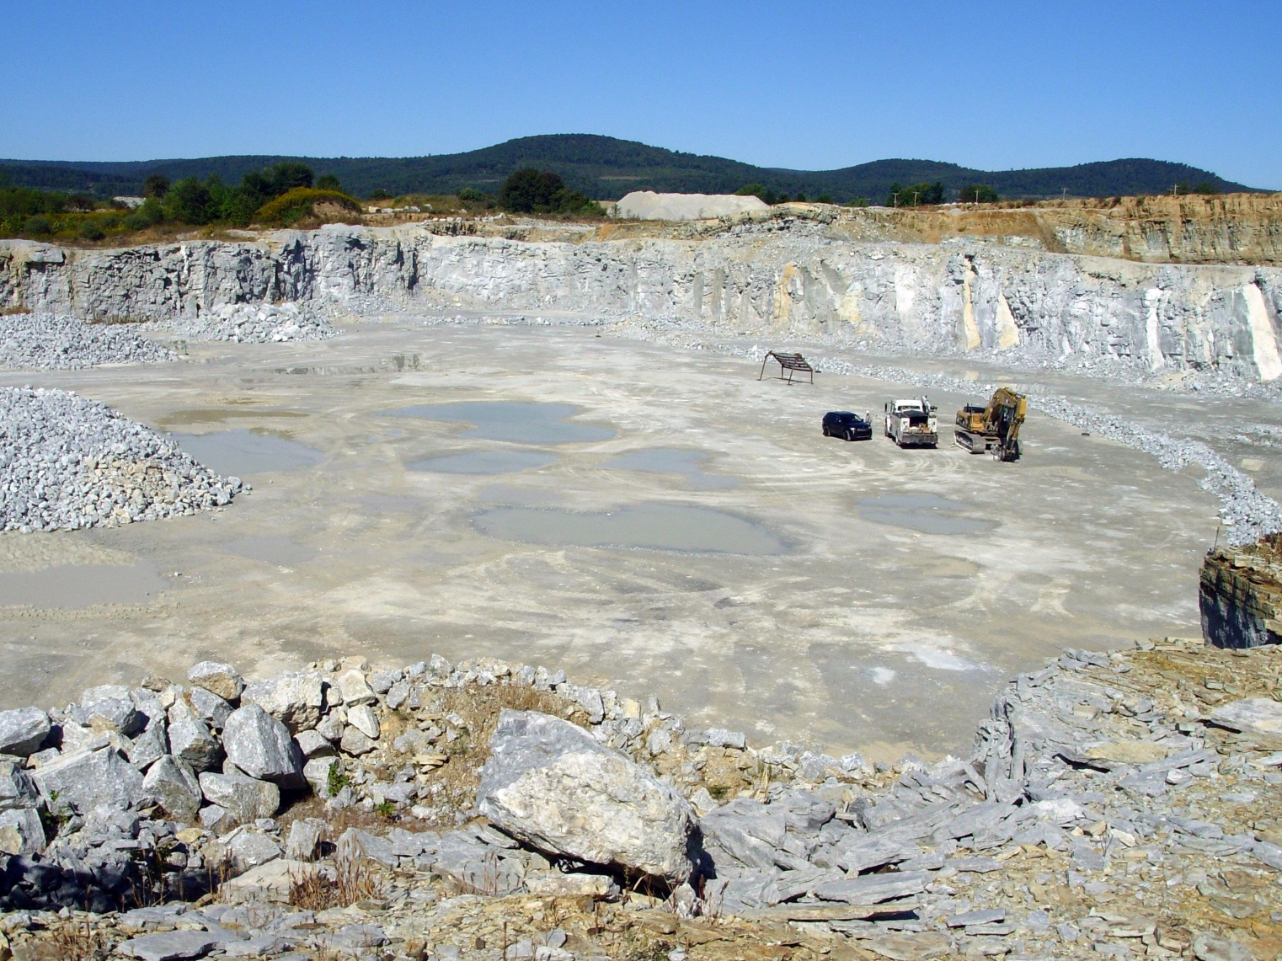
Highly metamorphosed conglomeratic carbonate rocks lacking siliciclastic “Blue Ridge” clasts are not at all typical Gettysburg Basin strata
The age of the structurally isolated, metamorphosed carbonate rocks quarried
by Valley Quarries near Fairfield, Pennsylvania has long been in doubt.

Slide 3
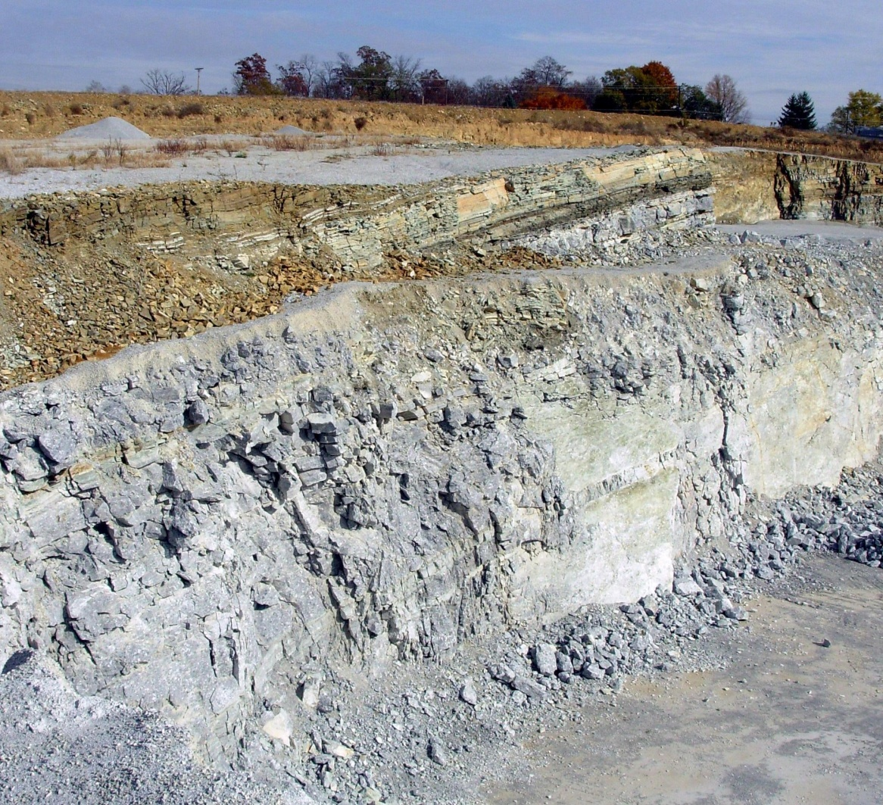
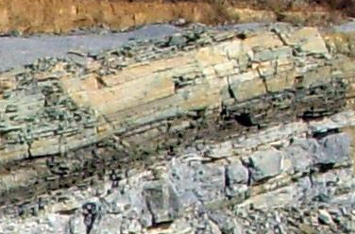
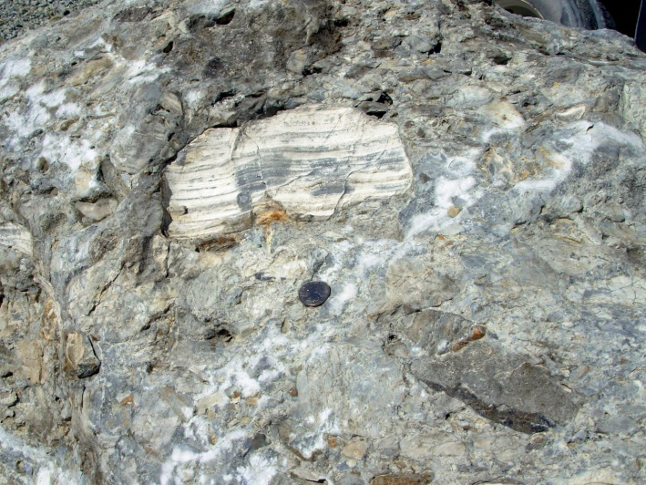
Two principle lithologies are present: thin shaly beds and thick carbonate-conglomerate beds

Slide 4
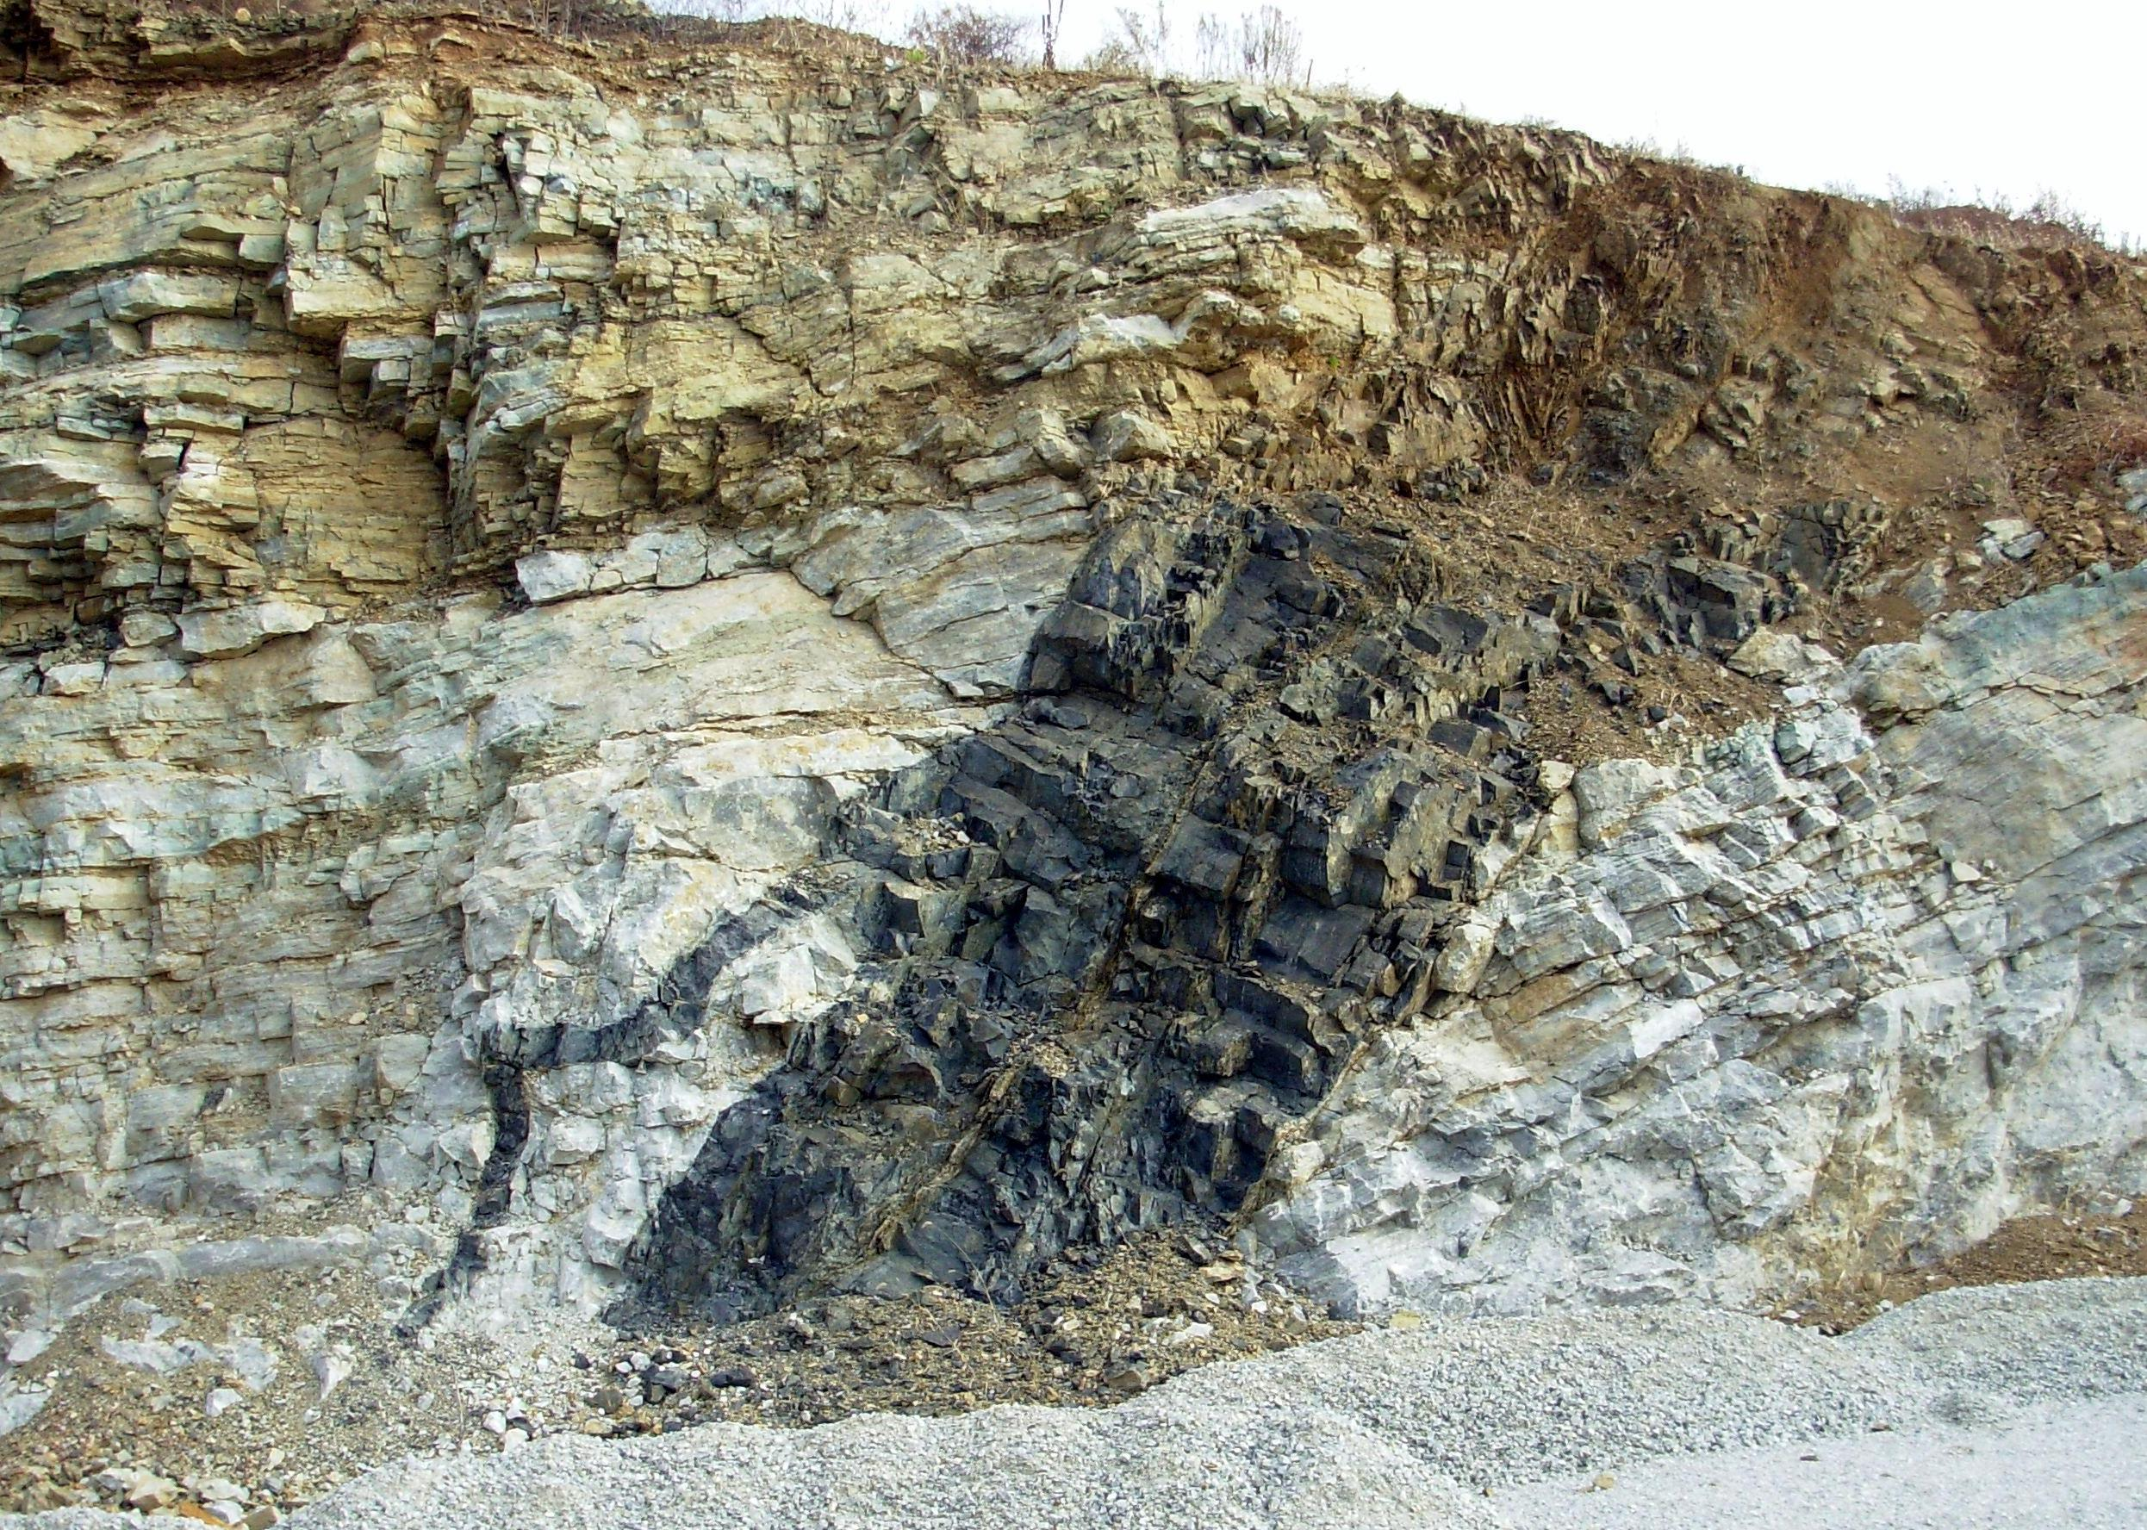
Intrusive CAMP diabases demonstrate a pre-Jurassic age. Better age control was not possible before the discovery of footprints.

Slide 5
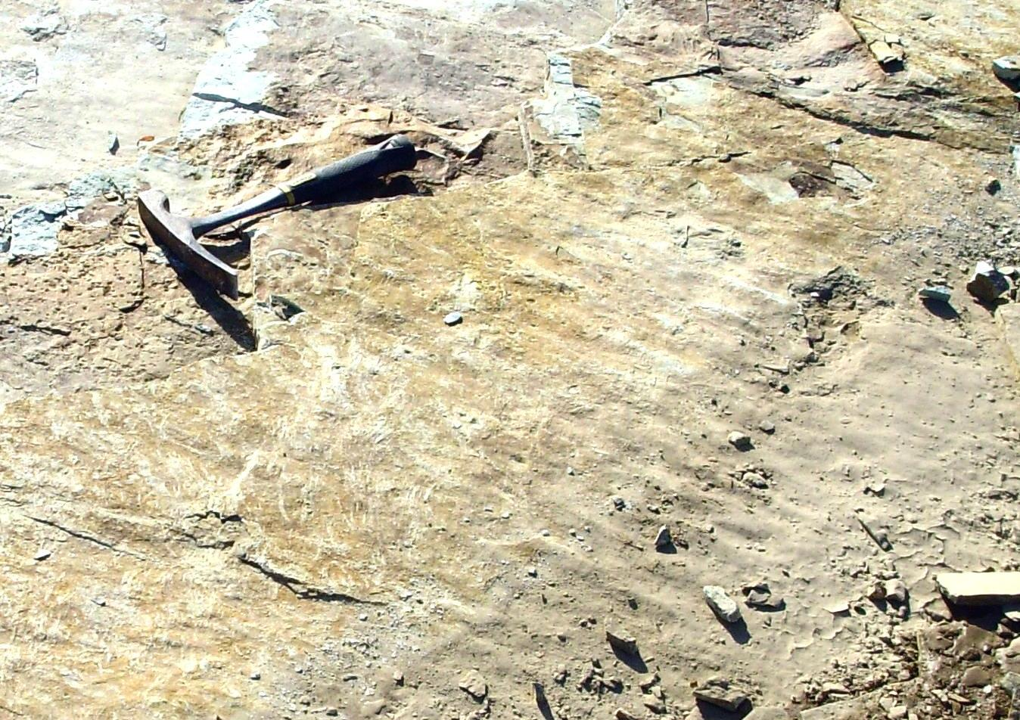
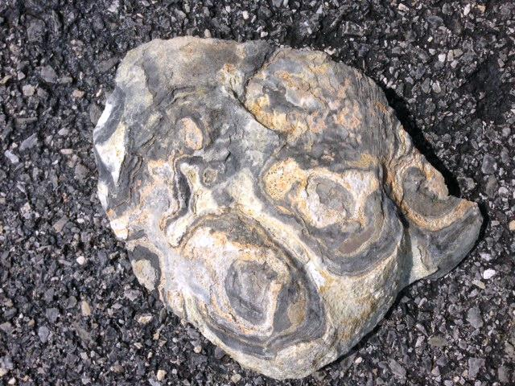
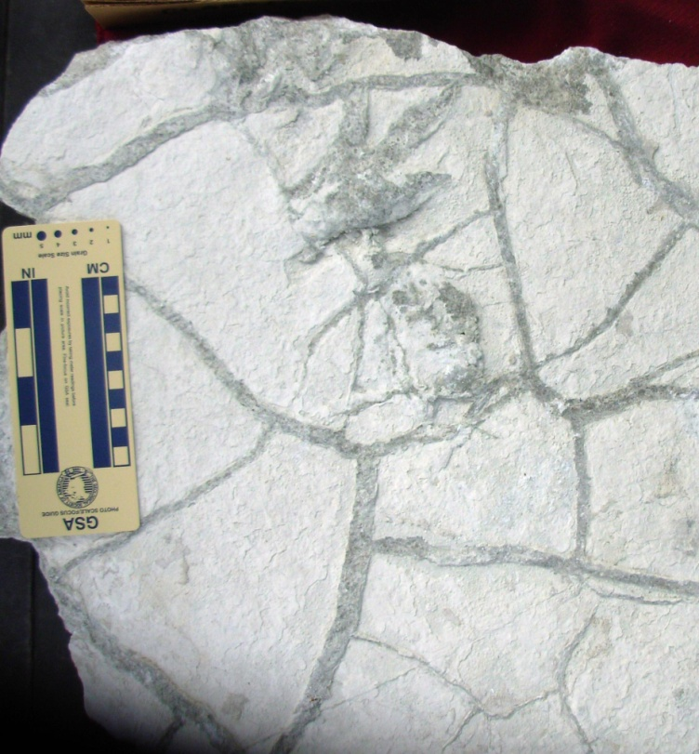
The thin shaly intervals have proven to have not only ripple marks, stromatolites, and mudcracks, but also reptile footprints

Slide 6
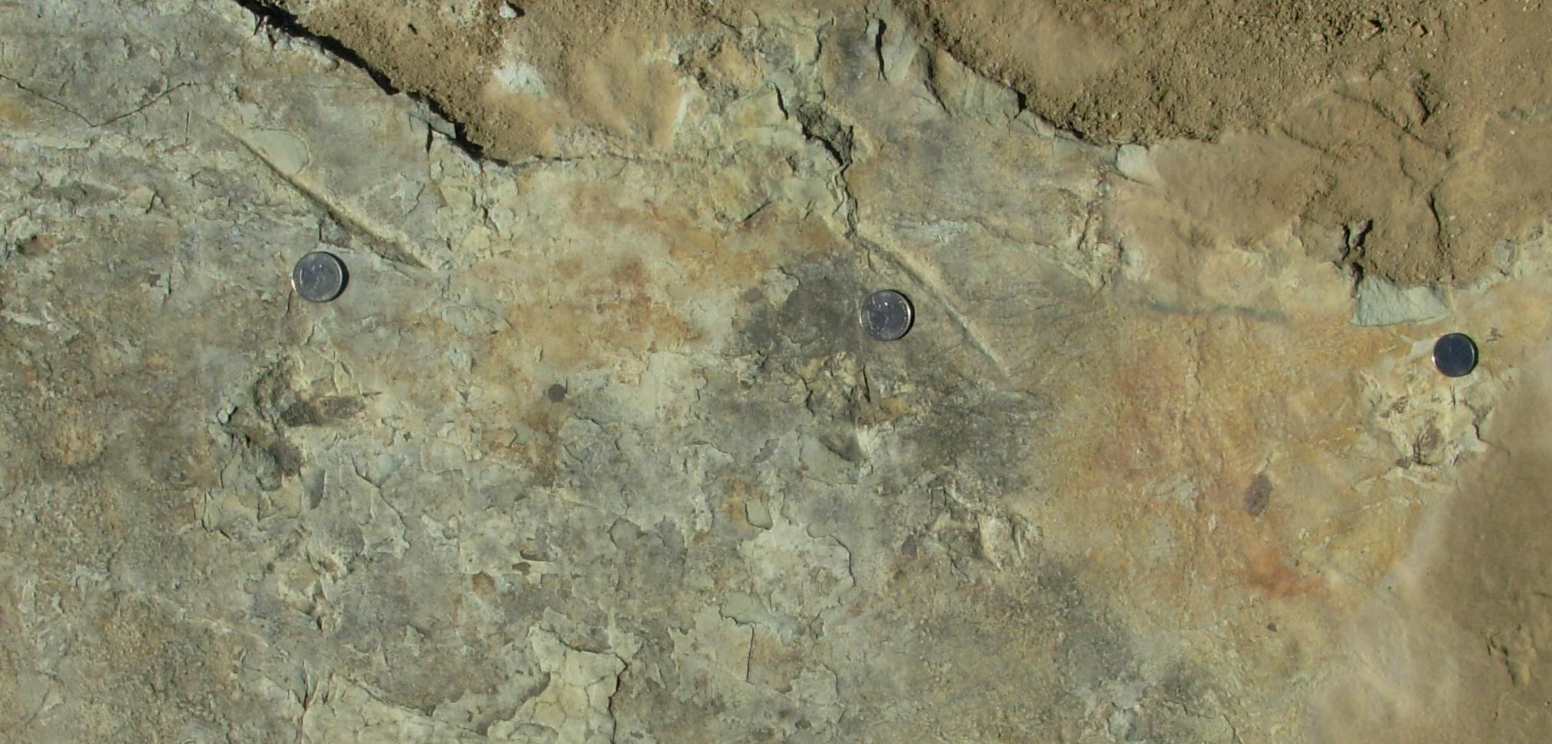
Five kinds of tracks and trackways were uncovered on a single bedding plane, exposed with the help of people from Valley Quarries, Pennsylvania Geologic Survey, and Dickinson College
Most tracks trend either northwest-southeast (perpendicular to the basin axis)
Or southwest-northeast (parallel to the basin axis). These trends were probably
normal or parallel to the shoreline of a shallow lake present at that time.

Slide 7
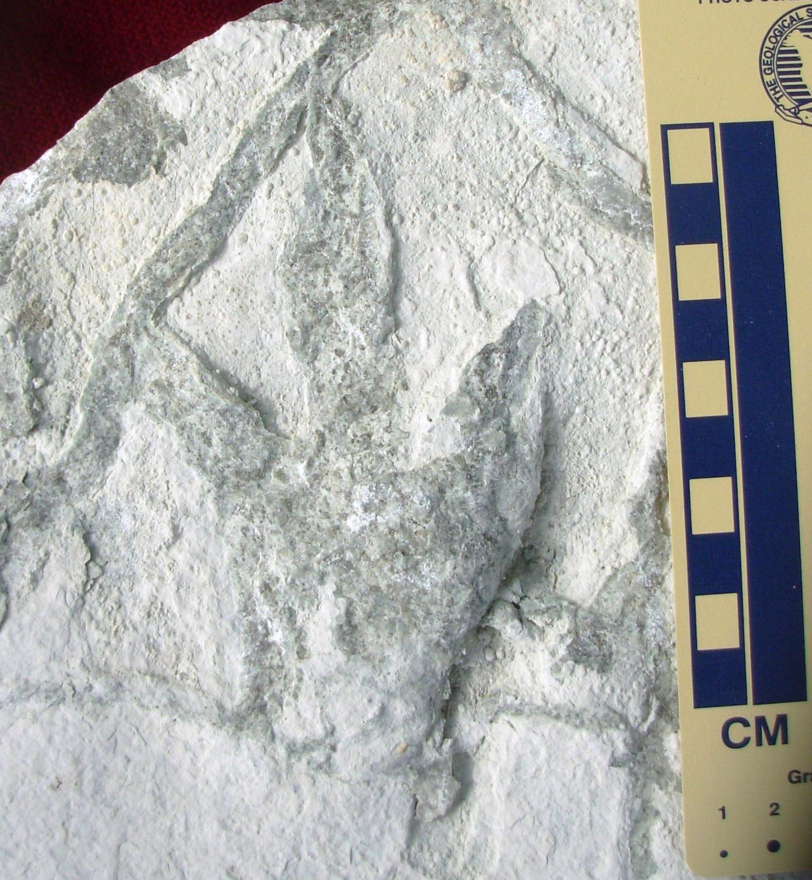
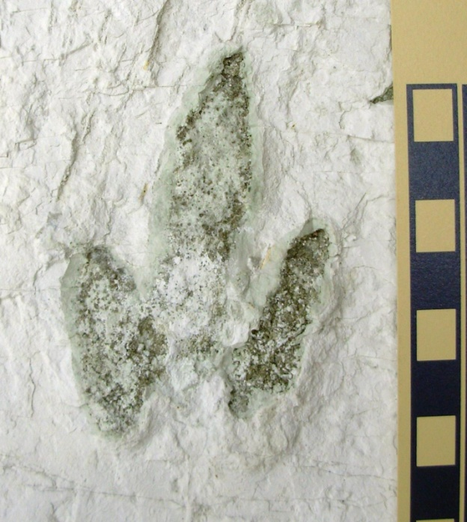
Two kinds of dinosaur tracks are represented
Small bird-like
Grallator
Grallator tuberosus
(not found on main track surface)

Slide 8
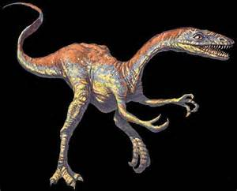
These animals were very similar to the small dinosaur Coelophysis bauri from New Mexico

Slide 9
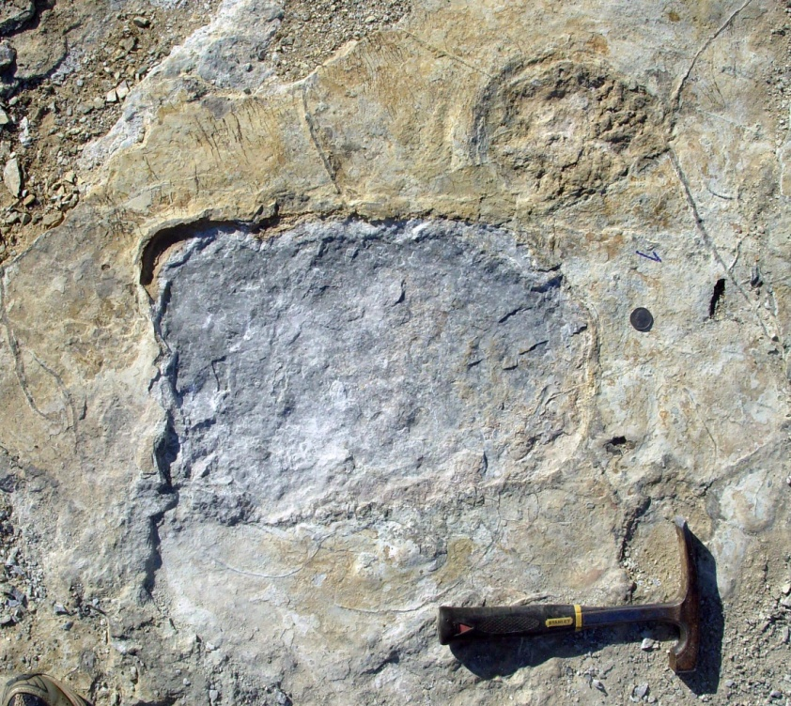
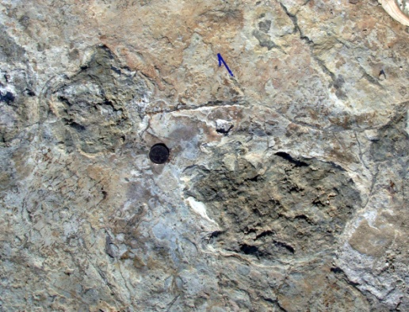
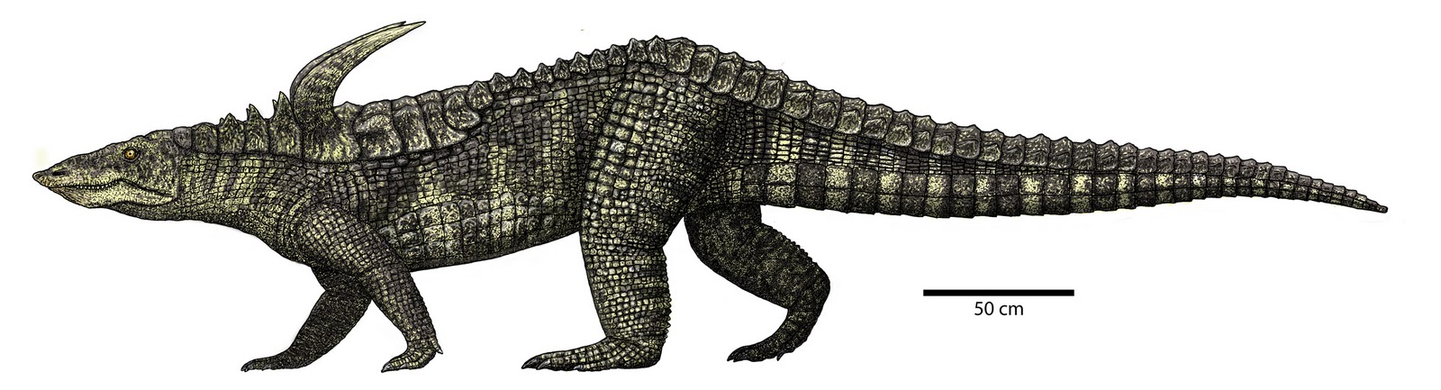
Big and small brachychirothere tracks (made by aetosaurs) also are present. They occur only in the Triassic.
Brachychirotherium parvum
Brachychirotherium hassfurtense
Restoration of the aetosaur
Desmatosuchus

Slide 10
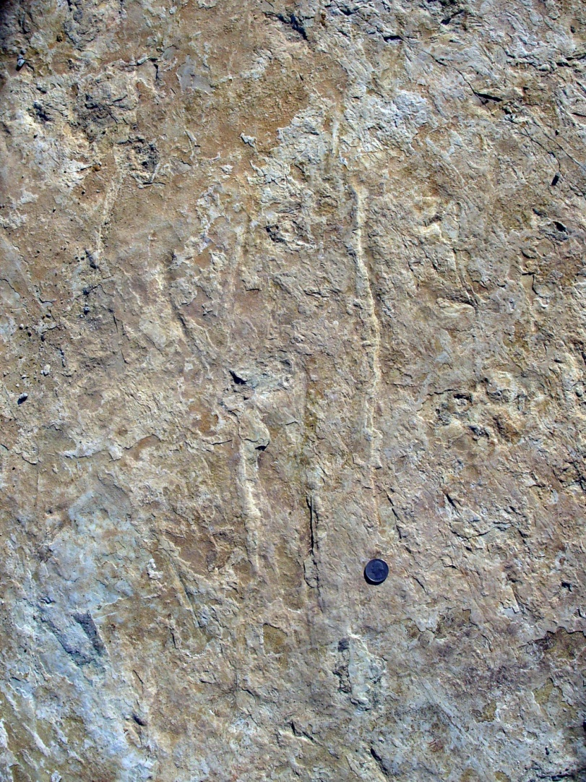
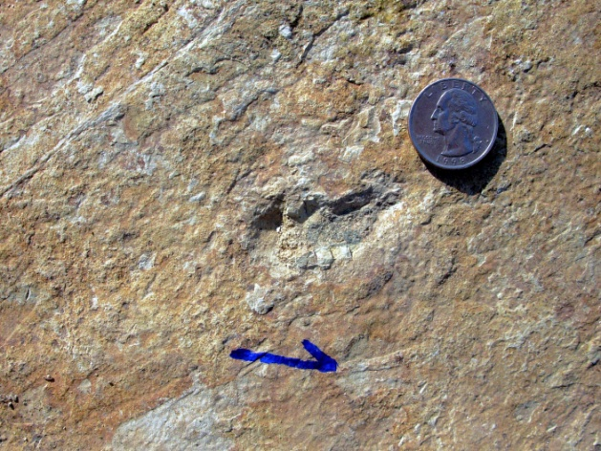
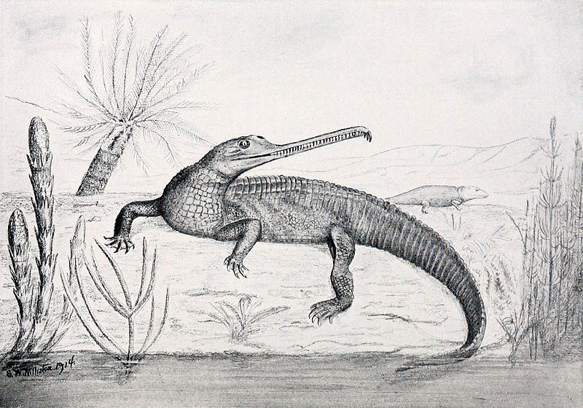
Two other trackmakers also are present
Rhynchosauroides
(Lizard-like reptile)
Apatopus lineatus
(Swimming scrapes
of a parasuchian)

Slide 11
These ichnotaxa co-occur only in the Upper Triassic

Slide 12
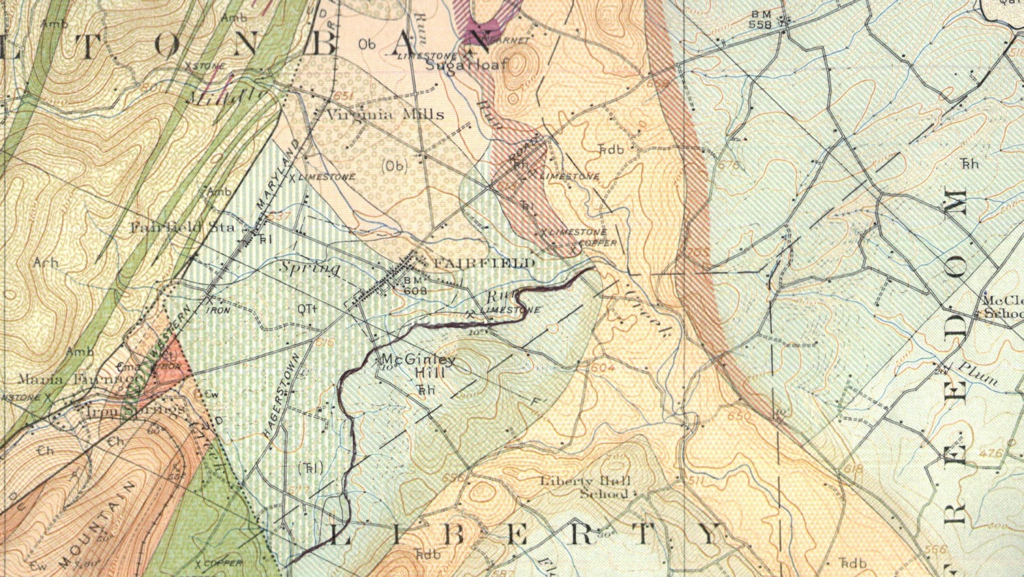
Stose & Bascom (1929) were essentially correct: the quarry is developed in strongly metamorphosed Gettysburg strata high within or above the Heidlersburg Member
Heidlersburg Member
The Redondestheria grovetonensis conchostracan zone recently was found just below the Heidlersburg Member

Slide 13
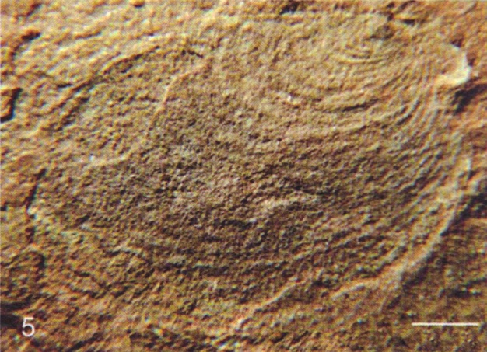
The Redondestheria grovetonensis conchostracan zone is the basal zone of the upper Norian (Sevatian), so the quarry footprint fauna is almost certainly late Norian in age
These zones are missing in
The Newark Supergroup,
But present in New Mexico
and Germany
Redondestheria
grovetonensis
1 mm

Slide 14
The Culpeper Quarry footprint site in Virginia lies just below the R. grovetonensis zone, so the Fairfield Quarry site is younger

Slide 15
The Fairfield tracksite is the first diverse ichnofauna reported from the upper Gettysburg Formation. Two other track sites from lower in the basin have been reported in the past

