Slide 1



Service Learning in Environmental Geochemistry
The River Meadow Brook Project
Geological Society of America • Northeast Section Conference • March 2014 • Lancaster, Pennsylvania
Lori Weeden, University of Massachusetts Lowell

Slide 2
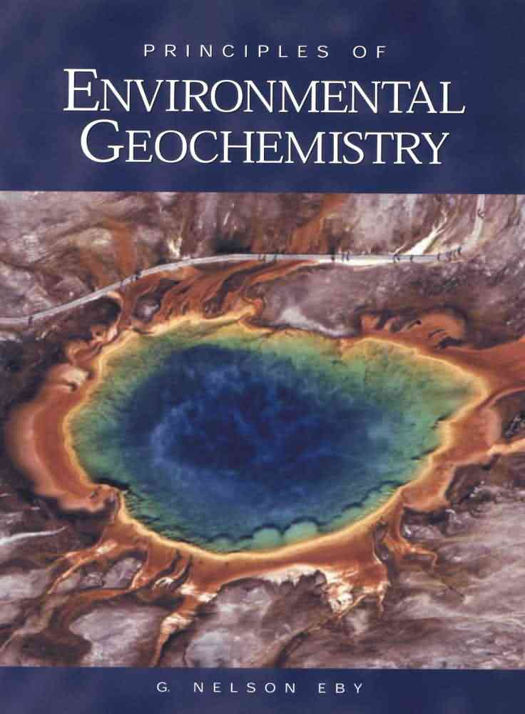

Environmental Geochemistry is a upper level required course for all environmental science majors at UMass Lowell. The course focuses primarily on low-temperature geochemistry, anthropogenic contamination of the environment and the interaction and ubiquity of water.
*When I began teaching this course, it did not include a laboratory component.

Slide 3
There have been numerous papers written on the benefits of active learning. I created lab assignments to mirror and reinforce material in class.
Date | Exercise
Sept 4 | Introduction to spreadsheets – Population exercise
Sept 11 | Lab safety and equipment review
Sept 18 | Thermodynamics
Sept 25 | Covanta-Haverhill Waste to Energy plant tour
Oct 2 | Acid Mine Drainage
Oct 9 | Oxidation – Reduction
Oct 23 | Midterm Exam
Oct 30 | River Meadow Brook field trip to collect water samples
Nov 6 | UML Nuclear Reactor tour – River Meadow Brook water analysis I
Nov 13 | River Meadow Brook water analysis II
Nov 20 | Cation Exchange First Draft RMB paper with references due
Dec 5 | Optional Final Exam Review Final RMB paper due
The majority of the lab exercises were intentionally easy to do and understand. There were also field trips incorporated into the semester.
The River Meadow Brook project was created as a opportunity for the students to bring all of the material covered over the semester into a community project.

Slide 4
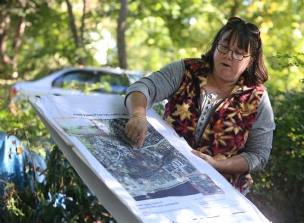

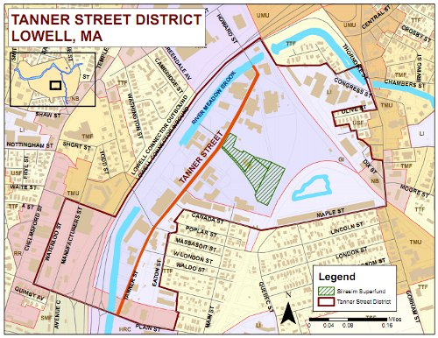
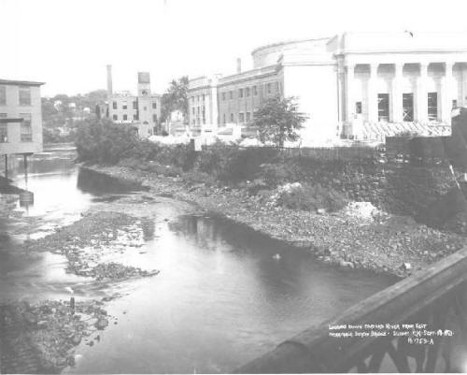
How did I get it started?

Slide 5
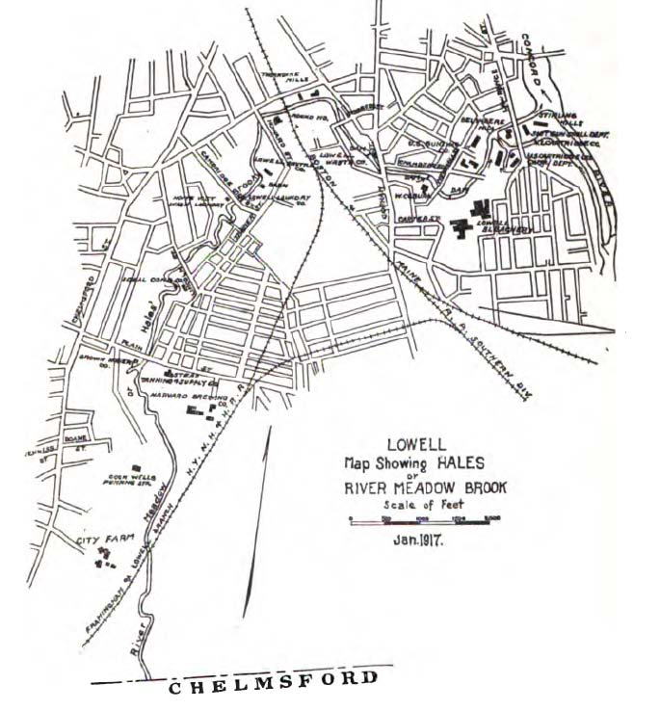

Slide 6
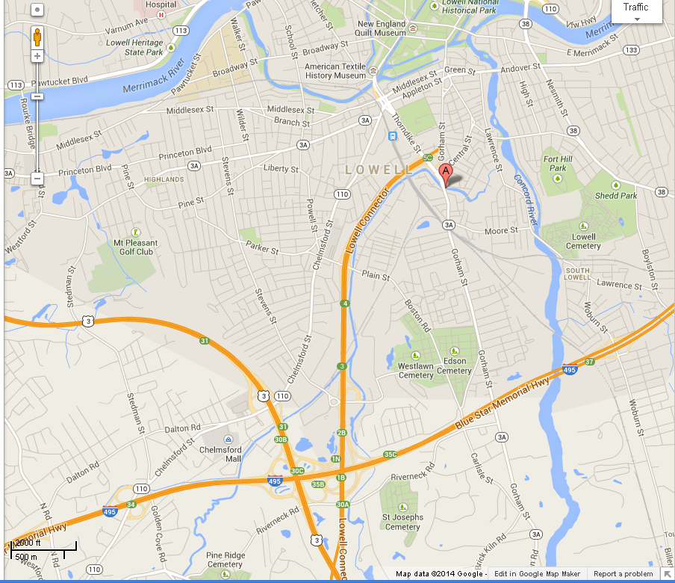

Slide 7
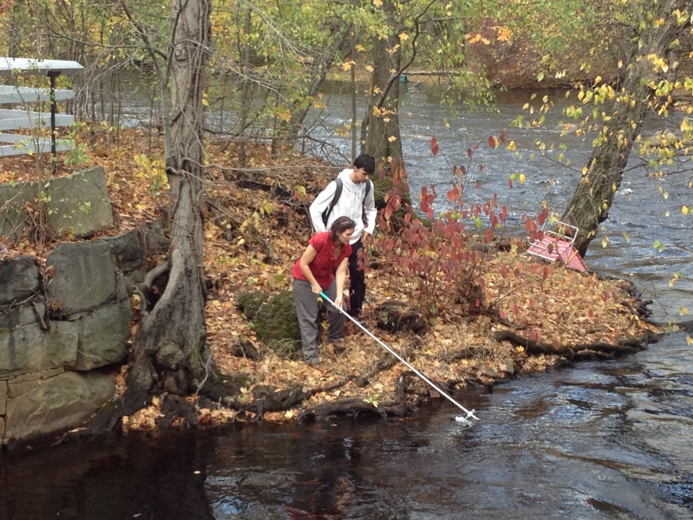
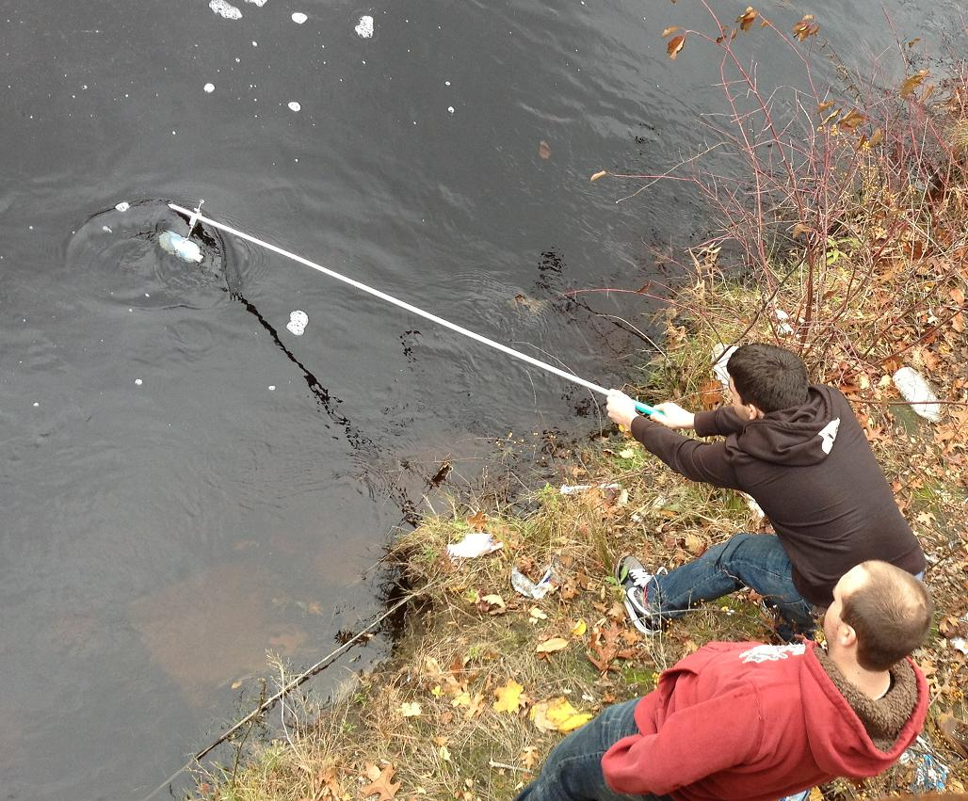
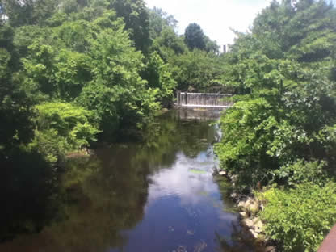
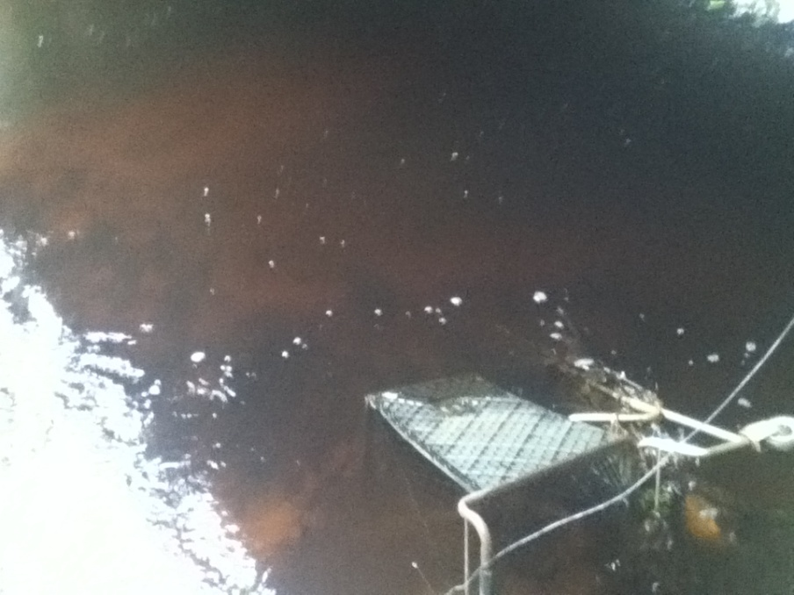

Slide 8
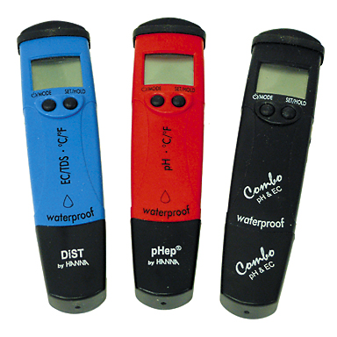
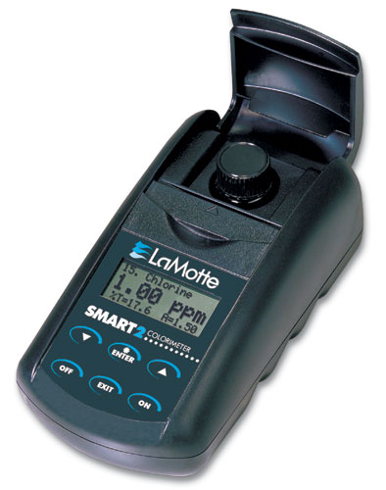
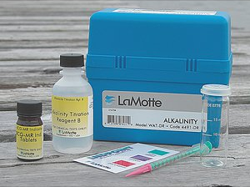
Once the samples were back in the lab, the students were tasked with testing the water for several different chemicals using three different methods. They were also assigned a control sample of Lowell tap water or water from the Merrimack River—both of which are routinely tested by the city of Lowell. Students were required to complete a charge balance with their data.
Parameters tested:
TDS Cl⁻ SO₄²⁻ Ca²⁺ Mg²⁺
pH Alkalinity NO₃⁻ PO₄³⁻ Cu
DO ORP Fe Temperature

Slide 9
The final product was to be a professional report to be handed into the Lowell Parks and Conservation Trust and potentially shared with the City of Lowell, MA.
Results were varied…….

Slide 11
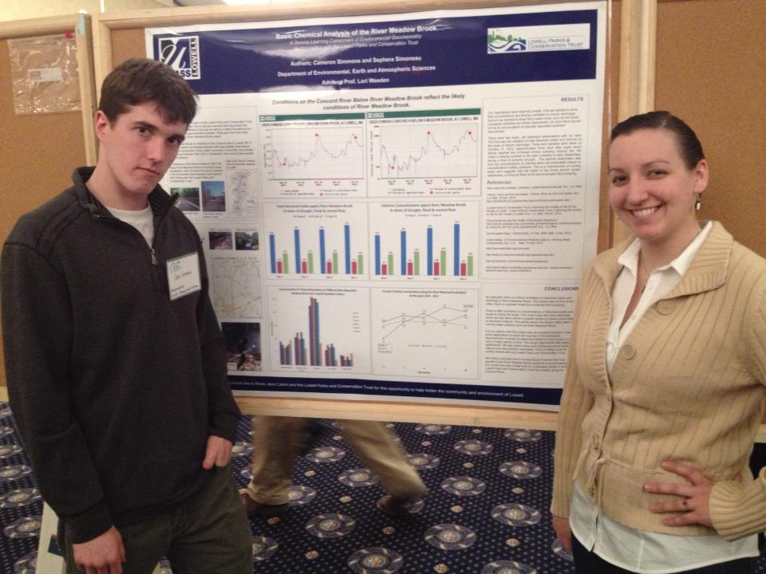
The first year (2011) Some students got the idea.
Most did not.
The second year (2012) I provided more instruction and guidance.
Jane Calvin came in to speak to the class and made a good impression.
The papers improved and two students presented a poster on their findings

Slide 12

In 2013 the students were required to include a reflection piece in the form of a cover letter. The resulting de-identified artifacts are being used to assess the AAC&U rubrics for Integrative Learning, Foundations and Skills for Lifelong Leaning, and Civic Engagement.
It is from this assessment that UMass Lowell will determine the qualifications for a campus-recognized service learning course credit.
Other AAC&U rubrics such as quantitative literacy can also be assessed with this project.

Slide 13
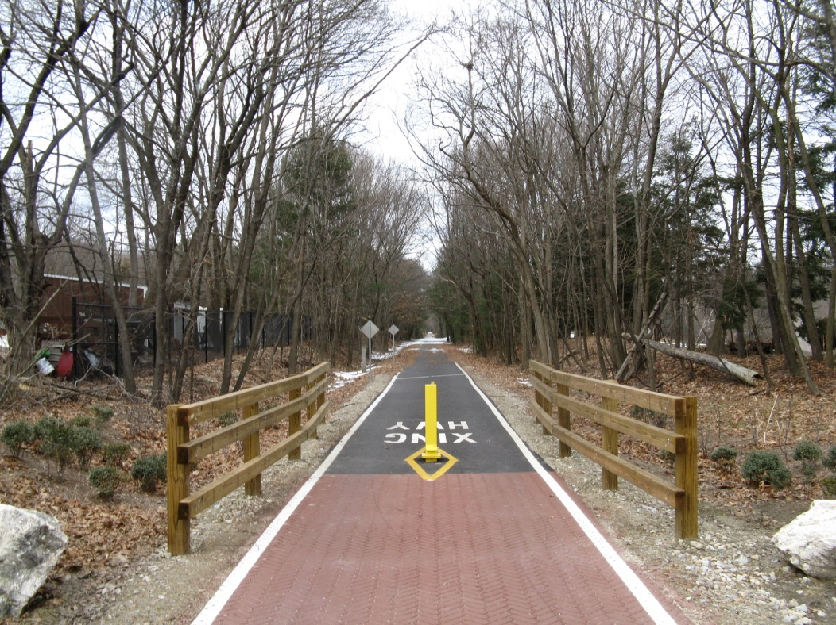
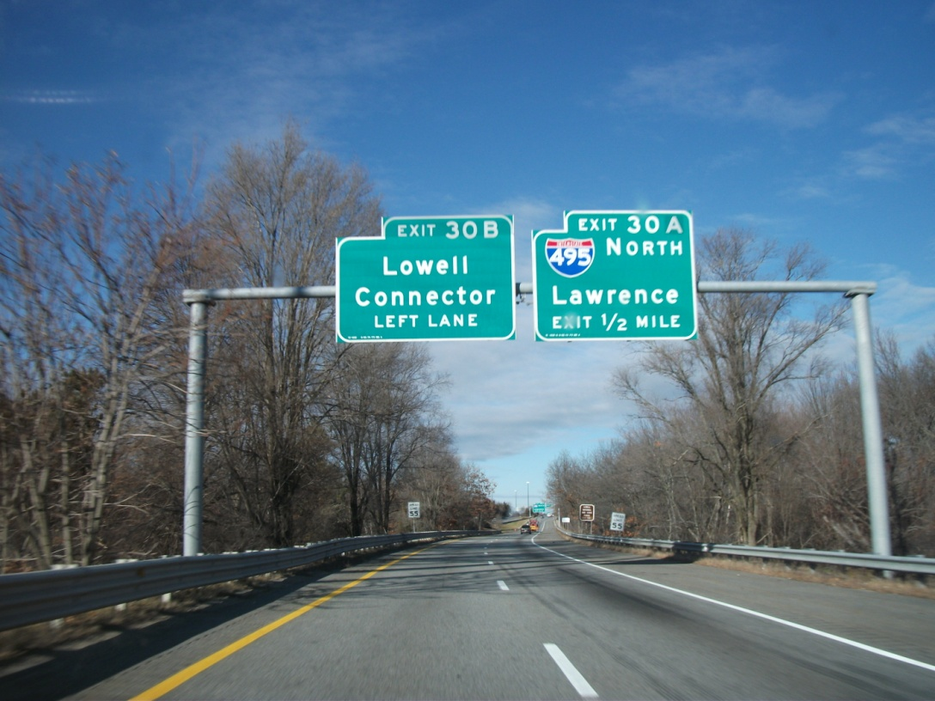
Thanks to the hard work of the Lowell Parks and Conservation Trust, the City of Lowell officials have been working to extending the rail trail that currently ends at the Chelmsford-Lowell line into Lowell and along the River Meadow Brook.
The extension should happen within the next five years when the Lowell Connector is rebuilt.
We helped.

Slide 14
A few student comments from course evaluations:
“Had an awesome time, good project. I felt like I could use this experience in the real world when looking for a job.”
“This project was a great experience and I can not say enough positive things about it. I wish all classes had a big project like this instead of a final.”
“Really helped reinforce the course material.”
“I felt a lot more involved and connected to Lowell. I really enjoyed the hands-on experience. It is something I’d love to do again.”
All of the students felt the assignment made them appreciate the importance of environmental geochemistry in the community.
Most felt strongly that the assignment brought together all of the topics that were covered over the semester.
Many suggested that writing the paper for an outside party made them take it more seriously and also made them feel professional.

Slide 15
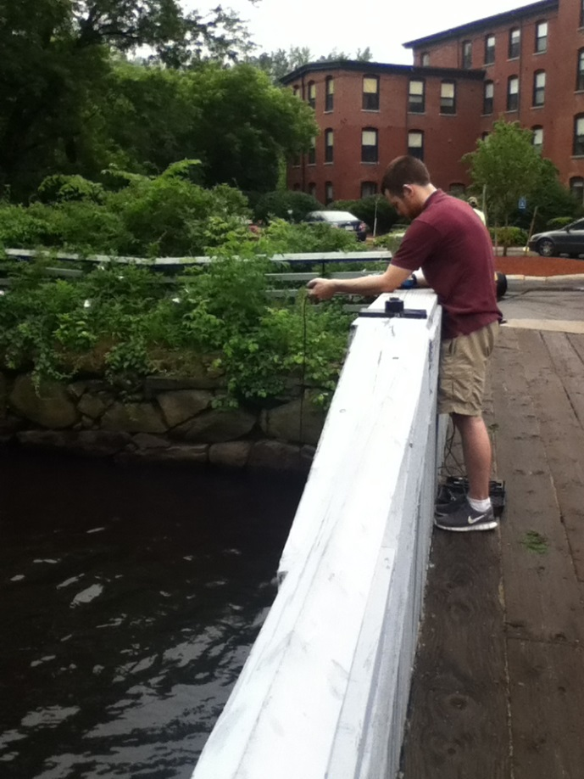
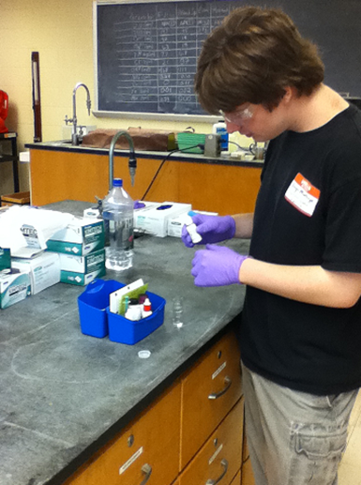
Continued work has helped to establish a data base for River Meadow Brook.
It also provides an excellent opportunity to include undergraduates in research within the department.

Slide 16
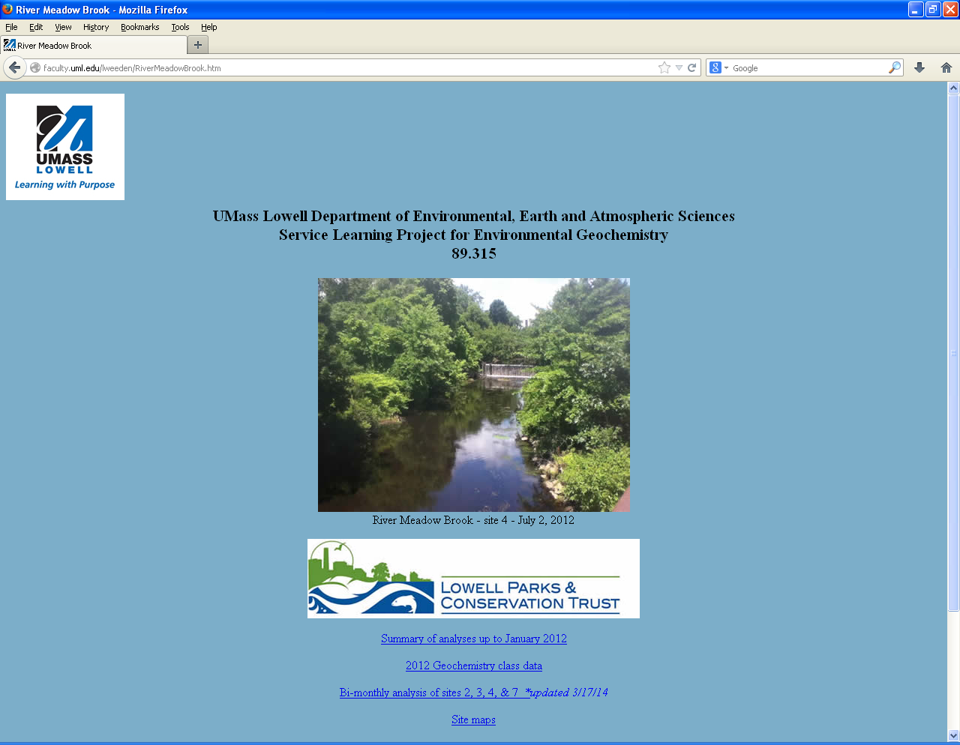

Slide 17
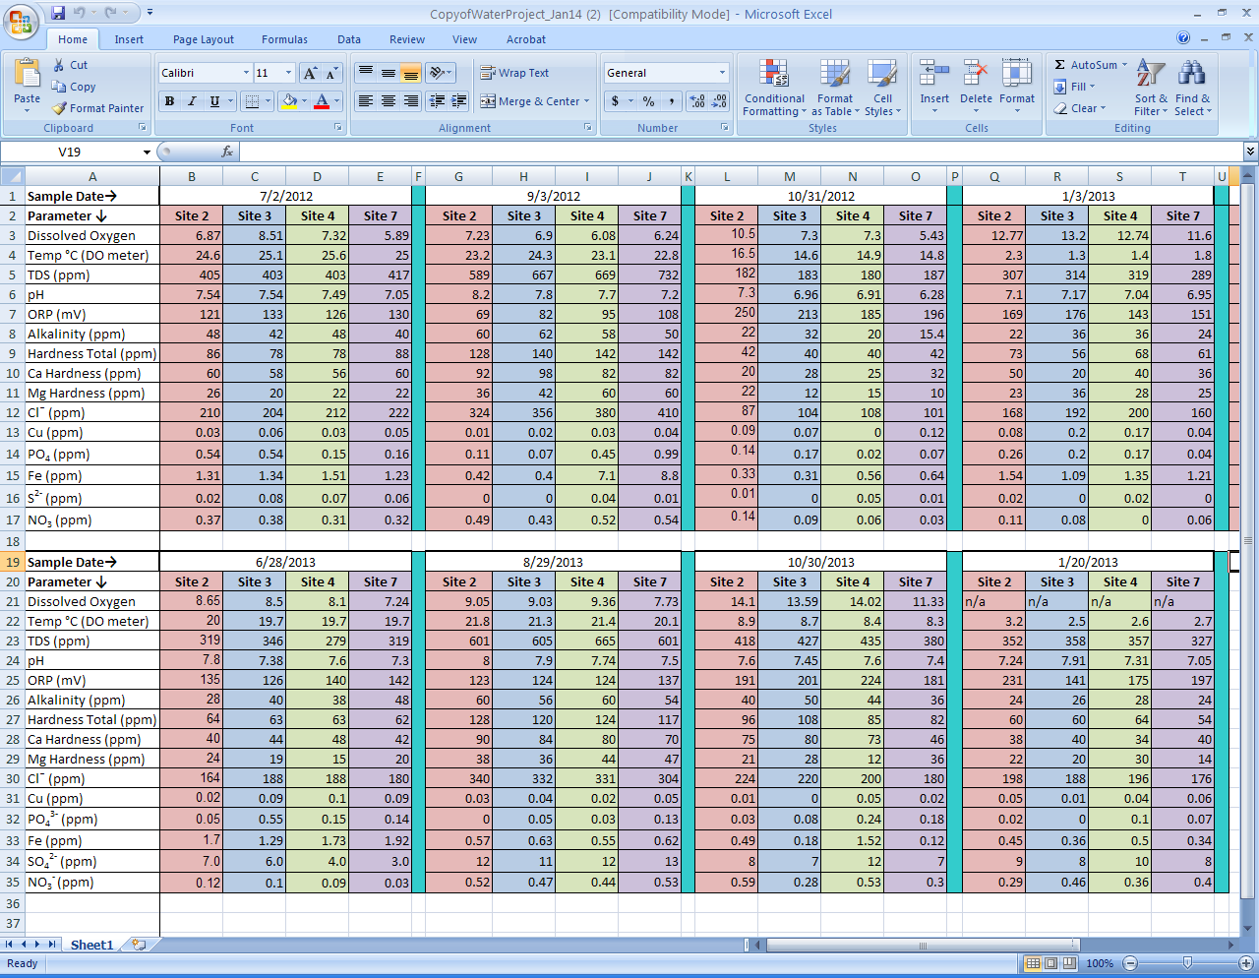

Slide 18
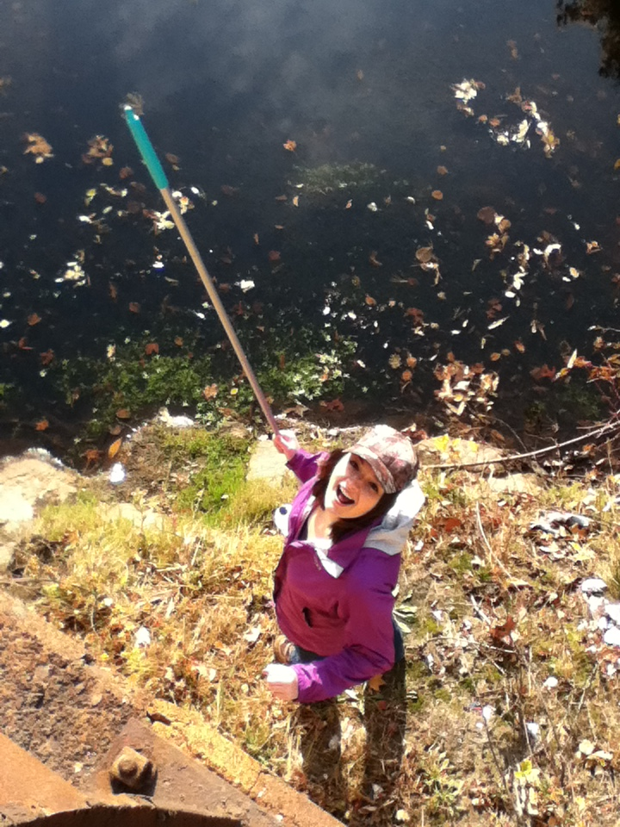
Service Learning engages students
Service Learning connects students and faculty to the community
Service Learning is an excellent way to bring in active learning as well as address AAC&U rubrics
Service Learning is a great opportunity for students to work in real-world situations.
Service Learning makes teaching fun!

