Slide 1
What a State Geological Survey Learned from Contributing to the NGDS
Denise J. Hills
Geological Survey of Alabama

Slide 2


Sponsored by the U.S. Department of Energy under award DE-EE0002850 to the Arizona Geological Survey acting on behalf of the Association of American State Geologists

Slide 3
Goal of NGDS
To make large quantities of geothermal-relevant geoscience data available to the public by creating a national, sustainable, distributed, and interoperable network of data providers

Slide 4
Data at the GSA
In association with the State Oil and Gas board, the Geological Survey of Alabama (GSA) is a repository for data, including:
  Geophysical well logs
  Cores, cuttings, and other physical samples, sometimes with descriptions
  Fluid production and injection information from oil and gas wells
  Geologic maps

Slide 5
Data at the GSA
However -
  Lack of standardization and documentation of data and metadata
  Provenance and quality of data often poor or unknown
  Data discovery often challenging
  Data preservation hit and miss
NGDS was the first experience for the GSA to generate large quantities of digitally preserved data in a standardized format

Slide 6
Example Well Data Forms – Record of Completion

Slide 7
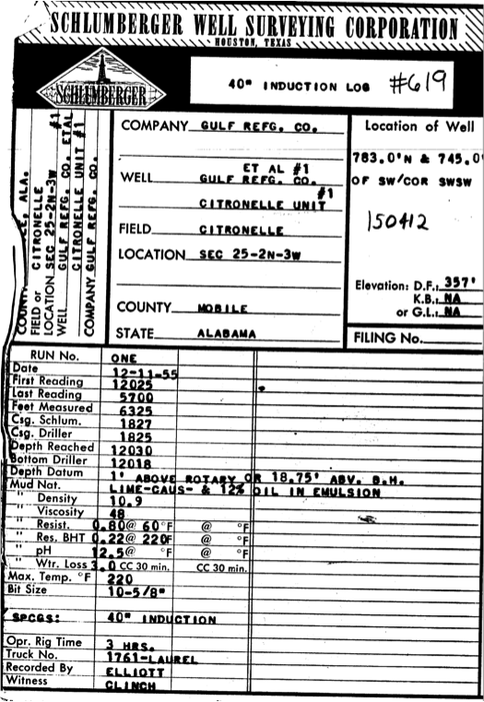
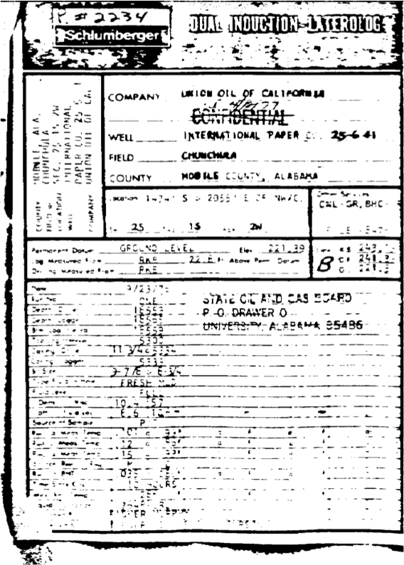
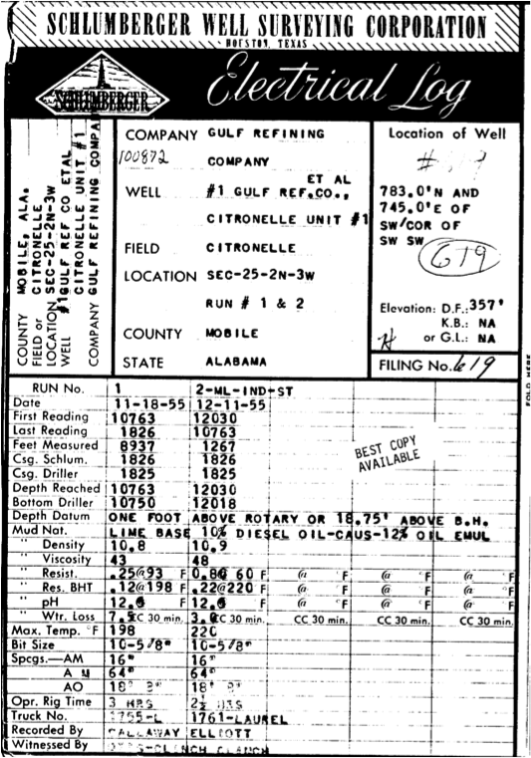
Geophysical Well Logs

Slide 8
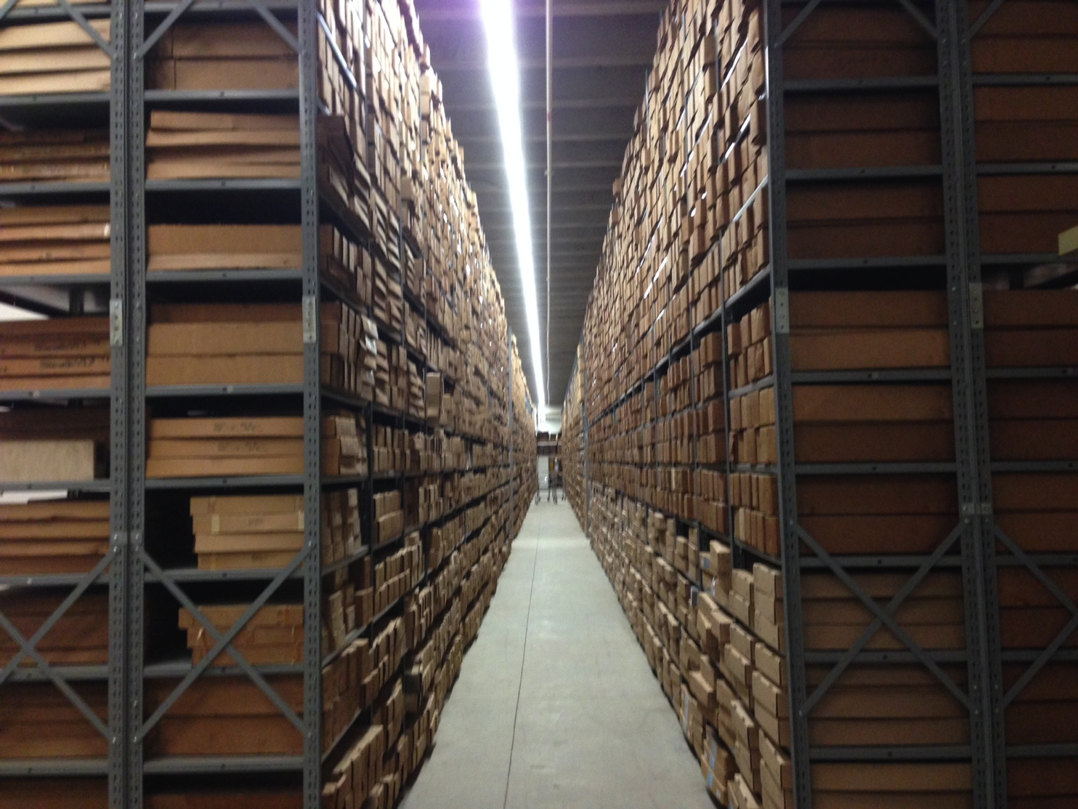
Core Warehouse

Slide 9
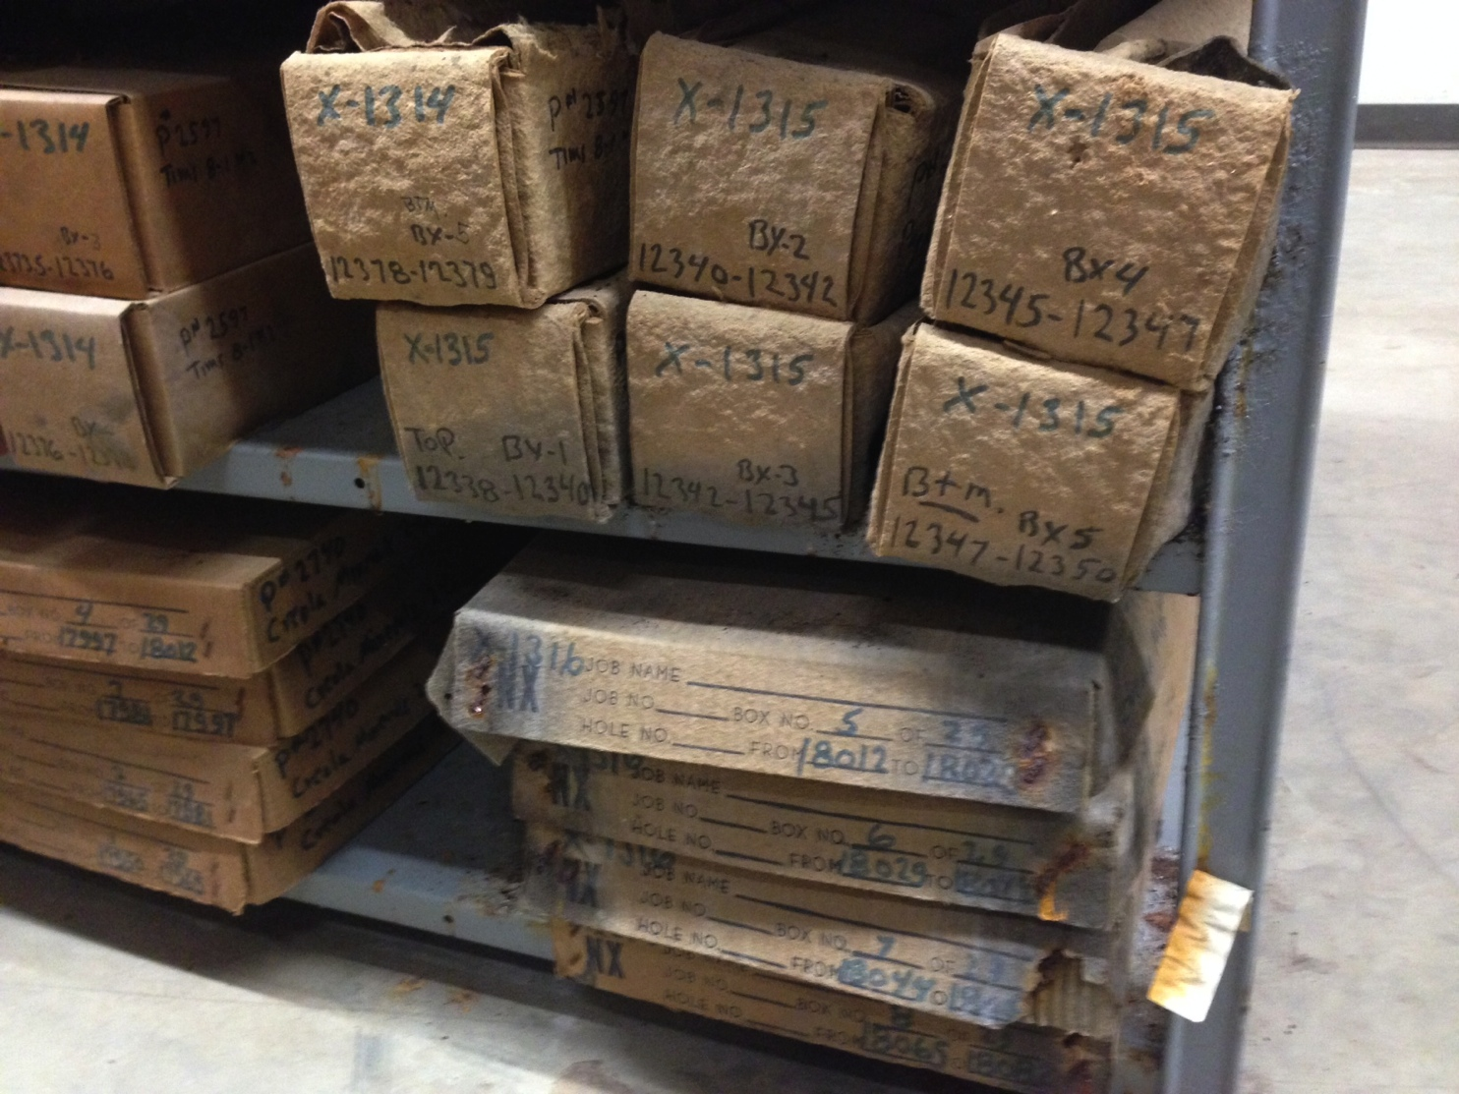
Preservation of Core

Slide 10
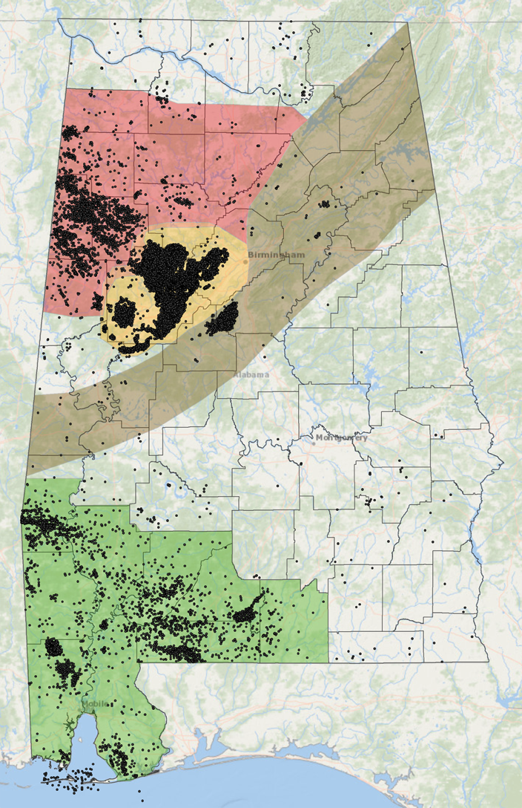
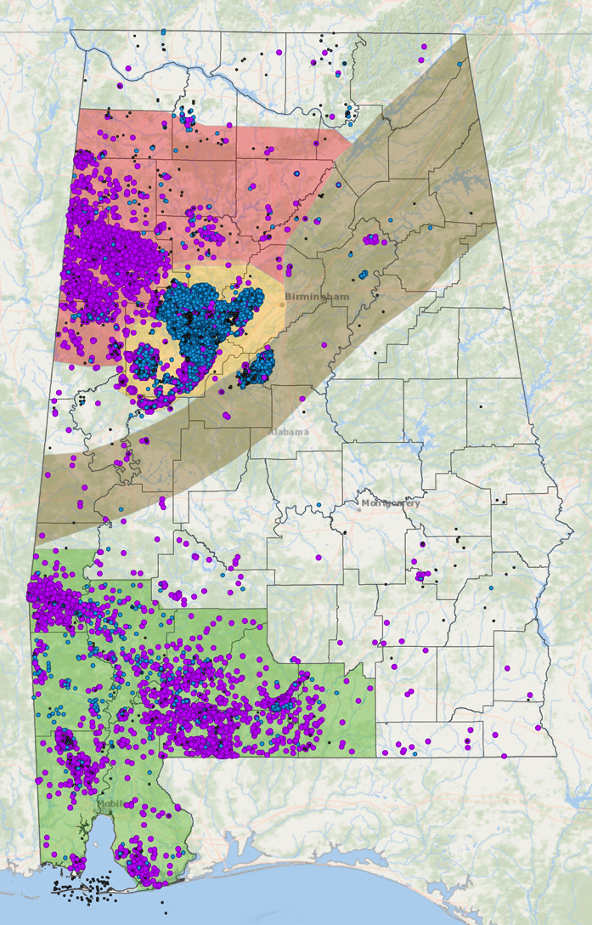
Alabama Oil and Gas Wells
>18,000 permitted wells; >30,000 well logs examined for NGDS
In all, GSA submitted >11,500 BHT measurements from >6,500 oil and gas wells

Slide 11
NGDS and OneGeology
NGDS encouraged project participants to submit their state geologic maps to OneGeology
Even if the map was not formally submitted, participants were encouraged to at least start the process of generating a OneGeology compatible state geologic map

Slide 12
USGIN OneGeology US Map Service Workshop
Concept: Establish prototype web map and feature services for State Geological Surveys using USGIN and OneGeology standards and protocols to foster wider adoption of standard service-based publication of geologic map data and expansion of OneGeology USA services
Prior to workshop, participants given instructions for preparing their data, as well as a “cookbook” that would be used

Slide 13

United States Geoscience Information Network (USGIN)
Helps users join or build networks that can be used to access and share geoscience data in a few easy steps
Has developed standardized protocols for registering and publishing geoscientific information resources
http://usgin.org

Slide 14
USGIN Data Provider Workflow
Step 1: Data Assessment
  Do you have data to share?
  Who is the intended audience?
  How can you share your data?
Step 2: Data Integration
  Digitizing the data
  Schema Mapping
  Vocabulary Mapping
Step 3: Data Deployment
  Publishing the data as part of a USGIN data-sharing network, such as NGDS

Slide 15
GeoSciML-Portrayal
GeoSciML (Geoscience Markup Language) is designed for sharing geoscience data, to reduce discrepancies in adjacent maps
Process:
  Map source data to GeoSciML-Portrayal schema
  Establish symbology for lithostratigraphic polygon portrayal that can be used by the map server
  Deploy web service, create metadata for dataset and service

Slide 16
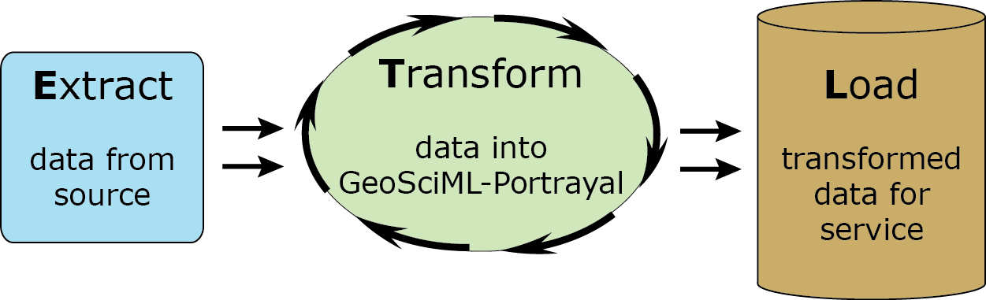
‘ETL’ Process
Most difficult part of ETL process is typically determining what representative categories from a standard vocabulary to assign

Slide 17
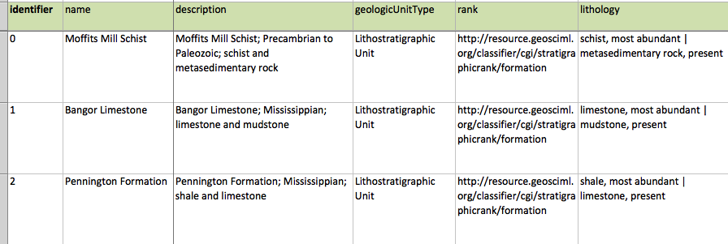
GeoSciML-Portrayal Content Model

Slide 18
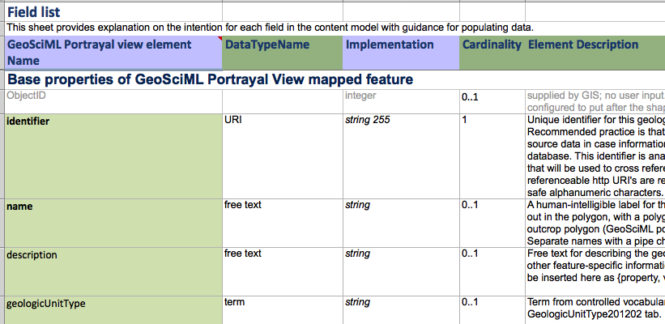
GeoSciML-Portrayal Content Model

Slide 19
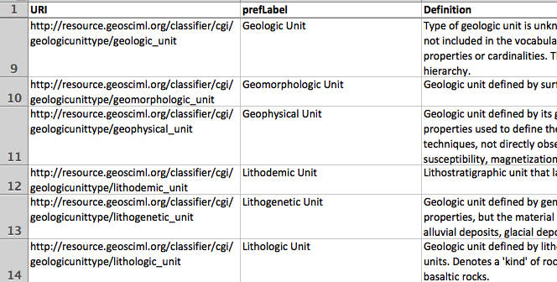
GeoSciML-Portrayal Content Model

Slide 20
Schema Mapping
GeoSciML-Portrayal content model needs to be joined to geometric fields that are necessary for an actual GIS feature class (e.g., through ESRI software via join function)
To be fully compliant with OneGeology, the joined data still need to be mapped to the appropriate feature-class schema that contains the symbology

Slide 21
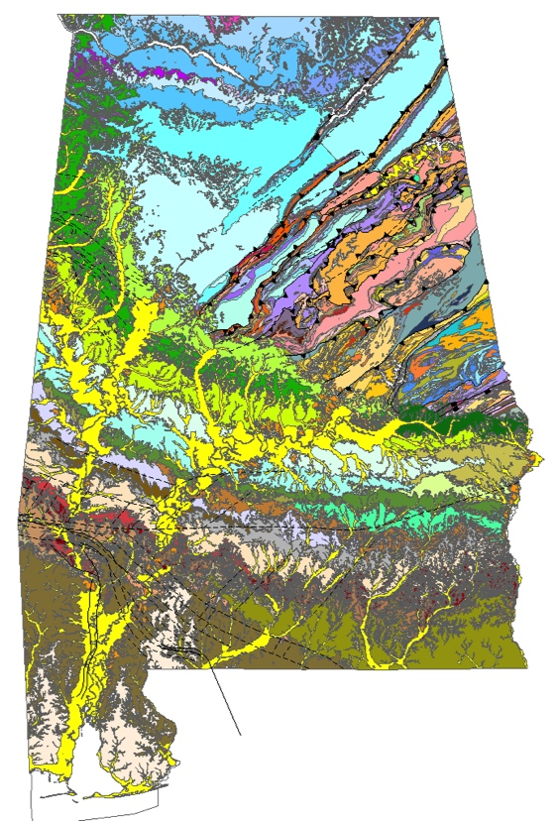
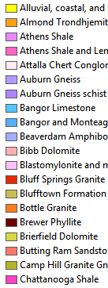
GeoSciML-Portrayal – Lithostratigraphy

Slide 22
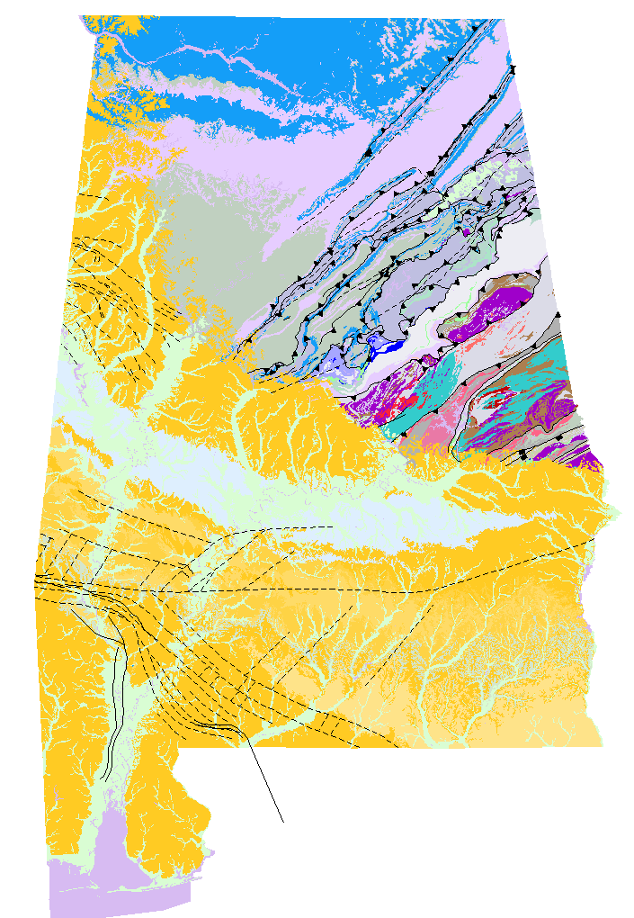
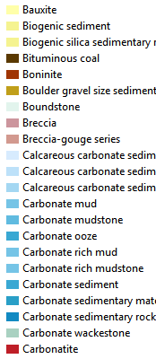
GeoSciML-Portrayal – Lithology

Slide 23
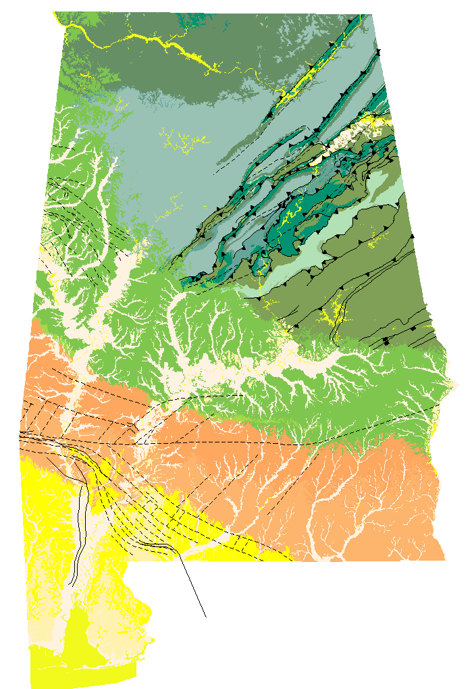
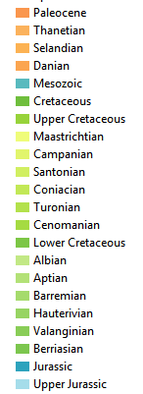
GeoSciML-Portrayal – Representative Age

Slide 24
Deploy Web Service
Surficial Geologic Map of Alabama is deployed as a web service via ArcGIS at http://map.gsa.state.al.us/ogbmaps/rest/services/OneGeology
  WFS: http://goo.gl/YHYCt4
  WMS: http://goo.gl/dKYILA
Final step – register service with OneGeology

Slide 25
What the GSA Learned
Need to aware of, and comply with when possible, accepted schemas and standards of (meta)data preservation and management
USGIN Content Models provide a guide for standardization of GSA metadata beyond NGDS
If data are not in compliance, there are processes to map original schema to an accepted schema

Slide 26
What the GSA Learned
Schema-mapping processes can even be taught to those without much experience to assist with goal of data being interoperable and accessible
  Tech-transfer is the key to success!
While issues of data provenance, quality, and preservation remain for legacy data, standards are being discovered, developed, and applied to any new data (including samples) moving forward

Slide 28
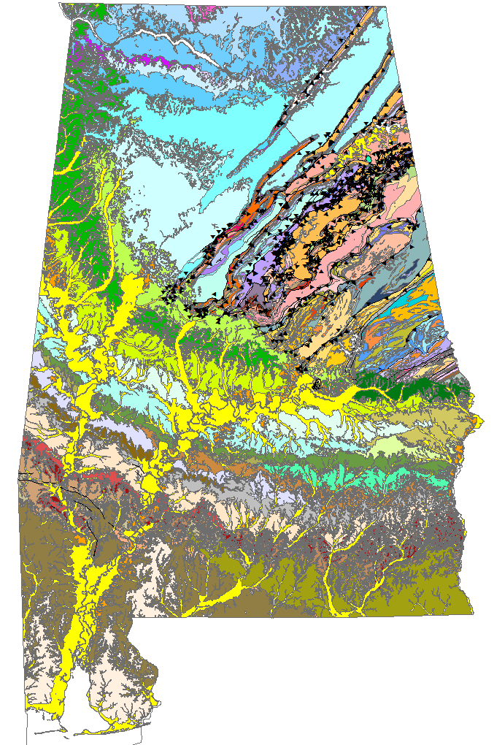
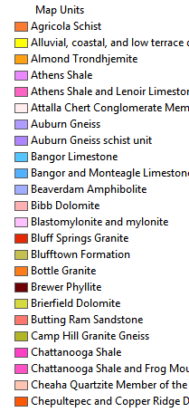
Geologic Map of Alabama

Slide 29
Feature Types
ContactView – contains features that represent mapped traces of boundaries between geologic units
ShearDisplacementView – contains features that represent mapped trace of any type of fault or shear zone
GeologicUnitView – contains polygon features that represent outcrop of a geologic unit

Slide 30
Map Source Data and Establish Symbology
Map existing content fields to corresponding GeoSciML-portrayal schema elements
Determine controlled vocabulary terms for lithology and age
Use standardized vocabulary to determine representative symbology

Slide 31
ContactView Schema

Slide 32
ETL Workflow
Determine which fields in source data contain information that is to be delivered in GeoSciML-portrayal
Determine steps necessary to get content into GeoSciML-portrayal format (e.g., concatenating multiple fields; standardized vocabulary)
Generate table to match GeoSciML-portrayal schema (through use of a content model)
Join generated table to geometry elements to generate final feature class

Slide 33
USGIN Objectives
To facilitate public access to interoperable digital geoscience data
To reduce the cost of online data publication
To preserve ownership, credit, and control of existing data
To distribute the logistical overhead associated with sharing digital information
To minimize reliance on proprietary software applications

Slide 34
GeologicUnitView Schema

Slide 35
Roadblock – “Disconnect” Between Data Creators and Data Scientists
Early on, standard data science and archival practices could be confusing for a data creator/provider, including the terminology
AZGS provided many useful resources
Webinars and workshops were conducted that greatly improved creator/provider’s understanding of expectations and of the data science field

Slide 36
Lessons Learned
Tech-transfer is key to the success of a robust, usable database – and this needs to be two-way
Data providers and creators need to be aware of existing standards, how they are used, and how they may be modified to best suit their needs if necessary

Slide 37
Roadblocks Overcome – A Shift in Mindset at GSA
In the past, GSA has primarily been data generator, with little concern about interoperability
New process: To think about what all different users might need with respect to metadata, for data discovery and access, and for object/data preservation

Slide 38
Moving Forward
A new web search database is in development for the GSA, with a variety of stakeholder needs addressed
NGDS Content Models provide a guide for standardization of GSA metadata beyond NGDS
While issues of data provenance, quality, and preservation remain for legacy data, standards are being discovered, developed, and applied to any new data (including samples) moving forward

