Slide 1
A Reappraisal of Flora in the Bertie Group and their potential significance in analyzing the environment of Late Silurian New York State and Canada
By Patrick R. Nolan
Senior Thesis
March 2014

Slide 2
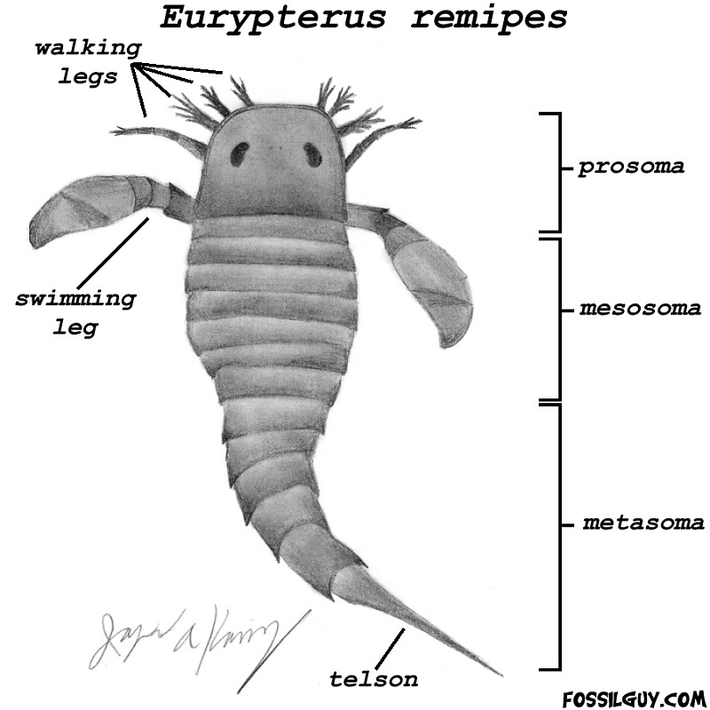
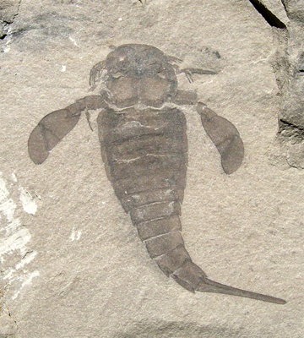
Introduction
The Bertie Group is well-known globally for its excellently-preserved eurypterid specimens.
As a result, most studies devoted to analyzing the environment represented in the Bertie Group have used the eurypterids as the measuring stick.
This is troublesome due to uncertainty in interpreting the actual environmental preferences of eurypterids, which has likewise led to different interpretations of the specific environment represented by the biota (Ex: Heckel 1972; Ruedemann 1925; Kindle 1934).
The focus of this study is to therefore examine non-faunal remains to determine whether or not Bertie flora can narrow down these possible environmental hypotheses.

Slide 3
Paleogeography
Geologic units of interest: Salina Group and overlying Bertie Group of the Late Silurian (~425 mya)
Deposited in the northern part of the Appalachian foreland Basin
Climatic conditions shifted from arid to humid and back to arid from the Late Ordovician to Late Silurian

Slide 4
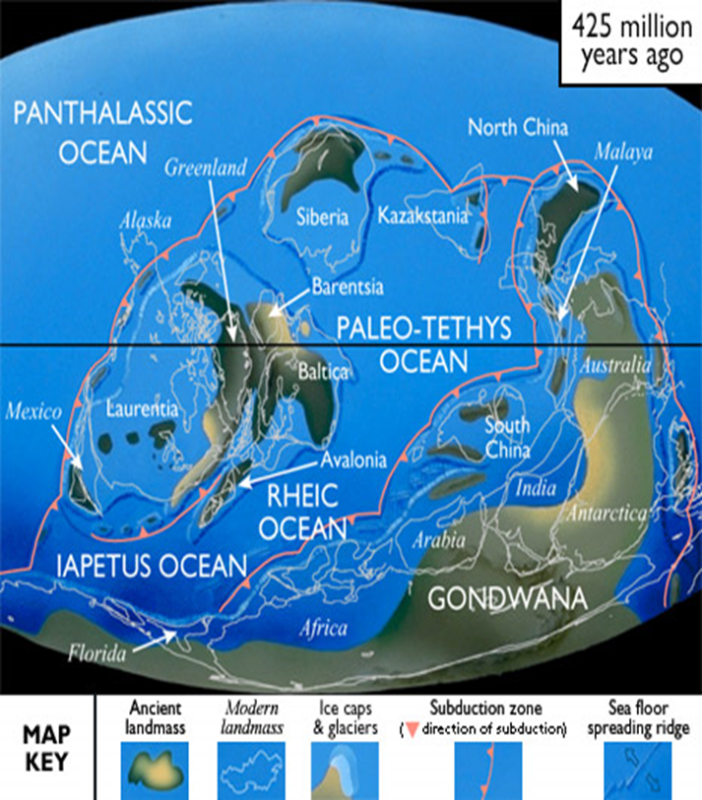
Major outcrop area of Bertie Group

Slide 5
Salina Group
The Salina Group represents three basic types of successive depositional environments (Gill 1997): Shallow subtidal, intertidal, and supratidal-intertidal flats.
Immediately prior to Salina time, there existed a thriving environment characterized by reef-building organisms.
This was followed by a period of extreme evaporation at the beginning of the Salina Group that ultimately led to severe desiccation and the deposition of potash salts.

Slide 6
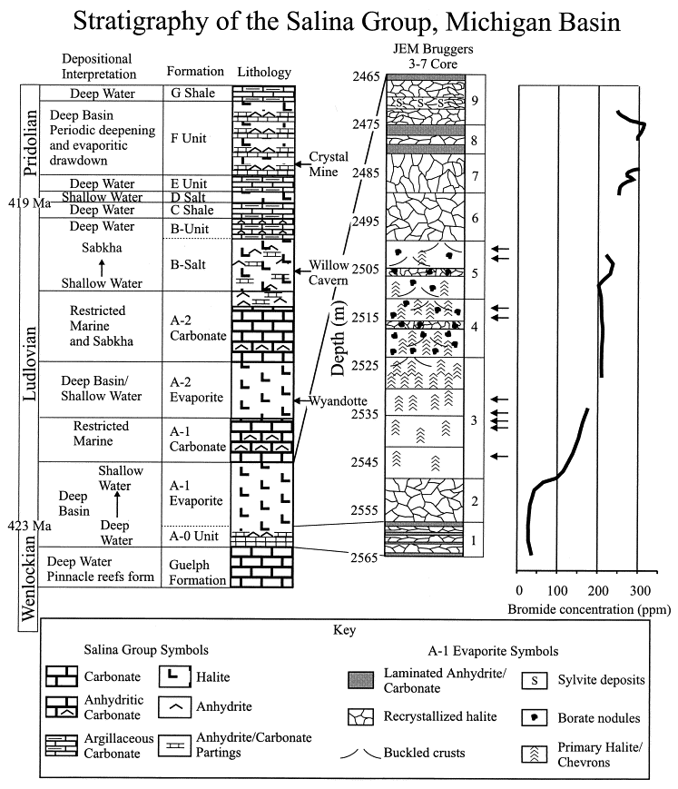
Salina Group
Due to the relatively low slope of the basin area, even minor changes in sea level resulted in substantial oscillations in Salina water level.
Oscillations created pattern of submergence and desiccation equivalent to four sabkha cycles.
Cycling frequently restricted water inflow/outflow and isolated the Salina Group from open exchange with the rest of the sea as indicated by a strikingly low faunal variety (Kluessendorf 1994).

Slide 7
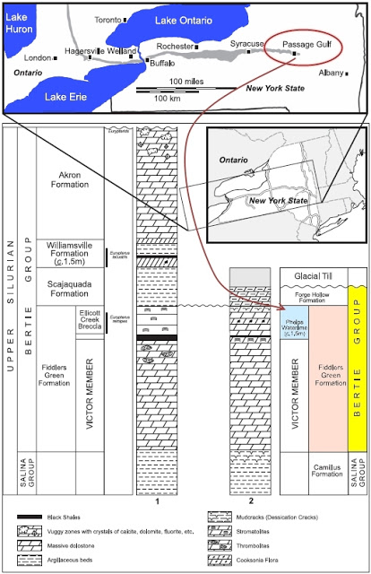
Bertie Group
First formally named by Chapman (1864).
Widely recognized to minimally represent a relatively stable, near-shore environment.
Abundant salt hopper crystals throughout group indicates a fairly hypersaline environment.
Identification of specific environment via biota is often based on incomplete eurypterid ecology.
Split into four major formations: Fiddlers Green, Scajaquada, Williamsville and Akron.
Overall stratigraphy denotes the progress of transgression/regression cycles.

Slide 8
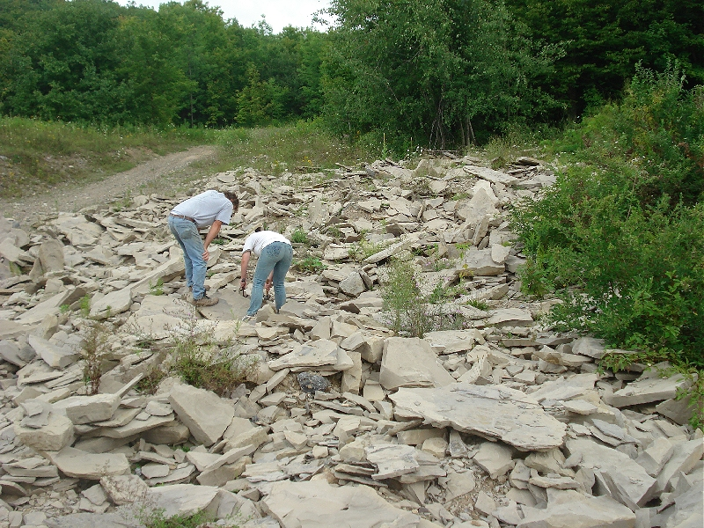
Fiddlers Green Formation
One of two highly-fossiliferous formations within the Bertie Group.
About 75% of the Formation is comprised of the Victor Member, consisting of massive, fossiliferous dolostone with thrombolites present at the member’s cap.
Uppermost portion of the formation, separated from the Victor Memeber by a thin layer of black shale, is known as the Ellicott Creek Breccia. This unit is interpreted as a paleoseismite created by the eastward migration of the Appalachian Basin (Brett et al. 1994).

Slide 9
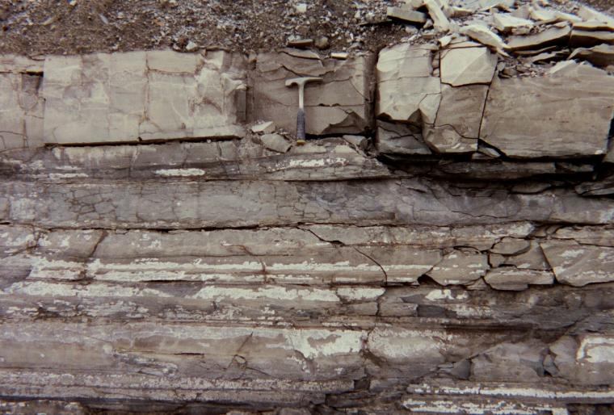
Scajaquada Formation
Comprised of argillaceous beds with small chert nodules, siliceous grains found at irregular intervals and a near-complete lack of fossils (Ciurca 2011).
Generally interpreted as a supratidal environment, specifically an evaporite basin.

Slide 10
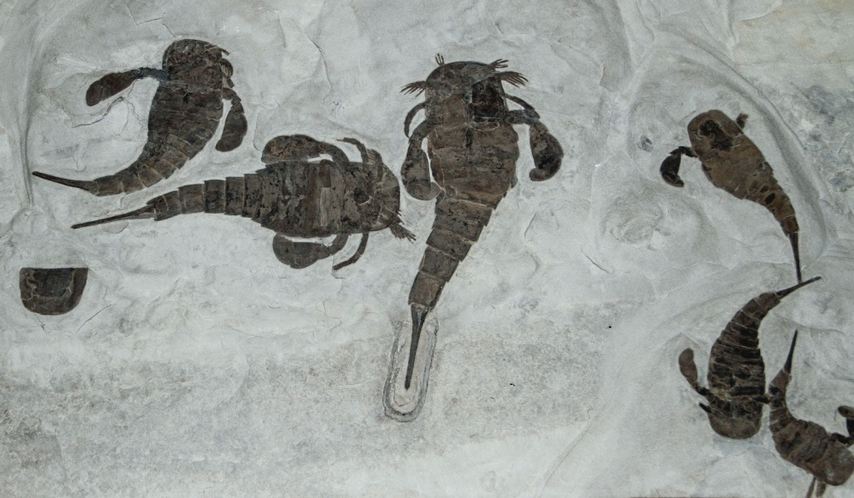
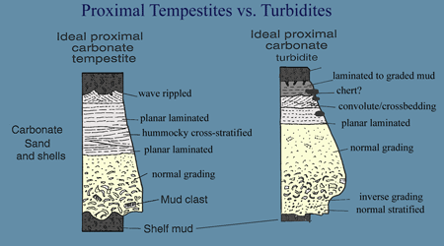
Williamsville Formation
Highly-fossiliferous unit, alongside Fiddlers Green Formation.
Separated into two units, Williamsville ‘A’ and Williamsville ‘B’, by a thin layer of black shale.
Williamsville ‘A’: Ludicrously fossiliferous in regards to eurypterids.
Williamsville ‘B’: Argillaceous beds with very few fossils.
Abrupt truncation of Williamsville ‘A’ at boundary before continued deposition suggests a storm event of some sort. Unable to determine if it is a proximal tempestite or turbidity deposit due to inexplicable lack of data on sedimentary structures.
Absence of salt hopper crystals in some portions may suggest that portions of the formation may have been deposited outside of hypersaline conditions.

Slide 11
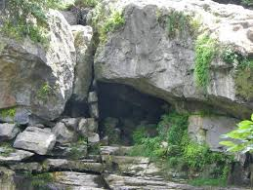
Akron Formation
Decent faunal variety, but an almost complete absence of eurypterids.
May possibly represent a massive thrombolite deposit (Ciurca 2011).
Base of formation marks a high point in sea level while upper portions represent regression, indicated by vuggy porosity (Belak 1980).

Slide 12
Methodology
Fossil samples extracted from outcrops of the Fiddlers Green and Williamsville Formations.
Locations represent two isolated ‘pools’ within Bertie depositional history.
Limitations of study based on excess of fossils from Fiddlers Green and paucity of fossils from Williamsville.
Due to lack of preserved detail, comparisons are made solely on the basis of morphology.

Slide 13
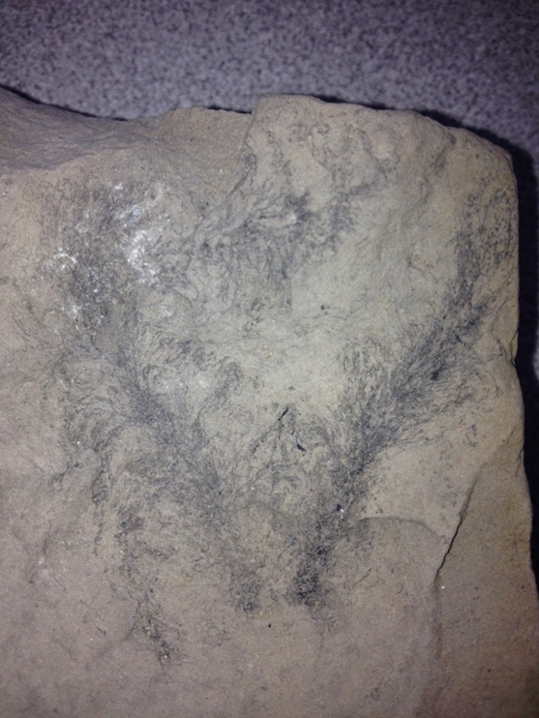
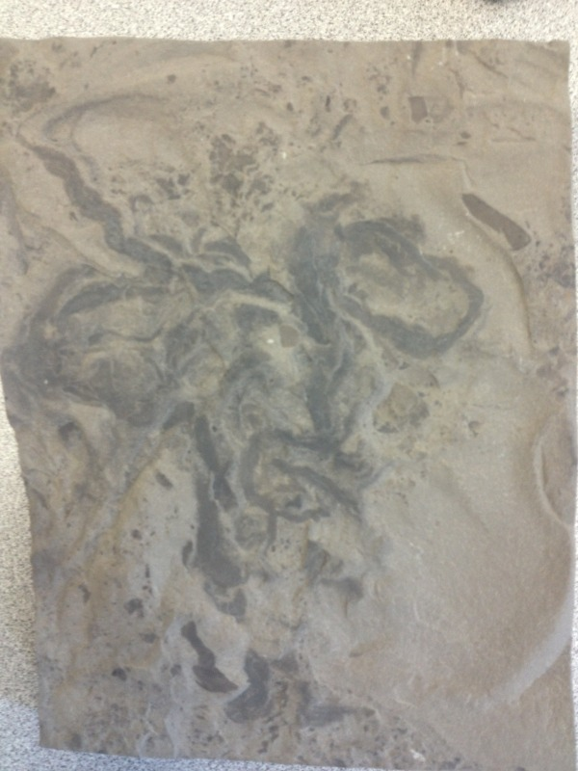
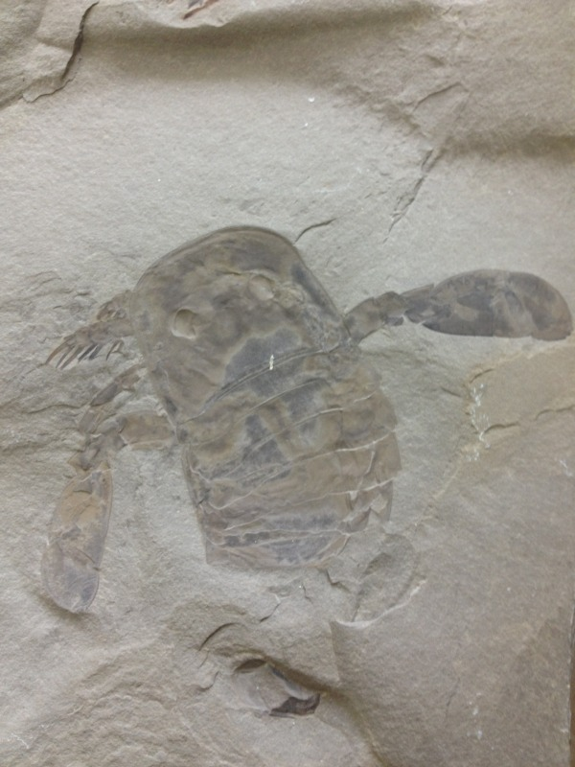
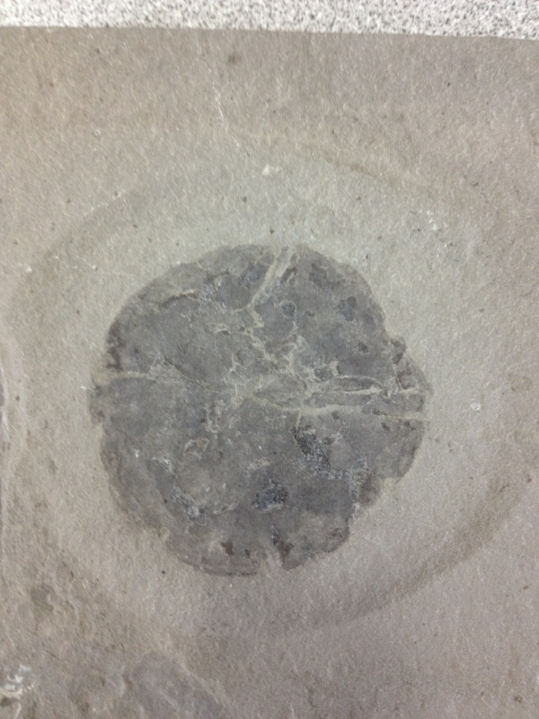
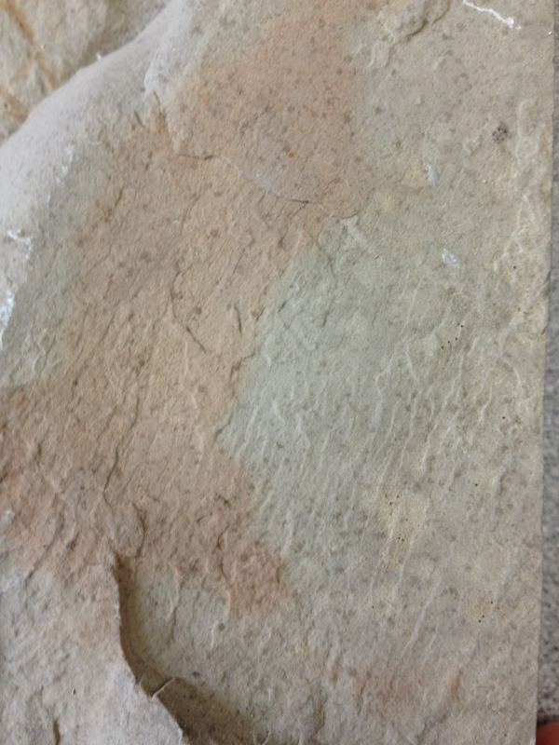
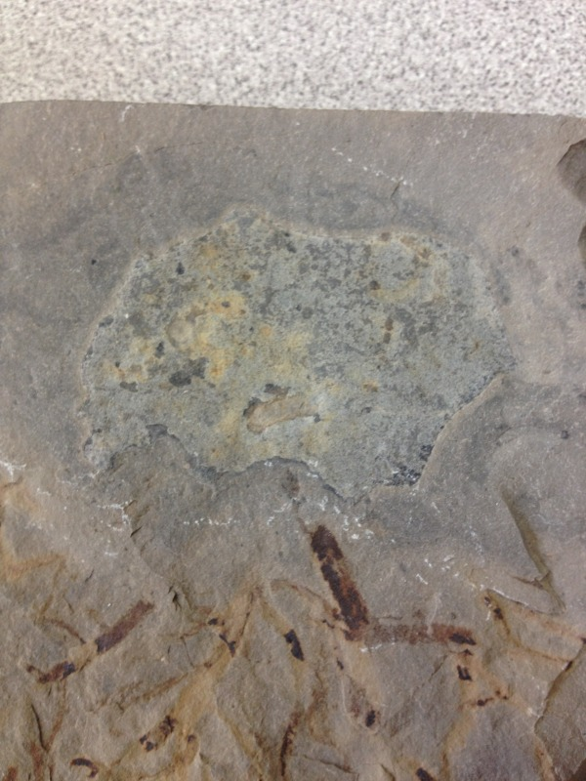
Fossil Specimens: Samples of previously-described organisms
1cm
1cm
1cm
Medusaegraptus mirabilis
Inocaulis lesquereuxi
Eurypterus remipes
1cm
1cm
1cm
Pterygotus (Acutiramus) macrophthalmus cummingsii
Algal mats
Indescribable organic blobs/stains

Slide 14
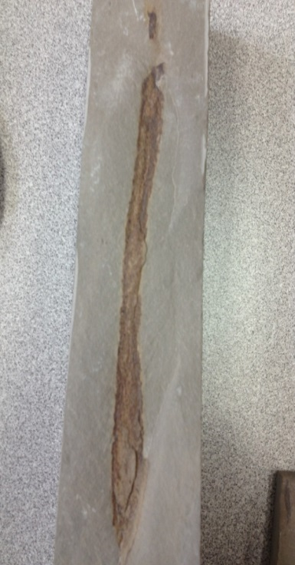
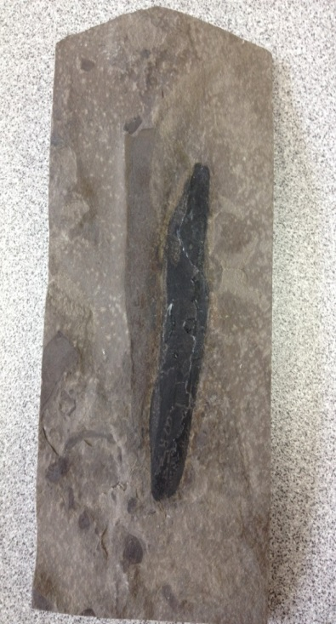
Undescribed occurrence: Prototaxites sp.
Characterized by distinct shape, the presence of thin lines running through lighter samples and the presence of thick, dark, opaque carbonaceous material (Etheridge 1881).
Generally agreed upon today as representing the fruiting structure of a giant fungus.
1cm
1cm

Slide 15
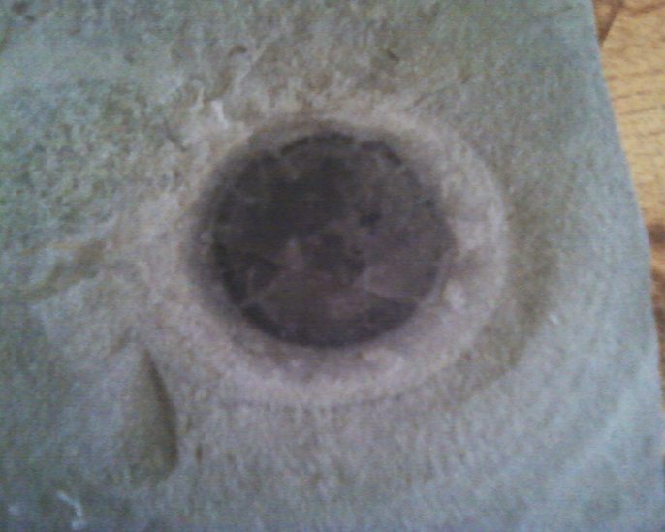
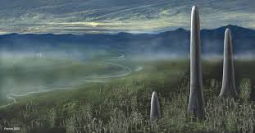
Undescribed occurrence: Prototaxites sp.
Similar specimens have been described in Canada and cross-sectional samples indicate that the specific species observed is Prototaxites loganii.
Further analysis beyond morphology impossible due to poor preservation of soft tissues to the point where even chemical peels are ineffective.
Never described in Bertie Formation before, but supports interpretation of a near-shore environment.
1cm

Slide 16
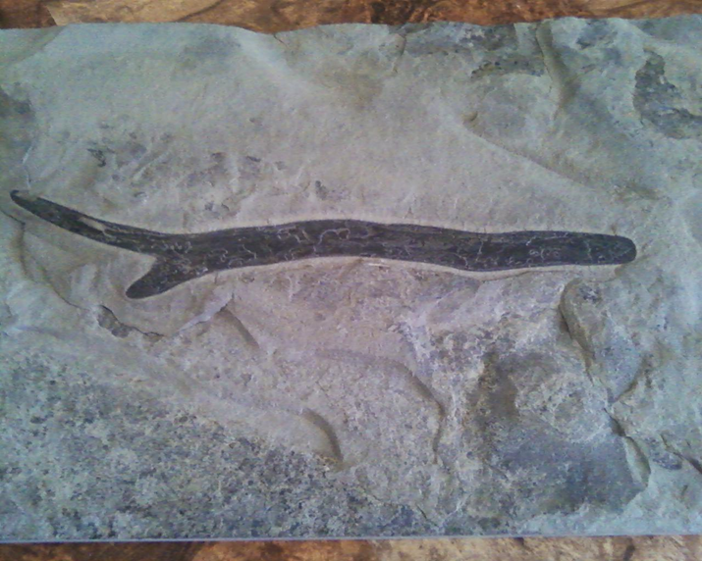
Undescribed floral morphology set #1
Specimen resembles Prototaxites sp. but displays clear branching/bifurcation of the body stalk.
This is in stark contrast to the traditional morphological model assigned to the genus Prototaxites.
The affinity and significance of this morphology is still uncertain.
1cm

Slide 17
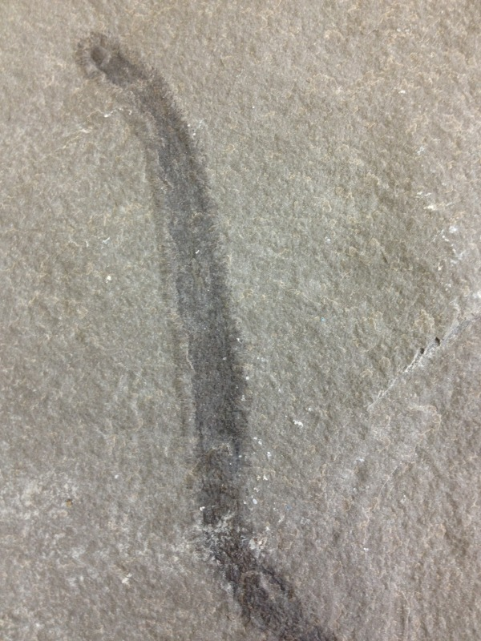
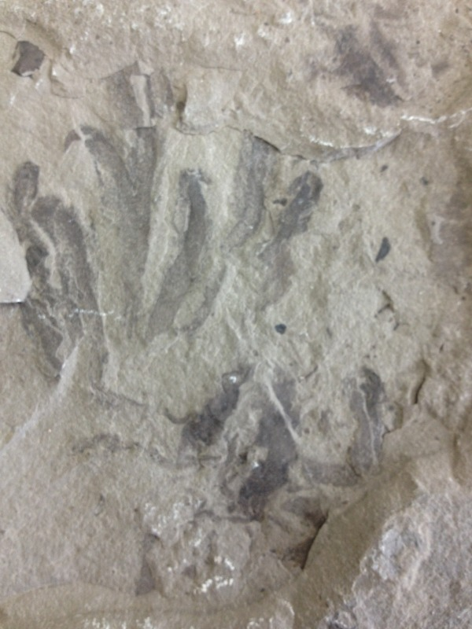
Undescribed floral morphology set #2
Differentiated by existence and length of filament-like structures on outer edges surrounding a solid, dark core.
Short, straight filaments = Williamsville Formation; long, angled filaments = Fiddlers Green Formation
1cm
1cm

Slide 18
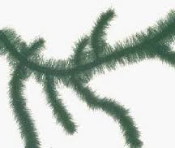
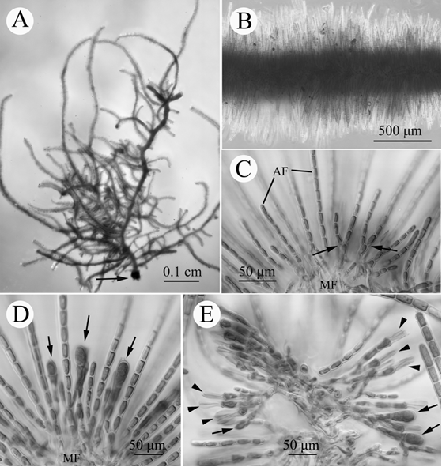
Undescribed floral morphology set #2
Modern morphological analogues exist for samples in Thorea hispida (long filaments) and Thorea violacea (short filaments), which are red algae.
Found in shallow, temperate to warm bodies of alkaline freshwater in NA, SA and EU.
Morphologies may denote new species, but further morphological research is required for verification.
0.5mm

Slide 19
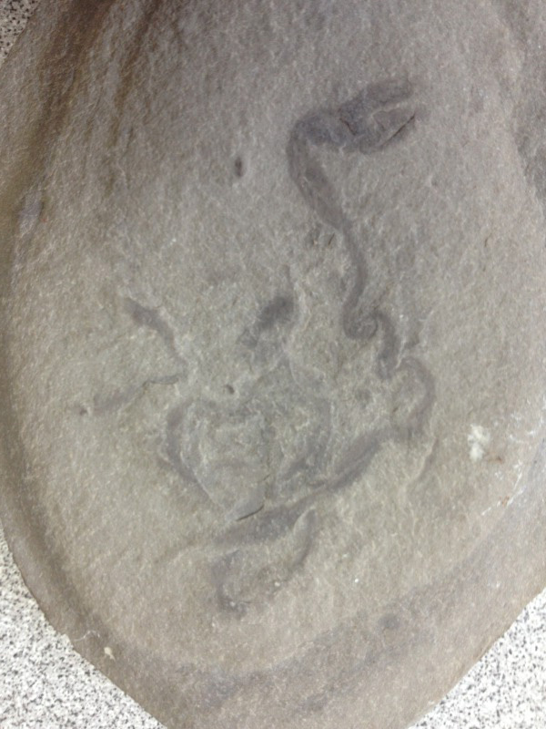
Undescribed floral morphology set #3
Morphology defined by unique twisting of a stem-like structure and elongated outgrowth on the distal end of the fossil.
Morphological traits are not shared by any other fossils collected in study nor any recognized in previous studies of the Bertie Group.
Morphological traits similar to what is seen in Tortilicaulis, but does not closely match any known specimens.
1cm

Slide 20
Discussion: Interpretation of Bertie Group environment
Undescribed nature of specimens = unsure environmental preferences, so it is hypothesized that they shared environmental preferences similar to those of their closest morphological analogues.
Prototaxites: Terrestrial or at the very least partially-terrestrial environment.
Undescribed floral morphology set #1: Affinity indeterminable.
Undescribed floral morphology set #2: Freshwater environment.
Undescribed floral morphology set #3: Brackish sub-intertidal environment.

Slide 21
Discussion: Interpretation of Bertie Group environment
Altogether, floral analysis seem to match the interpretation of the Bertie Group given by Kindle (1934) as a brackish to freshwater lagoon or estuary.
Uncertain affinities of most observed specimens nonetheless leaves the environmental context of the Bertie biota too complicated to fully understand with present data.
Possibility of wash-in material further muddles interpretations of the environment and potential specimen source areas.

Slide 22
Conclusion
Interpretations of the Bertie Group’s environment are varied and flawed in not taking into heavy consideration floral remains.
A floral study into the biota of the Bertie Group has revealed the presence of Prototaxites and several undescribed potential plant and/or algae morphologies.
While no certain conclusion can be made to pinpoint the exact identity of the environment represented, environmental links between the described fossil specimens and their closest morphological analogues tentatively suggest a brackish to freshwater lagoon or estuary as first proposed by Kindle (1934).
Issues regarding the affinities of observed specimens and the actual source area for present fossils are still difficult to deal with without further data.
Further floral analyses will hopefully help refine this interpretation and in turn spur additional research to better understand the distribution, occurrence and identification of fossil floral remains within the context of the Bertie Group and what environment the overall biota represents.

Slide 23
References
Altmeyer, H. (1973). “Astnarben an Prototaxiten?” Der Aufschluss 24, 350-356.
Beaumont, C., Quinlan, G., & Hamilton, J. (1988). "Orogeny and stratigraphy: Numerical models of the Paleozoic in the eastern interior of North America." Tectonics, 7(3), 389-416.
Belak, R. (1980). "The Cobleskill and Akron members of the Ronadout Formation: Late Silurian carbonate shelf sedimentation in the Appalachian Basin, New York State." Journal of Sedimentary Research, 50(4), 1187-1204.
Braddy, S. J. (2001). "Eurypterid palaeoecology: palaeobiological, ichnological and comparative evidence for a 'mass-moult-mate' hypothesis." Palaeogeography, Palaeoclimatology, Palaeoecology, 172, 115-132.
Brennan, S. T., & Lowenstein, T. K. (2002). "The major-ion composition of silurian seawater." Geochimica et Cosmochimica Acta , 66(15), 2683-2700.
Brett, C. E., Goodman, W. M., LoDuca, S. T., & Lehmann, D. F. (1994). Ordovician and Silurian Strata in the Genesee Valley area: Sequences, cycles and facies: New York State Geological Association 66th Annual Meeting Guidebook. University of Rochester, 381-439.
Chamberlin, T. C. (1900). “On the habitat of early vertebrates.” Journal of Geology, 8, 400-412.
Chapman, E. J. (1864). A popular and practical exposition of the minerals and geology of Canada. WC Chewett and Company.
Ciurca, Jr., Samuel J. (2011). "Eurypterids Illustrated: The Search for Prehistoric Sea Scorpions." Geologic Journal, 46(6), 662-691.
Clarke, J. M. (1900). Merostomata. Textbook of Paleontology. Macmillan, London, pp. 673ą678.
Das, N., Horita, J., & Holland, H. D. (1990). "Chemistry of fluid inclusions in halite from the Salina Group of the Michigan basin: Implications for Late Silurian seawater and the origin of sedimentary brines." Geochimica et Cosmochimica Acta, 54(2), 319-327.
Edwards, D. (1979). "A late silurian flora from the Lower Old Red Sandstone of south-west Dyfed." Palaeontology, 22, 23-52.
Edwards, D., & Axe, L. (2004). "Anatomical Evidence in the Detection of the Earliest Wildfires." PALAIOS, 19(2), 113-128.
Etheridge, R. (1881). "On Plant-remains from the base of the Denbigshire Grits." The Quarterly journal of the Geologic Society of London, 37, 490 496.
Gill, D. (1997). "Salina A-1 sabkha cycles and the Late Silurian paleogeography of the Michigan Basin." Journal of Sedimentary Research, 47(3), 979- 1017.
Hamell, R. D. (1982). "Stratigraphy, petrology and paleoenvironmental interpretation of the Bertie Group (Late Cayugan) in New York." Empire State Geogram, 18, 37-38.

Slide 24
References
Heckel, P. H. (1972). "Recognition of ancient shallow marine environments." The Society of Economic Paleontologists and Mineralogists, Special Paper, 16, 226-286.
Kindle, E. M. (1934). "A new Silurian eurypterid locality in eastern Canada." Transactions of the RoyalSociety of Canada, 28, 43-47.
Kluessendorf, J. (1994). "Predictability of Silurian Fossil-Kosservat-Lagerstatten in North America." Lethaia, 27(4), 337-344.
LoDuca, S. T. (1990). "Medusaegraptus mirabilis Ruedemann as a noncalcified dasyclad alga." Journal of Paleontology, 64(3), 469-474.
Monahan, J. W. (1931). "Study of the fauna of the Bertie Formation." American Midland Naturalist, 12, 377-400..
Muir, L. A., Zhang, Y., & Lin, J. P. (2013). "New material from the Ordovician of China indicates that Inocaulis is a graptolite." Alcheringa, 37(4), 565- 566.
Ruedemann, R. (1924). “Recent publications on the origin and habitat of the Eurypterida.” American Journal of Science, 207, 227-232.
Ruedemann, R. (1925). "The Bertie Waterlime fauna, in some Silurian (Ontarian) faunas of New York." New York State Museum bulletin, 265, 8-14.
Schieber, J. (2013). "Microbial mats in terrigenous clastics: The challenge of identification in the rock record." PALAIOS, 14(1), 3-12.
Størmer, L. (1934). Merostomata from the Downtonian sandstone of Ringerike, Norway. I Kommisjon hos Jacob Dybwad.
Størmer, L. (1955). Merostomata, p. P4–P41. Treatise on Invertebrate Paleontology, Pt. P, Arthropoda, 2.
Tetlie, O. E., Victor, Tollerton Jr., V. P., & Ciurca Jr., S. J. (2007). "Eurypterus remipes and E. lacustris (Chelicerata: Euryptida) from the Silurian of North America." Bulletin of the Peabody Museum of Natural History, 48(1), 139-152.
Van der Voo, R. (1988). "Paleozoic paleogeography of North America, Gondwana and intervening displaced terranes: Comparisons of paleomagnetism with paleoclimatology and biogeographical patterns." Geologic Society of America Bulletin, 100, 311-324.
Wehr, J. D. (2002). Freshwater algae of North America: ecology and classification. Academic Press.
Witzke, B. J. (1990). Palaeoclimates constrains for palaeozoic Palaeolatitudes of Laurentia and Euramerica. Geological Society, London, Memoirs, 12(1), 57-73.

