Slide 1
A Tribute to Allan Thompson
Or – “How to Make an Earth Scientist out of a Mall Chick from Jersey”

Slide 2
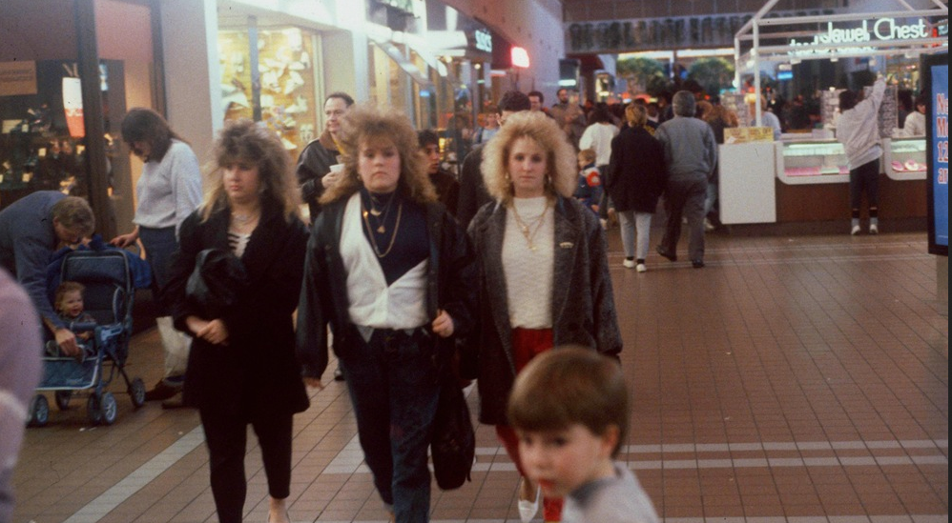
When I first met Doc Thompson, I was a mall chick!

Slide 3
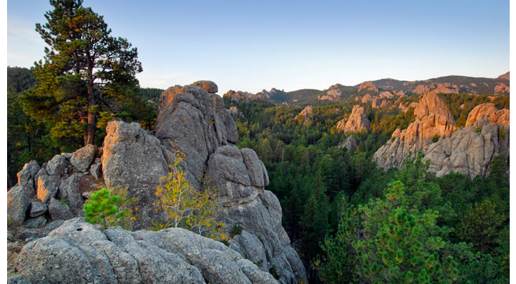
Then we went to Field Camp in South Dakota and Wyoming

Slide 4
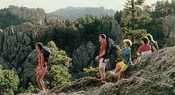
And he showed me how beautiful the natural world is

Slide 5
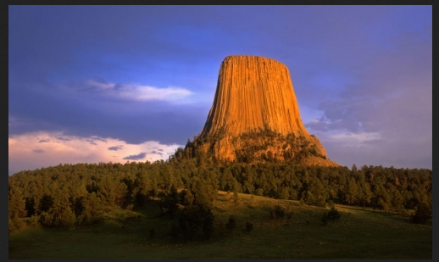
And some great geology!

Slide 6
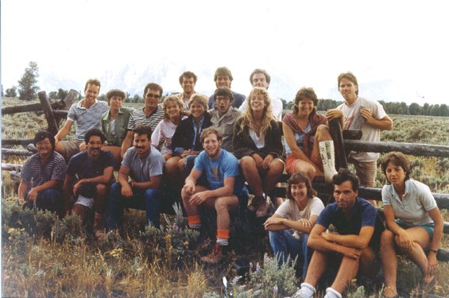
He taught me that I could build my life around my new-found love for the great outdoors

Slide 7
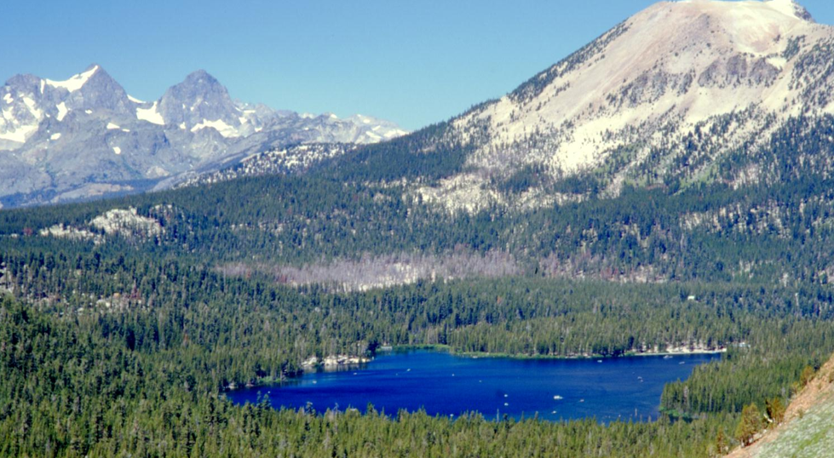
So I went to Grad School, and moved to California

Slide 8
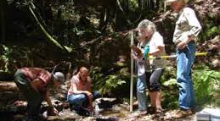
I started teaching about stream restoration

Slide 9
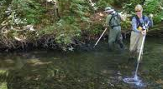

Slide 10
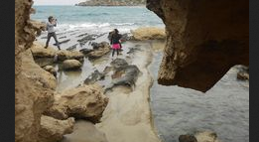
Then I moved to Bahrain and started teaching kids to love nature

Slide 11
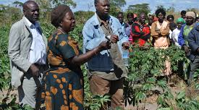
I continued my teaching in Zambia – growing cassava for drought prone climates

Slide 12
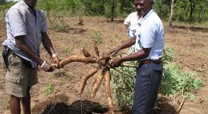

Slide 13
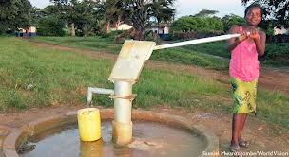
And taught them how science can be used to help make better lives for people

Slide 14
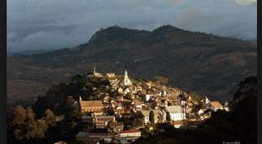
Kept spreading the word in Madagascar

Slide 15
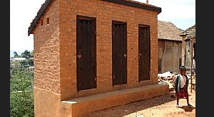
Building composting latrines in a historic city

Slide 16
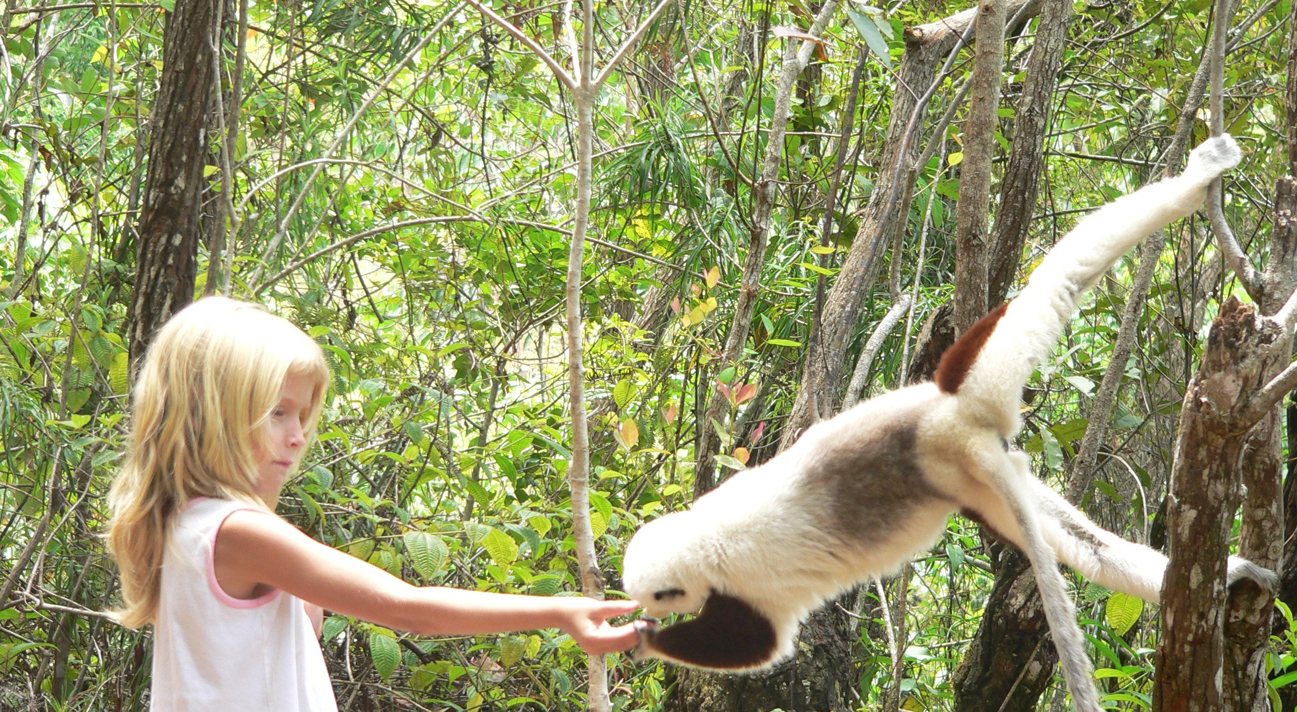
And saw a lot of lemurs

Slide 17
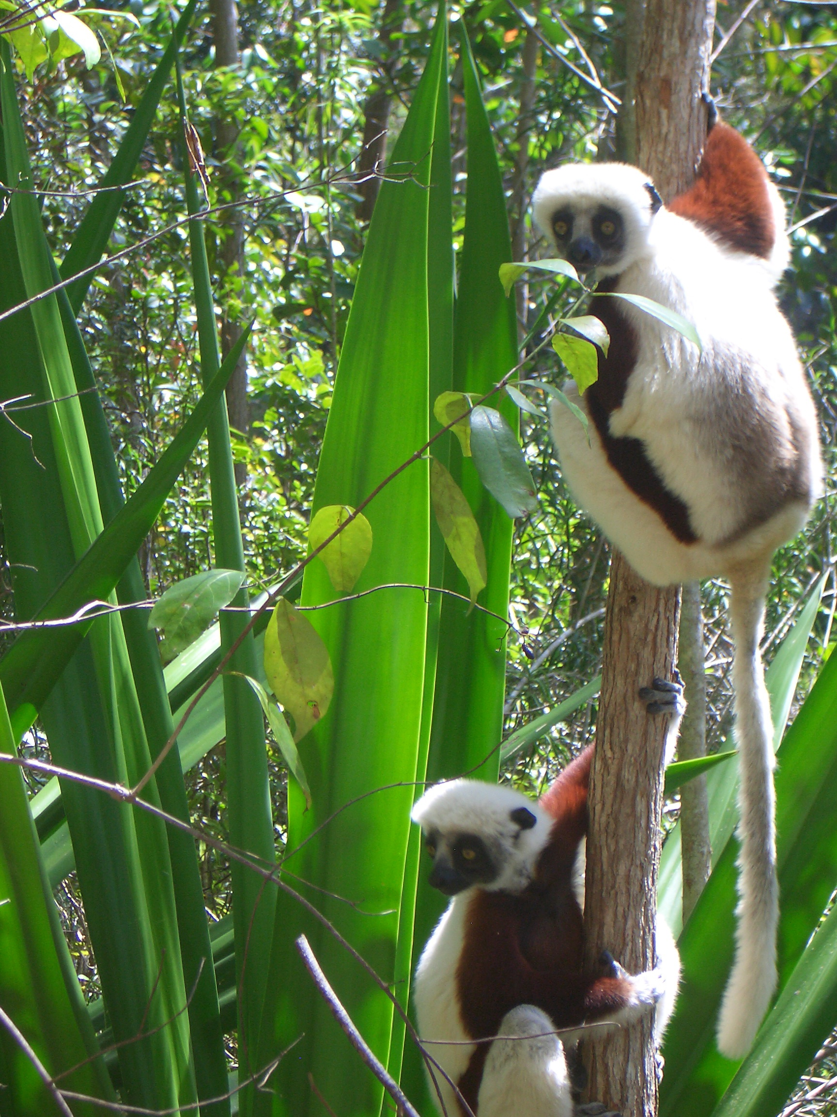
And saw some lemurs

Slide 18
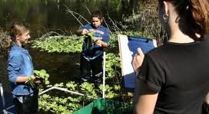
And in Florida – did a lot more water quality monitoring

Slide 19
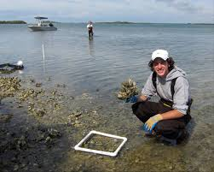

Slide 20
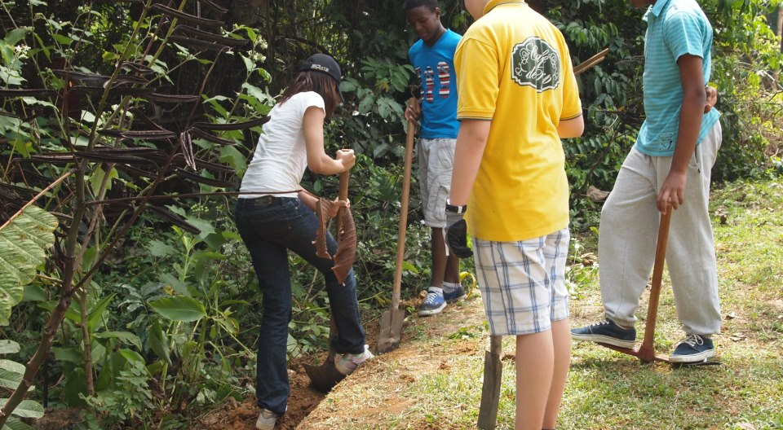
And in Cameroon – working at a gorilla and chimp sanctuary

Slide 21
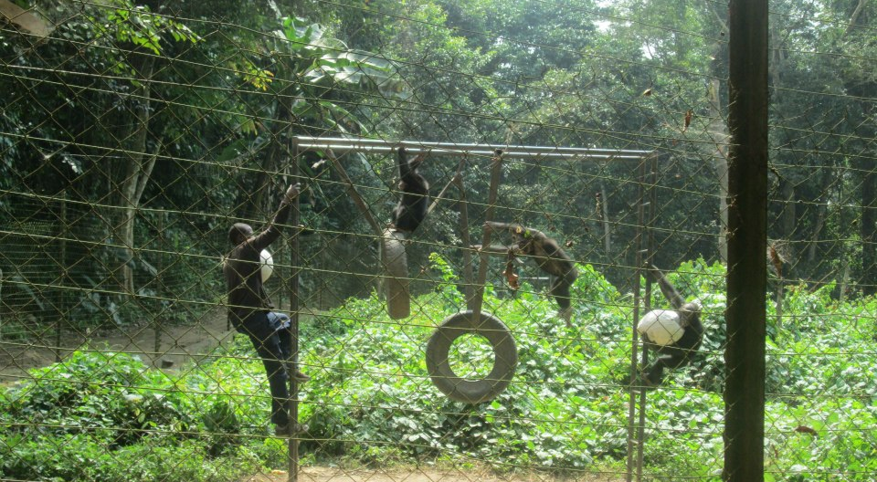
Building a play structure for orphan chimps

Slide 22
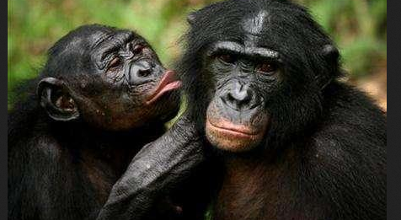
The next adventure is Congo

Slide 23
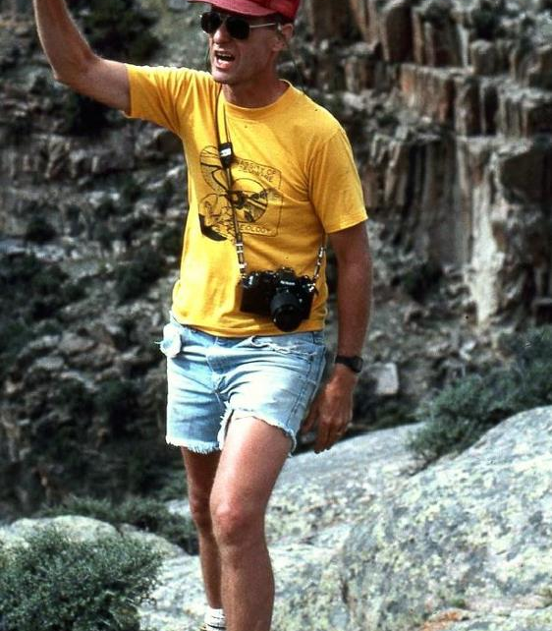
And it’s all because one man cared about that chick from Jersey!

Slide 24
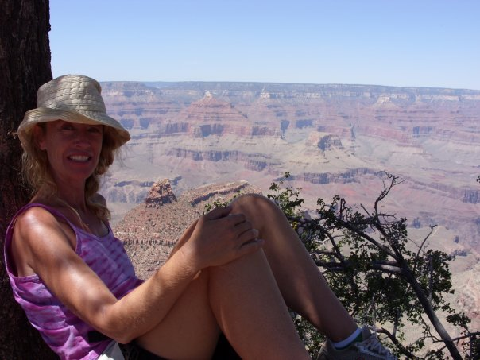
Thanks Doc Thompson – you will live in my heart forever!!!

