Slide 1





NEW APPLICATIONS FOR INTERFEROMETRIC
SYNTHETIC APERTURE RADAR [INSAR]:
FIELD VALIDATION STUDIES OF
PERSISTENT, DISTRIBUTED, AND TEMPORARY SCATTERERS
Brian S. Bruckno, Ph.D., P.G.
Edward J. Hoppe, Ph.D., P.E.
Andrea Vaccari, M.Sc.
Scott T. Acton, Ph.D. (P.I)
Elizabeth V. Campbell
Notes:
EVERY MAP: START WITH MAP, ADD PD, DS, and TS in ORDER

Slide 2
RITA-10
Project
RITA-10 Project
United Stated Department of Transportation Research and Innovative Technology Administration No. RITARS-11-H-UVA “Sinkhole Detection and Bridge/Landslide Monitoring for Transportation Infrastructure by Automated Analysis of Interferometric Synthetic Aperture Radar Images”
The views, opinions, findings, and conclusions reflected in this paper are the responsibility of the authors only and do not represent the official policy or position of the
USDOT/RITA, or any state or other entity
InSAR
Karst
Workflow
Conclusion

Slide 3

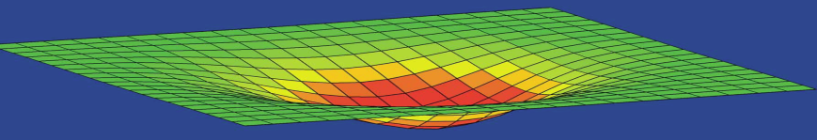
RITA-10
Project
InSAR
Interferometric Synthetic Aperture Radar
COSMO-SkyMed (Italian Space Agency)
32 images collected over ~1 year
X-band (λ = 3.1 cm)
Millimeter-scale accuracy in elevation measurements
InSAR
Karst
R2
Scatterer = A detectable
surface expression of varying
size and behavior
R1
Workflow
Conclusion

Slide 4
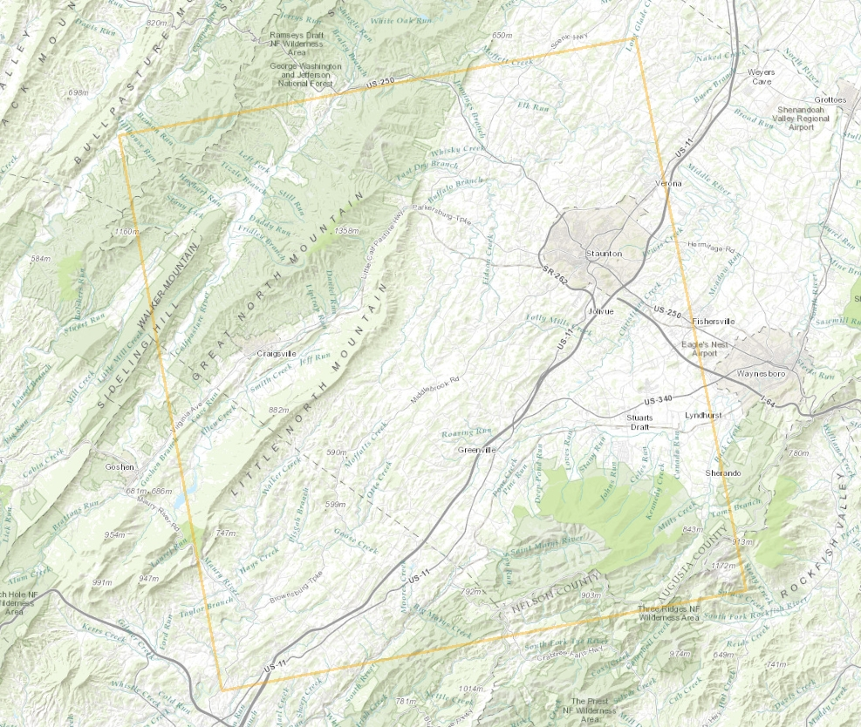
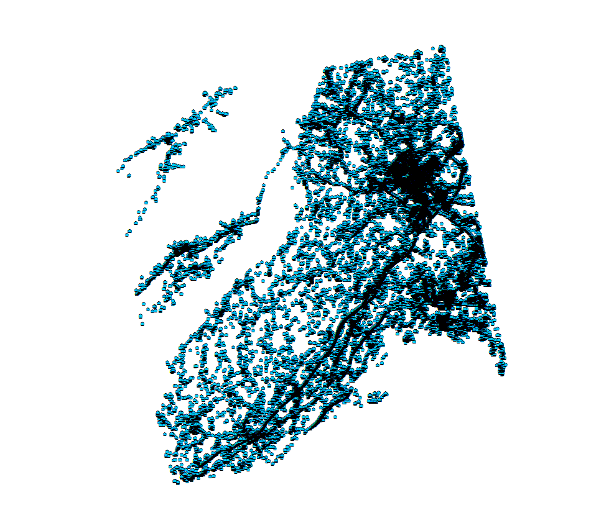
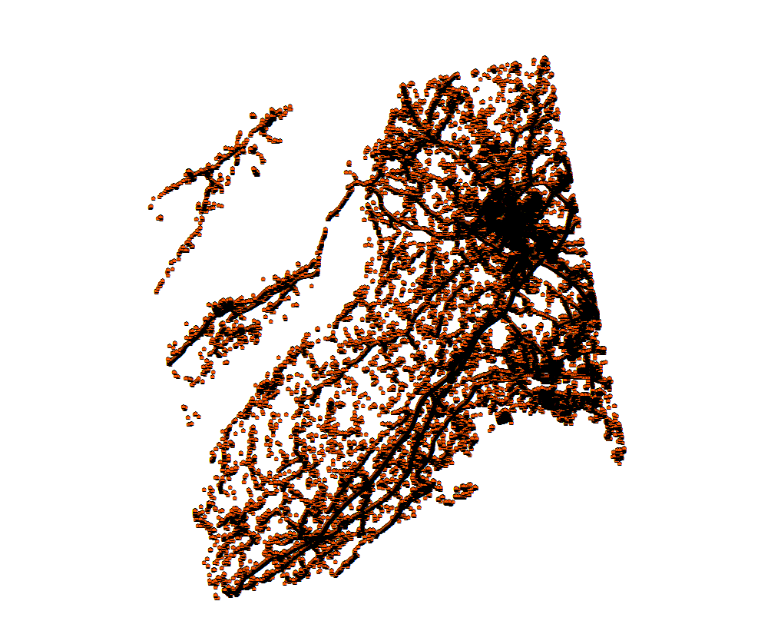
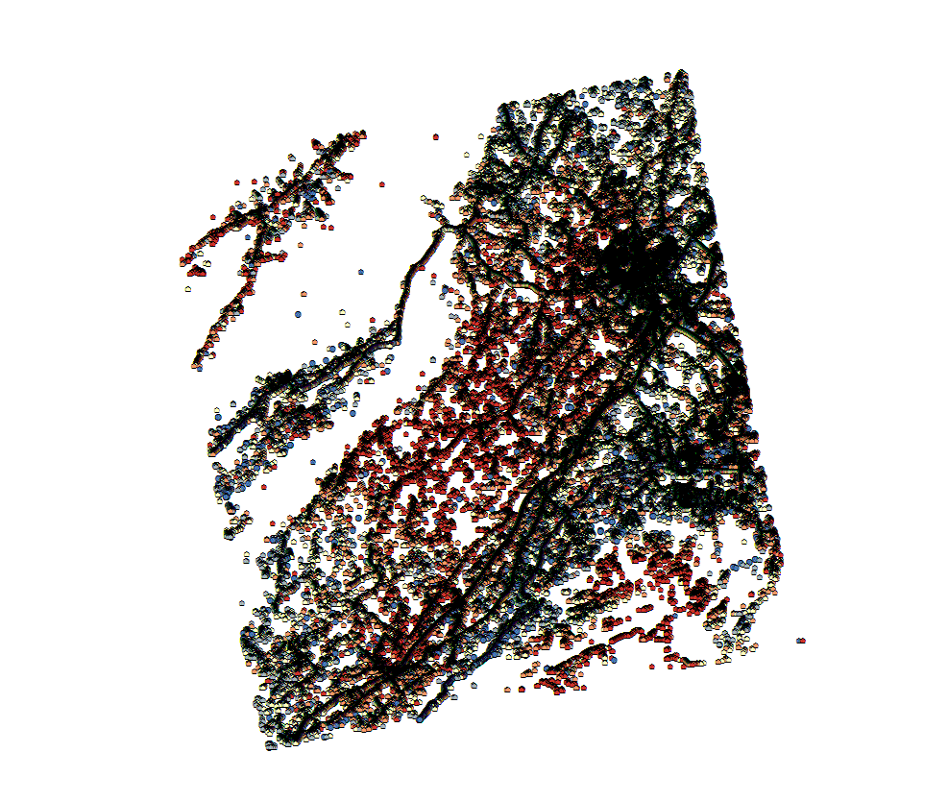
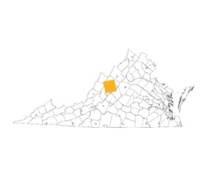

RITA-10
Project
InSAR
Each scatterer is associated with a set of metadata:
Velocity Towards or Away from Satellite
Acceleration Rate
Coherence Value
Effective Area
40 km
40 km
InSAR
PS: 167,801
DS: 131,285
TS: 724,882
Karst
N: 1,023,968
Workflow
Conclusion
ESRI ArcMap10.0, TRE dataset, VAGISP Base

Slide 5
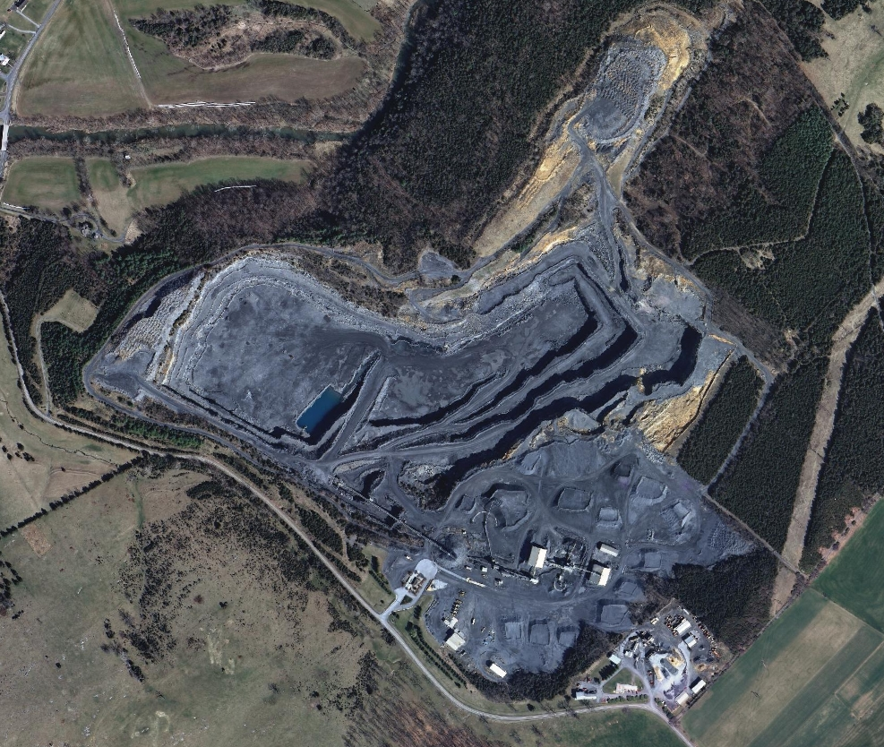
RITA-10
Project
InSAR
InSAR
Karst
Workflow
Conclusion
ESRI ArcMap10.0, TRE dataset, VAGISP Base

Slide 6
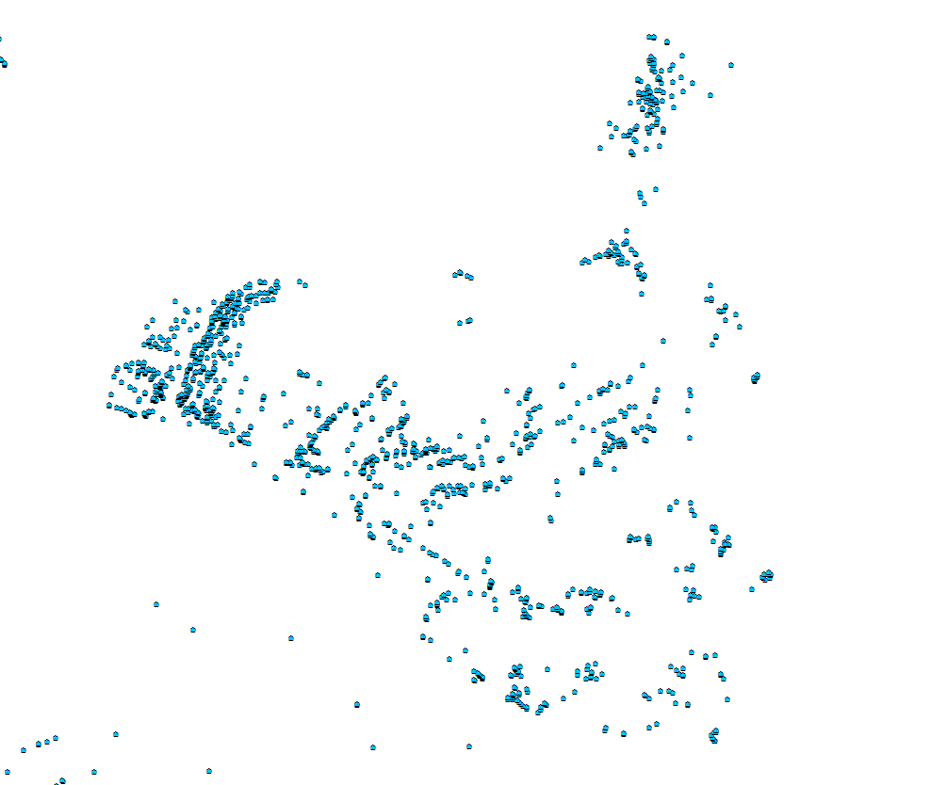
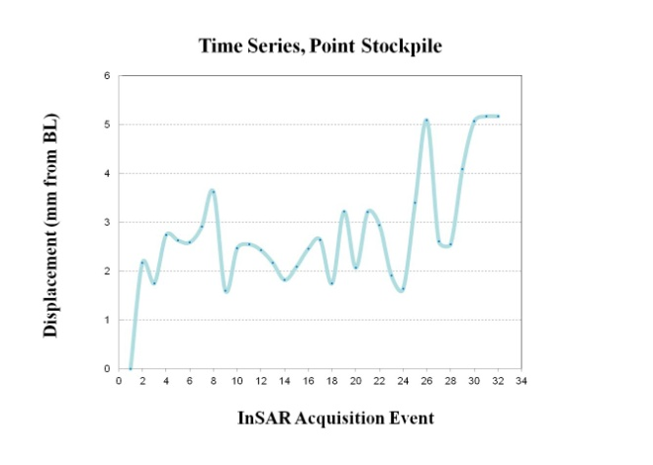
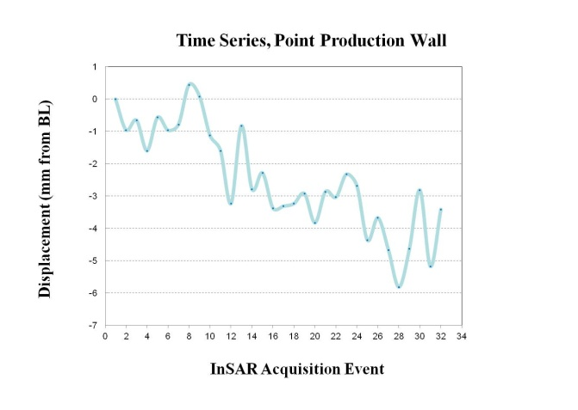
RITA-10
Project
InSAR
PS
InSAR
Karst
Workflow
Conclusion
ESRI ArcMap10.0, TRE dataset, VAGISP Base

Slide 7
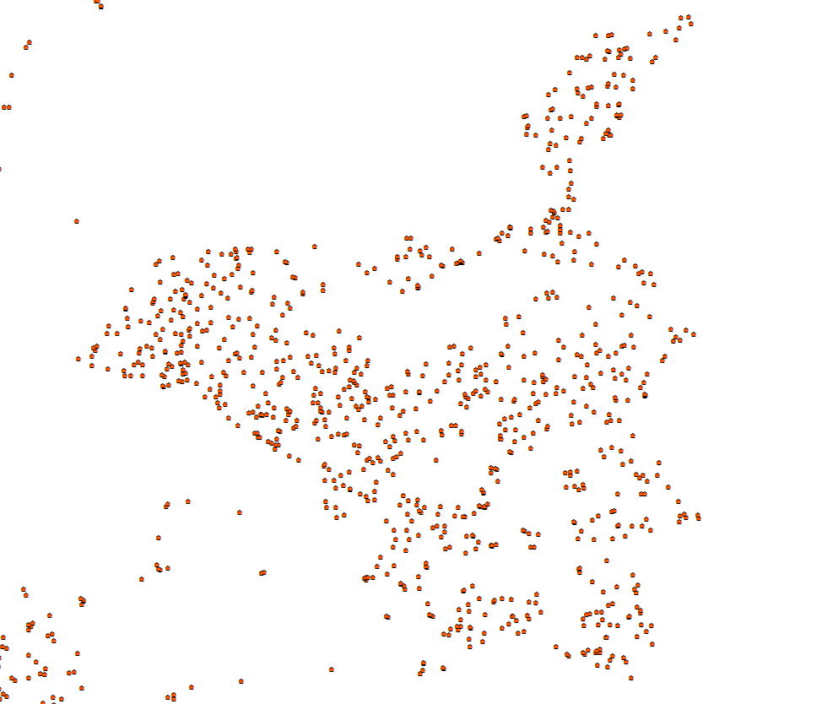
RITA-10
Project
InSAR
PS
DS
InSAR
Karst
Workflow
Conclusion
ESRI ArcMap10.0, TRE dataset, VAGISP Base

Slide 8
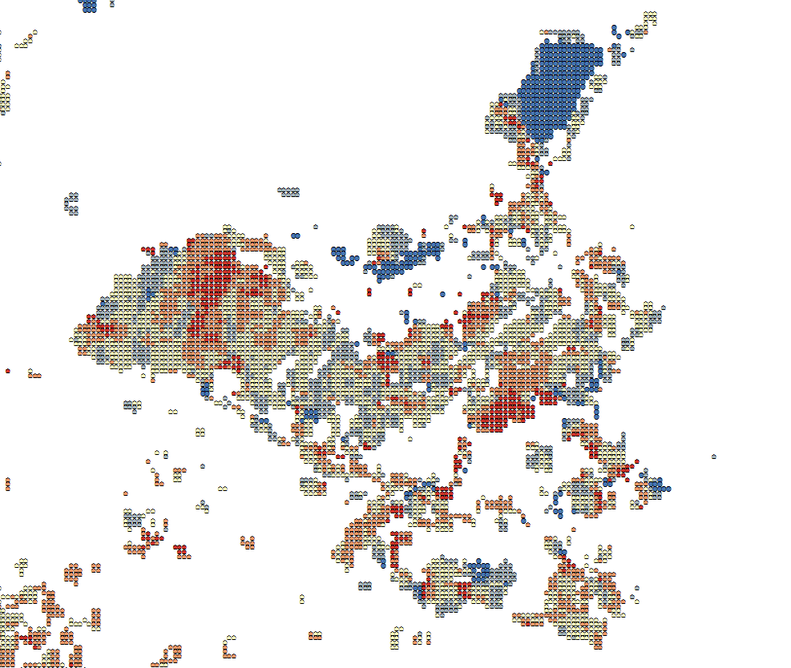
RITA-10
Project
InSAR
PS
DS
TS
InSAR
Karst
Workflow
Conclusion
ESRI ArcMap10.0, TRE dataset, VAGISP Base

Slide 9
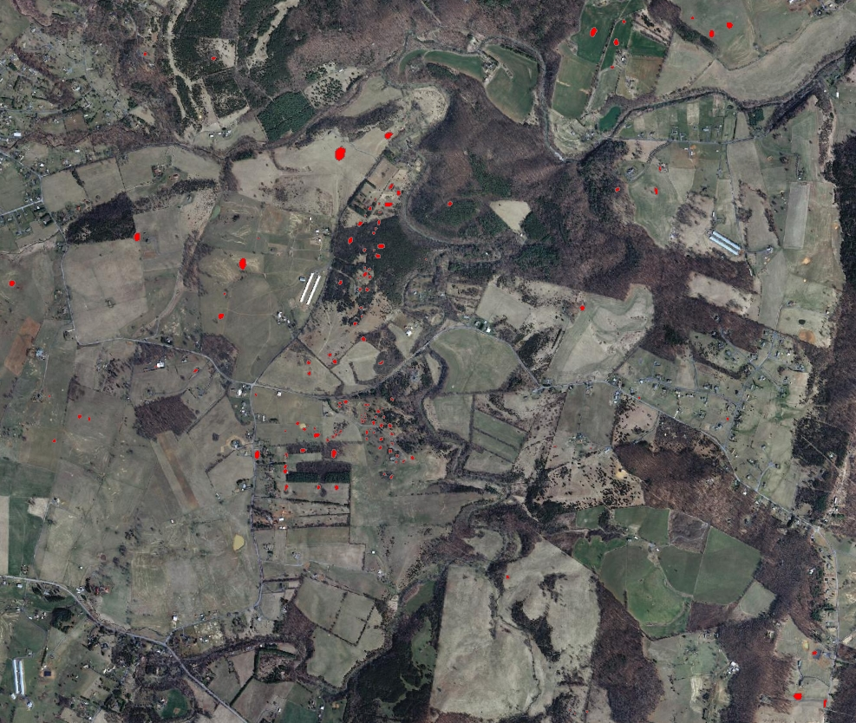
RITA-10
Project
Karst
Sinkhole
InSAR
Karst
Workflow
Conclusion
ESRI ArcMap10.0, TRE dataset, DMME VA Data, VAGISP Base

Slide 10
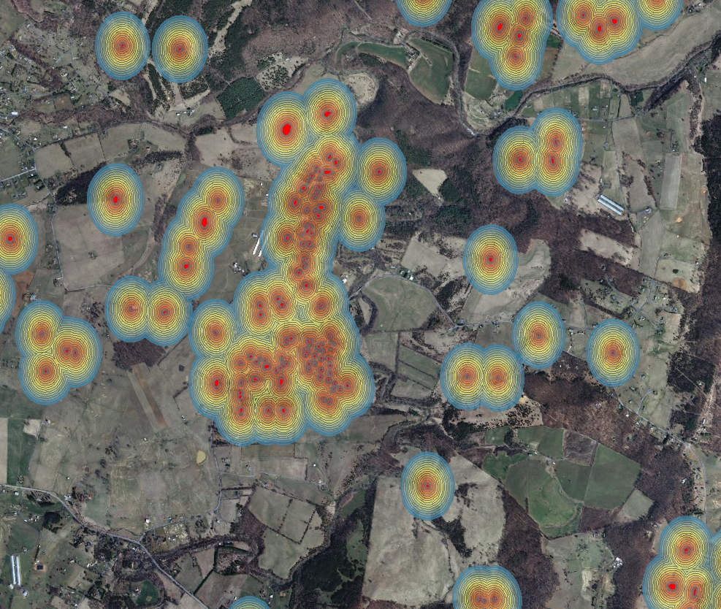
RITA-10
Project
Karst
Sinkhole
InSAR
Karst
Workflow
Conclusion
ESRI ArcMap10.0, TRE dataset, DMME VA Data, VAGISP Base

Slide 11
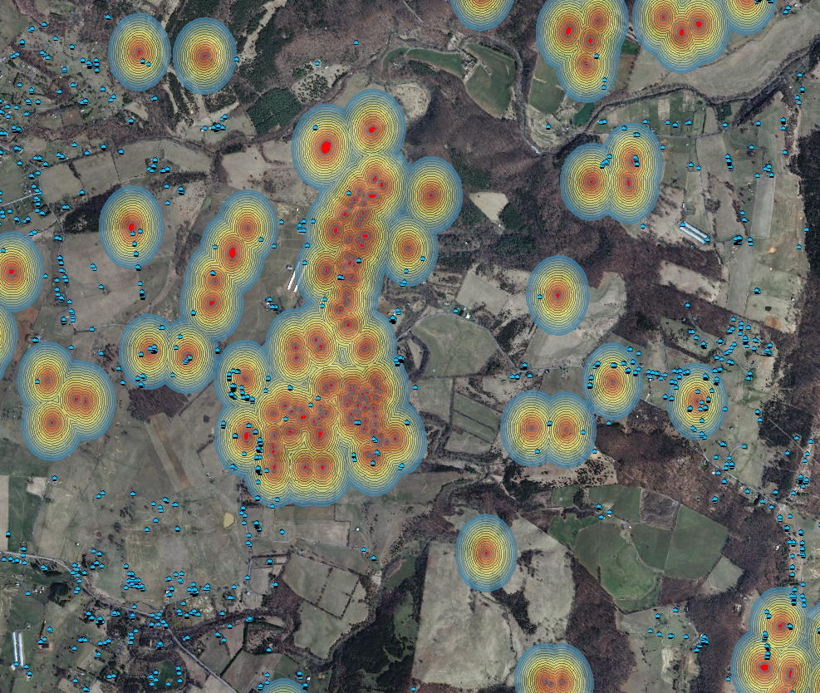
RITA-10
Project
Karst
Sinkhole
PS
InSAR
Karst
Workflow
Conclusion
ESRI ArcMap10.0, TRE dataset, DMME VA Data, VAGISP Base

Slide 12
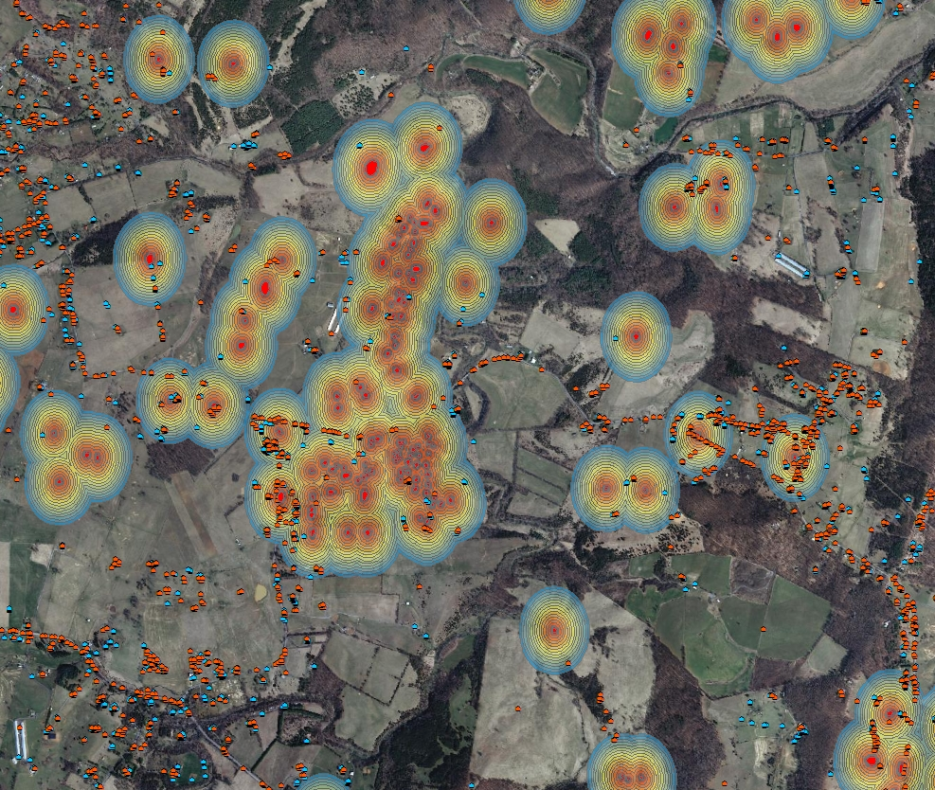
RITA-10
Project
Karst
Sinkhole
PS
DS
InSAR
Karst
Workflow
Conclusion
ESRI ArcMap10.0, TRE dataset, DMME VA Data, VAGISP Base

Slide 13
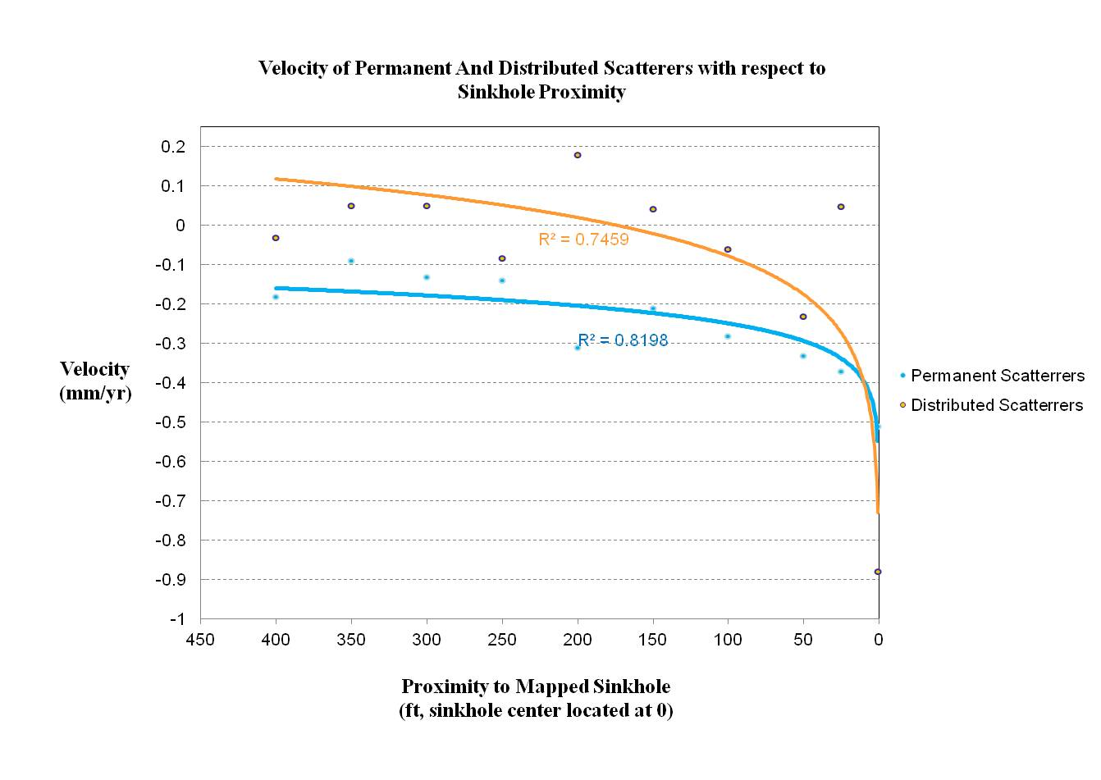
RITA-10
Project
Karst
InSAR
Karst
Workflow
Conclusion
Notes:
Mm/yr

Slide 14
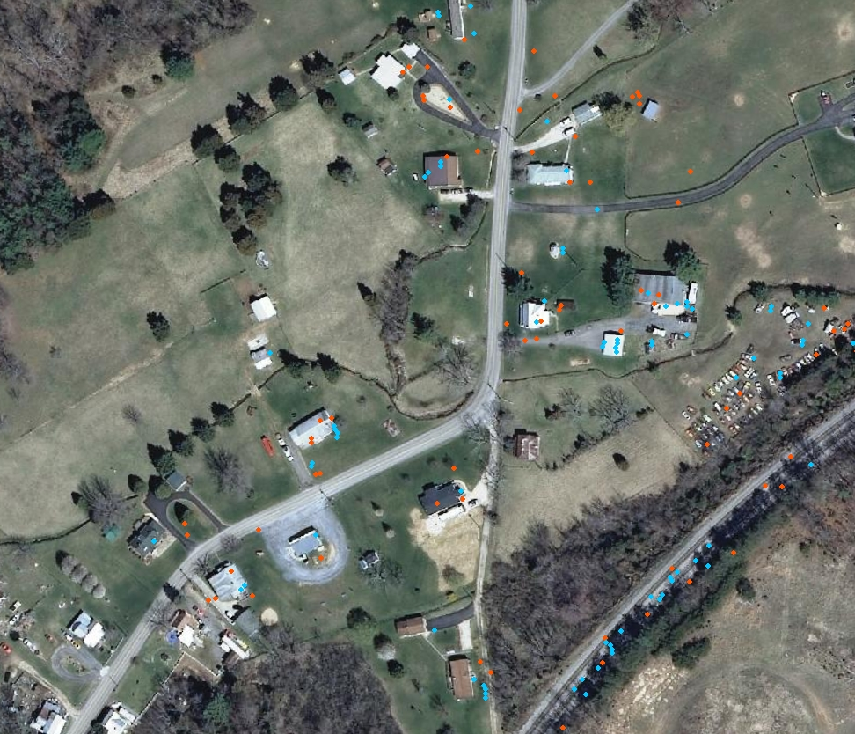
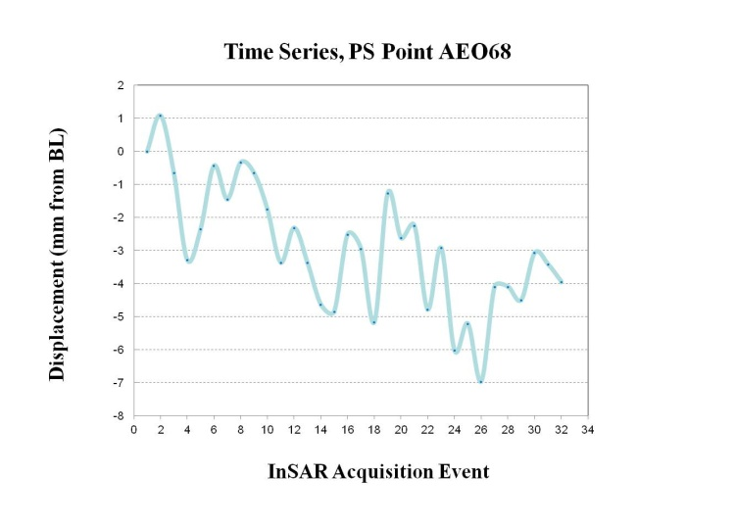
RITA-10
Project
Karst
PS
DS
InSAR
Karst
Workflow
Conclusion
ESRI ArcMap10.0, TRE dataset, VAGISP Base

Slide 15
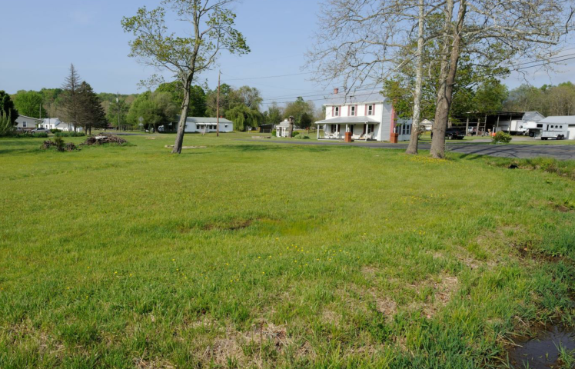
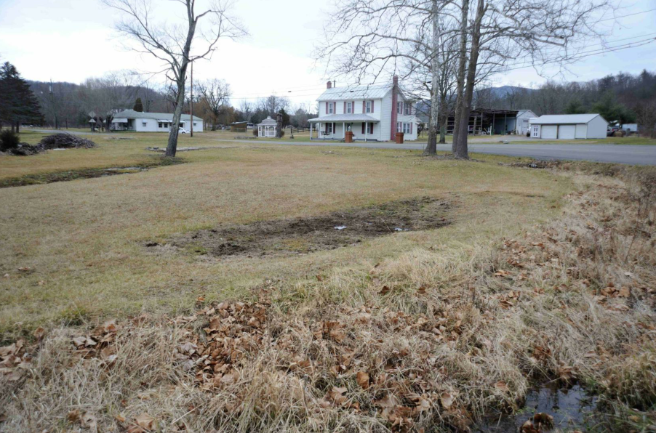
RITA-10
Project
Karst
InSAR
Karst
Workflow
Conclusion
Vesuvius Sinkhole Summer 2012 /Fall 2012 (Hoppe)

Slide 16
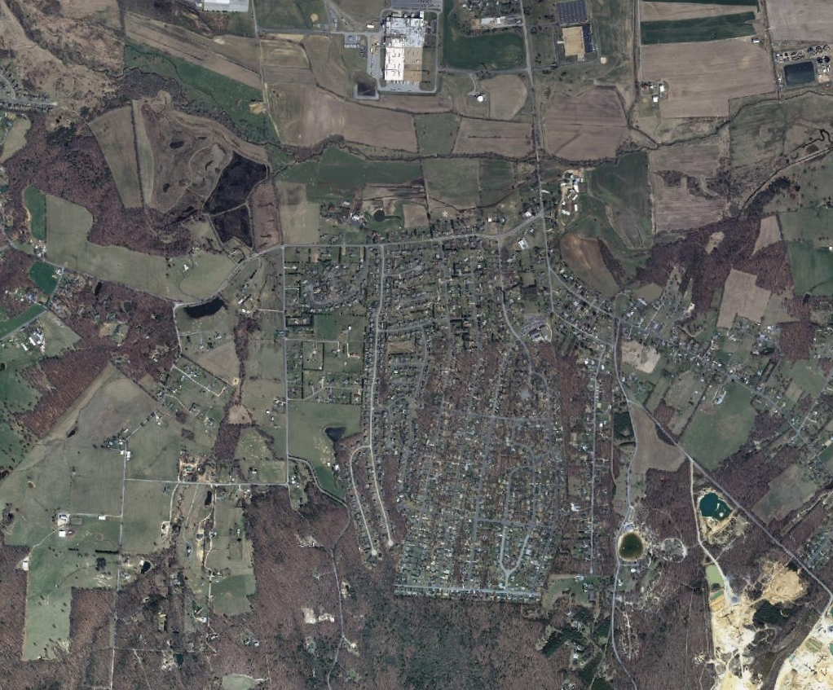
RITA-10
Project
Karst
InSAR
Karst
Workflow
Conclusion
ESRI ArcMap10.0, VAGISP Base

Slide 17
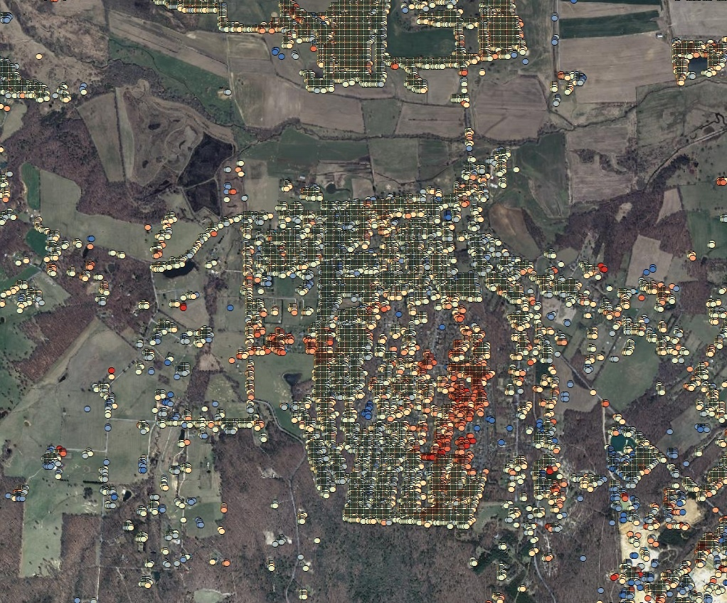
RITA-10
Project
Karst
PS
DS
TS
InSAR
Karst
Workflow
Conclusion
ESRI ArcMap10.0, VAGISP Base

Slide 18
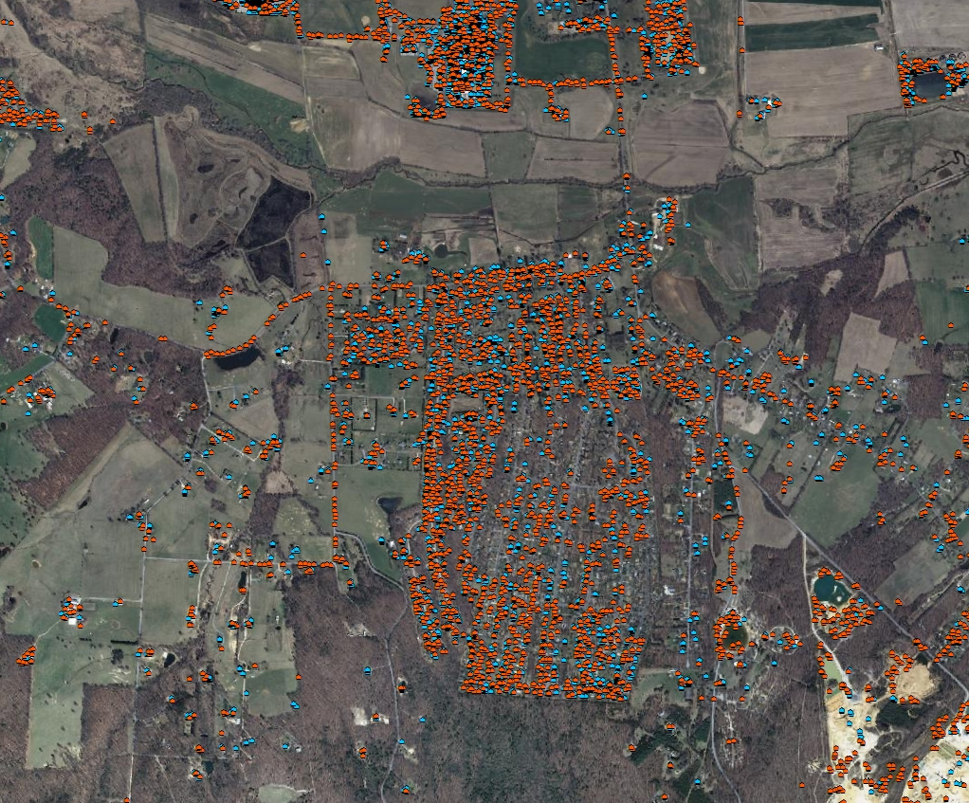
RITA-10
Project
Karst
PS
DS
InSAR
Karst
Workflow
Conclusion
ESRI ArcMap10.0, VAGISP Base

Slide 19
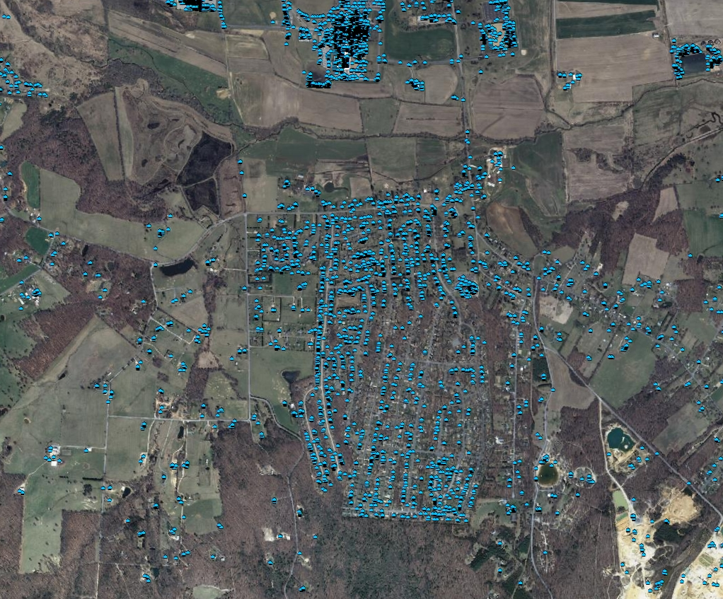
RITA-10
Project
Karst
PS
InSAR
Karst
Workflow
Conclusion
ESRI ArcMap10.0, TRE Dataset, VAGISP Base

Slide 20
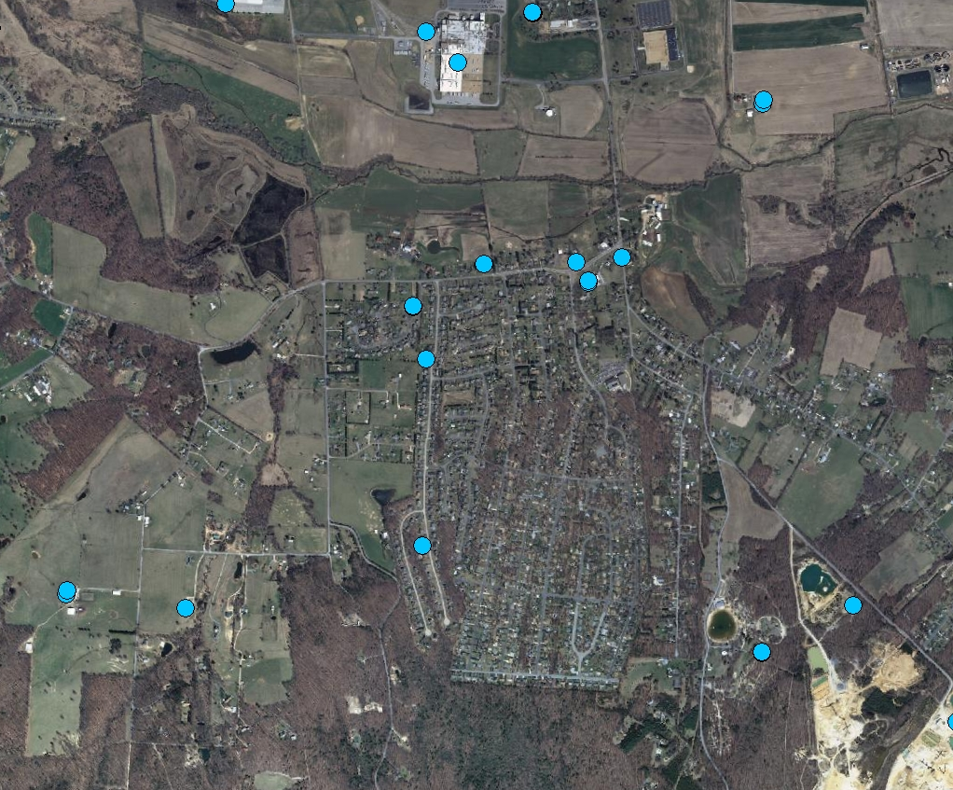
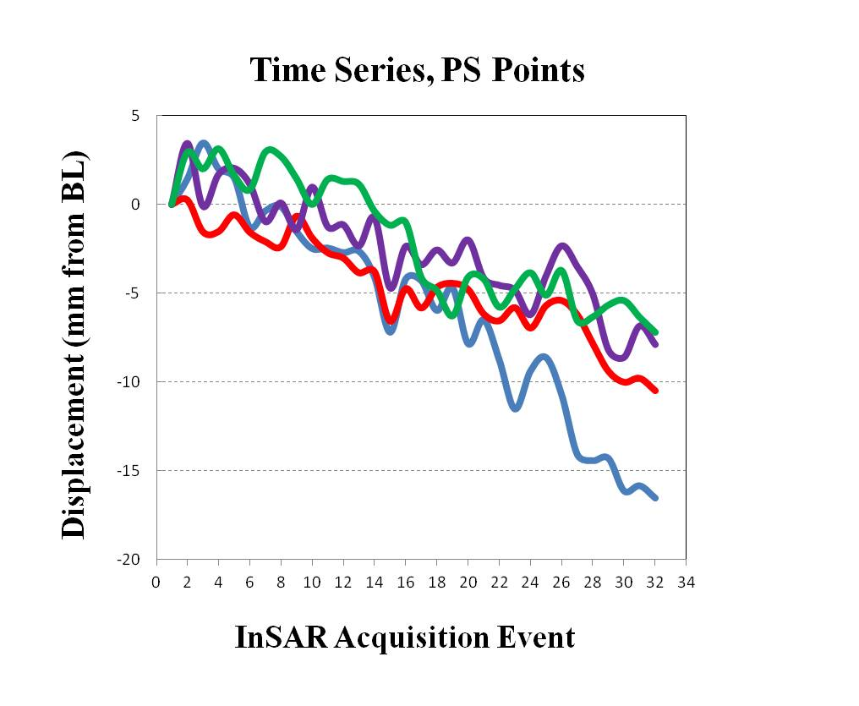
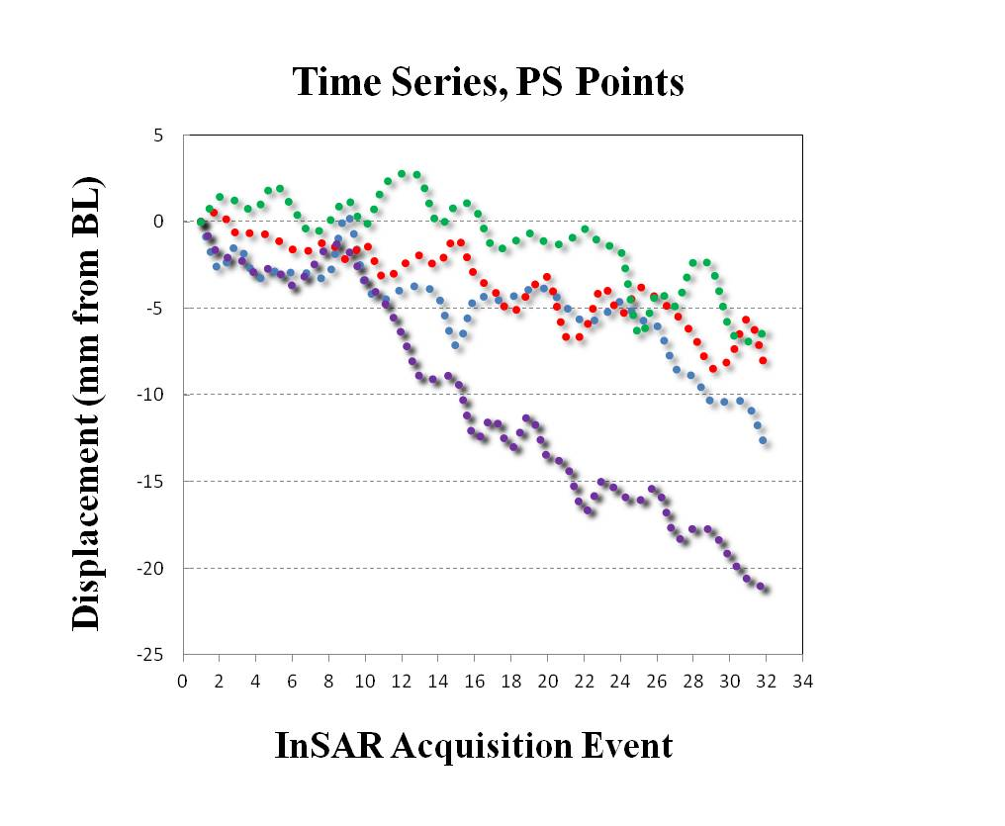
RITA-10
Project
Karst
PS
InSAR
Karst
Workflow
Conclusion
ESRI ArcMap10.0, TRE Dataset, VAGISP Base

Slide 21
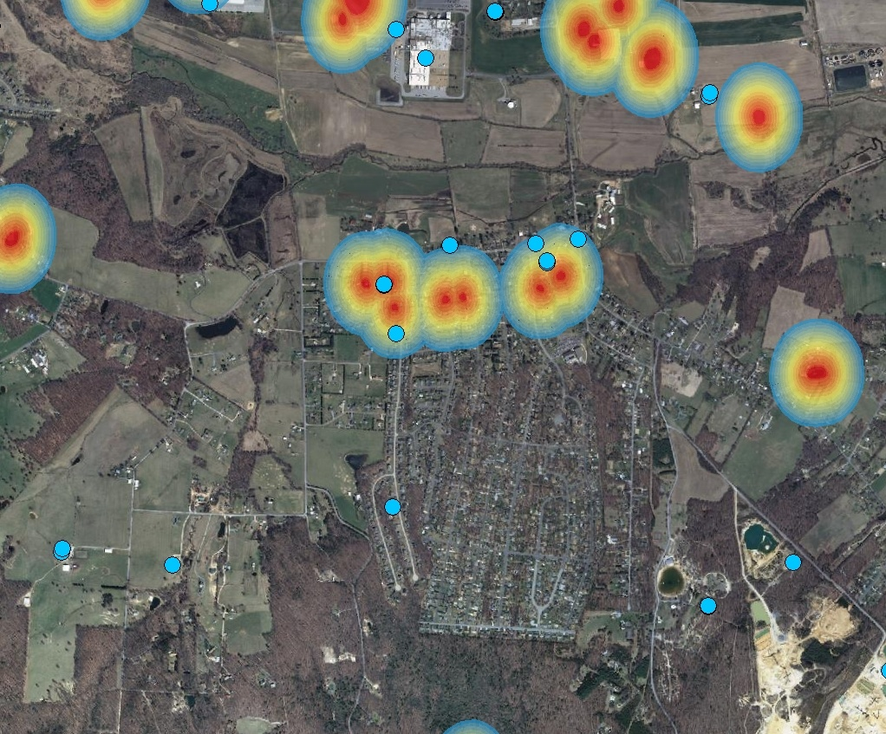
RITA-10
Project
Karst
Sinkhole
PS
InSAR
Karst
Workflow
Conclusion
ESRI ArcMap10.0, TRE dataset, DMME VA Data, VAGISP Base

Slide 22
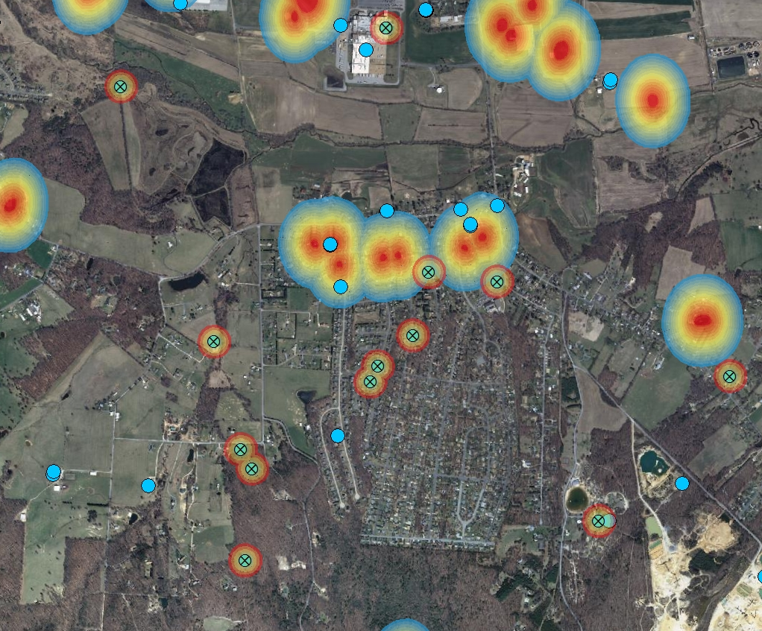
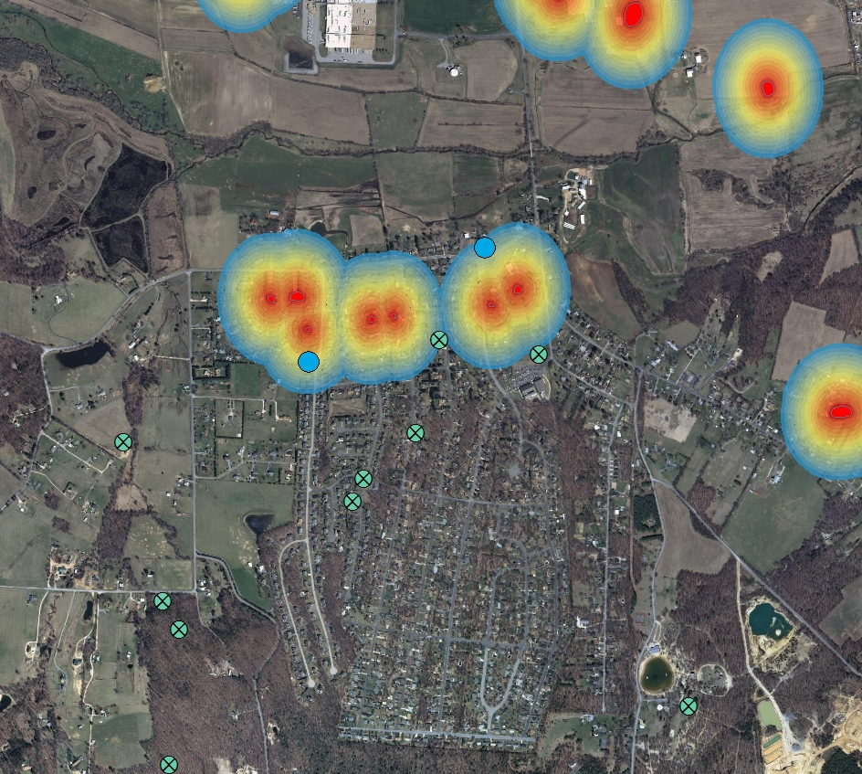
RITA-10
Project
Karst
Sinkhole
Well
PS
InSAR
Karst
Workflow
Conclusion
ESRI ArcMap10.0, TRE dataset, DMME VA Data, VADEQ Data, VAGISP Base

Slide 23
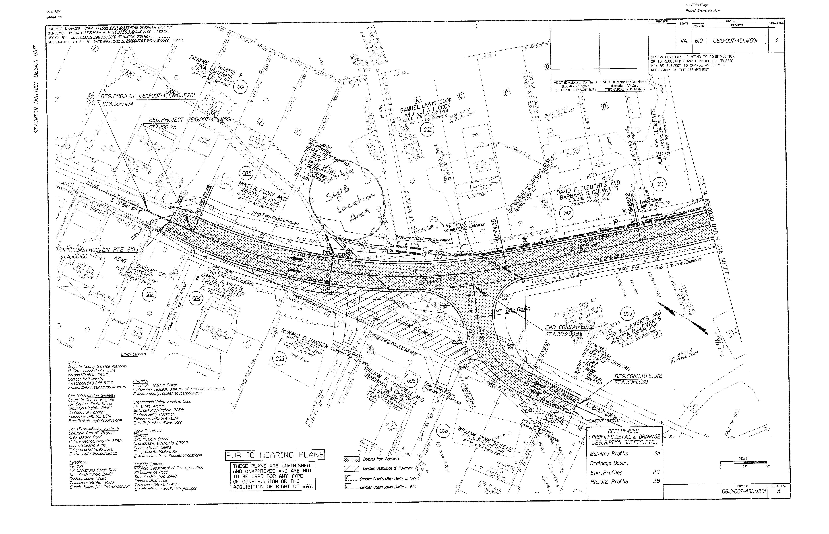
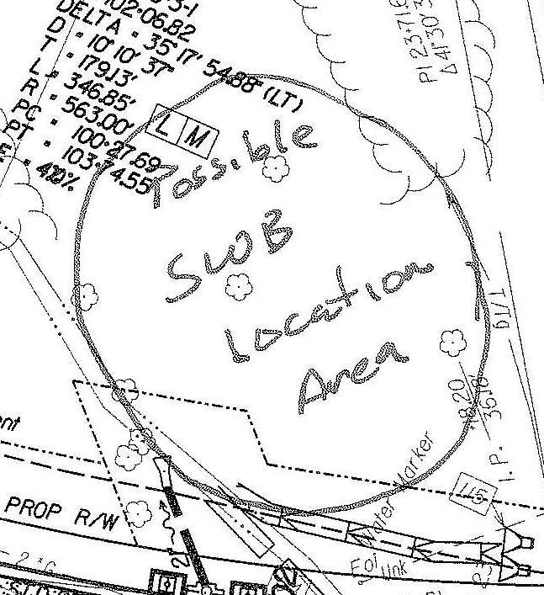
RITA-10
Project
Karst
InSAR
Karst
Workflow
Conclusion
VDOT Plans

Slide 24
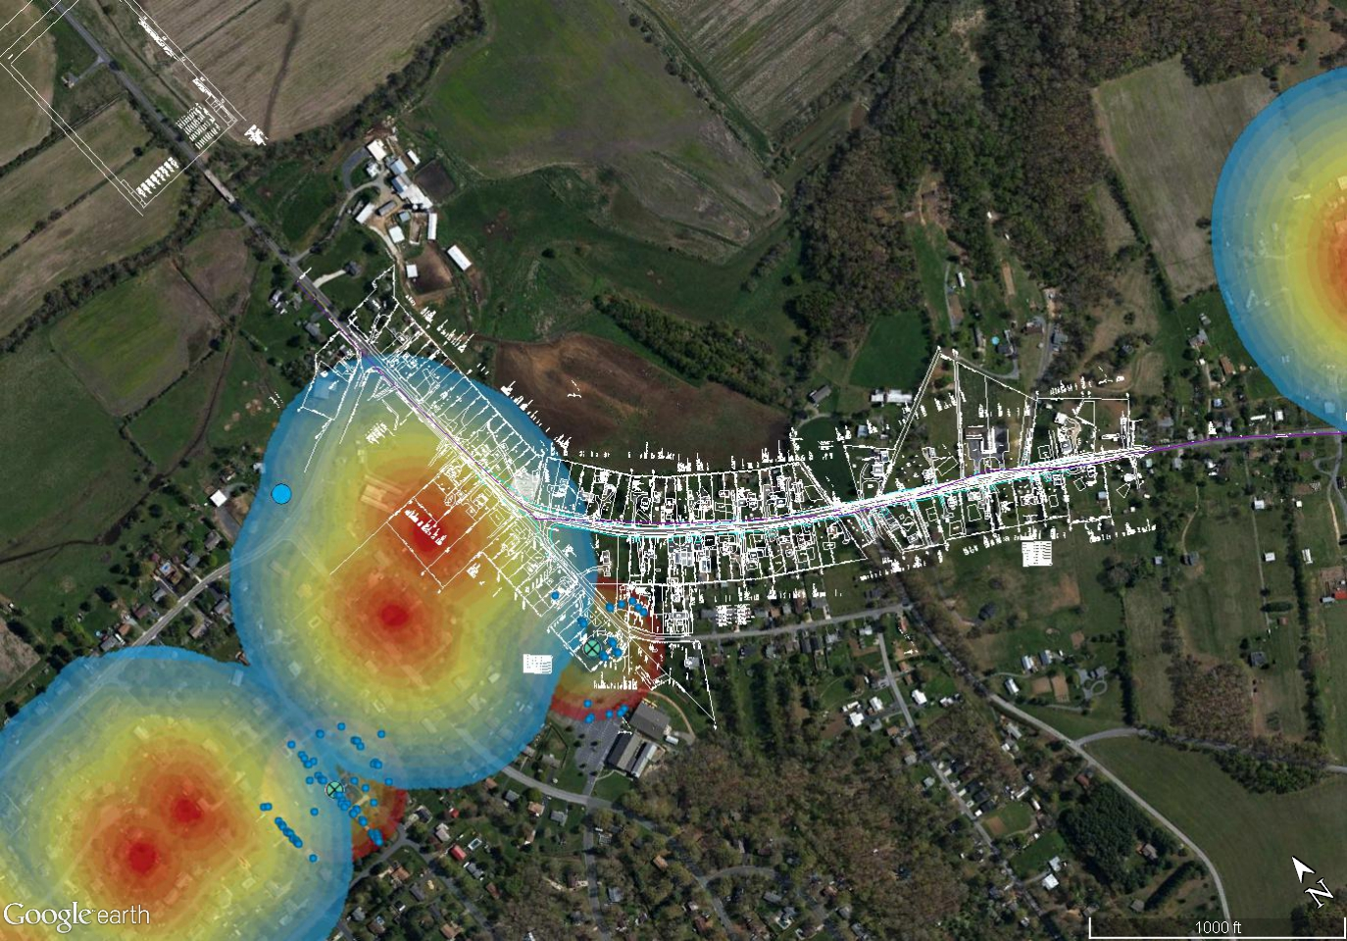
RITA-10
Project
Workflow
Google Earth Pro, TRE dataset, DMME VA Data, VADEQ Data, VDOT Plans
InSAR
Karst
Workflow
Conclusion

Slide 25
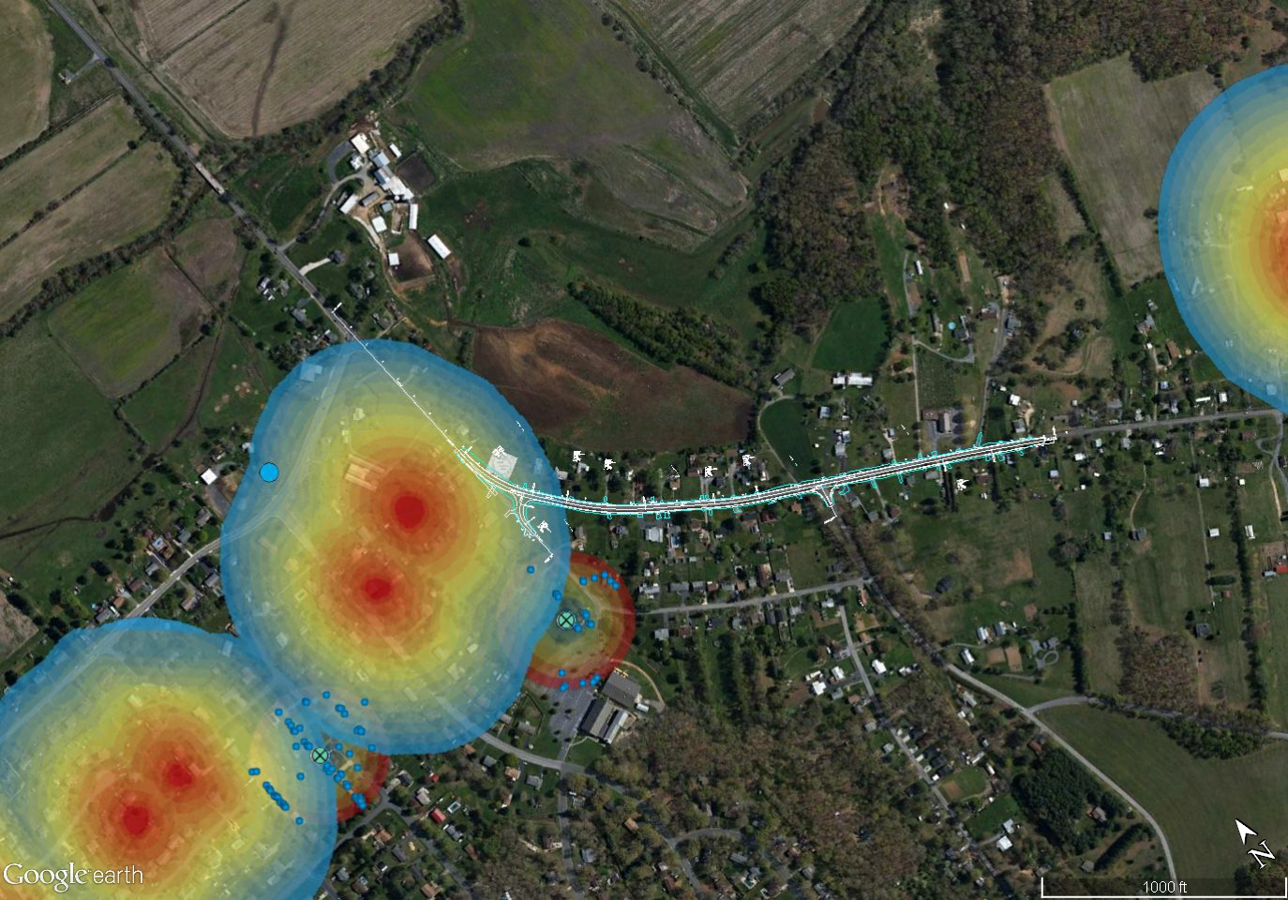
RITA-10
Project
Workflow
Google Earth Pro, TRE dataset, DMME VA Data, VADEQ Data, VDOT Plans
InSAR
Karst
Avg Vel +0.16 mm/yr
Workflow
Avg Vel -1.16 mm/yr
Conclusion

Slide 26
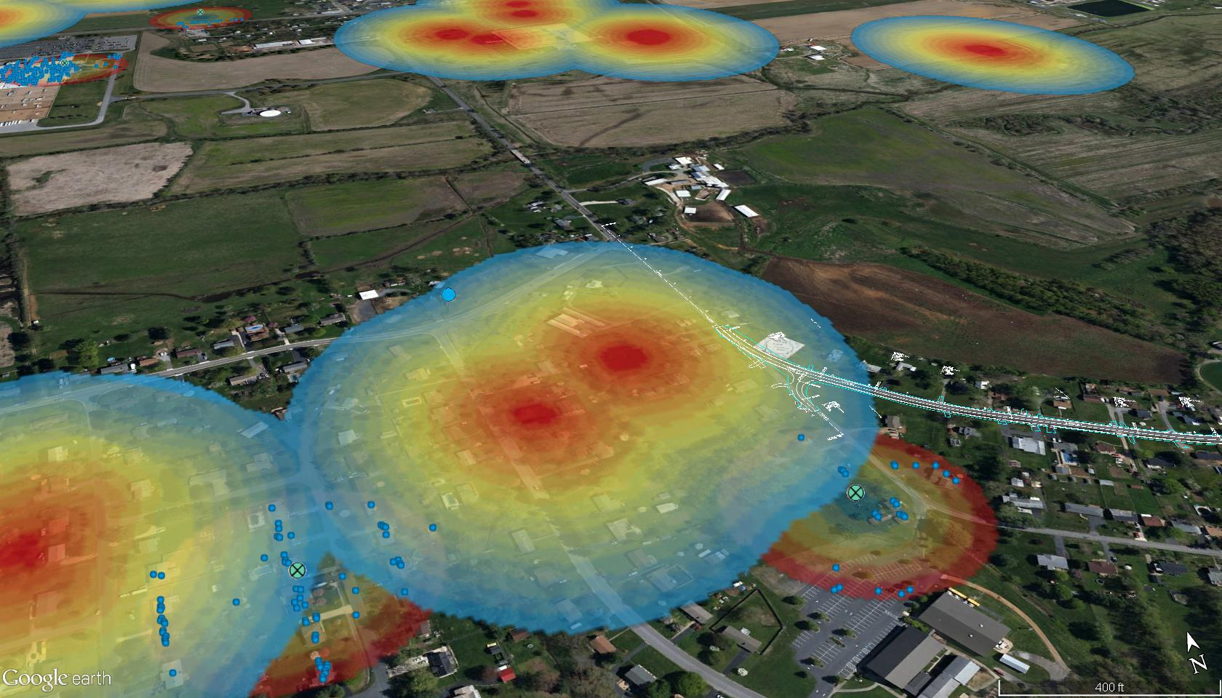
RITA-10
Project
Workflow
Google Earth Pro, TRE dataset, DMME VA Data, VADEQ Data, VDOT Plans
InSAR
Karst
Workflow
Avg Vel +0.16 mm/yr
Conclusion
Avg Vel -1.16 mm/yr

Slide 27
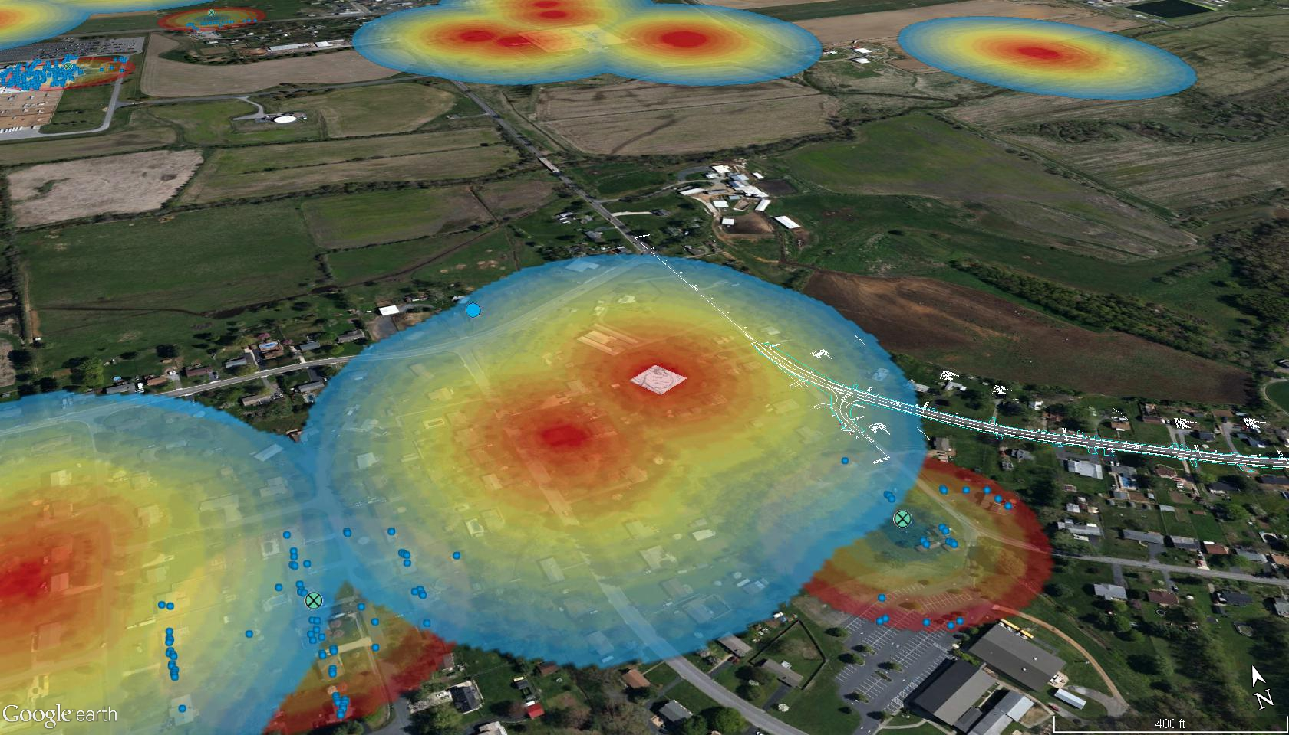
RITA-10
Project
Workflow
Google Earth Pro, TRE dataset, DMME VA Data, VADEQ Data, VDOT Plans
InSAR
Karst
Workflow
Avg Vel +0.16 mm/yr
Conclusion
Avg Vel -1.16 mm/yr

Slide 28
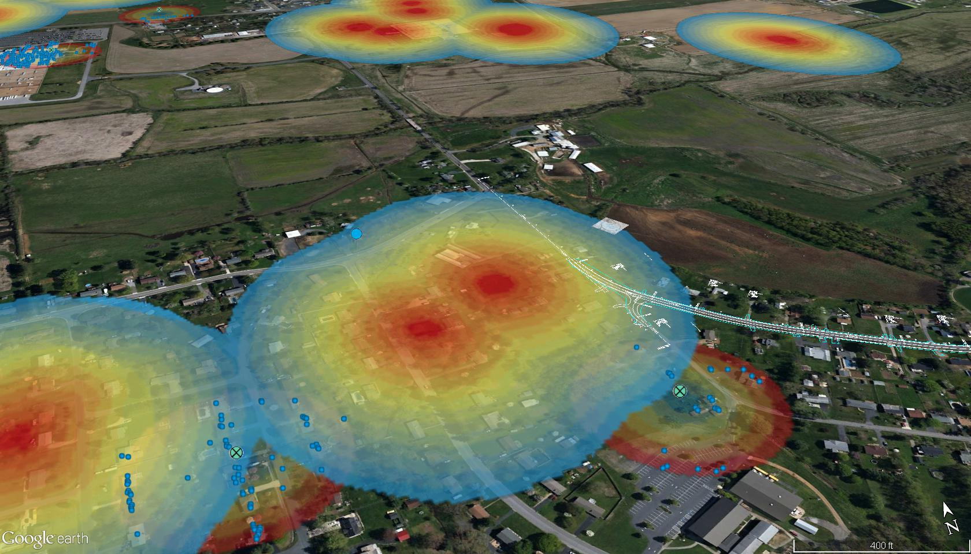
RITA-10
Project
Workflow
Google Earth Pro, TRE dataset, DMME VA Data, VADEQ Data, VDOT Plans
InSAR
Karst
Workflow
Avg Vel +0.16 mm/yr
Conclusion
Avg Vel -1.16 mm/yr

Slide 29

RITA-10
Project
Workflow
Google Earth Pro, TRE dataset, DMME VA Data, VADEQ Data, VDOT Plans
InSAR
Karst
Workflow
Avg Vel +0.16 mm/yr
Conclusion
Avg Vel -1.16 mm/yr

Slide 30
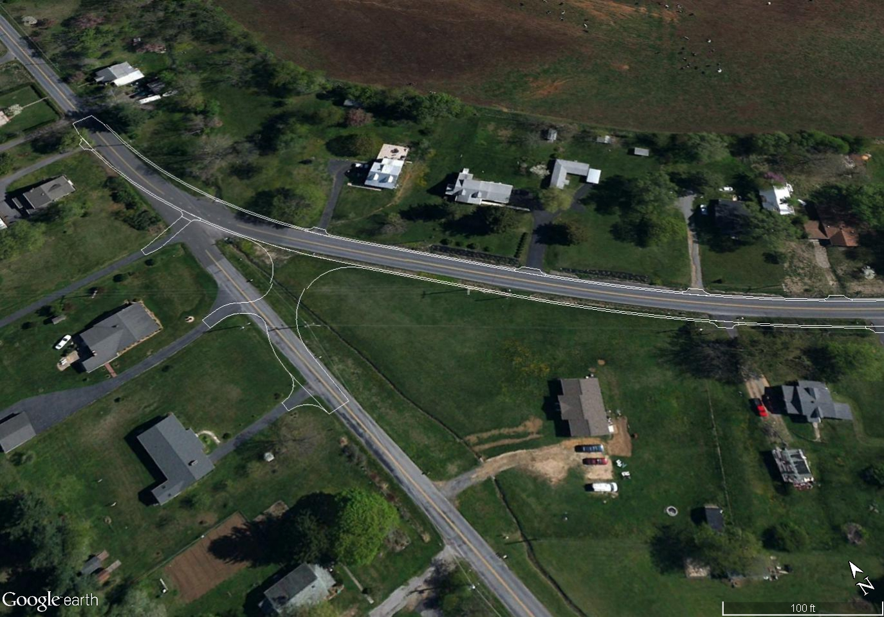
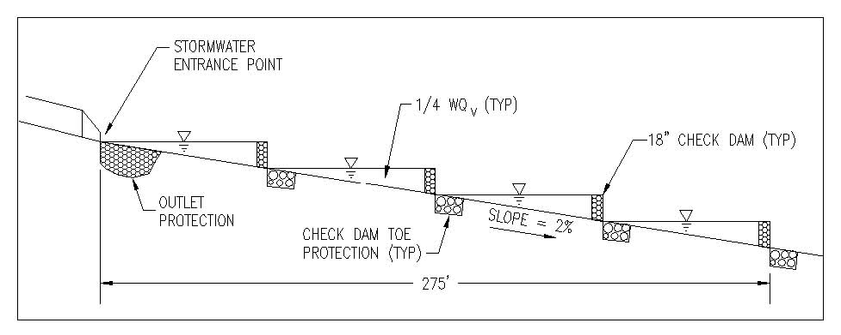
RITA-10
Project
Workflow
InSAR
Karst
Workflow
Conclusion
Google Earth Pro, TRE dataset, DMME VA Data, VADEQ Data, VDOT Plans

Slide 31
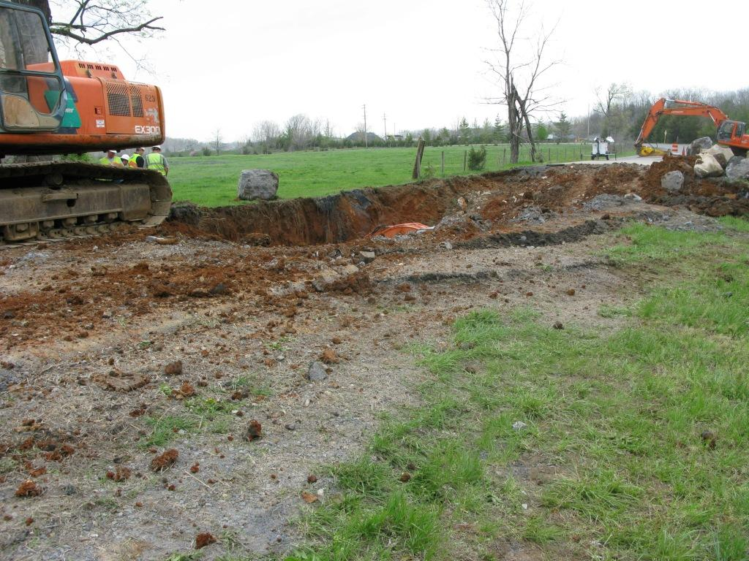
RITA-10
Project
Conclusion
InSAR data and metadata validated for:
                Karst mapping and sinkhole identification
                Karst planning, design workflow improvement, and karst aquifer protection
InSAR
Karst
Workflow
Conclusion

