Slide 1
Delivering Geohazard and Geotechnical Data: From the Satellite to the Field
49th Annual Meeting
The Geological Society of America
Northeastern Section
Notes:
Some stuff is in the master slide and you’ll have to edit that one if you want to change it.

Slide 2
Disclaimer
United Stated Department of Transportation Research and Innovative Technology Administration No. RITARS-11-H-UVA “Sinkhole Detection and Bridge/Landslide Monitoring for Transportation Infrastructure by Automated Analysis of Interferometric Synthetic Aperture Radar Images”
The views, opinions, findings and conclusions reflected in this presentation are the responsibility of the authors only and do not represent the official policy or position of the USDOT/RITA, or any State or other entity.

Slide 3
Overview of Presentation
Problem Statement
InSAR
Data Analysis Methodology
Results and Validation
Conclusion and Future Work

Slide 4
Project: Problem Statement
Can InSAR technology be used to detect and monitor ground features of interest to the transportation community?
Sinkholes?
Slopes?
Infrastructure?
Bridge damage?

Slide 5

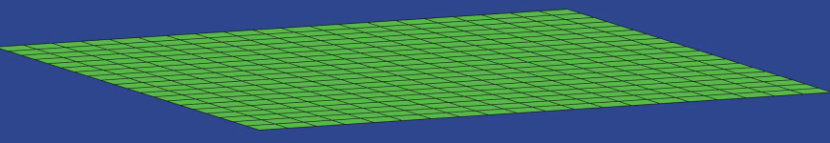
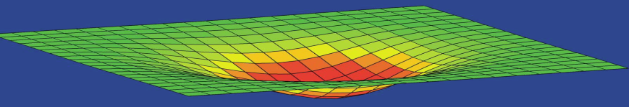
InSAR Technology: Theory
Scatterer = A detectable
surface expression of varying
size and behavior
R1
R2
ΔR

Slide 6
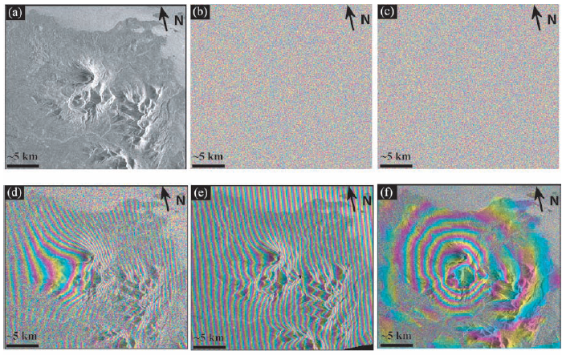
Differential InSAR
Raw Amplitude Data
Initial
Raw Phase Data Time 1
Raw Phase Data Time 2
Phase Interferogram
DEM-Corrected
Interferogram
Motion History Interferogram
Z. Lu, “InSAR imaging of volcanic deformation over cloud-prone areas - aleutian islands,” Photogrammetric Engineering
& Remote Sensing, vol. 73, no. 3, pp. 245–257, Mar. 2007.
Notes:
Example of the step:
Amplitude for october 95 (the amplitude for october 97 looks the same)
Phase from october 95
Phase from october 97
Difference (interferogram) between the phase show fringes due to: viewing geometry, topography, atmospheric delays, and deformation
Simulated interferogram showing contribution to (d) from topography (generated using existing digital elevation model)
Result of subtracting (e) from (d) leaves viewing geometry, atmospheric delays and deformation. Viewing geometry can be corrected knowing from what angle the two pictures were taken. Atmospheric delay is hard to remove and that’s why we use PSInSAR and SqueeSAR.

Slide 7
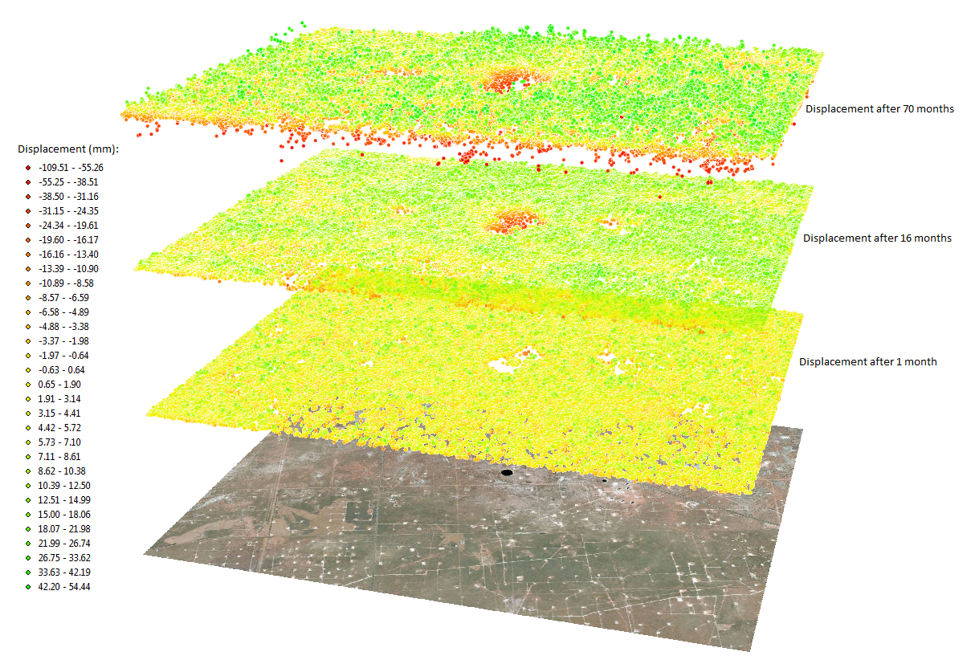
InSAR Technology: Data sets
Sinkholes
ArcMap10.0
Notes:
Arcmap visualization for texas sinkholes

Slide 8
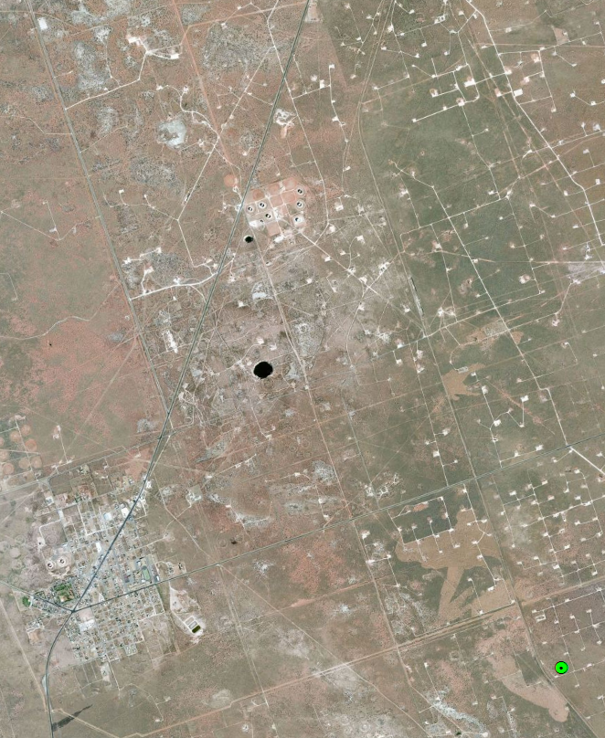
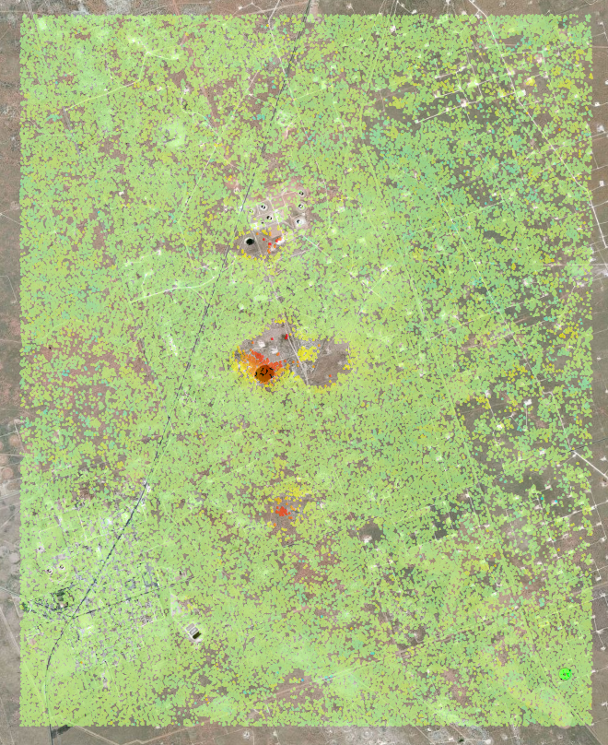
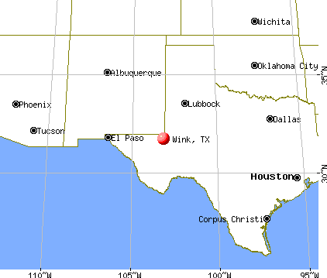
Sinkholes data set
93,513 “Scatterers”
22 Single look complex SAR
ERS Satellites
June 1992 to February 1998
55km² near Wink, SW Texas
1
2
4
3
ArcGis10.0

Slide 9
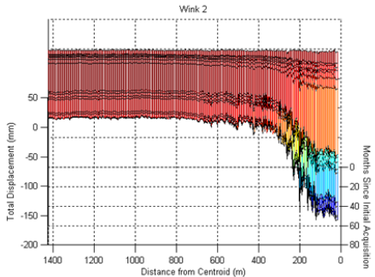
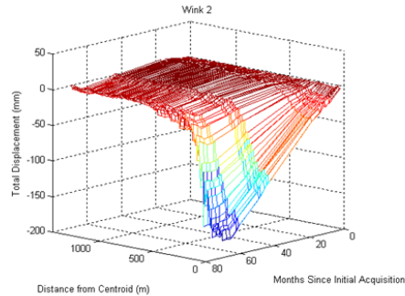
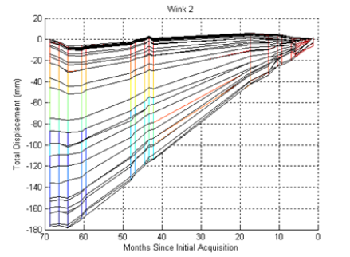
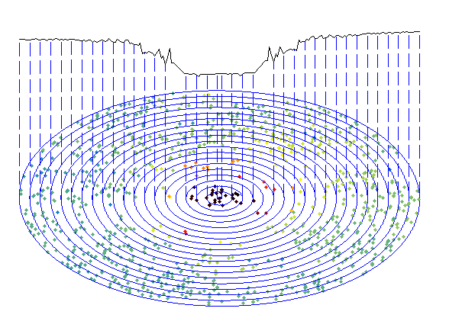

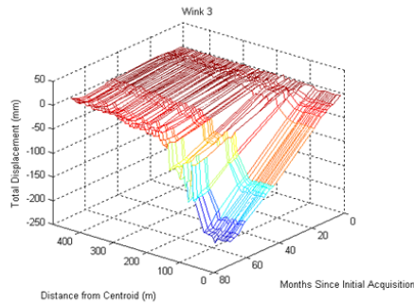
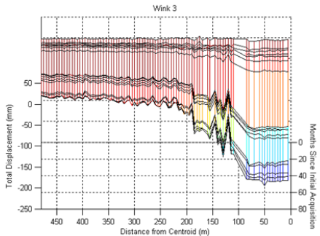
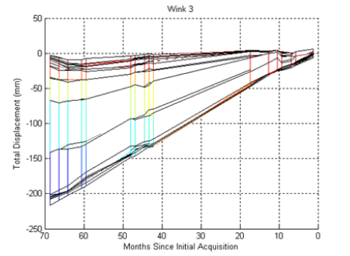
Profile extraction
2
3
ArcGis10.0
Notes:
How the Gaussian model came to existance:
Look at the profile binning the data into concentric circles and plotting the average displacement within each bin as function of distance from the center of the sinkhole
Then repeat for every time and put the profiles next to each other and look from different prospective: distance from center (the behavior looks gaussian) changes in time (looks linear)

Slide 10
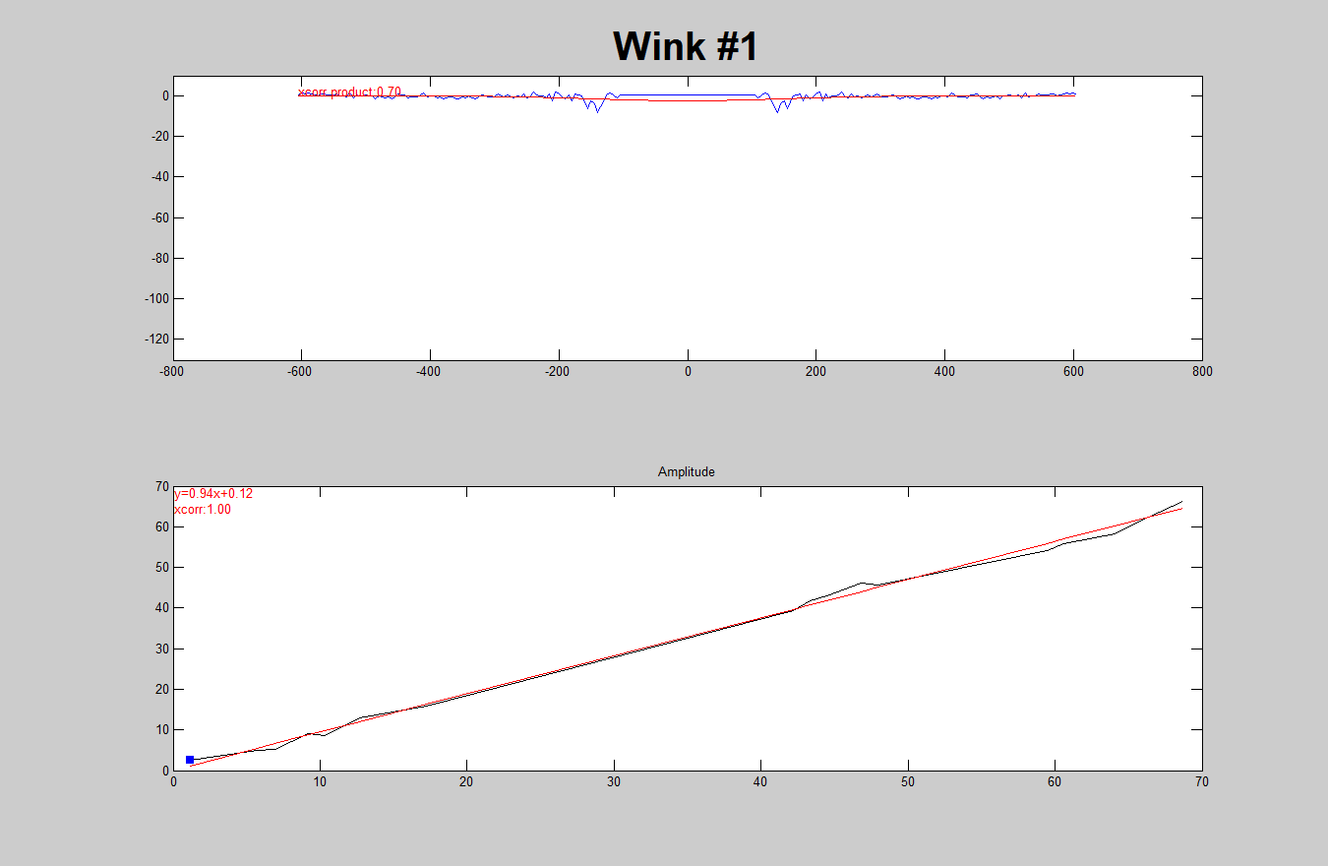
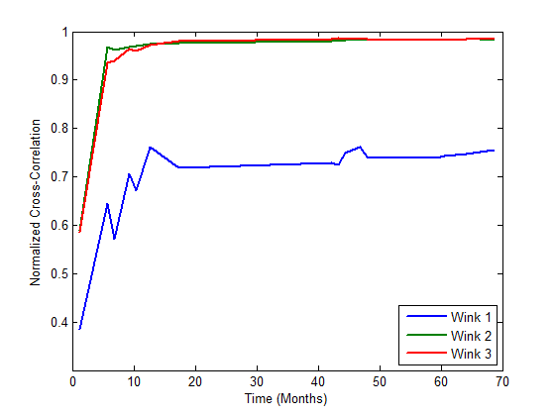

Spatiotemporal model
Evolving Gaussian?
$$g_{t}\left(x\right)=α_{t}exp\left(−x^{2}/2σ_{t}^{2}\right)$$
Notes:
Fitting a gaussian to see how good it fits

Slide 11
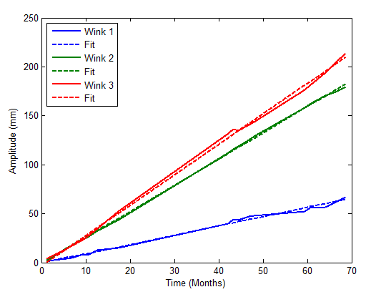
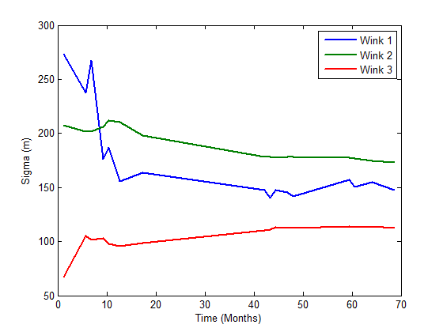

Spatiotemporal model
Evolving Gaussian!
$$g\left(x,t\right)=αtexp\left[−{(x−x_{0})}^{2}/2σ^{2}\right]$$
Notes:
Look at the behavior of amplitude and width: amplitude looks really linear, width reaches and asymptote

Slide 12
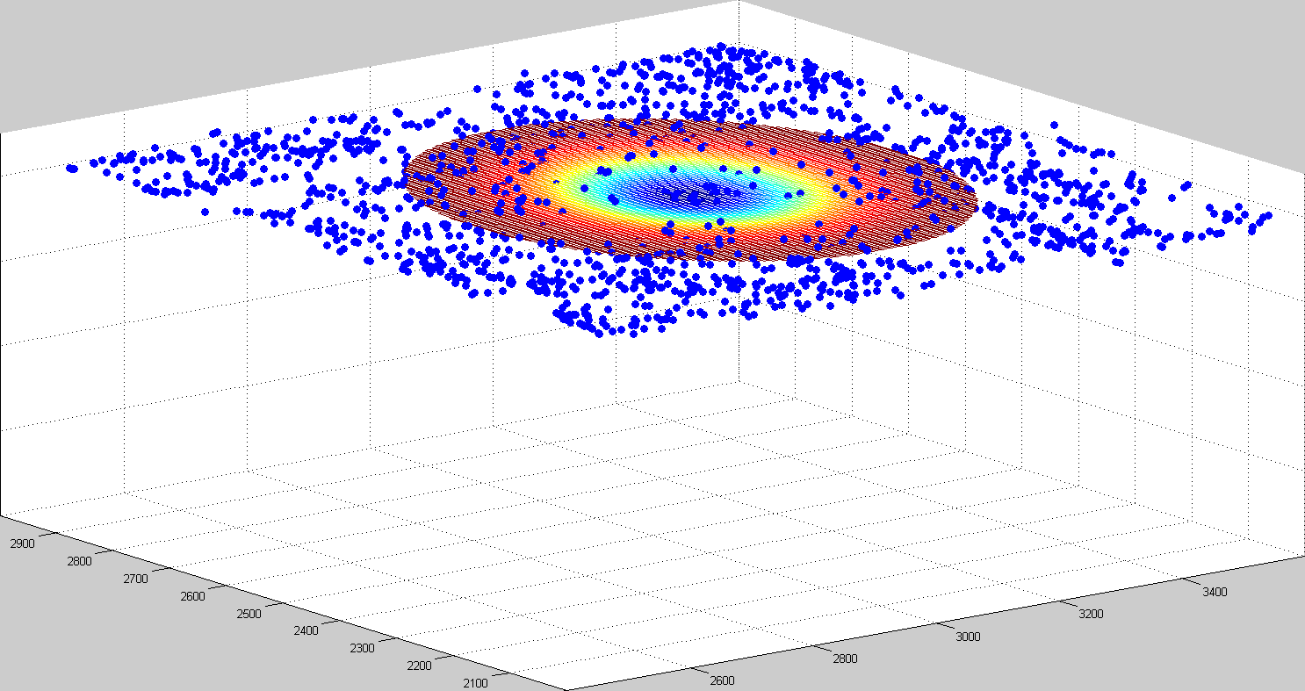
Feature Tracking: Approach

Slide 13


Feature Tracking: Theory
$$g_{p}\left(x,t\right)=αtexp\left[−{(x−x_{0})}^{2}/2σ^{2}\right]$$
Relative residual:
  Rewrite model in implicit form
  $T\left(x,p\right)=0$
  Discretize and limit the parameter space $p=[x_{0}$,$α$,$σ]$
  $p_{min}≤p≤p_{max}$ with step: $∆p$
  Define a residual matrix $r(p)$ with one element corresponding to each point $p$ in the parameter space
  For each point $p$ in the parameter space generate the corresponding template $g_{p}(x_{i},t)$ and define and influence region $R\left(p\right)$
  For each data point $x_{i}$ within $R(p)$ evaluate the relative residual
  $$μ\left(x_{i},t\right)=min\left(\frac{\left|d\left(x_{i},t\right)−g_{p}(x_{i},t)\right|}{max⁡\left(\left|d(x_{i},t)\right|,\left|g_{p}(x_{i},t)\right|\right)},1\right)$$
  Average results within $R(p)\underset{→}{s.t.mean}r(p)$
A. Vaccari, et al. “Detection of geophysical features in InSAR point cloud data sets using spatiotemporal models,” International Journal of Remote Sensing
Notes:
How we look for the cluster of datapoints in the spatiotemporal pointcloud that behave like our model. The summary of the slide:
For every possible combination of the speed of growth of the displacement and its size, we create a template and move it around in latitude and longitude and for each location we calculate how good is the fit with the data, the result is what we call the residual: the lowest the residual, the best the fit, the highest the probability this is really a sinkhole.

Slide 14
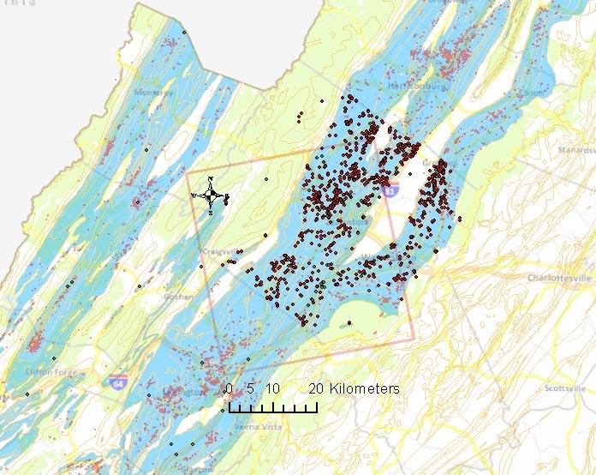
Central Virginia data set
COSMO-SkyMed Satellites (ISA)
32 Single-look complex SAR
August 2011 to October 2012
300,000 Scatterers
40x40km² Augusta County, VA

Slide 15
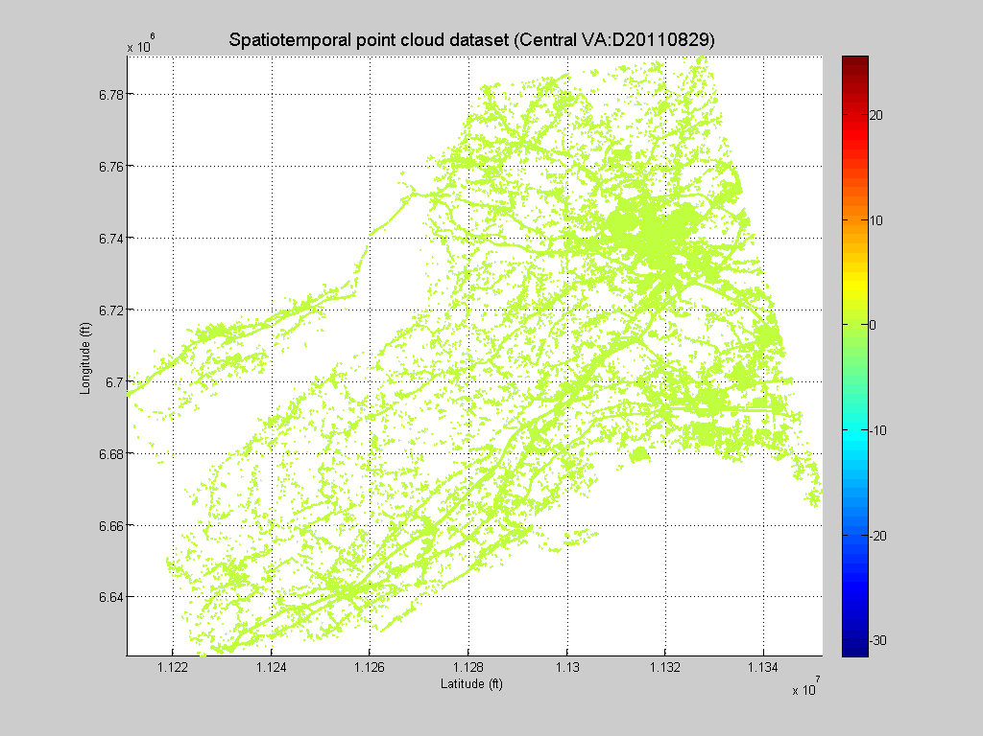
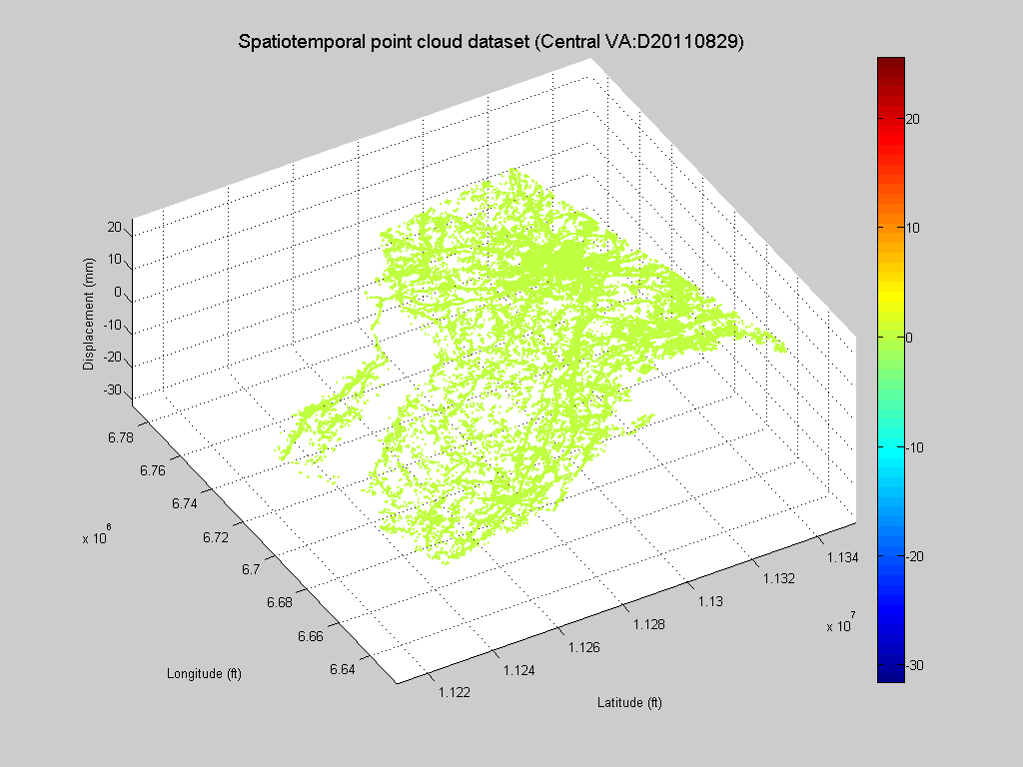
Central Virginia data set
Matlab2013a

Slide 16
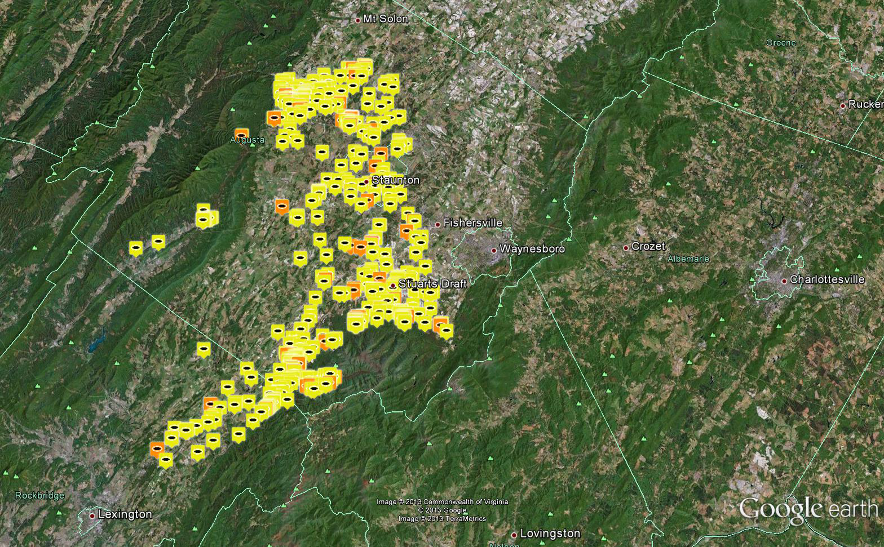
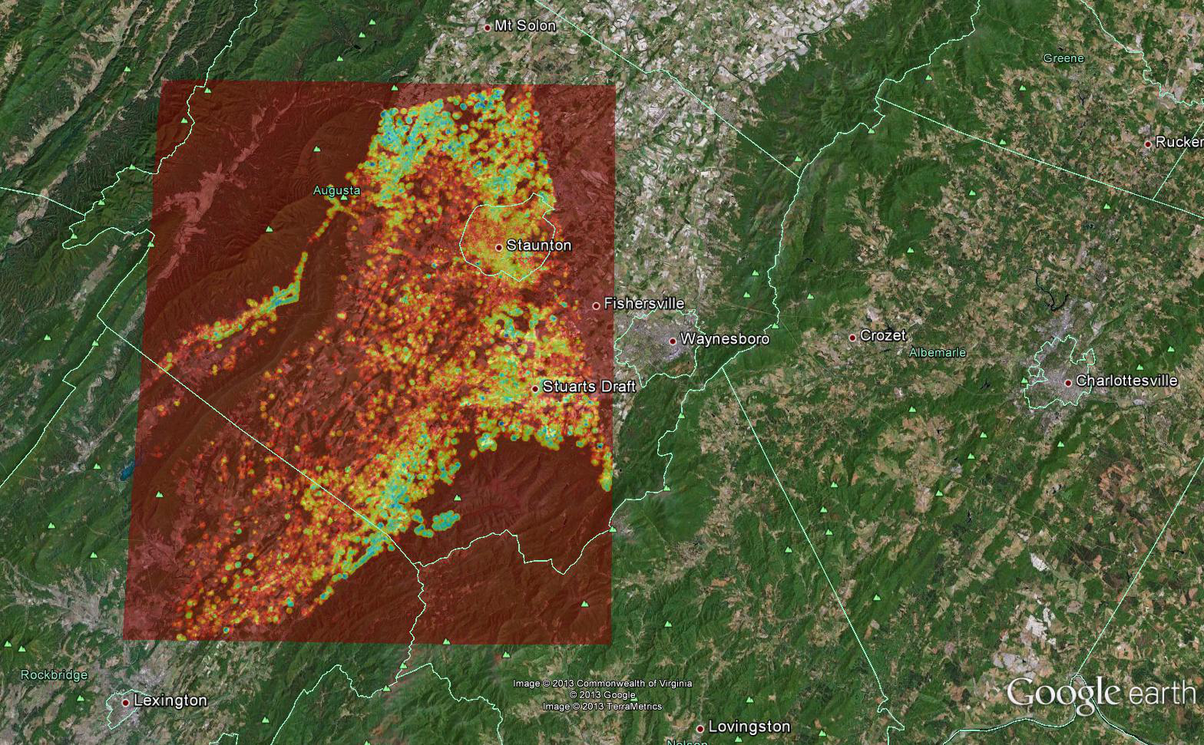
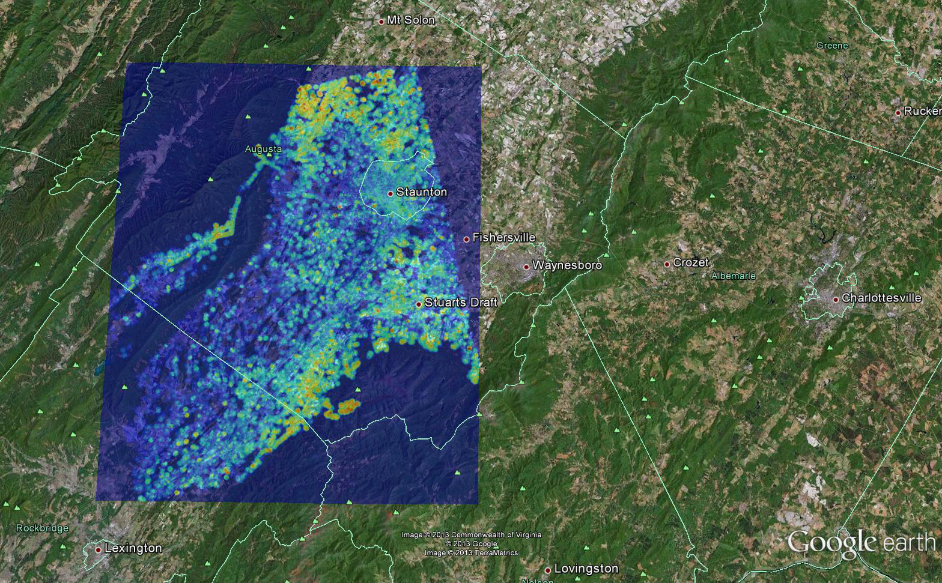
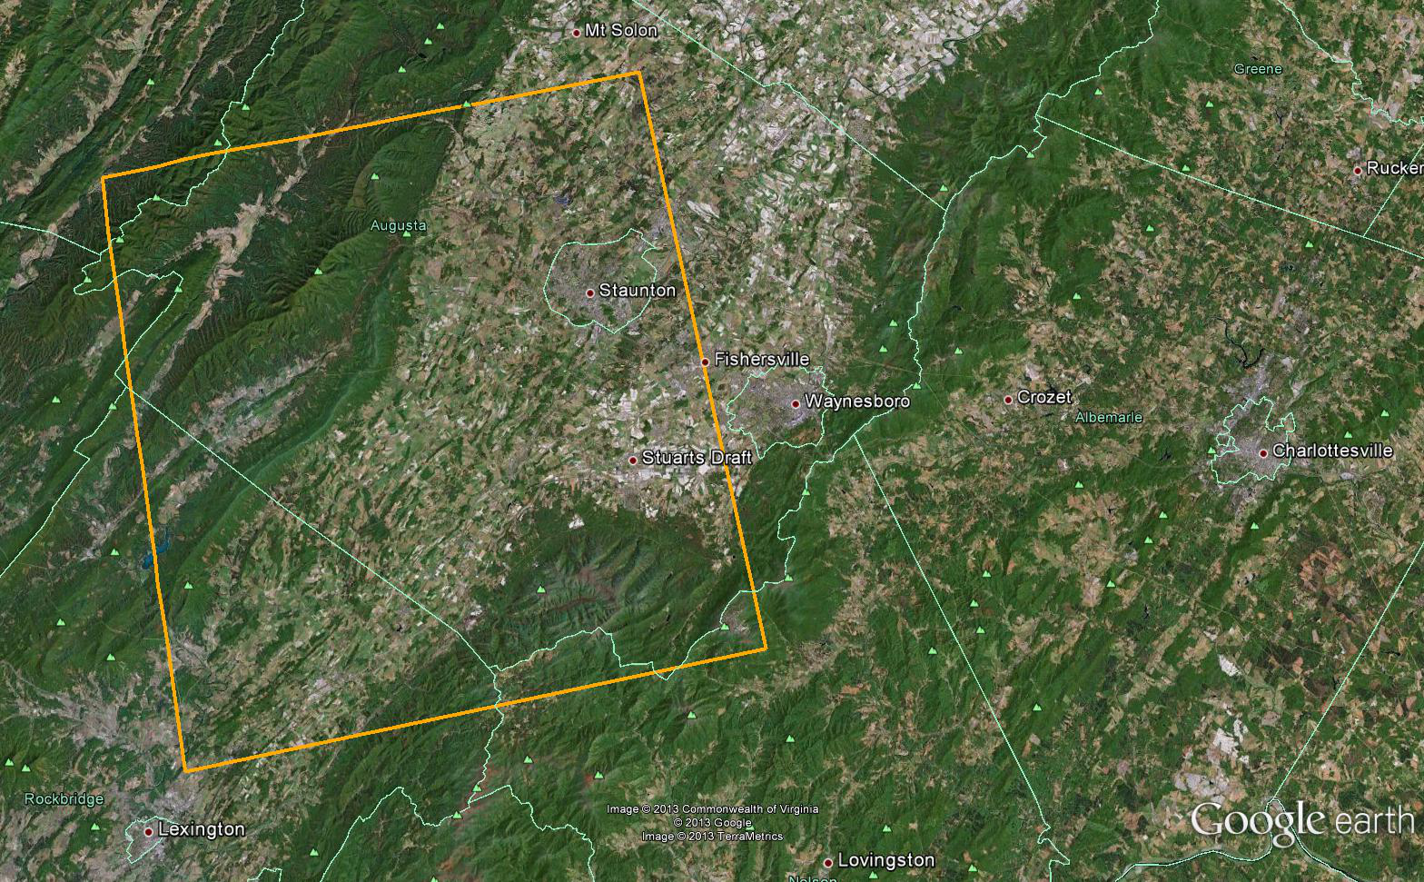





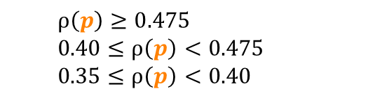
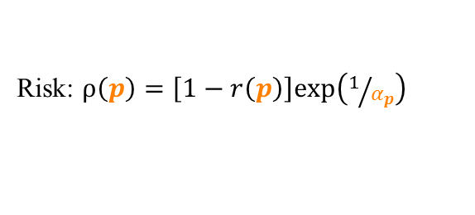

Central Virginia data set
Residual: $r\left(p\right)=r\left(x_{0},y_{0},α,σ\right)$
Risk: $ρ\left(p\right)=\left[1−r\left(p\right)\right]exp\left(1/{α_{p}}\right)$
$ρ\left(p\right)≥0.475$
$0.40≤ρ\left(p\right)<0.475$
$0.35≤ρ\left(p\right)<0.40$
Notes:
Result on viriginia, including the risk test function. The risk function was defined to increase show higher risk for regions where the fitted model is growing faster.
In this order:
Region of interers
Residual map
Risk function definition and risk map (the risk is what we used to define the regions that you guys visited)
Risk ranges
Location on the map (all the visualization was in ArcGIS)

Slide 17
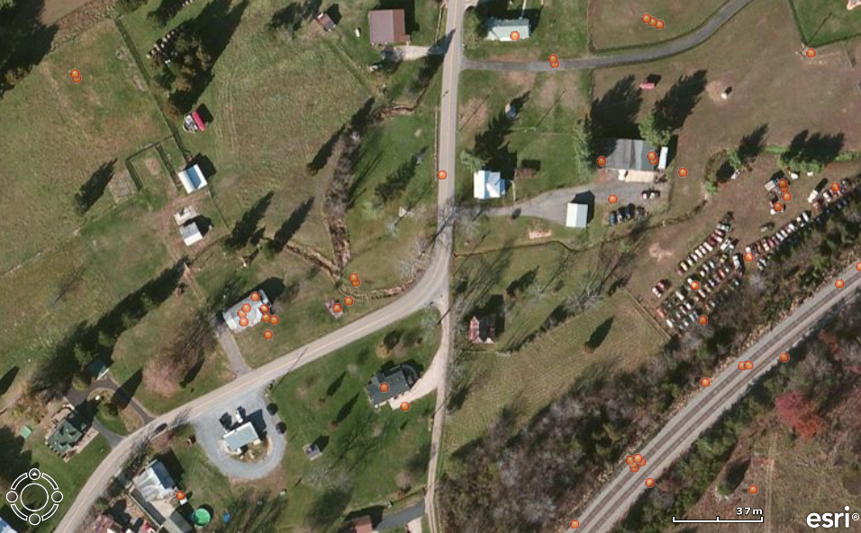
Field Validation: Vesuvius Sinkhole
Credit: Brian Bruckno, Ed Hoppe, VDOT, VCTIR

Slide 18
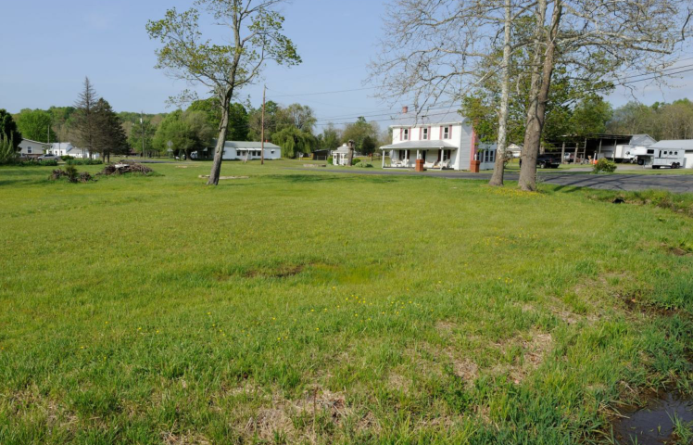
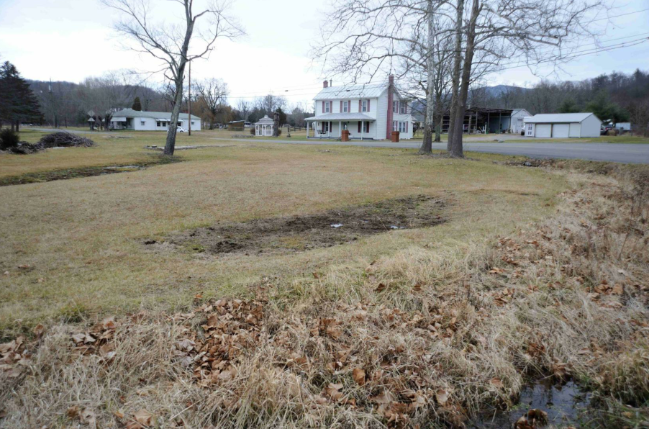
Field Validation: Vesuvius Sinkhole
Notes:
Keep just this

Slide 19
Central Virginia data set
Credit: Brian Bruckno, Ed Hoppe, VDOT, VCTIR
Categories | Infrastructure | Geomorphology
Absolute (A) | Cracks, settlement | Recent non-vegetated scarps
Strong (S) | Distortions or cracks | Overgrown scarps
Weak (W) | Repairs or cracks | Geomorphology indicates activity
Possible (P) | Near existing active region | In correct terrain, presence of pinnacles
None (N) | No or negative confirmation | No or negative confirmation
Risk | Evaluated | A | S | W | P | N
Severe | 7 | 4 (57%) | 2 (29%) | - | - | 1 (14%)
Moderate | 15 | 8 (54%) | 2 (13%) | 2 (13%) | 1 (7%) | 2 (13%)
Slight | 10 | 5 (50%) | 4 (40%) | - | 1 (10%) | -
Total | 32 | 17 (53%) | 8 (25%) | 2 ( 6%) | 2 ( 6%) | 3 (10%)
25 (78%)
Notes:
Your efforts!

Slide 20
Mobile Devices Deployment
Proof of concept on Android devices
LAMP (Linux, Apache, MySQL, PHP) server
Real time database query and update
Google Maps API
Notes:
We developed a simple proof of concept android app that shows the closest 10 hazards and allows to update comments to the server.

Slide 21
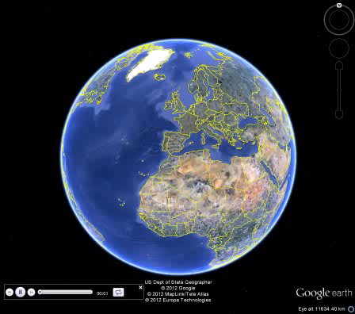
Results Delivery Example
kmz on Google Earth
Notes:
Fancy example on how to deliver data of sinkholes detection

Slide 22
Project: Future Work
Extend tested sinkhole algorithm to bridge, landslide, and pavement condition index with new spatio-temporal models
Deliver data via mobile device and integrate into design and maintenance programs
Develop risk-mapping algorithm based on existing and learned data

Slide 23
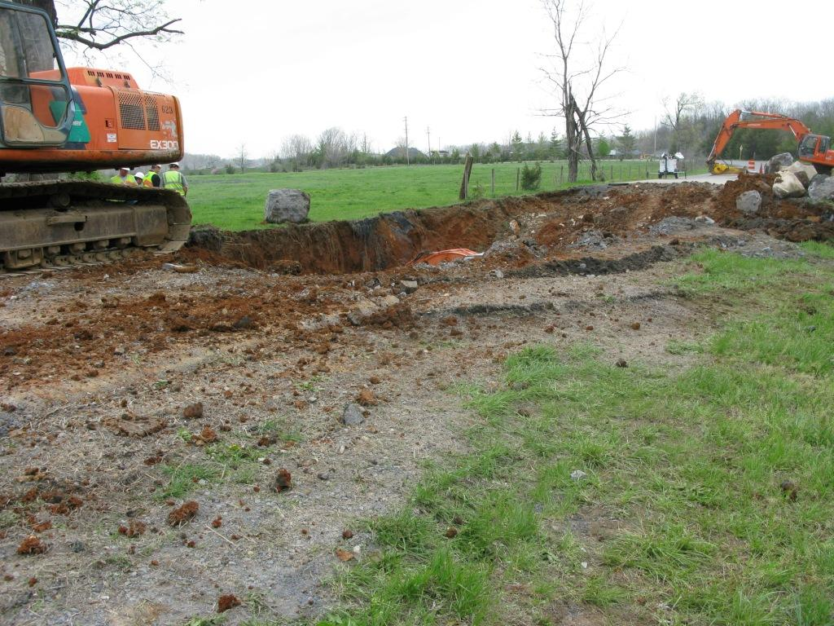
Thank you

