Slide 1
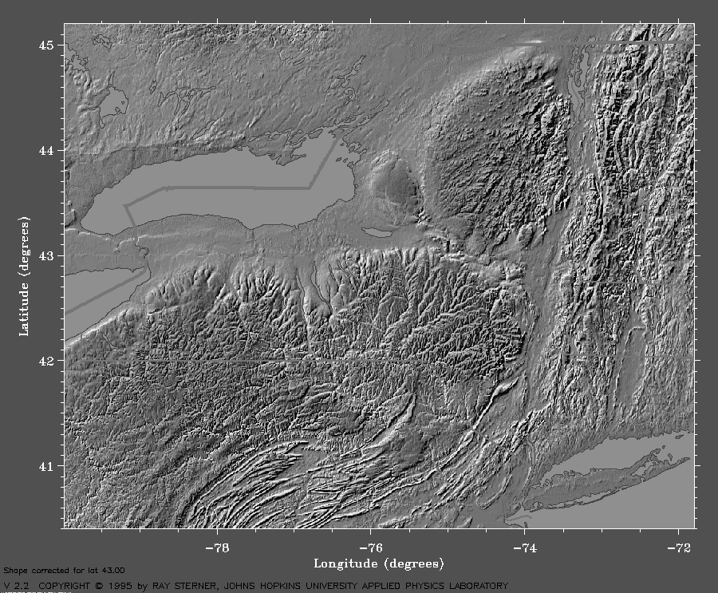
CHANGES IN ATTITUDES #2 The slope of the water planes of Glacial Lake Albany, Hudson Lowlands, NY
By
ROBERT DINEEN
Lamb Cottage
Geigertown, PA
ERIC HANSON
Hanson-Van Vleet
Clifton Park, NY
Notes:
Changes in Attitudes #2, the Slope of the Water Planes of Glacial Lake Albany, Hudson Lowlands, NY
This is a continuation of a theme we reported on at last years’ NEGSA.
Last year we covered the history of interpretation of the glacial-isostatic rebound for Lake Albany in the Hudson Valley.
The rebound curves were based on the elevations of lake deltas in the valley.
Studies in New England were yielding glacial lake rebounds that were twice the magnitude of the Hudson rebound.
An early application of the 4+ ft/mile New England rebound model to the Hudson Lowlands was developed by Stanford.
He did not use the gradient indicated by kame deltas, which had been used by the earlier workers.
We re-examined the elevations of glacial lake deltas and beaches in the Hudson lowlands and replotted the gradients.

Slide 2
St. Lawrence
Lowlands
Champlain
Lowlands
Adirondack
Mountains
Ontario Lowlands
4.6 ft/mile
Lake Iroquois
Pair and others, 1988
Mohawk
Lowlands
Erie
Lowlands
New England Uplands
Connecticut Lowlands
Hudson Lowlands
RAVENA
Allegheny Plateau
KINGSTON
4.7 ft/mile
Lake Hitchcock
Stone and others, 2005
PHYSIOGRAPHIC PROVINCES
Notes:
The glacial lakes in New York and New England usually occupied the lowlands.
Glacial Lake Albany lay in the Hudson Lowlands.
Glacial Lake Hitchcock was in the Connecticut Lowlands.
PAIR and others, 1988, had a rebound curve of 4.6 ft/mile for Lake Iroquois.
The 4.7 ft/mile isostatic gradient from by Stone and others in Lake Hitchcock inspired our re-evaluation of rebound gradients.

Slide 3
GF
GF: Glens Falls
S: Schenectady
T: Troy
A: Albany
R: Ravena
KI: Kinderhook
H: Hudson
K: Kingston
P: Poughkeepsie
N: Newburgh
S
T
A
R
KI
LAKE ALBANY
H
K
P
N
Notes:
The Hudson Lowlands held Glacial Lake Albany
Lake Albany extended from Newburgh to Glens Falls
A: Albany
GF: Glens Falls
K: Kingston
N: Newburgh
P: Poughkeepsie
R: Ravena
S: Schenectady

Slide 4
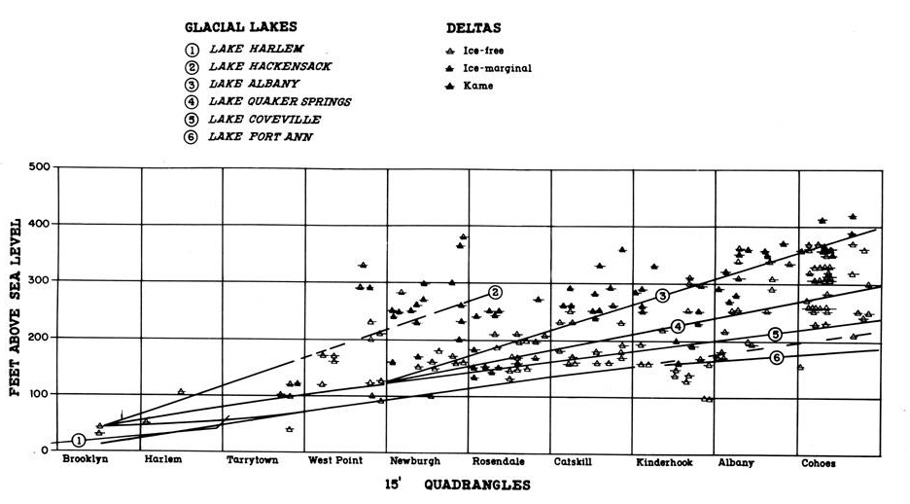
DINEEN, DESIMONE, HANSON, 1988
Notes:
At AMQUA in 1988, Dineen, DeSimone, and Hanson presented an plot of lake levels, using data from the reconnaissance mapping program.
The “classical” lake Albany levels were plotted.
The scatter of data points suggested that you could create any rebounded water level that you want.

Slide 5
SLOPE (Ft/Mile)
WOODWORTH, 1905 | 2.2 | Planar
FAIRCHILD, 1912, 1917, 1918 | 2.2 to 2.5 | Concave-up | Delayed until after Schenectady Delta
CHADWICK, 1928 (northern Hudson) | 2.25 to 2.5 | Planar | Contemporaneous with ice removal
CHAPMAN, 1937, 1942 (Lake Vermont) | 5 | Concave-up | Delayed until after Schuylerville deglaciated
CHADWICK, 1944 | 2.25 |  | Contemporaneous with ice removal
LAFLEUR, 1965, 1979, 1983 (northern Hudson) | 2.5 | Planar | Not caused by a wave of uplift
DINEEN, DESIMONE, HANSON, 1988 (southern Hudson) | 2.5 | Mixed | Contemporaneous with ice removal
REFERENCE
SHAPE
TIMING
Notes:
This two-part Table summarizes the range of gradients cited for Glacial Lake Albany

Slide 6
SLOPE (Ft/Mile)
CONNALLY and SIRKIN, 1986 (southern Hudson) | 2.4 | Planar | Rolling rebound
DINEEN and others 1992 (southern Hudson) | 2.65 | Mixed | Contemporaneous with ice removal
DeSimone and LaFleur, 1992 (northern Hudson) | 2.7 | Planar | Contemporaneous with ice removal
CONNALLY and Cadwell, 2002 (southern Hudson) | 1.6 | Planar | Rolling rebound
STONE and others, 2005 (Lake Hitchcock) | 4.7 | Planar | Delayed 2000 years after Deglaciation of lower Connecticut Valley
DeSimone and others, 2008 (northern Hudson) | 3.7 | Planar | Contemporaneous with ice removal
STANFORD, 2009, 2010 | >4 | Planar | Contemporaneous with ice removal
REFERENCE
SHAPE
TIMING
Notes:
PAIR and others, 1988, had a rebound curve of 4.6 ft/mile for Lake Iroquois.
The work by Stone and others in Lake Hitchcock inspired our re-evaluation of rebound gradients.

Slide 7
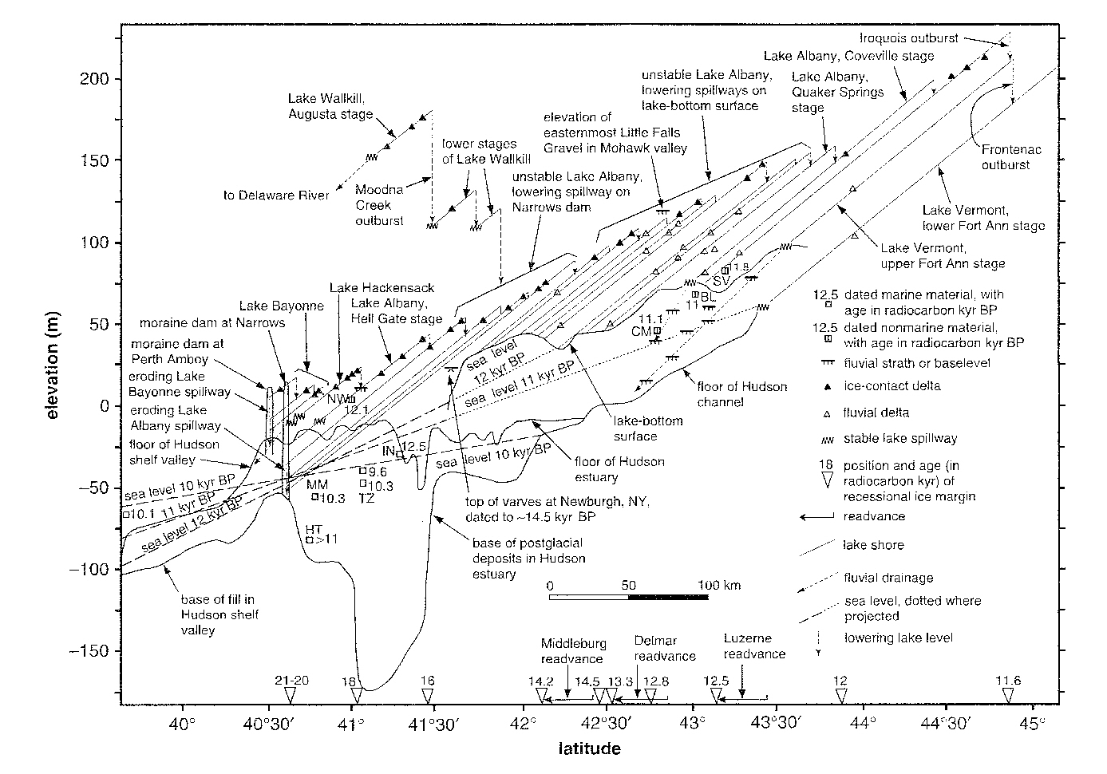
STANFORD, 2009
PLANAR
GRADIENT of 4 ft/mile
Notes:
Stanford 2009 plotted Lake Albany deltas in the Hudson Valley and showed a 4 ft/mile gradient.
He also related the lake levels to rising sea level and various events in the Hudson Valley area.

Slide 8
STANFORD, 2009
KAME DELTAS SUGGEST GRADIENT of 2 ft/mile
Notes:
The earlier workers plotted the early, ice-contact Lake Albany levels using kame or ice-contact deltas.
The ice-contact or kame deltas form a plane of 2 ft/mile.

Slide 9
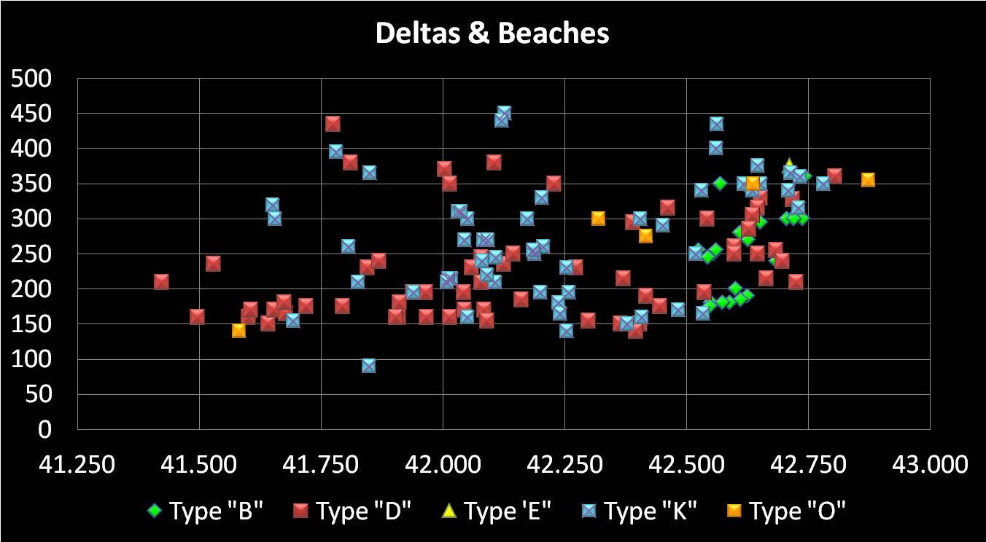
ELEVATION in FEET
NEWBURGH
POUGHKEEPSIE
KINGSTON
HUDSON
RAVENA
ALBANY
SCHENECTADY
LATITUDE
BEACH
DELTA
ESKER
DELTA
KAME
DELTA
OUTWASH
DELTA
Chart thanks to Lisa Elfenbien
Notes:
We decided to determine and plot the Delta and Beach elevations in the Hudson Lowlands south of Schenectady.
Based on observation of exposures north of Kingston by Dineen and Hanson.
Based on LaFleur’s (1965) map north of Kinderhook.
Based on interpretation of airphotos, topographic maps, and soils maps south of Kinderhook.
K+O+E+D+B Scatter Plot
We had hoped that a re-examination of the dat clarify some of the issues concerning isostatic rebound.
You could plot any gradient that you want

Slide 10
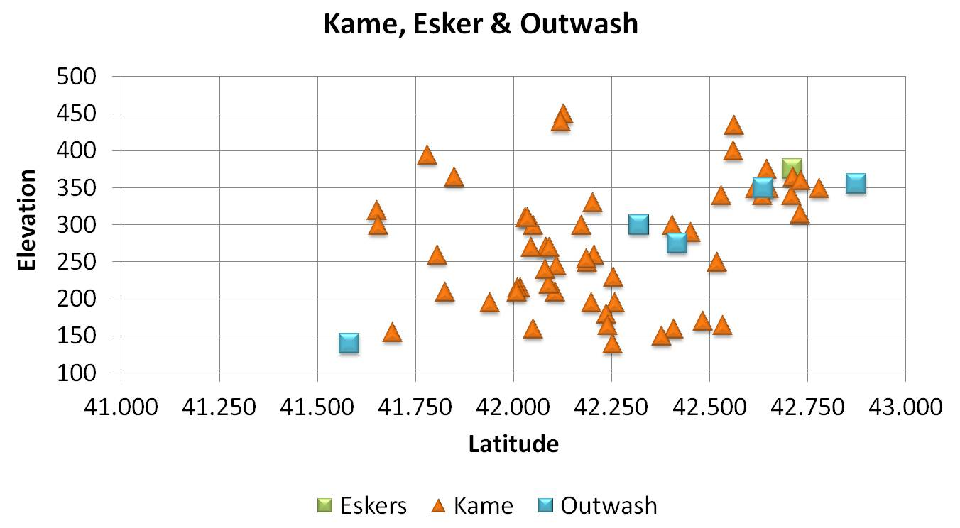
Deltas
SCHENECTADY
NEWBURGH
POUGHKEEPSIE
KINGSTON
HUDSON
RAVENA
ALBANY
N= 58
Chart thanks to Lisa Elfenbien
Notes:
We plotted the distribution and elevations of the Kame, Outwash, and Esker deltas in this section of the valley.
These deltas were the traditional “upper level” or ice-contact phase of Lake Albany.

Slide 11
Deltas
Schodack
Pleasant Valley
Lake Albany I
Lake Albany II
Quaker Springs
& Coveville
SCHENECTADY
NEWBURGH
POUGHKEEPSIE
KINGSTON
HUDSON
RAVENA
ALBANY
Chart thanks to Lisa Elfenbien
Notes:
This is the “Traditional” interpretation of the deltas and uses a planar rebound curve.
The green arrows along the X axis are areas where the lake outlet was within the inner Hudson bedrock gorge.
The gorge is incised into a 150 ft bedrock terrace.
The line labeled “Schodack” marks an early stage of Lake Albany that was mapped by LaFleur in 1965.
Pleasant Valley lies along the eastern edge of the Hudson Lowlands.
It held an ice-contact lake that was contemporaneous with Lake Albany.

Slide 12
Deltas
Hudson Highlands
Catskill-Helderberg
Narrows
Pleasant Valley
Schodack
Lake Albany I
M-R Readvance
Lake Albany II
Quaker Springs
& Coveville
SCHENECTADY
NEWBURGH
POUGHKEEPSIE
KINGSTON
HUDSON
RAVENA
ALBANY
Chart thanks to Lisa Elfenbien
Notes:
Note the scatter of K-O-E delta elevations between Kingston and Ravena.
This scatter occurs in the narrows caused by the Catskill-Helderberg uplands.
It was probably caused by the presence of numerous ice blocks persisting in the Narrows.
Chadwick (1944) and Cook (1945, 1946) both noted abundant evidence for stagnant ice in this area.
They also thought that Lake Albany was choked by ice blocks in this reach.
The ice blocks were primarily the wasting remnants of the Middleburgh-Rosendale Readvance.
Plus icebergs pushed to the narrow portion of the lake by wind and currents.

Slide 13
Narrows
Notes:
Uplands pinch Hudson Lowlands, creating a narrows between Ravena & Kingston

Slide 14
Deltas
3.0 ft/mi
Pleasant Valley
Schodack
4.3 ft/mi
3.0 ft/mi
Lake Albany I
Lake Albany II
3.8 ft/mi
1.5 ft/mi
Quaker Springs
& Coveville
SCHENECTADY
NEWBURGH
POUGHKEEPSIE
KINGSTON
HUDSON
RAVENA
ALBANY
Chart thanks to Lisa Elfenbien
Notes:
Here are the gradients on the rebound for the various lake stages.
The Pleasant valley lake had a gradient of 4.26 ft/mile.
Lake Albany gradients ranged from 2.99 to 3.77 ft/mile, with increasing gradients with decreasing age.
The gradient defined by the lower kames in the Narrows is 1.45 ft/mile.

Slide 15
Deltas
Hudson Highlands
Catskill-Helderberg
Narrows
Schodack
Pleasant Valley
Meadowdale
Schenectady-
Niskayuna
Quaker Springs
& Coveville
SCHENECTADY
NEWBURGH
POUGHKEEPSIE
KINGSTON
HUDSON
RAVENA
ALBANY
Chart thanks to Lisa Elfenbien
Notes:
This is the “Wild and Crazy” interpretation of the ice-contact deltas.
Here, the data points suggest concave-upwards rebound curves.

Slide 16
Deltas
Hudson Highlands
Catskill-Helderberg
Narrows
4.4 ft/mi
3.3 ft/mi
Schodack
3.6 ft/mi
Meadowdale
Pleasant Valley
Schenectady-
Niskayuna
5.1 ft/mi
2.1 ft/mi
2.5 ft/mi
2.5 ft/mi
SCHENECTADY
NEWBURGH
POUGHKEEPSIE
KINGSTON
HUDSON
RAVENA
ALBANY
Chart thanks to Lisa Elfenbien
Notes:
Again, the Lake Albany stages increase in gradient from 3.33 to 5.07 ft/mile as they get younger.
The inflection marking the increase in gradient appears to be a “hinge line” that follows the ice front as it retreats northward.

Slide 17
Deltas
Hudson Highlands
Catskill-Helderberg
Narrows
4.4 ft/mi
3.3 ft/mi
Schodack
3.6 ft/mi
Meadowdale
Pleasant Valley
Schenectady-
Niskayuna
5.1 ft/mi
2.1 ft/mi
2.5 ft/mi
2.5 ft/mi
SCHENECTADY
NEWBURGH
POUGHKEEPSIE
KINGSTON
HUDSON
RAVENA
ALBANY
Chart thanks to Lisa Elfenbien
Notes:
Again, the Lake Albany stages increase in gradient from 3.33 to 5.07 ft/mile as they get younger.
The inflection marking the increase in gradient appears to be a “hinge line” that follows the ice front as it retreats northward.

Slide 18
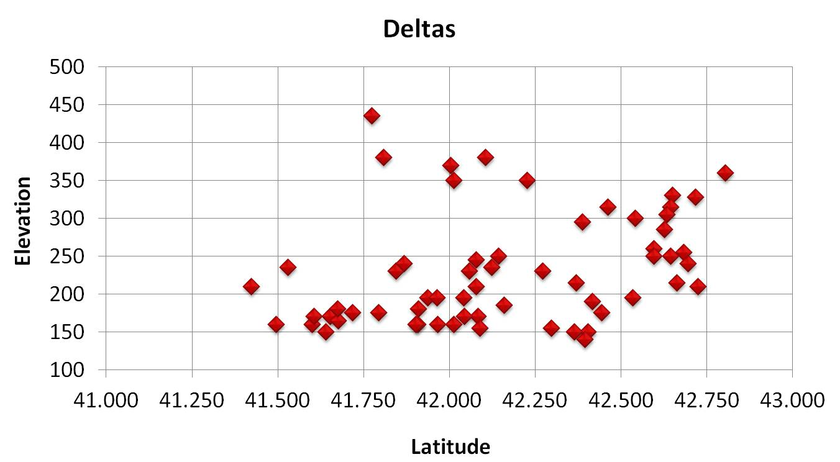
Hudson Highlands
Catskill-Helderberg
Narrows
SCHENECTADY
NEWBURGH
POUGHKEEPSIE
KINGSTON
HUDSON
RAVENA
ALBANY
N= 59
Chart thanks to Lisa Elfenbien
Notes:
Next we plotted the ice free deltas.

Slide 19
Hudson Highlands
Catskill-Helderberg
Narrows
Albany I
Albany II
Quaker Springs
Coveville
SCHENECTADY
NEWBURGH
POUGHKEEPSIE
KINGSTON
HUDSON
RAVENA
ALBANY
Chart thanks to Lisa Elfenbien
Notes:
Here we plotted the “Traditional” lake levels on the ice-free deltas.

Slide 20
Hudson Highlands
Catskill-Helderberg
Narrows
Albany I
3.4 ft/mi
2.3 ft/mi
Quaker Springs
2.3 ft/mi
Coveville
1.8 ft/mi
SCHENECTADY
NEWBURGH
POUGHKEEPSIE
KINGSTON
HUDSON
RAVENA
ALBANY
Chart thanks to Lisa Elfenbien
Notes:
The Traditional gradients for the Lake stages decrease from 3.42 to 1.81 ft/mile from older to younger lake stages.

Slide 21
Hudson Highlands
Catskill-Helderberg
Narrows
Albany II
Albany I
Quaker Springs
SCHENECTADY
NEWBURGH
POUGHKEEPSIE
KINGSTON
HUDSON
RAVENA
ALBANY
Chart thanks to Lisa Elfenbien
Notes:
This is the “Wild and Crazy” interpretation of the (relatively) ice-free deltas.
Note the base line at 150 ft south of Kingston..
This was probably where the lake outlet was carved into older lake deposits.
It would be defended by a wide-spread bedrock terrace between Hyde Park and Poughkeepsie.

Slide 22
Hudson Highlands
Catskill-Helderberg
Narrows
Albany II
Albany I
7.2 ft/mi
5.2 ft/mi
Quaker Springs
3.6 ft/mi
1.5 ft/mi
0.8 ft/mi
2.0 ft/mi
SCHENECTADY
NEWBURGH
POUGHKEEPSIE
KINGSTON
HUDSON
RAVENA
ALBANY
Chart thanks to Lisa Elfenbien
Notes:
Again, the lake stage gradients decrease from older to younger from &.42 to 3.62 ft/mile.

Slide 23
Hudson Highlands
Catskill-Helderberg
Narrows
Albany II
Albany I
7.2 ft/mi
5.2 ft/mi
Quaker Springs
3.6 ft/mi
1.5 ft/mi
0.8 ft/mi
2.0 ft/mi
SCHENECTADY
NEWBURGH
POUGHKEEPSIE
KINGSTON
HUDSON
RAVENA
ALBANY
Chart thanks to Lisa Elfenbien
Notes:
Again, the lake stage gradients decrease from older to younger from &.42 to 3.62 ft/mile.

Slide 24
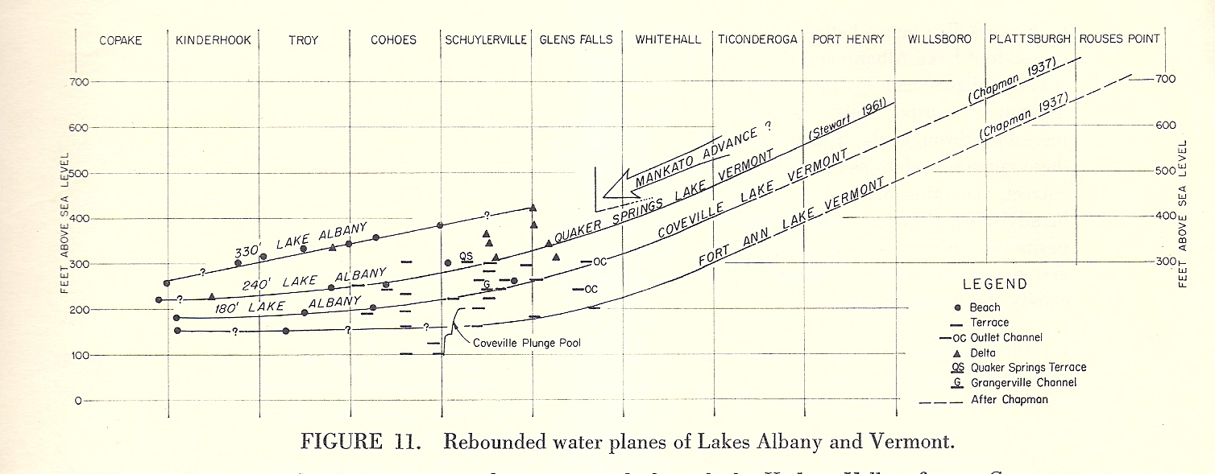
LAFLEUR, 1965
Albany
Schenectady
Concave-up gradient
2.5 ft/mile Hudson Lowlands
5.6 ft/mile Champlain Lowlands,
from Chapman, 1937, 1942 and Stewart, 1960
Notes:
Robert LaFleur, in 1965, published a glacial geology map of the Troy 15 minute quadrangle.
The oldest, 330 ft Lake Albany level, was defined by kame deltas and the Schenectady delta.
It had a post-rebound gradient of 2.5 ft/mile in the Hudson Lowlands.
He added the 5.6 ft/mile gradient in the Champlain Lowlands from Chapman, 1937 and 1942 and Stewart, 1961.
He showed a concave-upward gradient.
In 2008 DeSimone, LaFleur and others re-evalutated the rebound gradients to north of Albany to 3.7 ft/mile.

Slide 25
SLOPE (Ft/Mile)
WOODWORTH, 1905 | 2.2 | Planar
FAIRCHILD, 1912, 1917, 1918 | 2.2 to 2.5 | Concave-up | Delayed until after Schenectady Delta
CHADWICK, 1928 (northern Hudson) | 2.25 to 2.5 | Planar | Contemporaneous with ice removal
CHAPMAN, 1937, 1942 (Lake Vermont) | 5 | Concave-up | Delayed until after Schuylerville deglaciated
CHADWICK, 1944 | 2.25 |  | Contemporaneous with ice removal
LAFLEUR, 1965, 1979, 1983 | 2.5 | Planar | Not caused by a wave of uplift
DINEEN, DESIMONE, HANSON, 1988 | 2.5 | Mixed | Contemporaneous with ice removal
REFERENCE
SHAPE
TIMING
Notes:
Here we highlight the shapes of the rebound curves, based on the literature.

Slide 26
SLOPE (Ft/Mile)
CONNALLY and SIRKIN, 1986 | 2.4 | Planar | Rolling rebound
DINEEN and others 1992 | 2.65 | Mixed | Contemporaneous with ice removal
DeSimone and LaFleur, 1992 | 2.7 | Planar | Contemporaneous with ice removal
CONNALLY and Cadwell, 2002 | 1.6? | Planar | Rolling rebound
STONE and others, 2005 (Lake Hitchcock) | 4.7 | Planar | Delayed 2000 years after Deglaciation of lower Connecticut Valley
DeSimone and others 2008 | 3.7 | Planar | Contemporaneous with ice removal
STANFORD, 2009, 2010 | >4 | Planar | Contemporaneous with ice removal
REFERENCE
SHAPE
TIMING

Slide 27
SLOPE (Ft/Mile)
Pleasant Valley | 4.4 | Planar | Delayed
Schodack (Wild & Crazy) | 3.3 | Concave-up | Delayed
Albany I (Meadowdale) | 3.6 | Concave-up | Contemporaneous with ice removal
Albany I (Schenectady) | 5.1 | Concave-up | Contemporaneous with ice removal
Schodack (Traditional) | 3.4 | Planar | Contemporaneous with ice removal
Albany I (Schenectady) | 2.3 | Planar | Contemporaneous with ice removal
Quaker Springs | 2.3 | Planar | Ice in Champlain Lowlands
Coveville | 1.8 | Planar | Ice in Champlain Lowlands
Albany Stage
SHAPE
TIMING
Notes:
This Table shows the results from this study.
Blue highlights the Wild & Crazy Gradients we calculated.
Orange highlights the Traditional Gradients.
The Wild & Crazy gradients are steeper than the Traditional Gradients.

Slide 28
WHERE ARE WE?
Kame Deltas suggest a Rebounded Ice-Contact Lake Plane
of ~3.3 to 5.1 ft/mile
Lake Planes Steepen North OF ALBANY
Both Planar and Concave-Upwards curves fit the Data
in the mid-Hudson Lowlands
The concave-up curves suggests an isostatic “hinge line”
Followed the retreating ice front
The lake outlet was within the Hudson’s bedrock gorge
South of Kingston
The outlet migrated from:
newburgh (albany I) to
kingston(albany ii) to
hudson (quaker springs)
Notes:
WHERE ARE WE?
Kame Deltas suggest a Rebounded Ice-Contact Lake Plane
of ~3.3 to 5.8 ft/mile
Lake Planes Steepen North OF ALBANY
Both Planar and Concave-Upwards curves fit the Data
in the mid-Hudson Lowlands

Slide 29
GENERAL PROBLEMS WITH LAKE ALBANY DELTAS
We’ve historically connected the ice-contact or kame deltas
There is a great deal of scatter in the elevations of ice-contact or kame deltas
Especially in the Narrows
The large number of deltas make correlation difficult.
Exposures of the topset-foreset contact are rare and exposures are short-lived
Many LA deltas have very thin topsets (Thanks Carl!)
The literature contains few actual descriptions of the LA topset-foreset contact
Most delta identifications and elevations are based on surface landforms.
The area between the Hudson Highlands and Poughkeepsie is heavily developed
Making exposures rare and modifiying the landforms
POSSIBLE SOLUTIONS
Make more observations in deltas south of Kinderhook
Use Ground-Penetrating Radar profiles of deltaforms to ID the topset/Foreset
interface
Use LIDAR to “trace the bathtub rings” between deltas
This is a good project for a team of geophysicists, glacial geomorphologists,
statisticians, and stratigraphers
Notes:
GENERAL PROBLEMS WITH LAKE ALBANY DELTAS
We’ve historically connected the ice-contact or kame deltas
There is a great deal of scatter in the elevations of ice-contact or kame deltas
Especially in the Narrows
The large number of deltas make correlation difficult.
Exposures of the topset-foreset contact are rare and exposures are short-lived
Many LA deltas have very thin topsets (Thanks Carl!)
The literature contains few actual descriptions of the LA topset-foreset contact
Most delta identifications and elevations are based on surface landforms.
The area between the Hudson Highlands and Poughkeepsie is heavily developed
POSSIBLE SOLUTIONS
More observations in deltas south of Kinderhook
Ground-Penetrating Radar profiles of deltas to ID the topset/Foreset interface
Use LIDAR to “trace the bathtub rings”
Good project for a team of geophysicists, glacial geomorphologists, statisticians, and stratigraphers

Slide 31
Geography
Uplands vs. Lowlands
Physiographic Image
Uplands pinch Hudson Lowlands between Ravena & Kingston
Wallkill Lowlands open to the southwest
Hudson Lowlands held Glacial Lake Albany
Lake Albany extended from Newburgh to Glens Falls
The water plane of the lake has been measured by various workers
Until the 1990s, the consensus slope was approximately 2.5 ft/mile
AMQUA & FOP chart
Lake Albany was contemporaneous with Lake Hitchcock in the Connecticut Lowlands
New England Mafia measured an isostatic tilt of 4+ ft/mile during 80s and 90s
Glacial Movement
Focused into narrows
Spread into Wallkill Lowlands
Middleburgh-Rosendale Readvance reached just south of Kingston
Where Wallkill sublobe pulled flow away from Hudson LL
Ice Movement map
M-R Readvance stagnated in the Ravena-Kingston neck
As indicated by numerous low-elevation KDs in neck, as noted by Cook & Chadwick.

Slide 32
Check Antev’s correlation betwixt Hudson & Connecticut lowlands retreats.
Ice front was further south in HLL, because of M-R Readvance.
Thus isostatic contours were bent south in HLL.
This slowed rebound in the HLL, so the immediate rebound from the retreat through the Hudson Highlands had passed north.
In addition, the M-R readvance would have reversed rebound because of the rapid addition of ice.
A probable factor in the difference between rebound rates in the southern HLL was differences in the physical characteristics (elasticity, brittleness) between a subduction zone (HLL: west) and a failed rift (CLL: east).
The compressed rocks in the HLL would differ from the pulled-apart rocks under the CLL.

Slide 33
LONGITUDINAL PROFILES
Based on exposures north of Kingston on the west side of the HR
Based on LaFleur (1965) north of Kinderhook.
Based on airphotos, topographic map analysis, and soils maps south of Kinderhook (or Kingston) plus work by Connally
K+O+E+D+B Scatter Plot
You could plot any gradient that you want
K+O+E Scatter Plot
K+O+E plot focuses on the upper-most kame deltas that were the traditional Plot
Note cluster of low-elevation KDs in the Ravena-Kingston neck.

Slide 34
B Scatter Plot shows beaches.
Much less scatter than deltas
Two concave-up lines are defined by the beaches.
Upper line curves up from 250 ft @ 42.55^{O} to 330 ft @ 42.65^{O} (80 ft in
0.1 degree of latitude)
Upper line ends with large scatter.
Upper line is Defreetsville-Voorheesville, Meadowdale moraine line
Lower line curves up from 175 ft @42.55^{O} to 200 ft @ 42.60^{O} to 355 ft @
42. 75^{O} (25 ft in 0.05 degree of latitude to 155 ft in 0.15 degree of latitude).
Lower line is Schenectady Delta line.
Difference between the two line is ~75 ft.
Suggests a fall in lake level from Albany Ia to Lake Albany Ib (both ice contact)
of 75 ft when ice retreated ( to Niskayuna margin?) and unblocked the Mohawk
Lowlands.
Lake Amsterdam flooded into the HLL

