Slide 1
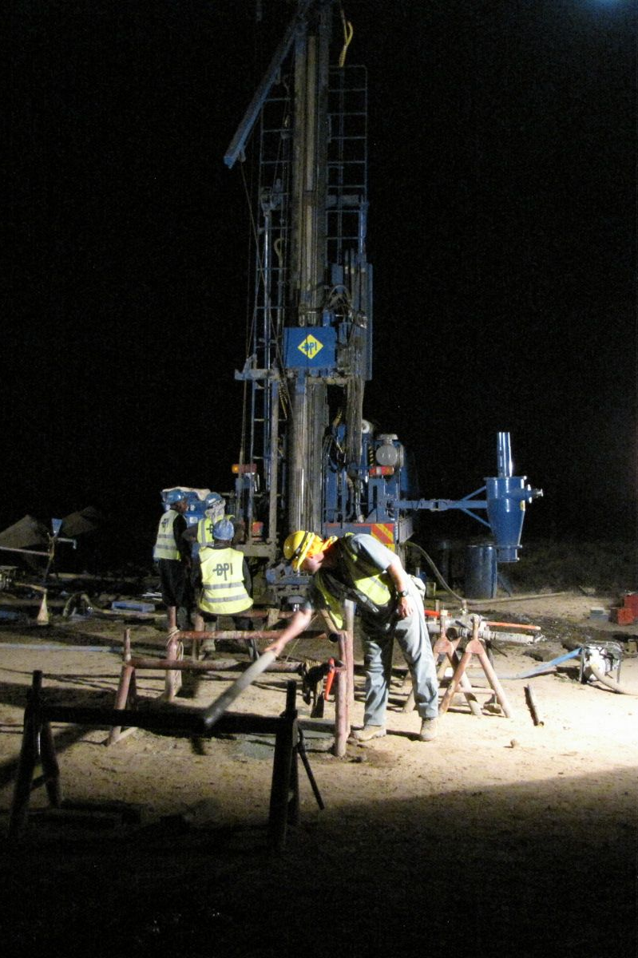
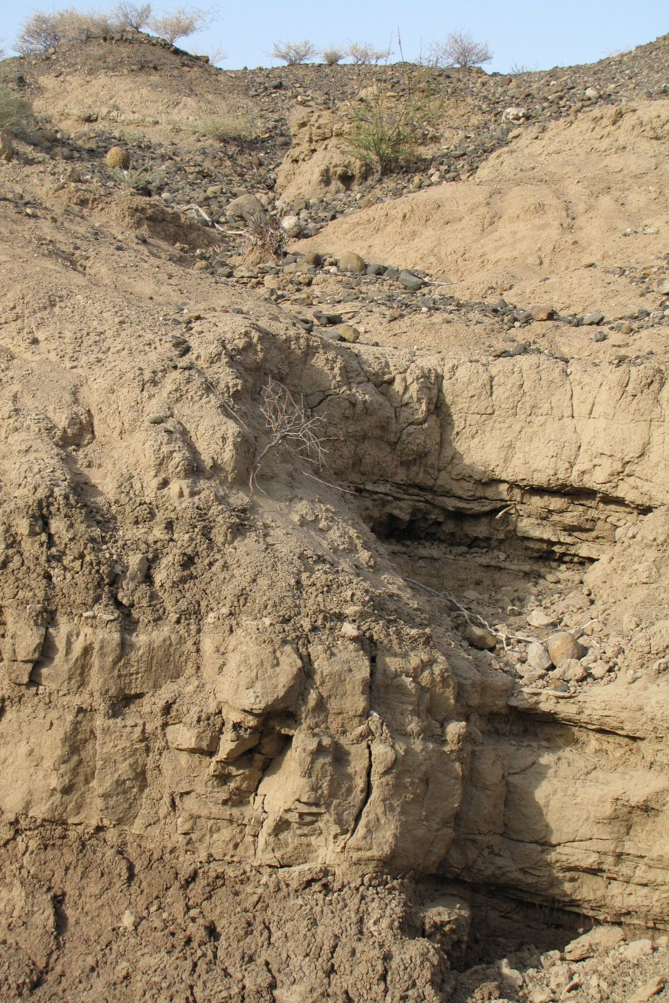
An Integrated Multi-proxy Investigation of Outcrop and Core Records
from an Early Pleistocene Lacustrine Sequence in West Turkana, Kenya
Craig S. Feibel, Jeroen van der Lubbe, Chad Yost, Catherine Beck, Hubert Vonhof, Josephine Joordens, Andrew Cohen

Slide 2
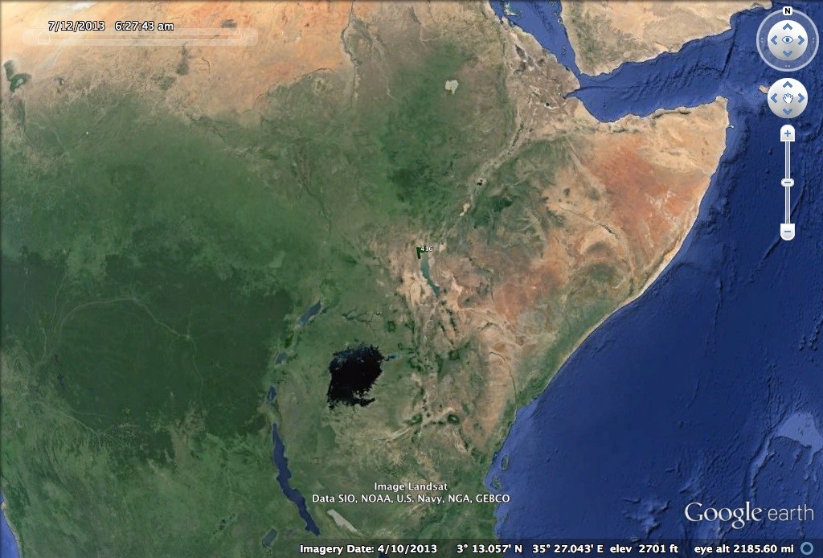
Turkana Basin
East African
Rift System

Slide 3
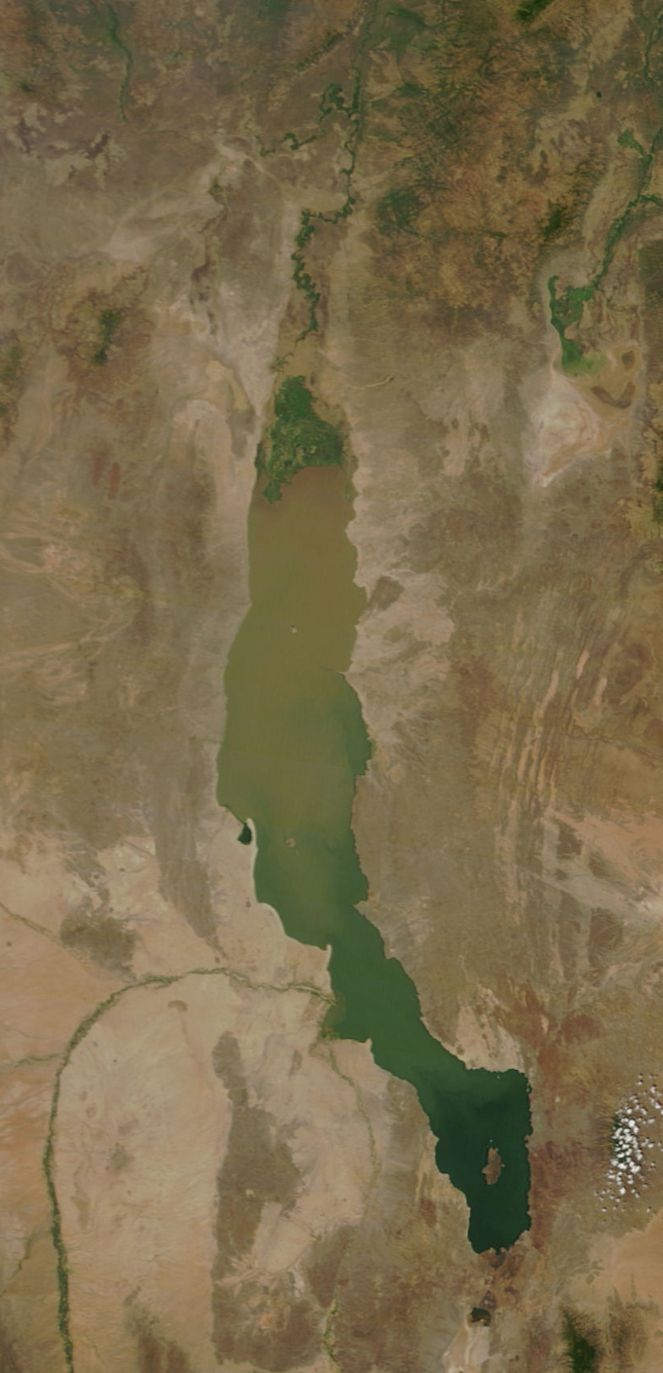
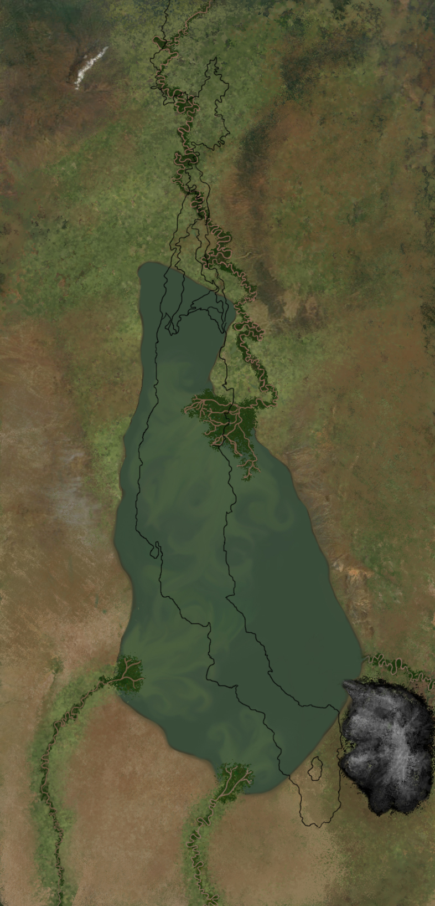
Modern Lake Turkana
Lorenyang Lake
1.9 Ma
Kaitio
MODIS 11 Jan 2010

Slide 4
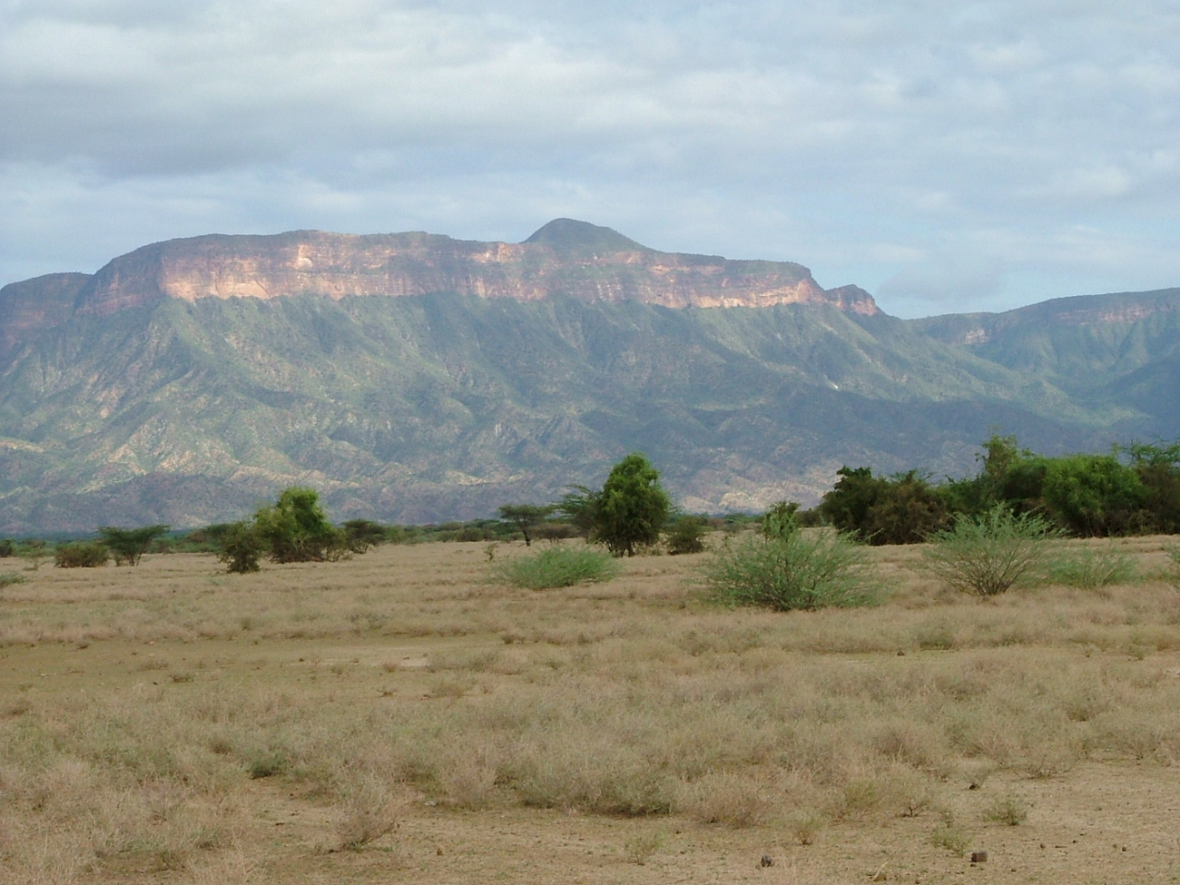
Context for Rift Evolution
Cretaceous rift strata in footwall uplift, Labur

Slide 5
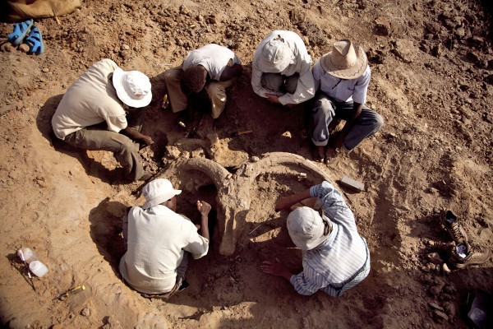
Context for Paleontology
National Geographic Bones of Turkana

Slide 6
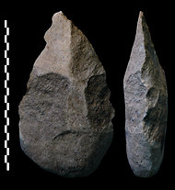
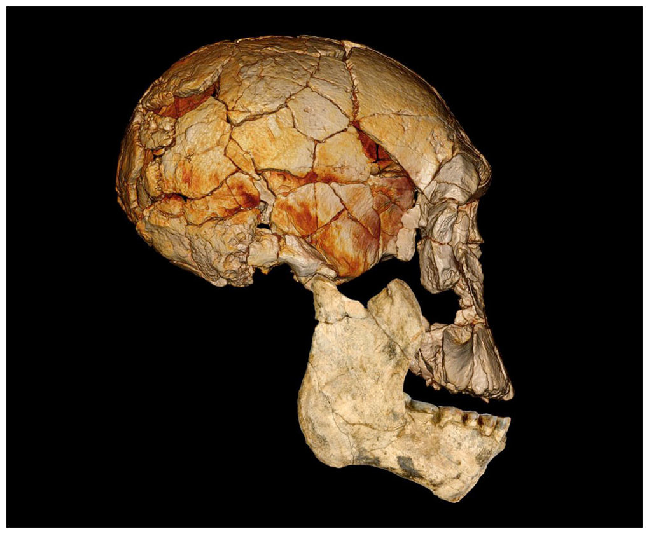
Context for Human Evolution

Slide 7
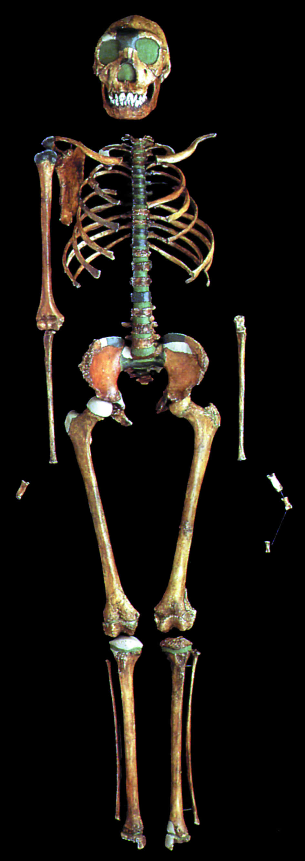
Context for Human Evolution
KNM-WT 15000
Turkana Boy
Homo erectus
Notes:
WTK13 is only 2.5 km from NK3

Slide 8
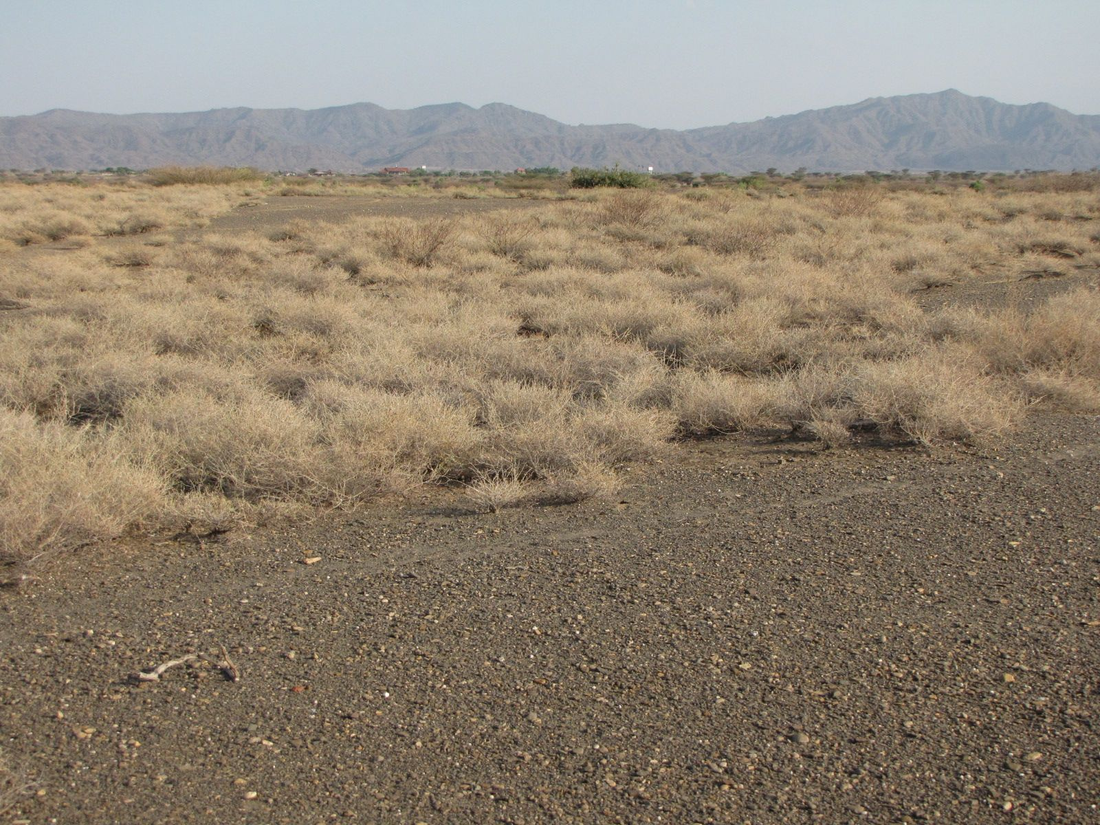
Lacustrine Records from Kaitio
HSPDP
Hominin Sites and Paleolakes Drilling Project
216 m HQ (2.5”) core
TCP
Turkana Cyclostratigraphy Project
160 m section

Slide 9
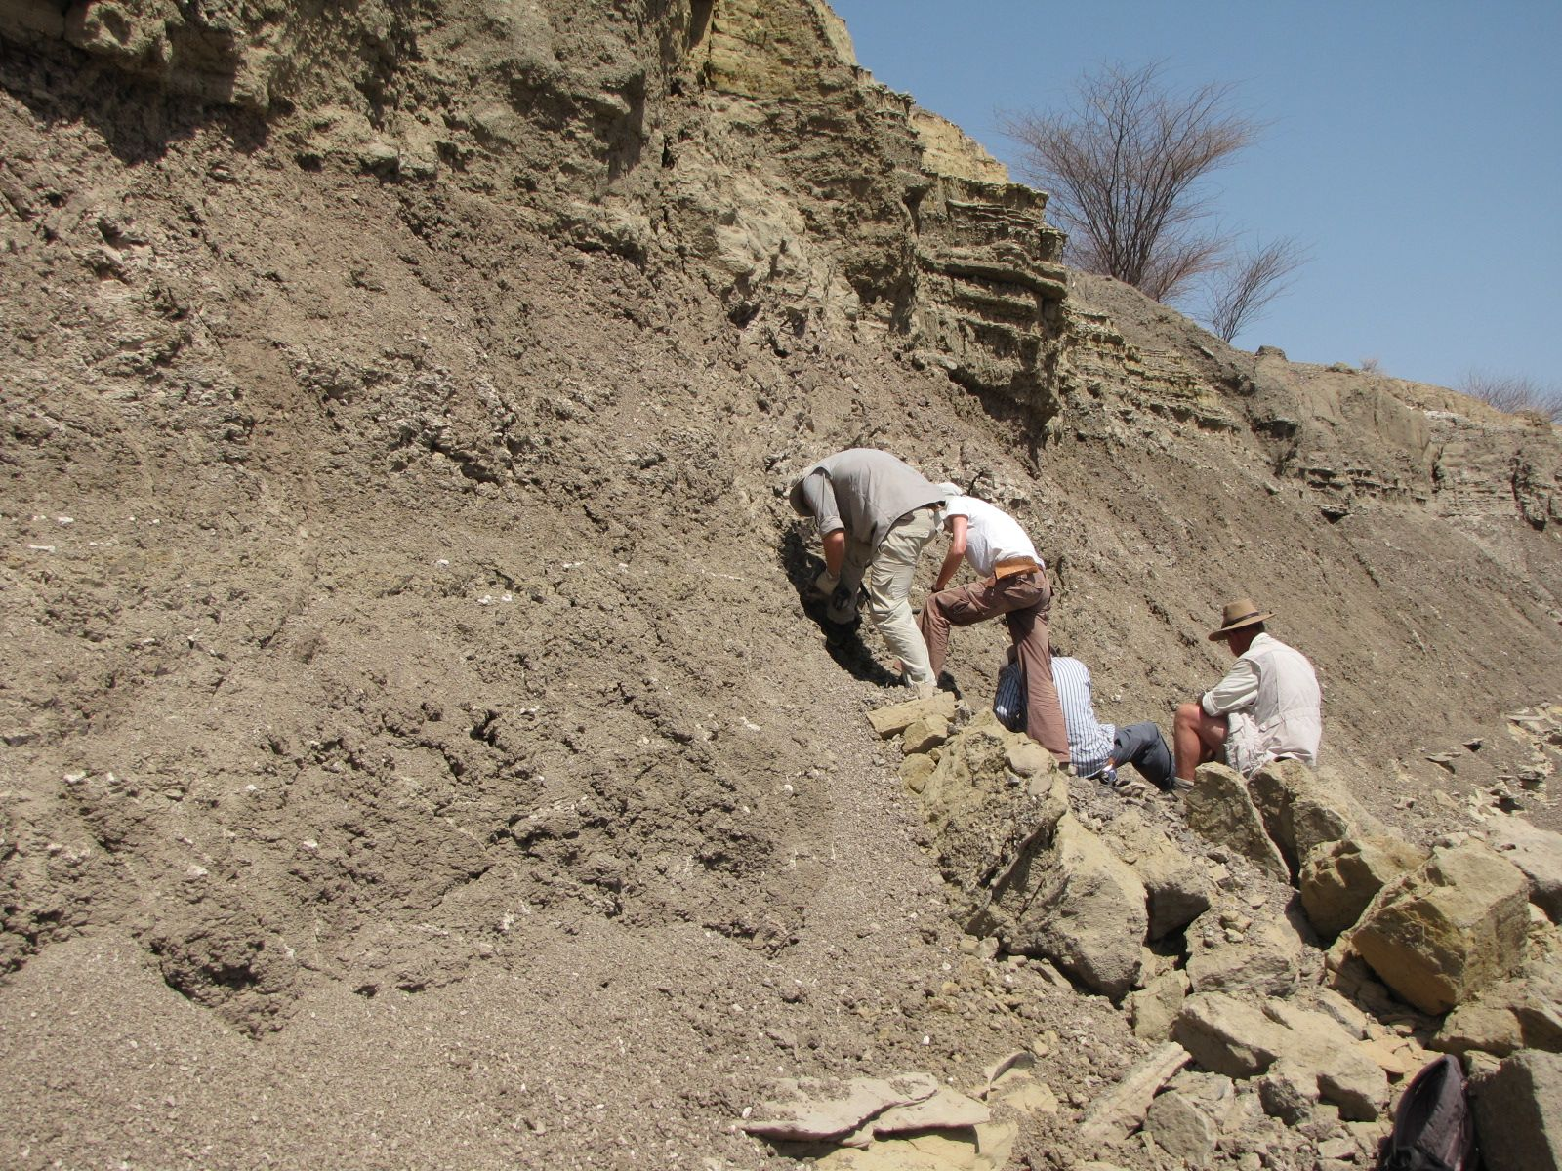
Outcrop Campaign
sampling interval 50 cm
paleomag
bulk sediment
lithostratigraphy
tephra collection

Slide 10
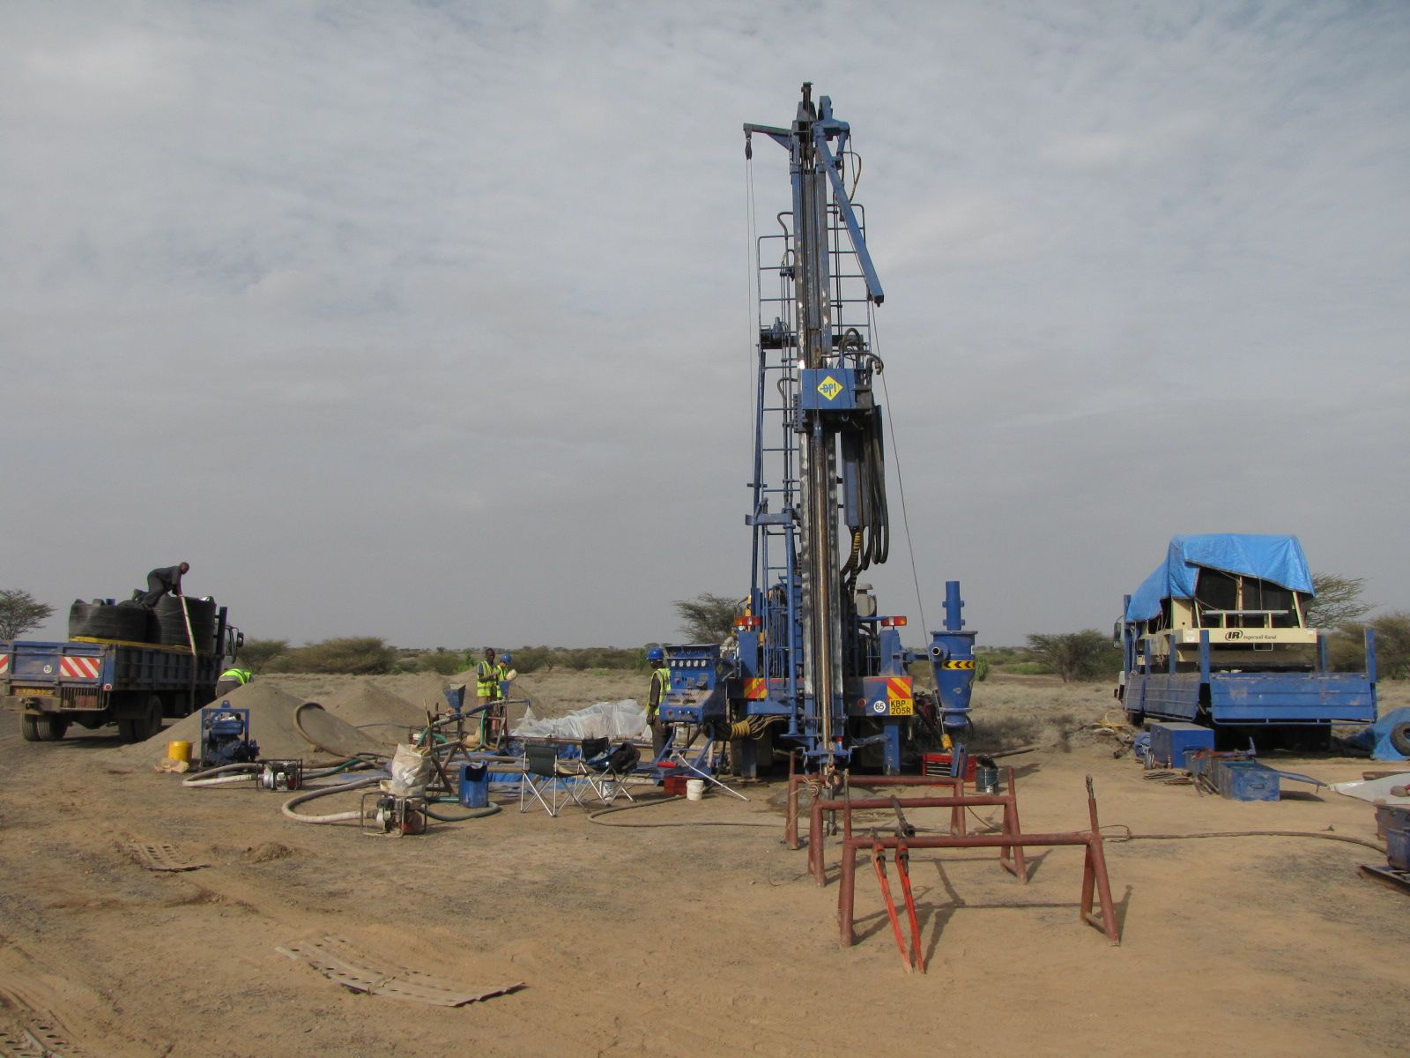
Drilling Campaign
216 m core in pvc liners

Slide 11
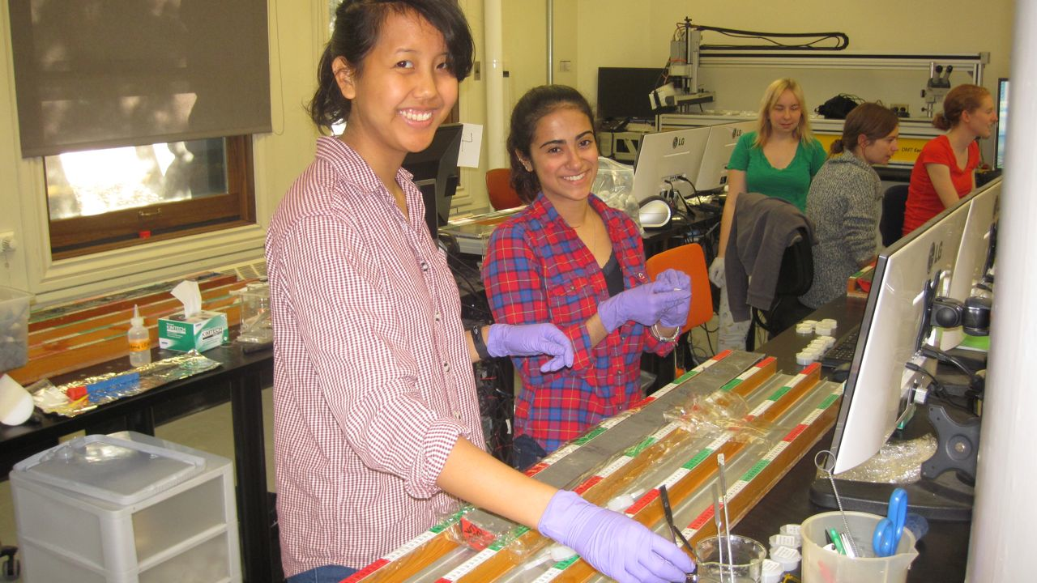
WTK13 Core Sampling Party LacCore Facility
University of Minnesota, Minneapolis
sampling interval 32 cm

Slide 12
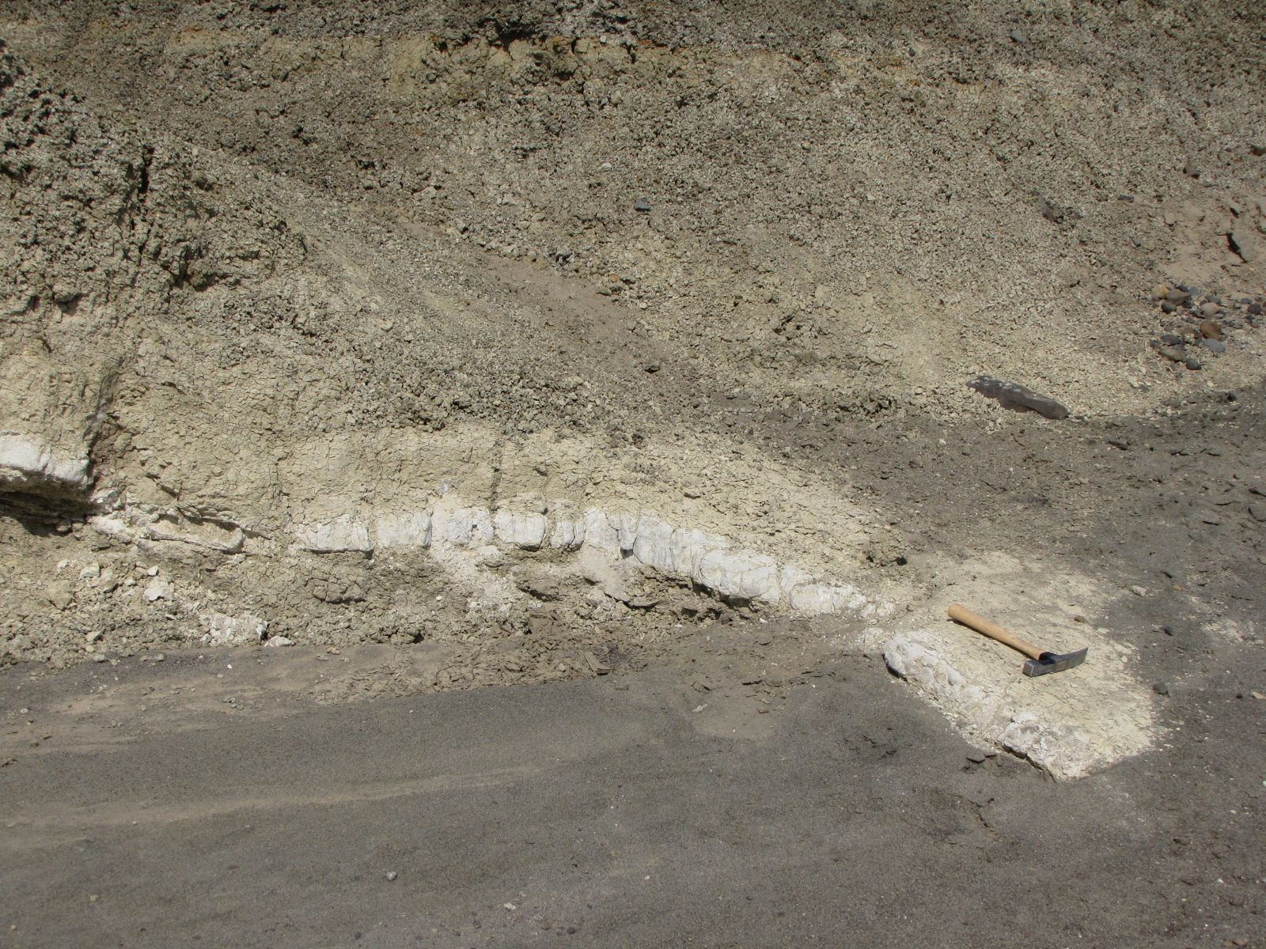
Age Model
KBS Tuff 1.87 Ma
WTK13-1A-72Q-3

Slide 13
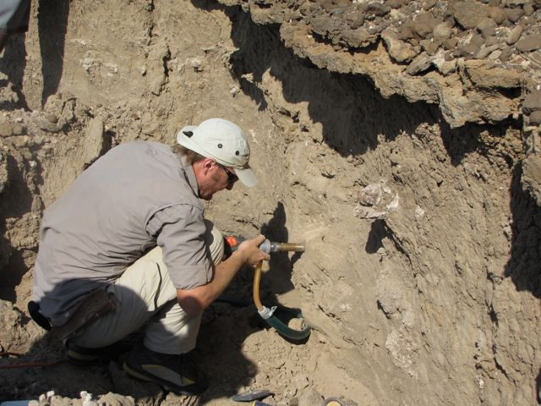
Age Model
Magnetic Polarity Stratigraphy
base and top Olduvai Subchron 1.95 – 1.78 Ma
Vrica event
pre-Olduvai event

Slide 14
Lokapetamoi Tuff 1.42 Ma
Kaitio Section 2013
Natoo Tuff
Etirr Tuff 1.44 Ma
macrotephra
microtephra
magnetic polarity stratigraphy
magnetic susceptibility
Sr isotope stratigraphy (fish)
O isotope stratigraphy (ostracods)
KBS Tuff 1.87 Ma

Slide 15
Sr Isotope Proxy
from Joordens et al., 2011 & 2013

Slide 16
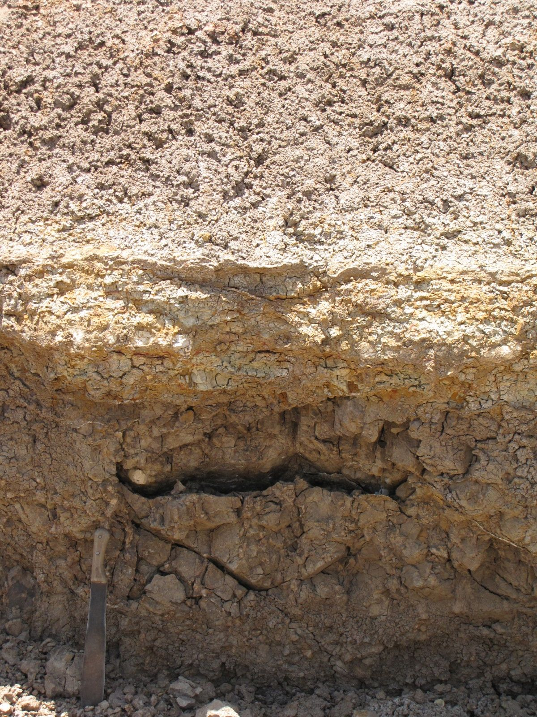
Kaitio Section 2013
33 flooding surfaces

Slide 17
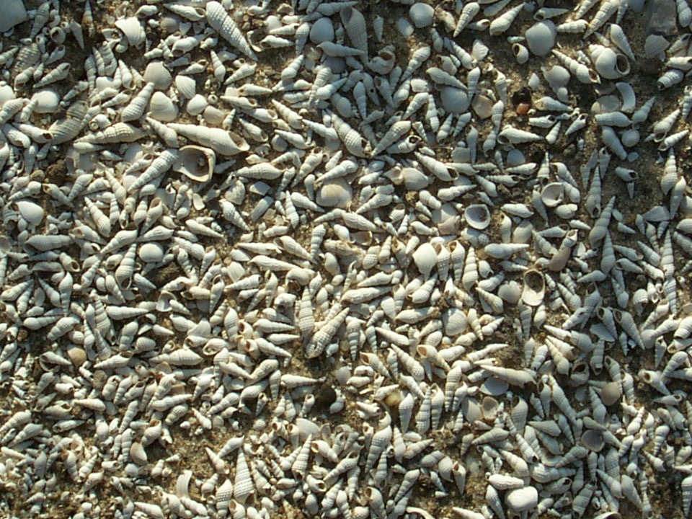
Lorenyang Lake Sequence
Comparable Records
WTK13-1A-38Q-2 10-22 coquina

Slide 18
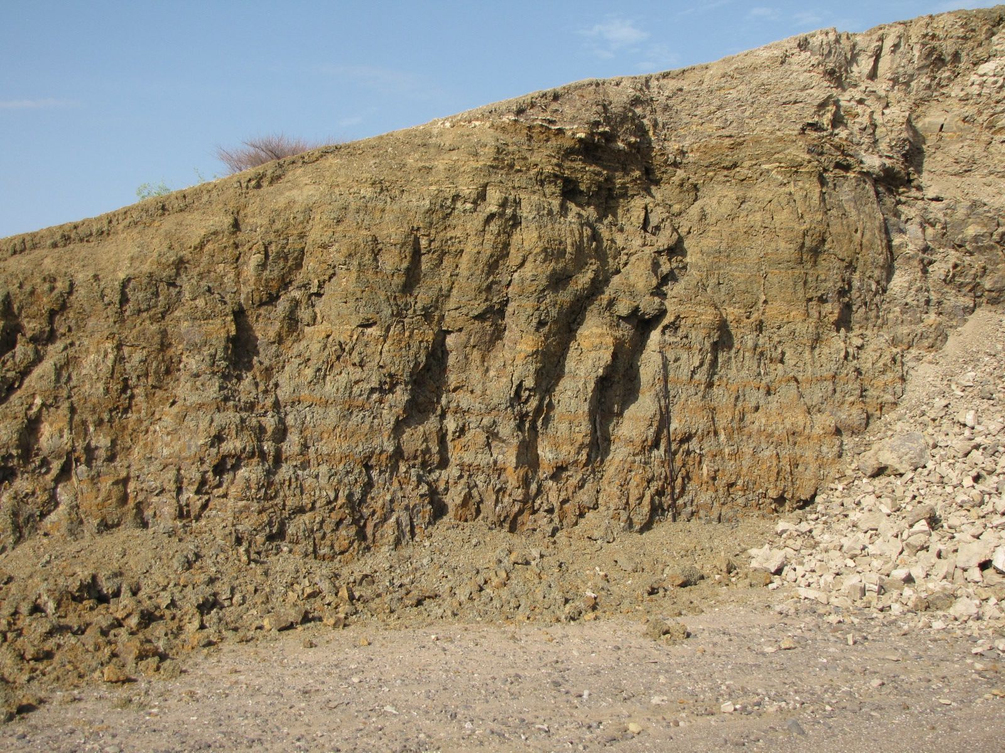
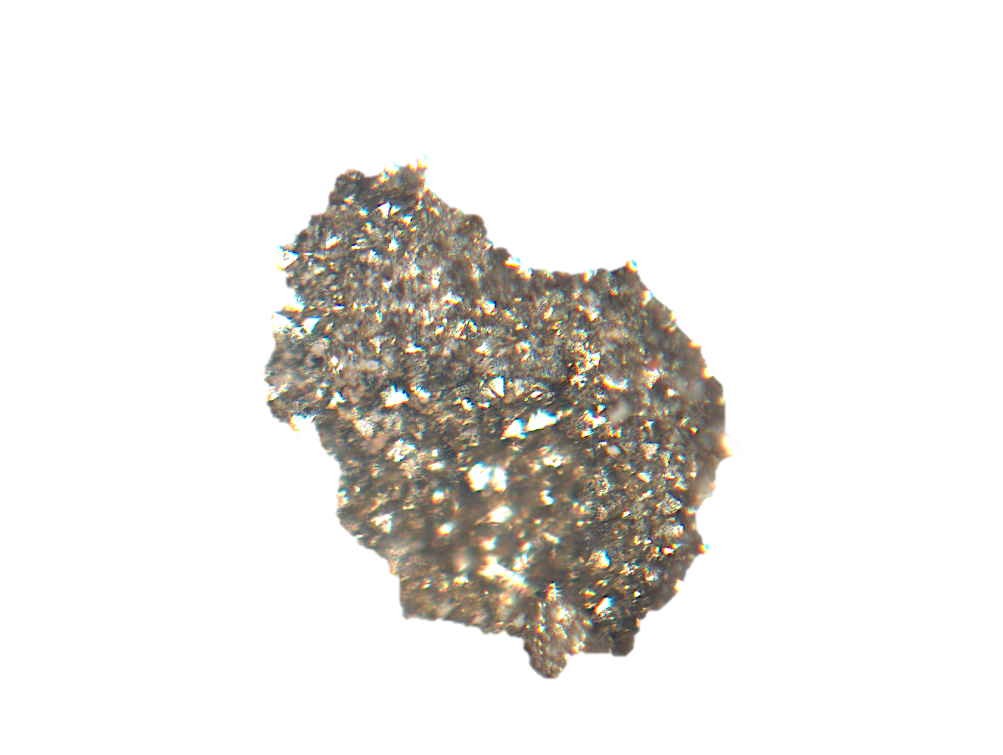
Lorenyang Lake Sequence
Different Perspectives

Slide 19
Lorenyang Lake Sequence
Contrasting Perspectives
WTK13-1A-37Q-2

Slide 20
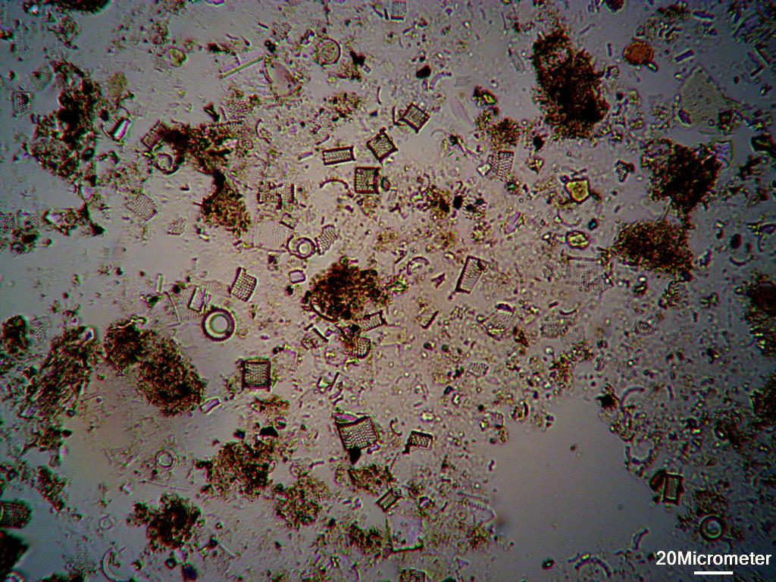

Slide 21
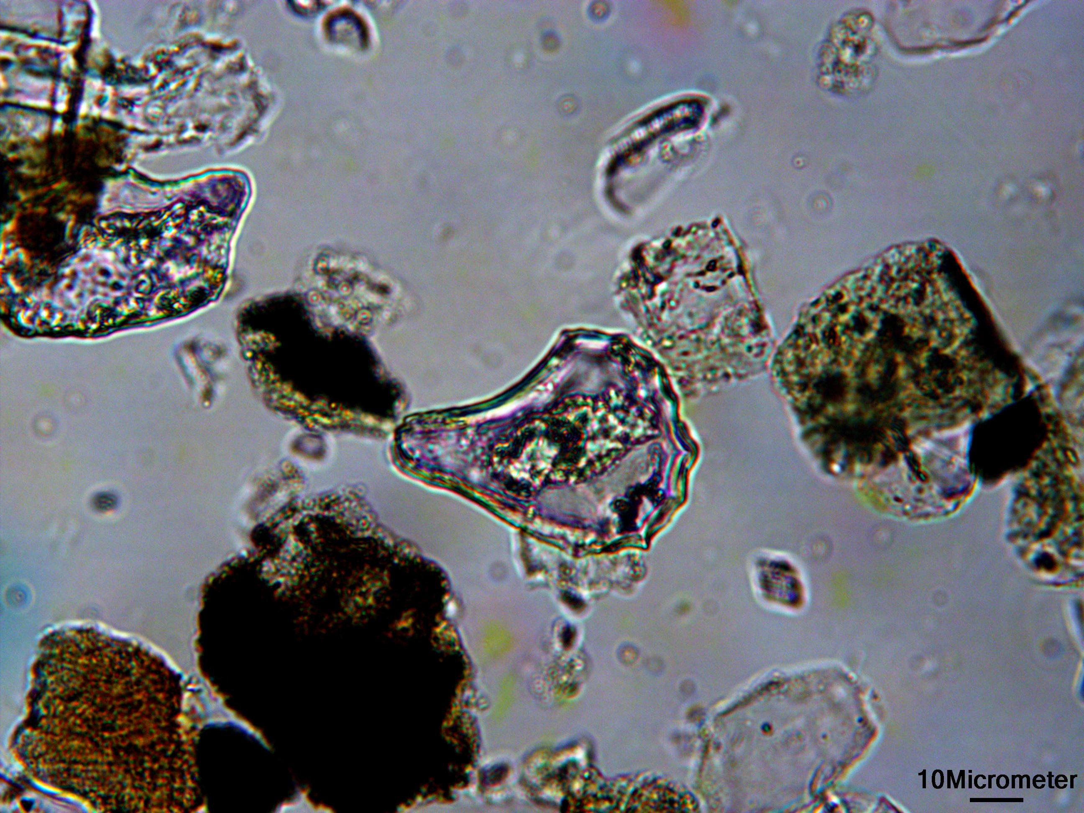
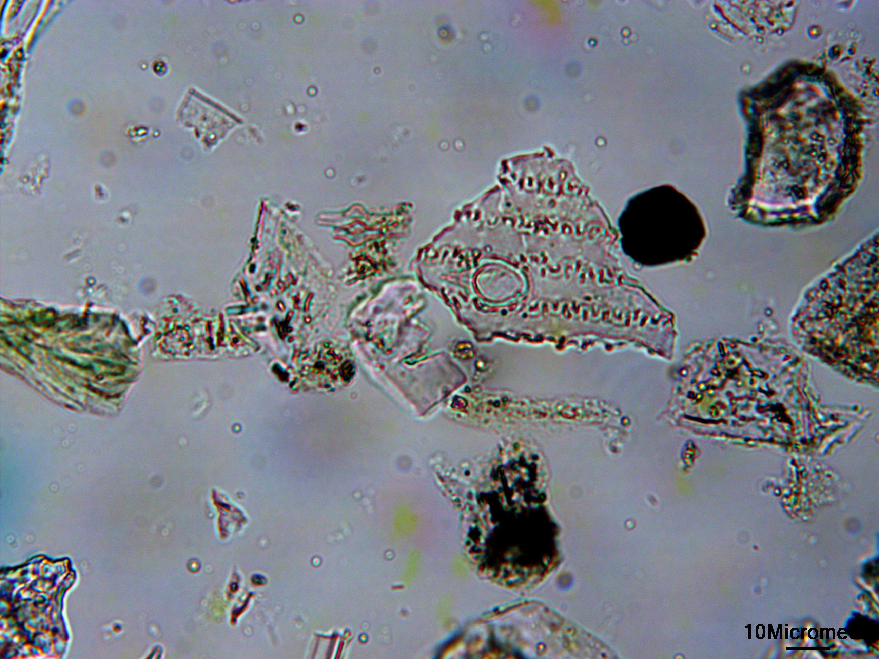
Phytoliths

Slide 22
WTK13-1A-68Q-2
WTK13-1A-33Q-1

Slide 23
Conclusions
Integrated outcrop and coring approaches provide unique opportunities to test hypotheses on diagenetic history
Multi-proxy investigations build robust cross-tested datasets
Continuous and regular sampling combined with new (and old) analytical tools will allow lake-based environmental data to exceed the potential of distant marine records.

Slide 24
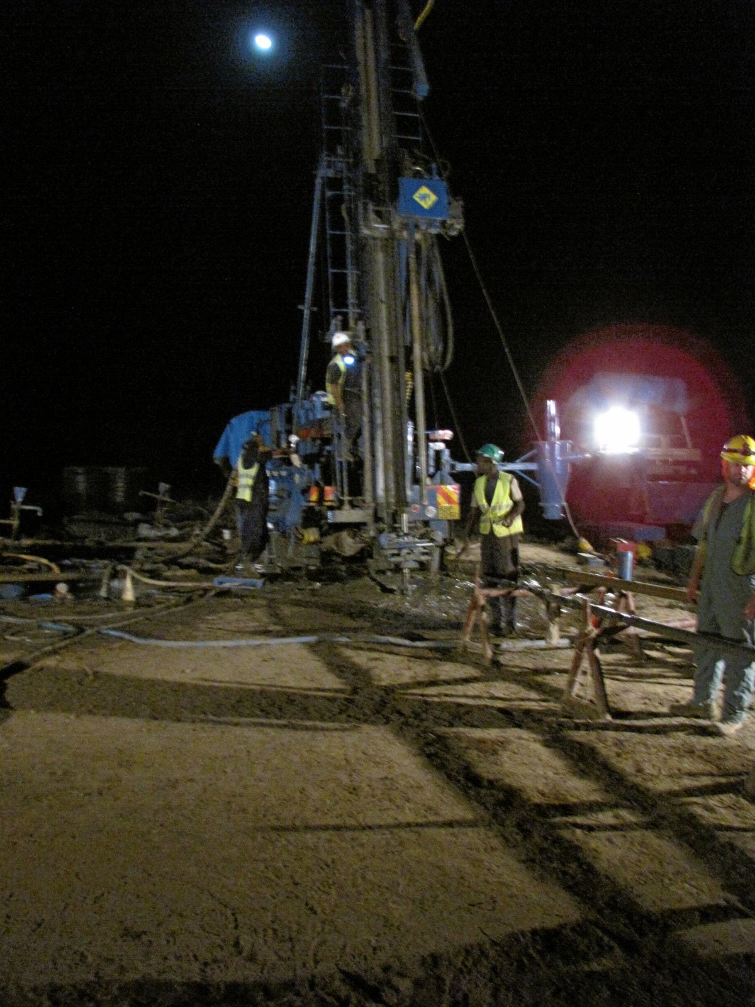
Thanks!
Research Supported by:
ICDP
NSF
Ostracods by Anna Gravina
Fieldwork carried out by the HSPDP WTK13 and TCP teams.
Research in Kenya was undertaken with permission from the Office of the President and Turkana County, with logistical support from the National Museums of Kenya and the Turkana Basin Institute

