Slide 1
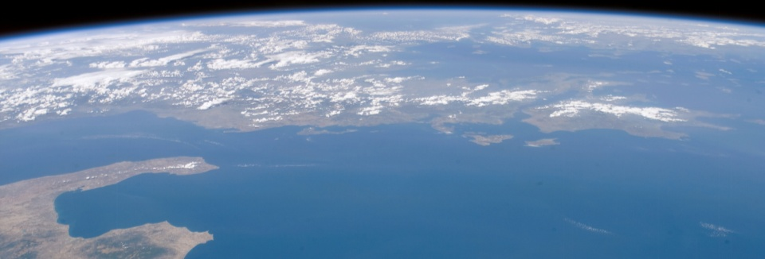




New Applications for Interferometric Synthetic Aperture Radar [InSAR] : Interpretation of Persistent, Distributed, and Temporary Scatterers for Geohazard and Infrastructure Monitoring and Evaluation
Brian S. Bruckno, Ph.D., P.G.
Edward J. Hoppe, Ph.D., P.E.
Andrea Vaccari, M.Sc.
Scott T. Acton, Ph.D. (P.I)
Elizabeth V. Campbell
Notes:
EVERY MAP: START WITH MAP, ADD PD, DS, and TS in ORDER

Slide 2
RITA-10
Project
RITA-10 Project
United Stated Department of Transportation Research and Innovative Technology Administration No. RITARS-11-H-UVA “Sinkhole Detection and Bridge/Landslide Monitoring for Transportation
Infrastructure by Automated Analysis of Interferometric
Synthetic Aperture Radar Images”
InSAR
Geohazards and Assets
The views, opinions, findings, and conclusions reflected in this paper are the responsibility of the authors only and do not represent the official policy or position of the
USDOT/RITA, or any state or other entity
Karst
Infrastructure
Rock Slopes
Conclusion

Slide 3
RITA-10
Project
RITA-10 Project
United Stated Department of Transportation Research and Innovative Technology Administration No. RITARS-11-H-UVA “Sinkhole Detection and Bridge/Landslide Monitoring for Transportation
Infrastructure by Automated Analysis of Interferometric
Synthetic Aperture Radar Images”
InSAR
Geohazards and Assets
The views, opinions, findings, and conclusions reflected in this paper are the responsibility of the authors only and do not represent the official policy or position of the
USDOT/RITA, or any state or other entity
Karst
Infrastructure
Rock Slopes
Conclusion

Slide 4

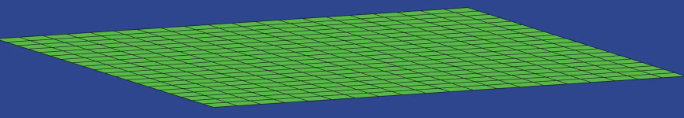
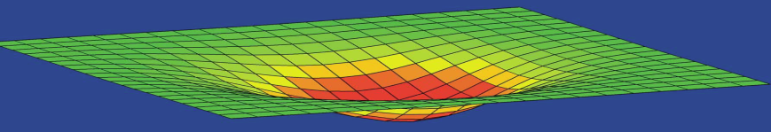
RITA-10
Project
InSAR
Interferometric Synthetic Aperture Radar
InSAR
COSMO-SkyMed (Italian Space Agency)
32 images collected over ~1 year
X-band (λ = 3.1 cm)
Millimeter-scale accuracy in elevation measurements
Geohazards and Assets
R2
Karst
Scatterer = A detectable
surface expression of varying
size and behavior, defined by centroid
R1
Infrastructure
Rock Slopes
Conclusion

Slide 5
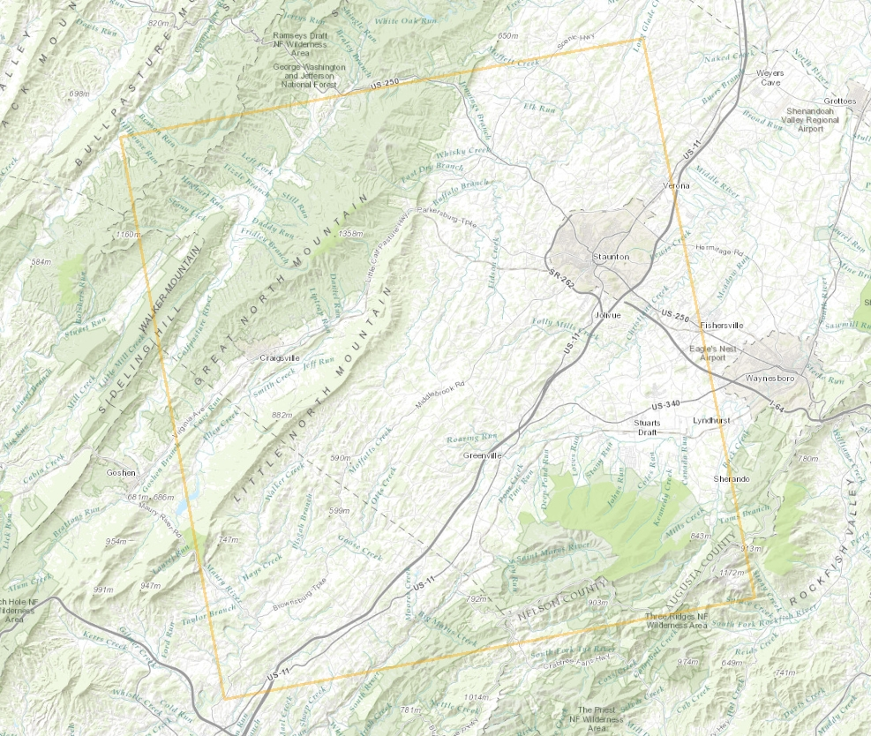
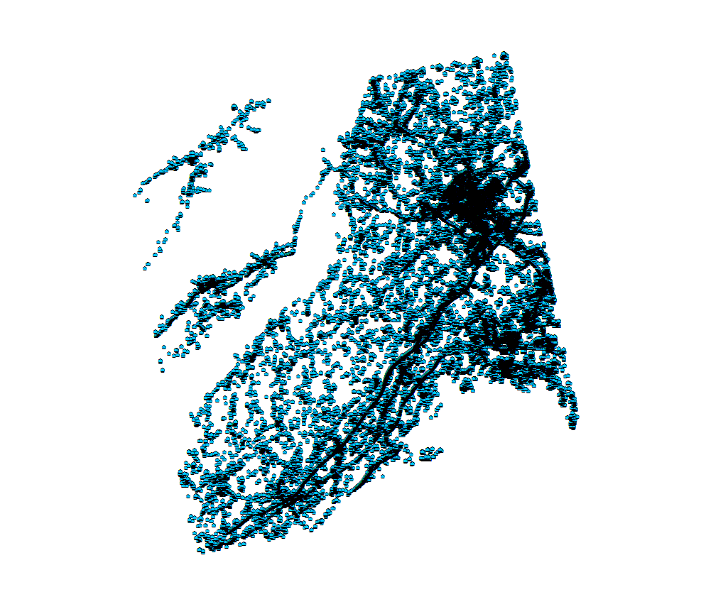
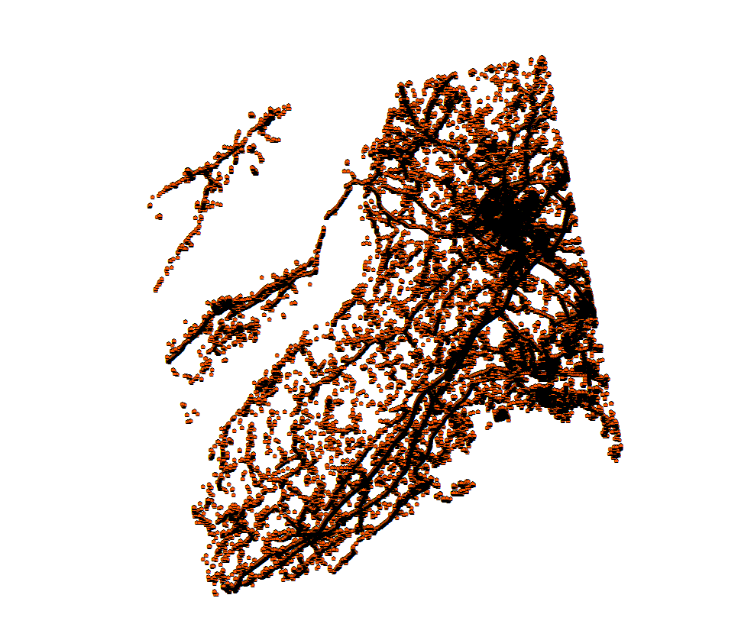
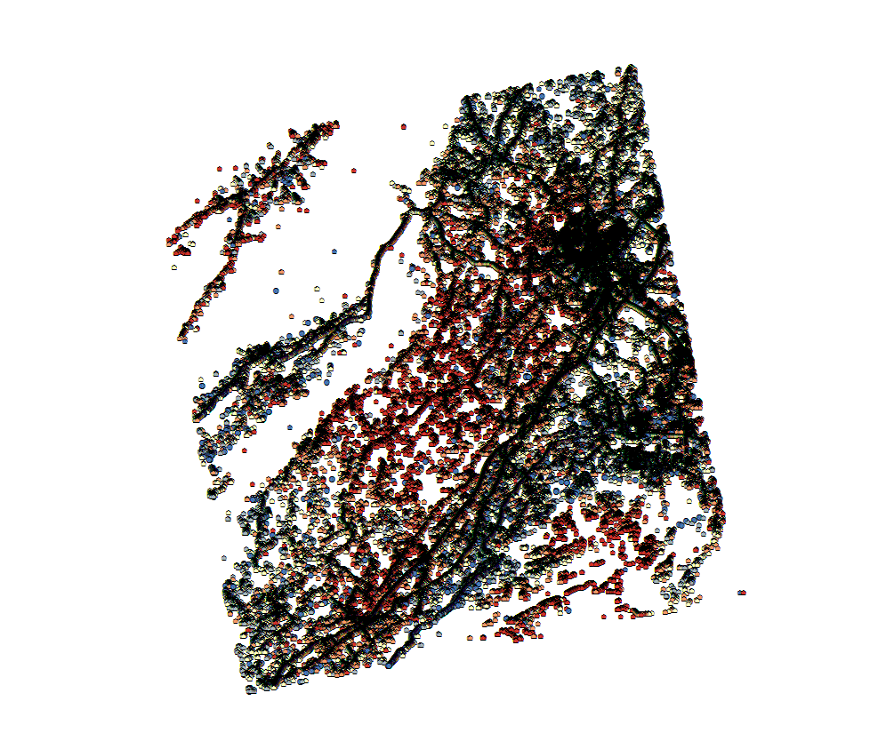
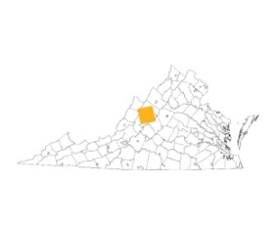

RITA-10
Project
InSAR
Each scatterer is associated with a set of metadata:
Velocity Towards or Away from Satellite
Acceleration Rate
Coherence Value
Effective Area
InSAR
40 km
40 km
PS: 167,801
Geohazards and Assets
DS: 131,285
TS: 724,882
Karst
N: 1,023,968
Infrastructure
Rock Slopes
Conclusion
ESRI ArcMap10.0, TRE dataset, VAGISP Base

Slide 6
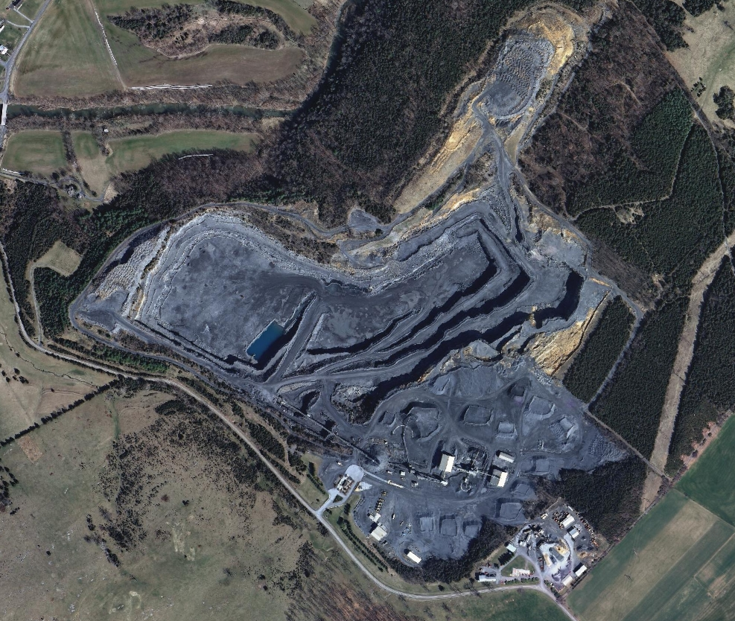
RITA-10
Project
InSAR
InSAR
Geohazards and Assets
Karst
Infrastructure
Rock Slopes
Conclusion
ESRI ArcMap10.0, TRE dataset, VAGISP Base

Slide 7
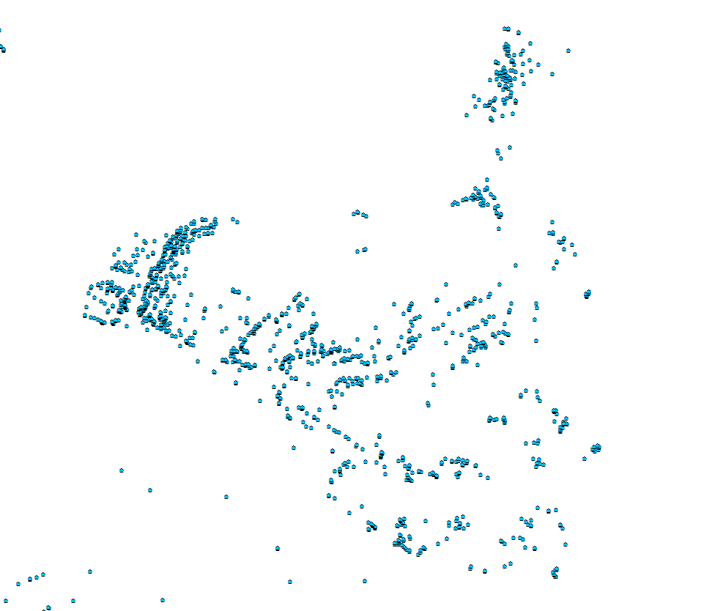
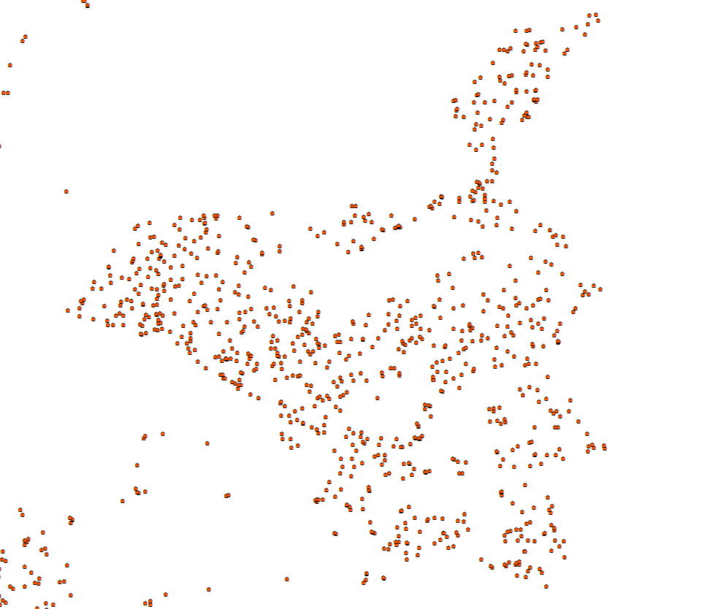
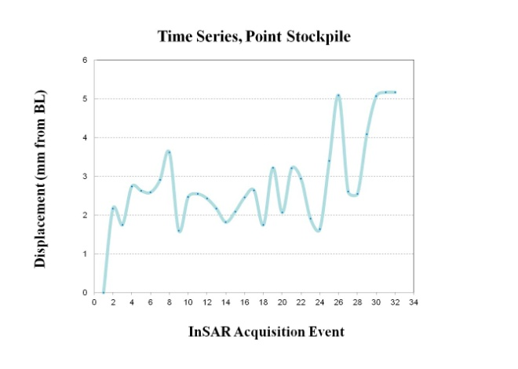
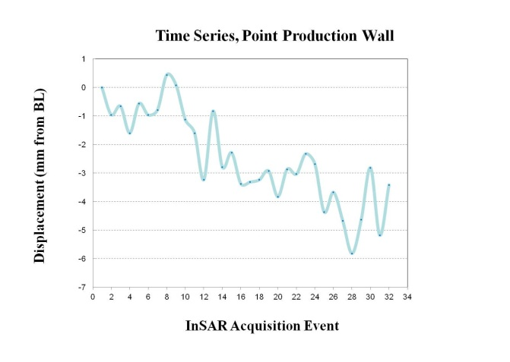
RITA-10
Project
InSAR
InSAR
PS
DS
Geohazards and Assets
Karst
Infrastructure
Rock Slopes
Conclusion
ESRI ArcMap10.0, TRE dataset, VAGISP Base

Slide 8
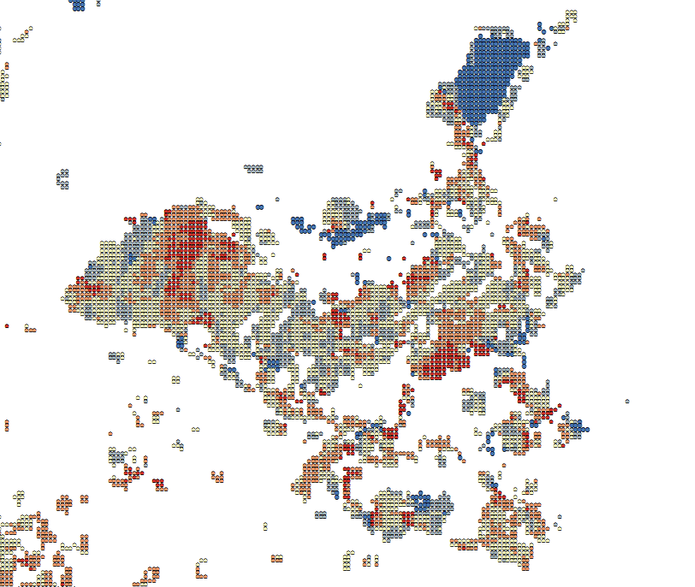
RITA-10
Project
InSAR
InSAR
PS
DS
TS
Geohazards and Assets
Karst
Infrastructure
Rock Slopes
Conclusion
ESRI ArcMap10.0, TRE dataset, VAGISP Base

Slide 9
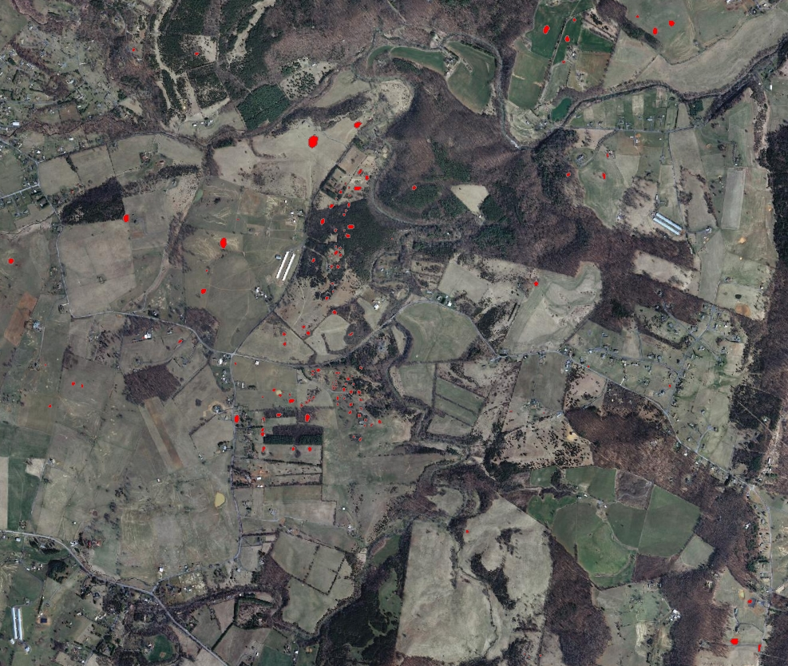
RITA-10
Project
Karst
InSAR
Sinkhole
Geohazards and Assets
Karst
Infrastructure
Rock Slopes
Conclusion
ESRI ArcMap10.0, TRE dataset, DMME VA Data, VAGISP Base

Slide 10
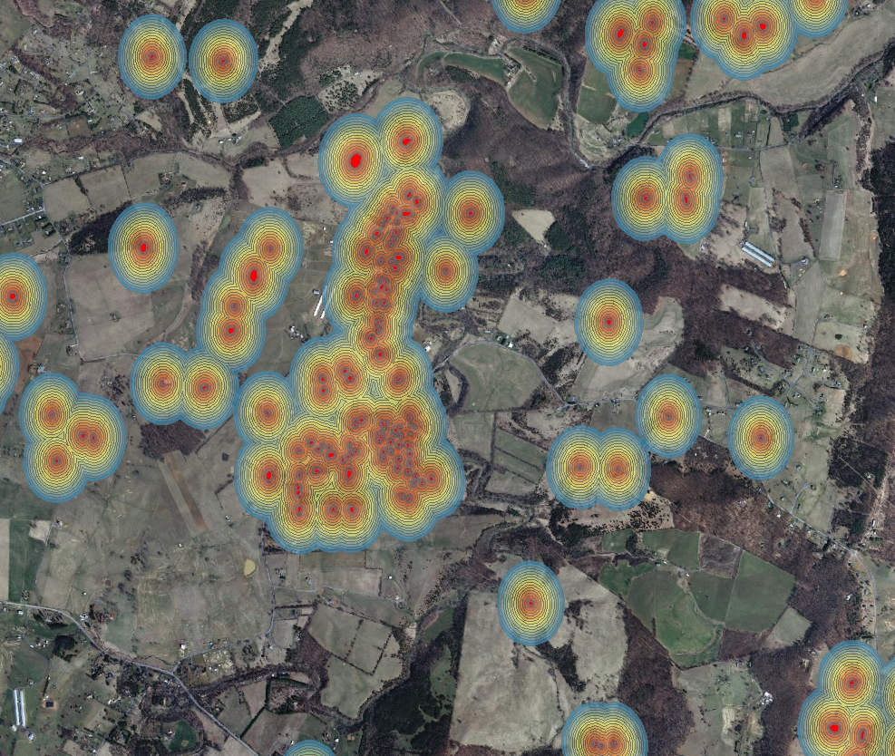
RITA-10
Project
Karst
InSAR
Sinkhole
Geohazards and Assets
Karst
Infrastructure
Rock Slopes
Conclusion
ESRI ArcMap10.0, TRE dataset, DMME VA Data, VAGISP Base

Slide 11
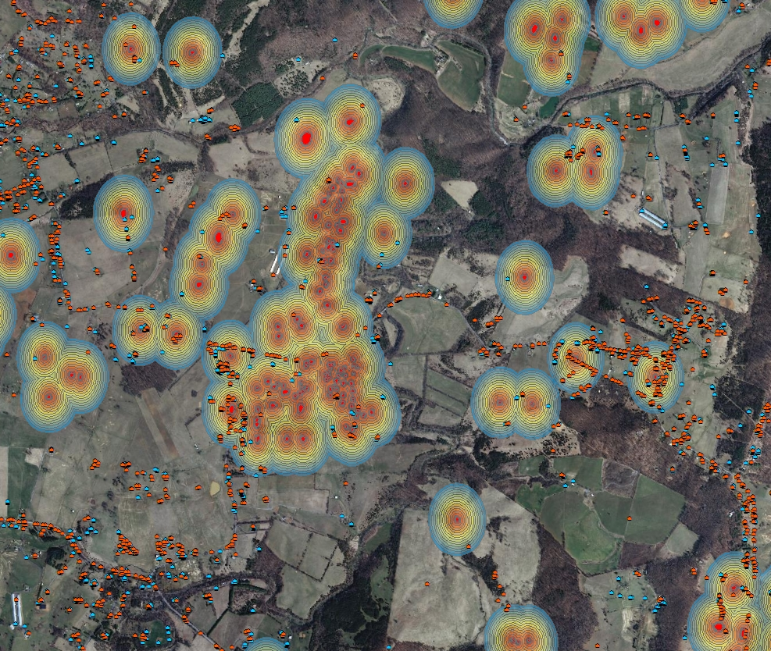
RITA-10
Project
Karst
InSAR
Sinkhole
PS
DS
Geohazards and Assets
Karst
Infrastructure
Rock Slopes
Conclusion
ESRI ArcMap10.0, TRE dataset, DMME VA Data, VAGISP Base

Slide 12
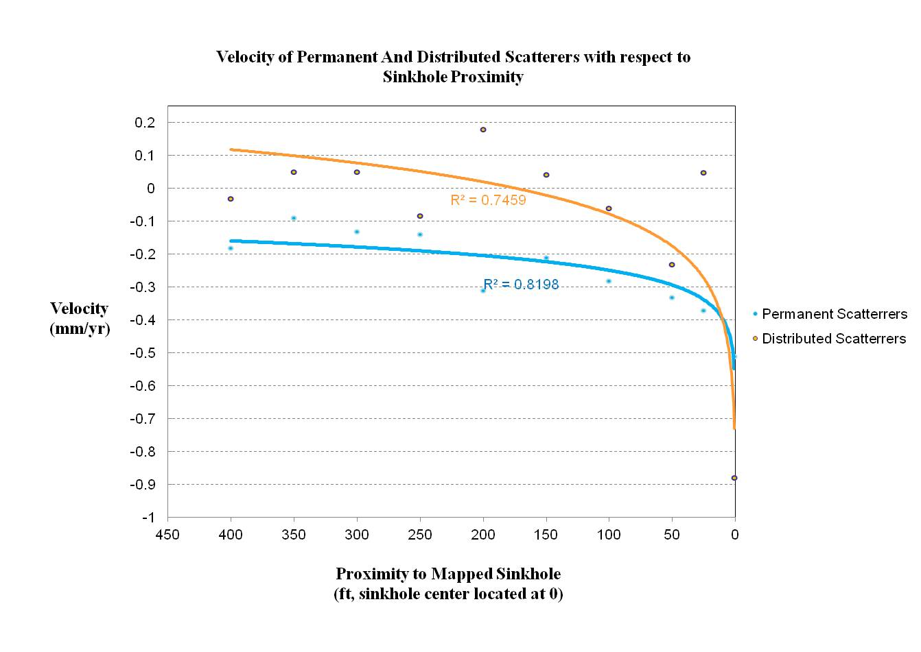
RITA-10
Project
Karst
InSAR
Geohazards and Assets
Karst
Infrastructure
Rock Slopes
Conclusion
TRE dataset, DMME VA Data
Notes:
Mm/yr

Slide 13
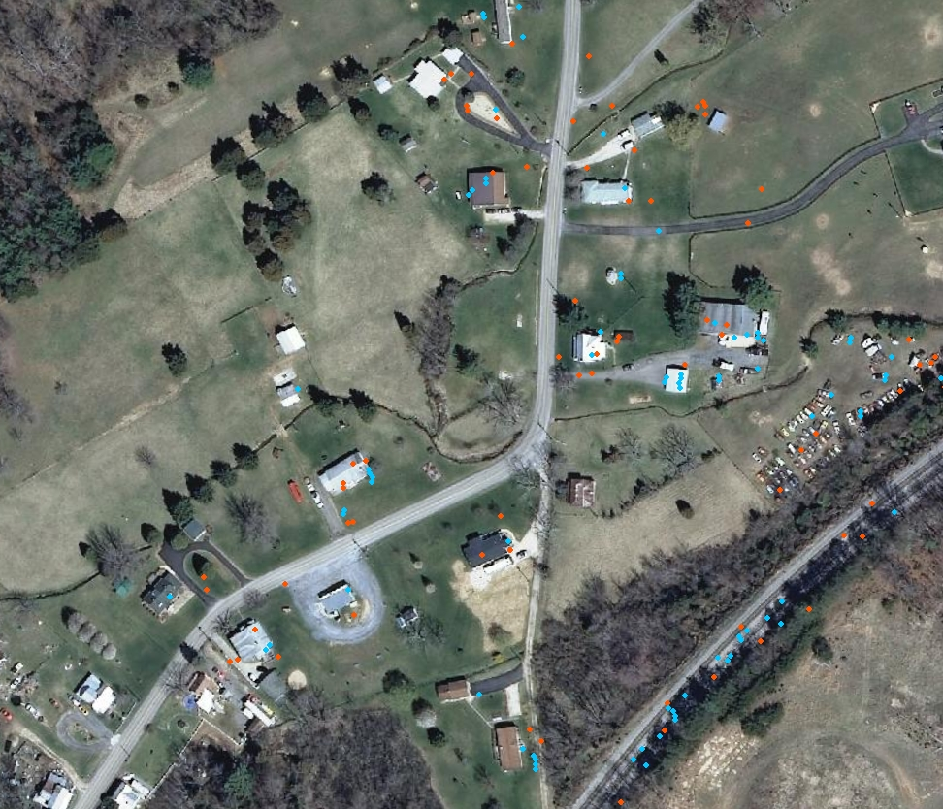
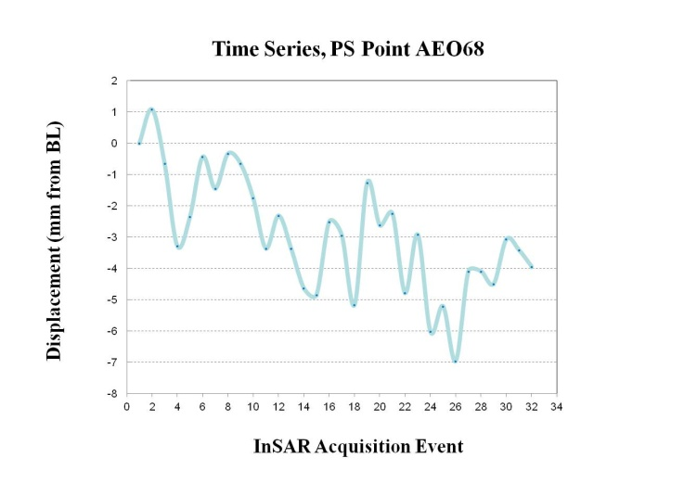
RITA-10
Project
Karst
InSAR
PS
DS
Geohazards and Assets
Karst
Infrastructure
Rock Slopes
Conclusion
ESRI ArcMap10.0, TRE dataset, VAGISP Base

Slide 14
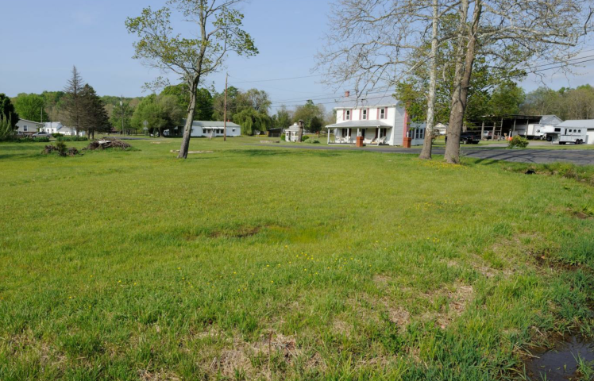
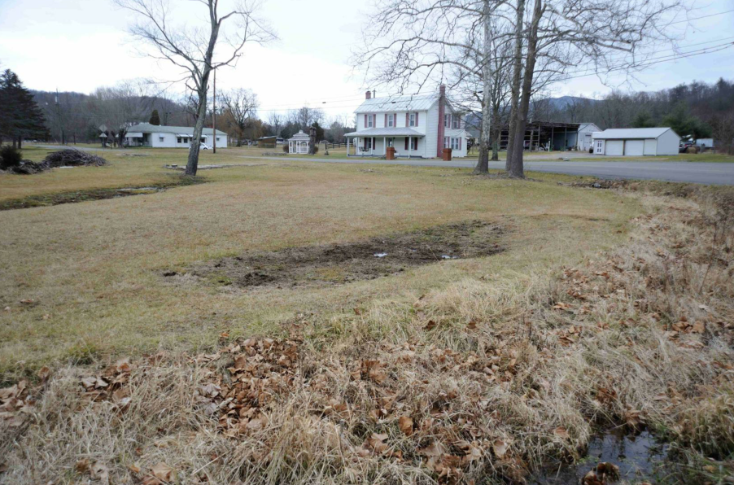
RITA-10
Project
Karst
InSAR
Geohazards and Assets
Karst
Infrastructure
Rock Slopes
Conclusion
Vesuvius Sinkhole Summer /Fall 2012 (Hoppe)

Slide 15
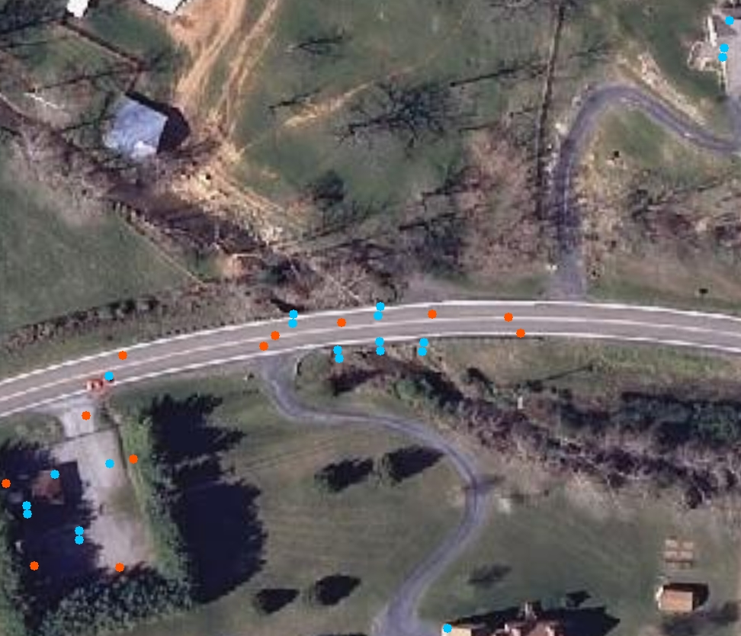
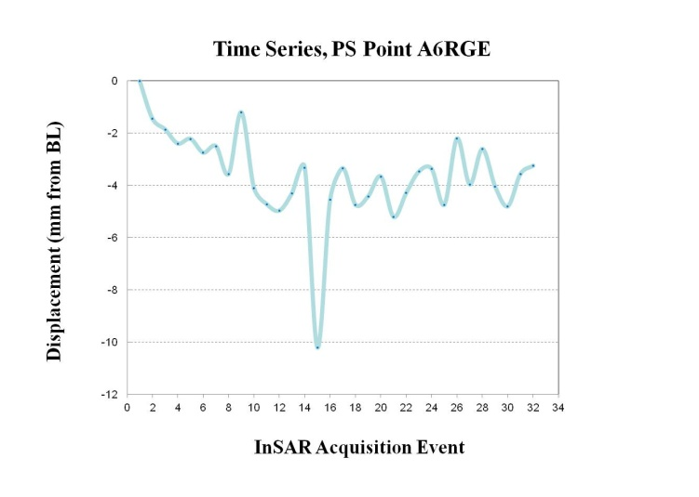
RITA-10
Project
Infrastructure
InSAR
Geohazards and Assets
Karst
Infrastructure
Rock Slopes
Conclusion
ESRI ArcMap10.0, TRE dataset, DMME VA Data, VAGISP Base

Slide 16
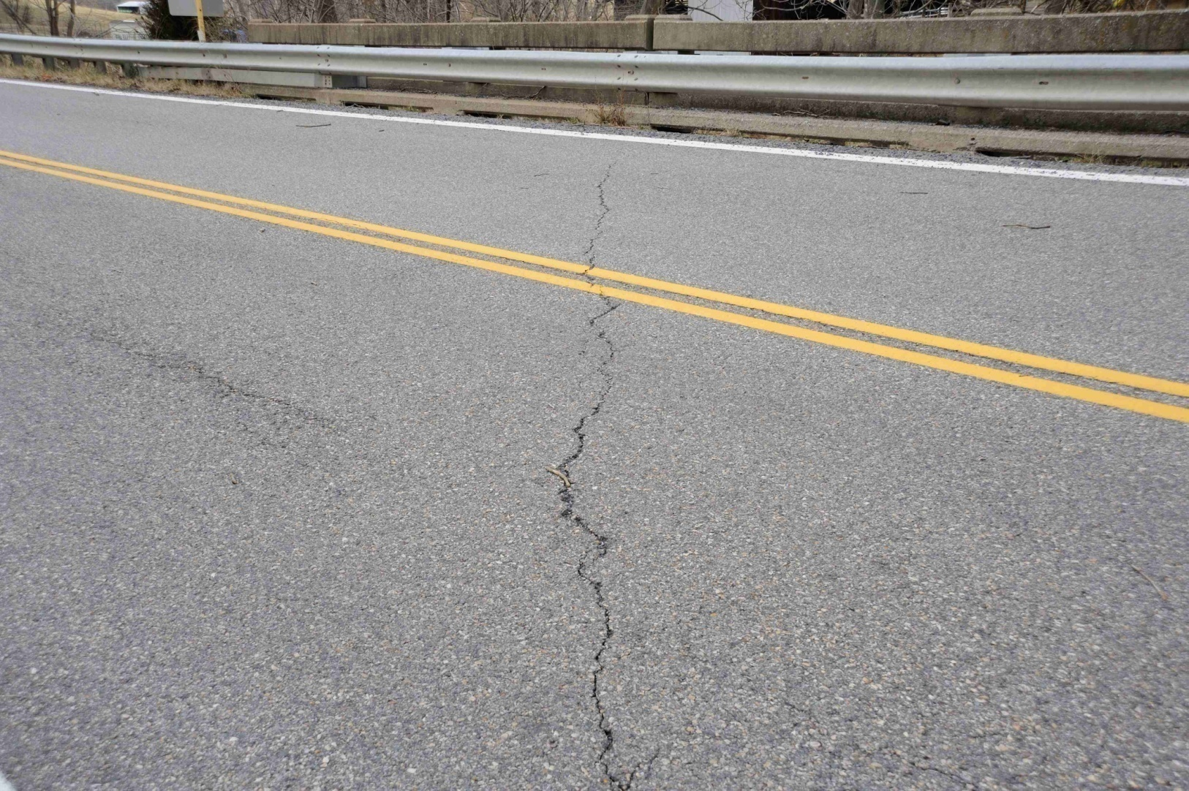
RITA-10
Project
Infrastructure
InSAR
PS
Geohazards and Assets
Karst
Infrastructure
A6RGE
Rock Slopes
Conclusion
Route NOS Bridge February 2013 (Hoppe)

Slide 17
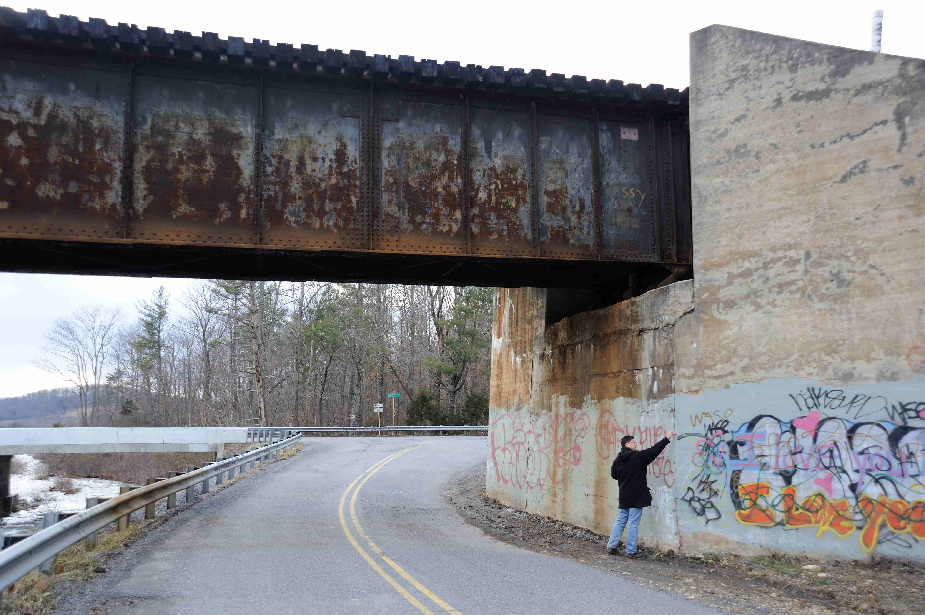
RITA-10
Project
Infrastructure
InSAR
PS
DS
TS
Geohazards and Assets
Karst
Infrastructure
PS
DS
TS
Rock Slopes
Conclusion
Route 608 Bridge February 2013 (Hoppe)

Slide 18
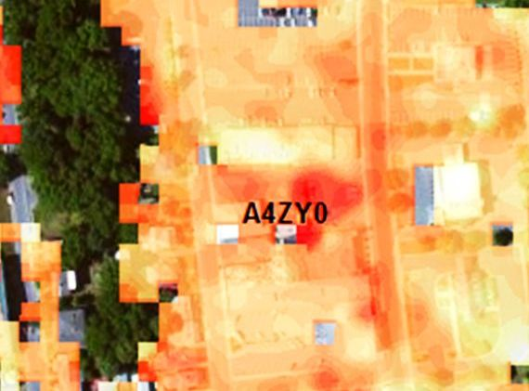
RITA-10
Project
Infrastructure
InSAR
“Hotter” Colors = Greater Relative Motion
Geohazards and Assets
Karst
Infrastructure
Rock Slopes
Conclusion
TS Color Ramp over Staunton Near Lewis Creek(Hoppe)

Slide 19
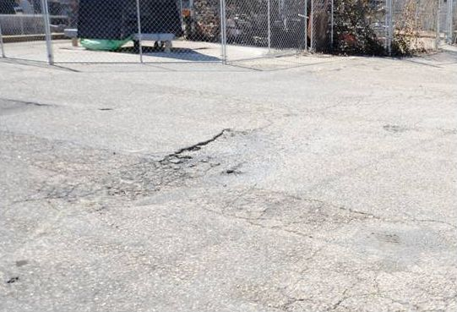
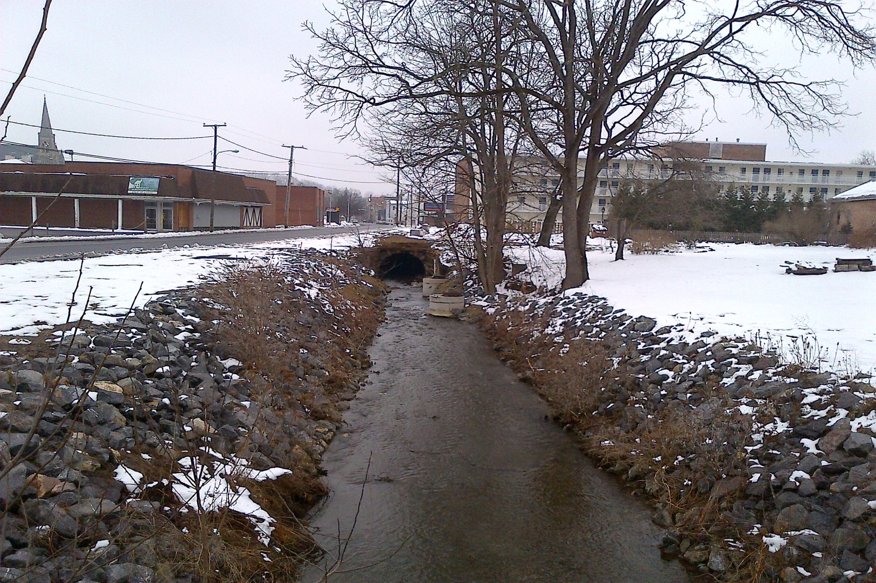
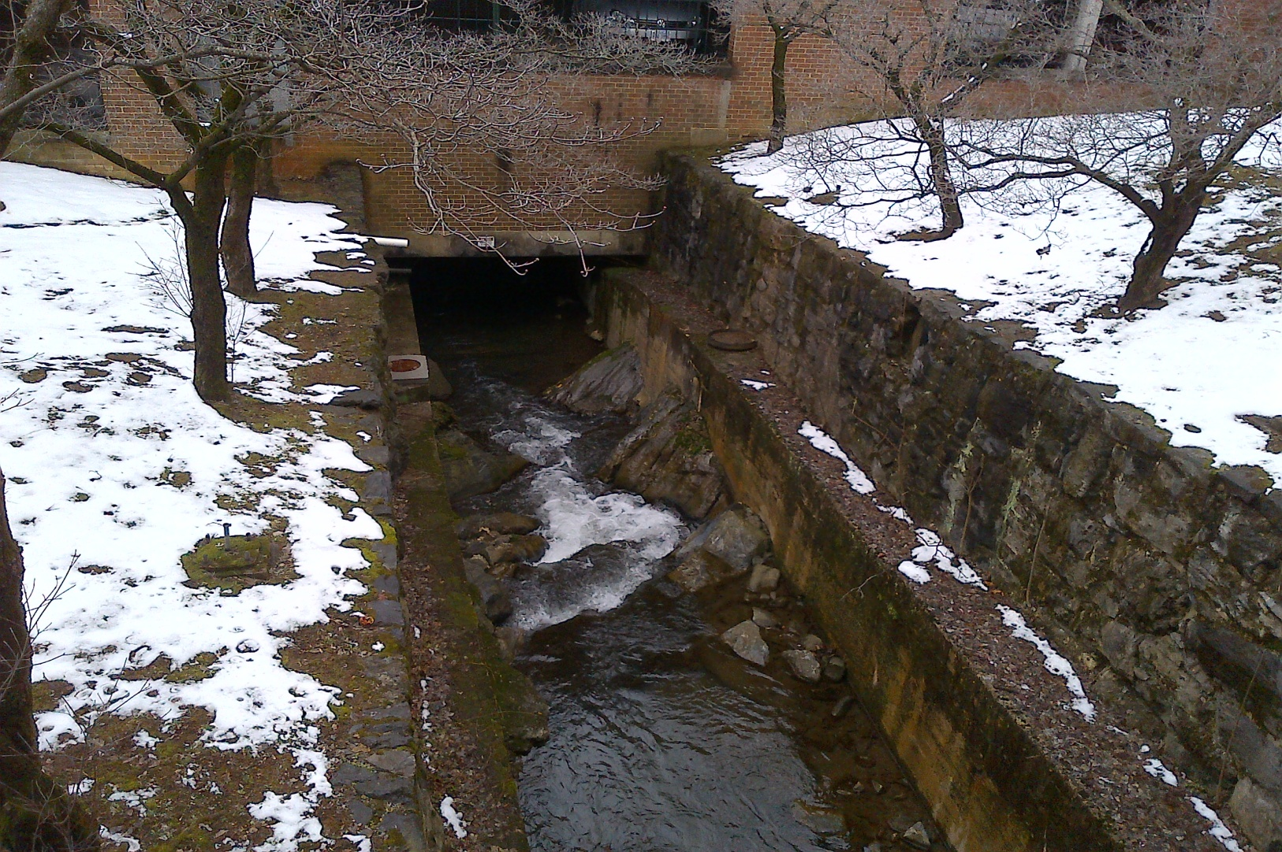
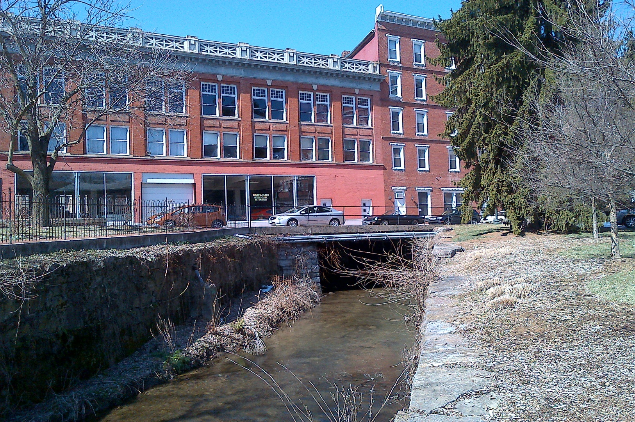
RITA-10
Project
Infrastructure
InSAR
Geohazards and Assets
Karst
Infrastructure
Rock Slopes
Conclusion
Over Lewis Creek(Hoppe)

Slide 20
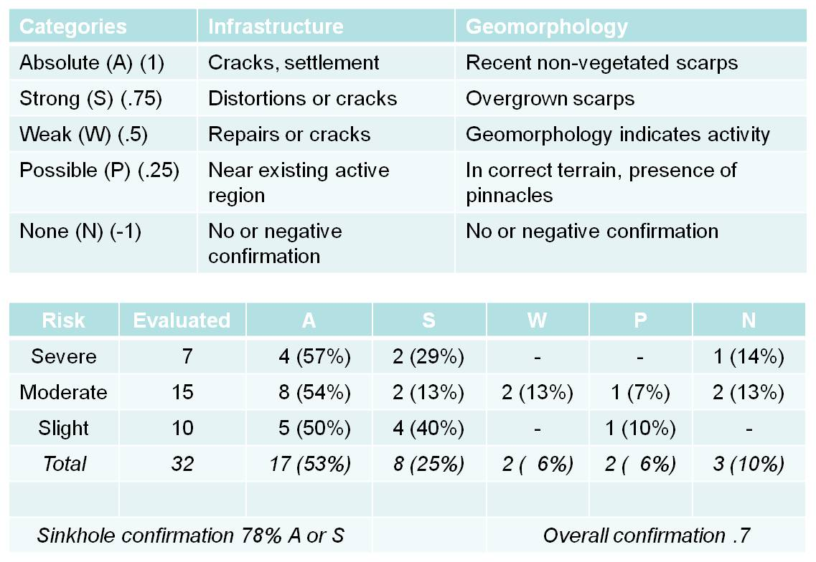
RITA-10
Project
Infrastructure
InSAR
Geohazards and Assets
Karst
Infrastructure
Rock Slopes
Conclusion

Slide 21
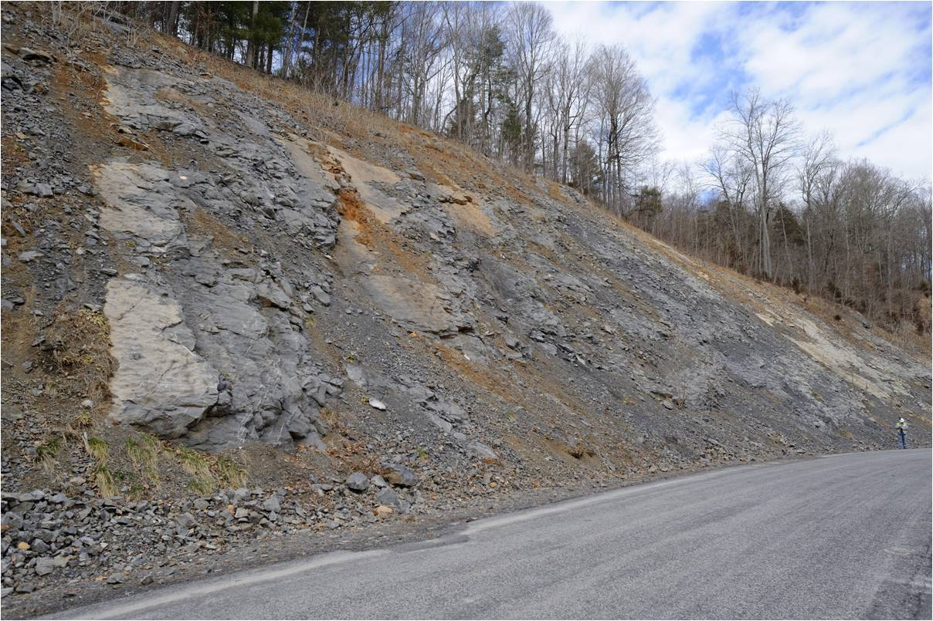
RITA-10
Project
Rock Slopes
InSAR
Geohazards and Assets
Karst
Infrastructure
Rock Slopes
Conclusion
Route 600 Slope (Bruckno)

Slide 22
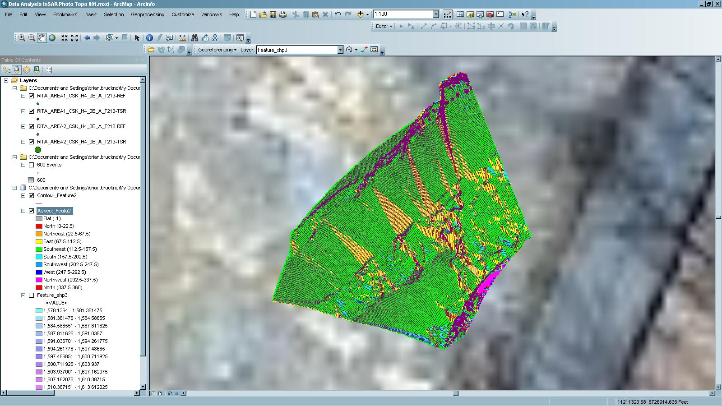
Rock Slopes
Field Conditions
Low-angle Wedge Failures
Broad Failure Mode
ESRI ArcMap10.0, Niemann raw data, Bruckno DEM, VAGISP Base

Slide 23
Rock Slopes
Low-angle Wedge Failures
SiroJoint
ESRI ArcMap10.0, Niemann raw data/SiroJoint, Bruckno DEM, VAGISP Base

Slide 24
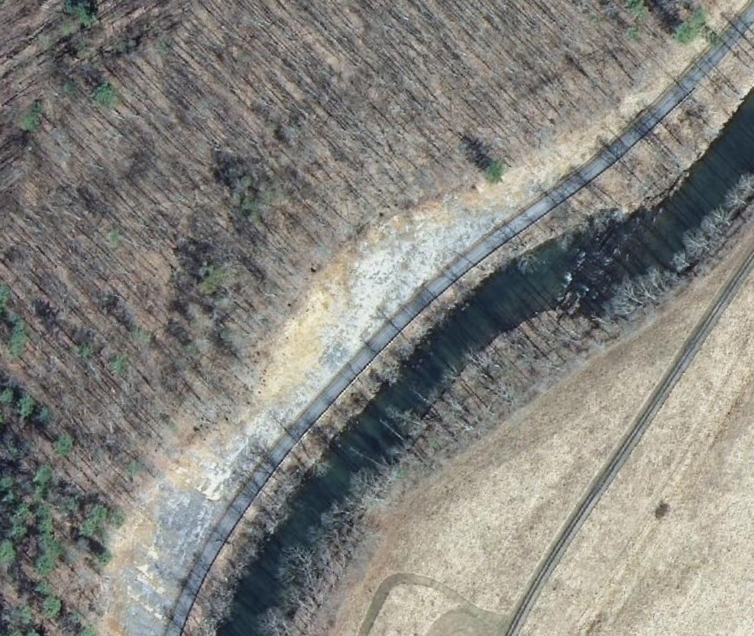
RITA-10
Project
Rock Slopes
InSAR
Geohazards and Assets
Karst
Infrastructure
Rock Slopes
Conclusion
ESRI ArcMap10.0, TRE dataset, VAGISP Base

Slide 25

RITA-10
Project
Rock Slopes
EA :724
C : .89
Vel: -2.12
Acc: -23.65
EA :624
C : .89
Vel: -7.32
Acc: -19.84
EA :491
C : .88
Vel: -5.1
Acc: -22.51
InSAR
Geohazards and Assets
Karst
Infrastructure
Rock Slopes
Conclusion
ESRI ArcMap10.0, TRE dataset, VAGISP Base

Slide 26

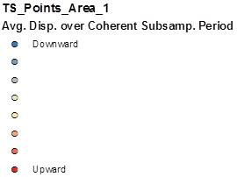
RITA-10
Project
Rock Slopes
InSAR
Geohazards and Assets
Karst
Infrastructure
Rock Slopes
Conclusion
ESRI ArcMap10.0, TRE dataset, VAGISP Base
Notes:
Change to displacement

Slide 27
RITA-10
Project
Conclusions
Increased availability of civilian radar satellites
+
Near-continuous, millimeter range deformation measurements over large land masses
+
The validation of InSAR for karst detection, bridge deformation monitoring, infrastructure quality assessment, and slope stability evaluation
=
An emerging, potentially very valuable, remote sensing technology.
InSAR
Geohazards and Assets
Karst
Infrastructure
Rock Slopes
Conclusion

Slide 28
