Slide 1
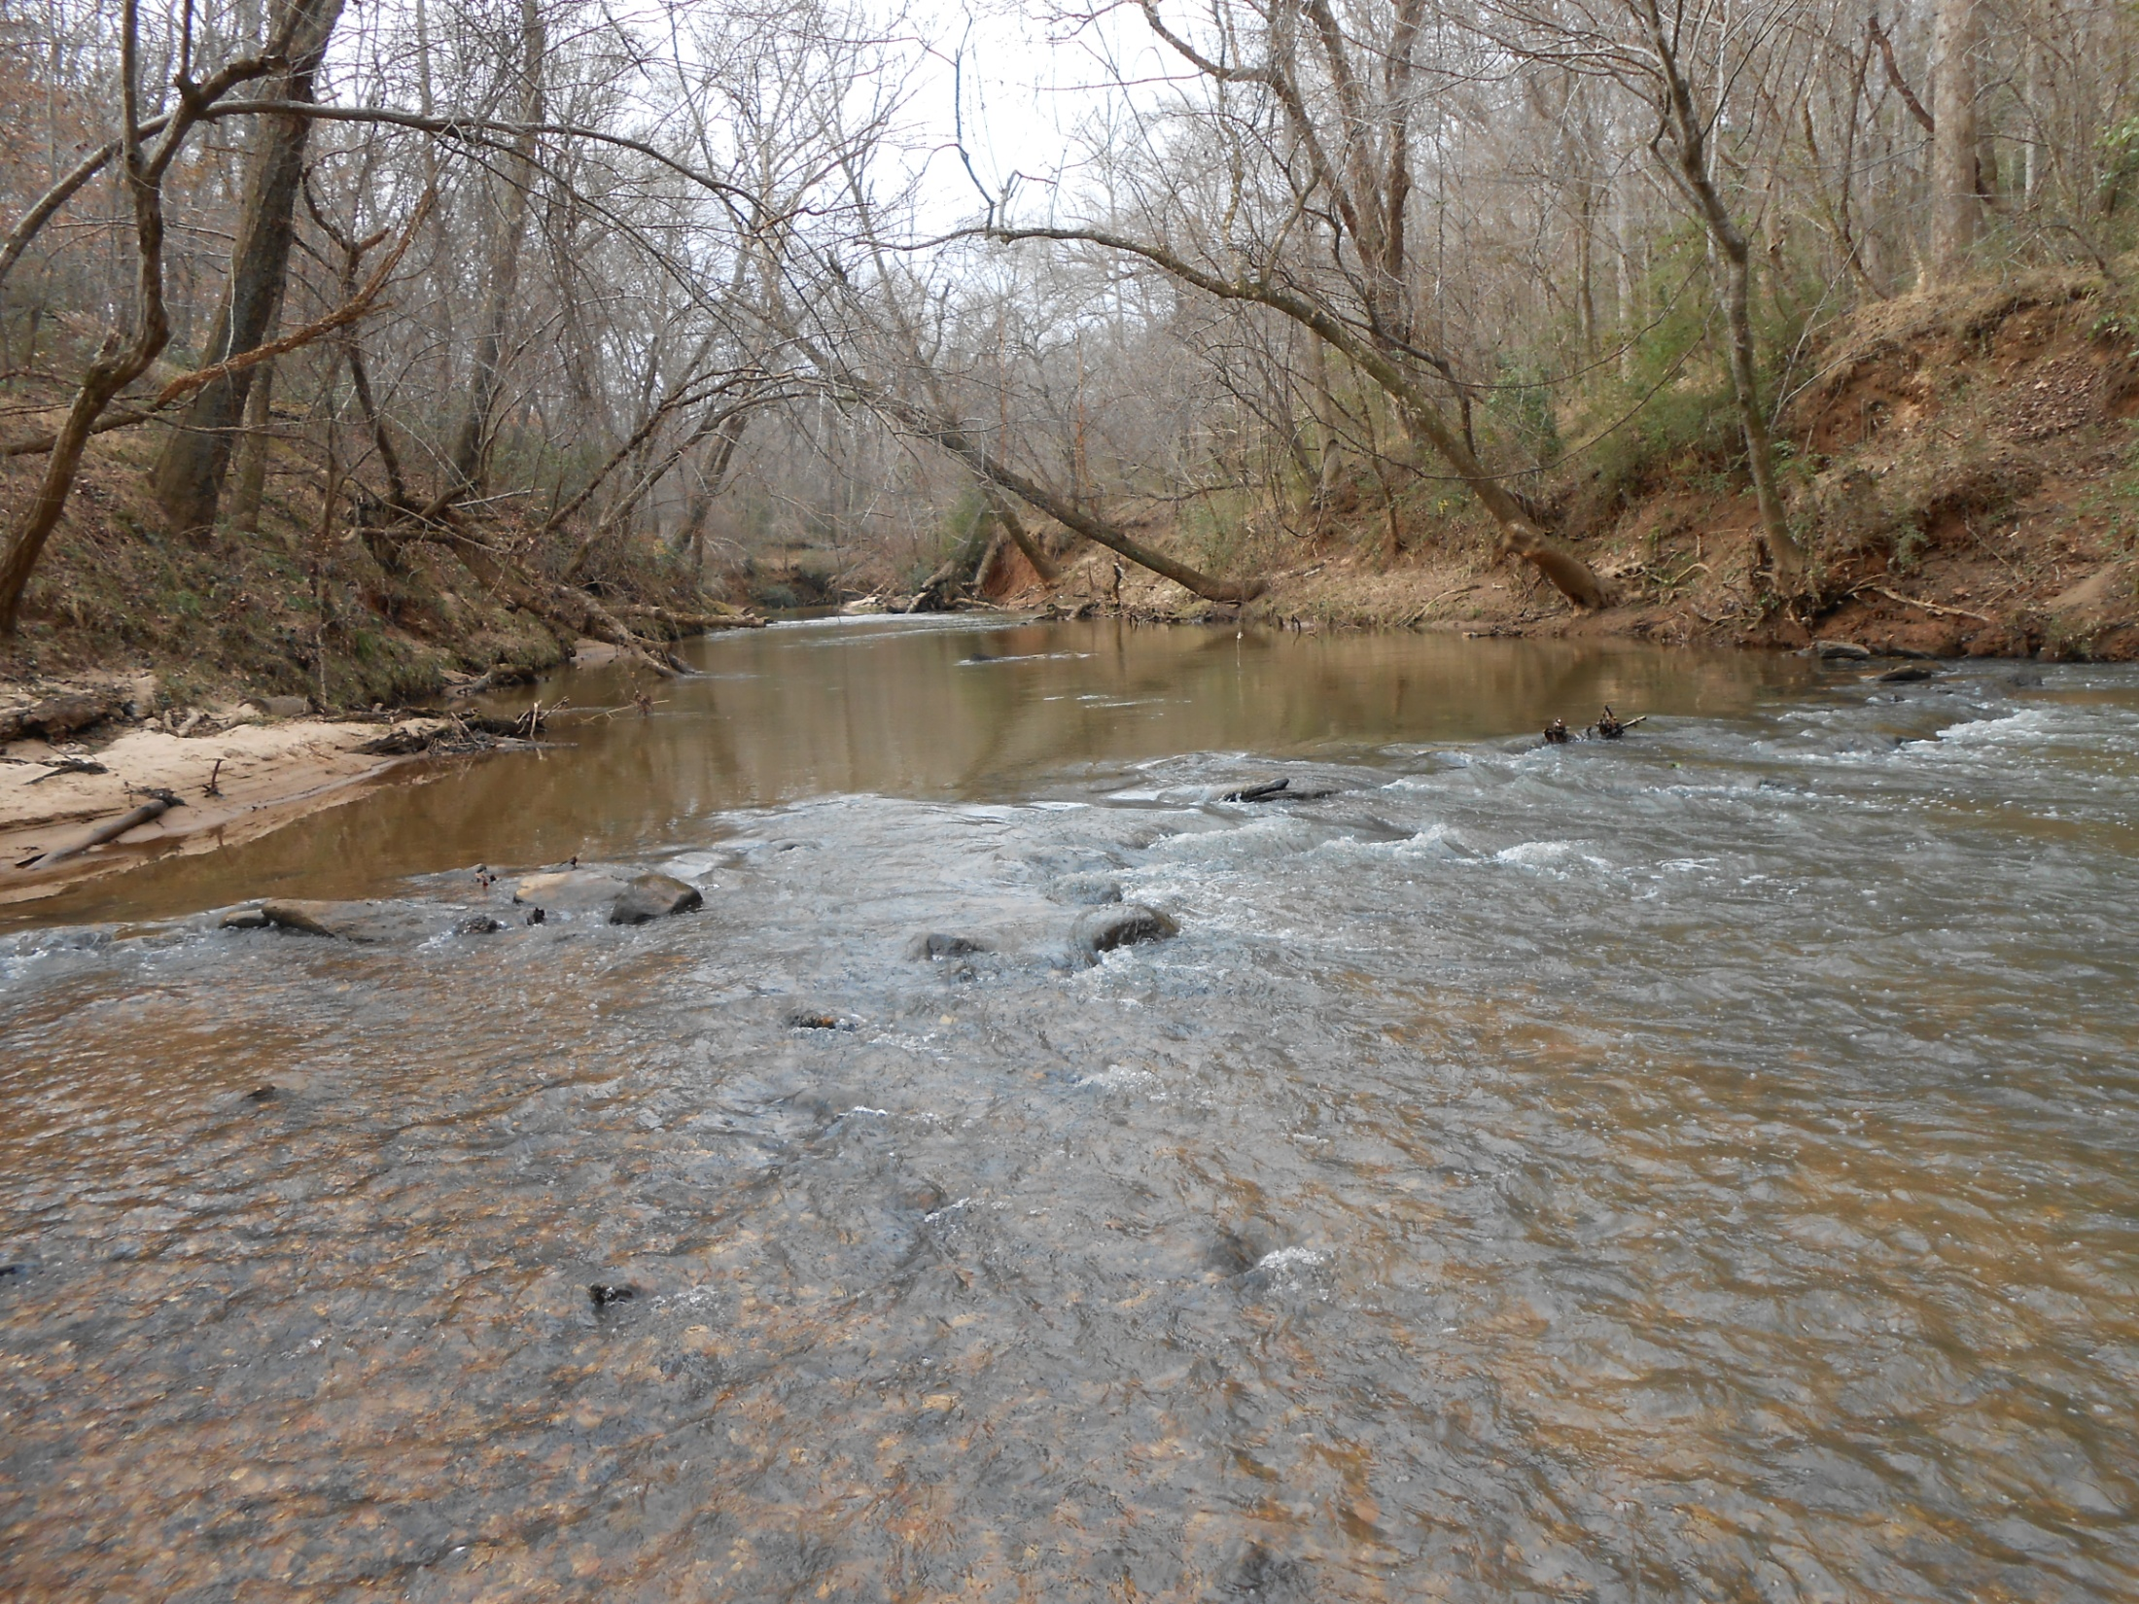


Sediment source tracking using stable isotopes in a mixed-use watershed, South Carolina
SEGSA, 2014
South Carolina Geological Survey
Land Water and Conservation District,
Dept. Nat. Resources
Kerry McCarney-Castle, PhD
Tristan Childress
Reid Heaton

Slide 2
Overview
Overview: sediment in streams
Location of study
Objectives of study
Why this watershed?
Hypothesis
Methods
Results
Closing statement and future work

Slide 3
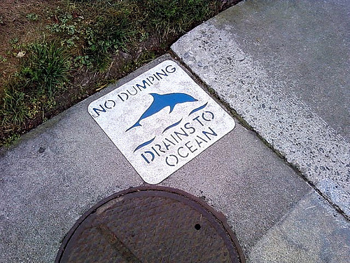
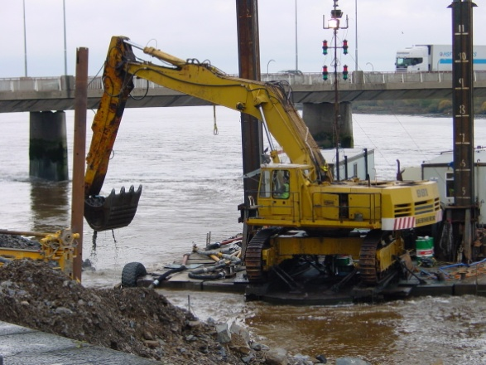
Sediment
Excess sediment is considered the greatest pollutant in U.S. waters and is a major environmental factor in the degradation of stream habitat (EPA, 2000; Waters, 1995).
Water chemistry
Contaminant transport
Fisheries and hatcheries
Nutrient supply
_________________________
Reservoir sedimentation
Navigation
Alteration of river flow/gradient
Morphological changes
Flooding
Quality
Quantity

Slide 4
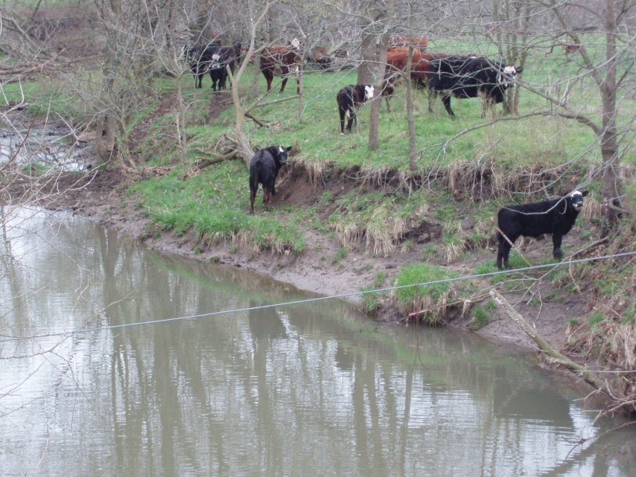
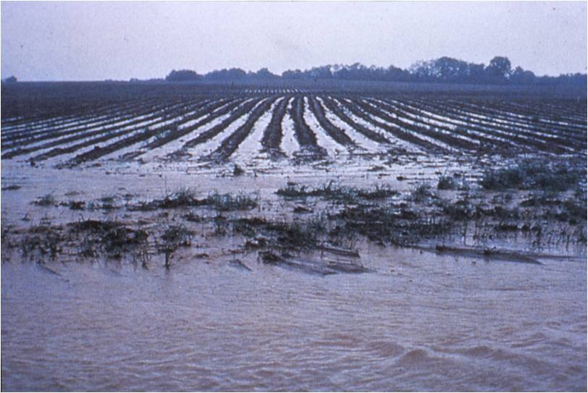
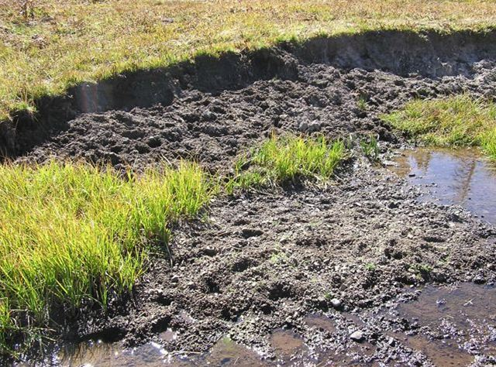
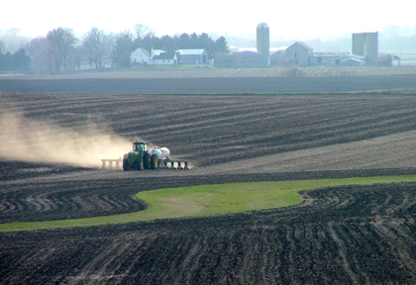
Present-day sediment sources
In-stream sediment: Where does it come from?
1. Livestock (grazing, hoof shear)
2. Agricultural practices (clearing, tilling, plowing)

Slide 5
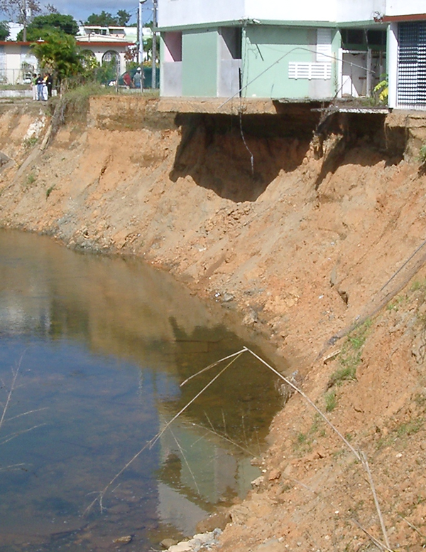

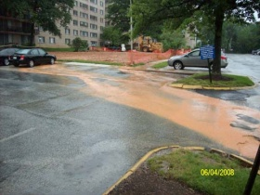
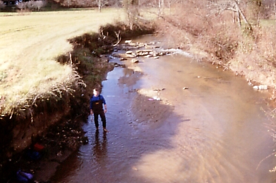
Present-day sediment sources
3. Urban storm water runoff
4. Bank erosion (gully erosion)

Slide 6
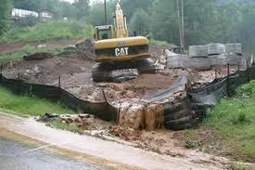
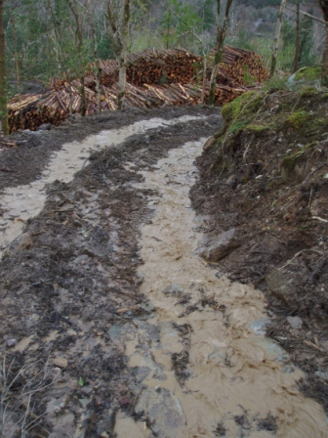
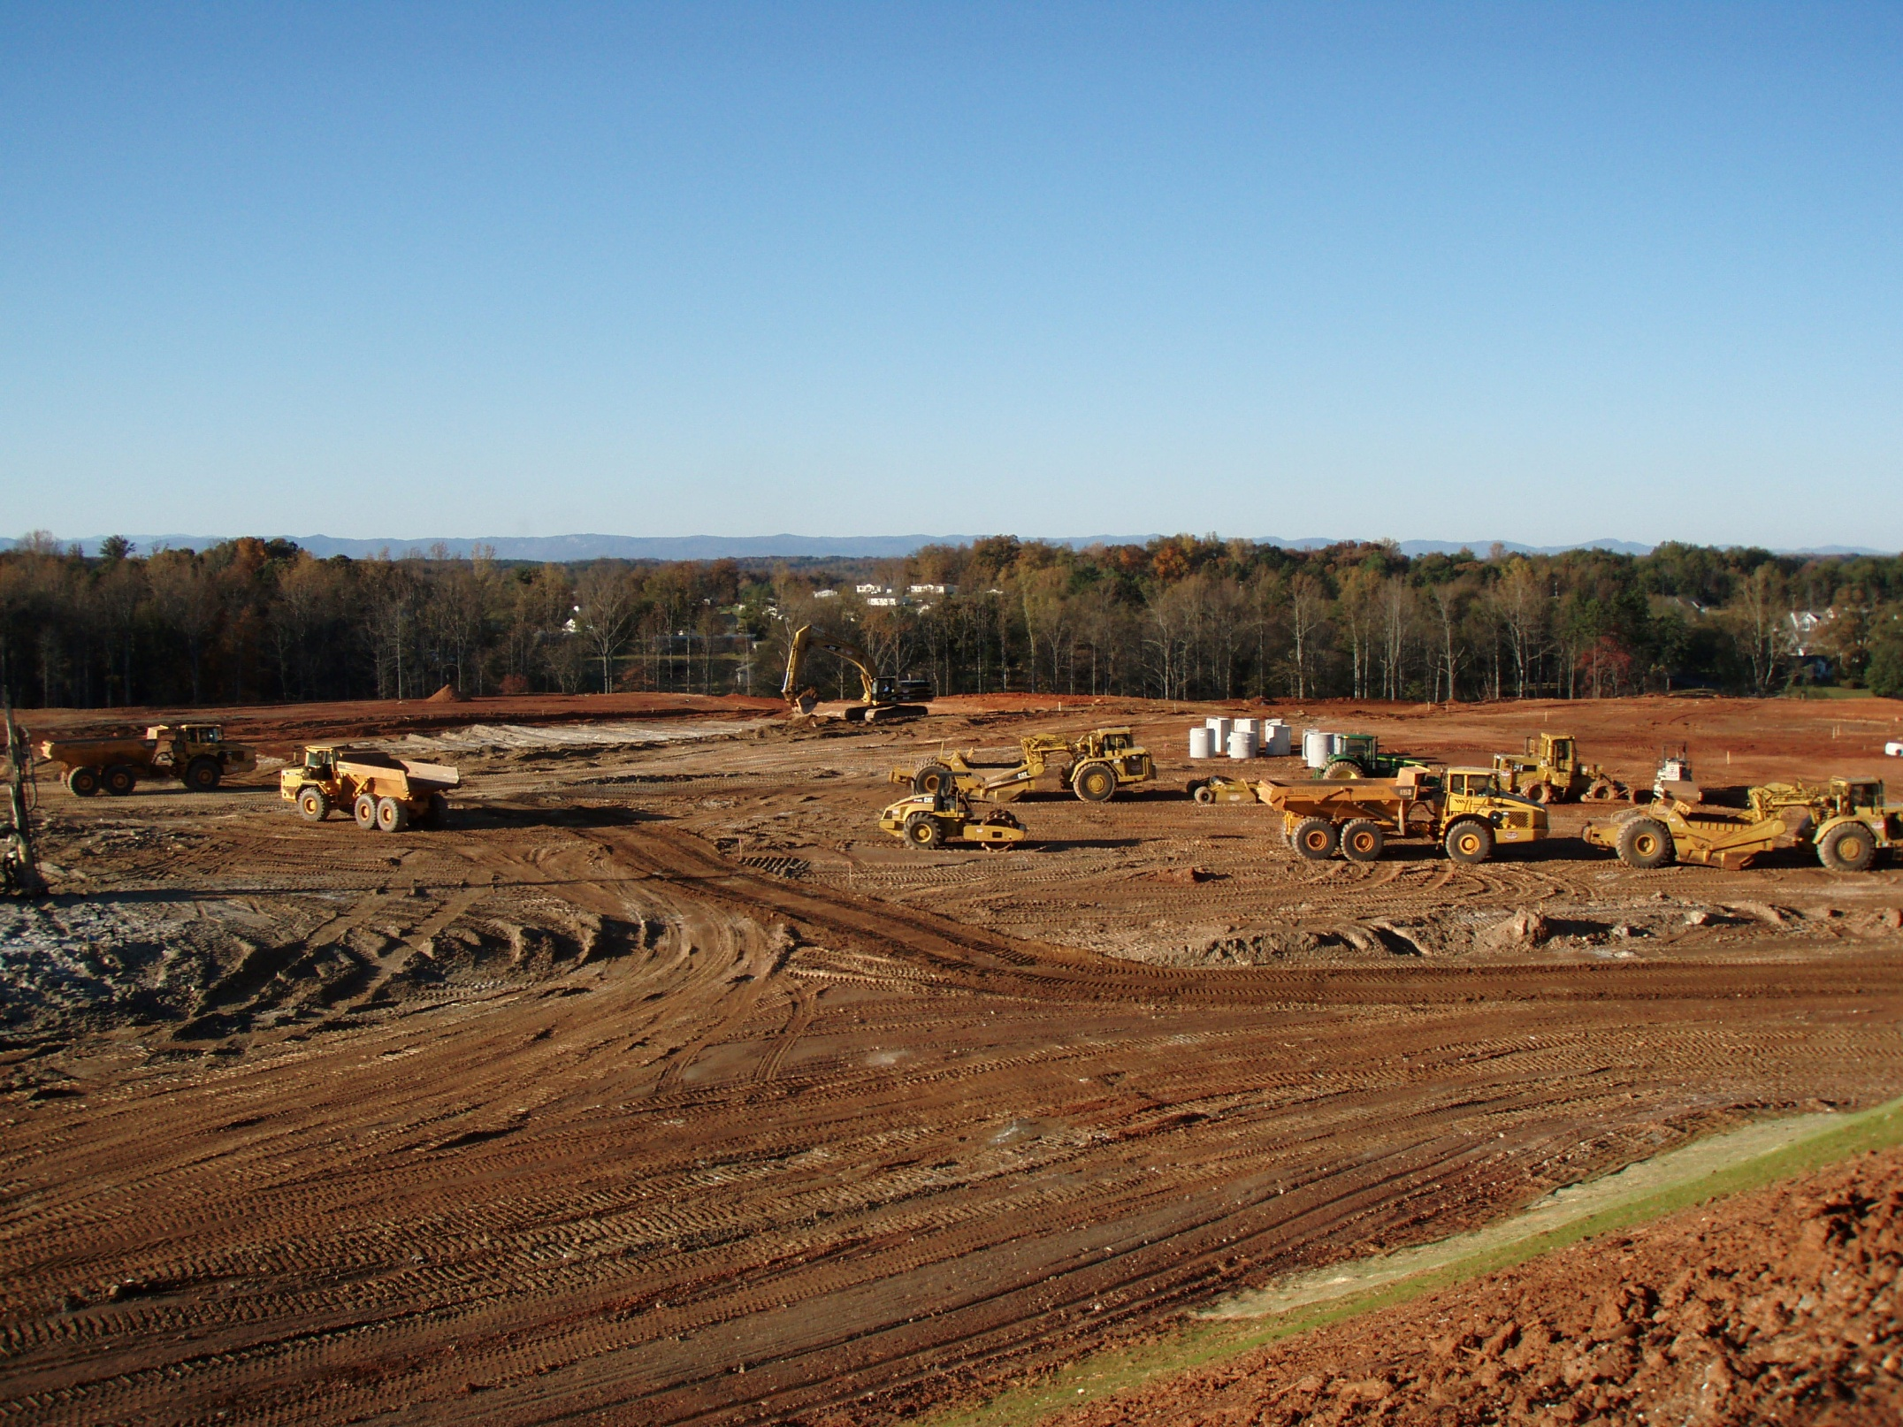
Present-day sediment sources
http://www.riverlink.org/october2009newsletter.htm
5. Logging roads in forests
6. Construction sites

Slide 7
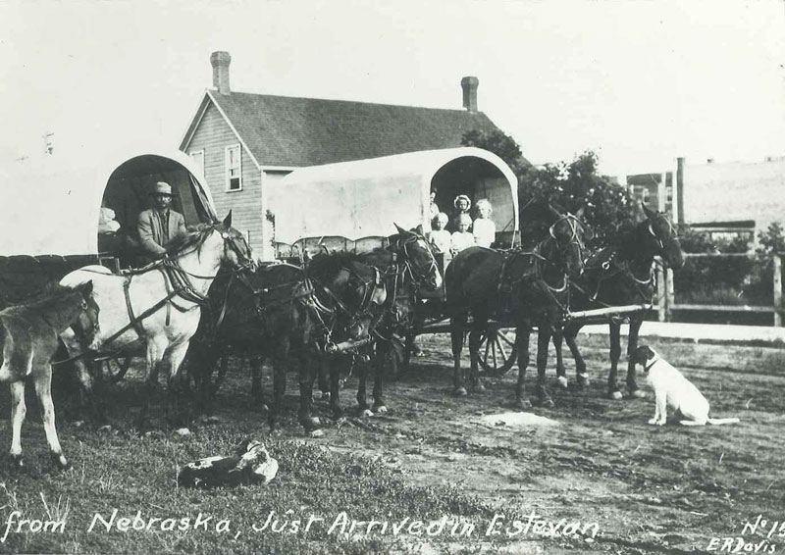
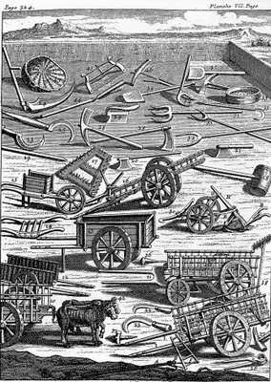
Historical (legacy) sediment
The Southern Piedmont is one of the most severely eroded areas in the U.S. (Trimble, 1974)
http://www.sseer.ca/history.htm
…..caused by widespread deforestation and subsequent cultivation plus poor farming practices from the early 1800’s to 1930.
http://www.google.com/imgres?q=early+american+agriculture&um=1&hl=en&sa=N&rls=com.microsoft:en-us:IE-SearchBox&biw=1280&bih=852&tbm=isch&tbnid=zh_Yly8HWDtgtM:&imgrefurl=http://americangardenhistory.blogspot.com/2009/09/tools-john-evelyn.html&docid=bMwkChmeUK4A9M&w=284&h=400&ei=X32UTrWOOoK4twfjq435Bg&zoom=1&iact=rc&dur=281&page=1&tbnh=167&tbnw=127&start=0&ndsp=23&ved=1t:429,r:6,s:0&tx=80&ty=92

Slide 8
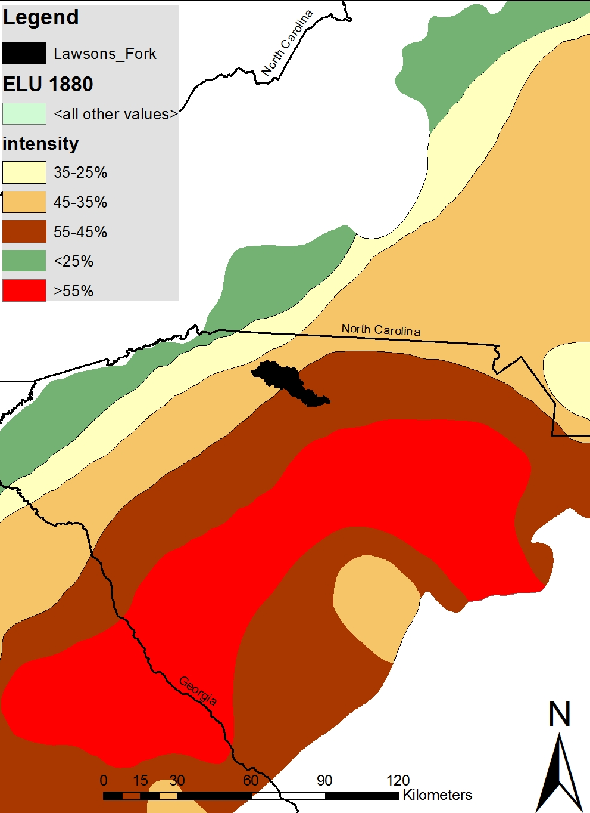
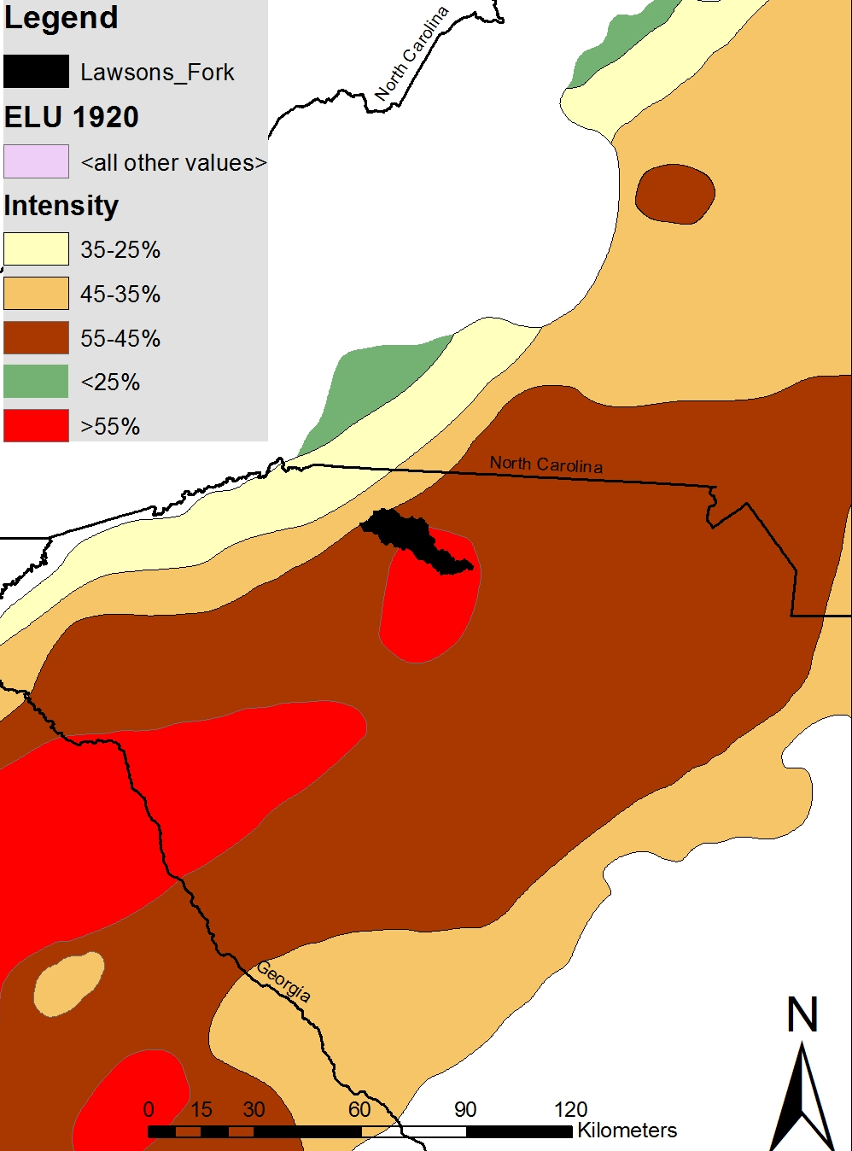
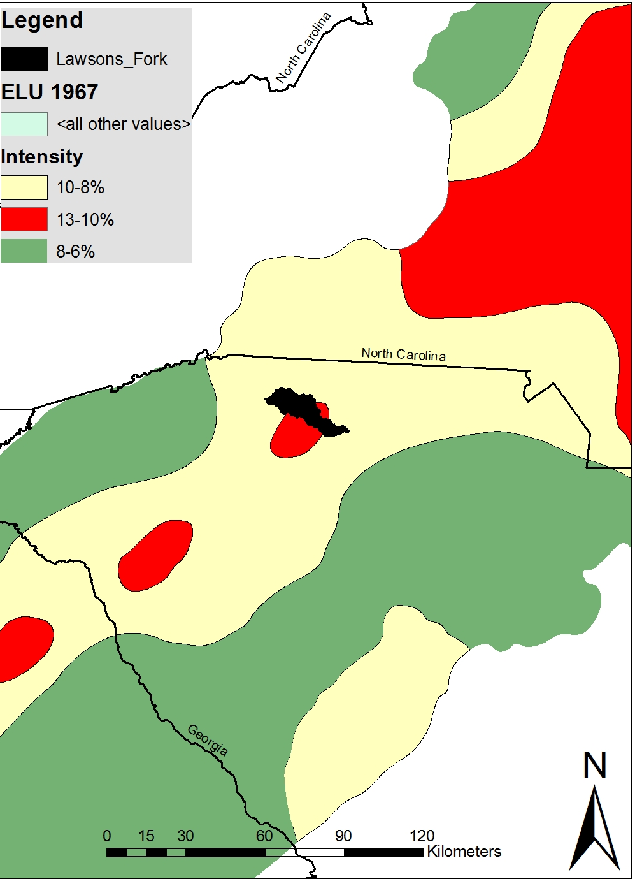
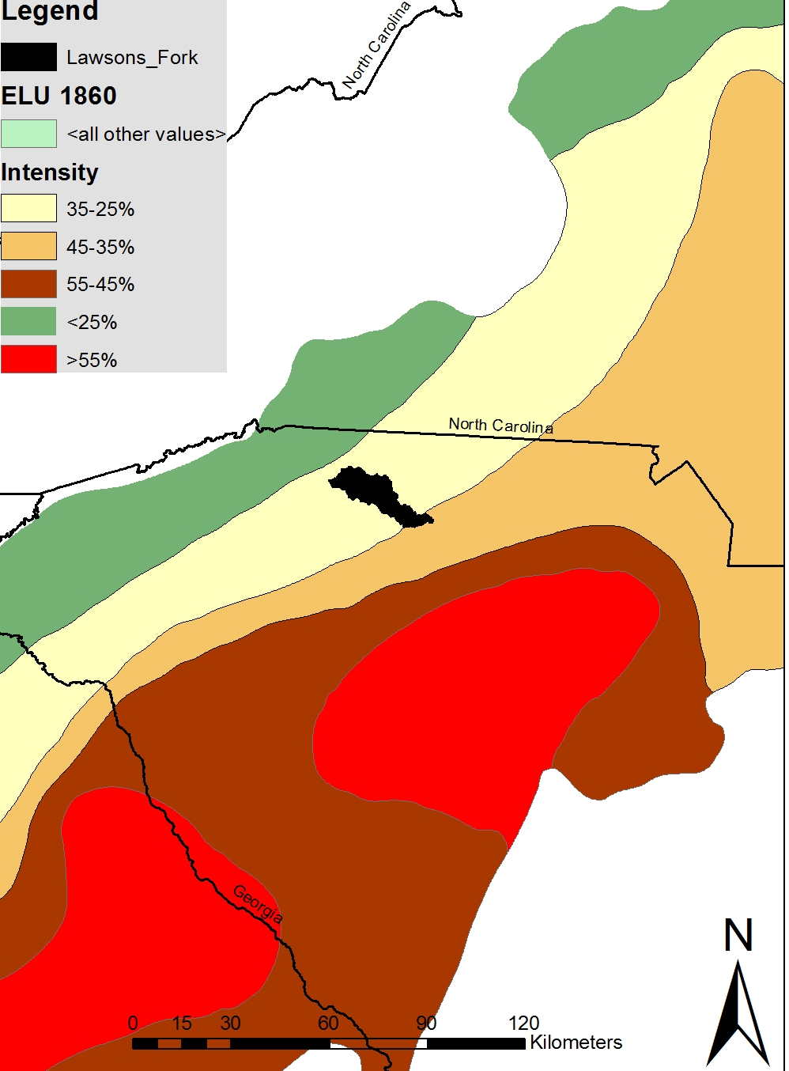
Historical (legacy) sediment
Rates of soil erosion due to land use change were estimated by Trimble (1974) and converted to a composite index of erosional intensity.
South Carolina experienced the greatest percentage of erosion than any other Piedmont state.
The soils lost from this intense period of erosion filled stream channels and valleys across the Piedmont.
Modified from Trimble, 1974

Slide 9
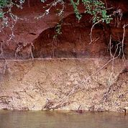
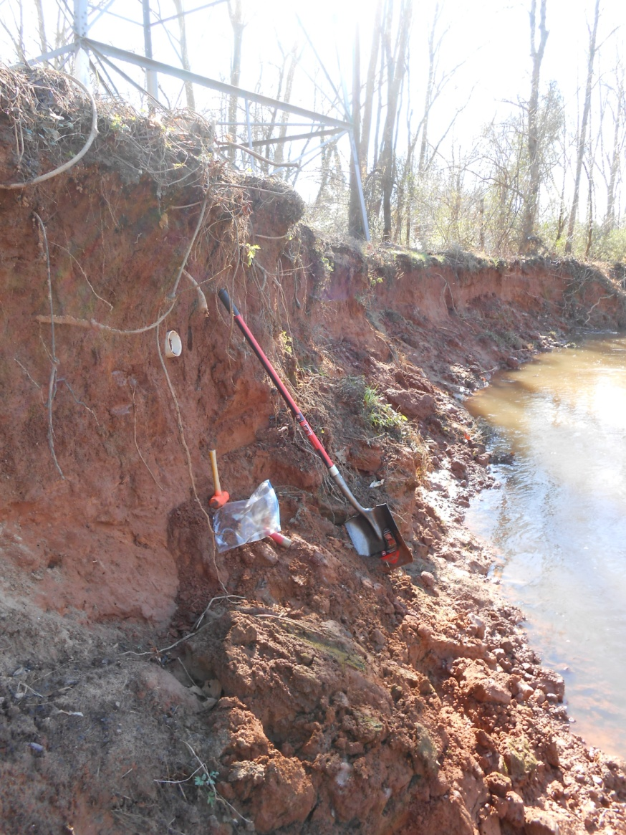
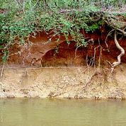
Historical (legacy) sediment
Evidence of eroded (legacy sediment) soils overlying fluvial sediment
Photo courtesy of T. Ferguson, Wofford University
Lawsons Fork Creek; Actively eroding bank (mass wasting)
Photo courtesy of T. Ferguson, Wofford University

Slide 10
Objectives
Measure and assess suspended sediment loads and turbidity in the Lawson’s Fork Creek watershed.
Determine the source of suspended sediment using sediment fingerprinting.

Slide 11
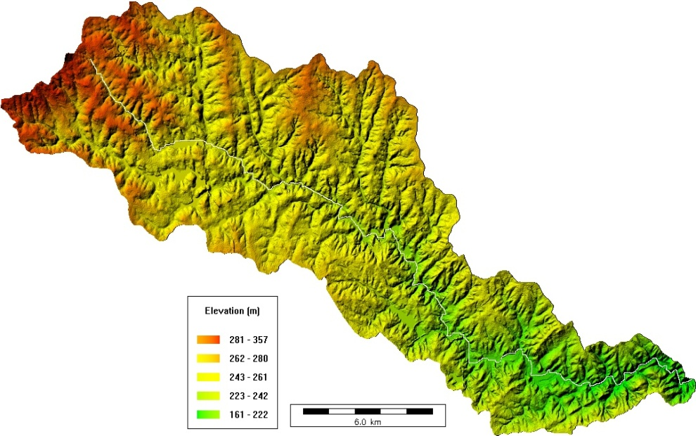
Location: Lawson’s Fork Creek watershed
Lawsons Fork Creek watershed located in the Broad River sub-basin (Santee Basin) in the Piedmont of South Carolina (HUC 03050105)
Spartanburg Co. (288,745 pop); Population
has increased ~70% over the last 40 years; this trend is expected to continue
Basin area 217 km²; Max elevation 357m; Min elevation 161 m
Spartanburg
Columbia

Slide 12
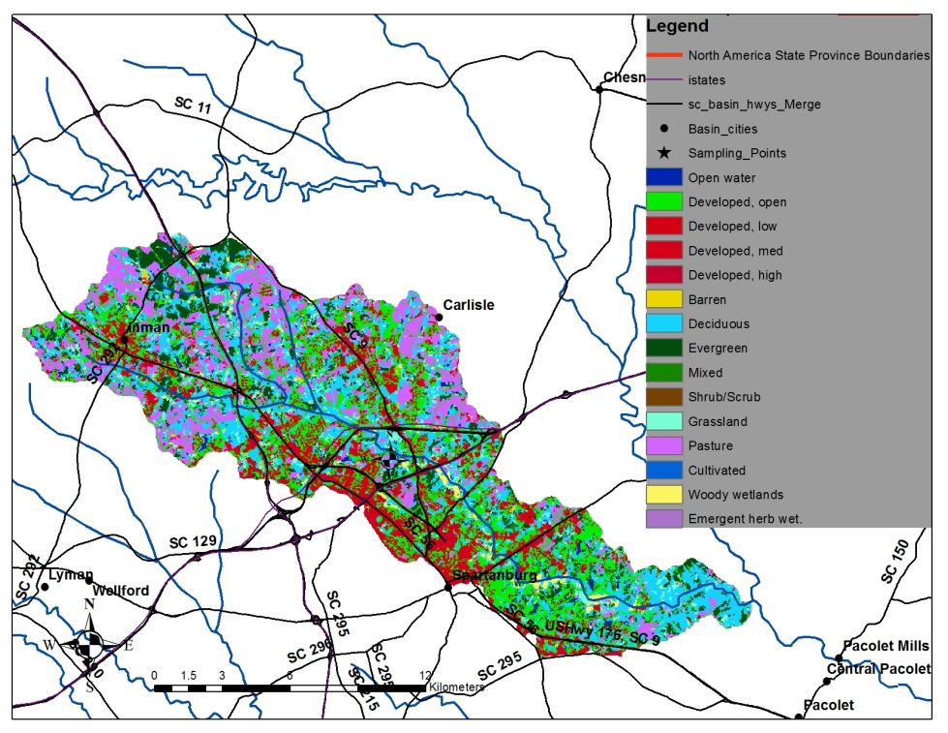
Location: Lawson’s Fork Creek watershed
Current land use is mixed
National Land Cover Database, 2006
HUC 0305010514 | Open water | Developed | Barren | Deciduous | Evergreen | Mixed | Shrub/scrub | Grassland | Pasture | Woody wetland
Area (km2) | 1.35 | 94.18 | 0.91 | 49.76 | 20.75 | 0.90 | 1.13 | 8.62 | 38.07 | 4.50
% of basin | 0.61 | 42.74 | 0.41 | 22.58 | 9.42 | 0.41 | 0.51 | 3.91 | 17.28 | 2.04

Slide 13
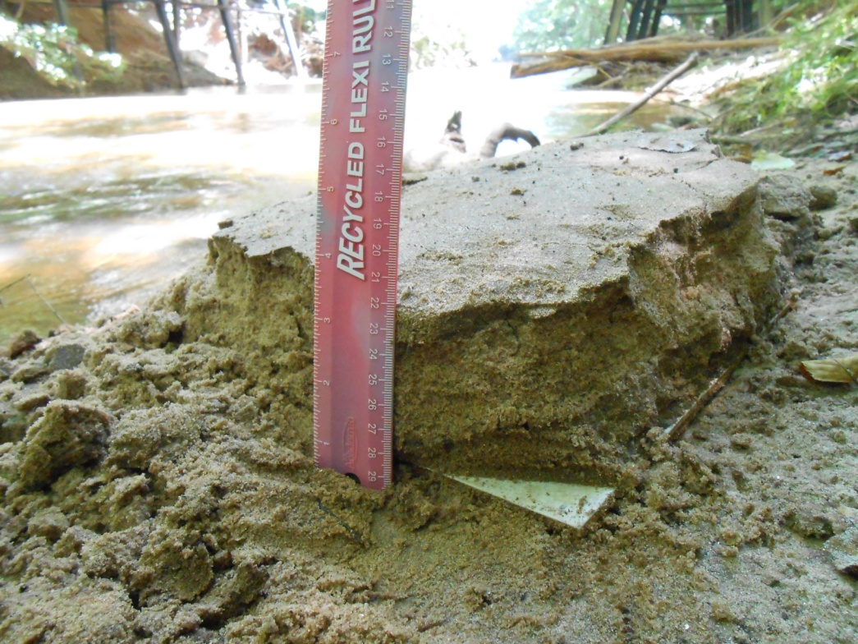
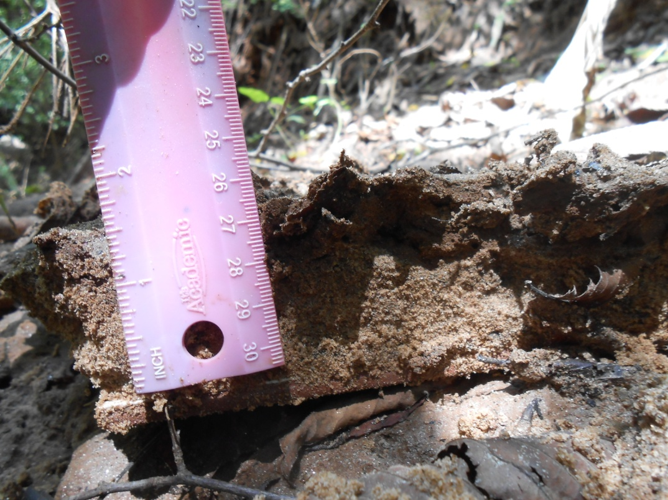
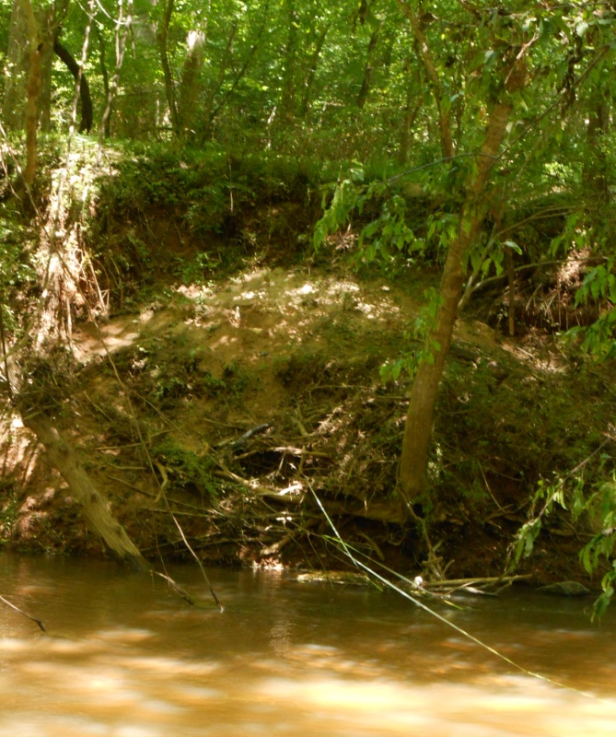
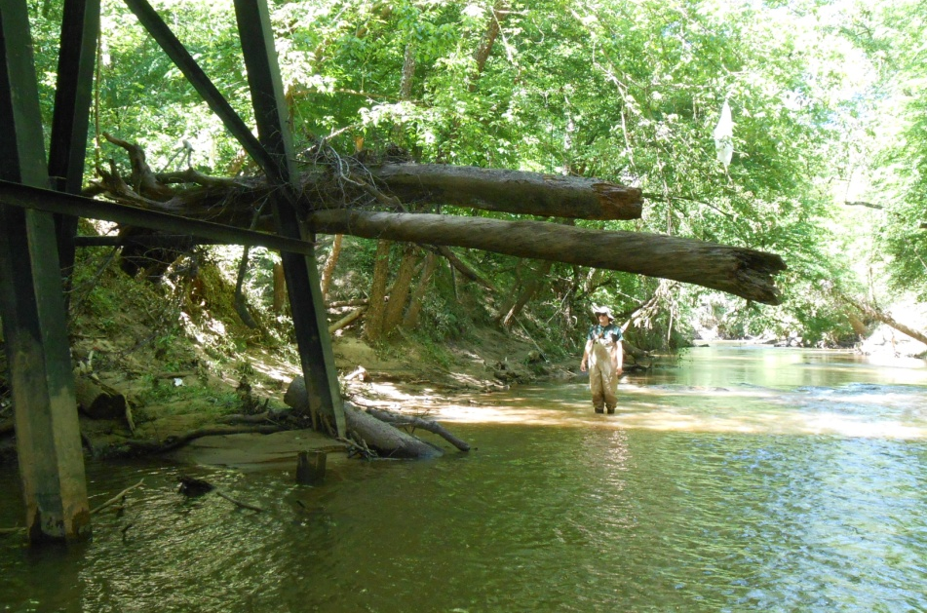
Why this watershed?
Field evidence: excessive flood deposits in the downstream reach
8-23-13 Upper left bank
6/14/13 Lower right bank
Evidence of active erosion/high flows
Slumped bank with up to 7” of deposited sediment: 7’ above water surface

Slide 14
Why this watershed?
2. Preliminary 1-D modeling: resulted in extremely high sediment loads.
SPARROW (USGS) was used to determine sediment yields throughout the Broad River basin. Lawsons Creek yielded the highest sediment load per basin area.

Slide 15
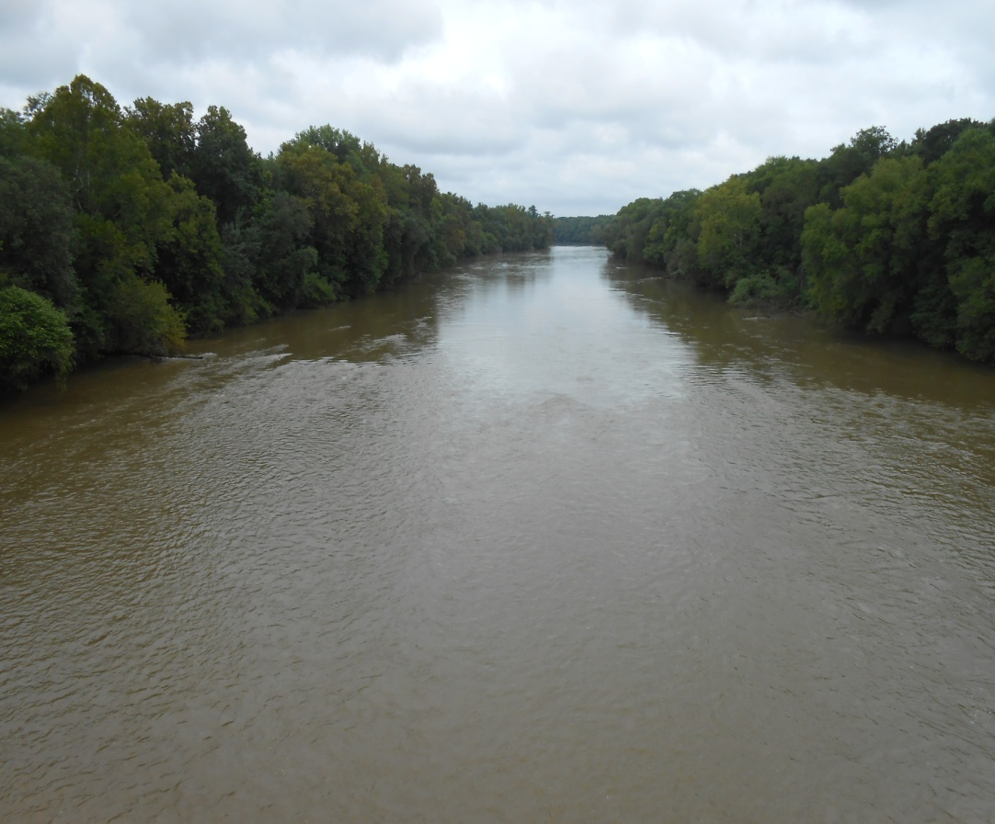
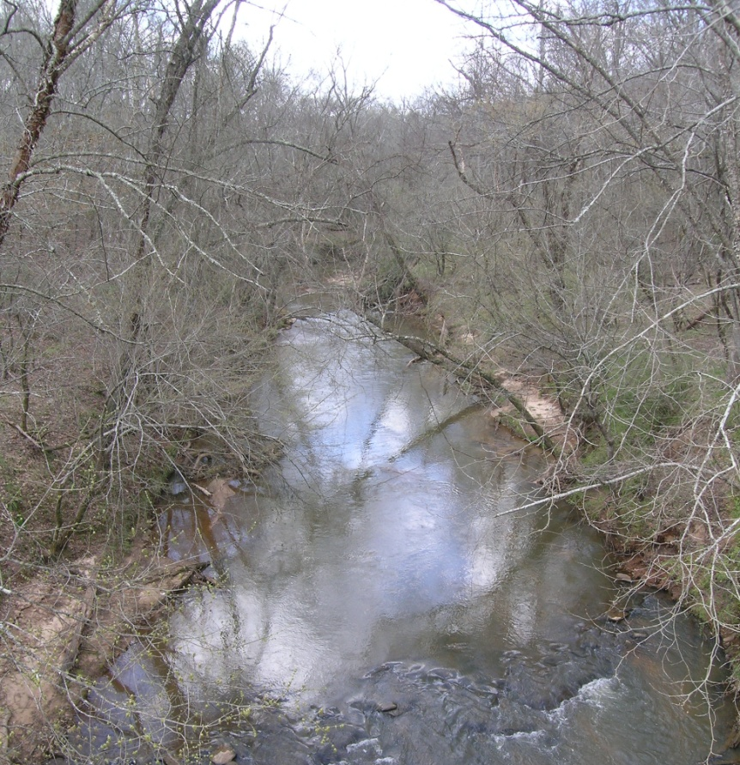
Why this watershed?
3. Extremely high turbidity: Routine basin-wide water samples yielded the highest range of turbidity (NTU) from Lawsons than in any stream, even the main Broad River, EXAMPLE:
5/6/2013 Flood Broad River (10,000 km²)
  Discharge = 41,200 cfs
  Turbidity = 119 NTU
5/6/2013 Flood Lawsons Fork (217 km²) Discharge = 4,594 cfs
Turbidity = 147 NTU
385 ft
50 ft

Slide 16
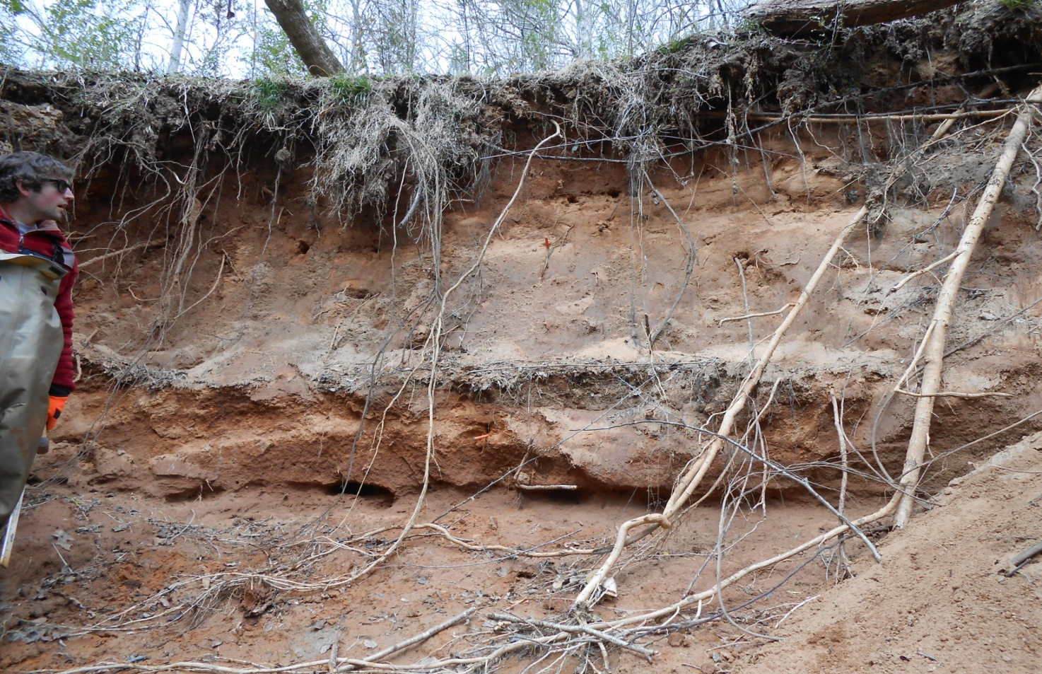
Hypothesis
We hypothesize that urban expansion has reduced soil infiltration and increased peak flows, which has led to increased bank erosion.

Slide 17
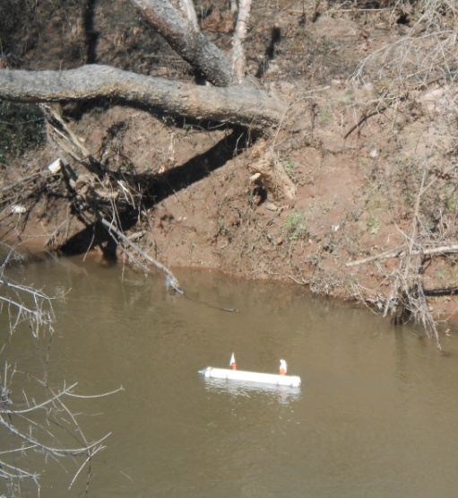
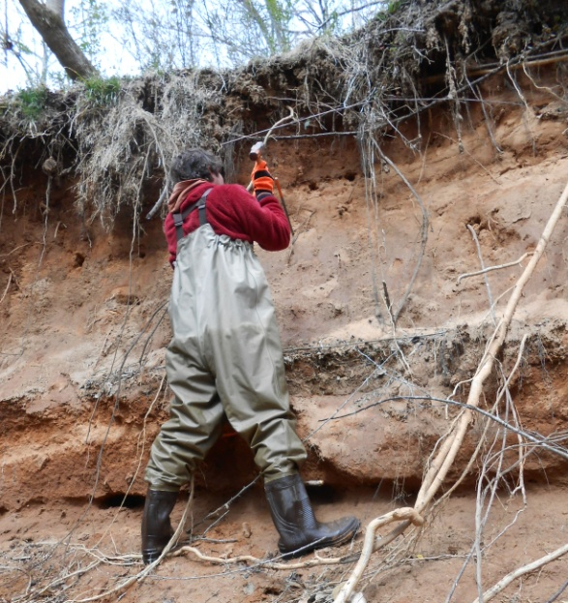
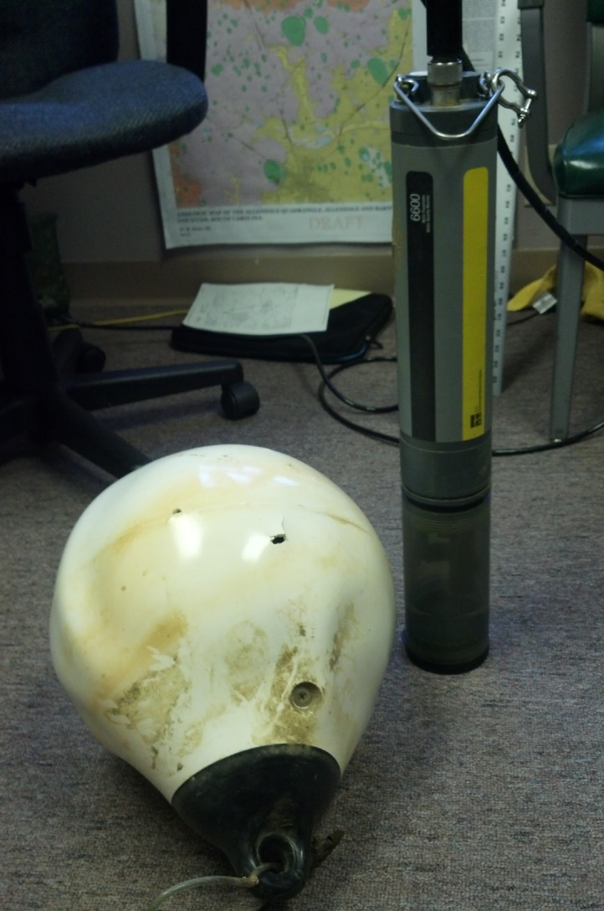
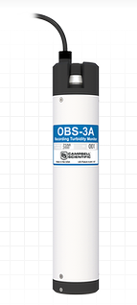

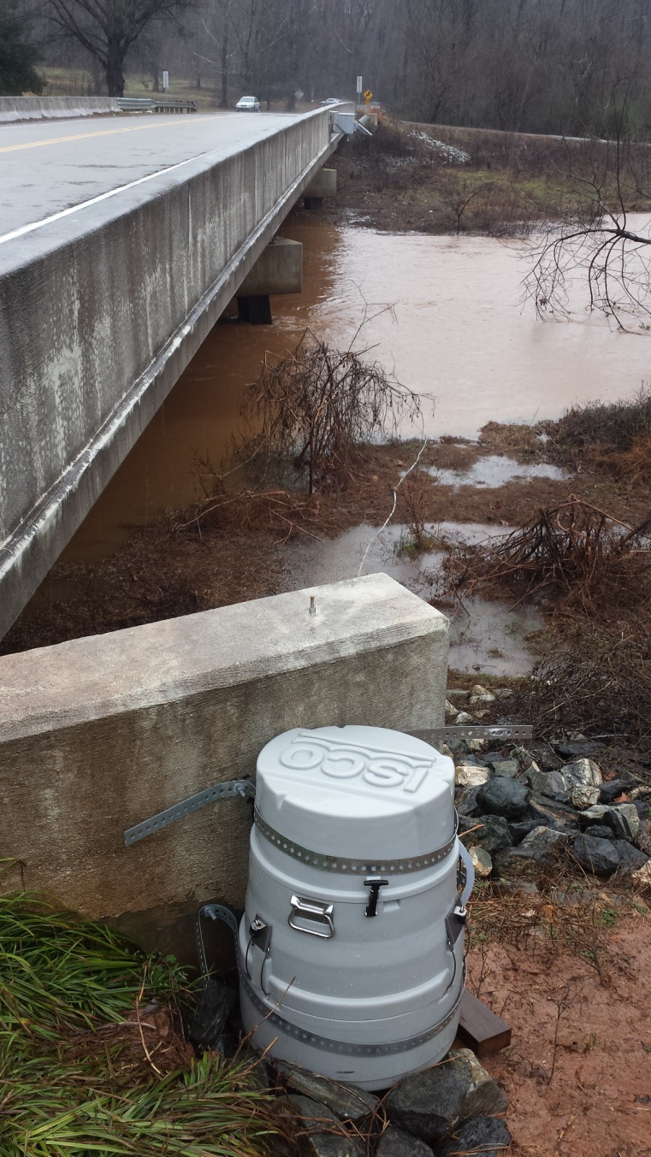
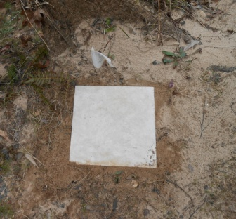


Methods: Field
Passive sediment sampler (Phillips, 2000) deployed to capture time-integrated samples during flooding events.
6 sets of bank pins were installed at the 2 cross-sections
YSI sonde deployed for continuous turbidity (stolen!!)
Campbell Sci. OBS-3A for continuous turbidity
Manual collection of depth-integrated suspended sediment samples and velocity profiles for two years under all flow regimes to establish sediment rating curve.
HOBO data loggers (temp and pressure)
D-74
Sediment tiles
DH-48
ISCO automatic pump sampler

Slide 18

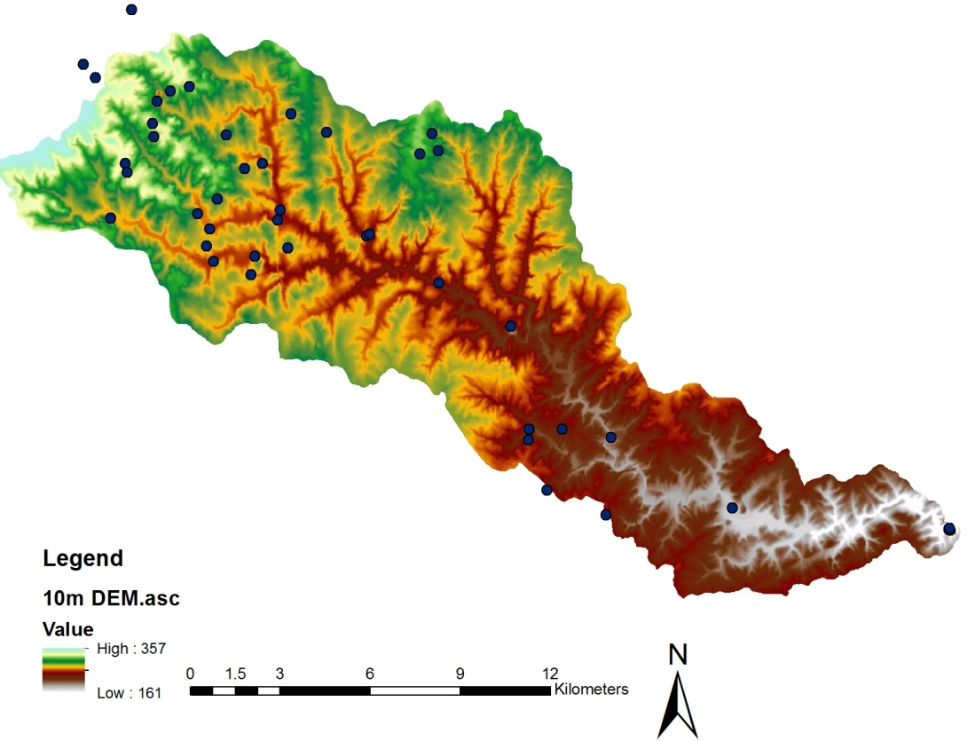
Methods: The fingerprinting approach
To determine source of sediment: The fingerprinting approach compares source with in-stream suspended sediment to establish relative source contribution.
Nearly 100 samples were collected (stratified by land use) throughout the basin to determine isotopic ratios of δ¹⁵N and δ¹³C plus Total C and N.
This suite of isotopes was chosen based on Mukundan (2009), who found that these signatures were most suitable in a similar watershed in the Piedmont.

Slide 19
Results
Tracer concentrations
Field data collection
Upland samples: collected from the upper 0-2 cm depth with stainless steel trowels, air dried and sieved to <63um
Bank samples: collected in areas of active erosion by scraping face of the bank
Suspended sediment samples: retrieved either from the passive sediment sampler (Phillips, 2000) or manually during flooding events and filtered through a 63um sieve onto pre-combusted glass fiber filter.
Analyzed the <63um fraction of both source and target samples ensured standardized particle size.
Stable isotope analysis was performed at the Stable Isotope and Soil Biology Lab at UGA.

Slide 20
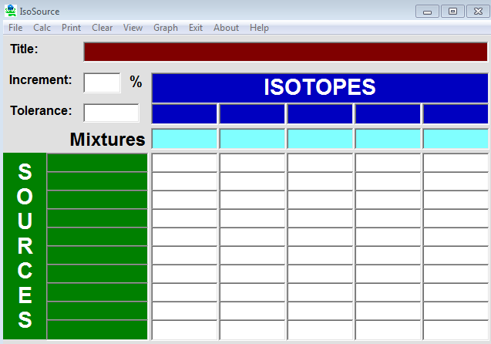
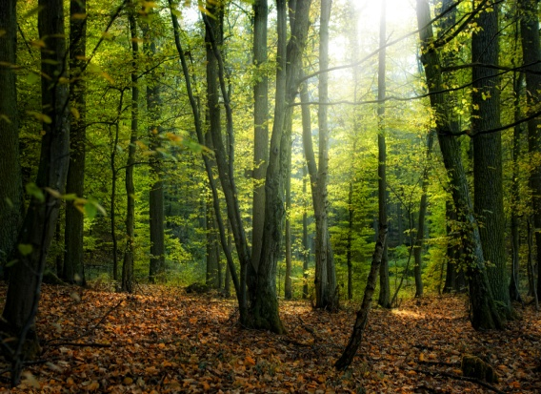
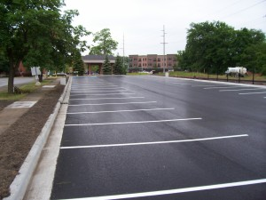

Results
Relative source contribution of suspended sediment was estimated using the isotopic mixing model IsoSource
(Phillips and Gregg, 2001;2003)
The following potential sediment sources were analyzed:
Forest
Urban/roads
Pasture
Stream bank

Slide 21
Results
The IsoSource results estimate that bank material accounts for between 86% and 100% of mass of any given suspended sediment sample.
Urban source contributes between 0-12%
Pasture source contributes between 0-10%
Forested source accounts for the least amount of material, 0-5%, which is expected due to low erosion rates.
Contribution % | Forested | Urban | Pasture | Bank
Mean | 2 | 3.5 | 3 | 91.5
Min | 0 | 0 | 0 | 86
Max | 5 | 12 | 10 | 100
1 percentile | 0 | 0 | 0 | 86
50th percentile | 2 | 3.5 | 2 | 92
99th percentile | 5 | 11 | 9 | 99
StDEV | 1.4 | 2.9 | 2.4 | 3

Slide 22
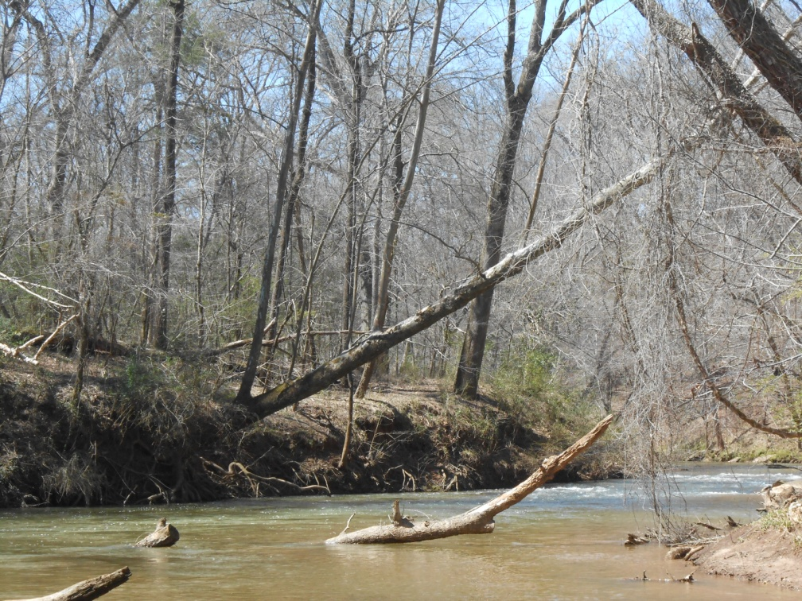
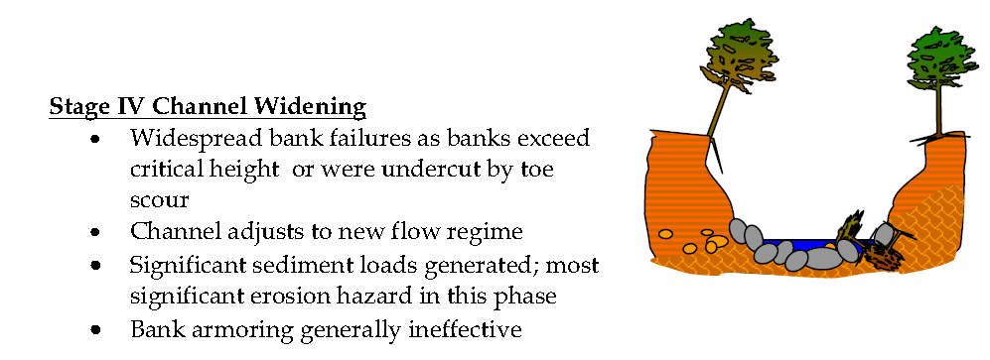
Results
Stable isotopic results are consistent with our geomorphological field assessments where banks were noted overall as unstable.
According to the Channel Evolution Model (Simon, 2001), the Lawsons Fork stream is at a Stage IV: Channel Widening

Slide 23
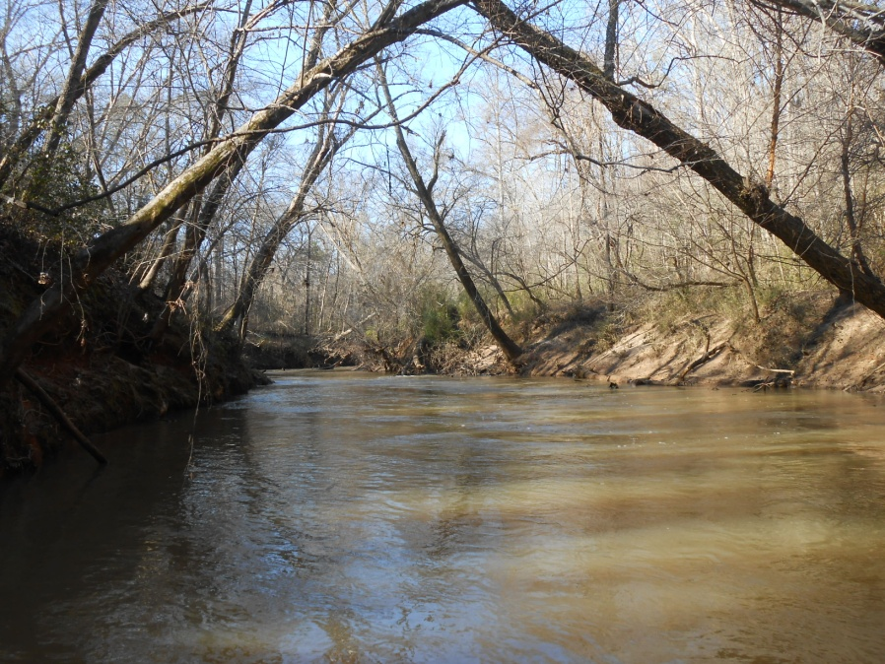
Results
Suspended Sediment Flux Results
Stable
0.20 T/ha/yr
Unstable
0.48 T/ha/yr
Lawsons Fork
2.5 – 3.8 T/ha/yr
Based on 53 depth-integrated suspended sediment samples collected over a 20 month period capturing large range of flow regimes.
Suspended sediment transport rates in the Piedmont for drainage basins 101-1000 km²
(Klimentz and Simon, 2007)
In many reaches, banks are undergoing mass or rotational failure. Trees are falling into the stream or leaning sharply.

Slide 24
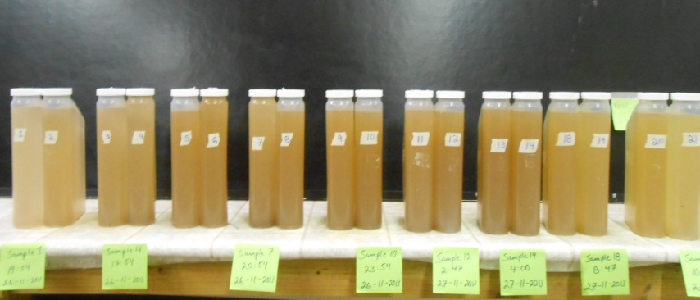
Future work
During a recent flooding event (March, 2014), samples were collected with an ISCO automatic pump sampler to analyze 1) grain size distribution and 2) sediment source over different stages of the hydrograph. These results are forthcoming.
Additional upland samples will be collected and analyzed to increase representation across the watershed; statistics will be run at that time (Kruskall Wallis for tracer discrimination; Monte Carlo for uncertainty)
Field data collection will continue with the OBS to verify relationship between discharge and suspended sediment flux……and how sediment loads compare to others in the Broad River Basin

Slide 25
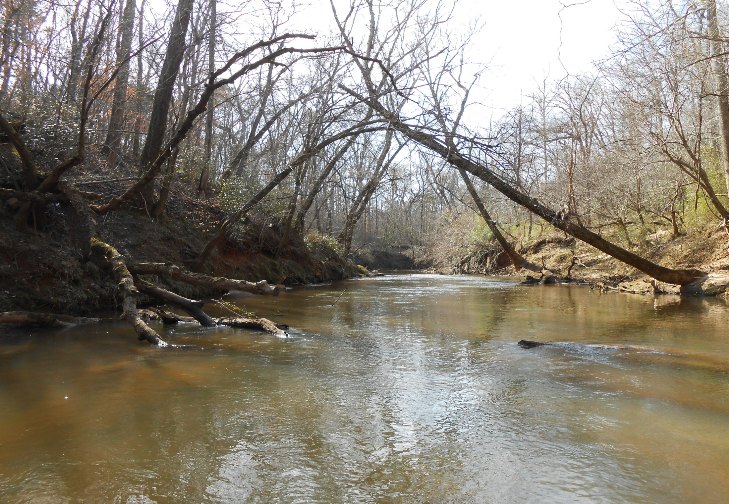
Closing statements
Bank material contributes the majority of the suspended sediment in the stream. Most of it is likely legacy sediment, however, more testing is needed to confirm this.
Creating BMP’s for sediment load reduction in this watershed is warranted based on our preliminary data.
Sediment collected from a passive sediment sampler (Phillips, 2000) returns adequate results and retrieves enough sample for stable isotope analysis of this type. This simple low-cost instrument can replace traditional expensive truck-mounted centrifuges.
Many places on the Lawsons Fork watershed give indication of widening, therefore, further contribution of sediment from bank erosion can be expected.

Slide 26
Acknowledgements
Broad River Mitigation Trustees (Duke Power Company; South Carolina Electric and Gas; Lockhart Power Company; SC Department of Natural Resources; US Fisheries and Wildlife Service)
United States Geological Survey
Wofford University
University of South Carolina
SC Wildlife and Freshwater Fisheries division of DNR

Slide 27
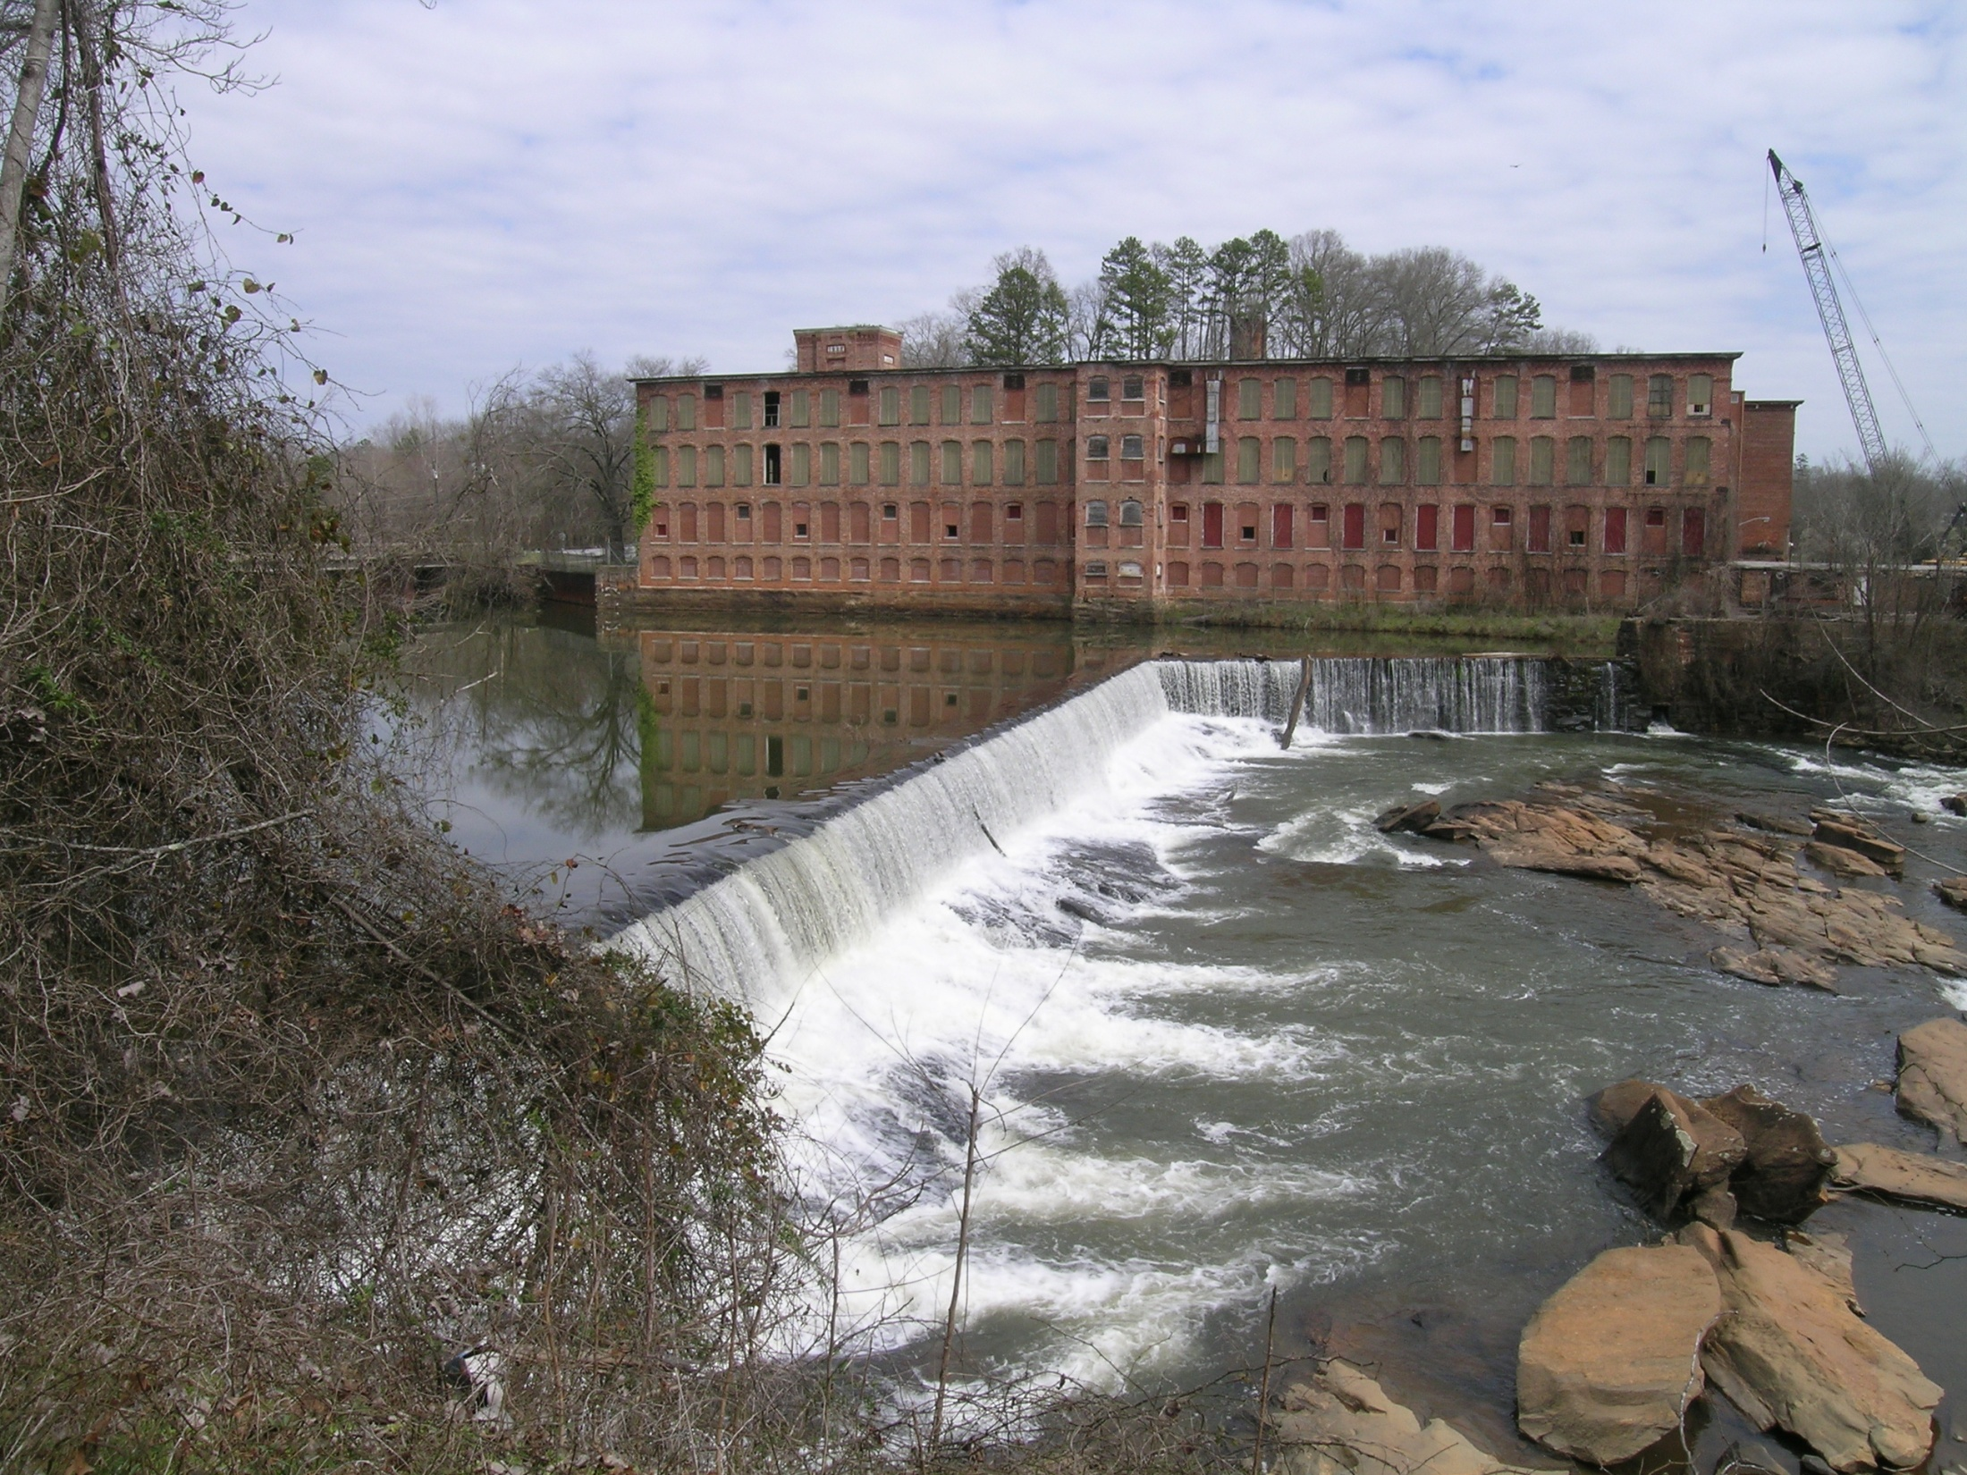
Questions?

Slide 28
