Slide 1

Computer Graded Visualizations
John Fountain and Katherine Ryker
Marine, Earth and Atmospheric Sci.
GSA SE Meeting April 10, 2014

Slide 2

Development Team
Katherine Ryker
  Visualization Development
  Class Use
  Evaluation
Doel Gonzalez
  Database
  Server
  Sever/Client communication

Slide 3
Value of Visualizations
Visualizations invaluable for learning in geosciences (e.g. Libarkin, 2002; McConnell et al., 2003 )
And Assessment: Student-created products invoke higher level skills, while multiple choice questions typically examines low Depth of Knowledge Skills (e.g. Yuan and Le, 2012).

Slide 4
Manual Grading Limits Use
Although value proven, grading student-created products requires more resources, which limits use (Darling-Hammond and Adamson, 2013)

Slide 5
Research Objective
Allow increased use of visualizations in assessment by developing an auto-scoring method.
Method designed for routine use, including daily “homework” assignments

Slide 6
ICAT (Instructional Computer Adaptive Test)
Visualization Grading added to ICAT
ICAT combines instruction and assessment to enhance student mastery of material to be learned outside of class: Not Simply Assessment

Slide 7
Three Types of Drawing
Freehand drawing
Polylines (connected straight segments)
Insertion of symbols

Slide 8
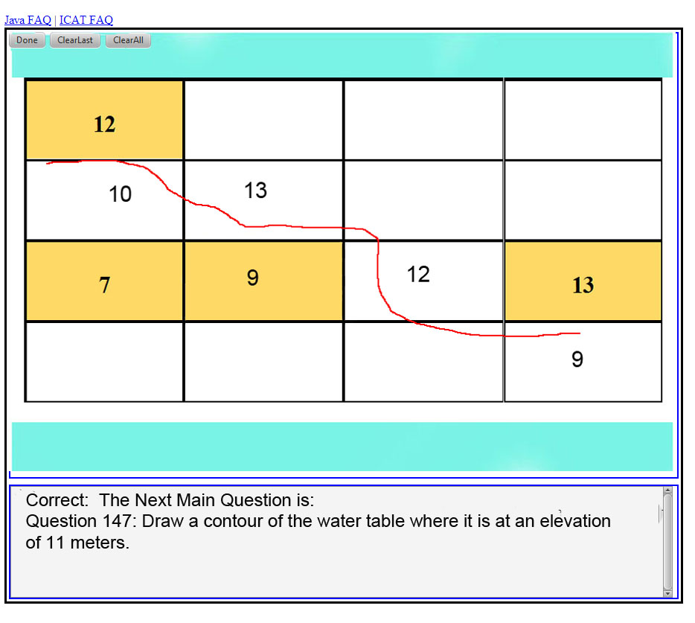

Slide 9
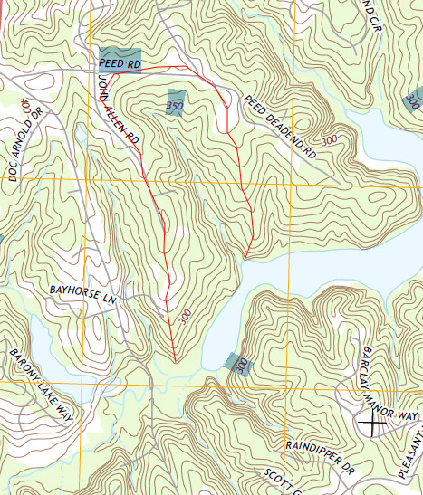
Polyline: allows precise location

Slide 10
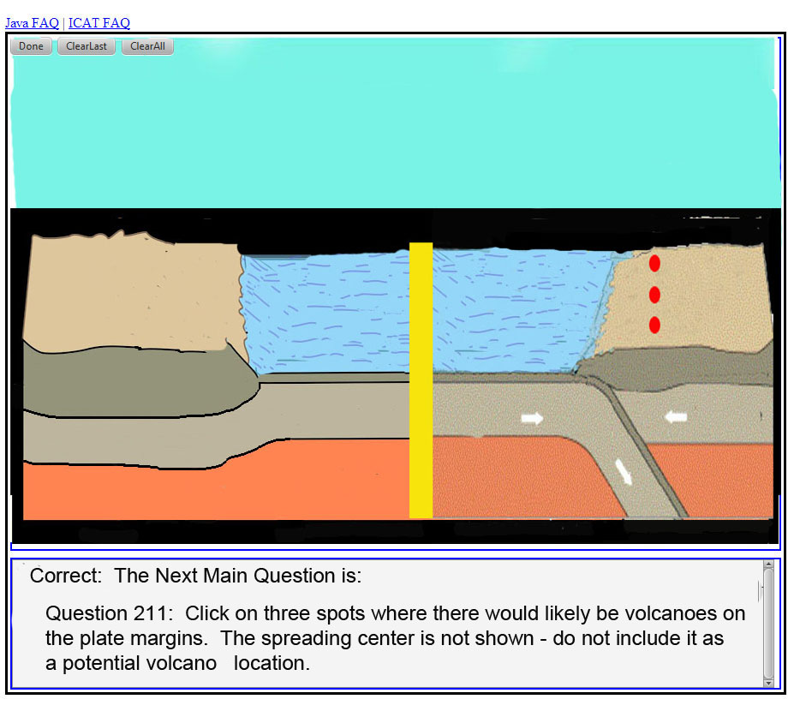

Slide 11
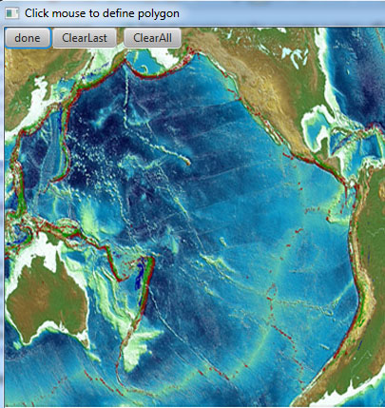
Grading Visualizations

Slide 12
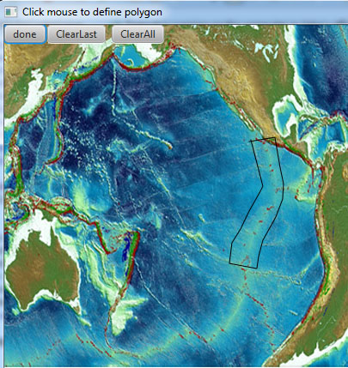
Define “Correct” Area” area

Slide 13
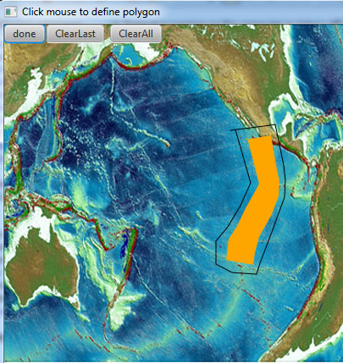
Up To Five Areas

Slide 14
Rubric Flexible
Example: 90% of student’s line in “correct” area and 0% in “wrong” area = A
Can be as complex as desired, using multiple logical statements

Slide 15
If The Answer is Wrong?
If a high level question is missed, what does it mean?
Usually involves synthesis of multiple knowledge areas
ICAT designed to identify knowledge gaps and address them

Slide 16
Instructional
ICAT provides instructional material when a question is not answered correctly
May be videos or text + image

Slide 17
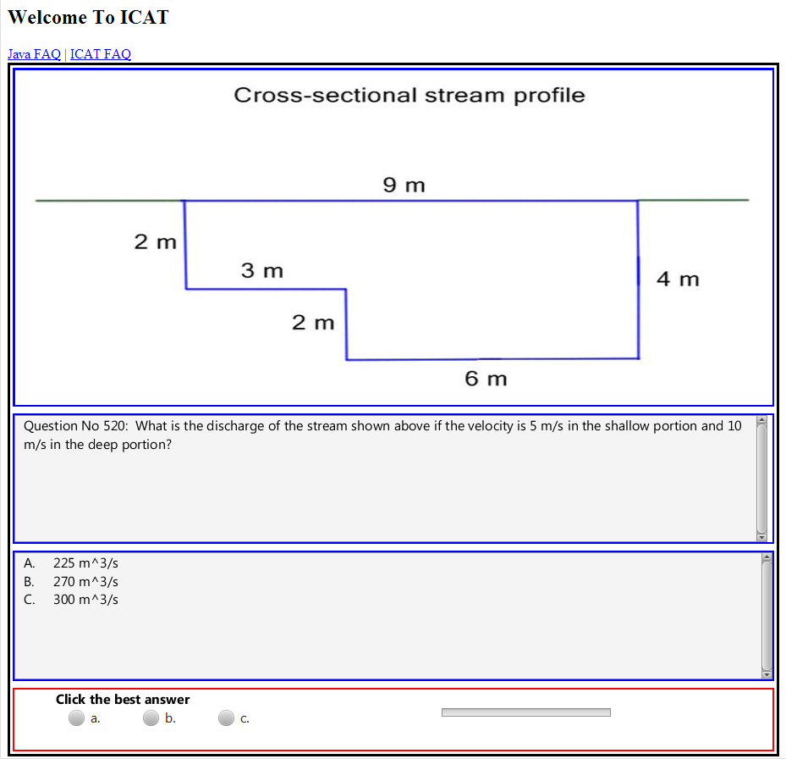

Slide 18
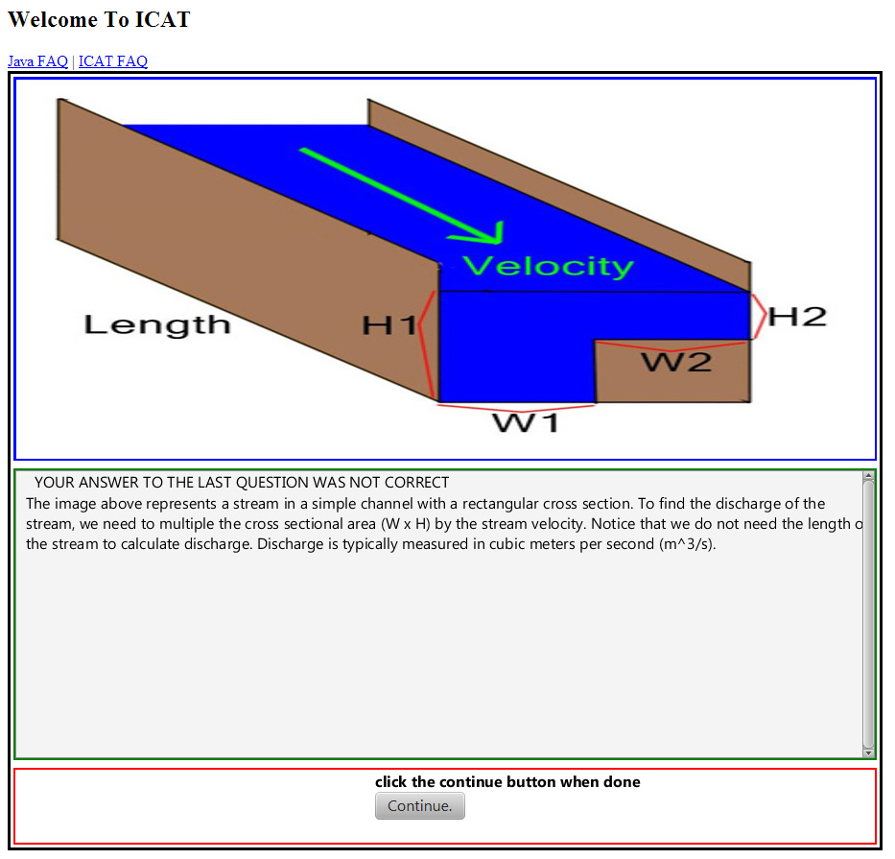

Slide 19
Investigate Underlying Concepts
Sub-questions investigate individual knowledge areas
Instructional material directed to specific area

Slide 20
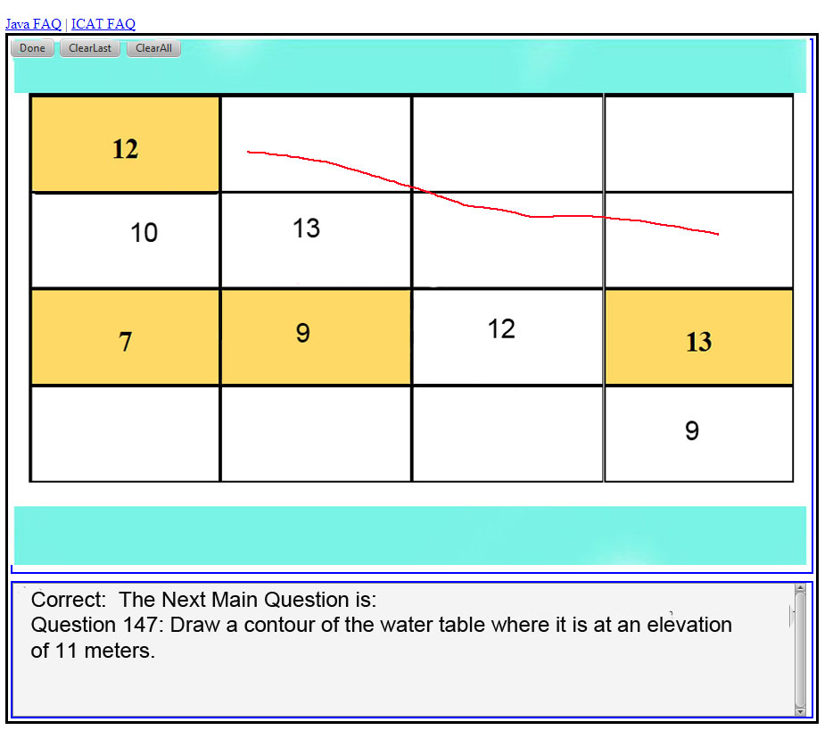

Slide 22
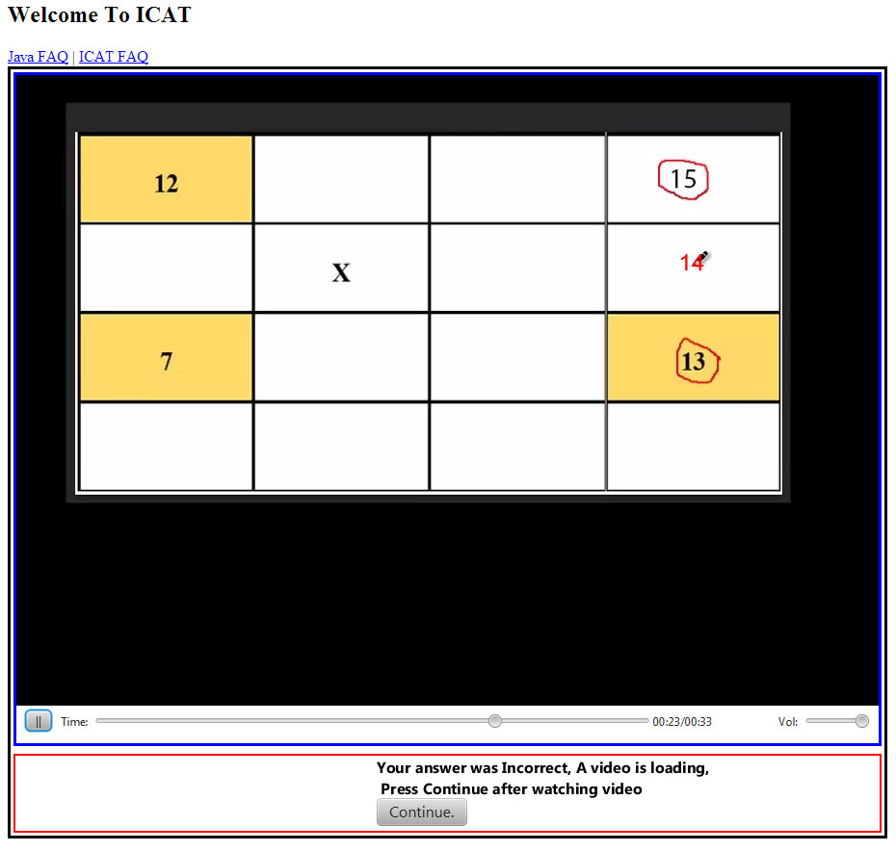

Slide 23
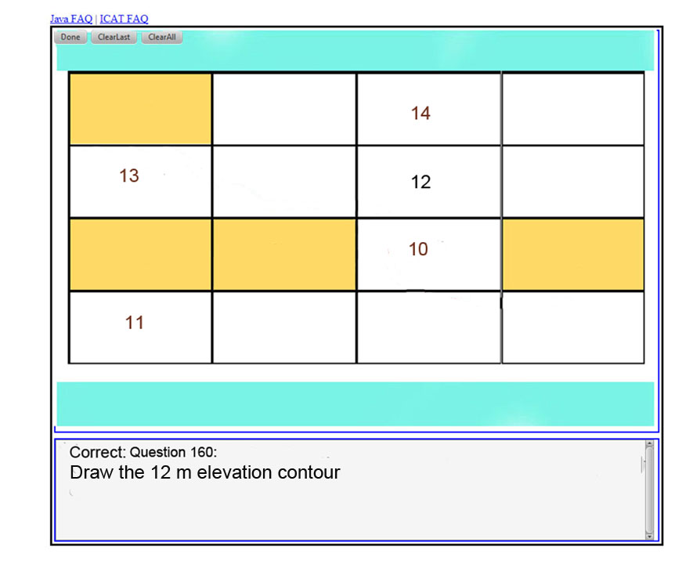

Slide 24


Slide 25
Why The Question was Missed
Sub-questions can investigate individual knowledge areas underlying main question
Information keyed to responses can build knowledge needed to answer questions

Slide 26
Missed Questions Repeated
After a question is missed:
  information may be given
  Or a sub-question that investigates underlying knowledge areas
Eventually the missed question will be returned to

Slide 27
Automatic Grade Book
Gradebook has student grade list plus:
  Master Quiz Grades
  Separate Grades For Each Visualization
  Evaluations of Each Question
    Was material learned?
    What was not understood?
    Sub-questions results show knowledge areas that were not mastered

Slide 28
Conclusion
Auto-grading of visualizations implemented in ICAT
Used successfully in Introductory Geology Classes
Allows routine (daily) use of visualizations for assessment

Slide 29

Thank You for Listening!
Questions??
Funding from the
National Science Foundation’s Opportunities for Enhancing Diversity In the Geosciences Program

