Slide 1
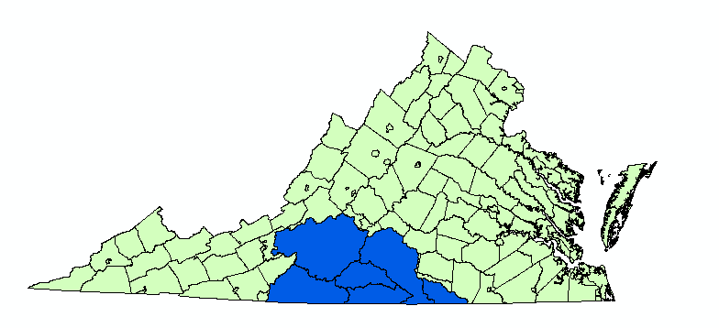

Geologic Sources of Manganese in the Roanoke River Watershed
Zachary Kiracofe
Madeline Schreiber
William Henika

Slide 2
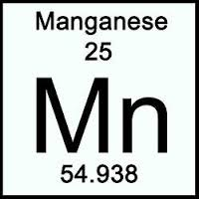
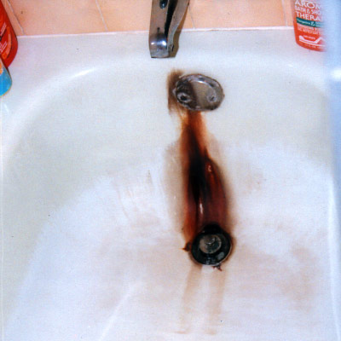
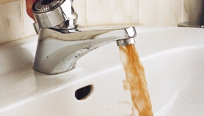
Manganese is a ubiquitous metal that can adversely affect water quality.
EPA Secondary Drinking Standard: 50 ppb
Aesthetic effects: staining clothing, taste & color
Human health benchmark: 300 ppb (EPA)
Notes:
Other sources: http://www.google.com/imgres?imgurl=http%3A%2F%2Fi1.cpcache.com%2Fproduct_zoom%2F648798783%2Fperiodic_table_manganese_small_mug.jpg%253Fheight%253D250%2526width%253D250%2526padToSquare%253Dtrue&imgrefurl=http%3A%2F%2Fwww.cafepress.co.uk%2F%2Bperiodic-table-elements%2Bmugs&h=250&w=250&tbnid=cuuTjvoRU_5JiM%3A&zoom=1&docid=Z2mz8nU70U9x7M&ei=oBw0U5O0Iujb0QHd24GIBg&tbm=isch&ved=0CIEBEIQcMCg4rAI&iact=rc&dur=1689&page=15&start=318&ndsp=24
http://www.thewaterclinic.com/info-stainers.php
http://gtwe-nu.com/technology/drinking-water-purification/iron-and-manganese-removal

Slide 3
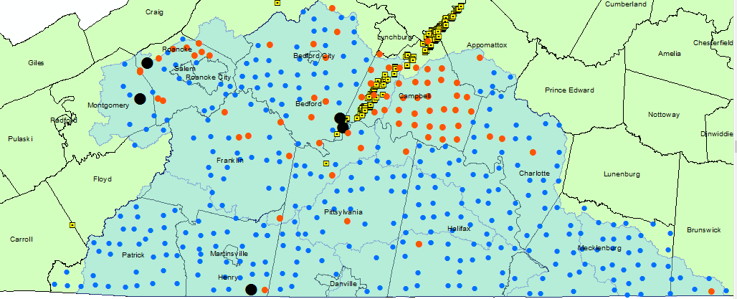

Manganese concentrations are elevated in groundwater of the Roanoke River watershed: 30% of wells > 50 ppb
Dissolved Manganese (ppb)

Slide 4

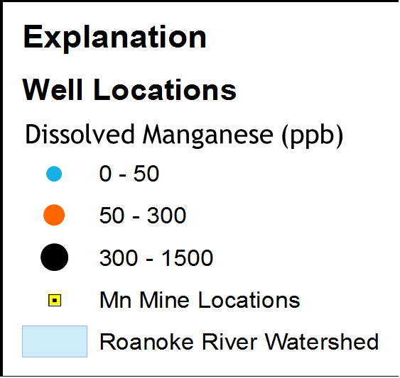

Manganese concentrations are elevated in groundwater of the Roanoke River watershed: 30% of wells > 50 ppb
HM

Slide 5
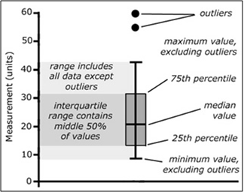
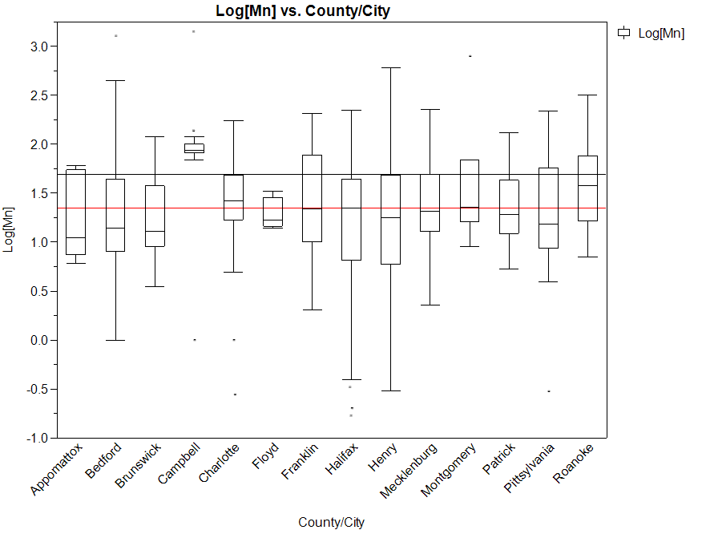
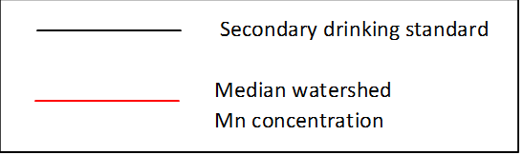
Spatially, Mn in groundwater is consistently above 50 ppb in Campbell Co.
Log(Mn) in groundwater (ppb)
Why?

Slide 6
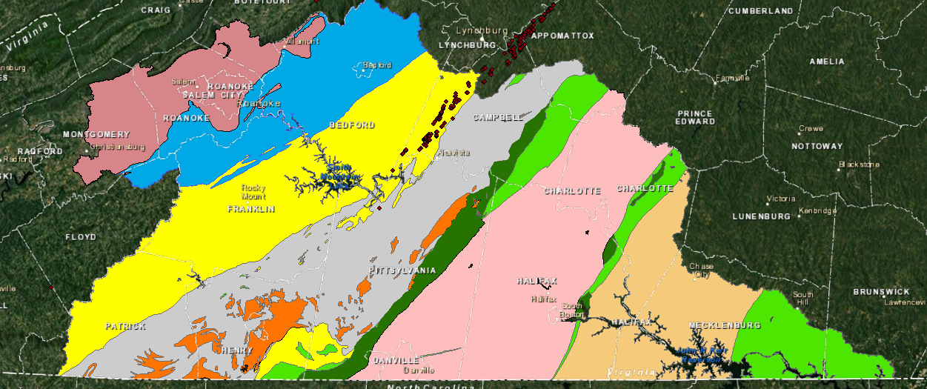



Geologically, the region is complex, has several thrust sheets, Triassic rift basins, and extensive belts of igneous rocks.

Slide 7
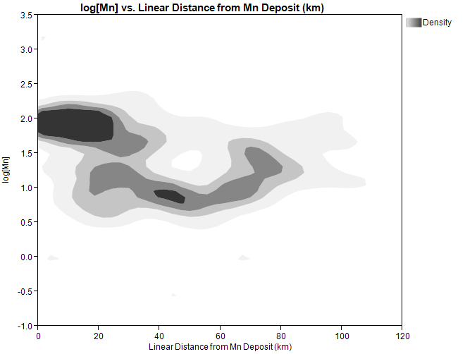

Spatial analysis reveals that Mn to concentrations in groundwater are higher closer the ore deposits
Density plot: log Mn vs. linear distance
s
Method:
Set boundaries
Bowens Creek Fault/Ridgeway Fault
Chatham Fault/Ridgeway Fault
Record Mn concentration at each well within boundaries
Measure distance between each well and the nearest documented ore deposit
Log(Mn) in groundwater (ppb)
Linear distance from Mn deposit (km)+

Slide 8
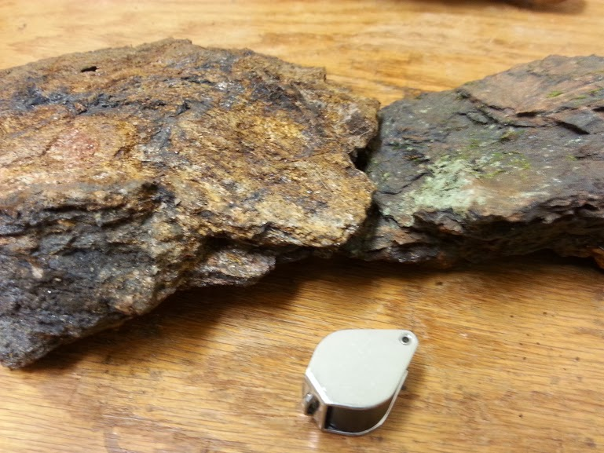
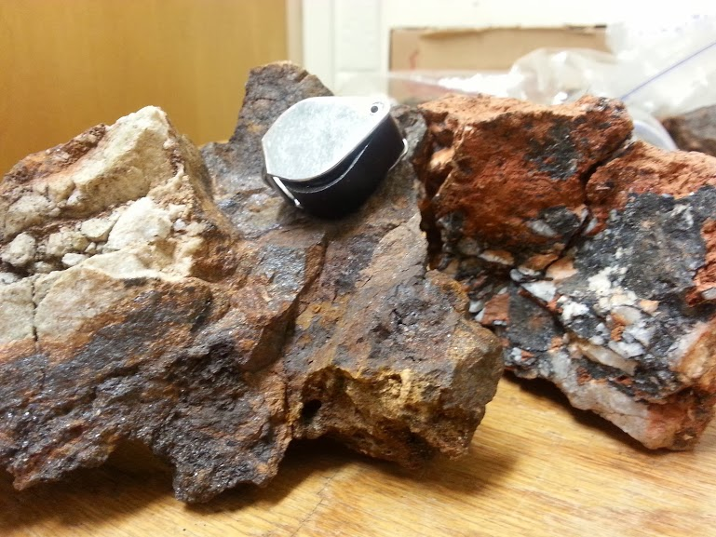
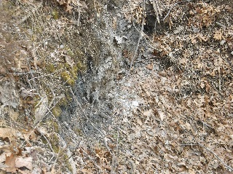
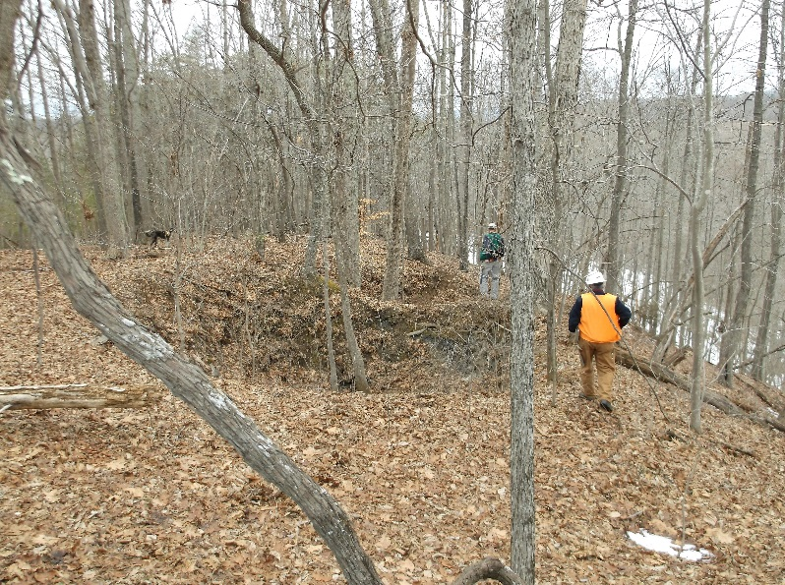
There are three main forms of Mn ores in the JR-RR Mn District of the watershed: massive replacement, breccia, and soil “wad”
Massive replacement/void filling
Quartzite breccia (Mn-oxide matrix)
Soil deposits (“wad”)

Slide 9
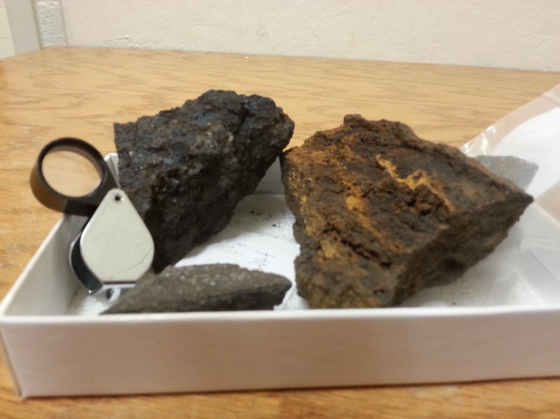
There are three main forms of Mn ores in the JR-RR Mn District of the watershed: massive replacement, breccia, and soil “wad”
Massive replacement/void filling
Quartzite breccia (Mn-oxide matrix)
Soil deposits (“wad”)
Samples from the Hutter Mine
How were these ores formed?

Slide 10
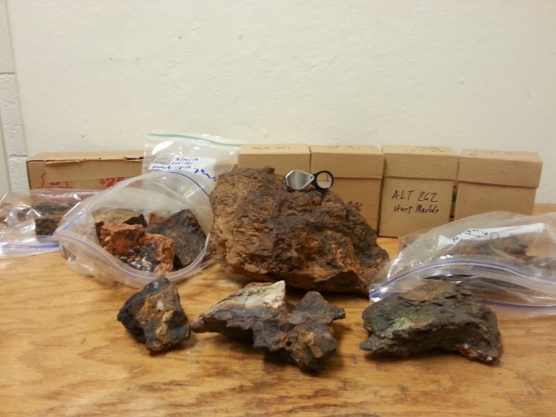
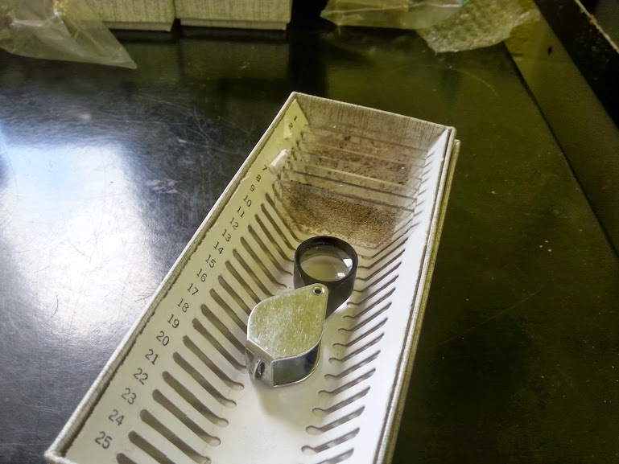
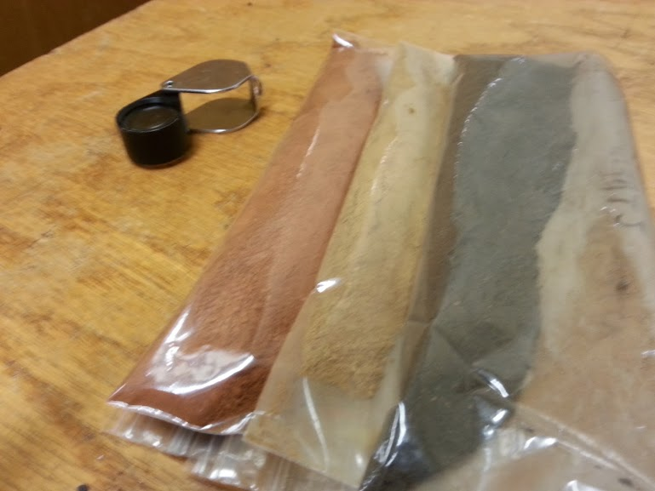
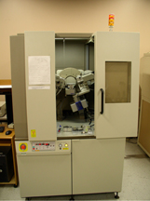
My research focuses on characterizing Mn ores to link ore attributes to groundwater chemistry
Research Questions
Were these ores formed from supergene groundwater circulation or remobilized by hydrothermal fluids?
What are the characteristic mineralogical and chemical signatures?
How is Mn released from minerals to groundwater?
Are any mineral phases more likely to release Mn than others?
Is Mn introduced into groundwater from carbonate rocks or from ores?
Sample Collection Petrologic analysis of thin sections XRD/XRF analyses (mineralogy/elements)
Methods

Slide 11

Preliminary results…
A sneak peak of what is to come…

Slide 12
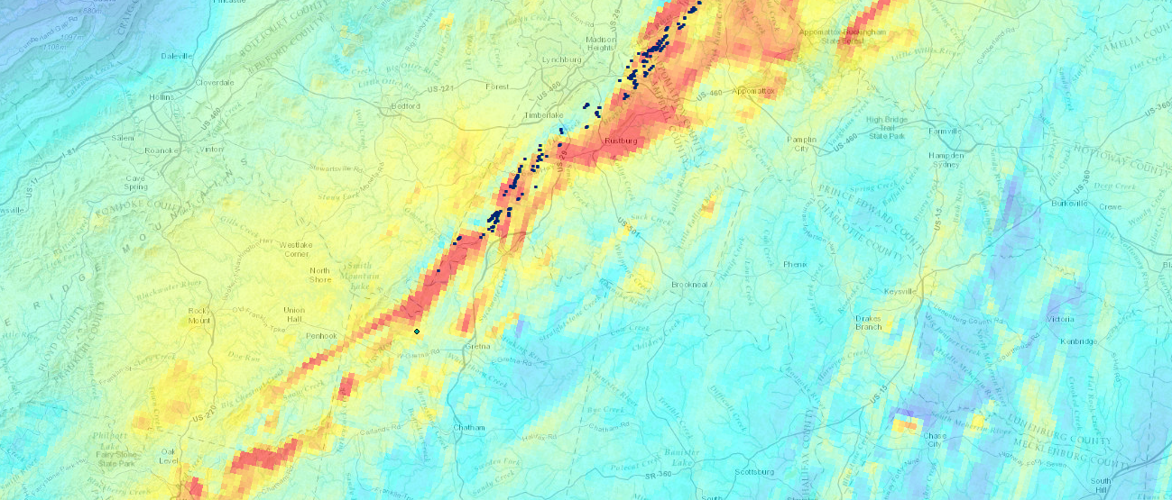
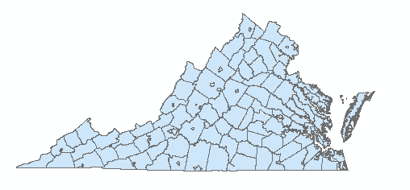
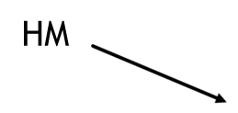
Aeromagnetic maps show that Mn deposits are located in magnetically anomalous areas.

Slide 13
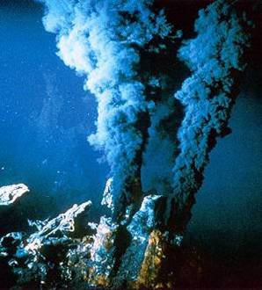
Deposits of the Hutter Mine are believed to have been metamorphosed from volcanogenic deposits on the ocean floor (Beard et al., 2002).
Fe
Modern analog: “Black Smokers”
Mn
Potential source of primary Mn
S
S
Mn may have been remobilized by intrusive igneous bodies
(e.g. diabase dikes)

Slide 14

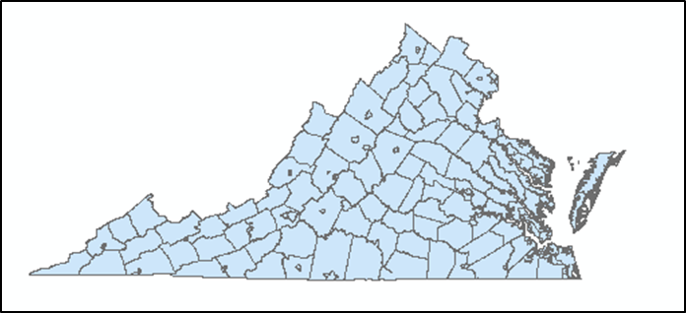

These types of deposits may explain the presence of other “hot spots” in the study area.
Potential Mn ores?

Slide 15

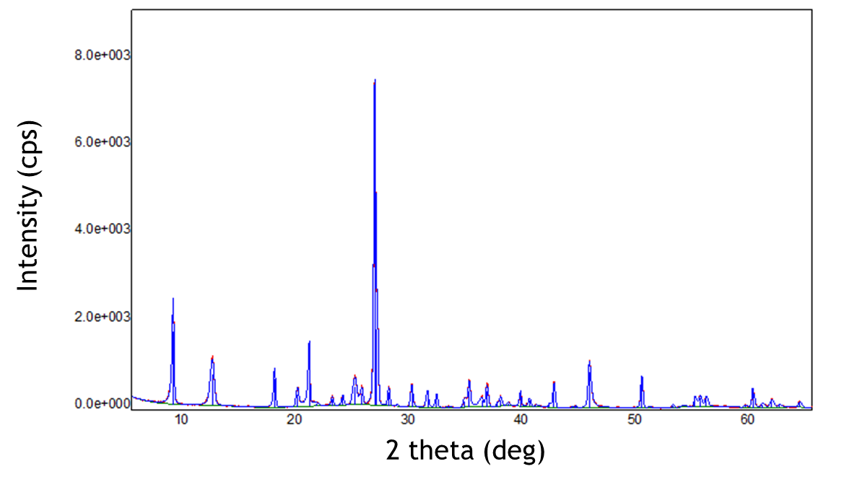
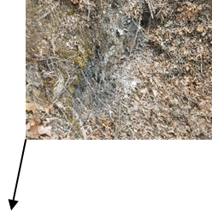

Preliminary XRD analysis suggests that identifying Mn minerals will require more qualitative work to be certain of mineral species.

Slide 16
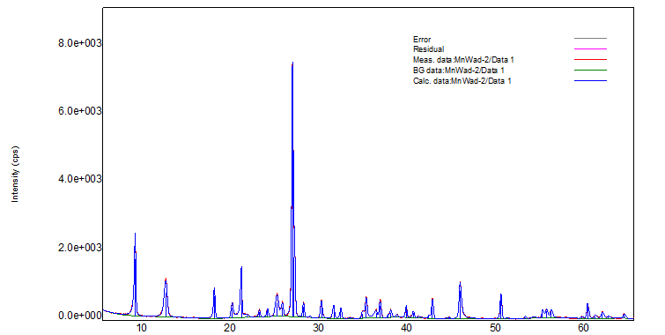
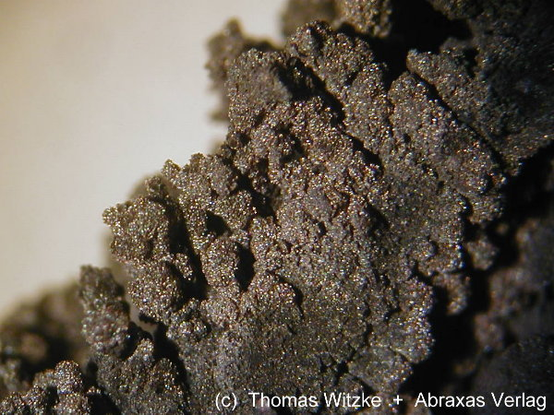
Preliminary XRD analysis suggests that identifying Mn minerals will require more qualitative work to be certain of mineral species.
Muscovite
Quartz
Muscovite
Quartz
Intensity (cps)
2 theta (deg)
Birnessite?
(Na_{0.3}Ca_{0.1}K_{0.1})(Mn⁴⁺,Mn³⁺)₂O₄·1.5H₂O

Slide 17

My goal is to develop a predictive model of conditions that are conducive to elevated Mn in groundwater
Identify which minerals are soluble and are likely to contribute Mn to groundwater
Characterize groundwater geochemistry, especially redox conditions and pH
Approximate groundwater flow direction(s) in study area (groundwater flow maps)
Reduced
groundwater
Mn²⁺ transported in reduced groundwater
MnO₂ + 2e⁻ + 2H⁺ = Mn²⁺ + 2H₂O
Biogeochemical interactions with ores release Mn²⁺ into groundwater

Slide 18

Acknowledgements
Committee Members
Madeline Schreiber
William Henika
J. Donald Rimstidt
Jim Beard, VMNH
I would also like to thank the following individuals for their contributions to this project.
Joshua Rubenstein, DMME
William Lassetter, DMME
Neil Johnson

