Slide 1
Phylogenetic signals in phytosaur tooth enamel microstructure and implications for Newark Supergroup phytosaurs
HOFFMAN, Devin K.¹, MILLER-CAMP, Jessica A.², and HECKERT, Andrew B.¹, (1) Dept. of Geology, Appalachian State University, ASU Box 32067, Boone, NC 28608, hoffmandk@appstate.edu, (2) Dept. of Geoscience, Iowa State University, Iowa City, IA 52242

Slide 2
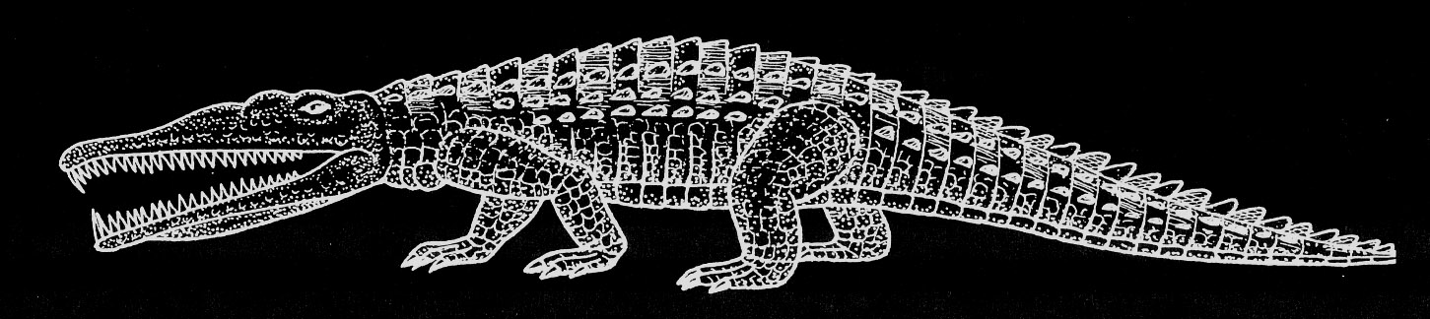
Phytosaurs
Lucas (2007, fig. 4.11)
Primitive, aquatic carnivores
“Crocodile-line” archosaurs
Only lived in Late Triassic
Rutiodon—From NC, first phytosaur in North America
Heterodont

Slide 3
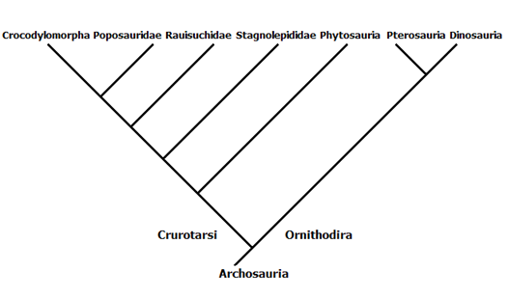
Traditional Phylogenetic Position
Sereno, 1991

Slide 4
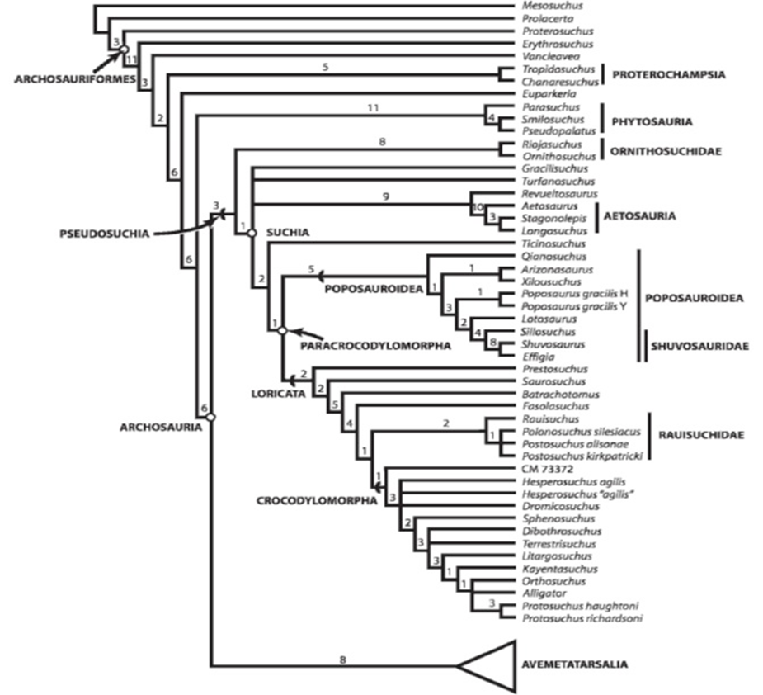
Recent Interpretation
Nesbitt, 2011
Phytosauria

Slide 5
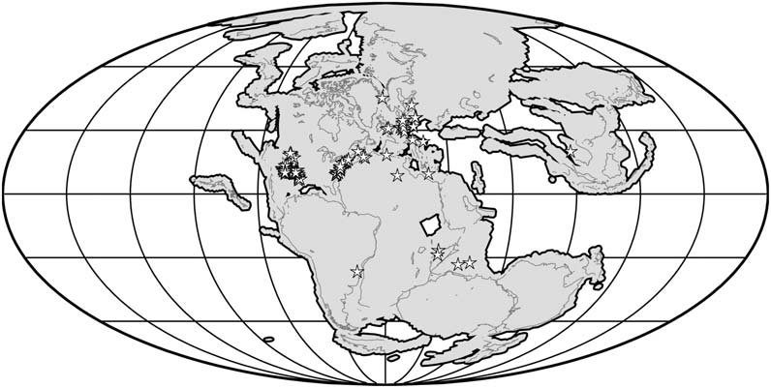
When and Where
Late Triassic (~237 Ma to ~201)
Stocker & Butler 2013

Slide 6
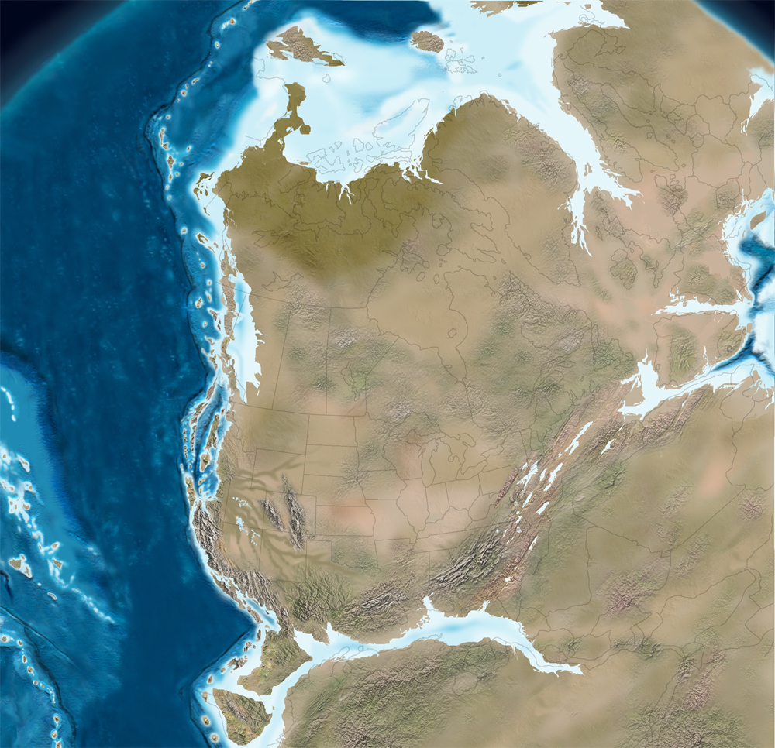
East meets West
Chinle/Dockum
Numerous heterodont phytosaurs
Stratigraphically superposed taxa
Newark Supergroup
Phytosaurs known, but under-studied
http://jan.ucc.nau.edu/~rcb7/namTr210.jpg

Slide 7
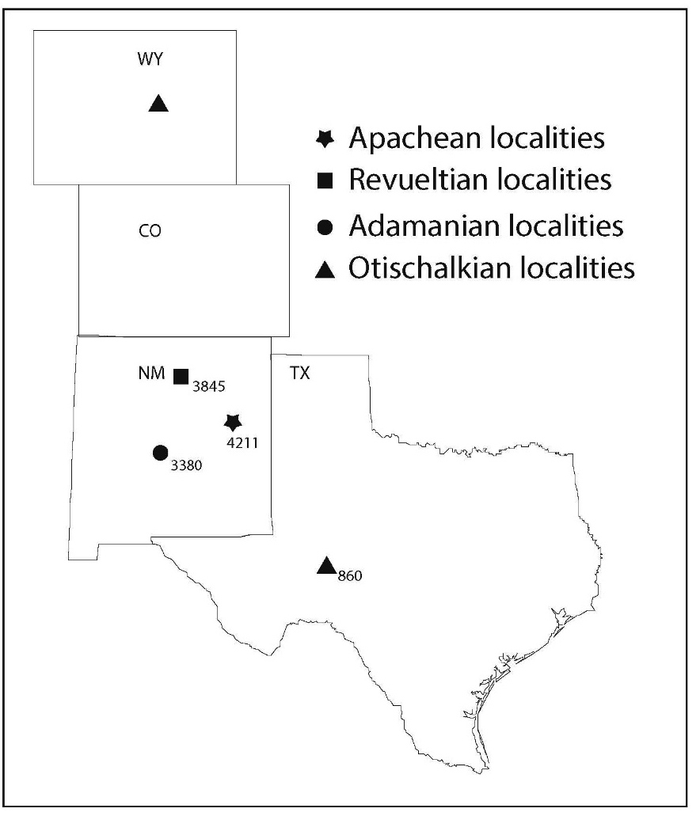
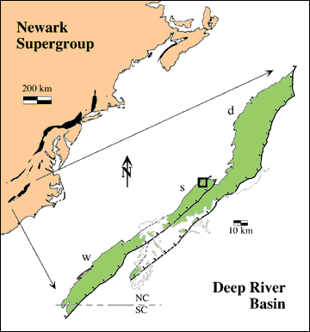
Our Localities
Wadesboro sub-basin, Deep River Basin
Cumnock Formation, Newark Supergroup
Newark Supergroup Figure
from P.E. Olsen’s web page

Slide 8
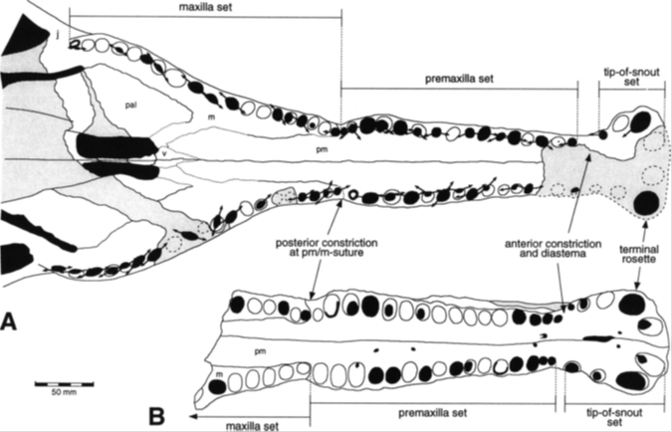
Problems with Identification
Phytosaurs are identified by their skulls
  Skulls are rarely preserved
  Teeth are rarely preserved in place
  (seem to fall out shortly after death)
Most of fossil record is individual teeth
  Heterodonty
Leads to taxonomic issues
Hungerbühler, 2000

Slide 9
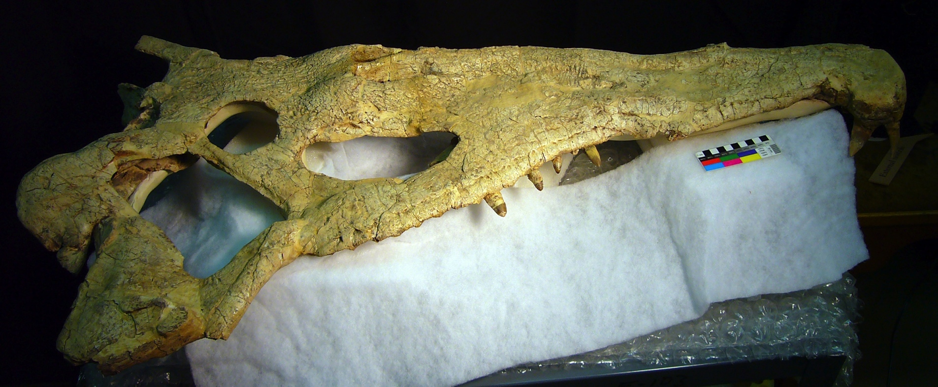
Ideal Fossils
USNM 18313 Machaeroprosopus/Smilosuchus from the Blue Hills, Arizona

Slide 10
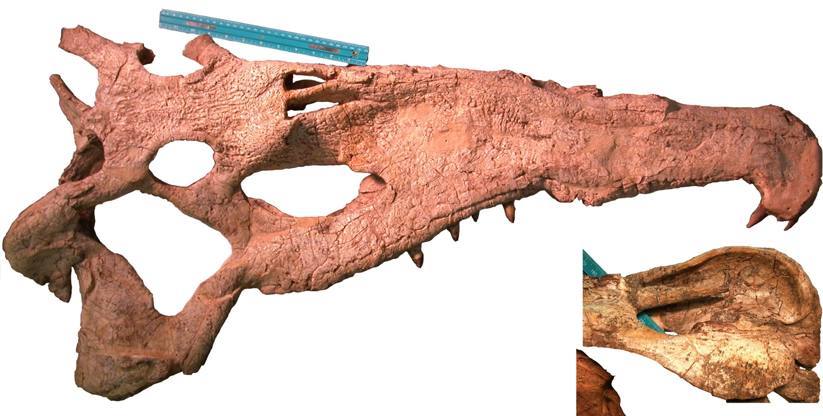
Key features
Size, shape, orientation of fenestrae,
especially supratemporal fenestra
Diverse features of squamosal
(this is internal view of right)

Slide 11
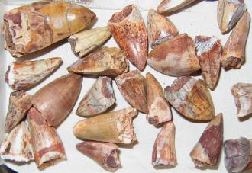
Reality
http://www.rhyniechert.com/triassicsanmiguel2.html

Slide 12
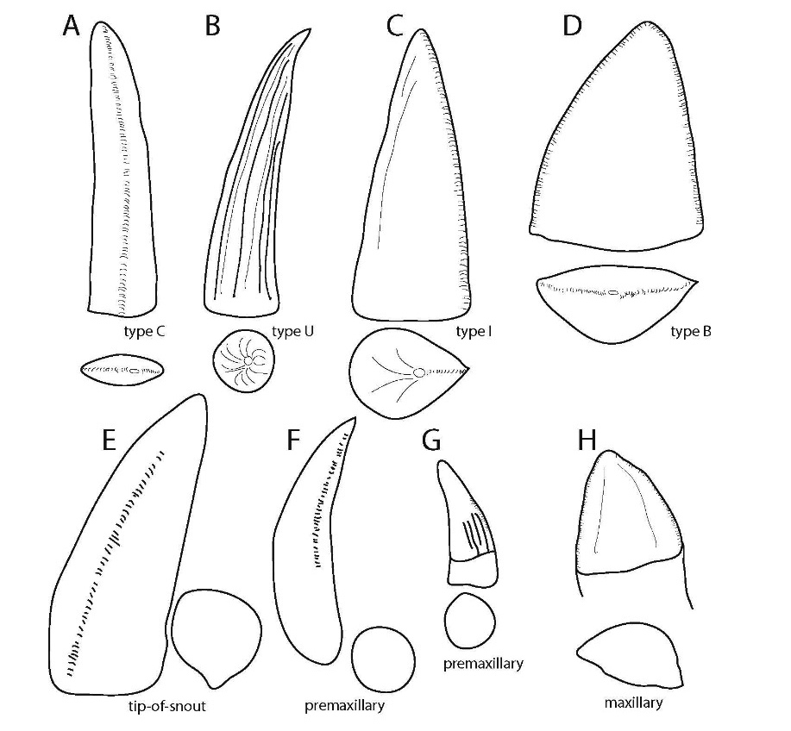


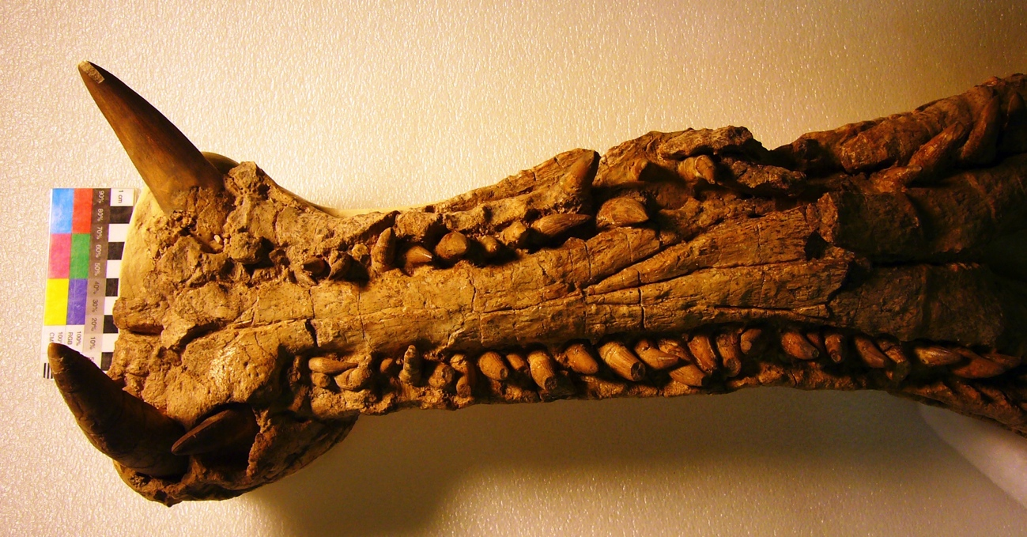
Heterodonty
Similar teeth occur in the lower jaw.
(This is USNM 18313 again)

Slide 13
Tooth Enamel Microstructure
What
Why
Microscopic structures in the tooth enamel
“Schelzmuster”
Key structures
  Enamel thickness
  Structure (parallel/columnar)
  Basal Unit Layer (BUL)
  Lines of Incremental Growth (LIG)
Sander, 1999
  Huge differences in enamel thickness
Possible phylogenetic signals
Paleobiological implications

Slide 14
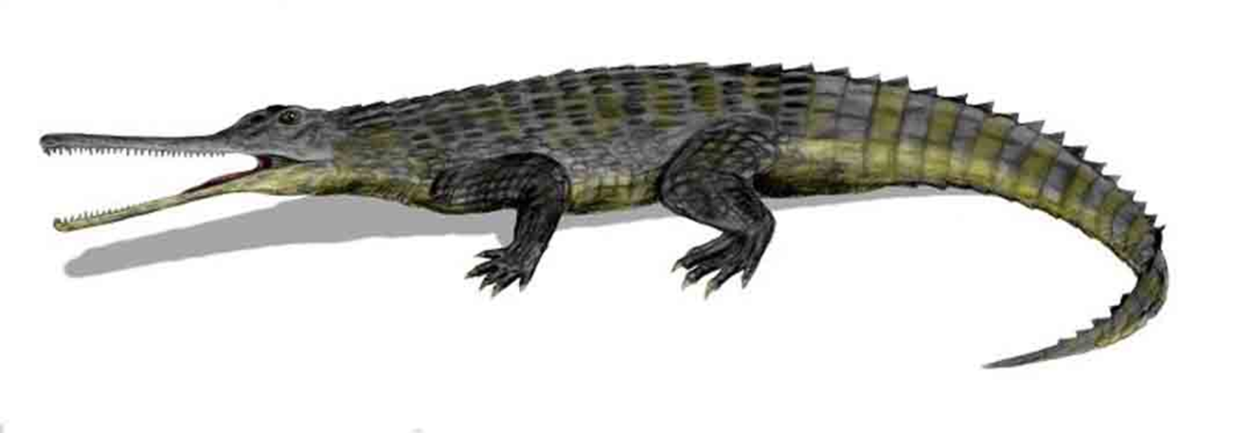
Motivation
What if variation documented by Sander has taxonomic significance?
  As Heckert and Miller-Camp (2013) pointed out, what’s enamel thickness if size isn’t controlled?
  Could be used for identification
http://www.texas-geology.com/Phytosaur.jpg

Slide 15
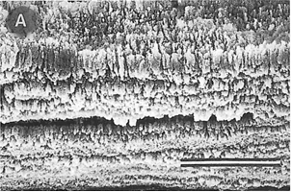
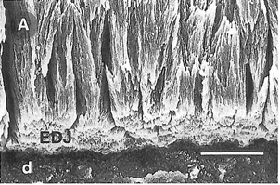
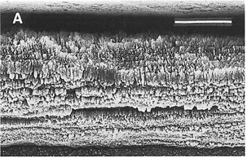
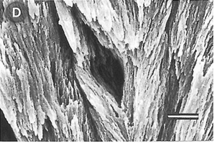
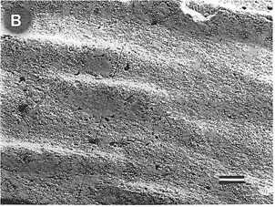
IPB E 2007 I: Parallel and LIG
IPB E 2007 I: BUL
IPB E 2007 I: Parallel
IPB E 2007 II: Enamel void
IPB E 2007 II: Columns
IPB E 2007 III: Surface of tooth with striations
Sander, 1999 Phytosaur Images

Slide 16
Sander (1999)
Some Dockum teeth with thin (~20µm), parallel enamel
Other Dockum phytosaur teeth with thick (150µm), columnar enamel
LIGs rare, not well-defined
Not controlled by size
Might it be possible to distinguish co-occurring taxa by enamel microstructural features?
IPB E 2007 I: Parallel
IPB E 2007 II: Enamel void

Slide 17
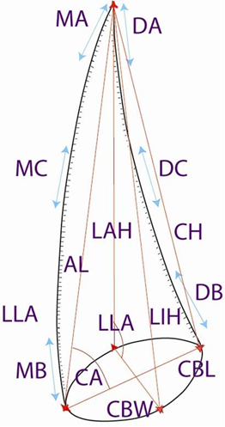
Methods
Sampled 28 teeth from several heterodont taxa
Made macroscopic measurements according to Smith, 2005
Created molds and casts*
Followed guidelines of Sander, 1999; Hwang, 2005&2006
  Embedded in resin
  Sectioned in transverse or longitudinal
  Sputter coated in gold
  Examined and imaged under SEM
  Analyzed images with ImageJ

Slide 18
Chinle Samples
Apachean—Redondasaurus
Revueltian—Machaeroprosopus/Pseudopalatus buceros
Adamanian—Smilosuchus
Otischalkian—Angistorhinus/?Brachysuchus

Slide 19
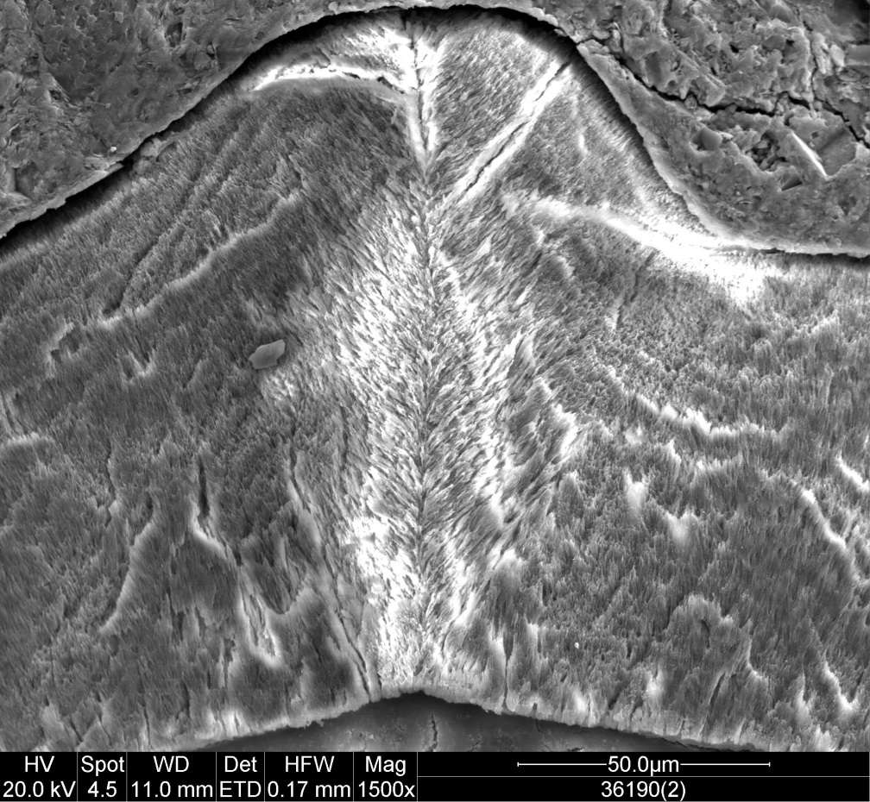
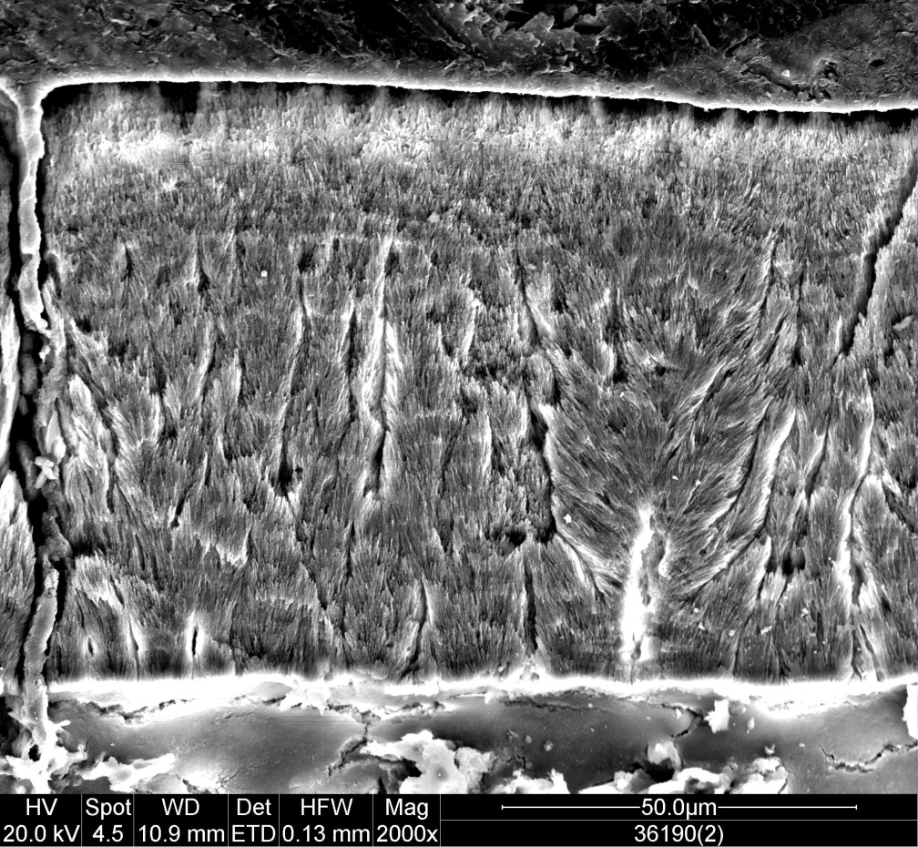
“Angistorhinus”
Popo Agie Fm (Otischalkian)
Denticle
Labial-Columns

Slide 20
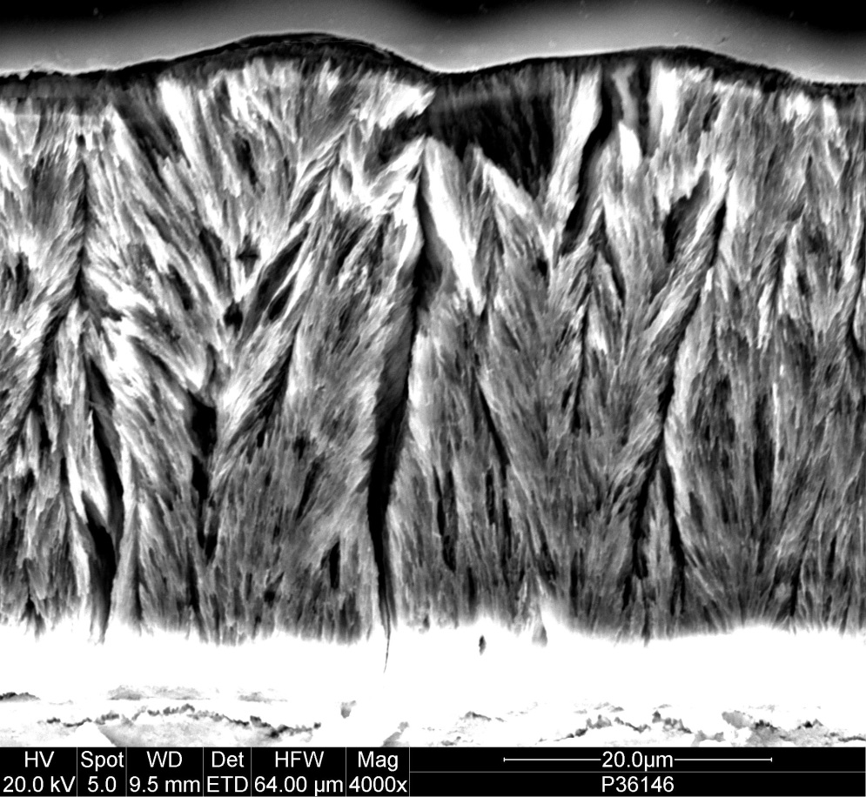
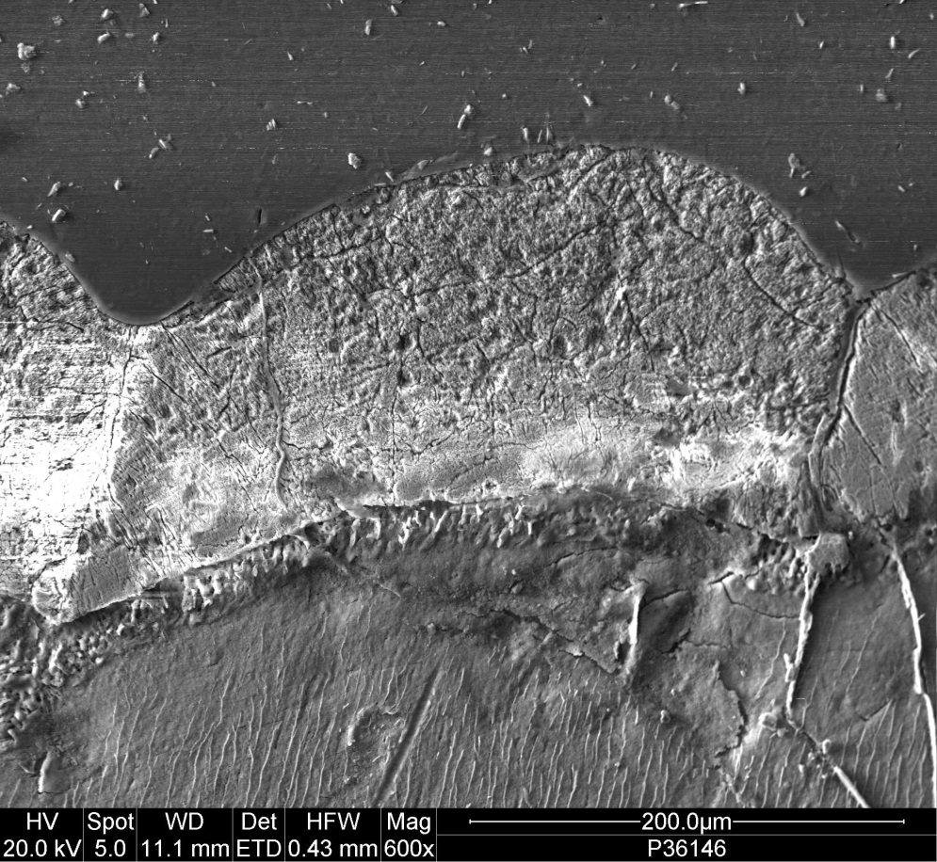
“Smilosuchus”
Bluewater Creek Fm (adamanian)
Columns
Denticle with thin LIG

Slide 21
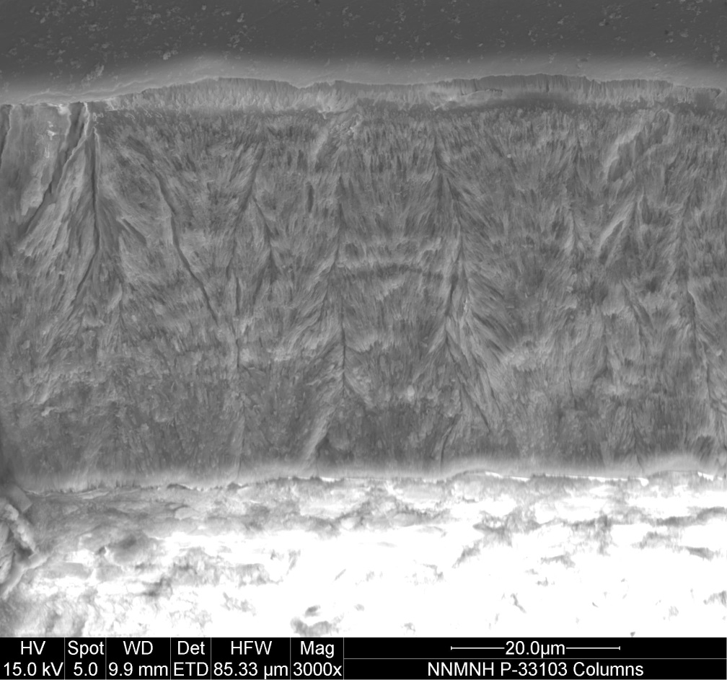
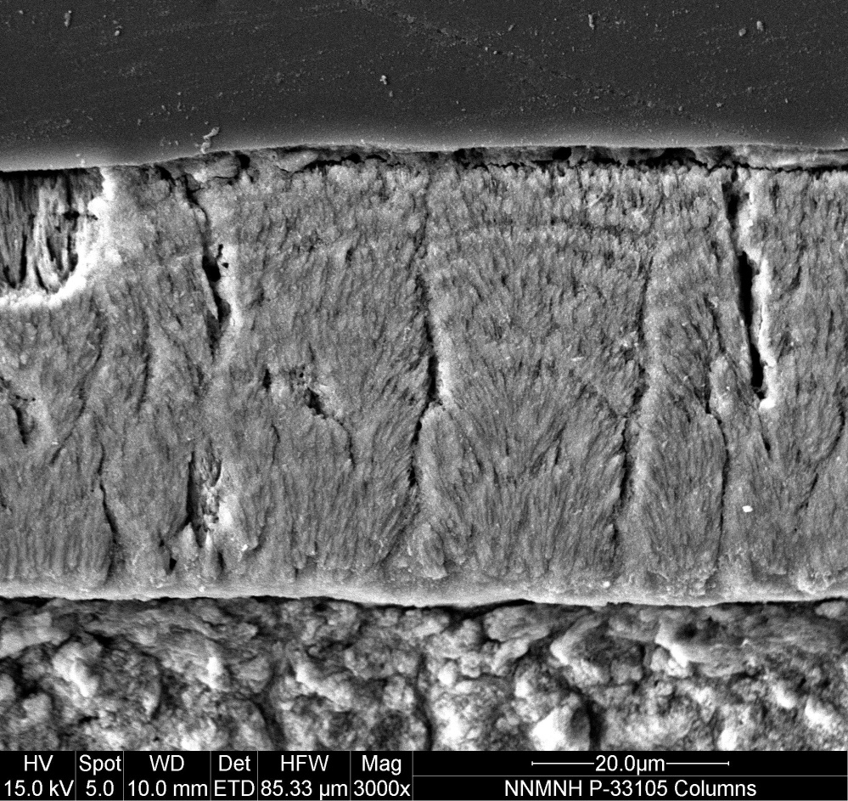
Machaeroprosopus Buceros
Petrified Forest Fm (revueltian)
Columns
Columns

Slide 22
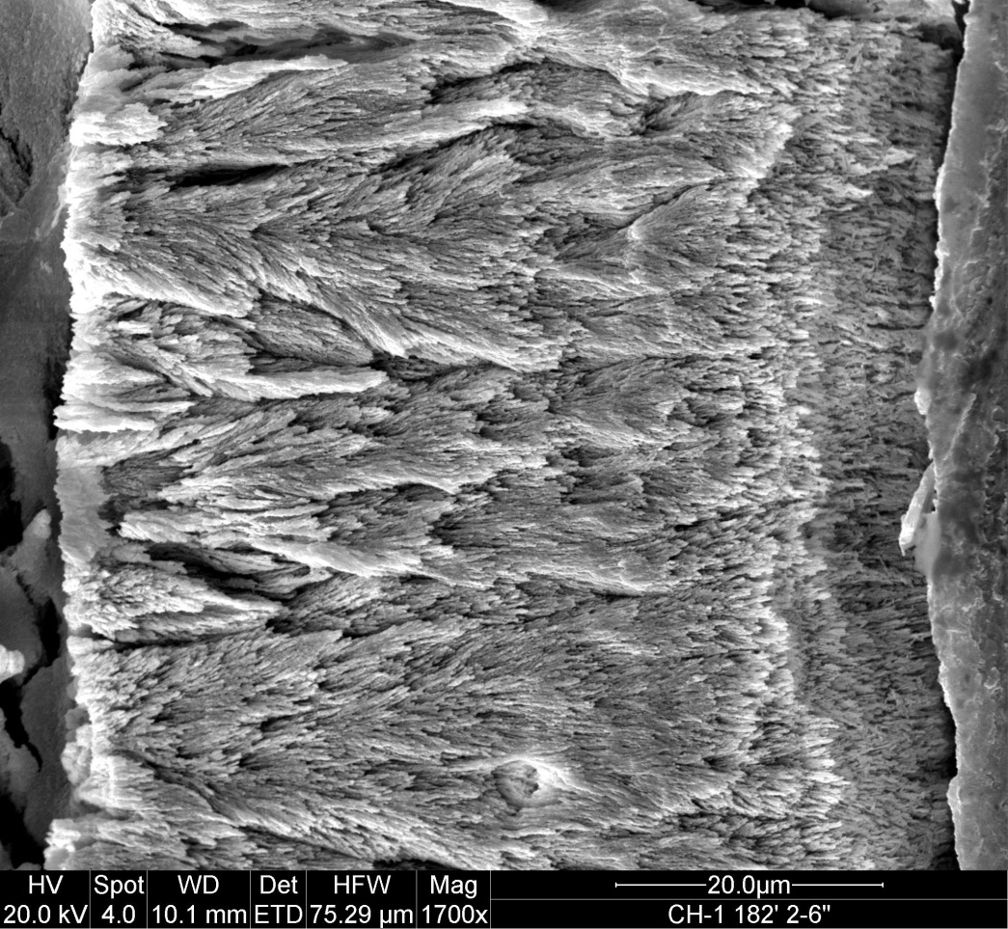
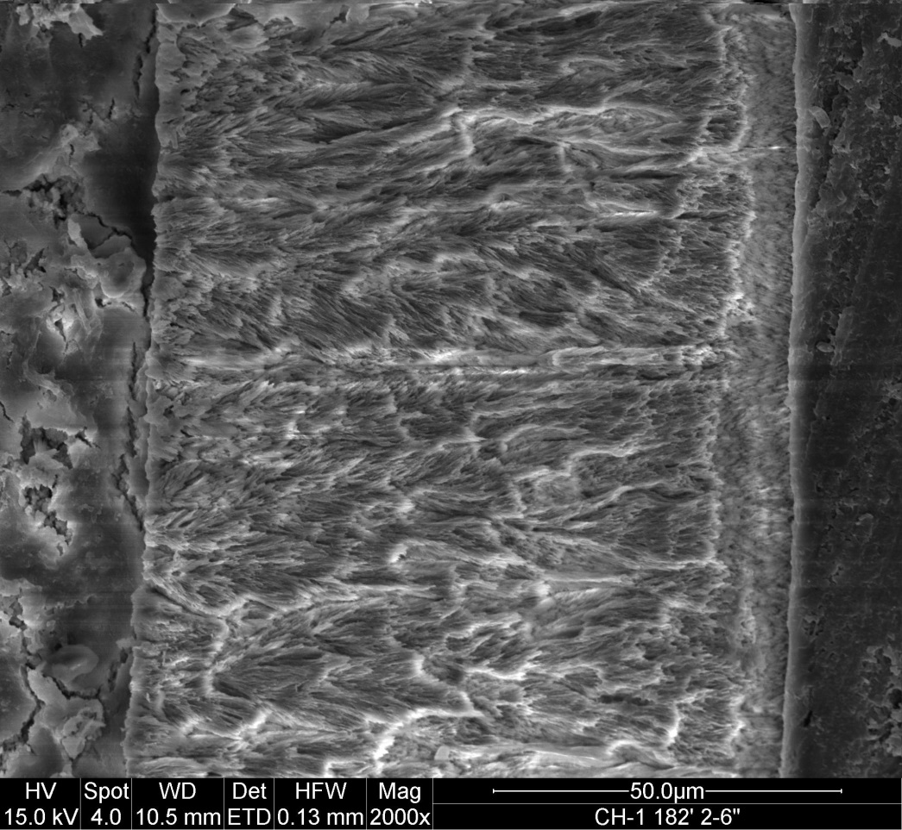
Redondasaurus
Redonda Fm (Apachean)
Columns with thin outer rim of parallel
Columns

Slide 23
Summary—Chinle teeth
Sampled 28 teeth from several heterodont taxa; teeth were of similar size
Chose stratigraphically superposed localities
with known heterodont phytosaurs
All have moderately thick enamel (18µm – 155µm)
All exhibit columnar enamel
Some have weakly developed LIGS, BUL
No obvious distinctions between taxa
Did not see thin, parallel enamel that Sander (1999) reported

Slide 24
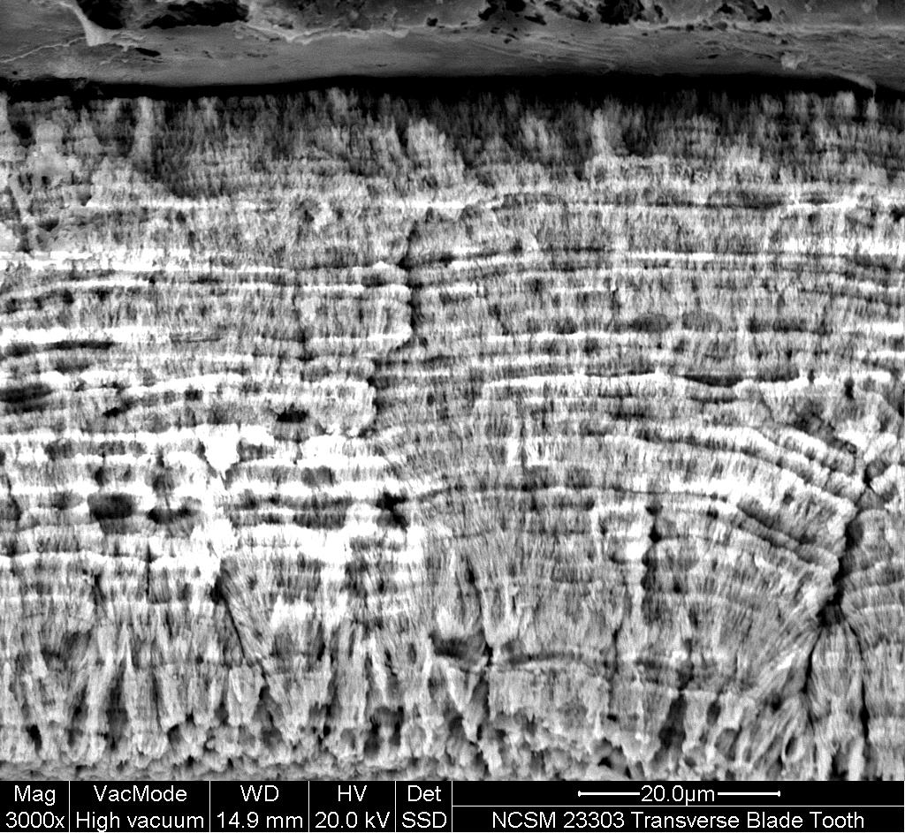
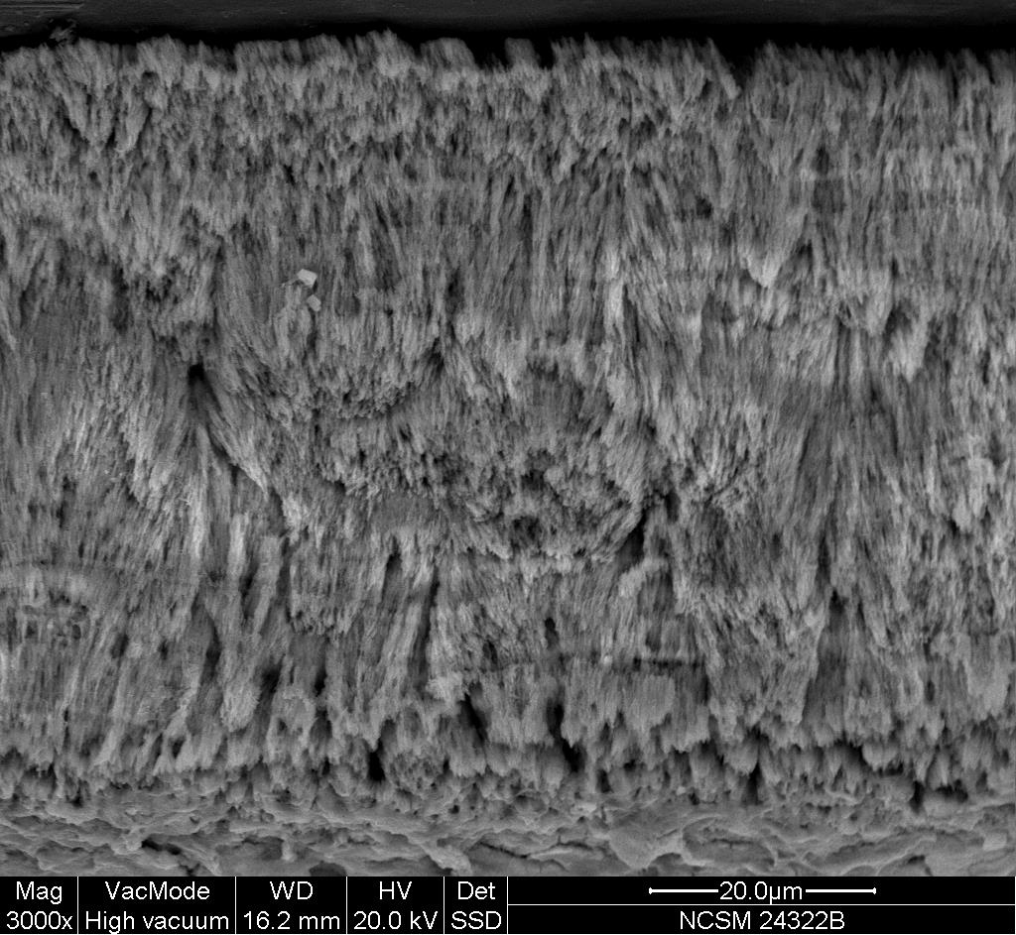
Cumnock FM Heterodont Phytosaur
Columns and LIGs, maybe parallel
Columns and LIGS

Slide 25
Conclusions
Did not replicate Sander’s (1999) thin, parallel enamel
Chinle heterodont phytosaurs typically posses columnar enamel, are not readily distinguished
Type B (“maxillary”) teeth tend to have thicker enamel
Variation within basins appears small but possible variation between different basins
Phytosaur enamel microstructure does not appear plesiomorphic for Archosauria at this time

Slide 26
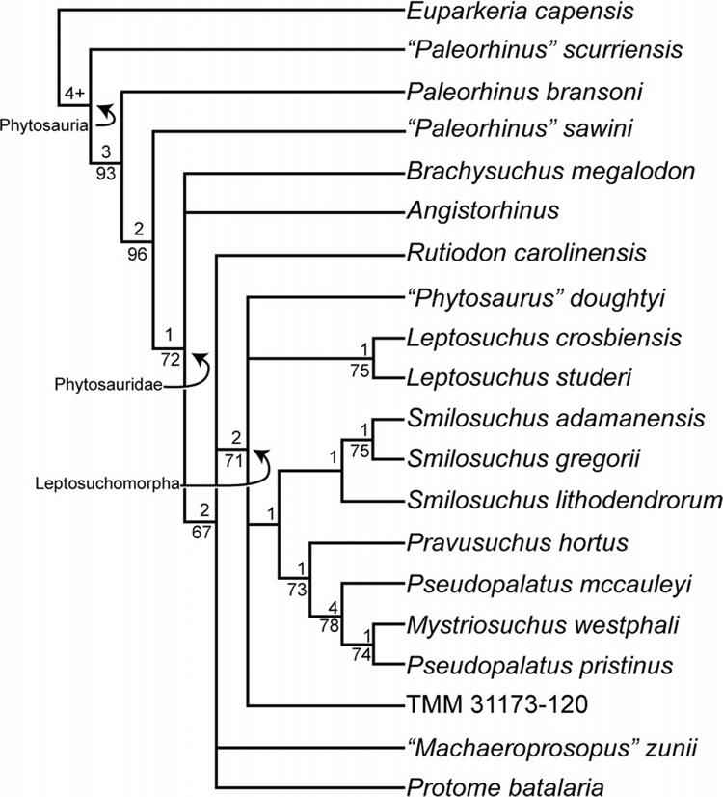
Future directions
Variation within basins appears small but possible variation between different basins
Still more teeth to image especially NC teeth
Might thin, parallel enamel teeth be primitive?
  e.g., “non-phytosaurid” phytosaurs?
Consider sampling in situ teeth from bonebeds
  More detailed statistics once data set is complete
  Possible paleobiological implications
    Parallel v. columnar functional significance
Stocker, 2012

Slide 27
Acknowledgments
Dr. Vince Schneider (NCSM) and Dr. Spencer Lucas (NMMNH) for permission to borrow and destructively sample specimens
Dr. Guichuan Hou of the College of Arts & Sciences Microscopy Center for use of the of the SEM and sputter coater
Anthony Love for assistance in preparation of remaining specimens
Office of Student Research travel grant, SE GSA travel grant, Dept. of Geology Undergraduate Research Award for support

