Slide 1


Experimental Run Product Archive,
Produced Using the EGEMS Geological Database,
Promotes Long-term Preservation and Accessibility for Both Specimens and their Associated Information
By: Sarah Timm and Jim Beard

Slide 2
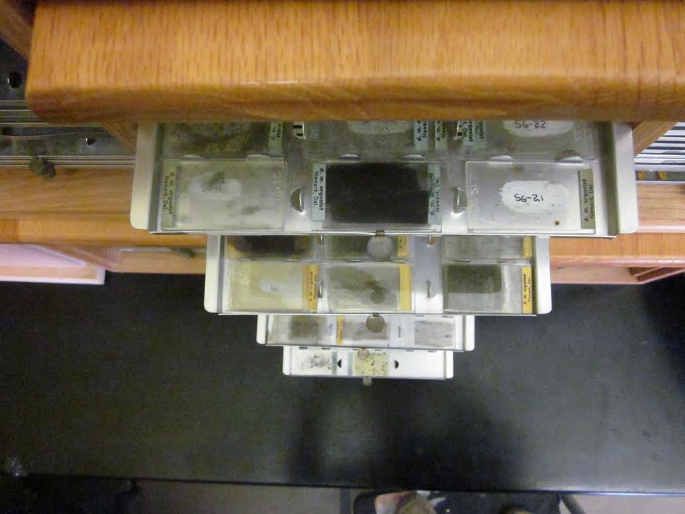
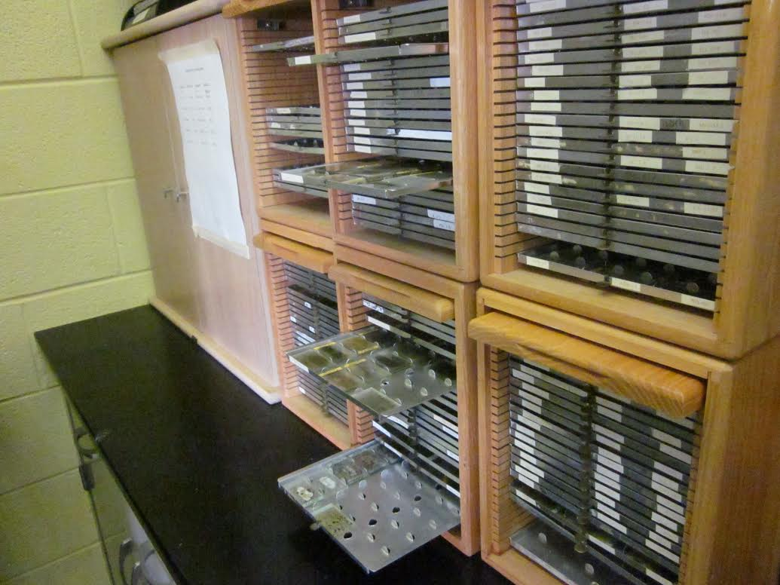
Research Products
Thin Sections

Slide 3
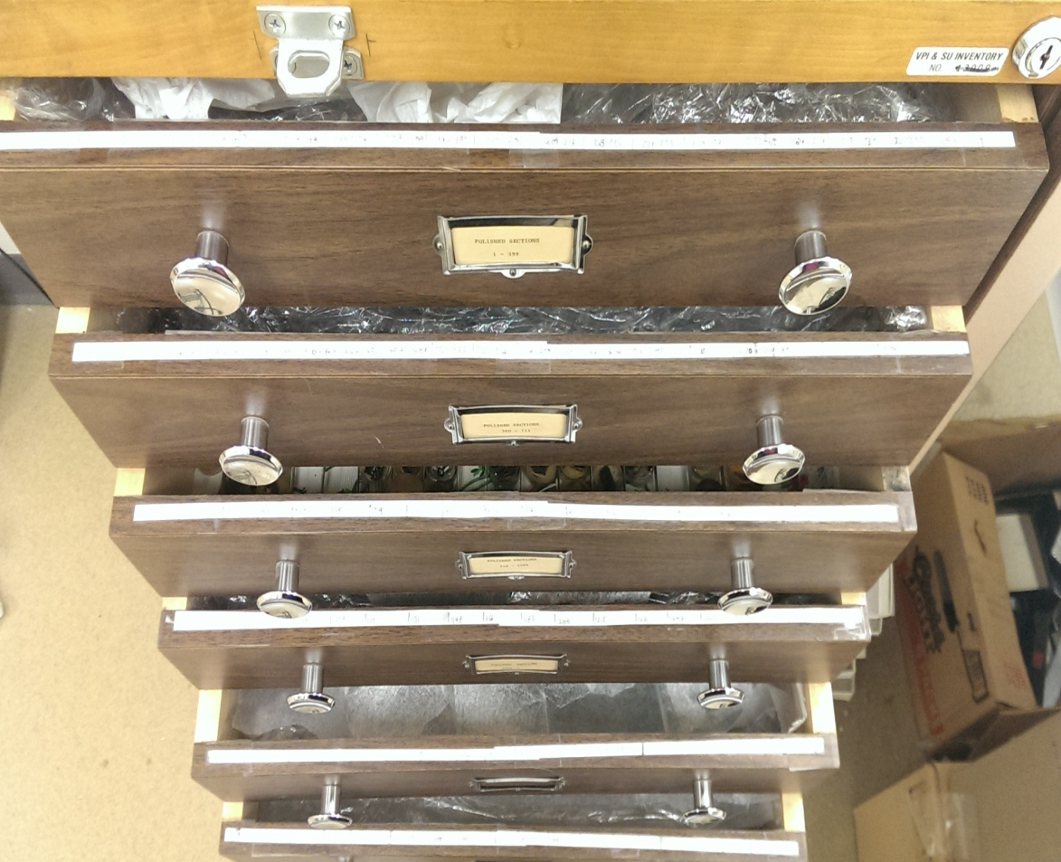
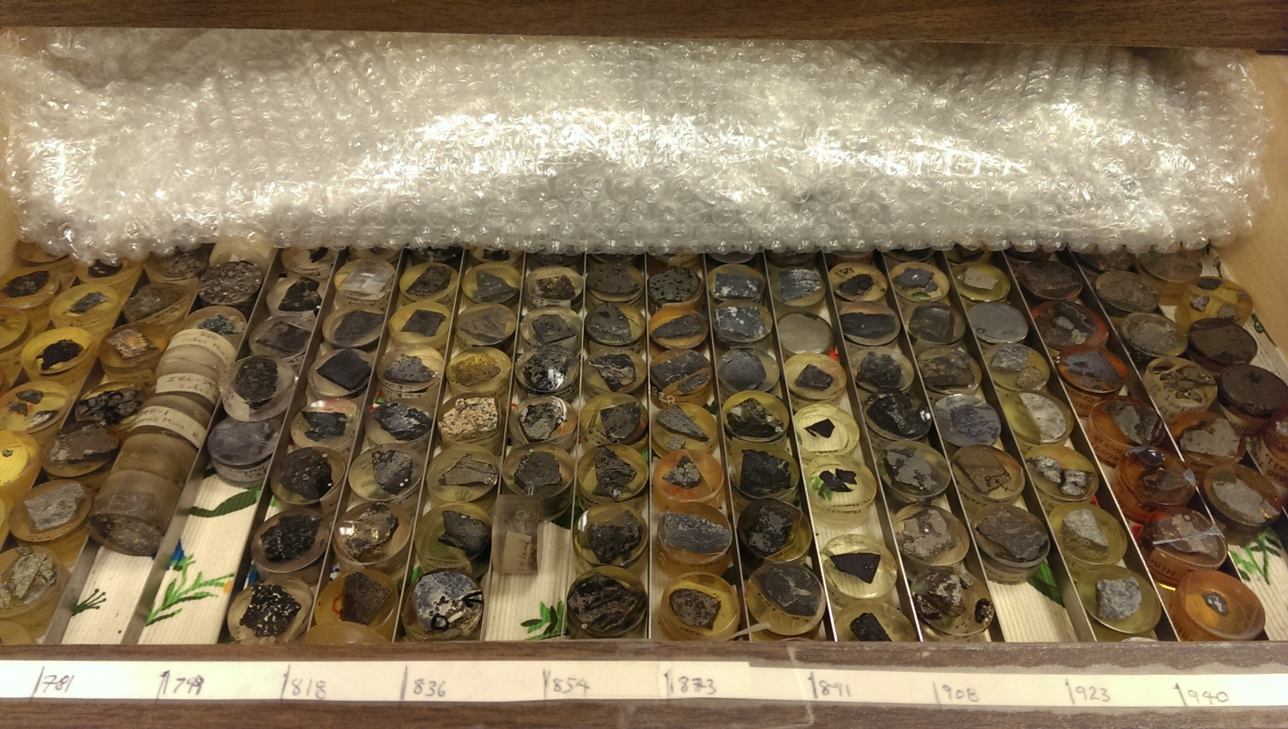
Research Products
Polished Sections

Slide 4
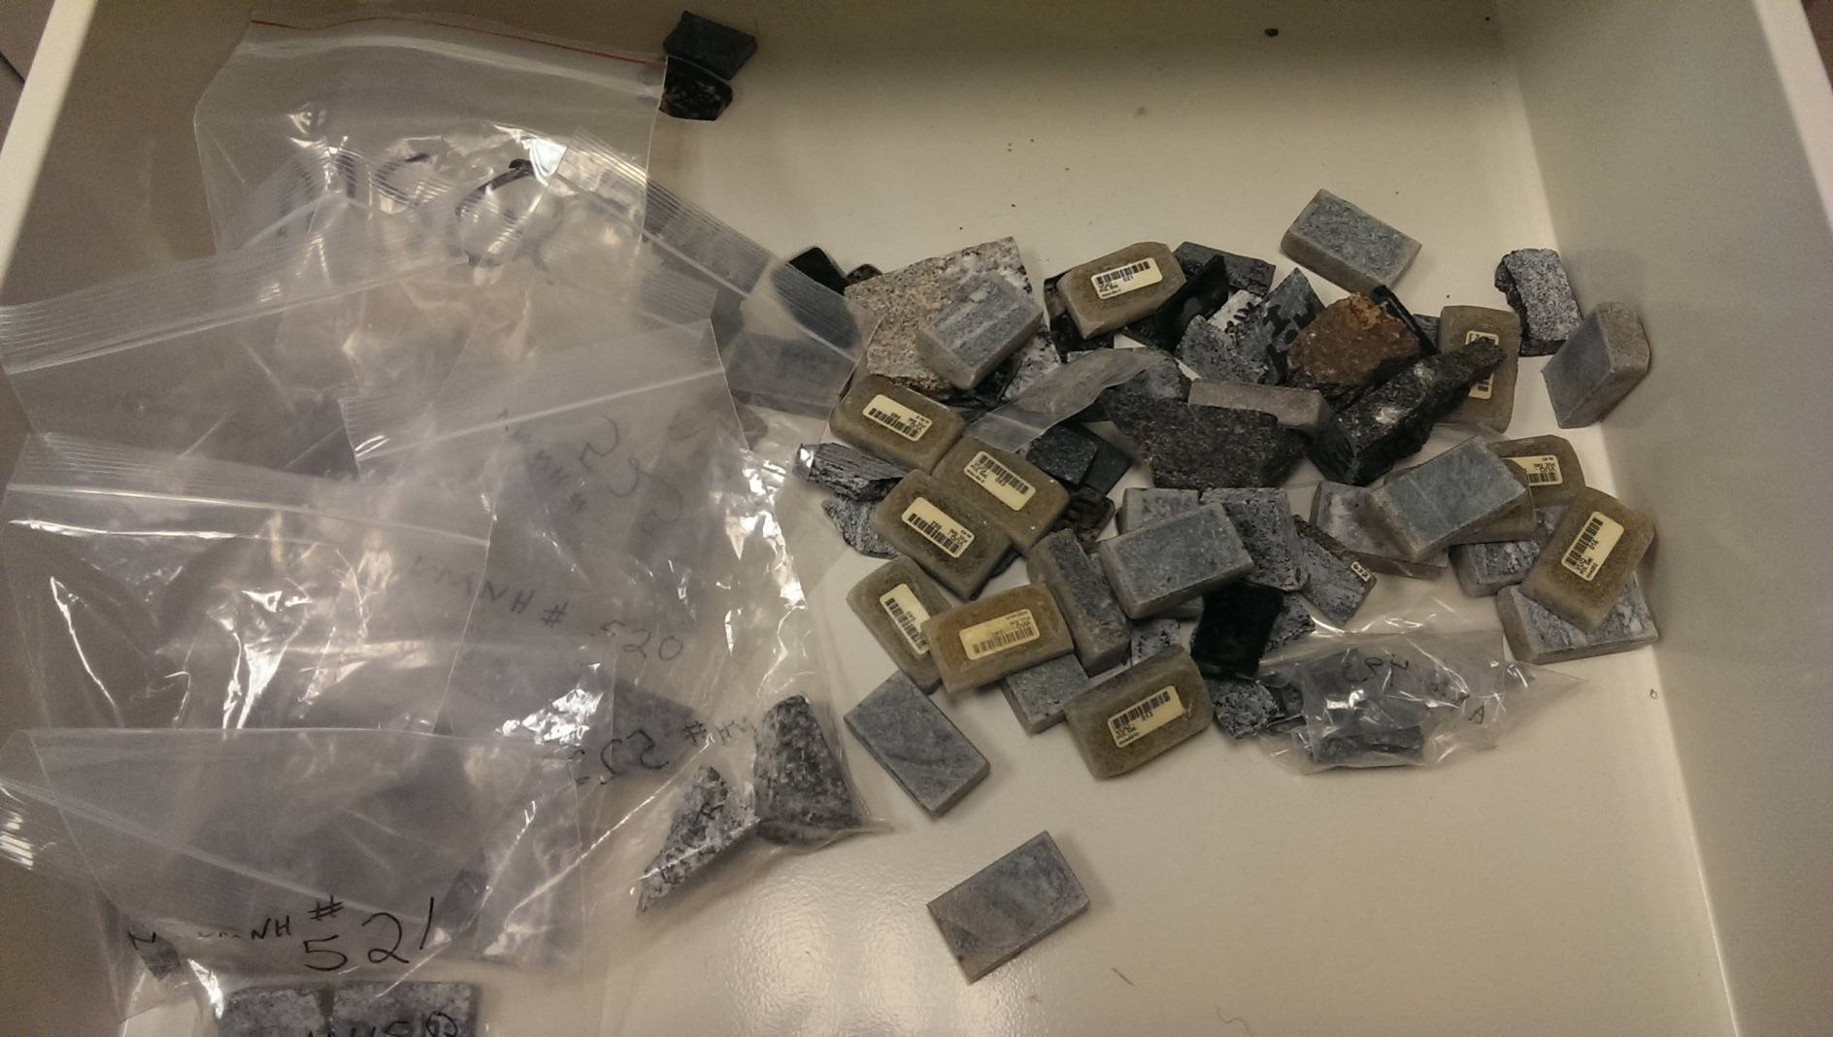
Research Products
Billets

Slide 5
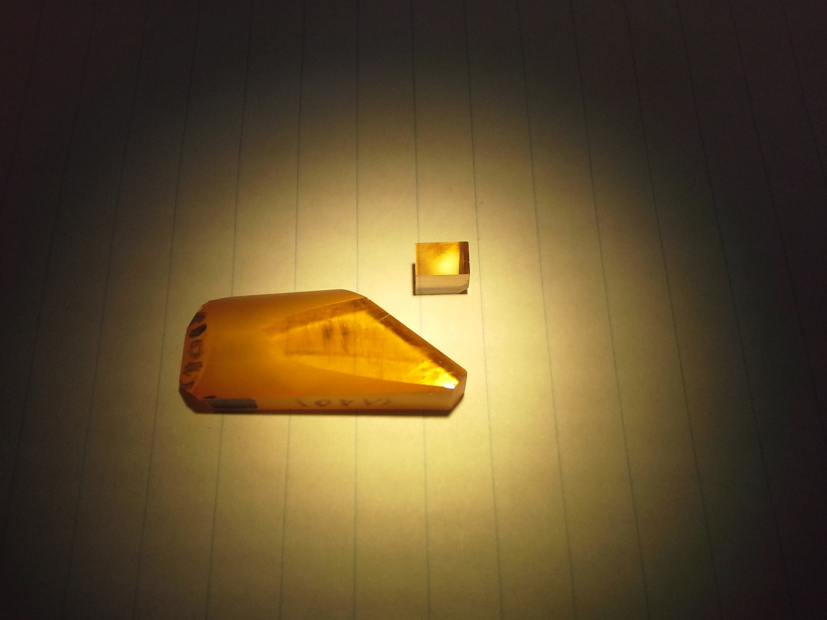
Research Products
Synthesized Materials

Slide 6
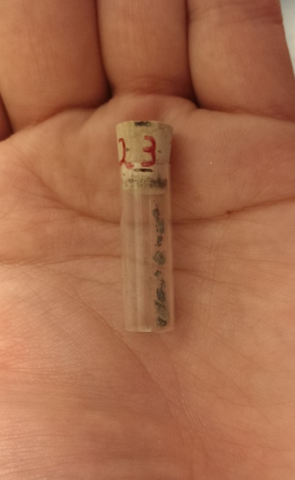
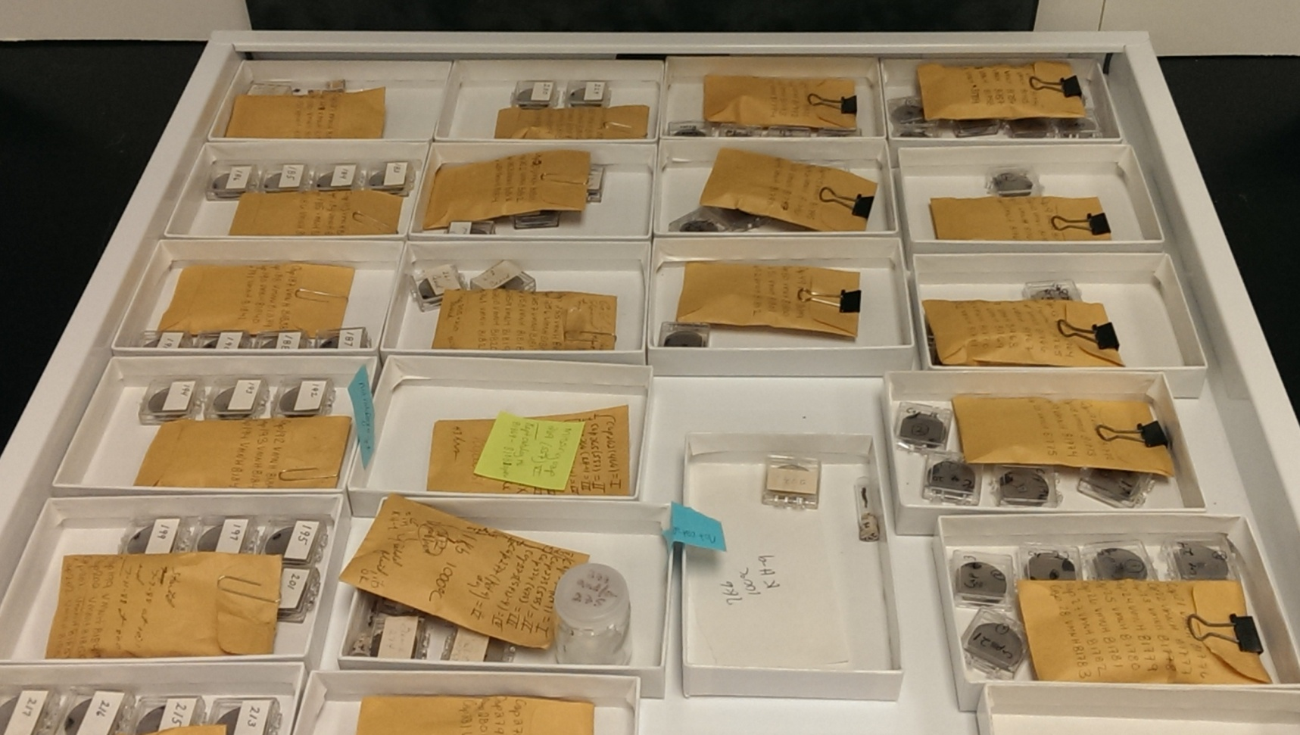
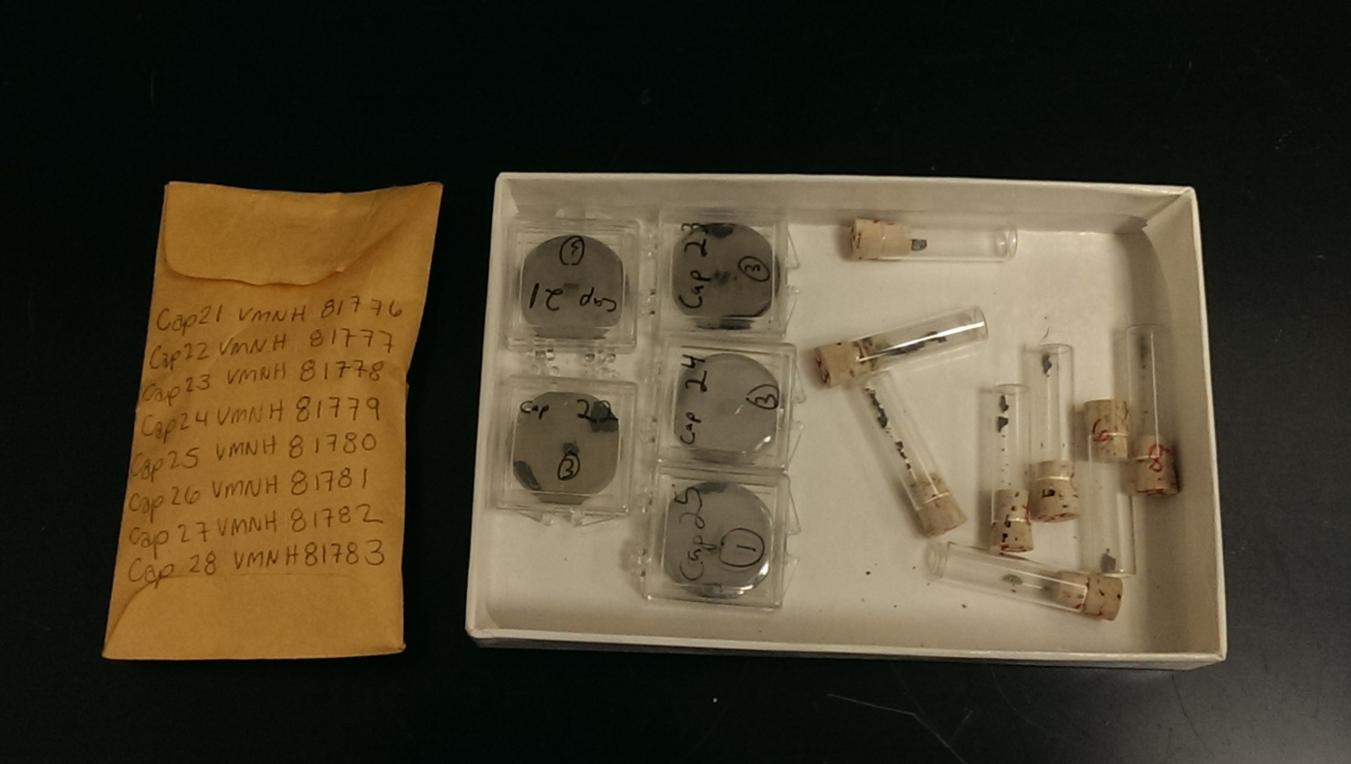
Research Products
Experimental Run Products

Slide 7
Importance - Resources
Step | May Require (Action)
1. Obtain original material (from the field) | Approval for fieldwork, fieldwork to obtain specimen
1. Obtain original material (synthesized) | Collecting starting materials, approval for equipment time, work to create synthesized specimen
1. Obtain original material (from a collection) | Researching and contacting a source, shipping or travel to obtain specimen
2. Convert original material into research product of choice | Cutting or polishing the material, shipping specimen out
3. Work to finish prepping sample for analysis | Purchasing equipment such as carbon rods or polishing grit, use of equipment to finish prep work
All above require a combination of TIME, ENERGY, & MONEY

Slide 8
Importance - Resources
 | Institution A | Institution B
Budget for Research in 2012 | $1,000 | $1,000
25 Polished Thin Sections @ $30 each, 1 order | $750 | $750
Investment in preservation | $200 | $0
10 years passes and budget takes a hit
Budget for Research in 2022 | $800 | $800
Amount it costs to access thin sections created in 2012 | $0 | $750 minimum
Total spent | $950 | $1,500

Slide 9
Importance - Generation Turnover
“From the early 1980’s until the mid‑1990’s, fieldwork was done in Norway resulting in a number of master’s degrees (15?) and a handful of PhD theses (5?). All the sample materials (several thousands of hand samples, as well as thin/plane sections, powders, etc, etc) have been discarded, or at best, gotten lost.”
“A colleague of mine rescued several hundreds of fluorescence-impregnated thin sections of concrete and other building materials from the waste-bin... While I lack the documentation (ie. engineering consultancy assessment reports) and the cores that the sections have been prepared from (so I cannot use them for research), they have been valuable as instruction materials.”
“My current concern is the large number of polished sections of starting materials and run products, and glass slides containing powders used for X-ray diffraction, plus lab notebooks, that will be lost when I’m not around anymore.”

Slide 10
Importance - Generation Turnover
“several thousands of hand samples, as well as thin/plane sections, powders, etc, etc”
“several hundreds of fluorescence-impregnated thin sections of concrete and other building materials”
“large number of polished sections of starting materials and run products, and glass slides containing powders used for X-ray diffraction, plus lab notebooks”

Slide 11
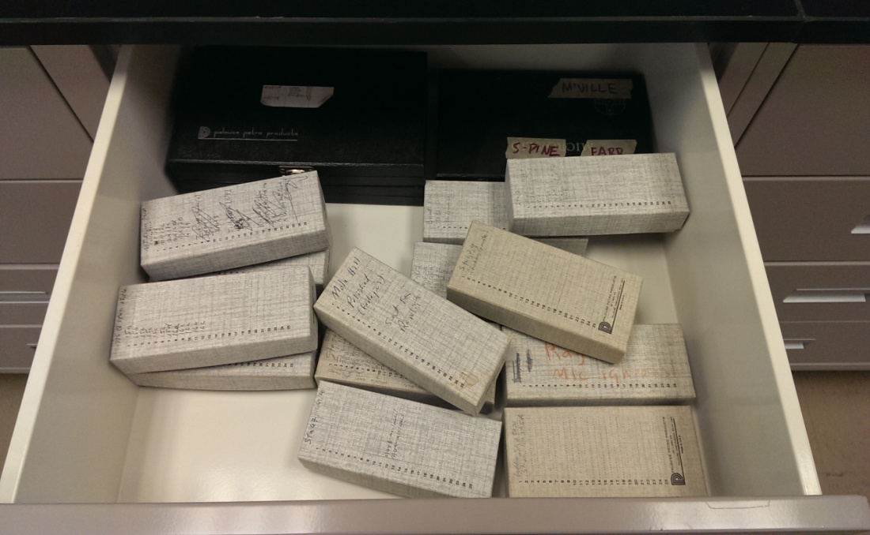
VMNH Research Products

Slide 12

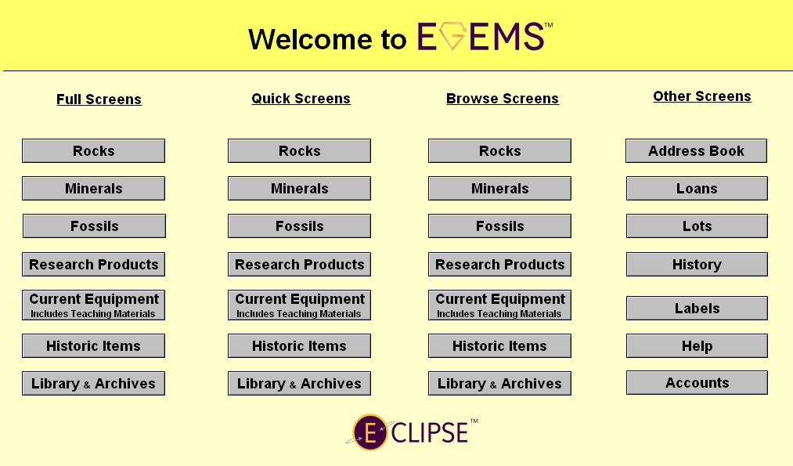
Electronic Geological Management System

Slide 13
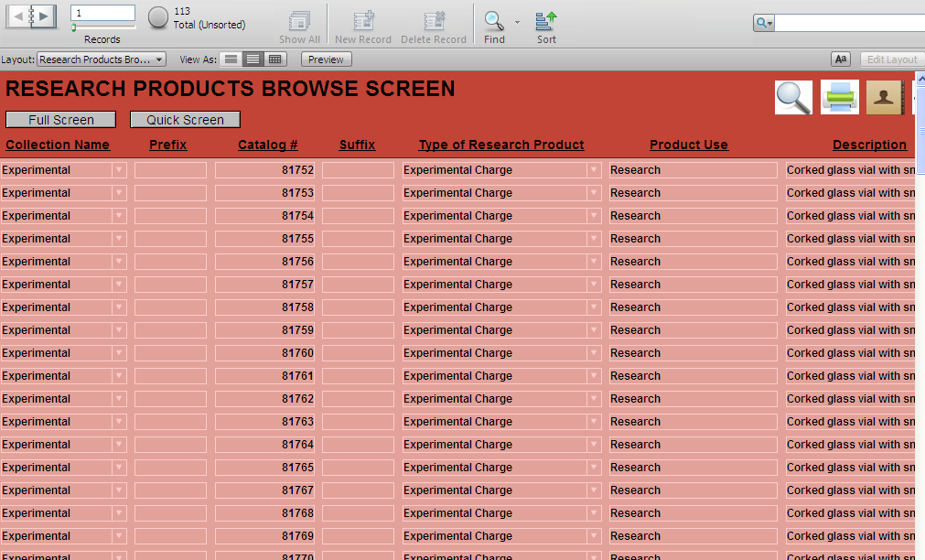
Experimental Run Product Archive

Slide 14
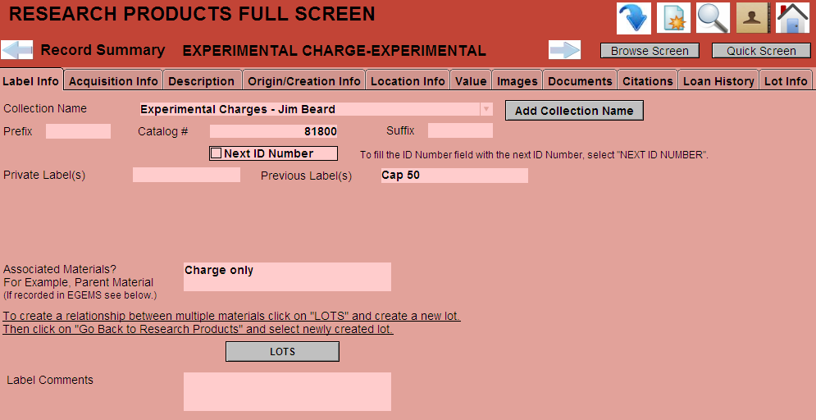
Label Info – Experimental Charges

Slide 15
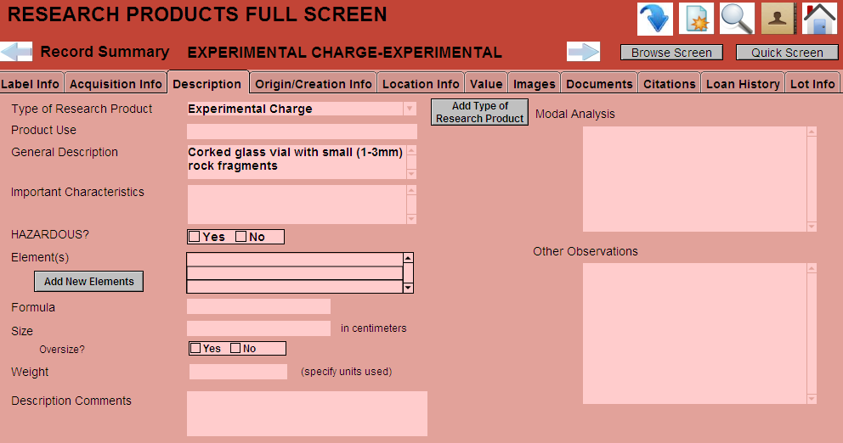
Description – Experimental Charges

Slide 16
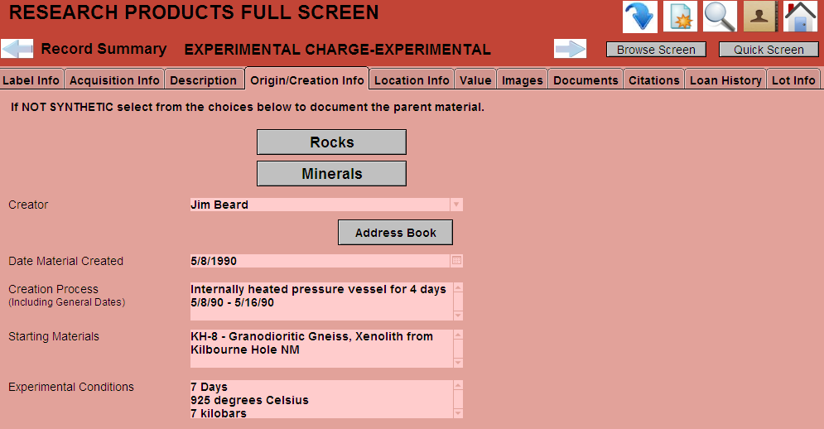
Creation Info – Experimental Charges

Slide 17
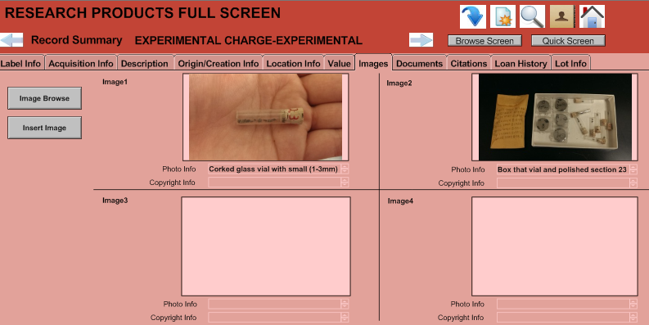
Images – Experimental Charges

Slide 18
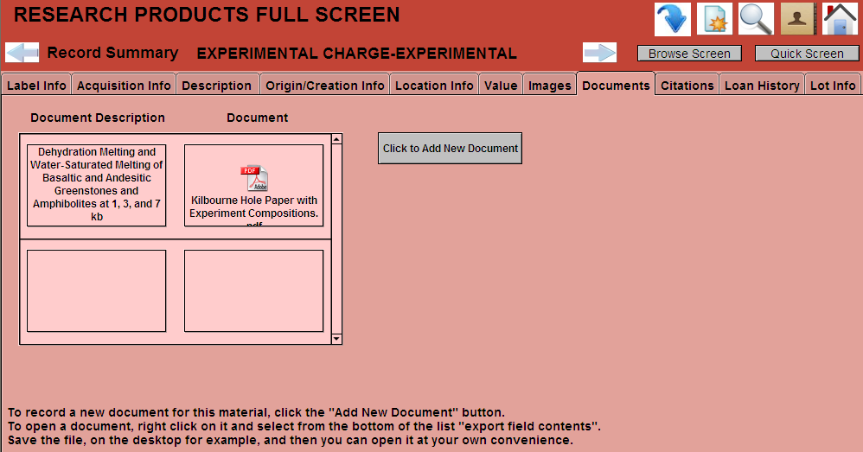
Documents – Experimental Charges

Slide 19
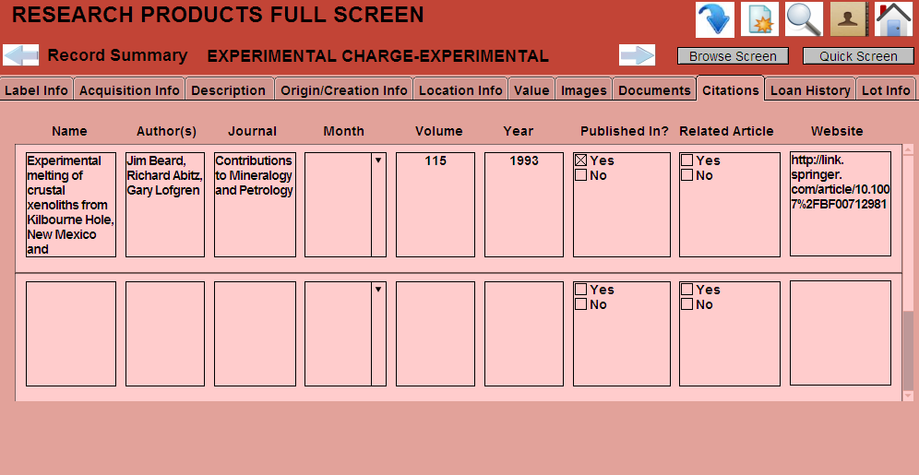
Citations – Experimental Charge

Slide 20
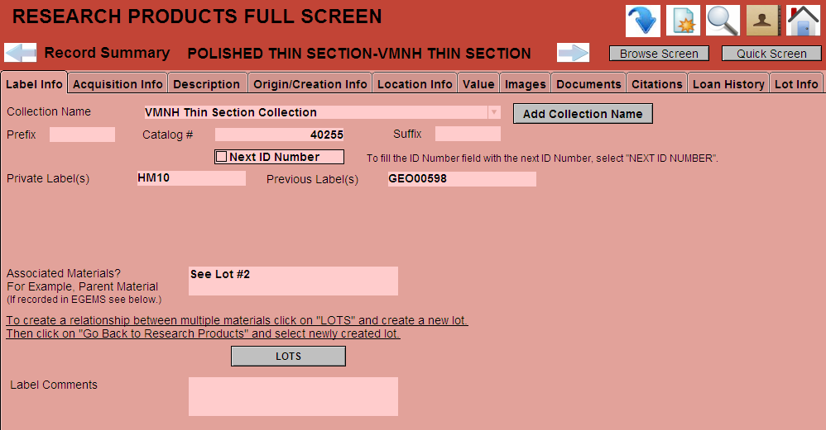
Label Info – Thin Sections

Slide 21
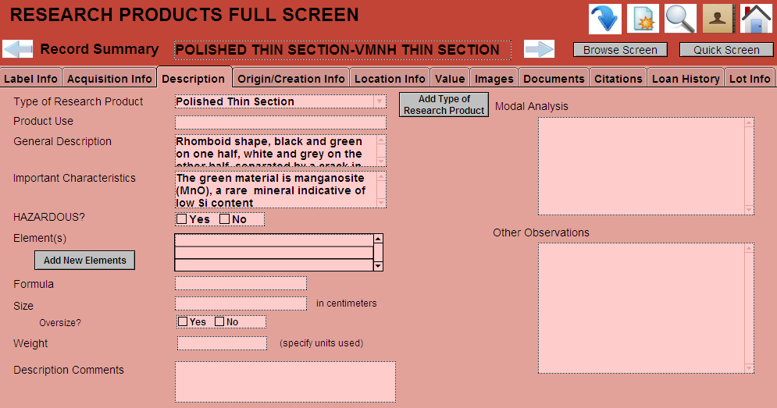
Description – Thin Sections

Slide 22
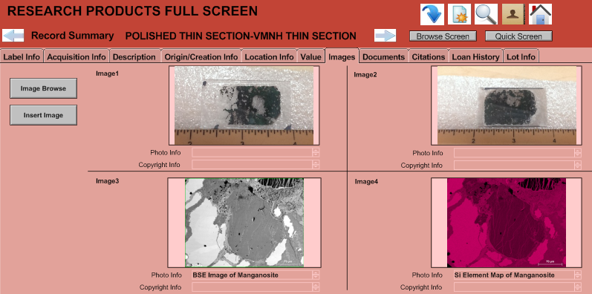
Images – Thin Sections

Slide 23
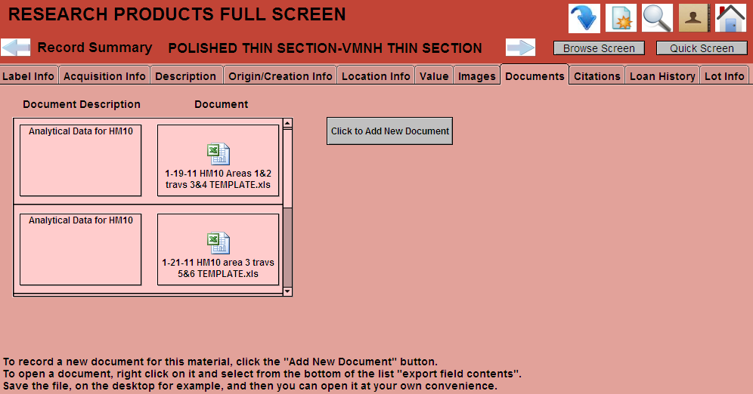
Documents – Thin Sections

Slide 24
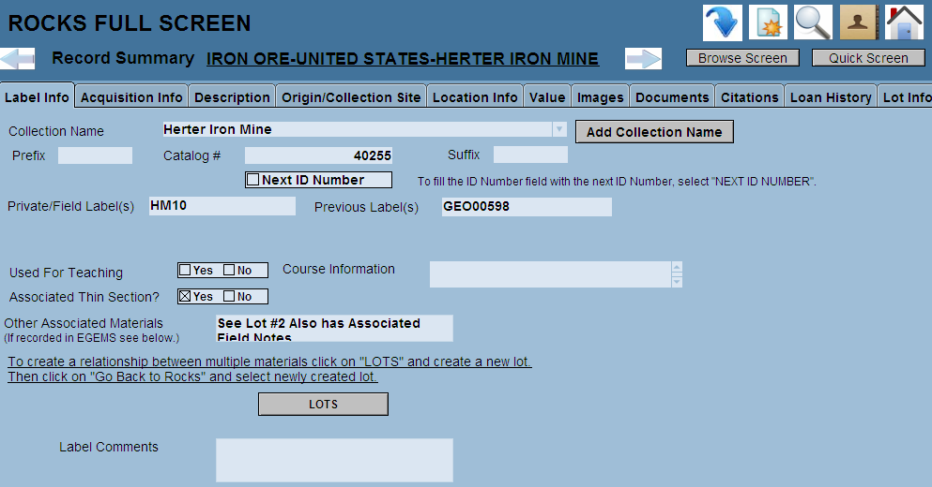
Linking Records – Lots

Slide 25
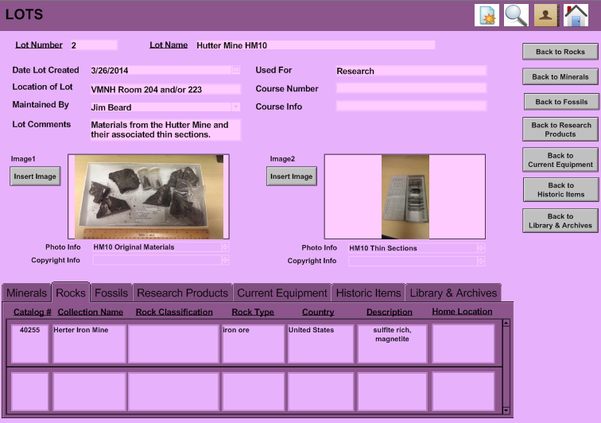
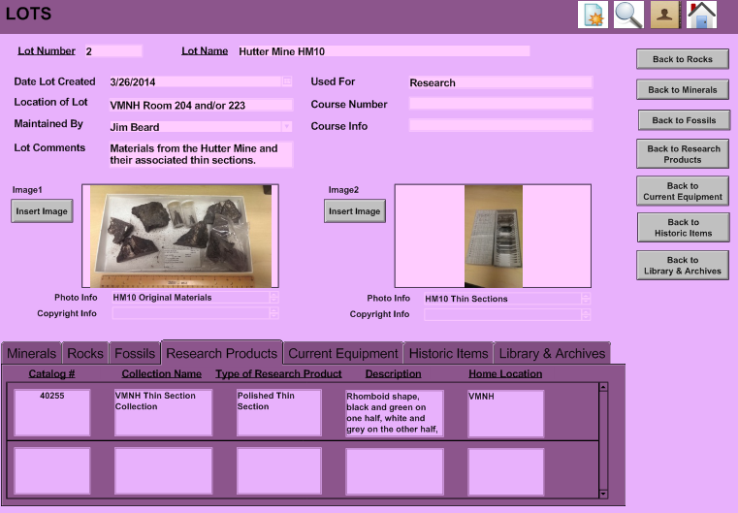
Linking Records – Lots

Slide 26
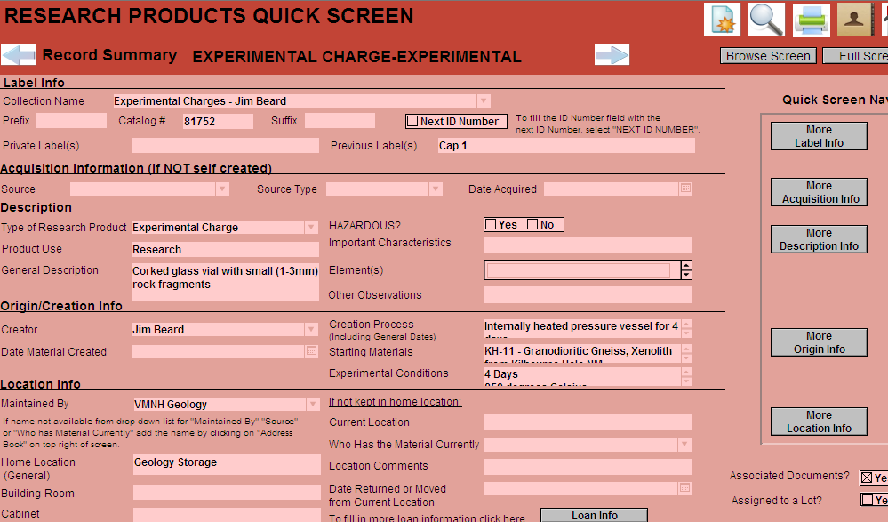
Research Products – Quick Screen

Slide 27
Policy = Priority
60 Grad Students x 10 Specimens
= 600 Records

Slide 28
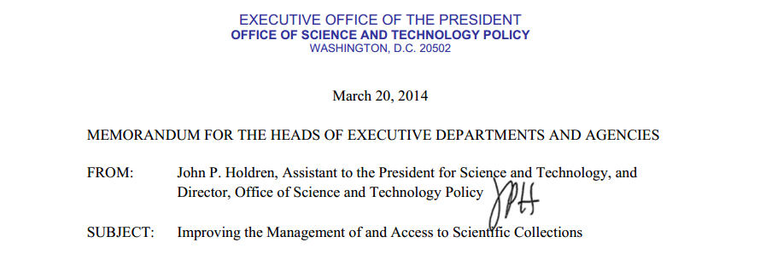
Current Approach
Scientific collections provide an essential base for developing scientific evidence and are an important resource for scientific research, education, and resource management. Scientific collections represent records of our past and investments in our future. They are also tools that can be harnessed to address challenges facing humankind. Federally supported scientific collections are public assets, and their stewardship by Federal agencies carries with it trustee responsibilities. Policies and procedures for maintaining, preserving, and developing Federal scientific collections while also increasing access to those collections for appropriate use are, therefore, central to their value.
http://www.whitehouse.gov/sites/default/files/microsites/ostp/ostp_memo_scientific_collections_march_2014.pdf

Slide 29
The Future
“Given that a system for developing an experimental
materials archive now exists, we can look forward to a time when no experiment will have to be repeated simply because the original material has been lost.”

Slide 30
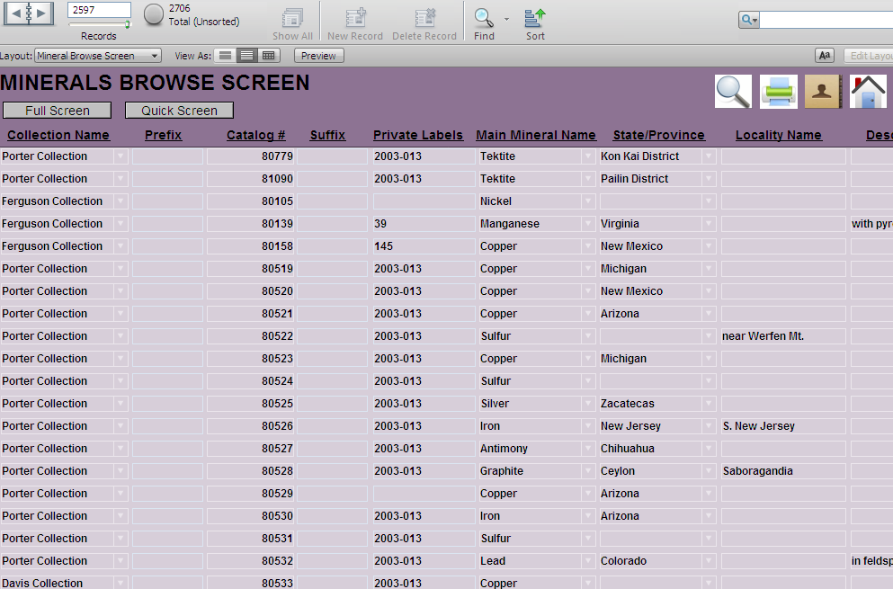
Minerals Browse Screen

Slide 31
Data Analysis
VMNH Loan Use
 | Total
Education | 2
Exhibit | 4
Presentation | 1
Research | 5
Grand Total | 12

Slide 32
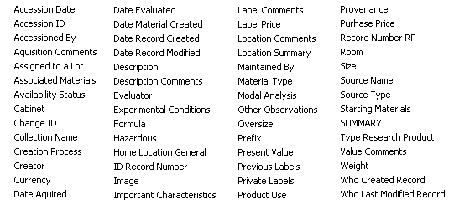
Research Product Table Fields

Slide 33
Importance - Resources
25 Polished Thin Sections @ $30 each, 1 order | $750
If each of 515 geoscience departments sent an order out | $386,250
If half of these orders had to be redone at some point | +$193,125
If these collections were preserved and no orders had to be redone | +$0
Keeping in mind if research products such as this sections need to be re-done it require access to the original material which may require additional recourses

Slide 34
Importance - Resources
TABLE 4. Federal obligations for science and engineering to the 100 universities and colleges receiving the largest amounts, ranked by the total amount received in FY 2009: FY 2001–09
(Dollars in thousands)
Rank |  | Institution | 2007 | 2008 | 2009ª
 |  | All institutions | 28,181,929 | 28,424,681 | 36,166,184
1 |  | Johns Hopkins U., The | 1,162,196 | 1,113,271 | 1,565,452
2 |  | U. MI all campuses | 549,399 | 587,047 | 777,537
3 |  | U. WA | 660,316 | 613,428 | 761,845
4 |  | U. PA | 536,396 | 518,711 | 669,903
5 |  | Columbia U. in the City of
 |  | New York | 450,440 | 433,119 | 667,868
6 |  | U. CA, San Diego | 476,109 | 517,998 | 662,130
7 |  | U. CA, Los Angeles | 514,317 | 512,034 | 619,362
8 |  | U. WI-Madison | 435,874 | 453,095 | 597,618
9 |  | U. CA, San Francisco | 470,405 | 522,525 | 567,259
10 |  | Harvard U. | 466,397 | 437,392 | 554,028
60 |  | VA Polytechnic Institute and State U. | 102,497 | 103,884 | 183,025
 |  | All other institutions | 5,786,614 | 5,986,248 | 7,402,241
ª Includes American Recovery and Reinvestment Act of 2009 obligations.
SOURCE: National Science Foundation/National Center for Science and Engineering Statistics, Survey of Federal Science and Engineering Support to Universities, Colleges, and Nonprofit Institutions.

