Slide 1
Informing the public through multimedia outlets:
How a team of interdisciplinary scientists aided in the understanding of local water quality issues
Kelly Borgmann and Dylan Hayes

Slide 2
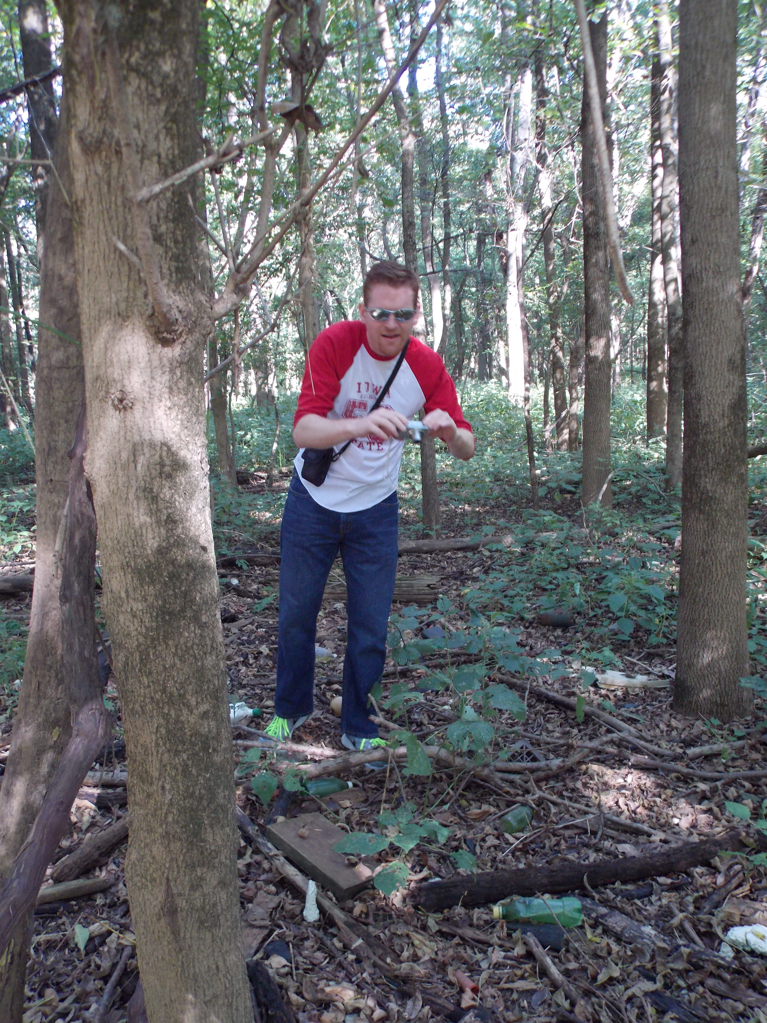
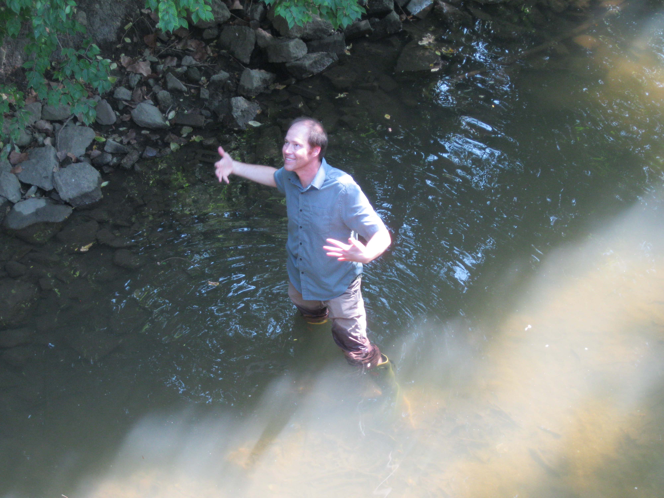
Background
In November of 2011 Dr. Adam Kuban approached Dr. Lee Florea to talk about the problems between journalism and science.
In the spring of 2013 they started a Ball State Immersive Learning course through the BBC.

Slide 3
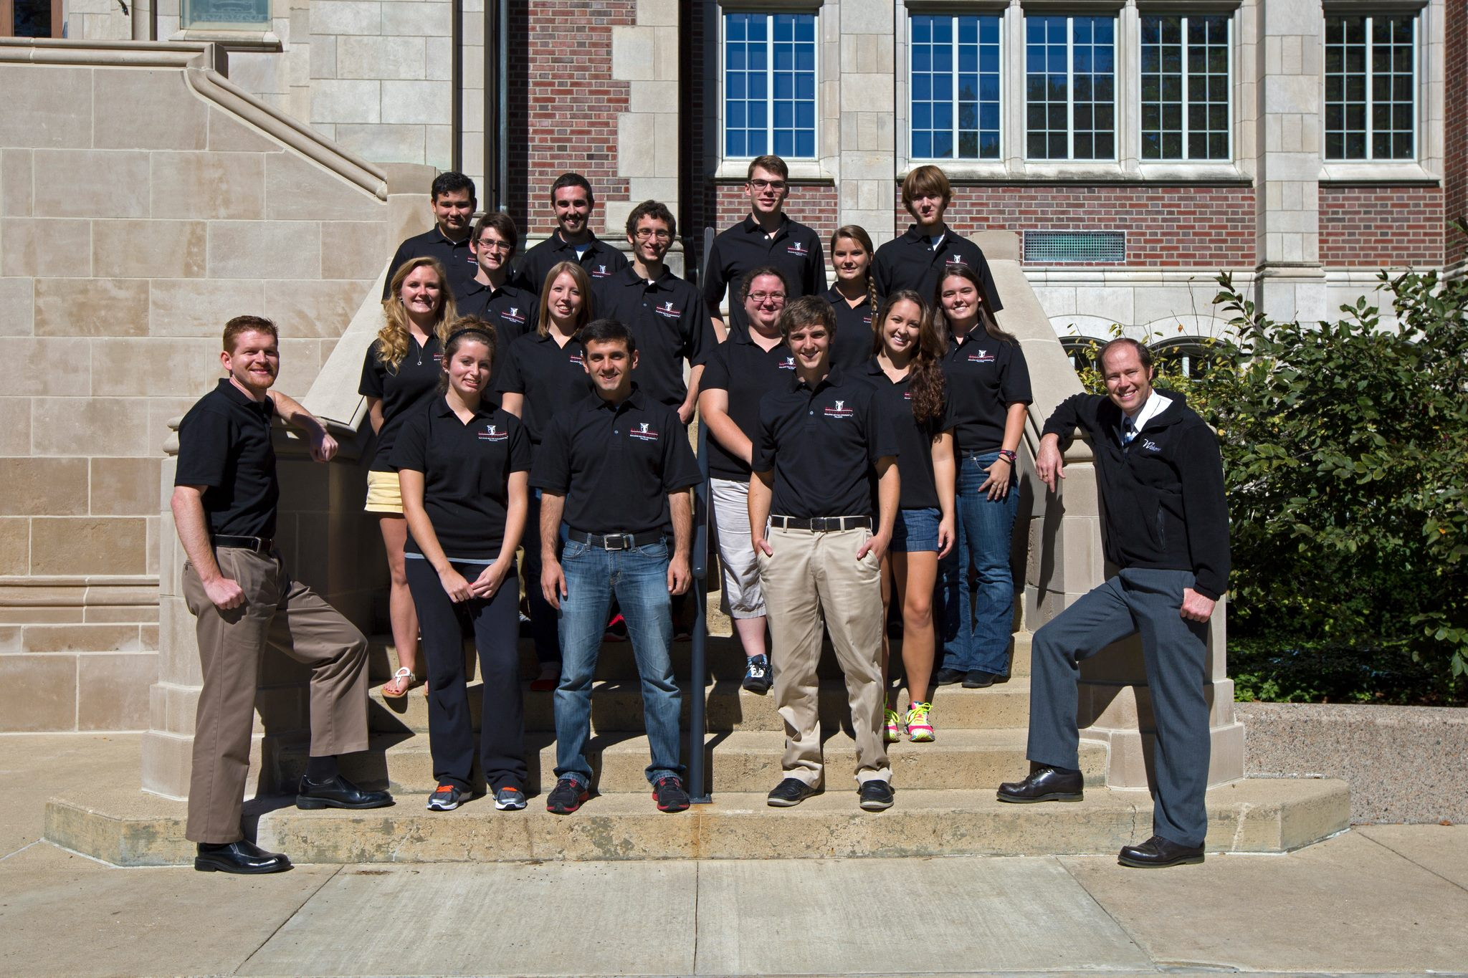
They interviewed students and put together a team of journalism and science students to study water quality in Delaware County

Slide 4
Background
Building Better Communities (BBC)
teams of students work with communities, businesses, and government agencies to develop real-world solutions to real-world problems
engage participants in an active learning process that is student-driven but guided by a faculty mentor

Slide 5
Background
Our community partner, FlatLand Resources

Slide 6
Background
Why water quality?

Slide 7
Methods
What we did:
Field Sampling
Laboratory Analysis
Interviews and Media Production

Slide 8
Results:
Our website
All our data and publications were collected and put on a website.

Slide 11
Discussion:
Why use multi-media
Accessibility
Use by multiple organizations
Future expansion

Slide 12
Discussion:
Merging Science and Media
15 students representing 6 majors worked on this project.
Everyone participated in both the scientific and media tasks.
Media students learned about the science behind water quality
Science students learned how to interview and present information in an engaging way.

Slide 13
Discussion:
Community Impact
Website hosted on the Soil Water Resources webpage
Data collected used by Flatland Resources
Conference presentations
Story on Indiana Public Radio

Slide 14
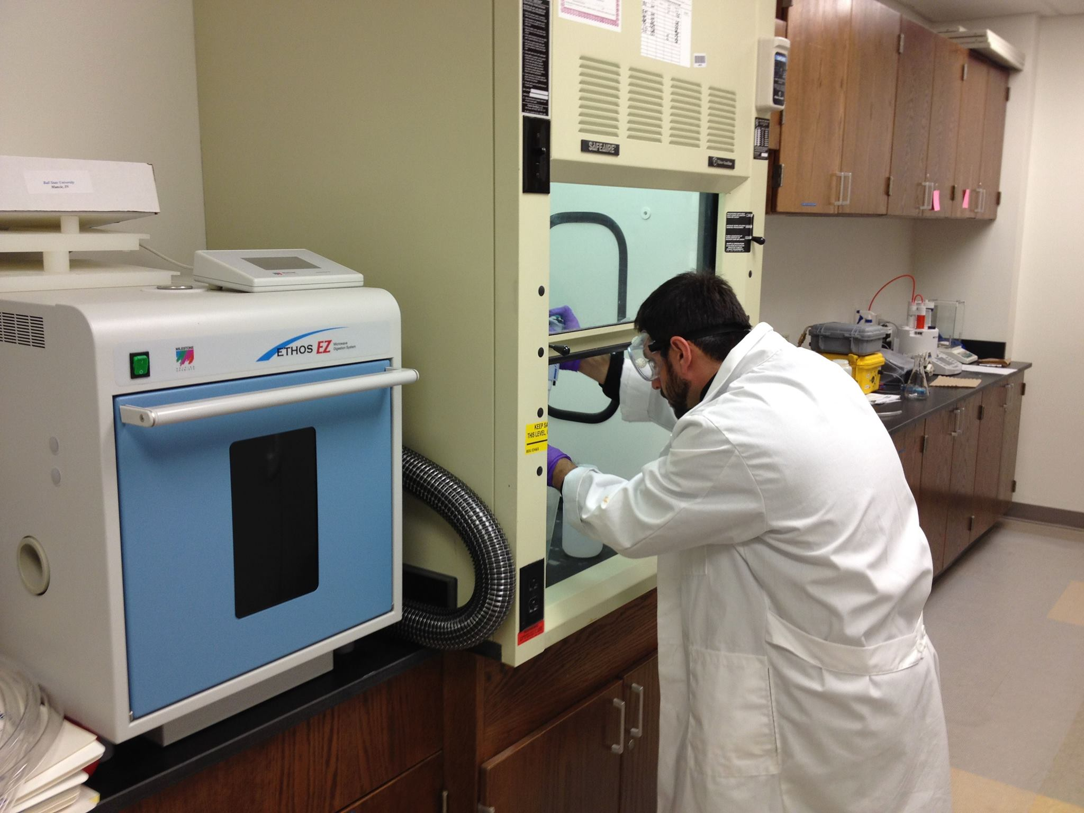
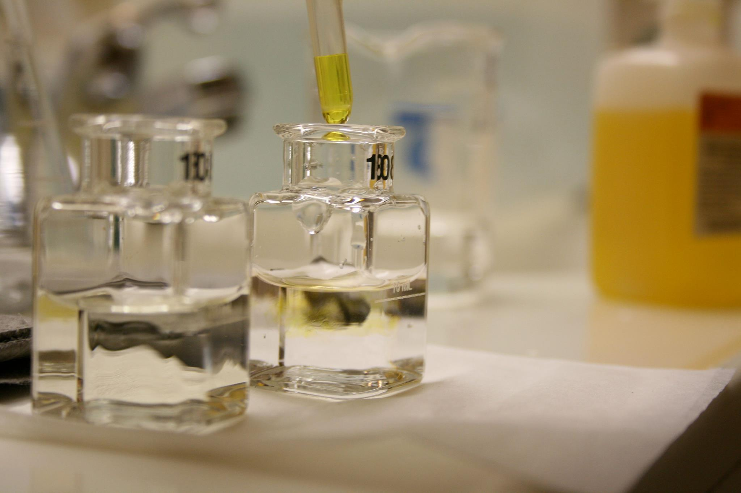
Questions?

