Slide 1
ASSESSING THE POTENTIAL OF SCOUR NUCLEI FOR THE DISCOVERY OF SUBMERGED PREHISTORIC ARCHAEOLOGICAL SITES, INNER-TO-MID CONTINENTAL SHELF, GEORGIA BIGHT, U.S.A
GARRISON, Ervan, Geology, The University of Georgia, GG Building, Athens, GA 30602, egarriso@uga.edu
ABSTRACT OF THE ABSTRACT
For an accurate interpretation of the prehistoric archaeological potential of the U.S. continental shelves it is necessary to be able to locate and excavate sites. These potential sites are oft-times buried by shifting palimpsest sand sheets, clastic sediments or both. In this paper I will describe naturally occurring and anthropogenic bottom features, termed scour nuclei, which can be examined for their potential for exposing, through erosion, buried prehistoric archaeological and paleontological sites. Otherwise, the detection of these buried sites is difficult if not nearly impossible without the use of "heroic" expensive and/or time-intensive marine survey methods which do not detect the actual site per se but only the landforms which may contain sites. This paper describes research carried out at two scour nuclei located in adjacent areas on the mid continental shelf of the Georgia Bight. One of these nuclei is of anthropogenic origin –an artificial reef created by the hull of World War II "Liberty Ship" - while the other nuclei is natural in origin – a "live bottom" outcrop.

Slide 2
Methodologies for finding submerged prehistory
The search for submerged prehistoric sites – archaeologic, primarily, has burgeoned in the late 20th-early 20th c.
One prevailing methodology that has had some success is largely premised on the well-known Principle of Uniformitarianism.
In this approach, prior information, premised on the age, distribution, etc. for terrestrially located prehistoric archaeological sites is used as analog to “predict” submerged site locations. This methodology focuses on the search for terrestrial evidence of the earliest human presence then extrapolates that information to the near-and-offshore (Benjamin and Hales, 2012; Gaffney, et al., 2007; Fitch et al., 2007; Pearson, et al (1988; 2008). Faught (2004) and others applied this analog-extrapolation method, successfully, in discovering several shallow, submerged prehistoric sites in the northern Gulf of Mexico. In its 21st century iteration it is known as the “Danish Model.”

Slide 3
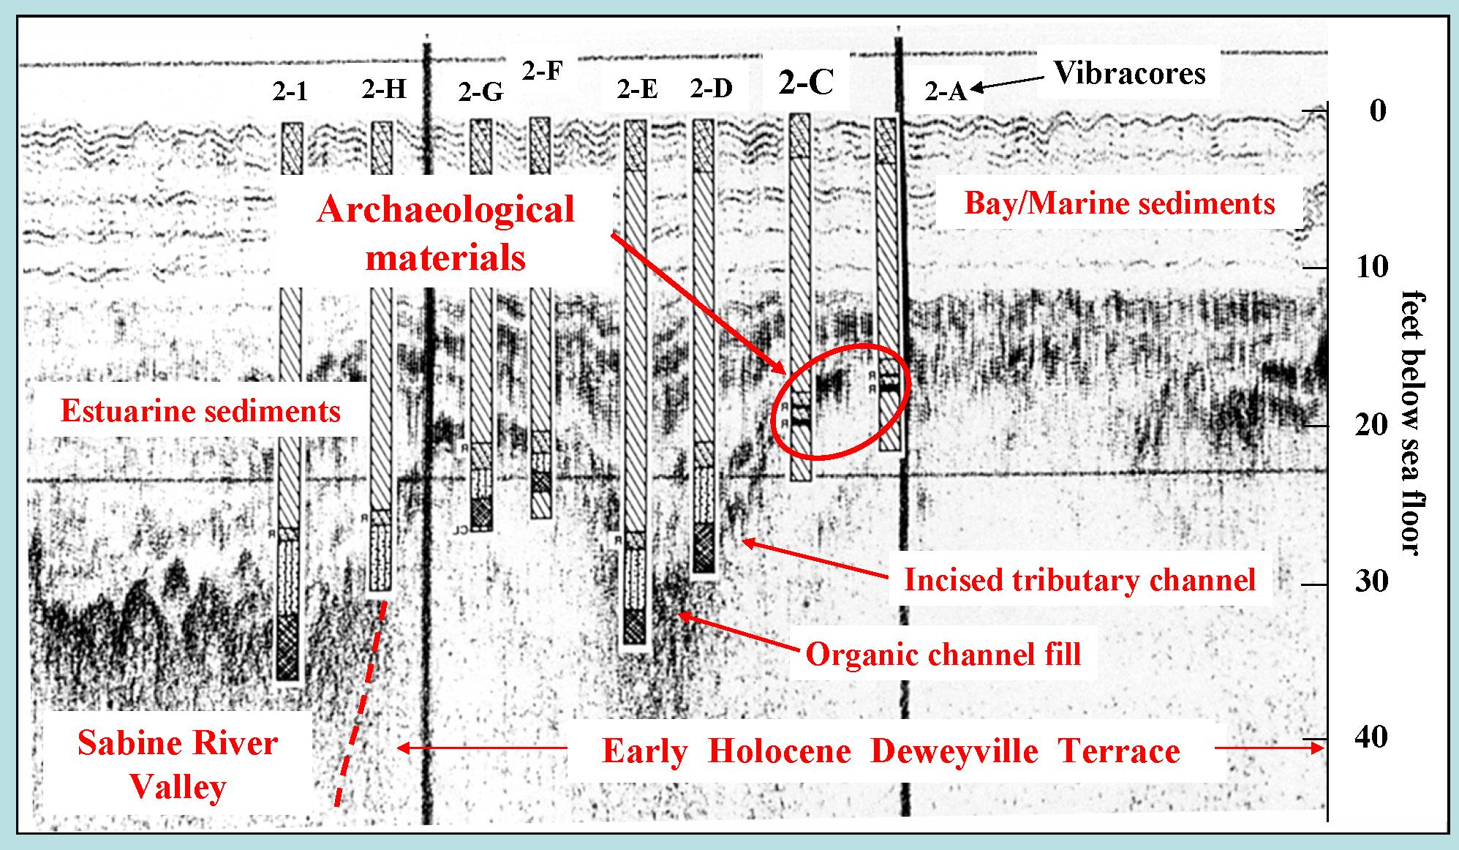
Methodologies for finding submerged prehistory cont.-
Does it work? Yes….but only when: (a) deposits are exposed or (b) deposits are penetrated by sampling devices such as sediment corers and….of course, one has access to large geophysical data sets.
Acoustical profile and schematic view of sonar images produced by an acoustic subbottom profiler of a drowned paleochannel in 15 m water depth in the Gulf of Mexico. Sediment vibracore locations are indicated. This ancient estuary is illustrated its drowning at transgression ca. 6000 BC. (Pearson, et al., 2008)

Slide 4
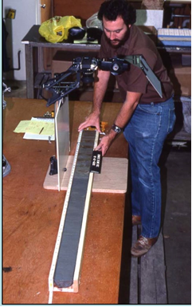
Methodologies for finding submerged prehistory cont.-
Left, sampling the drowned Sabine estuary shown in preceding slide with a vibracorer; right, analyzing the sediments in a vibracore taken from the estuary (Pearson, et al., 2008).

Slide 5
Methodologies for finding submerged prehistory
Recently, in the North Sea, the search for submerged prehistoric sites – archaeologic - has taken a slightly different tack than earlier studies such as Pearson et al., (supra).
“Doggerland”, as it called, is the reconstructed Mesolithic landscape of the southern North Sea aka “Doggerland” (Gaffney, et al., 2007).
Gaffney and co-workers have examined large submarine area geophysical data sets to recover of information pertaining to the Mesolithic landscape of 13,000 years ago when this area was dry land. .
The geophysical survey data cover more
than >22,000 km2 in the Southern North Sea
alone (Fitch, et al., 2007). The flat-topped
Dogger Bank rises to within 15 m of the
surface, providing a total relief of 45 m over
a distance of about 500 km east-to-west.

Slide 6
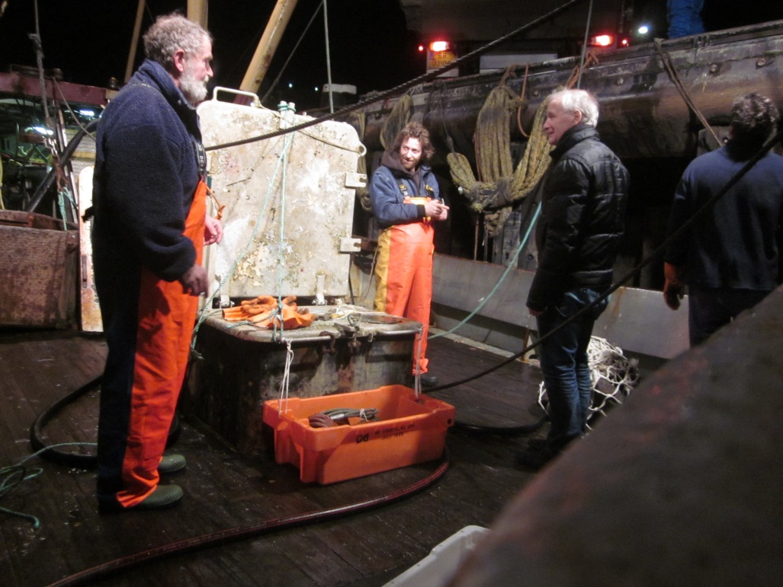
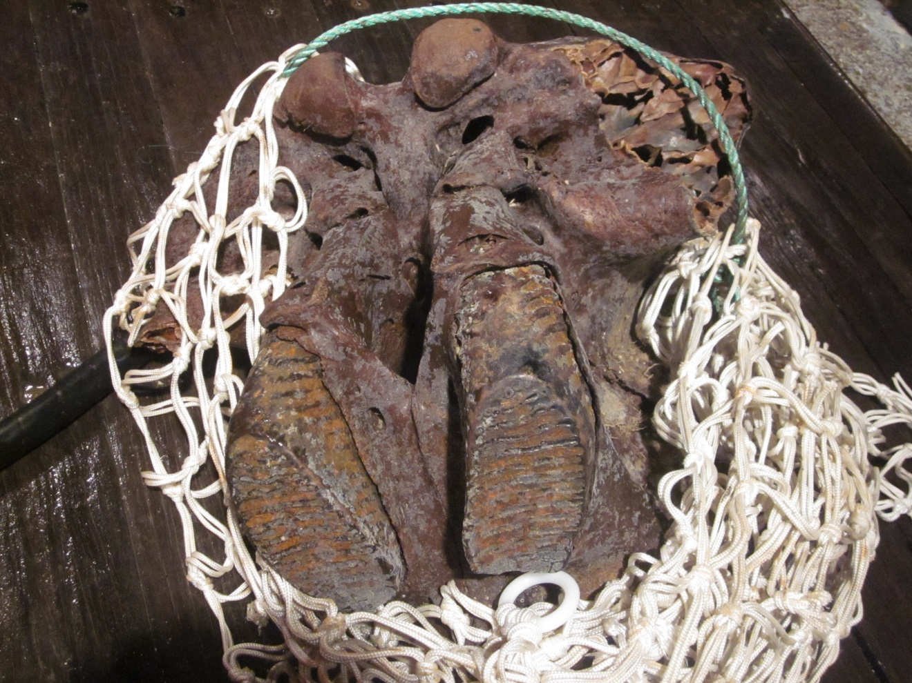
Methodologies for finding submerged prehistory cont. -
“Doggerland” today: right, a Dutch research trawler, 2014; below, a mammoth cranium on deck. Photograph by the author.
“Doggerland” is a tough place to explore. Dredgers and trawlers have done most of the work to date.
Megafauna such as Mammoth as well as early stone tools and human skeletal remains have been recovered, primarily off the Netherlands.

Slide 7
Methodologies for finding submerged prehistory cont. -
Trawling, dredging, grab-sampling and coring methods are hardly
subtle methods for recovering submerged archaeological materials.
Accurate location/relocation of find spots is difficult using these methods – coring; grab-sampling not so bad, dredging and trawling?
A more preferable approach would locate the archaeological materials on the sea floor, map and record (photos/video/sketch) THEN recover the finds.
Archaeologically-trained divers can do this in depths to 40 meters w/o exotic gas mixtures. Advanced ROVs can do this at all depths.

Slide 8
Methodologies for finding submerged prehistory cont. –
The application of geophysics to the search and discovery of paleo-landforms have become primary method. Almost any modern survey for submerged prehistoric uses acoustical profilers, side-scan and multi-beam SONAR together with magnetic search tools.
Coupling these data with the so-called “Danish Model” researchers hope to increase the likelihood of prehistoric site discovery.
Ironically, recent prehistoric site discoveries off Israel, in the Baltic – Wismar Bay - and the Adriatic, have not been made as much a result of this synthetic use of geophysics and GIS-based predictive modelling as just long hours of visual search by low-tech divers. What these surveyors need is exposure of prehistoric sites and materials on the sea floor.
One way to do this is to use Scour Nuclei and associated sea floor erosion feature.

Slide 9
SCOUR NUCLEI – WHY? A Question of Scale
After over a decade of geoarchaeological research, on the continental shelves, with the work described herein, including the large scale and “heroic” studies,
Pearson, Fitch, Gaffney, etc., few prehistoric sites have actually been found and investigated. Why? It is a question of SCALE. Landforms can be large but artefacts, by comparison, are usually small.
By examining scour nuclei – anthropogenic and natural - perhaps more SMALL–SCALE features representative of a larger population of archaeological sites, exposed by these sea floor features, can be more expeditiously located and studied?
One significant advantage of scour nuclei is their observed capacity for generating relatively deep – 2- 3 meter deep erosional features - which clearly exceed the limited capabilities of sediment corers, bottom dredges and grabs, all of which the author has used in the search of archaeological sites on the continental shelf.
The use of these scour nuclei for the detection and identification of archaeological-bearing sediments can greatly improve the current methodology utilized for the detection of submerged prehistoric sites.

Slide 10
SCOUR NUCLEI – WHAT?
“We conclude that the likely origin of the depressions is scour about compact obstacles on or embedded within the seabed. This conclusion is based on (1) the depths, diameters and growth rates being consistent with those predicted by relationships based on laboratory investigations of scour around vertical piles and short cylindrical objects; (2) the diameters being consistent with other observations in the nearshore of scour about rocks on a sand substrate; (3) the fact that the depressions sometimes formed on an otherwise featureless flat bed; (4) in the one
instance for which compact obstacles (hydrozoan colony fragments) were known to be on the seabed, depressions formed about these objects; and (5) the spatial distribution of depression first occurrences was nonrandom, more than 50% instead occurring in approximately the same locations and resulting in a clustered, non-Poisson occurrence location distribution. [60] The nature of the obstacles is not clear. Stones and pebbles, known on the basis of sediment cores to occur in the study area, are one possibility. Large shells or shell fragments, also known to be present, represent another. “
Naturally occurring scour pits in nearshore sands
Alex E. Hay and Rachel Speller. JOURNAL OF GEOPHYSICAL RESEARCH, VOL. 110, F02004, doi:10.1029/2004JF000199, 2005
“Local depressions in a sediment bed, caused by local nonuniformity of the flow, are often found in the vicinity of obstacles lying on or embedded in the sediment. It is concluded that current crescent scour marks can be explained as effects of the stretching and accumulation of the vortlcity in the flow approaching an obstacle, the fluid-mechanical aspects of vorticity transport being described in some detail.”
Peter D. Richardson , JOURNAL OF SEDIMENTARY PETROLOGY, VOL. 38, No.4, P. 965-970
FIGS. 1-3, DECEMBER, 1968

Slide 11
Example 1: The Abby B. Daniels
The Liberty Ship, A. B. Daniels is an example of an anthropogenic large scour nuclei located at 31°36.207’N, 80°47.750’W or "J-Reef" (see below). This locale is an artificial reef composed of two large sections of a World War II Liberty Ship, the A. B. Daniels.

Slide 12
Example 1: The Abby B. Daniels cont. -
The vessel was sunk in 1975 to create a “fish haven”. It is roughly a half kilometer distant from a fossil-bearing coquina deposit at the Research Ledge locale at J-reef. The artificial reef is part of a string of sunken vessels and military vehicles placed within one nautical mile (1.85 km) of the A.B. Daniels site. Two large sections of the wreck, hereafter referred to as “stern” and “bow” sections, were broken, and separated from one another, by a tropical cyclone sometime after 1975.
One result of this breakup is any erosion rate must have begun after the two hull sections separated and scour was reinitiated. This said, one can presume at least three decades for scour processes to have eroded the sea floor at this location.

Slide 13
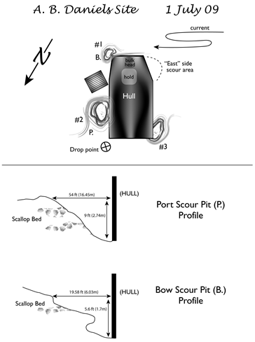
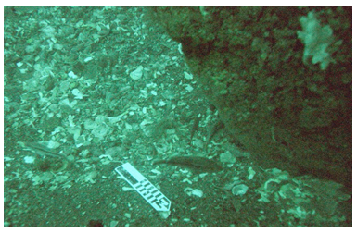
Example 1: The Abby B. Daniels cont. -

Slide 14
Example 1: The Abby B. Daniels cont. -
Table 1.
Organic materials recovered at two scour nuclei – A.B. Daniels and adjacent J-Reef, 2009.
# element width length color comments location

Slide 15
Example 1: The Abby B. Daniels cont. -
The A.B. Daniels scour pits have proven to be rich trove for sub-fossil Pleistocene faunal remains – terrestrial and marine taxa. Table 1 lists the faunal materials from the A.B. Daniels and the nearby "Research Ledge“, another scour location.
Comparisons between individual scour locales indicate the portside scour pit contained fewer faunal materials in relation to large amounts of invertebrates (shell) in the bow scour pit (cf. preceding slide)). The taxonomic richness and diversity of fossil and sub-fossil bone (n =38) amply demonstrates the potential for scour nuclei in exposing large erosional features that can penetrate up to 2 meters into previously buried deposits. Sediments and fossils found at the A.B. Daniels site were largely from Marine Isotope Stage (MIS) 3, 54-29 ka, (Garrison, et al, 2008).

Slide 16
Example 1: gray’s reef
Gray’s Reef is a series natural rock outcrops or “live bottom” which acts as scour nuclei It is located roughly 10 nautical miles south of "J-Reef" (see below).

Slide 17
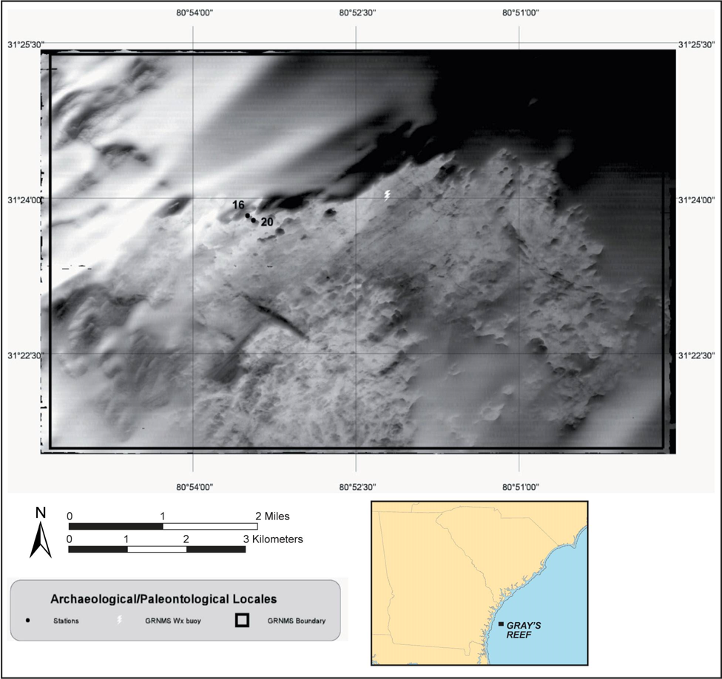
The Georgia Bight, Gray’s Reef

Slide 18
Gray’s Reef

Slide 19
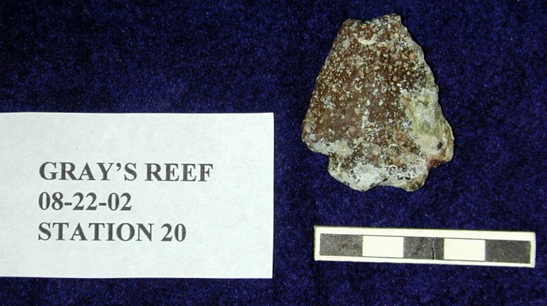
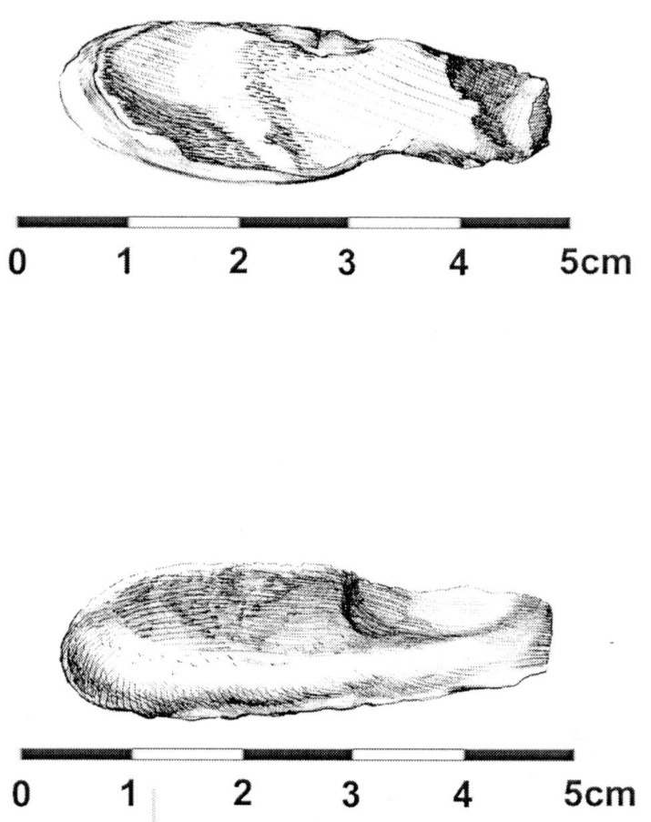
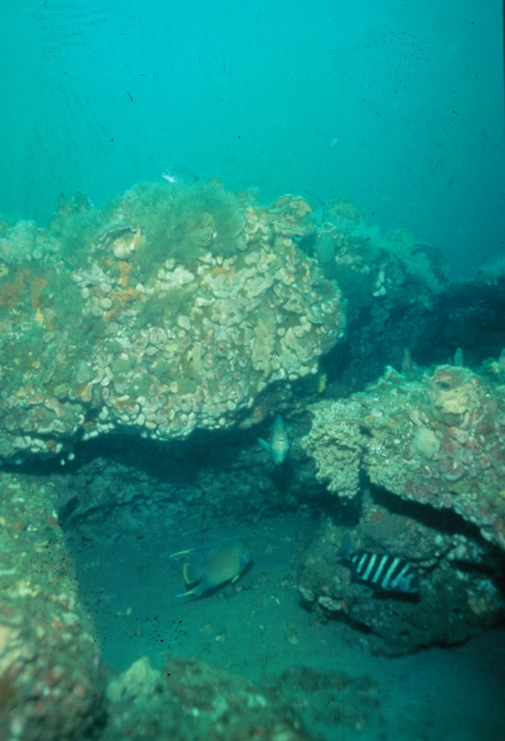
Scour on the Continental Shelf – Gray’s Reef, Georgia Bight
Two artefacts found at Gray’s Reef – left, an “arenite” stone Archaic Period projectile point; right, a worked piece of antler made into an atlatl hook; Left – typical scouring around ledges and outcrops.

Slide 20
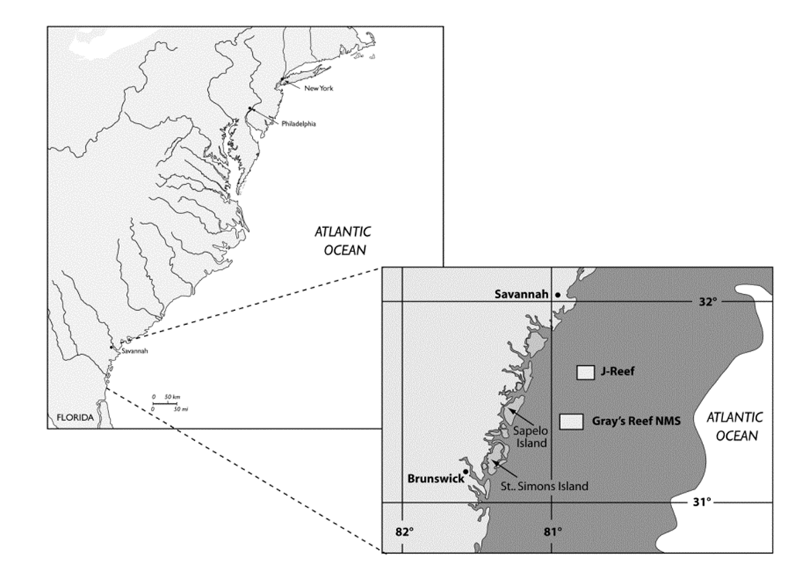
SCOUR NUCLEI – Example 2. Research Ledge, J-reef

Slide 21
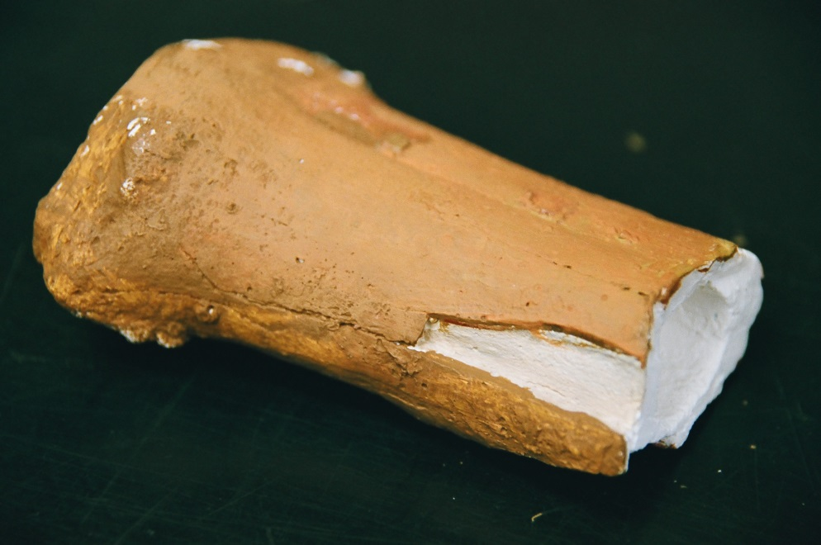
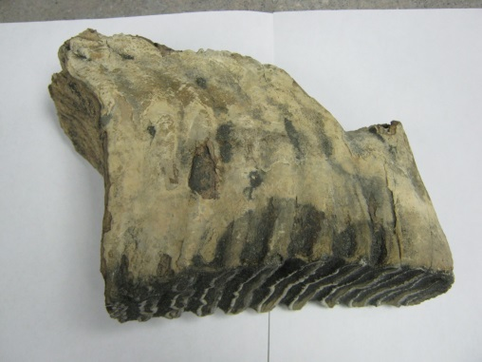
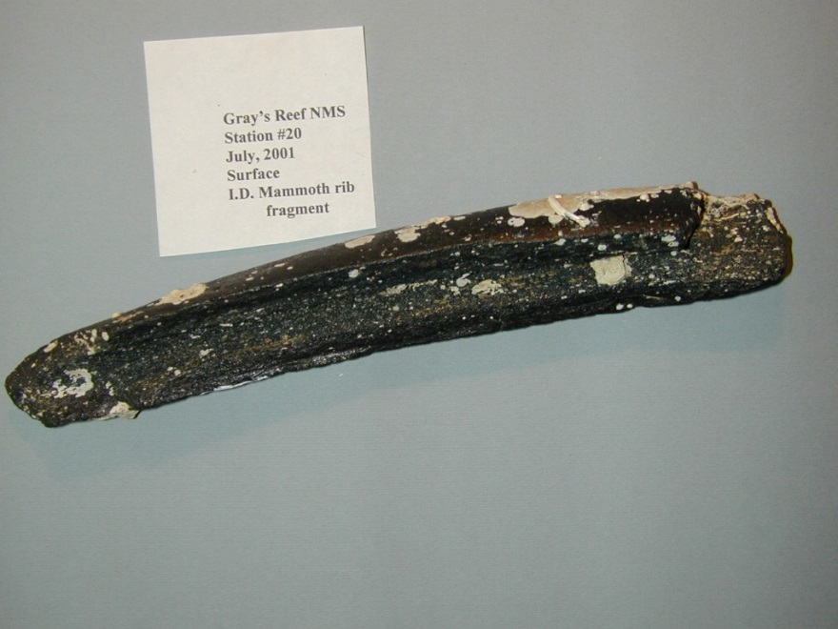
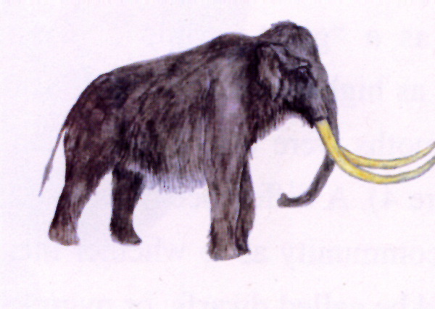
Scour on the Continental Shelf – Georgia Bight cont. -
Evidence for prehistoric game species. Right, a cast of a bison metatarsal AMS dated to 6080 BP; below, mammoth rib bone found at Gray’s Reef, no date; molar, mid-page, found by divers near Gray’s Reef, unprovenanced.

Slide 22
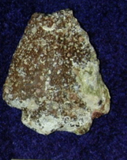


Scour on the Continental Shelf – Gray’s Reef, Georgia Bight cont. -

Slide 23
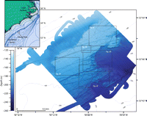
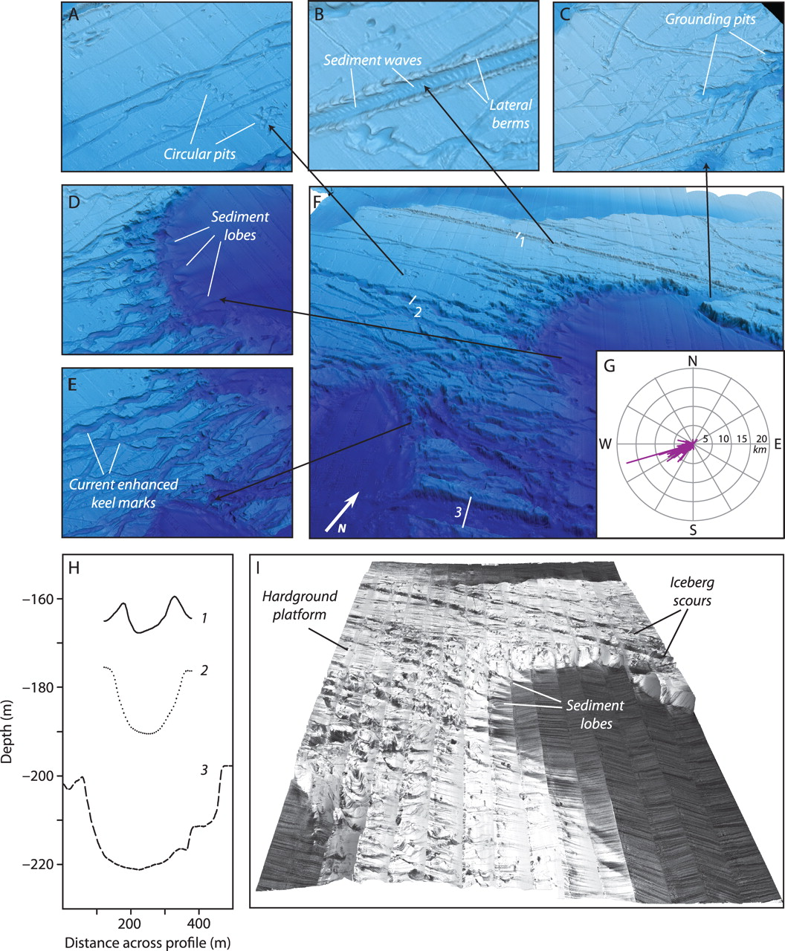
SCOUR without nuclei – icebergs
Hill, et al., 2008.

Slide 24
SCOUR nuclei – Summary & potential
Drowned terrestrial prehistoric sites with archaeological potential are probably focused between the 15–25 m depth range, the depth range encompassed by the slow stand of sea level, and the 55–60 m range, the sea level low stand position. Because of the relatively shallow, bedrock-controlled bathymetric gradient, there are potentially many locations in the Georgia Bight in the 15–25 m depth range. Gray’s Reef is but one example.
In spite of a shelf-wide palimpsest sand cover, there are long, continuous stretches of exposed pre/post-low stand landforms or outcrops of bedrock
which can act as scour nuclei. Add to these natural scour nuclei, anthropogenic ones, like tanks, rail cars and ship hulks and the potential for sufficient scour locales, to examine for archaeological sites, increases.

Slide 25
References:
Benjamin, Jonathan, and Alex Hale. 2012. Marine, Maritime, or Submerged Prehistory? Contextualizing the Prehistoric Underwater Archaeologies of Inland, Coastal, and Offshore Environments. European Journal of Archaeology ,15(2): 237–256.
Cherkinsky, Alexander. “Can We Get A Good Radiocarbon Age from “Bad Bone”? Determining the Reliability of Radiocarbon Age from Bioapatite.” Radiocarbon, Vol 51. Nr 2 (2009): p 647-655.
Fitch, S., V.L. Gaffney and K. Thomson 2007. In Sight of Doggerland: From speculative survey to landscape exploration. Internet Archaeology, 22.
Gaffney, Vincent, Kenneth Thomson, and Simon Fitch, eds. 2007. Mapping Doggerland: The Mesolithic Landscapes of the Southern North Sea. Oxford, England: Archaeopress.
Garrison, E.G., G. McFall and S.E. Noakes. 2008. Shallow Marine Margin Sediments, Modern Marine Erosion and the Fate of Sequence Boundaries, Georgia Bight, U.S.A. Southeastern Geology, 45(3): 127–142.
"Gray's Reef Area." Project Oceanica. Web. 10 Apr. 2012. <http://oceanica.cofc.edu/seamap/GraysReefArea/default.htm>.
Hill, Jenna C., Paul T. Gayes, Neal W. Driscoll, Elizabeth A. Johnstone and George R. Sedberry. 2008.
Iceberg scours along the southern U.S. Atlantic margin, Geology, 36(6) 447-450.
Lee-Thorp, Julia A., Judith C. Sealy, and Nikolaas J. van der Merwe. "Stable Carbon Isotope Ratio Differences between Bone Collagen and Bone Apatite, and Their Relationship to Diet." Journal Of Archaeological Science 16.6 (1989): 585-599. GeoRef. Web. 30 Apr. 2012.
Pearson, C.E., D.B. Kelley, R.A. Weinstein and S.M. Gagliano. 1986. Archaeological investigations on the Outer Continental Shelf: A study within the Sabine River Valley, offshore Louisiana and Texas. Coastal Environments, Inc. Prepared by Coastal Environments Inc. Published by Minerals Management Service, US Department of Interior, Reston, VA.
Pearson, C.E., R.A. Weinstein, and D.B. Kelley. 2008. Prehistoric site discovery on the Outer Continental Shelf, United States of America. Paper presented at the 6th World Archaeological Conference, Dublin, Ireland, June 28–July 4.

Slide 26
SCOUR nuclei – thank you!

Slide 27
Acknowledgements
Dr. Charles (Charlie) Pearson, Coastal Environments, Inc.
Ms. Jessica Cook Hale, The University of Georgia
Dr. Andrew Hemmings, Mercyhurst University
Dr. James (Jim) Dunbar, Archaeological Research Institute (ARI)
Dr. Michael Faught, SEARCH, Inc.
Mr. Klaas Post, Natural History Museum, Rotterdam
National Oceanic and Atmospheric Administration (NOAA)

