Slide 1


LESOTHO

Slide 2
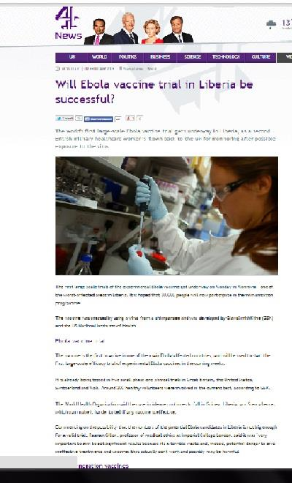
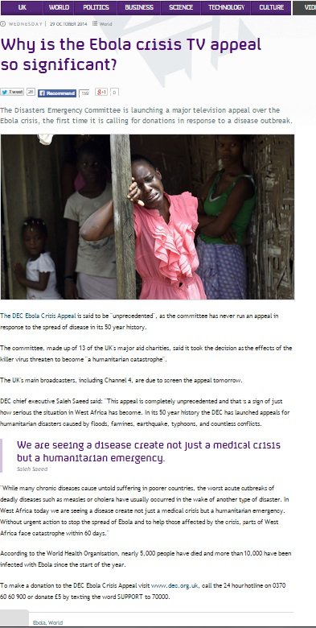
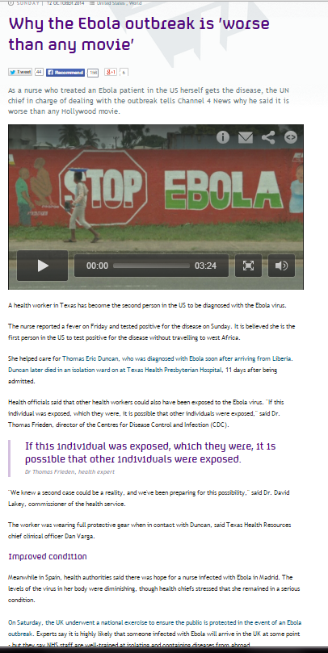
Ebola Articles

Slide 3
Our Prezi
http://prezi.com/z7z6q2dccktv/?utm_campaign=share&utm_medium=copy&rc=ex0share

Slide 4

OpenStreetMap
http://wiki.openstreetmap.org/w/images/7/79/Public-images-osm_logo.svg

Slide 5
What is OpenStreetMap?
OSM is a free, editable map of the world built by volunteers and released with an open-content license.

Slide 6
Are you a HOTTIE?
HOT is a group that uses OSM to map places to help many other countries.
We helped HOT map in Africa during the Ebola crisis

Slide 7

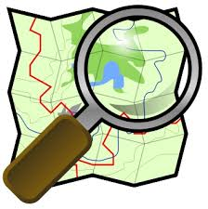
Humanitarian Outreach Team

Slide 8




Red Bank Goes Hot
http://wiki.openstreetmap.org/wiki/File:Hot_logo.svg
http://www.ndtv.com/world-news/one-in-three-kids-have-no-birth-certificate-united-nations-544243
http://www.communitynewspapers.com/coralgables/american-red-cross-hosts-a-special-girls-night-out-at-jimmy-choo/
http://www.acupunctuurpraktijk-gerrits.nl/the-world-health-organisation

Slide 9
Red Bank Goes Hot
OSM HOT
American Red Cross
United Nations
United Health Organizations
HP donated $5 million to get better imagery
OSM has made national news
OSM board member is now part of the presidents staff
We now have 10,000 HOTTIES!!

Slide 10
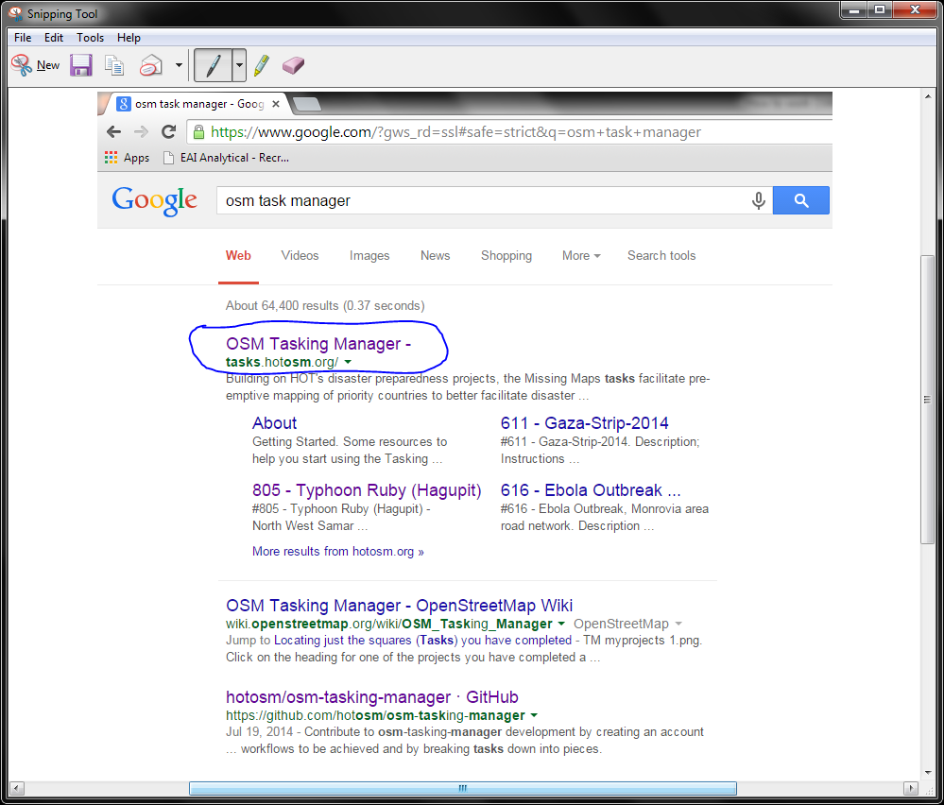

Slide 11
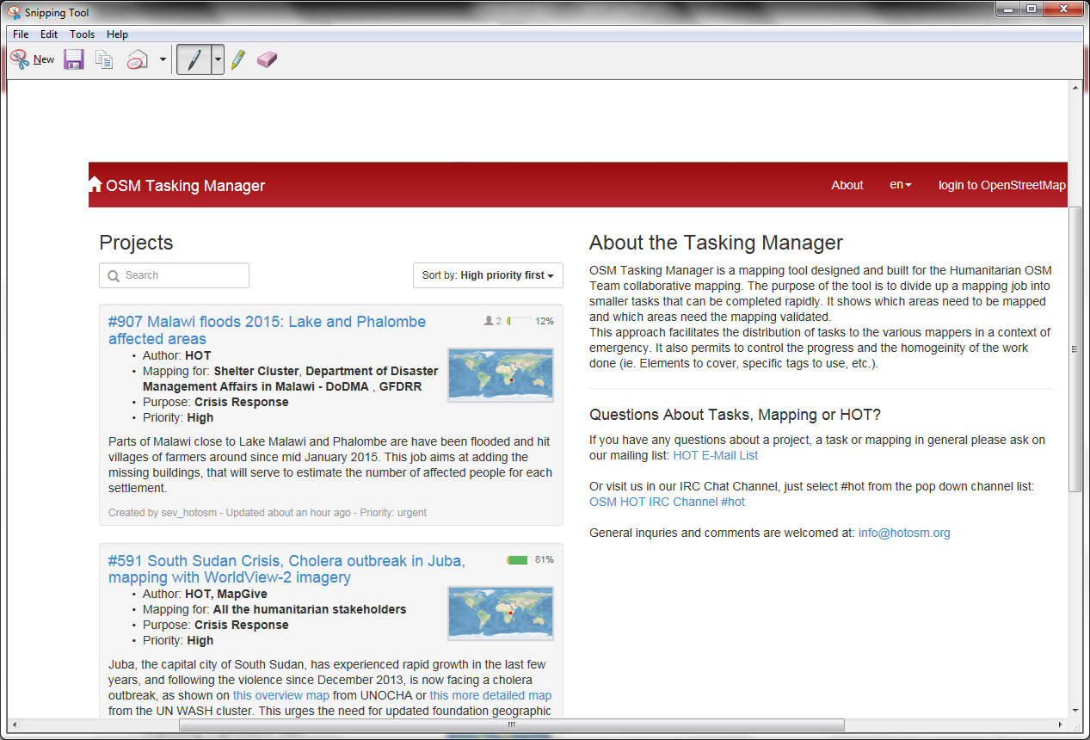

Slide 12
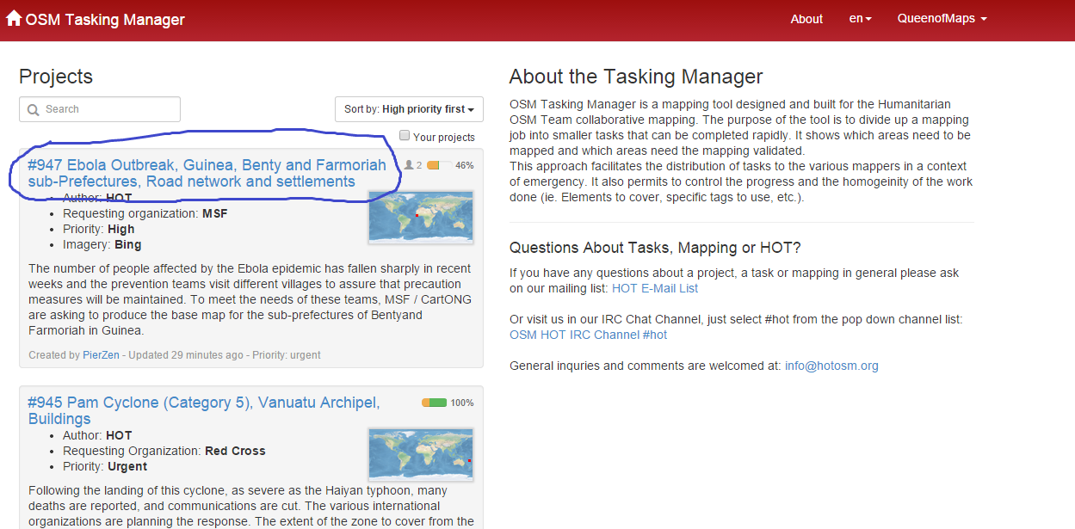

Slide 13
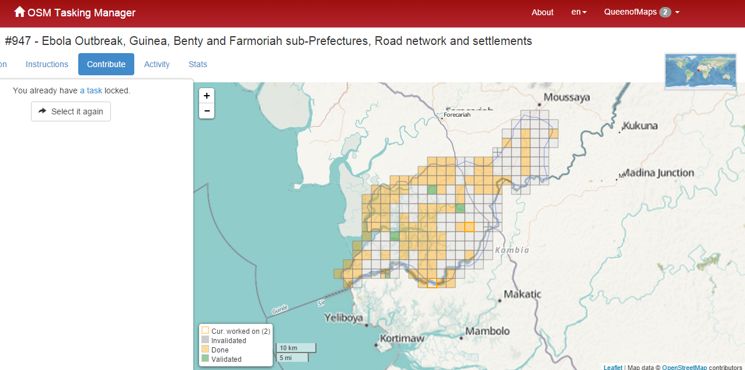

Slide 14
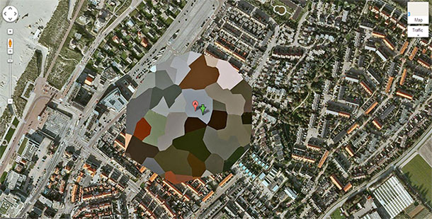


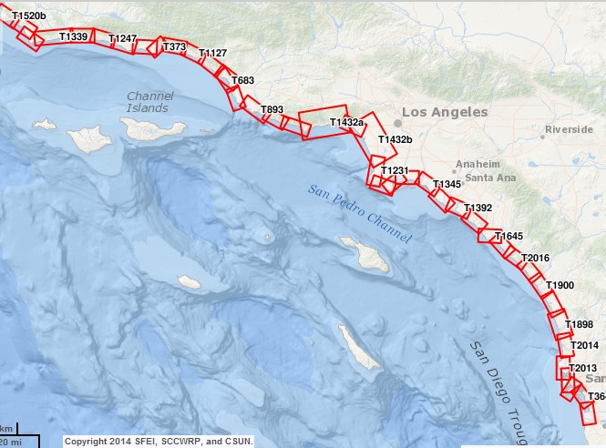
Problems
http://list25.com/25-places-that-are-suspiciously-blurred-out-on-google-maps/
http://flowtility.com/collection/objects-and-bullets/
http://www.sccwrp.org/Homepage/News/14-08-27/Changes_losses_to_Southern_California%E2%80%99s_coastal_wetlands_documented_in_comprehensive_new_historical_analysis.aspx
http://drwritings.com/when-you-are-out-of-time/

Slide 15

World Health Organization Kentucky

Slide 16
What they needed us to do
WHO needed us to map all the houses, roads, and waterways that we could see
We also were helping by vectoring the disease
They used our data as quickly as possible as soon as their smart phones updated

Slide 17
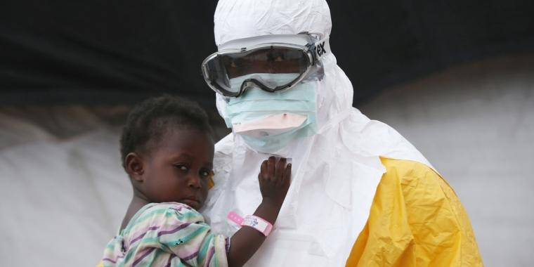
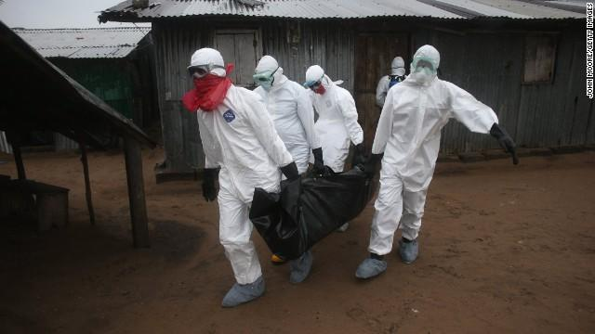
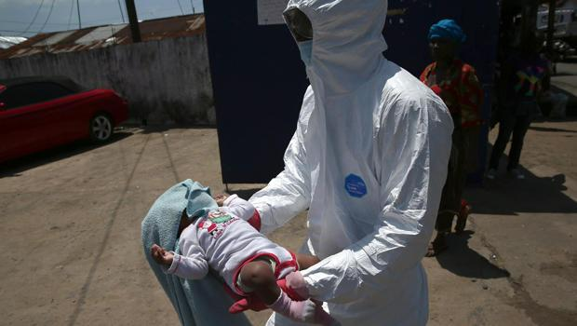
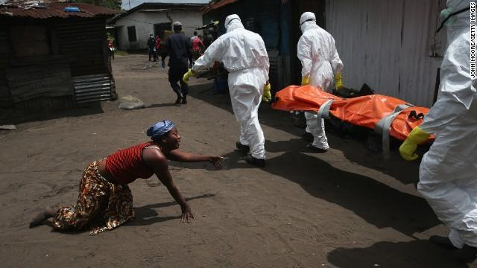
10,000
www.cnn.com
www.doctorswithoutborders.org
www.cnn.com
www.cbsnews.com

Slide 18
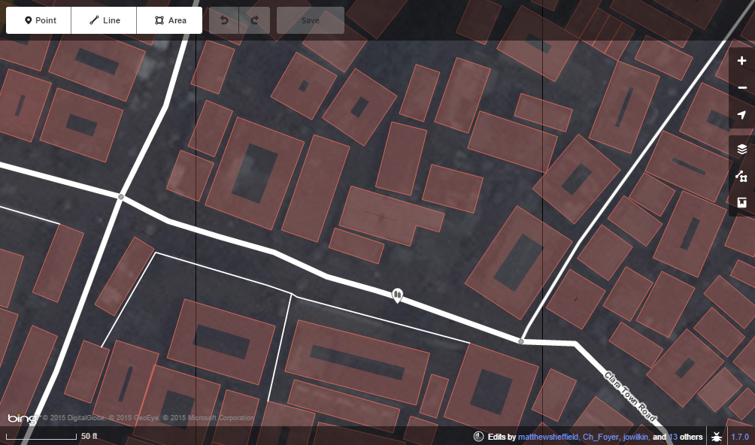
Editing in Liberia
This is an area called Monrovia, Liberia. This is where we mostly mapped and helped find small villages that could not be seen on a normal map. The more professional GIS mappers worked with the bigger cities. They had the WORST imagery and GIS members told us to STAY AWAY and work with smaller, darker jungles.

Slide 19

Dr. Mueller

Slide 20
Dr. Mueller
Emailed Mrs. Keith one day asking for help on how to check to see if his students are actually mapping and not just fooling around.
Asked how to run a class on Humanitarian mapping (OSM HOT)
How to grid it off, how to make assignments, should not do time frame, but buildings
Suggested a map – a – thon
To be truly effected to do HOT, to do a map – a –thon
Asked to be part of the next one

Slide 21

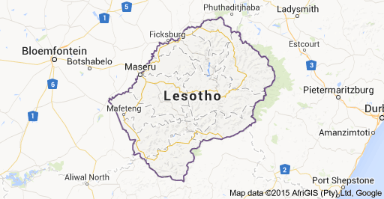
Three continents-one voice
Ireland
America
Colombia
Solvegave.com
Map data 2015AfriGIS(Pty)Ltd,Google

Slide 22
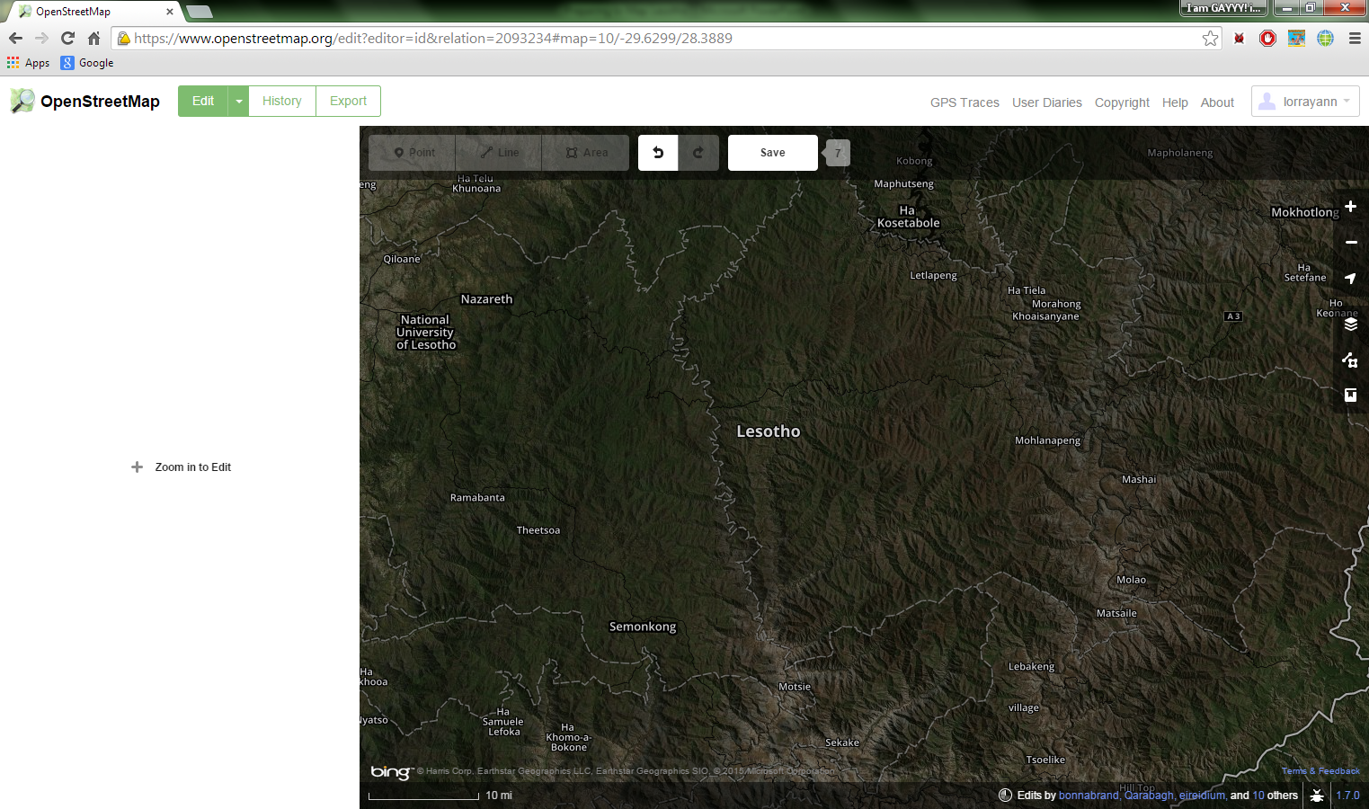
Preparing to Map Lesotho
-One week preparation.
-A lot of stress, but worth it in the end.
-Brought in extra experienced students.
-We had three continents working on Lesotho, it was a world effort.
-We had 90 students work together on this within a 24 hour period

Slide 23
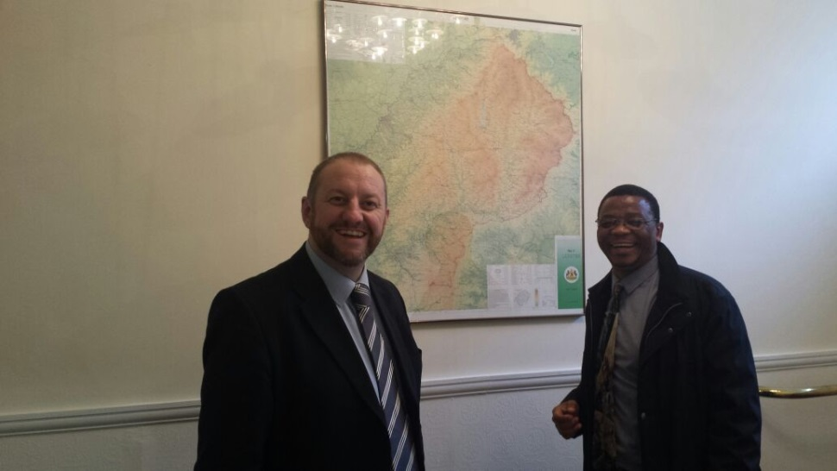
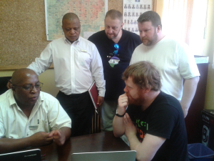
Ciaran Staunton
Project management facilitation role with various Local Authority led projects:
- Strategic Tourism Initiative
- Dublin Airport Stakeholders Forum
- Fingal Data Hub and Fingal Data Analytics Unit
- Strategic Initiatives for Business
- Emergency Management Information Officer
I work in the Economic Development Services Department of the Local Authority which manages strategic projects to increase the Economic and Social potential of the County levering the input of external agencies, local stakeholders and new partnerships

Slide 24
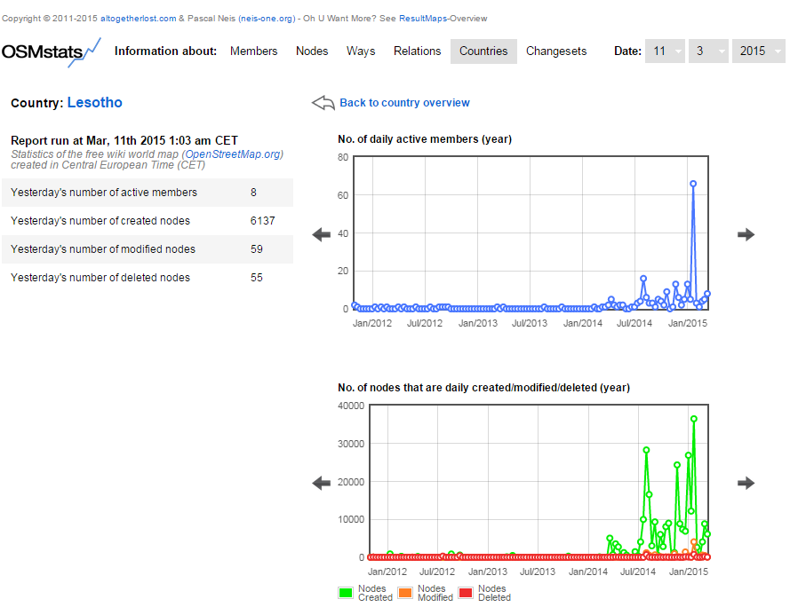
Stats

Slide 25
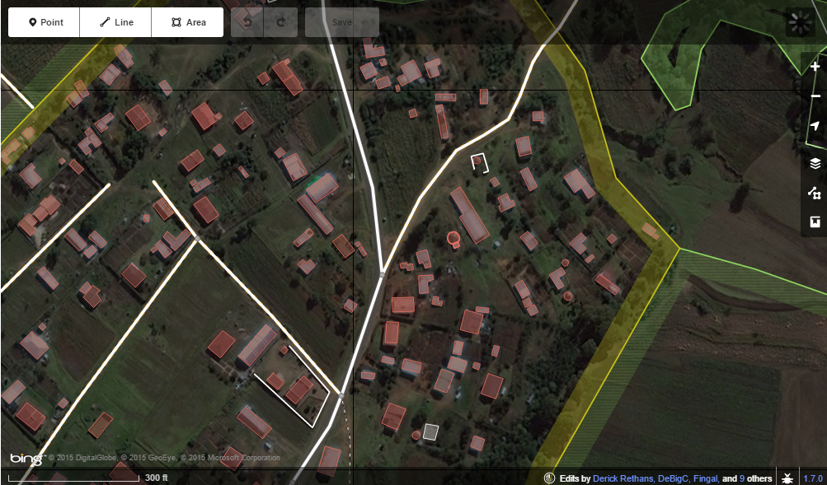
Editing in Lesotho
DeBigC and many other mappers have been working in the Kingdom of Lesotho since our mapathon. They are currently mapping as we speak. We basically worked all over the country, except, of course, areas that we were told not to go. The picture is of Nazareth, Lesotho at which DeBigC is mapping currently with many others.

Slide 26
Outcomes
The outcomes of us mapping Lesotho with us making around 9, 234 edits with about 3 houses per edit.
We ended up making a bit of difference towards a poverty stricken, diseased area.

Slide 27
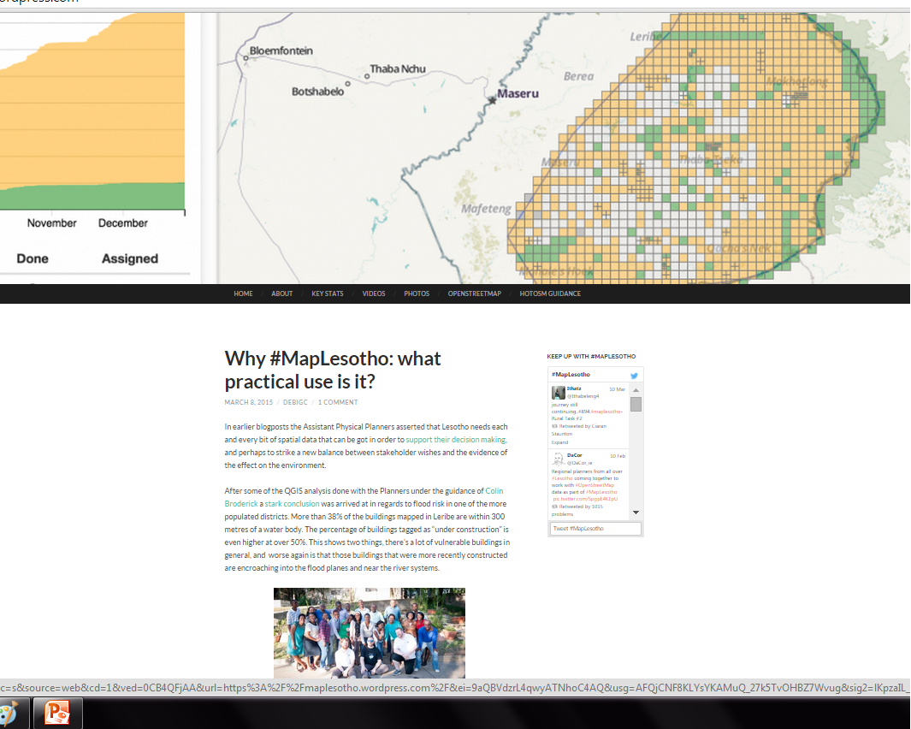
Map Lesotho Blog/Twitter

Slide 28
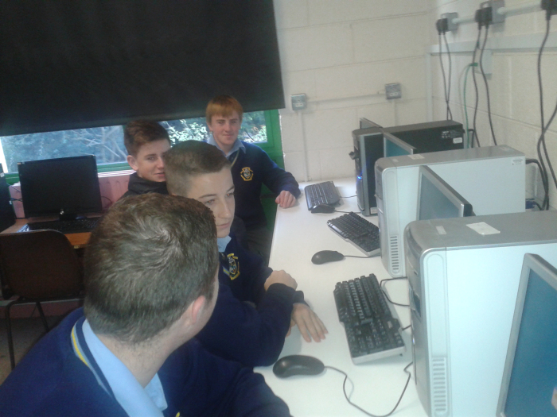
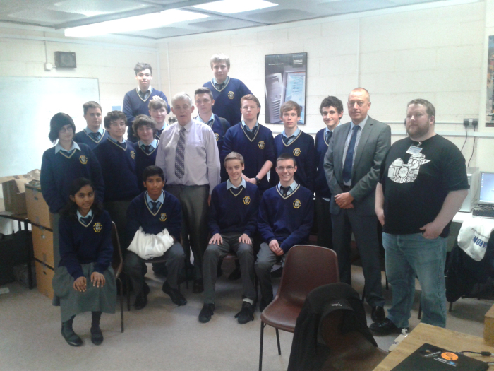
Ireland Class

Slide 29
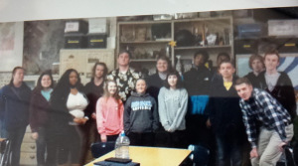
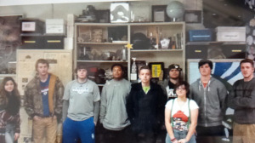
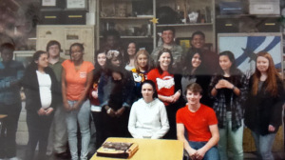
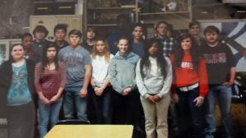
Our Classes
Astronomy
GIS Mapping
Scientific Research
Geology

Slide 30
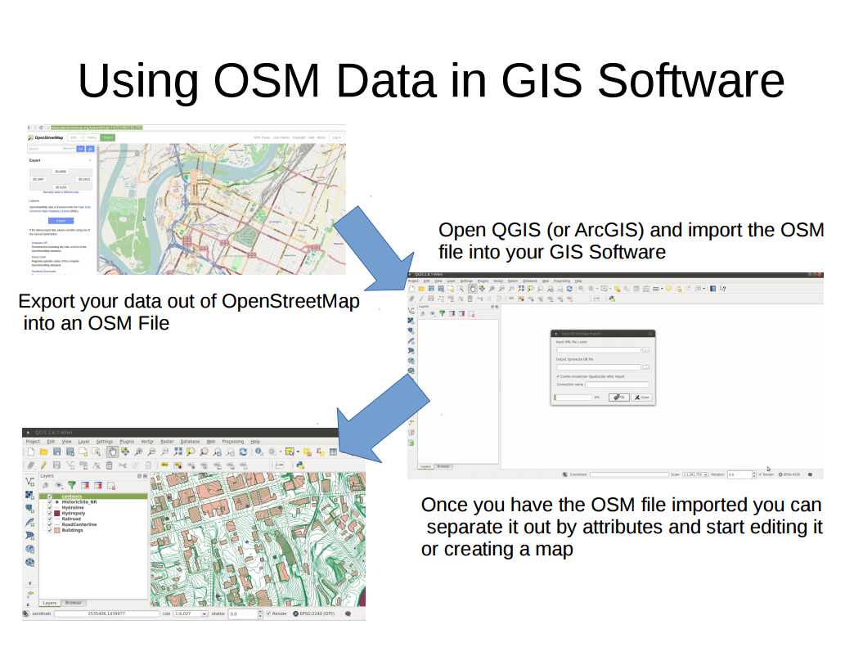
Randy Hale

Slide 31
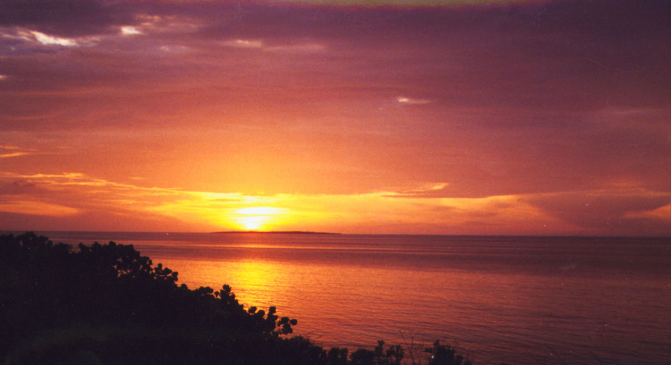
WHY?
The children shall lead them

Slide 32
Questions/Contact Information
LeahKeithHoule@gmail.com
Keith_leah@hcde.org

Slide 33
Bibliography
www.channel4.com/news/ebola-exposure-vaccine-trial-tests-sierraleone
www.channel4.com/news/dee-disaster-launch-ebola-spread
www.channel4.com/news/us-ebola-health-worker-infected
http://wiki.openstreetmap.org/w/images/7/79/Public-images-osm_logo.svg
https://vimeo.com/9182869
http://www.openstreetmap.org/

Slide 34
Bibliography
https://www.openstreetmap.org
http://www.Solvegave.com
https://www.google.com/earth/
www.google.com
http://tasks.hotosm.org/
https://maplesotho.wordpress.com/?ref=spelling
https://maplesotho.wordpress.com/stats/
https://maplesotho.wordpress.com/photos/#jp-carousel-49
http://wiki.openstreetmap.org/w/images/7/79/public-images-osm_logo.svg
http://vimeo.com/9182869

