Slide 1

Hurricane Mapping San Salvador and St. Thomas
April 2014-March 9, 2015
Red Bank High School Maps For a Purpose

Slide 2
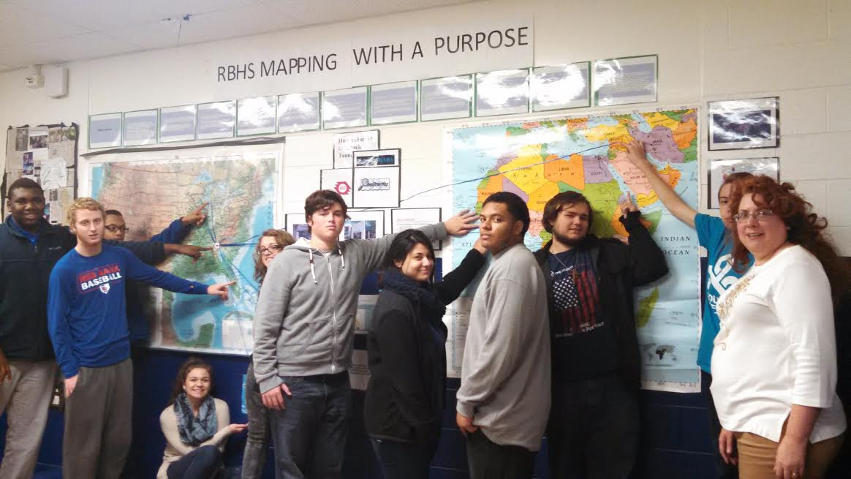
Our Class
Jaylon
Ian
Tyrell
Samantha
Spencer
Deshoen
Jeff
Karla
Will
Loray
Mrs. Keith

Slide 3

Mrs. Leah Keith-Houle
was given a grant of $5,000 by Fund For Teachers to travel to the island of San Salvador in the Bahamas.

Slide 4
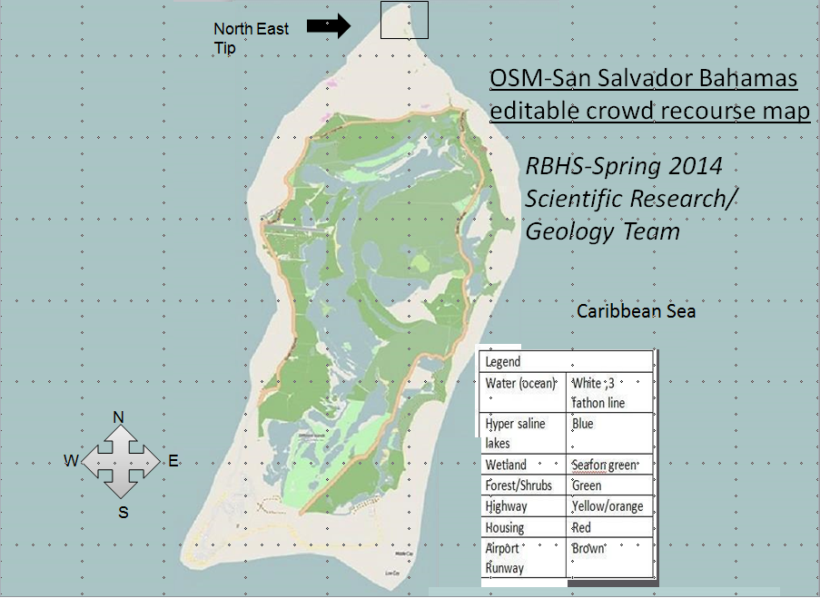
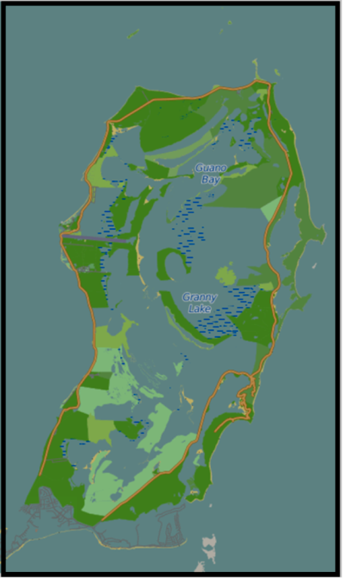
Edited by Conagher Smith & Monnie Lewis

Slide 5
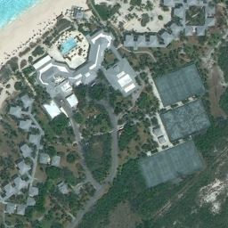
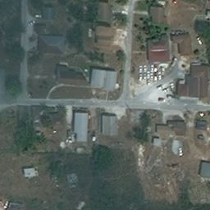
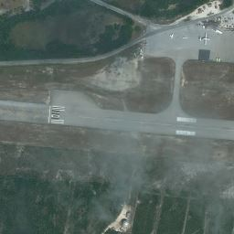
Geology
4th block
Monday, February 24, 2014
14:08 Military time
BeforeOSM
Club Med
Cockburn Town
Airport

Slide 6
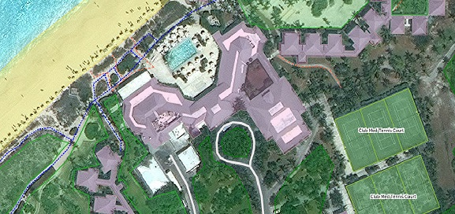
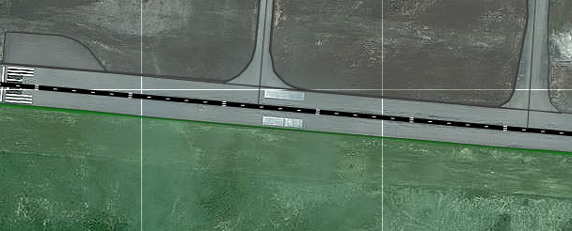
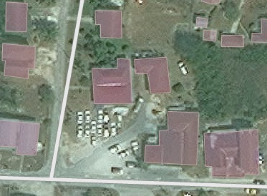
1 Week after in
OSM
Club Med
Airport
Geology
4th block
Monday, March 3, 2014
14:00 Military time
Cockburn Town

Slide 7
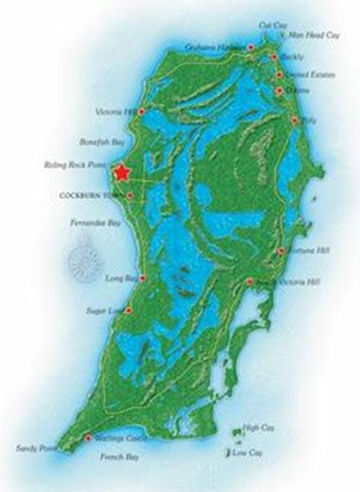
What We Mapped
Buildings
Roads
Saline Lakes/Rivers
Coral Reef
Gerace Center
Airport
Address
People who live in homes
Wetlands

Slide 8
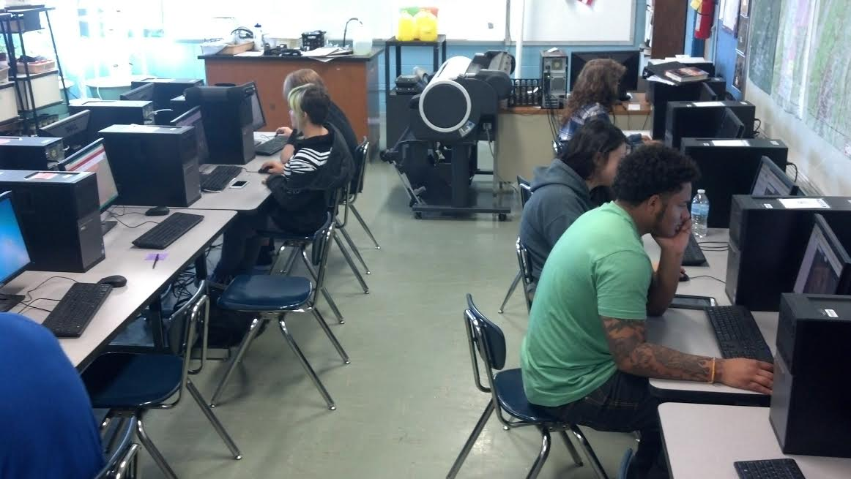
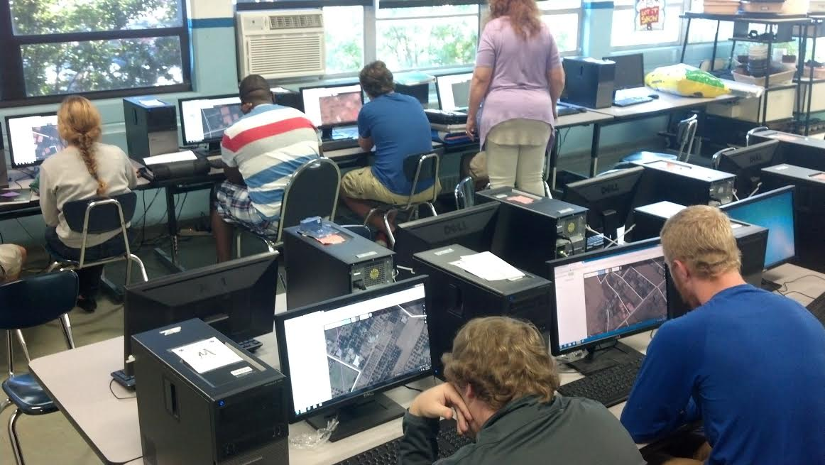
GIS Class students in their natural habitat

Slide 9
Benefits of OSM over GIS
For Mapping in Caribbean
Free open source
Editable from any where on the globe
Don’t need a special program to do
Don’t have to ask for data
Data can cost in the thousands of dollars
Other services can’t find owners to obtain layer data.
We were able to find the GIS data at the Gerace Center.

Slide 10
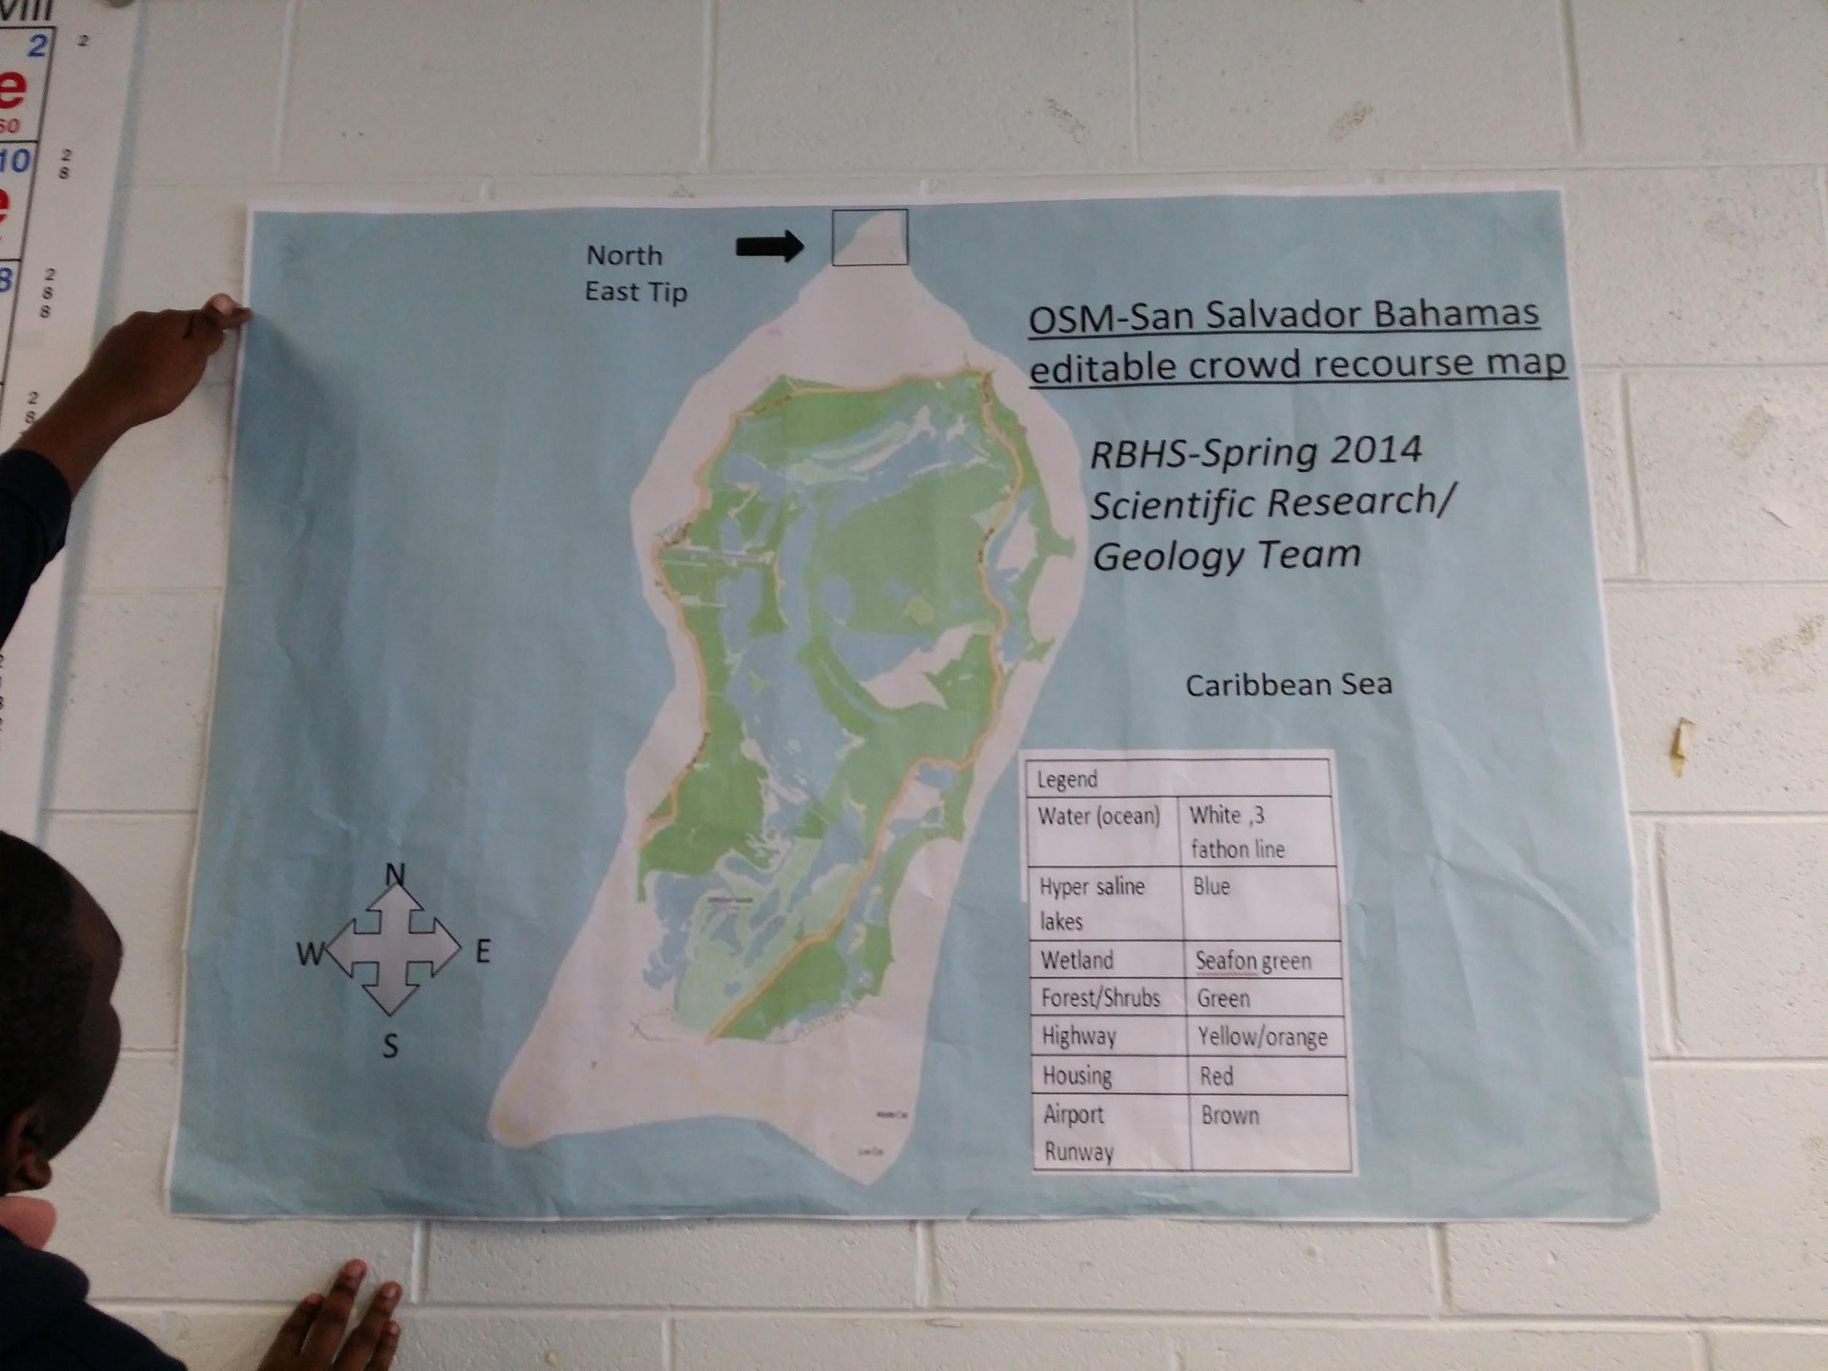
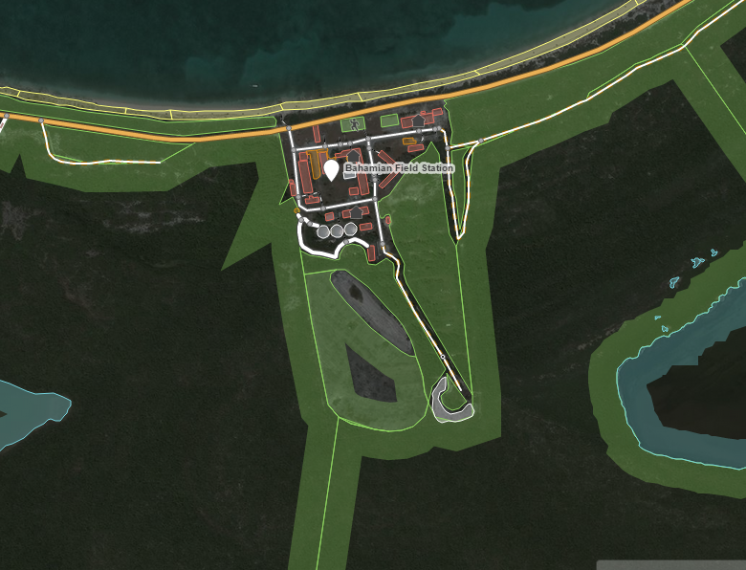
Basemap Improvements
http://www.openstreetmap.org/

Slide 11
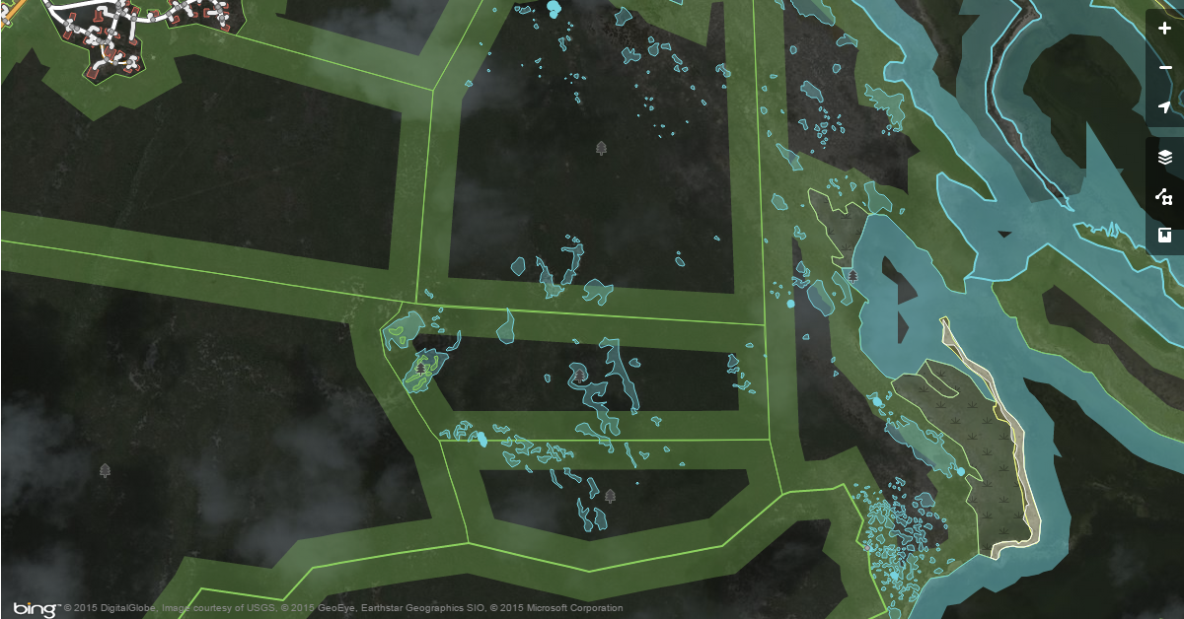
Mapped Area of Swampland
On San Salvador

Slide 12
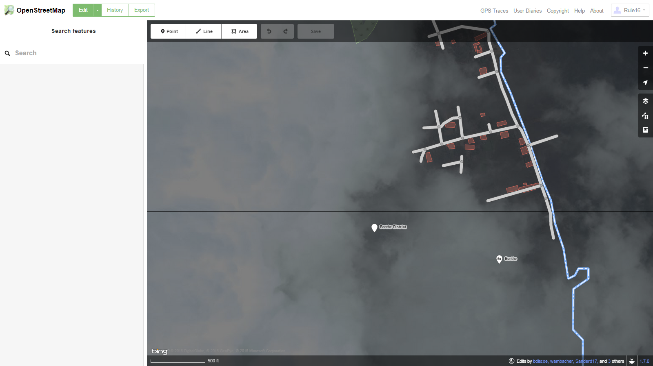
Some people like cloud watching…
We don’t…

Slide 13
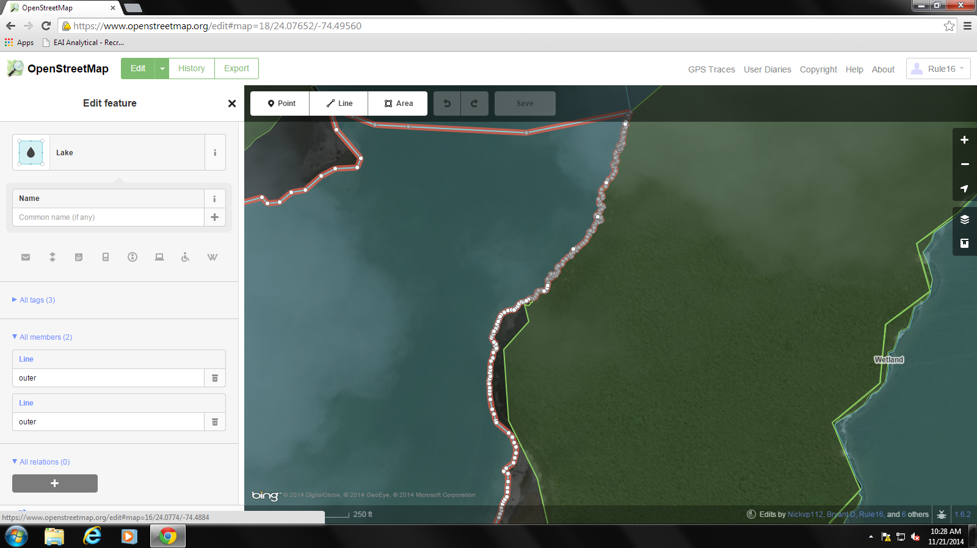
Our Old Friend Little Brother:

Slide 14
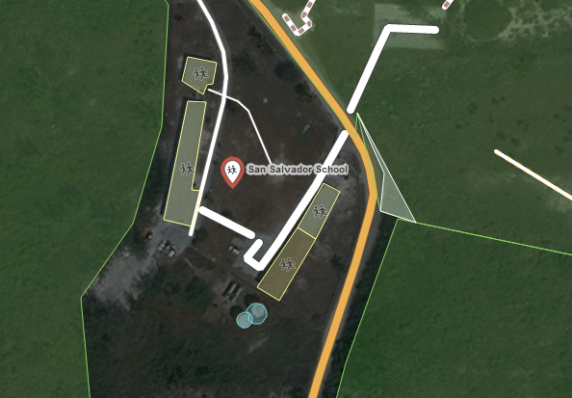
We have worked with high schools in San Salvador, St. Thomas, and St. Croix to create Hurricane
Preparedness
Maps.

Slide 15
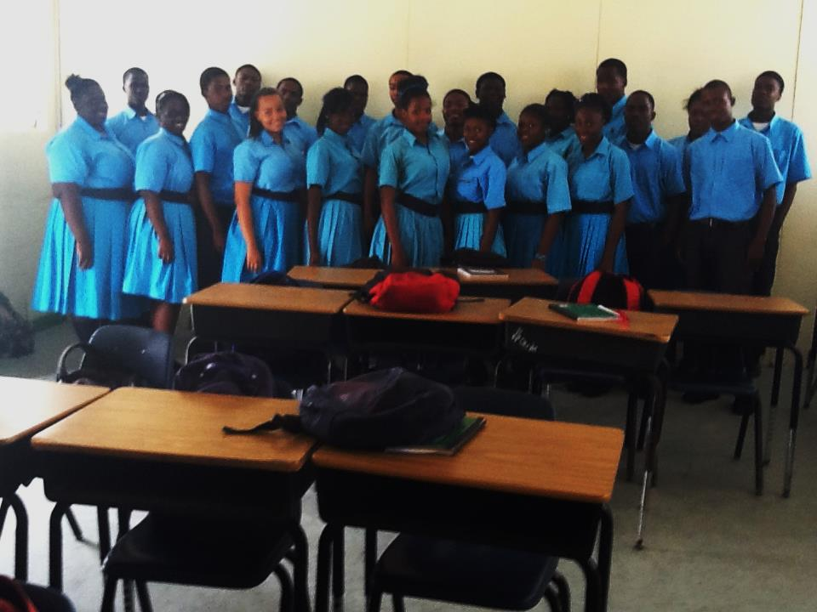
San Salvador High School Picture

Slide 16

Letters to Pen Pals
During the summer of 2014, Mrs. Keith – Houle spent some time down in San Salvador with students from the local high school. While she was there, she had the students write to her students back home. When they were finished writing the letters, she came around and picked them up from each one. Once she came back home, she distributed the letters from the students in San Salvador to the ones that she is currently teaching. She then told her students to read and write them back, so they did. They have now been sent to the students in San Salvador and are hopefully enjoying their newfound friends.

Slide 17

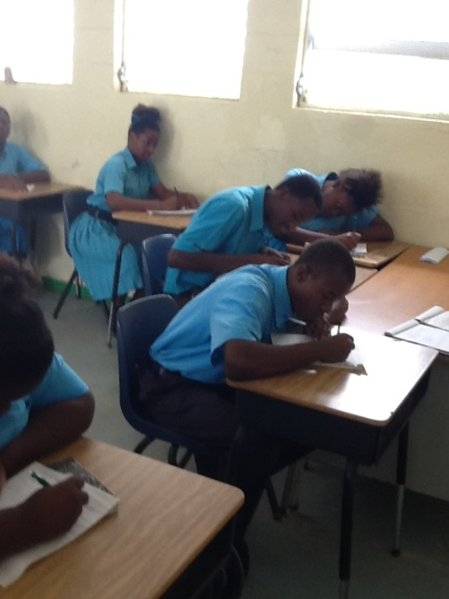
11th Grade mapping
With no trained mappers on the island, the Juniors were taught how to map their own neighborhoods .

Slide 18

Example of walking papers - low tech when you cannot use Fulcrum/
Smartphone App

Slide 19
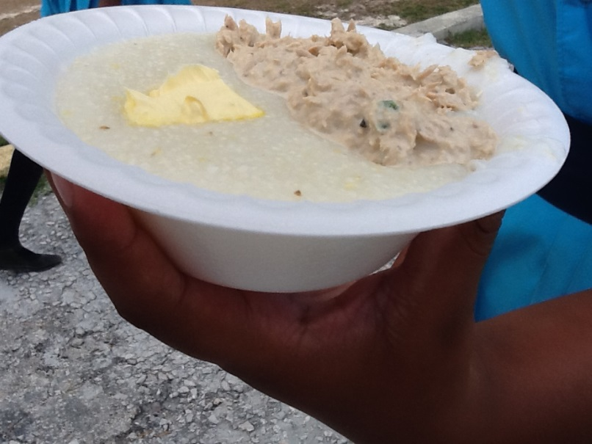
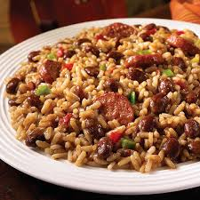
Daily Life
Breakfast/ Dinner

Slide 20
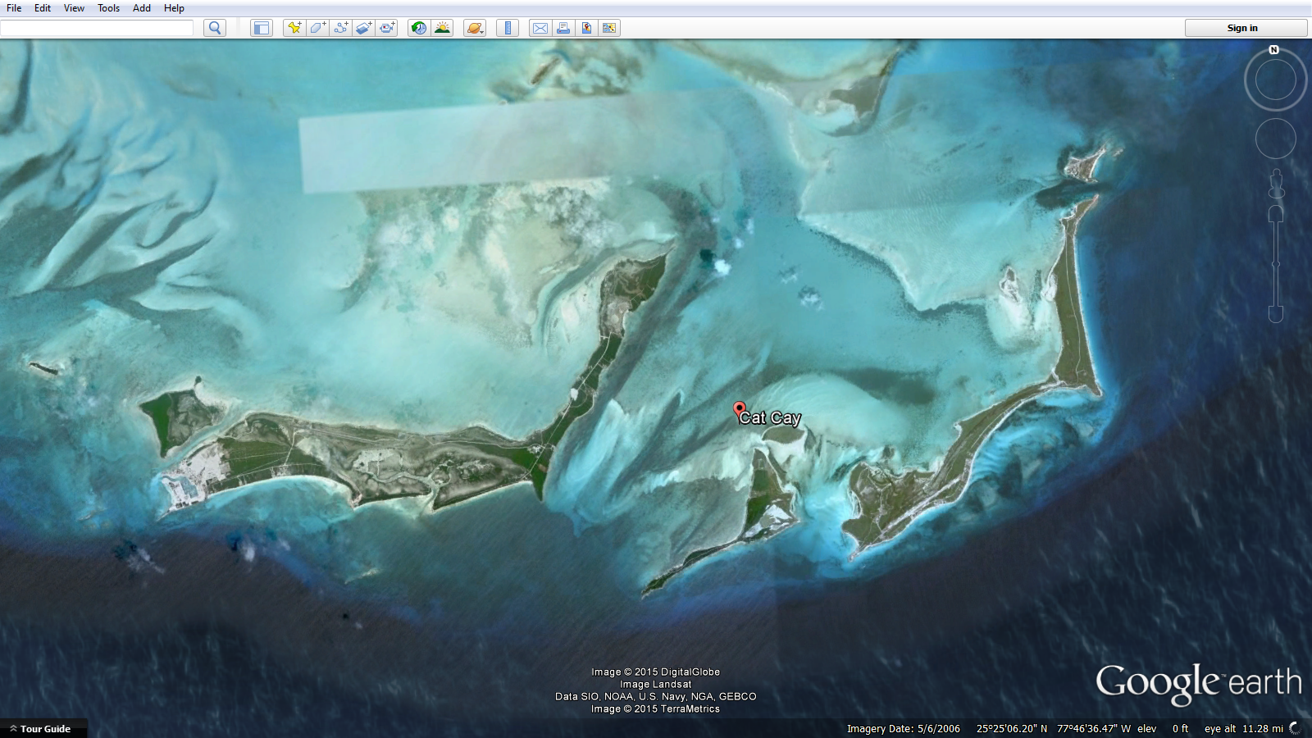
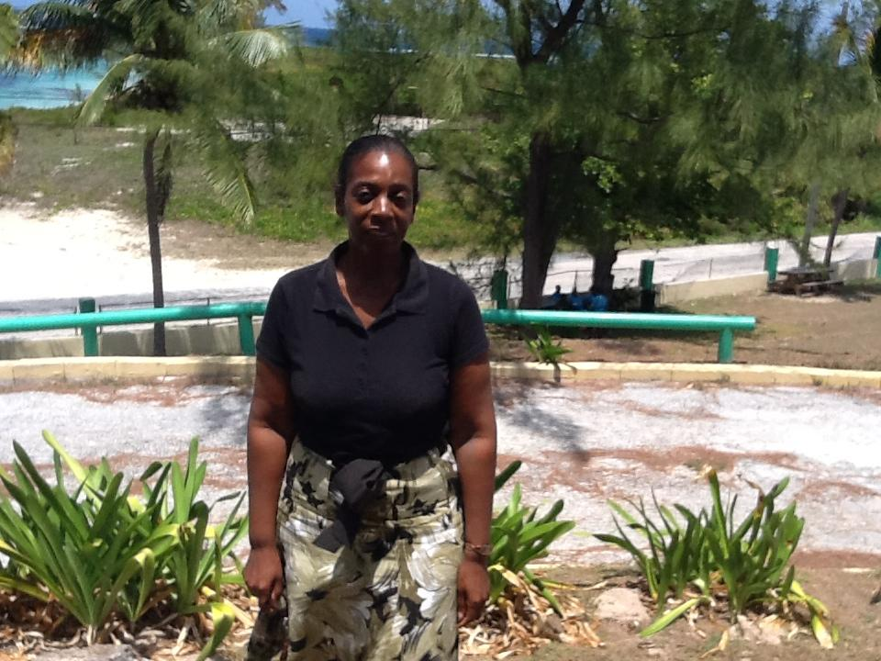
Principal’s Request
Ms. Forrester

Slide 21
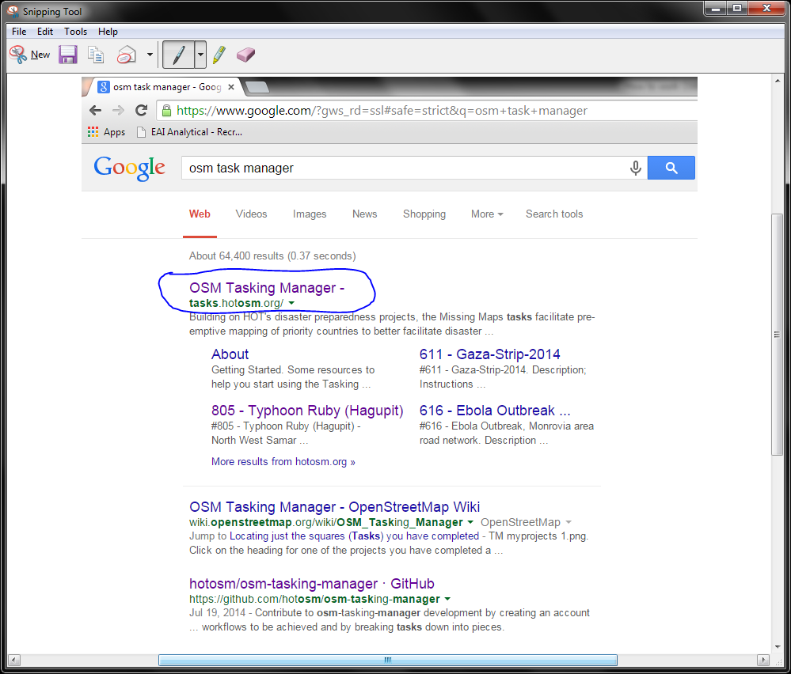

Slide 22
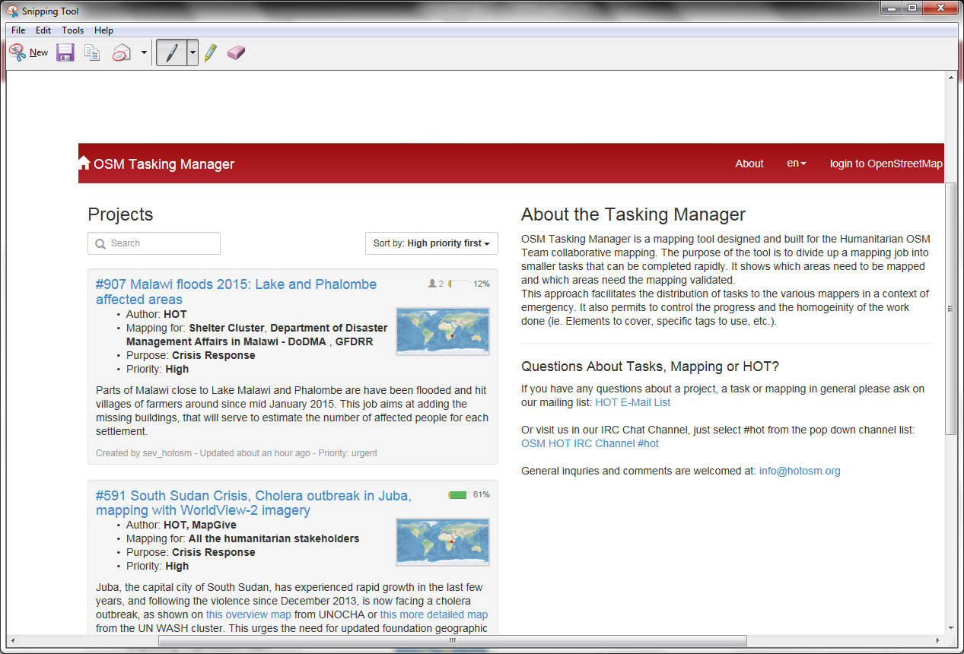

Slide 23
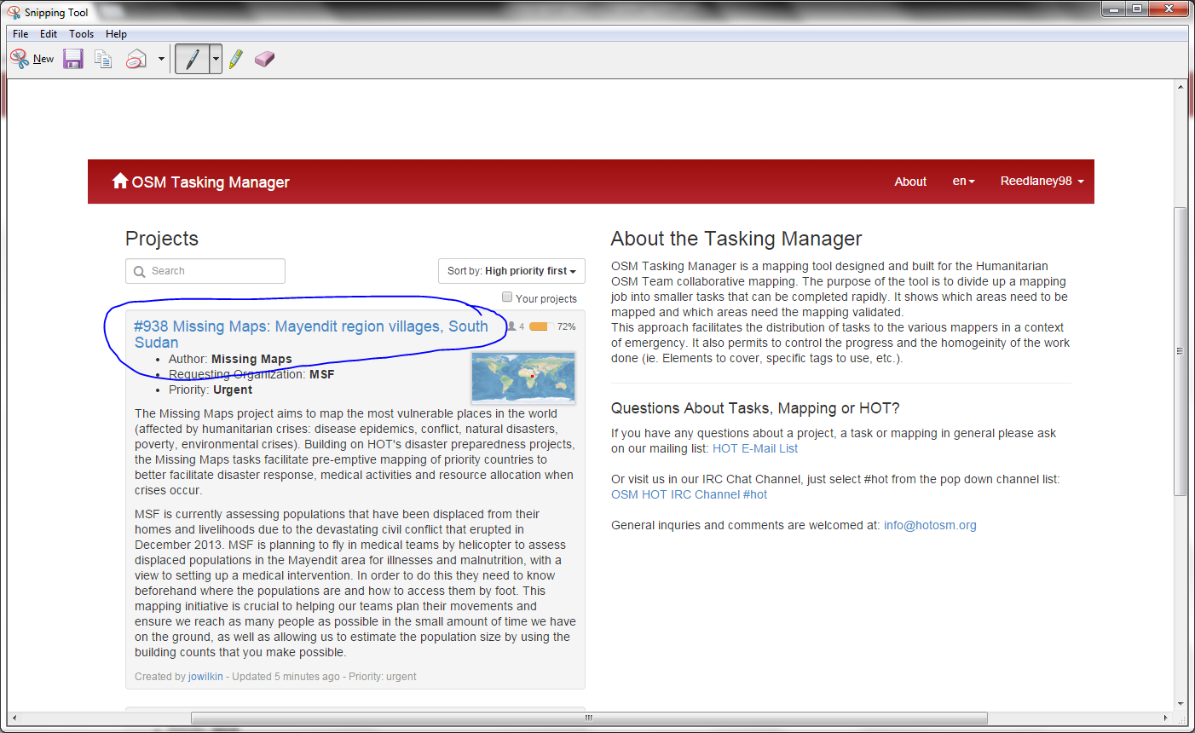

Slide 24
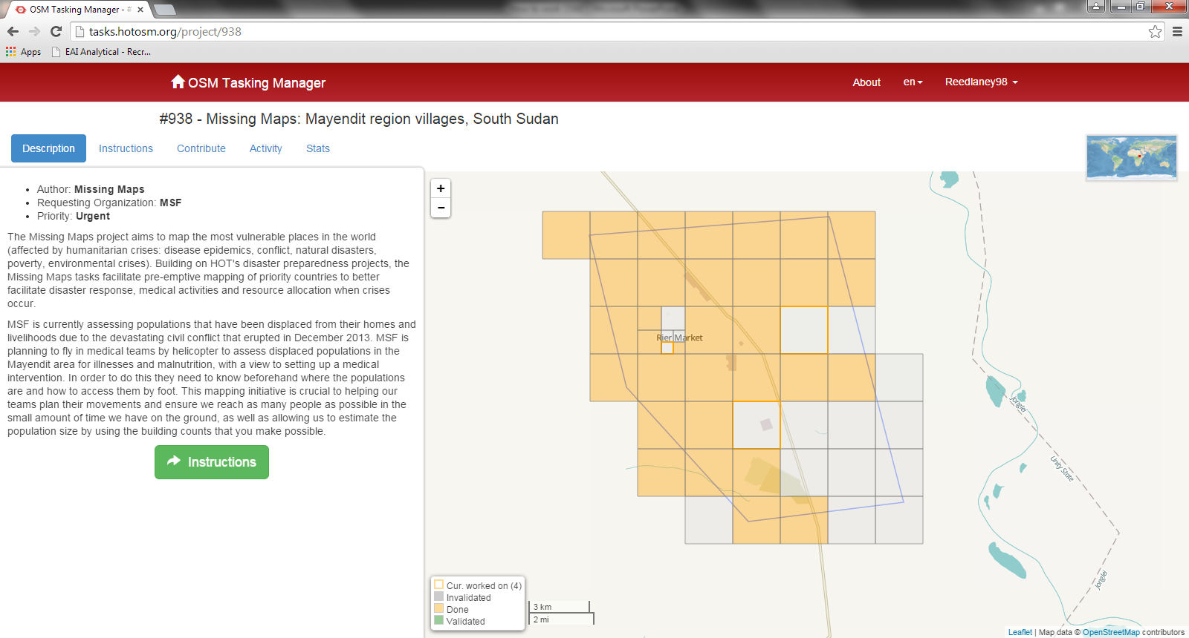

Slide 25
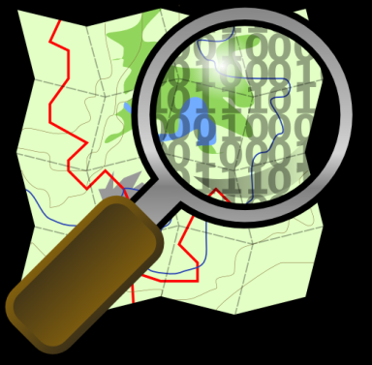
Non Emergency GIS
Open Street Maps can be helpful also for things that are not of Earth Shattering importance.
Go to Openstreetmap.org to use their services for regular mapping. You also need an account with them to use OSM HOT.

Slide 26
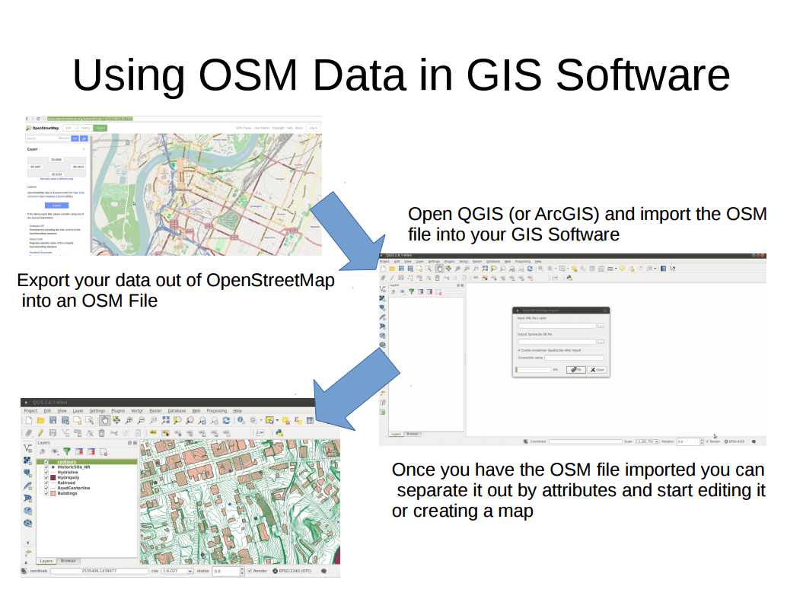
Randy Hale

Slide 27
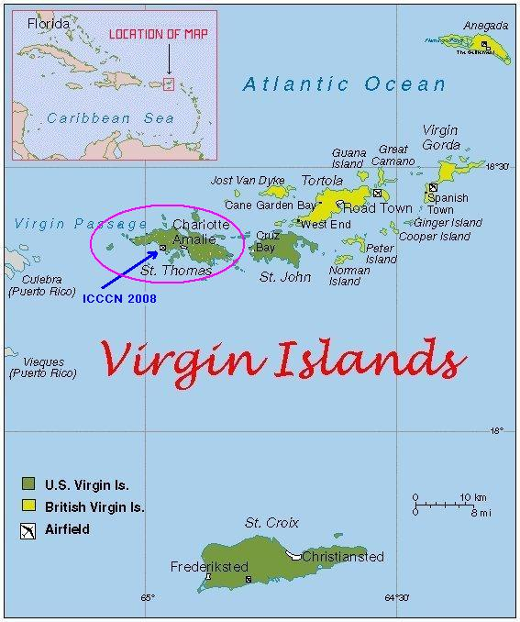
Mapping in St. Thomas

Slide 28






Lack of Addressing
Even Emergency Services don’t know their own addresses!

Slide 29
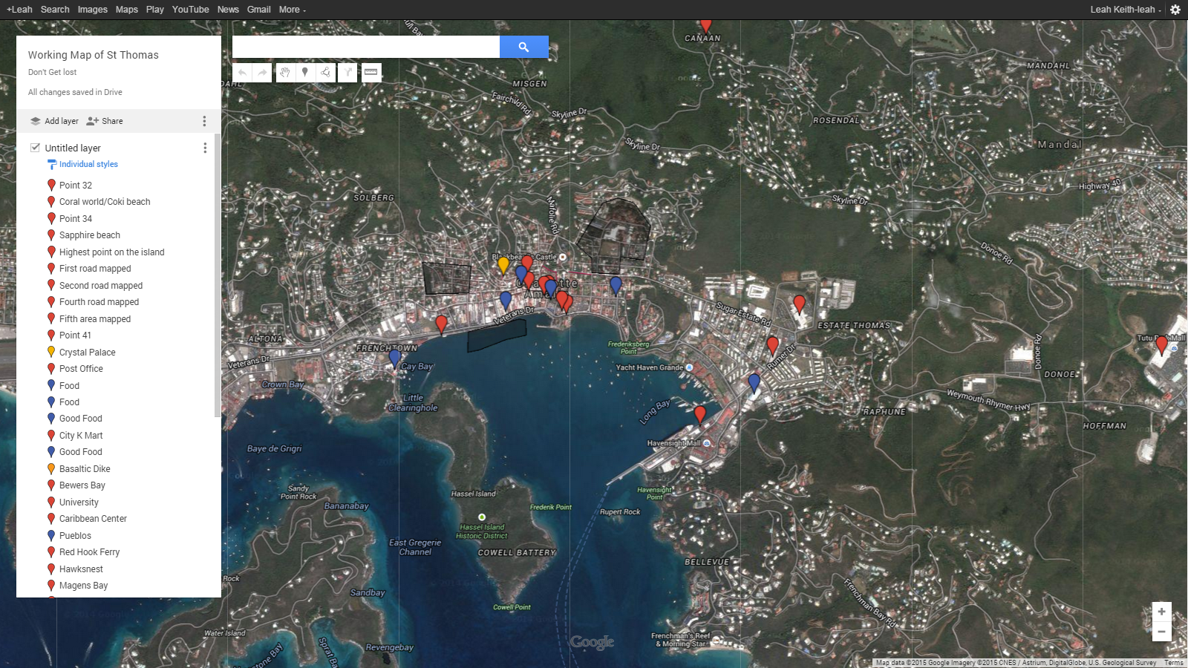
Randy’s Basemap

Slide 30
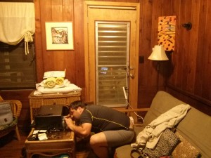
Known problems while mapping in the Caribbean
If you need the internet, computer and power−expect only 2 of the 3 to work!!
Printer hooked to an extension cord.
Extension cord run through hole in screen door to the laptop outside - reception better!
My bed is a couch. My couch is in the office.
Zac utters every 5 seconds -“I think I know why the printer isn’t working”.
http://www.northrivergeographic.com/archives/hippie-hut

Slide 31
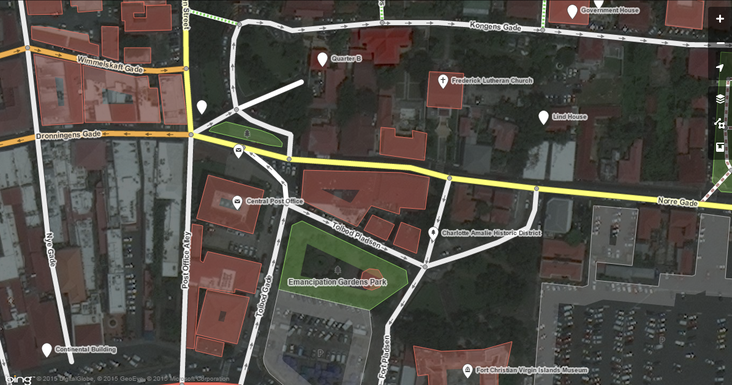
Mapping in St. Thomas

Slide 32

Why?
And the little children should lead them…

Slide 33
References
Hale. (2013, October 29). Re: Hippie Hut [Web log comment]. Retrieved from http://www.northrivergeographic.com/hippiehut
Hale. (2013, May 5). Re: One Bad Day [Web log comment]. Retrieved from http://www.northrivergeographic.com/wp-content
Hessler, J. (2014, Winter). History of GIS and Computer Cartography Project. ArcNews, 35, (4), 27.
Introduction to Open Source Mapping. (n.d.). Retrieved , from http://OSM.com
Download site for QGIS.(n.d.). Retrieved from http://QGIS./.site/index/html

