Slide 1
THE GEOLOGY AND GENOMICS OF THE GRAY AND OTHER WHALE SPECIES,THE GEORGIA BIGHT
GARRISON, Ervan, Geology, The University of Georgia, GG Building, Athens, GA 30602, egarriso@uga.edu
Survey and recovery of subfossil paleontologic remains of the gray and other whale species, in the Georgia Bight, since 2006, has provided bone samples which have been assayed for replicable DNA. To date the remains of at least four gray whales (Eschrichtius robustus) have been identified in Georgia and Florida. The Florida finds were made in the 1980s and provided by the Florida Museum of Natural History. The tooth of a sperm whale (Physeter macrocephalus) and two currently unidentified otoliths make up the sample population discussed herein. The age range for the various the gray whale finds is from Marine Isotope Stage (MIS) 3 (59-24 ka) to the early Holocene, ~8000 BP. The sperm whale tooth had eroded from MIS 3 sediments. The age determination for the subfossil bone was done using the AMS-radiocarbon method. Sediments were dated using optical stimulated luminescence (OSL).
The otoliths were recovered from a prehistoric burial found on the Georgia Bight barrier island, St. Simons, GA. The burial was that of a Late Woodland Period culture, ca. AD 900. Another otolith was found in a separate burial but permission to recover a genomic sample from this specimen has not been granted by the U.S. National Park Service as yet. Because the Georgia Bight is the calving ground for the modern right whale (Eubalena glacialis, speciation of these otoliths, using genomics, could bear on the consanguineous usage of the Bight by this or other (gray) whale species in late prehistory. The genomic study of these archaeological finds and the older geologic specimens has been carried at the University of York (UK) and/or the Max Planck Institute, Leipzig (DE

Slide 2
THE GEOLOGY AND GENOMICS OF THE GRAY AND OTHER WHALE SPECIES,THE GEORGIA BIGHT
Survey and recovery of subfossil paleontologic remains of the gray and other whale species, in the Georgia Bight, since 2006, has provided bone samples which have been assayed for replicable DNA. To date the remains of at least four gray whales (Eschrichtius robustus) have been identified in Georgia and Florida.

Slide 3
THE GEOLOGY AND GENOMICS OF THE GRAY AND OTHER WHALE SPECIES,THE GEORGIA BIGHT
Survey and recovery of subfossil paleontologic remains of the gray and other whale species, in the Georgia Bight, since 2006, has provided bone samples which have been assayed for replicable DNA. To date the remains of at least four gray whales (Eschrichtius robustus) have been identified in Georgia and Florida.
The Florida finds were made in the 1980s and provided by the Florida Museum of Natural History. The tooth of a sperm whale (Physeter macrocephalus) and two currently unidentified otoliths make up the sample population discussed herein.

Slide 4
THE GEOLOGY AND GENOMICS OF THE GRAY AND OTHER WHALE SPECIES,THE GEORGIA BIGHT
Survey and recovery of subfossil paleontologic remains of the gray and other whale species, in the Georgia Bight, since 2006, has provided bone samples which have been assayed for replicable DNA. To date the remains of at least four gray whales (Eschrichtius robustus) have been identified in Georgia and Florida.
The Florida finds were made in the 1980s and provided by the Florida Museum of Natural History. The tooth of a sperm whale (Physeter macrocephalus) and two currently unidentified otoliths make up the sample population discussed herein.
The age range for the various the gray whale finds is from Marine Isotope Stage (MIS) 3 (59-24 ka) to the early Holocene, ~8000 BP. The sperm whale tooth had eroded from MIS 3 sediments. The age determination for the subfossil bone was done using the AMS-radiocarbon method. Sediments were dated using optical stimulated luminescence (OSL).

Slide 5
THE GEOLOGY AND GENOMICS OF THE GRAY AND OTHER WHALE SPECIES,THE GEORGIA BIGHT
Survey and recovery of subfossil paleontologic remains of the gray and other whale species, in the Georgia Bight, since 2006, has provided bone samples which have been assayed for replicable DNA. To date the remains of at least four gray whales (Eschrichtius robustus) have been identified in Georgia and Florida.
The Florida finds were made in the 1980s and provided by the Florida Museum of Natural History. The tooth of a sperm whale (Physeter macrocephalus) and two currently unidentified otoliths make up the sample population discussed herein.
The age range for the various the gray whale finds is from Marine Isotope Stage (MIS) 3 (59-24 ka) to the early Holocene, ~8000 BP. The sperm whale tooth had eroded from MIS 3 sediments. The age determination for the subfossil bone was done using the AMS-radiocarbon method. Sediments were dated using optical stimulated luminescence (OSL).
The otoliths were recovered from a prehistoric burial found on the Georgia Bight barrier island, St. Simons, GA. The burial was that of a Late Woodland Period culture, ca. AD 900. Another otolith was found in a separate burial but permission to recover a genomic sample from this specimen has not been granted by the U.S. National Park Service as yet. Because the Georgia Bight is the calving ground for the modern right whale (Eubalena glacialis, speciation of these otoliths, using genomics, could bear on the consanguineous usage of the Bight by this or other (gray) whale species in late prehistory.

Slide 6
THE GEOLOGY AND GENOMICS OF THE GRAY AND OTHER WHALE SPECIES,THE GEORGIA BIGHT
Survey and recovery of subfossil paleontologic remains of the gray and other whale species, in the Georgia Bight, since 2006, has provided bone samples which have been assayed for replicable DNA. To date the remains of at least four gray whales (Eschrichtius robustus) have been identified in Georgia and Florida.
The Florida finds were made in the 1980s and provided by the Florida Museum of Natural History. The tooth of a sperm whale (Physeter macrocephalus) and two currently unidentified otoliths make up the sample population discussed herein.
The age range for the various the gray whale finds is from Marine Isotope Stage (MIS) 3 (59-24 ka) to the early Holocene, ~8000 BP. The sperm whale tooth had eroded from MIS 3 sediments. The age determination for the subfossil bone was done using the AMS-radiocarbon method. Sediments were dated using optical stimulated luminescence (OSL).
The otoliths were recovered from a prehistoric burial found on the Georgia Bight barrier island, St. Simons, GA. The burial was that of a Late Woodland Period culture, ca. AD 900. Another otolith was found in a separate burial but permission to recover a genomic sample from this specimen has not been granted by the U.S. National Park Service as yet. Because the Georgia Bight is the calving ground for the modern right whale (Eubalena glacialis, speciation of these otoliths, using genomics, could bear on the consanguineous usage of the Bight by this or other (gray) whale species in late prehistory.
The genomic study of these archaeological finds and the older geologic specimens has been carried at the University of York (UK) and/or the Max Planck Institute, Leipzig (DE).

Slide 7
History & Taxonomy of Atlantic Gray Whales
The North Atlantic gray whale went extinct prior to formal analysis of its taxonomy. However, it is currently classified as the same species as gray whales in the North Pacific.
It is not clear if this assumption is valid or not because some closely related baleen whale populations are defined as different species (separated by > 3 million years) in the North Pacific and North Atlantic (e.g. right whales), whereas others are classified as one species, with some evidence of occasional movement between oceans (e.g. humpback whales). Additionally, it is not clear if the North Atlantic gray whale represented one panmictic population, or if it existed as two or more populations within the Atlantic (one population on either side of the Atlantic, for example).
In this presentation I will:
1. Present recent results for Atlantic gray whale studies in Europe and the Georgia
Bight;
2. Discuss the recent use the genetic data to test two hypotheses regarding gray whale
taxonomy: (1) that gray whales in the North Atlantic represent the same species as
those in the North Pacific; and (2) that gray whales on either side of the Atlantic
represented one panmictic population.
Relate the results of 1 & 2 with regard to the extirpation of the Atlantic gray whale in the Georgia Bight and the western Atlantic basin.
Briefly discuss archaeological finds of possible rorqual whale in coastal Georgia.

Slide 8
History & Taxonomy of Atlantic Gray Whales
The North Atlantic gray whale went extinct prior to formal analysis of its taxonomy. However, it is currently classified as the same species as gray whales in the North Pacific.
It is not clear if this assumption is valid or not because some closely related baleen whale populations are defined as different species (separated by > 3 million years) in the North Pacific and North Atlantic (e.g. right whales), whereas others are classified as one species, with some evidence of occasional movement between oceans (e.g. humpback whales). Additionally, it is not clear if the North Atlantic gray whale represented one panmictic population, or if it existed as two or more populations within the Atlantic (one population on either side of the Atlantic, for example).
In this presentation I will:
1. Present recent results for Atlantic gray whale studies in Europe and the Georgia
Bight;
2. Discuss the recent use the genetic data to test two hypotheses regarding gray whale
taxonomy: (1) that gray whales in the North Atlantic represent the same species as
those in the North Pacific; and (2) that gray whales on either side of the Atlantic
represented one panmictic population.
Relate the results of 1 & 2 with regard to the extirpation of the Atlantic gray whale in the Georgia Bight and the western Atlantic basin.
Briefly discuss archaeological finds of possible rorqual whale in coastal Georgia.

Slide 9
History & Taxonomy of Atlantic Gray Whales
The North Atlantic gray whale went extinct prior to formal analysis of its taxonomy. However, it is currently classified as the same species as gray whales in the North Pacific.
It is not clear if this assumption is valid or not because some closely related baleen whale populations are defined as different species (separated by > 3 million years) in the North Pacific and North Atlantic (e.g. right whales), whereas others are classified as one species, with some evidence of occasional movement between oceans (e.g. humpback whales). Additionally, it is not clear if the North Atlantic gray whale represented one panmictic population, or if it existed as two or more populations within the Atlantic (one population on either side of the Atlantic, for example).
In this presentation I will:
1. Present recent results for Atlantic gray whale studies in Europe and the Georgia
Bight;
2. Discuss the recent use the genetic data to test two hypotheses regarding gray whale
taxonomy: (1) that gray whales in the North Atlantic represent the same species as
those in the North Pacific; and (2) that gray whales on either side of the Atlantic
represented one panmictic population.
Relate the results of 1 & 2 with regard to the extirpation of the Atlantic gray whale in the Georgia Bight and the western Atlantic basin.
Briefly discuss archaeological finds of possible rorqual whale in coastal Georgia.

Slide 10
History & Taxonomy of Atlantic Gray Whales
The North Atlantic gray whale went extinct prior to formal analysis of its taxonomy. However, it is currently classified as the same species as gray whales in the North Pacific.
It is not clear if this assumption is valid or not because some closely related baleen whale populations are defined as different species (separated by > 3 million years) in the North Pacific and North Atlantic (e.g. right whales), whereas others are classified as one species, with some evidence of occasional movement between oceans (e.g. humpback whales). Additionally, it is not clear if the North Atlantic gray whale represented one panmictic population, or if it existed as two or more populations within the Atlantic (one population on either side of the Atlantic, for example).
In this presentation I will:
1. Present recent results for Atlantic gray whale studies in Europe and the Georgia
Bight;
2. Discuss the recent use the genetic data to test two hypotheses regarding gray whale
taxonomy: (1) that gray whales in the North Atlantic represent the same species as
those in the North Pacific; and (2) that gray whales on either side of the Atlantic
represented one panmictic population.
Relate the results of 1 & 2 with regard to the extirpation of the Atlantic gray whale in the Georgia Bight and the western Atlantic basin.
Briefly discuss archaeological finds of possible rorqual whale in coastal Georgia.

Slide 11
History & Taxonomy of Atlantic Gray Whales
The North Atlantic gray whale went extinct prior to formal analysis of its taxonomy. However, it is currently classified as the same species as gray whales in the North Pacific.
It is not clear if this assumption is valid or not because some closely related baleen whale populations are defined as different species (separated by > 3 million years) in the North Pacific and North Atlantic (e.g. right whales), whereas others are classified as one species, with some evidence of occasional movement between oceans (e.g. humpback whales). Additionally, it is not clear if the North Atlantic gray whale represented one panmictic population, or if it existed as two or more populations within the Atlantic (one population on either side of the Atlantic, for example).
In this presentation I will:
1. Present recent results for Atlantic gray whale studies in Europe and the Georgia
Bight;
2. Discuss the recent use the genetic data to test two hypotheses regarding gray whale
taxonomy: (1) that gray whales in the North Atlantic represent the same species as
those in the North Pacific; and (2) that gray whales on either side of the Atlantic
represented one panmictic population.
Relate the results of 1 & 2 with regard to the extirpation of the Atlantic gray whale in the Georgia Bight and the western Atlantic basin.
Briefly discuss archaeological finds of possible rorqual whale in coastal Georgia.

Slide 12
Genomic Studies – Recent Findings
Methods to extract DNA from old bone specimens have improved greatly over the years, to the point where it is now common to obtain DNA that is over 10,000 years old.
Drs. Frasier & McLeod at Saint Mary’s University have been conducting long-term studies of contemporary North Atlantic right whales and North Pacific gray whales for many years, and therefore have an abundance of DNA from each species already in hand.
Indeed, Dr. McLeod’s findings from her DNA study of over 300 historic & archaeological whale bone samples (McLeod, 200X) indicate the Atlantic gray whale was not present, at all, and the Northern Atlantic right whale’s presence was far less than anticipated. Her sample was dominated by the bowhead whale.
Two things can be deduced from these findings, presuming the sample was statistically sufficient, with regard to the Atlantic gray whale:
The Northern Atlantic gray whale population, in the western Atlantic basin, was so small/extinct as to be “archaeologically invisible” by historic times, 16th -19th c. and/or
2. The Northern Atlantic gray whale population, in the western Atlantic basin, was not
hunted in historic times.

Slide 13
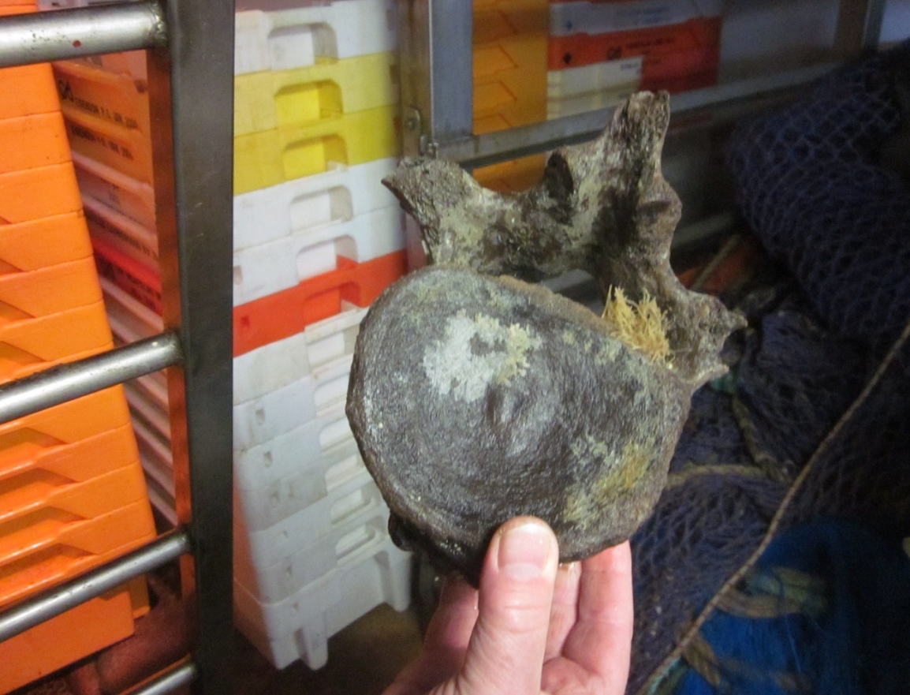
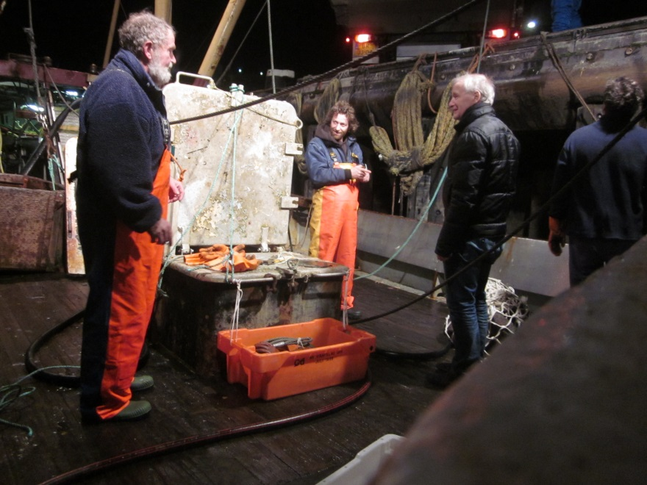
The Atlantic gray whale – eastern Atlantic basin
Assuming the appropriate taxonomic entities have been clearly identified – the Atlantic gray whale, in particular, - genetic data can be used to infer the demographic history of the historic population prior to extirpation. Specifically, the hypothesis that the Atlantic population(s) - eastern and western - were in decline prior to the onset of human exploitation, as McLeod’s data indicates.
Sub-fossil rorqual whale vertebra, 2014, North Sea (photographs by author)

Slide 14
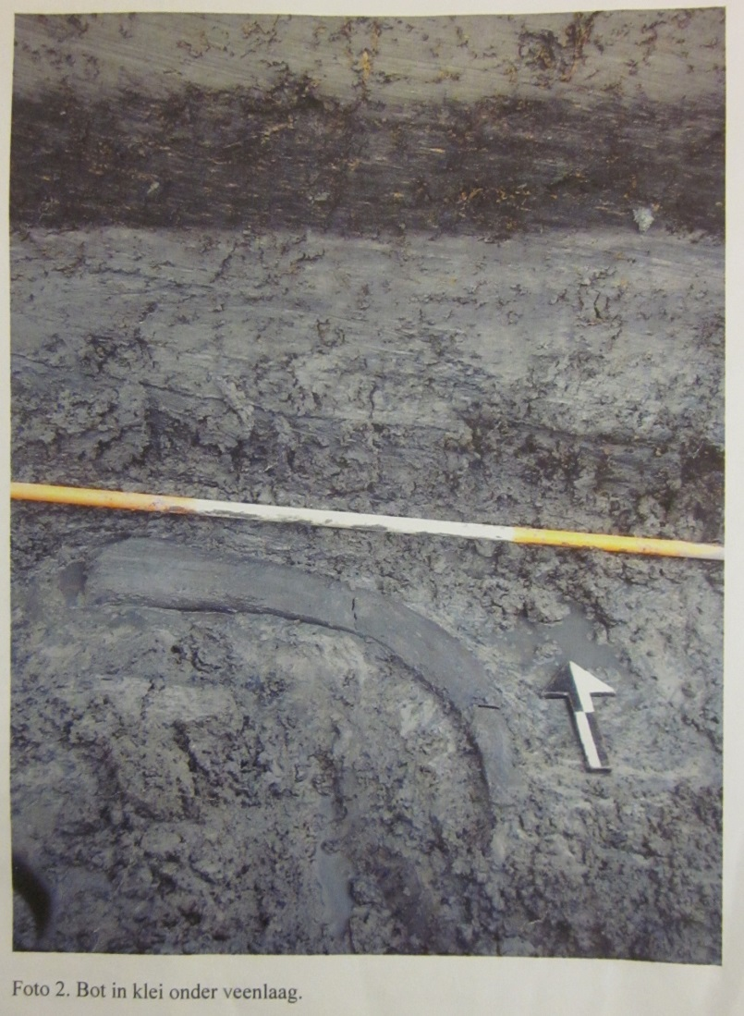
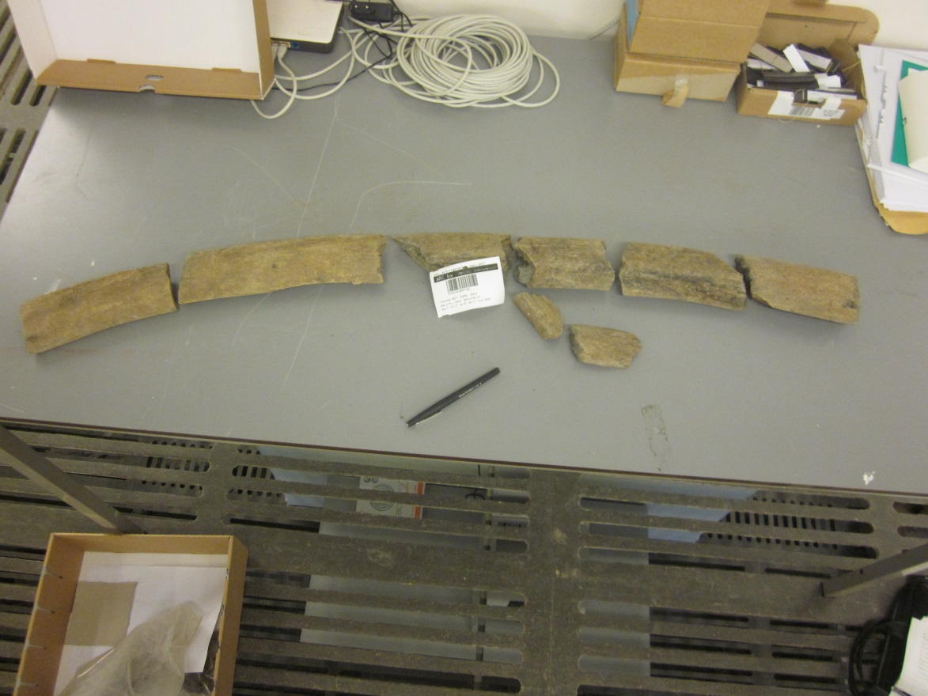
The Atlantic gray whale – eastern Atlantic basin
Left, photograph of gray whale “rib” in situ; right, the same find, reconstructed by the author at the Nautralis Museum, Leiden, Netherlands, in 2014. Record indicates it being sampled for DNA study by Alter, et al., 2015.

Slide 15
Genomic Studies – Recent Findings
To test the hypothesis that the Atlantic gray whale population have been a species distinct from that of the North Pacific, European researchers, at York University and the Max Planck Institute, Leipzig, have conducted phylogenetic analyses of the sequences obtained, primarily, from eastern Atlantic materials (Alter, et al., (2015) These analyses have compared the sequence data from the sub-fossil bone specimens, such as the rib just shown, to those from modern North Pacific populations.
If these two sets of materials were to represent a separate species, then the sequences should be reciprocally monophyletic between samples from the two oceans (the samples from each ocean should represent distinct clades). Reciprocal monophyly represents a common criterion for species delimitation based on molecular data. Thus, the hypothesis of a single species could be rejected. If the sequences were reciprocally monophyletic with respect to samples from the Atlantic and Pacific oceans, the timing of the divergence of the species could be estimated to place that speciation event into an appropriate temporal and ecological context.
If the sequences are not reciprocally monophyletic with respect to oceans, this would not necessarily lead to the acceptance of the single species hypothesis. Instead, distinct species may not be reciprocally monophyletic if not enough time has passed for complete genetic differentiation to occur.

Slide 16
Genomic Studies – Recent Findings
The eastern North Atlantic basin
….a combination of ancient and modern DNA, radiocarbon dating and
predictive habitat modeling has been used to better understand the distribution of gray whales during the Pleistocene and Holocene. “Our results reveal that dispersal between the Pacific and Atlantic was climate-dependent, and occurred – at least twice - both during the Pleistocene prior to the last glacial period, and the early Holocene immediately following the opening of the Bering Strait.” Thus, the hypothesis of a single species can not be rejected.
Genetic diversity in the Atlantic declined over an extended interval that
predates the period of intensive commercial whaling, indicating this decline may have been precipitated by Holocene climate or other ecological causes.
Alter, et al., 2015. Climate impacts on trans-ocean dispersal and habitat in gray whales from the Pleistocene to 2100. Molecular Ecology. In press.

Slide 17
Genomic Studies – Recent Findings
The eastern North Atlantic basin
….a combination of ancient and modern DNA, radiocarbon dating and
predictive habitat modeling has been used to better understand the distribution of gray whales during the Pleistocene and Holocene. “Our results reveal that dispersal between the Pacific and Atlantic was climate-dependent, and occurred – at least twice - both during the Pleistocene prior to the last glacial period, and the early Holocene immediately following the opening of the Bering Strait.” Thus, the hypothesis of a single species can not be rejected.
Genetic diversity in the Atlantic declined over an extended interval that
predates the period of intensive commercial whaling, indicating this decline may have been precipitated by Holocene climate or other ecological causes.
Alter, et al., 2015. Climate impacts on trans-ocean dispersal and habitat in gray whales from the Pleistocene to 2100. Molecular Ecology. In press.

Slide 18
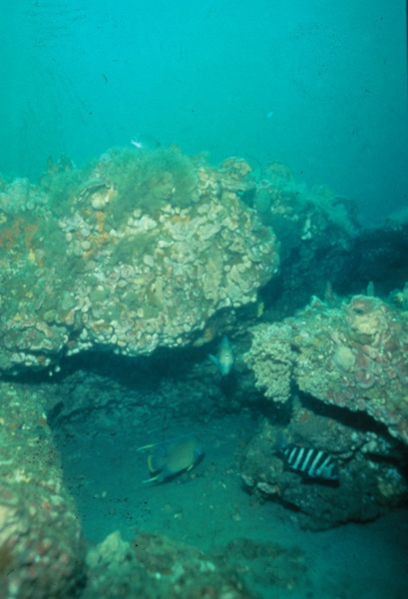
The Atlantic gray whale in the western Atlantic Basin, Georgia Bight
Do the western Atlantic gray whale data support the conclusion that “a dispersal between the Pacific and Atlantic was climate-dependent, and occurred – at least twice - both during the Pleistocene prior to the last glacial period…”?
Reef ledge, Georgia Bight, photograph by author.

Slide 19
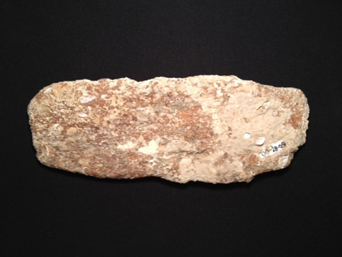
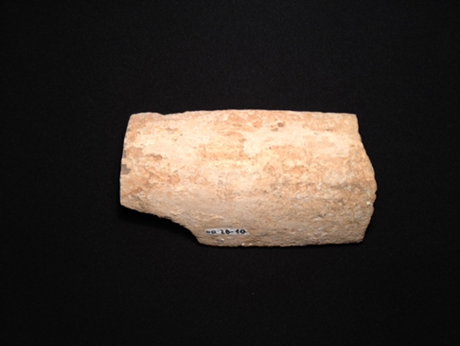
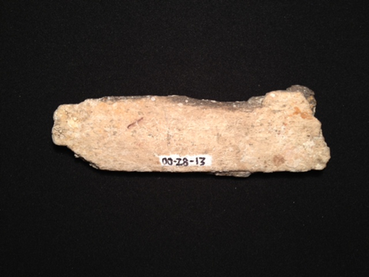
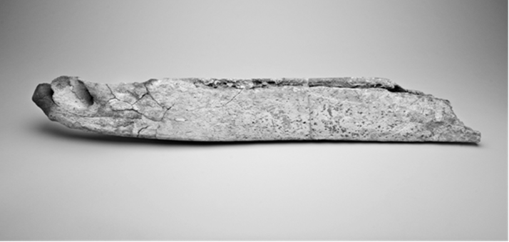
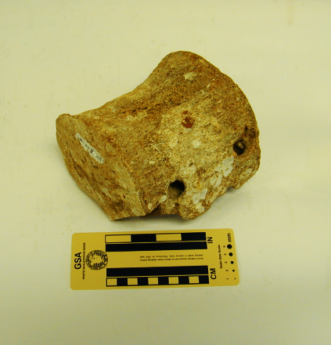
The Atlantic gray whale in the western Atlantic Basin, Georgia Bight – How many animals?
A
B
C
Laboratory # | δ¹³C [‰] vs. VPDB | δ¹⁸O [‰] vs. VPDB | δ¹⁸O [‰] vs. VSMOW
Sample A (00-28-09) | -5.11 | 0.22 | -31.14
Sample B (00-28-10) | -5.04 | 0.14 | -31.05
Sample C (00-28-10) | -4.80 | 0.92 | -31.86
4024 (vertebra) | -7.66 | - | -20.96
4281 (dentary) | -6.62 | - | -20.25
4215 (vertebra) | -6.67 | - | -21.21
12056 (crania) | -9.5 | - | -
12057 (crania) | -10.3 | - | -
4281

Slide 20
The Atlantic gray whale in the western Atlantic Basin, Georgia Bight cont. -
UGA # | Element | Condition |  | Find Location |  | ¹⁴C age, years BP
4024 | Vertebra | Sub fossil |  | J-Reef |  | 37,580±120
4281 | Mandible | Sub fossil |  | J-Reef |  | 36,570±300
4215 | Vertebra | Sub fossil |  | J-reef |  | 34,520±160
12056 | crania | Sub fossil |  | Florida |  | 2130+/-25
12057 | crania | Sub fossil |  | Florida |  | 2190+/-20

Slide 21
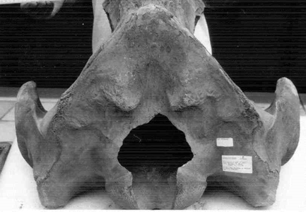
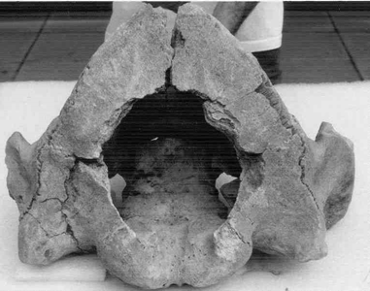
Two partial Atlantic gray whale crania, left, Hobe Sound; right, Jacksonville Beach, FL., Georgia Bight.
Noakes, et al (2013) report two additional juvenile gray whale cranial bones not far from the earlier dentary and vertebrae finds, both dating to 40,000 ka.
If we use the zooarchaeological estimator of population – MNI –
or “Minimum Number of Individuals” and equate each bone find to one individual, the western basin population is up to over a half dozen animals found on the last 3 decades.

Slide 22
Collagen based DNA species determination studies, at York University, confirms the two Florida finds to be Eschricthius robustus aka the Atlantic gray whale. Likewise, The existence of two populations – Pleistocene and Holocene is supported by the western Atlantic dates (5). The synchronous timing of the decline in the western and eastern Atlantic basins is supported by – three dates for a late Pleistocene population and two dates for the later Holocene population.
Conclusions:
(1) that gray whales in the North Atlantic – eastern and western basin - represent the
same species as those in the North Pacific; and
(2) that gray whales on either side of the Atlantic represented one
panmictic population.
Can we evaluate?
The Northern Atlantic gray whale population, in the western Atlantic basin, was so small/extinct as to be “archaeologically invisible” by historic times, 16th -19th c. and/or
The Northern Atlantic gray whale population, in the western Atlantic basin, was
not hunted in historic times.
Only that none our offshore finds date to the “historic” period.

Slide 23
Collagen based DNA species determination studies, at York University, confirms the two Florida finds to be Eschricthius robustus aka the Atlantic gray whale. Likewise, The existence of two populations – Pleistocene and Holocene is supported by the western Atlantic dates (5). The synchronous timing of the decline in the western and eastern Atlantic basins is supported by – three dates for a late Pleistocene population and two dates for the later Holocene population.
Conclusions:
(1) that gray whales in the North Atlantic – eastern and western basin - represent the
same species as those in the North Pacific; and
(2) that gray whales on either side of the Atlantic represented one
panmictic population.
Can we evaluate?
The Northern Atlantic gray whale population, in the western Atlantic basin, was so small/extinct as to be “archaeologically invisible” by historic times, 16th -19th c. and/or
The Northern Atlantic gray whale population, in the western Atlantic basin, was
not hunted in historic times.
Only that none our offshore finds date to the “historic” period.

Slide 24
Collagen based DNA species determination studies, at York University, confirms the two Florida finds to be Eschricthius robustus aka the Atlantic gray whale. Likewise, The existence of two populations – Pleistocene and Holocene is supported by the western Atlantic dates (5). The synchronous timing of the decline in the western and eastern Atlantic basins is supported by – three dates for a late Pleistocene population and two dates for the later Holocene population.
Conclusions:
(1) that gray whales in the North Atlantic – eastern and western basin - represent the
same species as those in the North Pacific; and
(2) that gray whales on either side of the Atlantic represented one
panmictic population.
Can we evaluate?
The Northern Atlantic gray whale population, in the western Atlantic basin, was so small/extinct as to be “archaeologically invisible” by historic times, 16th -19th c. and/or
The Northern Atlantic gray whale population, in the western Atlantic basin, was
not hunted in historic times.
Only that none our offshore finds date to the “historic” period.

Slide 25
Genomic Studies – Recent Findings cont. –
Can the archaeological finds be gray whales?
Whale Otolith Spools - Holder recorded two finds of an “…ossified ear-bone of a whale…” (Midden-pit 66, T11S3, 17-32; F42, surface; Artifact catalogue Site I) At the Sea Palms site two modified whale otoliths…. (Cook, 2013)

Slide 26
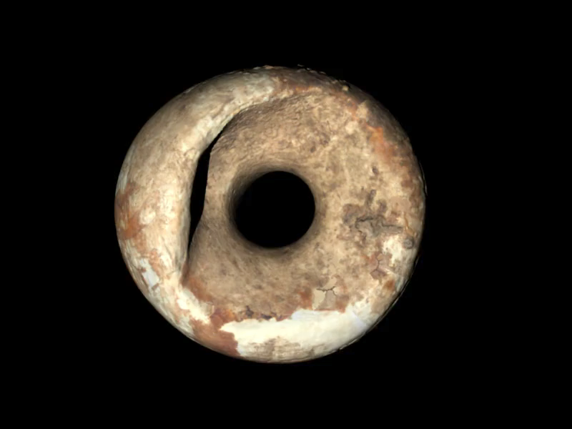

Slide 27
Geological map for the area of the Kelvin Culture, coastal Georgia, and proximity to the Georgia Bight shoreline, ca. 800 AD.

Slide 28
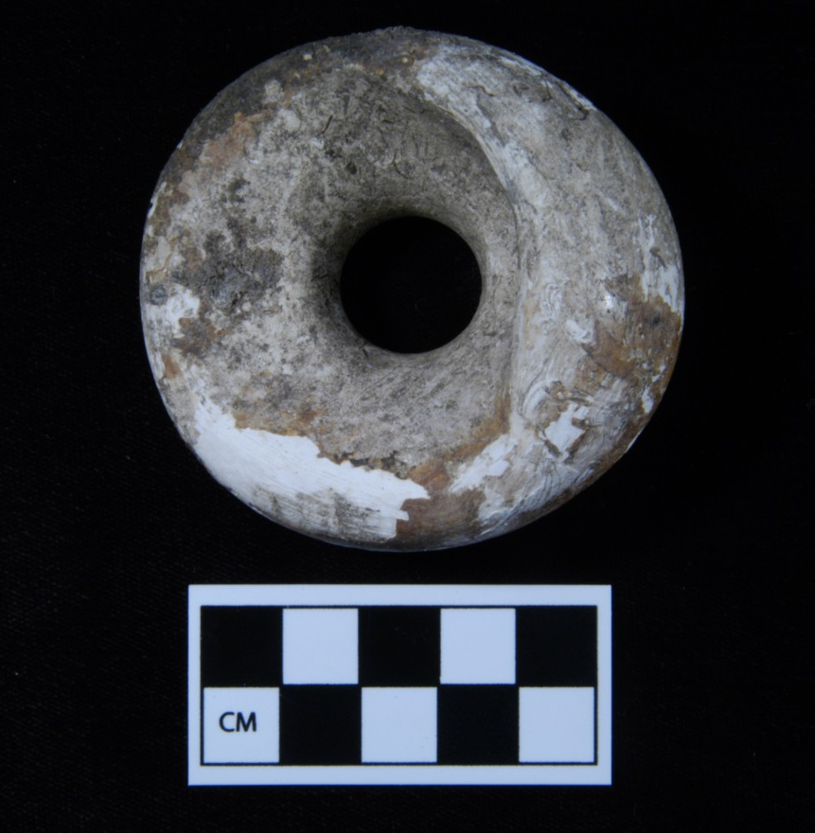
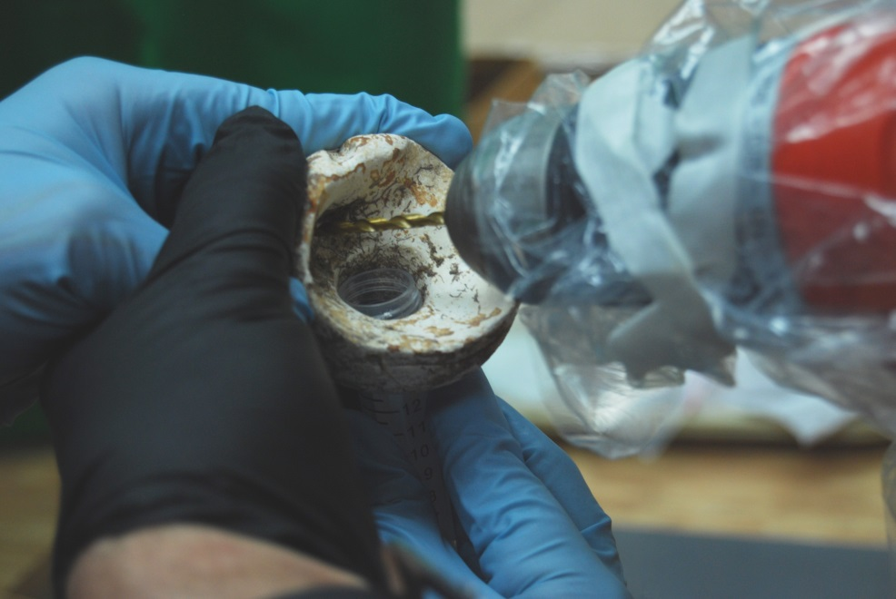
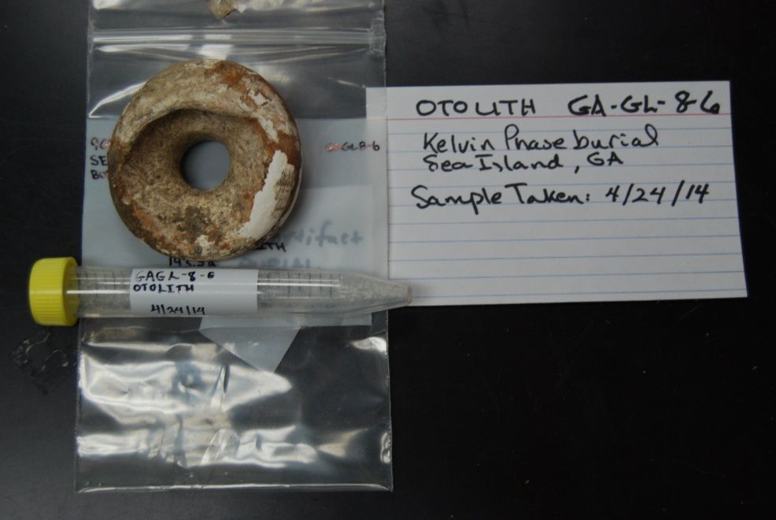
Genomic Studies – Recent Findings cont. -
Results, York University – no collagen; no DNA. They remain
“gray” only as a hypothesis but could be “right” or another whale species.

Slide 29
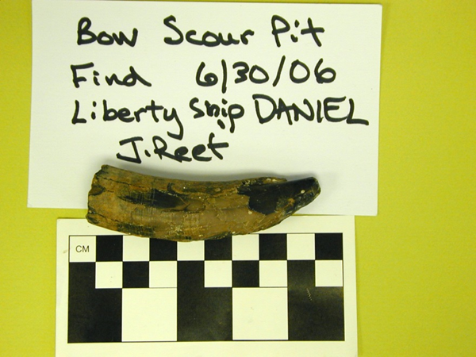
Oh yes, almost forgot – the Sperm whale…
The tooth was found in 2009 within a time-averaged faunal assemblage not far from the gray whale fossils were discovered.
Dating of associated shell from the coquina still in situ, indicated a minimum age of sometime within Marine Isotope Stage 3, 59- 24 ka.
NO DNA results nor isotopic data have been developed as yet.

Slide 30
Thanks!

Slide 31
Acknowledgements
Dr. Brenna McLeod, Tim Frazier – St. Mary’s University
Dr. Camilla Speller, York University
Dr. Michael Hofreiter, Potsdam University
Klaas Post, Natural History Museum, Rotterdam
Naturalis, Natural History Museum, Leiden
Gary S. Morgan, The New Mexico Museum of Natural History & Science
Dr. Alexander Cherkinsky, Center for Applied Isotope Studies, University of Georgia
Dr. Scott E. Noakes, , Center for Applied Isotope Studies, University of Georgia
The Laboratory for Archaeology, University of Georgia - Dr. Mark Williams; Amanda Thompson; Isabelle Cantin
Dr. Nicholas Pyenson, Smithsonian Institution
National Oceanic and Atmospheric Administration (NOAA)

