Slide 1
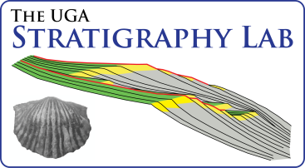
Community paleoecology of the Jurassic (Bajocian-Oxfordian) Sundance Seaway in the Bighorn Basin of Wyoming and Montana, United States
Kristopher M. Kusnerik* and Steven M. Holland
Department of Geology, University of Georgia
Athens, Georgia
30602-2501
kusnerik@uga.edu

Slide 2
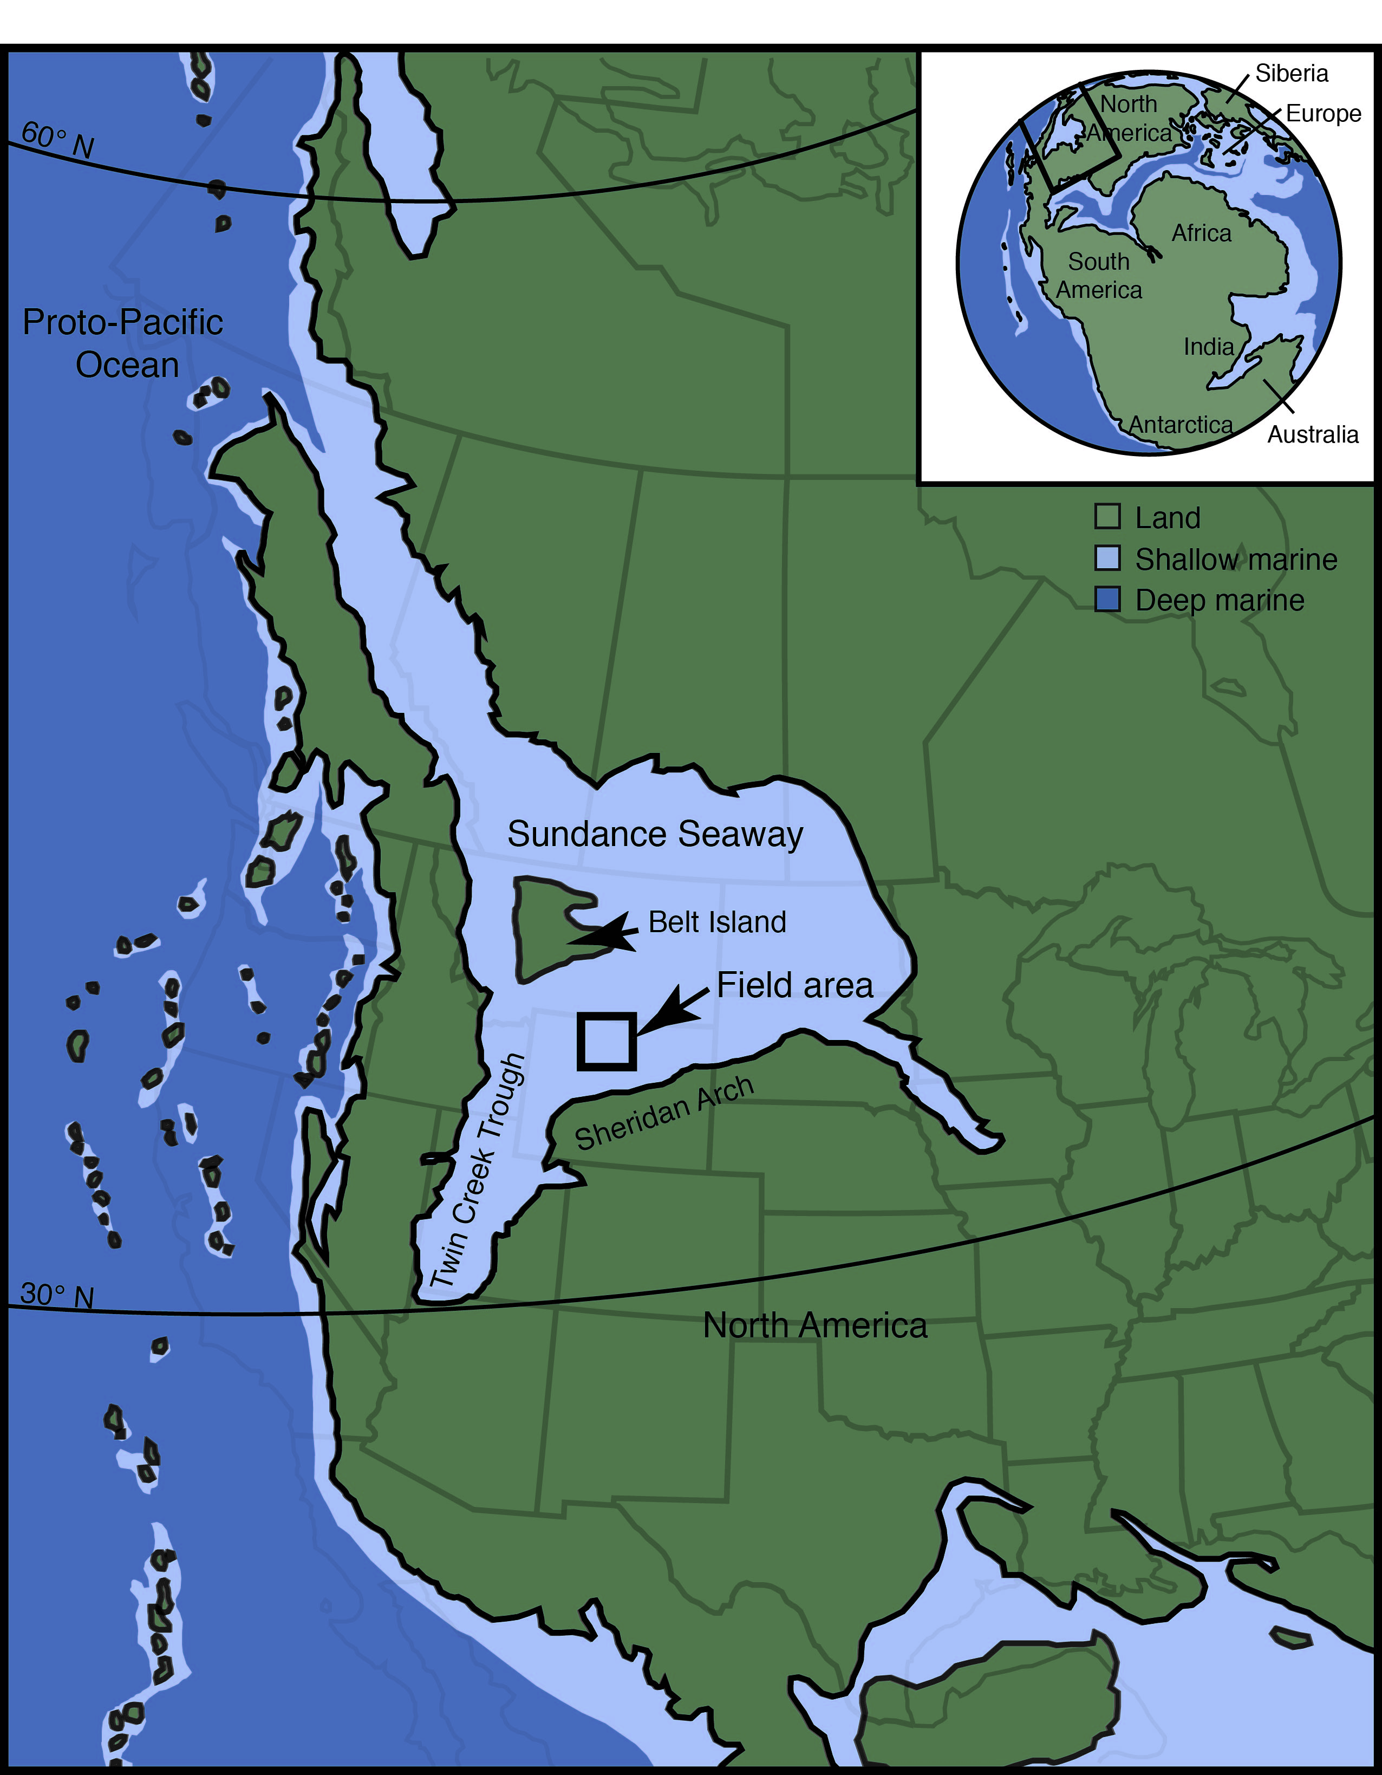
Paleogeographic Setting
Modified from Blakey (2014)
Notes:
Shallow, epicontinental seaway (Imlay, 1980; Kvale et al., 2001; Blakey, 2014)
Shallower than 100m
Single northern entranceway
Geographically restricted
Geologically short existence
180-140 MA
Covered Bighorn Basin for about 15 myr

Slide 3
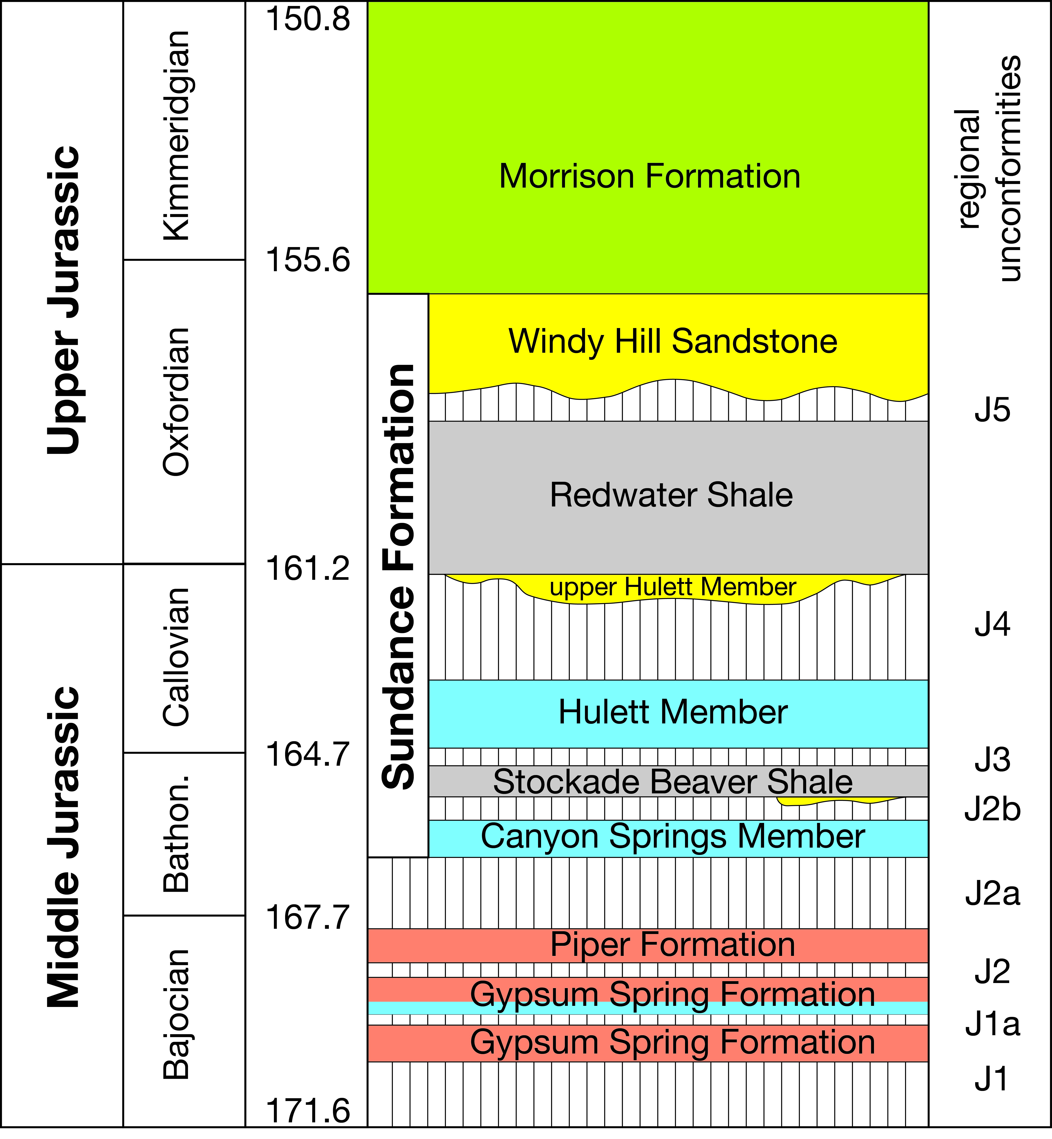
Geologic Setting
Modified from McMullen et al. (2014)

Slide 4
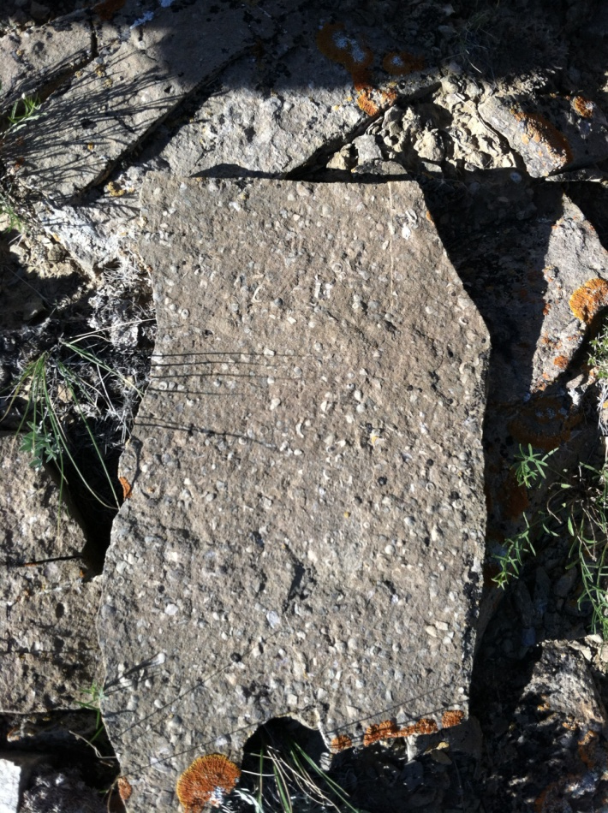
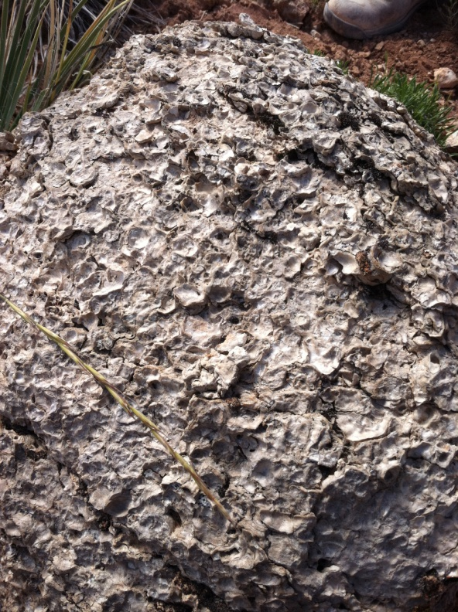
Goals
Notes:
What are the patterns of community composition through the Seaway’s existence, particularity in terms of dominance and diversity?
How do these patterns vary both within units and over time?
What are the factor(s) controlling community composition and variation?

Slide 5
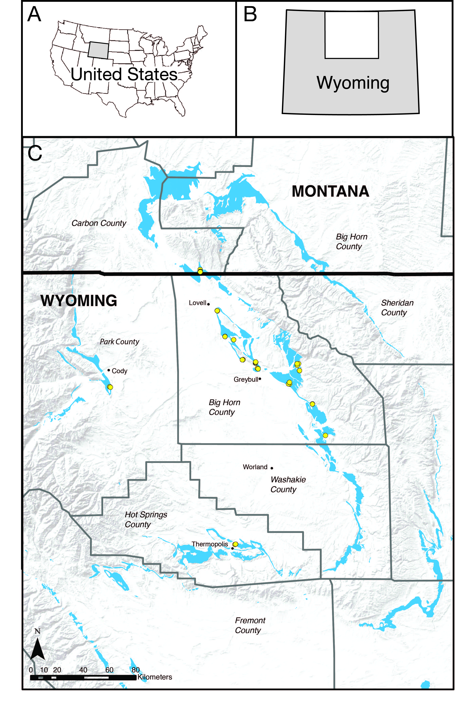
Sampling
13 localities
82 samples
49 taxa
14,550 specimens

Slide 6
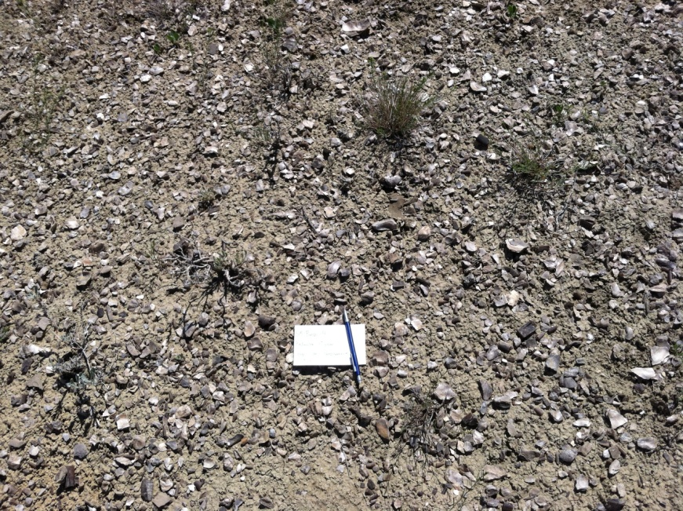
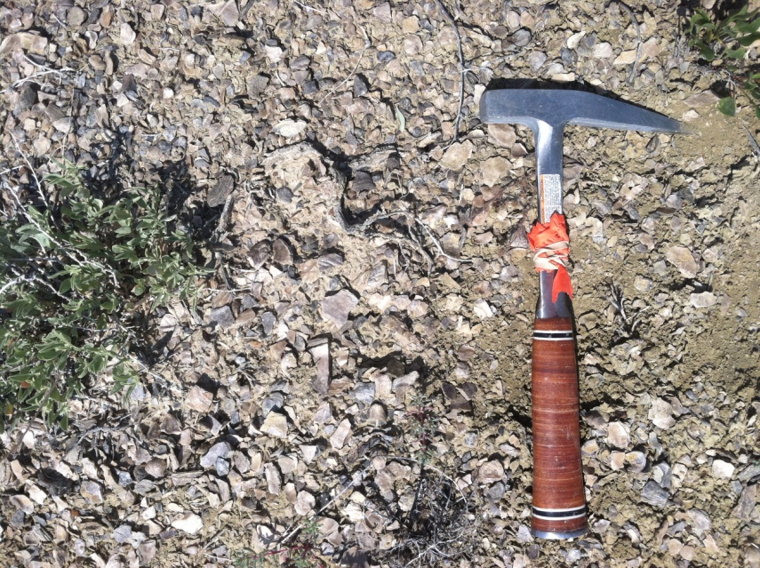
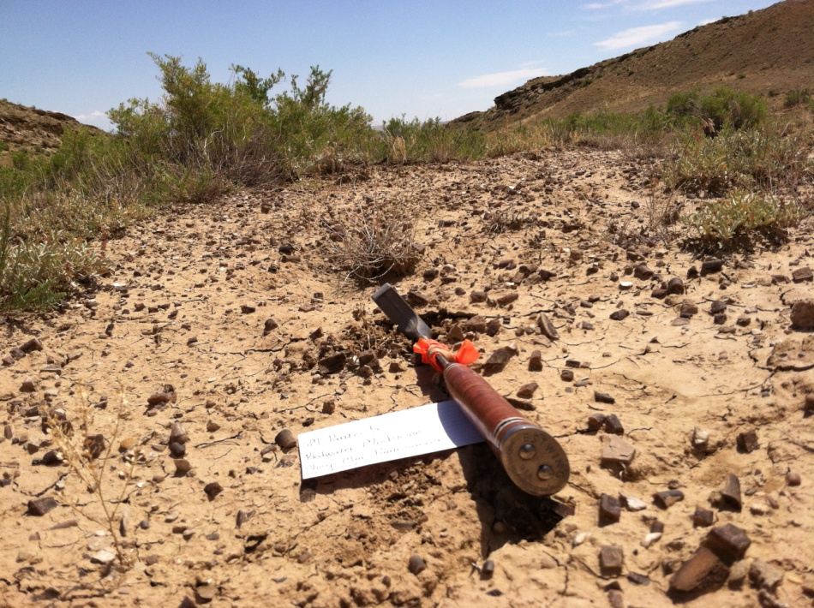
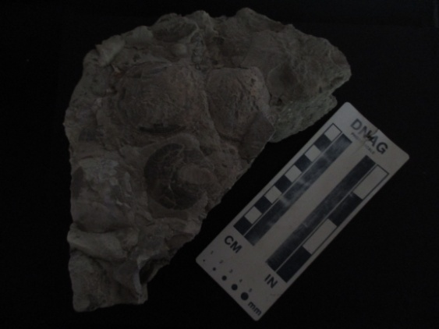
Dominance and Diversity
Gryphaea
Liostrea
Pachyteuthis
Camptonectes

Slide 7
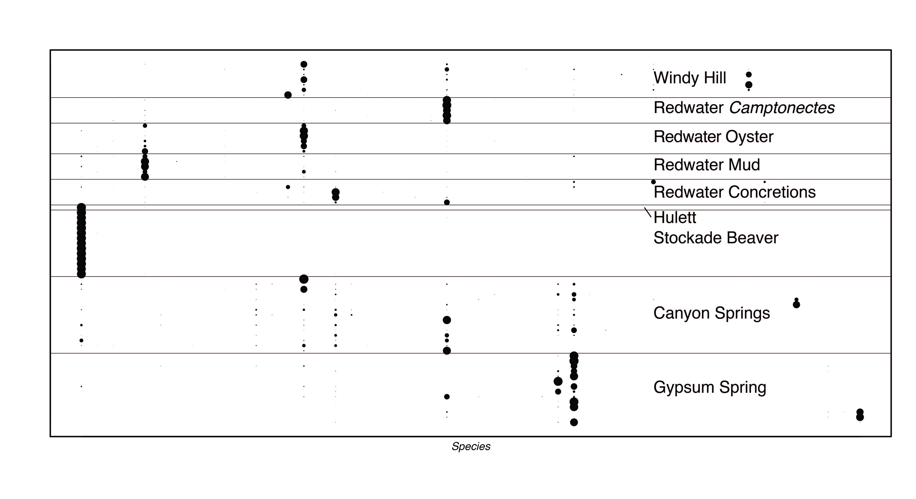
Dominance and Diversity

Slide 8
Dominance and Diversity
Camptonectes
Liostrea
Pachyteuthis
Gryphaea

Slide 9
Dominance and Diversity
Trigonia
Camptonectes
Pleuromya
Corbicellopsis

Slide 10
Dominance and Diversity
Liostrea
Procerithium
Pleuromya
Camptonectes

Slide 11
Dominance and Diversity
Kallirhynchia
Liostrea
Camptonectes
Mactromya

Slide 12
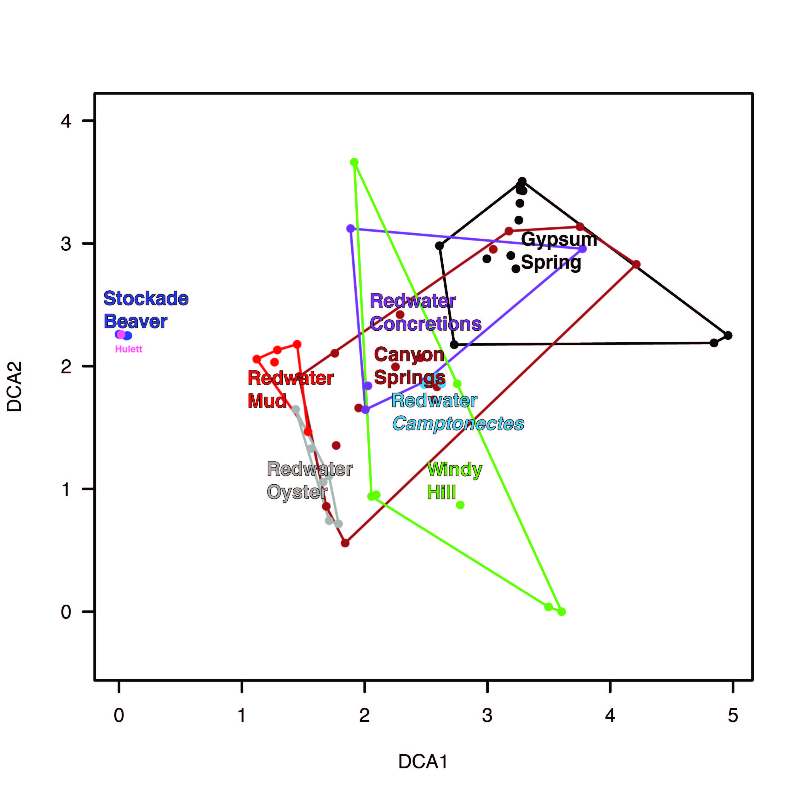
Detrended Correspondence Analysis
Shallow depth
Extreme salinities
Varied temperature
Deeper depth
Stable salinity
Stable temperature

Slide 13
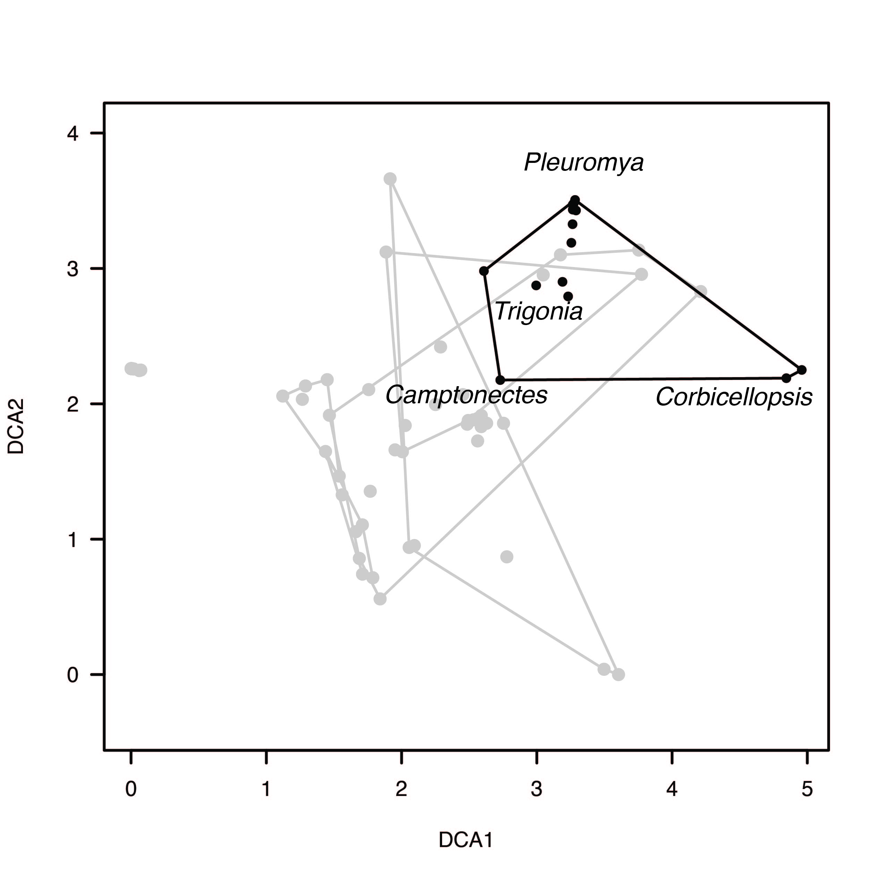
Regional Dominance

Slide 14
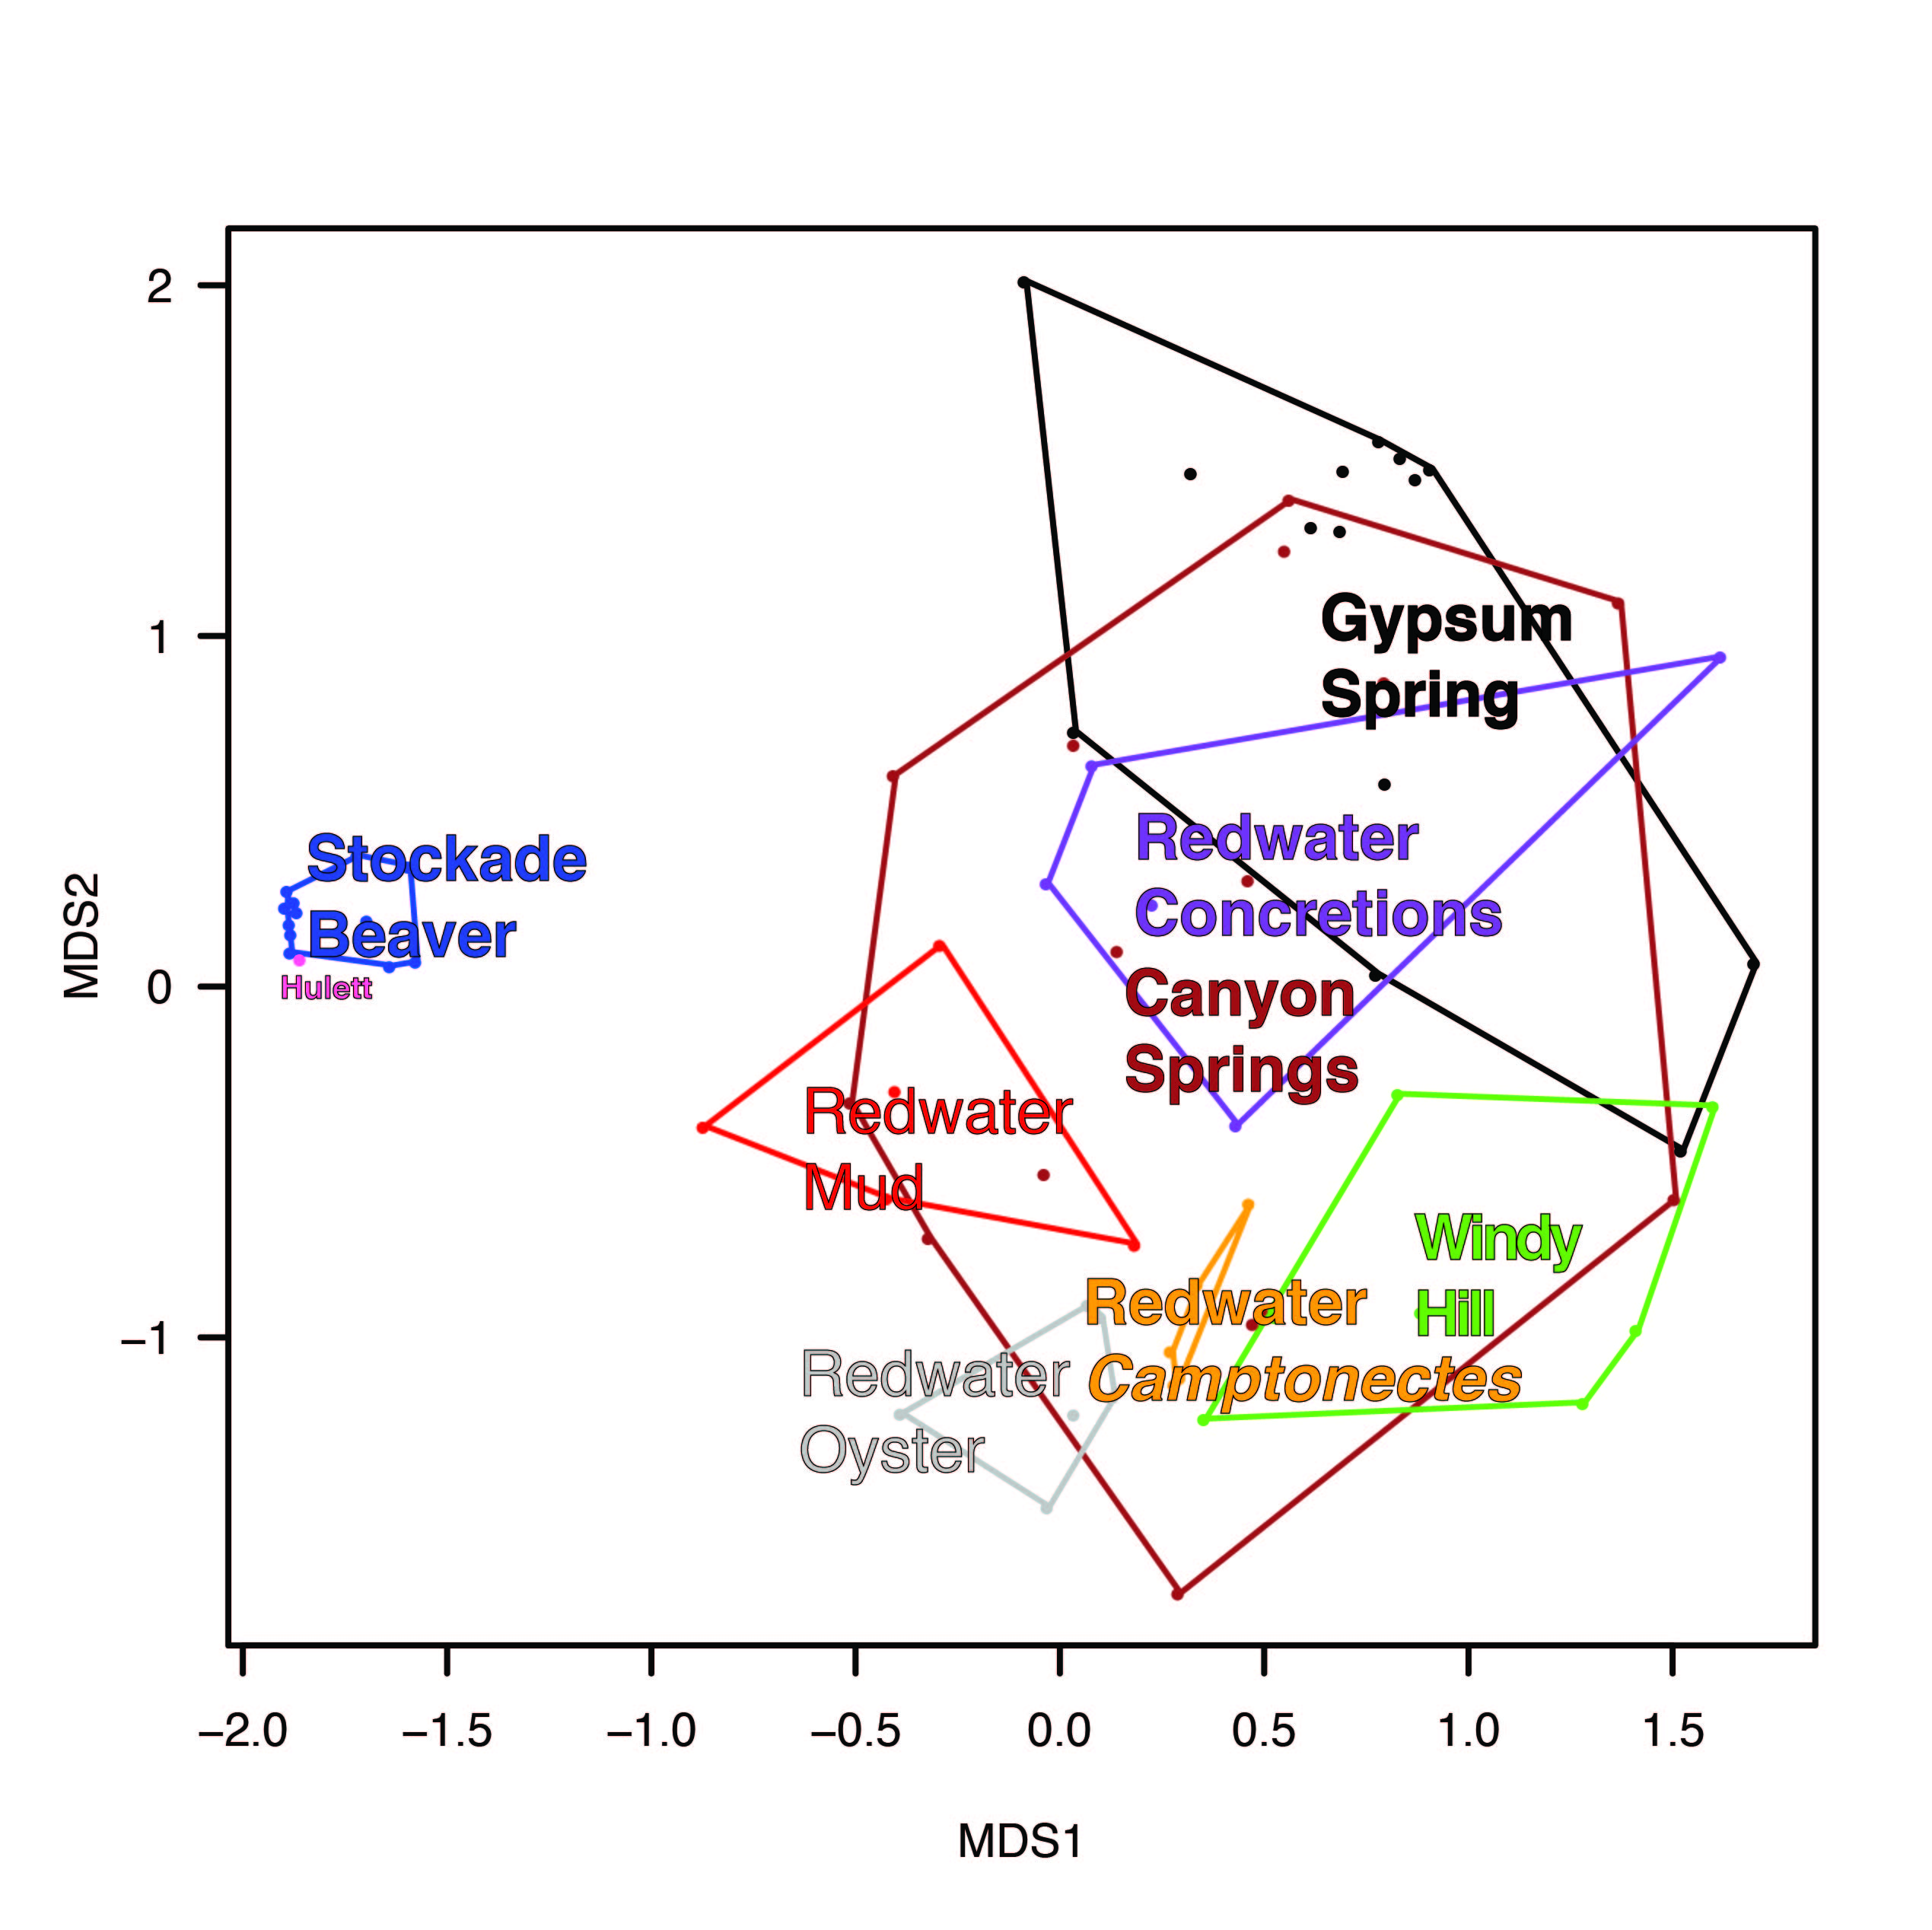
Non-Metric Multidimensional Scaling

Slide 15
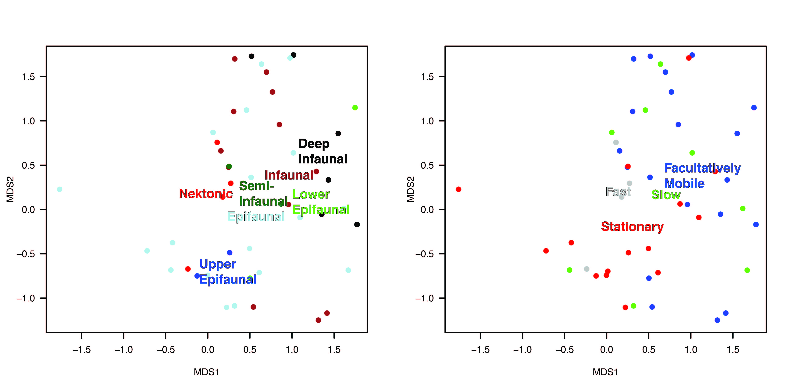
Non-Metric Multidimensional Scaling
Softer, muddier substrate
Harder, shelly substrate

Slide 16
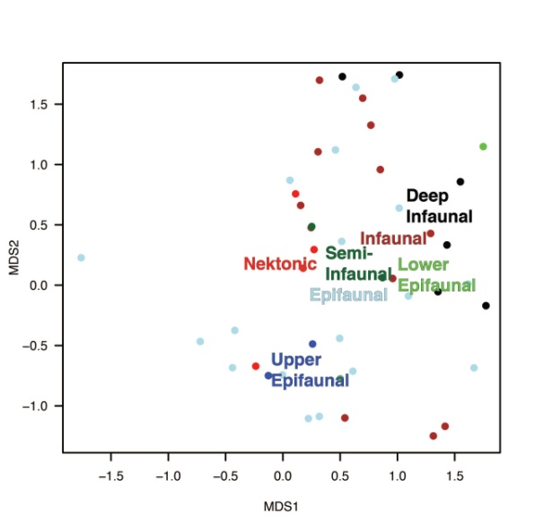
Conclusions
  1. Low diversity, high dominance
  2. Salinity, water depth, temperature
  (deep, stable v. shallow, unstable)
  3. Substrate
  (soft/muddy v. hard/shelly)

Slide 17
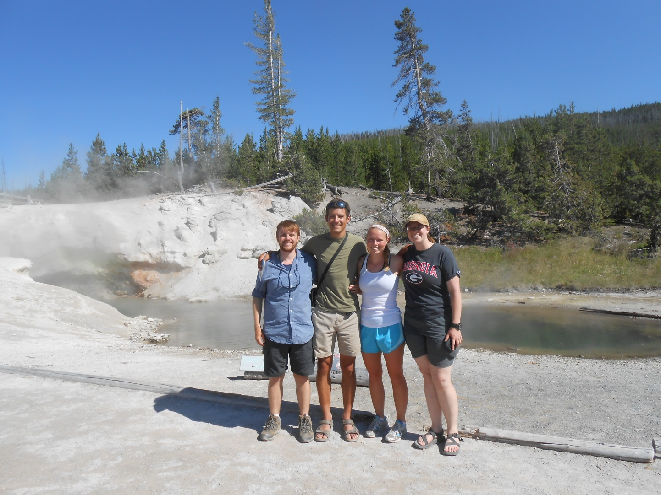

Thanks
Dr. Steven Holland
Courtney Herbolsheimer, Annaka Clement, Jason Burwell, and Silvia Danise for assistance in the field
Cliff and Row Manuel
Thanks to the Geological Society of America, the American Museum of Natural History, and the University of Georgia for providing
funding

