Slide 1
CREATION vs. EVOLUTION:
IT’S NOT ABOUT SCIENCE
Daryl P. Domning
Department of Anatomy
Howard University
Washington, D.C.

Slide 2



Slide 3


Slide 4
A lot of Americans reject evolution because they see it as a threat to their existential concerns (the meaning of life, existence of God, explanation of evil, etc.).
The creation-evolution controversy can never be resolved without addressing these theological concerns of those who are bothered by the idea of evolution: WE CAN’T JUST TALK ABOUT SCIENTIFIC EVIDENCE!

Slide 5


NCSE.COM

Slide 6
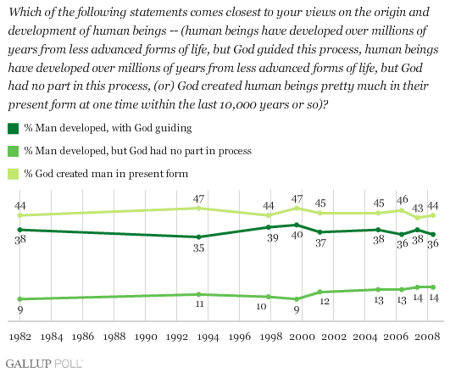
Gallup Poll Question on
Evolution, Creationism, and Intelligent Design
Notes:
For comparison of results from different poll questions, see George Bishop, RNCSE 27(5-6): 35-41, Sept.-Dec. 2007.

Slide 7
What Are The Options?
God created humans in present form within last 10,000 years [young-earth creationism] [44%]
Humans developed over millions of years, but God guided this process [theistic evolution ... or not?] [36%]
Humans developed over millions of years, but God had no part in this process [atheism ... or not?] [14%]

Slide 8
What Are The Real Options?
God created humans in present form within last 10,000 years [young-earth creationism]
God created the world and humans in present form, but over millions of years (e.g., day-age & gap theories) [old-earth creationism; intelligent design?]
Humans developed over millions of years, but God guided this process [interventionist theistic evolution; intelligent design]
Humans developed over millions of years by natural laws; God began and sustained this process but did not intervene in it in a way demonstrable by science [non-interventionist theistic evolution]
Humans developed over millions of years, but God had no part in this process [deism or atheism?]
Humans developed over millions of years solely by natural laws; there is no God [atheism]

Slide 9
E. Ecklund & C. Scheitle, 2014 / AAAS:
Religious Communities, Science, Scientists, and Perceptions: A Comprehensive Survey
“Creationism – God created the universe, the Earth, and all of life within the past 10,000 years”:
21.5% of population said “Definitely true”

Slide 10
Jonathan Hill, 2014 / BioLogos Foundation:
National Longitudinal Study of Religion and Human Origins
<http://biologos.org/ecf/grantees/support-for-the-national-longitudinal-study-of-religion-and-human-origins>
“At its most basic, creationism denies human evolution and affirms that God created humans. If we combine these two positions we find that 37 percent can be classified as creationists. If we restrict this to only those who are absolutely or very certain of their beliefs, we arrive at 29 percent of the population. … [Of these] only eight percent report that they believe in the literal days of creation and the recent creation of humanity.”
“… what counts as a plausible account of human origins is reinforced by important social relationships.”
“All of this tells us that a two-pronged strategy – one that attends simultaneously to sociological and theological factors – will make the most inroads in the end.”

Slide 11
If Not Creationism, ID, or Atheism, Then What?
The broad middle ground of “theistic evolution” (= evolution is God’s way of creating) is most compatible with both science and mainstream Christian (and much other) theology
Catholic theologian John Haught et al. insist that science’s understanding of evolution is not just something Christians can live with, but “Darwin’s great gift to theology”: a positive and indispensable source for theological reflection
Hence, we come to the evolutionary theology advocated by increasing numbers of Christian (especially Catholic) theologians today.

Slide 12
What Does “Non-interventionist Evolutionary Theology” Look Like?
God’s creation of the world is ongoing and unfinished
God respects creation’s autonomy, enabling and allowing it to assemble itself by its own laws interacting with chance, and to participate in God’s creativity by generating novelty
Nature’s laws inevitably entail suffering and death, and include natural selection with its consequence of enforced “selfishness” for all life (hence sin on the part of intelligent life)

Slide 13
Evolutionary Theology (cont.)
God’s self-withdrawal from (despite passionate concern for) the world is a precondition for us to become other than God, hence capable of deep relationship with God
God offers salvation from the futile, selfish Darwinian rat-race, inviting us to defy the law of natural selection and nurture the “unfit” rather than eliminating them; hence social justice
God’s power lies not in detailed “design” or coercion but in persuasive love, which seeks our freedom and creativity

Slide 14
If These or Similar Views Were
(part of) the Public Face of
Evolution Advocacy ...
... given that ~50% of the U.S. public in the Gallup Poll already accept evolution, with or without divine guidance ...
... and given that some fraction of the 44% “creationists” are not immovably committed to biblical literalism, but simply don’t see evolution as offering to solve their “crisis of meaning” (R. Pennock, 1997, Creation/Evolution 39) ...
... how many of these “creationists”, or Gallup’s 6% undecided, might be won over?

Slide 15
If opponents of evolution education were offered a view of evolution that they could live with – a theological view that might even help resolve their “crisis of meaning” – how much of their opposition might evaporate?

