Slide 1
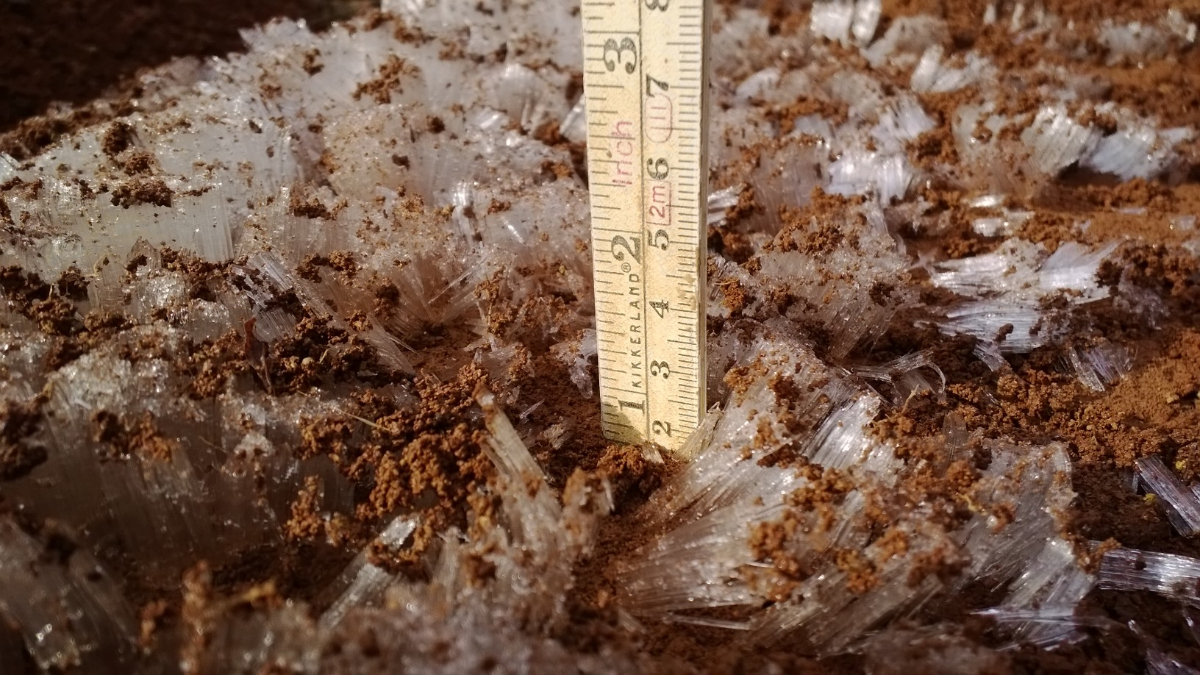
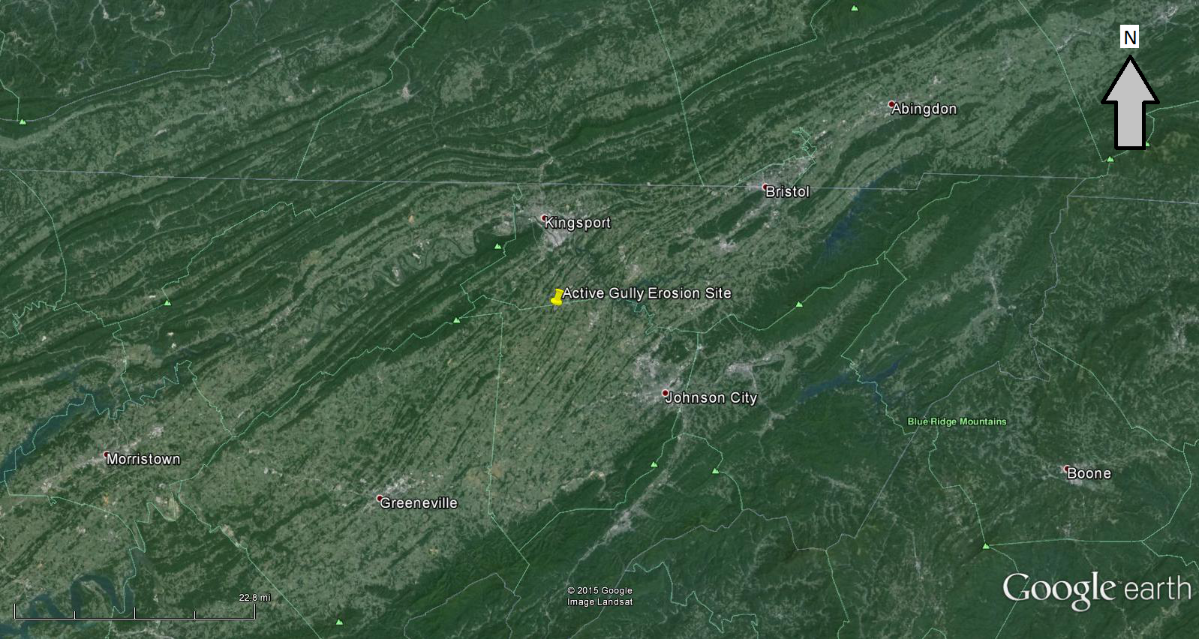
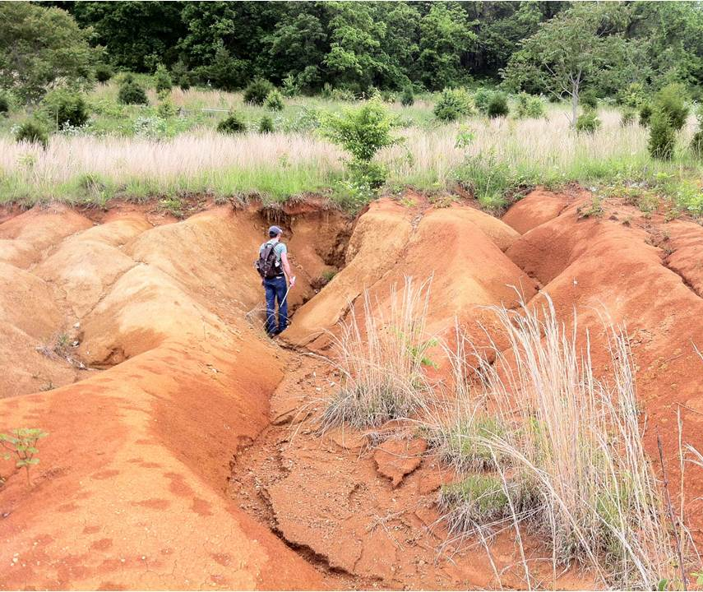
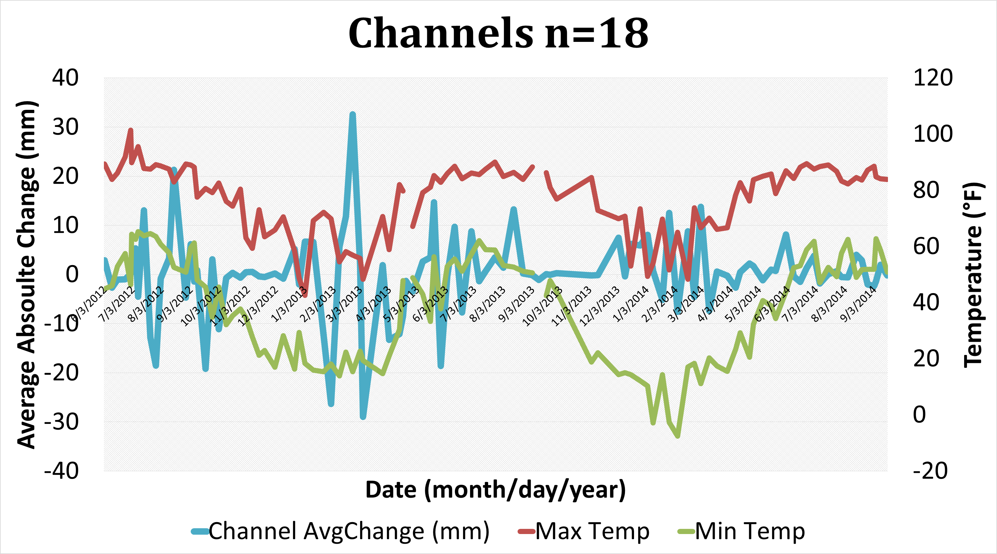
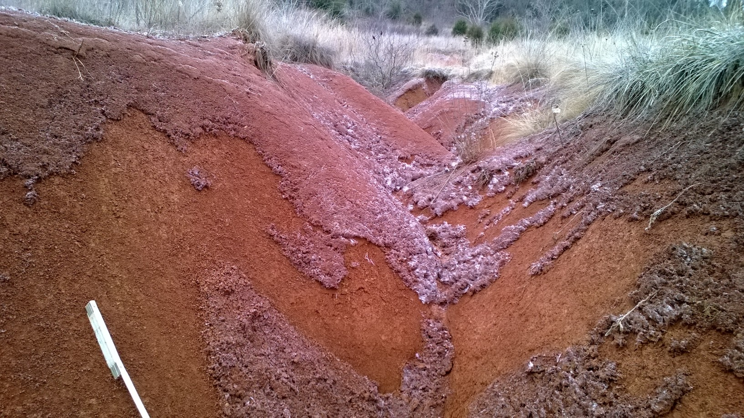
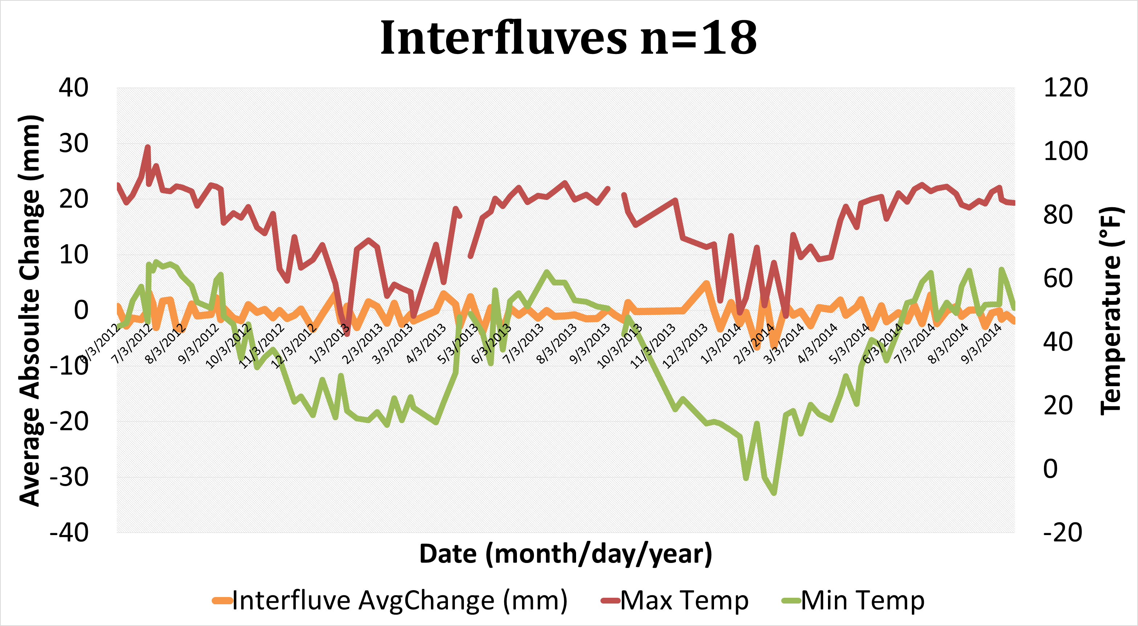
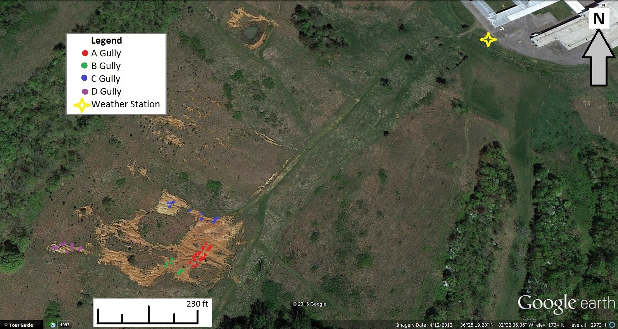
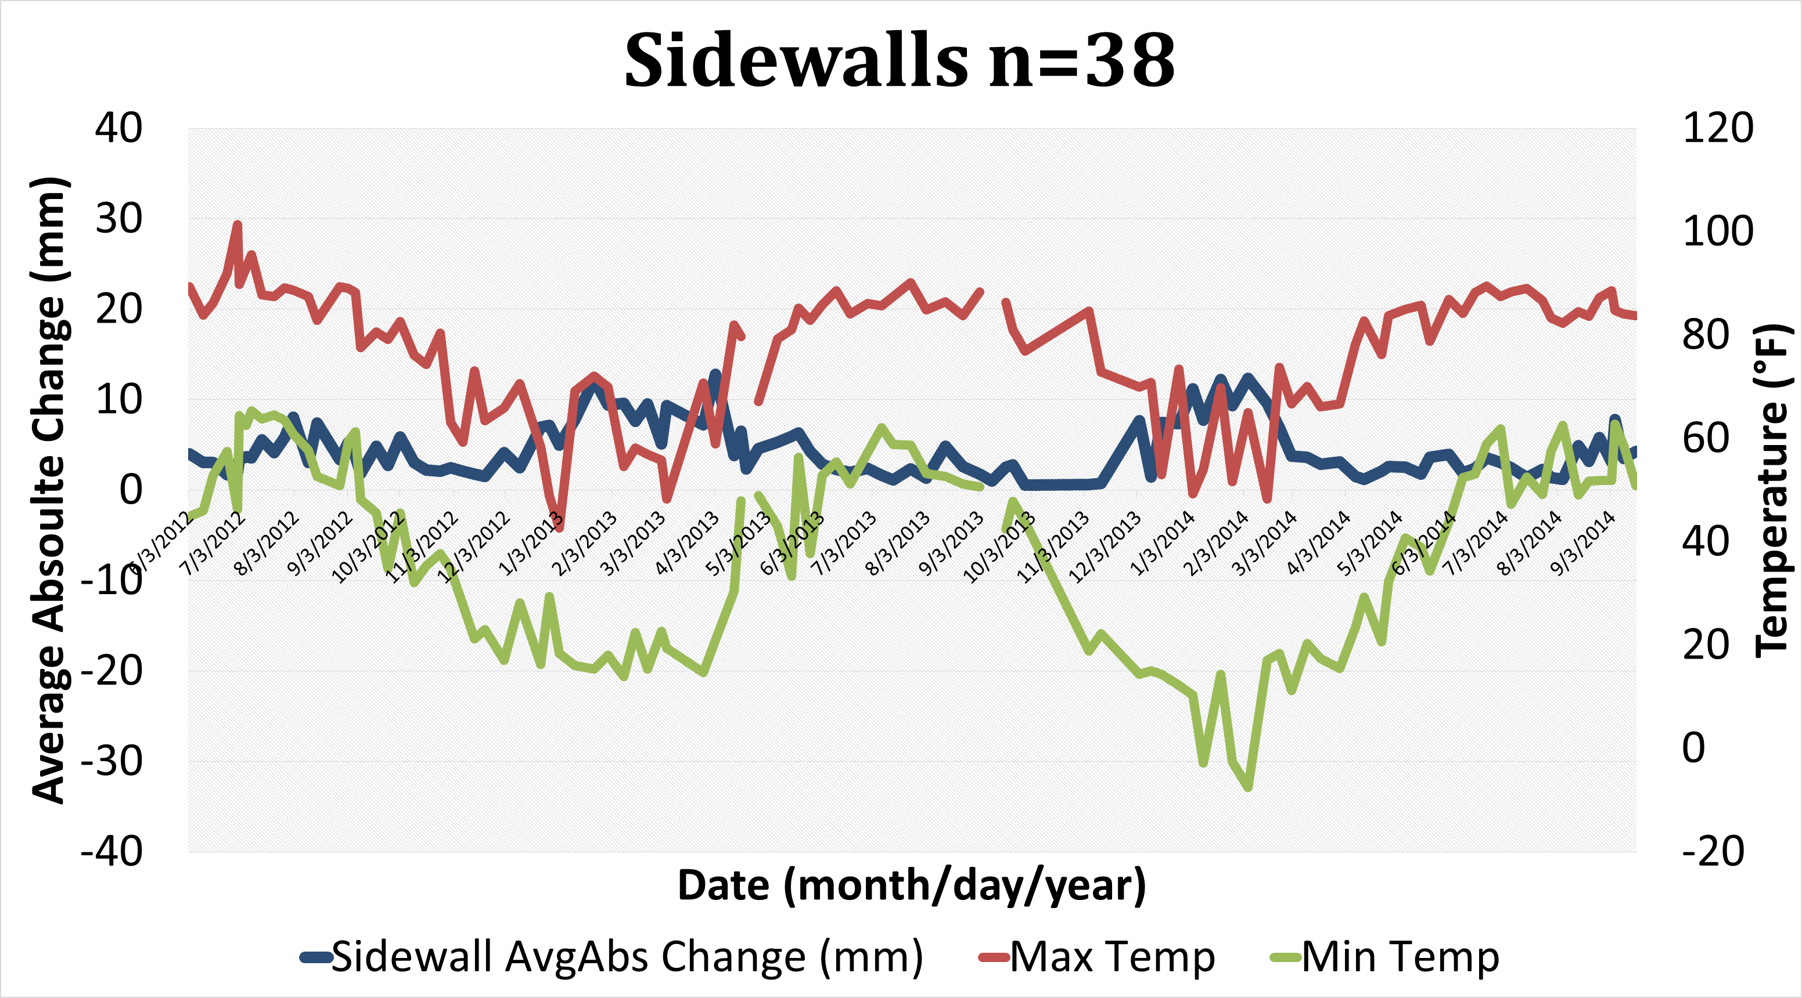
Gully Erosion and Freeze-Thaw Processes in Clay-Rich Soils, Northeast Tennessee, USA Nicolas Barnes, Ingrid Luffman, and Arpita Nandi, Department of Geosciences, East Tennessee State University
Introduction
Soil degraded by gully erosion is associated with loss of soil mass, loss of nutrients, and reduction of the soil’s capacity for biological activity. With the loss of biological and absorption capabilities, runoff increases allowing for greater erosion to occur (Lal, 1990). Freeze-thaw conditions lower the soil’s ability to resist water flow and change the depth of channels by freeze-thaw induced mudflows, soil slumps, and soil slides through which the eroded soil is deposited or removed (Gatto, 2000).
The objective of the study is to understand the relationship between freeze-thaw conditions and gully erosion in three geomorphic areas on clay rich ultisol hillslopes at weekly time scales.
Abstract
This study examines gully erosion in northeast Tennessee hillslopes within the context of temperature variability. Gully erosion is a form of mass sediment loss and transport resulting in deep channels and high, steep banks of sediment. Temperature controlled freeze thaw events dislodge soil particles and serve as a catalyst for erosion. The study area is located in the Southern Appalachian Valley and Ridge province, where a thick sequence of red clay ultisols overlies dolomite and limestone bedrock. Weekly measurements of gully erosion were collected at the East Tennessee State University Valleybrook Research Facility in northeast Tennessee. Gully erosion was measured using 78 erosion pins placed in three adjacent gully systems in three different morphological settings: channels, interfluves, and sidewalls. When daily temperatures ranged from below freezing to above freezing, there was increased erosion and deposition in the channels and increased erosion from the sidewalls. When daily temperature did not plunge below freezing, more stable gully conditions persisted.
Study Area
This study was performed at an active gully erosion site at the East Tennessee State University Valleybrook research facility. This facility is located near Kingsport, Tennessee and encompasses 144 acres of grassland, hillslope, and forest with a 72,000 square foot research and office complex (Figure 1).
Figure 4: Needle ice growth in gully channels (December 2014)
Discussion
A complex relationship exists between erosion and climate. Precipitation wets the soil which, when exposed to below freezing temperatures, forms needle-like ice crystals that lift the soil (Figure 4). This has a variety of effects on each geomorphic area:
Channels experience longer periods of saturation when ice forms allowing for soil transport to happen continuously.
In the interfluves, freeze-thaw events in the previous week are better able to explain erosion, suggesting a lagged effect. Subsequent rainfall may mobilize soil disturbed by prior freeze-thaw events. The notion that the effects of single events can emerge long time after the causing event may hold relevance at the Valleybrook site (Kreyling, 2010).
On the sidewalls, needle ice forms on unstable slopes which collapse in sheets into gully channels (Figure 5).
Results
The average absolute change in pin length for every geomorphic area was significantly correlated with freeze-thaw conditions (Table 1). Time series plots of pin length change vs. temperature show increased change during freeze-thaw days. Regression models relate increased erosion to more frequent freeze-thaw events (Figure 3).
Table 1: Spearman correlation
(**significant at p=0 .01)
 | % Freeze-Thaw | % Freeze-Thaw Lag 1
Channel AvgAbs Change | .256** | .272**
Interfluves AvgAbs Change | .306** | .333**
Sidewalls AvgAbs Change | .371** | .403**
Figure 1: Location of erosion site (left) and a close-up of gully system (right).
Methods
Erosion and temperature data were collected from 6/3/2012 to 9/17/2014 using 78 erosion pins placed in three geomorphic areas (channels, interfluves, and sidewalls) and an onsite Davis Vantage Pro weather station (Figure 2).
Daily temperature maxima and minima were aggregated to pin measurement periods and percent freeze-thaw days were calculated for each period.
Spearman’s correlation coefficients were calculated for erosion and freeze-thaw variables to identify potential explanatory variables for erosion.
Four erosion parameters (dependent variables) were generated from the erosion pin lengths: average change in pin length; average of absolute value of change in pin length; average erosion (only positive change); and average deposition (only negative change).
Linear regression models were developed using SPSS statistical software.
Figure 5: Freeze-thaw erosion on sidewalls (December 2014).
Summary and Conclusion
This study shows that freeze-thaw contributes to erosion in the East Tennessee Valley and Ridge Province. Three statistical models of gully erosion were developed to relate erosion to freeze-thaw conditions. The models were able to explain 11% of channel erosion, 14% of interfluve erosion, and 26% of sidewall erosion. The best model was of sidewall erosion, likely due to the combined effect of freeze-thaw and mass wasting.
References
Gatto, L. W. (2000). Soil freeze–thaw-induced changes to a simulated rill: Potential impacts on soil erosion. Geomorphology, 32(1), 147-160.
Henry, J. (2007). Geomorphic Regions of the United States. Middle Tennessee State University Geosciences Department [online textbook] http://capone.mtsu.edu/mabolins/geomorph.htm
Kreyling, J., Beierkuhnlein, C., & Jentsch, A. (2010). Effects of soil freeze–thaw cycles differ between experimental plant communities. Basic and Applied Ecology, 11(1), 65-75.
Lal, R. (1990). Soil Erosion and Land Degradation: The Global Risks. Advances in Soil Science (11) 129-172.
Nandi, A. and Luffman, I. (2012). Erosion Related Changes Physicochemical Properties of Ultisols Distributed on Calcareous Bedrock. Journal of Sustainable Development, 5 (8).
Poesen, J. (2003). Gully erosion and environmental change: importance and research needs. Catena , 50 (2-4), 91-133
Figure 2: Google Earth image of Valleybrook with gully systems, erosion pin locations, and weather station.
Figure 3: Time series data and regression results for each geomorphic setting.

