Slide 1

Speculation on Quaternary stress field changes in the East Tennessee seismic zone
Randel Tom Cox
Earth Sciences
University of Memphis
NRC UT
Notes:
There are many colleagues and pupils involved in this study (Bob, Jim, Steve, Ron) (Kathleen,Taylor, Eric, Jake, Lian)
I have not listed them as authors here because I may make some reckless statements based on scant data,
and I do not want them held responsible.

Slide 2
OUTLINE

Slide 3
OUTLINE
Current seismicity

Slide 4
OUTLINE
Current seismicity
Quaternary paleoseismicity

Slide 5
OUTLINE
Current seismicity
Quaternary paleoseismicity
Quaternary shortening directions and paleostresses

Slide 6
OUTLINE
Current seismicity
Quaternary paleoseismicity
Quaternary shortening directions and paleostresses
Guessing why

Slide 7
spatial
Knoxville
Smoky Mountains
Chattanooga
100 km
CERI catalog 1974 to 2015 (ETSZ only)
rejuv
Notes:
Here is a shaded relief map showing the spatial relationship of the ETSZ to the southern Appalachians.
Late Cenozoic rejuvenation has been argued for the Southern Appalachians (e.g., dynamic uplift related to the Farallon slab or delamination of the Appalachian root).
The spatial relationship of the ETSZ to the high Blue Ridge suggest the ETSZ may be a symptom of the rejuvenation

Slide 8
4.6 1973l
Hatcher et al. (2012)
Notes:
Cataloged earthquakes in the ETSZ are less than M 5
The strongest EQ recorded was the 1973 M4.6 event at Maryville, TN
NY-AL =

Slide 9
breakouts
σ1
Mazzotti and Townend, 2010
horizontal
Notes:
This is a stereogram showing current principal stress orientations from EQ focal mechanism solutions and well-bore breakouts for the ETSZ.
Sigma 1 is horizontal and NE-SW

Slide 10
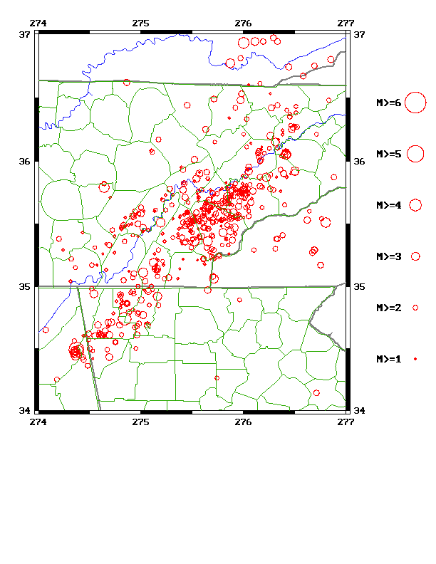
focal
KY
σ1
TN
NC
σ1
Mazzotti and Townend, 2010
GA
AL
Notes:
Focal mechanisms are varied but mostly NE-SW right-lateral slip and some E-W left-lateral slip
Matt has those for us

Slide 11
En echelon
KY
σ1
TN
NC
σ1
Mazzotti and Townend, 2010
GA
AL
basement
Notes:
This suggest the ETSZ source fault zone is a right-lateral system
(with less well defined antithetic & synthetic subsidiary faults).
It is likely an en echelon system of reactivated basement faults beneath the Valley and Ridge thrust sheets.

Slide 12
Paleoseismology

Slide 13
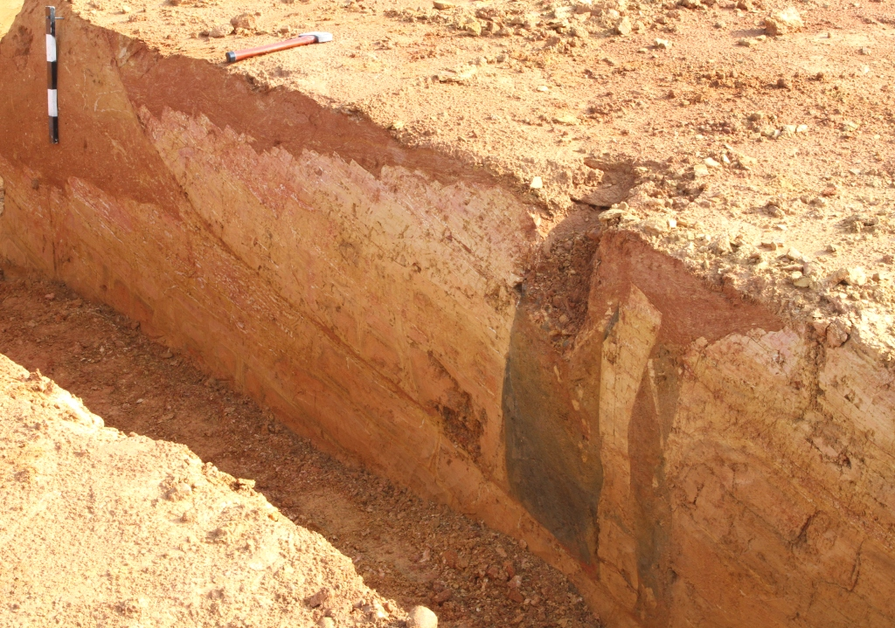
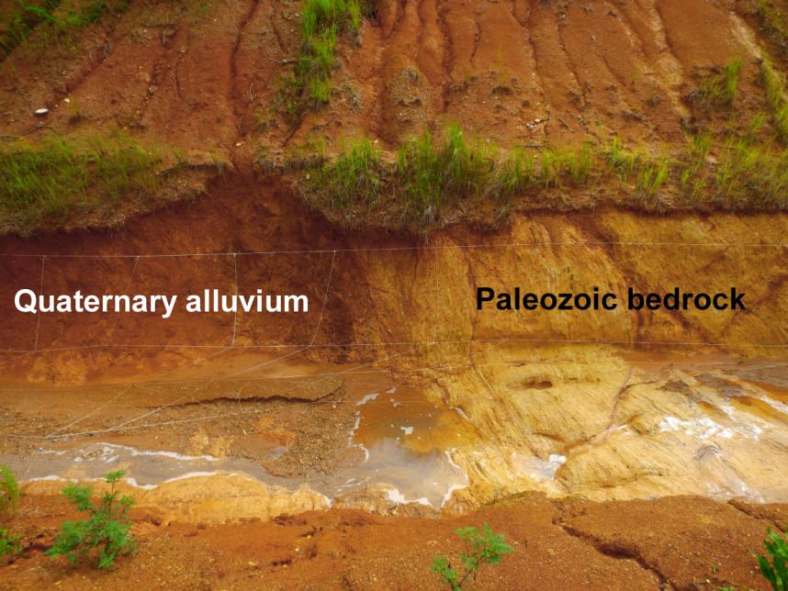
Hatcher
Fissures filled with alluvium from above
Quaternary alluvium
Paleozoic
bedrock
Douglas Lake
thrust
Vonore
thrust
stronger
Notes:
Bob Hatcher’s team has documented several sites of Quaternary faulting that suggest significantly stronger EQs than historic seismicity.
Here are two examples from near Dandridge, TN and near Vonore, TN
Fault offsets >2 m may record EQs of M7.

Slide 14
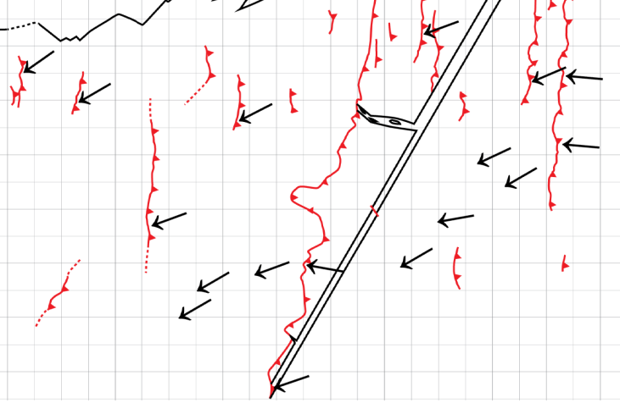
modern
Bearing of slickensides at Douglas Lake
(from Warrell, 2013)
From Warrell (2013)
Main thrust
Thrust in alluvium
Minor faults in saprolite
2 m
sapro
Notes:
NE-slicks consistent with the NE-SW contemporary maximum compressive stress direction are found on minor faults at the Douglas Lake thrust site.

Slide 15
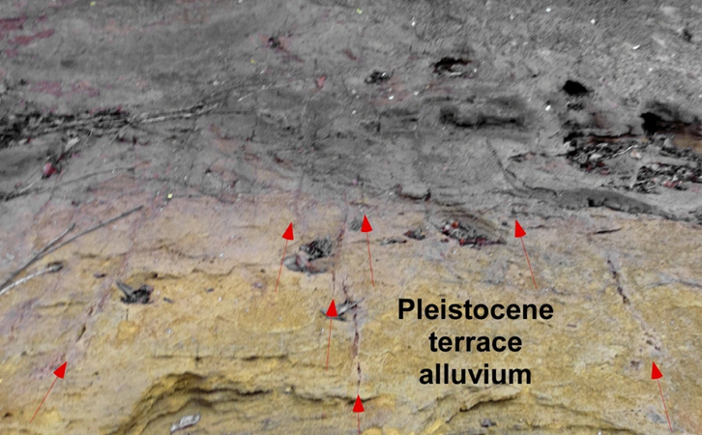
alluvium
Bearing of slickensides at Douglas Lake
(from Warrell, 2013)
From Warrell (2013)
Thrust in alluvium
Minor faults in saprolite
2 m
Douglas Lake late-stage joints in Quaternary alluvium
σ1
Holocene
Notes:
Also, NE-striking joints consistent with the NE-SW contemporary maximum compressive stress direction are found along strike of the Douglas Lake thrust.
I presume this compressive stress to characterize the Holocene.

Slide 16
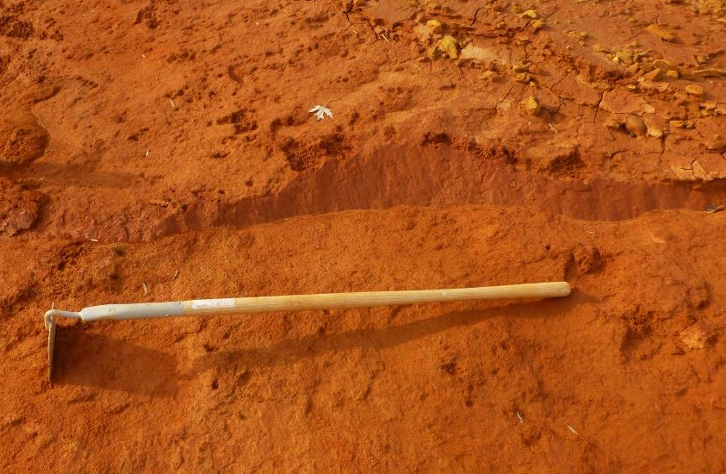
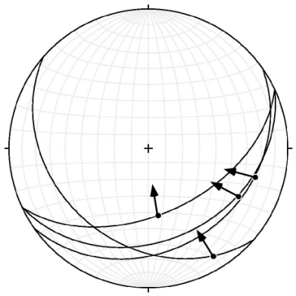
NW-SE short
Slickensided faults in Pleistocene alluvium
σ1
Douglas Lake thrust plane
NE trend
Notes:
However, there are a number of kinematic indicators along a NE trend that suggest a NW-SE shortening direction.
This includes two sites of contractional faulting with slickensides in Pleistocene alluvium (including the Douglas Lake thrust).

Slide 17
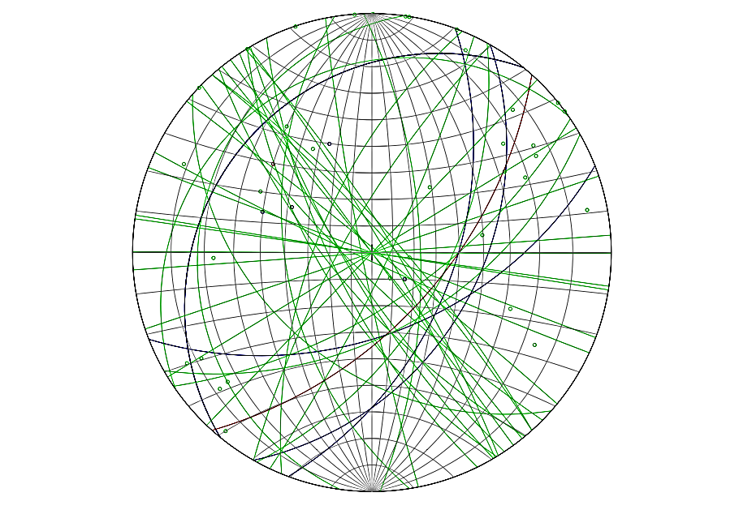
NW-SE short
Slickensided faults in Pleistocene alluvium
σ1
Douglas Lake thrust plane
Vonore, TN fractures in Pleistocene alluvium
σ1
Joints = green, normal fault = red, bedding = blue
NE trend
Notes:
In addition, prominent NW-striking, systematic joints are found in Pleistocene terrace alluvium.

Slide 18

hypoth
HOLOCENE
PLEISTOCENE?
σ1
σ1
Mazzotti and Townend, 2010
LGM
Notes:
So, I hypothesize there has been a rotation of the stress field in the ETSZ since Pleistocene,
Particularly since the last glacial advance.

Slide 19
field
TIMING CONSTRAINTS FOR NW-SE SHORTENING
LGM

Slide 20
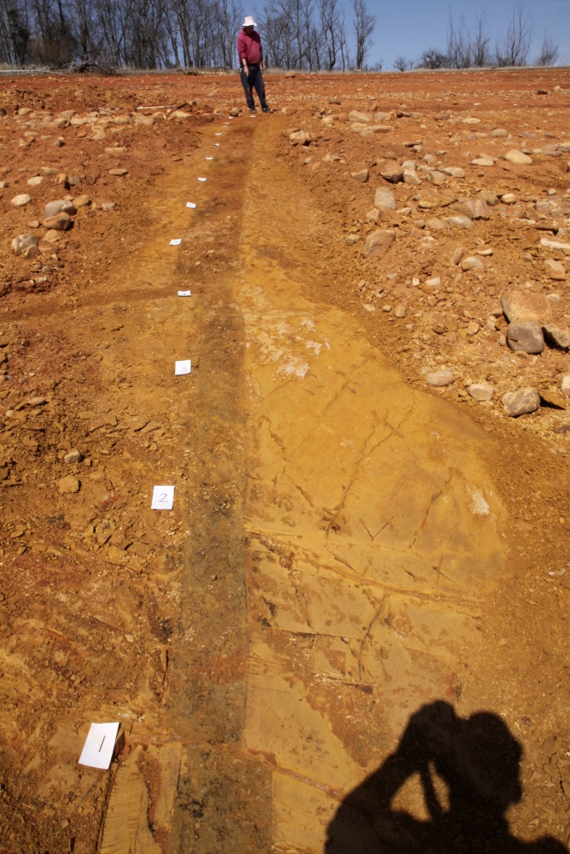
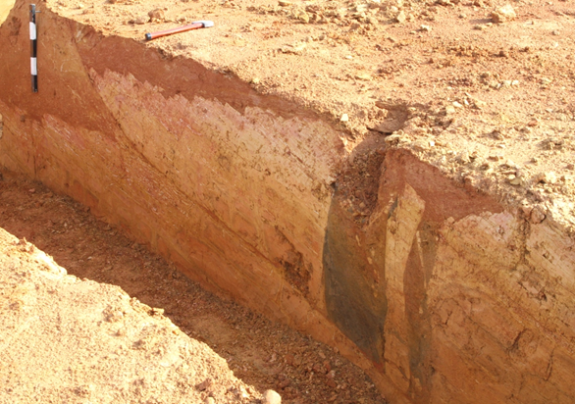
parallel
Douglas Lake thrust
Alluvium-filled fissure
2 m
N
spatial
Notes:
There are NE-striking, alluvium-filled fissures in bedrock cut by the Douglas Lake thrust.
These fissures strike sub-parallel to the thrust and are found only along the trend of the thrust,
suggesting that the thrust and the fissures are genetically related.

Slide 21
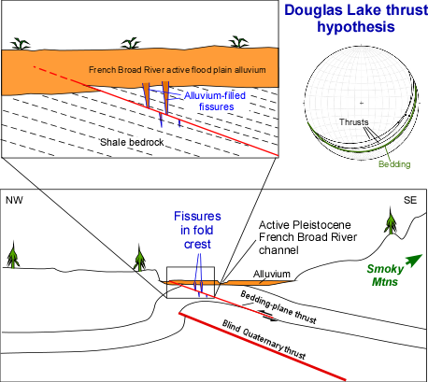
active fold
flood
Flexural slip bedding-plane fault hypothesis for Douglas Lake thrust
Appalach
Notes:
This cartoon shows the suggestion that the fissures formed in extension in the crest of an active fold,
and were cut by a bedding plane thrust during a subsequent EQ
(the structure in this schematic is exaggerated and folding would be superimposed on much stronger Appalachian structure)

Slide 22
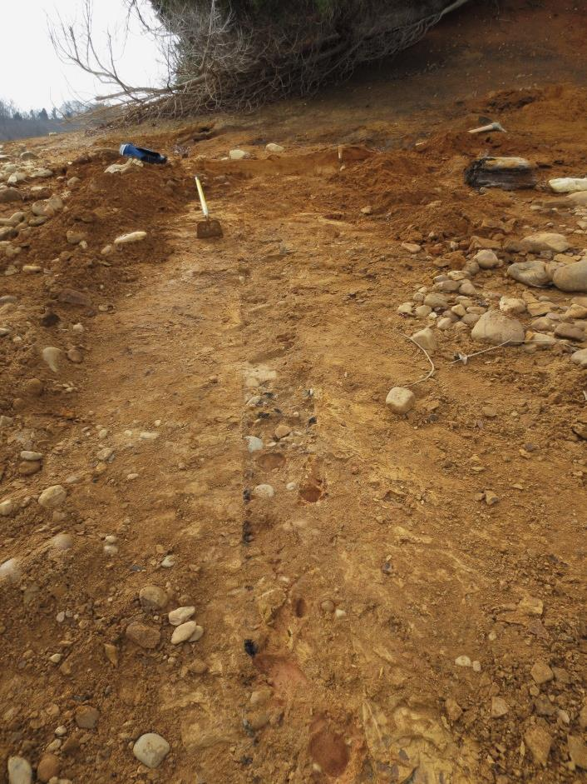
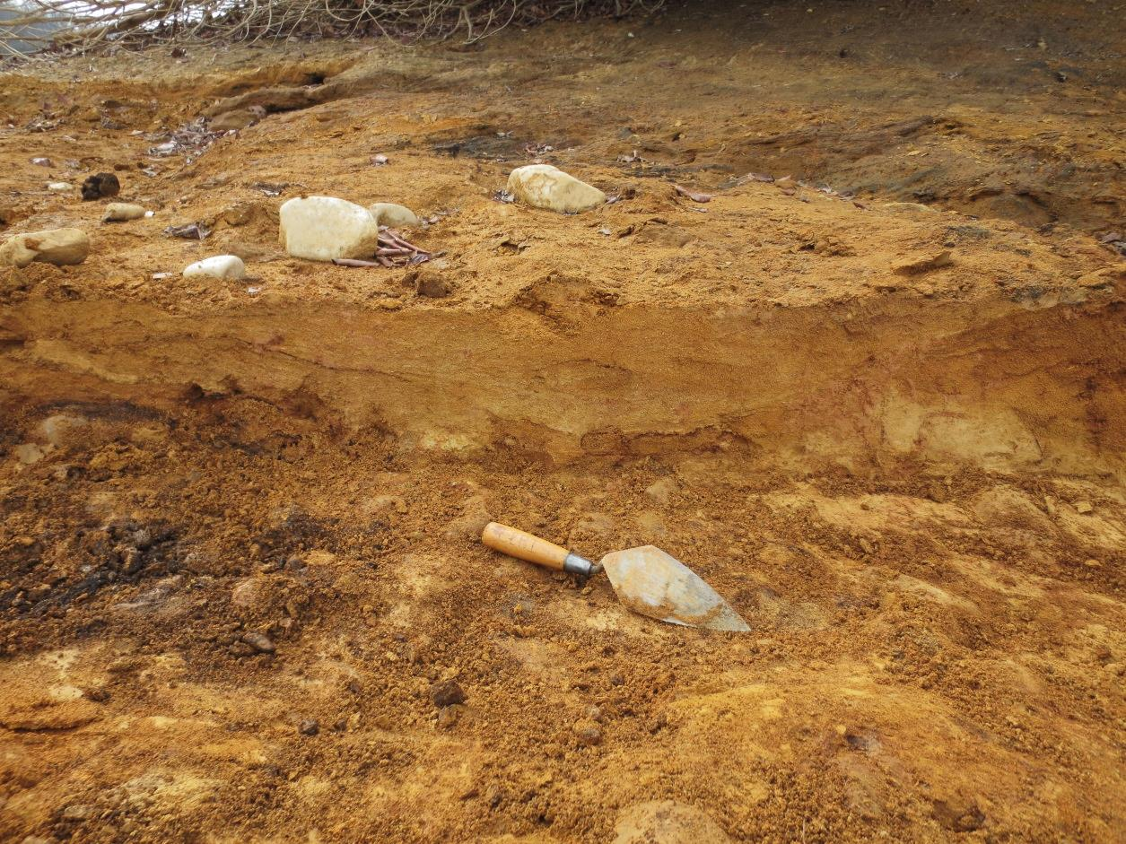
basal
Sagging alluvium beds
Horizontal alluvium filling sag trough
Sagging alluvium beds
Paleozoic shale
Paleozoic shale
Alluvium-filled fissure
FISSURE
Notes:
These fissures only disturb the basal beds of the Pleistocene terrace.
Troughs where bedding sagged into fissures are filled by horizontal alluvial beds,
Indicating that the fissures formed during deposition of the terrace.

Slide 23
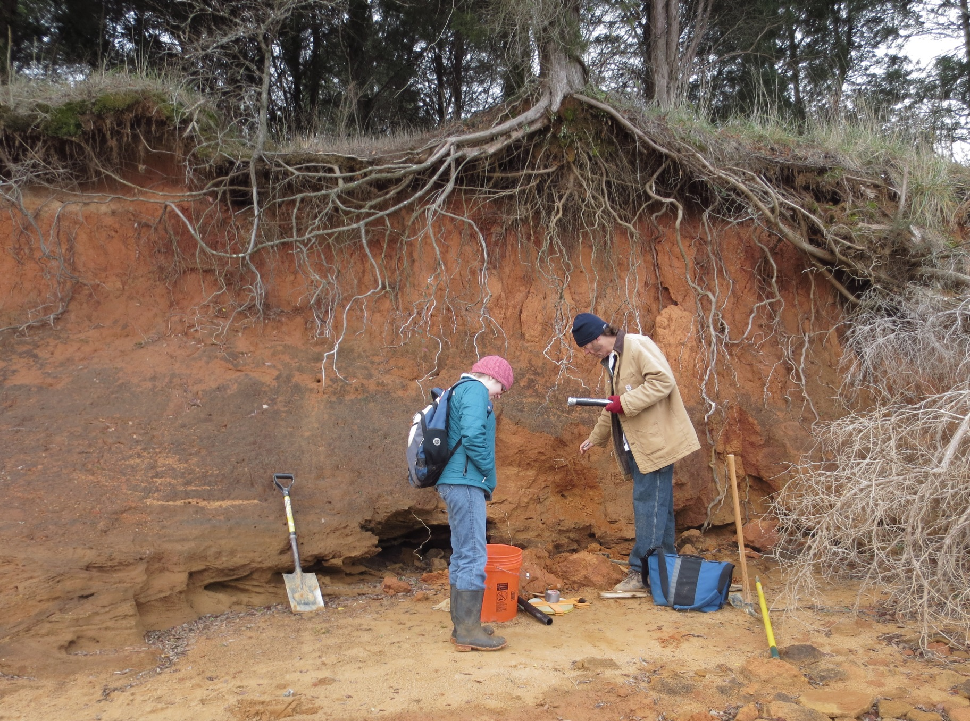
Post-date
Cross-bedded sand
Previous slide photo
10 m
OSL sample
(21.8+1.4 ka)
LGM
Notes:
This photo is only a few meters from the previous photo.
The terrace alluvium that post-dates formation of the fissures yields a Pleistocene OSL age of 22 ka

Slide 24
LGM rot
HOLOCENE
PLEISTOCENE?
σ1
σ1
Mazzotti and Townend, 2010
~70
Notes:
So, the stress field that caused the Douglas Lake thrusting and fissuring during the deposition of the Pleistocene French Broad River terrace
(and during the last glacial advance @ 22 ka)
may have had the principal compressive stress ~70 clockwise from that of the modern stress field

Slide 25
Guesswork

Slide 26
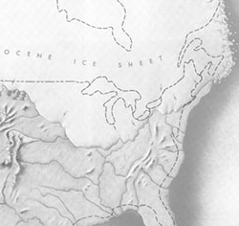
spec
Late
Pleistocene
Ice
Sheet
Last glacial maximum forebulge
East Tennessee seismic zone
S flank
Notes:
I speculate that this stress rotation may have accompanied loading of the North American crust during advance of the Late Pleistocene ice sheet.
The forebulge of this ice sheet passed through Kentucky,
and the southern flank passed through Tennessee

Slide 27
cartoon
Late
Pleistocene
Ice
Sheet
X
Last glacial maximum forebulge
East Tennessee seismic zone
X’
Notes:
Here’s a cartoon transect X-X’ from the ice sheet to TN

Slide 28
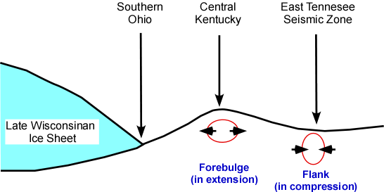
perpend
X X’
Notes:
The forebulge was in extension while the flank was in compression perpendicular to the trend of the forebulge

Slide 29
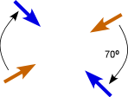
superimp
Plate
motion
Late
Pleistocene
Sheet
σ1
Ice
σ1
with glacial
loading
Last glacial maximum forebulge
σ1
East Tennessee seismic zone
not cause
Notes:
Superimposing this bending moment stress on the far field NE-SW far-field stress may have rotated the greatest principal stress clockwise to NW-SE.
I am NOT arguing that the ETSZ is caused by glacial loading/unloading,
only that the forebulge may have rotated the stress field locally.

Slide 30
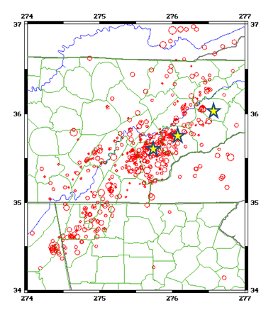
oblique
fault. . . . . .
Notes:
The sites displaying evidence of NW-SE shortening align obliquely to the overall ETSZ,
and…..

Slide 31
readily
Pleistocene σ1
sense/level
Notes:
…..perhaps this reveals a basement fault with an orientation more readily reactivated in thrusting in NW-SE Pleistocene compression.
This fault may have a different sense of slip and level of activity than during Late Pleistocene,
and this may hold true for other seismogenic faults in the ETSZ

Slide 32

?’s

