Slide 1
Complex Compositional Zoning in Clinopyroxene in late Cretaceous Potassic-alkaline Volcanic Rocks from Northern Turkey:
Implications for Magma Mixing
WATERS, Frank
GULMEZ, Fatma
GENC, S. Can
KARACIK, Zekiye
RODEN, Mike
BILLOR, Zeki
University of Georgia
Istanbul Technical University
Auburn University

Slide 2
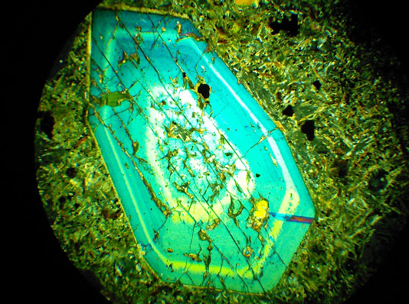
Complex zoning in cpx
sets of epitaxial bands
compositional jumps
sharp contacts
Notes:
Complex zoning is characterized by sets of epitaxial bands- bands or shells of chemically distinct crystal material that are deposited onto a phenocryst- these bands have abrupt inner and outer contacts and display large jumps in composition Mg#, Al content
Additionally the outer contacts of the bands are commonly resorbed or rounded- producing something akin to a nonconformity inside the crystal

Slide 3
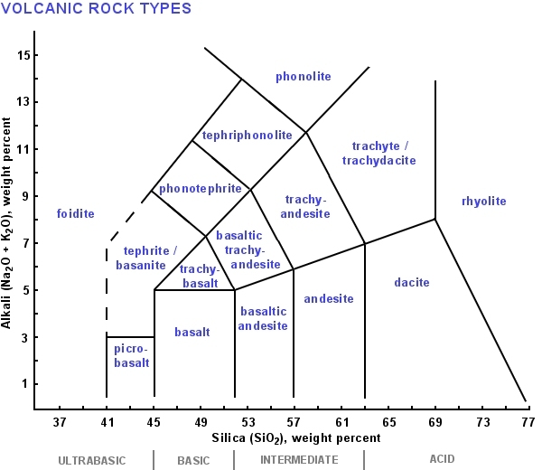
Potassic magmas
mafic
high K
http://f.tqn.com/y/geology/1/S/O/N/1/600TASvolcanic.jpg

Slide 4
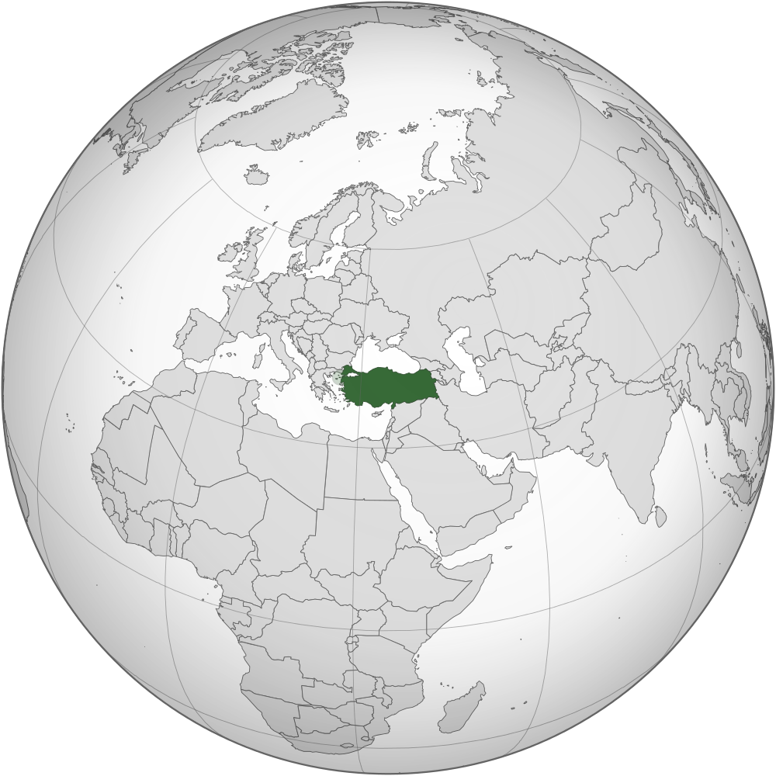
http://commons.wikimedia.org/wiki/File:Turkey_(orthographic_projection).svg

Slide 5
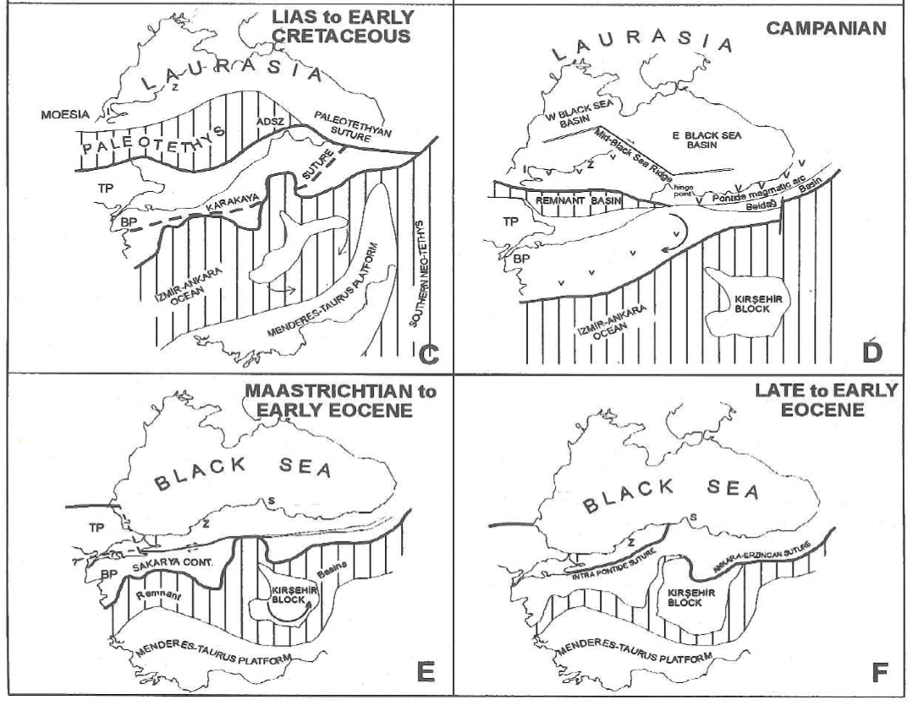
Regional Tectonics
Yilmaz, Y., Tuysuz, O., Yigitbas, E., Can Genc, S., Sengor A., 1997, Geology and tectonic evolution of the Pontides: ed. Robinson A.G., Regional and petroleum geology of the Black Sea and surrounding region: AAPG Memoir 68, p. 183-226.
Notes:
So this region has particularly complex tectonics with the consumption of the plaeotethys in the early cretaceous
Then in the late cretaceous the pontide volcanic arc is generated with the northward subduction of Neotethyan ocean
And it is along this arc, during the waining stages of subduction that my samples were generated.

Slide 6
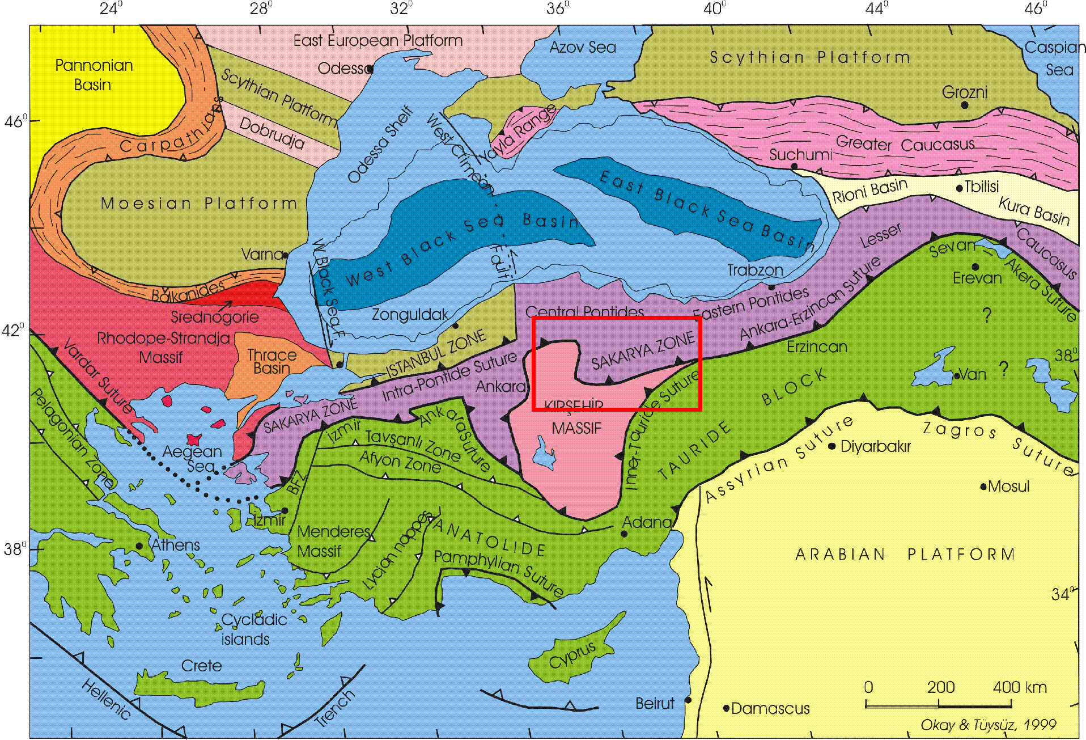
Key terranes of Anatolia (Turkey)
http://web.itu.edu.tr/~okay/AralOkayPapersThematically.htm
Notes:
An ka ra – Er zin can Suture Zone
Kirsehir Massif
Central Pontides
Ignore red box
Black box denotes approximate area of next map

Slide 7
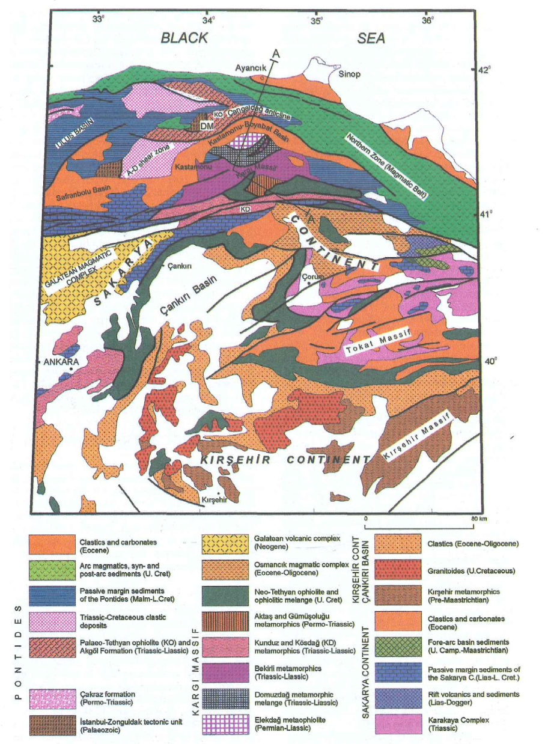
Ankara Erzincan Suture Zone
teal units
ophiolitic mélanges
Yilmaz, Y., Tuysuz, O., Yigitbas, E., Can Genc, S., Sengor A., 1997, Geology and tectonic evolution of the Pontides: ed. Robinson A.G., Regional and petroleum geology of the Black Sea and surrounding region: AAPG Memoir 68, p. 183-226.
Notes:
The Study area I will talk about today – the black box – is north, that is inboard, of the accretion complex

Slide 8
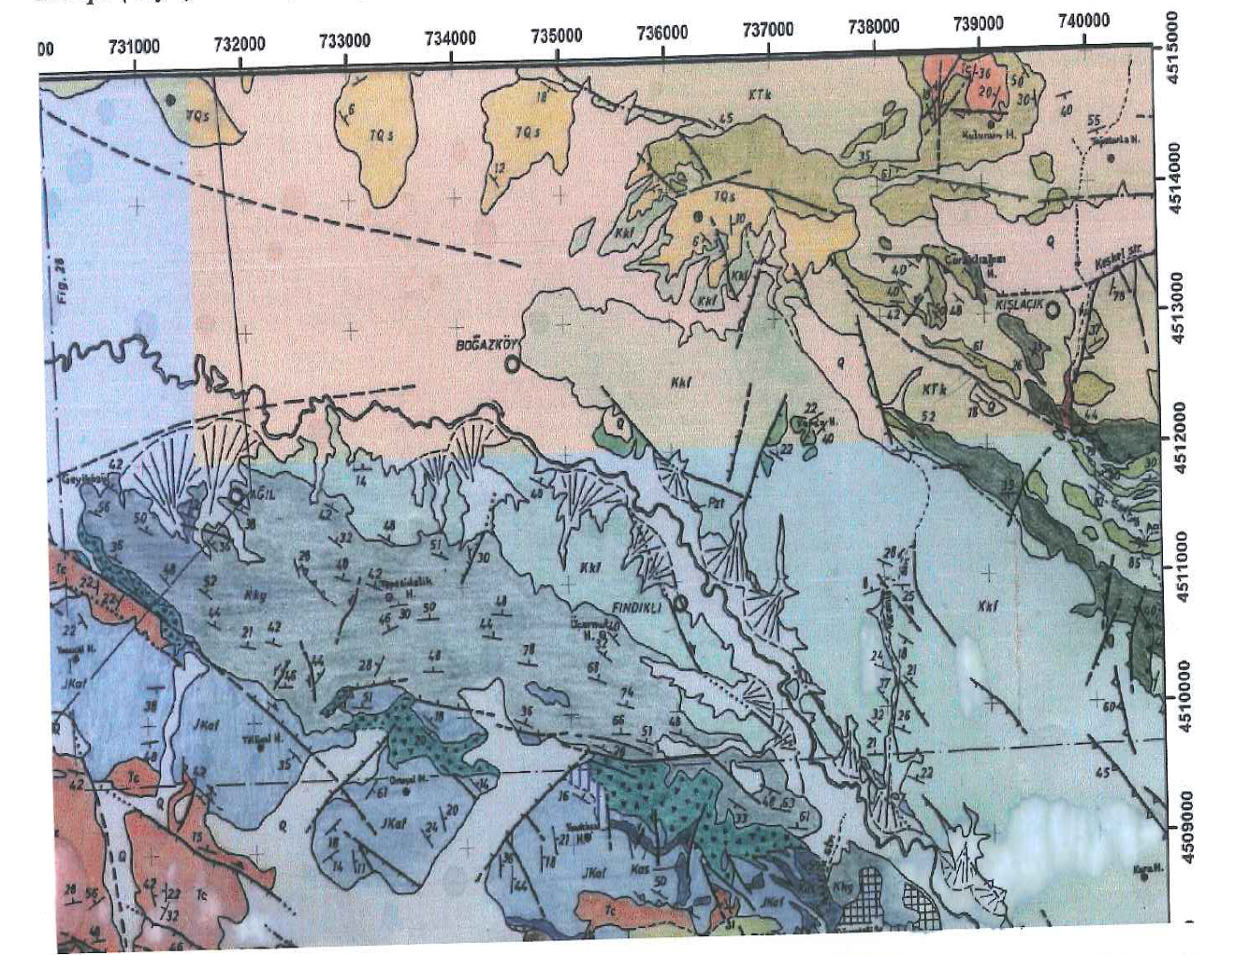

Leucitite
Minette
Madupite
Amasya
Bogazkoy
Map found in the field guide for this study
Notes:
The three samples I will discuss today come from the Amasya – Bogazkoy field area - note meter scale – so all of these samples are within 2000 m of each other
Samples were taken from the Cretaceous Lokman Formation, a volcano-sedimentary unit containing potassic and ultra potassic volcanic rocks
Samples include a Minette (an ultra potassic rock with primary biotite and feldspars in groundmass), a madupite (ultra potassic rock with primary cpx biotite and feldspars groundmass), and a leucitite (ultra potassic rock with leucite and cpx)

Slide 9
Amasya Bogazkoy
Ar-Ar radiometric ages: 78 and 75 Ma
Spider diagrams: LILE enrichments relative to HFSE,
depletions of Nb-Ta and Ti
These Signatures are typical of Arc magmatism
Also Mg#, Nb and Ni are not primitive
Gulmez, F., Genc, C., Tuysuz, O., Karacik, Z., Roden, M., Billor, Z., Hames, W., 2013, Geochemistry and petrogenesis of the late Cretaceous potassic-alkaline volcanic rocks from the Amasya Region (northern Turkey): Geophysical Research Abstracts, v. 15, EGU2013-9833
Notes:
Background on the potassic volcanic products of this region:
Ar-Ar radiometric ages yield ages between 78 and 75 Ma
N-MORB normalized spider diagrams display enrichments of LILE relative to HFSE, and depletions of Nb-Ta and Ti- arc magmatism
Also there is evidence that these are not primitive melts, but still mafic
The interpretation is that these potassic products are derived from A heterogenous mantle source that was modified by the subduction of the Neo-Tethys Sea during the late Cretaceous period.

Slide 10
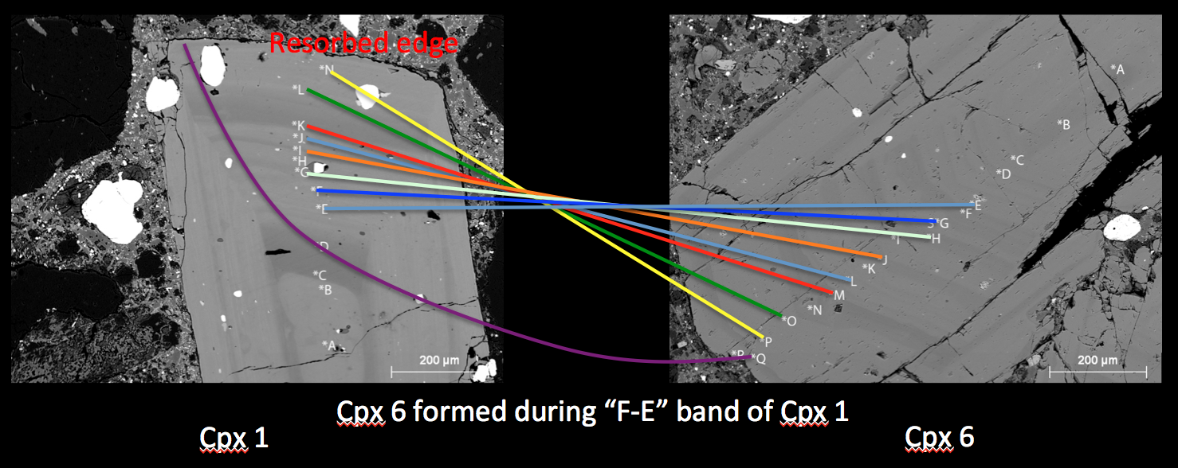
Phenocryst Families
Notes:
Expanding on the idea of complex zoning you can expect a parent magma to generate a set of epitaxial bands with characteristics that mirror melt composition – and you can expect phenocrysts that grew from the same magma to have similar sets of epitaxial bands
Grouping these similar phenocrysts together the term Family is used

Slide 11
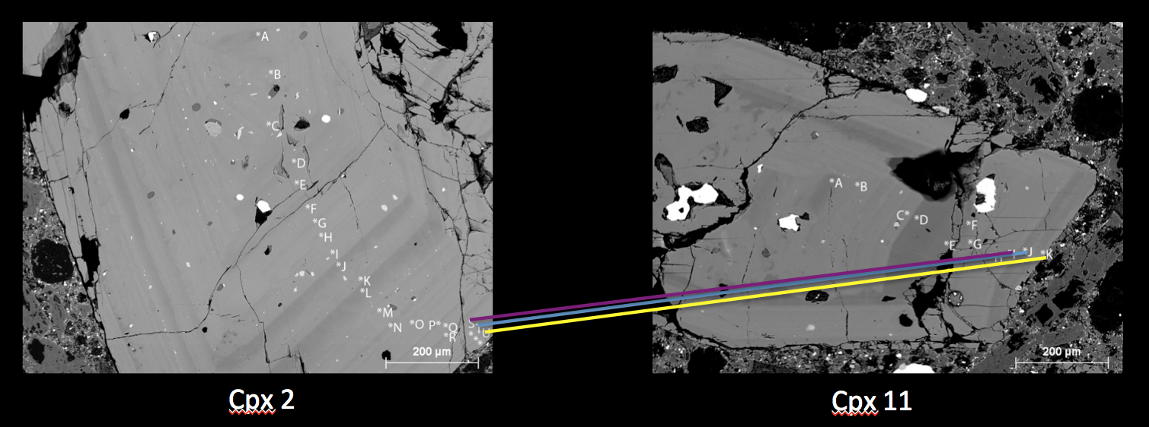
Phenocryst Families
Notes:
Additionally you can expect phenocrysts that are from different magma pods to develop unique sets of bands that differentiate the groups
Here the three outer most bands are chemically equivalent however past that the two phenocrysts do not share similar internal regions

Slide 12
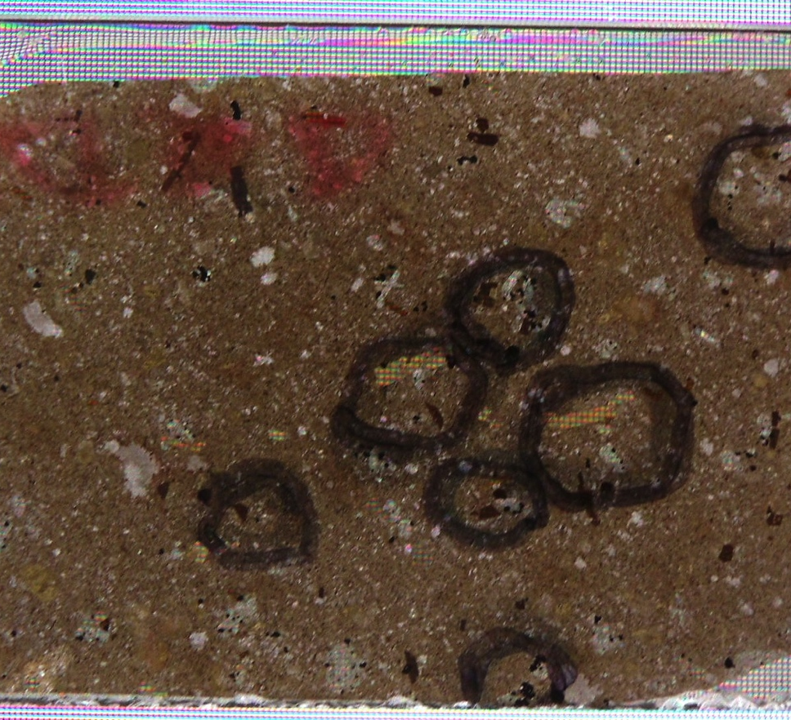
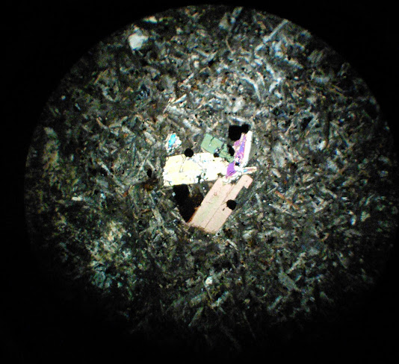
Minette [11-KT-36D]
Notes:
It occurred as a Dike
Phenocrysts: biotite – clinopyroxene – olivine – magnetite
Groundmass: sanidine – biotite – magnetite – cpx

Slide 13
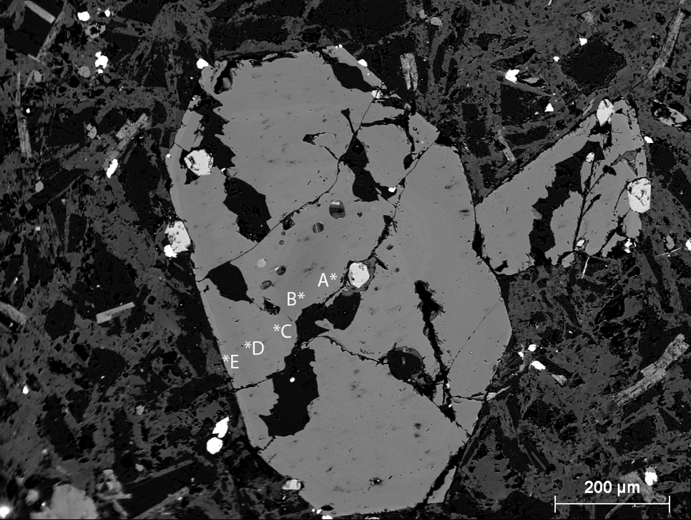
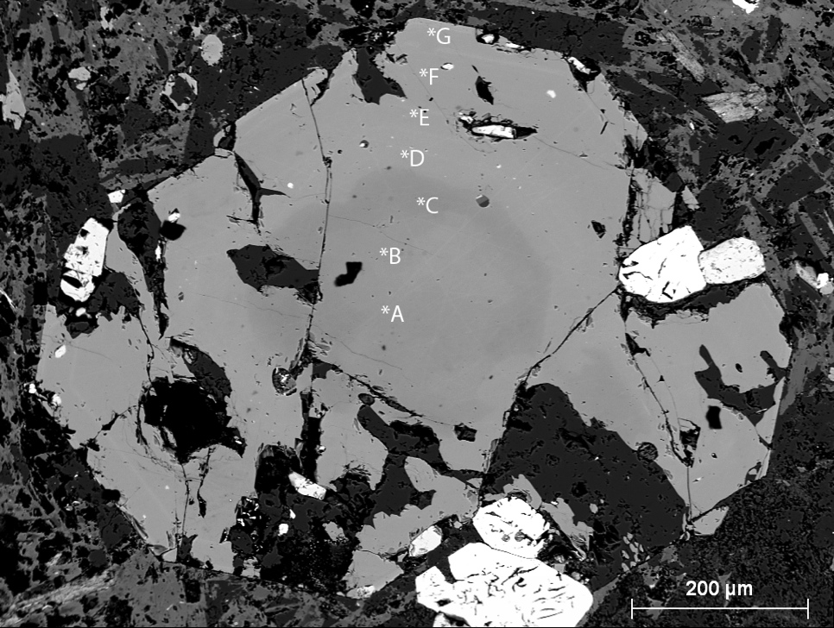
Minette [11-KT-36D]
Backscatter Electron Images of cpx in Minette
Cpx 3
Cpx 20
Notes:
The clinopyroxenes of this sample are relatively simple
BSE images and Microprobe data reveal only one family
Clinopyroxenes display
a rounded resorbed core followed by a slightly more Mg rich band which in turn is covered by a Fe-rich band – all diopside

Slide 14
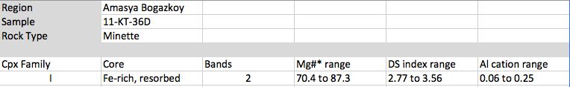
Minette [11-KT-36D]
Notes:
Chart of families

Slide 15
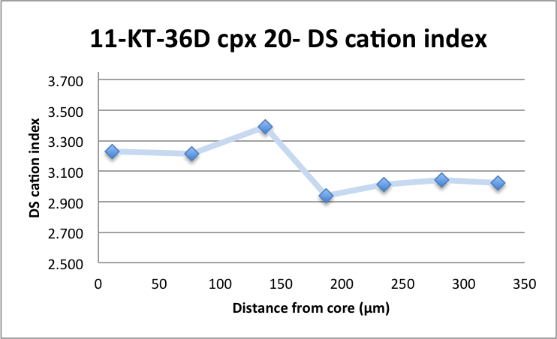
Minette [11-KT-36D]
DS cation index=
(Si+Cr+Mg+Ca)-(Ti+Al+Fe+Mn+Na)
(O’Brien et al., 1988)
Cpx 20
Notes:
I’ll find it useful to use the ds cation index
The cation index is the sum of cation species that are concentrated in diopside (relative to salite) minus the sum of the cation species that are more concentrated in salite –
salite is an Fe-rich version of Diopside

Slide 16
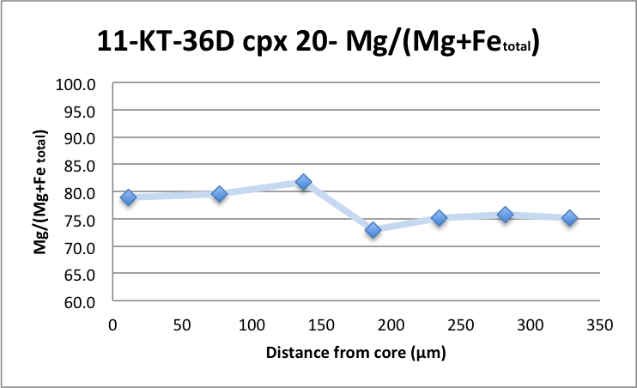
Minette [11-KT-36D]
Cpx 20
Cpx 20
Notes:
Variation

Slide 17
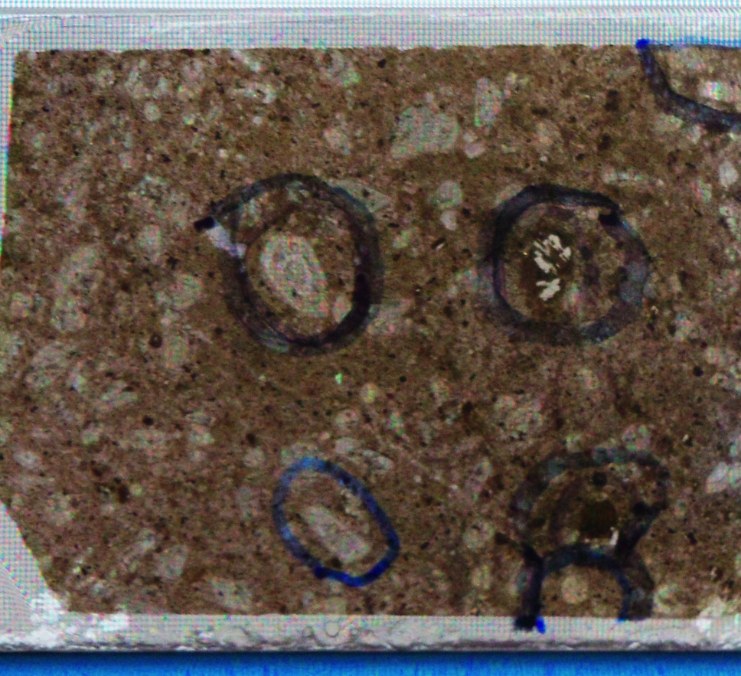
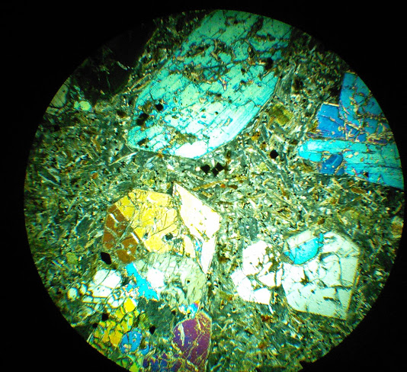
Madupite Lamprophyre [11-AMS-06]
Notes:
Phenocrysts: clinopyroxene – olivine – magnetite
Groundmass: albite – sanidine – biotite – clinopyroxene – magnetite

Slide 18
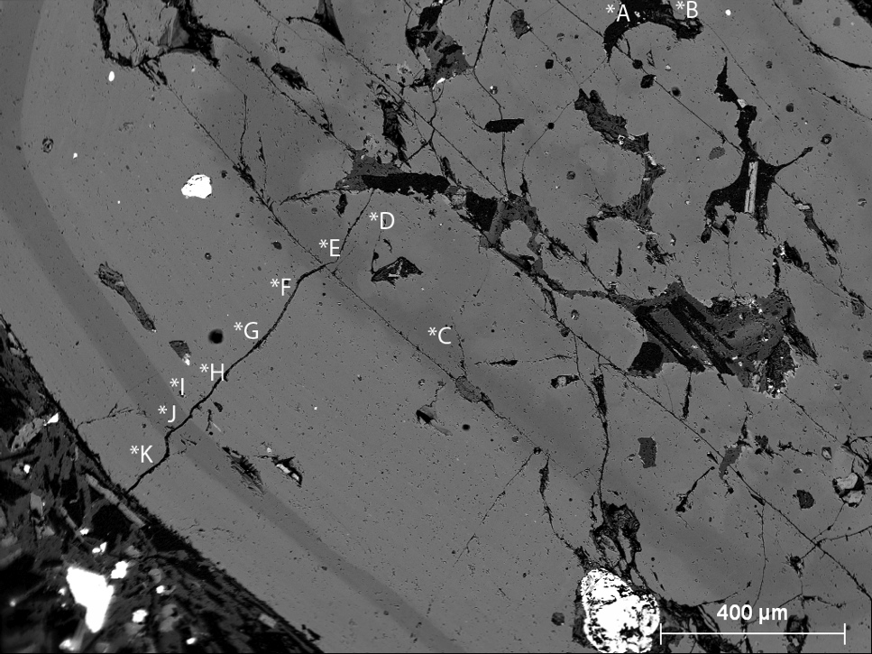
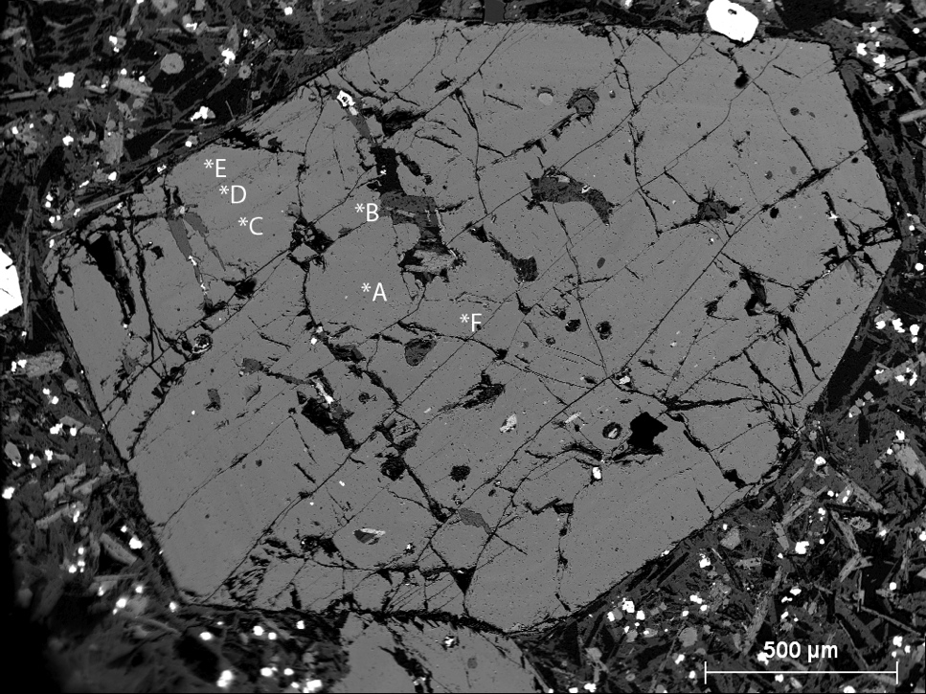
Madupite [11-AMS-06]
Cpx 9
Cpx 7
Notes:
BSE images of two of this samples three families
Both roughly the same size- one has very apparent complex zoning and the other has a relatively homogenous Fe-rich nature

Slide 19
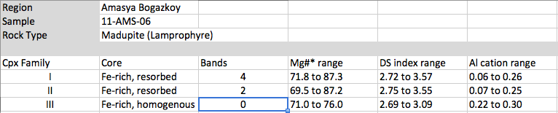
Madupite [11-AMS-06]
Notes:
Chart of families

Slide 20
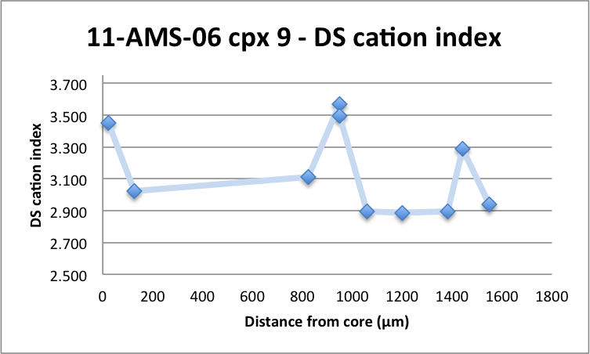
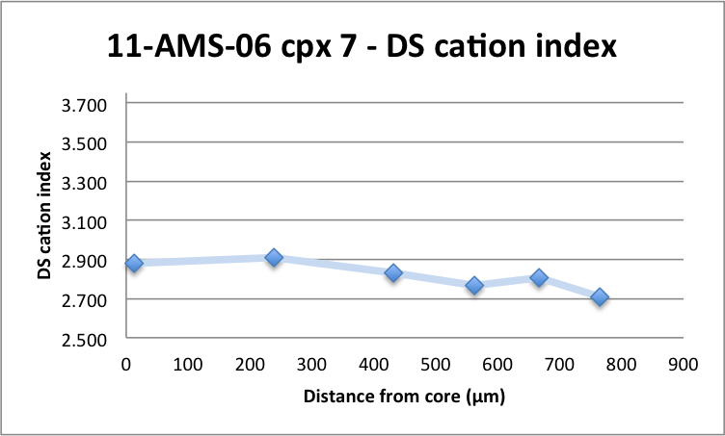
Madupite [11-AMS-06]
core
Cpx 9
Cpx 7
Notes:
Variation

Slide 21
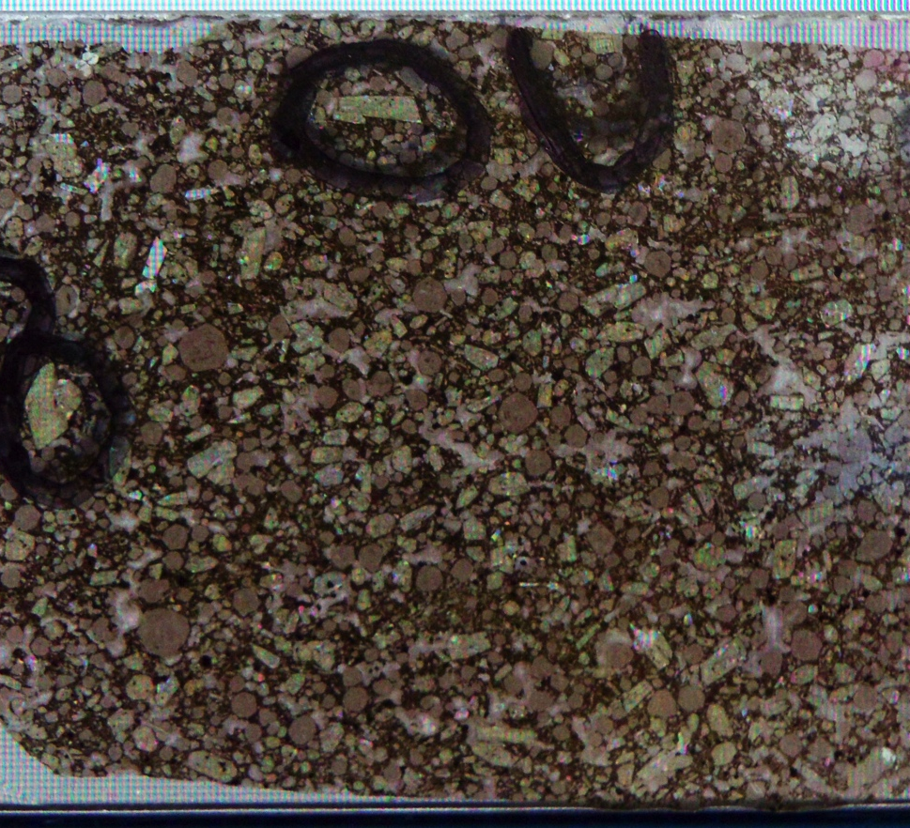
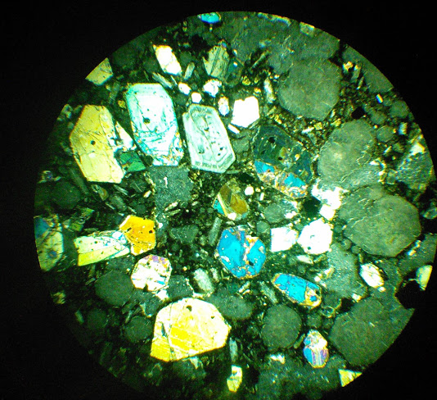
Leucitite [11-KT-34B]
Notes:
Phenocrysts: Leucite – Clinopyroxene – Plagioclase – Sanidine - Magnetite
Groundmass: clinopyroxene, magnetite, leucite

Slide 22
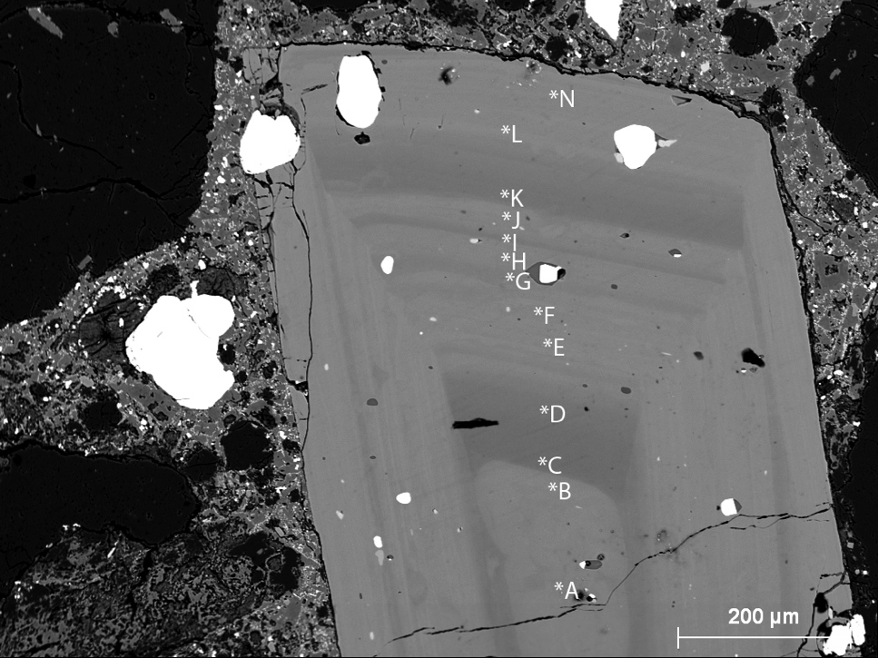
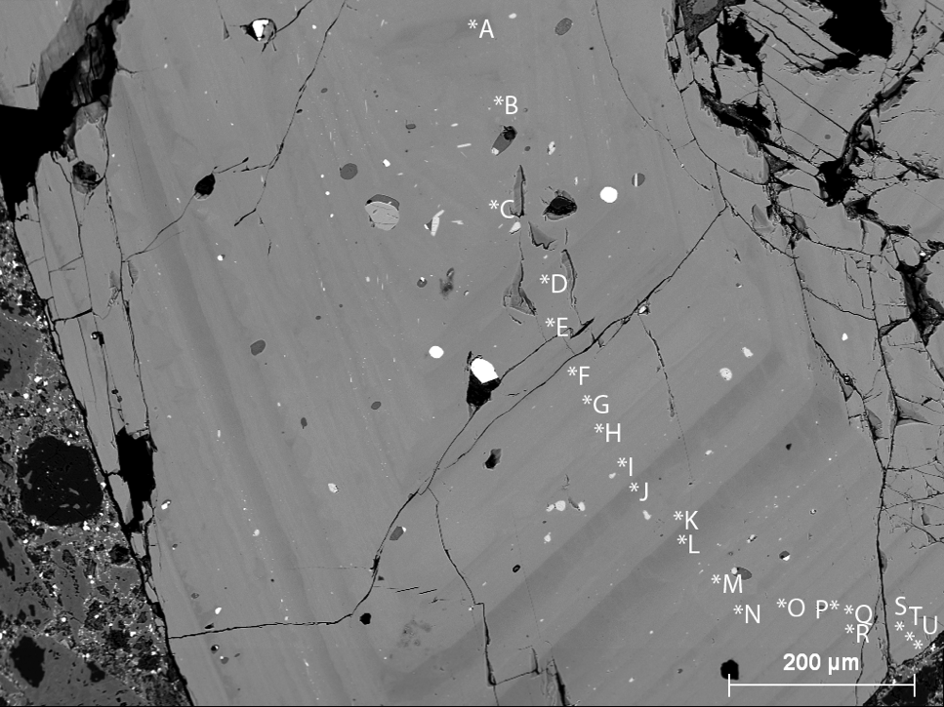
Leucitite [11-KT-34B]
Cpx 1
Cpx 2
Notes:
BSE image of two families
Side note the outer 3 bands match between these two

Slide 23
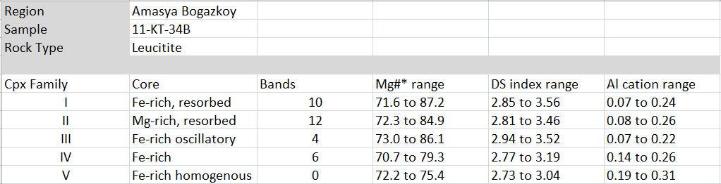
Leucitite [11-KT-34B]
Notes:
Chart of families

Slide 24
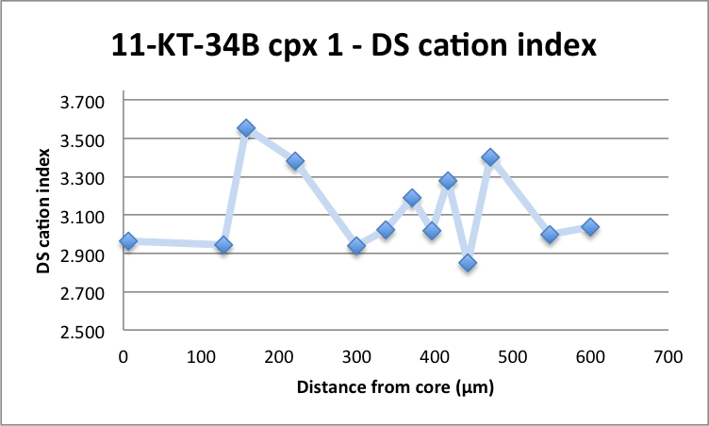
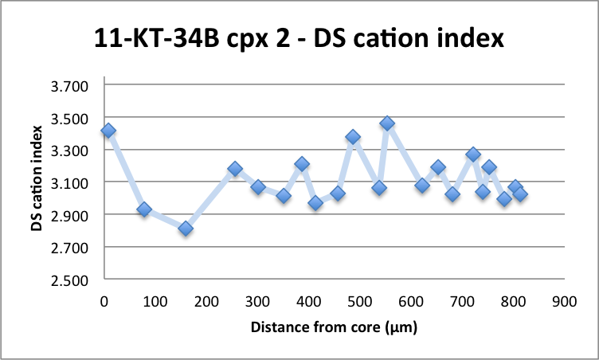
Leucitite [11-KT-34B]
Cpx 1
Cpx 2
Notes:
Variation

Slide 25
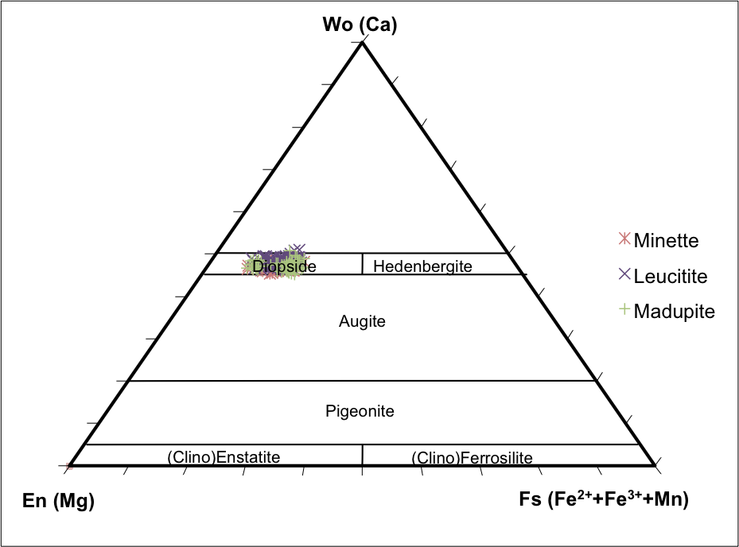
CPX compositions in Pyroxene Quadrilateral
Notes:
When plotted on the pyroxene quadrilateral all cpx from these samples plot in the same range
Implying they are very similar save the difference in phenocryst assemblage- particularly the presence or absence of biotite and feldspars-feldspathoids
The easiest way to account for this is magma water content – biotite rich minette magmas have high water that prevents feldspar growth
How do you get a low water magma- degas a minette via emplacement at shallow depth

Slide 26
Working with the degassed Minette idea
It is conceivable that these shallow magmas were allowed to interact with other magma pods more extensively prior to eruption
The leucites have cpx that are considerably more zoned
and
The leucites have more cpx families present
Notes:
Working with the idea that Water poor biotite-free leucitite are simply degassed minettes that were intruded into comparatively shallow depths
It is conceivable that these shallow magma were allowed to interact with other magma pods more extensively prior to eruption hence why there are considerably more zoned and why there are more families present in the leucitites

Slide 28
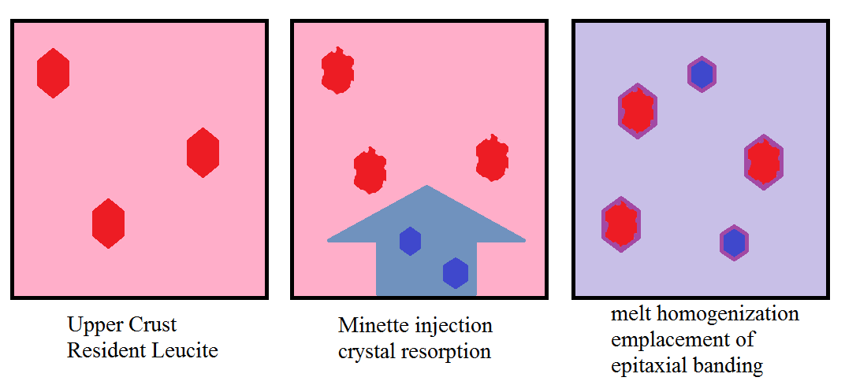
How to get two cpx families in the same magma.
CPX
Resident Leucitite

Slide 29
Much to be done
Questions ?
Suggestions ?

