Slide 1

CASE STUDIES OF CHROMITE ORE PROSPECTING IN CAMAGUEY PROVINCE, CUBA
Rubén González Pontón
Sociedad Cubana de Geología
2016 Geological Society of America Annual Meeting
Denver, Colorado. United States of America
24 – 28 September 2016

Slide 2

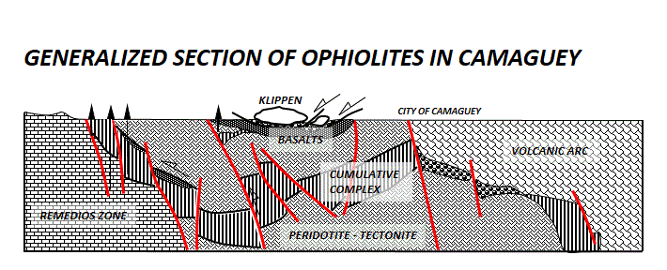
DISTRIBUTION OF OPHIOLITES IN THE ISLE OF CUBA
La Habana
0 100 200 km
Matanzas
Cajálbana
Iguará-Perea
Santa Clara
Section of ophiolites in Camagüey
Jagua
Isla de la Juventud
Mabujina
SEPTENTRIONAL OPHIOLITES
Yayabo
Camagüey
Holguín
Moa -Baracoa
AMPHIBOLITIZED OPHIOLITES
Mayarí
Santiago de Cuba
Sierra del Convento
Güira de
Jauco
THERE ARE LOTS OF OPHIOLITES IN CUBA AND MANY OF THE ULTRAMAFIC SECTIONS HOST IMPORTANT CHROMITE BODIES. THE ABUNDANCE OF CHROMITE ORE DEPOSITS IN CAMAGÜEY HAS ATTRACTED THE ATTENTION OF PROSPECTORS SINCE THE EARLY 20th CENTURY AND HELPED CUBA REACH PROMINENCE IN THE EXPORT OF CHROMITE DURING THE SECOND WORLD WAR.

Slide 3
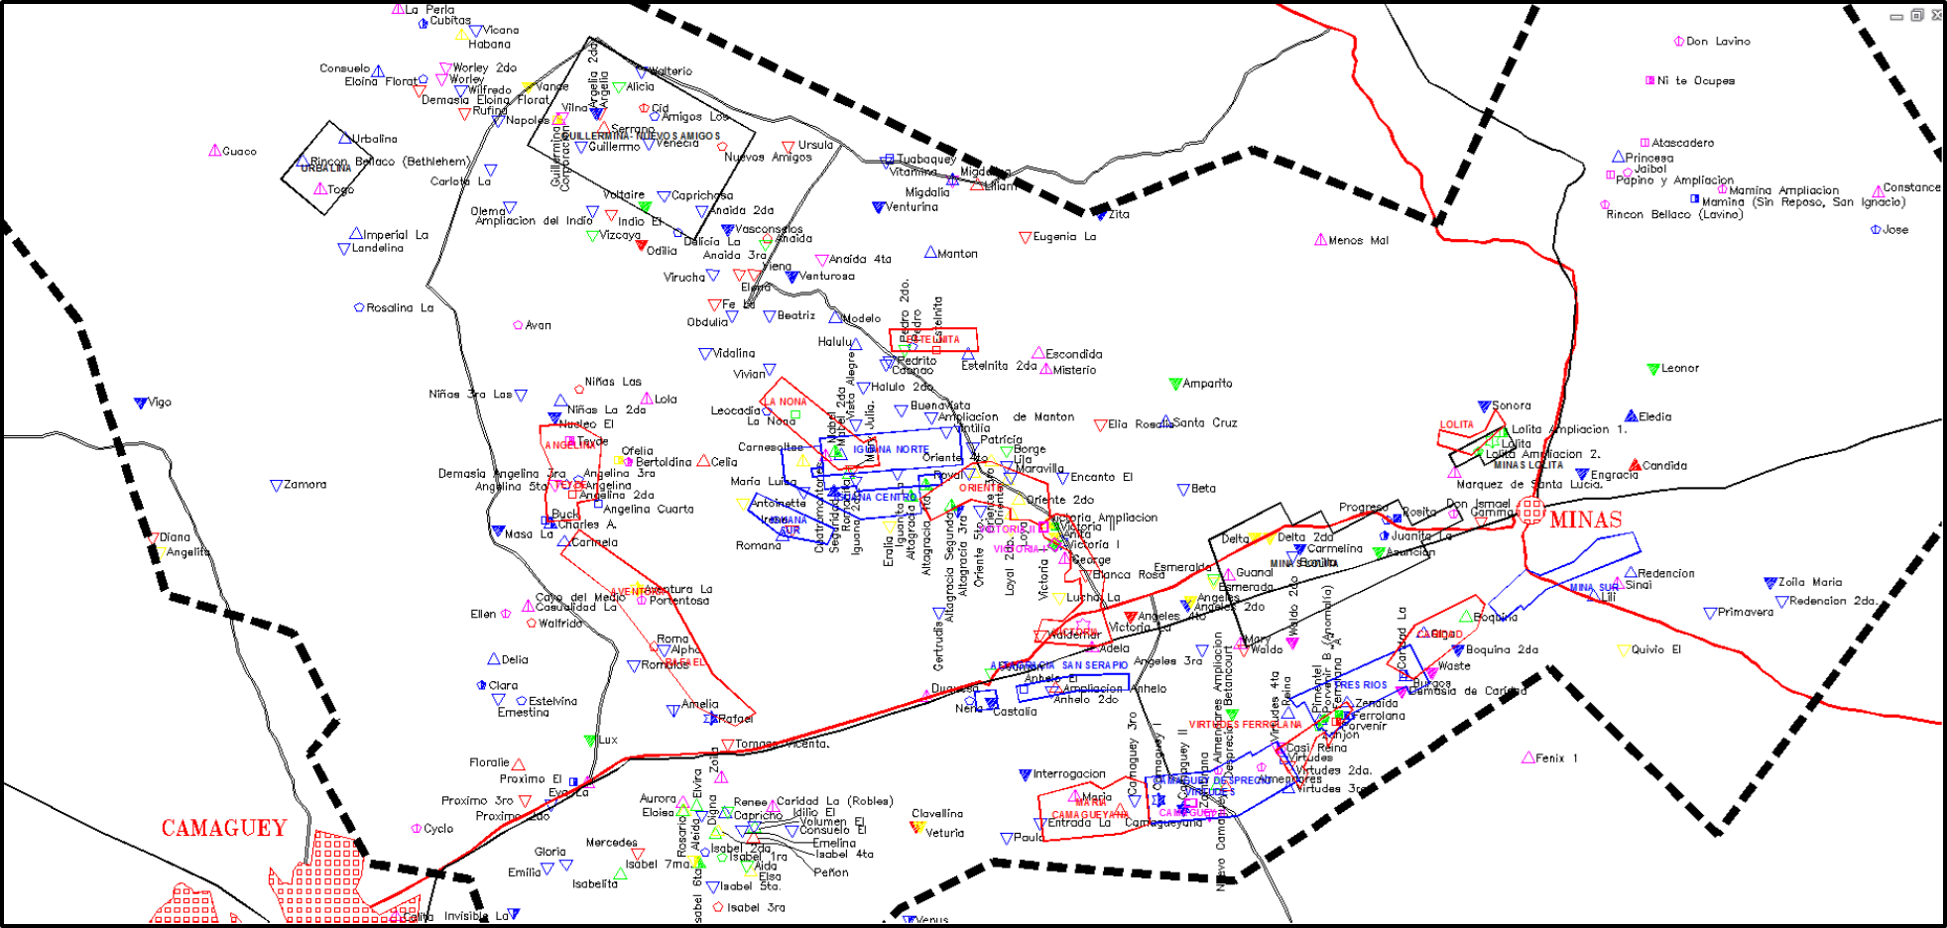
LOCATION OF CHROMITE ORE DEPOSITS AND SHOWINGS
MEDIUM TO LARGE DEPOSITS OF REFRACTORY CHROMITE WERE DISCOVERED DURING THAT EPOCH. MAJOR MINES WERE RAFAEL, AVENTURA, LOLITA, VICTORIA WITH MORE THAN 200 000 t EACH.
HUNDREDS OF CHROMITE ORE DEPOSITS AND SHOWINGS ARE LOCATED AT DIFFERENT LEVELS OF THE OPHIOLITIC SECTION.

Slide 4
LOCATION OF CHROMITE ORE DEPOSITS AND SHOWINGS
AVENTURA MINE
FOR THE FIRST TIME ADAIR E. L. PERFORMED IN 1937 A GEOPHISYC SURVEY USING THE TORSION BALANCE.
PROSPECTING WORKS WERE CARRIED OUT BY THAYER T. P. EN 1942; DELOS E. FLINT, JESÚS FRANCISCO DE ALBEAR Y PHILIP W. GUILD IN 1948, ALSO GRAVITY SURVEYS IN 1942 - 1943 AND 1954 - 1956 BY U. S. GEOLOGICAL SURVEY. THE BIGGEST DEPOSIT CAMAGUEY – II WAS DISCOVERED AT THAT TIME (700 800 t)
PROSPECTING FOR CHROMITE IN OPHIOLITIC BODIES RENEWED AFTER 1962 IN COLLABORATION WITH RESEARCHERS FROM EASTERN EUROPE.

Slide 5
LOCATION OF CHROMITE ORE DEPOSITS AND SHOWINGS
A CUBAN-GERMAN CREW OF GEOLOGISTS AND GEOPHYSICISTS PERFORMED TWO PROJECTS IN 60 Km² FOR CHROMITE PROSPECTING FROM 1983 – 1987 AND FROM 1987 – 1990 IN THESE SECTORS.
THE LOCATION OF THE TWO SITES TREATED AS CASE STUDIES IS HIGHLIGHTED HERE.

Slide 6

METHODOLOGY
SELECTION OF SECTORS
TOPOGRAPHIC SURVEY - DIGITAL MODELING OF THE TERRAIN
CONSTRUCTION OF 50 x 20 m GRID
GEOLOGIC MAPPING
GRAVITY SURVEY
MAGNETIC SURVEY
GEO-ELECTRICAL SURVEY
GEOLOGIC MAP
BOUGUER MAP
MAGNETIC MAP
GEO-ELECTRICAL DATA
TOPOGRAPHIC CORRECTION
CALCULATION OF LOCAL GRAVITY FIELD
GEOLOGIC CRITERIA
GEOPHYSICAL CRITERIA
CATALOG OF ANOMALIES
SELECTION OF DRILLING TARGETS
BASED ON THE DENSITY CONTRAST BETWEEN CHROMITITES AND HOST SERPENTINIZED PERIDOTITES, GRAVITY SURVEYS WERE THE PRIMARY EXPLORATION METHOD. VALUES OF DENSITY FOR ENCLOSING ROCKS VARY FROM 2.4 TO 2.5 g/cm³ WHILE THE ESTIMATED DENSITY FOR THE CHROMITE ORE AVERAGES 3.7 g/cm³.

Slide 7
METHODOLOGY
REQUIREMENTS FOR GRANTING ANOMALY CLASS
GRAVITY ANOMALY | POLARIZABILITY ηa | RESISTIVITY ρa | MAGN. FIELD ∆ T | CLASS (K) OF ANOMALY
+ | MINIMUM | MAXIMUM | MINIMUM | 1
+ | - | - | WEAK GRADIENT | 2
± | - | - | - | 3
- | - | - | - | 4
IF A POSITIVE LOCAL GRAVITY ANOMALY IS CHARACTERIZED WITH MINIMUM OF POLARIZABILITY, MAXIMUM OF RESISTIVITY AND MINIMUM OF MAGNETIC FIELD, THE ANOMALY BELONGS TO THE FIRST CLASS.
REQUIREMENTS FOR GRANTING ANOMALY PROSPECTIVENESS
GRAVITY ANOMALY | CLASS OF ANOMALY (K) | QUANTITY OF GEOLOGICAL CRITERIA | PROSPECTIVENESS P
+ | 1,2 | 2 | 1
+ | 1,2,3 | AT LEAST 1 | 2
+ ± | 1,2,3 | 1 PARTIALLY | 3
- | 1,2,3,4 | - | 4
FIRST AND SECOND CLASSES OF ANOMALIES THAT MATCH AT LEAST TWO GEOLOGICAL CRITERIA BELONG TO THE P1 PROSPECTIVENESS

Slide 8
METHODOLOGY
ANOMALY´S INTENSITY DEPENDENCE OF DISTURBER BODY´S DIMENSIONS
mgl
0.20
H = 10 m
H = 20 m
ORE BODY 1
ORE BODY 2
0.15
H = 30 m
H = 50 m
1
0.10
30 m
30 m
0.05
2
50 m
100 m
10 m
5 m
0
-50 -25 0 25 50 m
-75 -50 -25 0 25 50 75m
- 50 -25 0 25 50 m
-75 -50 -25 0 25 50 75m
52 500 t for chromite density σ = 3 500 Kg . m⁻³
ANOMALY´S INTENSITY DEPENDENCE OF DISTURBER BODY´S DEPTH AND DIPPING
mgl
60°
45°
60°
Angle of dipping
0.10
90°
At 5 m
depth
0.08
At 10 m
depth
20 m
0.06
0.04
30 m
0.02
- 10 -5 0 5 10 m
- 10 -5 0 5 10 m
- 10 -5 0 5 10 m
- 10 -5 0 5 10 m
5 m
10 500 t for chromite density σ = 3 500 Kg . m⁻³
MODELING OF CHROMITE BODIES TOOK IN ACCOUNT THE DIMENSIONS, DEPTH AND DIPPING OF DISTURBER OBJECTS.

Slide 9
CASE STUDY No. 1. VICTORIA - I
Victoria - I sector . A = 4.8 Ha
BELONGS TO THE CUMULATIVE COMPLEX OF OPHILITE ASSAMBLAGE
SERPENTINIZED HARZBURGITES ARE THE PREDOMINANT ROCK TYPE
(Up to 2.70 g/cm³ DENSITY)
SUBORDINATED SERPENTINIZED DUNITES
GABBROID BODIES OF MODERATE DIMENSIONS AND OLIVINIC COMPOSITION
GABBRO DIKES (Average density 2.85 g/cm³)
THE SECTOR IS BY THE SIDE OF EXHAUSTED CHROMITE MINE

Slide 10


INTERPRETATION OF GEOPHYSICAL AND GEOLOGICAL DATA
LITHOLOGY
M
SERPENTINIZED PERIDOTITES
NON DIFFERENTIATED GABBROS
INTERPRETED FAULTS
G
BY GRAVITY SURVEY
M
BY MAGNETIC SURVEY
ᴦ
ᴦ ᴦ
M
s
vvv
BY INDUCTIVE POLARIZATION
WITH DIRECTION OF DIPPING
s
CHROMITE ORE BODIES
PROJECTION TO THE SURFACE
ACCORDING RESULTS OF DRILLING
?
M
LOCAL GRAVITY ANOMALY
LINE 0.6 * 10⁻⁶ m.s⁻² GRIFFIN r = √‾s s = 20
s
M
s
MINIMUM OF MAGNETIC FIELD LINE 300 ηT
ᴦ
?
M
?
HOLES POSITIVE
NEGATIVE
M
HOLES VERTICAL
AT ANGLE
GRAVITY AND MAGNETIC SURVEYS AND I. P. HELPED MAPPING OF DISTURBED SURFACE BY HUMAN ACTIVITIES, ALSO THE INTERPRETATION OF TECTONIC STRUCTURES.
INTERPRETATION WAS UPDATED LATER WITH THE OUTCOMES OF EXPLORATION DRILLING.
IN RED COLOUR THE DRILL HOLES THAT INTERCEPTED THE ORE BODIES, THE BLUE ONES DID NOT.

Slide 11
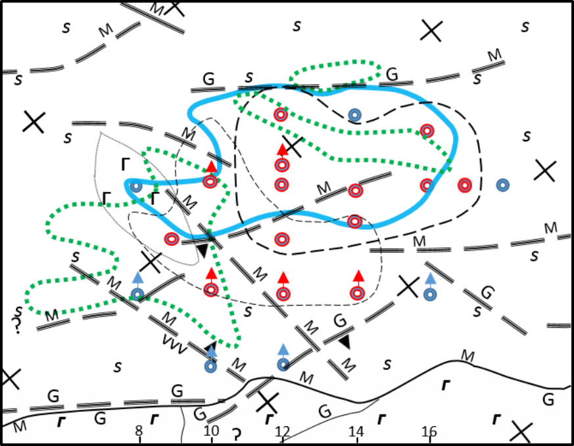
INTERPRETATION OF GEOPHYSICAL AND GEOLOGICAL DATA
SECTION 14
60
80
100
120
140
S S
S
S
S S
S
ᴦ
S
S S
S
ᴦ
ORE BODY No. 1
S S
S
ORE BODY No. 2
ᴦ
S
S
S S
S
50.00
65.00
90.00
90.00
DISCONTINUOS LINES ARE THE CONTOURS OF THE ORE BODIES ± MATCH THE LINE (IN BLUE COLOUR) OF VALUES 0.6 * 10⁻⁶ m.s⁻² EXCEPT ONE HOLE IN SECTION 14.
FOR ESTIMATION OF RESOURCES WE USED THE INTERPOLATION TO HALF OF THE DISTANCE BETWEEN TWO HOLES BUT NATURE DOESN´T UNDERTAND RULES….

Slide 12
INTERPRETATION OF GEOPHYSICAL AND GEOLOGICAL DATA
INTERPRETATION FROM LOCAL GRAVITY MAP MADE POSSIBLE TO IDENTIFY TWO ANOMALIES SHOWING ORE BODY, PROBABLY BROKEN IN TWO PARTS AS RESULT OF EMPLACEMENT OF OPHILITES AND TECTONIC STRUCTURES. THAT IDEA IS SUPPORTED BY EXPLORATION DRILLING IN THE NEXT SLIDE.

Slide 13
INTERPRETATION OF GEOPHYSICAL AND GEOLOGICAL DATA
SECTION 10
SECTION 12
40
60
80
100
120
140
40
60
80
100
120
140
S S
S
S S
S
ᴦ
70 m
ᴦ ᴦ
70 m
ᴦ
ᴦ
S
S S
S
S
S S
S
60 m
ᴦ ᴦ
S
S S
ᴦ
60 m
ᴦ
S
S S
S
50 m
ᴦ ᴦ
ᴦ
50 m
ORE BODY No. 1
40 m
40 m
S S
34.90
ORE BODY No. 1
ORE BODY No. 2
30 m
S
S S
S
30 m
S
S S
S
48.40
S
S S
S
20 m
20 m
S
S S
S
10 m
65.50
87.40
10 m
ᴦ
S
S S
S
0 m
ᴦ
80.00
100.90
0 m
113.60
100.00
TWO ORE BODIES DIPPING SW TO THE CONTACT OF SERPENTINITES WITH THE GABBROID BODY

Slide 14
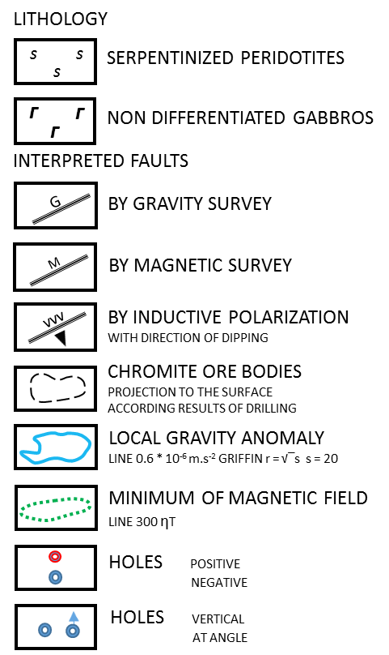
INTERPRETATION OF GEOPHYSICAL AND GEOLOGICAL DATA
MAGNETIC FIELD REVEALED TWO MINIMUMS IN THE AREA OF GRAVITY ANOMALY (DISCONTINUOS GREEN LINES).

Slide 15
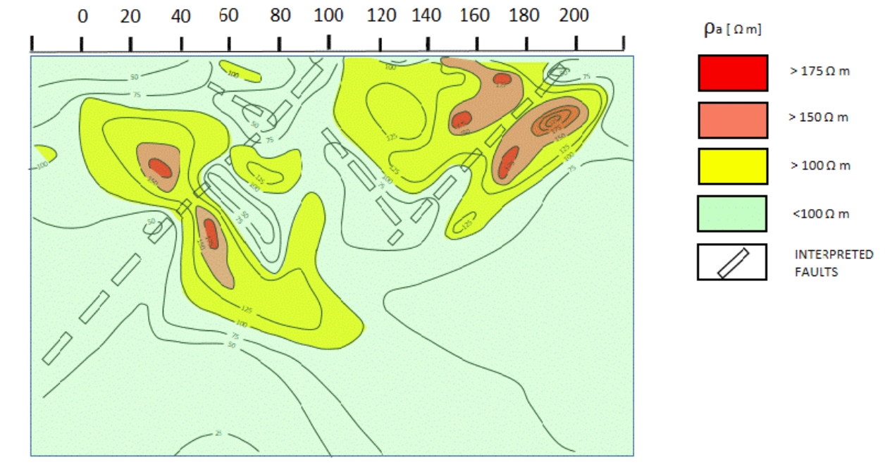
COMPLEX INTERPRETATION FOR SECTION 10 IN VICTORIA - I
ᴦ
2.6
2.1
2.3
2.8
ᴦ
2.5
2.5
ᴦ
2.3
2.6
3.6
2.5
3.8
2.6
ᴦ
2.6
2.4
FROM I. P. – TRIELECTRODIC PROBE: NO CONCLUSIVE INDICATIONS ABOUT THE EXISTENCE OF ANY ORE BODY, JUST TWO SITES OF MODERATE RESISTIVITY. ONLY VALID INFORMATION IS THE POSSIBLE EXISTENCE OF FAULTS, DIPPING SW TO THE CONTACT WITH GABBROS.
MEDIUM GRADIENT MAPS OF POLARIZABILITY AND RESISTIVITY DO NOT SHOW ANY POSSIBLE TECTONIC ELEMENT.

Slide 16
CASE STUDY No. 1. VICTORIA - I
THE GRAVITY SURVEY REVEALED THE ANOMALY VICTORIA-I AND LATER EXPLORATION BECAME THE DEPOSIT INTO THE FIRST OPEN CAST MINE RESULTED FROM THIS RESEARCH.
MASSIVE ORE AND MINOR DENSE DISSEMINATED CHROMITE WITH AVERAGE CONTENTS:
Cr₂O₃: 29.20 % SiO₂: 6.5 % Al₂O₃: 26.90 CaO: 0.9 %

Slide 17
CASE STUDY No. 2. MINAS SUR
Minas Sur Area: 2.50 Km²
BELONGS TO THE CUMULATIVE COMPLEX OF OPHILITE ASSAMBLAGE
HIGH DENSITY SERPENTINIZED HARZBURGITES ARE PREDOMINANT
(Up to 2.85 g/cm³ DENSITY)
THERE ARE LESS SERPENTINIZED DUNITES
GABBROID BODIES OF MODERATE DIMENSIONS AND OLIVINIC COMPOSITION
GABBRO DIKES (Average density 2.85 g/cm³)
BASALTS AND DIABASES (Up to 2.99 g/cm³)
MANY SURFACE FRAGMENTS OF MASSIVE CHROMITE-FLOATING CHROMITE

Slide 18
CASE STUDY No. 2. MINAS SUR
BOGUER GRAVITY MAP
LOCAL GRAVITY MAP
MAGNETIC FIELD MAP
SHOWS MANY GRAVITY ANOMALIES. IT WAS THE BASIS TO SET AREA TO DENSIFY SURVEY USING 25 x 10 m. GRID
REVEALED CLEAR DEFINITION OF
GRAVITY ANOMALIES 0.02 TO 0.08 mlg.
SUPPORTED THE SELECTION OF THE DENSIFICATION AREA WITH A FIELD OF MINIMUM VALUES.

Slide 19
CASE STUDY No. 2. MINAS SUR
GEOLOGIC MAP OF SELECTED AREA. GRID 25 X 10 m
LOCAL GRAVITY MAP AND DRILLING TARGETS
600
Serpentinized peridotites
600
Vertical testing
drill holes
Serpentinized
dunites
Inclined testing
drill holes
0.06
0.02
0.06
Gabbro dikes
0.06
0.06
500
Floating
chromite
500
0.1
0.06
0.06
0.08
Observed
faults
0.04
0.02
-0.04
0.02
0.04
0.02
0
0.02
400
Possible
faults
400
0
0
0.06
0
0.06
-0.02
0
-0.04
300
300
40
38
36
34
32
30
28
26
24
22
20
40
38
36
34
32
30
28
26
24
22
20
GEOLOGIC MAPPING REVEALED FAVORABLE CRITERIA: A WIDE SITE OF FLOATING CHROMITE, SOME DUNITE LENSES IN THE BACKGROUND OF SERPENTINIZED PERIDOTITIES AND DIKE SWARMS.
ONCE BEING PREPARED THE ANOMALY´S CLASSIFICATION CATALOG, CAME OUT DRILLING TARGETS TO BE CHECKEP UP.

Slide 20
CASE STUDY No. 2
ACCORDING THE RESULTS OF MAPPING, TRENCHES AND DRILLING, THE CAUSES OF THE 69 GRAVITY ANOMALIES ARE:
DRILLING SHOWED THAT THE NATURE OF DISTURBER BODY FOR THE 16 CHECKED UP ANOMALIES WAS:
THE UNEXPECTED RESULT IS THAT NO BLIND CHROMITE ORE BODY FOUND IN MINAS SUR AREA.
VERY DENSE HARZBURGITES | 50
DIABASES AND BASALTS | 12
GABBRO DIKES | 7
VERY DENSE HARBURGITES | 10
DIABASES AND BASALTS | 3
GABBRO DIKES | 3

Slide 21
CASE STUDY No. 2. MINAS SUR
SECTION OF DRILL HOLES OVER THE MOST PROSPECTIVE AREA
11-BD5
2-BD5
1-BD5
0 m
10 m
2.46
S S
SERPENTINIZED PERIDOTITIES
S
S
S
S
S
S
S
S
S
S
S
20 m
S
2.5
2.56
S
S
S
2.59
D D
SERPENTINIZED DUNITES
30 m
ᴦ
2.83
2.84
40 m
ᴦ
2.59
GABBRO
ᴦ
2.84
2.69
50 m
ᴦ ᴦ ᴦ
ᴦ ᴦ
2.60
2.84
MEASURED DENSITY
60 m
D D D
60.00
S
S
S
S
S
S
S
S
S
D D D
2.57
70 m
S
S
S
S
S
S
D D
2.77
2.58
60.00
2.56
96.60
USING MEASURED DENSITY, THE DETAILED STUDY OF ANOMALIES DEMONSTRATED THAT THE CAUSES WERE GABBRO DIKES AND VERY DENSE PERIDOTITES.

Slide 22
CONCLUSIONS
GRAVITY SURVEY IS THE MOST EFFECTIVE METHOD FOR PROSPECTING OF BLIND CHROMITE ORE BODIES.
MAGNETIC SURVEY PLAYS A SIGNIFICANT ROLE FOR DETERMINING TECTONIC STRUCTURES.
THE OUTCOMES OF ELECTRICAL METHODS ARE AMBIGUOUS IN MANY CASES.
MAJORITY OF ANOMALIES HAS THE CAUSE IN DENSE HARZBURGITES BLOCKS, MANY ARE PROVOKED BY GABBROS, LESS BY VOLCANIC ROCKS.
THERE ARE MANY GEOLOGICAL CRITERIA THAT PLAY AN OUTSTANDING ROLE IN PROSPECTING OF CHROMITE.
DETAILED PROSPECTING HAS COVERED RELATIVELY SMALL AREAS IN OPHIOLITES, SO THE PROSPECTIVENESS IS WIDE FOR DISCOVERING NEW BLIND CHROMITE BODIES.

Slide 23
Thanks

