Slide 1
LINKS BETWEEN THE DEVELOPMENT OF EXTENSIONAL BASINS AND THE FORMATION OF LOW-SULFIDATION EPITHERMAL AU-AG DEPOSITS: INSIGHT FROM THE
NORTHERN NEVADA RIFT
Justin B. Milliard and John L. Muntean
Ralph J. Roberts Center for Research in Economic Geology, University of Nevada Reno, 1664 N. Virginia St., Reno, NV USA 89557
2016 GSA Annual Meeting – T3 Economic geology of extensional terrains – P.No. 297-1

Slide 2
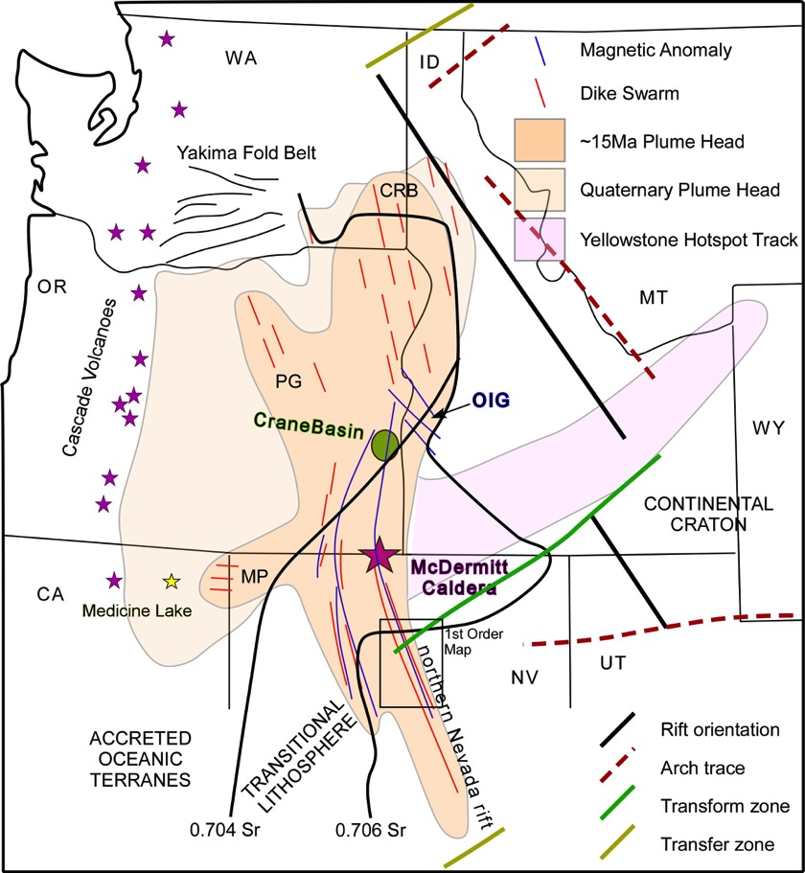
Regional Overview - Western North America
Hotspot magmatism
Volcanism
Basin & Range extension
Epithermal deposits
Project area
Modified from Ponce 2002, Camp 2004, Lund, 2008
2016 GSA Annual Meeting – T3 Economic geology of extensional terrains – P.No. 297-1

Slide 3
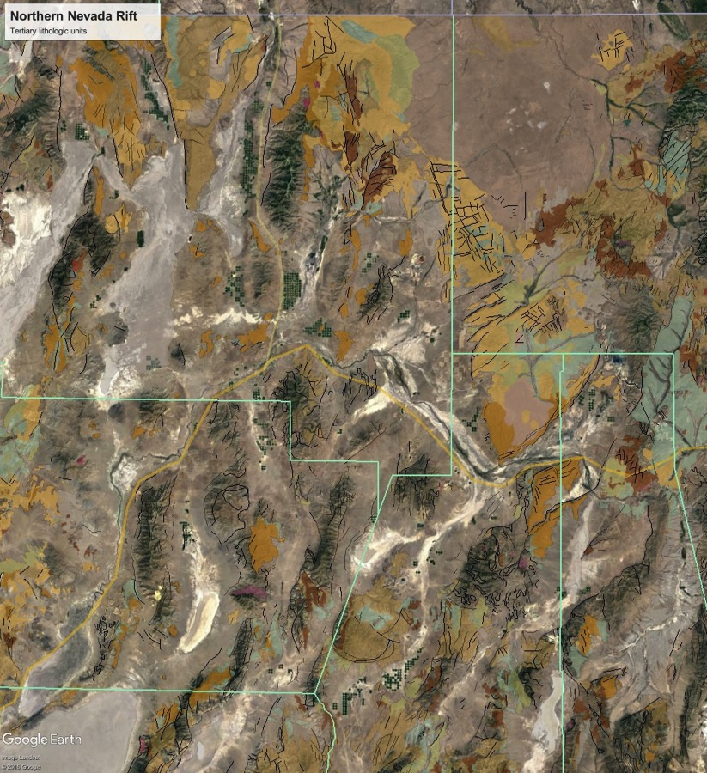
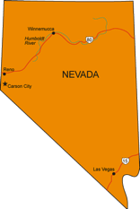

Project Overview - Southern NNR
4 basins
McD
North
Buckskin-National
3 dominate fabrics
(340°, 060°, 310°)
35 km
NNR
multiple epithermal occurrences
Sleeper
What are there relationships between volcanism, tectonism, and hydrothermal activity?
Do they influence deposit formation in both space and time?
Midas
>2M oz Au
Ivanhoe-Hollister
>2M oz Au
Winnemucca
Mule
Canyon
~1M oz
Elko
Battle Mountain
Gold Banks
Fire Creek
~1M oz @
>1 opt Au
This study hypothesizes that the rift’s architectural evolution influences deposit location and formation.
Buckhorn
~1/4 Moz
Iceberg
2016 GSA Annual Meeting – T3 Economic geology of extensional terrains – P.No. 297-1

Slide 4
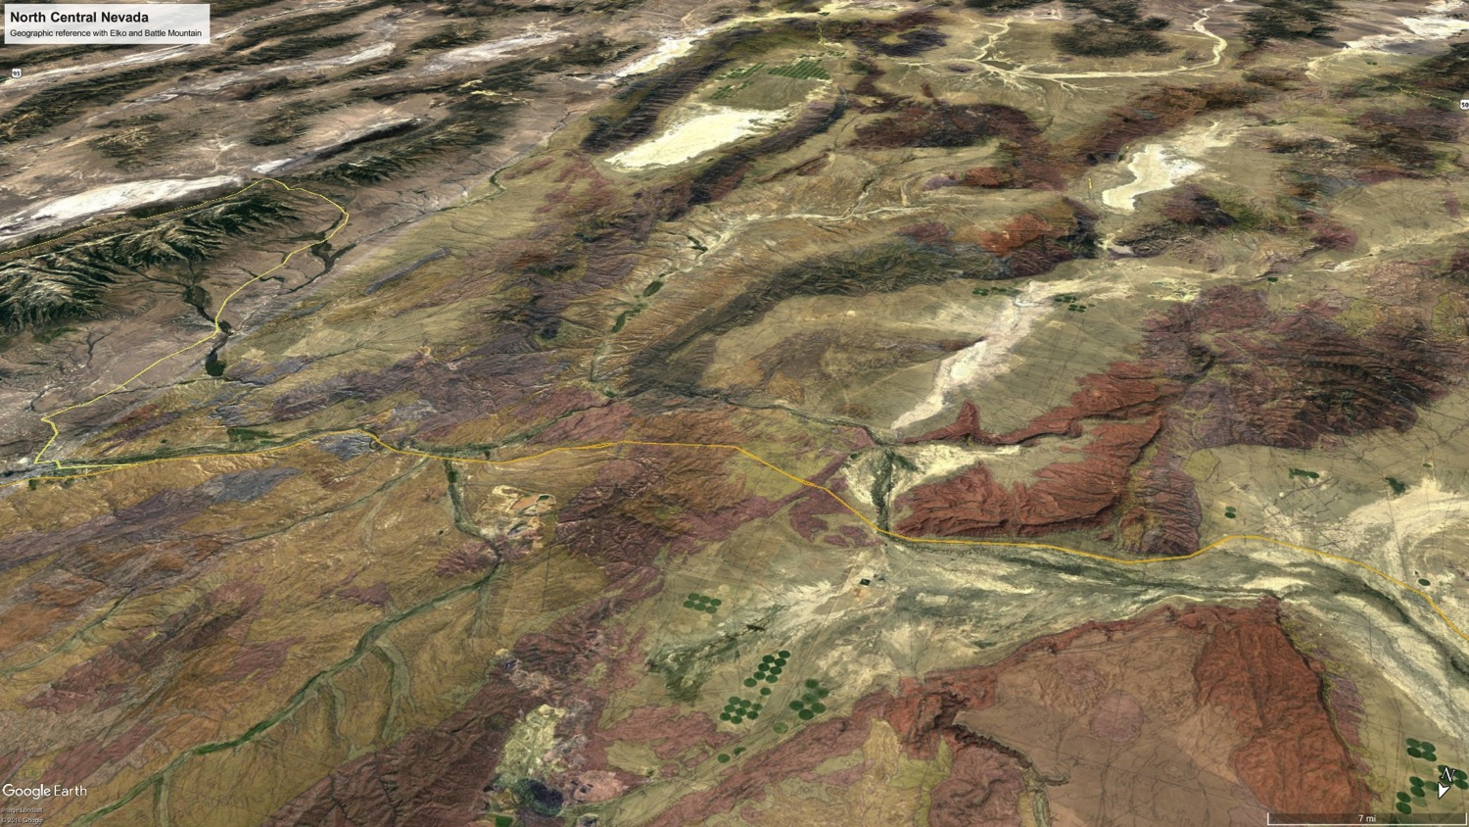
Fossilized Miocene Basins
VIEW SOUTH
Simpson Park Range
Roberts Mts.
Ruby Mountains
Cortez Range
Malpais Rim
Shoshone Range
CARLIN
Argenta Rim
ELKO
BATTLE
MOUNTAIN
Sheep Creek Range
2016 GSA Annual Meeting – T3 Economic geology of extensional terrains – P.No. 297-1

Slide 5
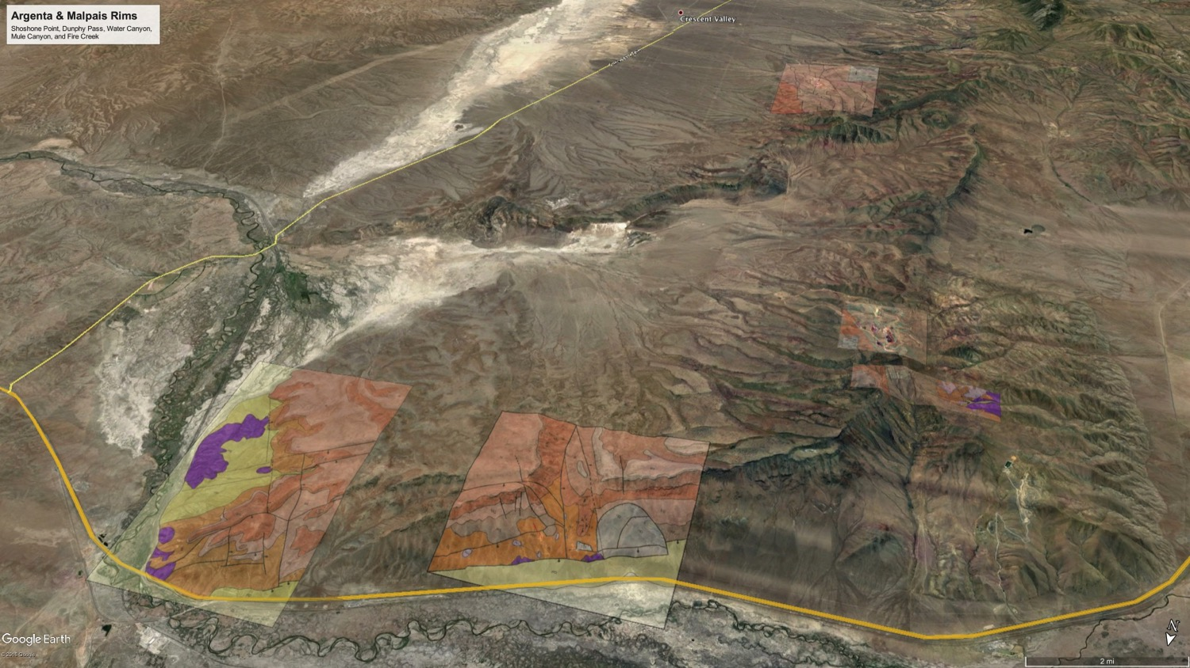
Argenta & Malpais Rims
Black Rock Cyn.
~14.7 Ma
Fire Creek Mine
Fire Creek
GMC
NNR
Horse Heaven
Red Devil
~16.4 Ma
~35 Ma
Dunphy Pass
Mule Canyon Mine
Beacon Light
Kassos, 2016 & John, 2003
A
A’
Argenta Plateau
Argenta Point
Muleshoe
VIEW SOUTH
2016 GSA Annual Meeting – T3 Economic geology of extensional terrains – P.No. 297-1

Slide 6
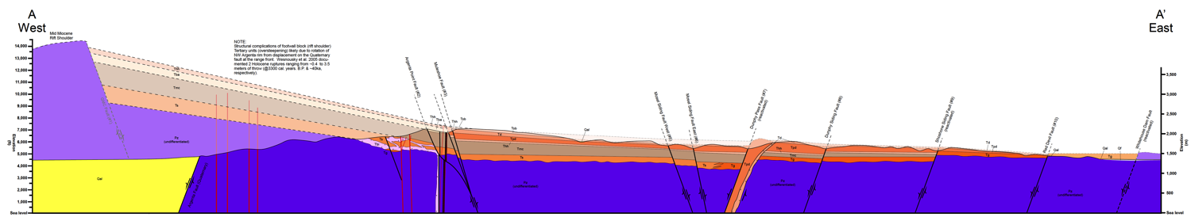
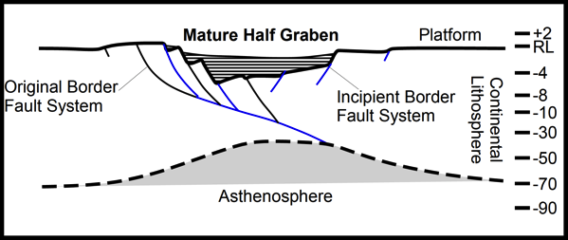
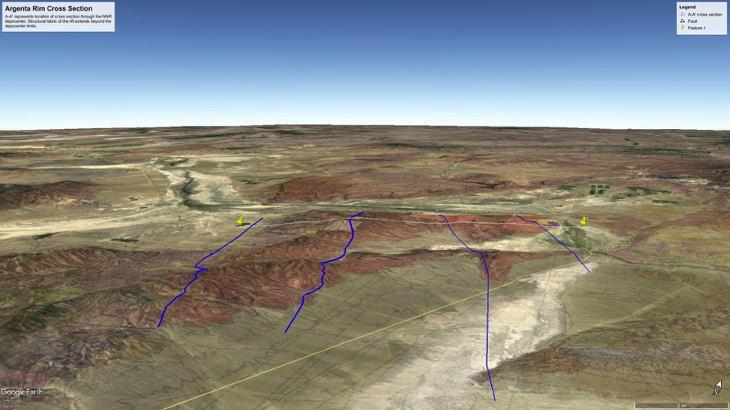
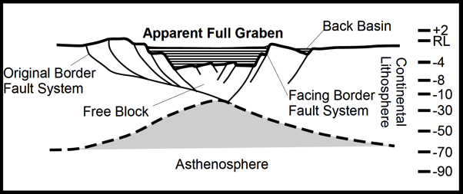
Basin History – Combined Section
GMC
Muleshoe
Dunphy Pass
Red Devil
>~16.4 Ma %29 total extension, basin forms (field obs. indicate Eocene in origin)
~16.4 – 15.9 Ma %42 total extension @ a rate of 12kyrs/1%, 6.9 Mw event possible (Mw=μ*d*A) capable of rupturing brittle crust, mature half graben established
~15.9 – 15.75 Ma %8 total extension @ a rate of 6kyrs/1%, Fire Creek & Mule Canyon form at apex of rider block
~15.75 – 15.3 Ma %19 total extension @ a rate of 29krs/1%, stress partitioned away from the original border fault system (western GMC-Muleshoe) to the eastern incipient border faults (Dunphy Pass-Red Devil)
~15.3 – 14.7 Ma %2 of total extension @ a rate of 300kyrs/1%, system fossilized
VIEW NORTH
Modified from Rosendahl, 1978
Modified from Rosendahl, 1978
A’
Battle Mountain
A
Mule Canyon
Fire Creek
Dunphy
Pass
Red Devil
GMC
Muleshoe
Take Away – close link between basin development/fault activity & deposit formation
Heave
5 volcanic units & 2 deposits
9 faults
Throw
2016 GSA Annual Meeting – T3 Economic geology of extensional terrains – P.No. 297-1

Slide 7
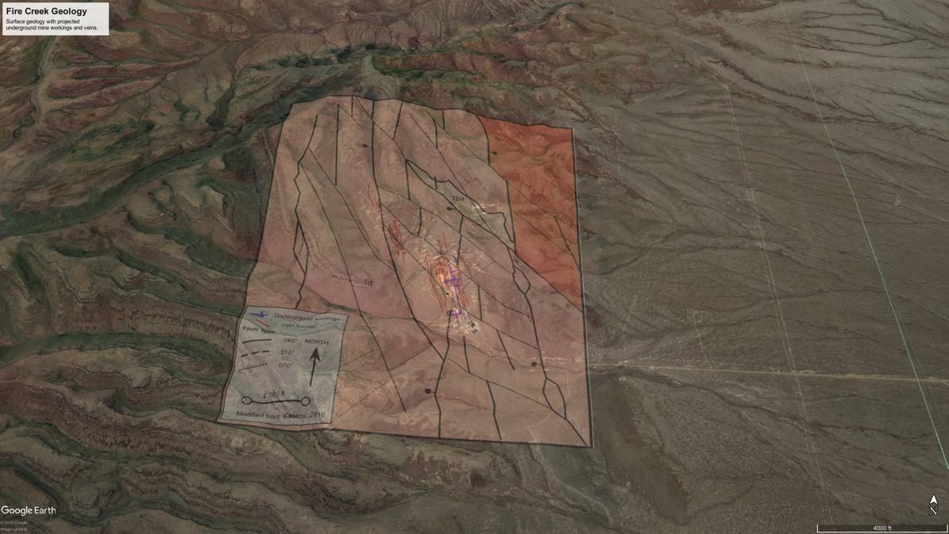
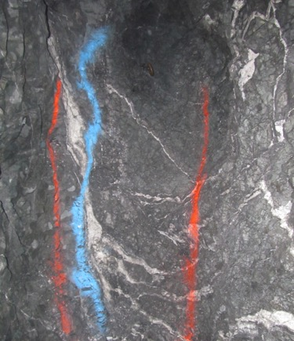
Kinematic Link – Fire Creek
Muleshoe
A’
A
See J. Whitmore @ booth 23
Vonnie face
1’
Muleshoe
GMC
Fault zone
Rider block
2016 GSA Annual Meeting – T3 Economic geology of extensional terrains – P.No. 297-1

Slide 8
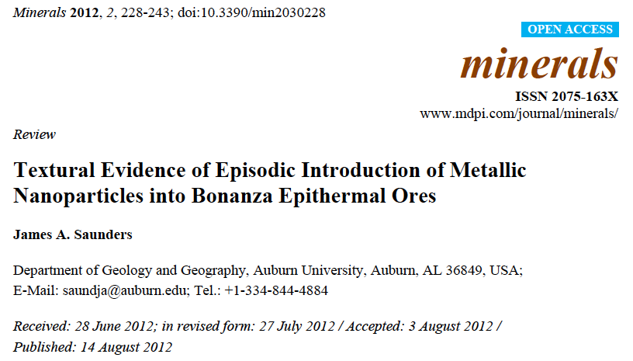
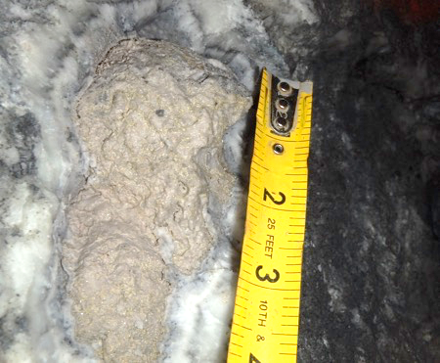
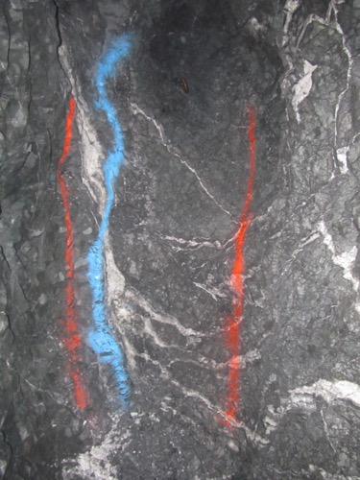
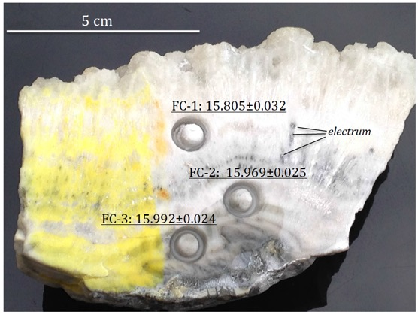
Kinematic Link – Fire Creek
Vonnie vein
dendritic gold mass of gold
(texture formed by
colloids)
See Dr. Saini-Eidukat @ 2:45
Epithermal veins
Cu isotope indicate magmatic metal source
Vonnie vein
episodic vein deposition
1’
Kassos, 2016
Vonnie face
2016 GSA Annual Meeting – T3 Economic geology of extensional terrains – P.No. 297-1

Slide 9
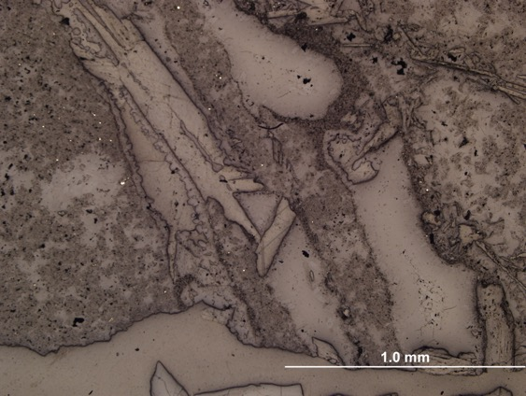
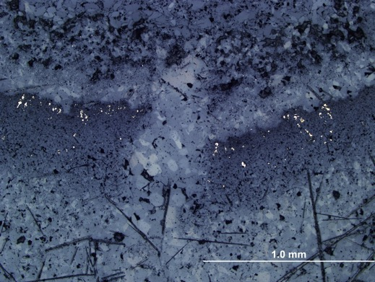
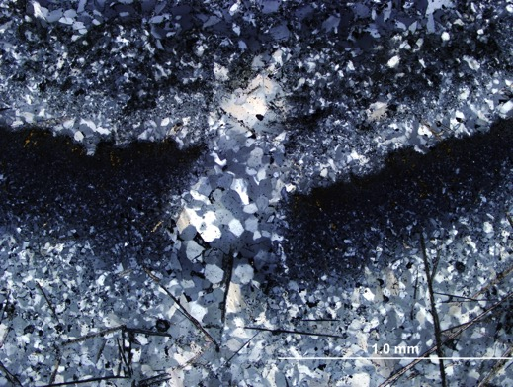
Kinematic Link – Fire Creek
HuWui vein
micro-growth fault
Vein center
Healed fault zone
5cm
younger
Reflected light
younger
Wall rock
coseismic
Propagating fault tip
Au
older
Transmitted-polarized
light
2016 GSA Annual Meeting – T3 Economic geology of extensional terrains – P.No. 297-1

Slide 10
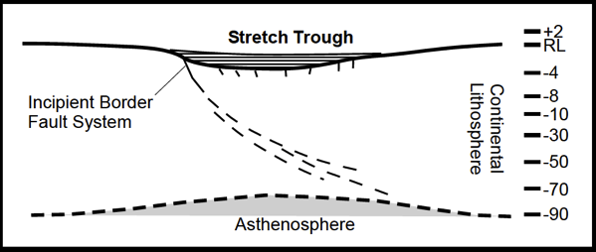

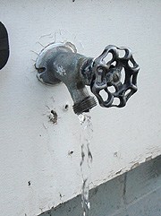
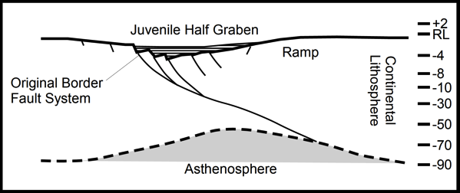


Basin History – Implications
Pre 16.5 Ma
- Stress accommodated for by broadly distributed, low displacement, & shallow faults. Forms Eocene-Oligocene basins.
During ~ 16.5 to 15.9 Ma
Propagation of through going, boundary fault system.
Adolescent development of an asymmetric pathway network for hydrothermal fluids-magmas.
FC - MC
After ~ 15.9 to 15.75 Ma
Establishment of efficient, asymmetric hydrothermal-magmatic pathways via basin boundary fault networks.
  Rider blocks, relays, & tilt-blocks
  Geometries sufficient for Mw≥6.9 to likely rupture through brittle crust
~15.75 to 14.7 Ma
- Further architectural development of central to northern NNR
Establishes dispersed hydrothermal-magmatic pathways.
?
?
?
2016 GSA Annual Meeting – T3 Economic geology of extensional terrains – P.No. 297-1
Modified from Rosendahl, 1978

Slide 11



THANK YOU
John Muntean
Klondex Mines Ltd.
  John Marma, Brian Morris, Randy Vance, Sid Tolbert, Lucy Hill, Mike Doolin, & Paul Huet
Newmont Mining Corp.
  Dick Reid
Barrick Gold Corp.
  Paul Doback & Johnny Muir
NuLegacy Gold Corp.
  Roger Steininger & Garret Frey
Carlin Resources
  Bob Thomas
SGS-Corescan
    Brigette Martini
PaleoResource Consultants
  Dr. Lanny Fisk
Herb Duerr
Eric Struhsacker
Ajeet & Caylen
2016 GSA Annual Meeting – T3 Economic geology of extensional terrains – P.No. 297-1

