Slide 1
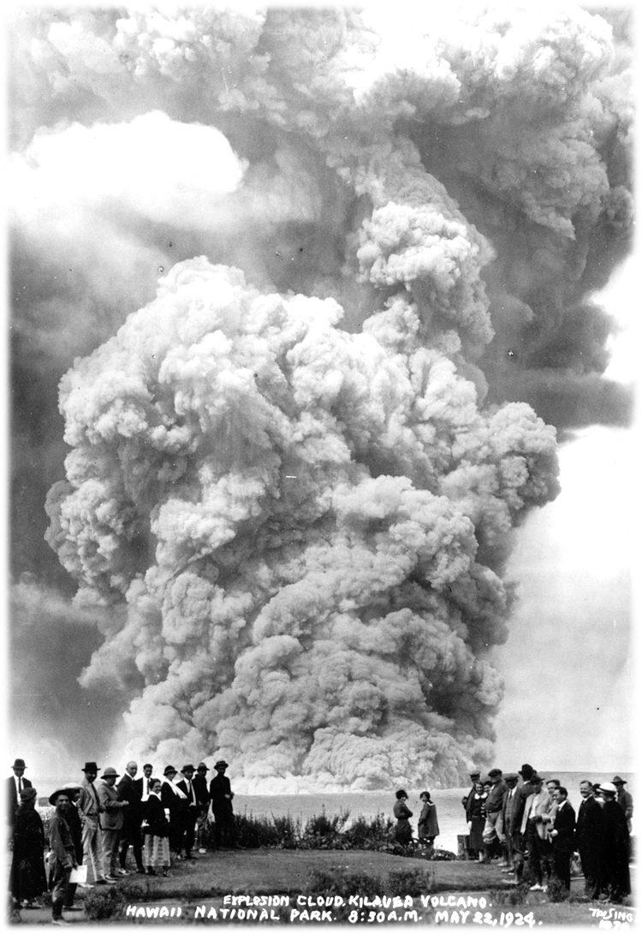
Deposits of the 1924 explosive eruption of Kīlauea Volcano, Hawaiʻi
Don Swanson, USGS-HVO
V. Dorsey Wanless, Boise State Univ.
Ben Gaddis, USGS-HVO
Line Stoppa, Fribourg University
May 22, 1924
Photo by Tai Sing Loo

Slide 2
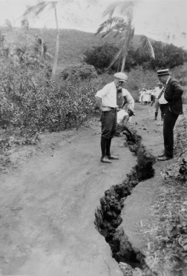
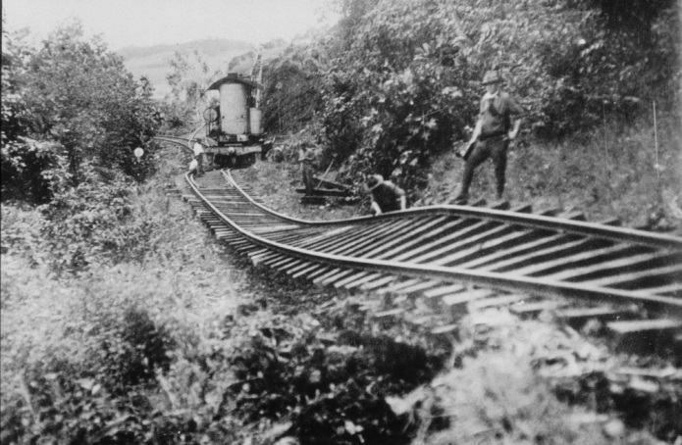
1924 eruption: summary
Magma migrated from Halemaumau reservoir into east rift zone in Feb-Mar, ending with intrusion at Kapoho in April
Kapoho
Halemaumau

Slide 3
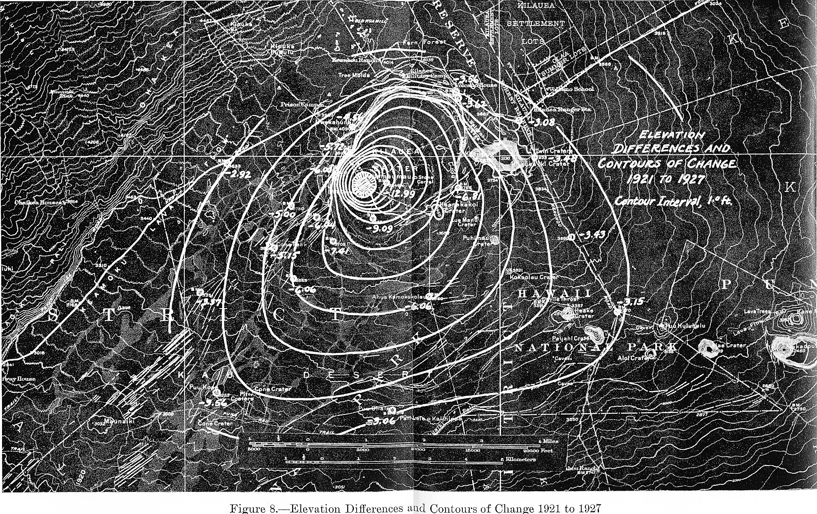
Kīlauea summit subsided
Maximum surface subsidence, >4 m
Benchmark
R.M. Wilson’s (1935) classic map of subsidence for the 1924 eruption. Contour interval, 1 foot (30 cm)

Slide 4
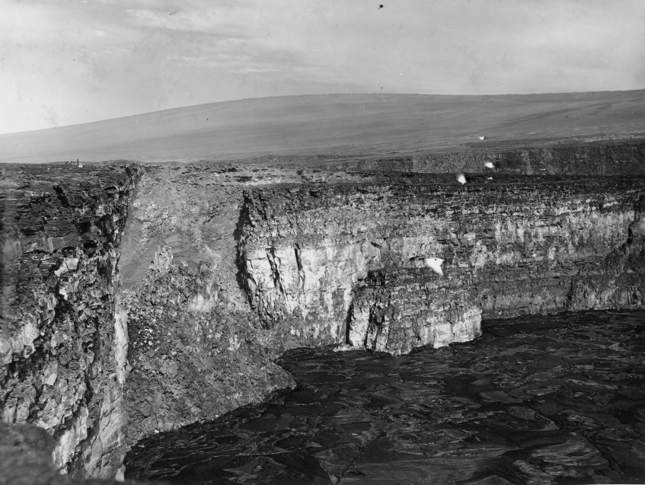
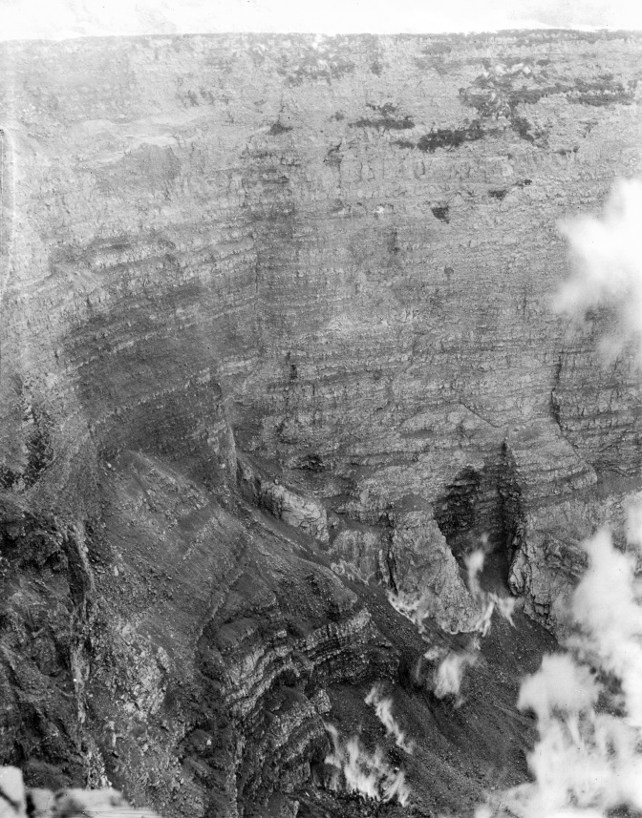
Lava drained from Halemaumau lava lake
Lava lake surface
5/13/1923; Jaggar photo
6/5/1924; Emerson photo

Slide 5
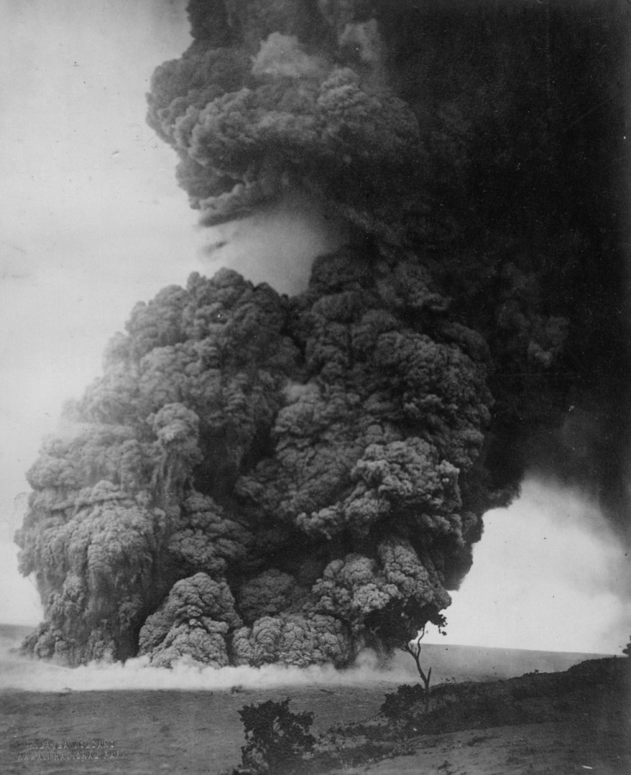
More than 50 phreatic explosions took place over a 2.5-week period starting May 10-11
11:15 a.m. Sunday May 18, 1924 from Uwēkahuna Bluff
This was the largest or next-to-largest explosion, and it killed one person
Photo by Kenichi Maehara

Slide 6
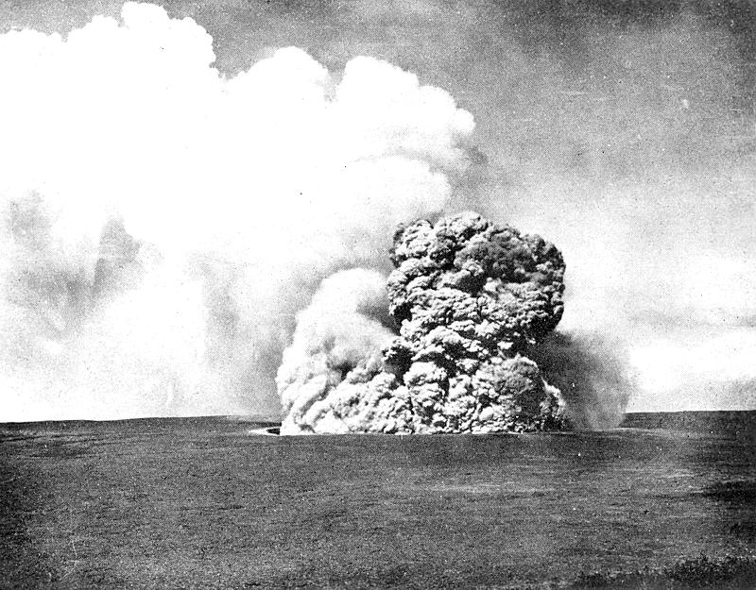
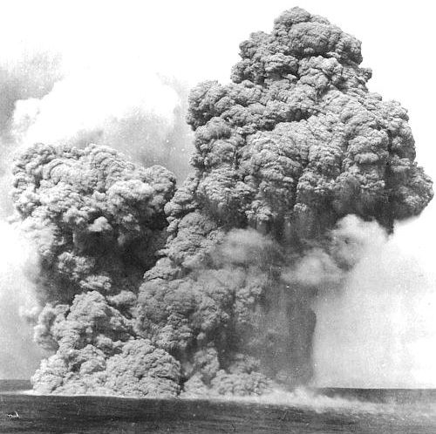
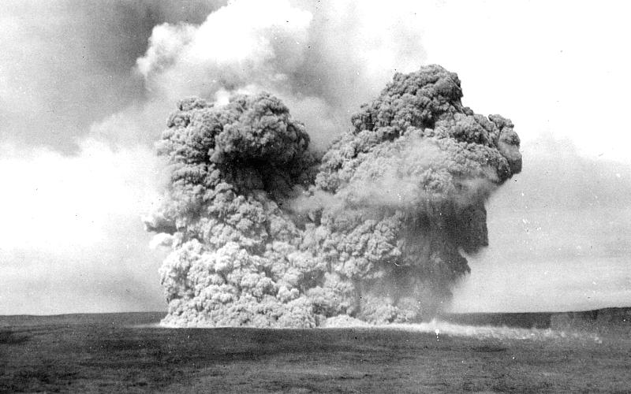
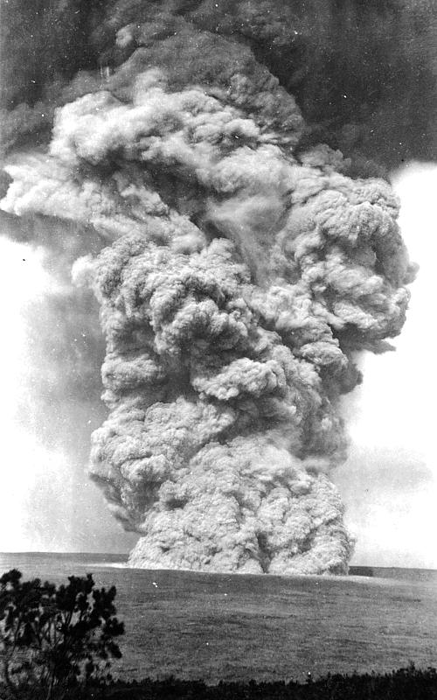
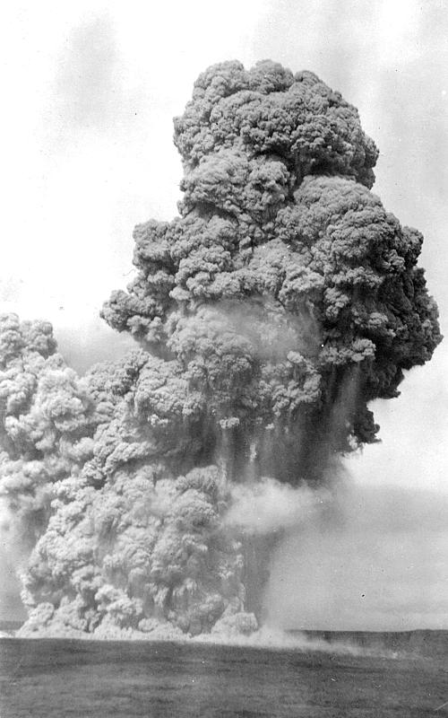
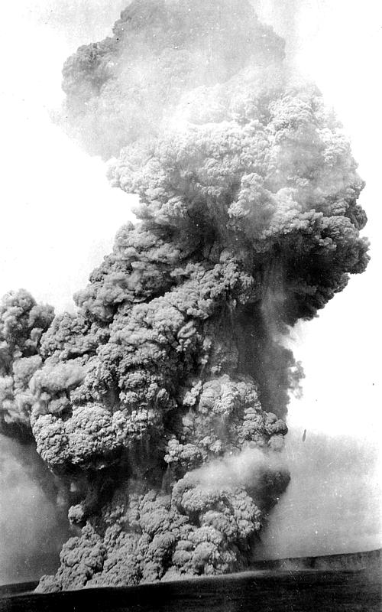
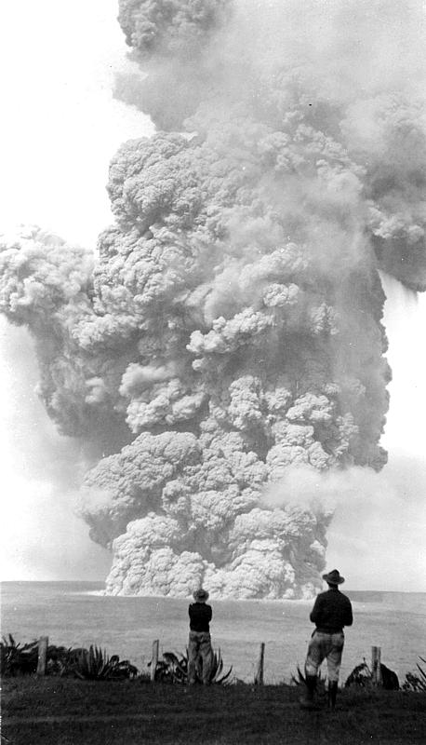
Growing eruption column, from Volcano House
May 22, 0810:30, 30 sec after start, 550 m high, rise rate 18 m/s
0811, 975 m wide, 1000 m high, rise rate 15 m/s
0812, 1650 m, 11 m/s
0820, >3.7 km, umbrella cloud
(photos by Tai Sing Loo)
0814, 2450 m, 7 m/s
0816, 3 km, 5 m/s
0818, 3.5 km, 4 m/s

Slide 7
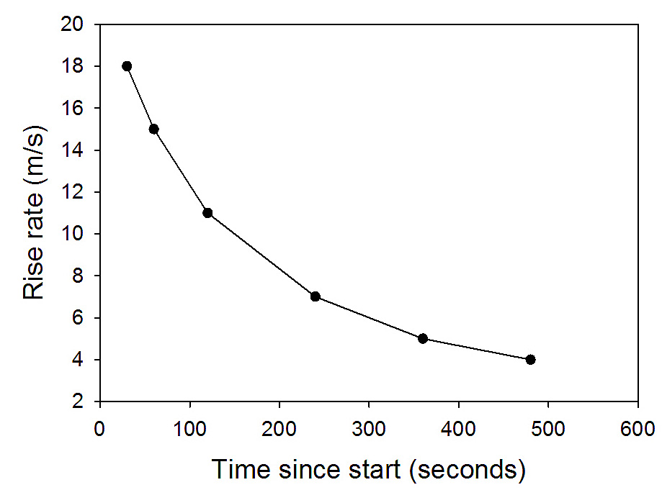
Decline in rise rates with time on May 22, consistent with only one explosive pulse

Slide 8
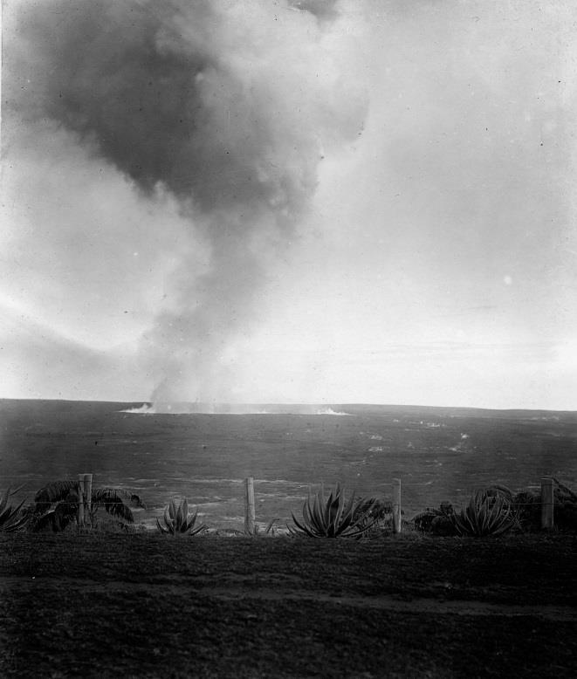
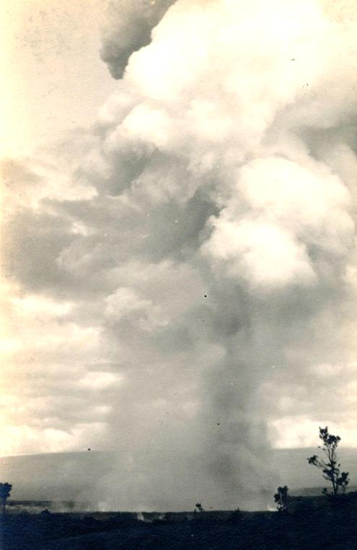
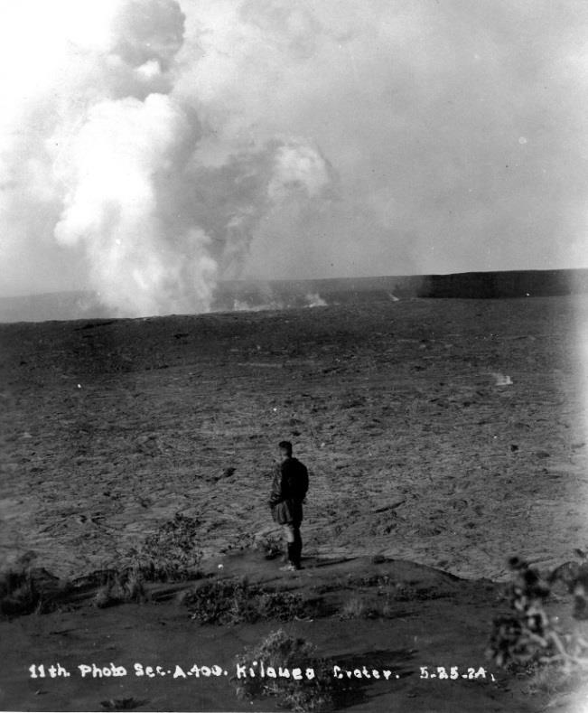
5/25, time unknown
5/16, 0730, Finch
5/18, 0630, Finch?
Background steam plume BETWEEN explosive events
Several HVO log entries note that steam plume weakened or disappeared minutes before explosions

Slide 9
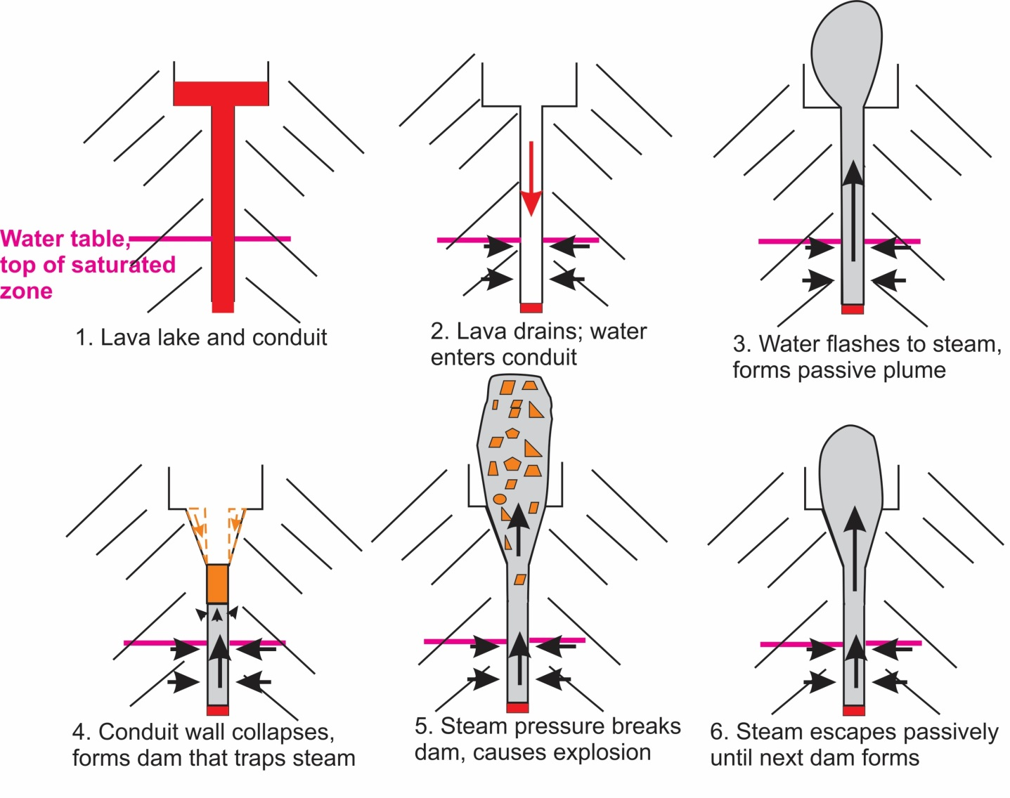

Slide 10
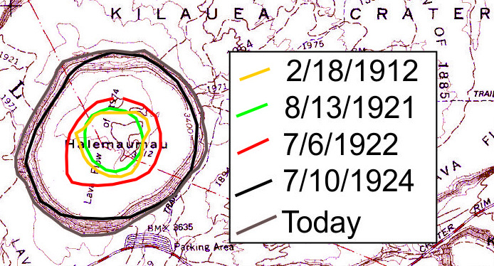
500 m
Based on map in Jaggar (1924)
Surveyed outlines of Halemaumau, 1912 to present

Slide 11
Jaggar and Finch (1924) calculations
Tephra constitutes only 0.4% of material removed from Halemaumau
Volume of uncompacted tephra: 1.8 million m³
Volume of compacted tephra: 0.8 million m³
Volume of Halemaumau enlargement: 202 million m³
“The explosive eruption was merely an incident in the mechanism of engulfment” Jaggar (1924)

Slide 12
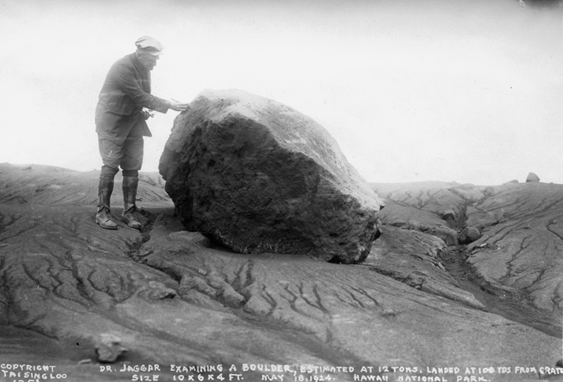
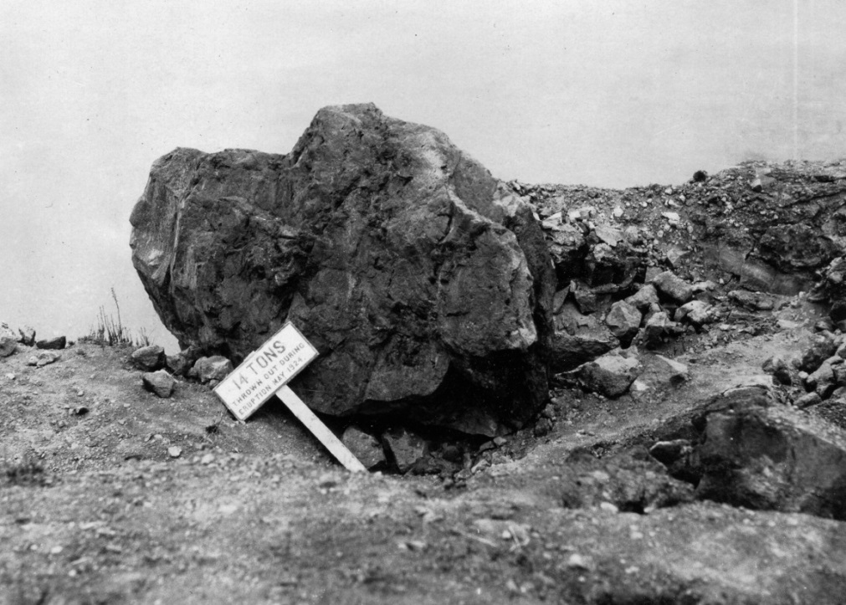
3 m by 1.8 m by 1.2 m, est. 12 tons
90 m(?) from west rim of crater
Photo by Tai Sing Loo
East rim of crater, est. 14 tons
Photo by E.S. Eakle
Two of the largest ballistic blocks; both later fell into the crater as it widened in the following decades

Slide 13
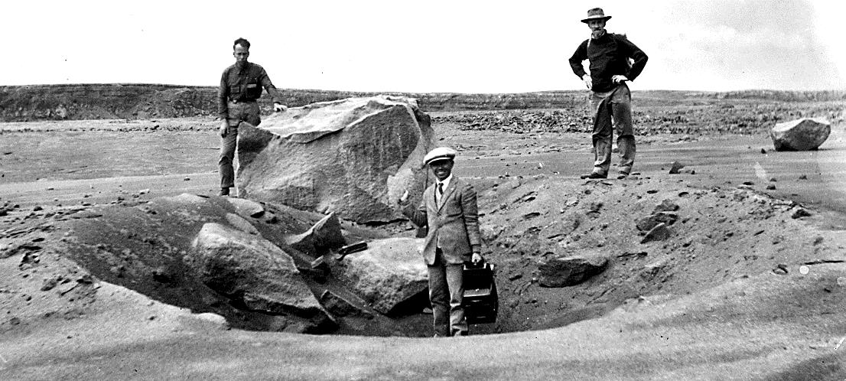
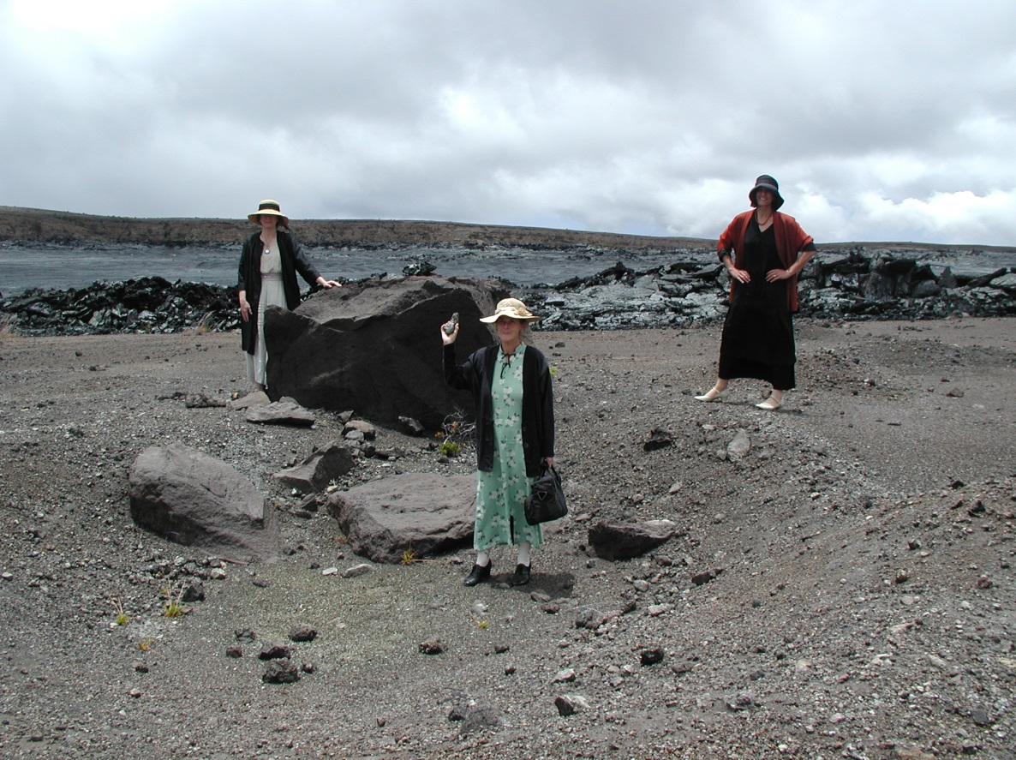
Then
Crater was formed in 134-year-old explosive deposits
With 1924 men’s fashions
H.T. Stearns, 5/22/1924
8-ton block on landing field, 600 m SE of rim of today’s Halemaumau
Now
But with 1920’s women’s fashions
5/17/2001

Slide 14
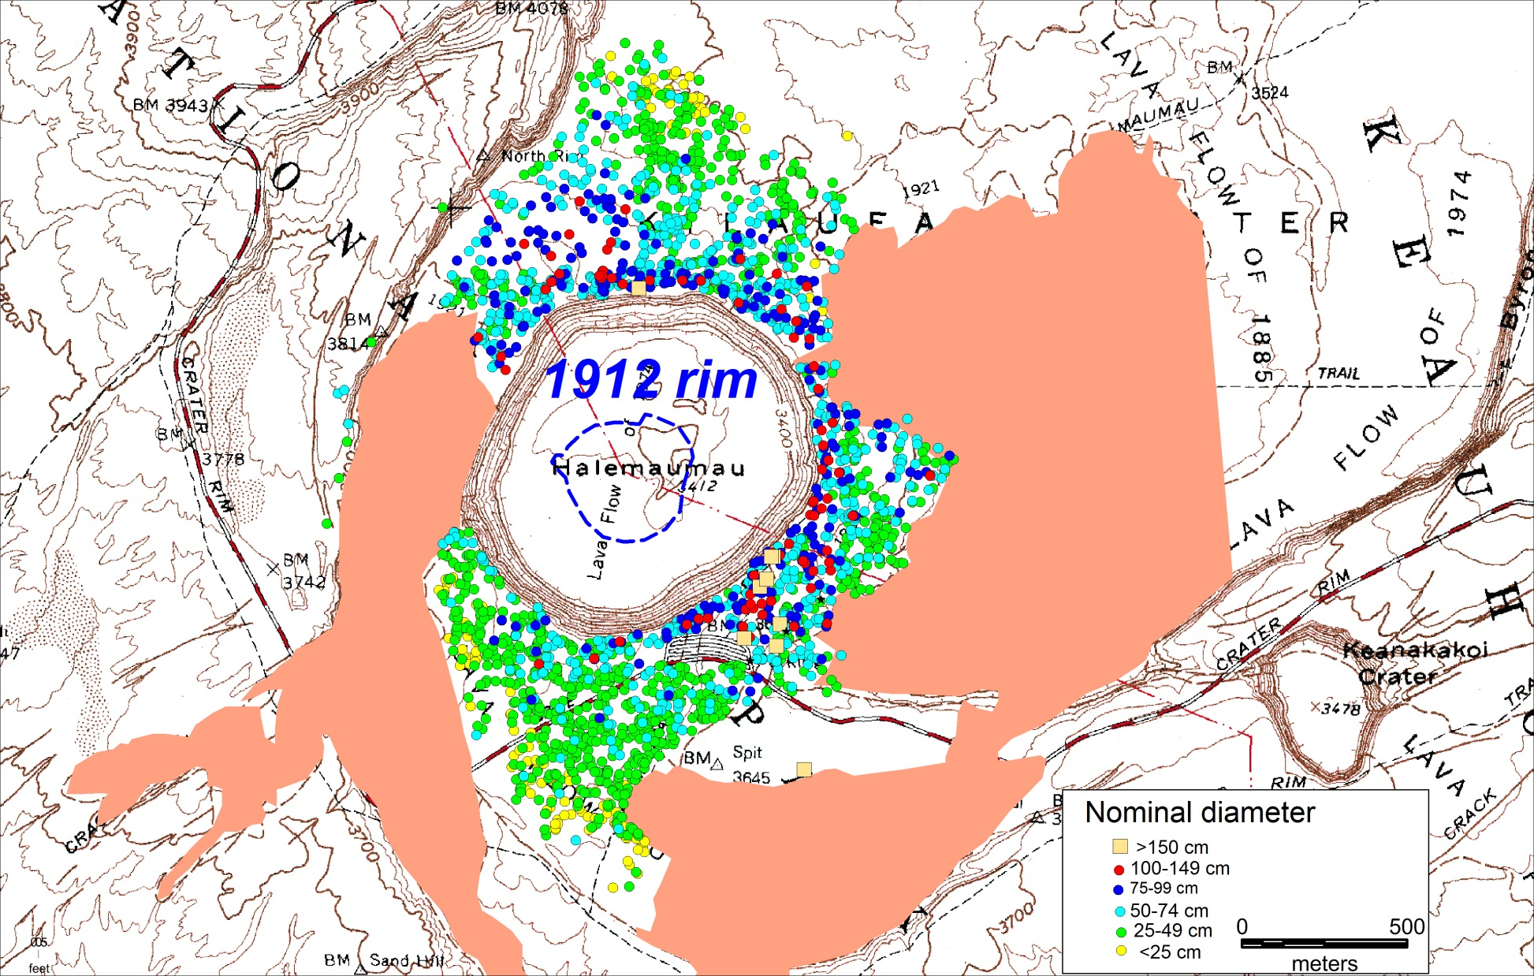
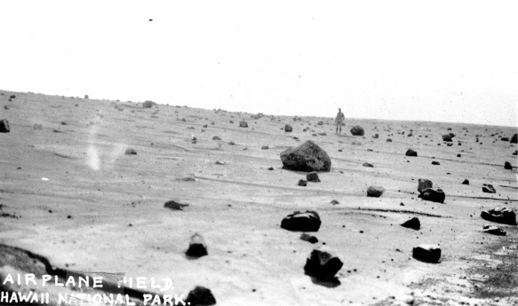
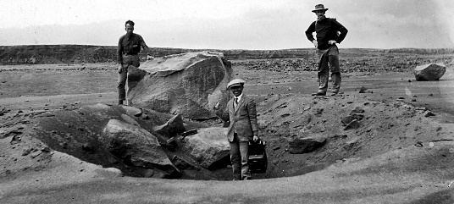
1924 ballistic distribution
Post-1924 flows

Slide 15
NE part of crater may have been the site for most of the explosions
Several contemporary accounts in HVO Record Books:
For example, on May 28, 1924, Emerson wrote that “it was evident that NE section was vastly deeper than SW.” The day before, Ruy Finch and Vern Hinckley noted that “the steam was rising from the usual vent at NE side.”
Monitoring today shows that the magma column is shallow (ca. 800 m depth) adjacent to the NE corner of Halemaumau

Slide 16
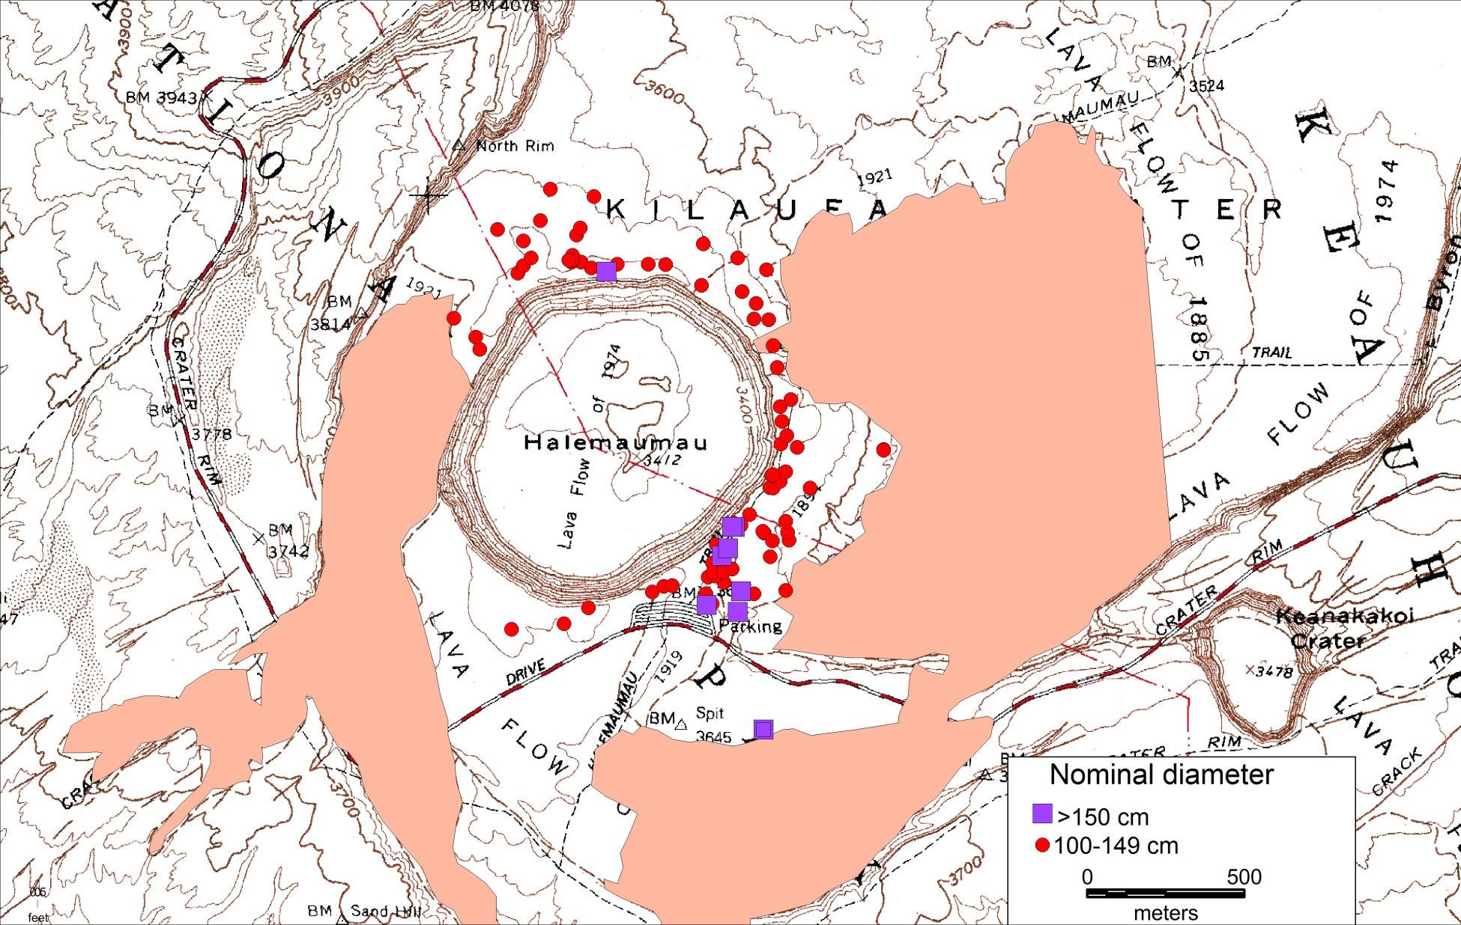
Ballistic blocks >1 m diameter
X and Y, hypothetical explosion sites used in calculations
X
Post-1924 flows
Y

Slide 17
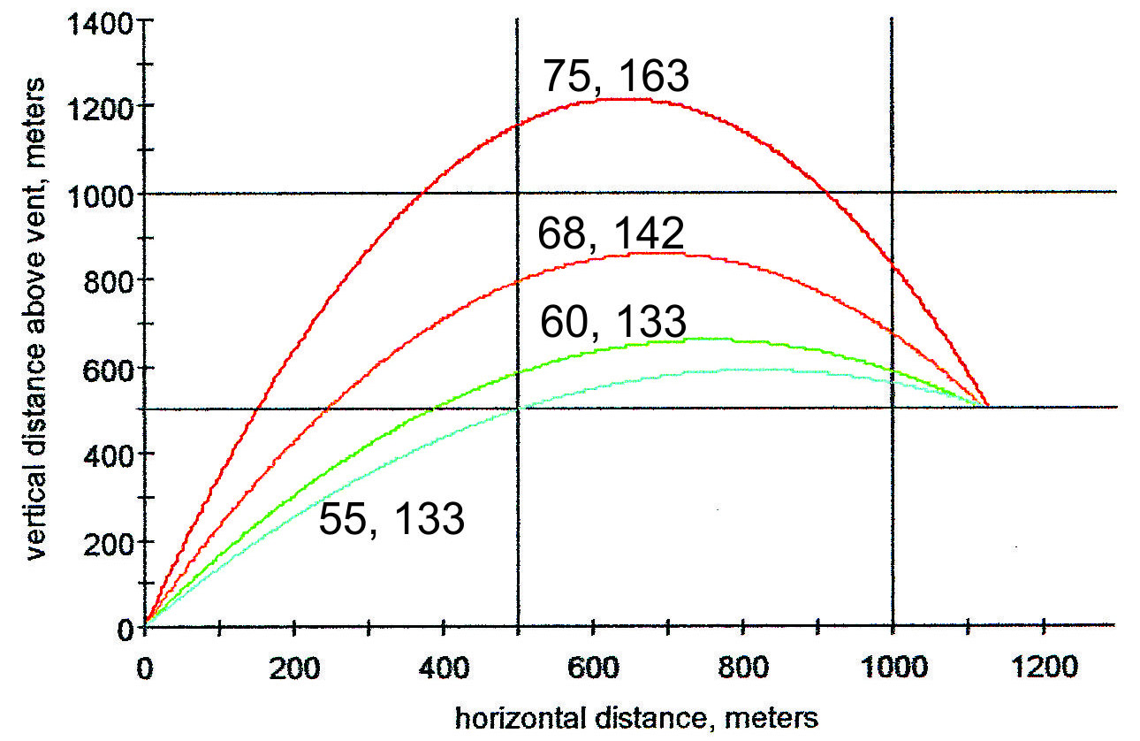
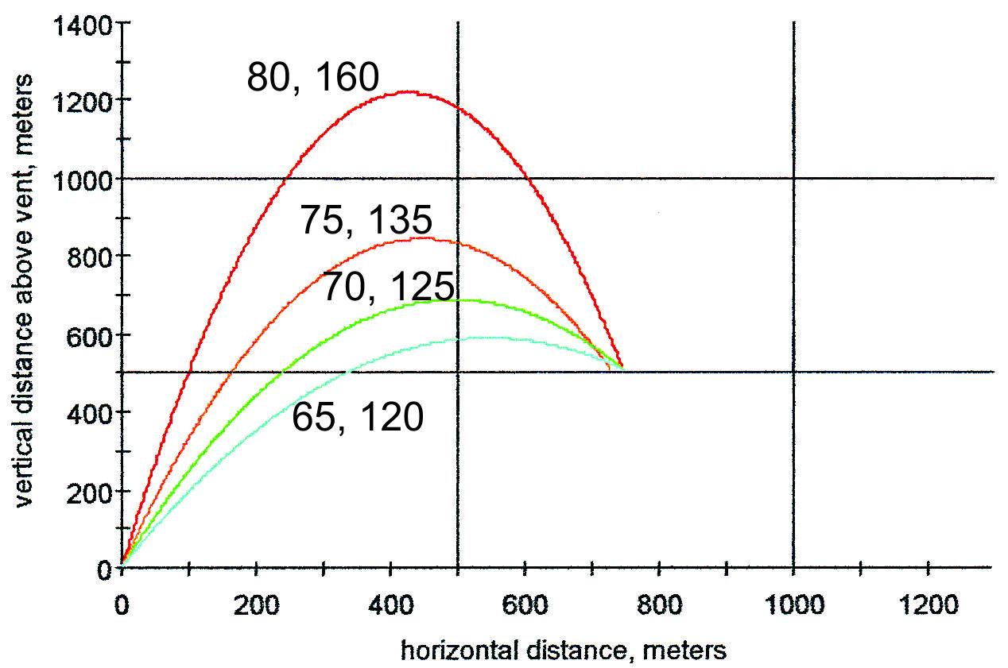
X. Favored NE explosion site
Y. Disfavored explosion site near today’s Overlook Crater
Blocks with trajectories as low as 55 degrees can escape Halemaumau
Blocks with trajectories less than 75 degrees hit the crater wall and are trapped within Halemaumau
ejection angle from horizontal
ejection velocity, m/s
X
X
Crater rim
8 ton
8 ton
Crater rim
Ground surface
Calculations and plots from Mastin (2001) Eject!; USGS Open-File Report 01-45

Slide 18
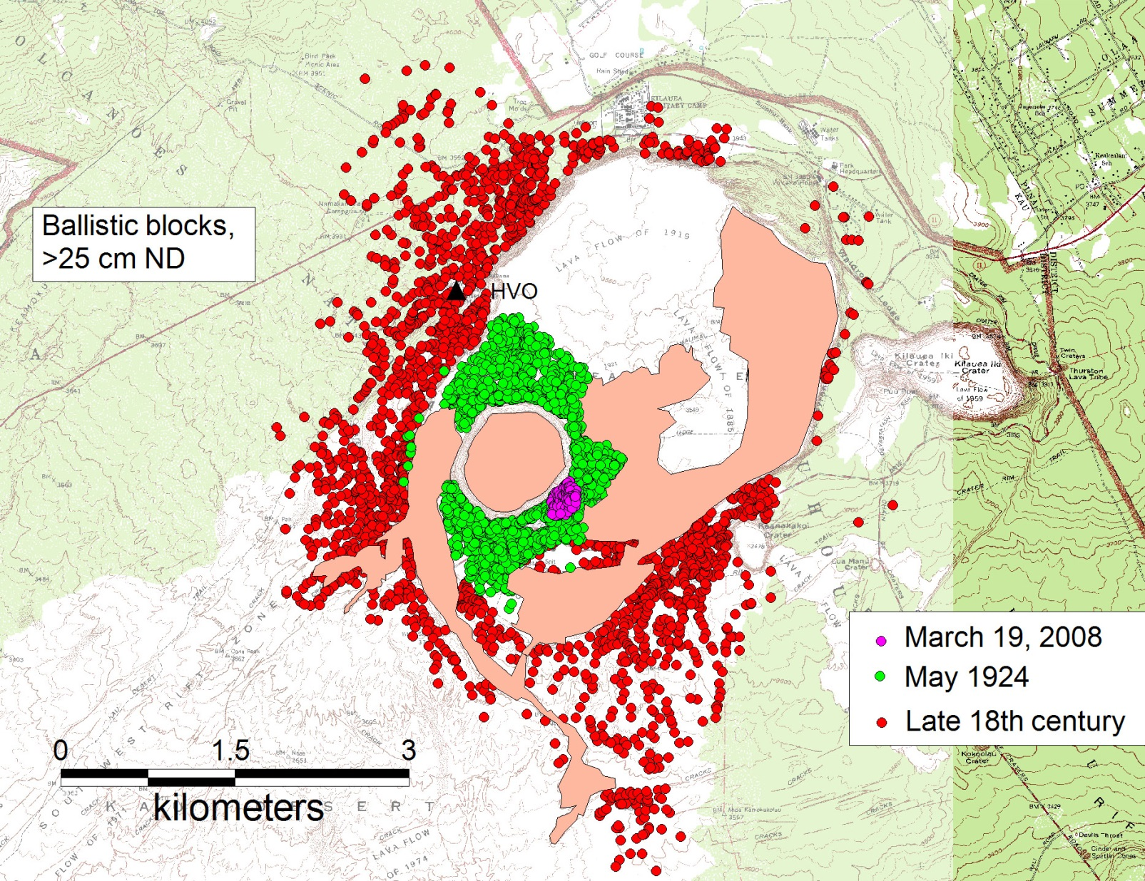
Post- 1924 flows

Slide 19
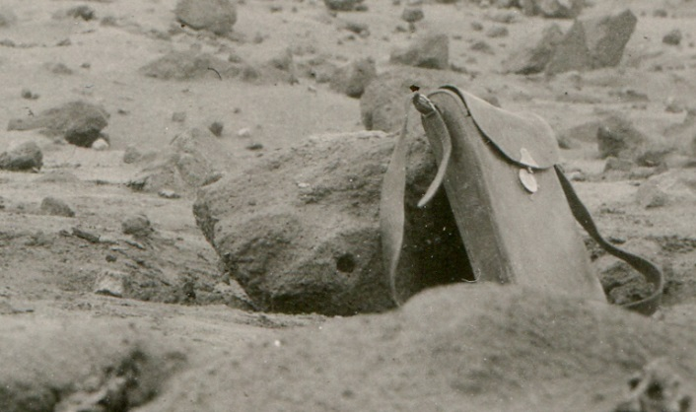

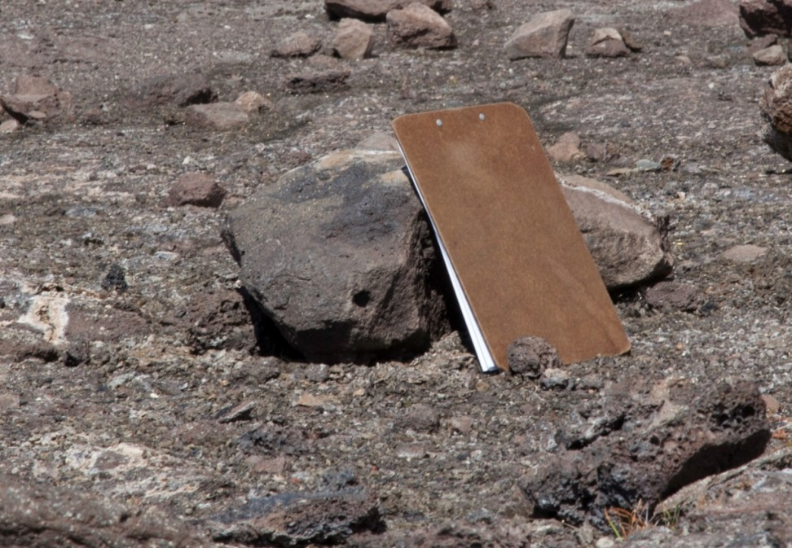
Block that killed Truman Taylor on May 18, 1924
Photo by H.T.Stearns July 27, 1924
Taylor block
Distance of block from crater rim
1924: 223 m (measured by Stearns)
2014: 213 m
About 10 m of rim retreat in 90 years
Photo by Ben Gaddis March 19, 2014

Slide 20
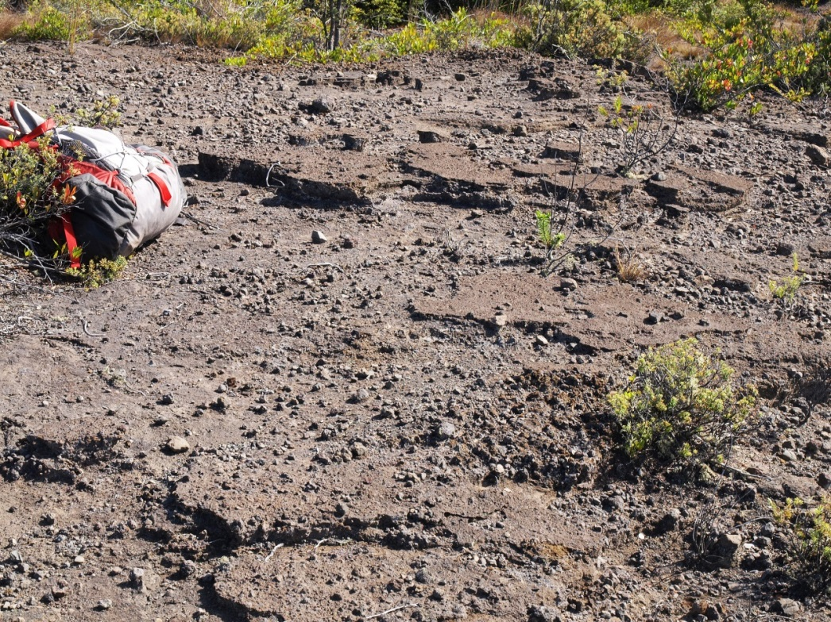
Very hard to distinguish 1924 lithic lapilli from 16th-18th-century deposits outside the caldera
1790 lithic surge deposit west of caldera

Slide 21
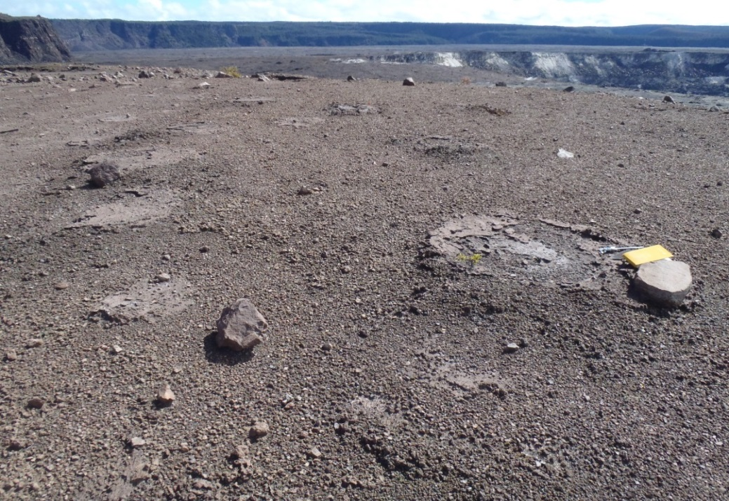
“Golden Pumice” erupted from fountains in early 19th century is a good marker; any rocks resting on it may be from 1924
Pumice dispersed mainly W and SW
Outcrops are mostly small and scattered owing to erosion
Impact pit
Golden pumice on caldera rim, with ballistic blocks and impact pits inferred to date from 1924

Slide 22
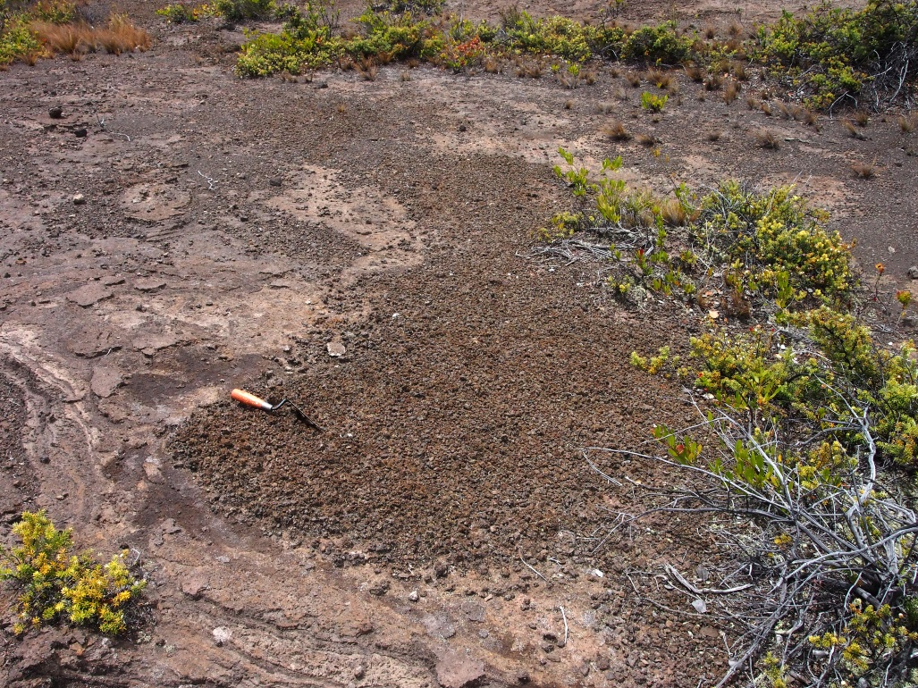
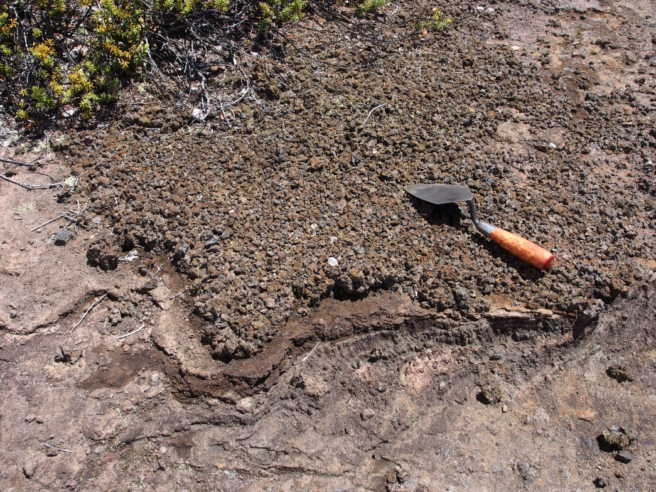
Erosional patches of golden pumice west of the caldera. Lithic lapilli on them were measured to obtain ML values of 1924 ejecta

Slide 23
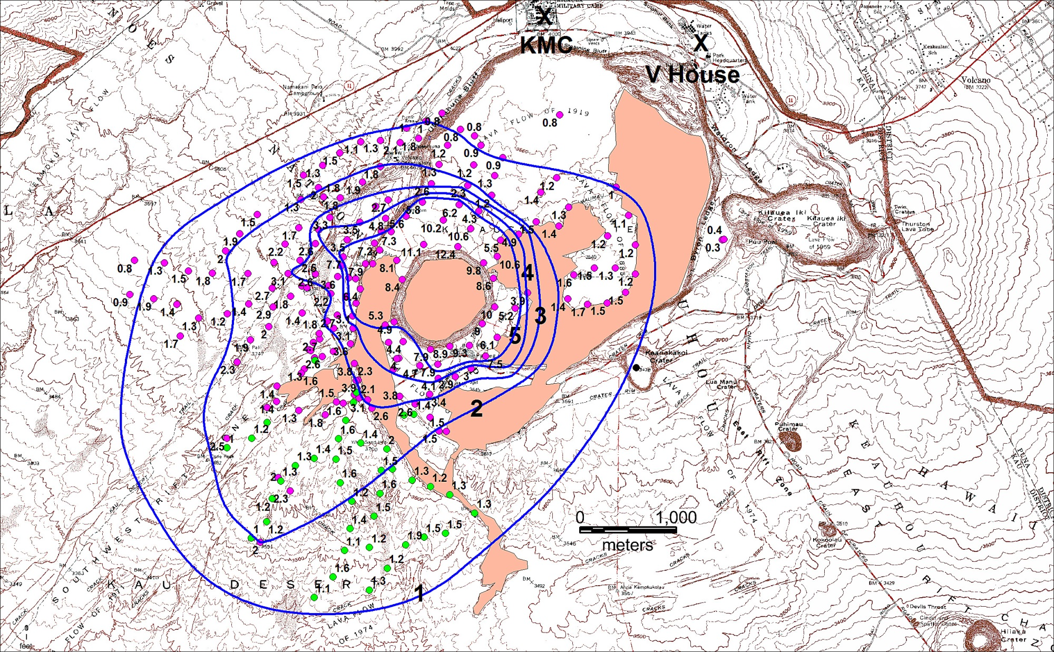
Maximum lithic size (ML, cm) in 1924 fall deposit
Post 1924
Jaggar, 1-2” max. diam.
ML is average of 15 diameters of 5 largest clasts
Isopleths in cm
Lapilli on fine ash; reworked? 1924?

Slide 24
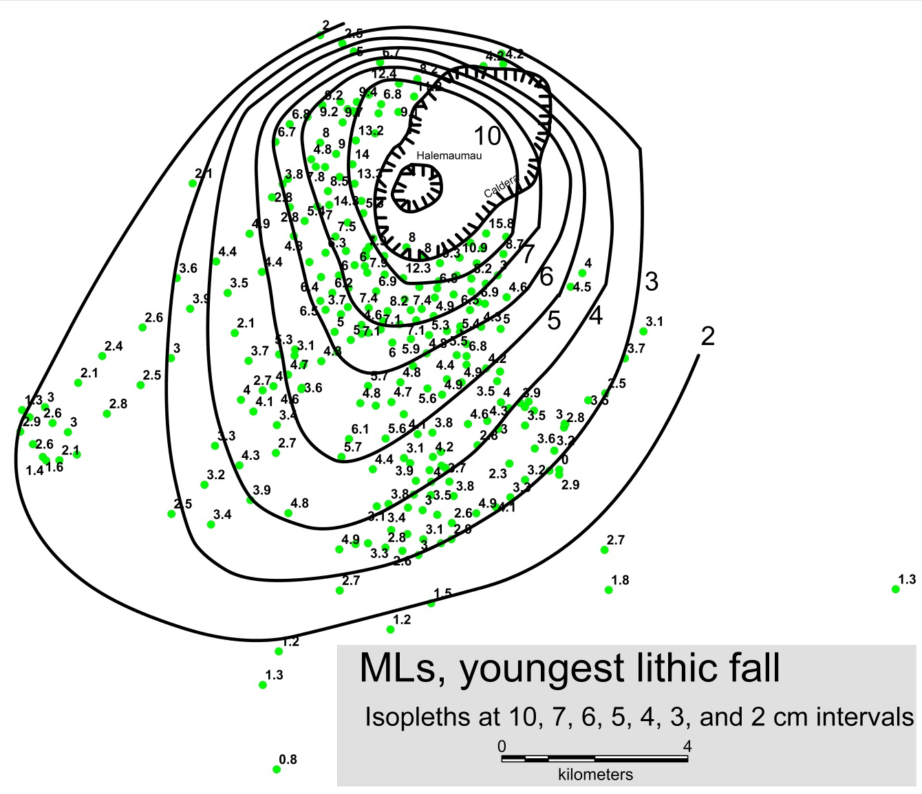
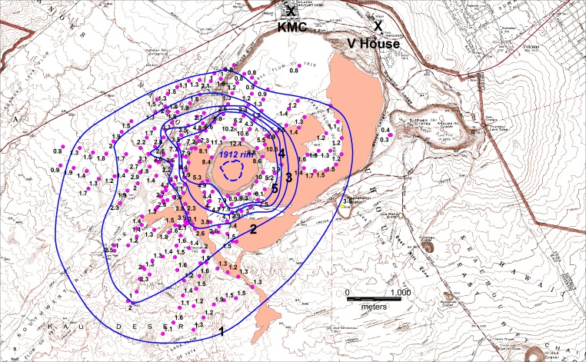
Early 19th century
Tie line
1924
2-cm isopleth is 3 km from Halemaumau
Comparison of lithic fall fields in 1924 and early 19th century
Both maps at same scale
Tie line connects center of Halemaumau
(MLs in cm)
2-cm isopleth 10.5 km from Halemaumau

Slide 25
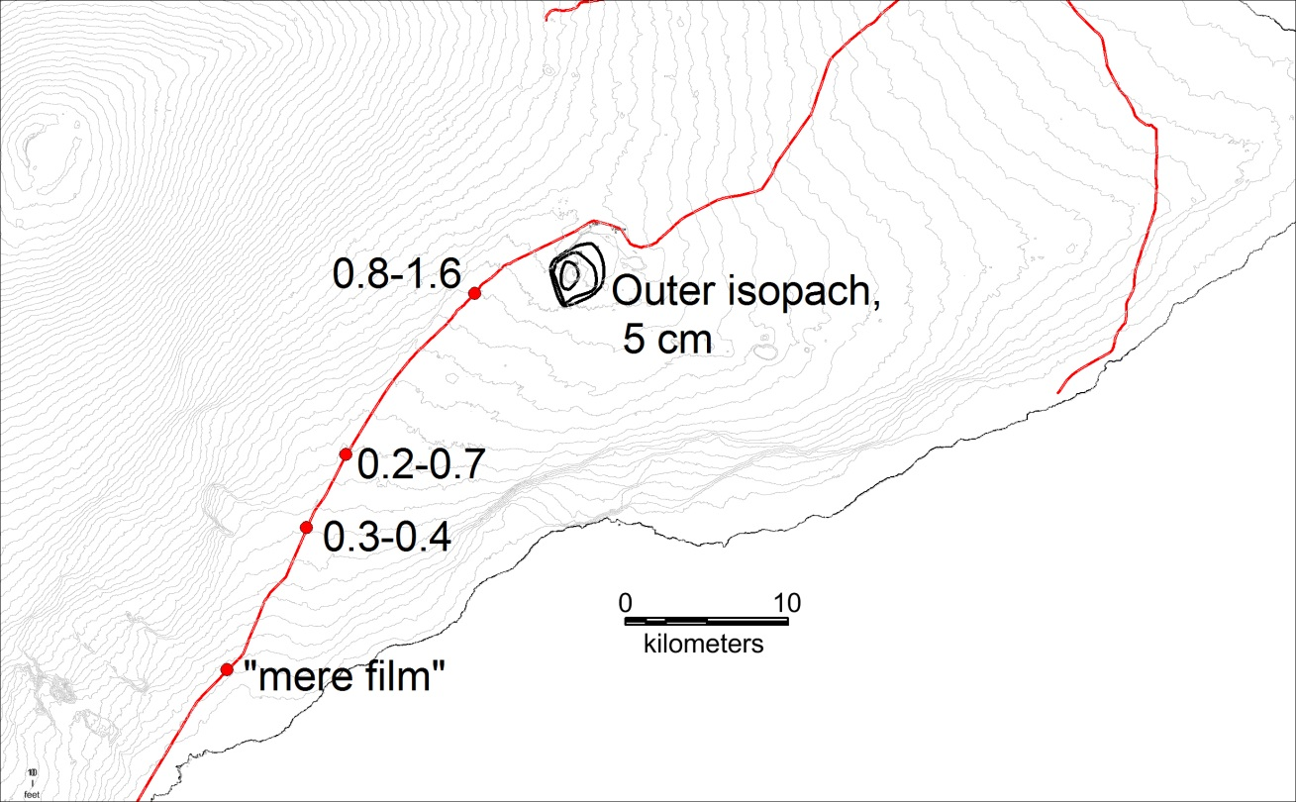
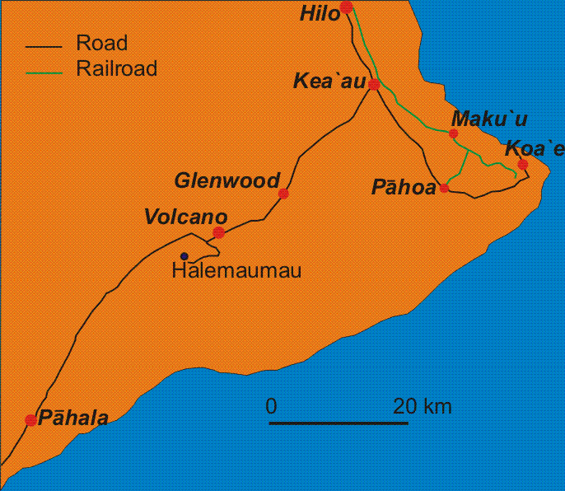
Trade wind direction
Slippery RR track
Gutter collapse
Ash fell throughout this area and beyond, but not heavily. At 2 p.m. May 16, the railroad track between Maku‘u and Pāhoa was briefly closed by slippery muddy ash on the rails. Gutter on store collapsed in Glenwood
Ash thickness, centimeters
Downwind distal ash thicknesses, measured by Jaggar on June 29, a month after eruption ended

Slide 26
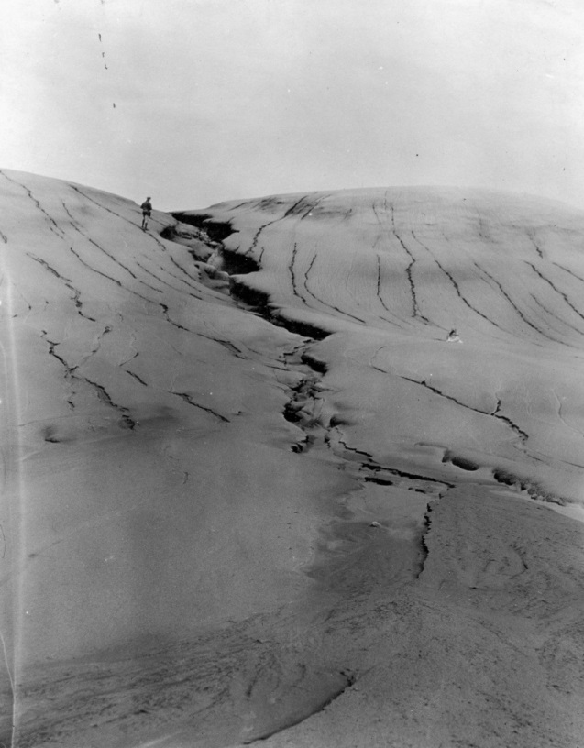
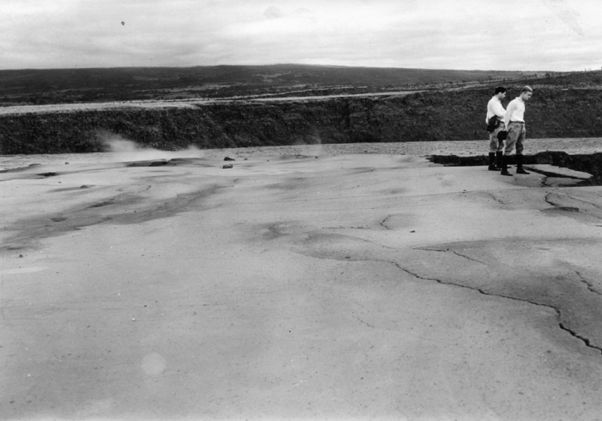
Photo by Emerson, 6/5/24
South rim of Halemaumau
Photo by Emerson, 5/29/24
SW wall of caldera
1924 tephra, mainly ash but including fine lithic lapilli and scattered blocks, soon after end of eruption

Slide 27
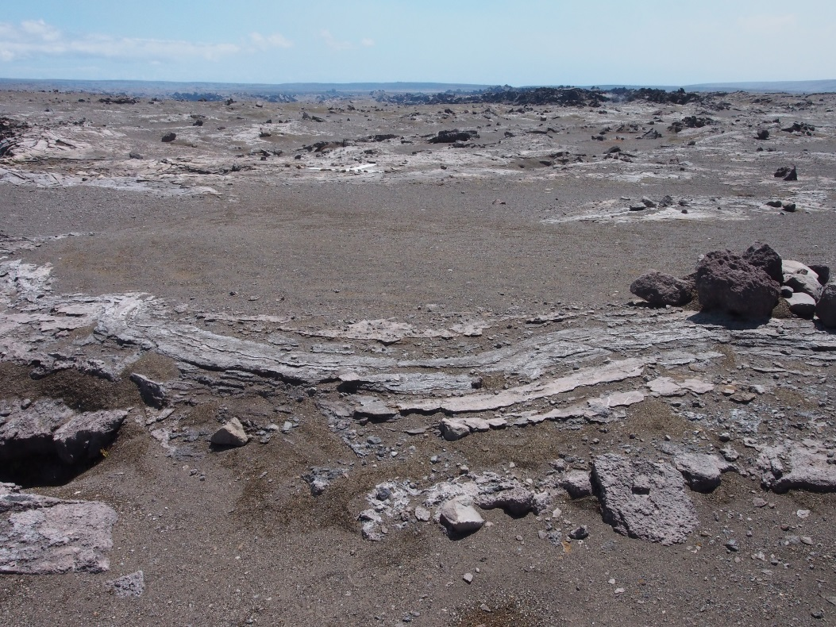
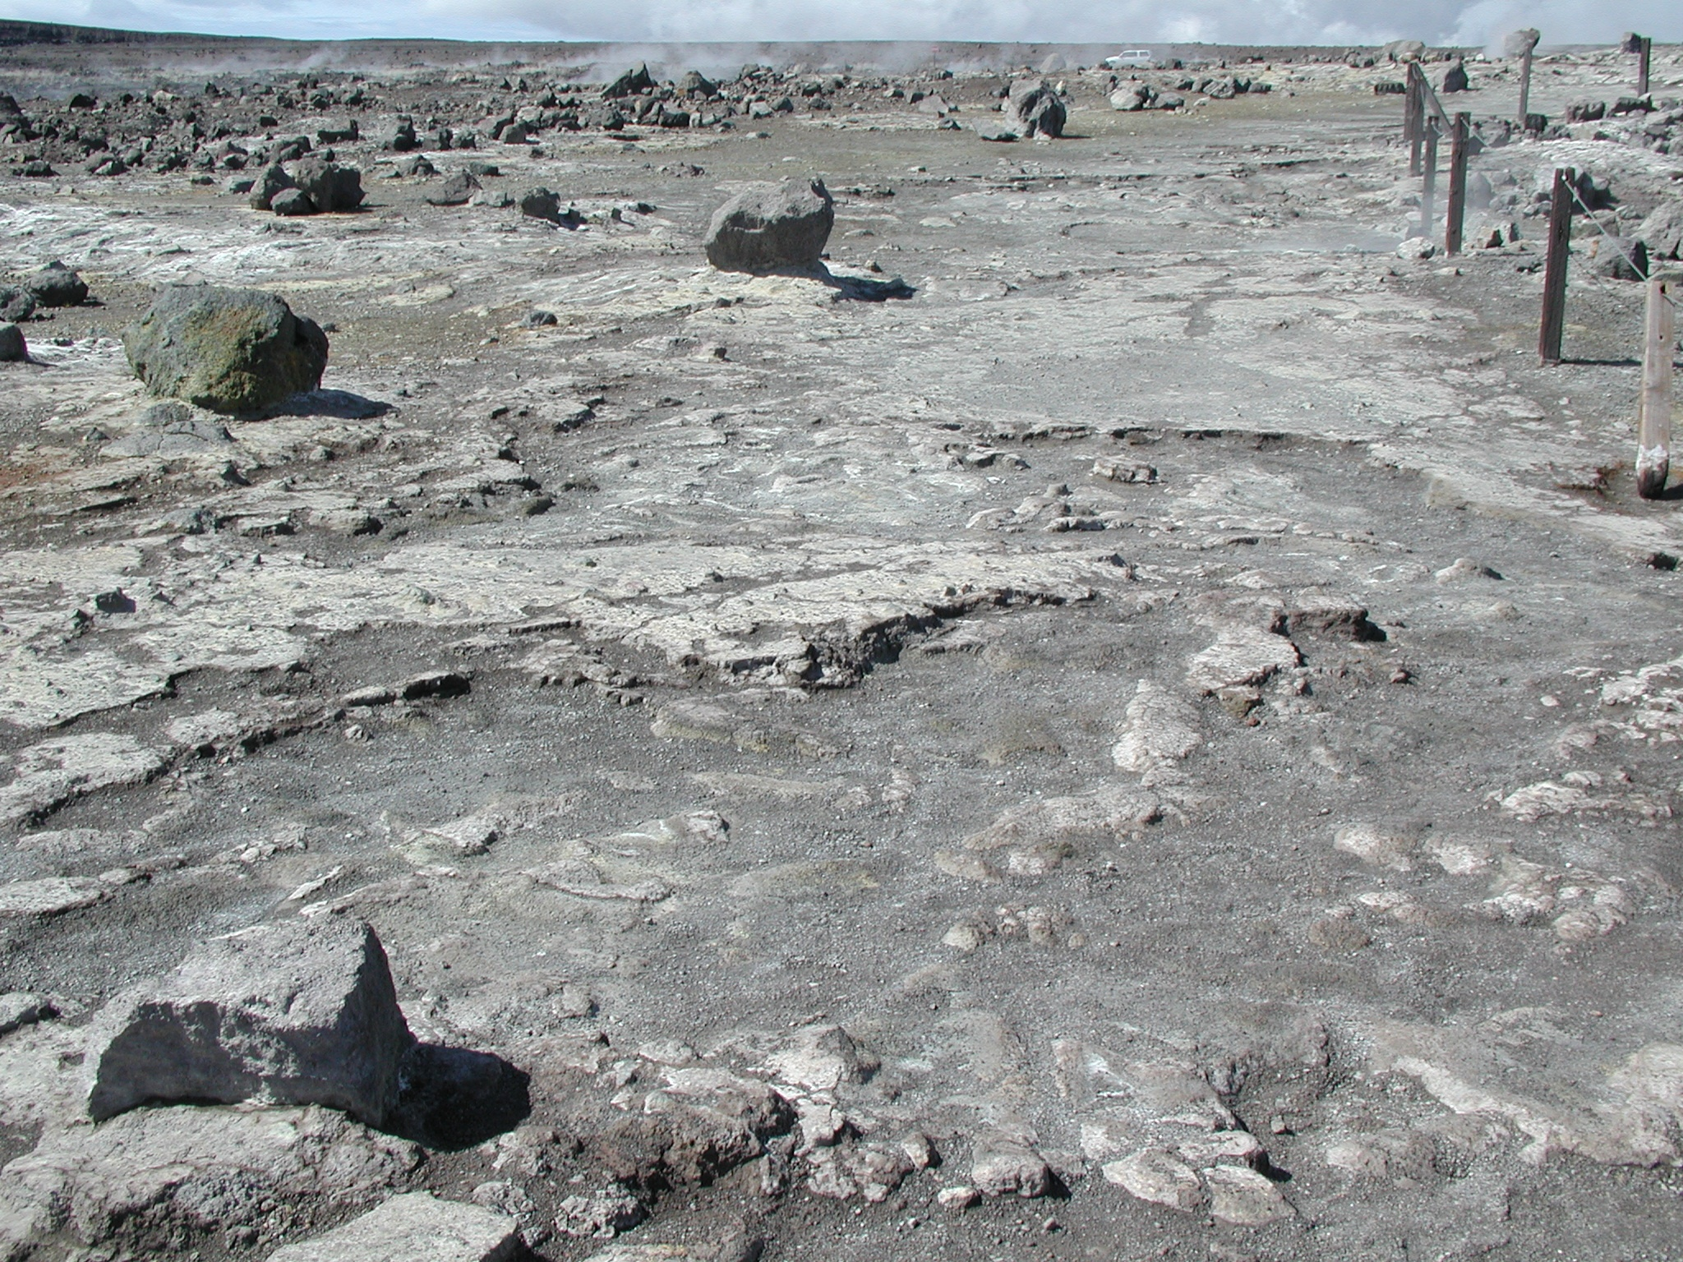
1924 ash near SW rim of Halemaumau, thoroughly indurated by acidic fume alteration
1924 ash layer with opaline cement along trail to visitor overlook
Good outcrops today of 1924 ash near Halemaumau

Slide 28
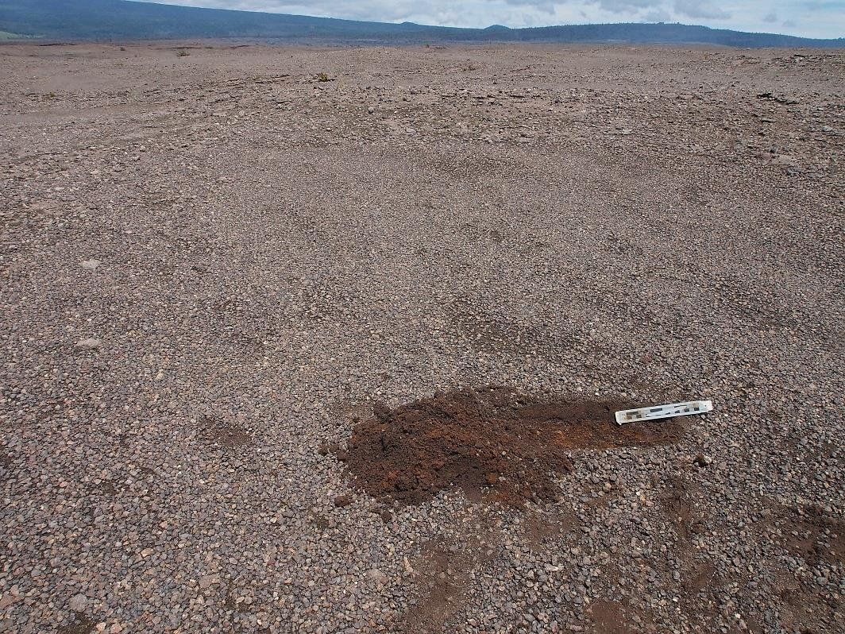
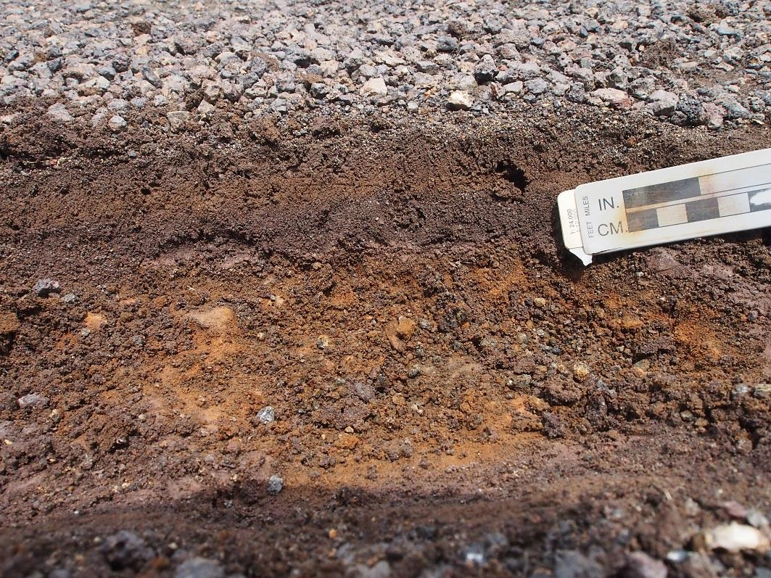
1924?
Late 18th century
Fine ash below pavement of fine and medium lithic lapilli in shallow swale 1.5 km SW of Halemaumau

Slide 29
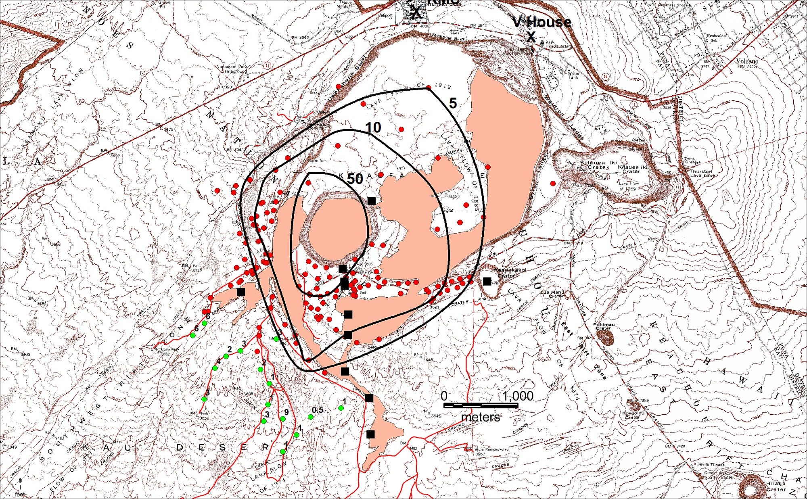
Thickness of 1924 ash deposit, in cm
Post 1924
13-25
43
13
20
10
2.5
5
4
2
1.3
1
Jaggar ash thickness, mostly on July 18, 1924
Fine ash in swales; reworked? 1924?

Slide 30
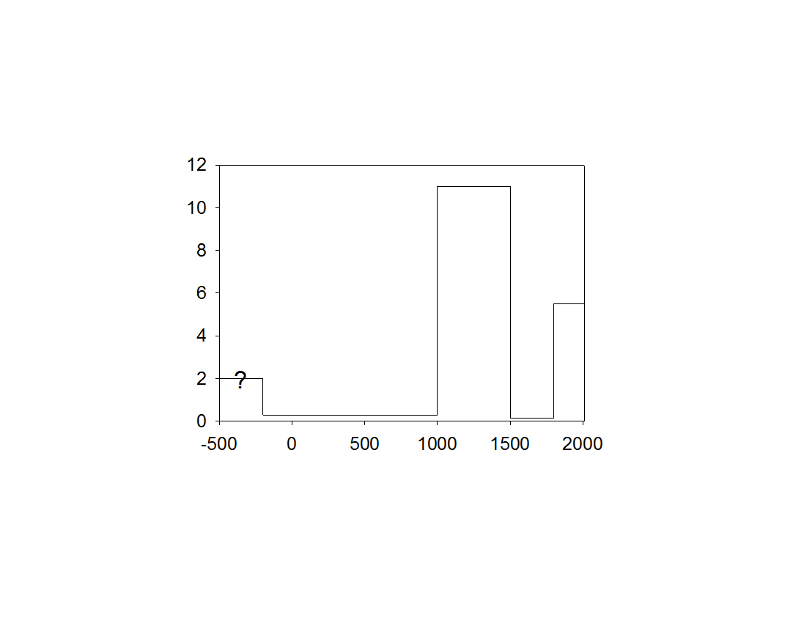
Eruption timing
Caldera collapse
Kīlauea’s eruptive style has been cyclic for past >2500 years, caldera collapse separating effusive and explosive periods
1924
Volume (km³)
Keanakākoʻi Tephra
?
Uwēkahuna
Tephra
1924 activity took place during high magma supply, effusive period with broad summit subsidence but no caldera collapse
Calendar years (BCE negative)
Approx. magma supply rate to the GROUND SURFACE
200 BCE-1000 CE, 2.5×10⁻⁴ km³/yr
1000-1500 CE, 2.2×10⁻² km³/yr
1500-1800 CE, 5×10⁻⁴ km³/yr
1800-2016 CE, 2.6×10⁻² km³/yr

Slide 31
Why didn’t 1924 lead to caldera collapse?
I think the difference in magma-supply rate is the key
With a rapid change to low rate, summit reservoir can’t be replenished and eventually empties almost completely, resulting in caldera collapse
Caldera remains deep, below water table, until supply rate increases
With high rates, reservoir can lose magma to east rift zone but be quickly replenished
Broad summit subsidence but no caldera collapse
Whatever caused reservoir draining in 1924 was doomed to be short-lived because the magma supply rate remained unchanged
Lava returned to Halemaumau 53 days after end of 1924 explosions

Slide 32
Final comments
The 1924 explosive eruption was small by Kīlauea standards but the largest in past ̴200 years
In terms of its explosive capability, Kīlauea is metastable, even during effusive periods
Future 1924-like explosive activity can occur during any major east-rift transfer of magma to low elevation
Possible near miss: 1960
Magma migrated from summit and erupted at Kapoho
Floor of Halemaumau dropped ̴60 m
There were fears at the time of another 1924

Slide 33

Kīlauea is an explosive volcano
The risk is high with future explosive eruptions such as that of 1924
Photo courtesy of the
James Tsuchiya Family
Photo Courtesy of the
James Tsuchiya Family

