Slide 1


The Effect of Guar Gum on the Mobility of Barium in Disposal Wells of the Arbuckle Formation
Pouyan Ebrahimi, Javier Vilcáez
Abstract ID: GSA-277991
School of Geology, Oklahoma State University
pouyan.ebrahimi@okstate.edu
Vilcaez@okstate.edu

Slide 2
Abstract
Flowback and produced water (wastewater) from unconventional gas wells in Oklahoma are injected into deep disposal wells of the Arbuckle formation. Total dissolved solids includes heavy metal ions (e.g., Ba and Sr) whose concentrations are in many cases hundreds of time above the US drinking water standards. This poses a huge environmental risk as wastewater disposed into deep wells might leak to shallow groundwater systems due to well integrity flaws or presence of natural fractures.
This work focuses on the effect of viscosifiers on the mobility of heavy metals, specifically we focus on the effect of guar gum on the mobility of Ba2+. Guar gum is used to increase the viscosity of the fracturing fluid to help suspend proppant (a granular material used to hold induced fractures open after treatment), and Ba2+ is one of the most common/abundant heavy metal detected in wastewaters. Although the effect of organic polymers on the mobility of oxidizing reagents in shallow aquifers has been studied before, this is the first work aiming to reveal the transport mechanism of heavy metals under the presence of polymers through Arbuckle dolomite rocks.
Batch and core-flooding experiments were conducted using powdered dolomite (300-412 µm grain size) and dolomite plugs (2.54 cm diameter and 5-12 cm length) prepared from Arbuckle outcrop in Missouri. The porosity and permeability of the plug was 7.2% and 0.4mD. We conducted five batch experiments to study the sorption of Ba2+ on the surface of powdered dolomite under the presence of guar gum and different salinities (18,000 and 180,000 mg/l). Core-flooding experiments were conducted at a confining pressure of 4000 psi, room temperature (22°C) and flow rate of 0.05ml/min. The concentration of Ba2+ and guar gum in the core-flooding experiments were 100 and 50 mg/l, respectively. Our results indicate that guar gum increases the sorption of Ba2+ on the surface of dolomite through chelation-like interactions between guar gum and Ba2+. Further Guar gum readily clogged the pore space of the dolomite plug. This was reflected by a reduction in the hydraulic conductivity of the dolomite plug and the accumulation of Ba2+ within the plug. Thus, the mobility of Ba2+ through dolomite plugs decreases by adding guar gum to the solution.
Page 2

Slide 3
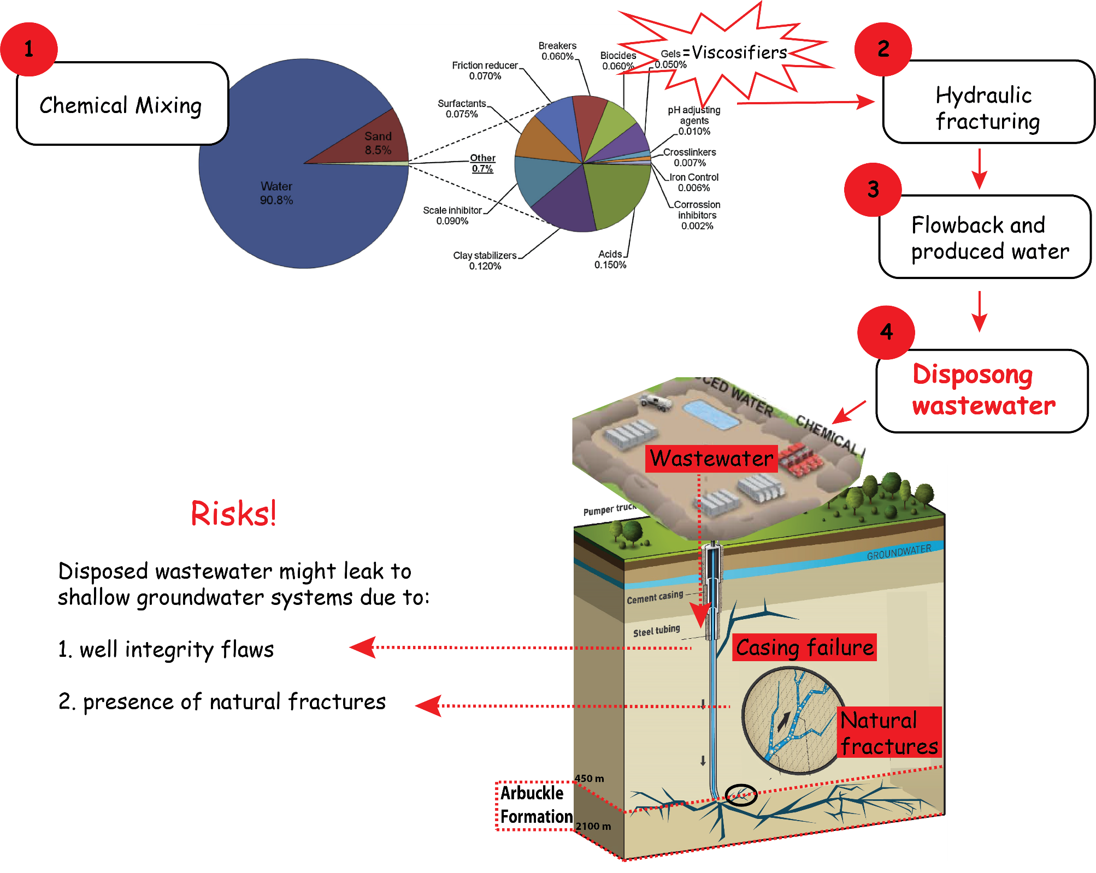
Introduction
Page 3

Slide 4
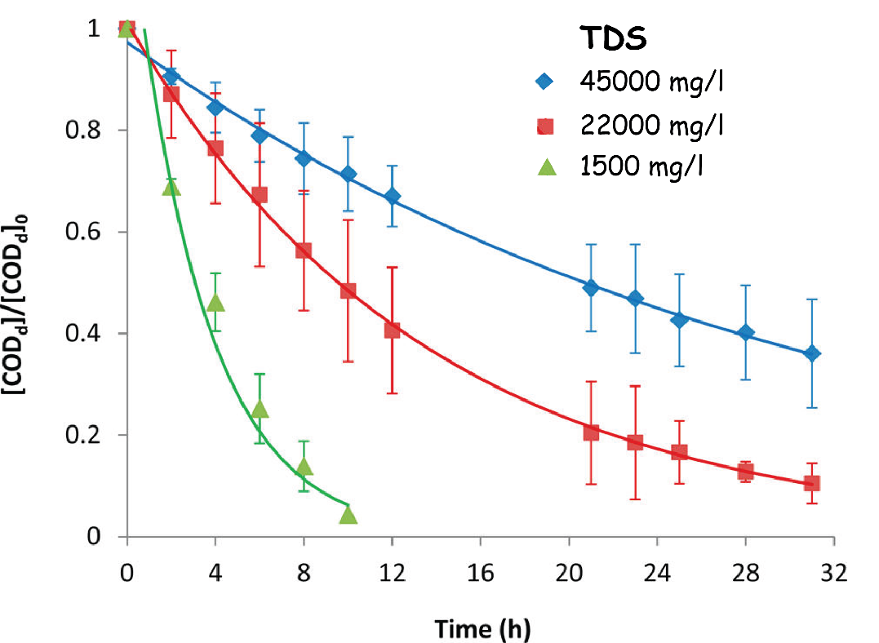
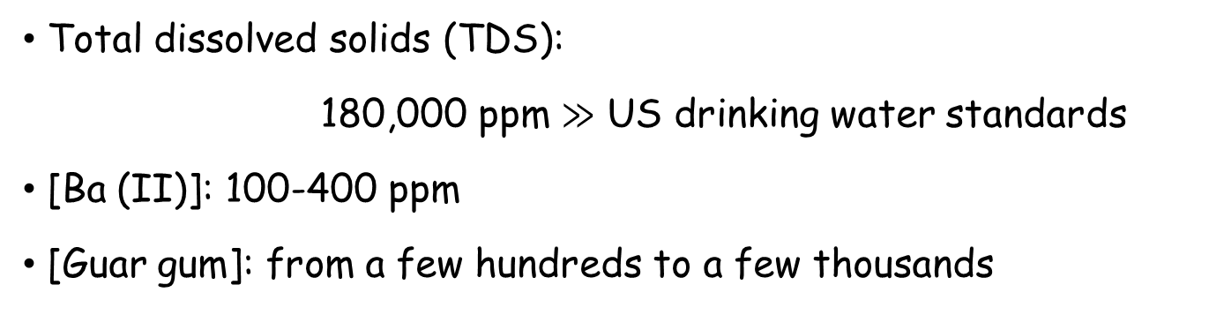
Wastewater:
Introduction
Total dissolved solids (TDS):
180,000 ppm $≫$ US drinking water standards
[Ba (II)]: 100-400 ppm
[Guar gum]: from a few hundreds to a few thousands
Although guar gum is biodegradable, it was shown that a sudden increase in salt concentration causes a drastic decrease in microbial activity.
Lester et al, 2013, Can we treat hydraulic fracturing flowback with a conventional biological process? the case of guar gum
Page 4

Slide 5
Objective
This work analyzes the effect of viscosifiers on the mobility of heavy metals.
In this study we focus on:
the effect of guar gum on the mobility of Ba (II) in tight dolomites of Arbuckle formation
Page 5

Slide 6
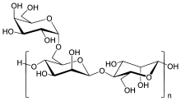
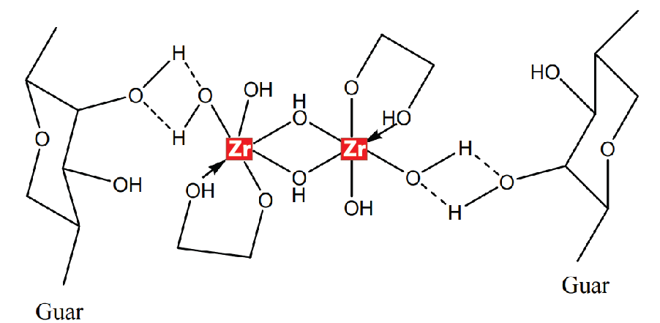
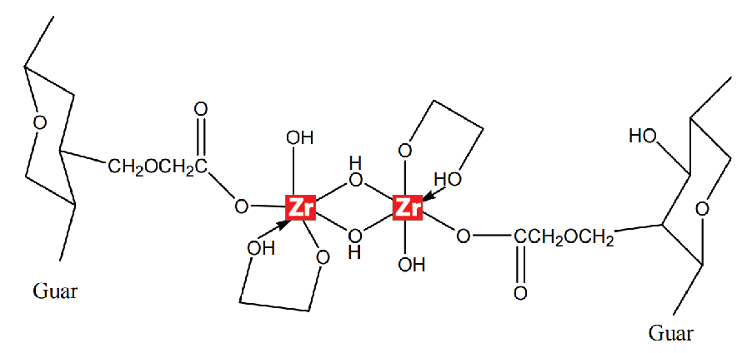
Guar gum
Background
Chelate-like complexes
Hydrogen bonding
Covalent bonding
Page 6

Slide 7
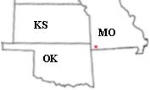
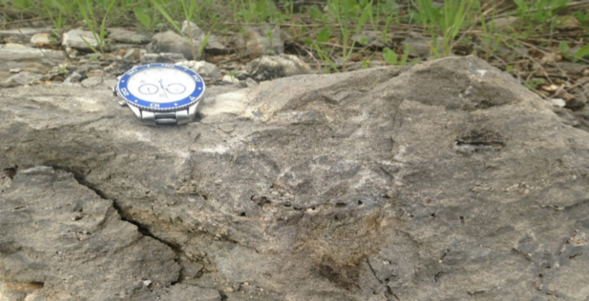
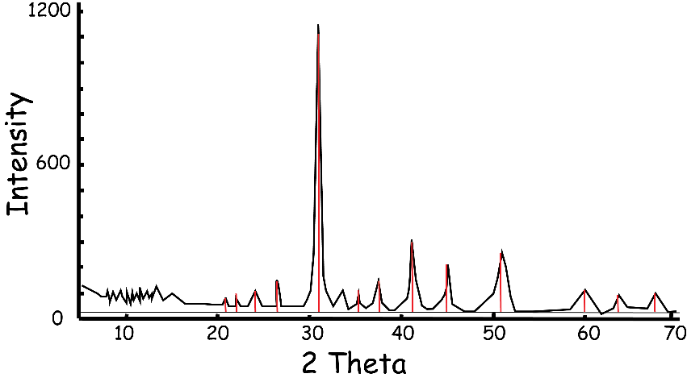
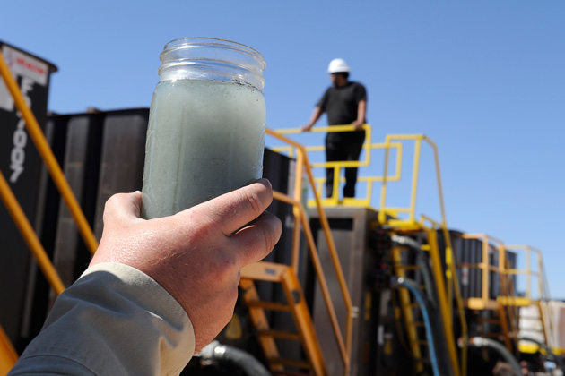
Material
Rocks
>97% dolomite
2. Wastewater
TDS: >180,000 ppm
Page 7

Slide 8
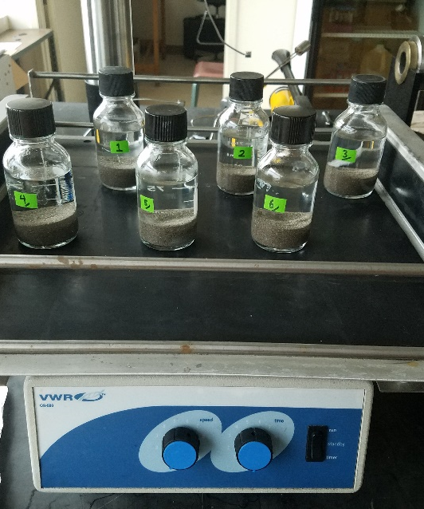
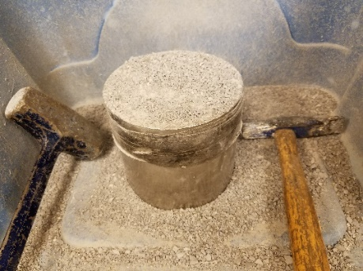
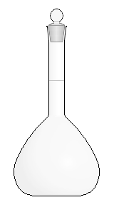
Batch Experiments
Method-I
Powdered dolomite
Size: 500-600 um
50 g
100 ml
Synthetic wastewater
[Ba (II)]: 100 ppm
[Guar gum]: 0, 50 and 500 ppm
[NaCl]: 18,000 and 180,000
Page 8
Notes:
To investigate the effect of salinity and guar gum concentration on adsorption of Ba(II) on the dolomite surface, I conducted batch experiment.

Slide 9
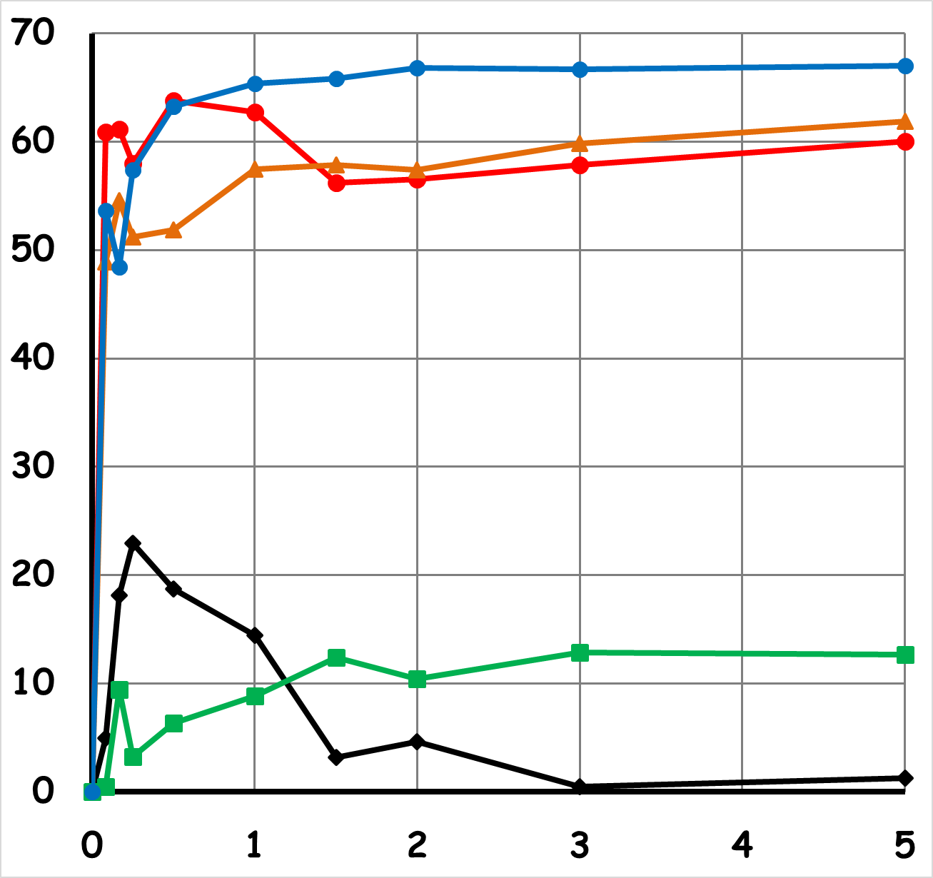
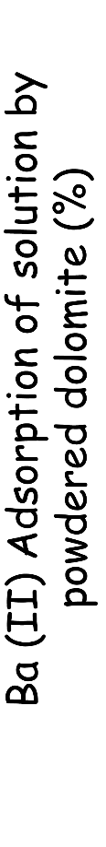
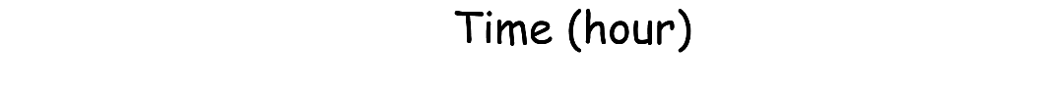

Batch experiments
Results-I
I. Increasing Salinity
Decreases Ba (II) adsorption
Low salinity
Increasing guar gum
High salinity
II. Increasing guar gum
Increases Ba (II) adsorption
Page 9

Slide 10
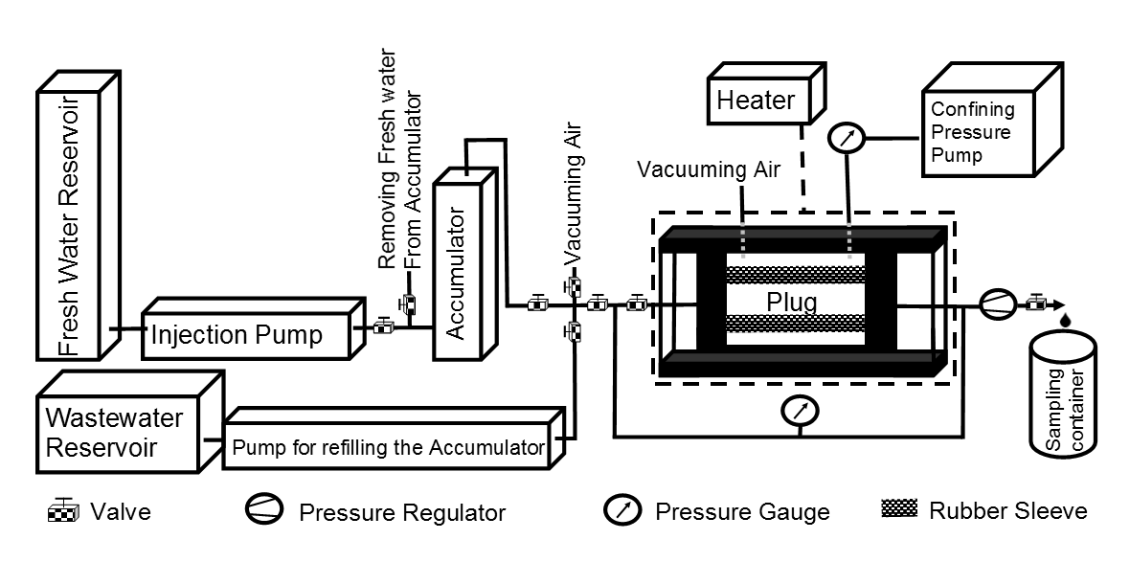
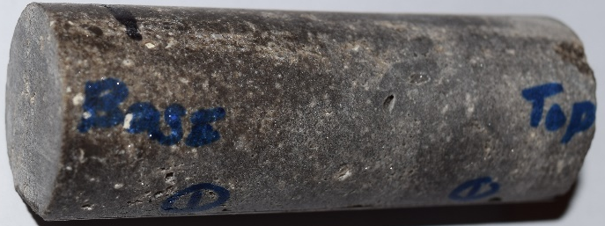
Core flooding experiments
Method-II
Core plug
diameter: 1”, Length: 2- 5”
Page 10

Slide 11
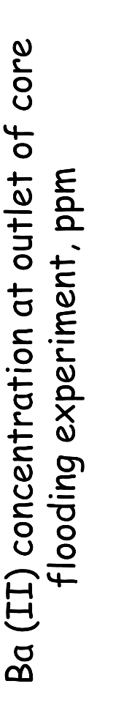
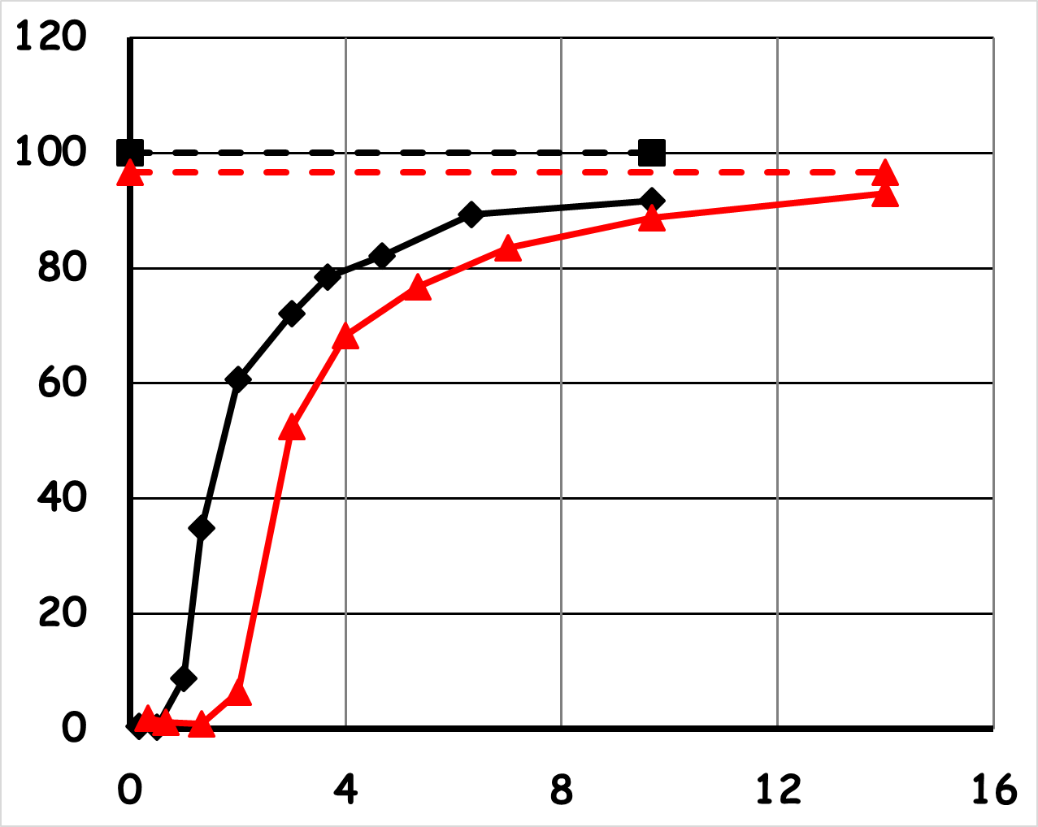
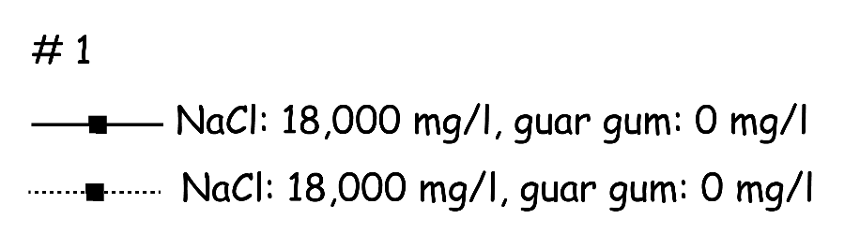


Results-II
Core flooding experiments
Plug properties: Porosity: 7.2%, Permeability: 0.4 mD, Flow rate: 0.05 ml/min
Solution:
no guar gum
with guar gum
Increasing guar gum
Postpone breakthrough time of Ba (II)
Page 11

Slide 12
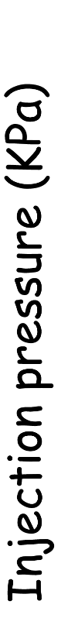
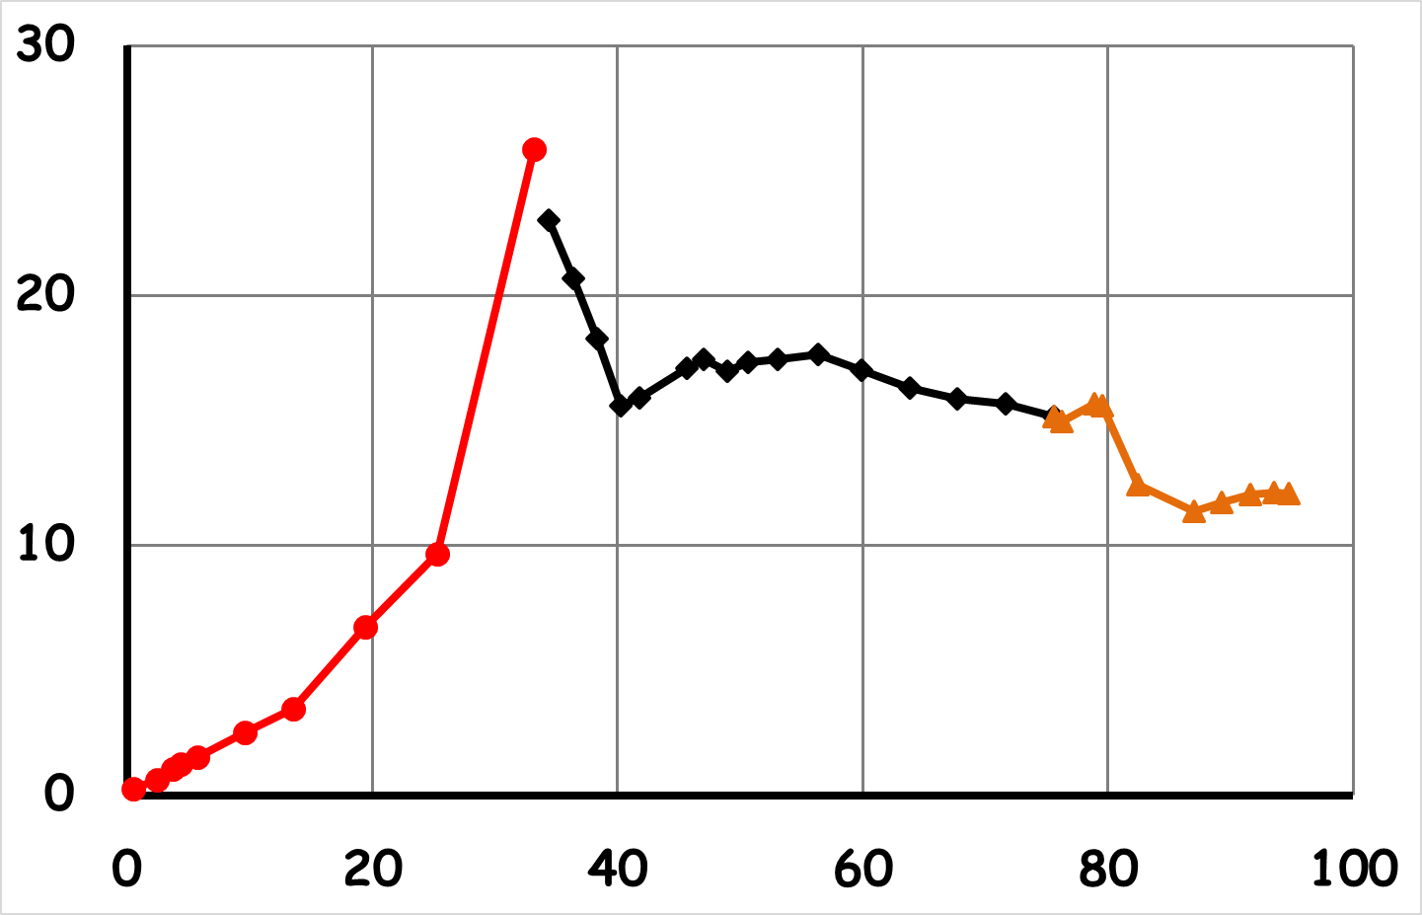


Core flooding experiments
Results-II
Why does guar gum postpone breakthrough time?
guar gum clog the core plug.
00
Injection pressure increases by time during injecting a fluid containing guar gum.
The pressure does not return to the initial pressure even after washing with acidic water
00
00
Page 12
Reasons

Slide 13
Conclusions
Guar gum increases the sorption of Ba (II) on the surface of dolomite (we still don’t know the mechanism but it might be chelation-like interactions between guar gum and Ba (II))
Increasing concentration of guar gum in the wastewater, decreases the mobility of Ba (II) through tight porous rocks such as Arbuckle dolomite by plugging the pore space and increasing the sorption of Ba (II)
A decrease in the mobility of Ba (II) was reflected by a reduction in the hydraulic conductivity of the dolomite plug and the accumulation of Ba (II) within the plug
Page 13

Slide 14
Next Steps
My research is at an interesting stage and will continue to investigate the effect of:
1. Guar gum concentration
2. Presence of microbes
3. Temperature
4. Fractures
Page 14

Slide 15
Thank you…
&
Questions…

