Slide 1
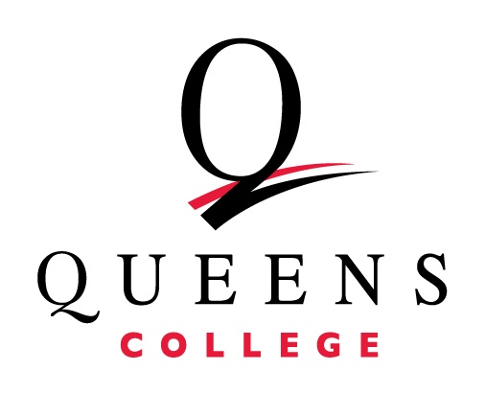
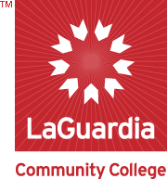

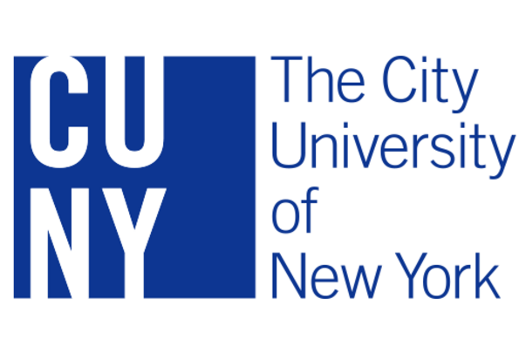
Easing transitions (in and out) for
geoscience undergraduates
Allan Ludman, Holly Porter-Morgan, and Monica Trujillo

Slide 2


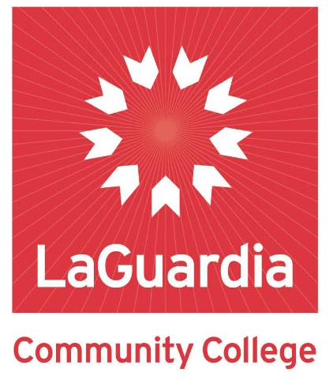

FRESHMAN YEAR
TO
GEOSCIENCE CAREER
NSF IUSE-GEOPATHS AT CUNY
Notes:
At GSA last year we outlined the strategies in our GEOPATHS project just before it began.

Slide 3
PLUGGING LEAKS IN THE GEOSCIENCE CAREER
UNDERGRADUATE PIPELINE
Community
College
Choose
Geoscience
major
Transfer from Community College
Complete
Geoscience
degree
Geoscience
Employment or
graduate school
RECRUIT
ADVISE
ENGAGE
CAREER COUNSELING
High School
HS→Geoscience major
Associates →
BA/BS institution
BA/BS institution→ Job or Grad School
Transitions
Notes:
We chose a holistic approach, one that addressed throughout the undergraduate career. In keeping with the theme of this session, today we will report only on the three transitions shown here. <CLICK> starting with true freshmen entering Queens College – the baccalaureate partner on our project.

Slide 4
TRANSITION 1. HIGH SCHOOL SENIOR →GEOSCIENCE MAJOR
QC traditional approach: capture students in large-enrollment general education courses
Freshman Year Initiative (FYI) approach targets students who expressed interest in Geology or Environmental Science during the admissions process or orientation
Queens College’s award-winning FYI Learning Community program eases the high school - college transition for >90% of freshmen.
Our learning community consists of 40 freshmen:
20 scheduled in Geol 101 & a linked freshman composition section
20 in EnSci 100 & a linked freshman composition section
Writing course hones college-level skills and coordinates with Geoscience courses for academic and social activities
FYI students required to participate in some GEOPATHS events and invited to career counseling workshops
Notes:
Until recently, we followed a traditional approach, recruiting aggressively in numerous non-lab general education courses. Numbers have dropped in those courses because a large percentage of new students are transfer students, who have already their satisfied science requirements. <CLICK>
We adopted a more focused approach, based on the College’s Freshman Year Initiative Learning Communities to target freshmen who have already expressed an interest during orientation or the admissions process. DESCRIBE AS SHOWN IN SLIDE we are now four weeks into the first such cohort, with hopeful results

Slide 5
PLUGGING LEAKS IN THE GEOSCIENCE CAREER
UNDERGRADUATE PIPELINE
Community
College
Choose
Geoscience
major
Transfer from Community College
Complete
Geoscience
degree
Geoscience
Employment or
graduate school
High School
2. Associates →
BA/BS institution
Transition
Notes:
This transition is critical to our Geoscience programs. A remarkable 67% of new Queens College students are transfers, most coming with Associates degrees from CUNY community colleges. They satisfy GenEd requirements before transferring so are not captured in our traditional recruiting. To maintain major numbers, we have partnered with Queensborough and Laguardia CC, our largest feeder schools, and are working to help their graduates make the transition from the Associates to the Bachelors program

Slide 6
Transition 2: Associates→ Baccalaureate College
Queensborough and Laguardia students who follow Geology and Environmental Science articulation agreements complete geoscience Bachelors degrees faster and often more successfully than our homegrown students. To recruit these students and ease their transition from an Associates to Bachelors program,
we have strong geoscience articulation agreements with our partners and are developing dual degree programs
Queens College undergraduate advisors participate in Queensborough and Laguardia major fairs and other recruiting events.
Queens College students who have made the transition successfully serve as peer advisors at QC and as ambassadors at their original campus
Most importantly, we are creating (with IUSE-GEOPATHS help), a multi-campus geoscience community with academic and social interactions
Notes:
The goal of this geoscience community is that Laguardia and Queensborough students are familiar with the transfer process and have already become familiar with their future Queens College faculty and classmates through extensive interactions for two years before actually transferring.

Slide 7
Associates→ Baccalaureate College, ctd.
One of the most successful strategies turns out to be involving students in research at their Associates college and continuing that research at Queens.
NYS (Collegiate Science and Technology Entry Program[CSTEP]) and CRSP (CUNY Research Scholar Program) funds have stimulated research at CUNY community colleges
Student interest in pursuing B.A. or B.S. degree is enhanced
Students arrive at QC with significant research skills and understand how scientists function, including presenting and publishing
LAGCC and QCC students doing research in areas where QC faculty are active form relationships with QC faculty and students before transferring. Some use our labs.
These relationships are strengthened at multi-campus research symposia – the first held last week.

Slide 8
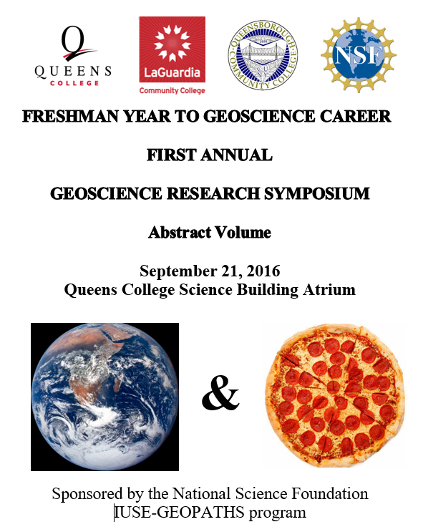
35 students and their mentors from QCC, LAGCC, and QC presented research posters to an audience of about 200.
QC Freshman Year Initiative Geoscience community students were required to attend
QCC and LAGCC visitors toured QC geoscience facilities
Many introductory Environmental Science and Geology students came to see what their lecturers and laboratory instructors do outside of class.

Slide 9
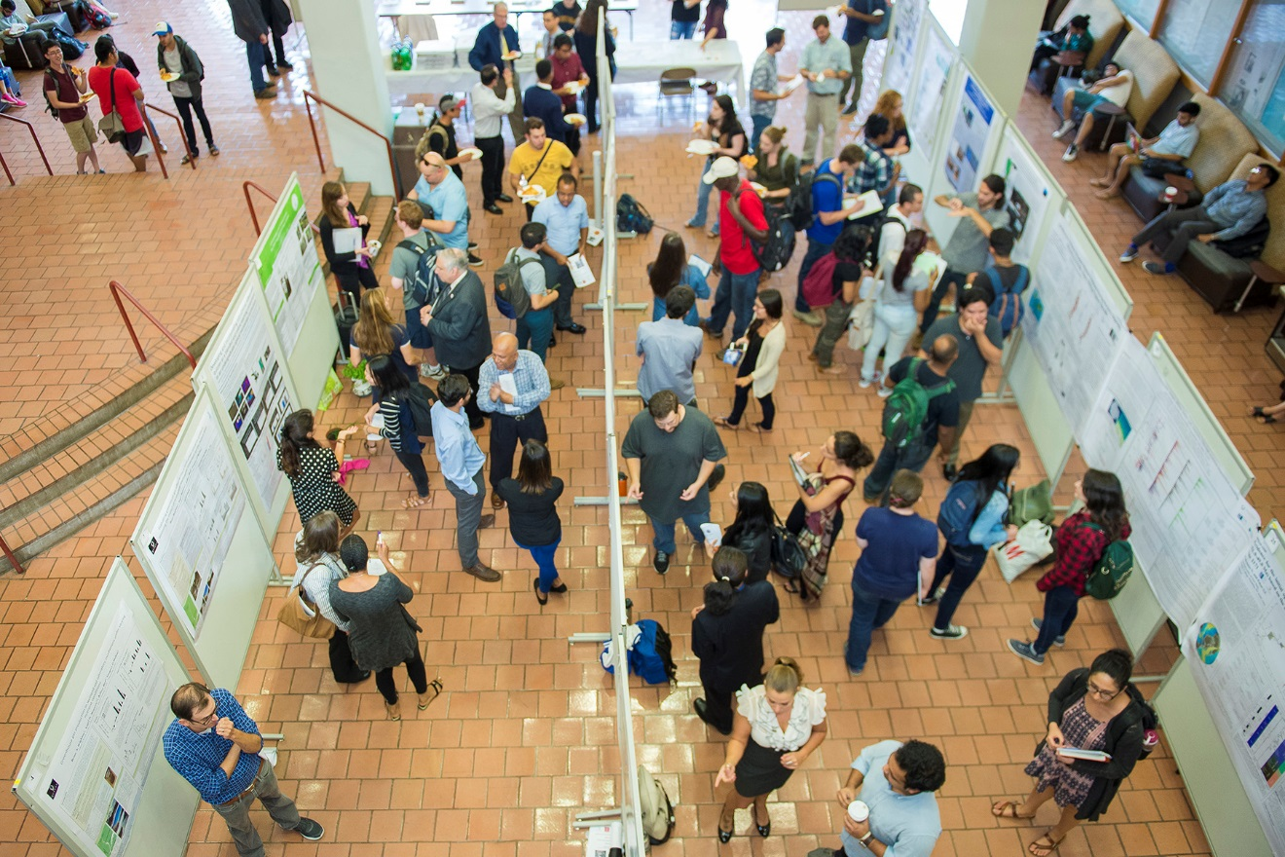
Notes:
It was busy

Slide 10
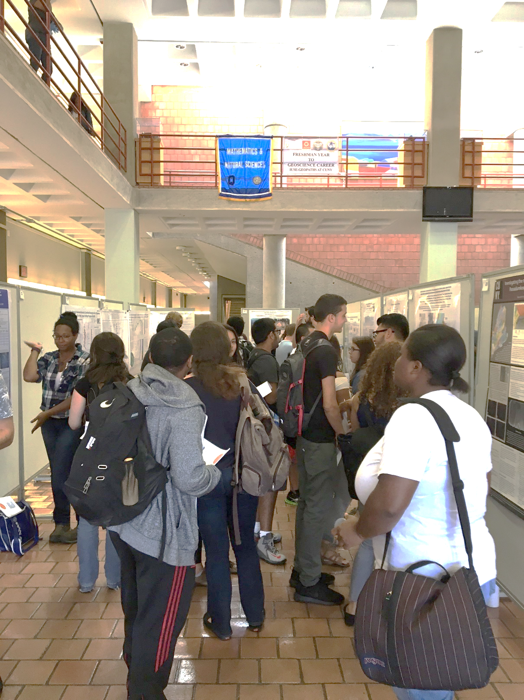
Posters covering a wide range of geologic and environmental areas were grouped by topic, stimulating conversations among students from the three campuses.
Our FYI students came with their Composition instructor, are writing about the experience, and discussing it in that class this week.
An added benefit
For the first time, our majors got out of the silos of their mentors’ labs and saw what their peers are doing. Result: several productive discussions and obvious pride in their department
Notes:
Note our Freshman Year to Geoscience Career banner was next to the Science Division banner, making our Dean happy.

Slide 11
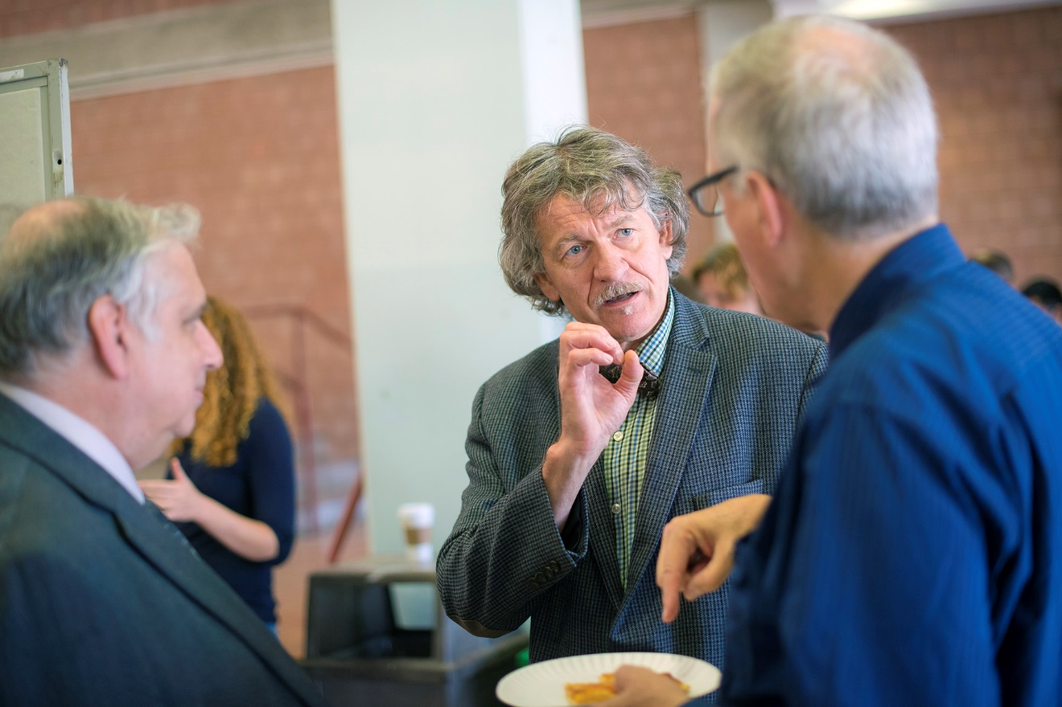
Notes:
Our dean (a microbiologist) and associate provost (physicist) attended for the entire event, speaking with students and faculty from our community college partners, and helping to strengthen our ties from a political as well as scientific perspective.

Slide 12
PLUGGING LEAKS IN THE GEOSCIENCE CAREER
UNDERGRADUATE PIPELINE
Community
College
Choose
Geoscience
major
Transfer from Community College
Complete
Geoscience
degree
Geoscience
Employment or
graduate school
High School
BA/BS institution→ Job or Grad School
Transition
Notes:
The final transition is to life after the Bachelors degree, when, unfortunately many of our students leak from the pipeline.
CLICK HERE

Slide 13
TRANSITION 3: Bachelors degree to ??
For many of our students, just graduating is the goal and they don’t plan for what follows their undergraduate careers. Our strategies:
Scaffolded career guidance workshops and one-on-one counseling in collaboration with QC Office of Career Guidance and Internships as soon as (or even before) a student declares a major
Career planning timeline: it’s never too early but it can be too late
Building a competitive transcript
Graduate school or employment?
Online research tools and campus resources
Writing effective résumés and application letters
Interview skills

Slide 14
TRANSITION 3: Bachelors degree to ?? (ctd)
Network with alumni/ae
career panel discussions
alumni/ae-sponsored scholarships and internships
Video library of alumni interviews inspired by UNAVCO Geoscience Career Spotlight videos but with a twist
Notes:
UNAVCO and AGI videos posted on our GEOPATHS website are well received, but Queens College students have an inferiority complex – they think that they can’t accomplish what the people in the videos have done. Our interviews are with former QC students who sat in the same seats as our current ones and who point out how well QC prepared them for careers that they enjoy.

Slide 15
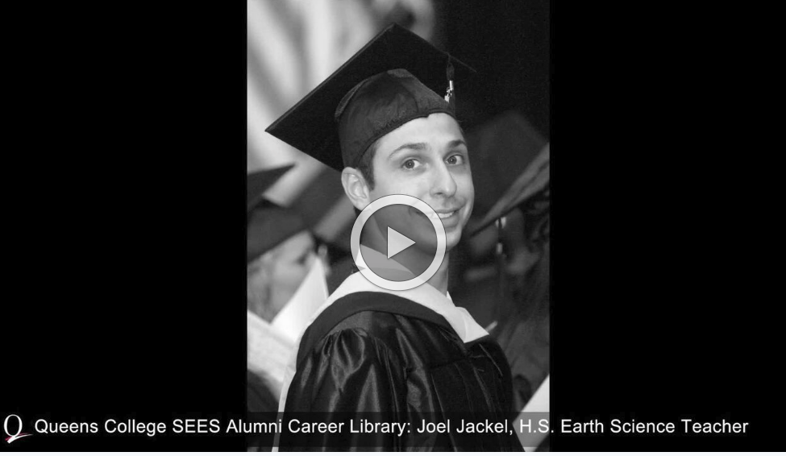
3-4 minute interviews with alumni/ae representing a broad range of geoscience careers including individual career paths and information frames

Slide 16
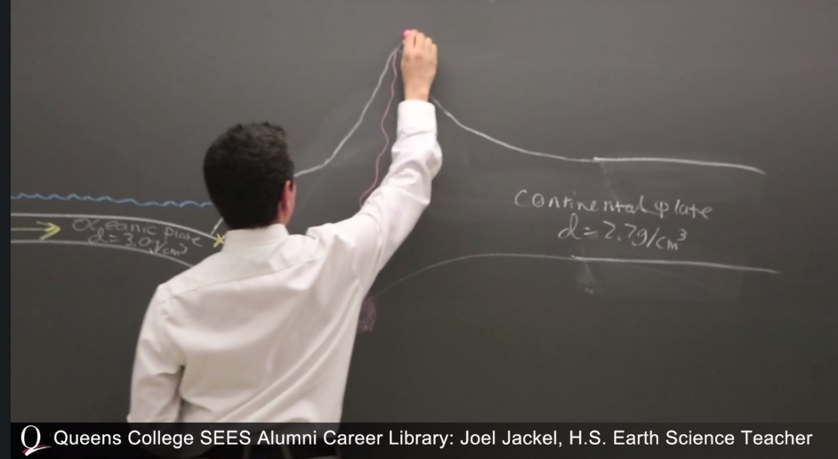
Why I chose to be a high school Earth science teacher. Why I still like it.

Slide 17
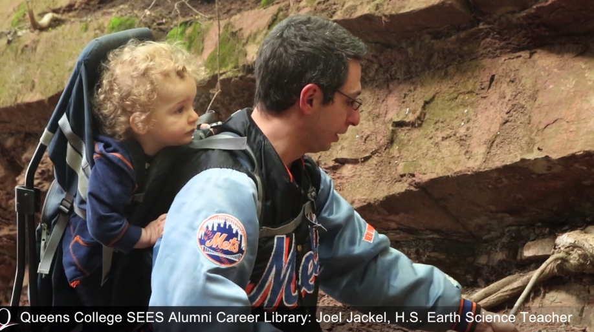
How this career choice affected the rest of my life

Slide 18
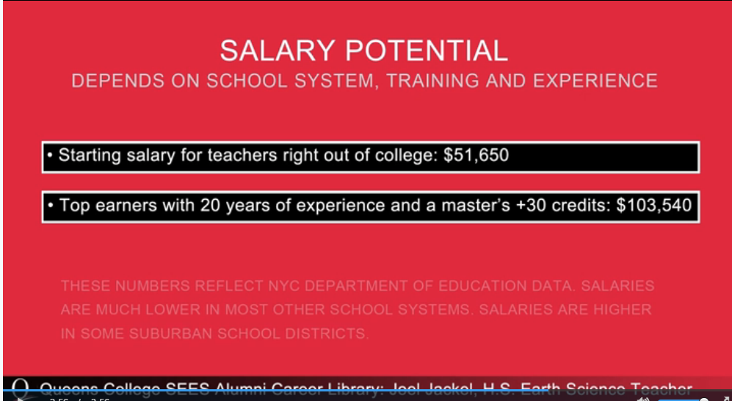
Notes:
Following the UNAVCO model, stills are interspersed throughout the interview, providing information about career paths, required skills, employment opportunities, salaries, etc.
Next year, we will be able to report the impact these and other interventions are having on the pipeline in Queens County, NYC.

