Slide 1

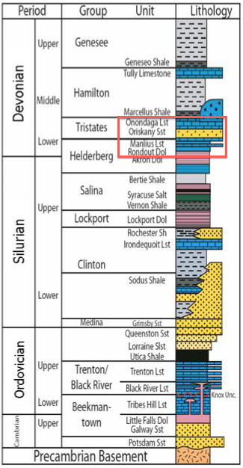
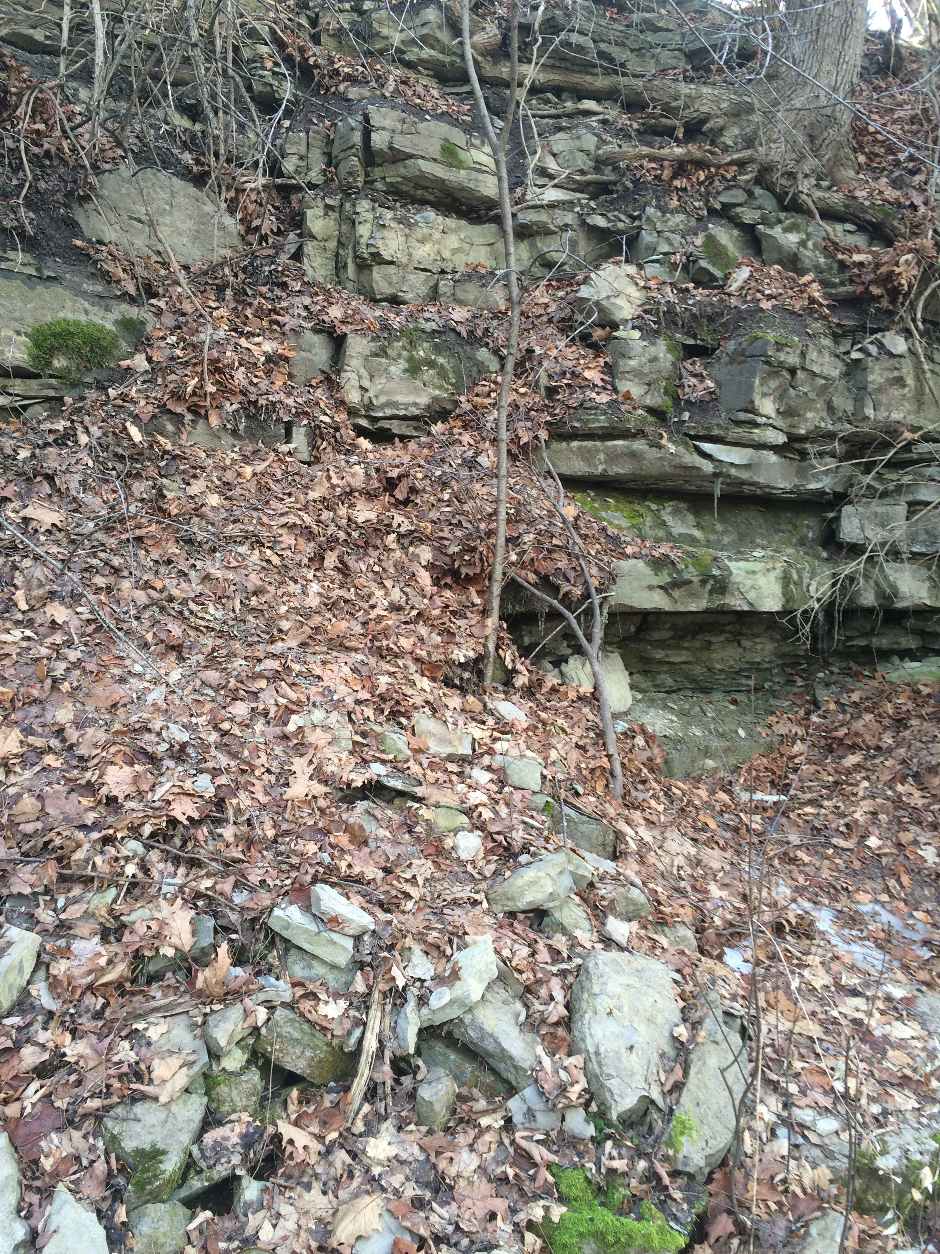
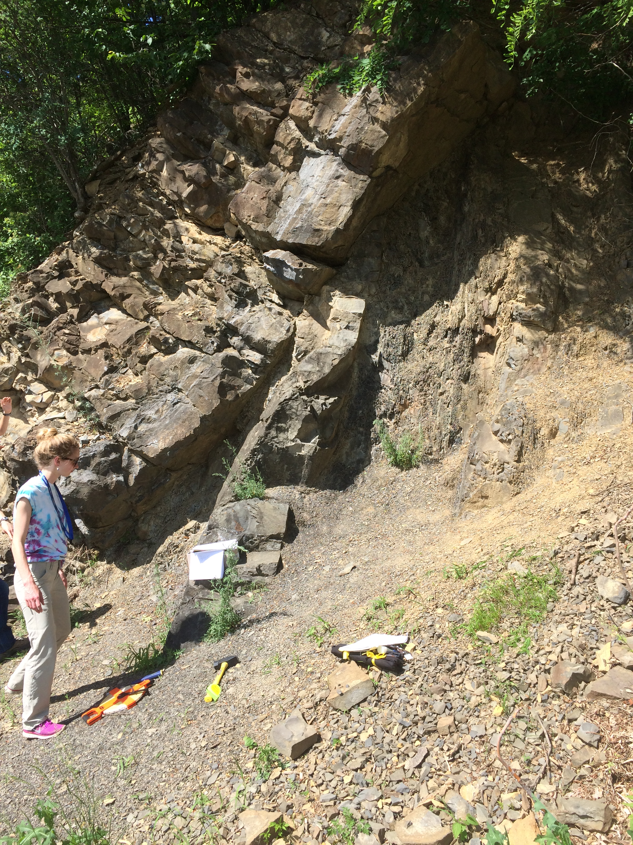
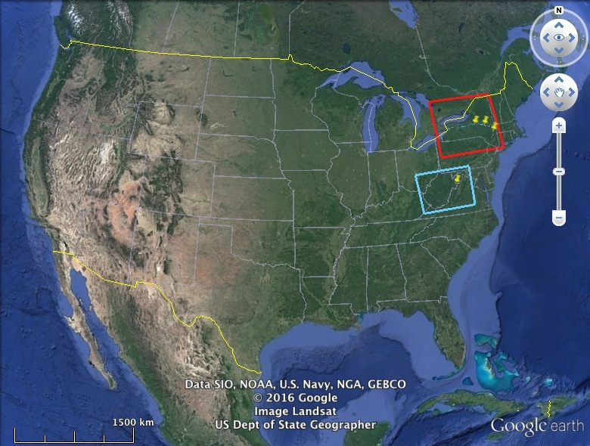
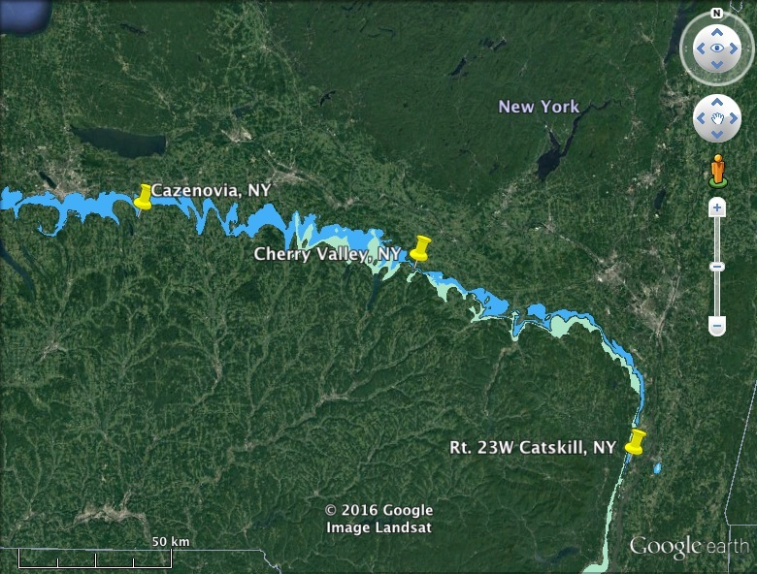
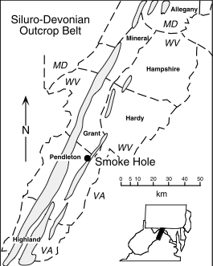
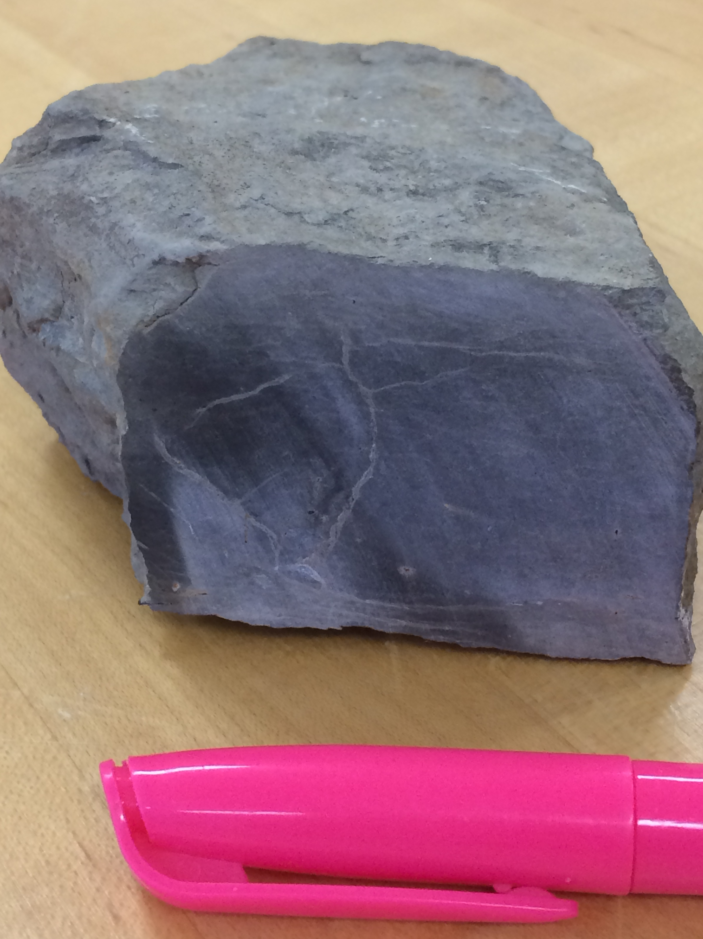
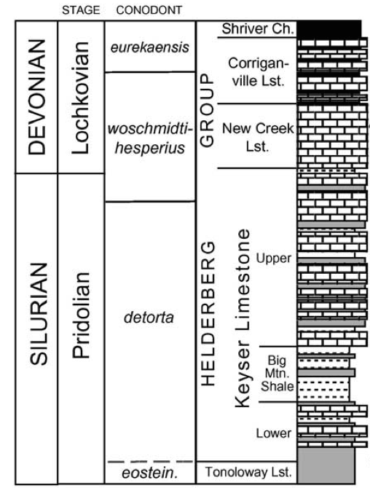
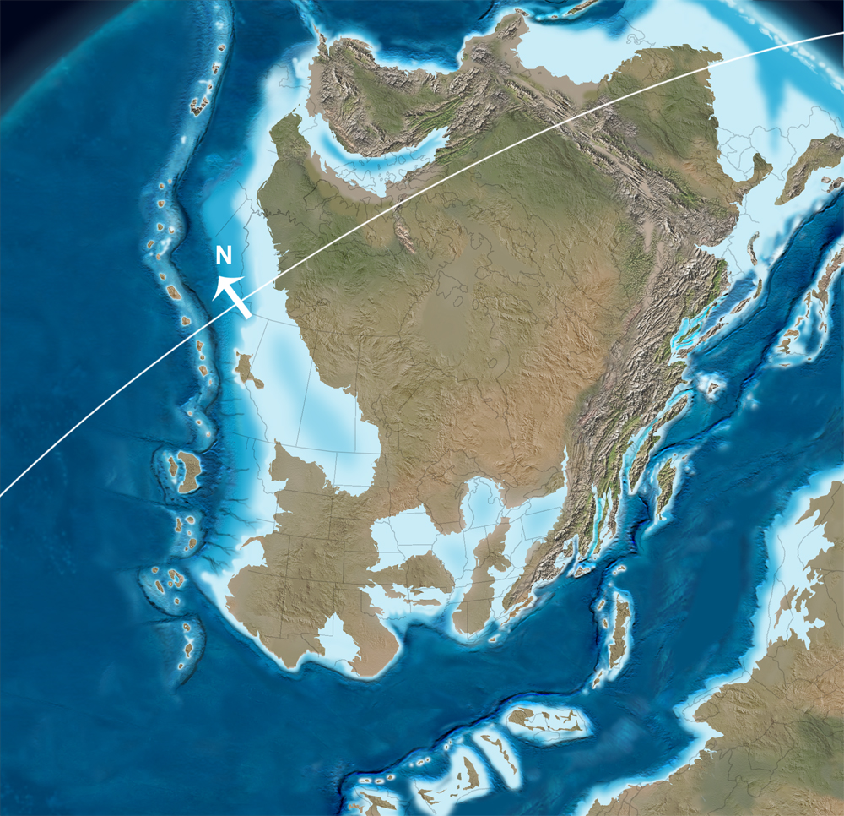
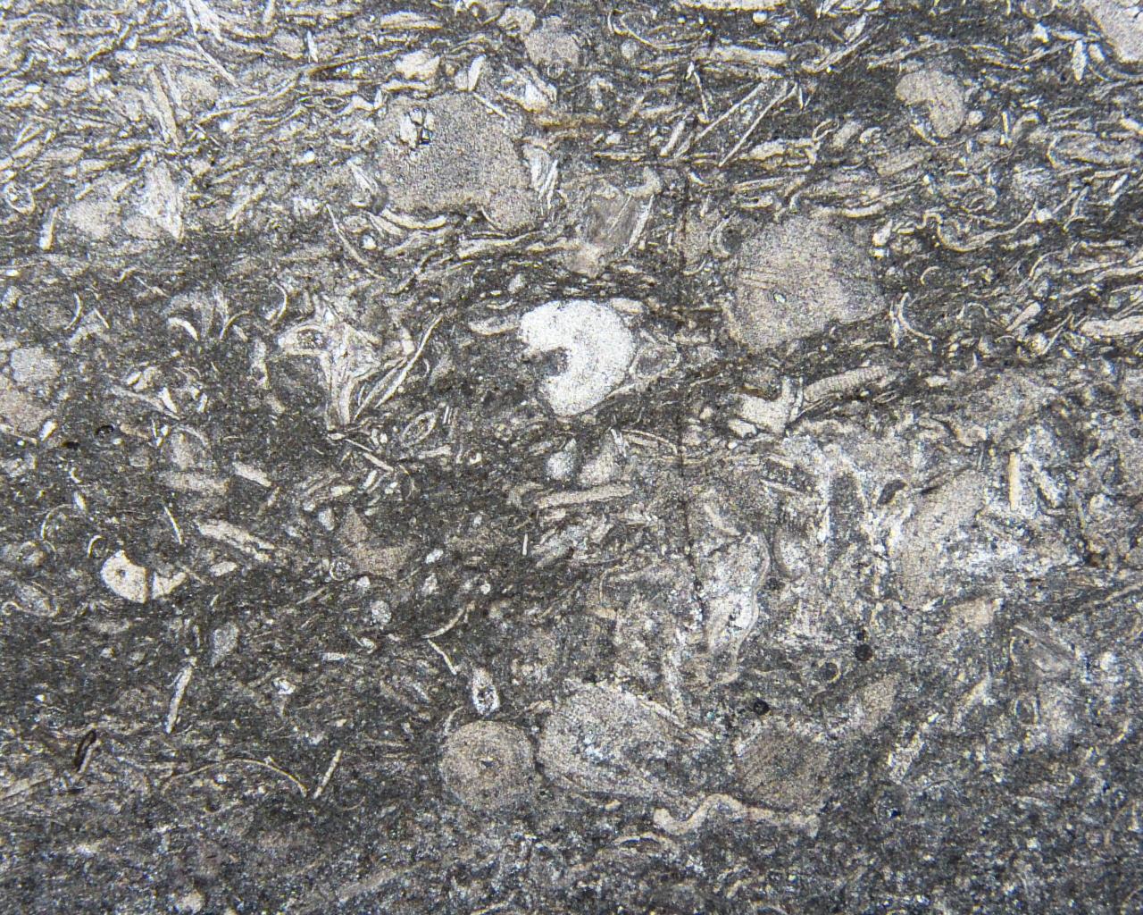
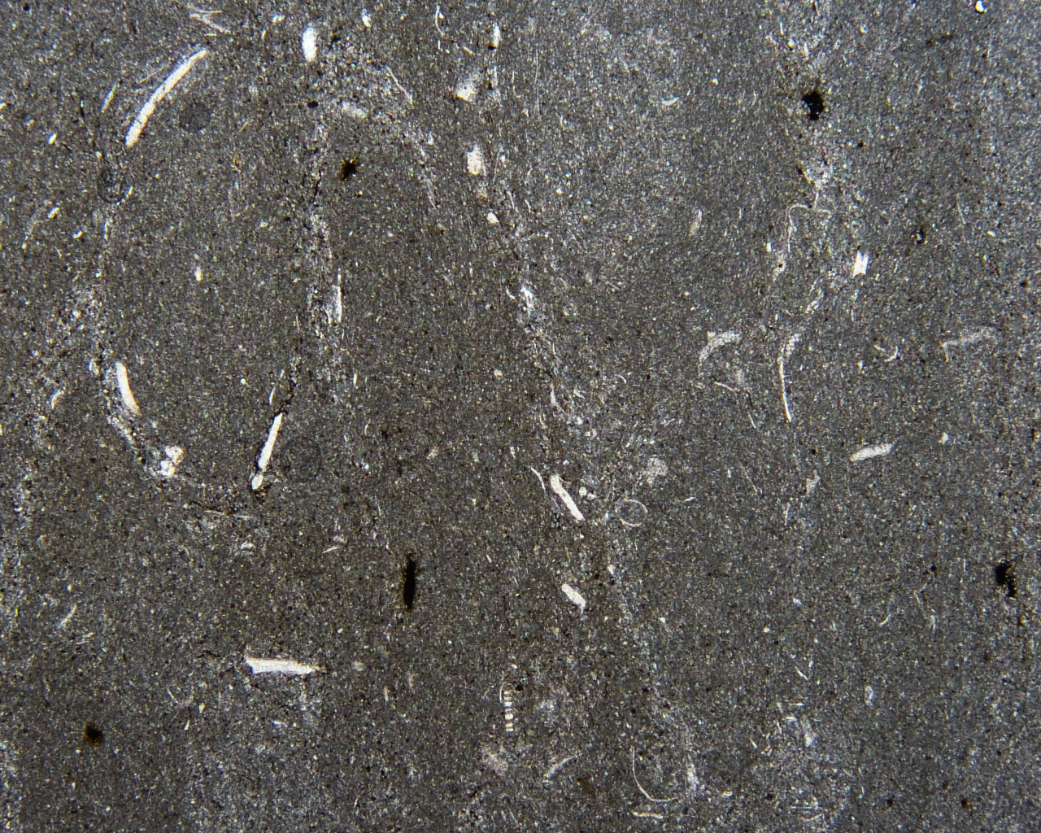
Stable Isotope and Petrographic Analysis of the Onondaga Limestone, Central New York
Alec Melone¹, Catherine Beck¹, Morgan Schaller², and Bruce Wegter¹
¹Hamilton College, Clinton, NY, ²Rennselaer Polytechnic Institute, Troy, NY
Introduction
The goal of this research was to investigate δ¹³C trends in the Middle Devonian from carbonate rocks of the Onondaga Formation and Helderberg Group in New York (Figures 1 and 2). Stable isotope measurements are a powerful tool for understanding oceanic water chemistry, though δ¹⁸O values from Paleozoic carbonates may be overprinted during diagenesis. Previous work from the Helderberg group from West Virginia reveal a positive δ¹³C shift in the Late Silurian and Early Devonian (up to +5.8‰) (Saltzman, 2002) (Figure 3). As δ¹³C values record changes in the carbon cycle during time of sediment deposition, this shift is attributed to an increase in organic carbon burial within the Appalachian Basin during the Silurian and Devonian. In addition to stable isotope analysis, petrographic analysis was conducted on representative samples to look for any features that might indicate sources of error in the isotope data, such as diagenetic alteration.
Onondaga Limestone Background:
Devonian unit that stretches from Ontario, Canada through central New York and down to West Virginia (Oliver, 1954) (Figure 1B)
Lies beneath the Marcellus Shale and unconformably above the Helderberg Group limestones of the Upper Silurian in central NY (Figure 2)
Formed when shallow, tropical ocean filled the Appalachian Basin (Figure 4)
Methods
Field Work
Used samples collected from a section of the Onondaga and Kalkberg Limestone in Cherry Valley, New York. Samples collected every meter.
Collected twelve samples from the Onondaga Limestone in Cazenovia, NY (Figure 5), though only loose blocks were collected.
Collected four samples of the Rondout Dolostone and six samples of the Manlius Limestone from New York State Route 23 near Catskill (Figure 6). Samples collected every meter.
Lab Work
Made petrographic microscope slides of four Onondaga Formation samples: two for each collection site, one with visible bioclasts and the other appearing more micritic.
Analyzed samples on the mass spectrometer at Hamilton College in duplicates.
Results (continued)
Isotope Analysis
Bulk of data plots in a cluster ranging from 0.6 to 2.0 ‰ δ¹³C and -8.3 to -4.9 ‰ δ¹⁸O (VPDB) (Figure 10)
Manlius Limestone plots in separate cluster
All samples, except for those from the Manlius, plot within the range of Saltzman data
Observed a positive shift in δ¹³C within the Manlius, along with a smaller increase from the Kalkberg to the Onondaga (Figures 11 and 12).
Figure 1: Stratigraphic column of the Paleozoic Appalachian Basin in New York. The red box highlights the Helderberg Group and Onondaga Limestone. (Source: Selleck, 2010)
A
B
Figure 10: Average Isotope ratio of δ¹⁸O versus δ¹³C of each sample. Keyser, New Creek, and Corriganville isotope data from Saltzman are shown in blue.
Figure 5: An outcrop of the Onondaga Limestone in Cazenovia, New York.
Figure 6: An outcrop of the Rondout Dolostone along New York Route 23 near Catskill, New York. Mary Langworthy for scale.
C
Results
Petrographic Analysis
Goal: Use thin thin sections of representative lithologies to better characterize the rocks and look for evidence of diagenesis in the Onondaga Formation
Cut surfaces on hand samples displayed discolored cracks (Figure 7)
Cracks not visible in thin section
Samples range in composition from bioclastic packstones (Figure 8) to bioclastic wackestones (Figure 9)
Majority of the bioclasts cannot be assigned to the genus or species level due to their fragmentary nature
Evidence of diagenesis:
Bioclasts range in appearance from distinct and clear to somewhat dusty-looking: possible diagenesis?
Could also problems with quality of thin sections: thickness of rock, scratches
Blue : Helderberg Group (Rondout ds, Manlius ls, Kalkberg ls)
: Onondaga ls
Figure 11: Average δ¹³C values for the Rondout and Manlius samples in relative stratigraphic order. Error bars are the standard deviation of each sample, which were for most samples too small to be displayed.
Figure 12: Average δ¹³C values for the Kalkberg and Onondaga samples in relative stratigraphic order. Error bars are the standard deviation of each sample, which were too small to be displayed for many samples .
Figure 2: The focus of our study and the study we reference. A: A map of the United States, with our study area outlined in red and the West Virginia study area of Saltzman, 2002 outlined in blue (Source: Google Earth). B: A closer view of our study area of New York, with our collection sites marked, along with the location of the Helderberg Group and the Onondaga Limestone within New York (Map data source: Google Earth. Geologic map data source: USGS). C: The study area of Saltzman, 2002 in West Virginia, with the location of study marked. (Source: Saltzman, 2002)
Conclusions
Samples analyzed in thin section matched description of Edgecliff member from Selleck, 2010.
Positive shift in δ¹³C values in the Manlius similar to that observed in the New Creek and Corriganville of West Virginia (Saltzman, 2002)
May be evidence of increase in the rate of organic carbon burial
Suggests a relation with the dramatic expansion and diversification of land plants
Figure 7: A cut hand sample OLCF2 from the Onondaga Formation, with discolored cracks suggesting potential diagenesis.
Future Research
Must improve the accuracy and resolution of our data
Stratigraphic relations between Onondaga collection sites only roughly measured: better stratigraphic correlations between the two outcrops on more regular sampling through longer sections needed
Sample each limestone every 10 cm as opposed to every meter as we did
Make thin sections of more samples, identify index fossils if possible
Equator
Shell fragments
Acknowledgements
We would like to thank Lindsay Buff, Patrick Donahoe, Mary-Margaret Allen, and Mary Langworthy for their help collecting and preparing samples.
Shell fragments
Micrite
References
Oliver, W. A., 1954, Stratigraphy of the Onondaga Limestone (Devonian) in Central New York: Bulletin of the Geological
Society of America, v. 65, p. 621-652.
Saltzman, M. R., 2002, Carbon isotope (δ13C) stratigraphy across the Silurian-Devonian transition in North America:
evidence for a perturbation of the global carbon cycle: Palaeo, v. 187, p. 83-100.
Selleck, B., 2010, Stratigraphy of the Northern Appalachian Basin, Mohawk Valley, Central New York State
http://offices.colgate.edu/bselleck/Publication%20PDF/Paleozoicguide.pdf (accessed May 2016).
Crinoid columnals
Figure 3: Stratigraphic column of Smoke Hole, West Virginia. The blue box highlights the Helderberg Group of West Virginia.
(Source: Saltzman, 2002)
Figure 4: A paleogeographic reconstruction of North America during the Middle Devonian (385 Ma), with New York located within the red box and West Virginia in the blue box. (Source: Dr. Ron Blakey, https://www2.nau.edu/rcb7/namD385.jpg)
Figure 8: Photomicrograph of fossils within sample HGOF2B (packstone) under plane polarized light. The fossils are mostly shell fragments, though some pieces appear to be crinoid columnals. Field of view = 11 mm.
Figure 9: Photomicrograph of fossils within sample OLCF2 (wackestone) under plane polarized light. The fossils are mostly unidentifiable shell fragments.
Field of view = 11 mm.

