Slide 1


Neogene Deep Sea Hiatuses: looking back after 33 years
John A. Barron, US Geological Survey, Menlo Park, CA 94025
Mitchell Lyle, COAS, Oregon State University, Corvallis, OR

Slide 2
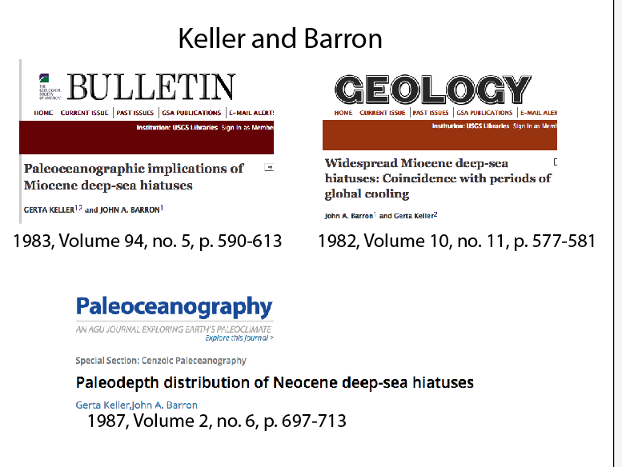

Slide 3
Types/Causes of Deep Sea Hiatuses
Erosive bottom currents –remove sediments
  More typical of the Southern Ocean and margins
  of the North Atlantic
  -Tend to be of long duration
Non deposition or sediment starvation
  Continental margins -sea level rise, coastal onlap
  Onshore sections –sea level fall, unconformities
Dissolution of predominantly calcium carbonate sediments (shoaling of the Carbonate Compensation Depth = CCD)

Slide 4
Recognition of deep sea hiatuses was based on biostratigraphy (planktonic foraminiferal, calcareous nannofossil, diatom radiolarian)
Datum levels
Age vs. Depth plots
Shorter hiatuses recognized in high biologic productivity regions (eastern Equatorial Pacific) where one would assume constant sedimentation
Seven main hiatuses –NH1 thru NH7 recognized

Slide 5
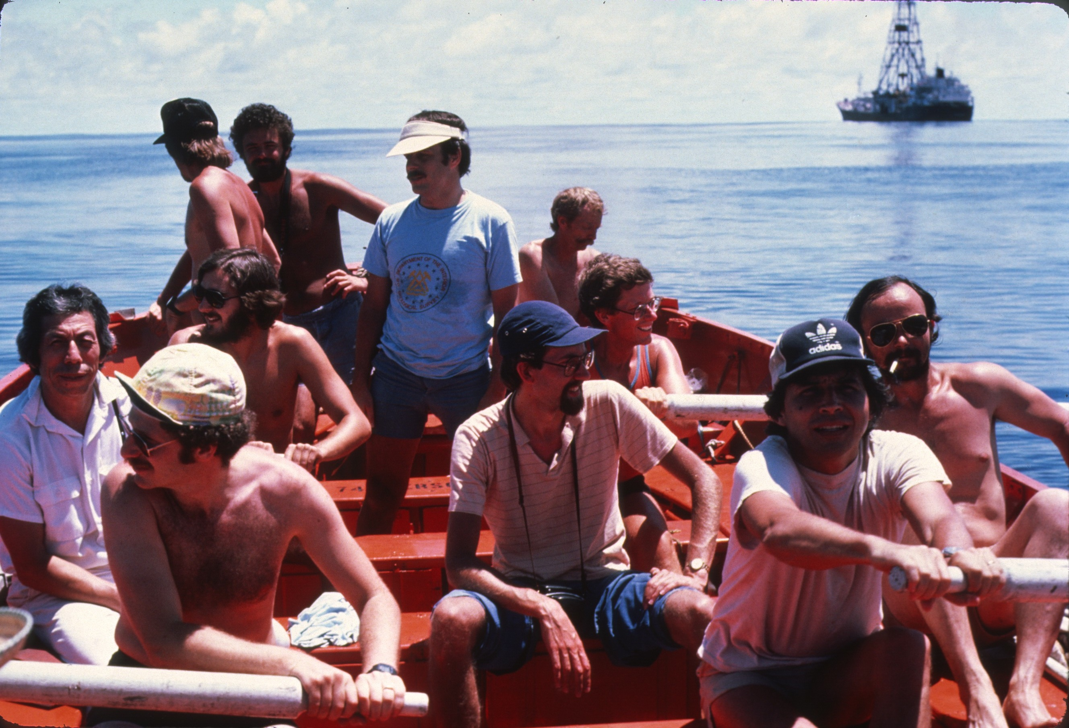
Looking for deep sea hiatuses -DSDP 85, 1982 equatorial Pacific
JB
Larry Meyer
Fritz
Theyer

Slide 6
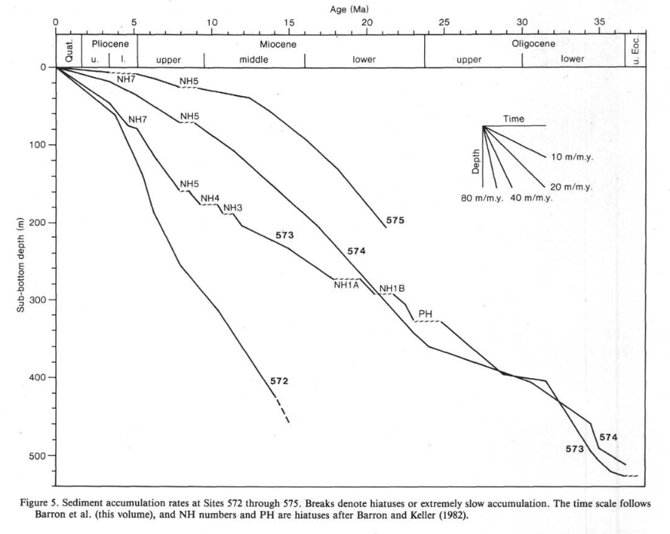
DSDP Leg 85
eastern equatorial Pacific
Age vs depth plots constrained by microfossil
datum levels (plank foram, calc. nanno, diatom, rad)

Slide 7
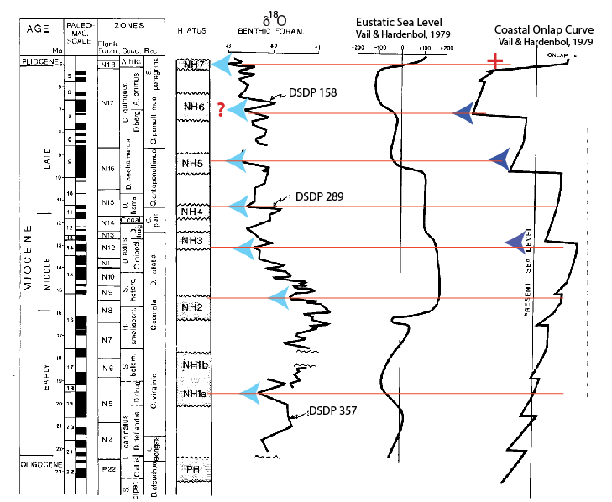
Correlation with cooling events and sea level fall?

Slide 8
Hypothesis: Neogene hiatuses coincident with global cooling events
Calcium carbonate dissolution events (shoaling of the CCD)
  Recognized by seismic stratigraphy on seafloor in the eastern equatorial Pacific (Larry Meyer, 1985)
In the eastern equatorial Pacific, these dissolution events often coincide with increased diatom deposition
? Coincident with sea level fall
? Erosive bottom currents in marginal areas of low biogenic sedimentation

Slide 9
How do these 7 Neogene deep sea hiatuses coincide with the present geologic time scale?
Constrained by microfossil datum levels identified by Barron and Keller (1982), Keller and Barron (1983, 1987)

Slide 10
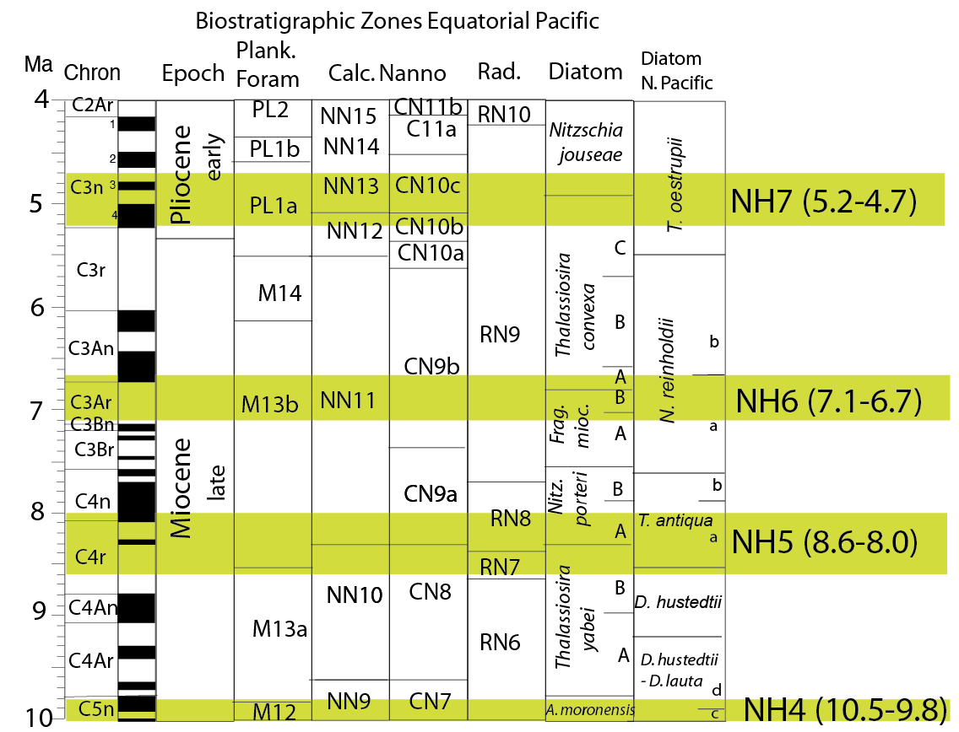

Slide 11
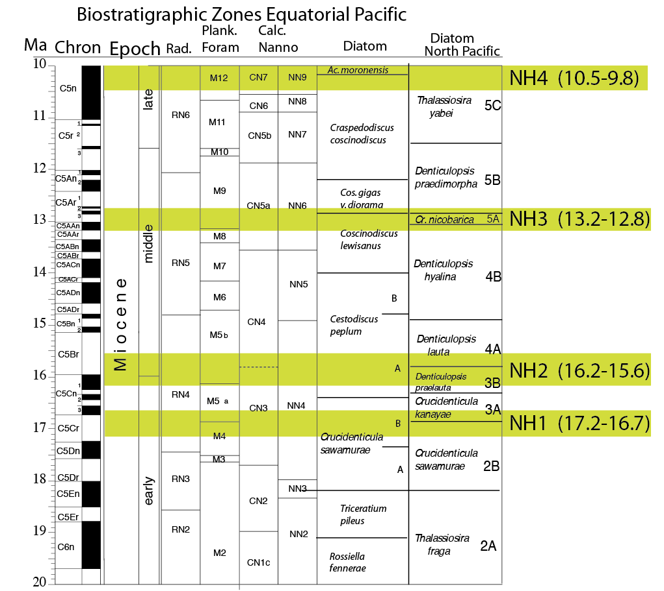

Slide 12
What Has Changed
Multiple coring of holes and correlation by physical properties eliminates coring gaps
High-resolution geochemical & isotope studies
Transects across areas of high biologic productivity (e.g., ODP 138, IODP 320/321 in the eastern equatorial Pacific)
Improved correlation with geologic time
  Paleomagnetic stratigraphy
  Astrometric tuning (41 kyr cycles) of time scale

Slide 13
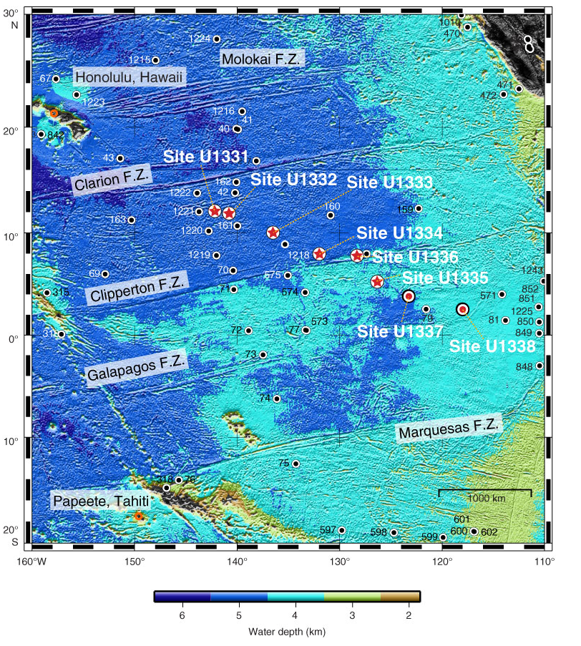
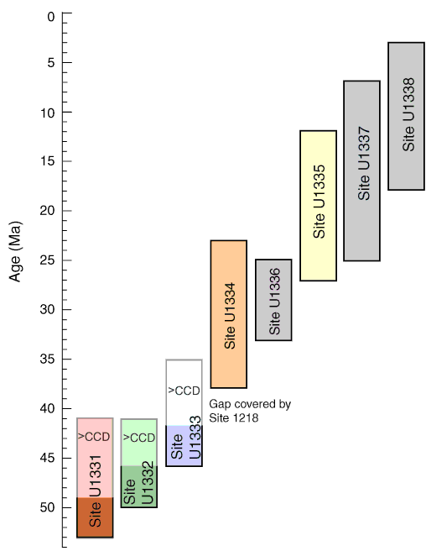
IODP Expedition 320/321 (2008)
Transect across the equatorial zone of high productivity
U1338
U1337
U1337
U1338

Slide 14
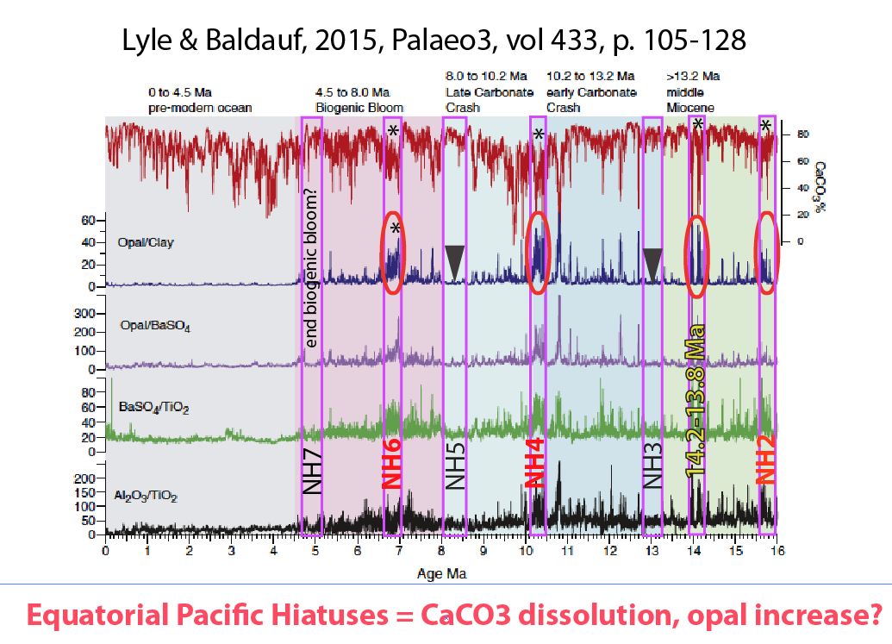
Site U1338
Biogenic Bloom

Slide 15
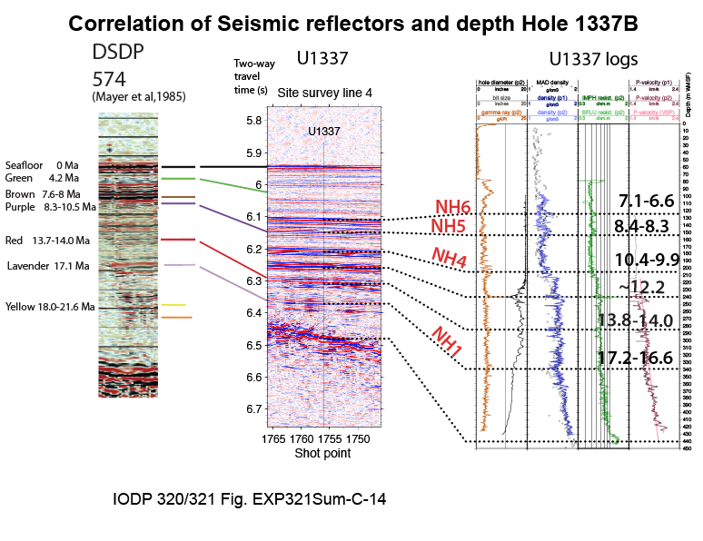
Ma

Slide 16
Hypothesis:
In areas of high biologic productivity (eastern equatorial Pacific) warm periods favor carbonate deposition, cold periods favor diatoms & carbonate dissolution (shoaling of the CCD)
-Cold = steepening of productivity gradient
-Warm = relaxation of productivity gradient

Slide 17
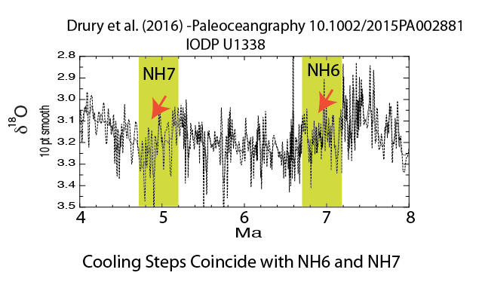
What do recent isotope studies in the equatorial Pacific reveal?

Slide 18
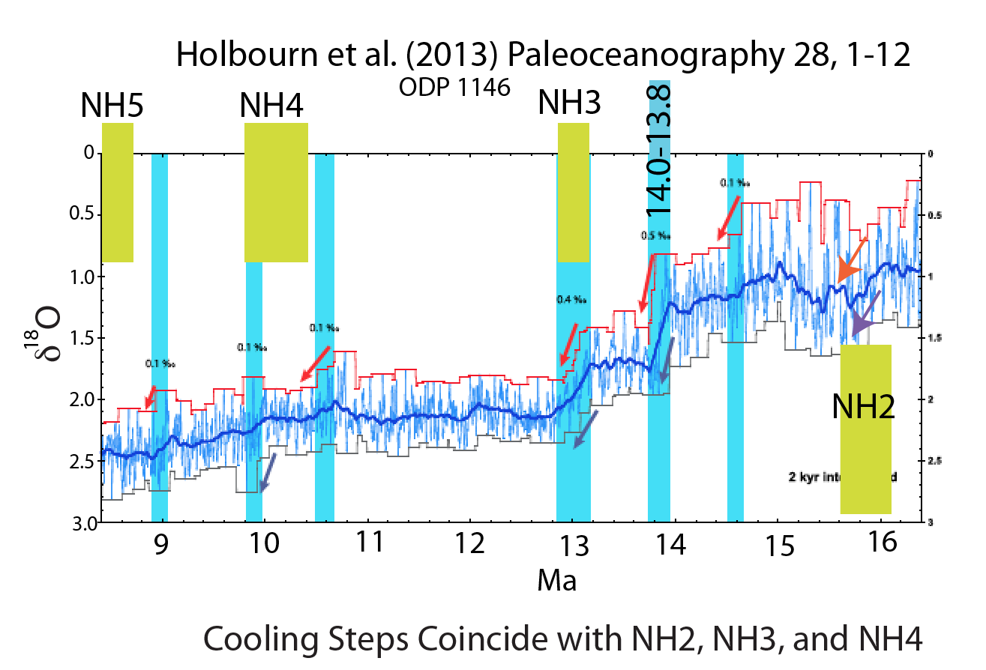

Slide 19
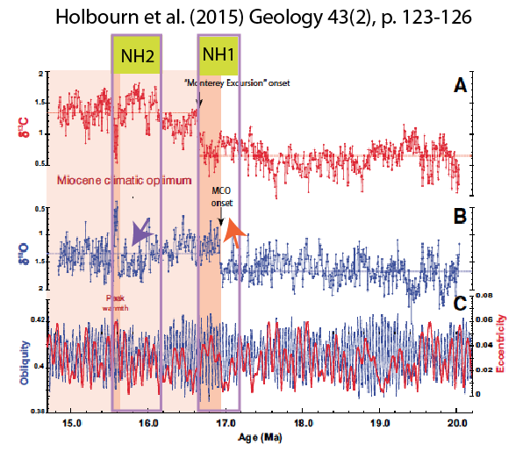
Site U1338
cooling
warming

Slide 20
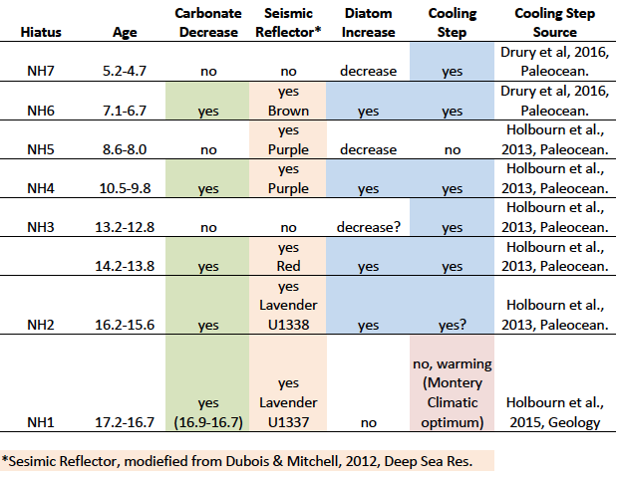

Slide 21
What is this telling us about past productivity patterns in the equatorial Pacific?

Slide 22
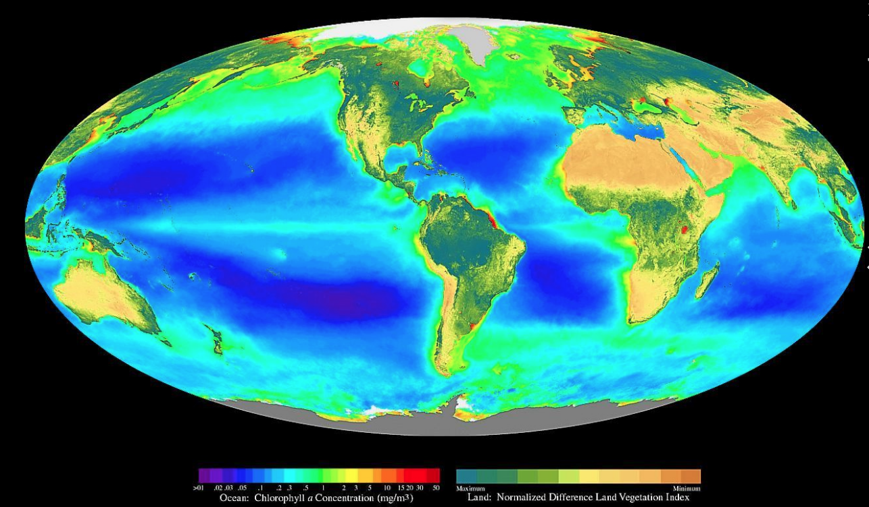
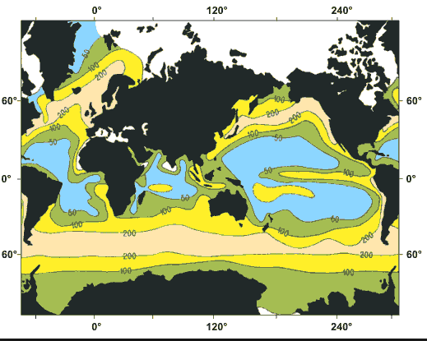
Global map of biologic productivity
Ocean –chlorophyll a concentration
Annual production of biogenic silica in the plankton of the world oceans (g/m²/yr) (modified from Lisitzin 1971)
Biogenic silica (= opal, mostly diatoms) tracks productivity

Slide 23
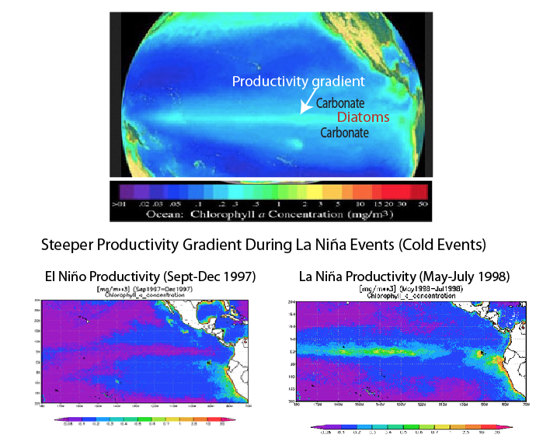

Slide 24
Concluding Thoughts
NH hiatuses of Keller and Barron appear to mark times of change in productivity gradients in the eastern equatorial Pacific
Many coincide with cooling steps in high-resolution oxygen isotope curves
Carbonate dissolution may be coincident
Don’t try to review 33+ years of progress in a 12 minute talk

