Slide 1
MCKENZIE, Scott C. and NYPAVER, Cole,
Geology, Mercyhurst University, 501 East 38th St., Erie, PA 16546, smckenzie@mercyhurst.edu
BERTIE PTERYGOTID : ACUTIRAMUS; PREDATOR OR PUSHOVER?
EURYPTERID INJURIES IN THE SILURIAN.

Slide 2
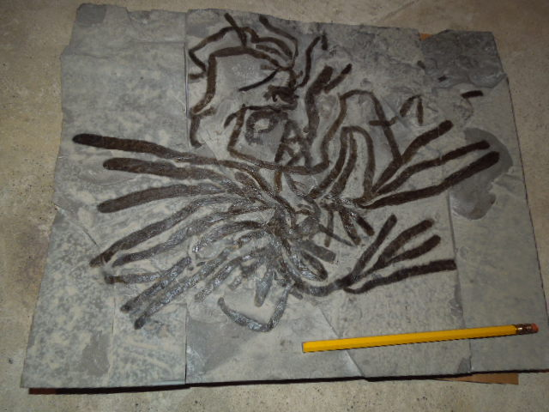
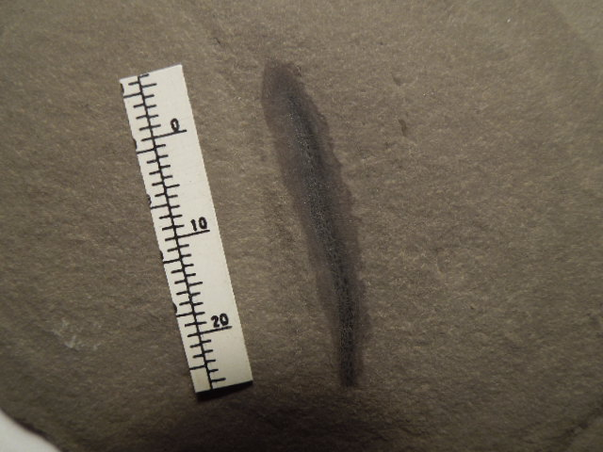
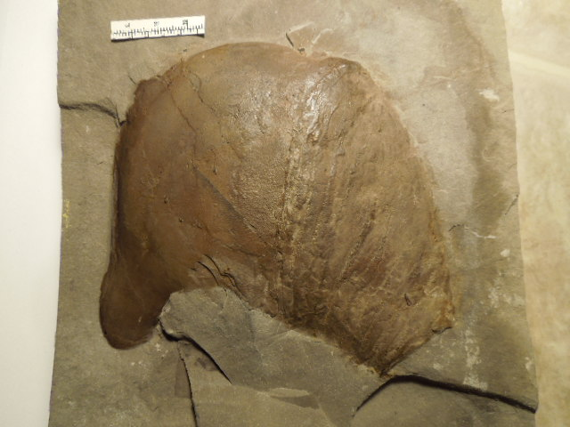
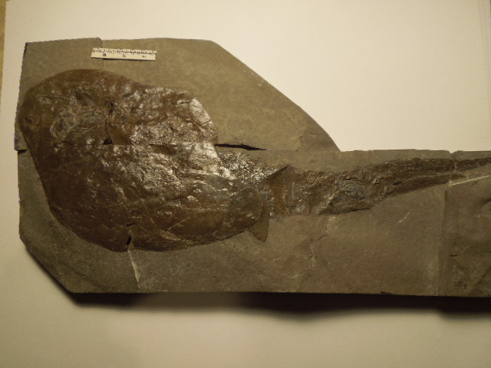
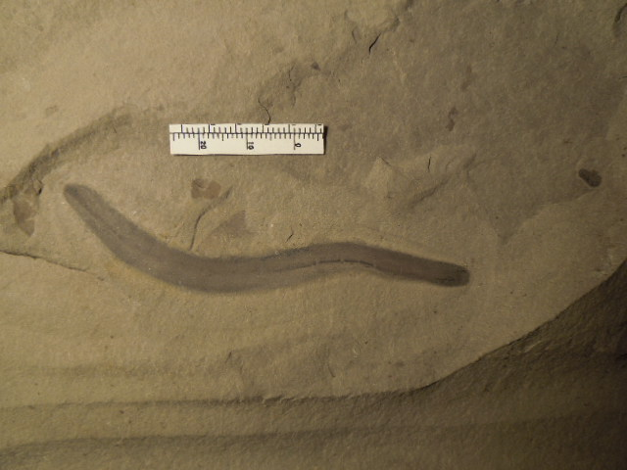
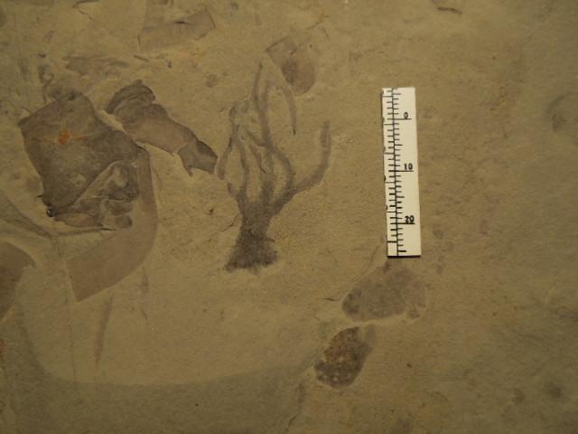
Possible thelodont?
Cephalopod
Brown Algae
Phyllocarid
Worm
Coelenterate?

Slide 3
Some main observations on the Bertie Group fossils
High diversity but low frequency of finds.
Fossils are not structurally preserved
Many undescribed forms.
Fauna dominated by eurypterids
Several environments are represented.

Slide 4
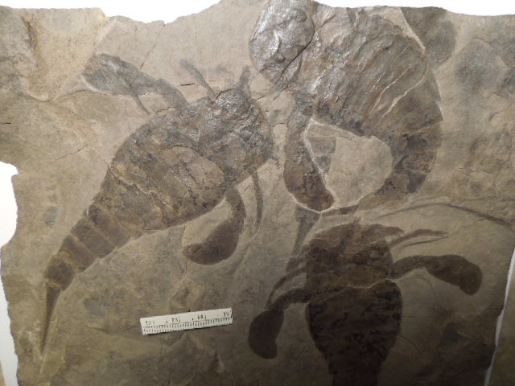

Slide 5
Most complete eurypterids are saved by collectors.
The majority of eurypterids are incomplete and are not saved.
Many of the non eurypterids are not easy to recognize in outcrop and are actually rare.
Injured eurypterids are more common than generally thought.

Slide 6
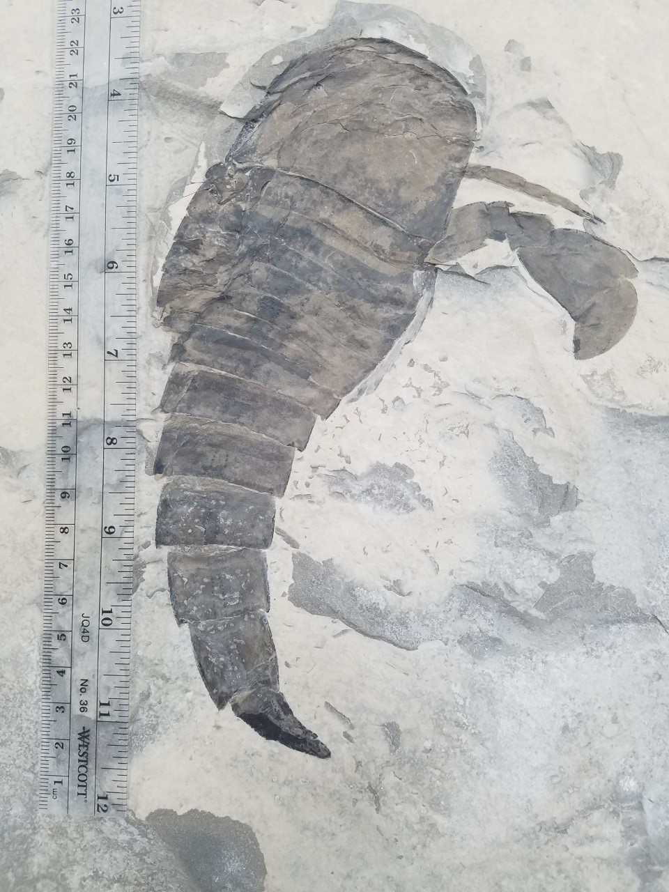
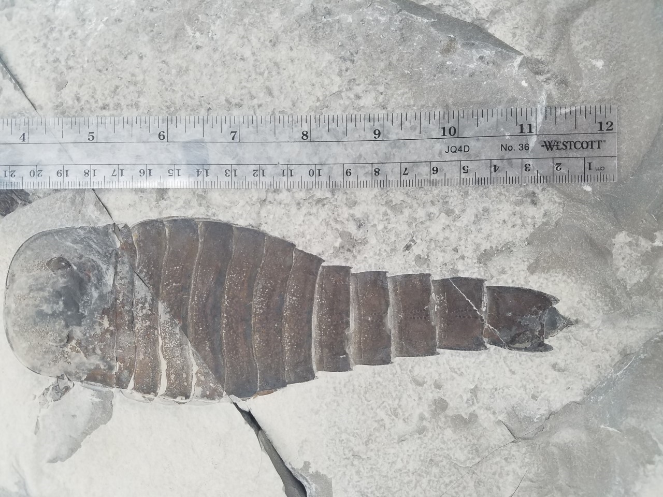
Bitten off and rehealed telsons
Buffalo “Pool”, Williamsville Mbr.
Some modern scorpion predators remove the stinger prior to consumption.

Slide 7
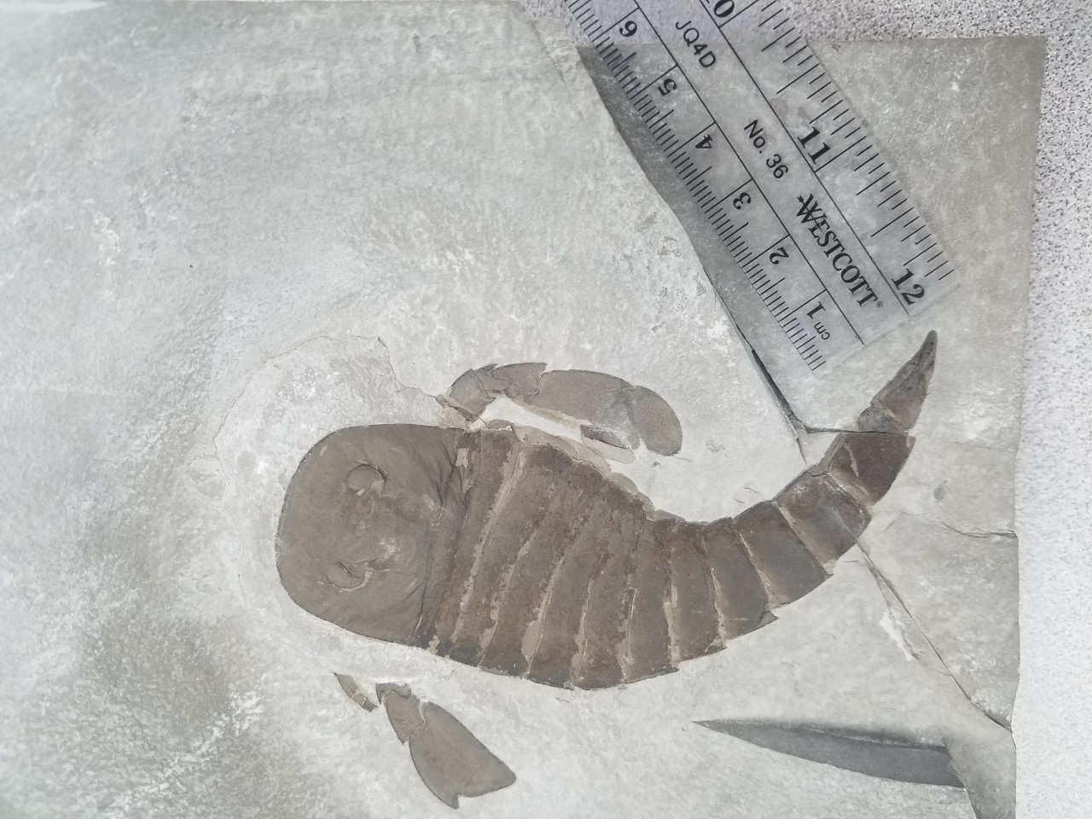
Bitten and rehealed telson
Williamsville A, ”Buffalo Pool”

Slide 8
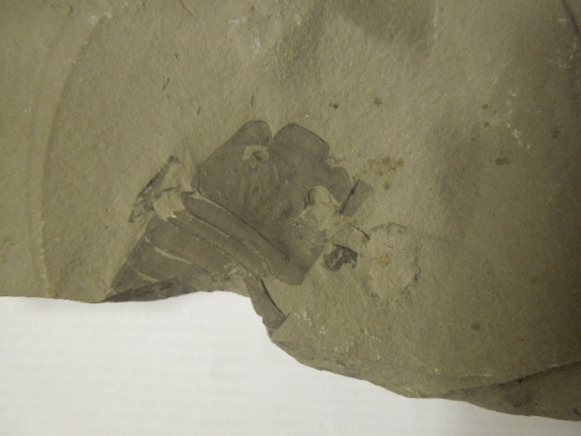
Several healed bites!
Lang Quarry, Herkimer Co., NY

Slide 9
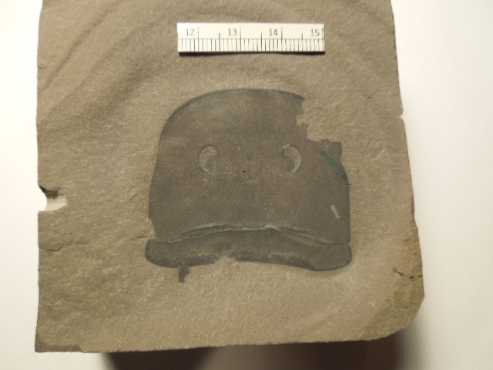
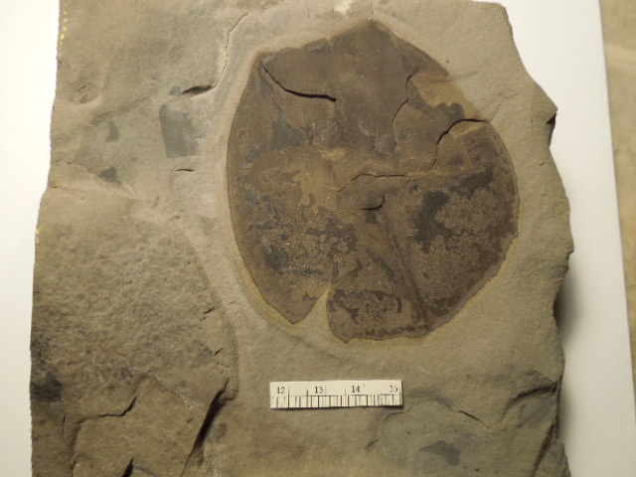
Below: Acutiramus telson with healed injury
Lang Quarry
Above: Eurypterus remepies showing
Feeding damage. Lang Quarry

Slide 10
The suspects!
Possible predators that may have made these
injuries are limited to Acutiramus or Pterygotus.
Cephalopods large enough to do this magnitude
of damage are rare in the Bertie. They may be
responsible for smaller bites.
Some remains could have been nibbled by Eurypterus after ectysis (J. Lamsdell personal communication). The other bites/punctures are from attacks by larger animals.

Slide 11
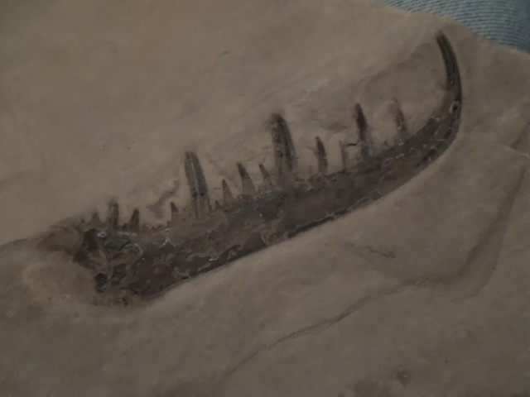
Pterygotus
A rare component of the Bertie fauna

Slide 12
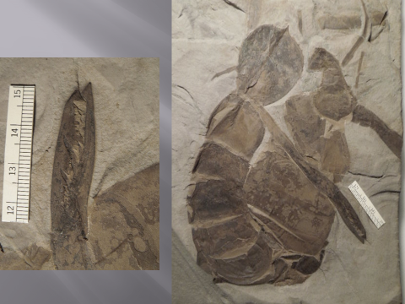
Acutiramis with enlargement of its claw

Slide 13
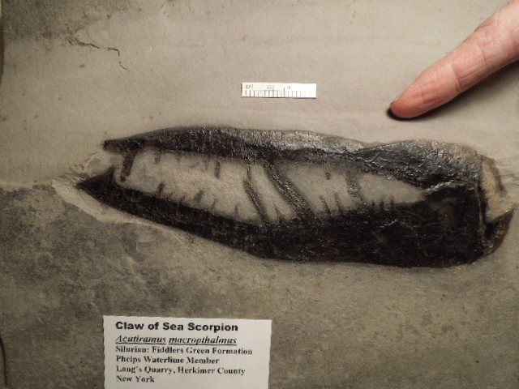

Slide 14
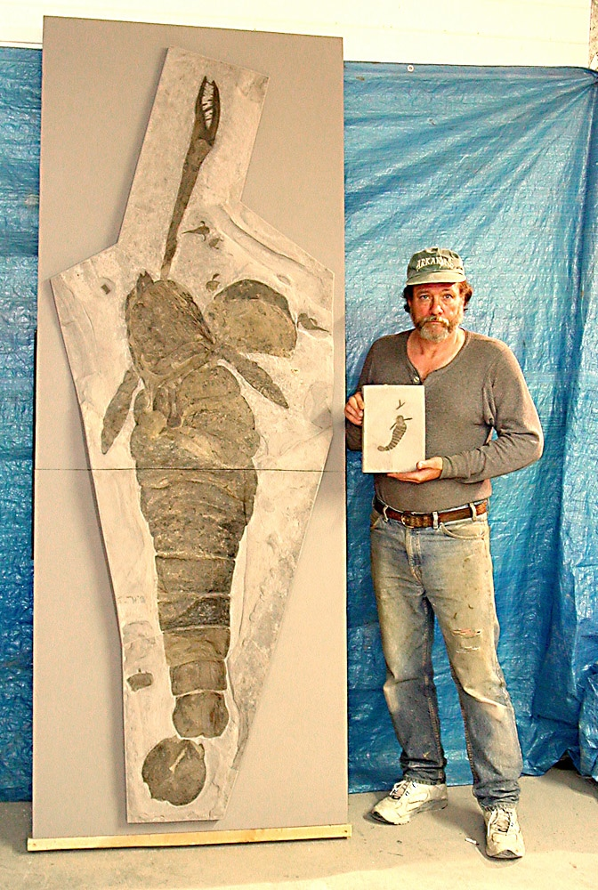
Al Langheinrich with the giant
Acutiramus from his quarry.

Slide 15
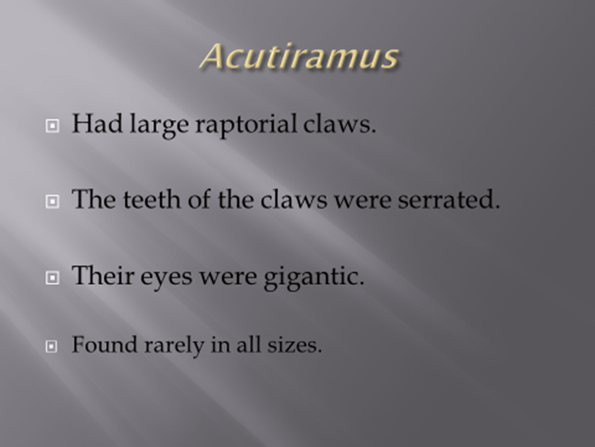

Slide 16
Recent studies suggest:
Anderson RP, McCoy VE, McNamara ME, Briggs DEG. 2014 What big
eyes you have: the ecological role of giant pterygotid eurypterids. Biol. Lett. 10:20140412
Acutiramus had weak claws and poor eyesight
Laub, R.S., Tollerton, Jr. V.P. and Berkof, R.S. The cheliceral claw of Acutiramus (Arthropoda: Eurypterida): functional analysis based on morphology and engineering principles. Bulletin of the Buffalo Society of Natural Sciences, 2010; 39: 29
Acutiramus had weak claws that could not puncture the shell of a medium size Limulus
And may have fed on plant material or may have been a scavenger.

Slide 17
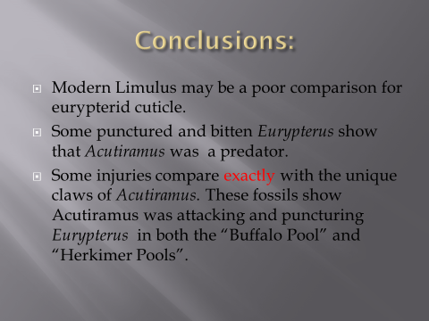

Slide 18
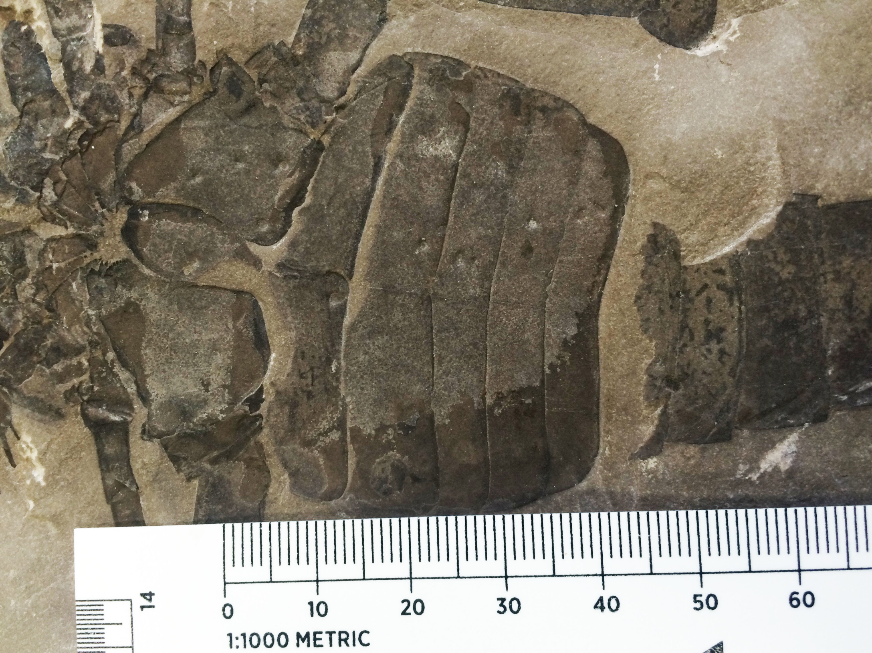
Eurypterid showing two sets of punctures
ending with the dash like mark from the
claw terminus.

Slide 19
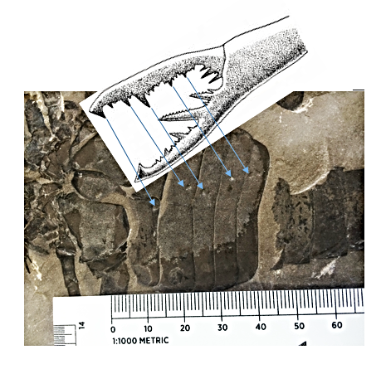

Slide 20
Sources
Laub, R.S., Tollerton, Jr. V.P. and Berkof, R.S. The cheliceral claw of Acutiramus (Arthropoda: Eurypterida): Functional analysis based on morphology and engineering principles. Bulletin of the Buffalo Society of Natural Sciences, 2010; 39: 29
Anderson RP, McCoy VE, McNamara ME, Briggs DEG. 2014 What big
eyes you have: the ecological role of giant pterygotid eurypterids. Biol. Lett. 10:20140412

Slide 21
Thanks to:
Iris And Al Langheinrich
Tod Clements
John Spina
Zarko Ljuboja
Sandy Porter
Andrew Wendruff
Victor P. Tollerton
Richard S. Laub
The late Michael E. Williams
Listing the people who have helped does not mean they agree with the findings!

