Slide 1
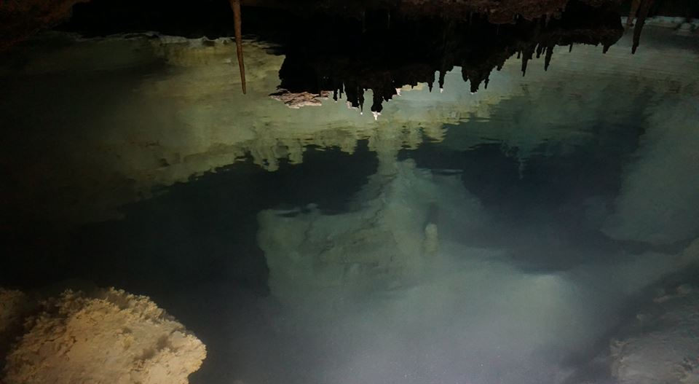


DEEP HORIZONS:
A GIS Tool to Forward Model Secondary Porosity in Carbonate Platforms
Aubri Jenson¹
Dr. Benjamin Schwartz^{1,2}
Dr. Todd Swannack³
Dr. Patricia Beddows⁴
¹Dept. of Biology, Texas State University, San Marcos, TX
²Edwards Aquifer Research and Data Center, San Marcos, TX
³U.S. Army Corps of Engineers
⁴Northwestern University, Chicago, Il
Notes:
- goal is to model the development of secondary porosity to test hypothesis about speleogenesis in carbonate platforms
- essential component of a complete, realistic model of a karst aquifer
- applications in water resource management as well as petroleum industry

Slide 2
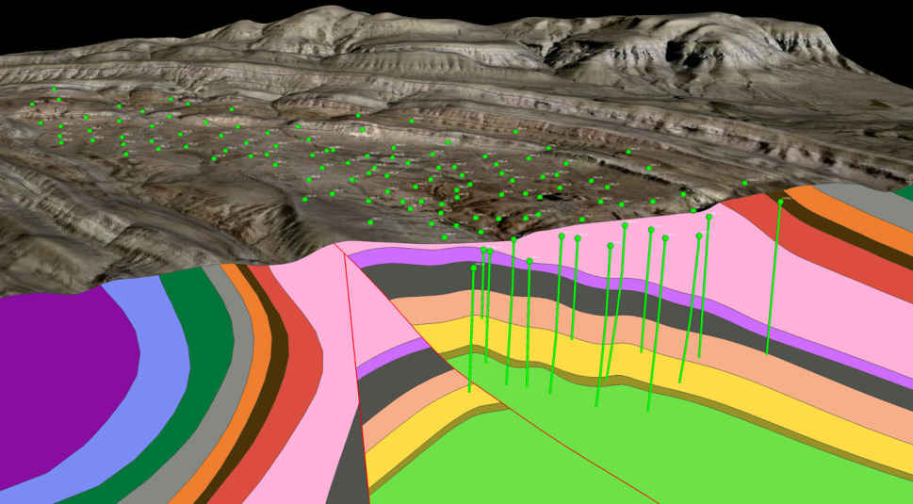
background
A need to model the development of Secondary Porosity:
Modeling subsurface either back modeled from observations
or forward modeled from starting assumptions
Secondary porosity complicates a model with dynamic flowpaths and feedback processes
Can be used to test hypotheses about speleogenesis
DEEP HORIZONS contributes toward a tool that brings forward modeling of secondary porosity to both petroleum and water management applications
Notes:
Existing models extrapolate from field data or attempt to recreate stratigraphy based on what we know about the depositional history of a particular area over a particular time
-models are by necessity simplistic and generalized to a large area. Degree of simplicity depends on scale and application.
-karst systems are difficult to model to because 1) heterogeneity 2) feedback loops between porosity/permeability and dissolution rates 3) dynamic flowpaths that fluctuate with changes in the elevation of the water table.
My model will test hypotheses about spleogenesis in order to identify the most significant variables required to accurately model kart carbonate platforms.
If we have a detailed understanding of how and where conduits form, then we can build a realistically complex model
that can be used in civil engineering applications and in the oil industry for reservoir characterizations.

Slide 3
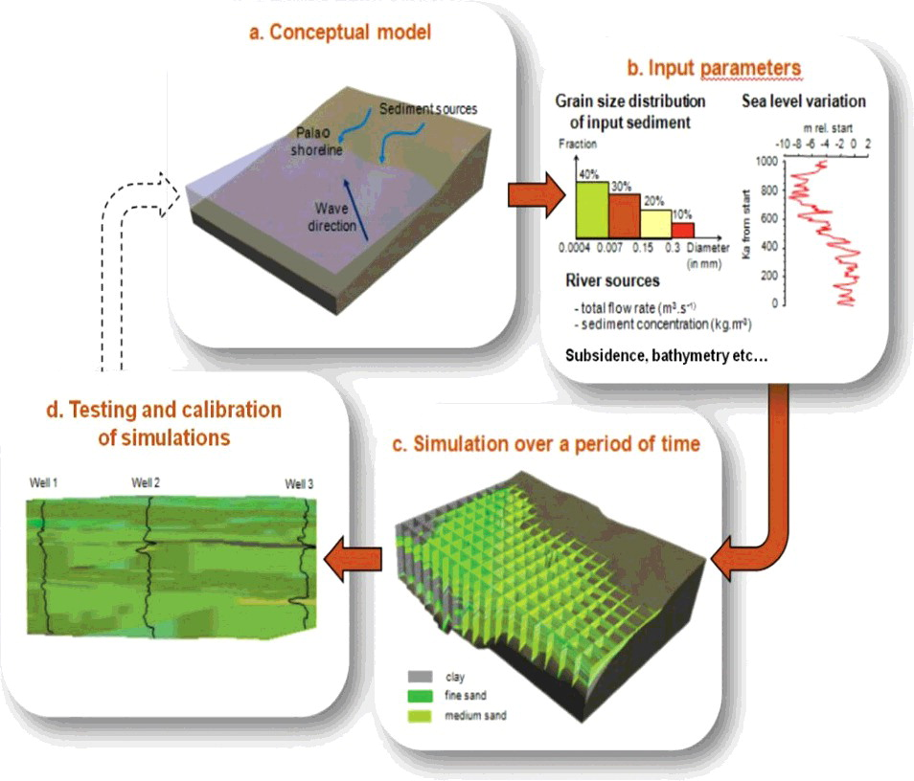
Notes:
-existing programs used in the petroleum industry tend to focus on reconstructing stratigraphy, starting with assumptions about depositional processes, adding climate data, and essentially creating a 3d matrix with each block exhibiting different hydrogeologic properties.
-there are processes that affect these properties subsequent to deposition, such as cementation, compaction, surface erosion, and dissolution
Of these, dissolution in the most complex because it introduces feedback loops, since flowpaths change with sea level and the presence of conduits
-My model aims to work out the details in the third step by simulating secondary porosity in a karst system.
while complex, secondary porosity can be modeled with the right variables and feedback relationships when informed by field data and tested against observations.

Slide 4
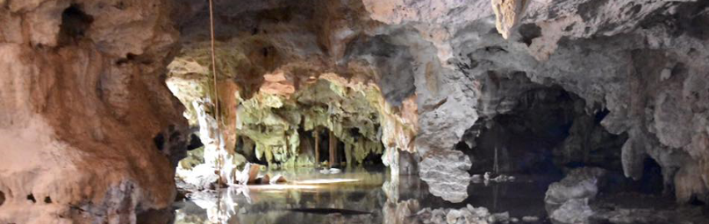
Questions for investigation
  Is mixing at the halocline the only significant driver of dissolution in carbonate platforms? Are there other influential mechanisms?
  What are the most important geochemical controls on dissolution rate?
  What is the role of flow dynamics in dissolution rate? Feedback?
Notes:
-well established that mixing is the dominant driver of dissolution in coastal karst systems
-other influences may include soil CO2, H2S, and possibly microbial
-variability in dissolution may reflect lithology, namely cementation, bedding planes, mineral content of different reef facies
-transitions to turbulent flow

Slide 5
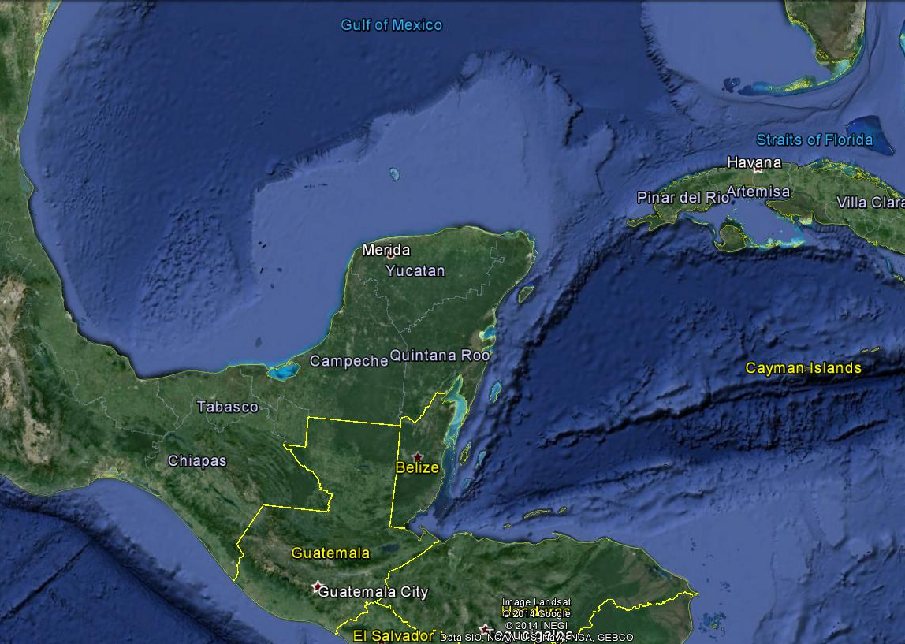
Campeche Bank
N
300 km
Google Earth, 2016
Notes:
-geology is not uniform; varies with reef assemblage, mineralogy, cementation, compaction
-chosen area in the NE because of high cave density
-growing very rapidly with tourism industry, urgent need to understand how and where groundwater flows

Slide 6
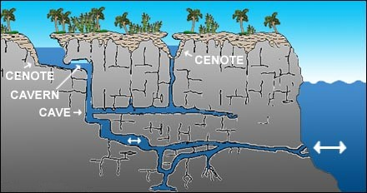
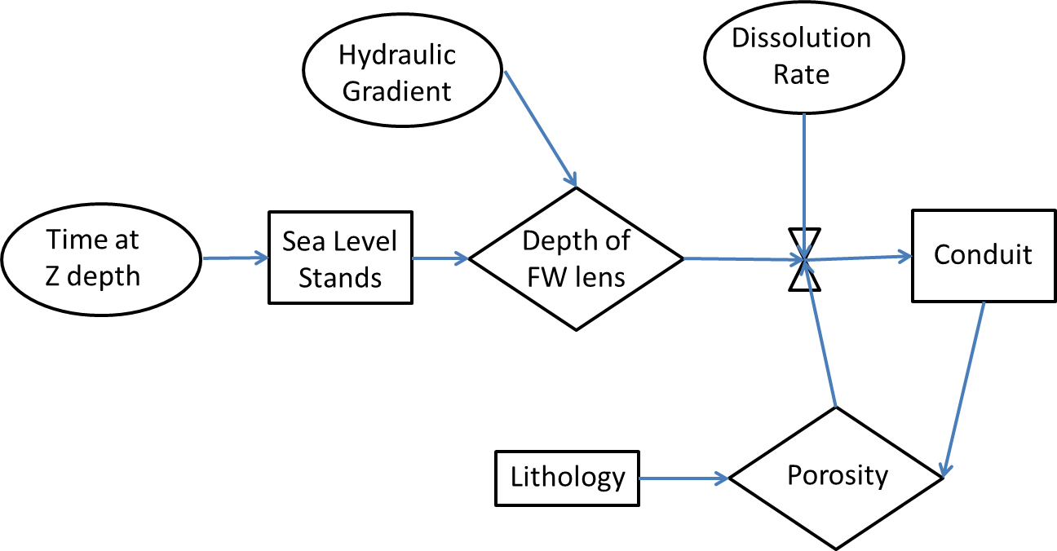
Input parameters:
  Global Sea level curves
  (Miller et al, 2005)
  Dissolution rate
  (Hanshaw and Back, 1980)
  Hydraulic Gradient
  (Beddows, 2004; Beddows, 2007)
Notes:
2d cross section shows concept of what is observed in Quintana Roo. Shallow cave systems near the water table at sea level with lots collapse, open access to the aquifer. Also observed deep circulation that poses a problem for sewage injection…becomes important to know where conduits are and how they effect flow. We can begin to forward model by assuming that dissolution is primarily controlled by mixing along the halocline
- expect to find caves that correspond to former sea levels and at a gradient that reflects the base of the water table during that time
Preliminary model (with constant lithology constant and ignore feedback loops for now) can simulate what we would expect to see based on past sea level history, dissolution rates due to mixing, and a gradient of the water table.
Some of these inputs have not been clearly worked out….i’m working on dissolution rate and gradient

Slide 7
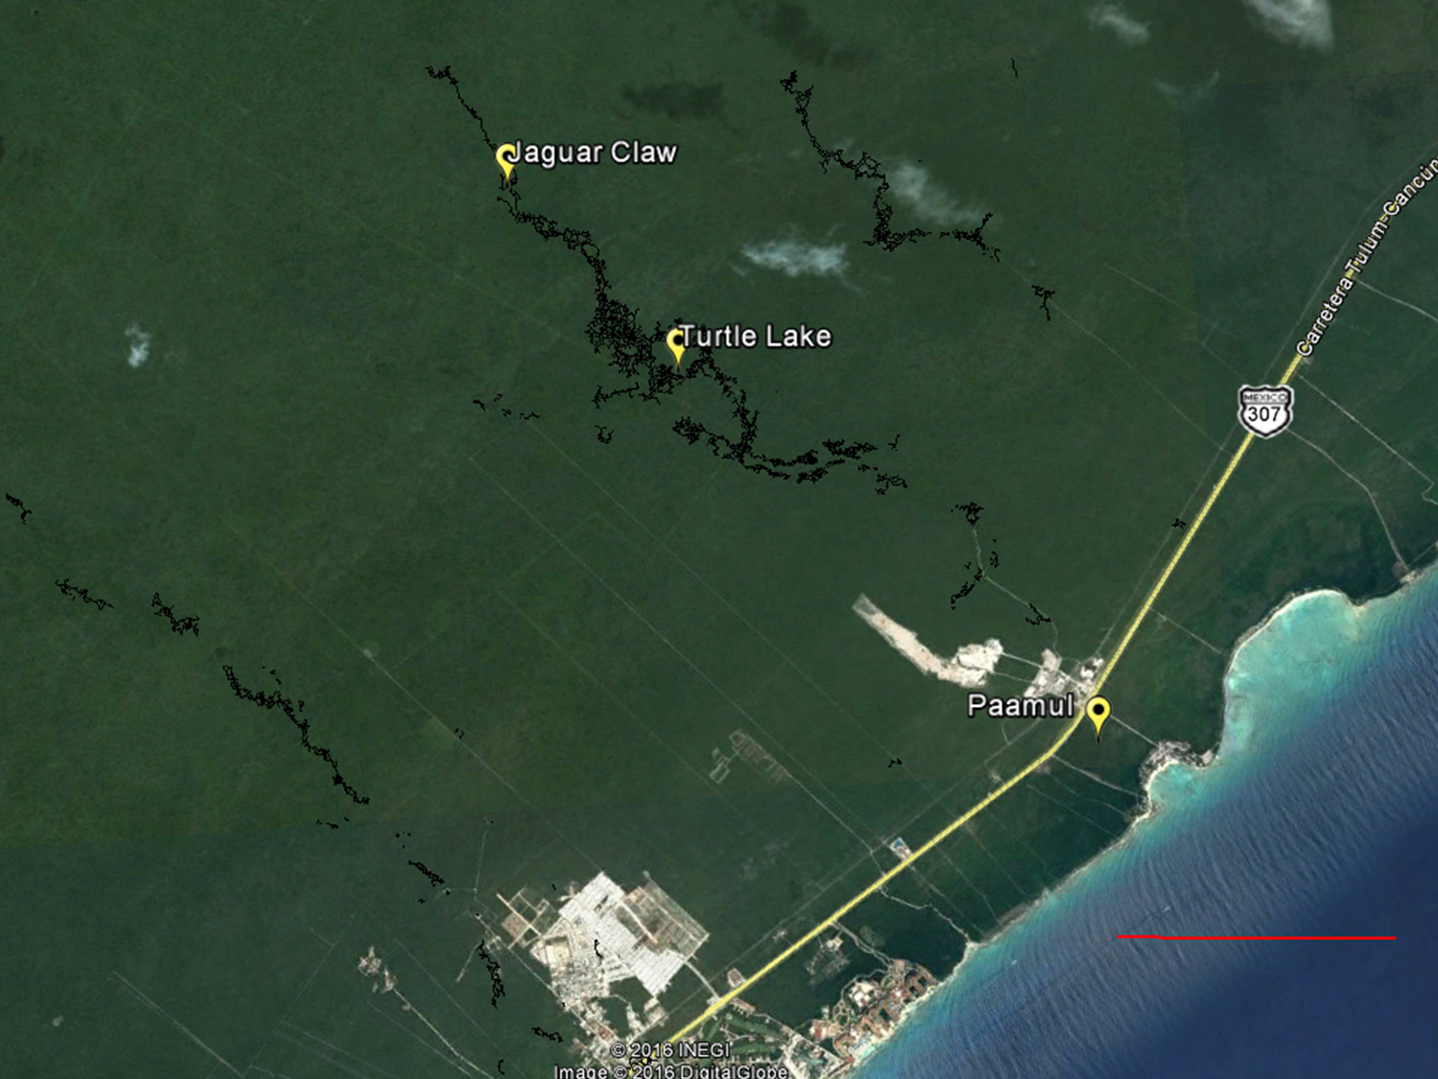
N
2 km
Notes:
-over 4o km of inland cave passage, recently surveyed
-provides access to the water table in a 6km transect perpendicular to the coast
-able to measure and observe changes in the gradient over time

Slide 8
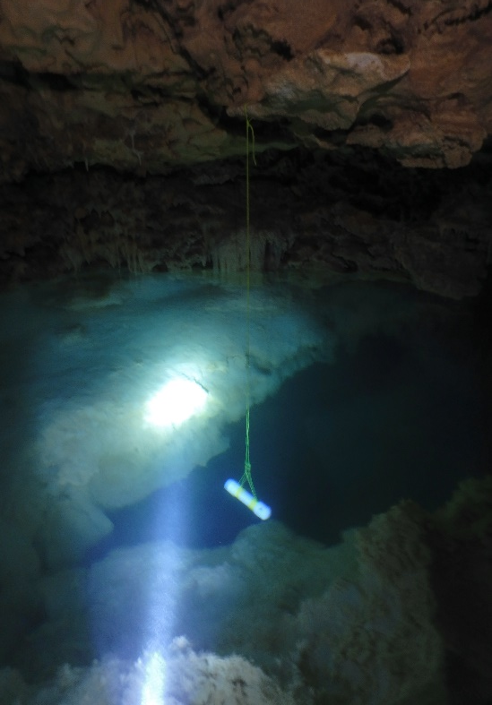
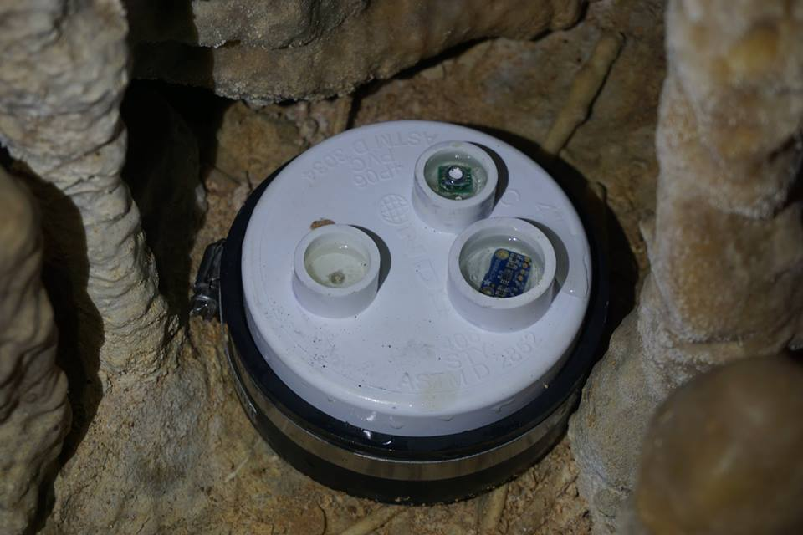
Hydraulic Gradient
Jan – Aug. 2015 at 30 min intervals
Both Schlumberger Divers and CavePearl DIY dataloggers
Average gradient 0.0007
Steeper gradient inland
Tidal signal delay of ~4 hrs
Jaguar Claw
Turtle Lake
0.0012
Paamul
0.0004
1.88 km
4.03 km

Slide 9
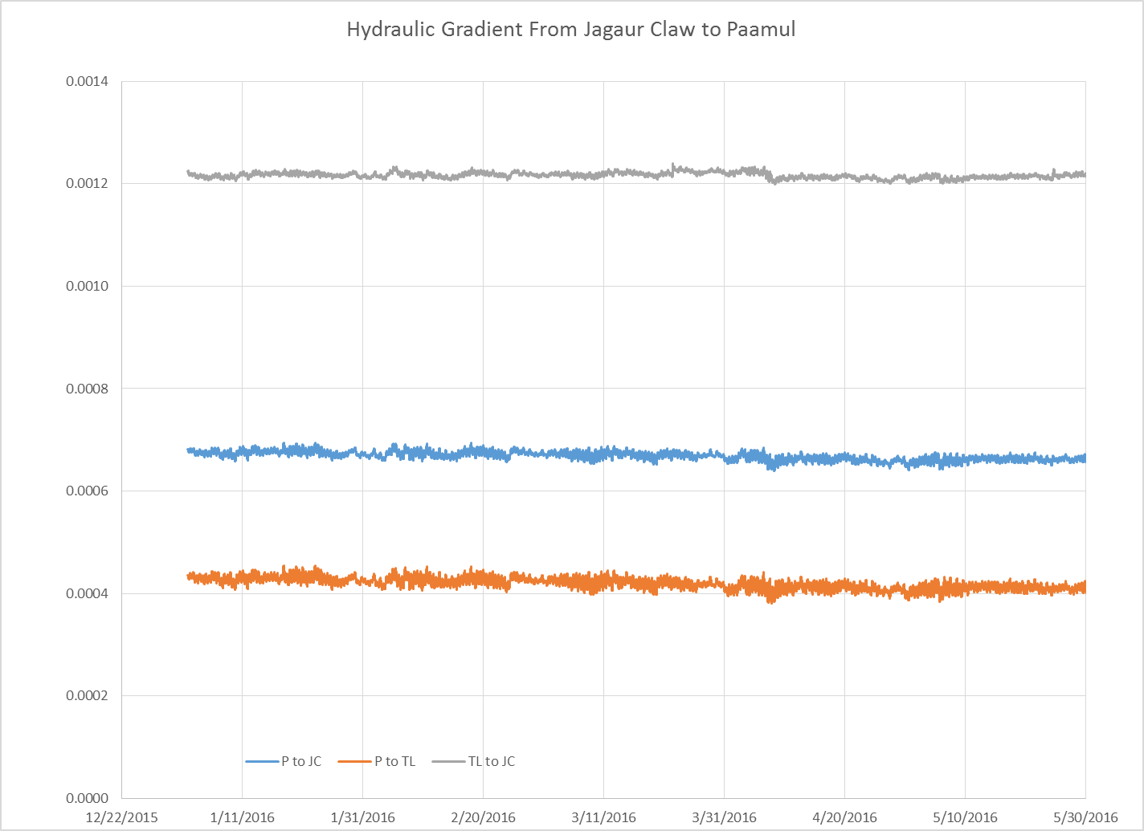
Notes:
- gradient between each observation point
- consistent with each other and over time
- instrument drift confounded last two months of data

Slide 10
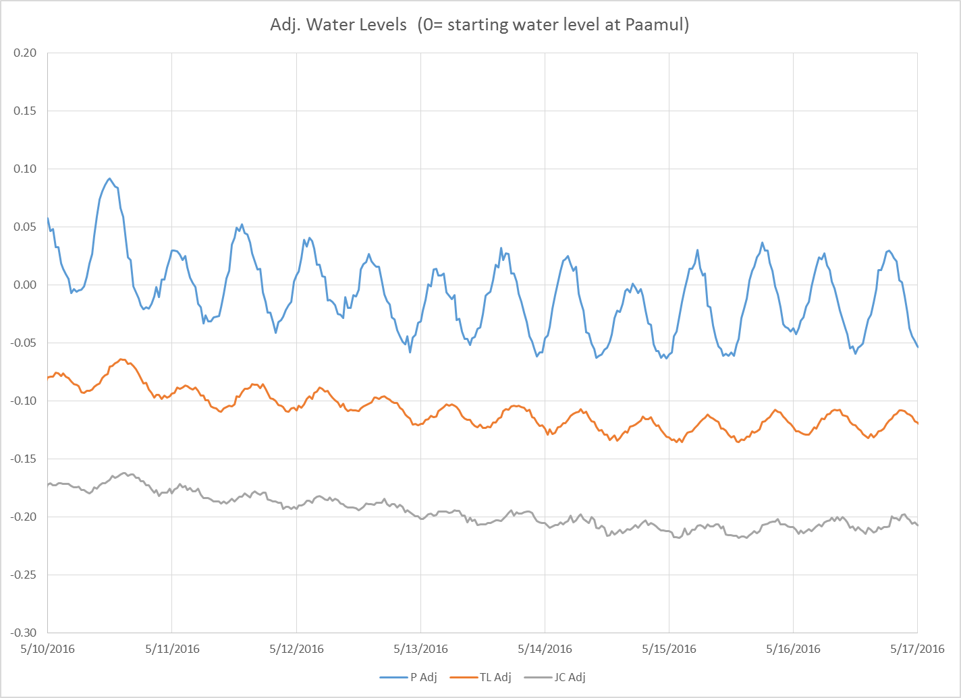
Notes:
-one week snapshot showing durnal tidal signal
-attenuation in amplitude
-lag time of 2.5-3hrs, 3.5.4hrs
-useful for estimating residence time and regional hydraulic condutivity

Slide 11
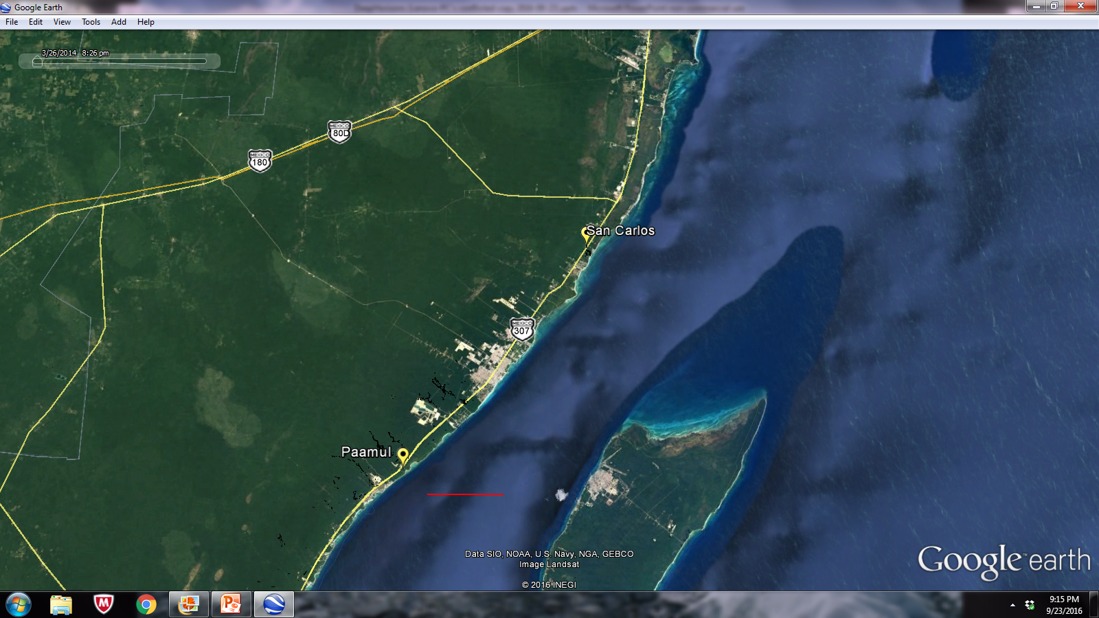
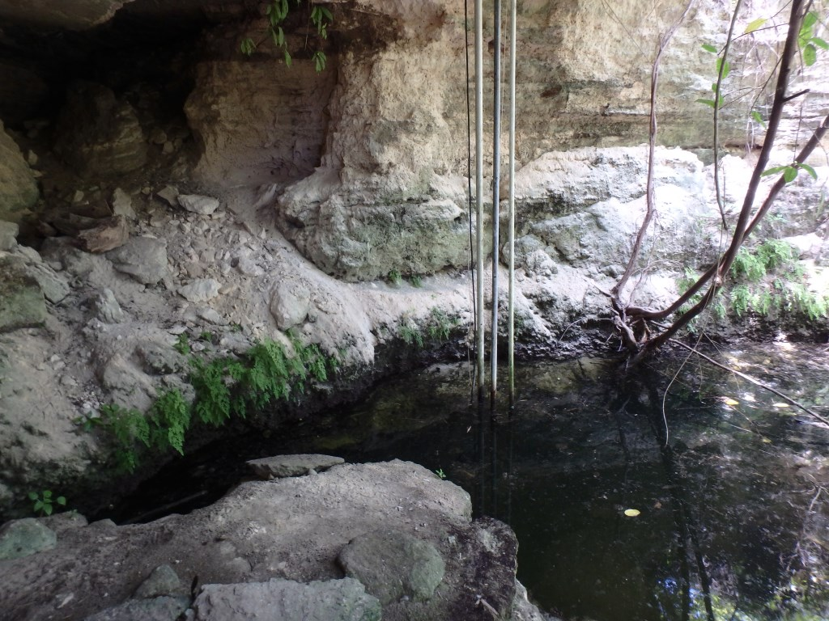
N
10 km

Slide 12
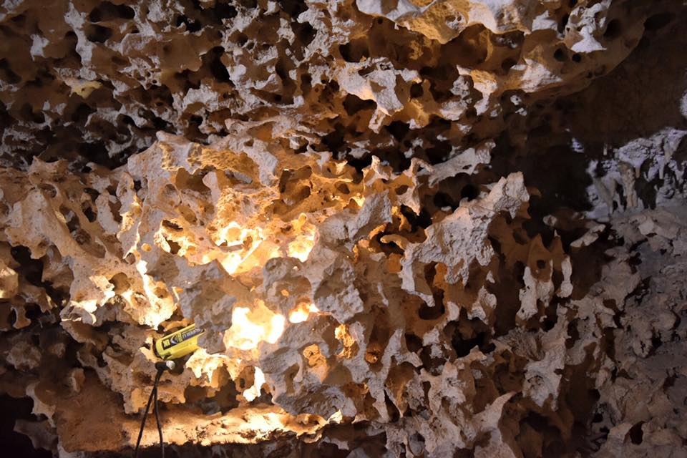
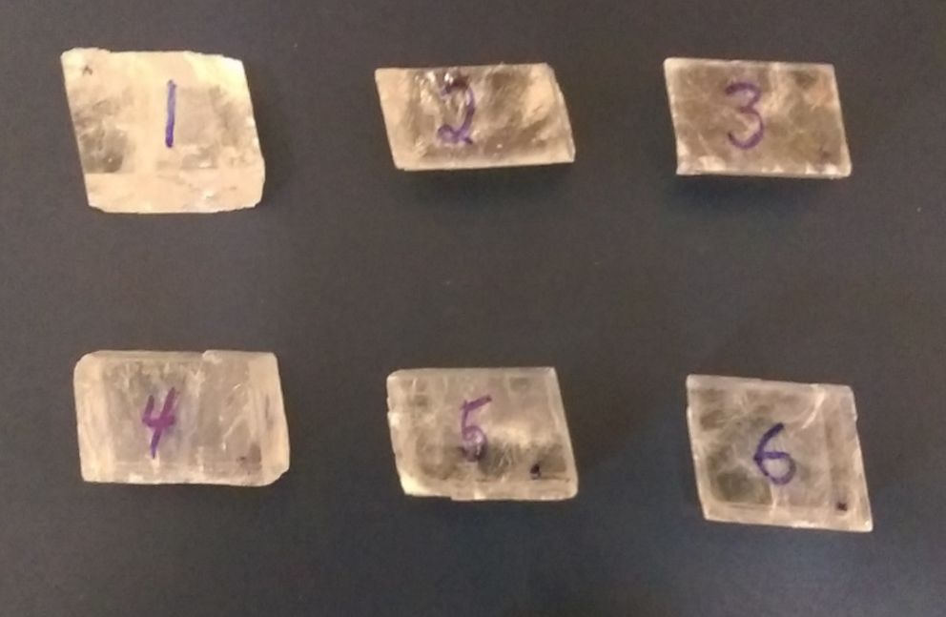
Dissolution rates

Slide 13
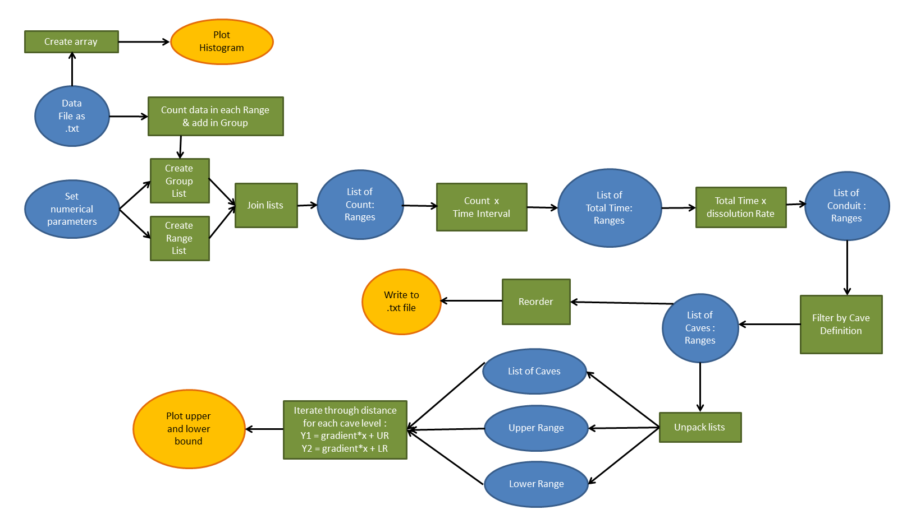
methods

Slide 14
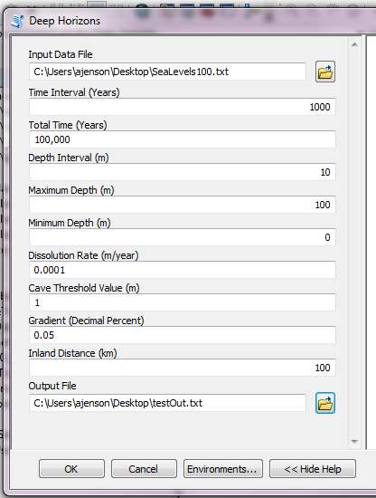
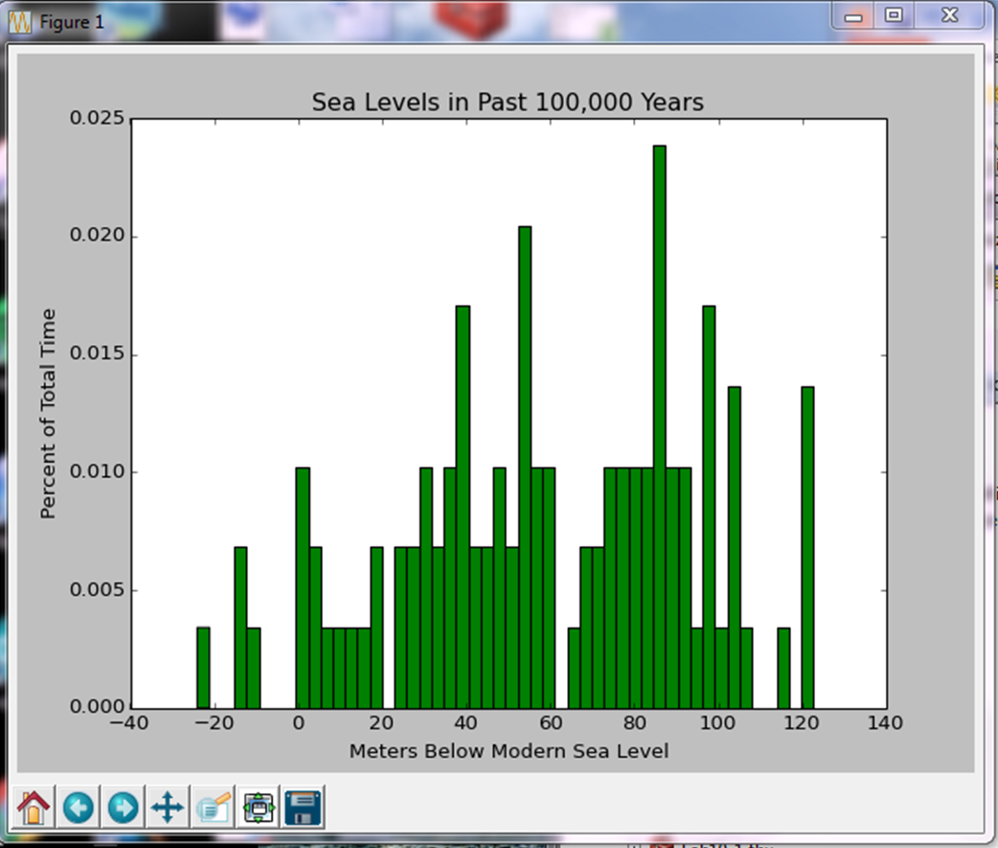
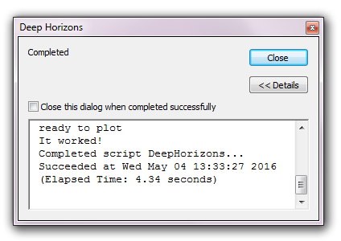
Example run

Slide 15
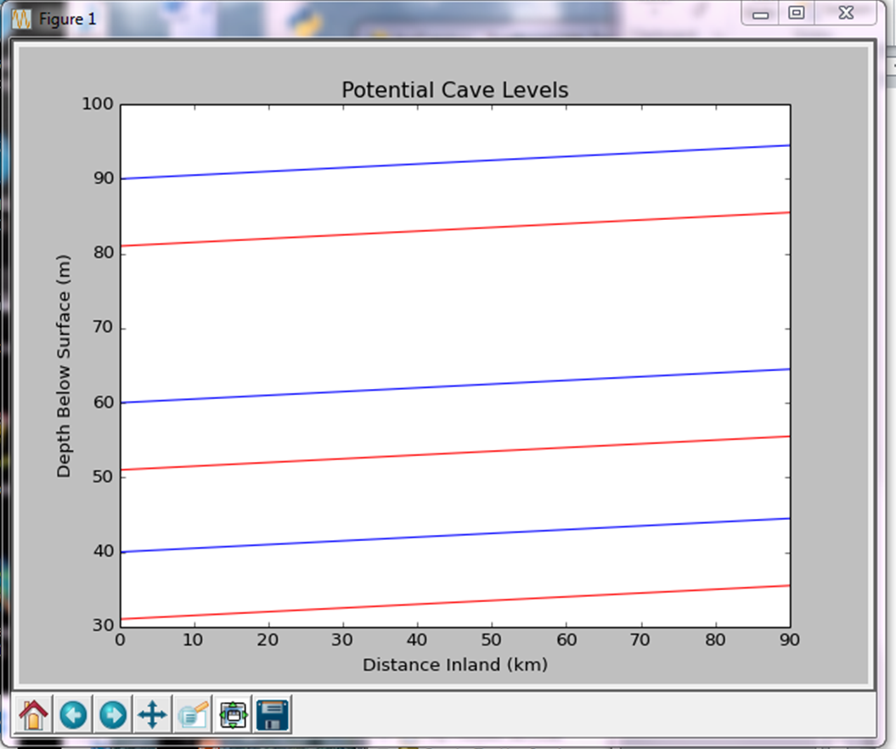
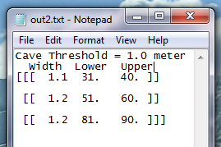
Example results
  Graph of Cross-section
  Shows upper and lower bounds of likely significant conduits
  Includes gradient of water table
Interpretation of Output
  Assumes pre-existing permeability
  (i.e., primary porosity)
  Results in maximum possible conduits within an interval
  Provides probable layers with significant sized conduits

Slide 16
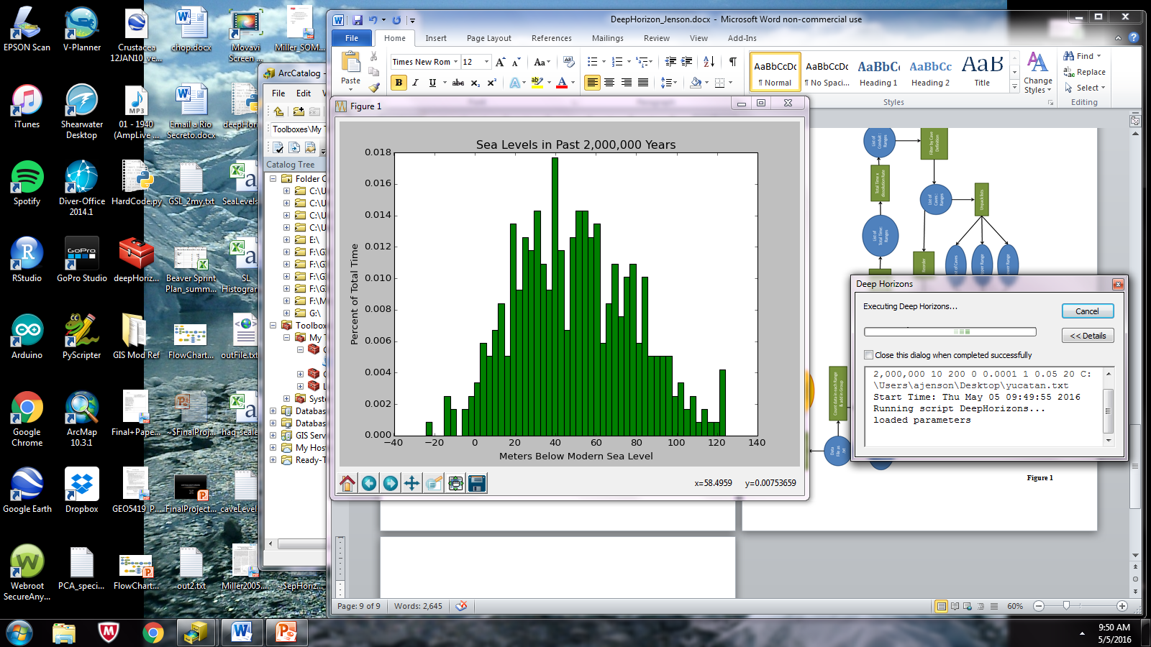
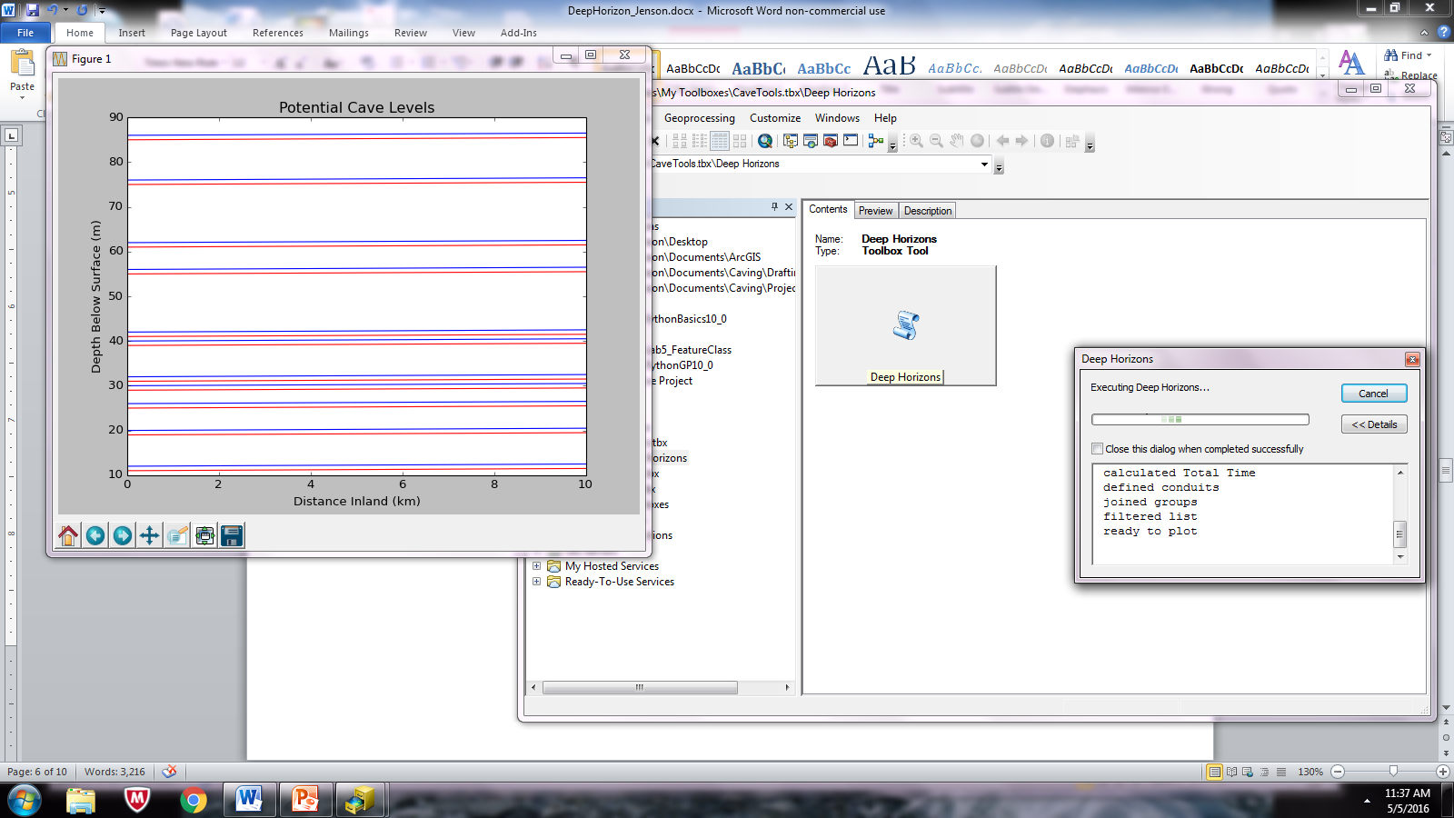
RESULTS and analysis
  Data set describing
  Quintana Roo, Mexico:
Using 5,000 year intervals,
with dissolution at 0.1 mm/year,
and a hydraulic gradient of 0.0007:
There could be 1m conduits at depths up to 90m below modern SL
The largest conduits are simulated
within 25-35 m of modern SL
Generally agrees with cave survey data (access bias)
Why are there not large conduits at all of these depths?
Test dissolution rate

Slide 17
What’s good
  Considers conditions and processes active in the past
  Will add realistic complexity to existing models
  Provides basis for spatial statistics & assessment of uncertainty
What’s not so good
  Only as correct as the input
  Changing gradient over time
  Feedback loops
What’s next?
  Additional factors
  3D matrix for variability
  Test against reality (drill records)

Slide 18
conclusions
Forward modeling secondary porosity is complex, but achievable with the right input variables and determination of feedback mechanisms.
A realistically complex model will aid in the development of
  Water budget estimates
  Urban planning (road construction, sewage disposal…)
  Environmental assessments
  Oil & gas reservoir characterization
It is reasonable to expect that processes other than mixing dissolution, such as soil CO₂ and H₂S, are significant influences in cave formation in carbonate platforms.

Slide 19
References
Al-Hajeri, M.M, Al Saeed, M.A., Basin and Petroleum System Modeling, 2009, Oilfield Review, vol. 21, no. 2, p. 14-29.
Beddows, P.A., 2004, Groundwater hydrology of a coastal conduit carbonate aquifer: Caribbean coast of the Yucatan Peninsula, Mexico. PhD Thesis, University of Bristol, United Kingdom.
Bosence, D.W.J, Pomar, L., Waltham, D.A., Lankester, T.H.G, 1994, Computer modeling a Miocene Carbonate Platform, Mallorca, Spain, AAPG Bulletin, vol. 78, no. 2, p. 247-266.
Florea, L.J., Vacher, H.L., Donahue, B., Naar, D., 2007, Quaternary cave levels in peninsular Florida, Quaternary Science Reviews, vol. 26, p. 1344-1361.
Hanshaw, B.B, Back, W., 1980, Chemical mass-wasting of the northern Yucatan Peninsula by groundwater dissolution, Geology, v.8, p.222-224.
Huang, X., Griffiths, C.M, Liu, J., 2015, Recent development in stratigraphic forward modeling and its application in petroleum exploration, Australian Journal of Earth Sciences, vol. 62, no. 8, p. 903- 919.
Miller, K.G., Kominz, M.A., Browning, J.V., Wright, J.D., Mountain, G.S., Katz, M.E., Sugarman, P.J., Cramer, B.S., Blick, N.C., Pekar, S.F., 2005, The Phanerozoic record of global sea-level change, Science, vol. 310, p.1293-1298.
Warrlich, G.M.D., Waltham, D.A., Bosence, D.W.J., 2002, Quantifying the sequence stratigraphy and drowning mechanisms of atolls using a new 3D forward stratigraphic modeling program (CARBONATE 3D), Basin Reserch, vol. 14, p. 379-400.

Slide 20
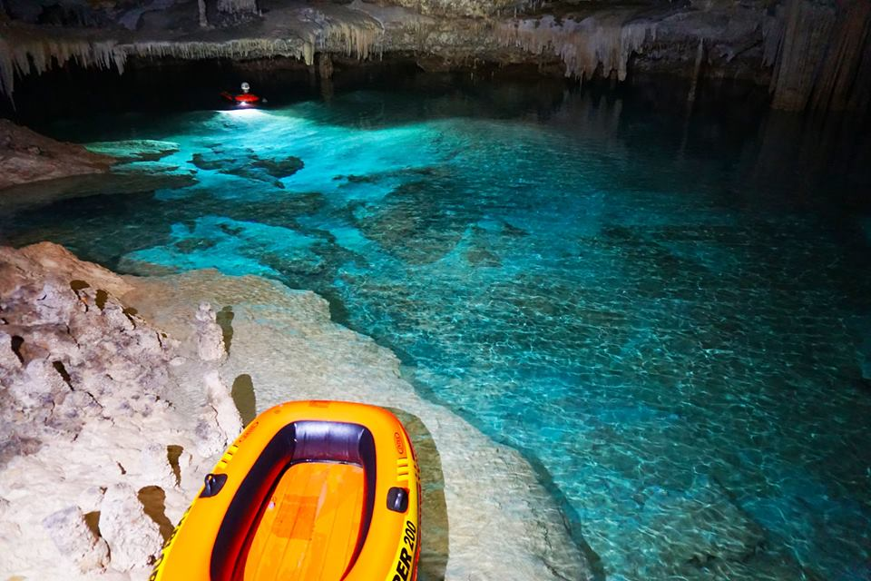

Acknowledgements
National Speleological Society
NASA Astrobiology Institute
UT Grotto and Paamul Grotto cavers

Slide 21
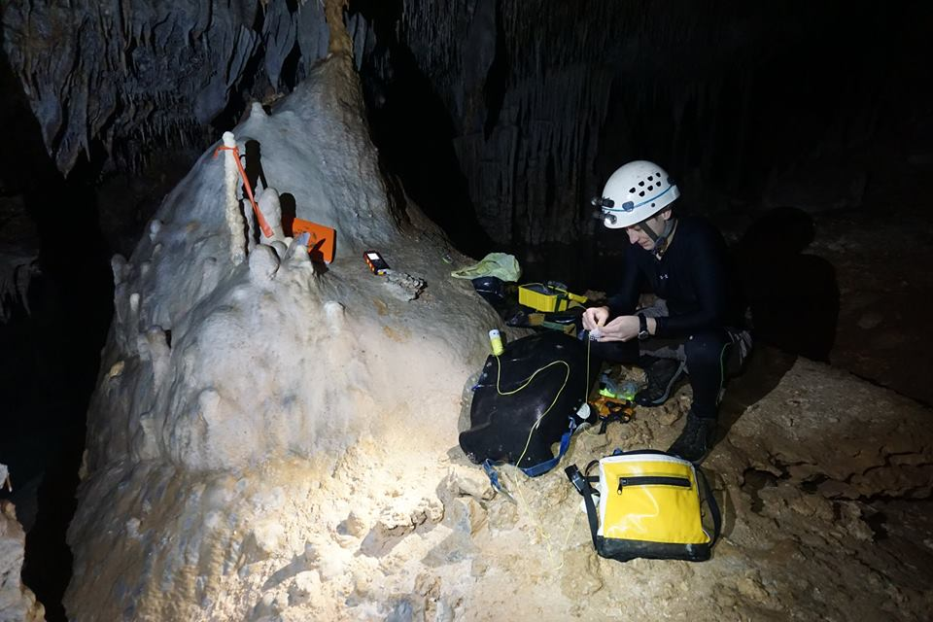
Questions?

Slide 22
#Bring in data file as array
#Create histogram from sea level data
#Adjust for elevation
Depth below surface = ([data] * -1) + Elev
#Create empty list to number depth intervals
#Make a list of ranges for depth intervals
#Populate the count list with number of points in each interval
#Calculate total time at each sea level elevation
Total time = Time interval * count
#Calculate potential conduit diameters at each depth
Conduit diameter = Total time*rate
#Join conduits with corresponding depths
#Filter out significant conduits as caves
Select (Conduits > definition of cave)
#Unpack lists to reference for plot
#Itterate through lists to plot data for each cave level
Y1 = gradient * distance inland + SL upper bound
Y2 = gradient * distance inland + SL upper bound
#Plot lines
#Write potential cave diameters and depth ranges to txt file

