Slide 1
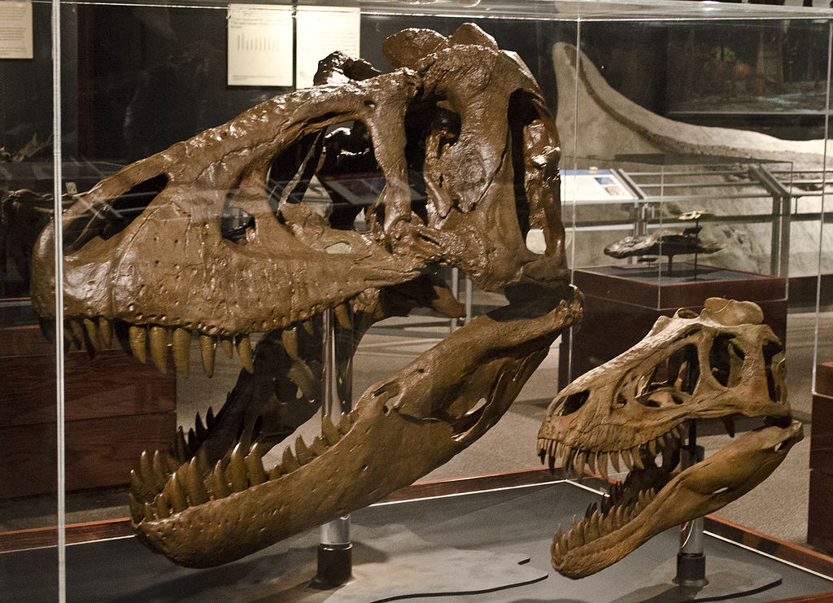
Hypothetical Divergent Evolution of Two Apex Predators from the Hell Creek Formation: Nanotyrannus lancensis and Tyrannosaurus rex
Michael Deak & Scott McKenzie
Mercyhurst University Geology Department
Tim Evanson/Museum of the Rockies. Wikimedia Commons.

Slide 2
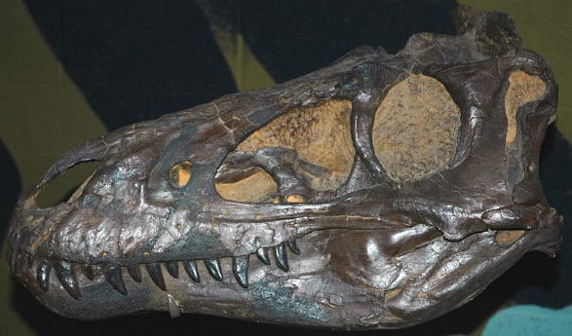
James St. John/Cleveland Museum of Natural History, Wikimedia Commons
CMNH 7541, Holotype of Nanotyrannus lancensis

Slide 3
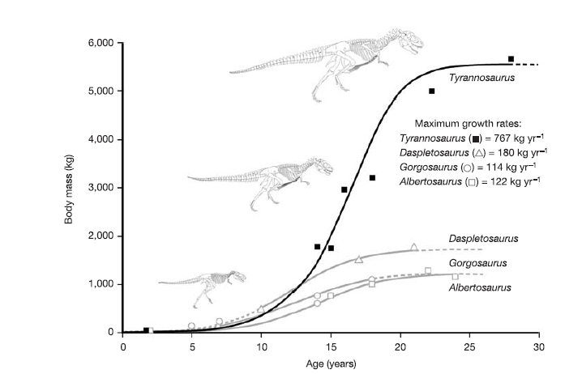
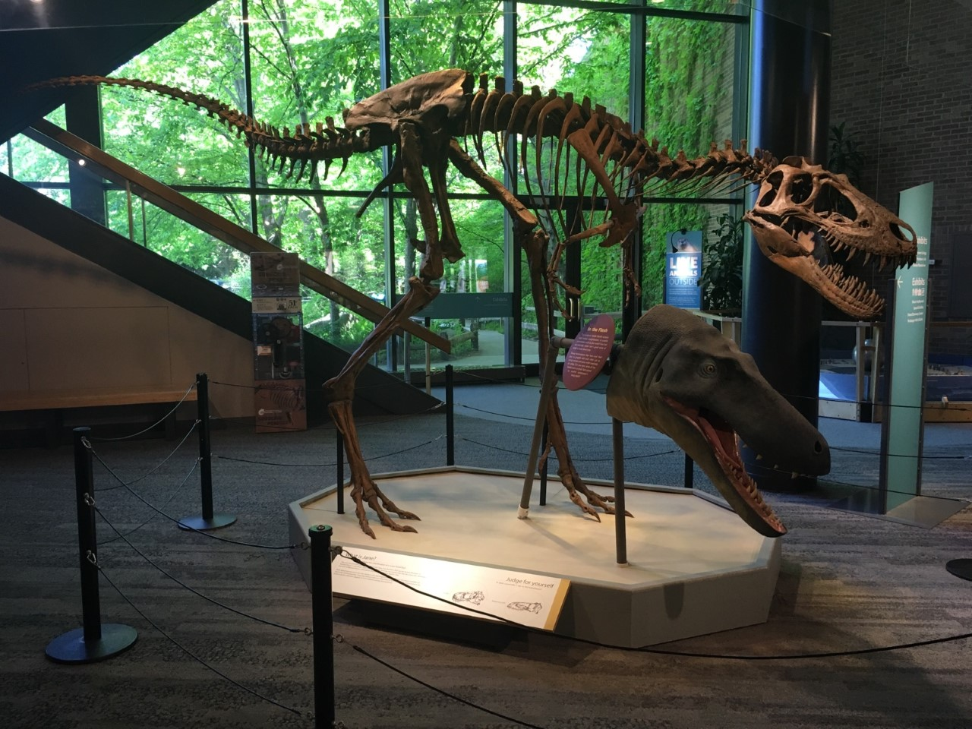
BMRP 2002.4.1 (“Jane”)
Erickson et al, 2004, “Gigantism and comparative life-history parameters of tyrannosaurid dinosaurs"

Slide 4
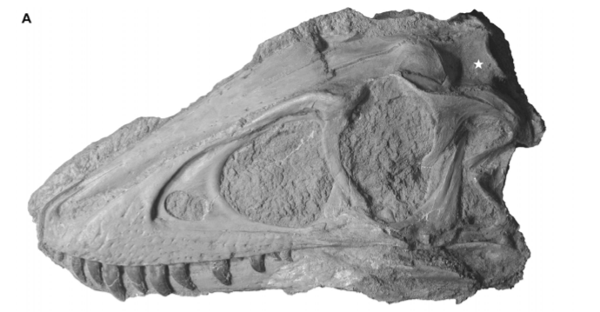
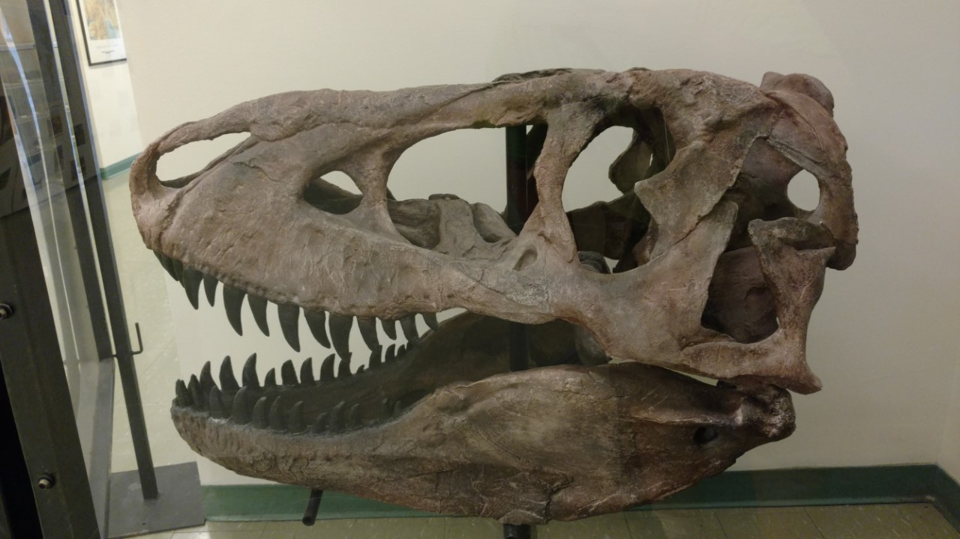
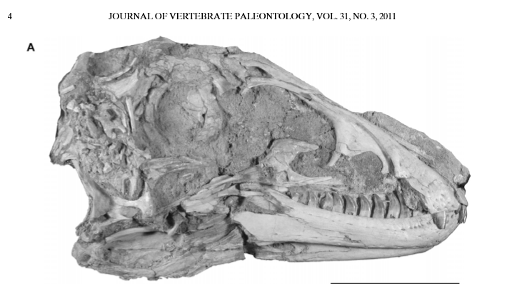
Tsuihiji et. al. 2011, “Cranial Osteology of a Juvenile Specimen of Tarbosaurus bataar (Theropoda, Tyrannosauridae) from the Nemegt Formation (Upper Cretaceous) of Bugin Tsav, Mongolia”
Left: Juvenile Tarbosaurus bataar MPC-D 107/7
Below: Cast of adult Tarbosaurus bataar from the Mercyhurst collection

Slide 5
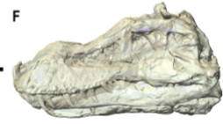
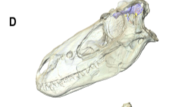
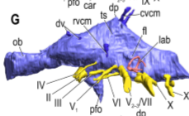
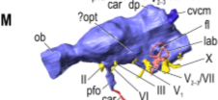
Witmer et al, 2009, “New Insights Into the Brain, Braincase, and Ear Region of Tyrannosaurs (Dinosauria, Theropoda), with Implications for Sensory Organization and Behavior”

Slide 6
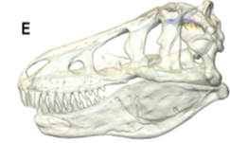
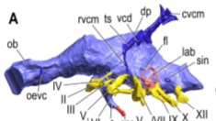
Despite skull crushing of some Tyrannosaurus specimens, the brain still maintains the same basic shape.
Witmer et al, 2009, “New Insights Into the Brain, Braincase, and Ear Region of Tyrannosaurs (Dinosauria, Theropoda), with Implications for Sensory Organization and Behavior”

Slide 7
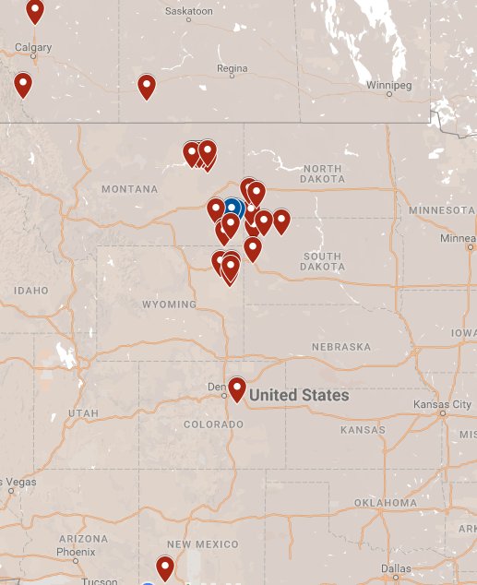
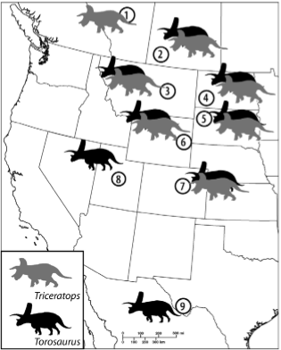
Range
Red = T. rex
Blue = N. lancensis
Longrich et. al. 2012, “Torosaurus Is Not Triceratops: Ontogeny in Chasmosaurine Ceratopsids as a Case Study in Dinosaur Taxonomy”
Tyrannosaurus rex locations after Larson (2008).

Slide 8
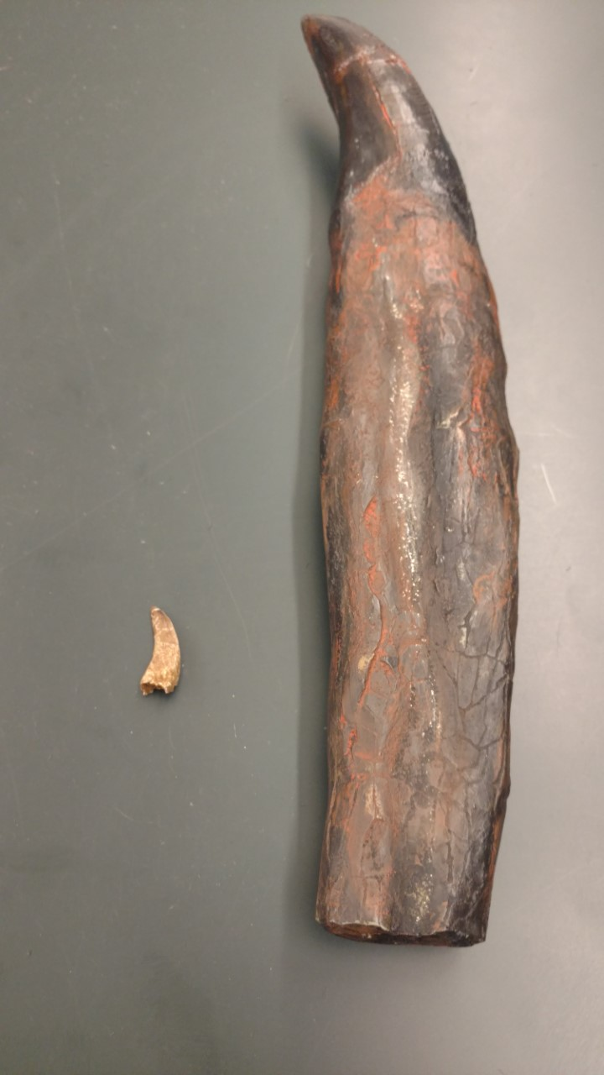
Tooth count and number of tooth placements
Nanotyrannus lancensis
Maxillary teeth: 15
Dentary teeth: 16-17
Tooth structure: Latteraly compressed and heavily serrated
Tyrannosaurus rex
Maxillary teeth: 11
Dentary teeth: 12-13
Tooth structure: Thick and minimal amount of serrations.

Slide 9
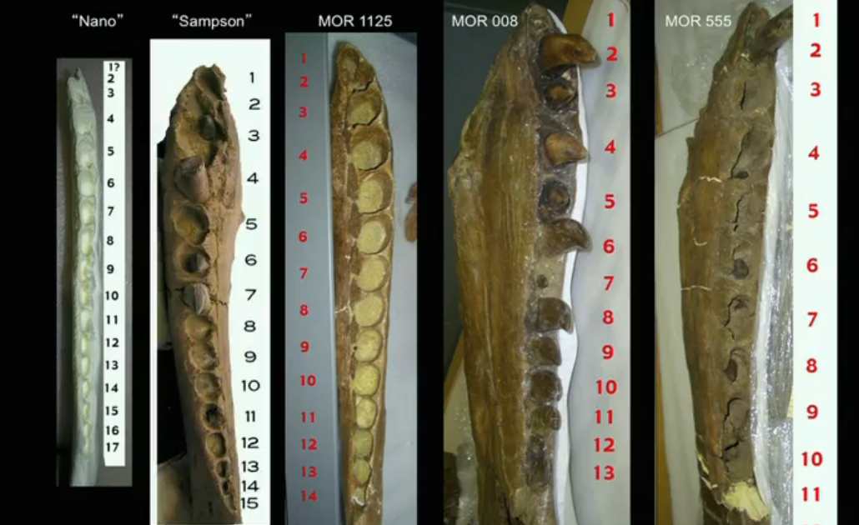
Possible evidence for dentary tooth reduction
Horner (2011), has observed a trend in the reduction of dentary tooth positions from the smallest individuals to the largest individuals.
Horner 2011, “Shape-Shifting Dinosaurs: The Cause of a Premature Extinction”

Slide 10
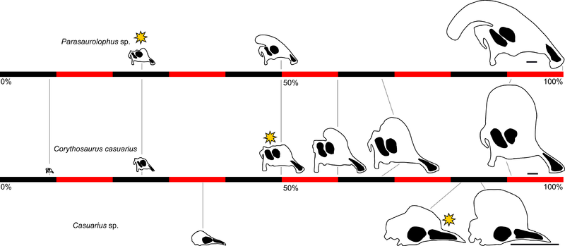
Stratigraphic Complications
MOR 1125 (B.rex) comes from strata that is 68 million years old.
BMRP 2002.4.1 has been stratigraphically aged at about 66.0-65.84 million years old by examining pollen collected from the site. (Harrison et. al. 2013).
Farke et. al. 2013, “Ontogeny in the tube-crested dinosaur Parasaurolophus (Hadrosauridae) and heterochrony in hadrosaurids”

Slide 11
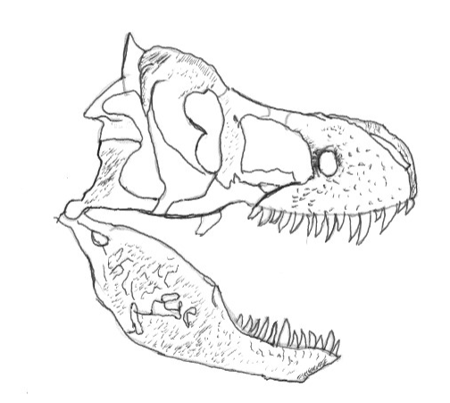
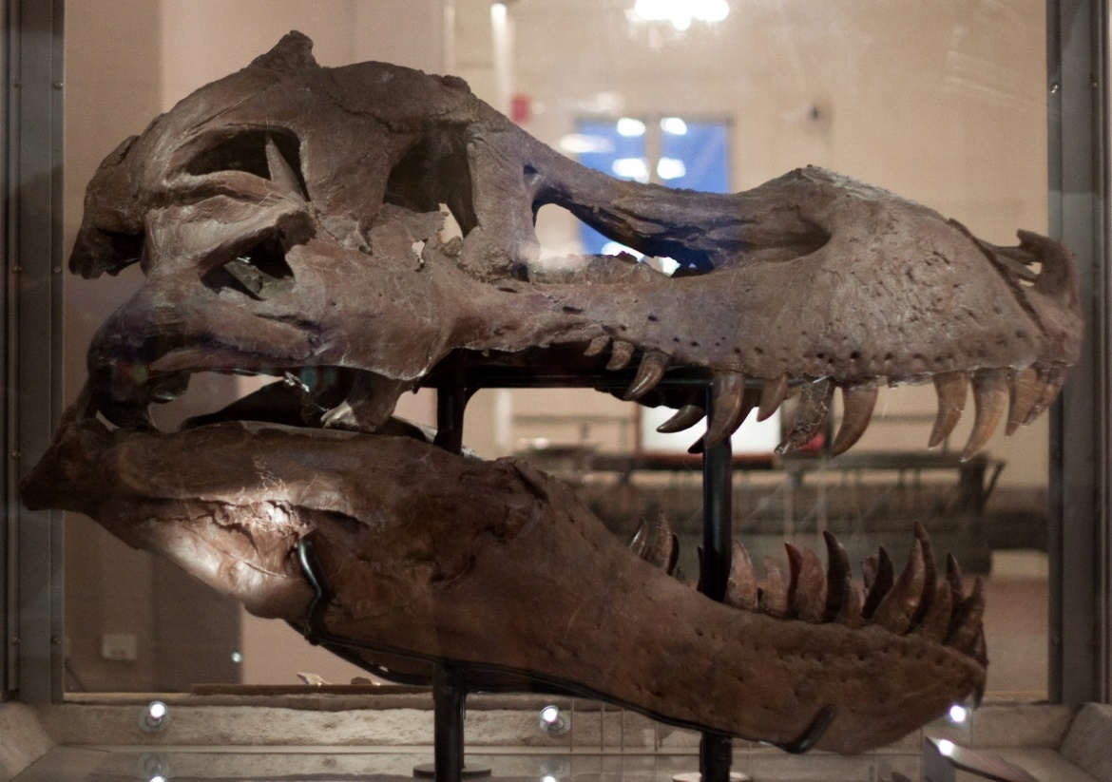
Size does not correlate with age and tooth count
MOR 1125 was between 16-20 years, and that the age of MOR 555 was between 12-16 (Horner et. al. 2004).
MOR 008 is larger than MOR 555 and has a dentary tooth count of 13.
MOR 008 has a skull that is about 1.34 meters in length (approximately 4-5 feet).
Geoffrey Fairchild/ Field Museum of Natural History. Wikimedia Commons

Slide 12
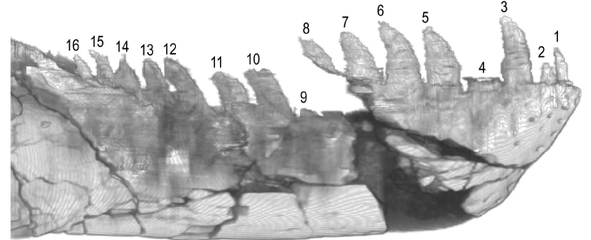
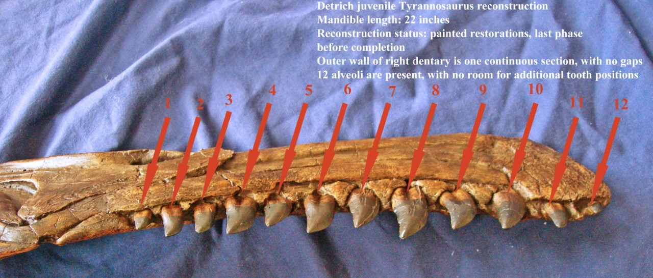
CMNH 7541 has 16 dentary tooth positions (Witmer et. al. 2010) and is a younger individual than BMRP 2002.4.1 which has 17 dentary tooth positions.
“Baby Bob” has 12 dentary tooth positions and is about 4 years old.
Witmer et. al. 2010, “The Cleveland Tyrannosaur Skull
(Nanotyrannus Or Tyrannosaurus): New Findings Based on CT
Scanning, With Special Reference to the Braincase”
Robert Detrich, Pers. Comm.

Slide 13
Tyrannosaurus rex size vs. age and tooth count
Specimen | Body Length (m) | Ontogenetic Age | Maxilary Tooth Count | Dentary Tooth Count
"Baby Bob" | Unknown | 4 years (Robert Detrich Pers. Comm.) | Unknown | 12
CMNH 7541* | Unknown | Unknown | 15 | 16
BMRP 2002.4.1* | 6.5 m | 11-12 years | 15 | 17
"Tinker" | 10.05 m | Unknown | Unknown | Unknown
MOR 1125 | 10.54 m | 16-20 years (Horner 2004) | 12 | 14
MOR 555 | 11.8 m | 12-16 years (Horner 2004) | 12 | 12
BHI 3033 | 11.9 m | 19 years | 11 | 13
AMNH 5027 | 12.0 m | 22 years | 12 | 14
CM 9380 | 12.04 m | 22 years | 11 | 12
"Samson" | 12.2 m | Unknown | 13 | 15
MOR 980 | 12.3 m | 21 years | 11 | 13
LACM 23844 | Unknown | Unknown | 11 | 13
MOR 008 | 12.3 m | 22 years | 11 | 13
FMNH PR2081 | 12.3 m | 28 years | 12 | 13
* = Possible specimens of Nanotyrannus lancensis

Slide 14
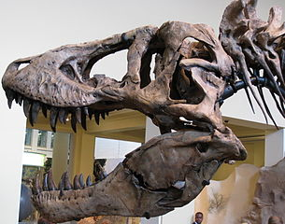
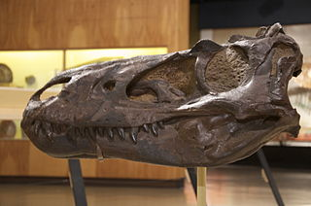
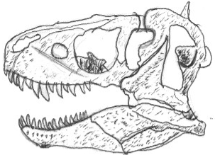
Daveynin/Carnegie Museum of Natural History, Wikimedia Commons
Scott Robert Anselmo/Cleveland Museum of Natural History, Wikimedia Commons

Slide 15
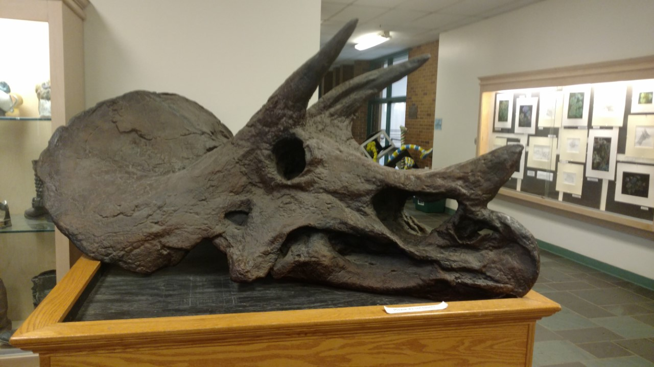
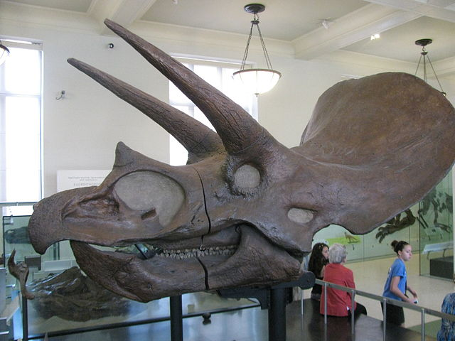
Below: Skull of the more primitive form: Triceratops horridus (Marsh, 1889) from the AMNH
Above: Cast of the skull of the more advanced form: Triceratops prorsus (Marsh, 1890) from the Mercyhurst collection
Janie and Jim Eden/American Museum of Natural History, Wikimedia Commons

Slide 16
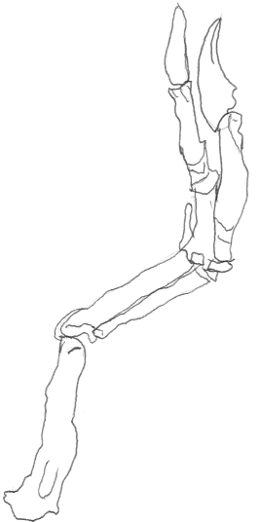
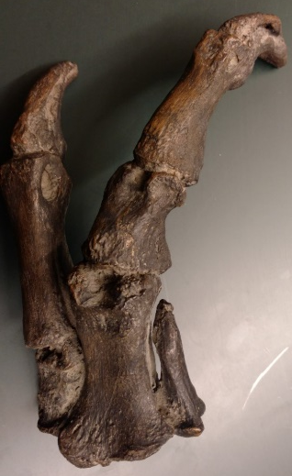
Possible atavism seen in Nanotyrannus

Slide 17

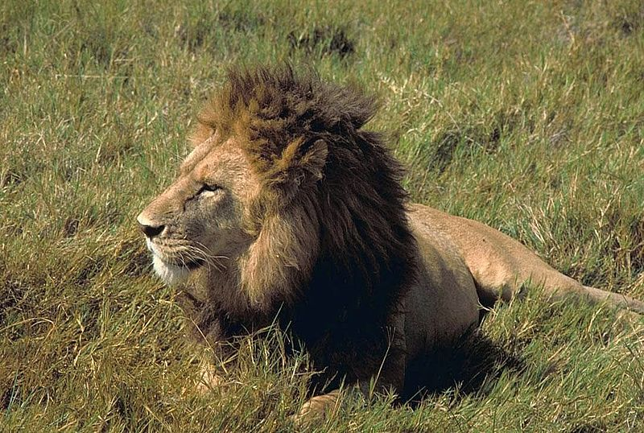
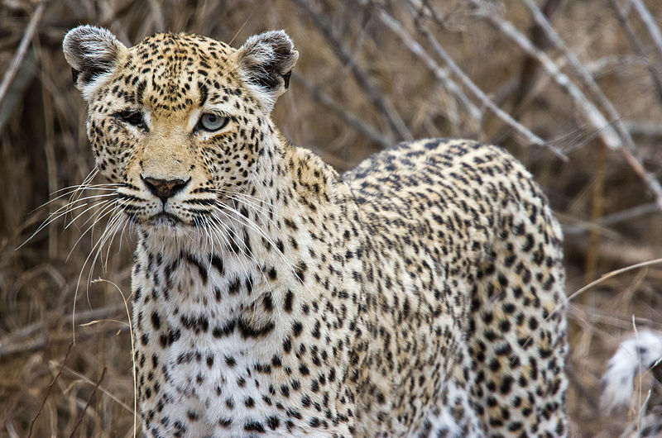


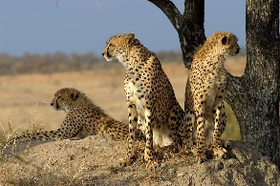
Why get small in a world of giants?
Resource partitioning to maintain punctuated equilibrium
Ex 1: North American canids and African felids evolved various sizes to exploit various prey
Gunnar Ries , Wikimedia Commons.. Christopher Bruno, Wikimedia Commons. Bengt Nyman, Wikimedia Commons. Public Domain Images. P. Lindgren, Wikimedia Commons. James Temple, Wikimedia Commons.

Slide 18
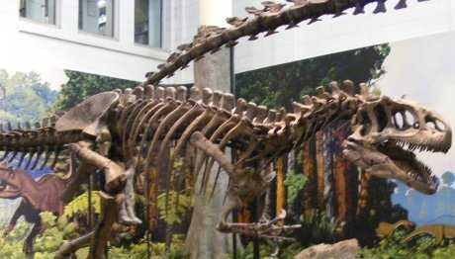
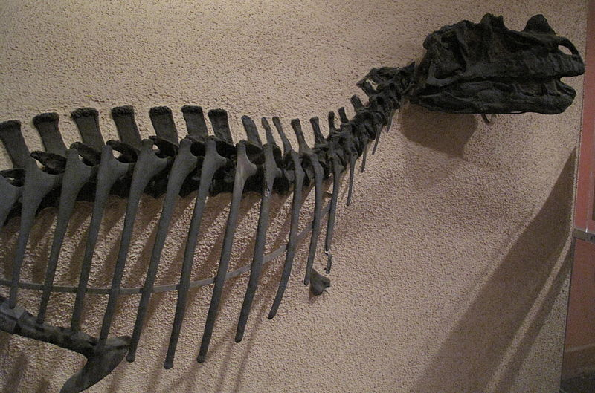
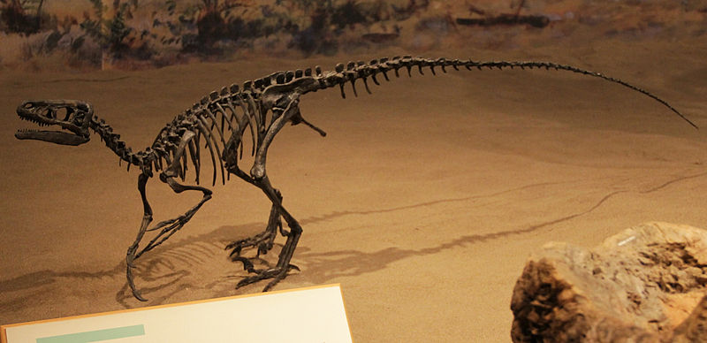
José Maria Silveira Neto, Wikimedia Commons
Venture Vancouver, Wikimedia Commons
Ex. 2: Late Jurassic Theropods also went down a similar evolutionary pathway.

Slide 19
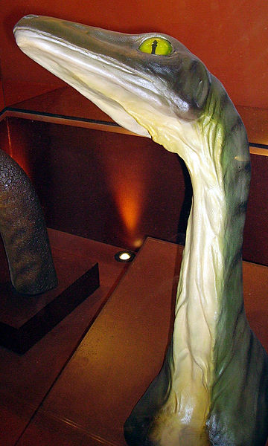
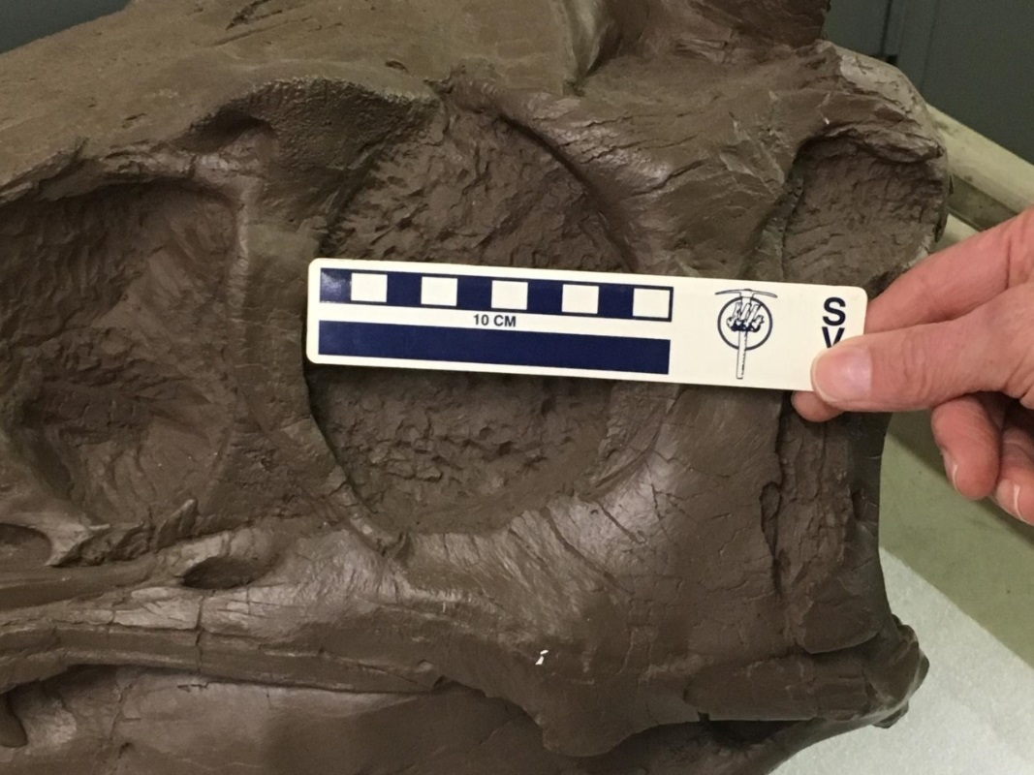
Possible role in Late Cretaceous ecosystem
Large Orbitals
Accounts for 15.4% of total skull length (Chure, 1998).
Juvenile character?
Indication of nocturnal behavior?
Mimicry?
Ballista/Museum of Natural History, London. Wikimedia Commons

Slide 20
Conclusions
Previous examinations of the skull of CMNH 7541 and of the histology of BMRP 2002.4.1 have shown that these two specimens of Nanotyrannus are still growing at a rapid pace.
The possibility that they represent juveniles of Tyrannosaurus rex is still plausible.
It is not clear if Nanotyrannus inhabited all of the localities and strata where Tyrannosaurus has been known to inhabit.
It is highly unlikely that Tyrannosaurus lost tooth positions throughout ontogeny due to:
Some intermediates being stratigraphically inconsistent
Individual variation of dental alveoli
If Nanotyrannus is a valid species, and if it diverged from Tyrannosaurus, then it shows that the dinosaurs are still diversifying in the Late Cretaceous.

Slide 21
Acknowledgments
Peter L. Larson
Black Hills Institute of Geological Research Inc., Hill City, SD, United States
Dr. Thomas R. Holtz Jr.
University of Maryland, College Park, MD, United States
Scott A. Williams
Burpee Museum of Natural History, Rockford, IL, United States
Dr. Philip J. Currie
Royal Tyrrell Museum of Paleontology, Drumheller, AB, Canada
Robert J. Detrich
Detrich Fossil Company, Robert@fossilking.net
Dr. John B. Scannella
Museum of the Rockies, Bozeman, MT, United States
Disclaimer: Although all these people aided us in this investigation, they may not agree with our conclusions. However, the help of these specialists is greatly appreciated.

Slide 22
Sources
Carr, T. D. (1999). Craniofacial ontogeny in tyrannosauridae (Dinosauria, Coelurosauria). Journal of vertebrate Paleontology, 19(3), 497-520.
Carr, T. D., & Williamson, T. E. (2004). Diversity of late Maastrichtian Tyrannosauridae (Dinosauria: Theropoda) from western North America. Zoological Journal of the Linnean Society, 142(4), 479-523.
Chure, D. J. (2000). On the orbit of theropod dinosaurs. Gaia, 15, 233-240.
Currie, P. J., Hurum, J. H., & Sabath, K. (2003). Skull structure and evolution in tyrannosaurid dinosaurs. Acta Palaeontologica Polonica, 48(2), 227-234.
Dodson, P. (1975). Taxonomic implications of relative growth in lambeosaurine hadrosaurs. Systematic Biology, 24(1), 37-54.
Erickson, G. M., Makovicky, P. J., Currie, P. J., Norell, M. A., Yerby, S. A., & Brochu, C. A. (2004). Gigantism and comparative life-history parameters of tyrannosaurid dinosaurs. Nature, 430(7001), 772-775.
Farke, A. A., Chok, D. J., Herrero, A., Scolieri, B., & Werning, S. (2013). Ontogeny in the tube-crested dinosaur Parasaurolophus (Hadrosauridae) and heterochrony in hadrosaurids. PeerJ, 1, e182..
Harrison, W. F., Nichols, D. J., Henderson, M. D., Scherer, R. P (2013). Using Pollen, Leaves, and Paleomagnetism to Date a Juvenile Tyrannosaurid in Upper Cretaceous Rock. Tyrannosaurid Paleobiology (239-249).
Horner, J. R., & Padian, K. (2004). Age and growth dynamics of Tyrannosaurus rex. Proceedings of the Royal Society of London B: Biological Sciences, 271(1551), 1875-1880.
Larson, P. L. (2008). Variation and sexual dimorphism in Tyrannosaurus rex. Tyrannosaurus rex, 103-130.
Larson, P. (2013). The case for Nanotyrannus. Tyrannosaurid Paleobiology, 15-53.
Longrich, N. R., & Field, D. J. (2012). Torosaurus is not Triceratops: ontogeny in chasmosaurine ceratopsids as a case study in dinosaur taxonomy. PloS one, 7(2), e32623.
TED. (2011, November). Jack Horner: Where are the baby dinosaurs? [Video file]. Retrieved from http://www.ted.com/talks/jack_horner_shape_shifting_dinosaurs?language=en
Tsuihiji, T., Watabe, M., Tsogtbaatar, K., Tsubamoto, T., Barsbold, R., Suzuki, S., ... & Witmer, L. M. (2011). Cranial osteology of a juvenile specimen of Tarbosaurus bataar (Theropoda, Tyrannosauridae) from the Nemegt Formation (Upper Cretaceous) of Bugin Tsav, Mongolia. Journal of Vertebrate Paleontology, 31(3), 497-517.
Witmer, L. M., & Ridgely, R. C. (2009). New insights into the brain, braincase, and ear region of tyrannosaurs (Dinosauria, Theropoda), with implications for sensory organization and behavior. The Anatomical Record, 292(9), 1266-1296.
Witmer, L. M., & Ridgely, R. C. (2010). The Cleveland tyrannosaur skull (Nanotyrannus or Tyrannosaurus): new findings based on CT scanning, with special reference to the braincase. Kirtlandia, 57, 61-81.

