Slide 1
SW Montana talc deposits: Growth enhancement by crack-sealing processes in basement carbonates under the Proterozoic Belt Basin?
S. J. Underwood
Childs Geoscience Inc.
GSA 2016 Annual Meeting, Denver, CO
T213 Structure and Tectonics of Mesoproterozoic Basins
September 26, 2016

Slide 2
Outline
Overview of Belt Basin & Lemhi Subbasin: Spatial relationship relative to talc occurrences
Proposed association of tectonic setting to multistage talc mineralization events
Focus on the first of two key hydrothermal fluid processes
Stage with metamorphic reactions @ low greenschist facies and into prehnite-pumpellyite facies in pre-Belt metacarbonate with crack-seal talc formation in concert with recurring microseismic swarms
Summary
Notes:
*In the first part of this presentation, I’ll share my motivation for suggesting a tie between talc formation and the Belt Basin and Lemhi Subbasin, and then ->
*I’ll emphasize an important talc formation mechanism that is part of the mineralization story
For later talc transport via hydrolysis reaction:
Mg₃Si₄O₁₀(OH)₂ + 6H⁺ =
3Mg²⁺ + 4SiO₂(aq) + 4H₂O

Slide 3
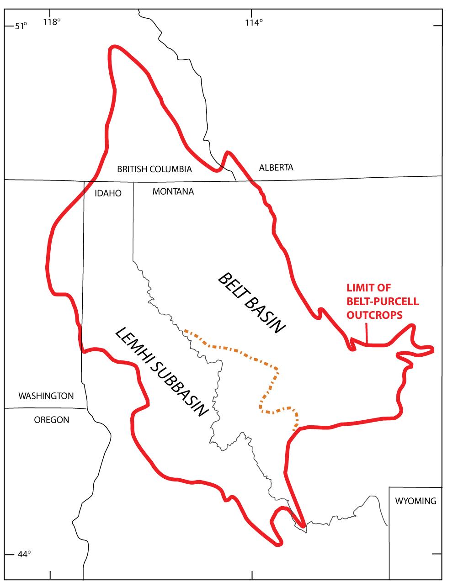
Mesoproterozoic Belt Basin & Lemhi Subbasin
- Circulating basinal fluids are plausible water sources for talc ‘formation’ based on stable isotope analyses (¹⁸O and D) from bulk talc ore samples
Glacier National
Park
- Paleogeothermometry study using oxygen isotope analyses of quartz-illite pairs yielded a temperature range of 225 – 310 °C through a 5.5 km package of Missoula Group sediments near Glacier Park (Erslinger & Savin, 1973)
Dillon Block
after Burmester et al., 2015
Notes:
*The motivation for invoking the Belt Basin and Lemhi Subbasin is a result of the stable isotope (¹⁸O and ²H) data from large talc bodies (SU and Brady et al. 1998). This general idea has been suggested several times, but not previously developed.
*Limit of Belt Basin/Lemhi Subbasin outcrops are outlined in red, and (click) the area of focus is the blue polygon on the Dillon Block. The Archean Wyoming province is to the southeast (off slide). (click)
*A paleogeothermometry investigation using oxygen isotope ratios (quartz-illite pairs) in ~5.5 km thick Missoula group sediments yielded a temperature range of 225 – 310 °C. So, a shallow graben or off-set series of wrench basins or some combination filled with the youngest Belt Basin/Lemhi Subbasin sediments could provide the conditions for talc formation by burial metamorphism. (click) The area bounded by the square is explored in the following map sequence.
Age of seds in Missoula Group spans _____ and Lemhi Subbasin seds spans ____ Ga
Xenotime overgrowths on zircon grains in other Belt sediments in Neoproterozoic. Some overgrowth of xenotime on zircons in Belt sediments has been interpreted (Aleinikoff et al. 2015) as resulting from greenschist facies and/or hydrothermal conditions.
Crustal subsidence/extension along reactivated basement faults and subsequent sediment deposition.
Need to maintain detrital zircon sources from TRM on Dillon Block. Carbonate clasts in LaHood formation with talc. Can some of those be analyzed for phase assemblies (see if a relative provenance can be identified)?
*References:
Link, P.K., Fanning, C.M., Lund, K.I., and Aleinikoff, J.N. 2007, Detrital zircon populations and provenance of Mesoproterozoic strata of east-central Idaho, U. S. A.; correlation with Belt Supergroup of southwest Montana: in Proterozoic geology of western North America and Siberia, Link, P.K., and Lewis, R.S., eds.: SEPM Special Publication 86, p. 101-128.

Slide 4
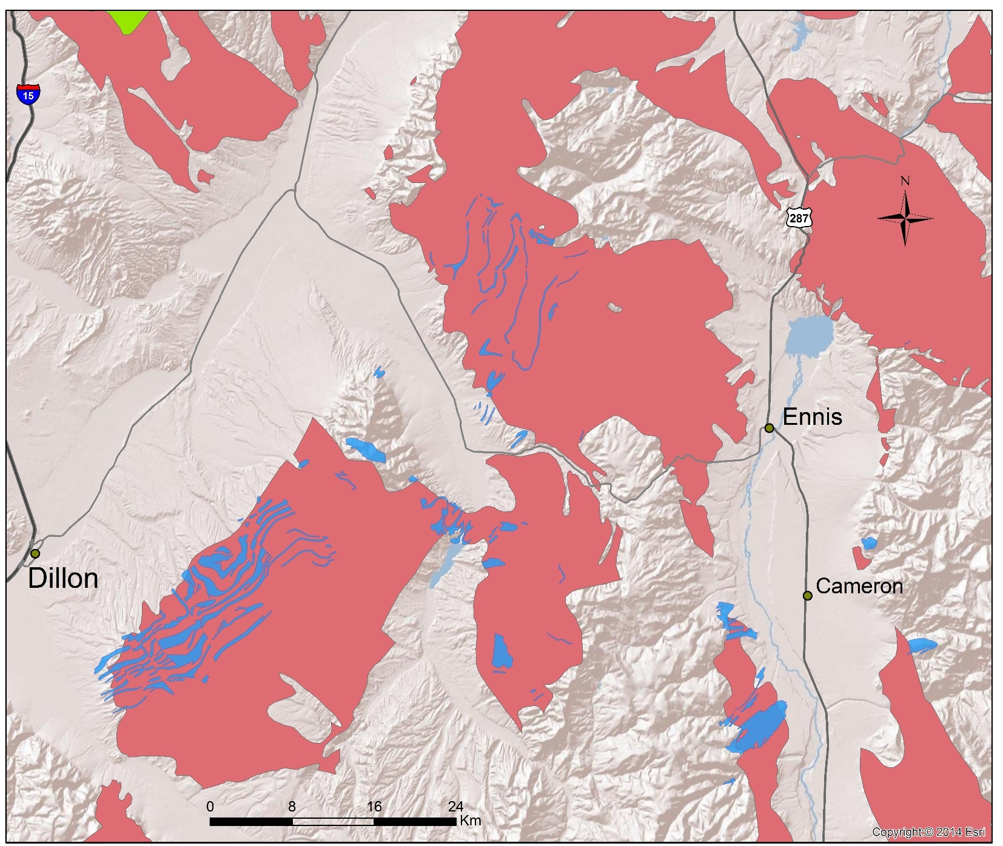
SW MT talc & host marble
Highland
Mountains
Tobacco
Root
Mountains
Ruby Range
Greenhorn Range
Gravelly Range
Notes:
Here is a simplified regional surface geology map: brick-red colored areas are outcrops of Archean and Proterozoic rocks with blue metacarbonates. Green patch is Mesoproterozoic Belt sedimentary rocks (point to).
The communities of Dillon, Ennis and Cameron (click) and modern mountain ranges are labeled.
The next slides will show exactly the same area with only the blue pre-Belt metacarbonates and green outcrops of Belt sediments in the Highland Mtns.
Auxillary Info.:
Berg (1979) compiled talc localities but placing talc formation in context of current tectonic understanding has not been done

Slide 5
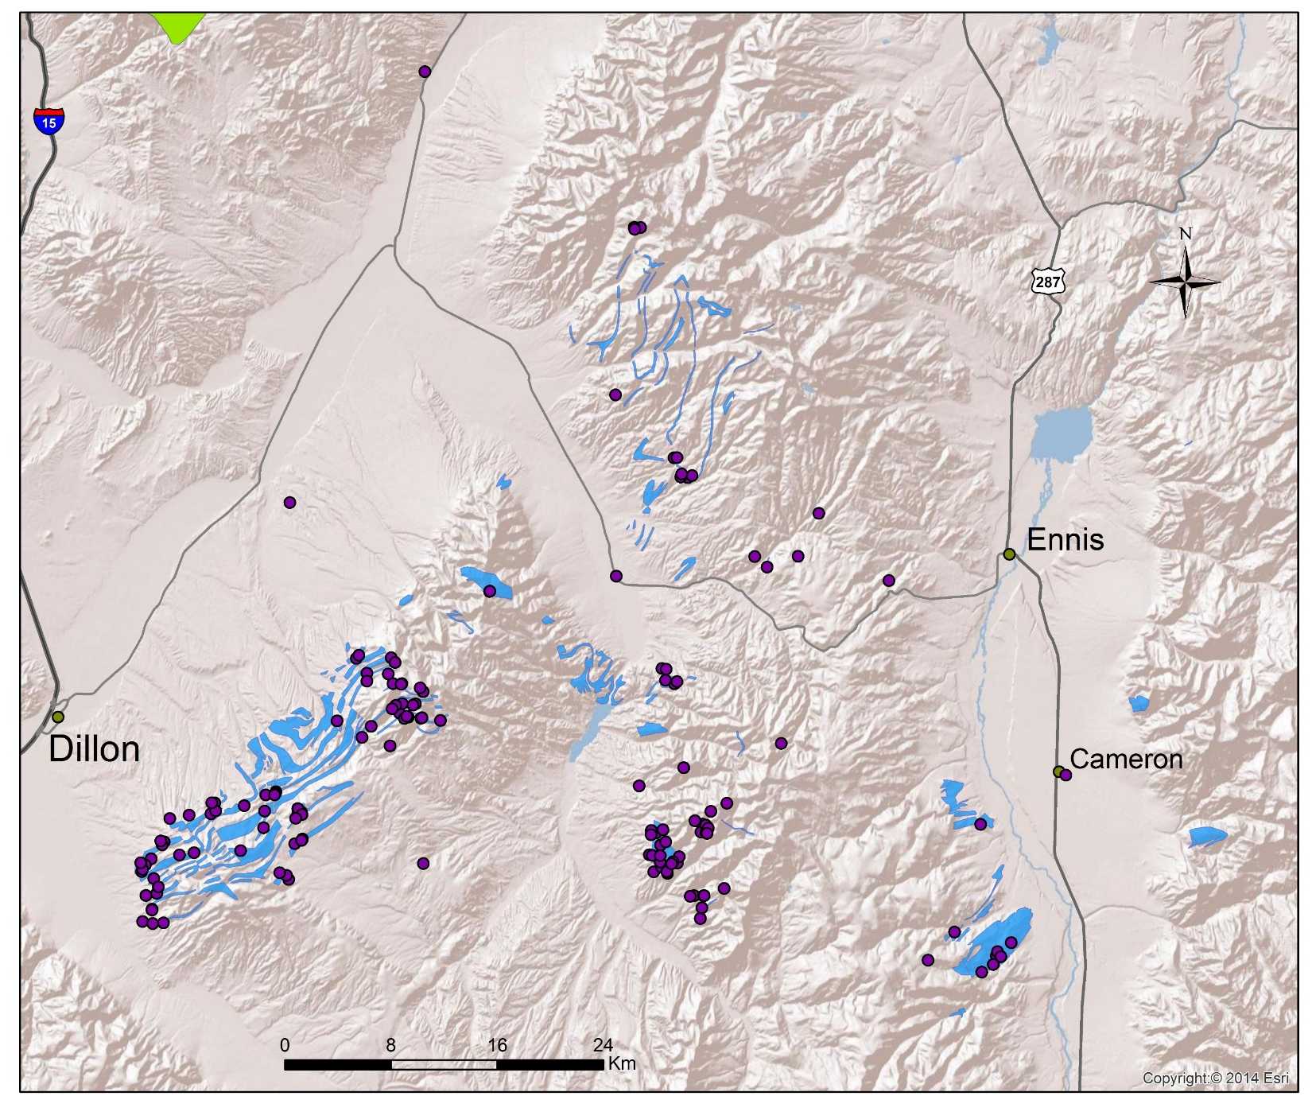
Talc occurrences & host marble
Notes:
Talc mineralization localities in SW MT are commonly hosted in pre-Belt meta-carbonates (purple dots from a talc selection in the USGS MRDS database). They vary in size from decimeter-scale pods and stringers to economic deposits capable of supporting a mining operation.
Antler Chlorite Mine – primarily clinochlore, but talc listed as a secondary commodity.

Slide 6
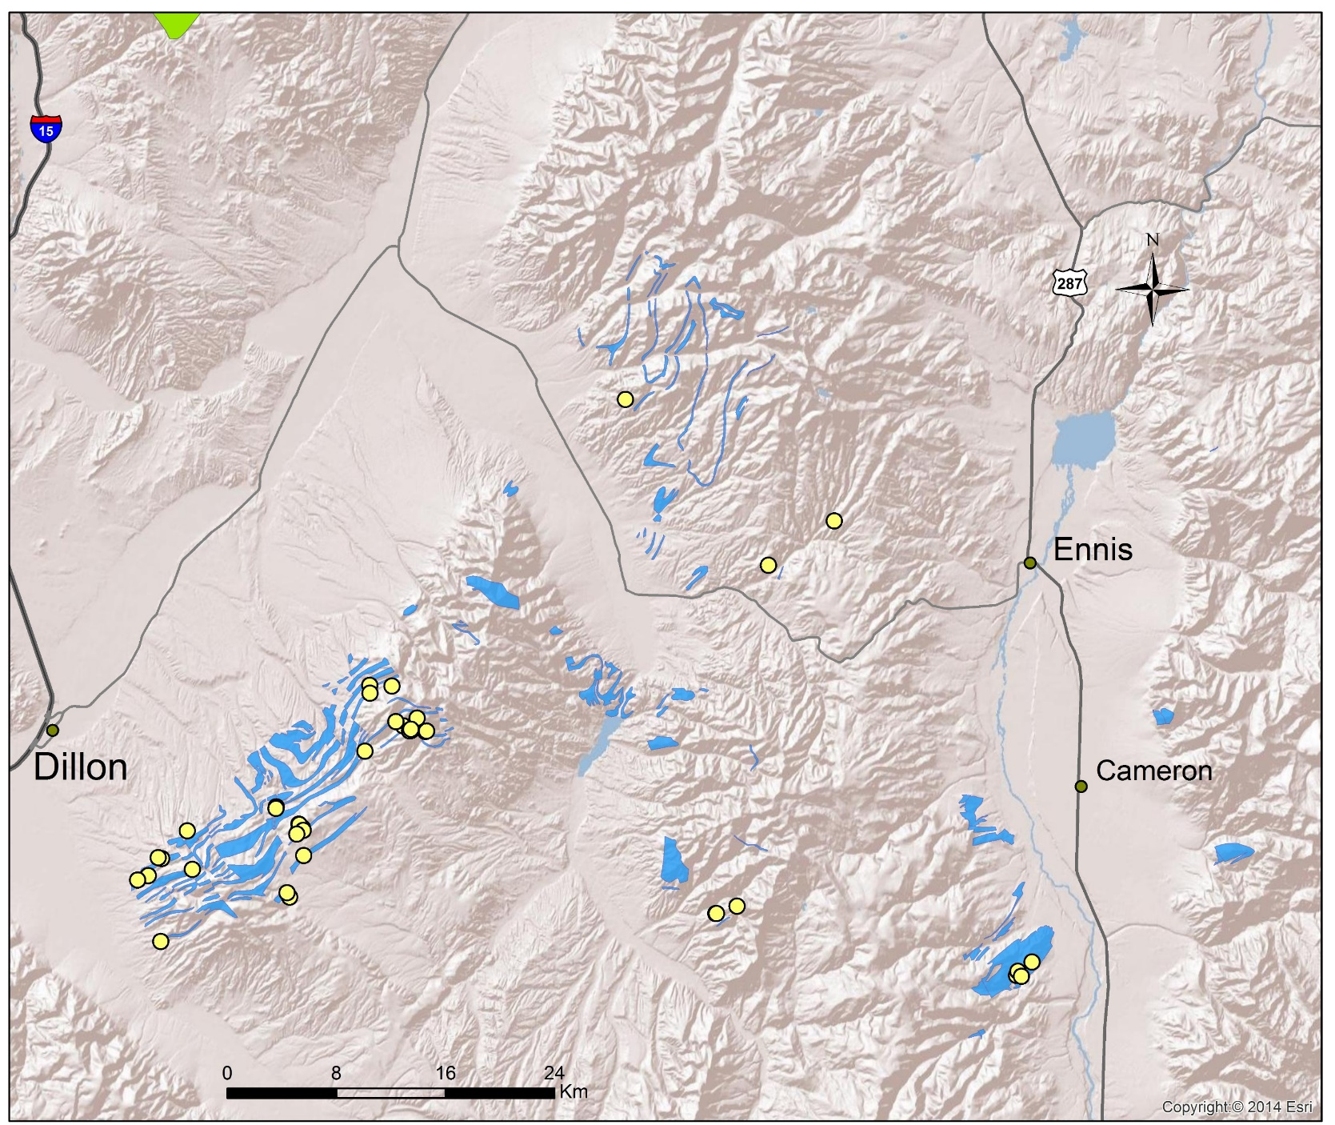
Talc occurrences vs. talc mines
Notes:
Here, the active and past producing talc mines are shown as yellow dots. Tonnage produced is not indicated, but many are low.
Gravelly Range: 2 general types of marbles, which might include probable allocthonous detachment of dolomitized (?) limestone (from paleohighland over TRM sheath fold). (The large Johnny Gulch ore body (Yellowstone Mine) formed in a thick stack of contorted carbonates (multiple fold generations) with brecciated zones and a complex network of intersecting faults with multiple generations of talc mineralization (Cerino, 2002). The adjacent Cadillac deposit (closed/reclaimed Burlington Mine) had geometry and features (e.g. botryoidal talc) consistent with hydrothermal ‘plumbing system’ (Berg, 1979). Mullions @ base of carbonates (now covered by reclamation) and purported quartz rods within stack.
Gravelly: 2nd type of metacarbonate is underlying possibly slightly higher grade Paleoproterozoic(?) marbles and meta-sediments. Apron of siliclastic and carbonaceous mantle surrounding Wyoming craton?
Greenhorn Ranges – mixed bag of detachments, reactivated faults, etc.

Slide 7
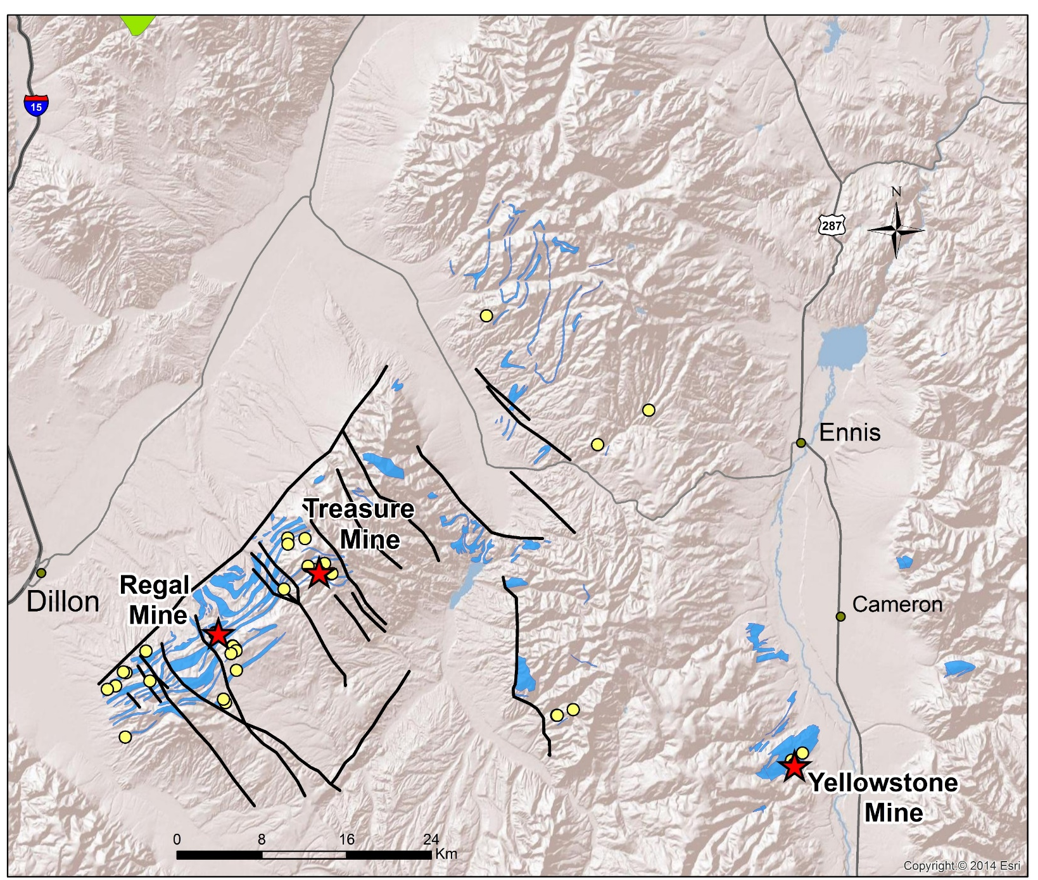
SW MT Proterozoic fluid pathways
American
Chemet
Notes:
The faults shown are a selection of [probably] long-lived structures with a history of periodic reactivation. Mines on commercial-scale deposits are operated by Barretts Minerals (Ruby Range) and Imerys Talc (Gravelly Range) (click)
Age dates:
American Chemet Mine: Sericite date for Ruby Range talc ~1.36 Ga Ar-Ar by Brady et al.
Altered gneisses(?) near the Treasure Mine 1.1 – 1.0 Ga, but these are K-Ar dates. If valid, may reflect younger talc growth episodes (see Aleinikoff et al. 2015).
Tobacco Root Mtns: Sheath fold geometry reflecting a thick, complexly folded stack of supracrustal rocks with a peak pressure of ~1.2 GPa in thickest part of future TRM (Harms et al., 2004).
Big Sky Orogeny (continent-continent collision) spans ~ 1.78 to 1.72 Ga in the Tobacco Root Mountains (Harms et al., 2006). Correlative event in Ruby Range 1.79 – 1.723 Ga (Baldwin, 2014). ~SW Ruby Range: Dahl (& others) state peak P/T conditions in amphibolite facies. More calcic marbles w/localized dolomitic marbles.
1450 Ma and 780 Ma mafic dike swarms → ?

Slide 8
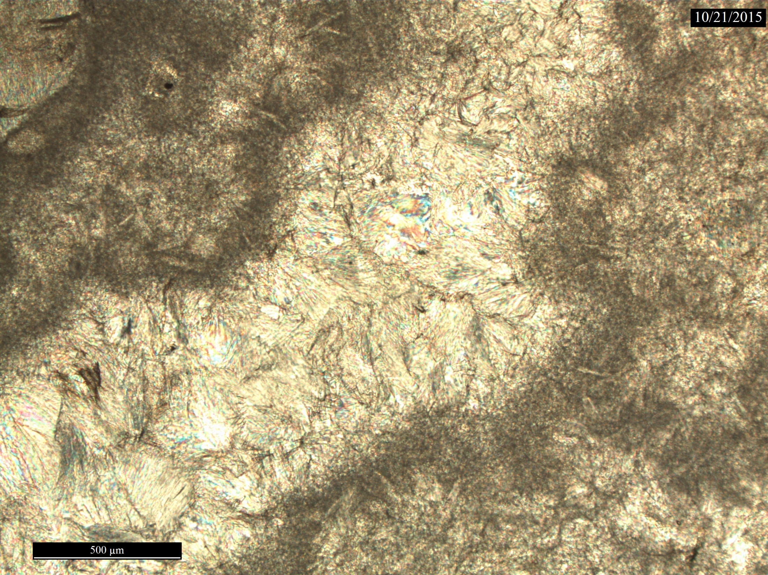
Common talc habits & textures in SW MT talc deposit ores
Microcrystalline talc
Fine to coarser grained
Botryoidal
Pseudomorphic replacement
Minor chlorite (clinochlore)
Talc vein filling (& some late-stage Mn-dendrites)
Notes:
Deciphering talc mineralization sequences from talc habits and textures exhibited at all scales is challenging. (click)
Exposures in pits and excavations often have very complex cross-cutting relationships.
Botryoidal precipitation in vugs.
Replacement of original mineral (e.g. dolomite, quartz or diopside) might be a result of infiltration by a talc-saturated solution
Chlorite rosettes indicate Al³⁺ in solution
Veins of coarser-grained talc cutting fine-grained talc →late-stage
Background image = Regal mine talc (xp photomicrograph) adjacent to a vug zone

Slide 9
Proposed sequence for generation of economic-sized talc deposit
Big Sky Orogeny in Ruby Range: 1.79 → 1.723 Ga (Baldwin, 2014). Peak T: ~650 – 700 ºC & Peak P: 0.6 – 0.7 GPa (Dahl, 1979)
Folding of rocks & shear zones established. These will become pathways for fluids. Minor talc formation.
Uplift & subsidence => Regional extension: ~1.72 → ~1.45 Ga
Sporadic regional uplift with minor talc along selected faults. Some fluid infiltration and replacement of minerals along fractures. Diabase dikes emplaced during extension. Minor talc formation.
Regional extension/subsidence in Belt Basin or Lemhi Subbasin: ~1.45 → 1.38 Ga
Sedimentation in basins. Burial/diagenesis develops at high geothermal gradient P/T conditions that sustain circulation of hot fluids and reactions in basement metacarbonates.
Continued tectonism w/erosion of cover ‘Belt sediments’: 1.38 → 0.65 Ga
Dissolution of shallow talc and precipitation as botryoidal talc in fluid channels associated with major fault zones. (780 Ma Gunbarrel mafic dikes for Rodinia break-up (Rogers et al. 2014; Harlan et al. 2008)).
Notes:
*Talc deposit genesis is divided into 4 periods. The first 2 are “prepatory” and the last 2 are where most of the talc formation and migration occurred.
* BS Orogeny: NW margin of Archean Wyoming craton overrun by converging Selway Terrane. This was a pre-talc mineralization / “ground preparation” event. Marble deformation (folds and ‘ruptures’) established a framework for subsequent talc formation processes. Small amounts of talc formed.
*The following 260 Myr period culminated in regional tholeiitic basaltic dike swarm. Some intrude faults. Many small talc occurrences reported today originate from these 2 periods.
* →The primary focus of this talk is the metacarbonate burial to a “sweet spot” depth, then regional talc formation began
* In the last 730 Mya period talc formation likely continued, but talc dissolution and precipitation after transport amplified some deposits. No time to discuss this today.
Result of midcrustal T/P with low H₂O and some decarbonation in carbonates; establish fracture network and grow porphyroblasts of forsterite, diopside, phlogopite. Localized tremolite.
For talc, importance of probable overlying volcanic field is possibly more important to future reservoir formation and maybe Mg⁺² for talc and other hydrous minerals. Movement along regional fracture/shear network. Some hydrous fluids may locally allow fluid infiltration for pseudomorph processes of original minerals, and minor chlorite.
Talc-bearing carbonate clasts found in ~1.5 Ga LaHood conglomerates could be taken as evidence of this.
Subsidence of Belt Basin and Lemhi Subbasin with late-stage sedimentation in “lows” on Dillon Block. Burial/diagenesis on extending crust leads prehnite-pumpellyite P/T conditions @ elevated geotherm? Now large hydrothermal circulation cells bring basinal brines into contact with carbonate layers at depth. Large volumes of water circulating through the sediments will satisfy the 600:1 fluid:rock ratio.

Slide 10
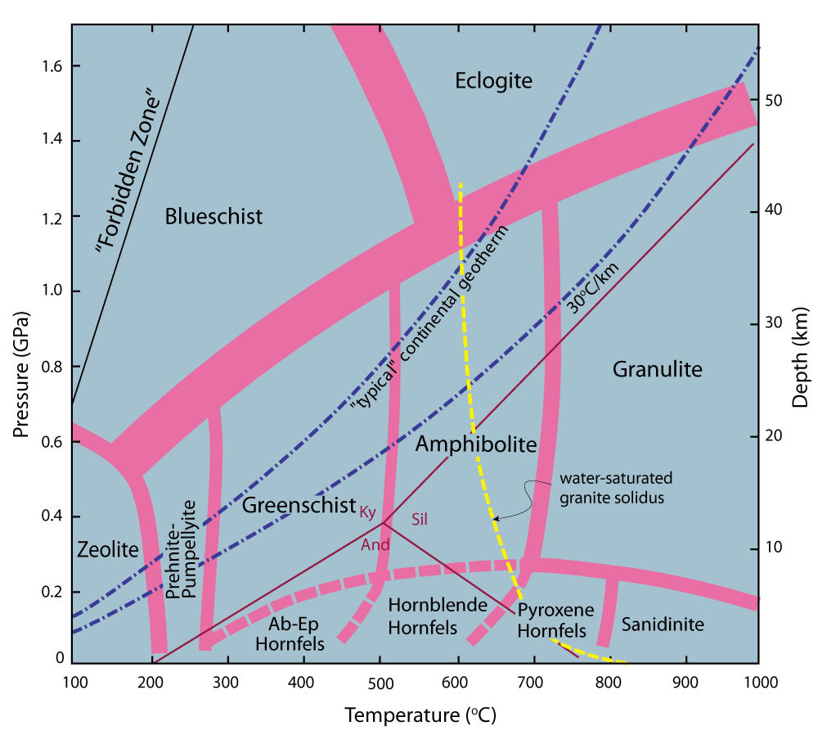
METAMORPHIC
FACIES
from Winter (2010)
Notes:
*To form all the talc in the previous slides, here is a standard metamorphic facies diagram. (click)
*Hydrothermal conditions for burial/diagenetic metamorphism beneath basin brine-saturated sediments is proposed for talc formation. Pressures and temperatures are guided by fluid inclusion results at a closed mine adjacent to Yellowstone Mine by Gammons and Matt (2002).
*The box encompasses both the normal continental and elevated geothermal gradients.
The Belt sediment cover that blanketed the basement has been eroded away with the aid of various episodes of uplift.
We would need to keep the Ar dates from sericites and micas in mind for this, so possibly 350 °C is an upper limit.
Geothermometers applied to Ruby Range talc ores are centered in this box

Slide 11
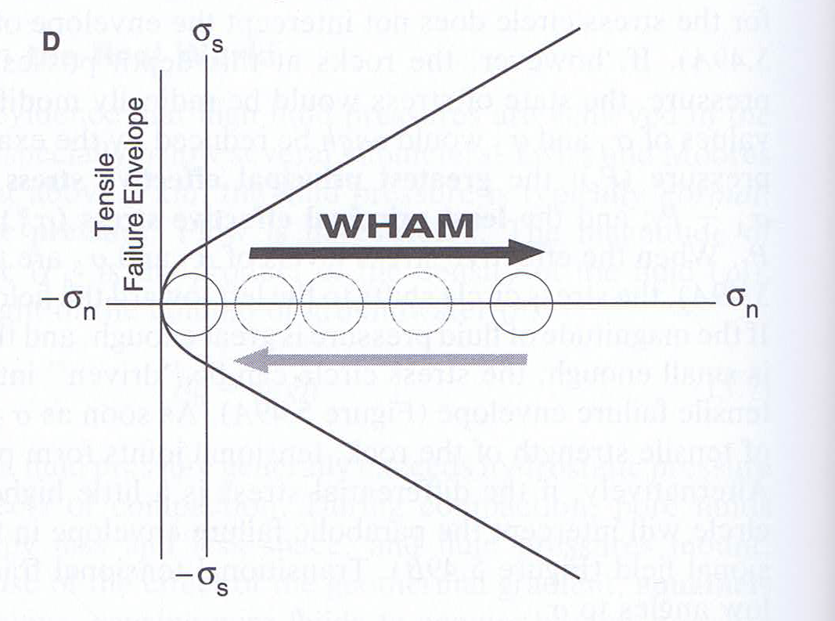
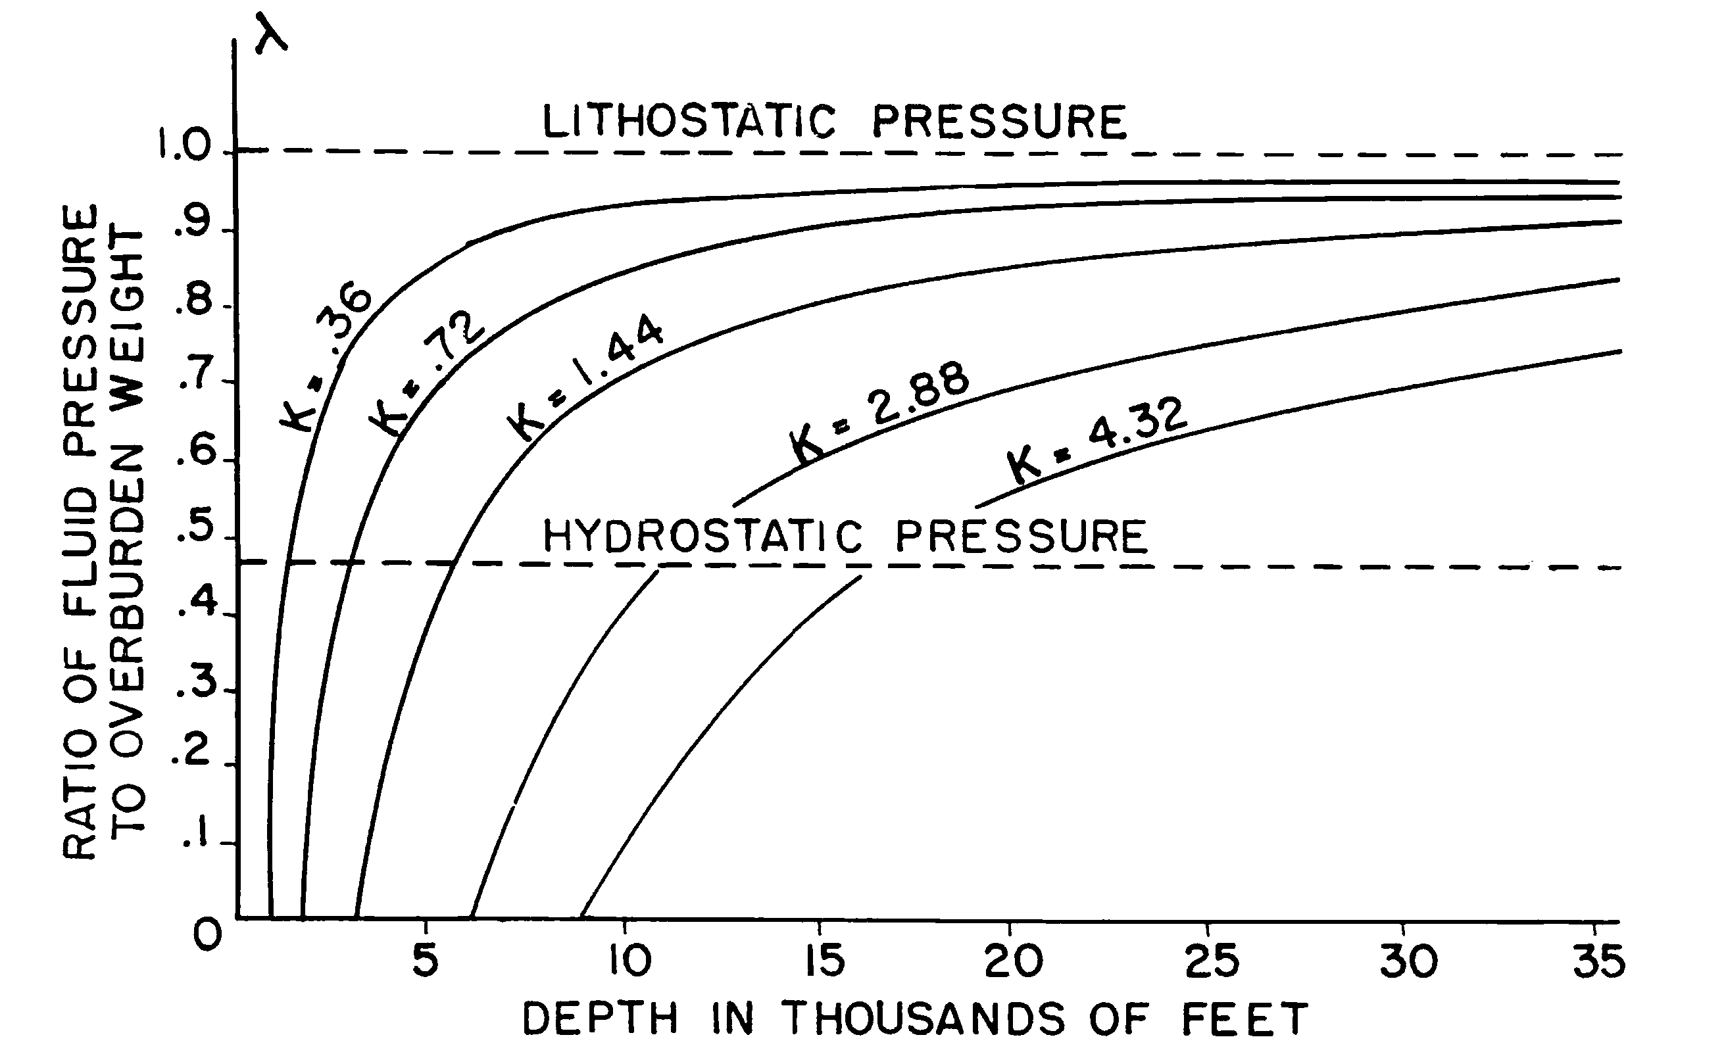
Hydrofracturing of carbonate basement
Primary chemical reaction responsible for SW MT talc is:
3MgCa(CO₃)₂ + 4SiO₂ + H₂O =
Mg₃Si₄O₁₀(OH)₂ + 3CaCO₃ + 3CO₂
Increasing lithostatic pressure
Increasing hydrostatic pressure
Adjacent to faults, pore fluid pressure likely approaches lithostatic pressure
Fig. after Davis & Reynolds (1996)
Brines react with siliceous carbonates to produce talc
Talc, chlorite & graphite reduce friction and facilitate slip
Hydraulic fracturing of marble likely between K = 1.46 and 4.18
Cox (2016)
Secor (1965)
Notes:
*The principle talc formation reaction is dolomite + silica + water forming talc, calcite and carbon dioxide. This reaction, in the talc-forming direction, has a net volume loss. (click)
*Research on petroleum reservoir mechanics shows that hydraulic fracturing of marble may be possible in the region bounded by the 5.5 km (~18,000 ft) and 10 km (32,800 ft) red lines and for K (tensile strength in English units) for the range 7 – 20 MPa appropriate for marbles. →Hydrofracturing opens marble and talc is formed via reaction of hot brine with a fresh carbonate surface. (click)
*Here’s a schematic image showing both Coulomb and tensile failure envelopes for a rock. A hydrostatic pressure (internal pore pressure) increase moves the Mohr’s circle toward the tensile failure envelope. A tensile failure results in an increase in the lithostatic pressure on the single crack, but transfers the increase in hydrostatic pressure to nearby sites. (click)
*However, the talc, chlorite, and graphite have low coefficients of sliding friction, so the simple diagram must be replaced by a diagram that illustrates the mechanical response by sheared carbonates further weakened by these disseminated minerals. (click) Now an increase in hydrostatic pressure increases to the point where hydraulic extension fracture forms, but catastrophically drops, and the differential stress decays in an oscillatory fashion.
*This type of mechanical-chemical response is recognized in hydraulically overpressured Au-mineralization systems, where multiple ruptures and mineral growth lead to genesis of multistage ore deposits.
Stress diagram, where the greatest principle stress (σ₁) and the least principle stress (σ₃) delineate the diameter of the example Mohr circle.

Slide 12
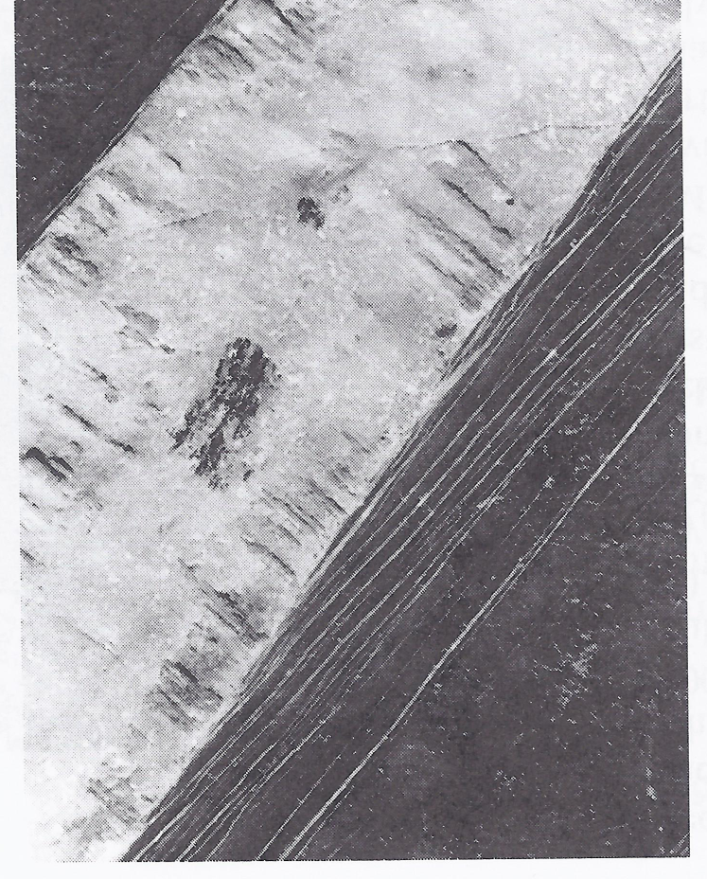
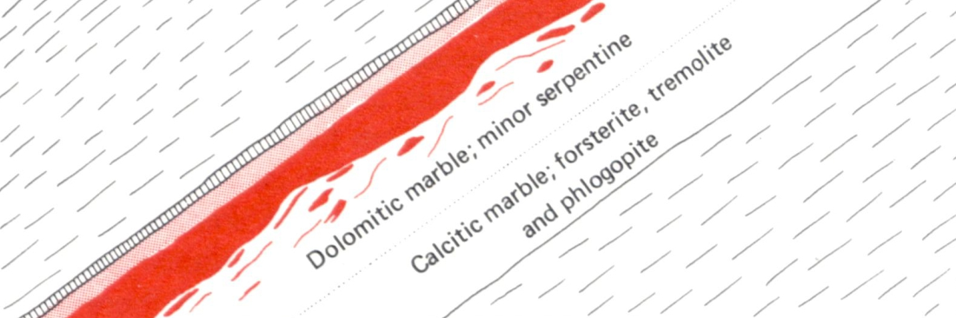
Crack-seal Talc & Swarm Seismicity
Calcite Vein
cutting
Limestone
Cox (2016)
Gradational contact
pC Bt QFG
Chlorite
Ser & Chl alteration of pC Bt QFG
pC Bt QFG
7 cm
Talc
50 m
Fig. after Davis & Reynolds (1996)
Willow Creek talc deposit, Greenhorn Mtns.
Berg (1979)
Notes:
*Oscillating dissipation of pore fluid overpressure and induced ruptures in recurring microseismic swarms could be correlated (Cox 2016). (Point to area of small displacement with overpressured and slip-prone system.)
*Periodic slip along master faults may rejuvenate the process subject to new conditions, and over time, the frequent microseismicity swarms may yield a lot of talc, but with little overall displacement. (Click)
*Example fine veins of calcite by crack-seal process in limestone. Compare this to the sketch of the talc exposed at the Willow Creek (surface) mine. Note the talc pods and stringers (from crack-seal hydrofrac stage) in dolomitic marble with minor serpentine below the irregular talc.
layer likely variably affected by late-stage transport of hydrothermal talc.
Coseismic stress drop = blue lines & coseismic slip = red dashed lines.
The formation of talc (and chlorite) may introduce a type of feedback important for forming voluminous talc deposits in carbonates.
Replacement mineralization could be late stage.

Slide 13
Summary for SW MT talc deposits
Hot brines circulating through pre-Belt carbonate basement rocks beneath overlying sediment package correlative with ~youngest Belt Basin/Lemhi Subbasin might “be” the regional retrograde greenschist facies event (speculations by previous workers in area)
Hydrothermal talc deposit formation by burial diagenetic metamorphic conditions with crack-seal processes and (later consolidation by dissolution and precipitation focused near faults)
Multistage mineralization could have been episodic over millions to tens of millions of years in Meso/Neoproterozoic eras
Notes:
*In conclusion, this work started as a project to aid talc exploration efforts, but has implications for the evolution and structure of the Mesoproterozoic Belt Basin/Lemhi subbasin.
*Although the rocks that may have filled this ancient basin are long gone, basement (non-metacarbonate) rocks near the marbles and proximal to fluid channels/fault/shear zones near the large talc deposits might have minerals or overgrowth/rims that contain geochemical clues to timing constraints and stages of talc mineralization for these hydrothermal environments.
1. Stable isotopes support a circulating hydrothermal basin fluids that form cells around faults.
2. Talc forming reactions may be slow, but where the reactions and transport mechanisms persist for long (geologic) times, large deposits of talc may form.
Localities with voluminous talc deposits had an earlier stage of talc formation by crack-seal and swarm seismicity mechanisms followed by volume enhancement in hydrothermal systems via dissolution and precipitation.
*Hydrothermal overgrowth on zircon, apatite, and ____ in QFGN layers? The proximity of the pre-Cambrian unconformity might be visible using selected trace elements.
*The importance of extensive hydrothermal plumbing to concentrating large amounts of talc….

Slide 14

Thanks to:
J.F. Childs and C. Walby at Childs Geoscience Inc. and R.B. Berg at Montana Bureau of Mines and Geology for stimulating talc discussions.
R. Lewis and R. Burmester (Idaho Geological Survey) and J. Lonn (MBMG) for Belt Basin and Lemhi Subbasin education.
M. Cerino (Barretts Minerals Inc.) for insightful field geology comments and detailed talc observations.
D. Crouse and E. Bartlett (Imerys Talc) for piquing my interest in the structural nuances at the Yellowstone Mine.

