Slide 1
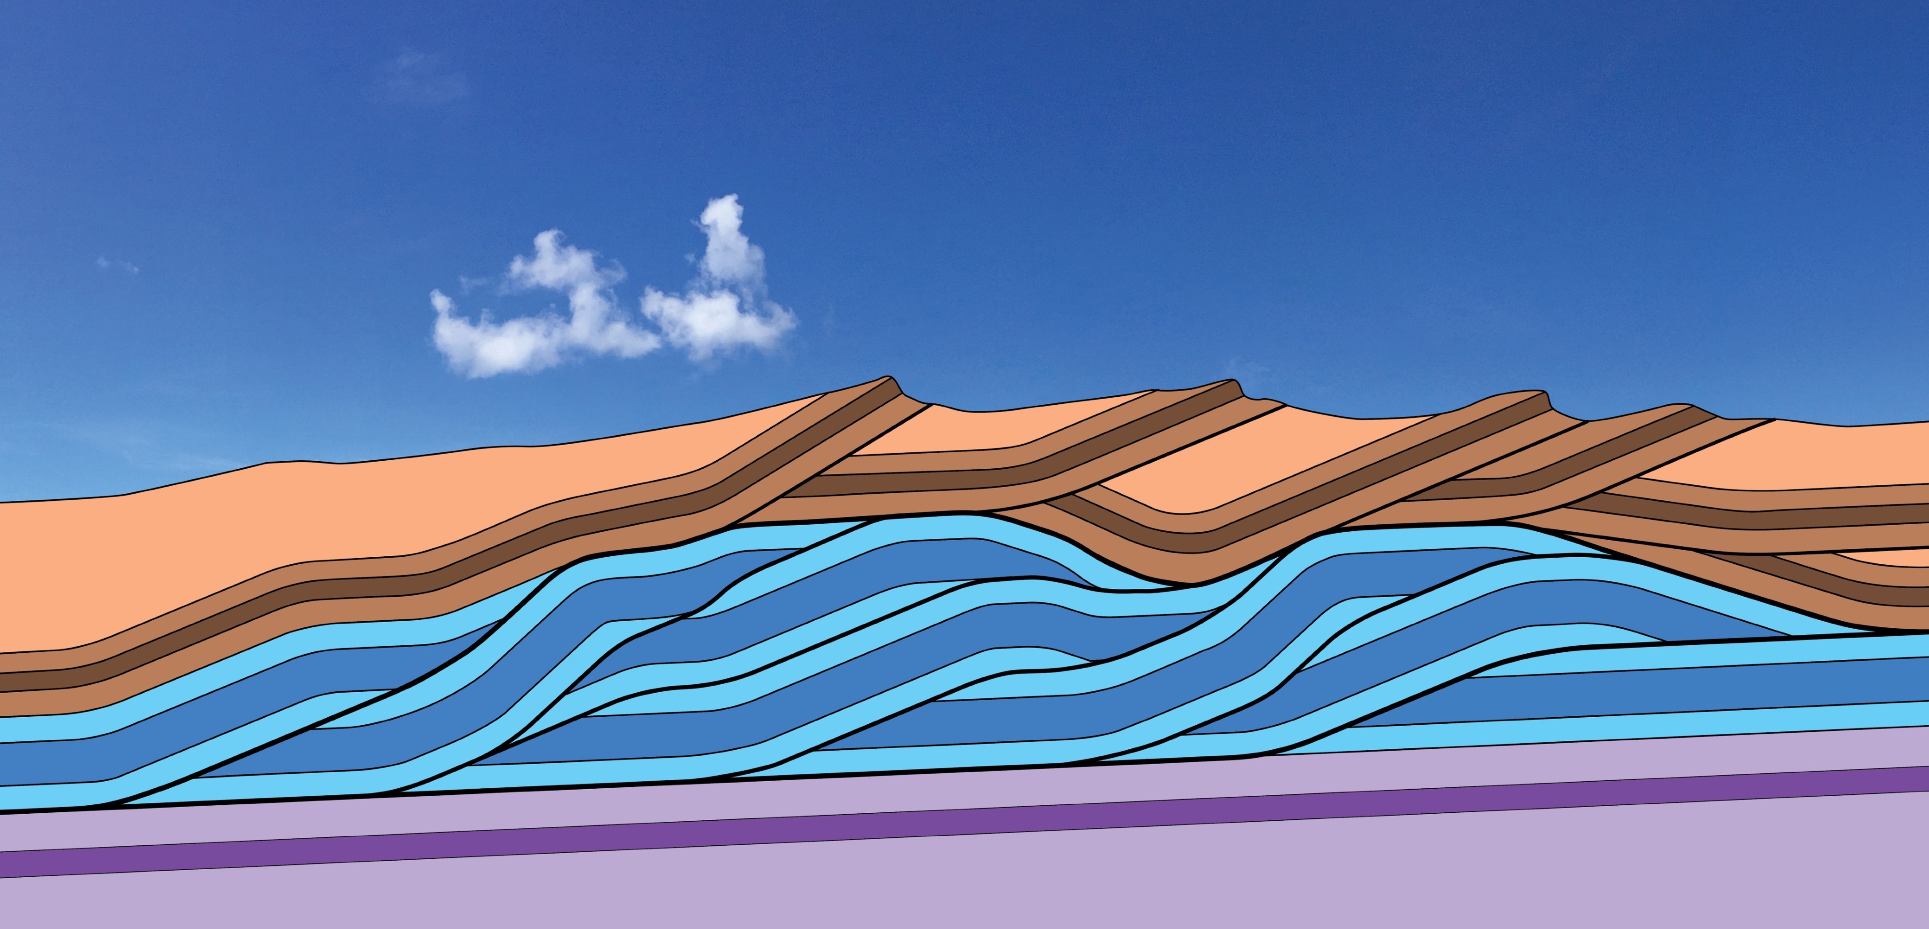
Duplexes as Slip-transfer Zones:
An Updated Synthesis
Gautam Mitra
Department of Earth &
Environmental Sciences
University of Rochester
Rochester, NY 14627
gautam.mitra@rochester.edu
Steven E Boyer
5726 Overlook Ave NE
Tacoma, WA 98422
boyersteve@me.com

Slide 2
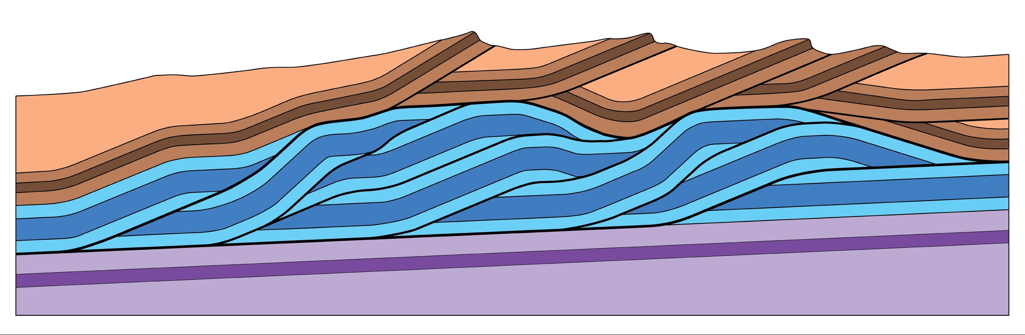
duplex fault zone
Notes:
When we use the term “duplex”, we are usually thinking of a fault zone, consisting of several imbricate slices . . .

Slide 3
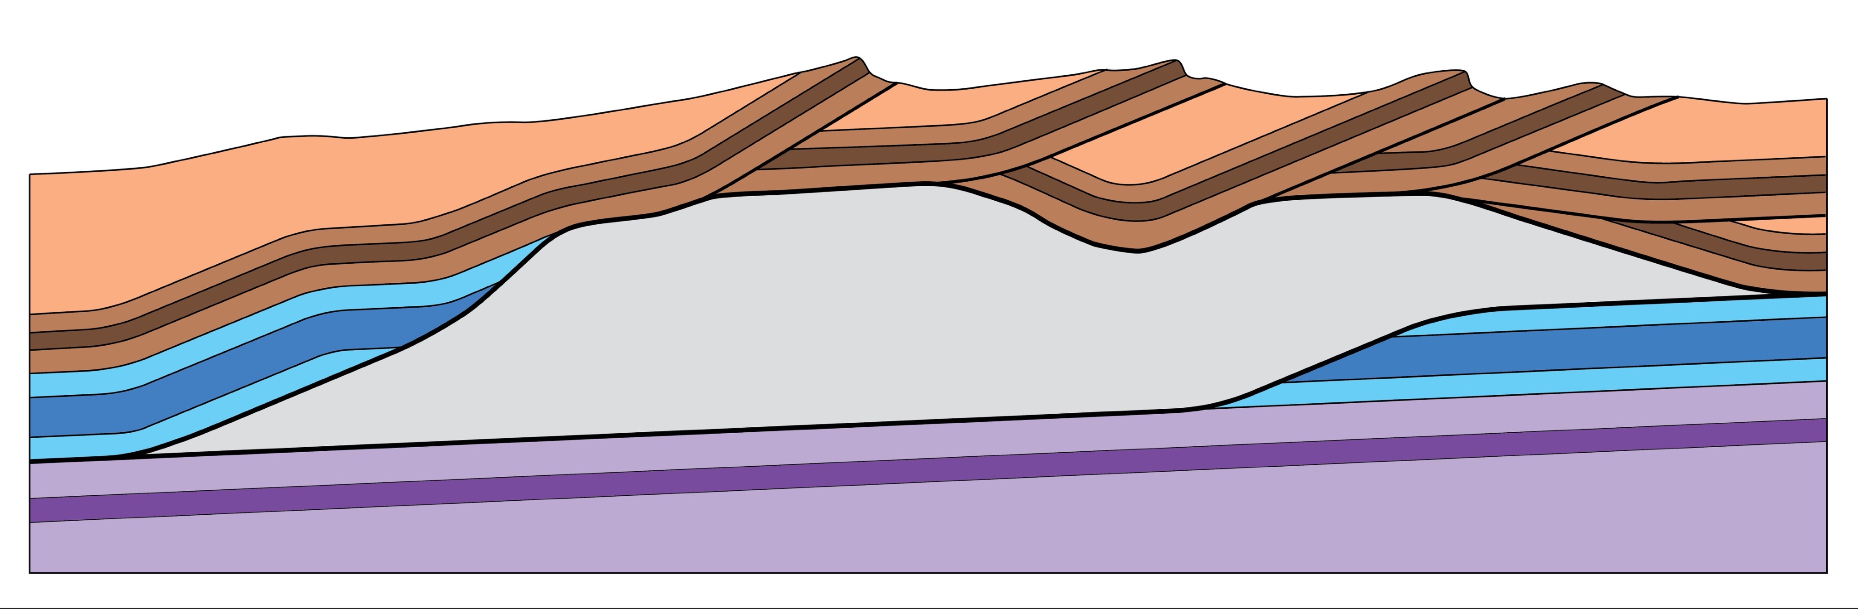
roof thrust
floor thrust
Notes:
. . . sandwiched between a roof thrust and a floor thrust.

Slide 4
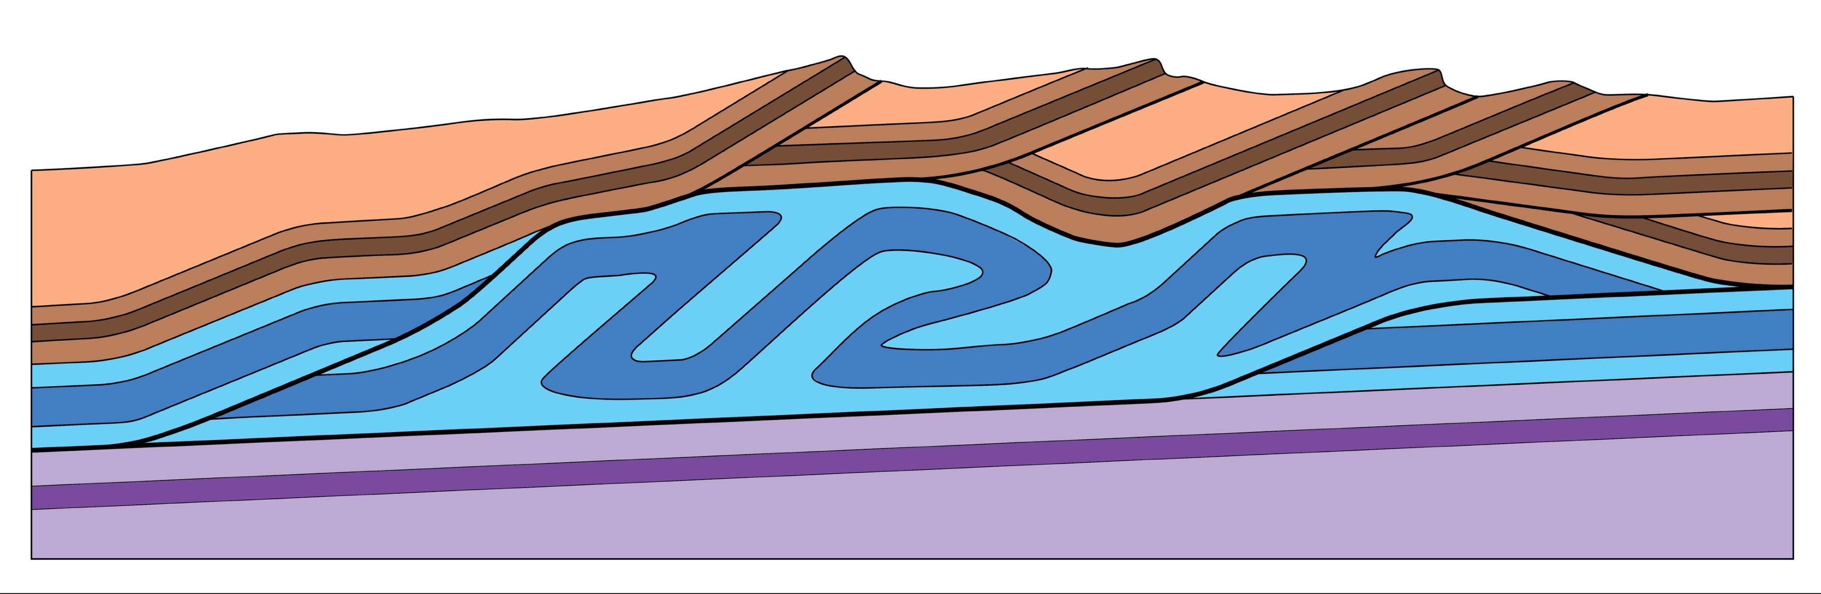
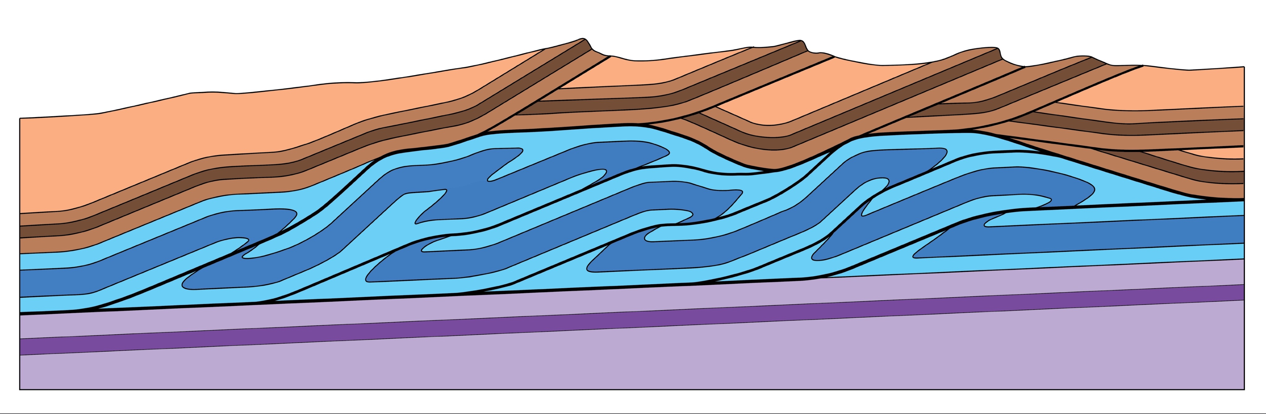
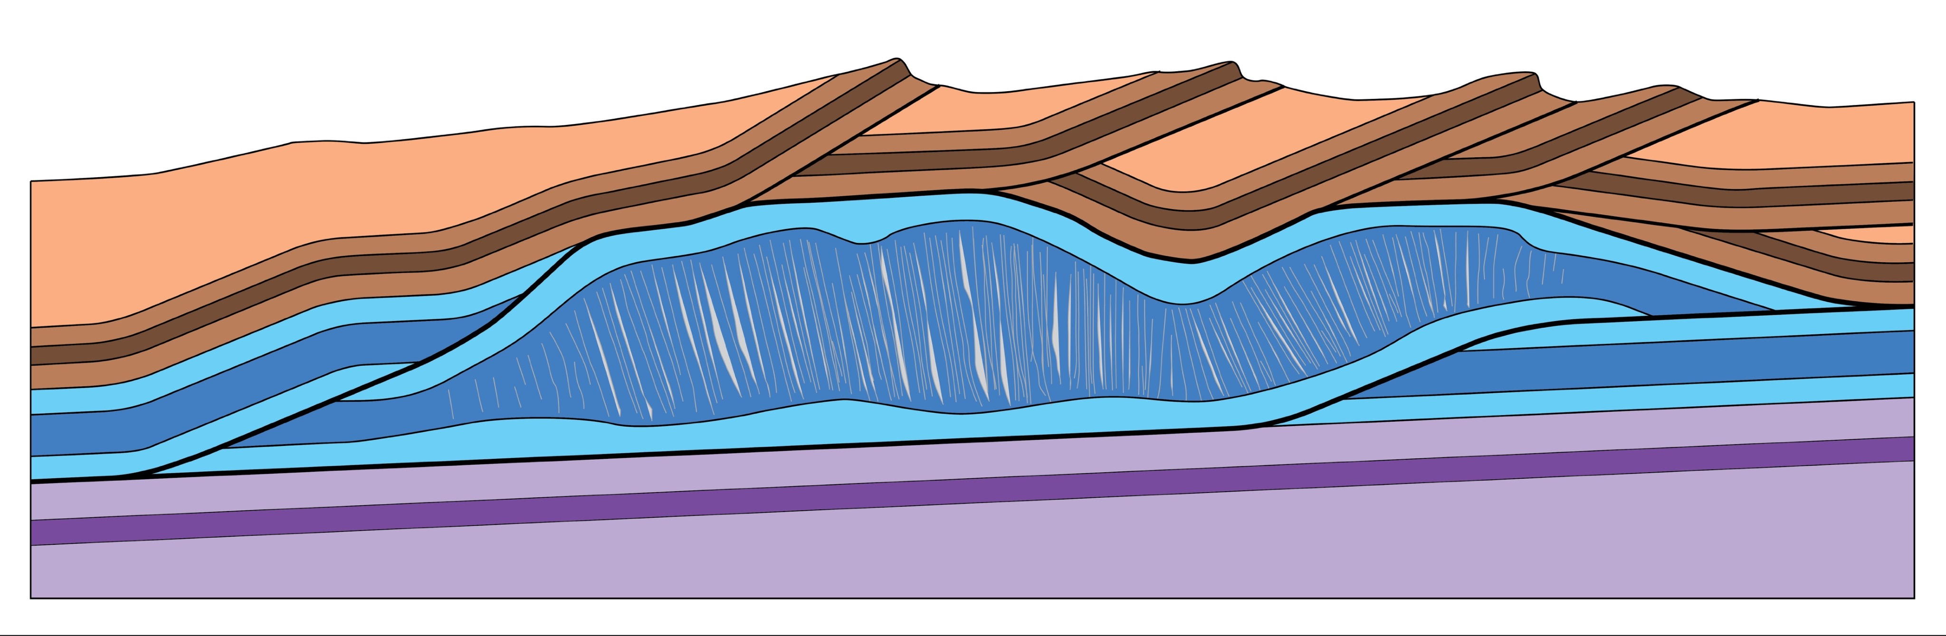
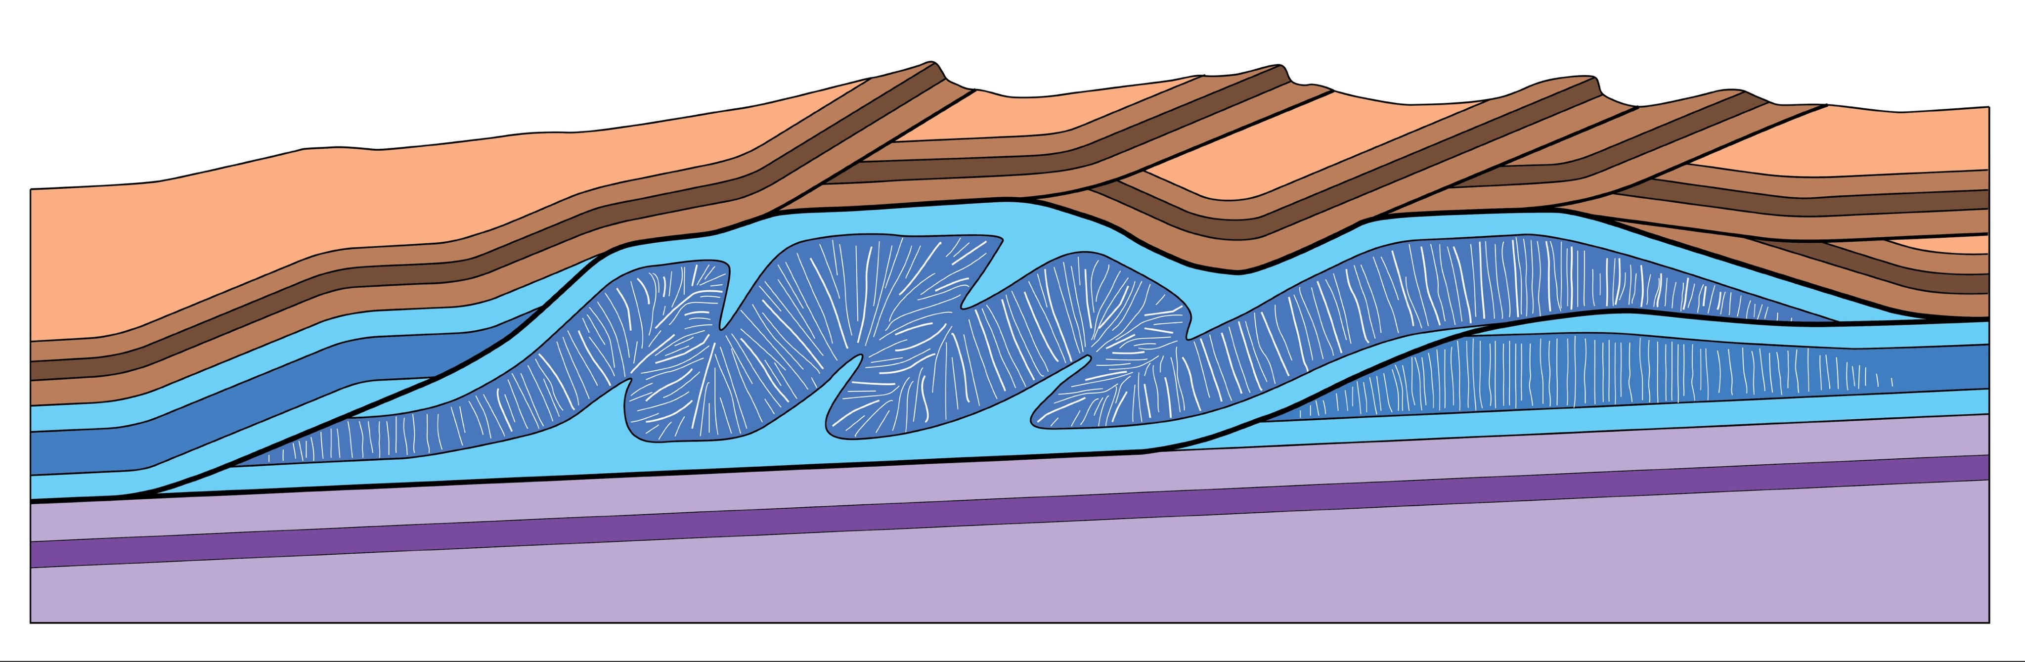
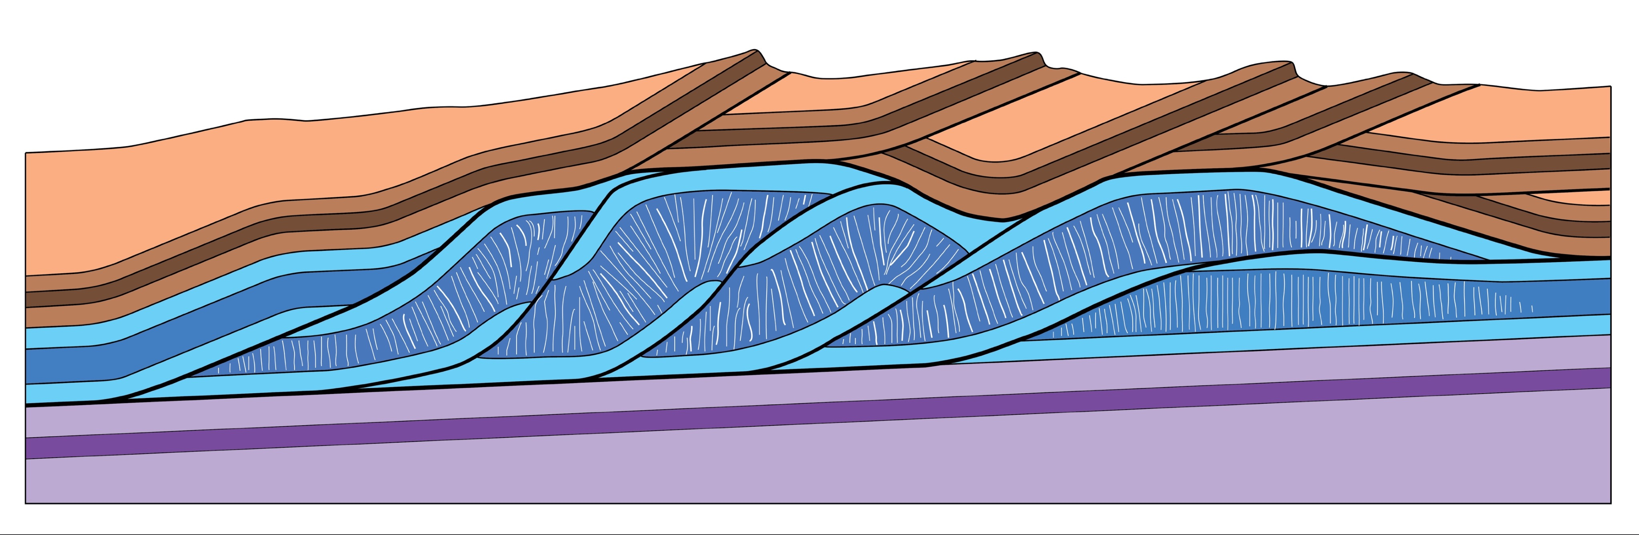
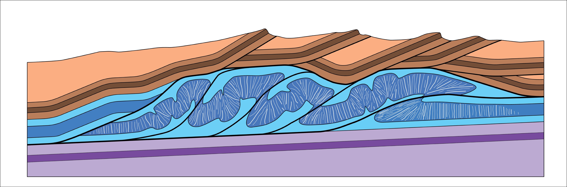

Slide 5
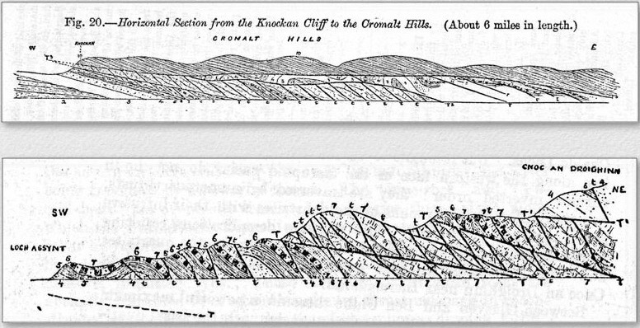
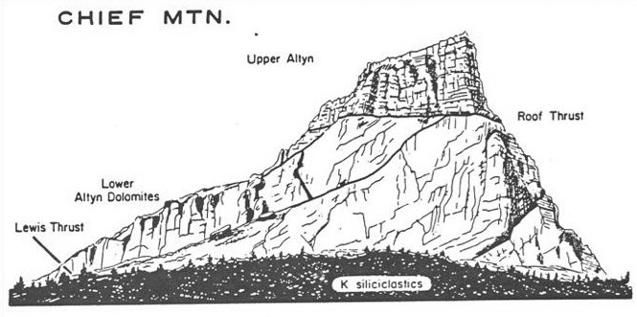
Peach, B.N., Horne, J., Gunn, W., Clough, C.T., Hinxman, L.W., and Cadell, H.M., 1888, Report on the recent work of the Geological Survey in the Northwest Highlands of Scotland, based on the field notes and maps: Quarterly Journal of the Geological Society of London, v. 64, p. 378-441.
NW Highlands of Scotland
Peach, Horne & others (1888)
Willis, B., 1902, Stratigraphy and structure, Lewis and Livingston Ranges: Geological Society of America Bulletin, v. 13, p. 305-352.
Lewis thrust sheet
Willis (1902)
Notes:
Such duplex fault zones were recognized as early as the late 19th century by geologists in the NW Scottish Highlands and Alps, where they were known as schuppen or imbricate structure.
In 1902 Bailey Willis published a GSA Bulletin article in which he depicted imbricate zones he had observed along the base of the Lewis thrust sheet in what is now Glacier National Park, Montana.
Additional notes: In the Alps, duplexes were known as Schuppenstruktur or simply schuppen (Suess, 1904) or imbricate structure (Hobbs, 1894). Elliott & Johnson published an updated account of the NW Highland duplexes in 1980.
Elliott, D., and Johnson, M.R.W., 1980
Structural evolution in the northern part of the Moine thrust belt, NW Scotland: Transactions of the Royal Society of Edinburgh: Earth Science, v. 71, p. 69-96.
Hobbs, W. H., 1894
Note on the English equivalent of Schuppenstruktur: Journal of Geology, v. 2, p. 206.
Horne, J.,1907
General description of the geological structure of the region affectedby post-Cambrian movements in the North-west Highlands, in Peach, B.N., and others, The geological structure of the North-west Highlands of Scotland: Geological Survey of Great Britain Memoir, p. 463-476.
Peach, B.N., Horne, J., Gunn, W., Clough, C.T., Hinxman, L.W., and Cadell, H.M., 1888
Report on the recent work of the Geological Survey in the Northwest Highlands of Scotland, based on the field notes and maps: Quarterly Journal of the Geological Society of London, v. 64, p. 378-441.
Peach, B. N., J. Horne, W. Gunn, M. A. Clough, and L. W. Hinxman, 1907
The geological structure of the North-west Highlands of Scotland: Geological Survey of Great Britain.
Peach, B.N., and Horne, J., 1914
Guide to the geological model of the Assynt mountains: Geological Survey and Museum, Edinburgh, p. 1-32.
Suess, E., 1904
The face of the earth (Das Antlitz der Erde), v. 1, trans. by Sollas, H. B. C.: Oxford Clarendon Press, 604 p.
Willis, B., 1902
Stratigraphy and structure, Lewis and Livingston Ranges: Geological Society of America Bulletin, v. 13, p. 305-352.

Slide 6
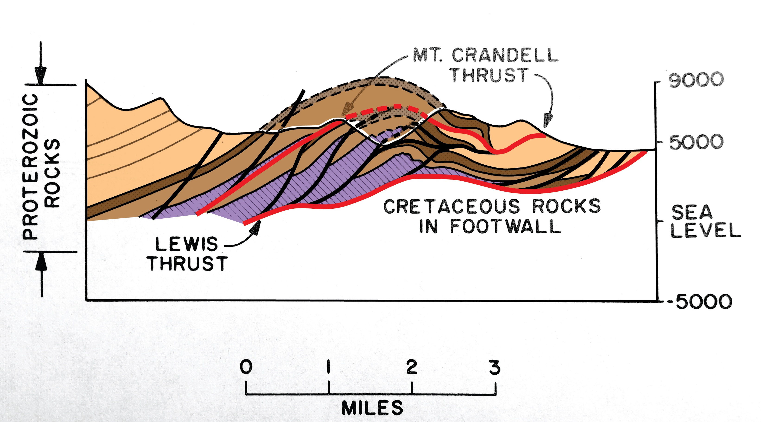
Dahlstrom (1970) – the Mt Crandell duplex
(after Douglas, 1952)
Structural geology in the eastern margin of the Canadian Rocky Mountains,
Bulletin of Canadian Petroleum Geology, v. 18, no. 3, p. 332-406.
Notes:
But such imbricate structures were largely ignored until the 1960s and 1970s, when they were found to contain large natural gas reserves in the Alberta foothills. In a landmark 1970 paper, Clint Dahlstrom introduced the term duplex, and as an example he cited the Mt Crandell structure, exposed in Waterton National Park.
Dahlstrom, C. D. A., 1970
Structural geology in the eastern margin of the Canadian Rocky Mountains, Bulletin of Canadian Petroleum Geology, v. 18, no. 3, p. 332-406.

Slide 7
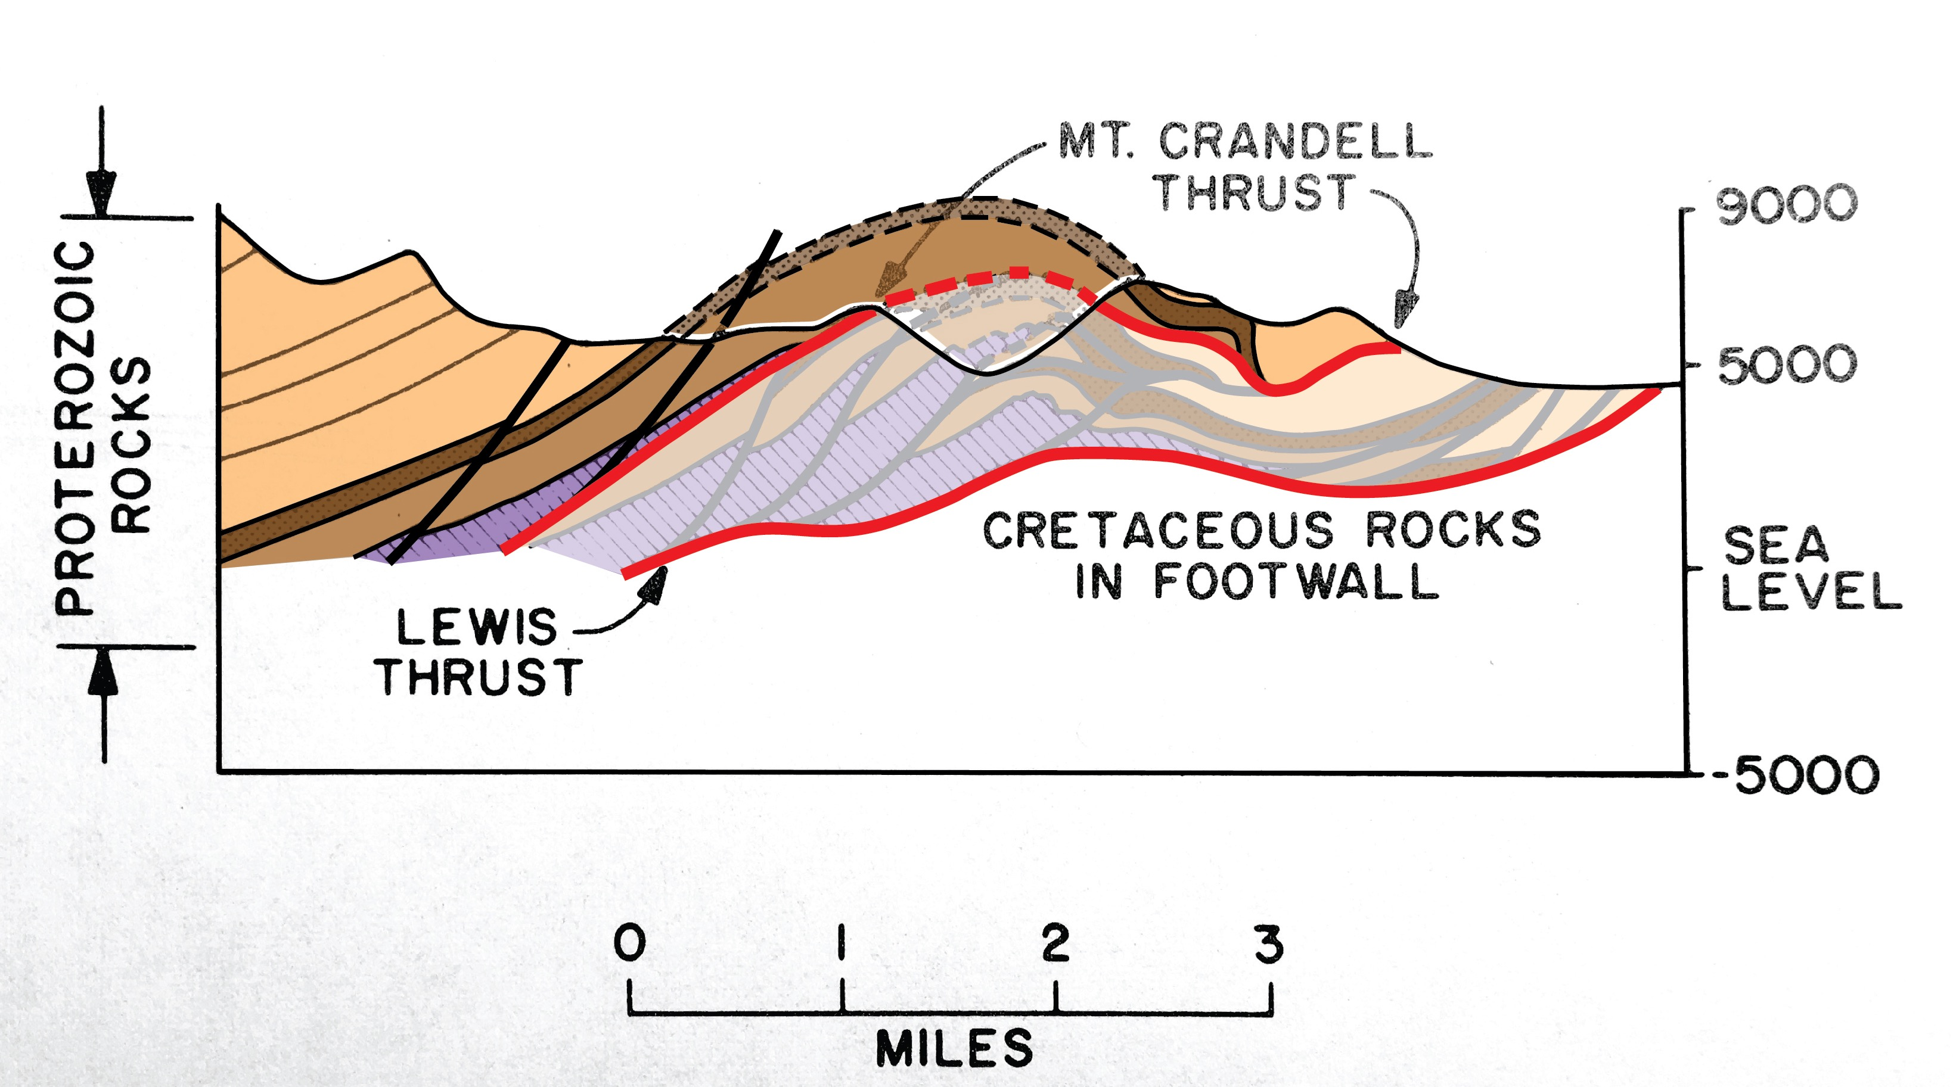
Dahlstrom (1970) – the Mt Crandell duplex
Notes:
The Mt Crandell thrust is the roof, and the Lewis thrust the floor of a duplex comprised of Precambrian metasedimentary rocks. By the way, this duplex is in the same structural position as the imbricate structures described by Bailey Willis in 1902, to the south in Glacier National Park.

Slide 8
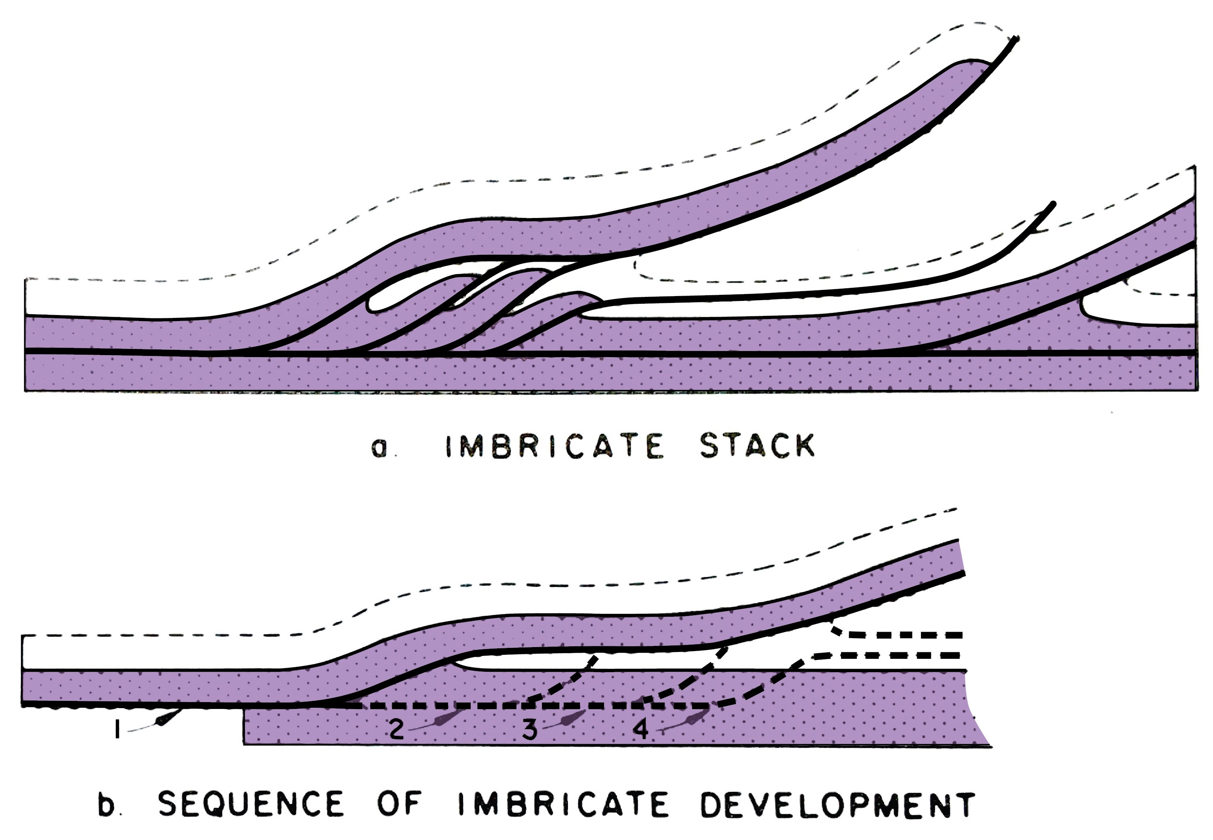
Dahlstrom’s duplex model (1970)
“trailing edge imbricate stack”
“trailing edge imbricate stack”
Dahlstrom’s duplex model (1970)
Notes:
Dahlstrom also used the term “trailing edge imbricate stack”, reflecting that duplexes often form near the rear, or “trailing edge” of major thrust sheets. Dahlstrom proposed that duplexes as formed by a hinterland-to-foreland progression of the imbricates.
Through invited lectures and interactions with colleagues, Dave Elliott helped spread Dahlstrom’s work to a larger audience of geologists working in the US Appalachians & Rockies & other thrust belts worldwide.

Slide 9
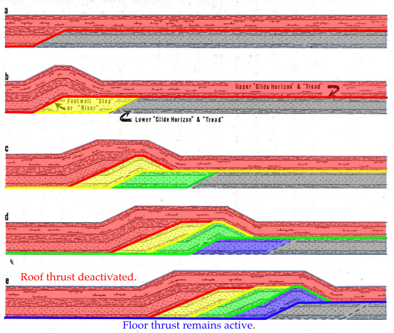
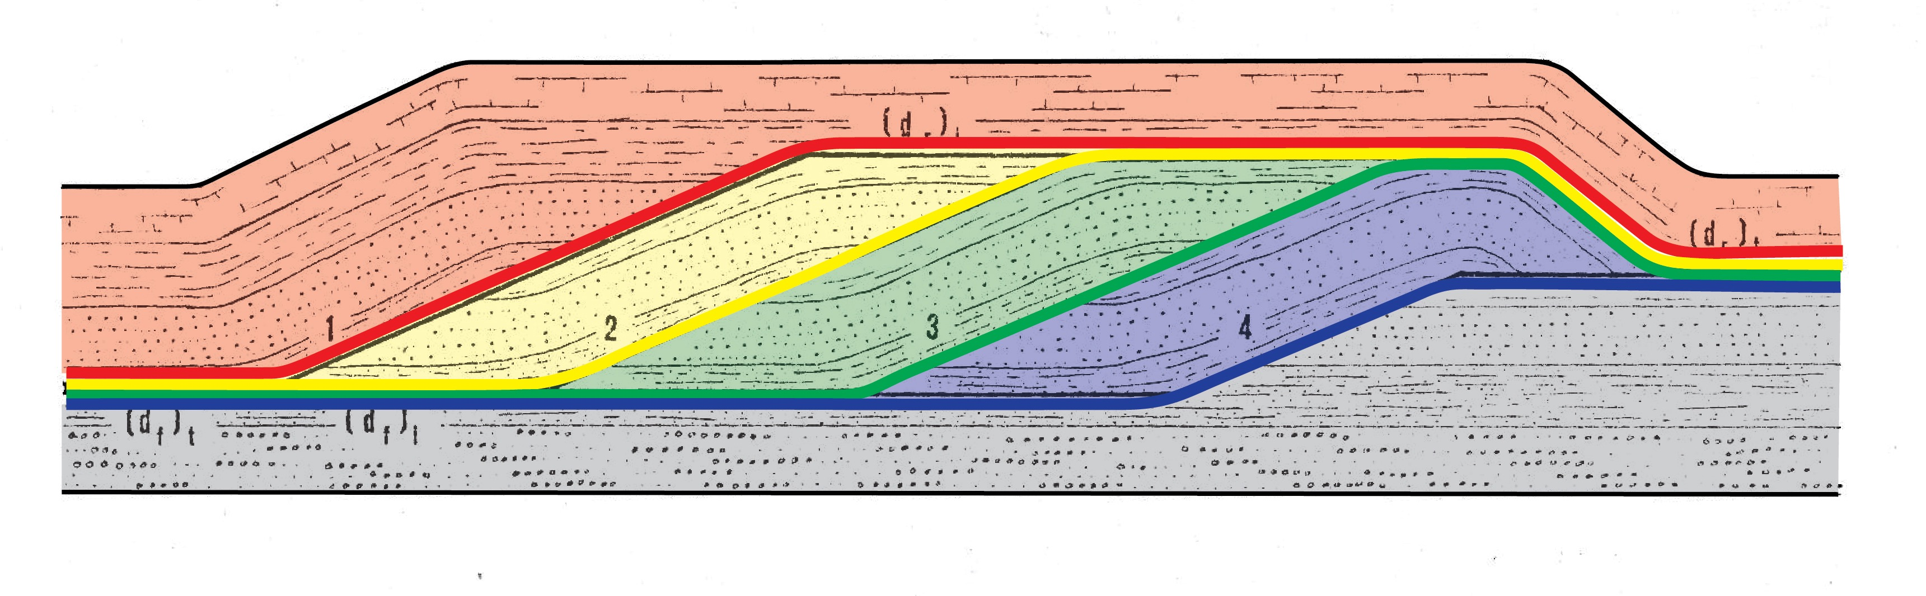
Boyer (1978)
Notes:
Dave proposed that tectonic windows in the southern Appalachian might be interpreted as exhumed duplex fault zones. Struggling for a thesis topic, I readily accepted Dave’s suggestion that I study the Grandfather Mountain Window. I began by turning to Clint Dahlstrom’s model.
In constructing such a kinematic model, one can see that a duplex fault zone transfers displacement from the floor thrust to the roof. In these diagrams the imbricate slices and associated faults are color coded to visualize the slip transfer. Each duplex imbricate robs displacement from the floor & feeds it into the roof. The displacement on the floor decreases as the displacement on the roof increases.
Additional notes: Duplex fault zones appear to provide a mechanical advantage for the emplacement of massive thrust sheets (Mitra & Boyer, 1986). It is fascinating to note that the mechanical role of duplexes was first suggested 110 years ago by Peach et al. (1907) based on their work in the Northwest Highlands of Scotland. In that volume, referring to the emplacement of the Moine thrust sheet, Horne (1907) suggested that the “imbricate structure may be said to have acted like rollers for the transport of advancing masses on higher thrust planes.” Bailey (1938) noted that “B. N. Peach in conversation would compare the advance of the a thrust-mass, riding upon schuppen, to the launching of a ship, carried upon roller . . .” Figures similar to the above were published in Boyer & Elliott (1982).
Bailey, E. B., 1938
Eddies in mountain structure: Geological Society of London Quarterly Journal, v. 94, p. 607-625.
Boyer, S.E., & D. Elliott, 1982
Thrust systems: American Association of Petroleum Geologists Bulletin, v. 66, p. 1196-1230.
Horne, J.,1907
General description of the geological structure of the region affectedby post-Cambrian movements in the North-west Highlands, in Peach, B.N., and others, The geological structure of the North-west Highlands of Scotland: Geological Survey of Great Britain Memoir, p. 463-476.
Mitra, G.. , and S. E. Boyer, 1986
Energy balance and
deformation mechanisms of duplexes: Journal of
Structural Geology, v. 8, p. 291-304, 1986.
Peach, B.N., Horne, J., Gunn, W., Clough, C.T., Hinxman, L.W., and Cadell, H.M., 1888
Report on the recent work of the Geological Survey in the Northwest Highlands of Scotland, based on the field notes and maps: Quarterly Journal of the Geological Society of London, v. 64, p. 378-441.
Peach, B. N., J. Horne, W. Gunn, M. A. Clough, and L. W. Hinxman, 1907
The geological structure of the North-west Highlands of Scotland: Geological Survey of Great Britain.

Slide 10
fold duplex
Notes:
But fault duplexes are not the only means of transferring slip between structural levels. Internal shortening & displacement transfer can also occur through a train of folds.

Slide 11
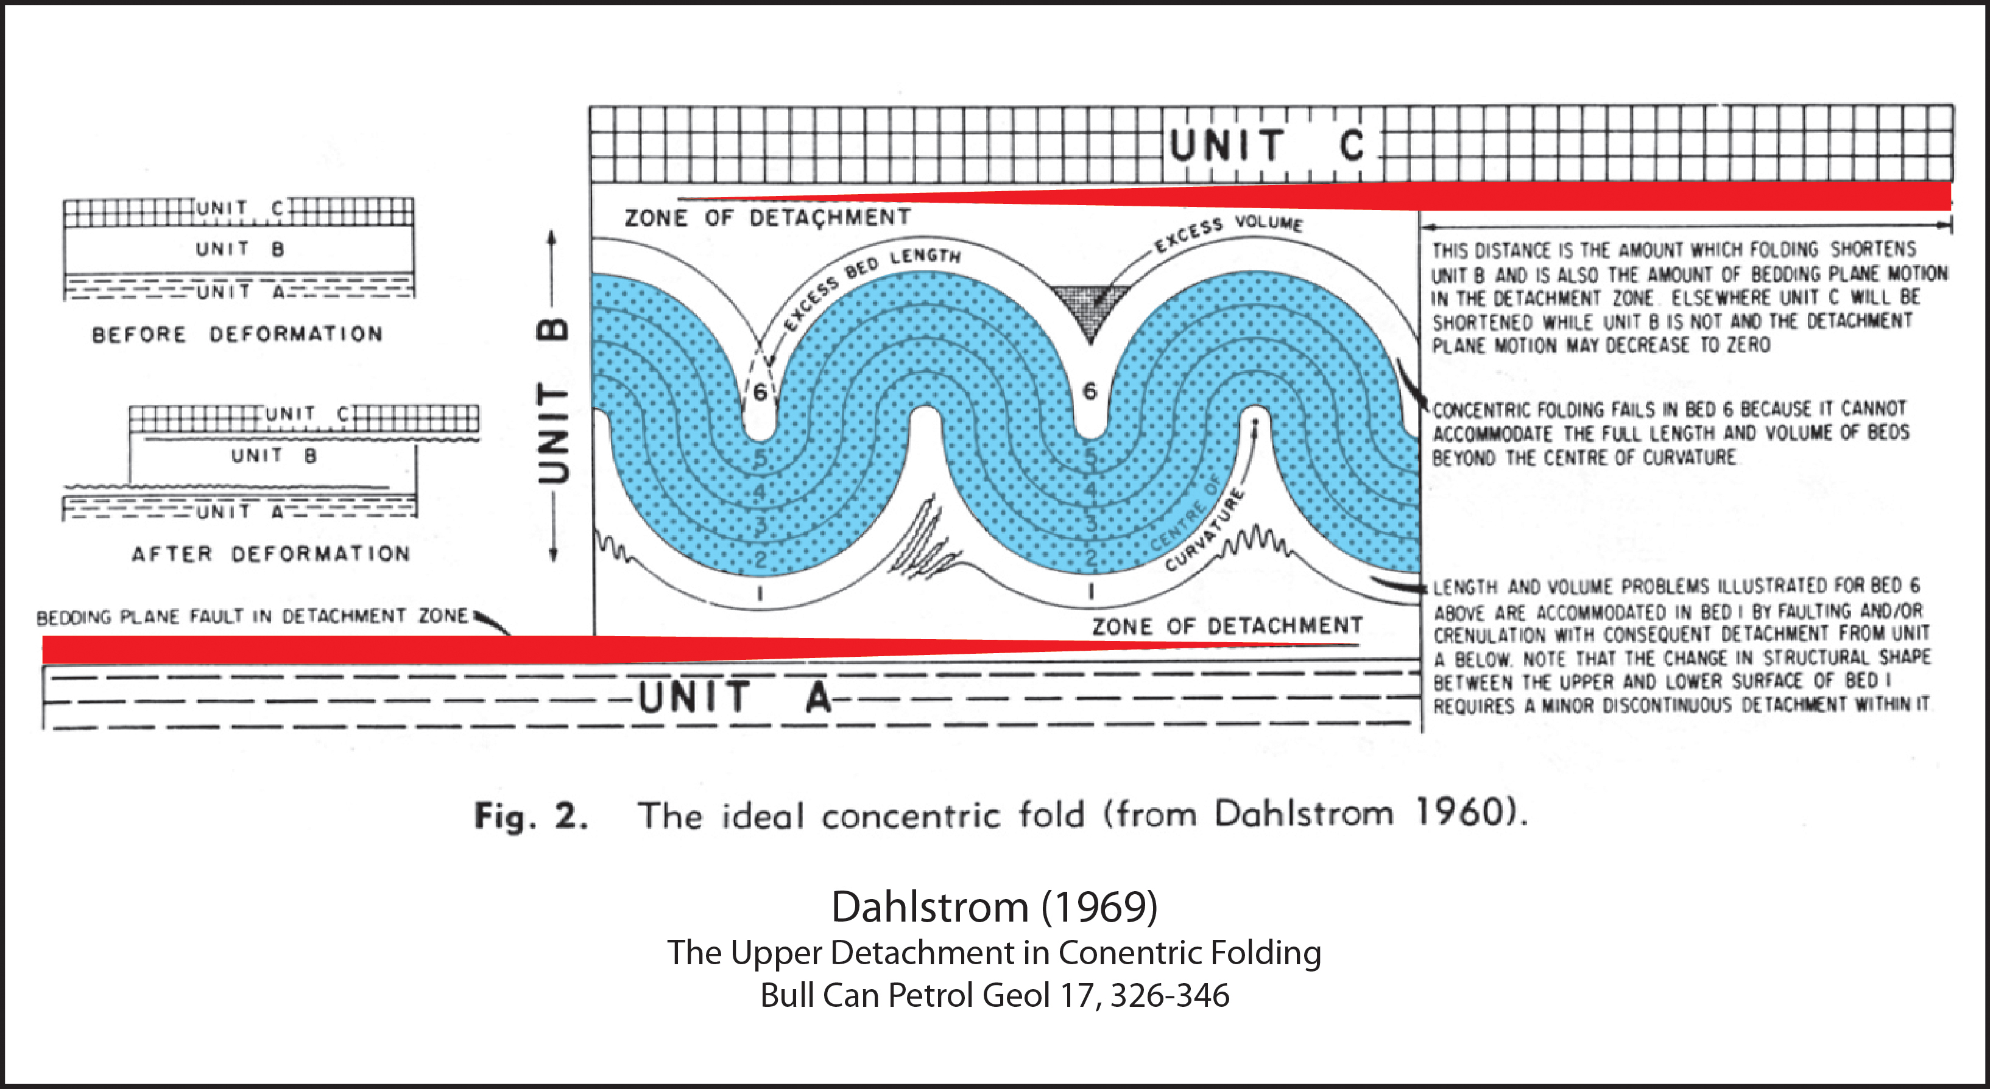
Notes:
Although Clint Dahlstrom did not use the term “fold duplex”, he was the first to hint that folding might play such a displacement-transfer role. Utilized balancing arguments & geometric constraints, Dahlstrom argued that folds detached above a decollement require an upper detachment as well.
As displacement on the lower thrust deceases, it is absorbed by folding. The crowding in the core of each syncline feeds into an upper detachment. The displacement on the upper detachment increases with each fold added to the fold duplex. Displacement on the lower detachment = fold shortening = displacement on the upper detachment.
Dahlstrom, C. D. A., 1969. The upper detachment in concentric folding. Bulletin of Canadian Petroleum Geology 17, 326-46.

Slide 12
cleavage duplex
Notes:
Layer-parallel-shortening (LPS) by cleavage formation, tectonic compaction, & other sub-resolution strain, is yet another mechanism for displacement transfer within a duplex.

Slide 13
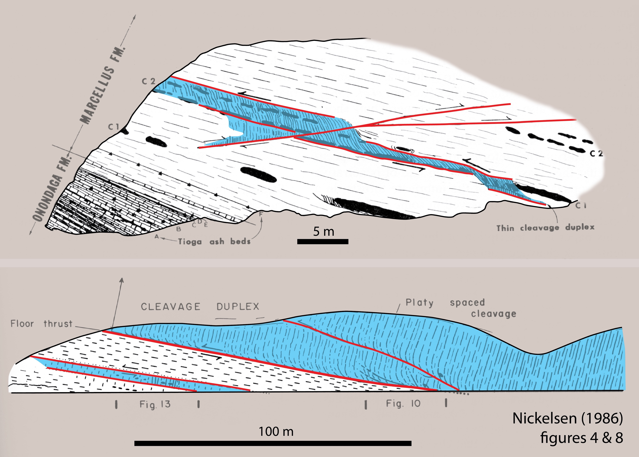
cleavage duplex – Dev Marcellus Shale, PA
Nickelsen (1986)
Notes:
Richard Nickelsen introduced the term cleavage duplex to explain these structures he observed in the Devonian Marcellus Shale of central PA. In the two sections, the areas the shales highlighted in blue shortened by crenulation cleavage. The crenulation cleavage was enhanced by pressure solution removal of calcite in the limbs of the crenulations. These zones constitute what Nickelsen termed cleavage duplexes and they are bounded above & below by bedding-parallel detachments.
Nickelsen, R. P., 1986. Cleavage duplexes in the Marcellus Shale of the Appalachian foreland: Journal of Structural Geology 8, 361-371.

Slide 14



Notes:
So, there are at least three mechanisms for transfering slip within duplexes: imbrication, folding, & layer-parallel-shortening by the formation of cleavages & other microscopic, grain-scale deformation.

Slide 15
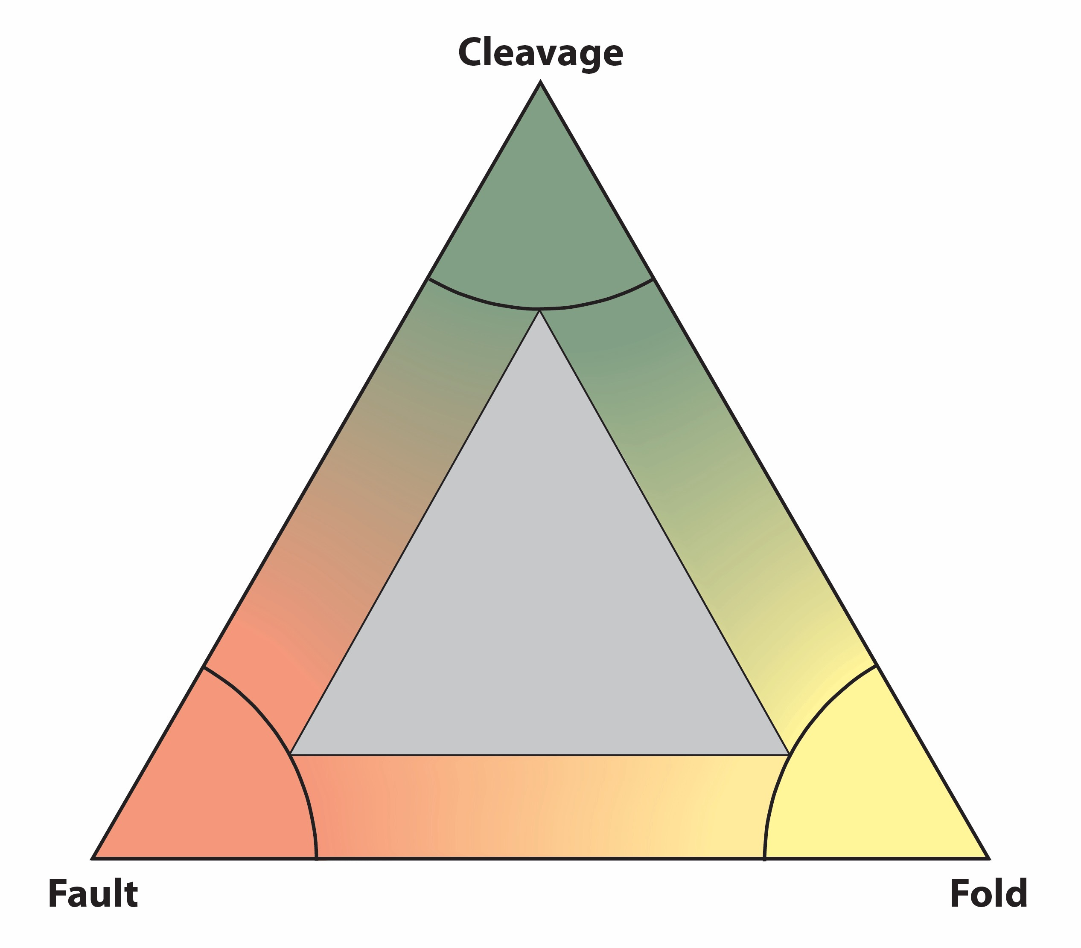
Notes:
These three types of duplexes can be plotted on a ternary diagram.

Slide 16
Hybrid
Hybrid
Hybrid
Notes:
And located on the sides of the triangle would plot hybrid forms, duplexes that contain two deformation mechanisms.

Slide 17
fault
duplex
Notes:
I’ll take you on a traverse around the diagram to discuss the various duplex styles in a bit more detail. We’ve already adequately discussed fault duplexes, so let’s move on to cleavage-fault duplexes.

Slide 18
cleavage
- fault
hybrid
Notes:
In cleavage-fault duplexes, deformation initiates with pressure-solution or crenulation cleavages, and is followed by faulting.

Slide 19
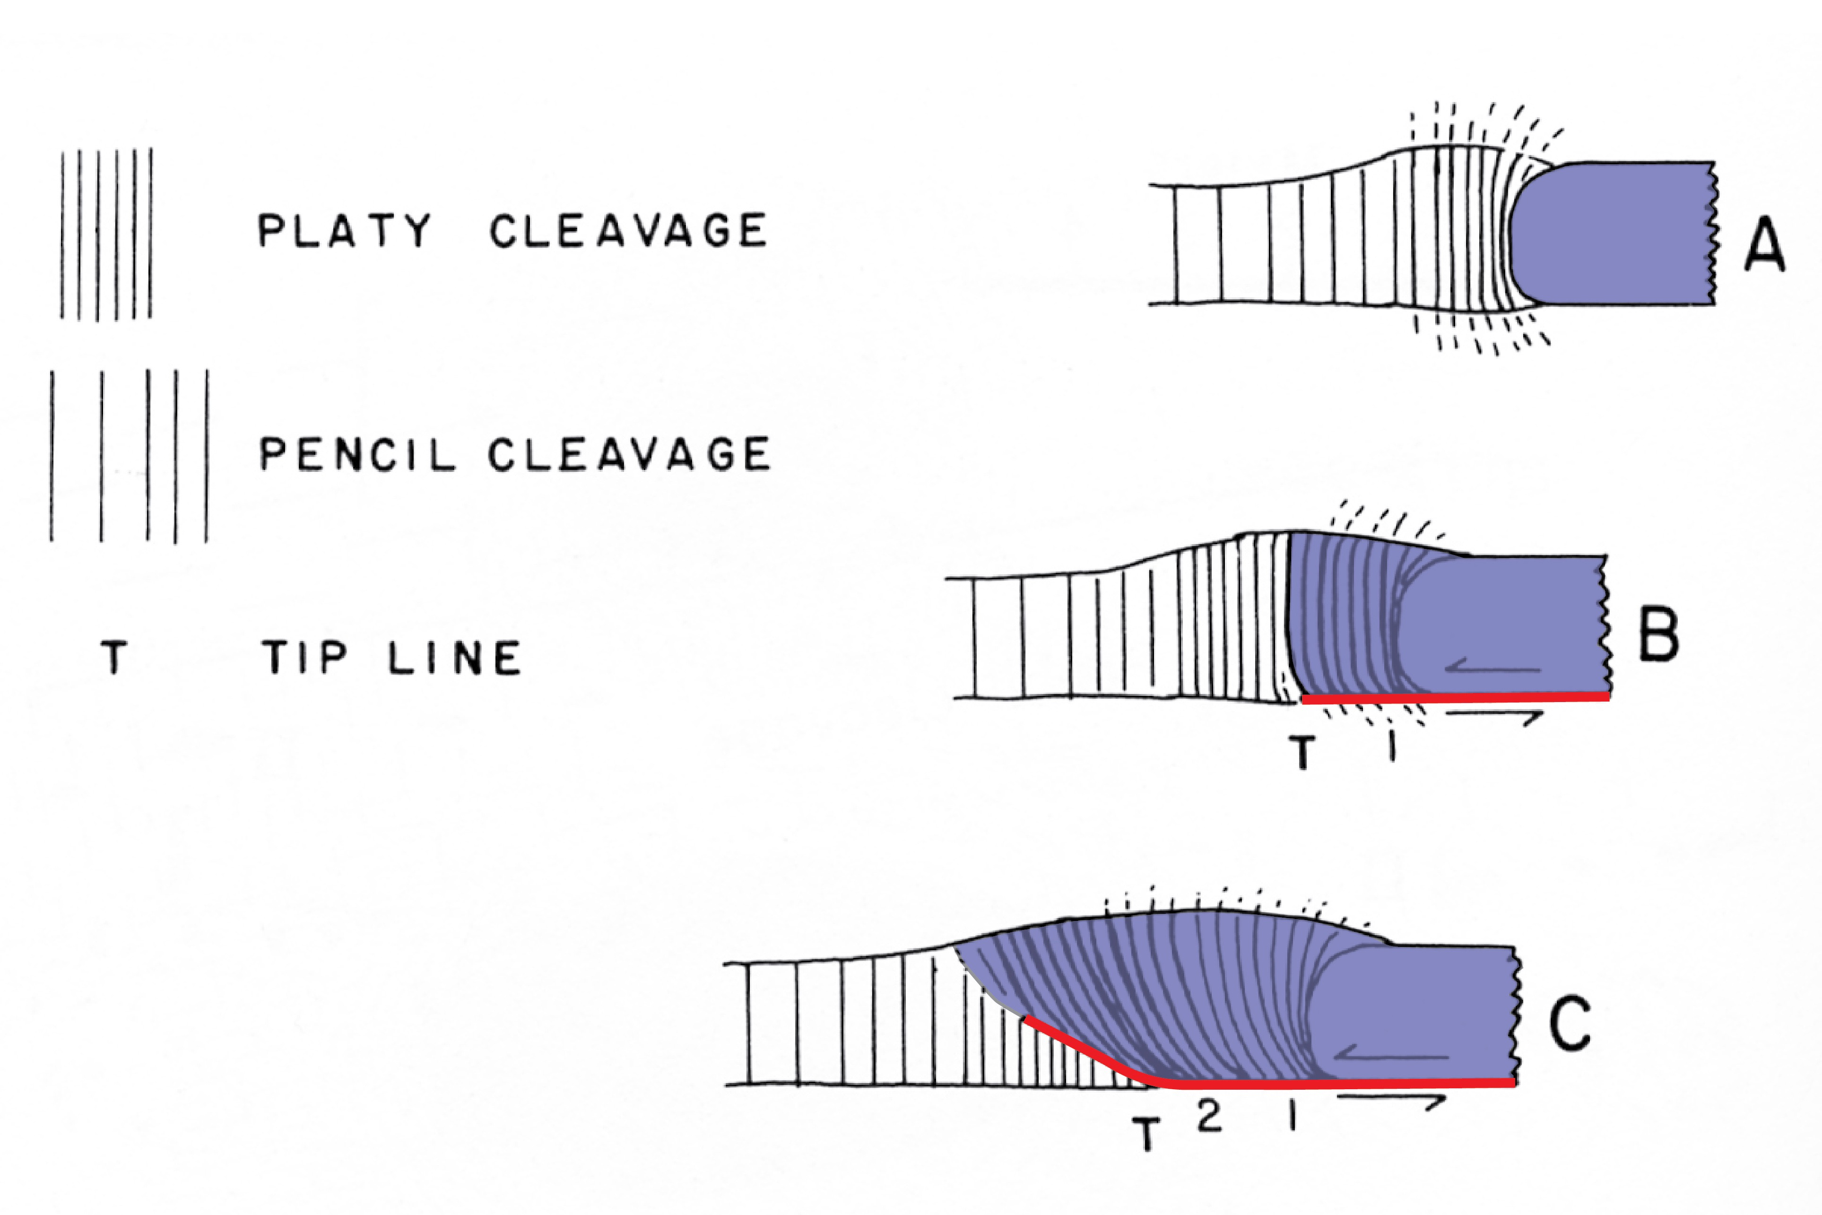
Nickelsen (1986)
Evolution of cleavage-fault duplex
Notes:
Nickelsen suggested this mechanism for the formation of a cleavage-fault duplex. A concretion or other mechanism initiates the formation of cleavage. As the cleavage front migrates it changes the material properties of the rock, leading to more brittle behavior, fracturing and the formation of imbricate faults. The vertical lines are the cleavage planes & the lavender color indicates the portion of rock that has been rendered brittle by the formation of cleavage.
Nickelsen, R. P., 1986, Cleavage duplexes in the Marcellus Shale of the Appalachian foreland: Journal of Structural Geology, v. 8, p. 361-371.

Slide 20
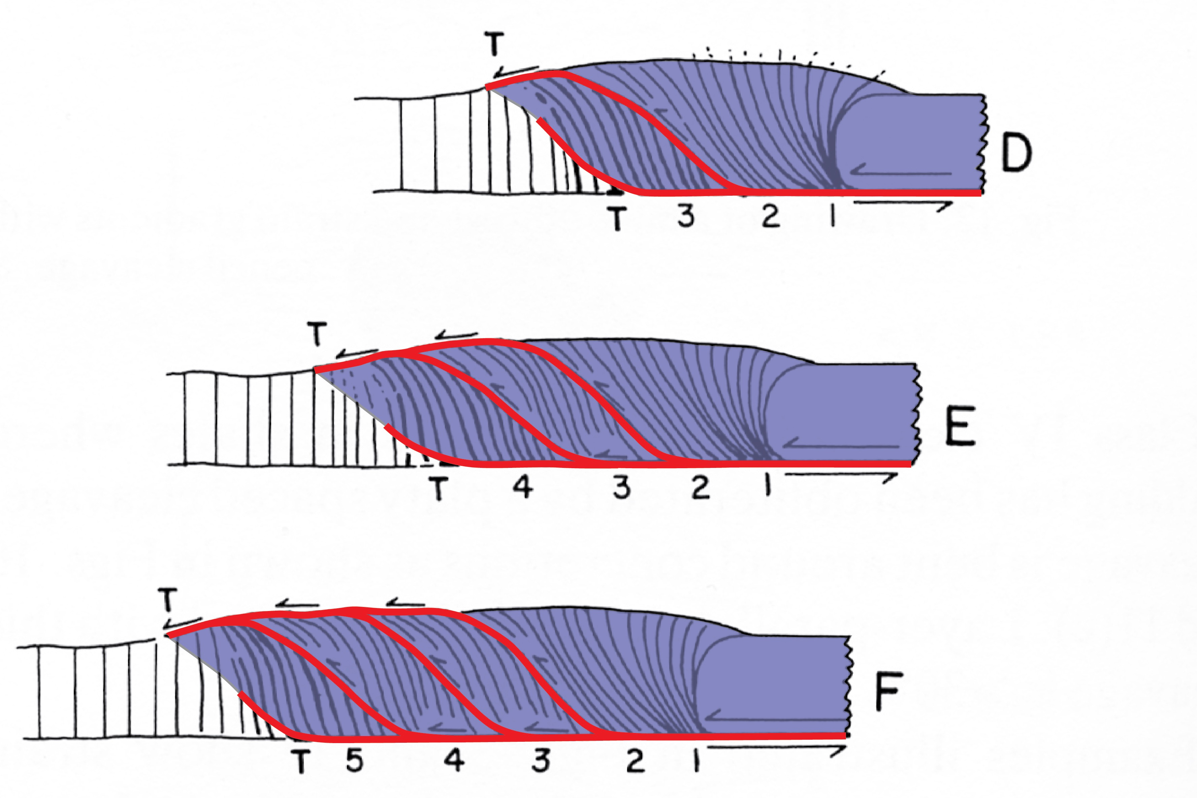
Nickelsen
(1986)
Evolution of cleavage-fault duplex
Notes:
Thus, through time, there is a migrating front of cleavage followed by the propagation of faults to form a hybrid duplex.

Slide 21
cleavage
duplex
Notes:
A cleavage duplex would consist entirely of cleavage shortening, produced by tectonic compaction and / or pressure solution.

Slide 22
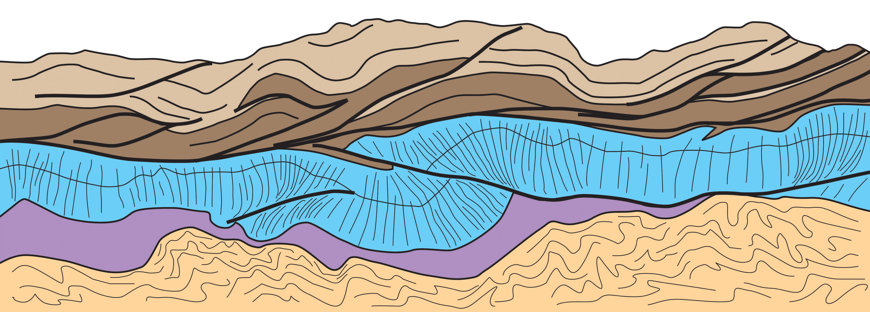
Cleavage duplex
Cretaceous carbonates
SW Montana
Kiorpes (1990)
5 meters
Notes:
We’ve previously discussed Nickelsen’s Marcellus cleavage duplex. Here is another example described by Steve Kiorpes in a University of Washington masters thesis. This is a sketch from photos. All the rocks are Cretaceous carbonates of SW Montana.
The upper fossiliferous limestone, brown, has shortened by thrust imbrication. The upper sequence may be a fault duplex, although the roof has been eroded away. The underlying blue unit, a clay rich, micritic limestone with few fossils, deformed by the formation of pressure-solution cleavage to form a cleavage duplex. Note that there also is a minor component of late faulting in the duplex, so it is transitional to a cleavage-fault duplex.
Kiorpes, S.T., 1990. Pressure solution leading to unbalanceable cross-sections: Analysis of an outcrop-scale example from the Southwestern Montana fold-and-thrust belt near Dillon, Montana. MS thesis, University of Washington.

Slide 23
cleavage
- fold
hybrid
Notes:
There can also be cleavage fold hybrids. LPS shortening by cleavage formation was followed by folding.

Slide 24
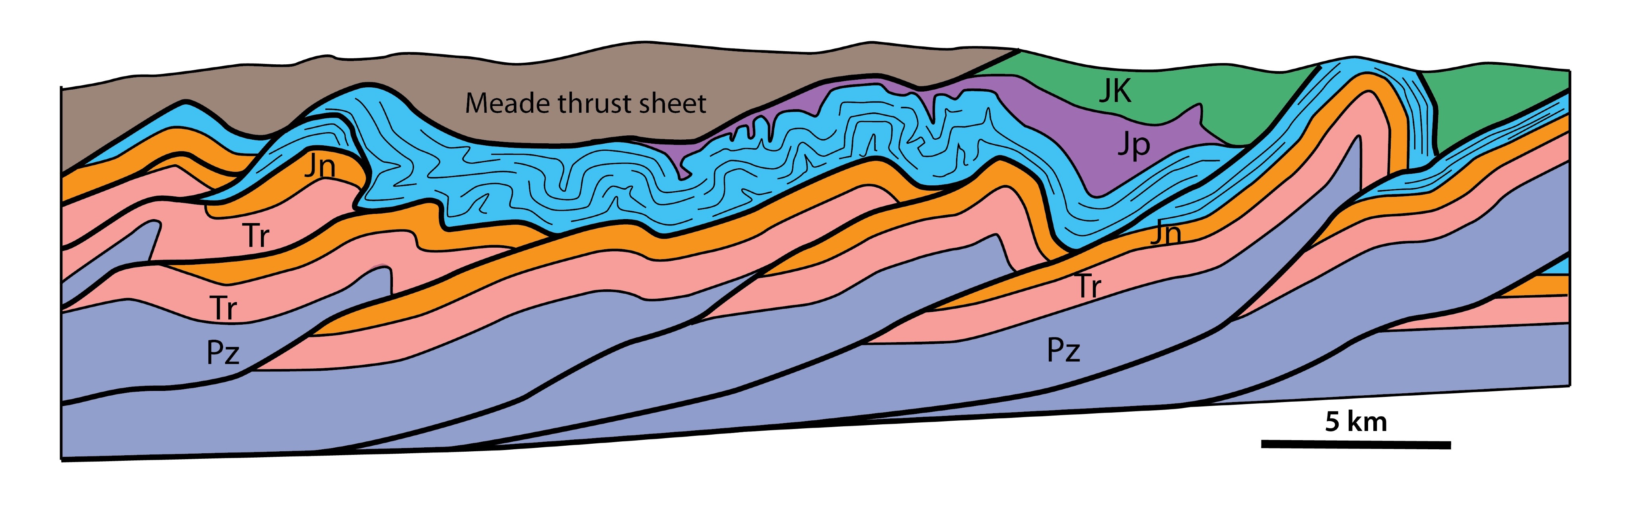
Synoptic cross section modeled after Coogan
(fig 17 in Coogan & Royse, 1990) &
incorporating field studies &
downplunge projections by
Coogan & Yonkee (1985),
Mitra & Yonkee (1985) &
Protzman & Mitra (1990).
Notes:
A cleavage-fold hybrid duplex lies in the footwall of the Meade thrust in the Ut-Wy-Id thrust belt. The Meade thrust sheet of Paleozoic & Mesozoic strata is shown in brown. Underlying the thrust are Jurassic Twin Creek limestones in blue. This generalized cross-section is based on the mapping & analysis of Jim Coogan, Adoph Yonkee, Gretchen Protzman, & Gautam Mitra.
Coogan, J.C., and Royse, F.R., Jr., 1990, Overview of recent developments in thrust belt interpretation: in S. Roberts (ed.), Geologic Field Tours of Western Wyoming and parts of adjacent Idaho, Montana, and Utah: Public Information Circular No. 29, p. 89 - 124.
Coogan, J.C., and Yonkee, W.A., 1985, Salt detachments in the Jurassic Preuss redbeds within the Meade and Crawford thrust systems, Idaho and Wyoming: Utah Geological Association publication 14, Orogenic Patterns and Stratigraphy of North-central Utah and southeastern Idaho, p. 75 - 82.
Mitra, G., and Yonkee, W.A., 1985, Relationship of Spaced Cleavage to folds and thrusts in the Idaho-Utah-Wyoming thrust belt. Journal of Structural Geology 7, 361-373.
Protzman, G. M., and Mitra, G., 1990, Strain fabric associated with the Meade thrust implications for cross-section balancing. Journal of Structural Geology 12, 403-417.

Slide 25
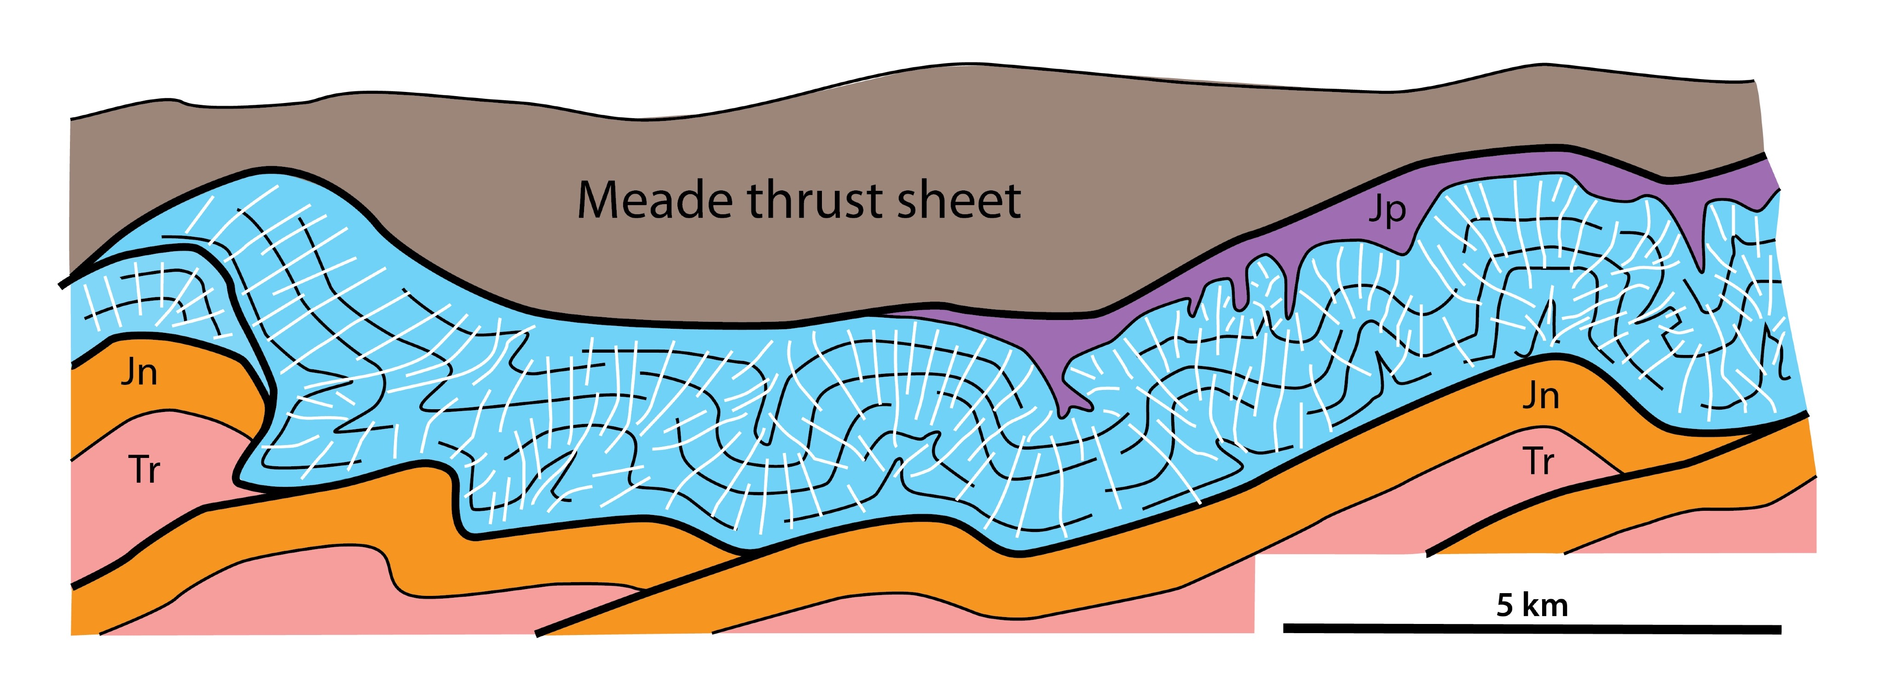
Notes:
During the emplacement of the Meade thrust sheet, the footwall sequence of Jurassic Twin Creek limestones deformed by the formation of pressure-solution cleavage & folding. As the shortening in the Twin Creek was taken up by cleavage formation and folding, the underlying Paleozoic and lower Mesozoic sequence deformed by imbricate faulting, essentially a fault duplex whose roof was at the base of the Twin Creek.

Slide 26
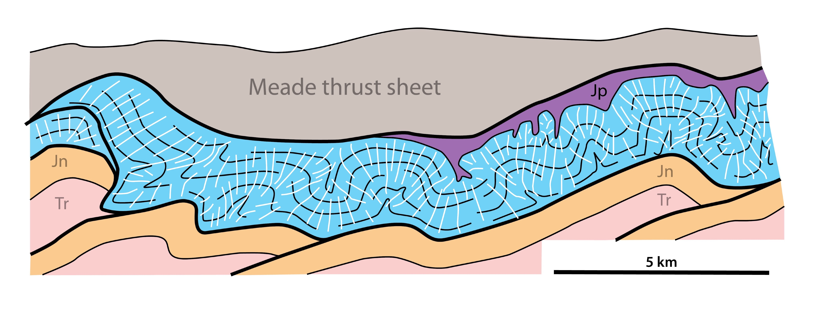
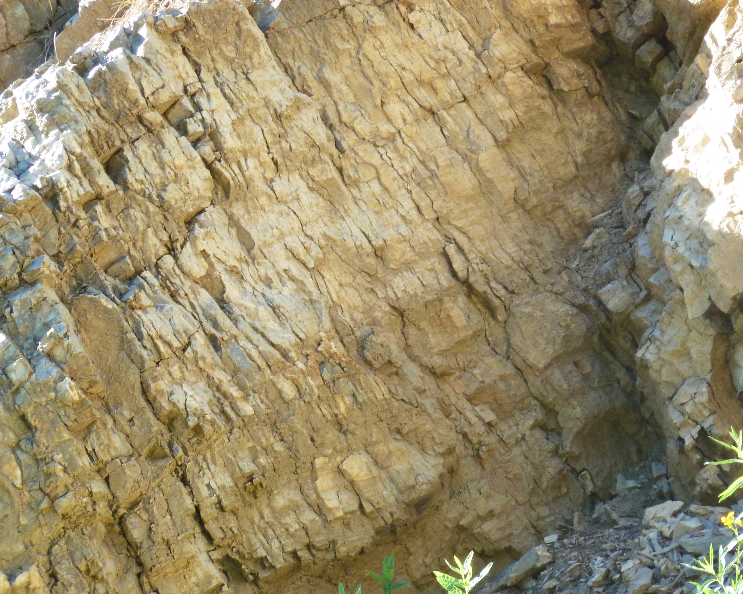
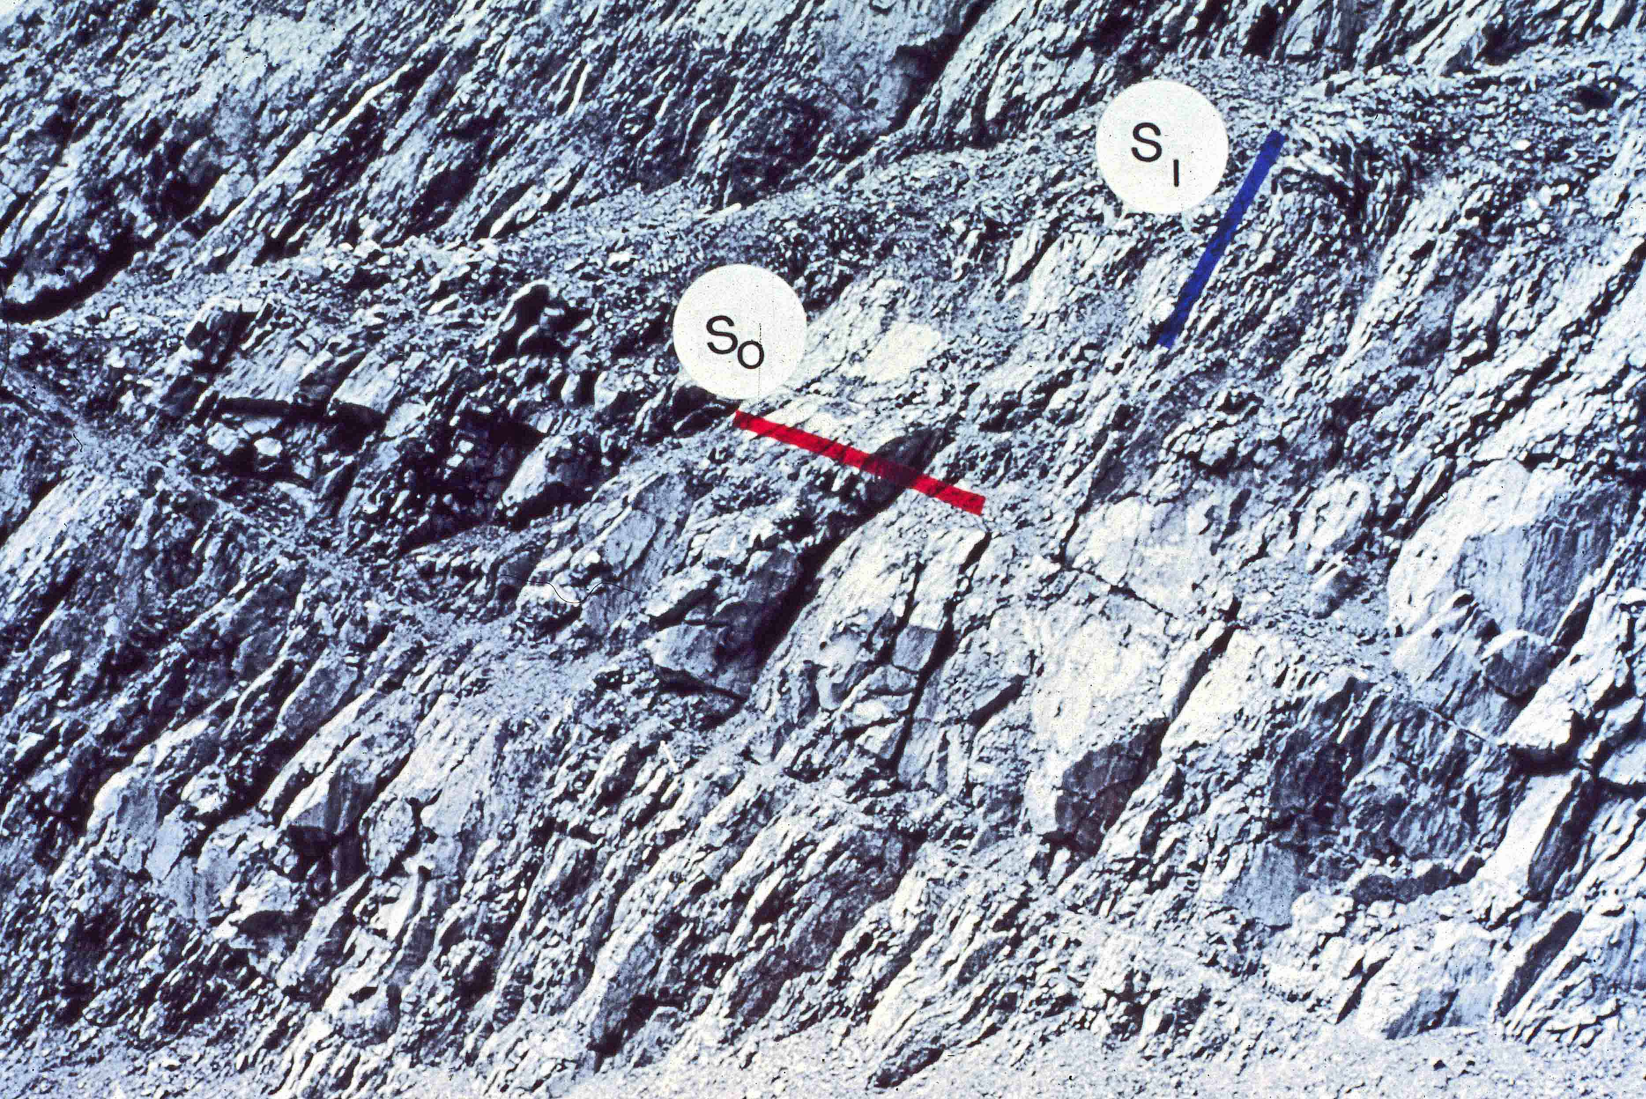


So
S1
Notes:
Gretchen Protzman, Adoph Yonkee, Jim Coogan, and my co-author Gautam measured strain & studied cleavage-bedding relations in the Twin Creek. As indicated by the photos, they observed that cleavage is at right angles to bedding regardless of structural position. Doesn’t matter whether you are looking at the west limb, the east limb, or the crest of a fold. This suggests that the rocks deformed by the formation of pressure-solution cleavage and then by folding.
So the deformed sequence of Jurassic carbonates constitutes cleavage-fold duplex. The Meade thrust is the roof, and a detachment in the Gypsum Springs member the Twin Creek formation is the floor.

Slide 27
fold
duplex
Notes:
There can also be fold duplexes, . . .

Slide 28
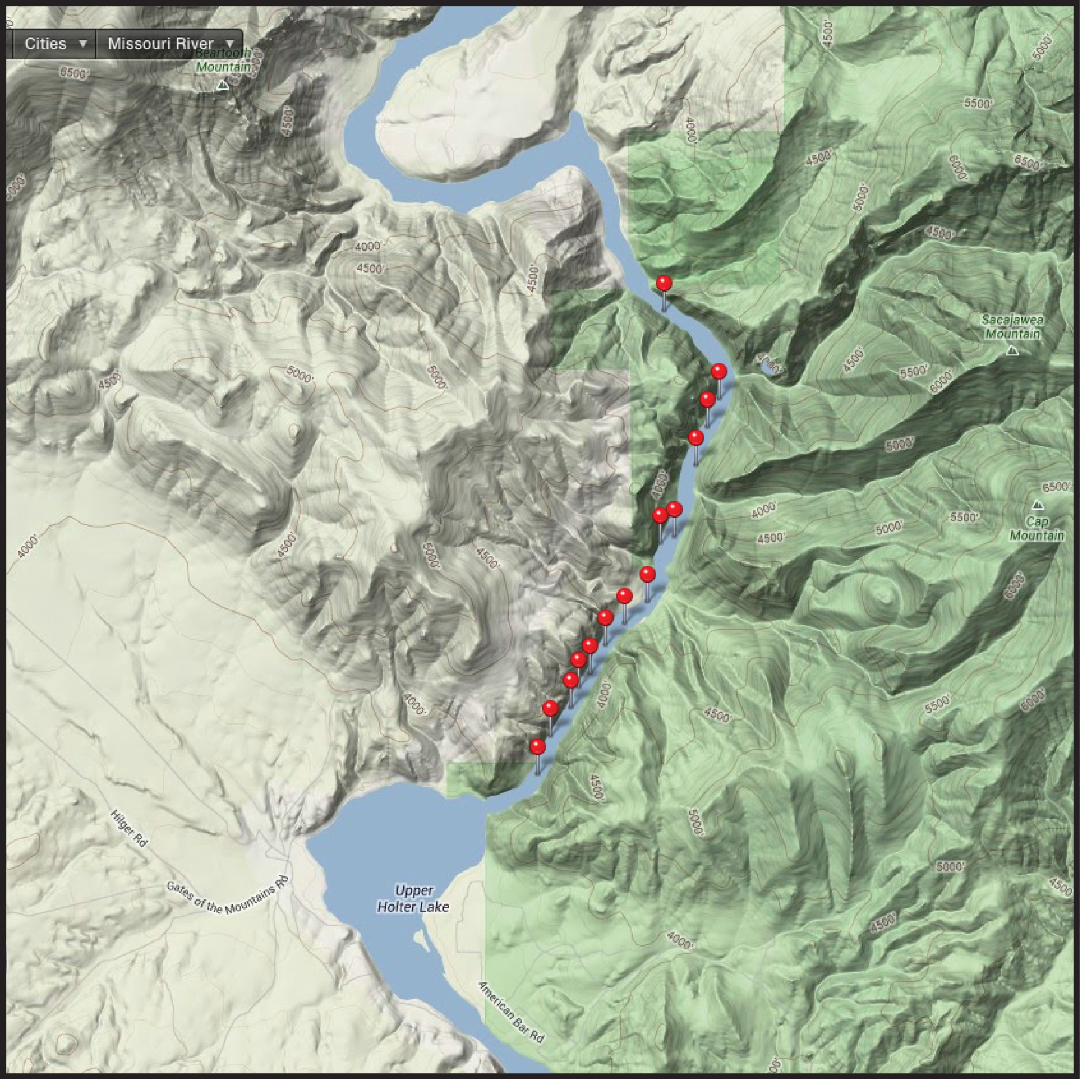
Gates
of the Mtns
––
Missouri R
Montana
Notes:
. . . and Gates of the Mountains, transected by the Missouri River, provides excellent exposures of such a fold duplex. On a boat traverse I took numerous photos of the canyon walls.

Slide 29
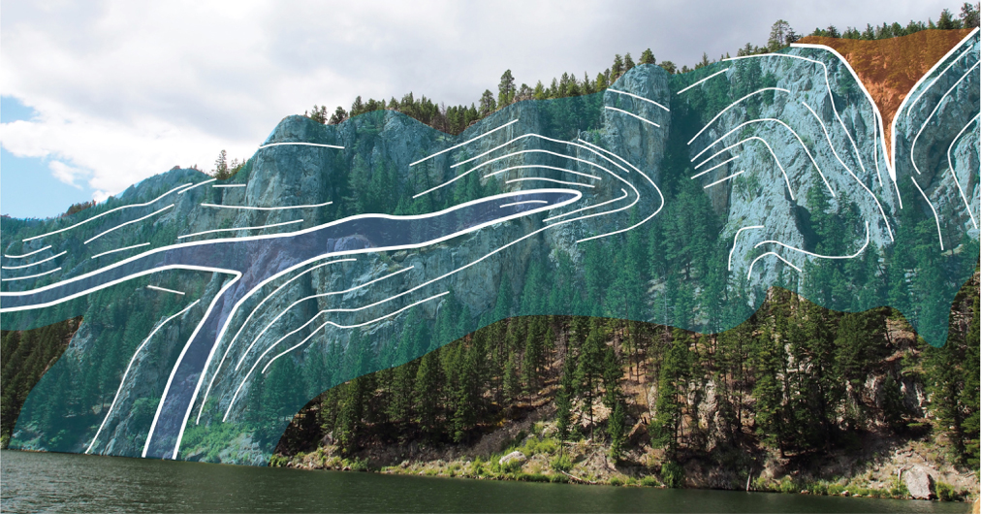
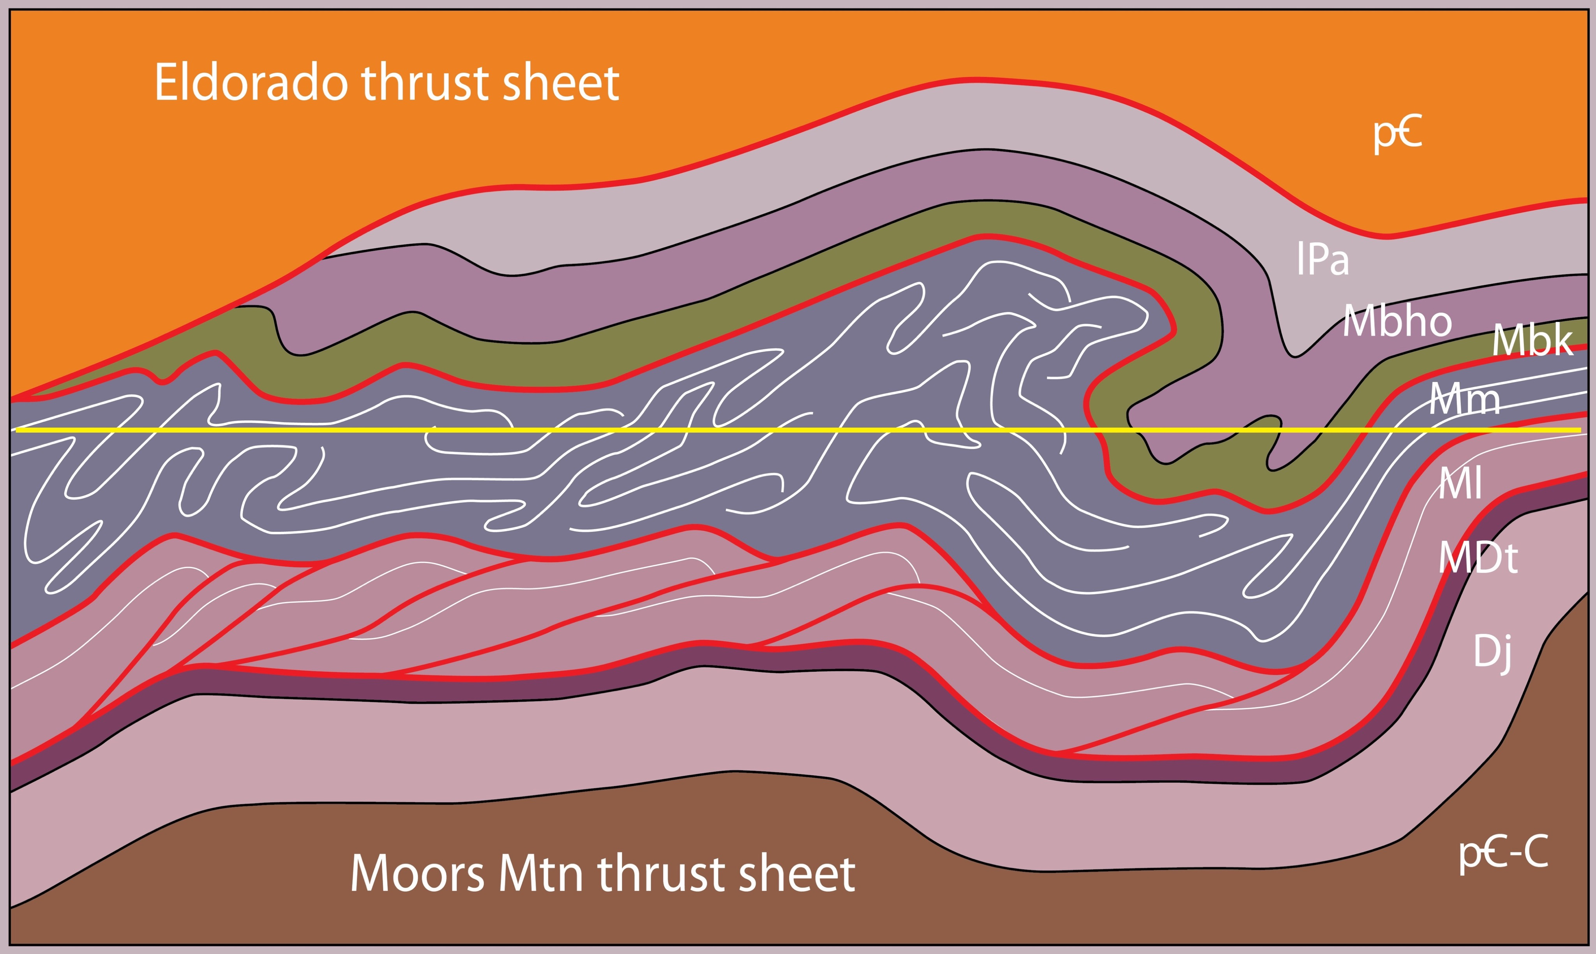
isoclinal fold duplex
Gates of the Mtns
after
Robinson
et al.
1969
Notes:
The photo at upper left shows one of the recumbent isoclinal folds exposed in the canyon. The schematic cross section is based on these photos. Throughout the length of the canyon Mississippian Madison Group carbonates are repeated isoclinal folds stacked one upon the other much like the fault imbricates of a duplex.
The blue-gray rocks are the Mississippian carbonates. Floor thrust at base separates the fold duplex from underlying Cambrian & Devonian clastics & carbonates. The duplex would have formed in the footwall of the overriding Eldorado thrust sheet of Precambrian Belt metasediments. The river level is shown by the yellow line. .

Slide 30
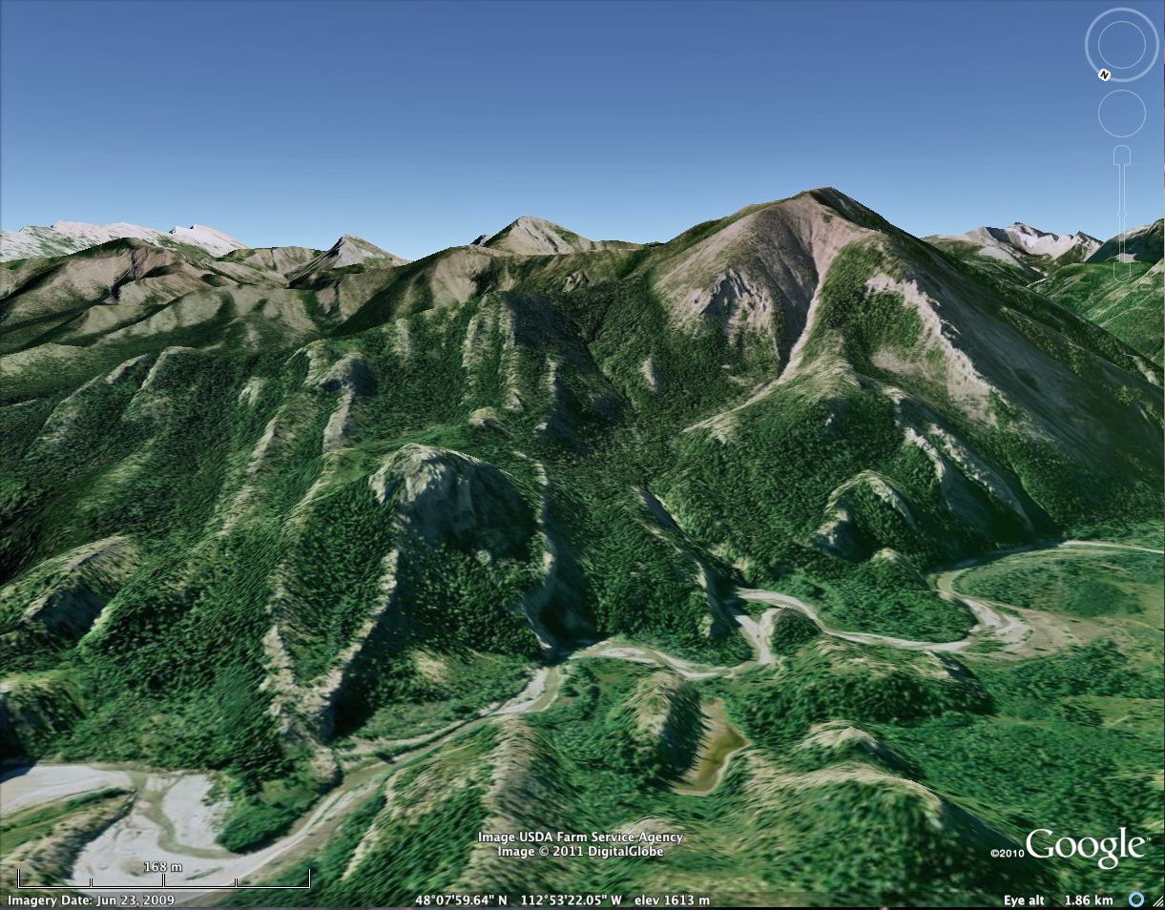
fold duplex – N Sawtooths, MT
Notes:
Another fold duplex to the north in the Sawtooth Ranges of Montana consists of upright isoclinal folds.

Slide 31
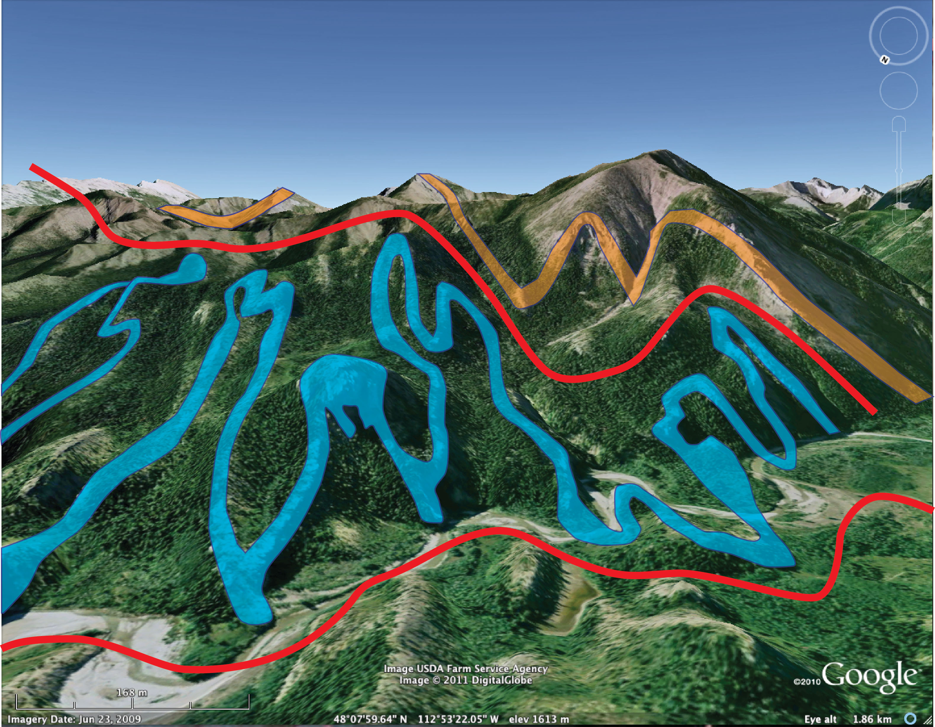
fold duplex – N Sawtooths, MT
Notes:
These folds are comprised of Cambrian carbonates and clastics, highlighted in blue.
The tight folding requires a basal detachment, and as suggested by Dahlstrom, an upper detachment. The roof thrust separates the Cambrian sequence from overlying Devonian carbonates and clastics, highlighted in brown.

Slide 32
fold - fault
hybrid
Notes:
There can also be fold-fault hybrids, in which folding preceded faulting, and . . .

Slide 33
cleavage -
fold - fault
hybrid
Notes:
. . . duplexes that can combine all three mechanisms.
Duplexes in which the strata first experience LPS by cleavage formation, then folding & finally faulting.

Slide 34
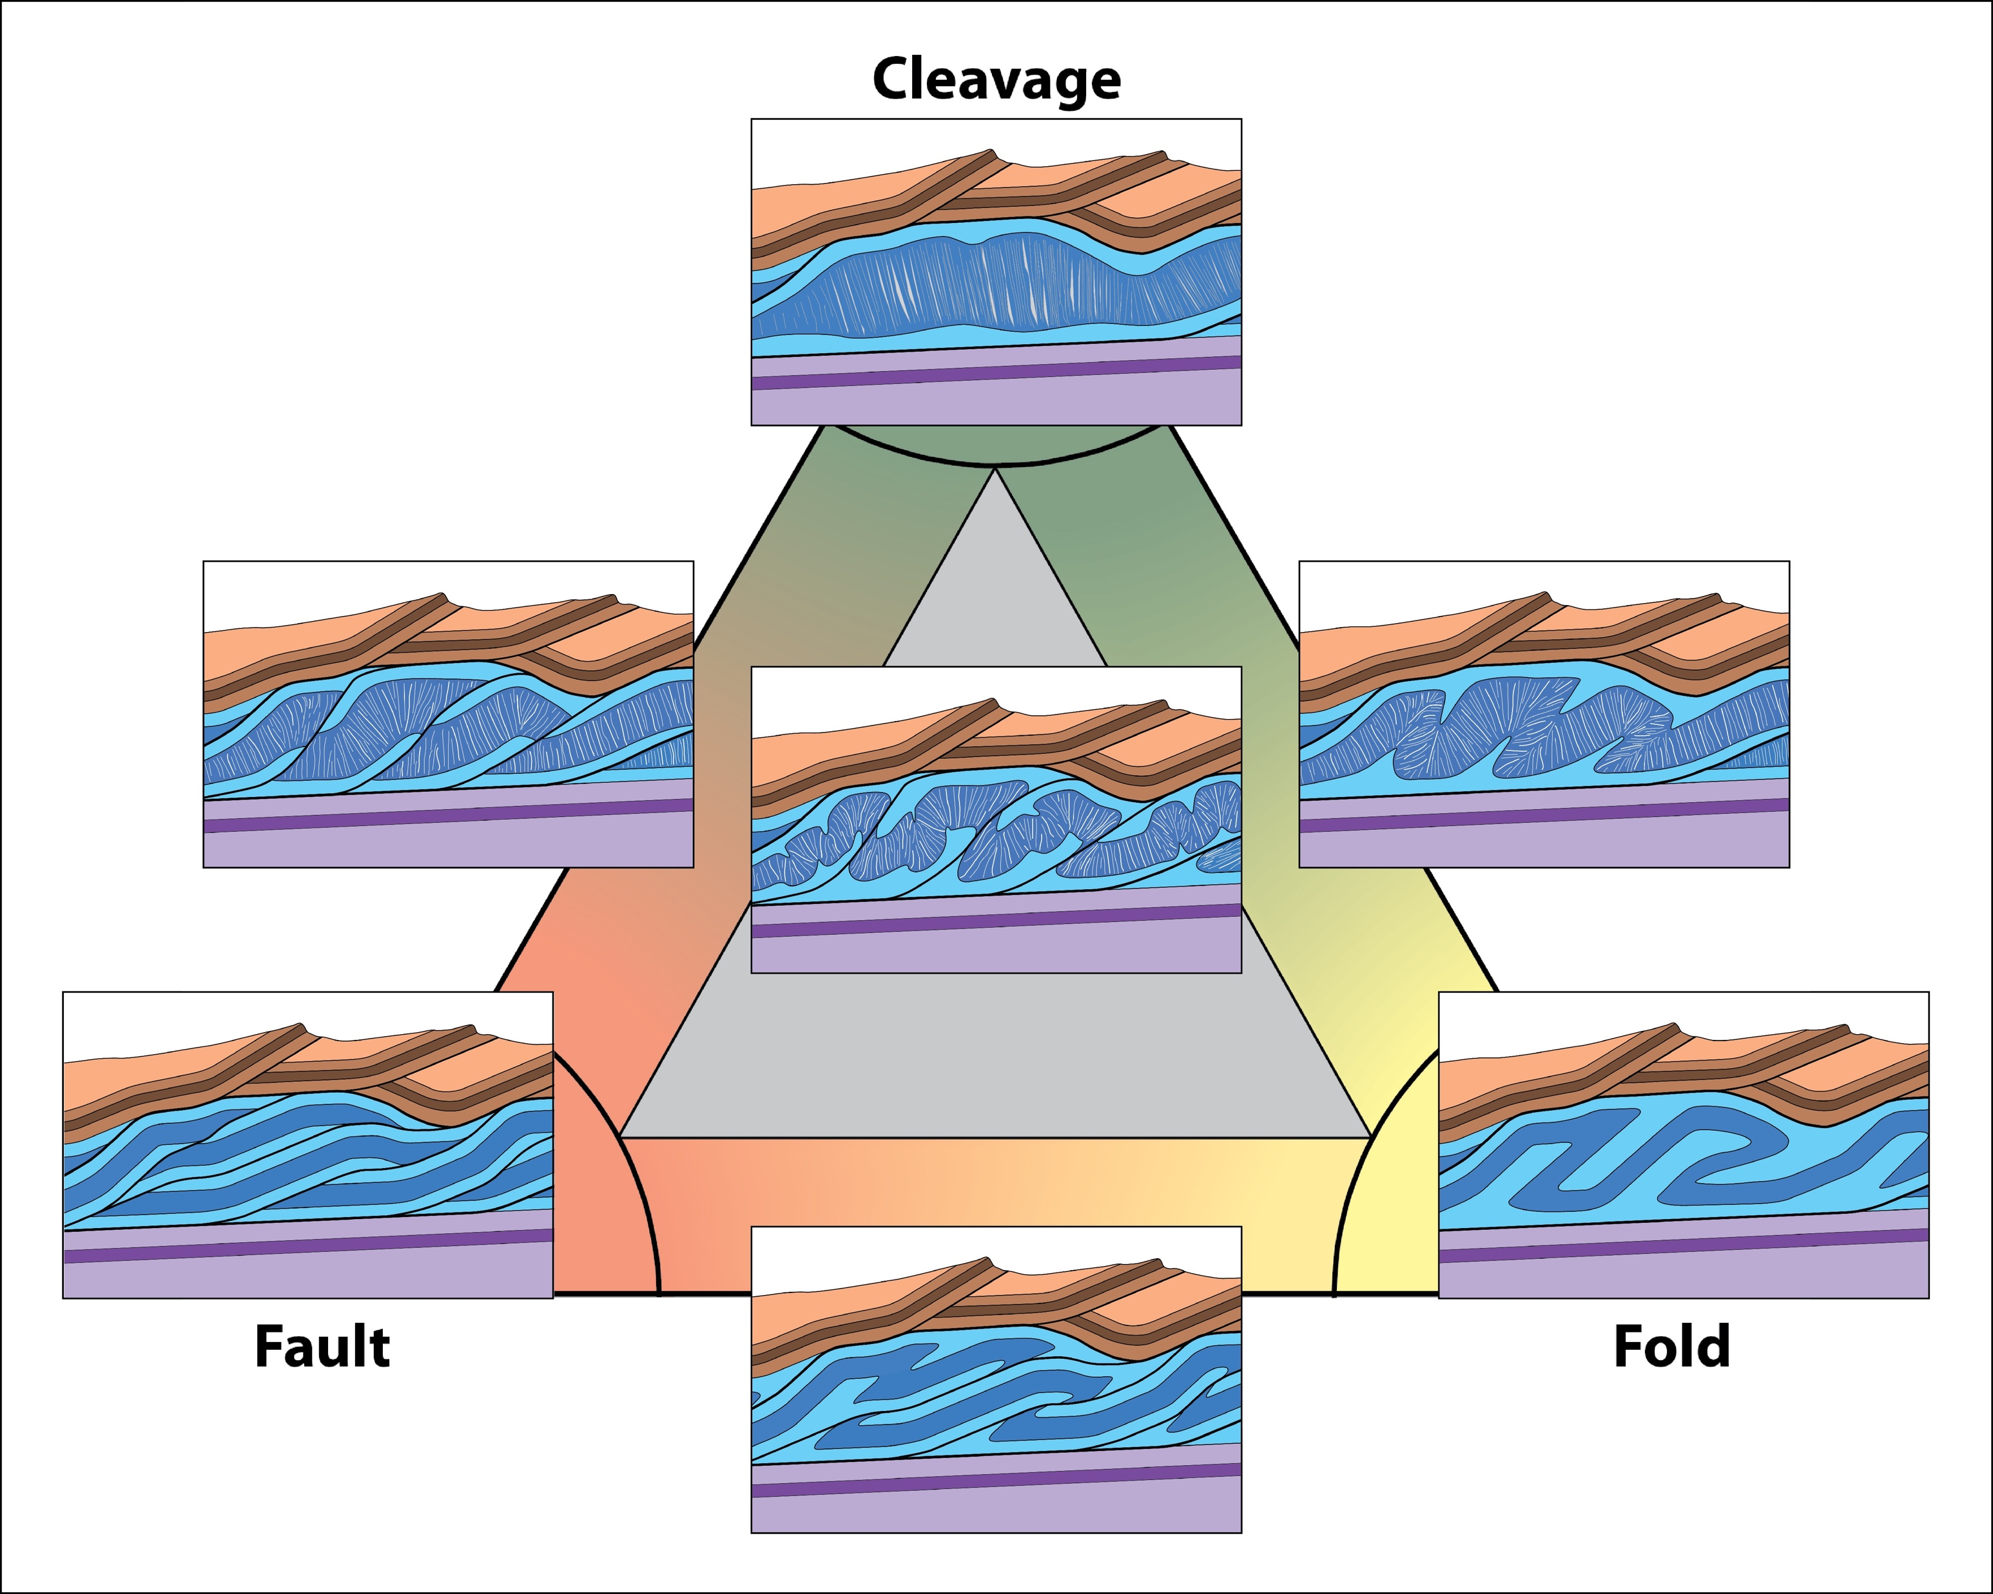
Notes:
This diagram summarizes all potential end member duplexes & hybrids.

Slide 35
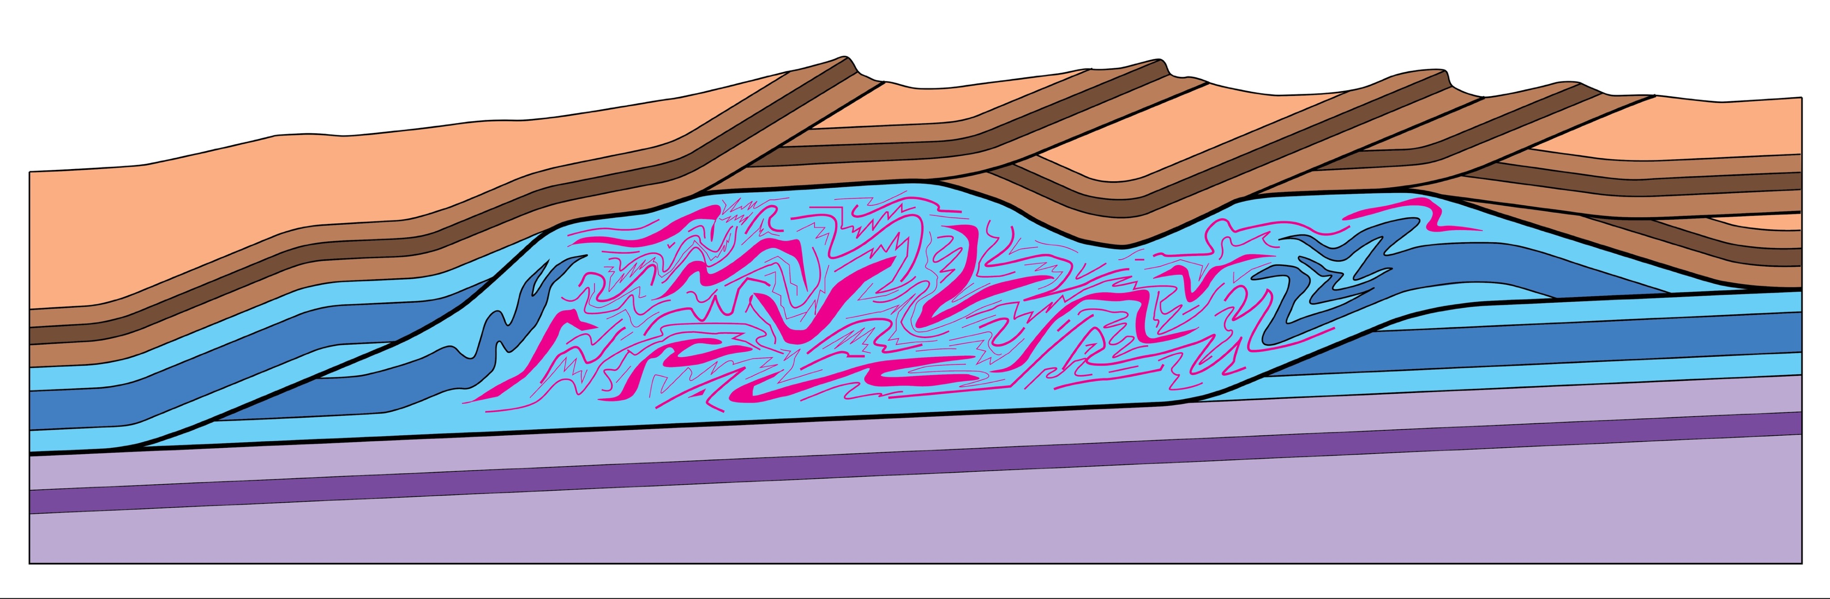
ductile flow duplexes
“Mushwad” (Thomas 2001)
Malleable Unctuous SHale Weaklayer Accretion in a Ductile duplex
Notes:
We can add yet one more duplex. In very weak, incompetent rocks, such as large thicknesses of evaporites, shale or coal, shortening may take place by massive, ductile flow. Bill Thomas has called these MUSHWADs.
Thomas, William A., 2001
Mushwad: Ductile duplex in the Appalachian thrust belt in Alabama, AAPG Bulletin, v. 85, p. 1847-1869.

Slide 36
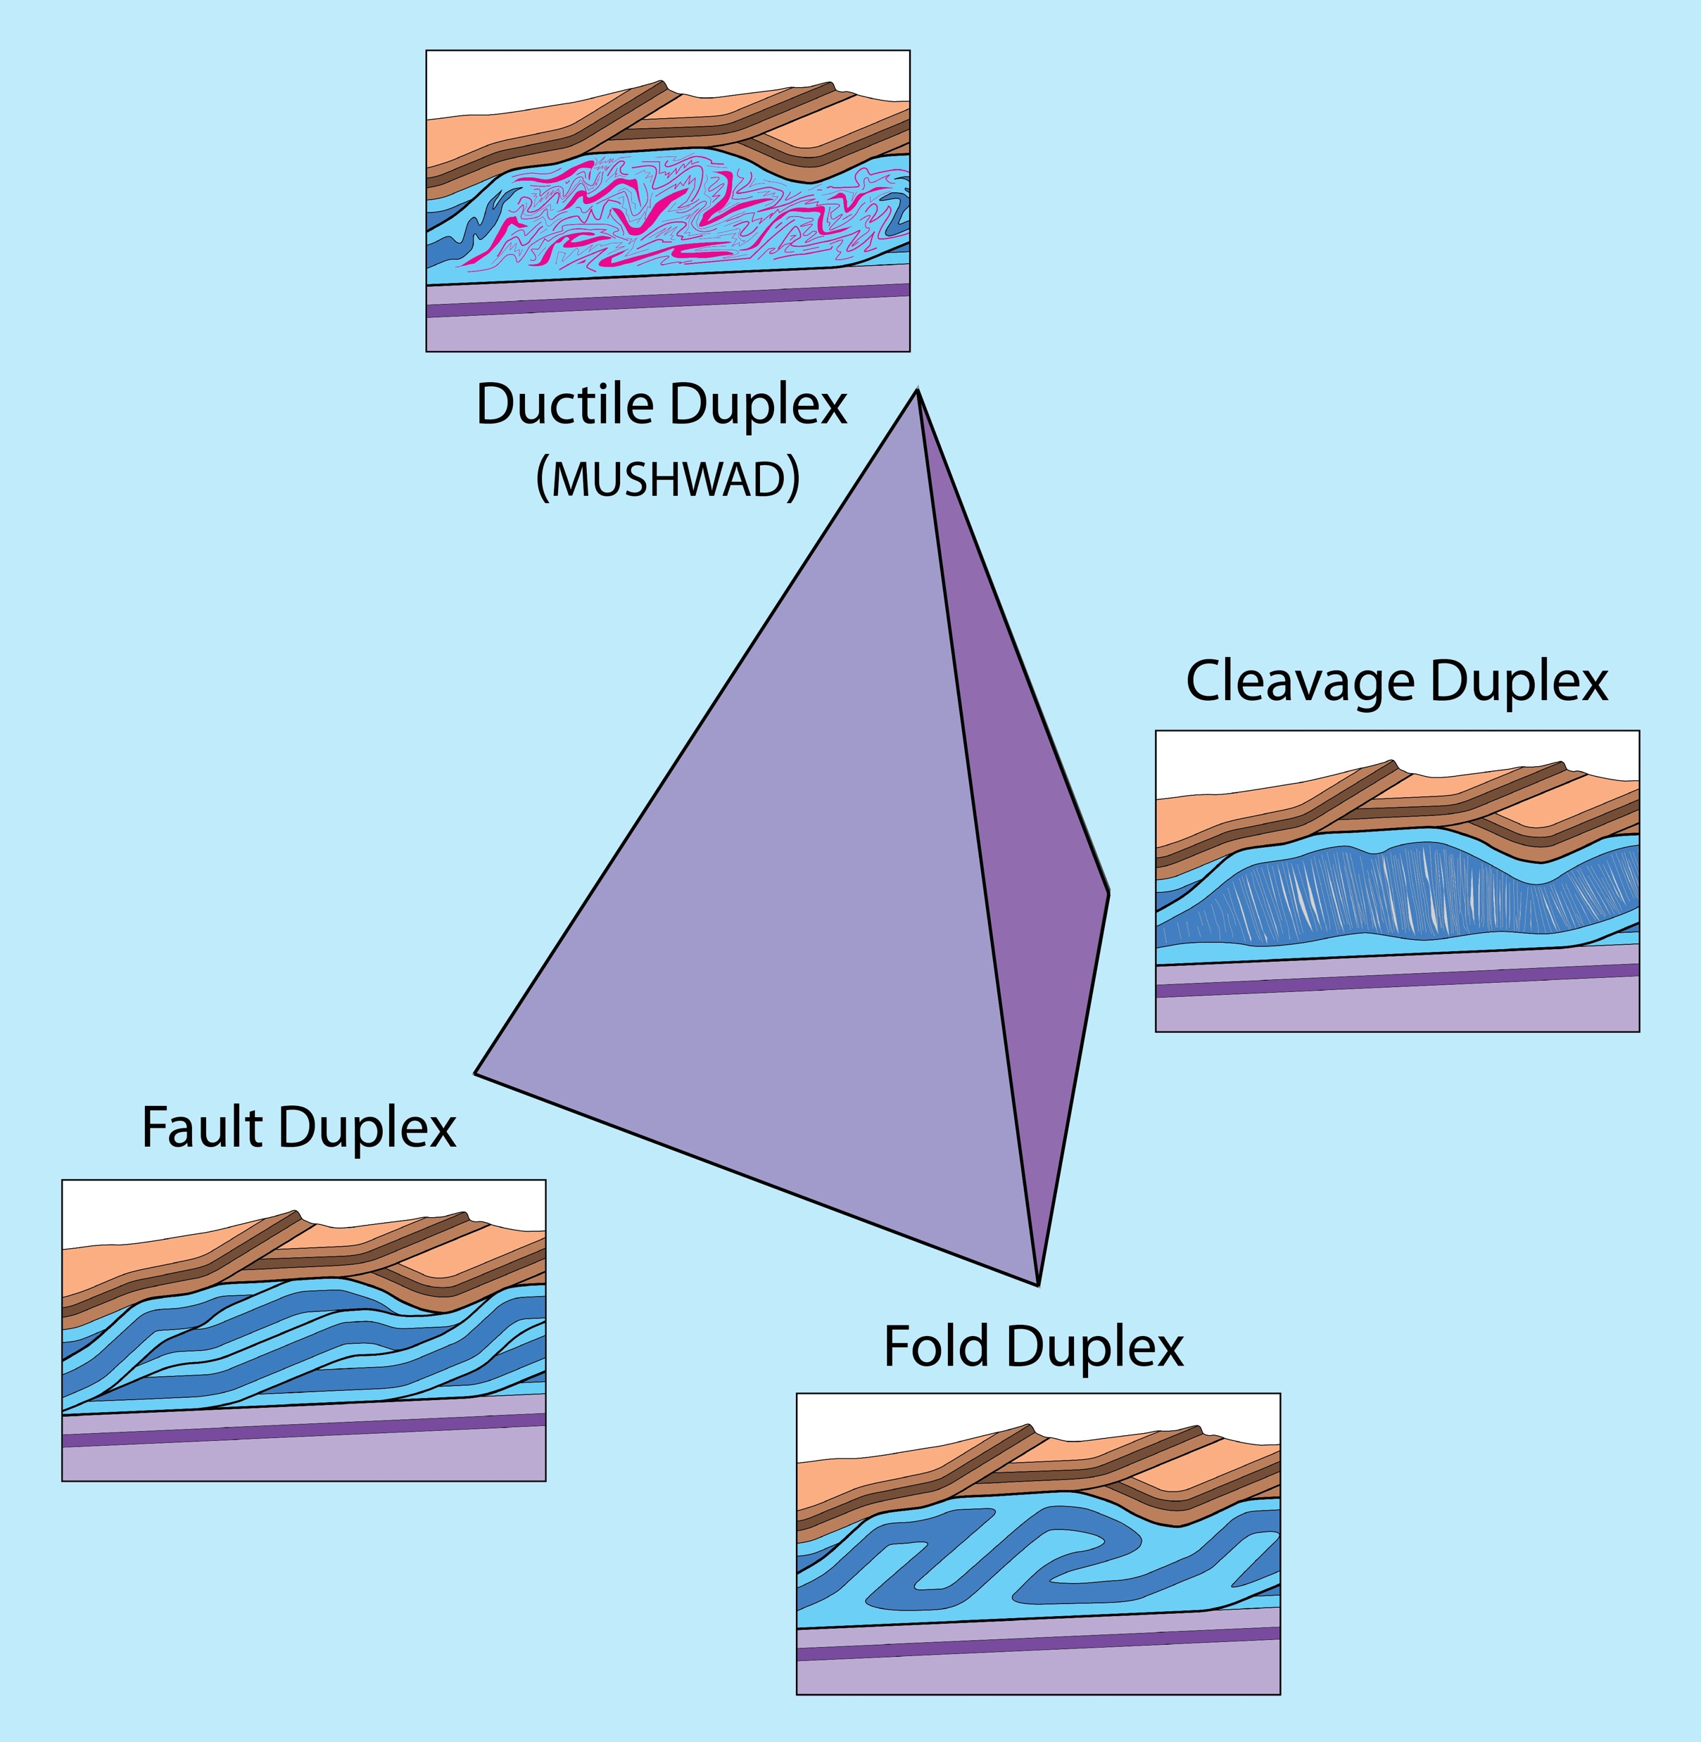
Notes:
So these 4 types of duplex can be plotted on a tetrahedron.

Slide 37
Conclusions
Remove
triangle
1. Duplexes are slip-transfer zones
Notes:
To conclude . . . 1) Duplexes constitute zones of displacement transfer between structural levels.

Slide 38
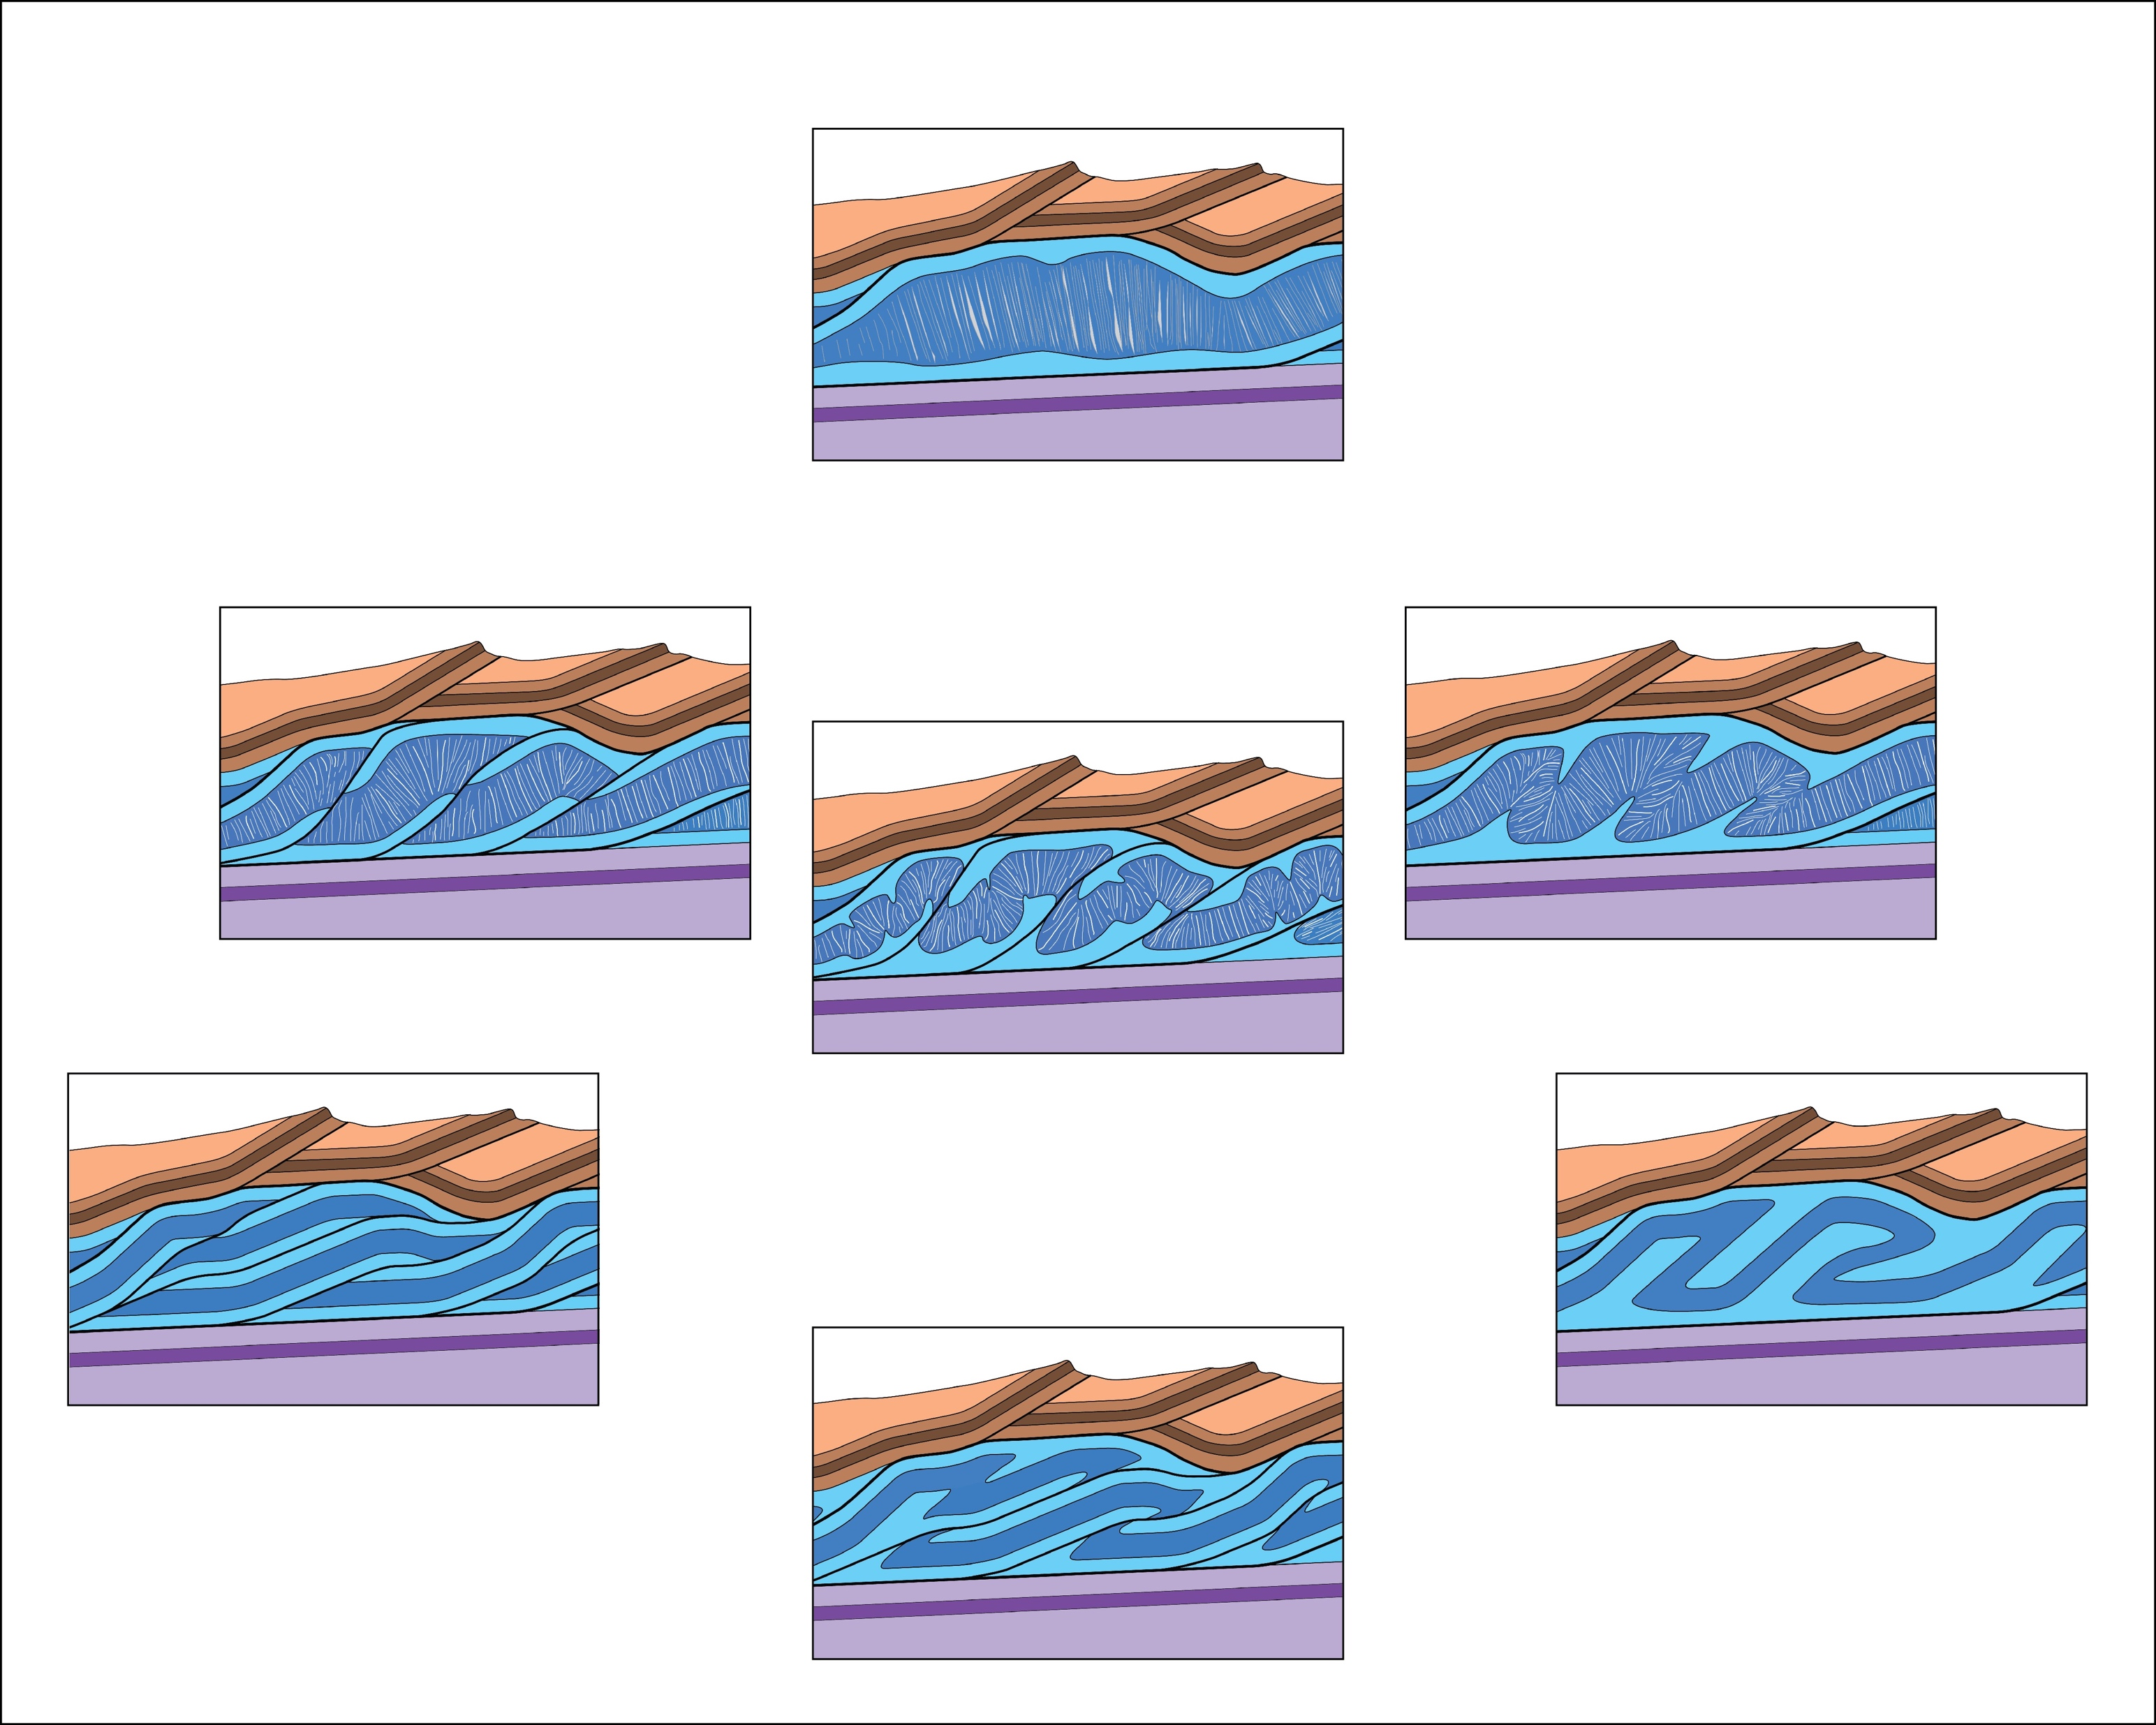
Remove
triangle
2. Faulting not the only mechanism for slip transfer
Notes:
2) But faulting is not the only means of displacement transfer. Shortening within duplexes & displacement transfer can take place through folding and the formation of cleavage & associated deformation mechanisms. And there may be hybrid styles combining two or more mechanisms.

Slide 39
3. Mechanisms can be depicted on ternary diagram
Notes:
3) It may be useful to plot duplexes on a ternary diagram . . .

Slide 40

3. Mechanisms can be depicted on ternary diagram
Notes:
. . . to depict the relative contribution of the various mechanisms.

Slide 41
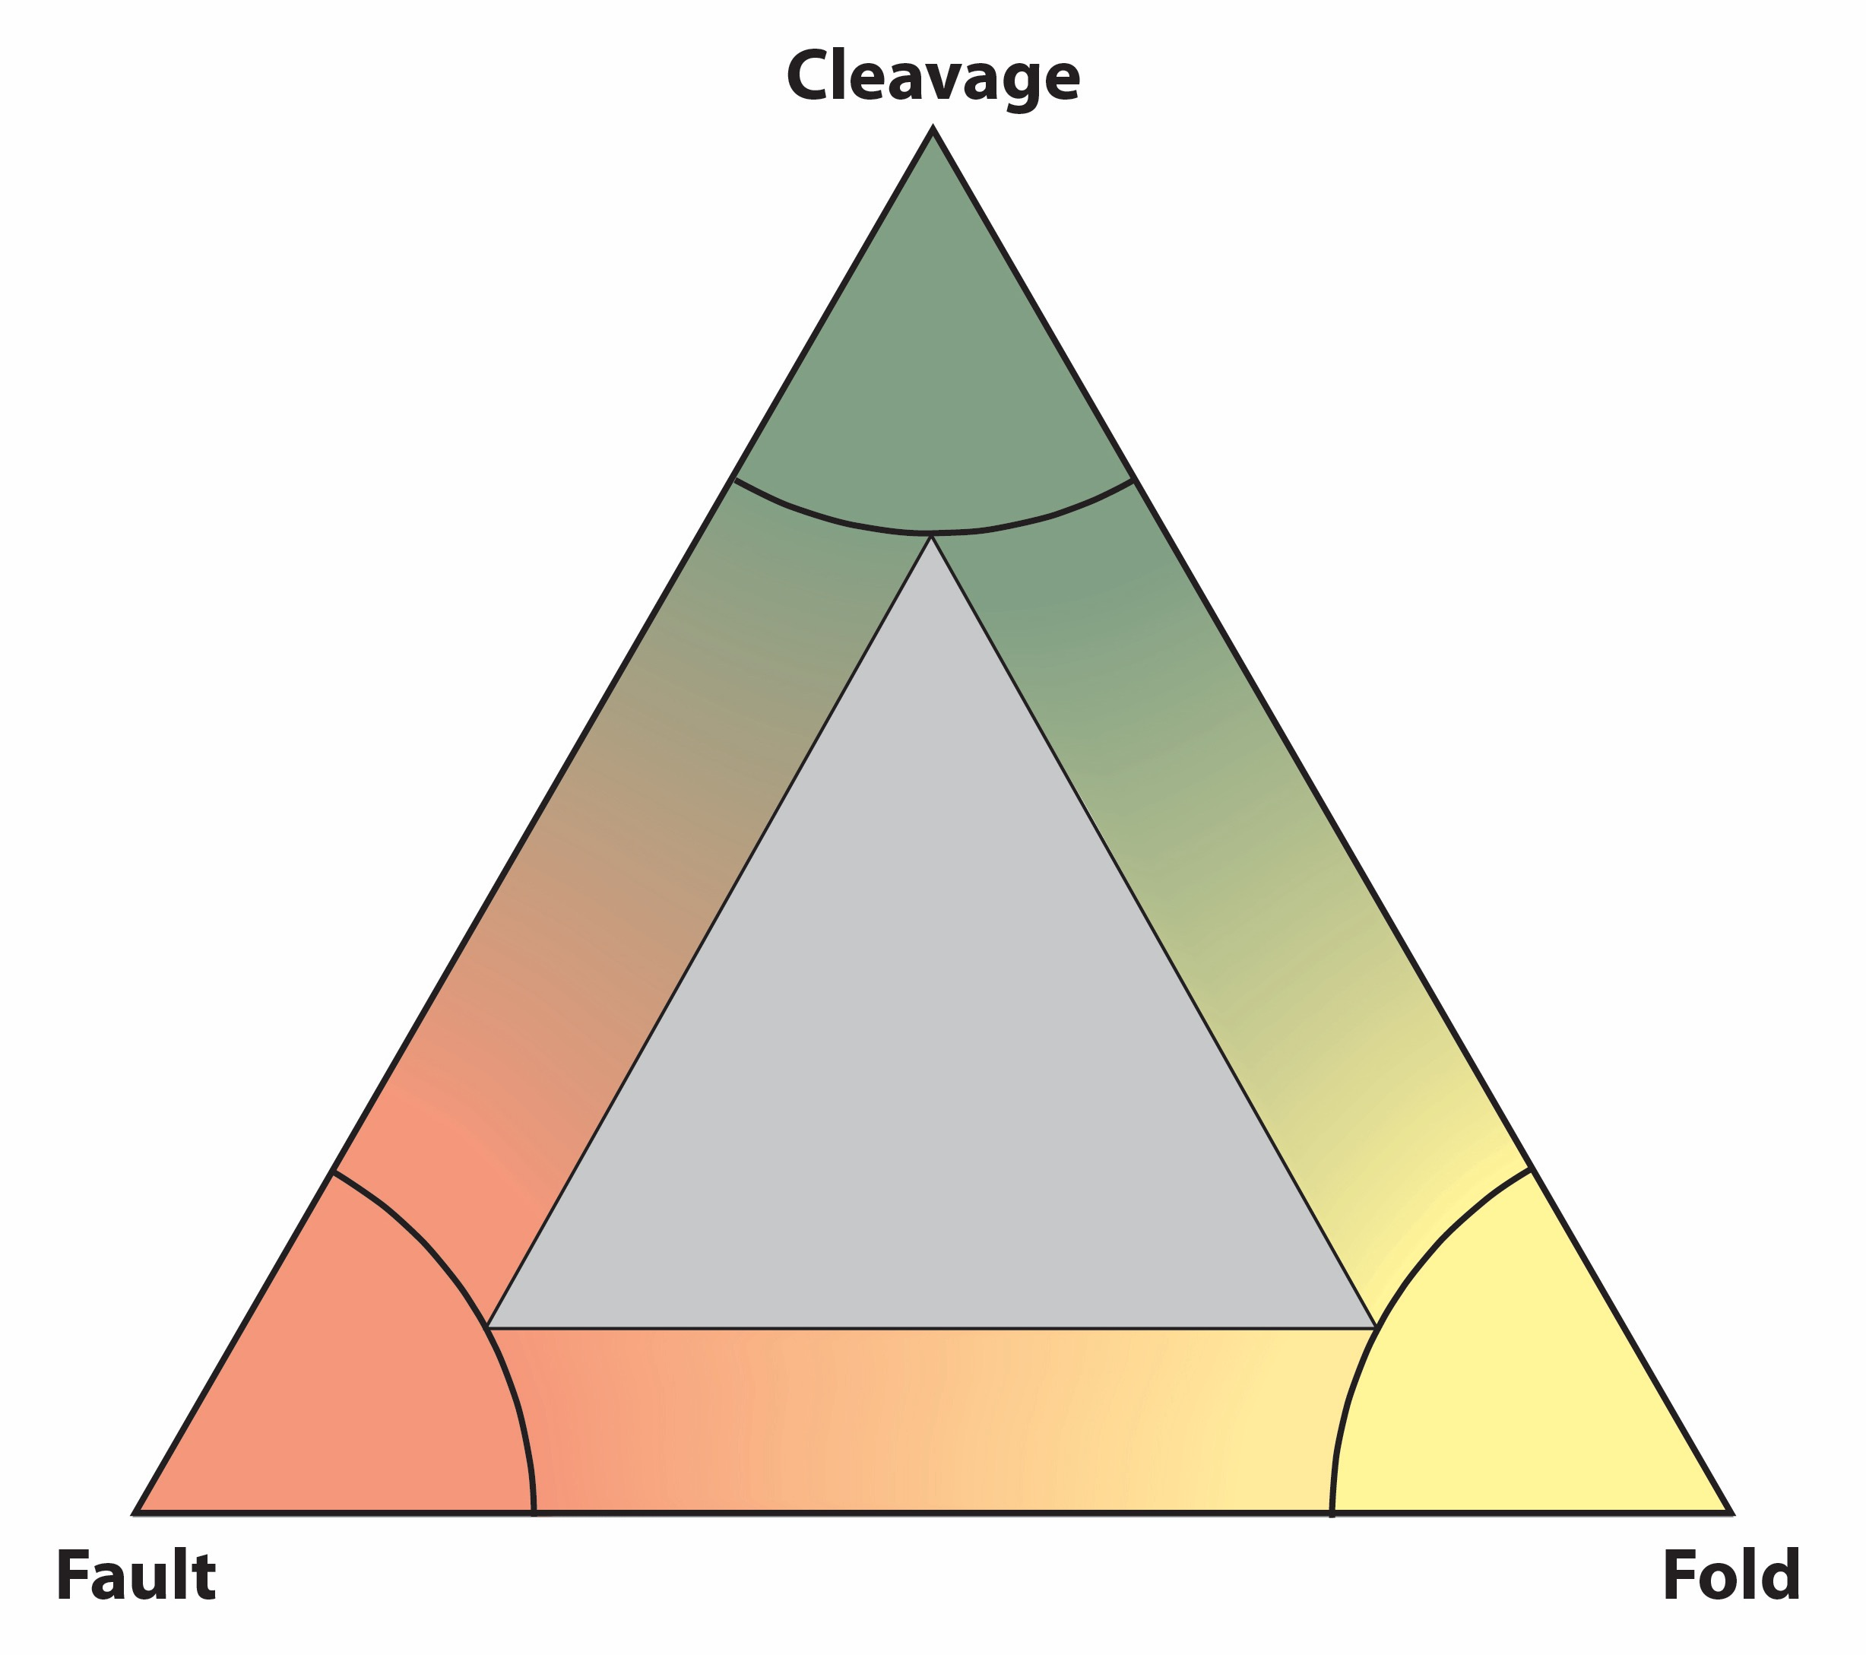
Protzman & Mitra(1999)
0%
100%
50%
50%
100%
0%
4. Slip-transfer mechanisms can be depicted quantitatively
Notes:
And finally, 4), the contribution of the various shortening mechanisms can be quantified. For example, along the cleavage-fold side of the triangle, a duplex plotting at the blue circle would be one in which 25% of the shortening occurred by the formation of cleavage & folding accounted for the remaining 75%.

Slide 42
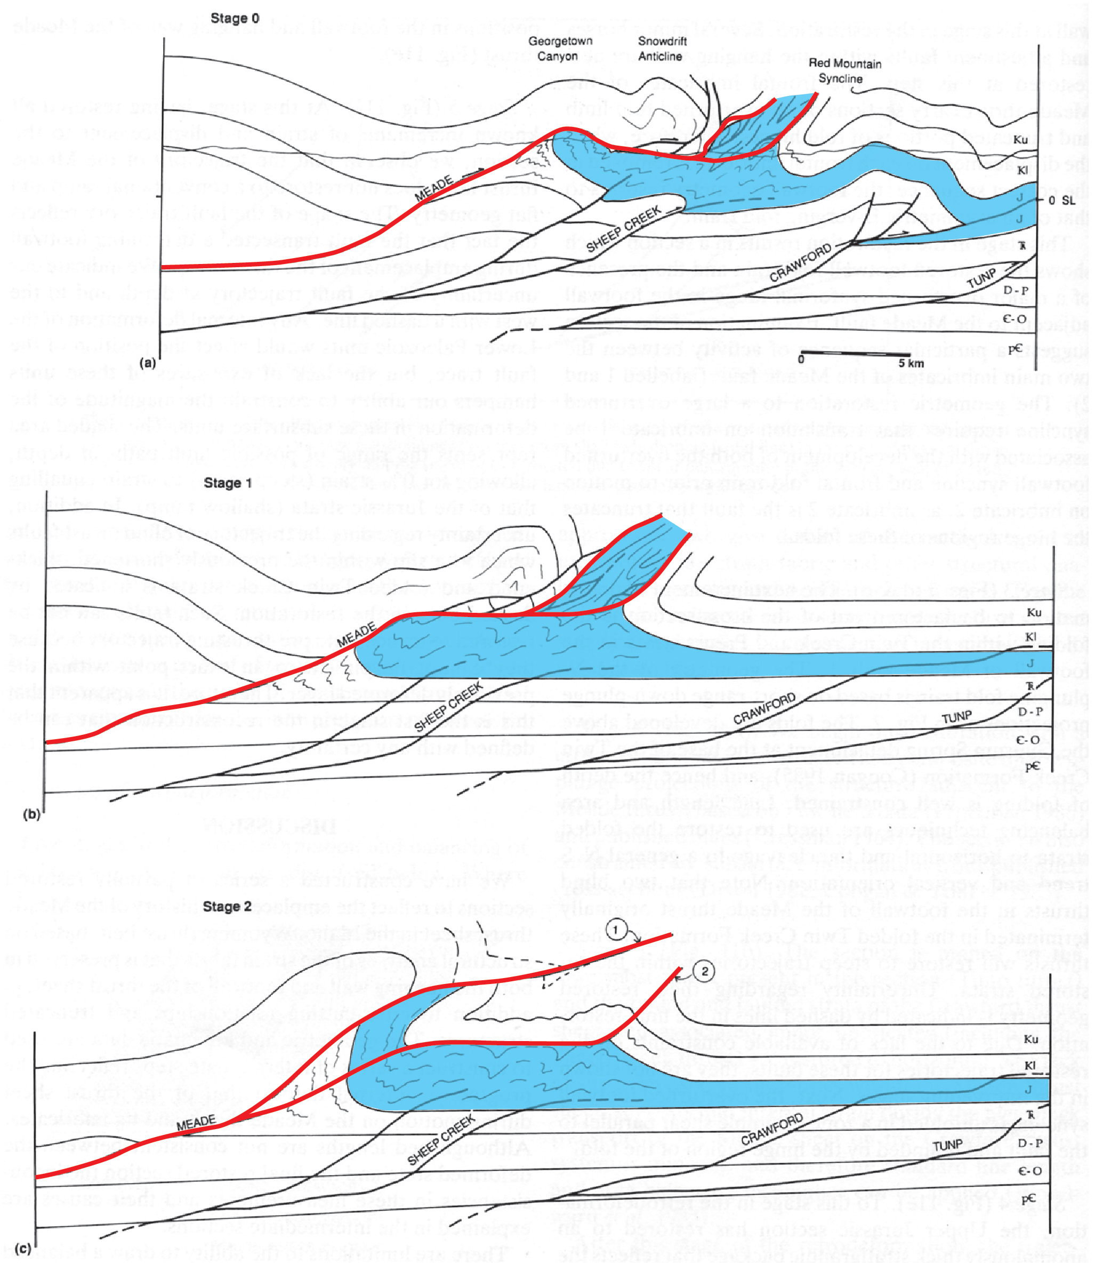
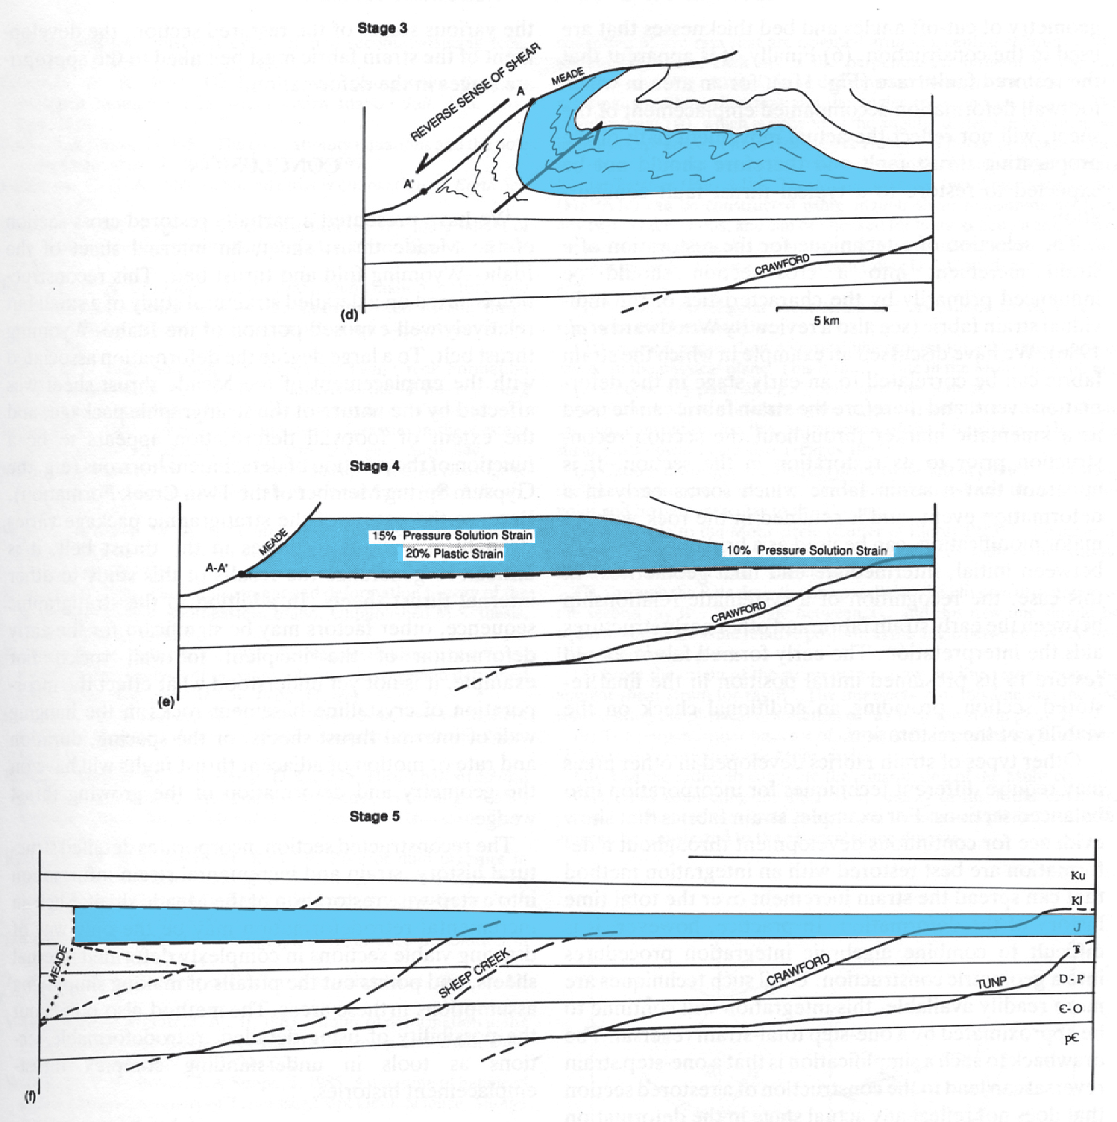
Protzman & Mitra (1999)
0%
100%
50%
50%
100%
0%
4. Slip-transfer mechanisms can be depicted quantitatively
fold shortening = 25%
cleavage (pressure-solution + plastic) = 35%
total shortening = folding (42%) +
cleavage related (58%)
Notes:
As an example consider the cleavage-fold duplex in the footwall of the Meade thrust. Gretchen Protzman & Gautam measured strain & constructed a cross section with the aid of a downplunge projection that incorporated map relations and strain data. Then they sequentially restored the section to analyze the relative contribution of strain mechanisms.
Folding produced a shortening of 25%. Pressure-solution cleavage & plastic strain accounted for 35% shortening.
Thus, of the total shortening, folding accounted for 42% and cleavage-related mechanisms 58%. So this cleavage-fold duplex would plot at the blue circle on the ternary diagram.
Protzman, G. M., and Mitra, G., 1990, Strain fabric associated with the Meade thrust implications for cross-section balancing. Journal of Structural Geology 12, 403-417.

Slide 43
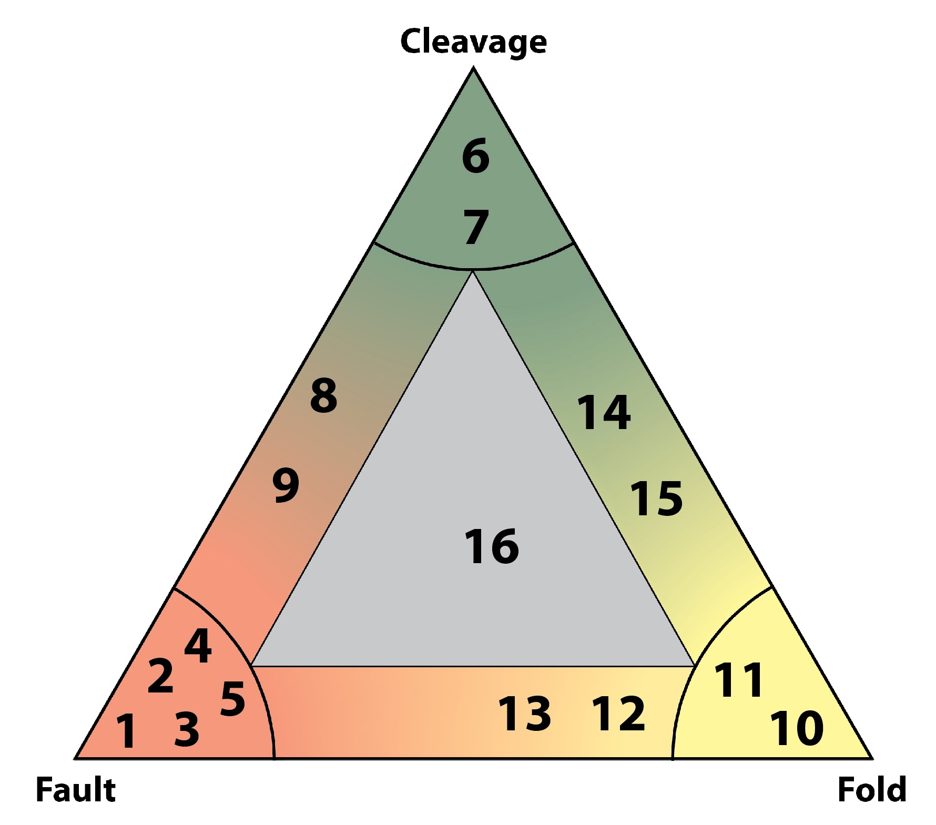
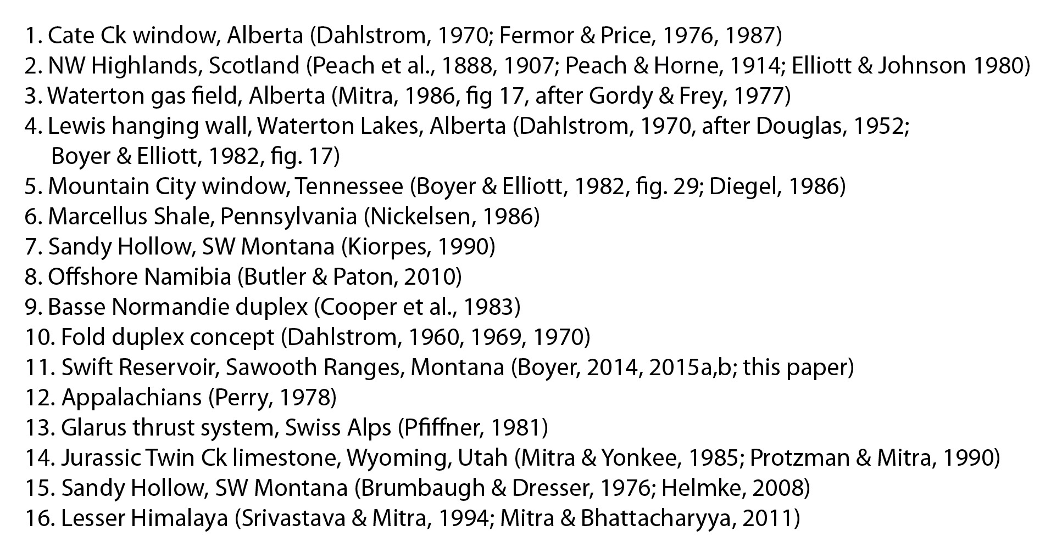
Notes:
Gautam & I have compiled some examples of the 3 basic duplex types and a number of hyrids. This is just an initial survey. So, please let us know of other examples that should be cited.

Slide 44
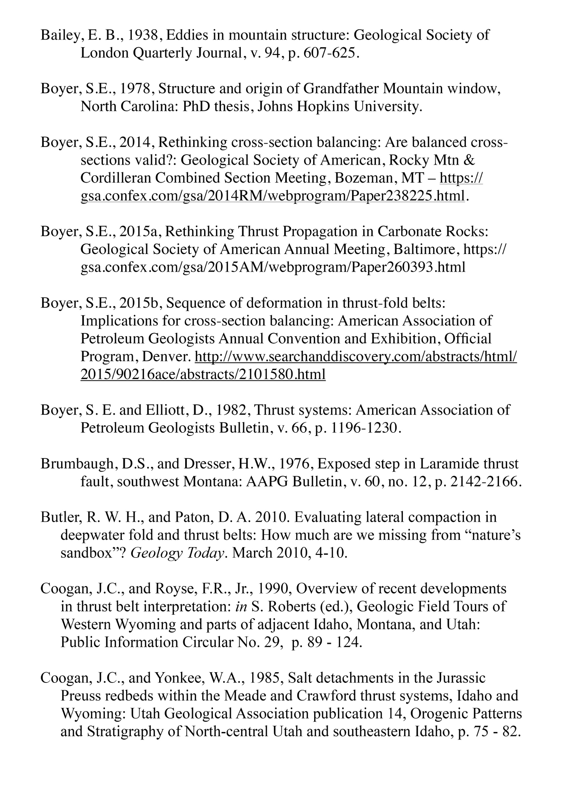
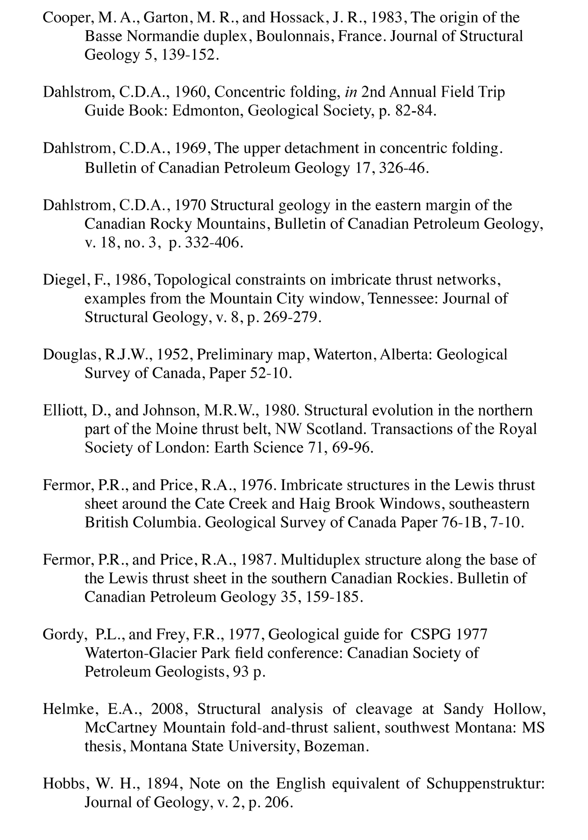
Notes:
The slideshow includes a bibliograpy of all cited references.

Slide 45
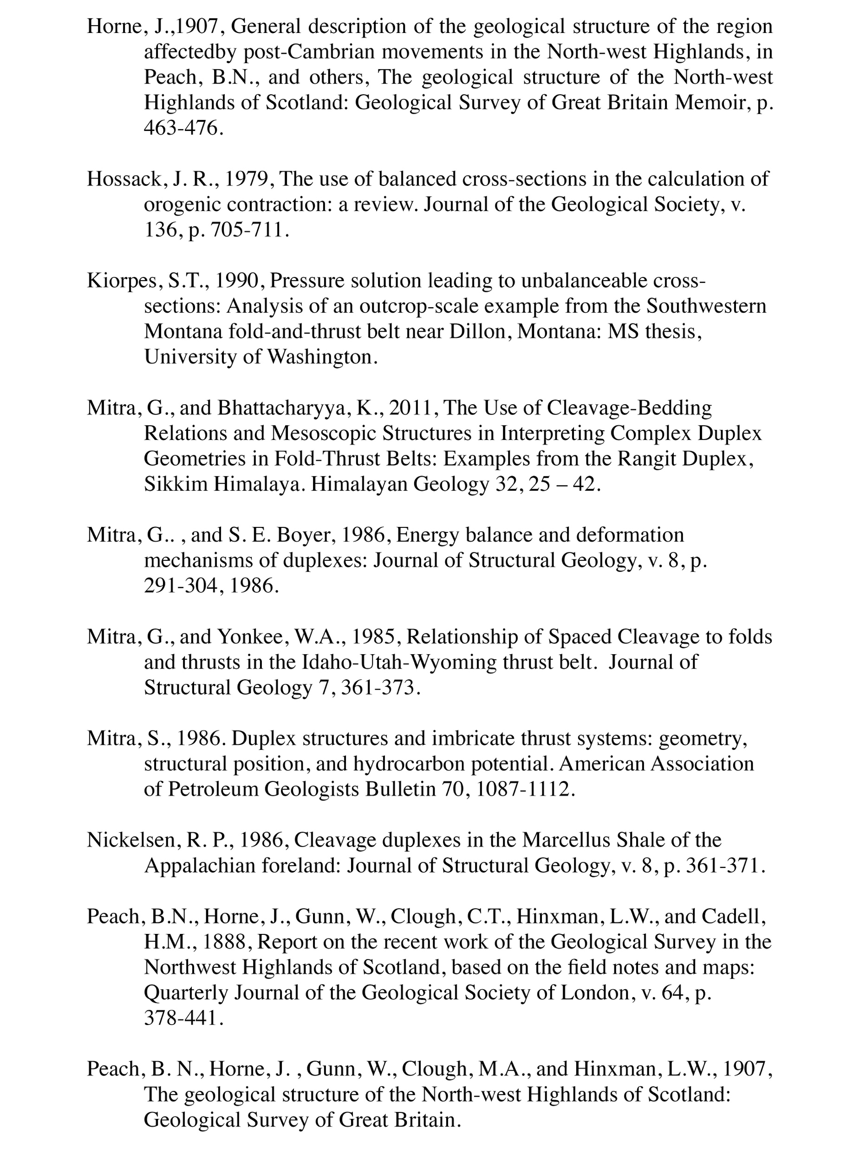
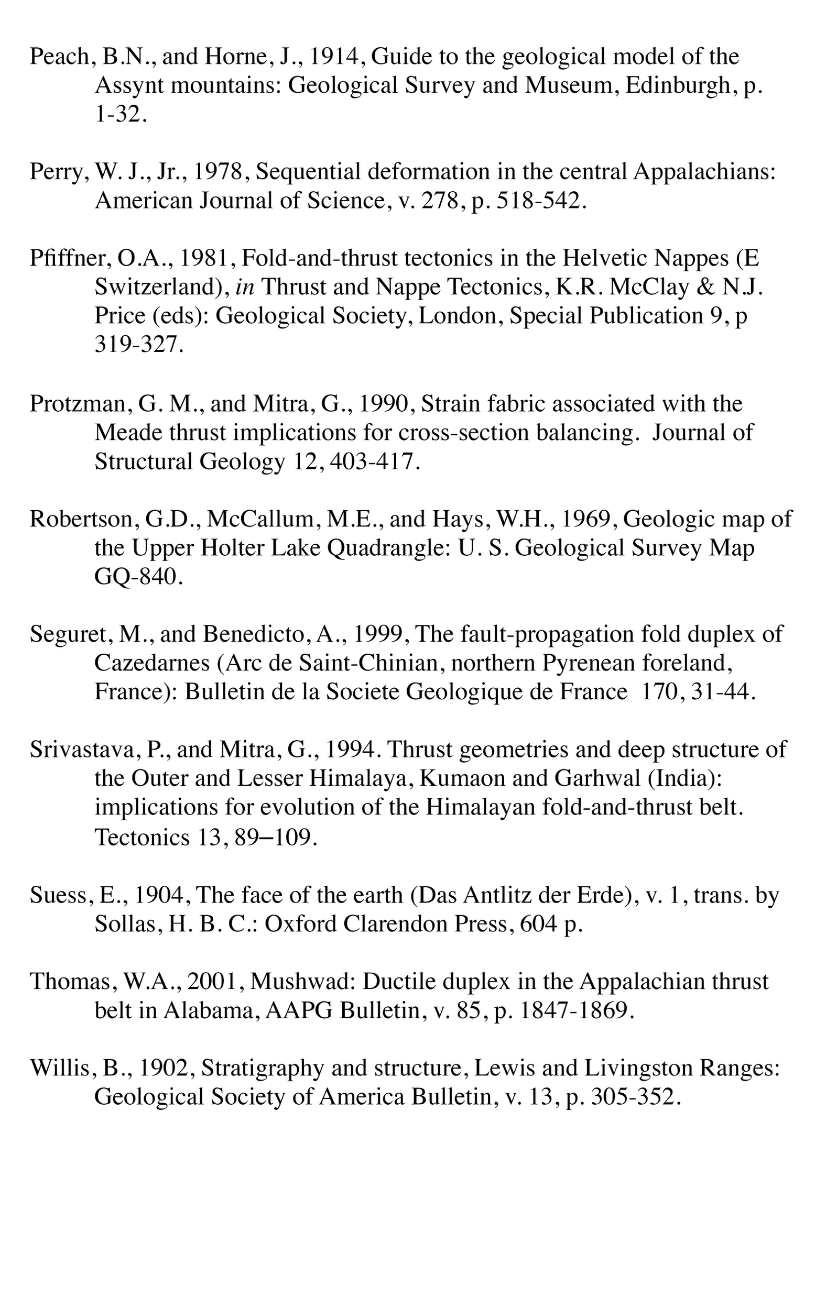

Slide 46
Contact us for copy of talk or
access at GSA website
at end of the meeting
Gautam Mitra
Department of Earth &
Environmental Sciences
University of Rochester
Rochester, NY 14627
gautam.mitra@rochester.edu
Steven E Boyer
5726 Overlook Ave NE
Tacoma, WA 98422
boyersteve@me.com
Notes:
All this will be available online & we welcome your comments & suggestions.

