Slide 1
Blinded by the light: A core collection’s journey to better discoverability
Denise Hills and Marcella McIntyre-Redden
Energy Investigations, Geological Survey of Alabama
Notes:
Presented at the Geological Society of America’s 2016 Annual Meeting, September 28, 2016, in Denver, CO.
Abstract:
The Geological Survey of Alabama (GSA) has been collecting and storing geological samples since its founding in 1848. As more information is being pushed online and into the cloud, the GSA is working to make our geological samples, numbering in the 10s of thousands, more discoverable through sample registration. Preparing the sample metadata for registration requires internal quality assessment so that the most accurate metadata is made available.
Over the past century and a half, the GSA’s sample collection has had various caretakers. These caretakers have recorded information for a wide variety of specimen types, often in their own system. Merging these various records has proved challenging. Specific challenges we have encountered while improving discoverability of our core and geologic sample collection include:
Omission of information through “general knowledge”
Omission of information through personal organizational systems
Inconsistent notational systems
Inconsistent and/or conflicting identification systems
To address these challenges, we have embarked on a process we are terming “metadata archaeology.” We have had to dig through old records, including formal and in-house publications, regulatory forms, and personal databases. Additionally, we have rediscovered other information sources (e.g., a filing cabinet full of well cards explaining some of the labels on the sample boxes) that no current employees knew we had. Sometimes, we have had to contact retired personnel to clarify information recorded. Most importantly, we have had to evaluate what sources should be considered most reliable to ensure that we have the most accurate metadata for sample registration.

Slide 2
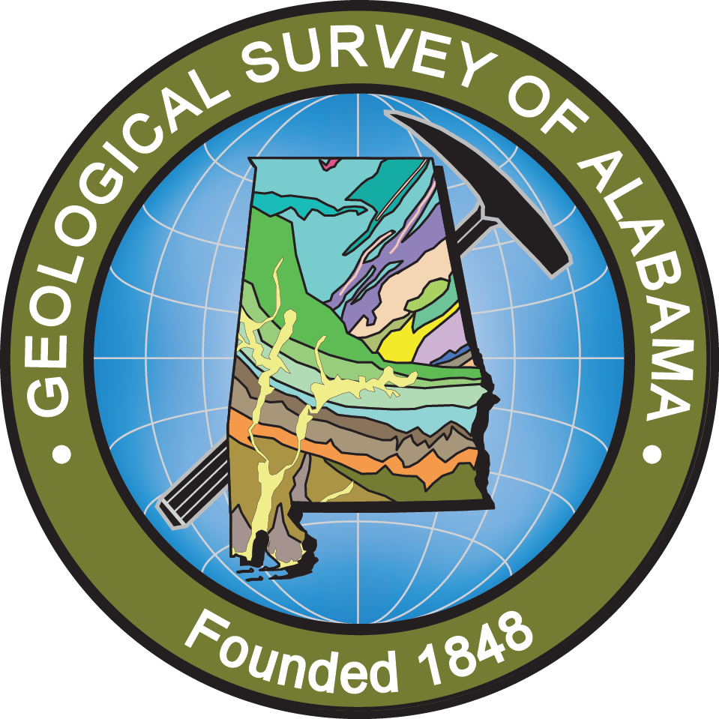
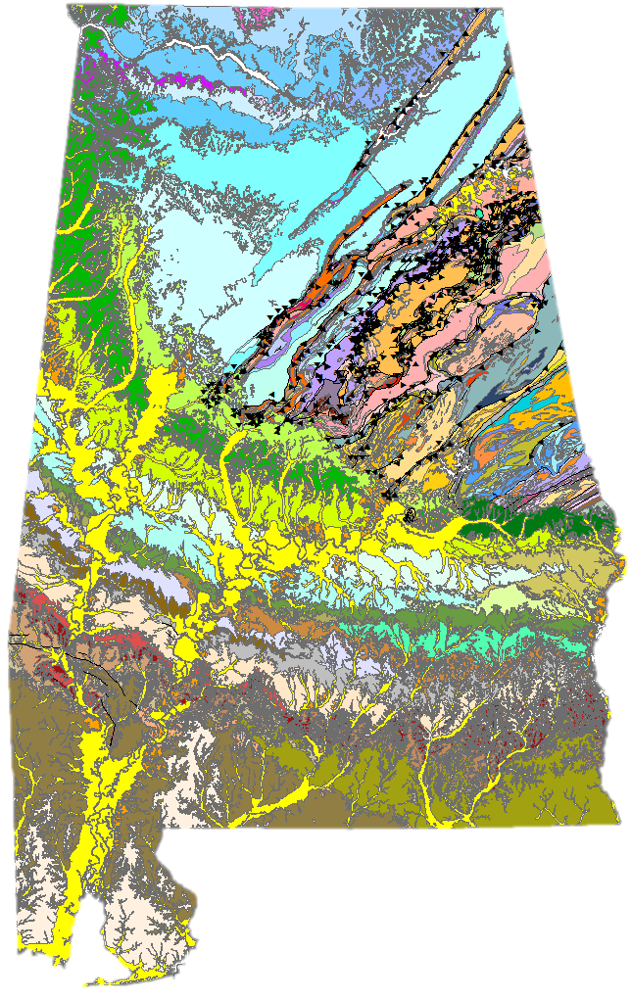
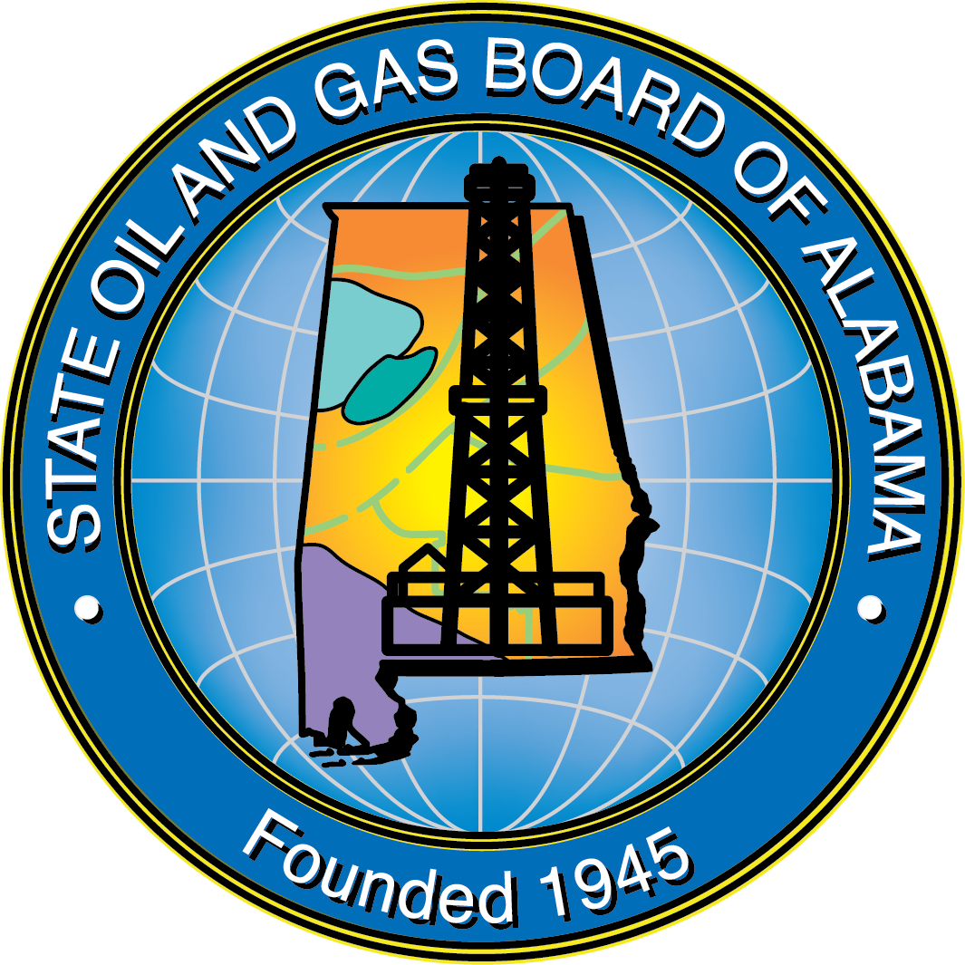
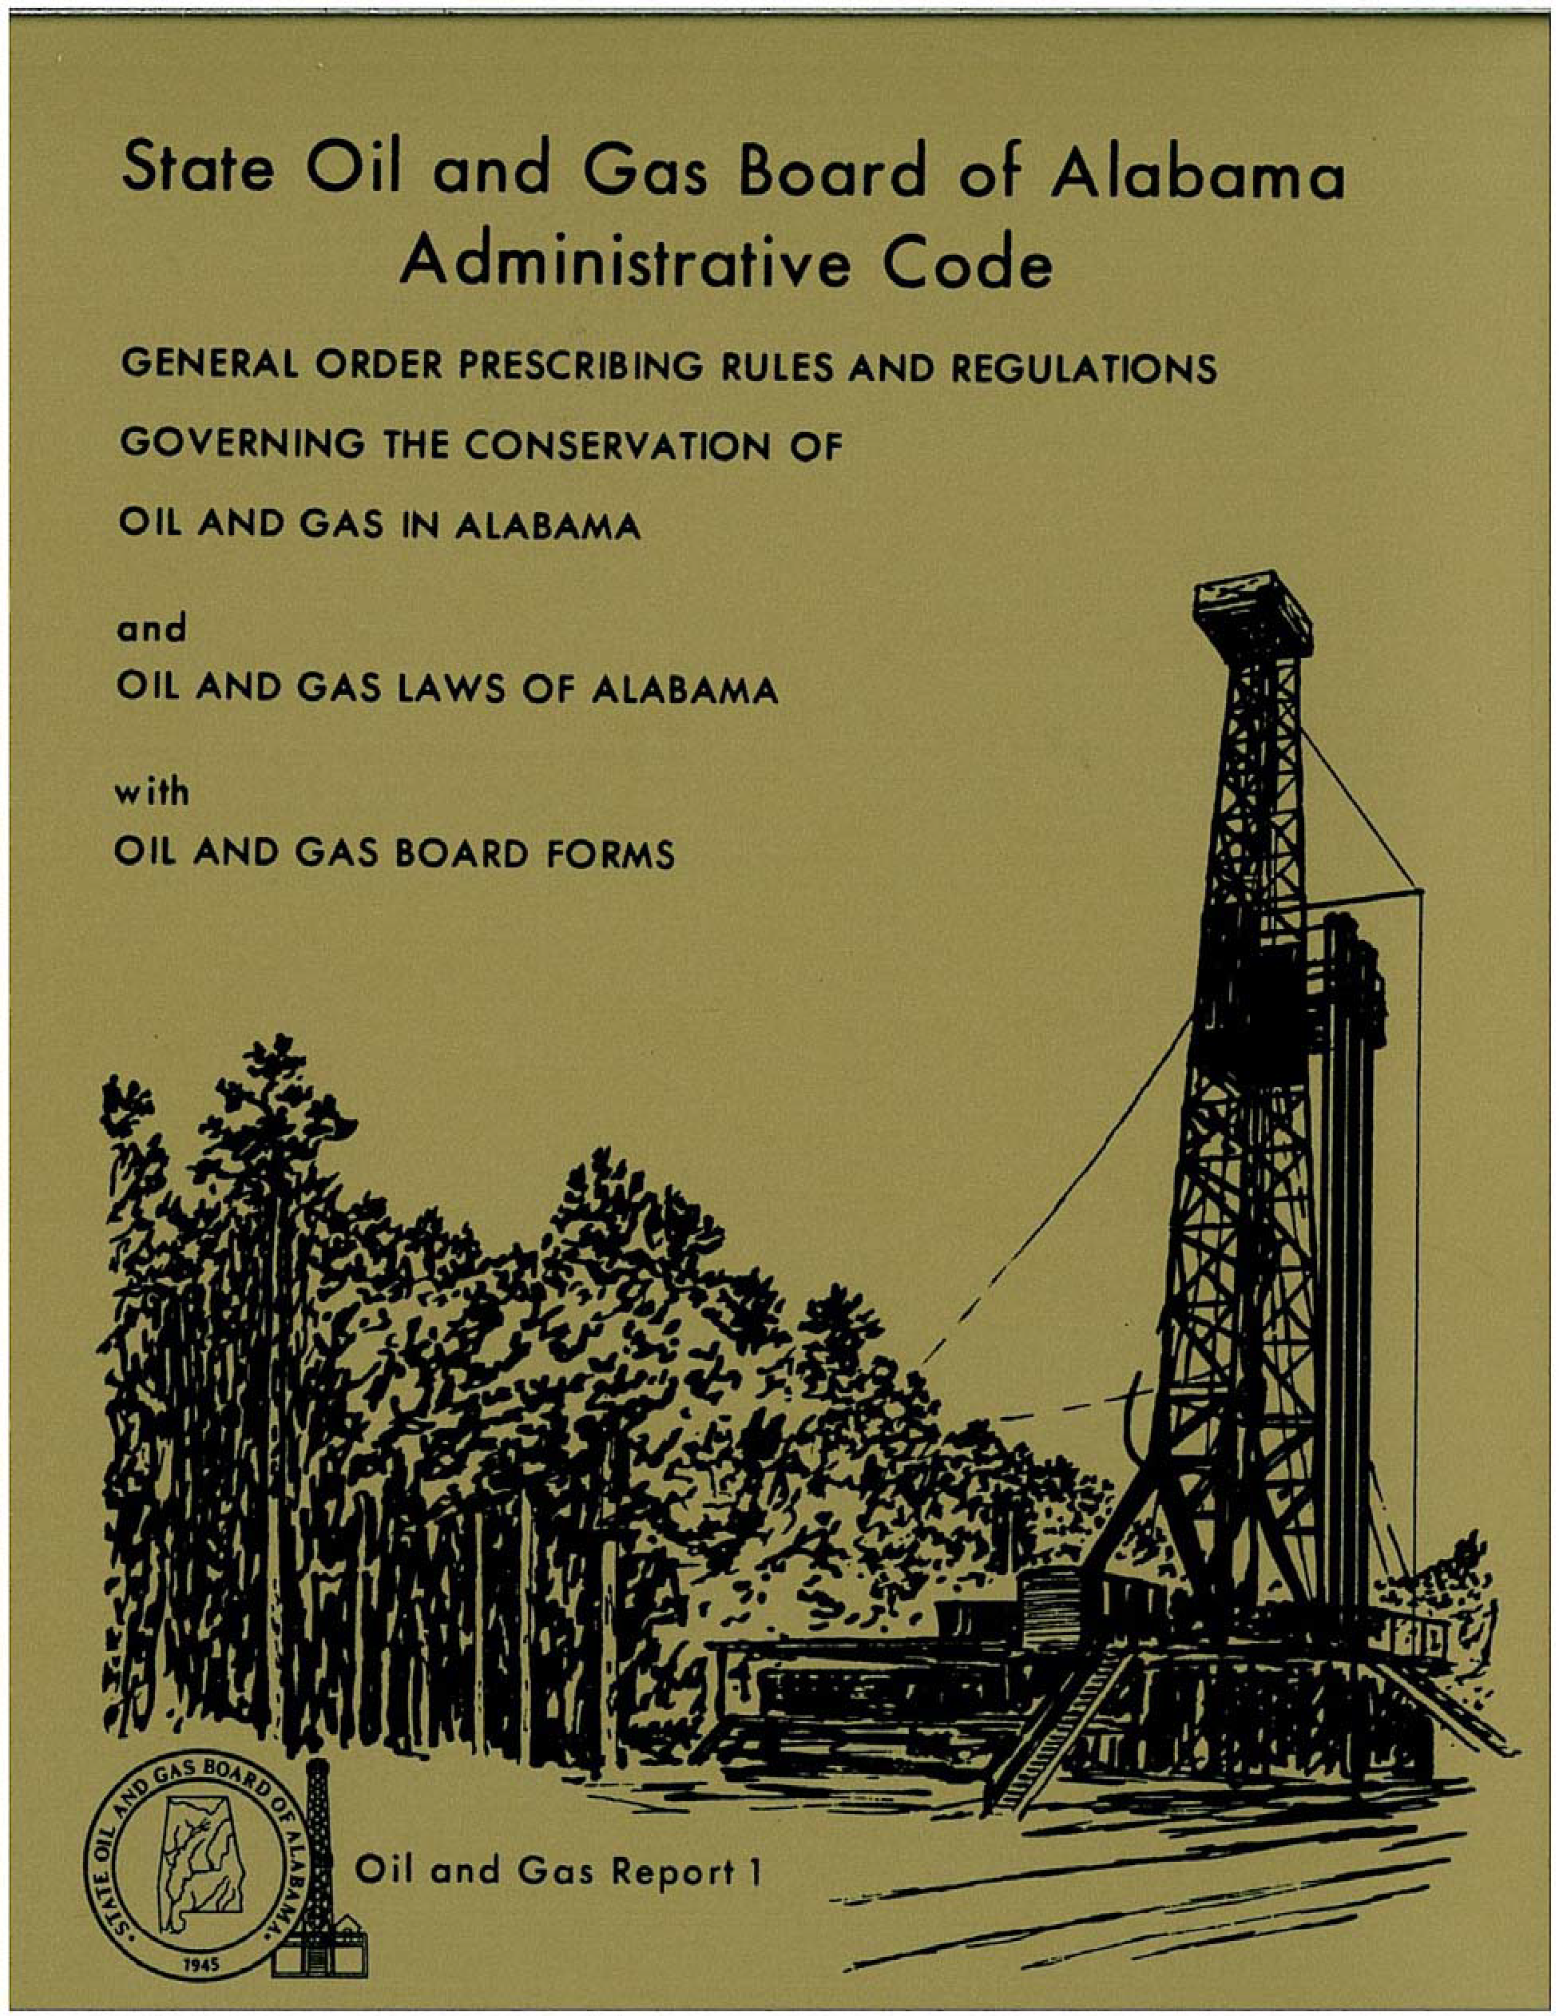
Legally charged to be a repository for data relating to energy and mineral resources.
Regulatory agency with the statutory charge promoting oil and gas while ensuring protection of environment and correlative rights of owners.
Notes:
The OGB is a regulatory agency of the State of Alabama with the statutory charge of preventing waste and promoting the conservation of oil and gas while ensuring the protection of both the environment and the correlative rights of owners. The Board is granted broad authority in Alabama oil and gas conservation statutes to promulgate and enforce rules and regulations to ensure the conservation and proper development of Alabama’s petroleum resources.
Statutory charge: In recognition of past, present, and imminent evils occuring in the production and use of oil and gas, as a result of waste in the production and use thereof and as a result of waste in the absence of co-equal or correlative rights of owners of crude oil or natural gas in a common source of supply to produce and use the same, this law is enacted for protection against such evils by prohibiting waste and compelling ratable production.
In order to prevent waste, the Board has been given broad authority to promulgate and enforce rules and regulations.
--
Regulatory history: http://www.gsa.state.al.us/documents/misc_ogb/Regulatory_history.pdf
“Gold Book” http://www.gsa.state.al.us/documents/misc_ogb/goldbook.pdf
Many state geological surveys have an information mandate. The GSA is no different. As a state government agency, GSA is mandated to explore for, characterize, and report Alabama’s mineral, energy, water, and biological resources in support of economic development, conservation, management, and public policy for the betterment of Alabama’s citizens, communities, and businesses.
GSA Programs include:
Geologic Investigations:
coastal resources; geologic mapping; geologic hazards; resources information
Ecosystems
Habitat assessment; Species distribution and monitoring
Groundwater Assessment
Assessments; Information Distribution; Geochemical Analyses
Energy Investigations
Coal Systems & tech; petroleum systems and tech; carbon sequestration; other geologic energy
Images: Pump Jack (Upper Left); Sinkhole (Lower Left); Geologic Map of Alabama (center); Cahaba Lily (Upper Right); Stream assessment (Lower Right)

Slide 3
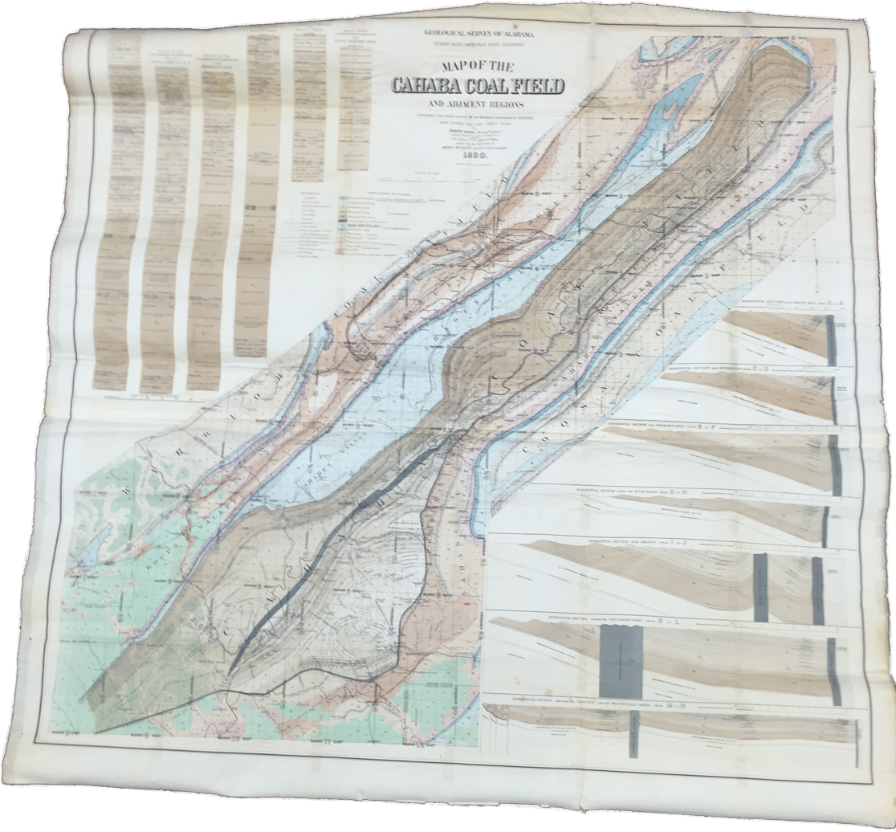
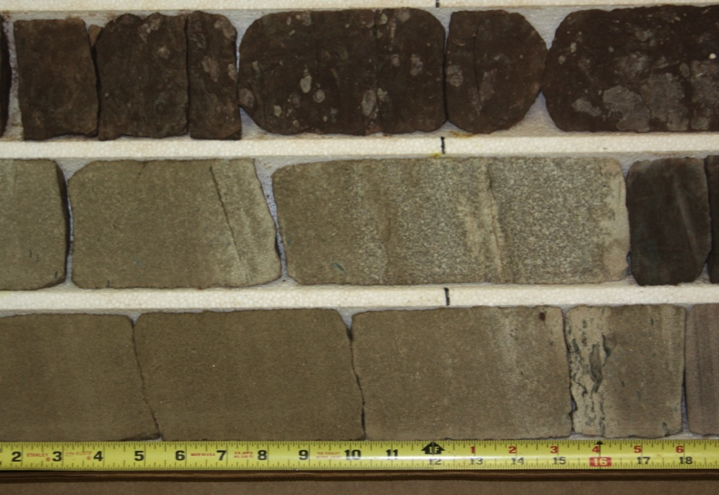
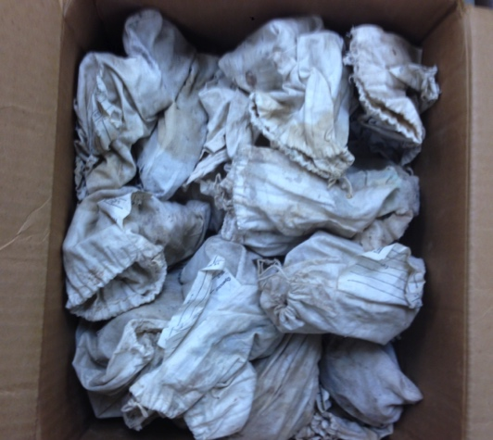
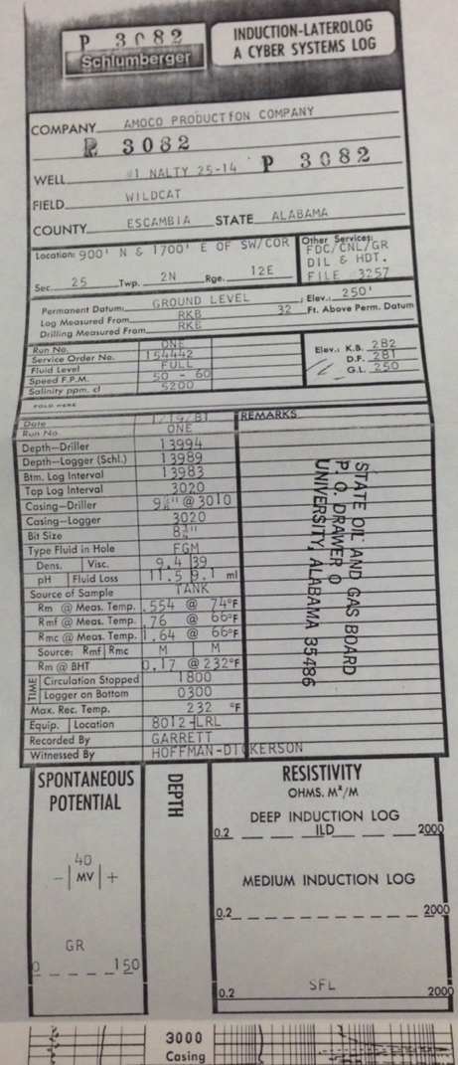
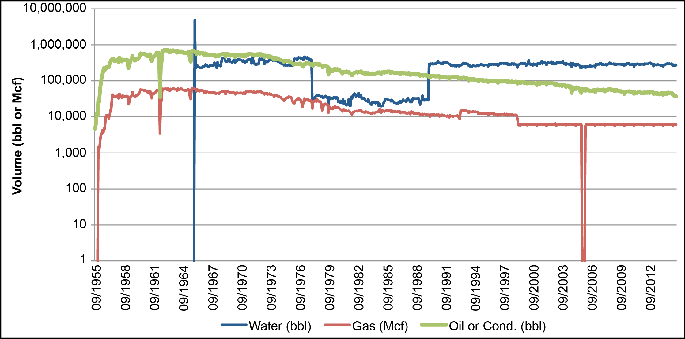
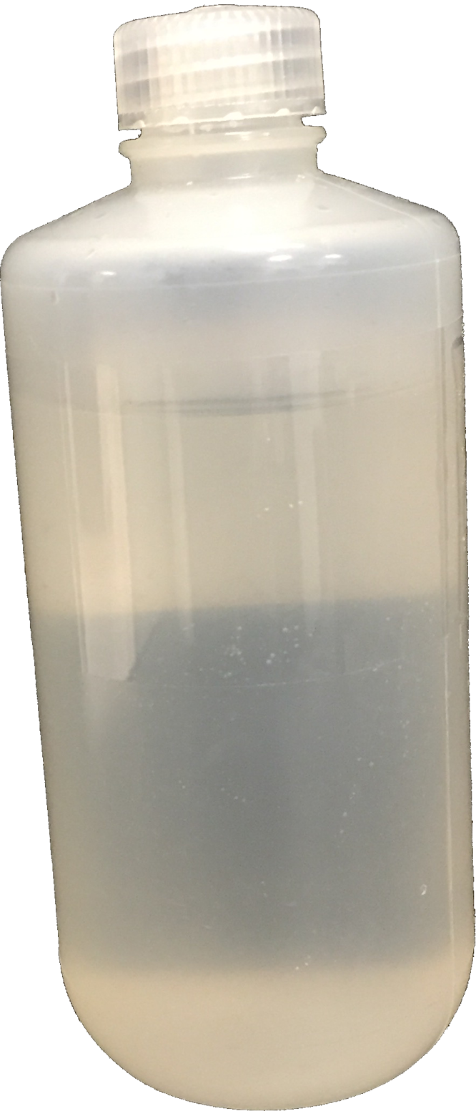
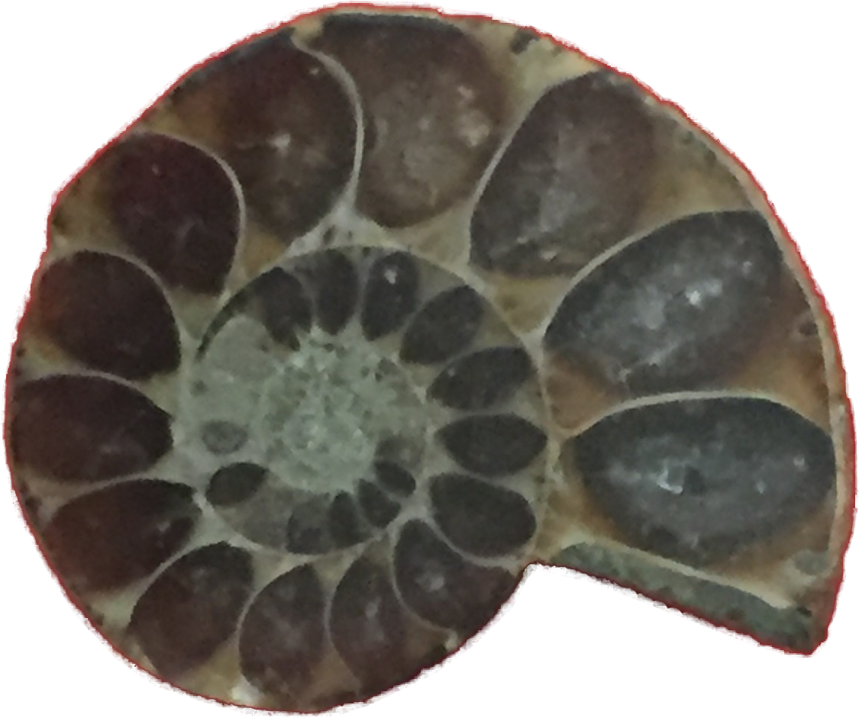
Data at the GSA/OGB
Goal: Improved Data Access
Notes:
As a state government agency, GSA is mandated to explore for, characterize, and report Alabama’s mineral, energy, water, and biological resources in support of economic development, conservation, management, and public policy for the betterment of Alabama’s citizens, communities, and businesses.
We have a LOT of data, including:
Geophysical well logs (e.g., left)
Cores, cuttings, and other physical samples, sometimes with descriptions (e.g., warehouse, top center; slabbed core (SECU D-9-8 Citronelle 11143_A), top right; hand samples, lower left; core samples, center center)
Fluid production and injection information from oil and gas wells (e.g., bottom right)
Geologic maps
As with many agencies, GSA/OGB has challenges:
Data discoverability often difficult
Much of the available information was analog
Even digital data was not always “machine-readable”
Lack of standardization and documentation of data and metadata
Provenance and quality often poor or unknown

Slide 4
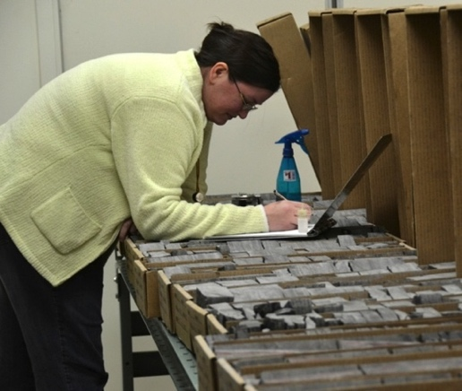
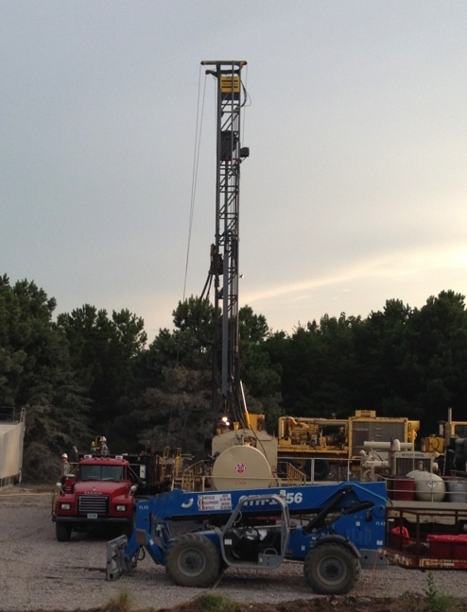
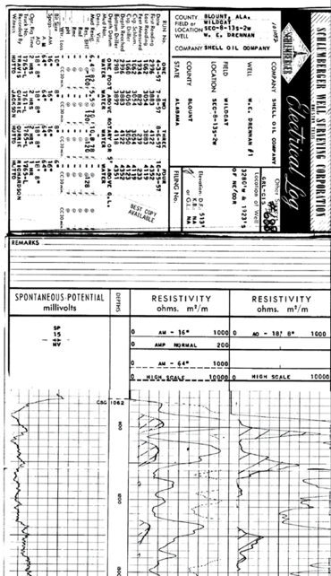

Importance of Legacy Data
THESE
cost less than
THIS
Notes:
Importance of Legacy Data
DO MORE WITH LESS
Agencies are faced with doing more with less money.
Well-documented and discoverable legacy data are part of the solution to this
Most times, it’s less expensive to re-use data and samples than it is to re-collect
Heritage/legacy data can also prove critical (e.g., Griffin, 2015) -
What is the value of ‘old’ data when much more sophisticated data are being acquired today in huge quantities with modern equipment and served up in ready-to-use form? Why the hype over delving into the past, when the observers were undoubtedly less well informed than they are today? What can such old records possibly teach us that we don’t already know better from modern electronic data and today’s sophisticated experiments? As this paper demonstrates, the answers to those questions lie in the critical scientific advantages of the long-term date-stamps which only historical data carry.
Data REUSE
Data management plans and data rescue plans have ultimate goal of INCREASING DATA ACCESS AND USABILITY => VALUE
Better data access means data is easier to find, easier to use, easier to cite thus => INCREASE VALUE
Value in this sense does not necessarily mean that the access to the data costs money, but rather, is seen as a valuable contribution to the greater good.

Slide 5
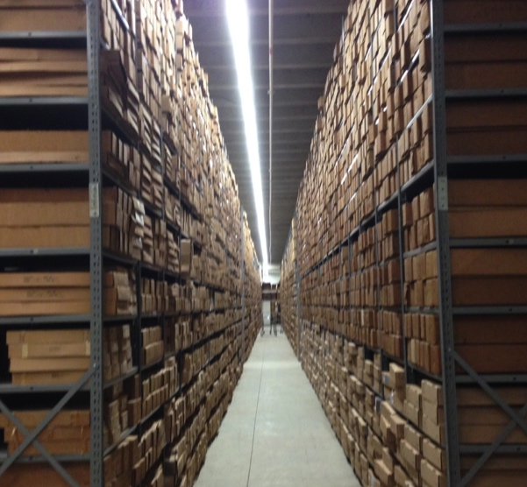
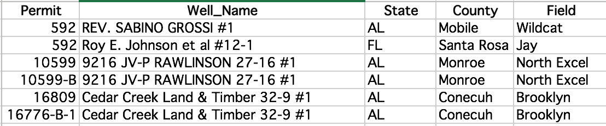
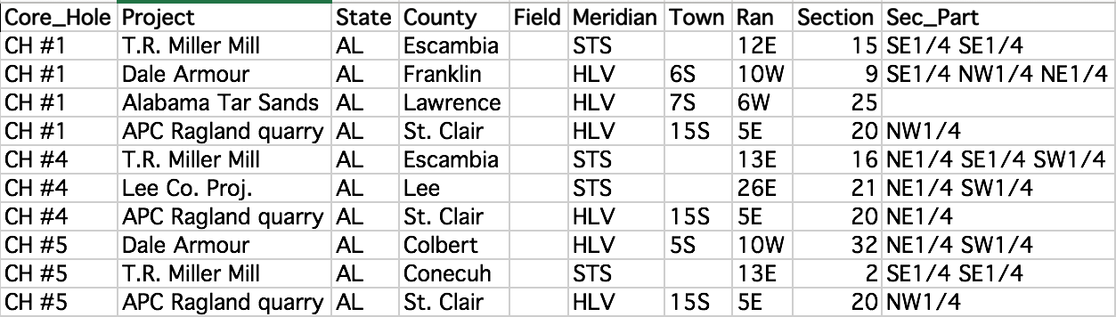
State of the Collection
Challenges ahead…
Notes:
In association with the State Oil and Gas board, the Geological Survey of Alabama (GSA) is a repository for data, including:
Geophysical well logs
Cores, cuttings, and other physical samples, sometimes with descriptions
Fluid production and injection information from oil and gas wells
Geologic maps

Slide 6

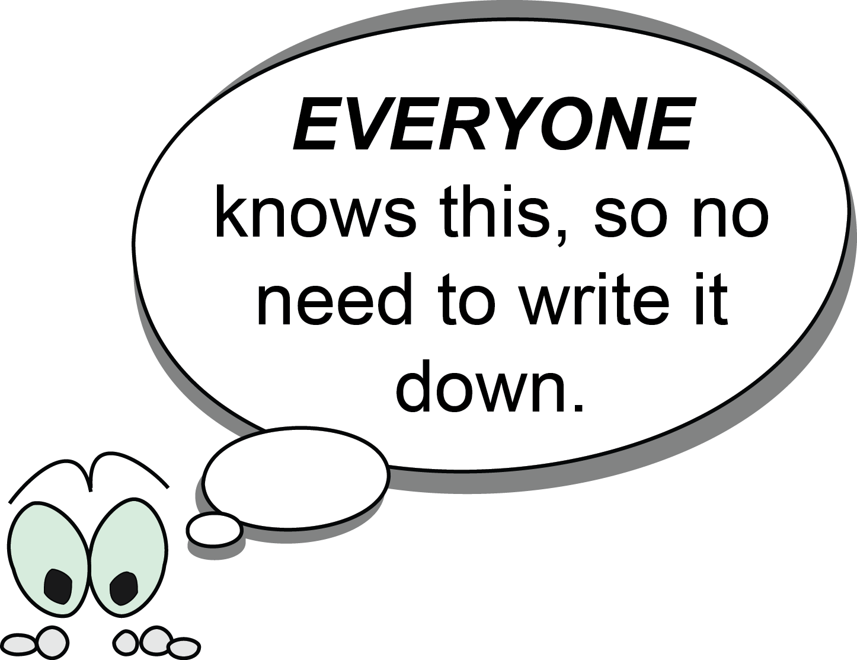
Omission through “general knowledge”
Notes:
Have you ever run across this?
Oh, everyone knows that – we don’t need to write it down.

Slide 7
Omission through personal organization systems

Slide 8
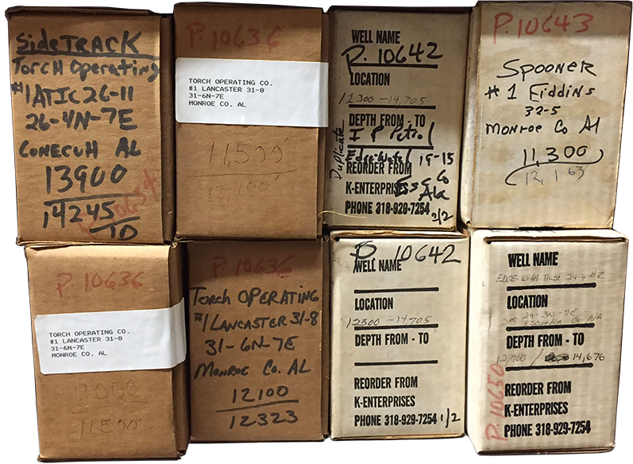
Inconsistent notational systems

Slide 9
Inconsistent and/or conflicting identification system
Notes:
Things to notice here:
-Non-unique ID
-Missing information (specific sample location)
Other things to note – this is one of the better spreadsheets we had, actually. We can backtrack and get locations for most of these (by using the OGB database)
What’s even more challenging is when we had NO KNOWN electronic records.

Slide 10

Metadata Archaeology
Turtles all the way down…
Notes:
Metadata Archaeology:
"Metadata archaeology" is often what you have to do during data rescue, when what metadata you have isn't enough or when what metadata you have isn't enough/isn't trusted. The archaeology part comes with figuring out that missing part.
Example: we have geo cores here, that have inconsistent/missing labels and little/no digital info associated. We've had to decipher codes on boxes, and dig through other records to try to discover the metadata. We also discovered old paper records are associated with these samples that no current employees knew we had and, of course, we've talked with former employees and dug through publications (both formal and in-house pubs). Digging thru all this, layer by layer, to discover most accurate/trusted metadata is sifting thru the past. This sifting/discovery/eval process is similar to archaeology, thus "metadata archaeology" Hope that explains it :)

Slide 11

less process
MORE PRODUCT
Notes:
Mark Greene and Dennis Meissner (2005) More Product, Less Process: Revamping Traditional Archival Processing. The American Archivist: Fall/Winter, Vol. 68, No. 2, pp. 208-263. doi: http://dx.doi.org/10.17723/aarc.68.2.c741823776k65863
Abstract: Processing backlogs continue to be a problem for archivists, and yet the problem is exacerbated by many of the traditional approaches to processing collections that archivists continue to practice. This research project reviewed the literature on archival processing and conducted surveys of processing practices to identify the scope of the problem and its impacts both on processing costs and on access to collections. The paper issues a call for archivists to rethink the way they process collections, particularly large contemporary collections. It challenges many of the assumptions archivists make about the importance of preservation activities in processing and the arrangement and description activities necessary to allow researchers to access collections effectively.
-
Put very simply, processing is not keeping up with acquisitions and has not been for decades, resulting in massive backlogs of inaccessible collections at repositories.
-If our goal is to maximize repositories’ holdings for use, getting too caught up in the process (granularity) is counterproductive.

Slide 12
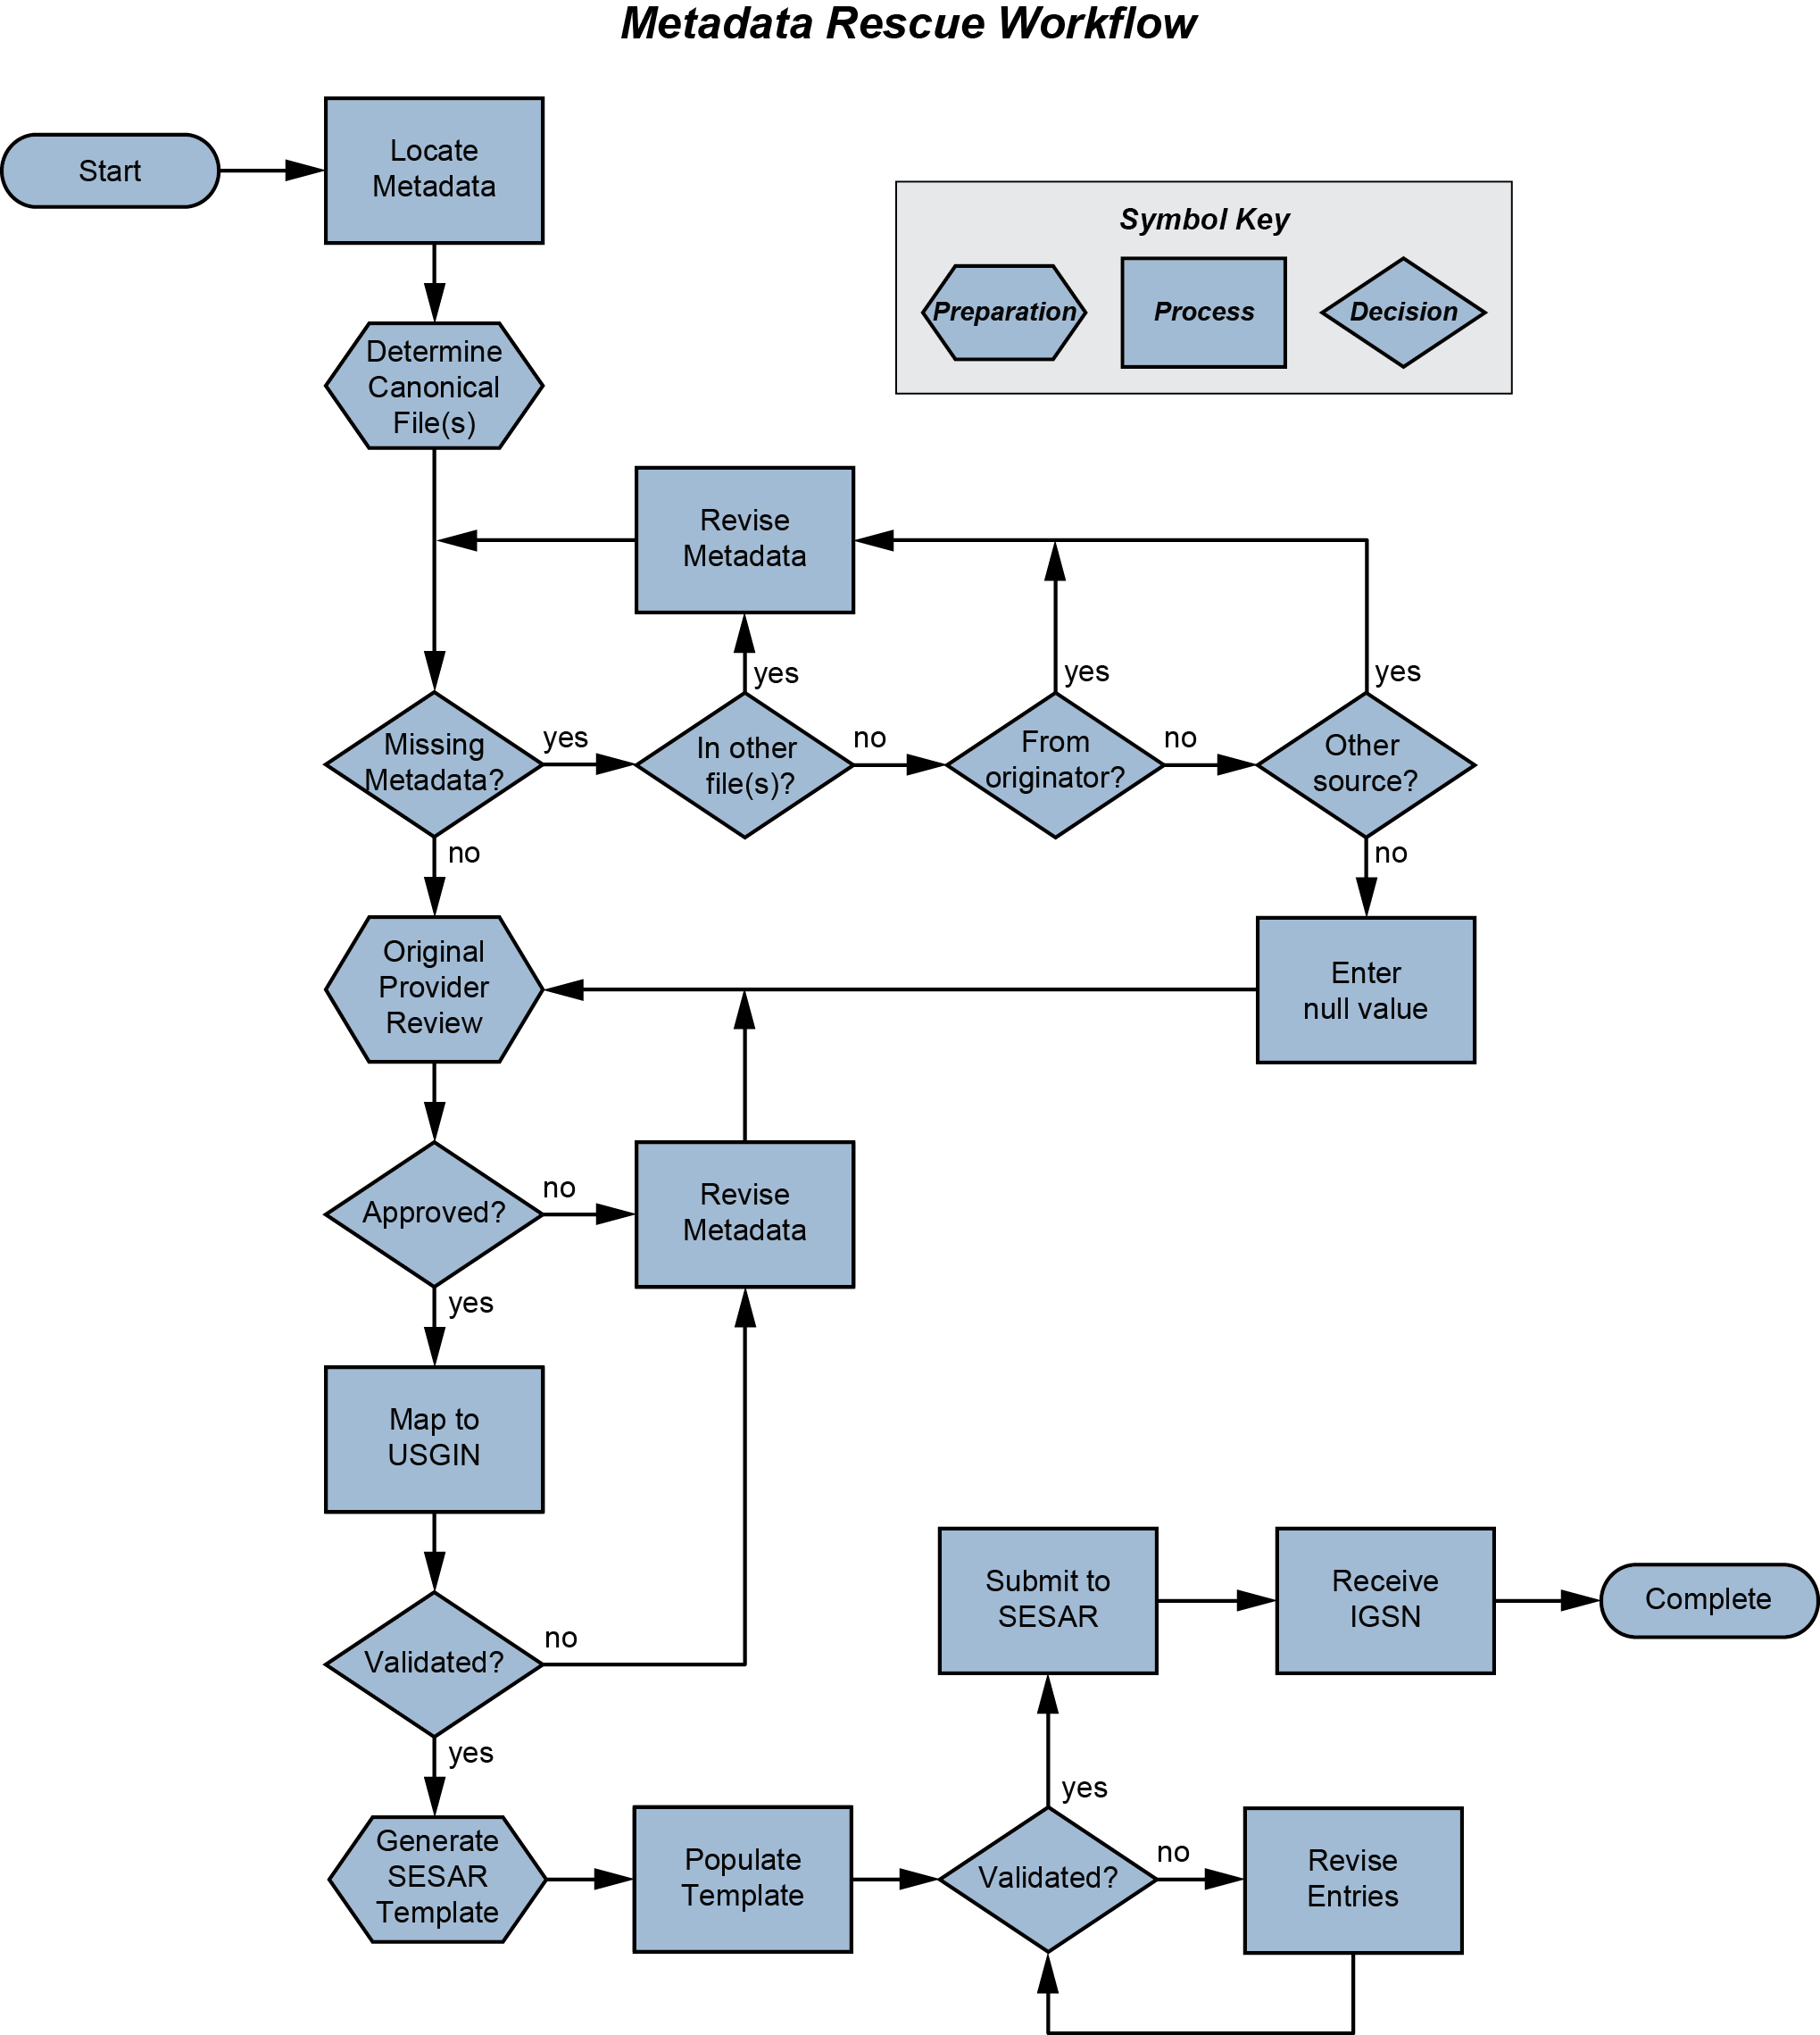
Responsive workflows for metadata capture
Hills, 2015
Notes:
Semi-automated workflow to capture information from current researchers with minimal effort. By making the legacy data rescue and preservation process as simple as possible through the development of template workflows, such as that presented here, personnel are more likely to adopt and adhere to standards. Template workflows also simplify training of additional personnel to assist in the registration process. Ultimately this increases data and metadata exposure and interoperability. (Hills, 2015)
Suggestions for data rescue plans:
Prioritize critical data – eg., person is about to retire, sample about to loss critical information, used by lots of people
Develop a workflow – iterative process to refine; be aware of internal and other existing standards
Involve current data holder as well as those not as familiar with the information – current archivist checks for accuracy, others check for usabilityConduct exit surveys specific to data
Register your samples and data – thus, people can FIND the information and use it => becomes VALUABLE
---
Reference: Hills, D.J. 2015. Let’s make it easy: A workflow for physical sample metadata rescue. GeoResJ, vol. 6, p. 1-8. doi:10.1016/j.grj.2015.02.007

Slide 13
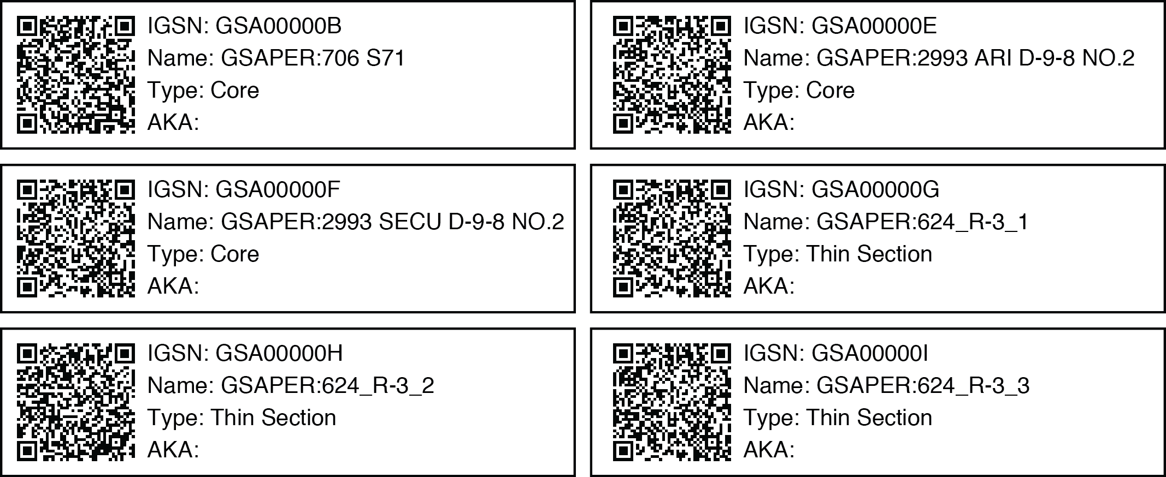
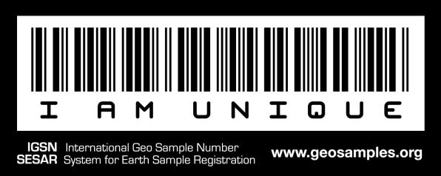
Register samples and data
Notes:
Many ways to register your samples and data. Things to consider:
-Long term stability (don’t go with a fly-by-night)
-what standards are they using? (see earlier slide re: why standards fail)
-cost (immediate and long-term)
DataCite (https://www.datacite.org/ ) is a good place to start to investigate how to get DOIs for data sets, as well as Registry of Research Data Repositories (https://www.datacite.org/)
SESAR (http://www.geosamples.org ) is a great place to register physical samples – they mint IGSNs

Slide 14


Slide 15


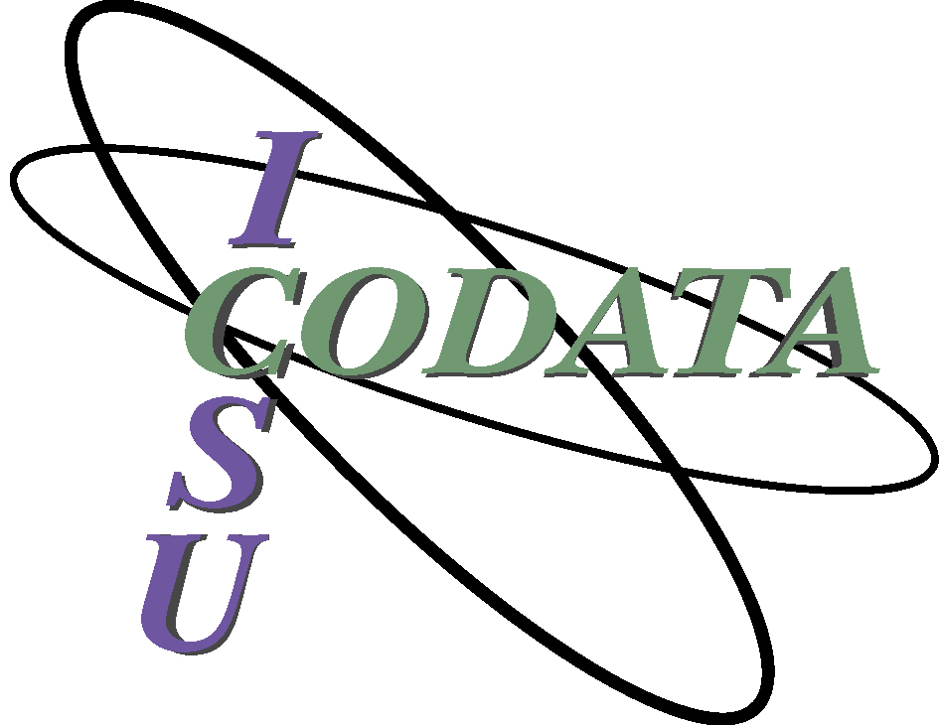
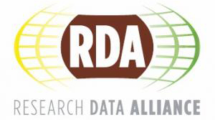



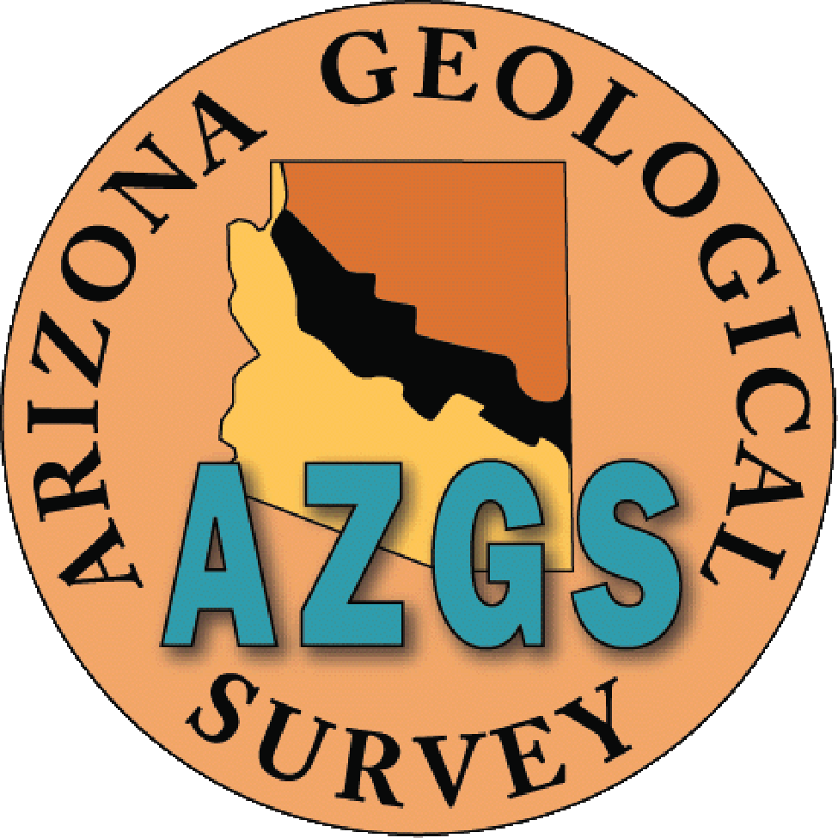

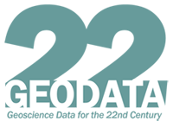

Acknowledgments
Notes:
This is a non-exclusive list – apologies for anyone who was left off.
AASG: NGDS program
AZGS: Christy Caudill, Steve Richard (now at IEDA), Lee Allison
USGS: NGGDPP; Betty Adrian (retired)
ESIP Federation, Data Stewardship Committee: Sarah Ramdeen, Ruth Duerr, H.K. Ramapriyan, Bob Downs
ESIP Federation, General: Peter Fox, Erin Robinson, Soren Scott, Josh Young, Karl Benedict
RDA: Helen Glaves, Lesley Wyborn
CODATA: Ruth Duerr, Chris Lenhardt
IEDA: Kerstin Lehnert, Bob Arko, Megan Carter
IGSN: Jens Klump, Lesley Wyborn
EarthCube: Jamie Ryan, Margie Chan, David Arctur, iSamples RCN
GSA & OGB: Marcella McIntyre-Redden, Nick Tew

Slide 17
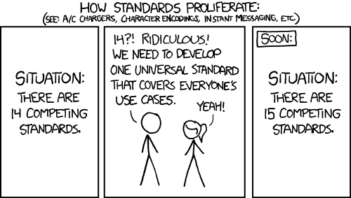
Use existing standards and best practices
https://xkcd.com/927
Notes:
Standards cartoon: https://xkcd.com/927/
Don’t reinvent! It’s a waste of time and resources, and if you want your data used beyond its initial project, it needs to be understood by others. Utilize existing standards, even though they’re not perfect
Idea that “good enough” is acceptable (Individuals and interactions over processes and tools) (Customer Collaboration over contract negotiation)
Why Standards Fail (Cargill, 2011 : http://dx.doi.org/10.3998/3336451.0014.103 )
The standard fails to get started.
The standards group fails to achieve consensus and deadlocks.
The standard suffers from “feature creep” and misses the market opportunity.
The standard is finished and the market ignores it.
The standard is finished and implementations are incompatible.
The standard is accepted and is used to manage the market.
Why it’s then important to use existing standards really falls under 4 and 5, mostly.

Slide 18
Specific Challenges
Omission of information through “general knowledge”
Omission of information through personal organizational systems
Inconsistent notational systems
Inconsistent and/or conflicting identification systems
Notes:
Specific challenges we have encountered while improving discoverability of our core and geologic sample collection include:
Omission of information through “general knowledge”
Omission of information through personal organizational systems
Inconsistent notational systems
Inconsistent and/or conflicting identification systems

