Slide 1
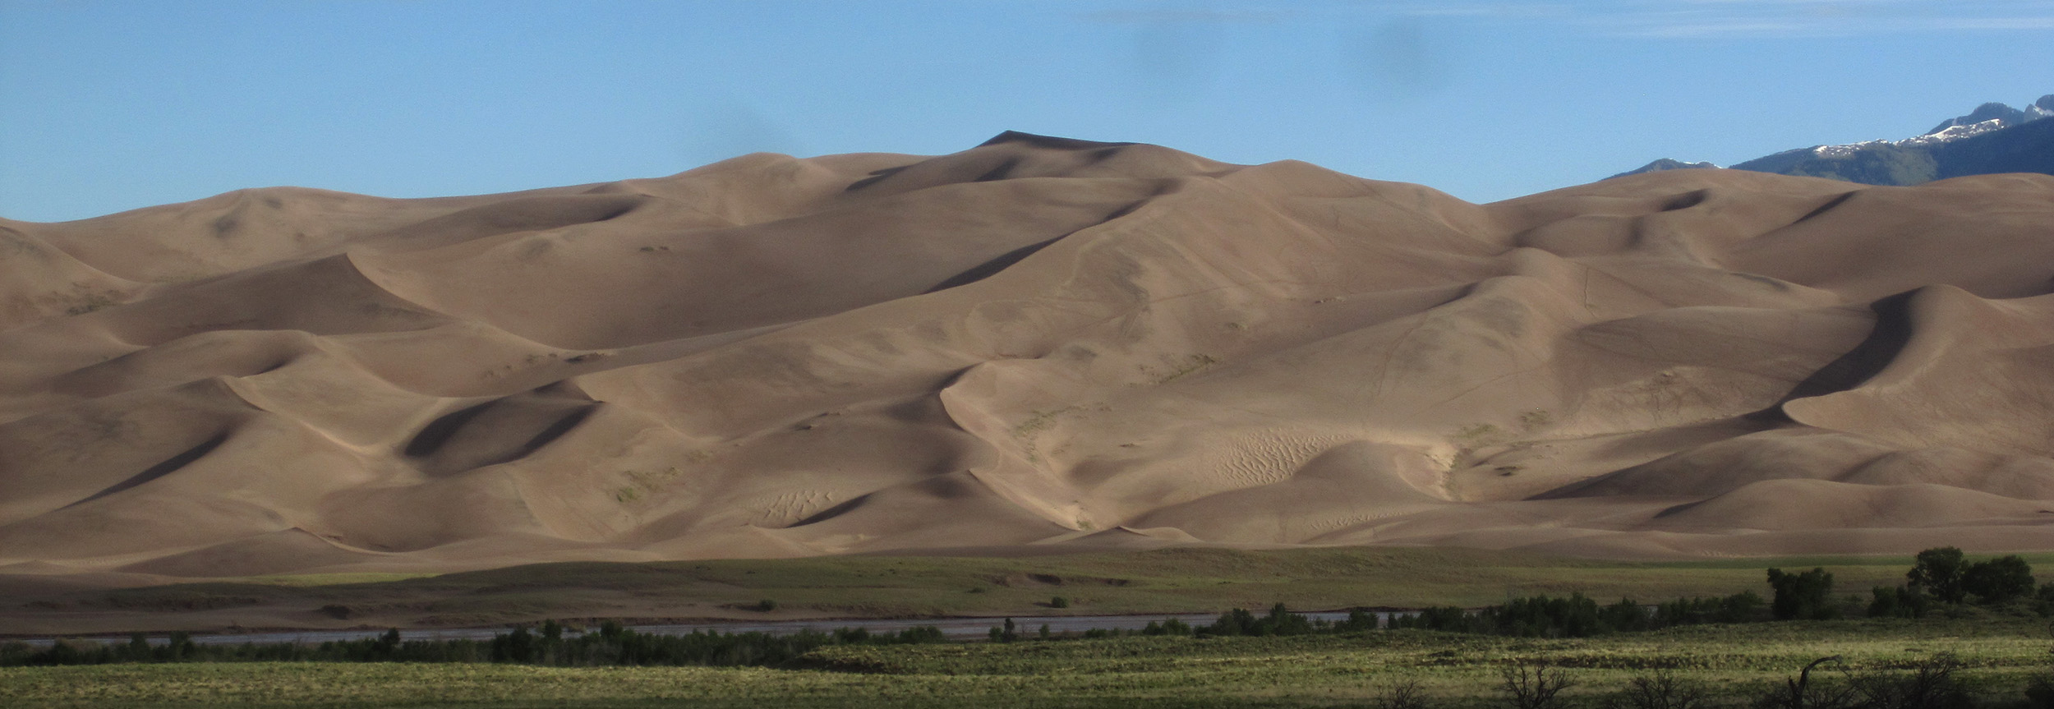
Monitoring Active Sand Dunes at
Great Sand Dunes National Park
and Preserve, Colorado
J.R. Zimbelman¹, A.D Valdez², S. Cartwright^{1,3},
M. Sierleja^{1,4}, M.B. Johnson¹, M.M. Thomas^{2,5}
¹National Air and Space Museum, Smithsonian Institution, ²Great Sand Dunes
National Park and Preserve, ³Middlebury College (VT), ⁴Kent State Univ. (OH),
⁵St. Lawrence Univ. (NY)

Slide 2
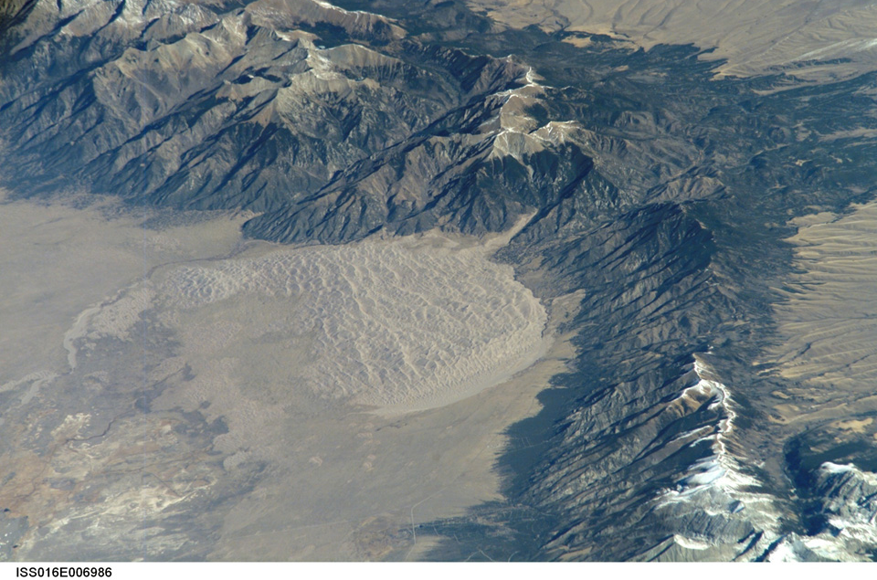
Great Sand Dunes National Park and Preserve, Colorado

Slide 3
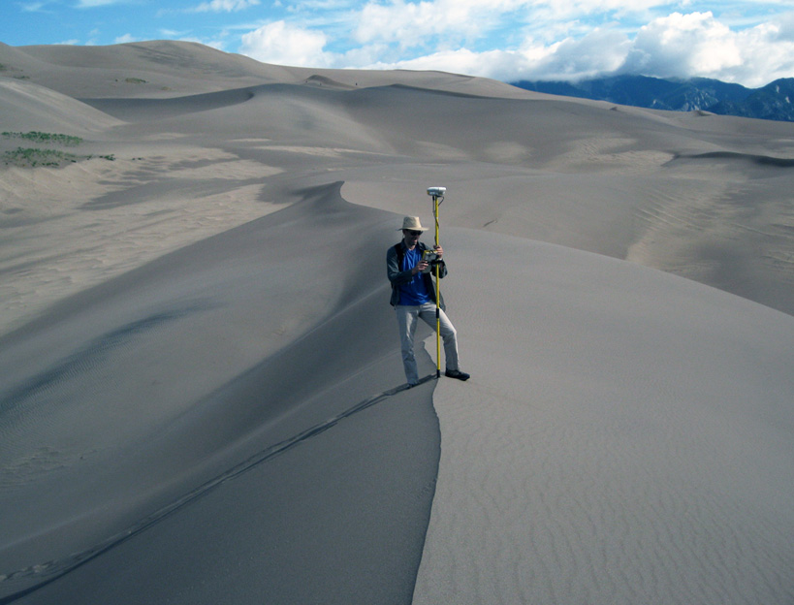
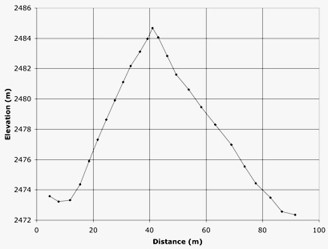
(9/09)

Slide 4
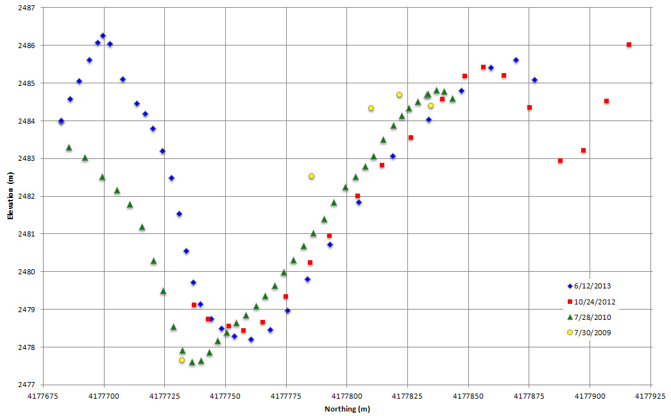
Northing vs Elevation: consistent extension to the North
12
13
09
10

Slide 5
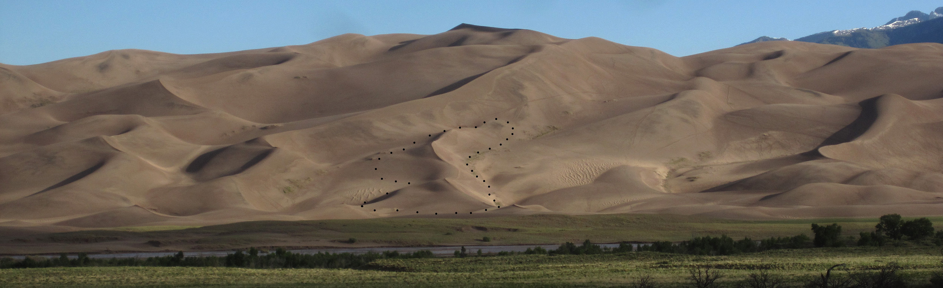
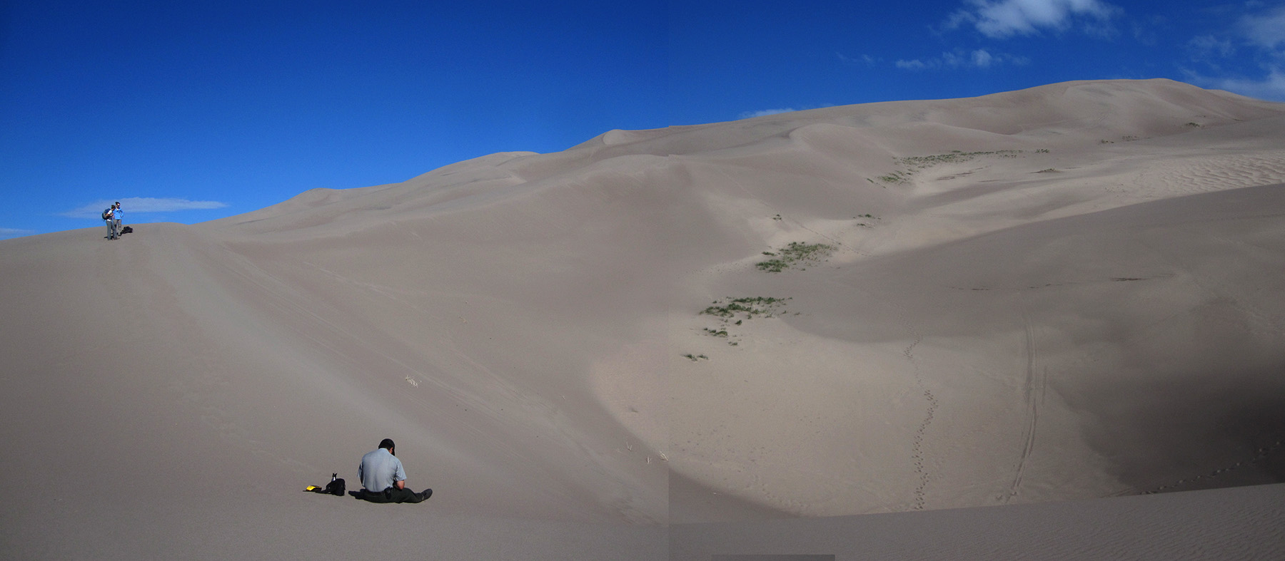
(6/11/15)

Slide 6
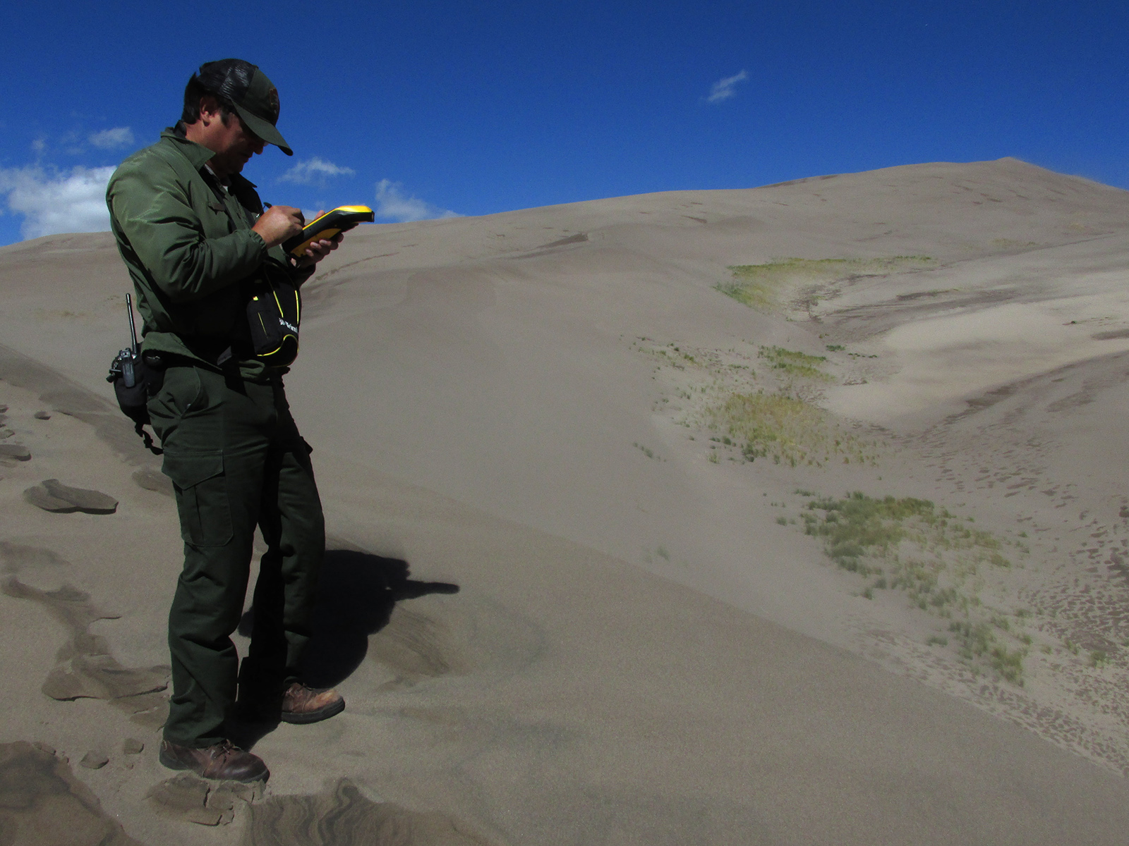
Trimble Geo XH
(9/23/16)

Slide 7
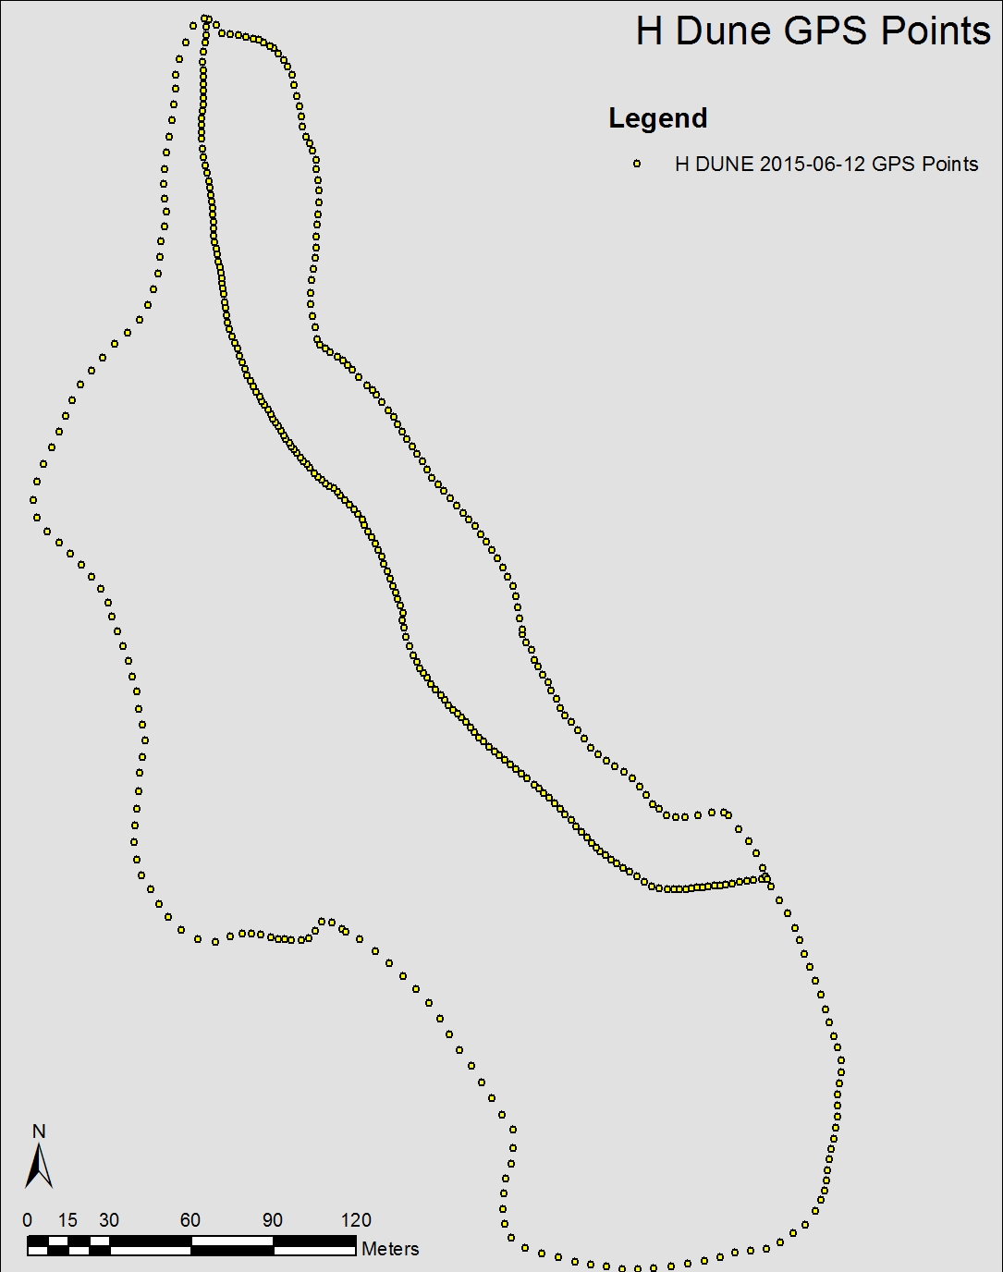

Slide 8
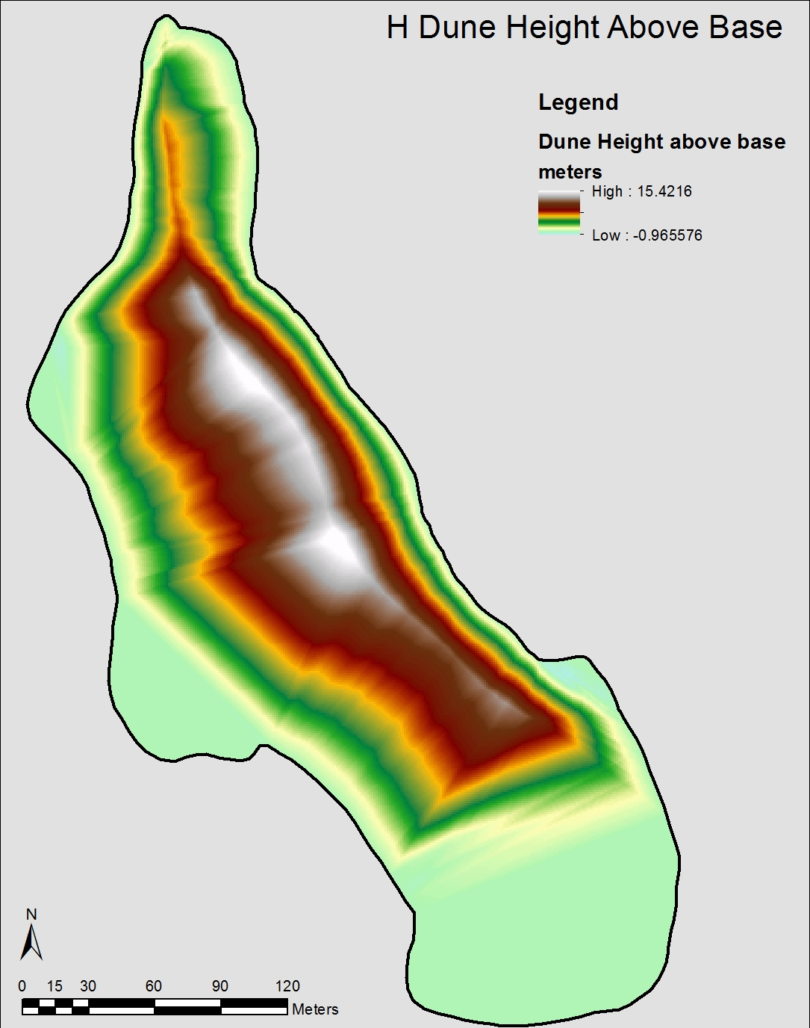
Notes:
From Triangulated Integrated Network, after removing average slope

Slide 9
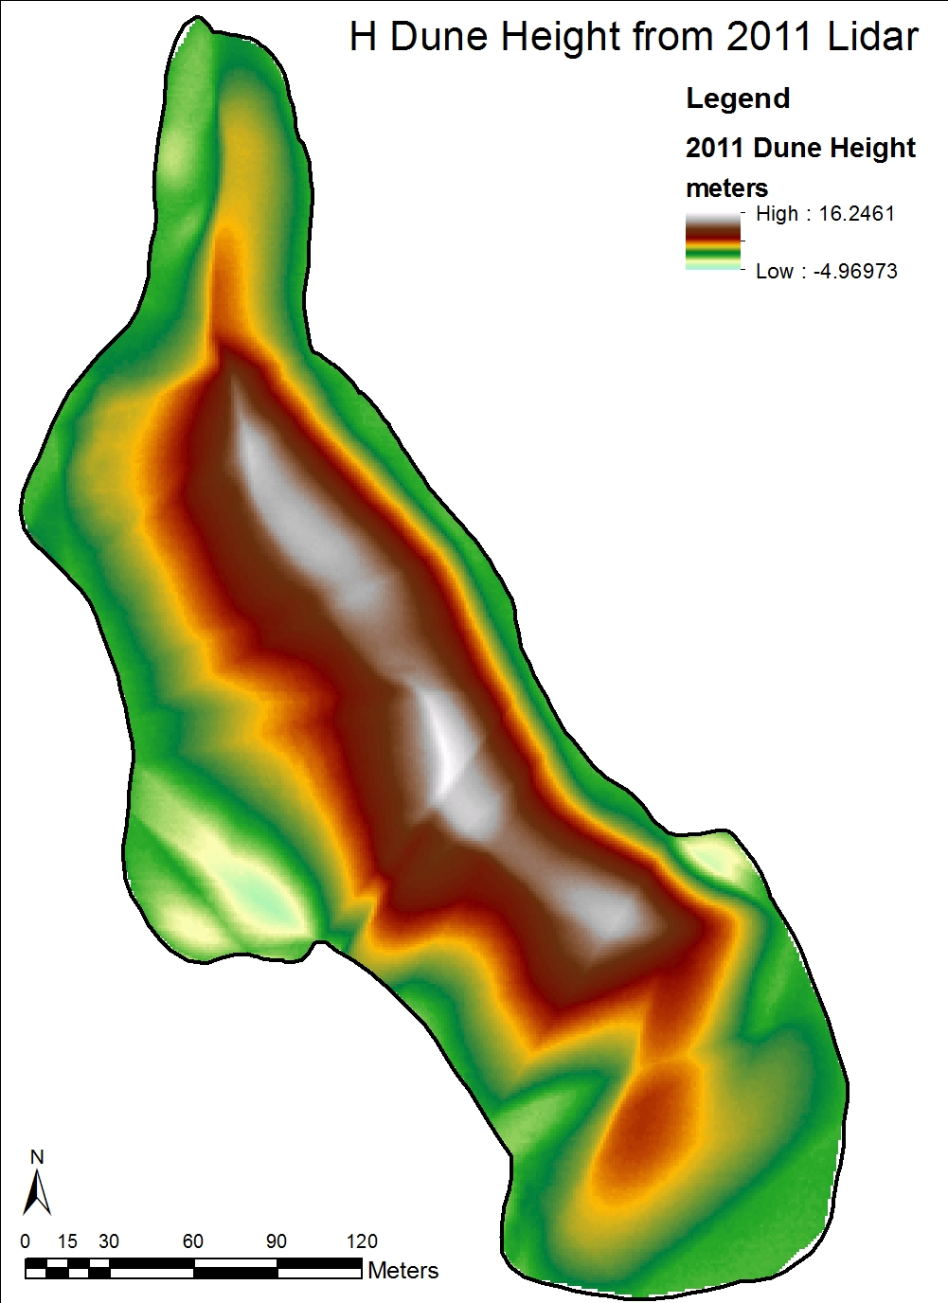

Slide 10
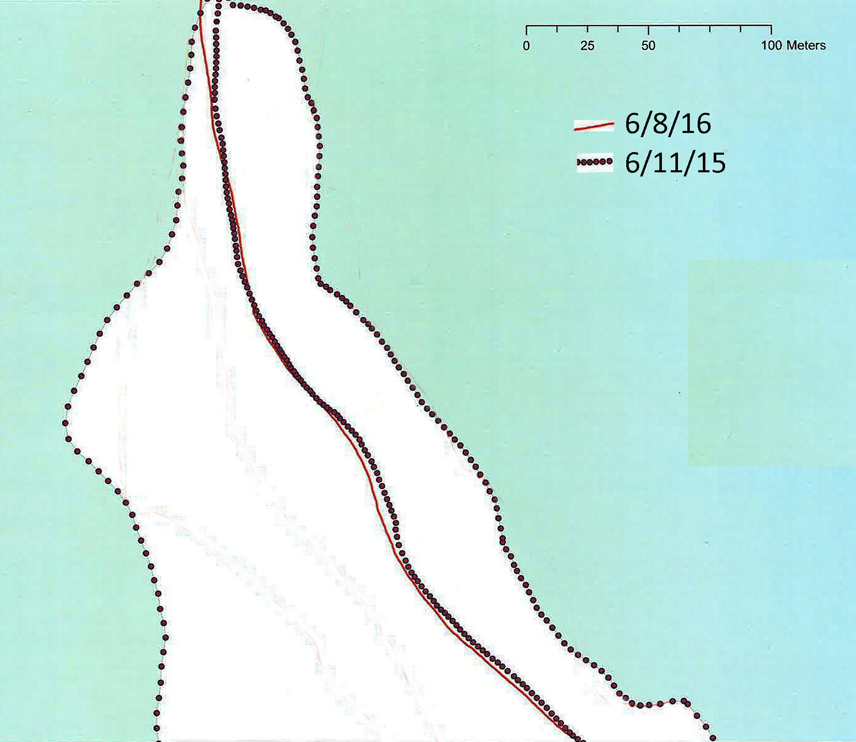

Slide 11
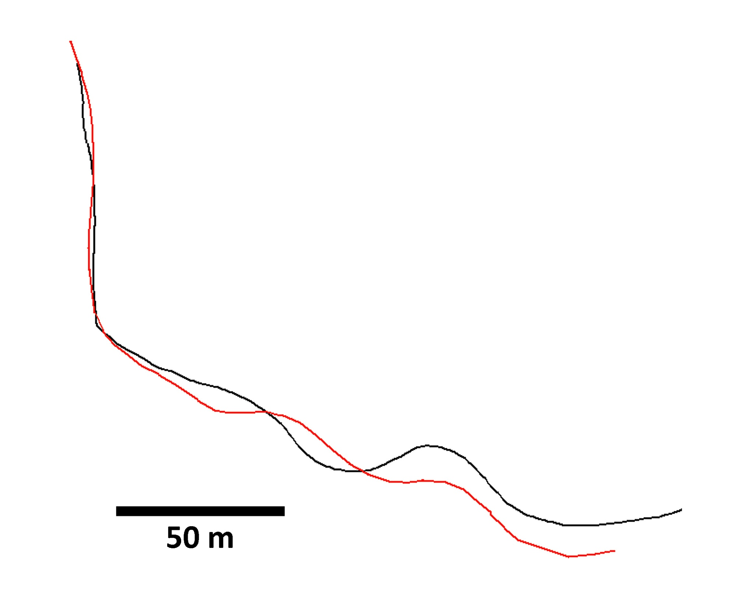
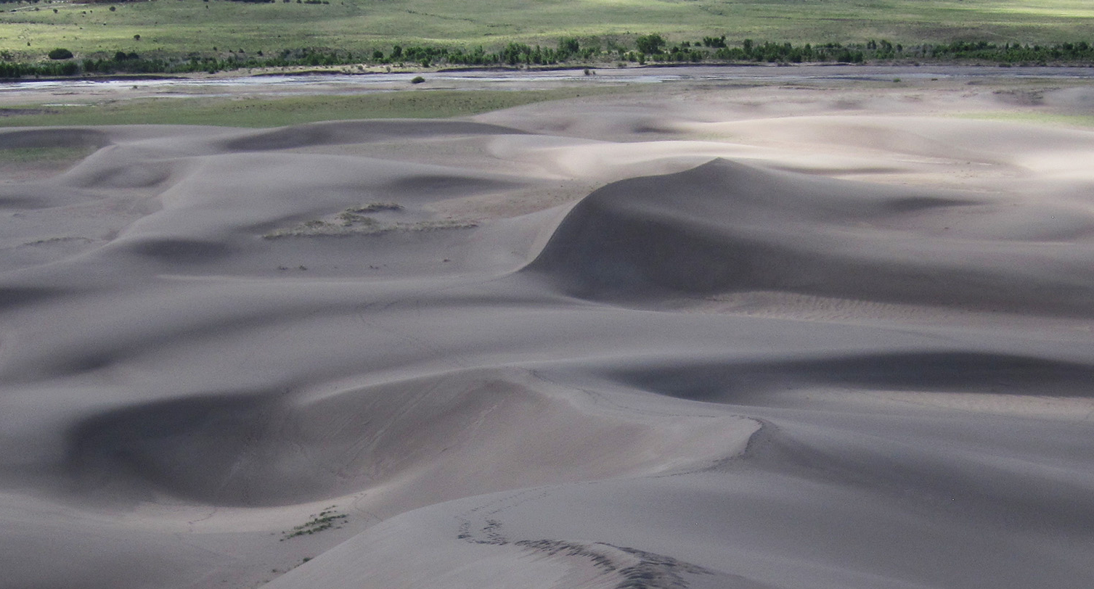
6/8/16
6/11/15

Slide 12
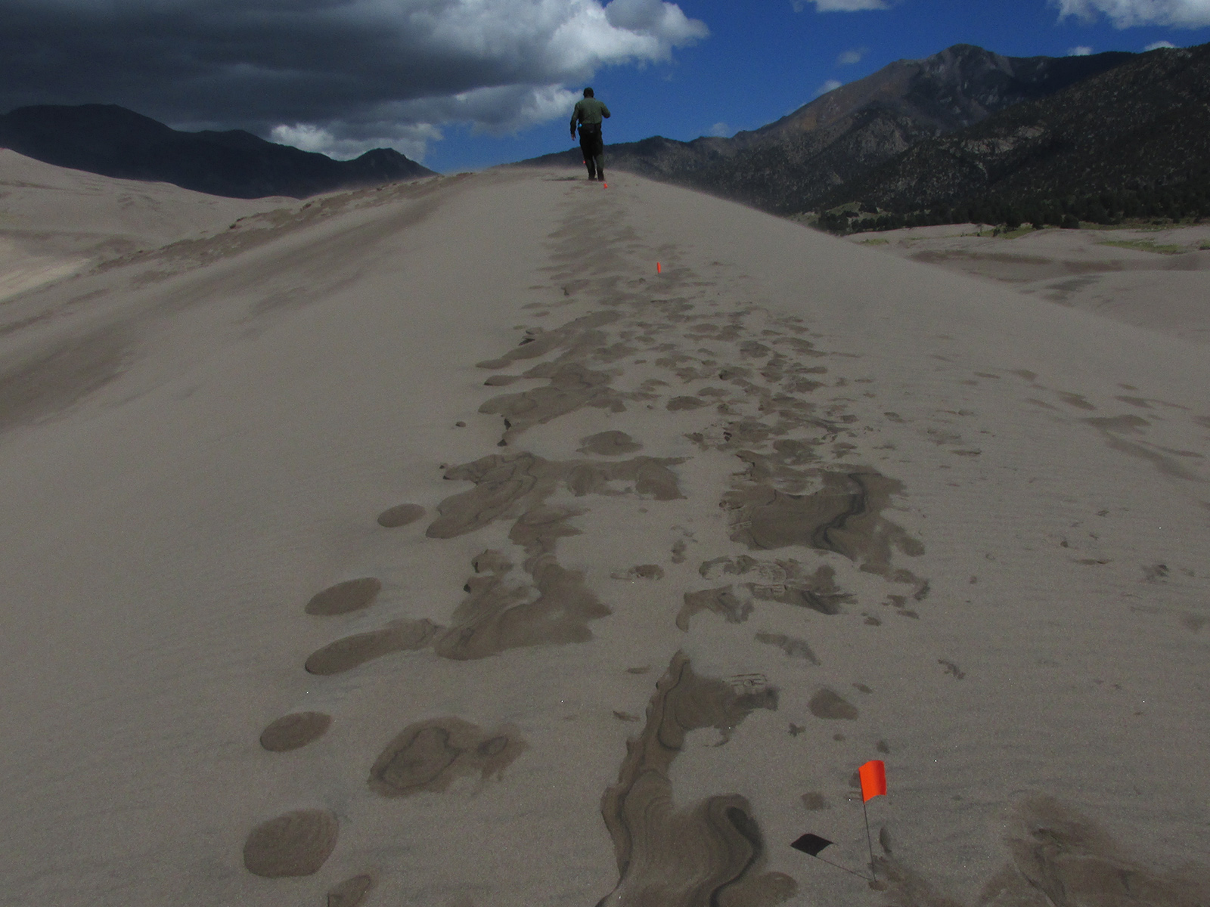
(9/23/16)

Slide 13
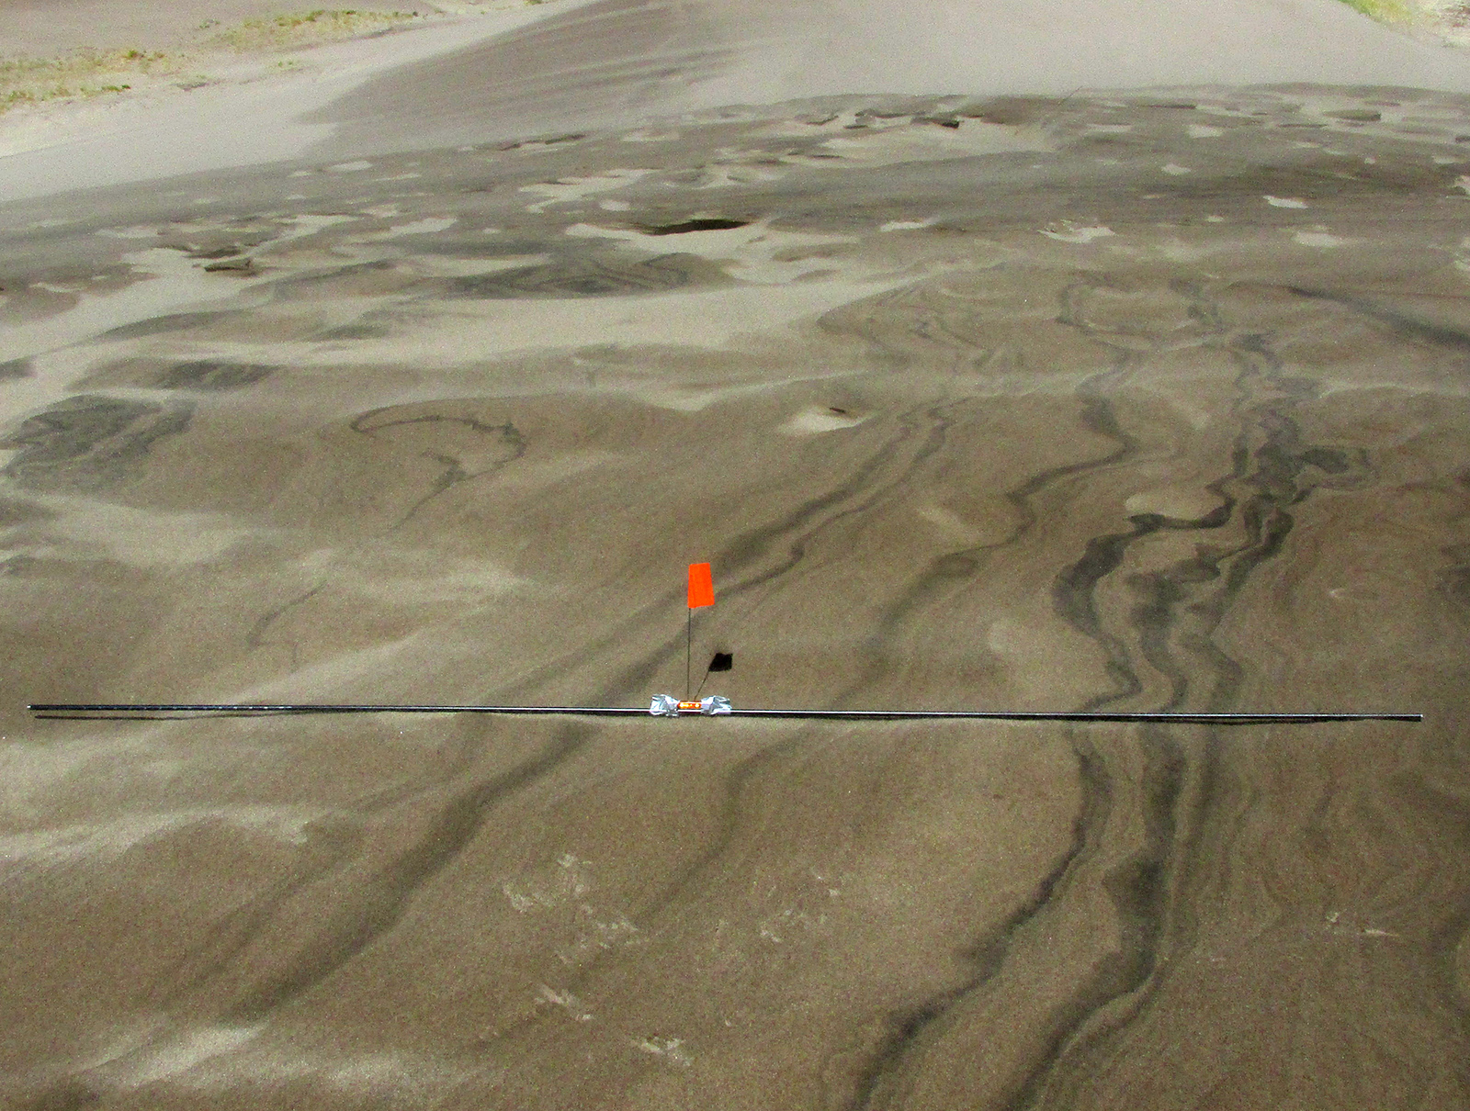
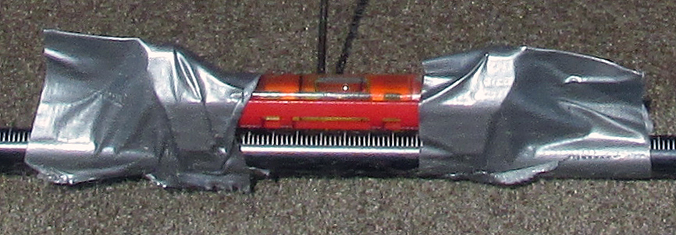
(9/23/16)

Slide 14
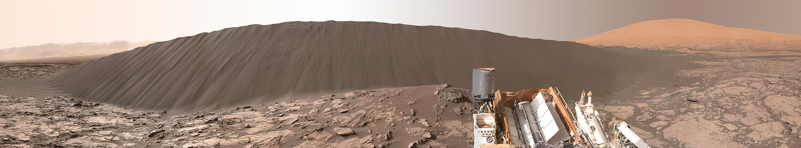
Take-away Points
National Parks like GSDNPP provide natural
laboratories for conducting basic research
Monitoring active sand dunes reveals complex
dune movements requiring complex winds
Lessons learned at GSDNPP can inform dune
movement on Earth and on other planets
‘Namib’ Dune on Mars, as imaged by Curiosity rover (NASA, 1/16)
Notes:
Relevant to understanding planetary dunes

